Slide 1
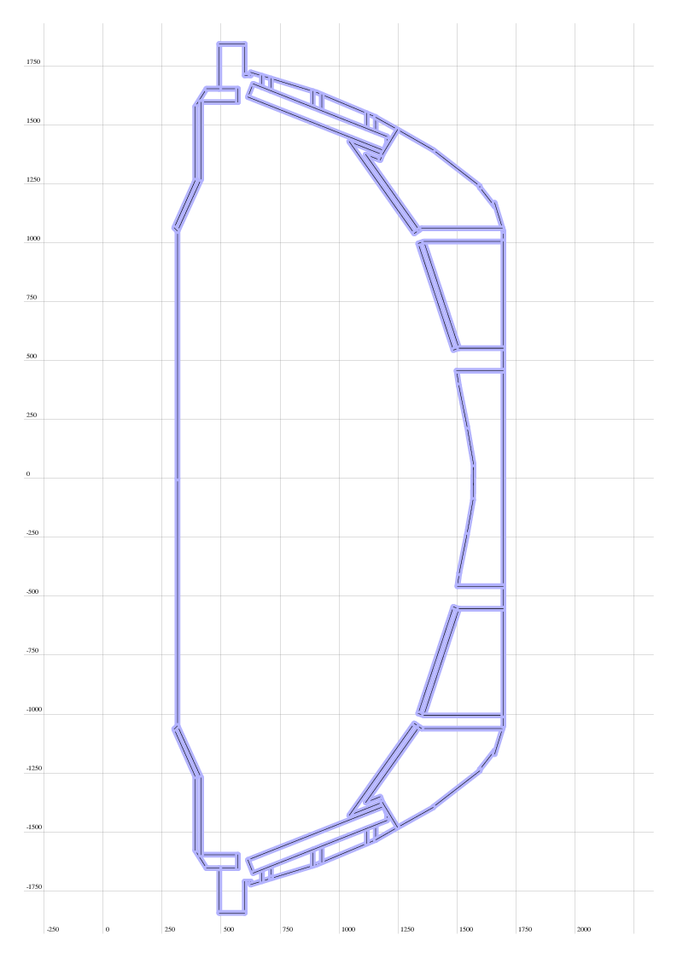
Vessel and PFC definitions for cryo calculations
Subset of elements contained in “nstx_28_ex.dg”
Center stack walls moved to reflect upgrade
Same inner wall as used in isolver
Has the important hardware (I think?)
No modifications for plenum/pump yet

