Slide 1




NSTX
Supported by
Drawings and Photos Related to Cryopump
SPG
Columbia U
CompX
General Atomics
FIU
INL
Johns Hopkins U
LANL
LLNL
Lodestar
MIT
Nova Photonics
New York U
ORNL
PPPL
Princeton U
Purdue U
SNL
Think Tank, Inc.
UC Davis
UC Irvine
UCLA
UCSD
U Colorado
U Illinois
U Maryland
U Rochester
U Washington
U Wisconsin
Culham Sci Ctr
U St. Andrews
York U
Chubu U
Fukui U
Hiroshima U
Hyogo U
Kyoto U
Kyushu U
Kyushu Tokai U
NIFS
Niigata U
U Tokyo
JAEA
Hebrew U
Ioffe Inst
RRC Kurchatov Inst
TRINITI
NFRI
KAIST
POSTECH
ASIPP
ENEA, Frascati
CEA, Cadarache
IPP, Jülich
IPP, Garching
ASCR, Czech Rep

Slide 2
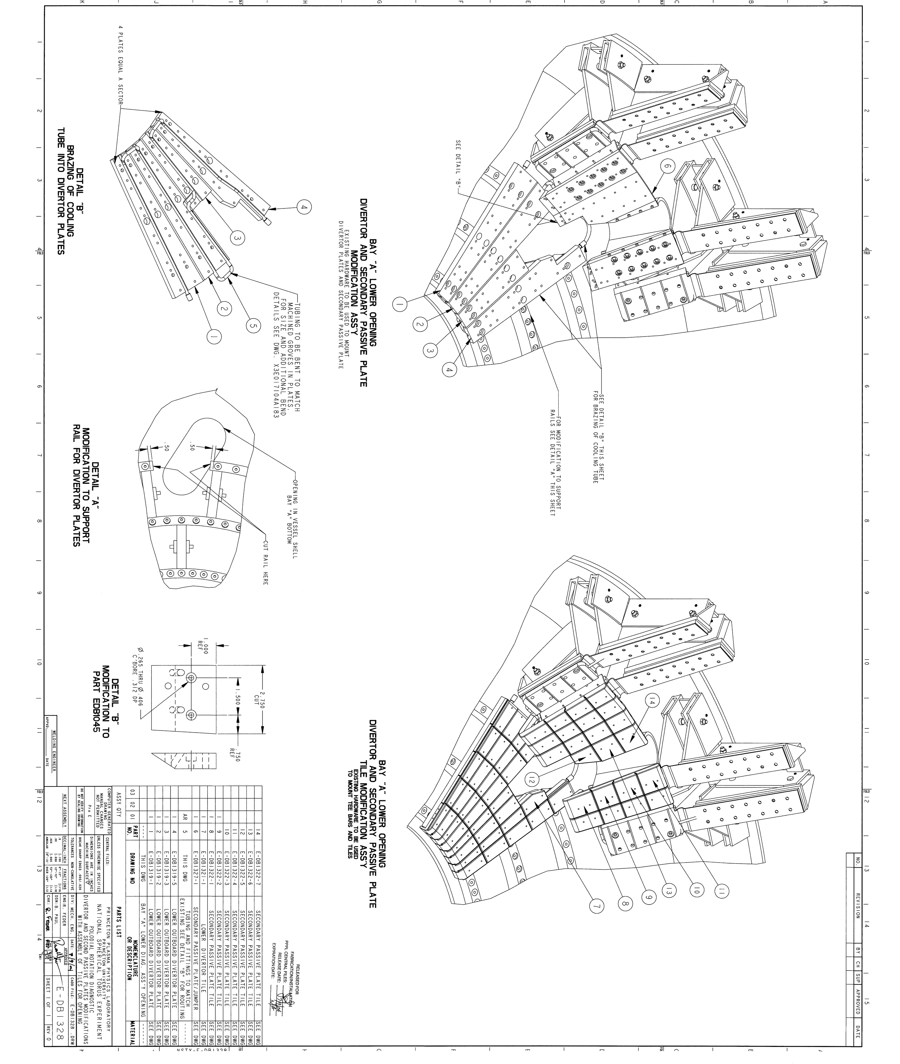

Slide 3
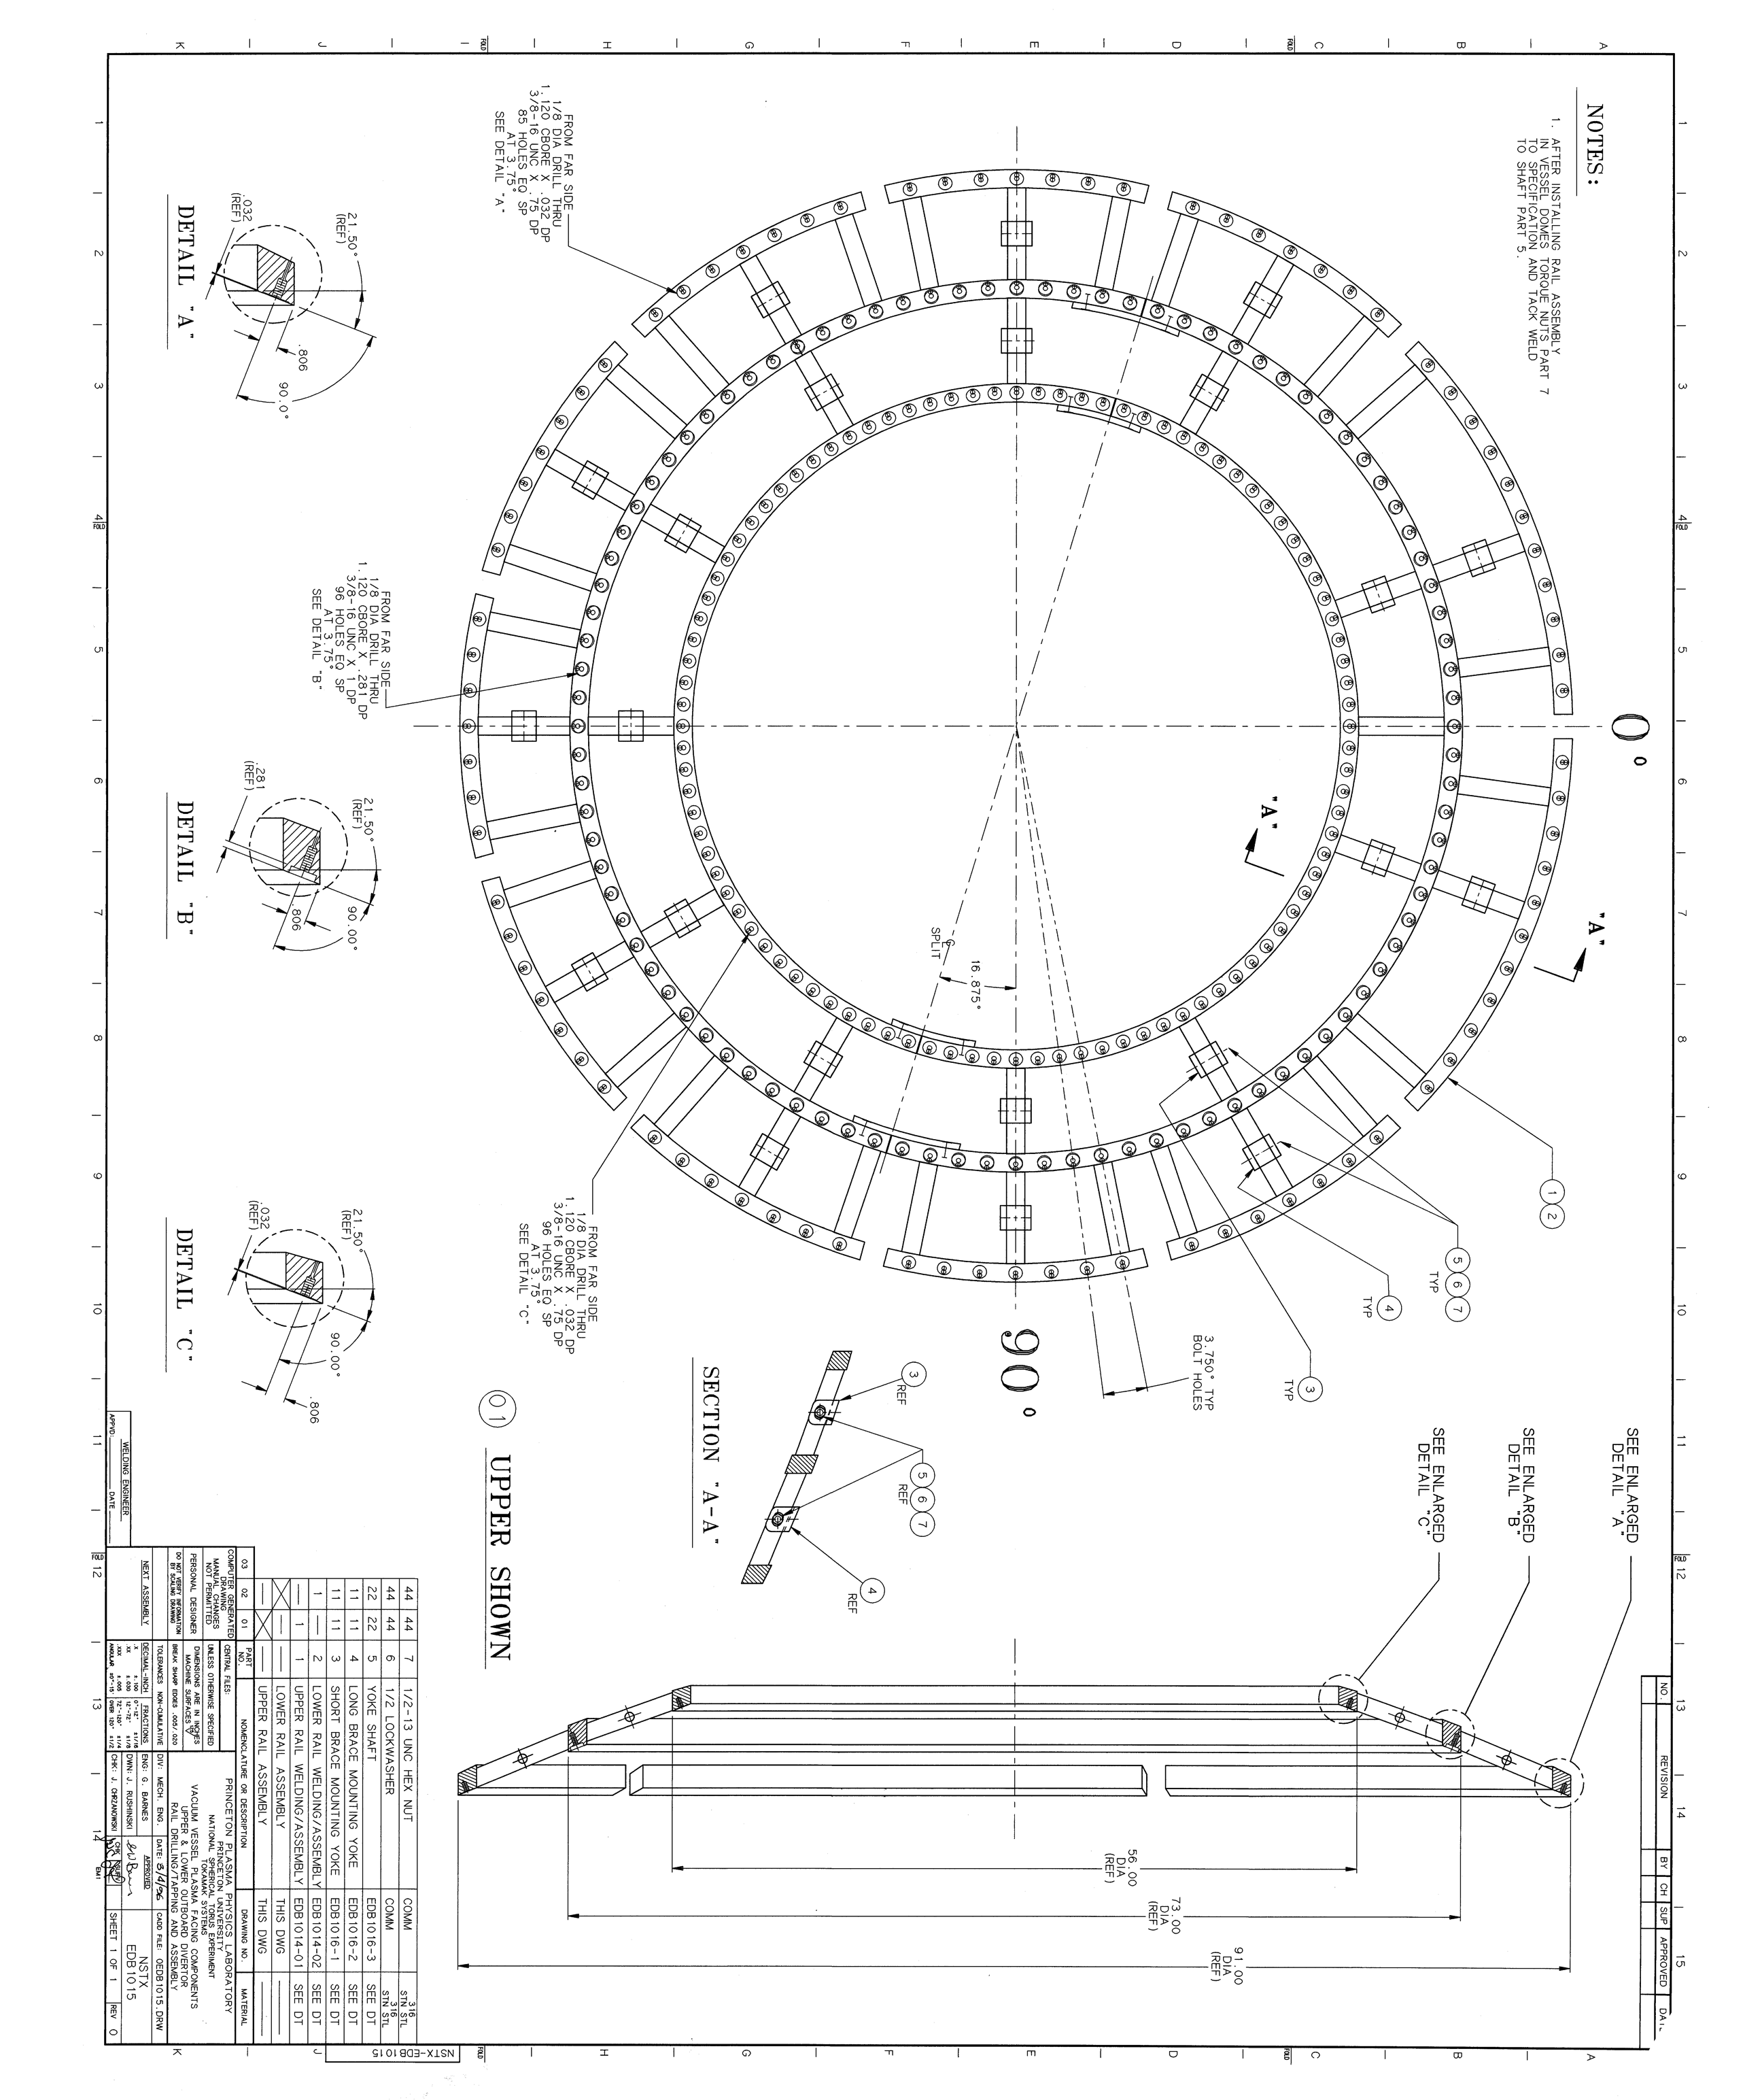
Barbque Rails Hold Divertor

Slide 4
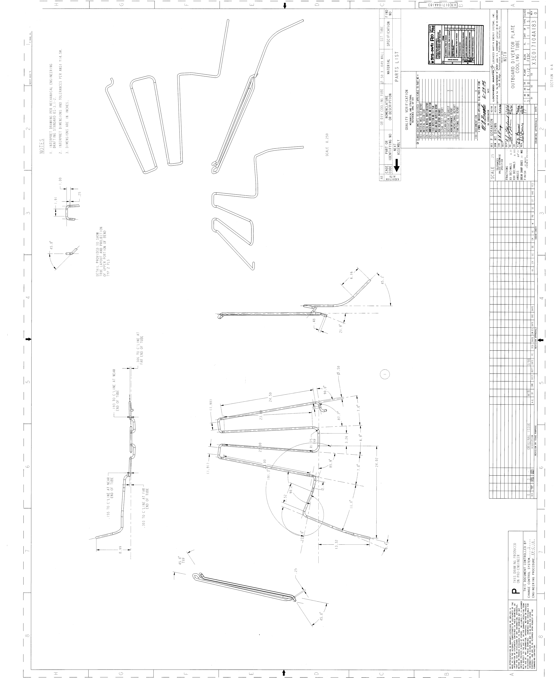

Slide 5
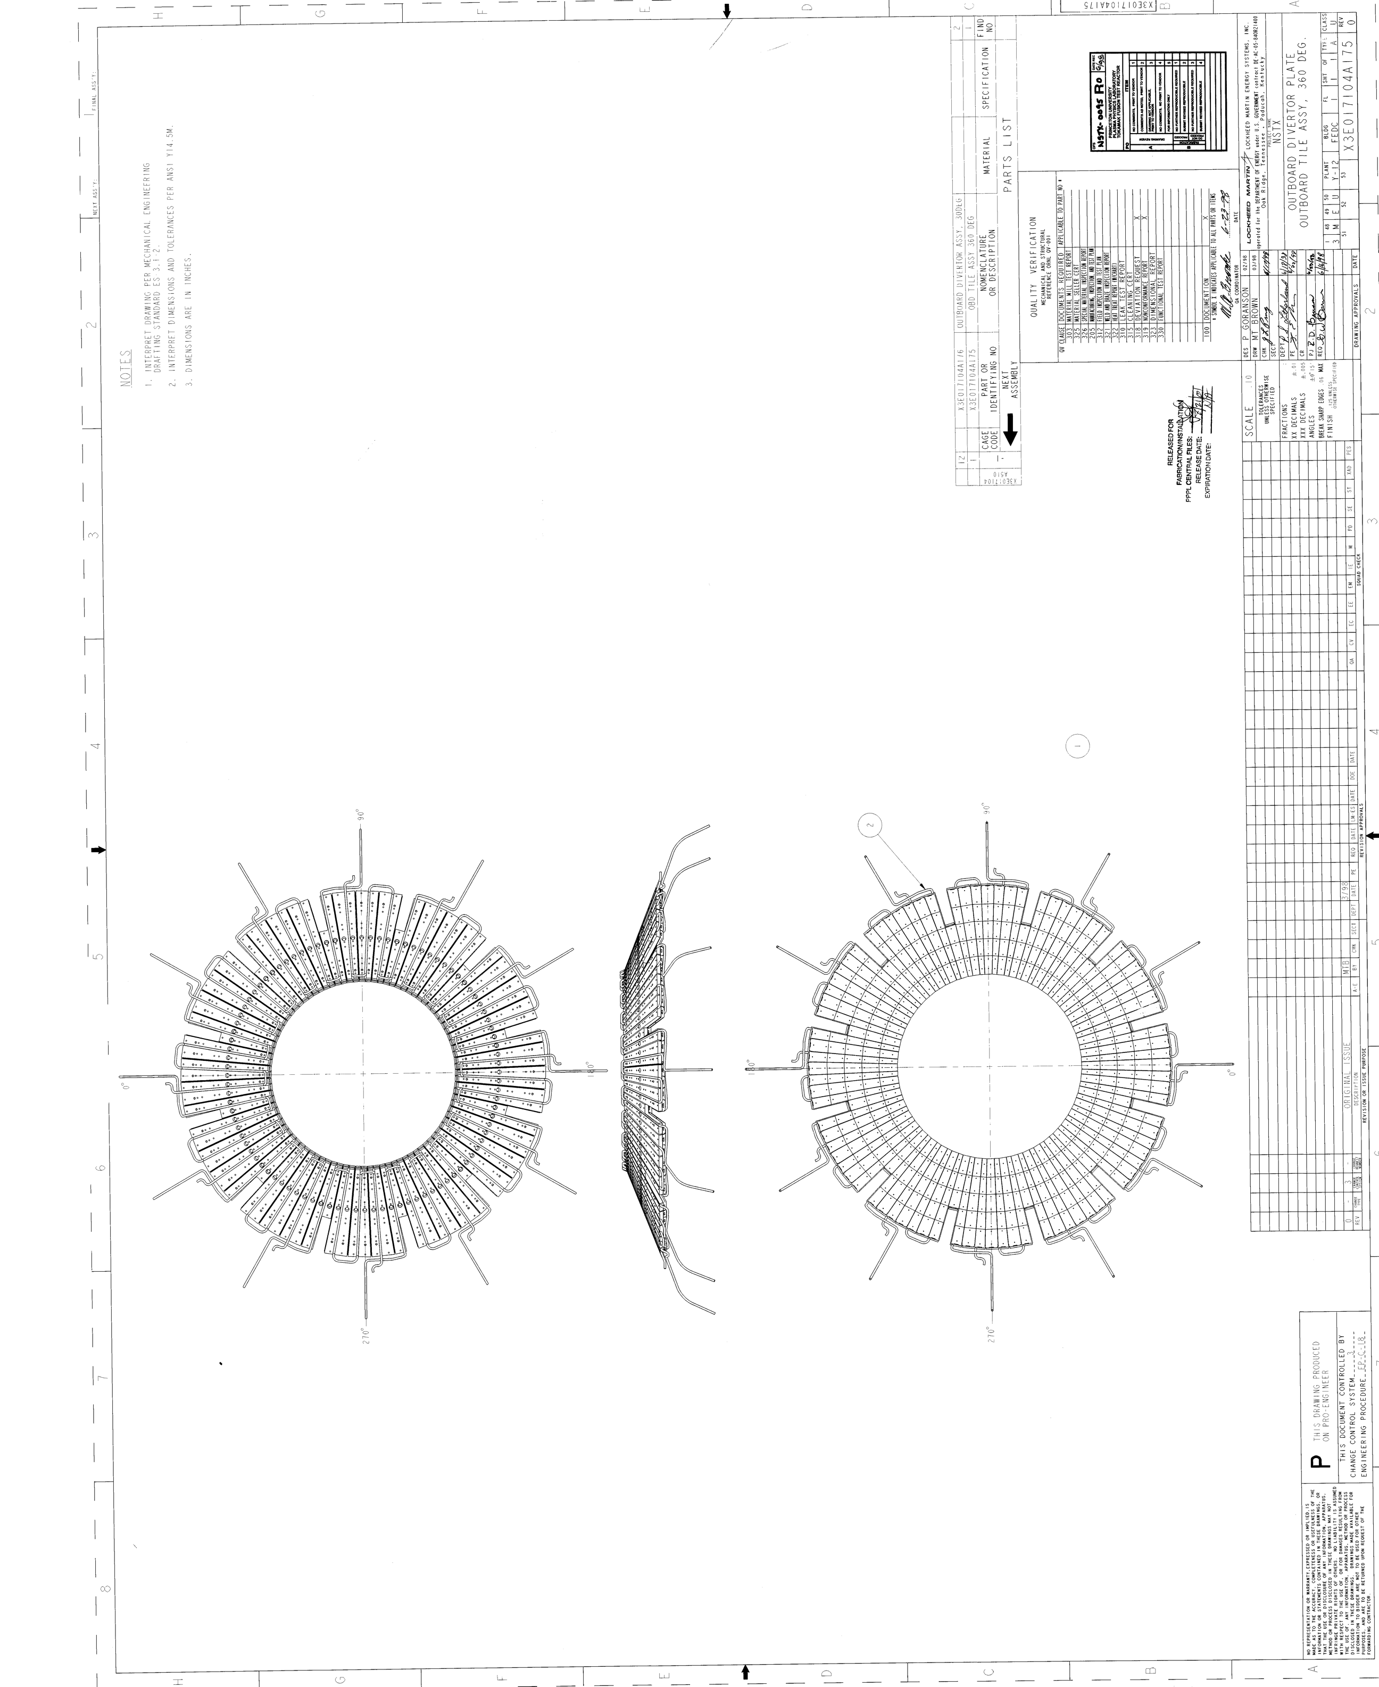

Slide 6
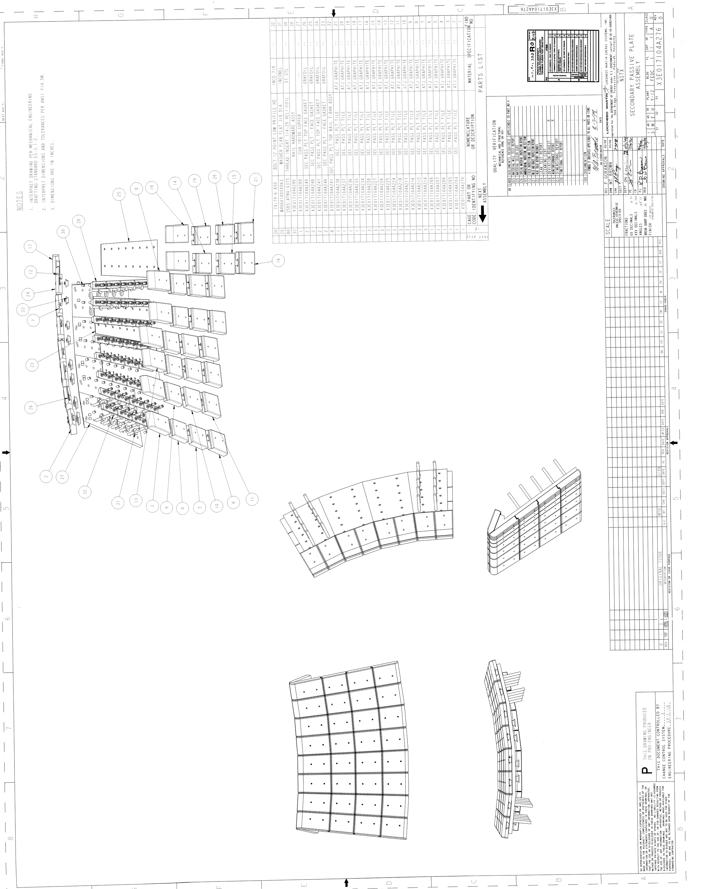

Slide 7
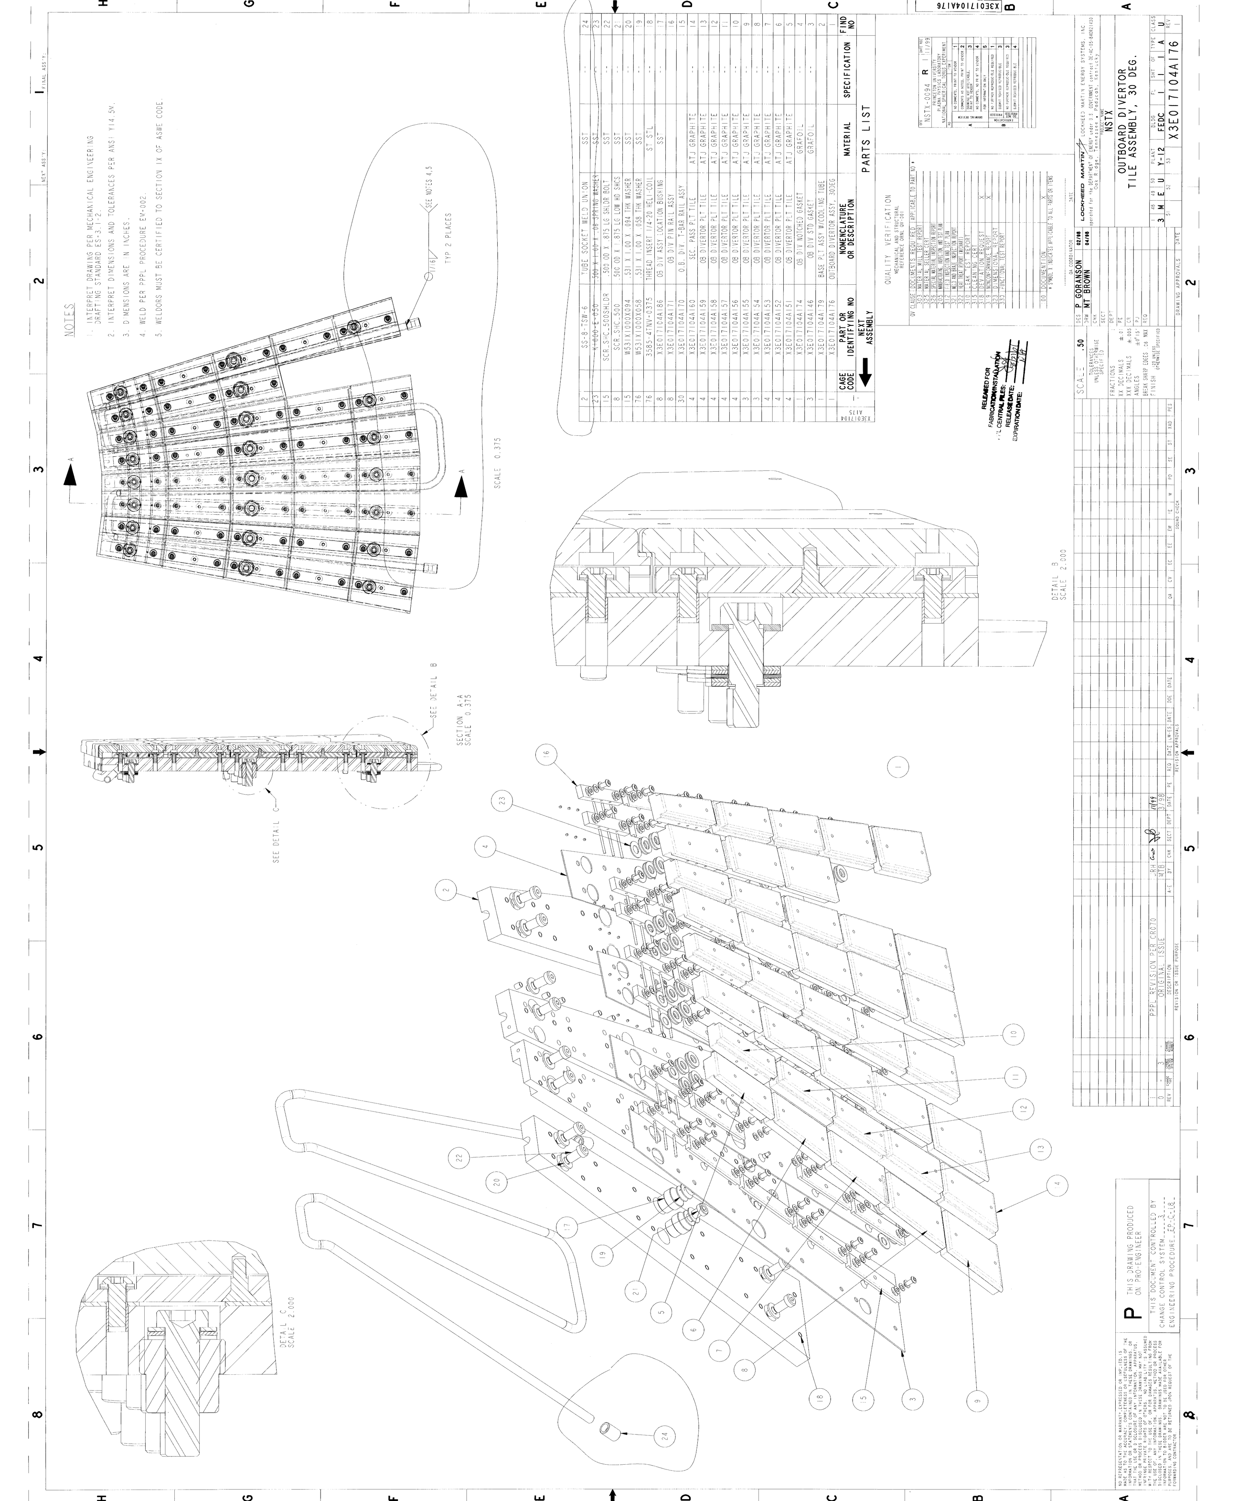

Slide 8
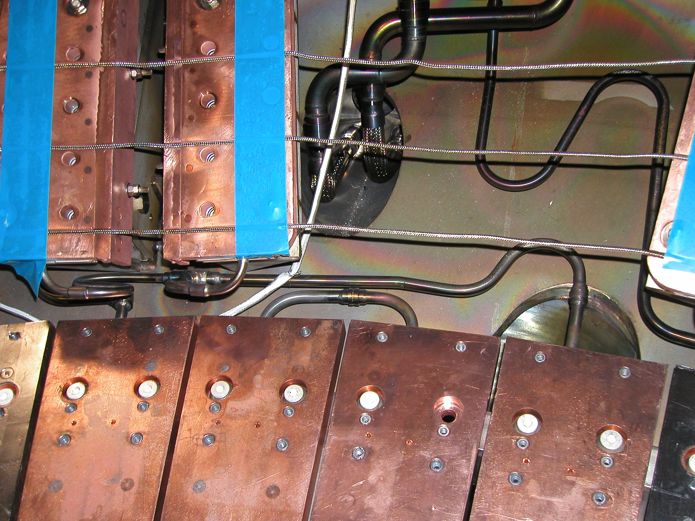

Slide 9
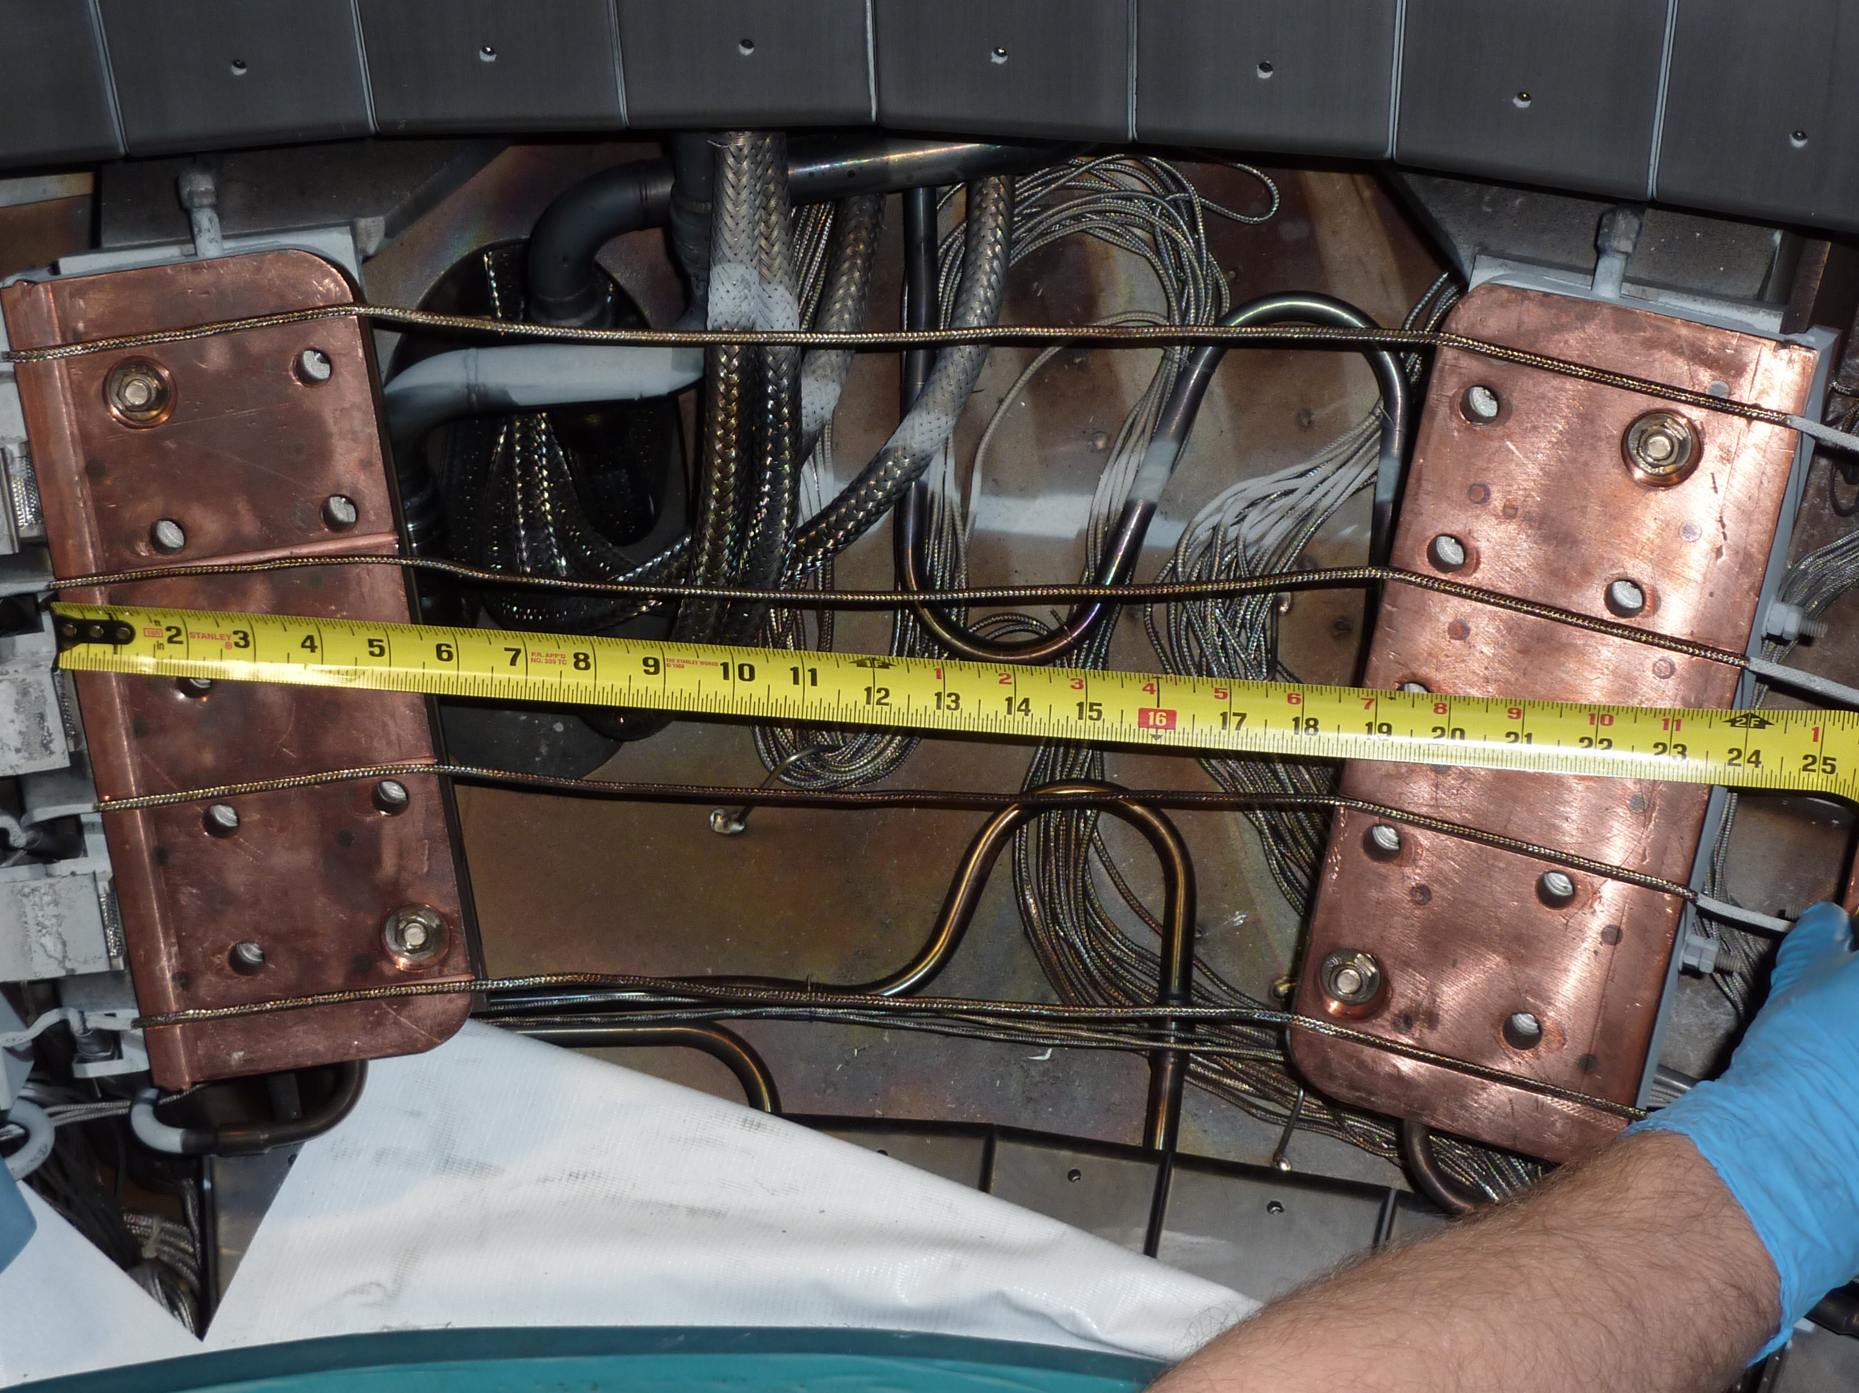

Slide 10
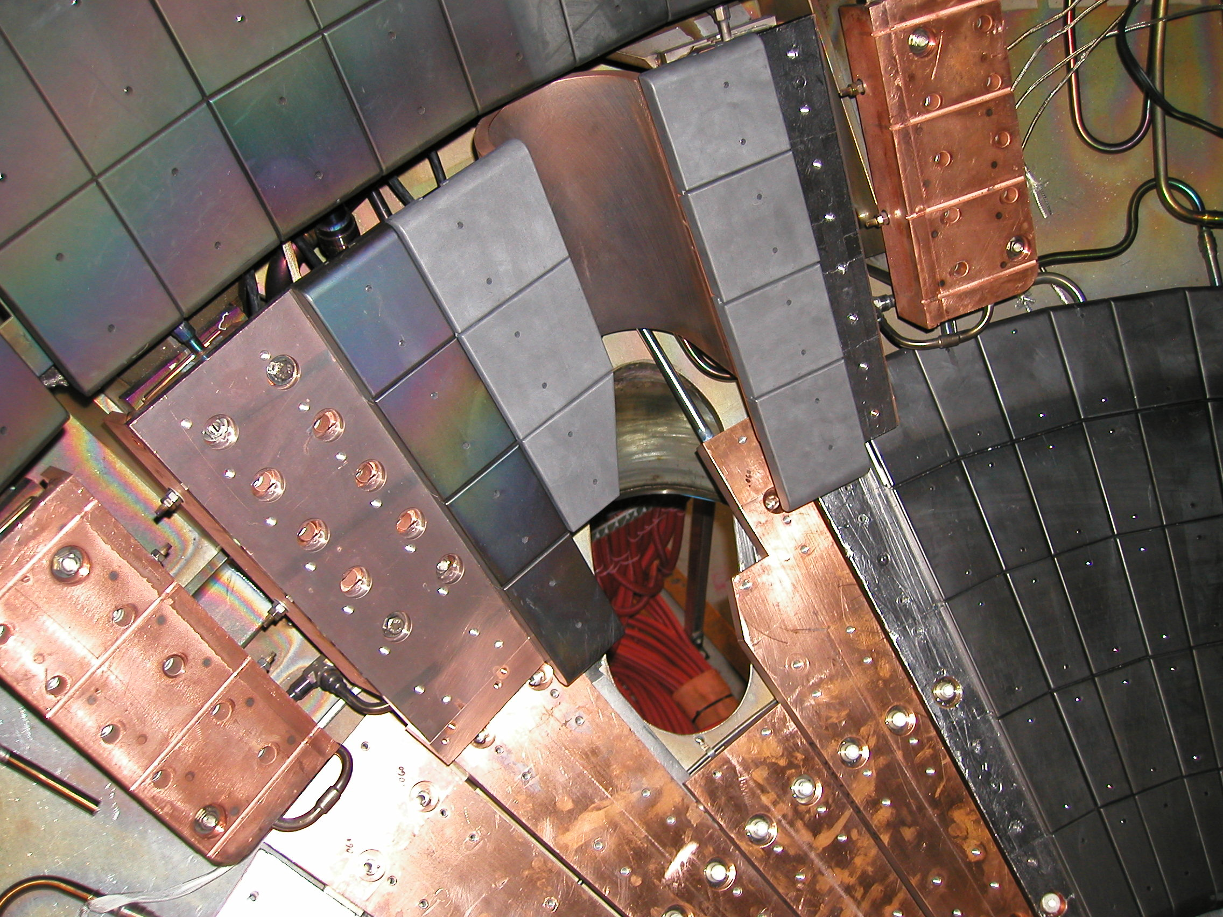

Slide 11
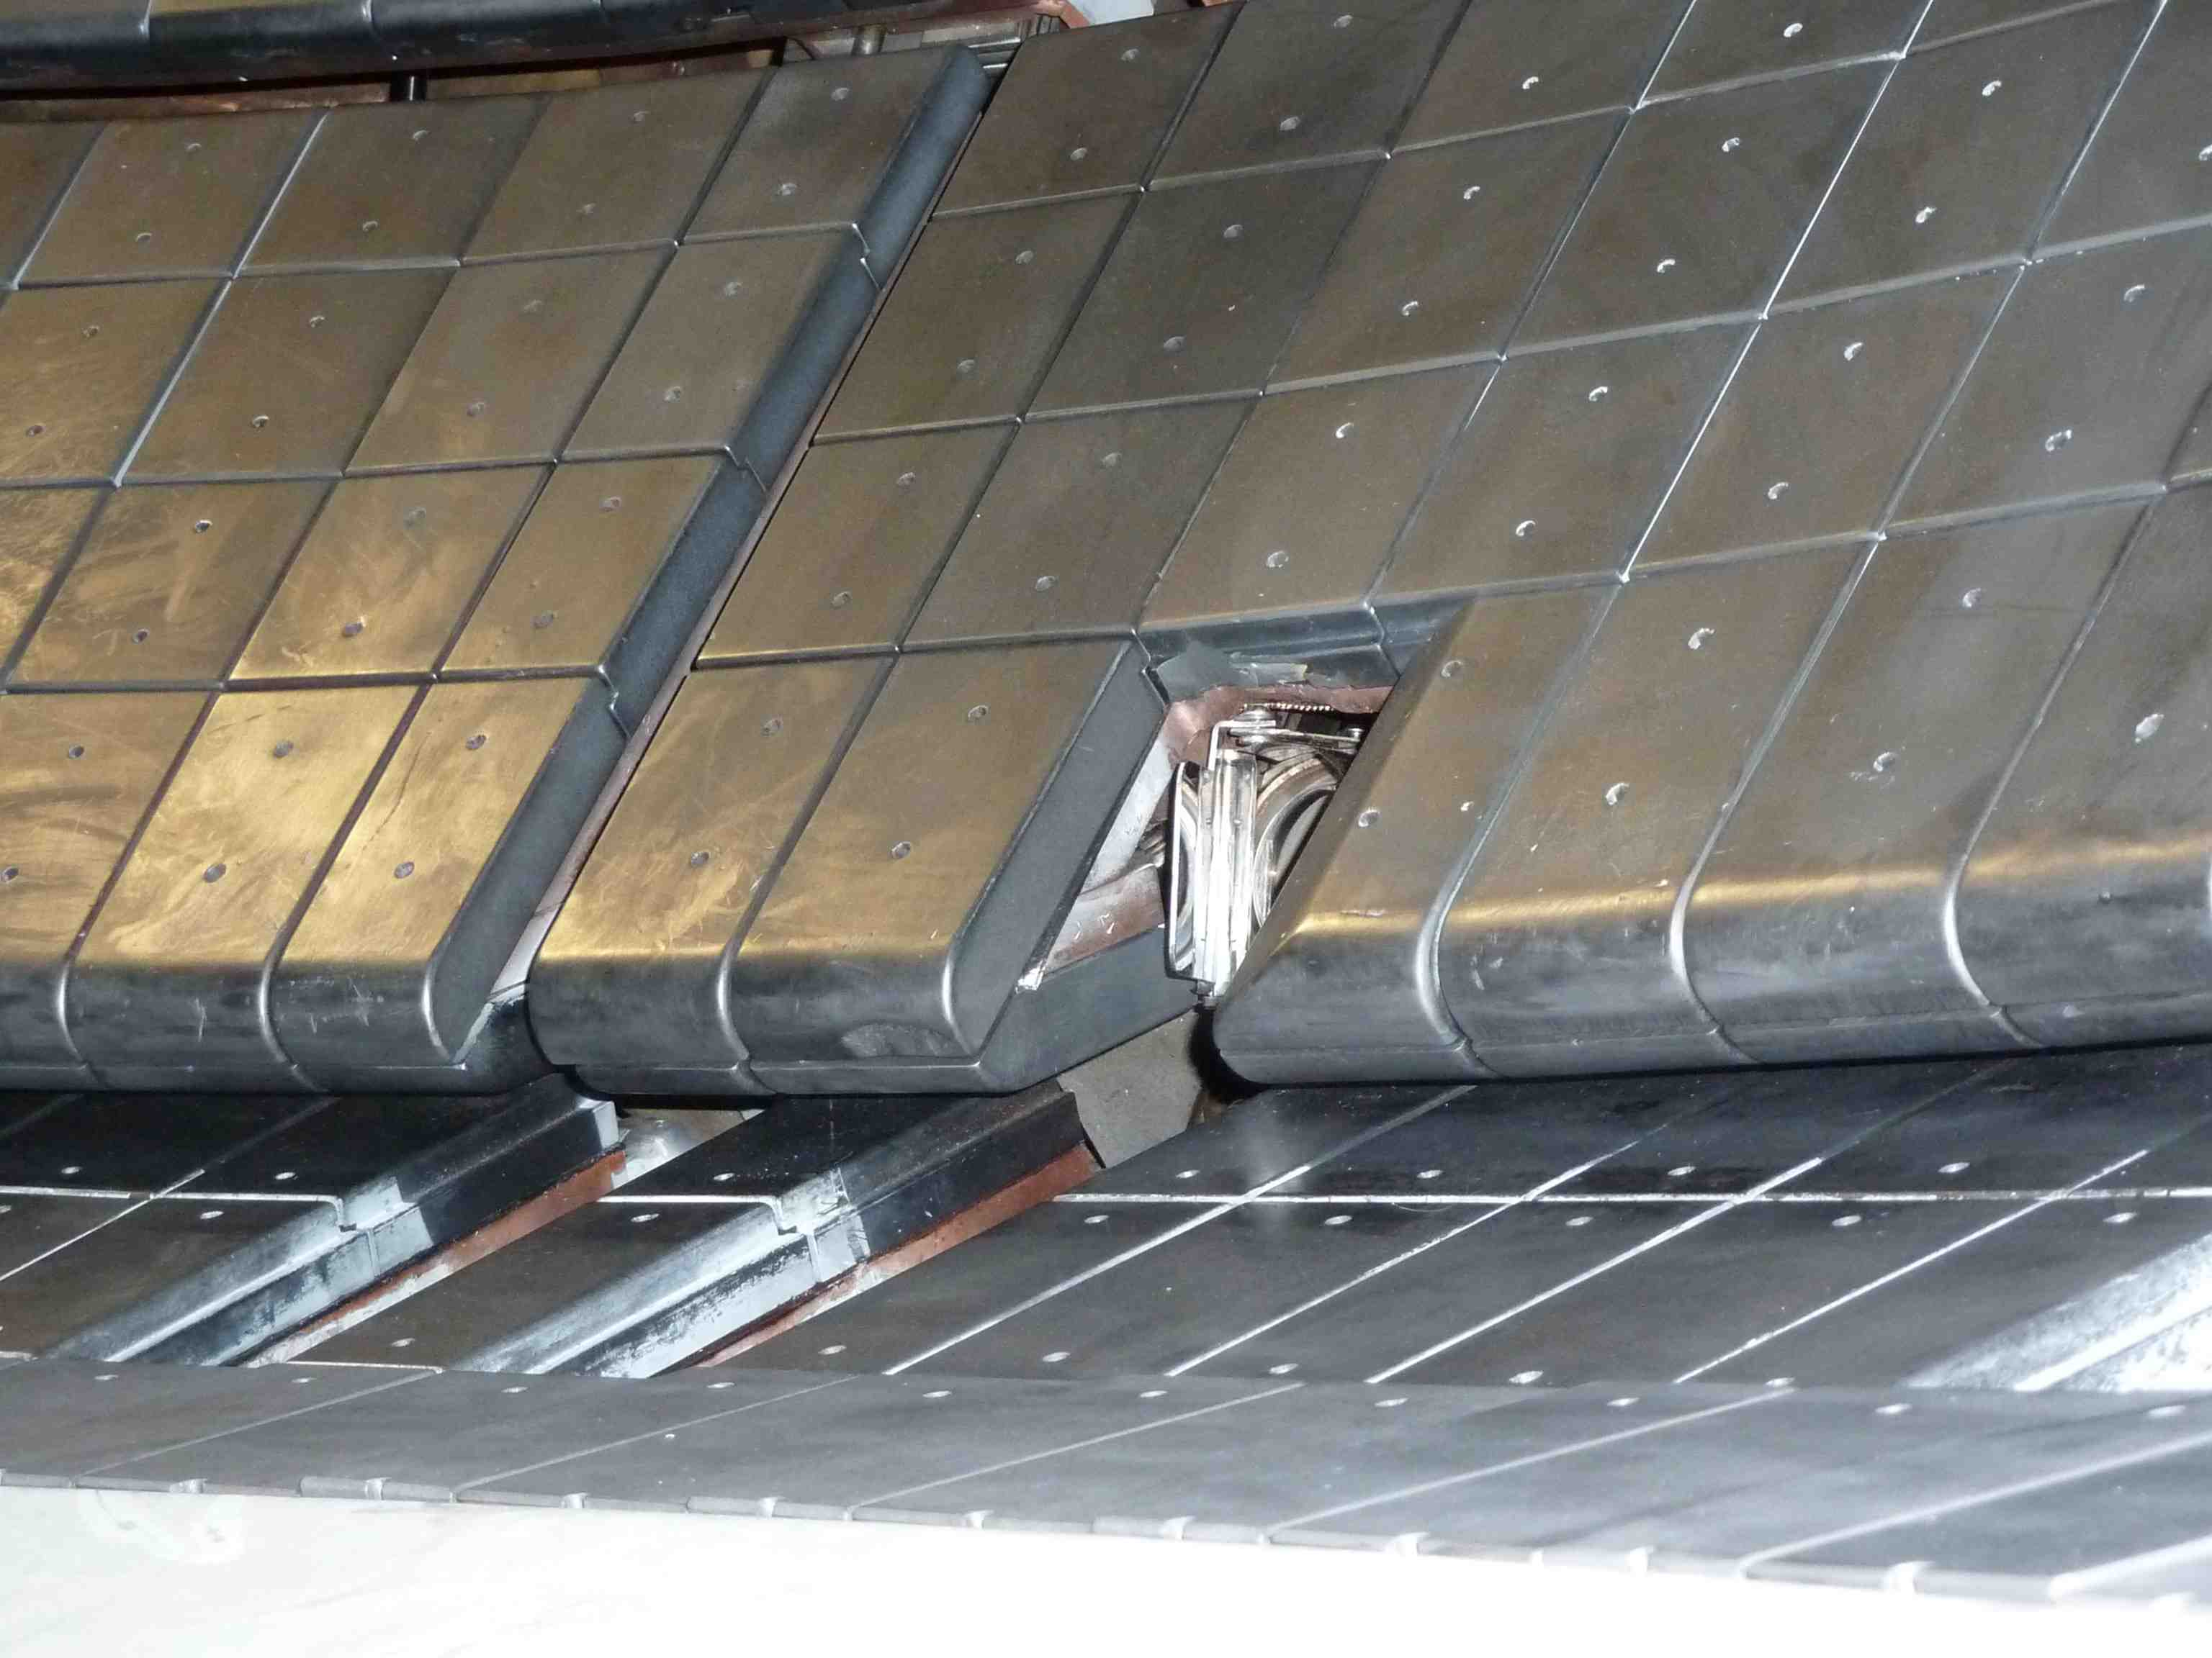

Slide 12
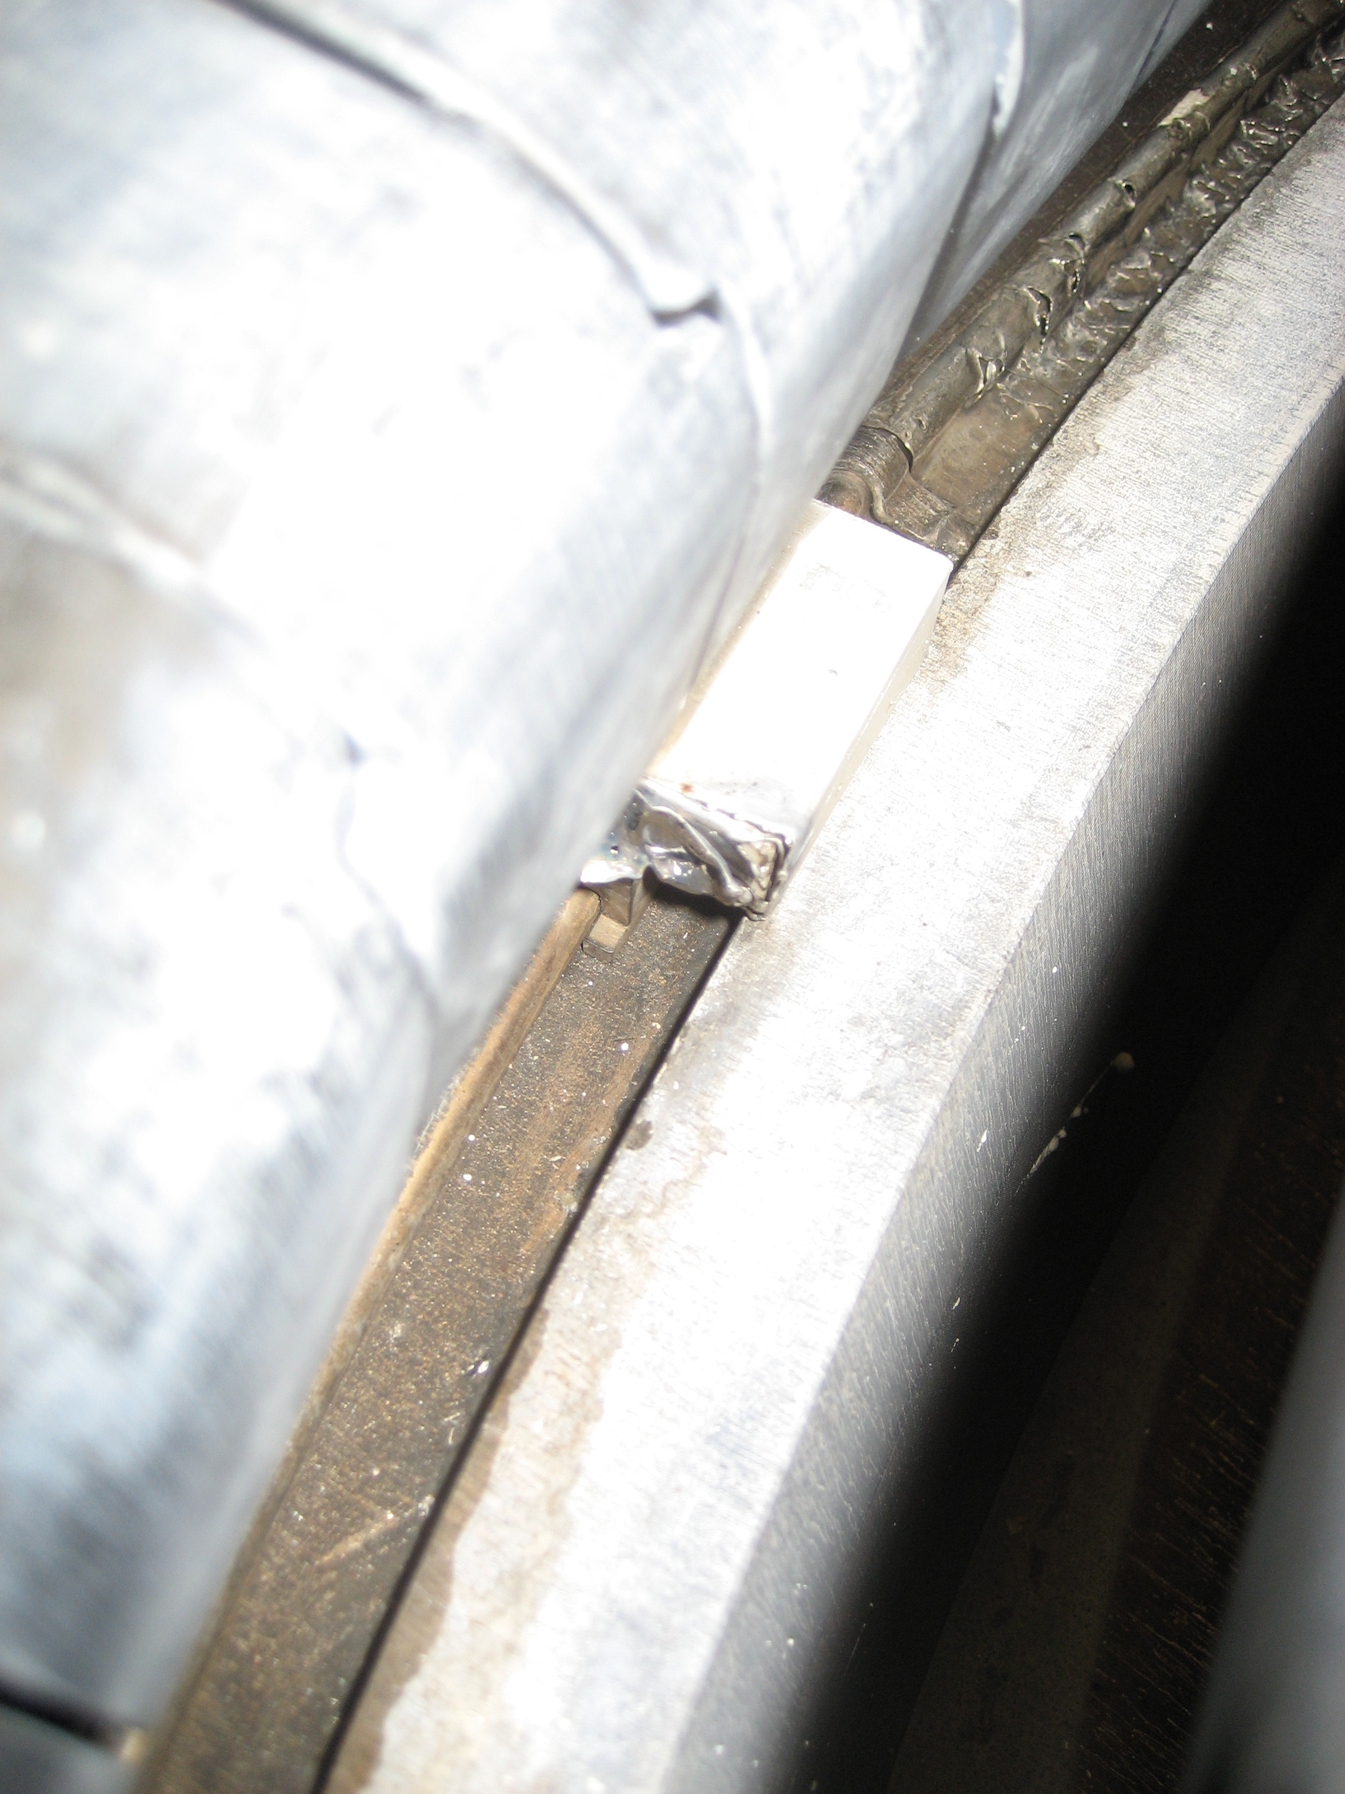
Gap is wider than the flange

Slide 13
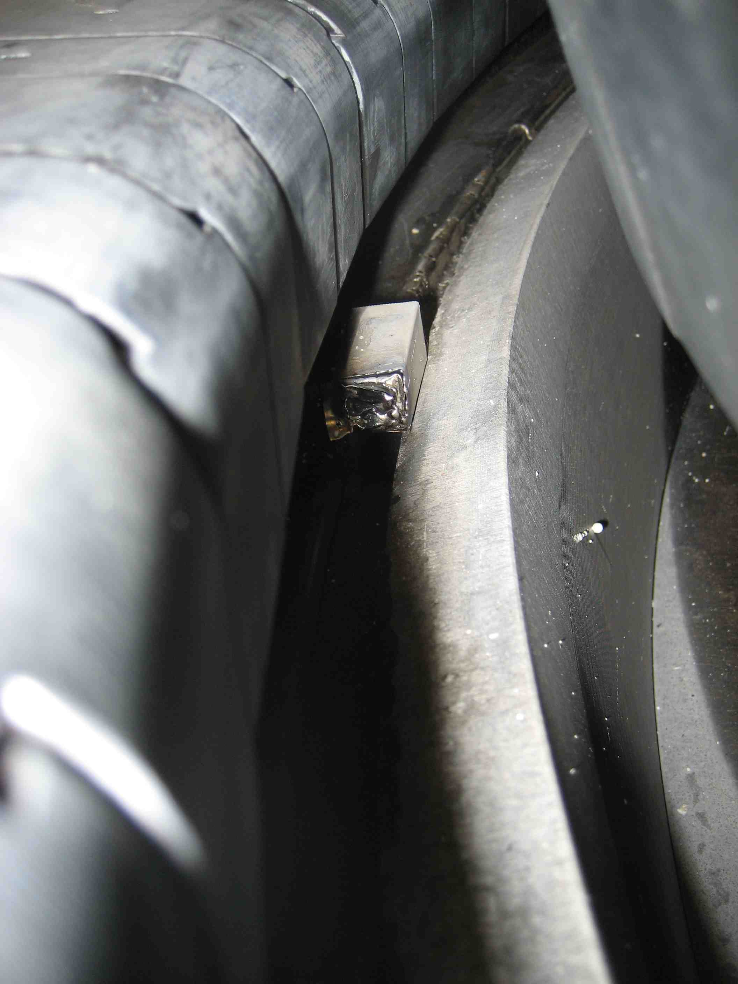

Slide 14
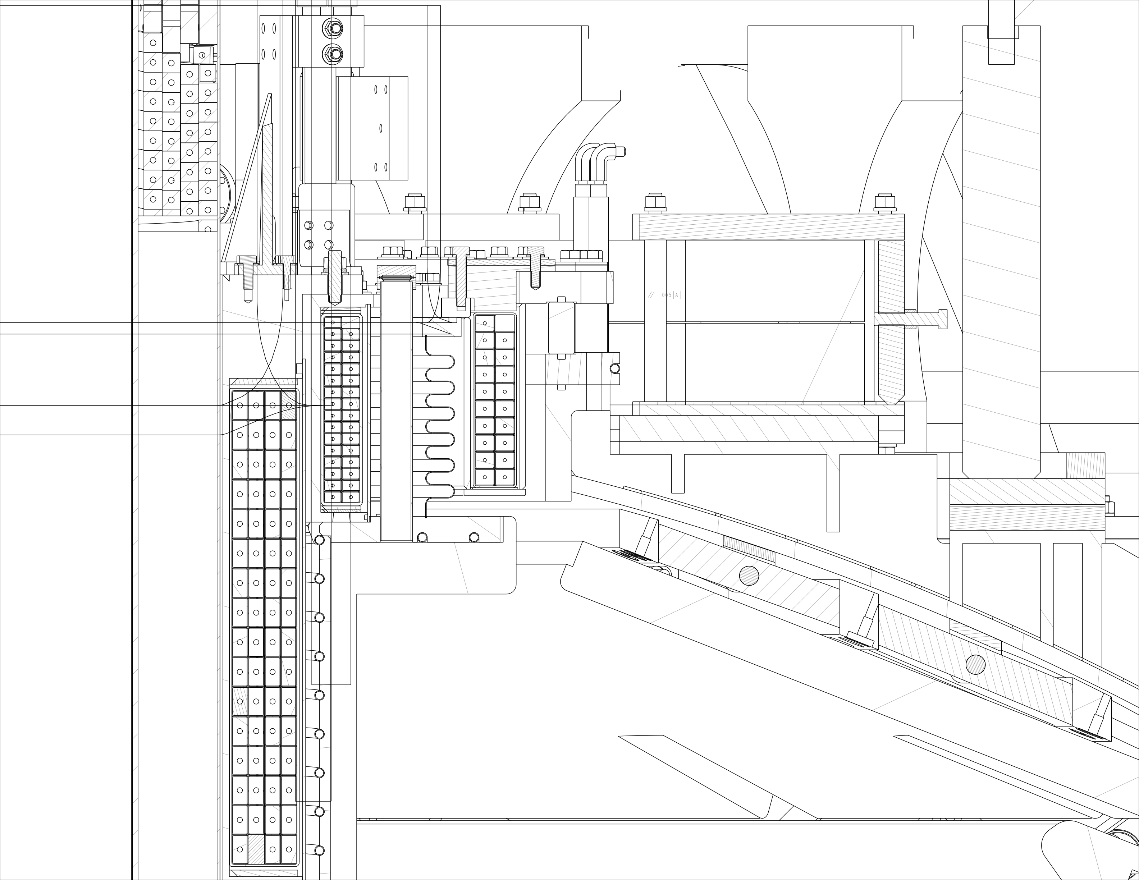
CHI Gap is More Narrow in the Upgrade

Slide 15
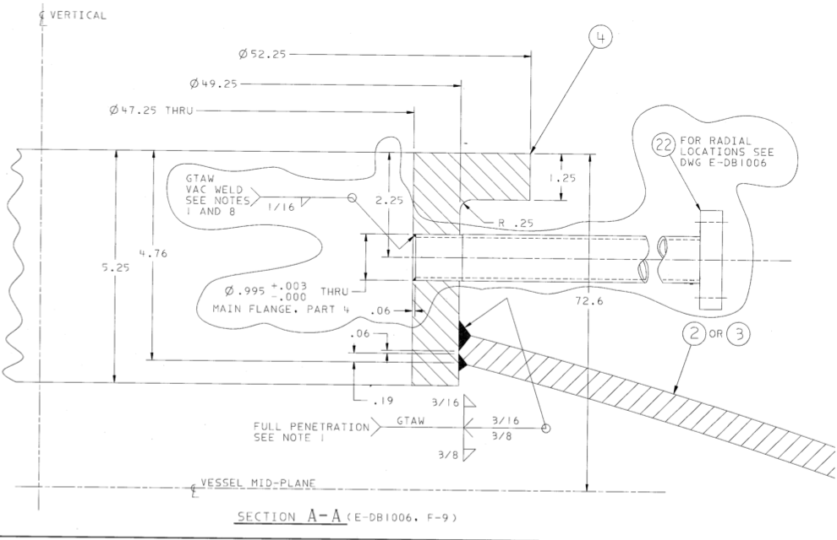
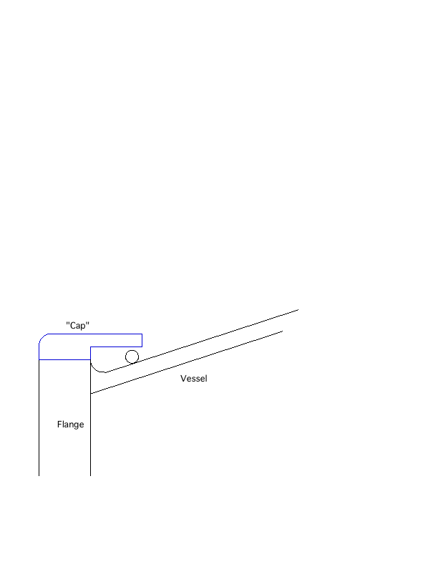
Proposed “Cap” in the CHI Gap (I)

Slide 16
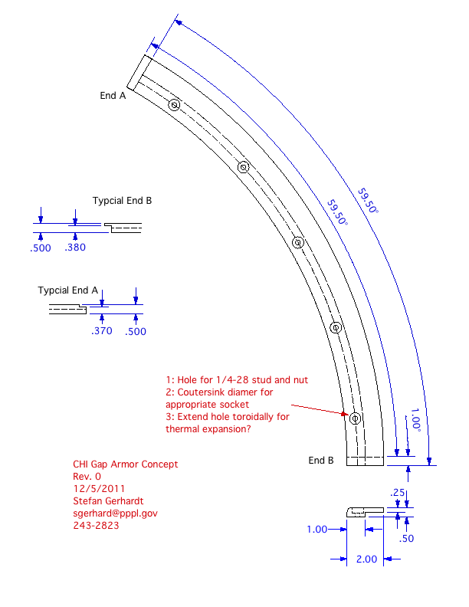
Proposed “Cap” in the CHI Gap (II)
Need to do:
Agree on basic parameters of design
Disruption analysis
Field line angle analysis

