Slide 1
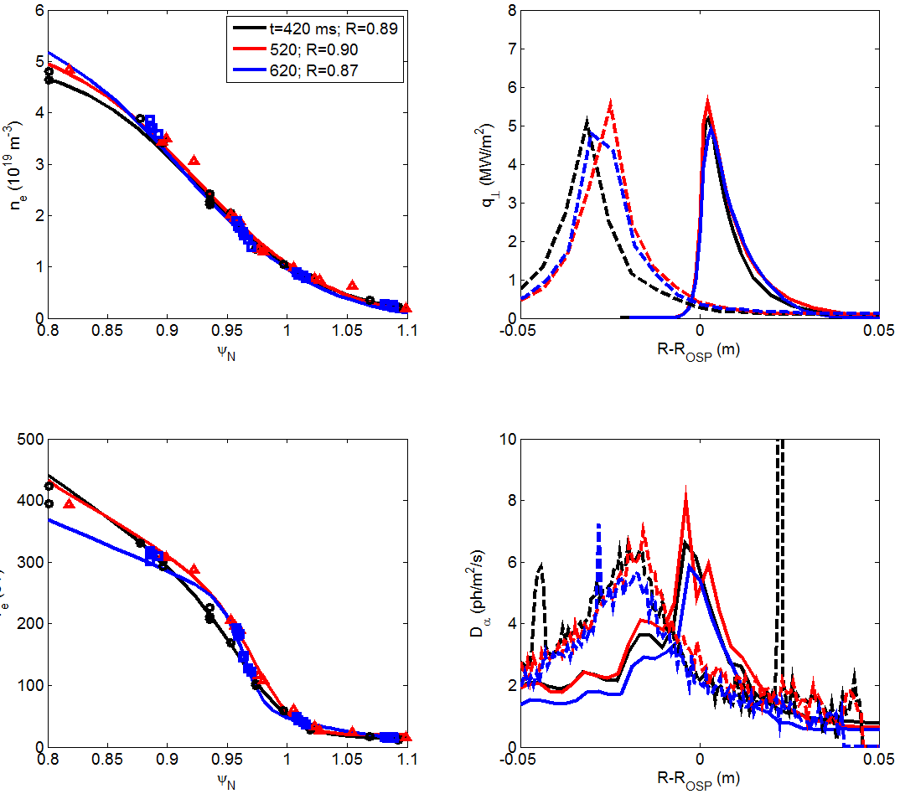
SOLPS modeling of three time slices in 129038
Nothing much changes
Points/dashed lines are measurements
SOL n_{e}, T_{e,} Peak heat flux, D_{α} all pretty constant
Constraints in modeling:
Fitted n, T profiles
Peak q_{div} (T_{e}^{sep})
Peak D_{α} (R)
Inferred R doesn’t change much
0.89, 0.90, 0.87

