Slide 1
2-pt model (sort of) used to estimate n_{e}^{sep}
Start with projected heat flux
Assume Te_{div}^{sep}
For now I use T_{e}=const in divertor, could also assume a ratio of separatrix to far SOL values
T_{e}^{div} is scanned over a range (10-100 eV)
Use 2-pt model (see Jaworski slides from meeting #6) to get upstream T_{e}, n_{e}
I really use ½ this value->fudge factor based on measured n_{e} at T_{e}=T_{e}^{2pt}, and Mike’s OEDGE modeling
Further assume that line-average density is 3*n_{e}^{sep}
Use divertor profiles of flux, ne, Te as usual to get plenum pressure as T_{e}^{div} (and hence n_{e}^{sep}) is varied

Slide 2
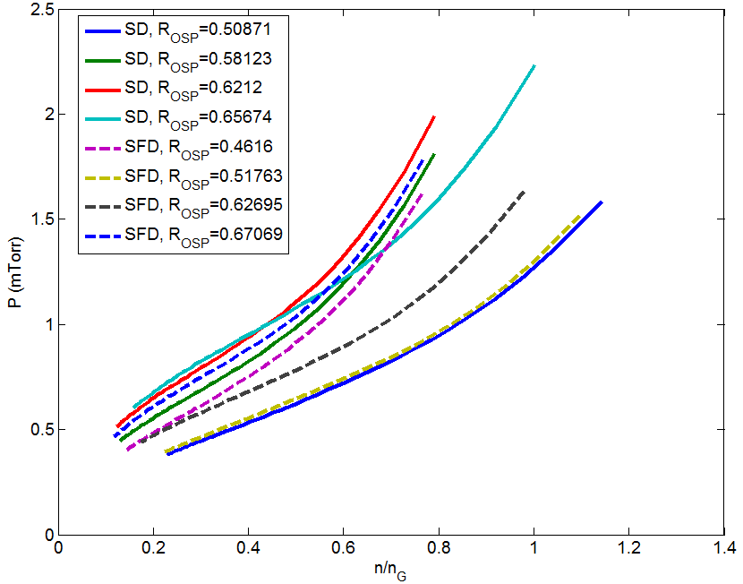
Pressure vs. density, 1MA
n_{g}~1x10²⁰ m⁻³, λ_{q}=9mm
To pump beams, need P~0.8 mTorr (or maybe really ~0.55 mTorr, according to Stefan and TRANSP)
If you believe this, you can run with ROSP close to the pump (might require SFD) to get f_{G} down to ~0.3, or run at more normal ROSP and puff to get to f_{G} ~ 1.0
To pump beam input

Slide 3
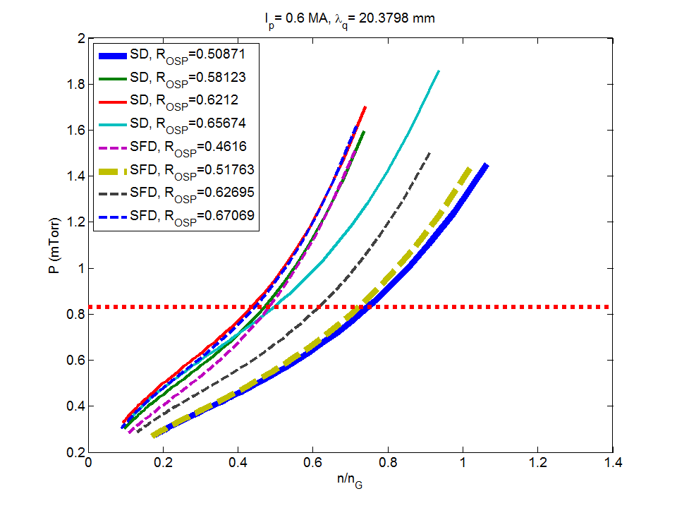
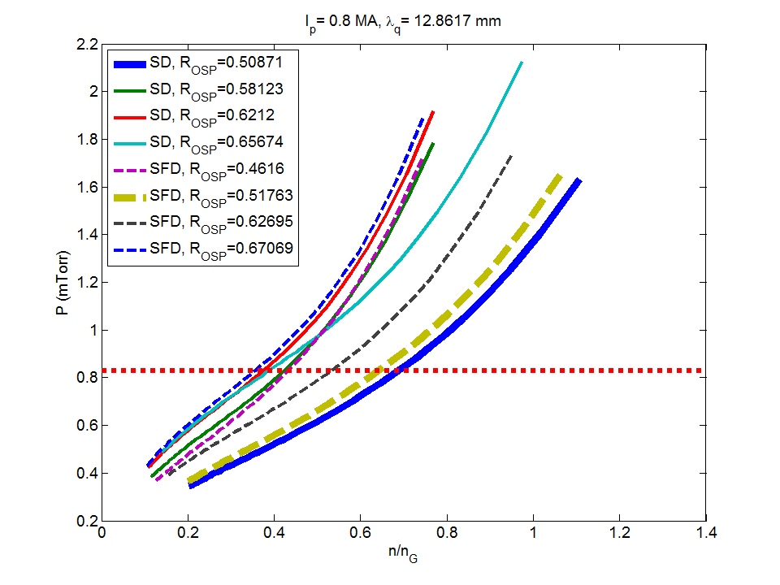
A bunch of currents…
This time R_{pump} 0.72

Slide 4
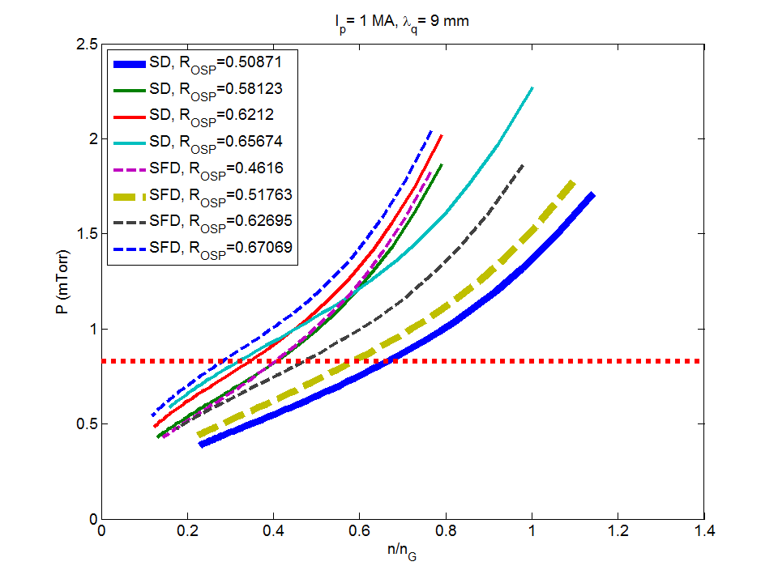
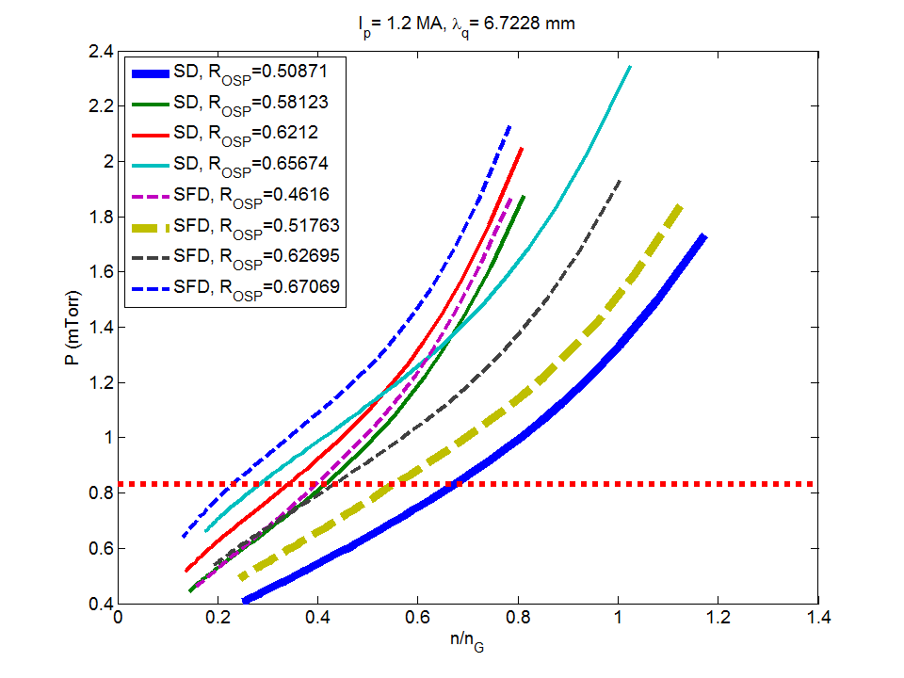
A bunch of currents…
This time R_{pump} 0.72

Slide 5
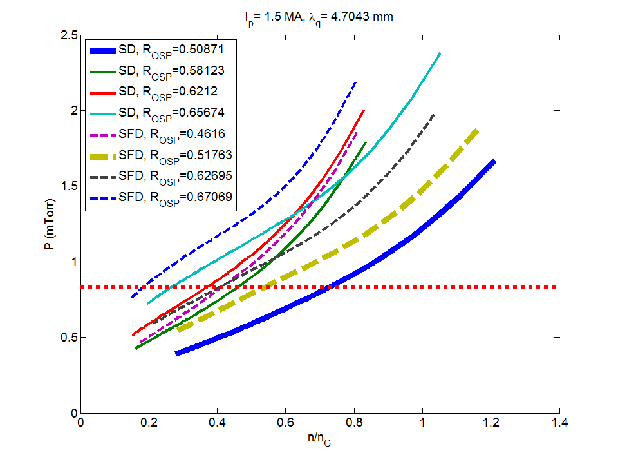
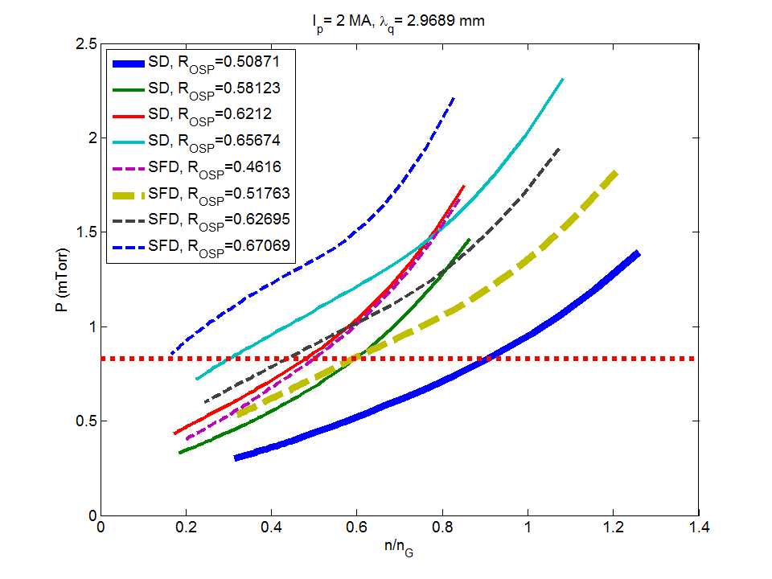
A bunch of currents…
This time R_{pump} 0.72

Slide 6
Greenwald fraction vs. I_{p} and pump location

Slide 7
Greenwald fraction vs. I_{p} and R_{OSP}

