Slide 1
Overview + Preliminary results from EAST experiments studying relative particle pumping of lithium and cryo-pumping
Jon Menard
M. Jaworski, D. Mueller, E. Kolemen, K. Tritz
NSTX-U Physics Meeting
June 25, 2012

Slide 2
2 EAST experiments proposed by J. Menard, M. Jaworski
JM: “Particle control comparison between lithium & cryo-pumping”
Goal: characterize the separate contributions of Li wall conditioning and cryos
Assess the persistence of deuterium pumping from lithium
MJ: “Evaporated lithium coating lifetimes on EAST Tokamak”
Goal: study the evolution of divertor conditions during long-pulse experiments on EAST
Langmuir Probes, filter-scopes to monitor local conditions over time, correlate with performance
Our experiments above were combined, and shot-plan further combined with another experiment studying H and L-mode access (and pumping) vs. strike-point position by Qingsheng Hu (ASIPP) and Zhenfing Ding (Dalian University of Technology)
Got ~80 shots over 2 days
Day 1 was from ~12PM to 1AM, Day 2 from ~12PM to ~5PM

Slide 3
From G. Z. Zuo – “Lithium Coating for H-Mode and High Performance Plasmas on EAST in ASIPP” – PSI2012

Slide 4
From G. Z. Zuo – “Lithium Coating for H-Mode and High Performance Plasmas on EAST in ASIPP” – PSI2012

Slide 5
From G. Z. Zuo – “Lithium Coating for H-Mode and High Performance Plasmas on EAST in ASIPP” – PSI2012

Slide 6
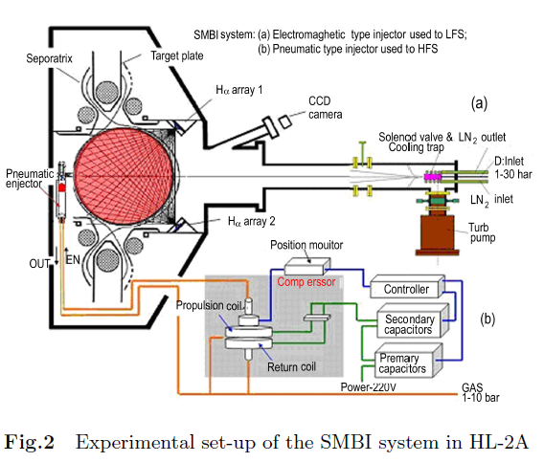
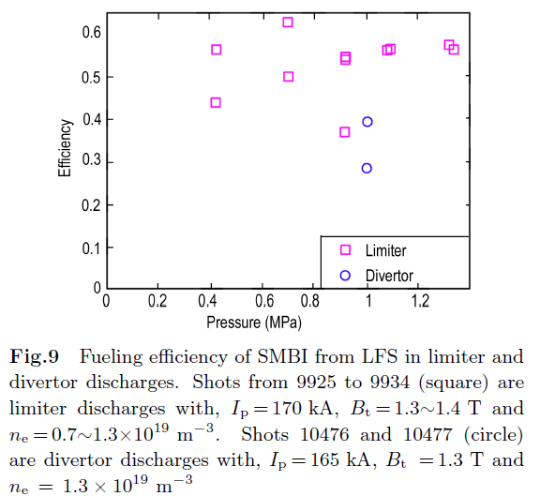
SMBI results from HL2-A show high fueling efficiency even with large distance between injector and plasma
HL-2A: R=1.65m, a=0.4m,
I_{P} = 160–480 kA, B_{T} = 1-3T, ECRH heated

Slide 7
SMBI density control recently developed for EAST (still need to get details on EAST system…)
Short ~10ms delay time between puff-end and density rise vs. 100-200ms for conventional gas fueling → very useful for pumping and fueling studies
0.4MA
0.5MA
~1MW LH-heated L-modes

Slide 8
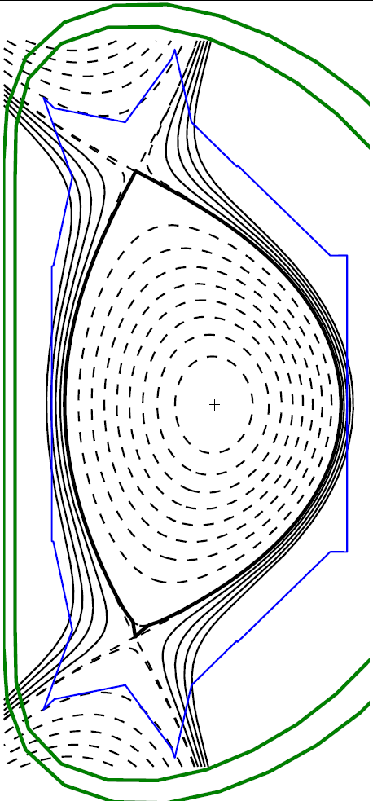
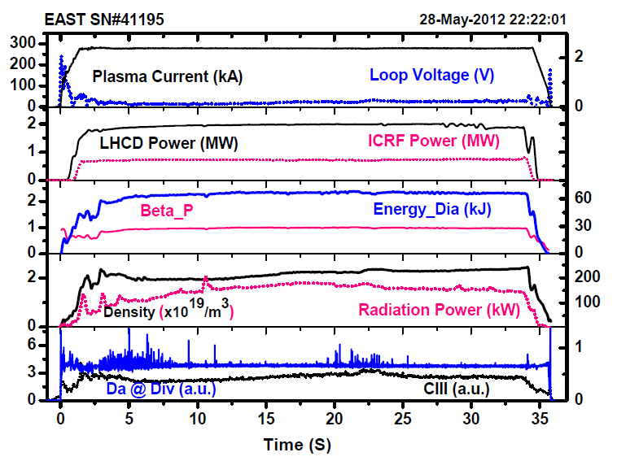
Reference plasma shape for long-pulse H-mode (30s) and this experiment
t=5.5s

Slide 9
Day 1 - Initial comparison of Li vs. cryo-pumping
400kA, 2T, 1MW LH (+ some ICRF), mostly L-mode
Used SMBI for density feedback control
Turn-off SMBI notch for global particle pump-out calculation
Scans (Li + cryos on):
DRSEP
LSN delta-Z
Measured degradation of Li pumping
Used LH + ICRF to access H-mode (no H-mode for dZ = -4cm)
Scans (No Li, no cryos - RF He GDC + regen to 40K cryos)
DRSEP scan
dZ scan (-4 to +4cm)
Still would like to have Li + cryos off (T=40K) case

Slide 10
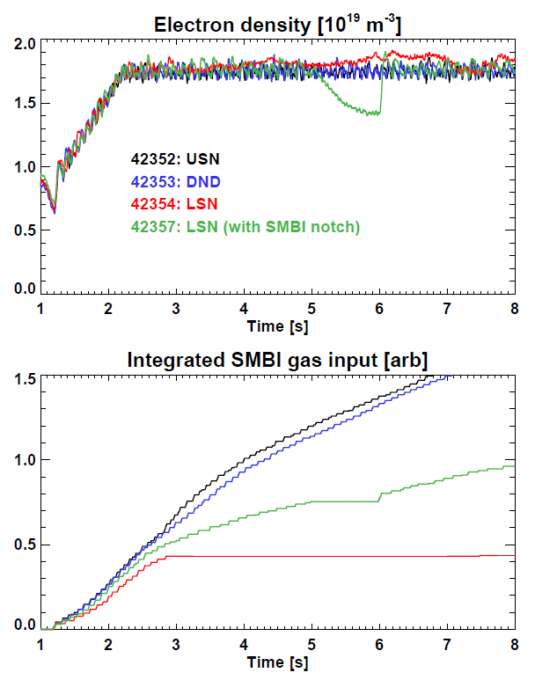
Results of early DRSEP scan with fresh Lithium
USN and DND have strongest pump-out as evidenced by higher integrated SMBI gas required to maintain density
LSN has less pumping
Counter-intuitive given cryo-pumping is on bottom of machine
Possible role of drifts?
Or up/down asymmetries in Li?
Have asked for reversed B_{T}
Due to small remaining run-time this year, likely won’t get…

Slide 11
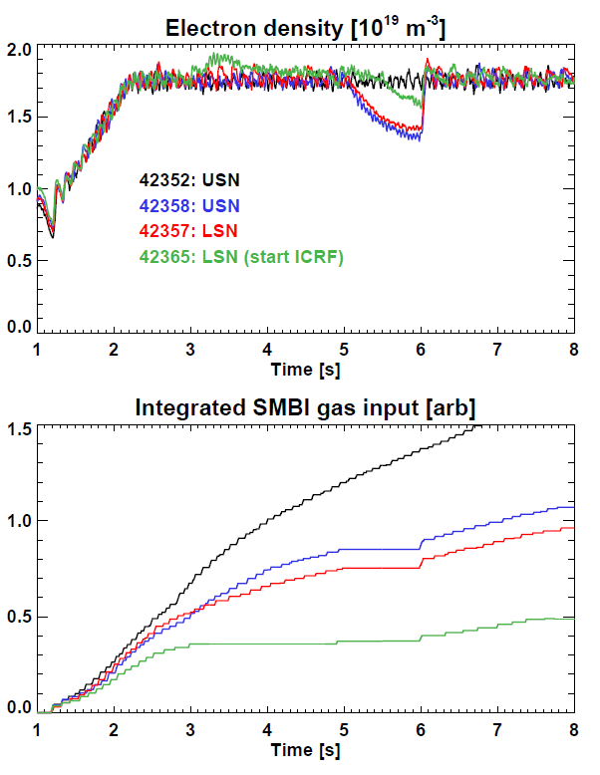
Degradation of strong Li pumping observed
Compare shots with same magnetic balance but similar increment in shot number
Observe 30-50% reduction in pumping after 6-8 shots
Each shot ~10s → 60-80 shot seconds of strong Li pumping

Slide 12
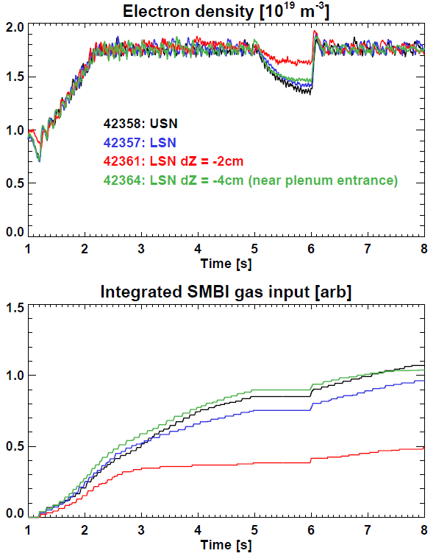
USN vs. LSN, scan of LSN strike-point
Pump-out is quite sensitive to exact location of strike-point
After upper lithium pumping has degraded, USN and LSN reference are similar
-2cm shift = weakest pumping
Li and D accumulation in private flux region?
-4cm strongest
Reason unclear – possible role of proximity to cryo? (see later part of talk)
(4cm away from cryo-entrance)

Slide 13
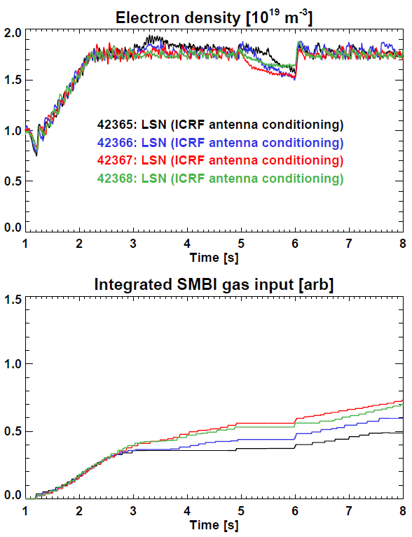
ICRF initially acts as modest particle source, but is conditioned after 3-4 shots

Slide 14
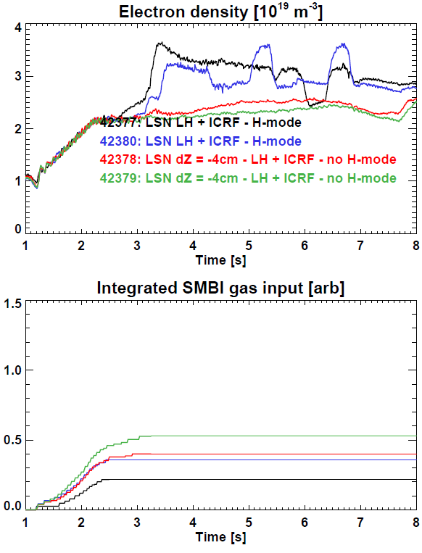
LH+ICRF H-mode with nominal LSN strike-point
Pumping insufficient for very low density H-mode
Density increases ~50% above requested control value
Could not obtain H-mode with -4cm shift
Did not spend much time to increase coupling + power
Remaining shots done only in L-mode

Slide 15
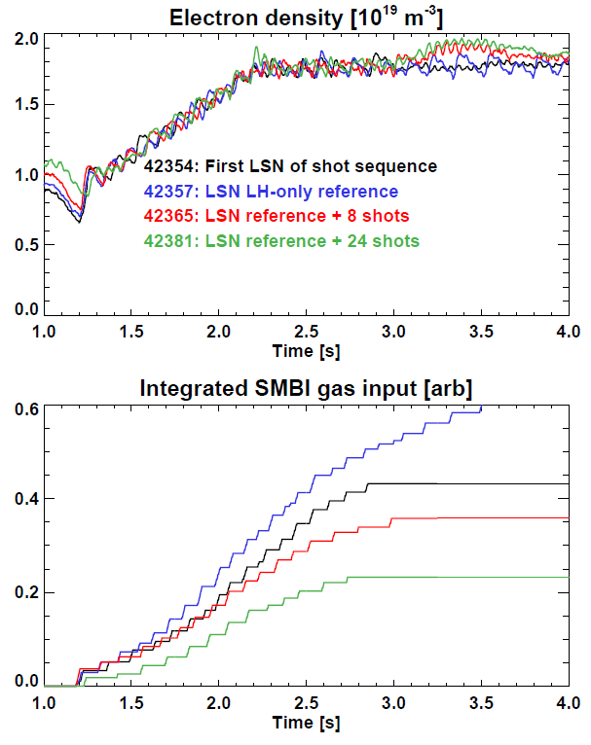
Long-term Li pumping reduction trend vs shot
Pumping decreased factor of 2 after 20-25 shots
200-250 shot seconds
Suggests significant passivation of fresh Li
Li pumping largely saturated (see next slides)

Slide 16
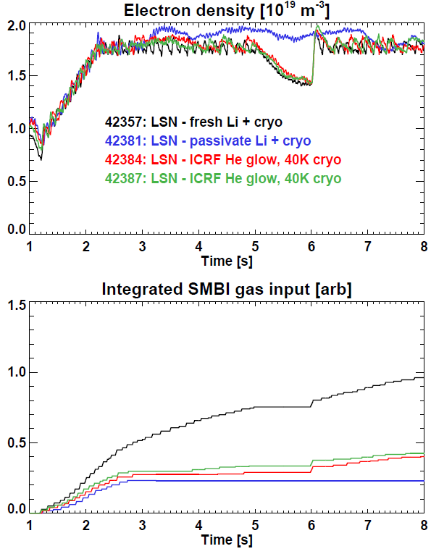
Reference LSN pumping - weakly dependent on cryo
Pumping of passivated Li + cryo similar to pumping from ICRF He-glow and warmed (40K) cryo
Pump-out during SMBI notch stronger after ICRF He-glow conditioning
Possible that ICRF He-glow detraps D?
Some re-activation of Li?

Slide 17
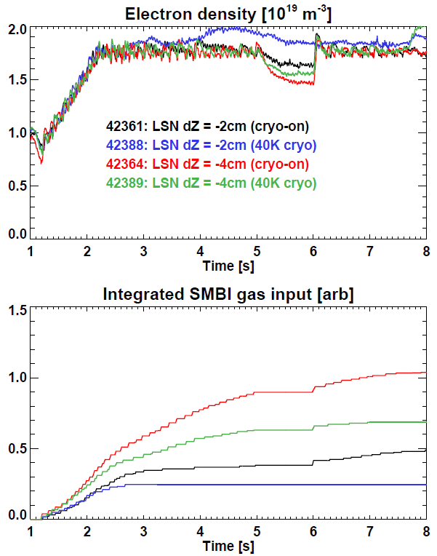
Pumping with -2cm shift with fresh Li + cryo weaker than -4cm with passivated Li and warm cryo – why?

Slide 18
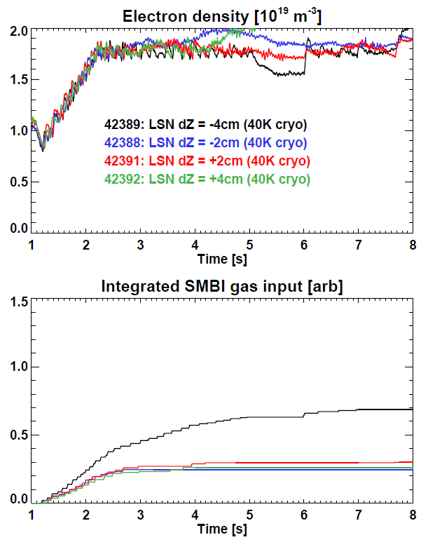
Pumping sensitive to strike-point location
After Li passivation, and cryos partially warmed, pumping independent of strike-point position except for -4cm
Still unclear why -4cm has better pumping

Slide 19
Day 2 - role of Li vs. cryo-pumping
400kA, 2T, 1MW LH – no ICRF, stay in L-mode
This time with fresh lithium, no cryo-pumping (T=40K)
SMBI not available for density feedback control
Spent ~10 shots optimizing waveform for low-field-side gas fueling including increased integral gains for density feedback control, improved DRSEP transition
Achieved good control of gas and electron density:
square-wave and impulse (turn-off) pumping response
Li trends = similar results as previous day:
USN and DND have more rapid pump-out than LSN
Observed reduction in Li pumping by 8-10 shots
Stationary pumping conditions by ~20 shots

Slide 20
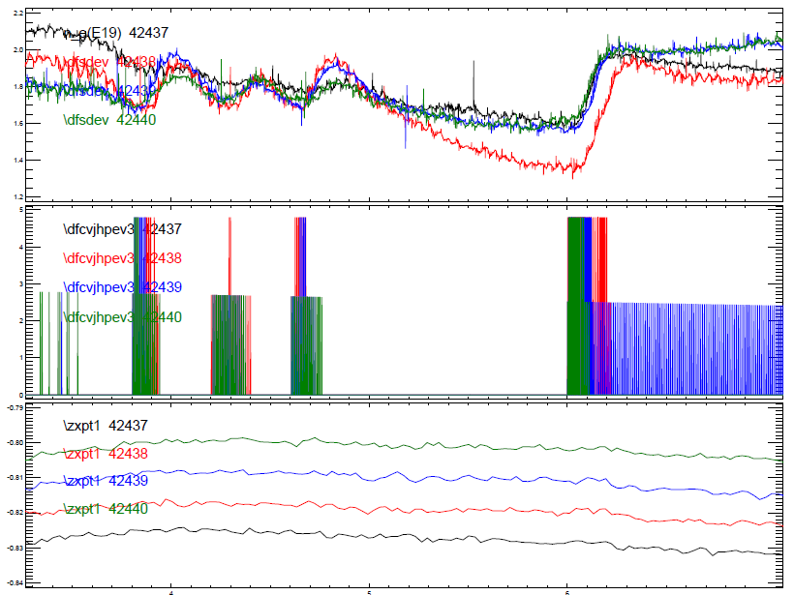
Day 2 – optimization of cryo-pumping
Performed X-point height scan with cryo cold (8K)
Tried shifts relative to reference LSN: -2, -4, -6, -8, -10cm
Only -8cm case exhibited increased particle pumping

Slide 21
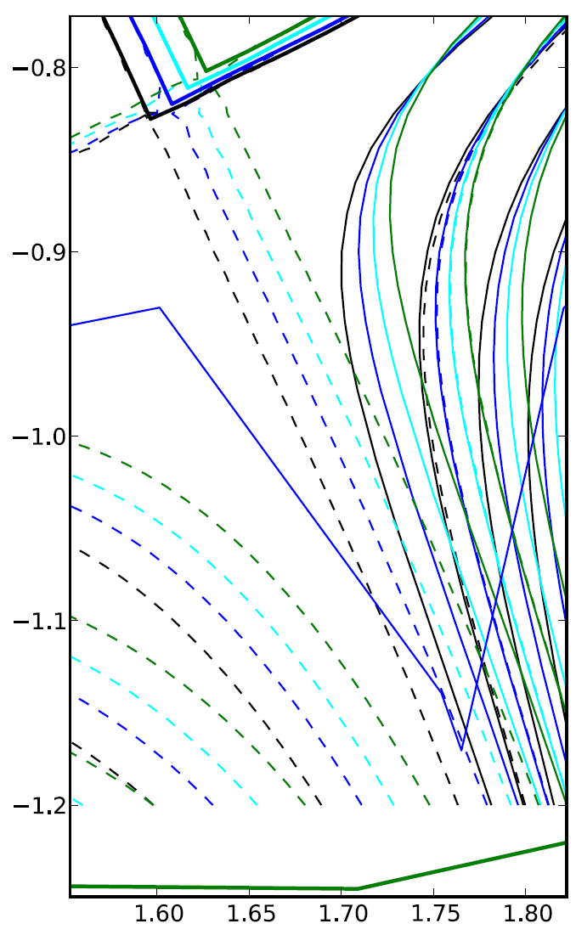
Cryo-pumping sensitive to strike-pt position
Case with increased density pump-out places strike-point directly at divertor corner (plenum entrance)
Other nearby shapes do not show significant pumping
Implies precise strike-point control likely needed for particle control with cryo

Slide 22
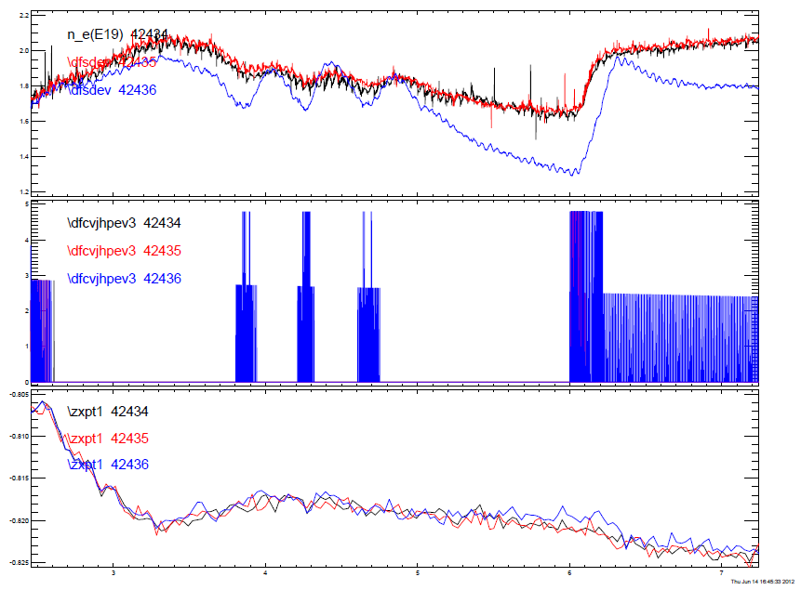
Clear dependence on cryo temperature
As expected, pump only effective below 20K (D₂ freezing)
T_{outlet}: 30K, 20K, 8K

Slide 23
Summary conclusions from experiment
Pumping from Li dominates reference LSN, since reference LSN has little/no cryo-pumping
Li pumping degraded by 30-50% after ~6-8 10s shots
Li pumping conditions saturated at factor of 2-3 lower pumping (relative to fresh Li) after ~20 10s shots
Results may be different for different plasma conditions!
Cryo-pumping appears to only be effective with strike-point directly at corner of divertor = plenum entrance
If very long-pulse H-modes saturate Li, will need very good strike-point control for cryo-pumping for D control
Achieved H-mode for reference LSN, but not for -4cm shift, and did not try -8cm → future work (not for me!)

