Slide 1
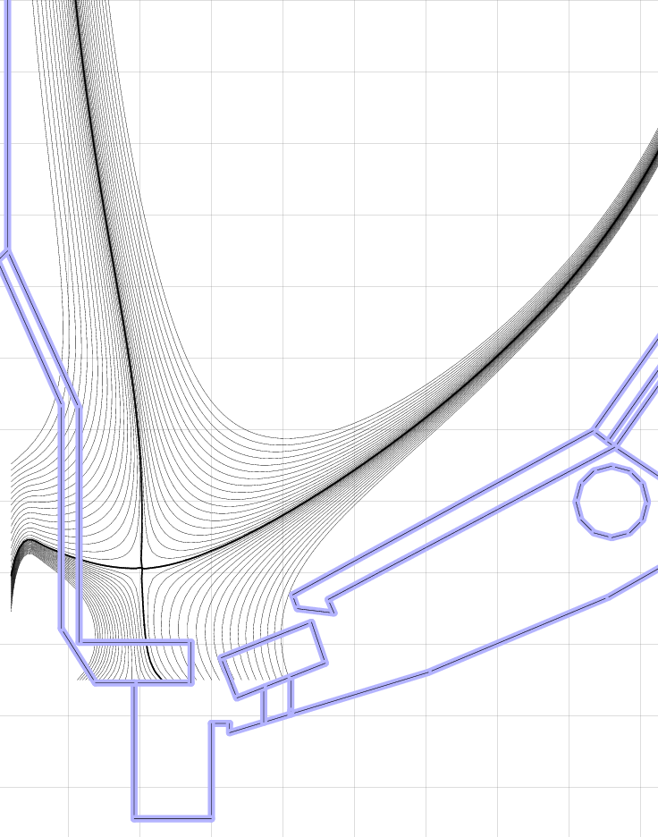
Updated NSTX-U cryo constraints
Cryo-baffle should end at secondary passive plate corner and maximize gap to plasma
Cryo-ring at R=0.9m – assume 10cm diameter outer shield
-1.8 -1.6 -1.4 -1.2 -1.0 -0.8
Z (m)
Eliminate direct line of sight for neutrals
Keep entrance radius, height, and gap same as before
0.4 0.6 0.8 1.0 1.2
Determine vessel-cryo gap that gives similar pumping as before
R (m)
Vertical gas seal at R=0.95m

