Slide 1
Design Option #1
Angled plates

Slide 2
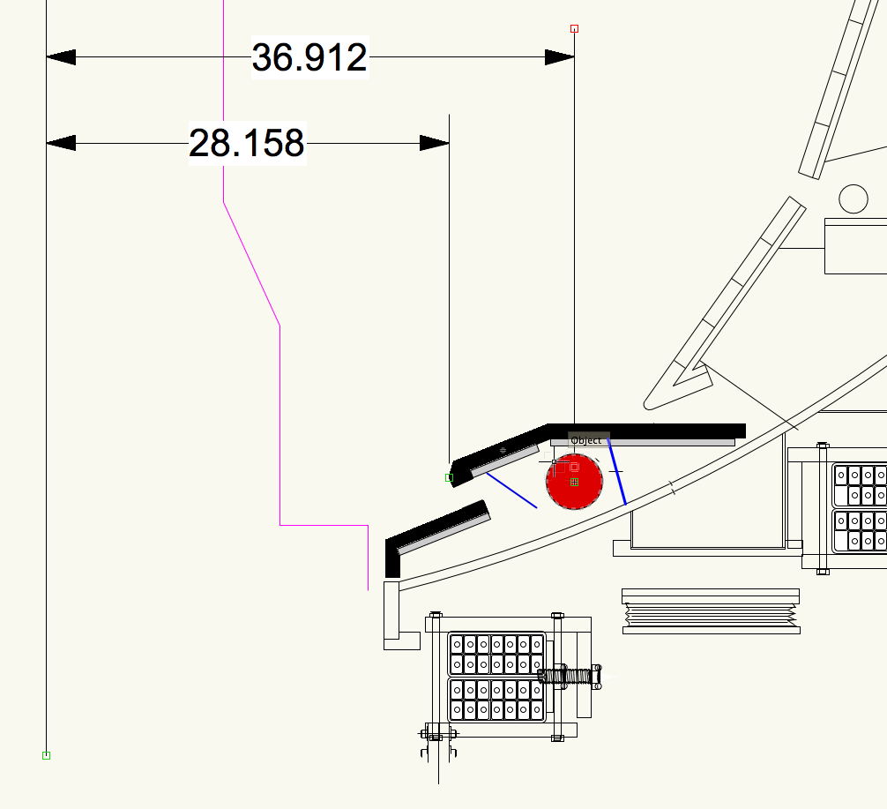

Slide 3
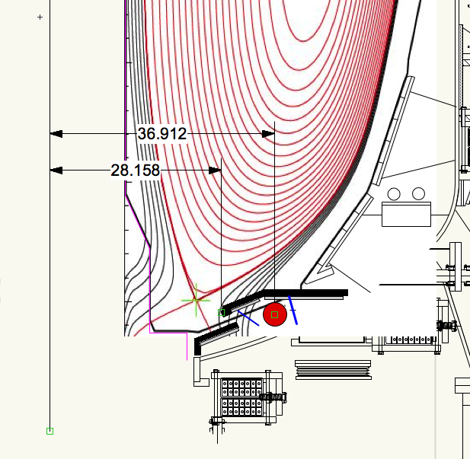

Slide 4
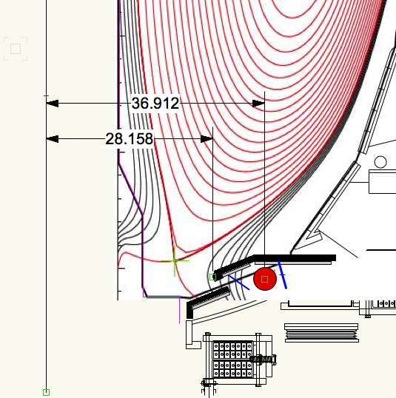

Slide 5
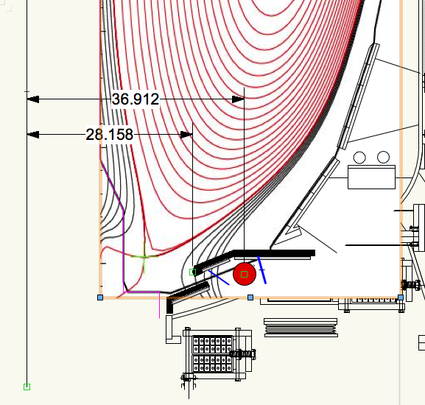

Slide 6
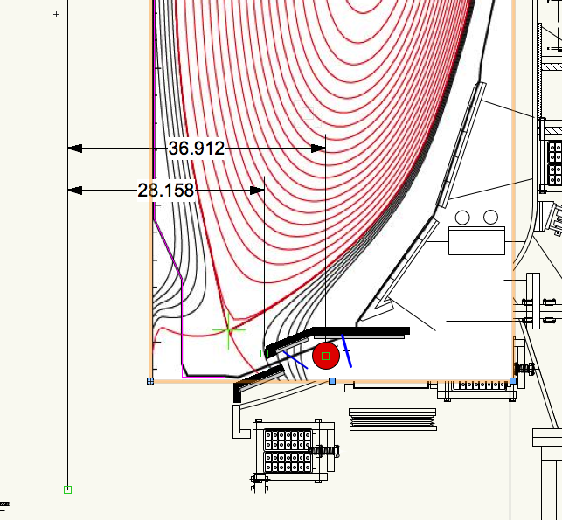

Slide 7
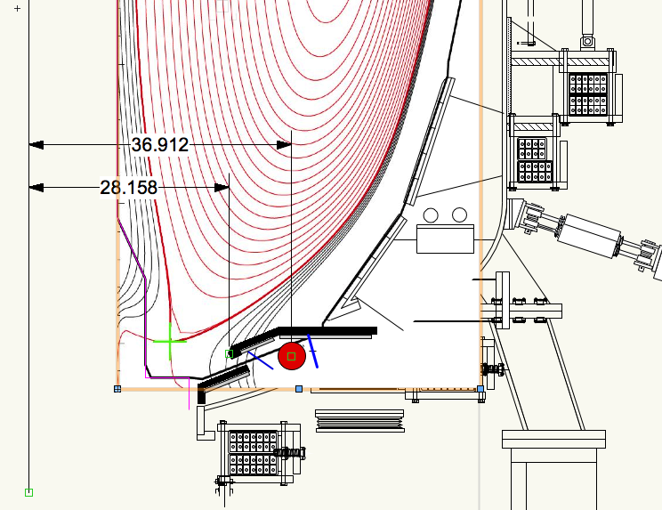

Slide 8
Design Option #2
Horizontal target outboard of the pump entrance.
Steep ramp on the “shelf”.
More clearance to a variety of plasma shapes.

Slide 9
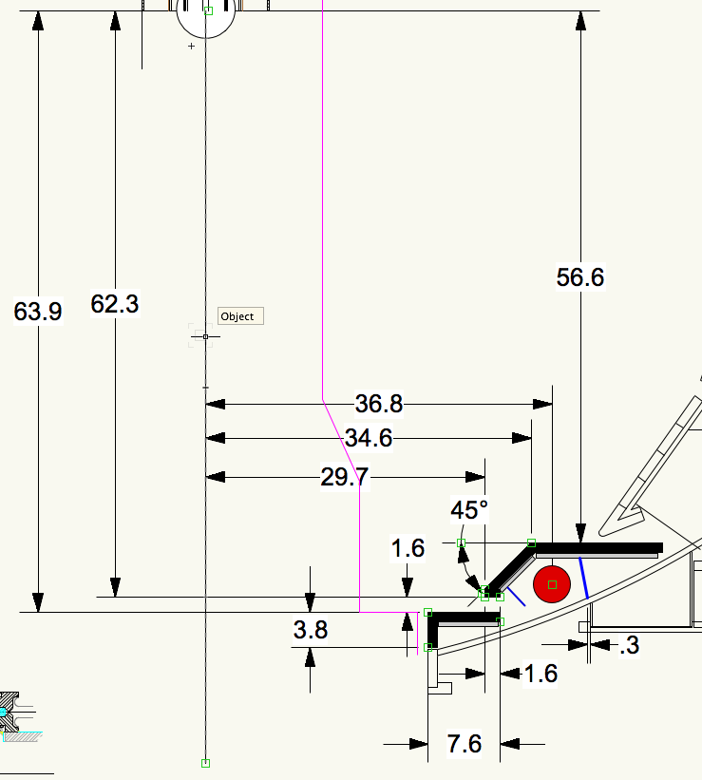

Slide 10
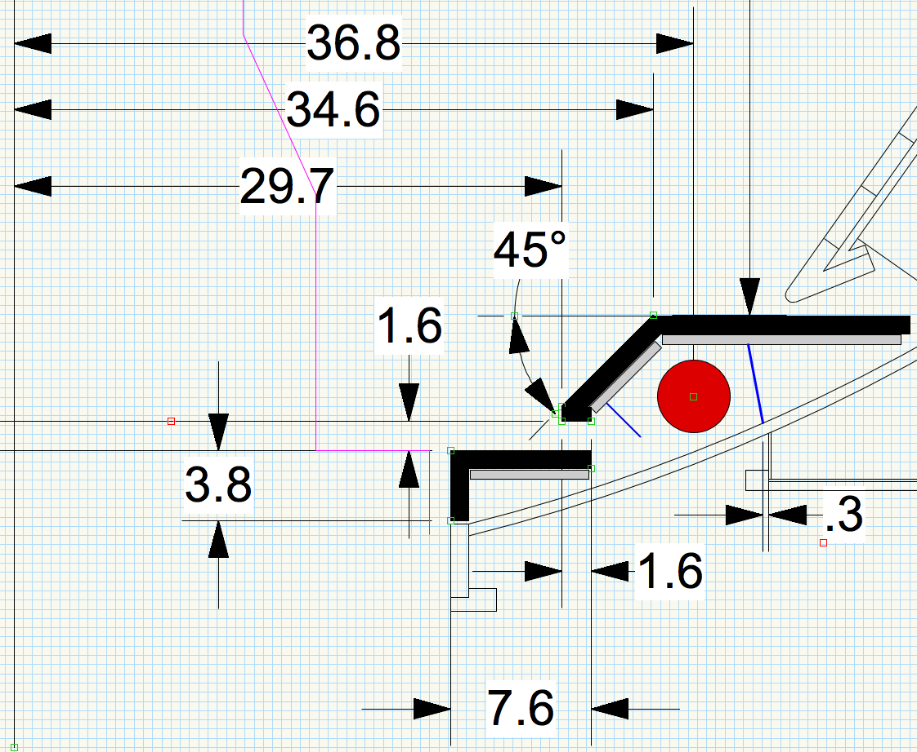

Slide 11
Grey is an underlying 316 SS mechanical structure, ½” thick
Magenta is outline of the new CS PFCs
Black Represents 1” thick Graphite
10 degree tilt on gas seal, 1/8” thick 316 SS,
0.3” from tube weld
Inner Tile Flush With Vessel Nozzle
2.6” long, 45 degree angle
Neutral Blocker
1/8” thick 316 SS

Slide 12
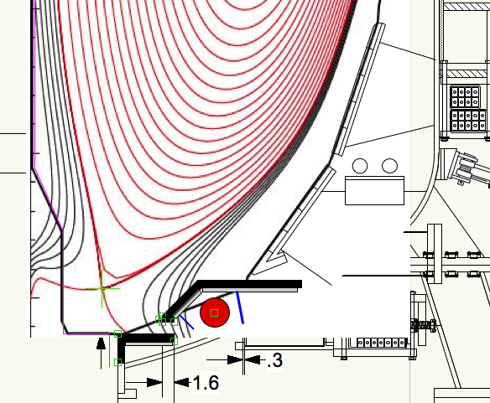

Slide 13
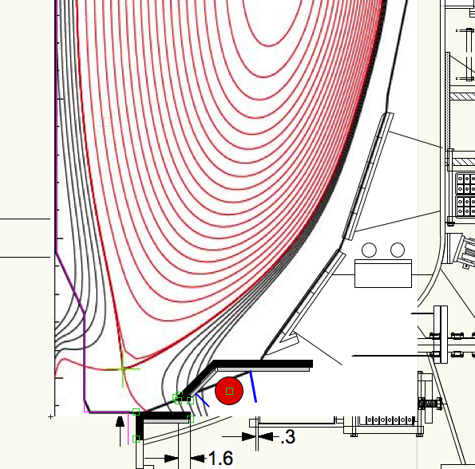

Slide 14
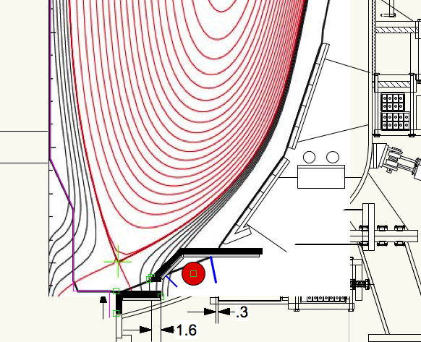

Slide 15
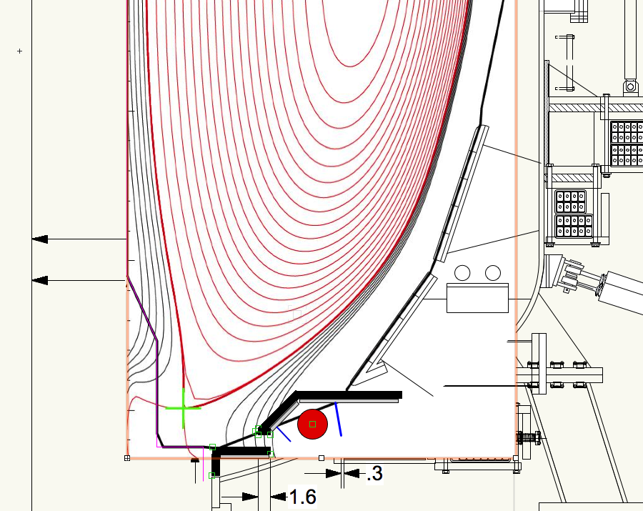

Slide 16
