Slide 1




NSTX-U
Supported by
Plans / collaboration discussion – stability/ control theory/modeling (Columbia U. group)
S.A. Sabbagh¹, J.W. Berkery¹ J.M. Bialek¹, Y.S. Park¹, T.E. Evans², S.P. Gerhardt³, S. Jardin³, S. Kruger⁴, J.-K. Park³, Z. Wang³
¹Department of Applied Physics, Columbia University, NY, NY
²General Atomics, San Diego, CA
³Plasma Physics Laboratory, Princeton University, Princeton, NJ
Tech-X, Boulder, CO
NSTX-U Macrostability TSG meeting
October 1st, 2013
PPPL
Coll of Wm & Mary
Columbia U
CompX
General Atomics
FIU
INL
Johns Hopkins U
LANL
LLNL
Lodestar
MIT
Lehigh U
Nova Photonics
ORNL
PPPL
Princeton U
Purdue U
SNL
Think Tank, Inc.
UC Davis
UC Irvine
UCLA
UCSD
U Colorado
U Illinois
U Maryland
U Rochester
U Tennessee
U Tulsa
U Washington
U Wisconsin
X Science LLC
Culham Sci Ctr
York U
Chubu U
Fukui U
Hiroshima U
Hyogo U
Kyoto U
Kyushu U
Kyushu Tokai U
NIFS
Niigata U
U Tokyo
JAEA
Inst for Nucl Res, Kiev
Ioffe Inst
TRINITI
Chonbuk Natl U
NFRI
KAIST
POSTECH
Seoul Natl U
ASIPP
CIEMAT
FOM Inst DIFFER
ENEA, Frascati
CEA, Cadarache
IPP, Jülich
IPP, Garching
ASCR, Czech Rep
V1.1

Slide 2
Columbia U. NSTX-U grant proposal research plans – drive suggestions for theory/simulation collaboration ideas
Physics research areas on NSTX-U
  Global MHD mode stabilization physics (incl. kinetic RWM physics)
  Global MHD mode active control
  Non-resonant plasma rotation alteration / physics / control (NTV)
  NCC coil design
Related/coordinated research on KSTAR
  Aimed at long-pulse, high beta
  Higher aspect ratio of KSTAR provides opportunity for comparison to NSTX-U to determine role of A
Quantitative analysis on ITER cases, future devices
  Device/code benchmarking efforts (major example – ITPA MDC-2)
Near-term analysis: continue analysis / publication of NSTX results, with related device/code benchmarking

Slide 3
List of physics topics / codes in use / planned
Kinetic RWM stabilization
  MISK (linear kinetic RWM stability code)
  M3D-C¹, NIMROD: further linear benchmarking, and non-linear runs for NSTX-U (e.g. NIMROD: toroidal resistive wall tests)
Active RWM control
  RWM state-space controller development (incl. multi-mode)
  VALEN / mmVALEN (multi-mode)
Non-resonant NTV physics (focus on active rotation control)
  NTVTOK (Shaing et al. formulation, connecting collisionality regimes)
Equilibrium development
  NSTX EFIT – further development for NSTX-U
KSTAR collaboration – closely coupled to NSTX-U
  Same analysis tools applied on related physics topics to investgate (i) aspect ratio dependence, (ii) long-pulse aspects

Slide 4
Planned analysis builds from present capabilities and collaborative work
Equilibrium
  Free-boundary: NSTX EFIT
  Fixed boundary: CHEASE (w/Liu), JSOLVER, etc.
Stability
  DCON, PEST: ideal linear stability analysis
  MISK (w/R. Betti): kinetic RWM stability analysis
  M3D-C¹ (w/S. Jardin, N. Ferraro): linear/non-linear stability
  NIMROD (w/S. Kruger): recent collaboration started - NSTX cases being run
3D Physics
  NTVTOK: NTV code on CU computer, used present NSTX data analysis
  TRIP3D (w/T. Evans): ELM mitigation – used for KSTAR, etc.
  M3D-C¹ (w/S. Jardin): global mode stability, effect of 3D field on stability, (w/ T. Evans, N. Ferraro, S. Jardin): plasma response
Control
  VALEN: RWM / dynamic error field control analysis
  Multi-mode VALEN: Unstable MHD mode spectrum and control
  RWMSC: State-space RWM analysis / feedback control

Slide 5
Multi-year ITPA MDC-2 benchmarking of kinetic RWM codes reaching its goals
 | r_{wall}/a | Ideal δW/-δW∞ | Re(δW_{k}) /δW∞ | Im(δW_{k})/ (δW∞) | γτ_{wall} | ωτ_{wall} | δW_{k}/-δW∞ (ω_{E} = ∞)
Solov’ev 1 (MARS-K) (MISK) | 1.15 | 1.187 1.122 | 0.0256 0.0179 | -0.0121 -0.0117 | 0.803 0.861 | 0.0180 0.0189 | 0.157 0.160
Solov’ev 3 (MARS-K) (MISK) | 1.10 | 1.830 2.337 | 0.0919 0.0879 | -0.169 -0.090 | 0.471 0.374 | 0.114 0.051 | 1.98 1.10
ITER (MARS-K) (MISK) | 1.50 | 0.682 0.677 | 0.241 0.367 | -0.046 -0.133 | 0.817 0.581 | 0.090 0.202 | 6.11 6.67
Recent success in producing agreement between MISK and MARS-K
  PENT code development added in 2013
MISK code has been extensively used to quantitatively compare theory/experiment in NSTX
  6 publications from NSTX (first is from 2008)
MDC-2 process has altered both MISK and MARS-K a bit
  MISK comparison to NSTX RWM stability experiments continues to evaluate changes

Slide 6
Discussion topics related to kinetic RWM stabilization
Stabilization physics due to fast particles should be further addressed
  Effects of anisotropic (e.g. NBI, RF) particle populations still not fully explored
  What are destabilization mechanisms (linear, or non-linear) that can be caused by fast particles?
  Is stabilization accounted due to Maxwellian distributions complete?
Long-standing issue – effect of key rational surfaces
  Generally, numerical integration of ideal eigenfunction very close to rational surfaces does not yield agreement with experiment
  In fact, omitting regions very close to key rationals yields results that compare better in quantitative comparison to experiment
  Major task with theory: develop an improved model of the plasma near key rationals

Slide 7
RWM active control capability increases as partial NCC coils are added (midplane RWM coils included)
Using present midplane RWM coils
Partial NCC 1x12 (upper), favorable sensors
NCC upper
1x12 coils
Partial 1x12 NCC coil set significantly enhances control
  Present RWM coils: active control to β_{N}/β_{N}^{no-wall} = 1.25
  NCC 1x12 coils: active control to β_{N}/β_{N}^{no-wall} = 1.52
Existing
RWM
coils

Slide 8
RWM active control capability increases further with full NCC (midplane RWM coils included)
NCC 2x6 odd parity, with favorable sensors
NCC 2x12 with favorable sensors, optimal gain
Full NCC coil set allows control close to ideal wall limit
  NCC 2x6 odd parity coils: active control to β_{N}/β_{N}^{no-wall} = 1.58
  NCC 2x12 coils, optimal sensors: active control to β_{N}/β_{N}^{no-wall} = 1.67

Slide 9
Comments and discussion topics related to NCC design analysis for NSTX-U
The present approach of combining key figures of merit to produce a multi-use coil system is the correct one
We need to be careful that further analysis / results in the coming year that influences the NCC design doesn’t greatly decrease multi-use flexibility
  E.g. recent ELM suppression results from DIII-D indicate that a subset of I-coils are adequate for ELM control – NCC coil design should (and can) expand to test this, rather than downsize
  Need to avoid similar potential issue based on unproven theory that might restrict physics studies rather than provide a coil to prove them
Next steps for NCC design for RWM active control (CU plan)
  Realistic sensors that minimize coupling to passive plates need to be designed and implemented in calculations of present NCC design
  NSTX-U should have sensors with both weak and strong coupling to passive plates for RWM state-space controller physics studies

Slide 10
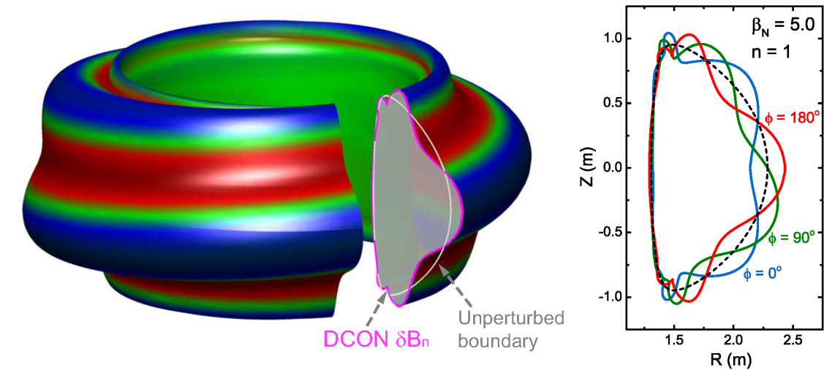
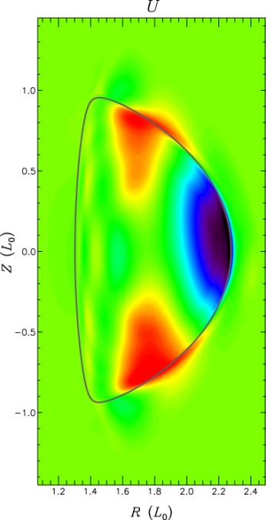
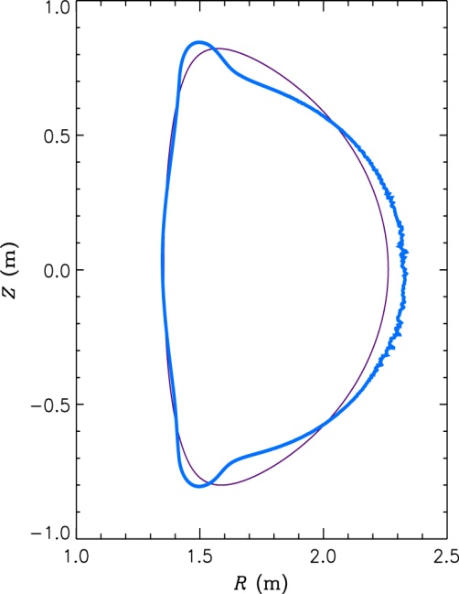
M3D-C¹ code example for KSTAR, comparison to DCON
KSTAR DCON n = 1 unstable mode eigenfunction
Linear stability analysis using M3D-C¹ code (collaboration with S. Jardin)
  Extended MHD code solving full two-fluid MHD equations in 3D geometry
  Non-linear code, presently being used in linear mode for initial runs
Ideal n = 1 stability limit from DCON and M3D-C¹ compare well
  For the same input equilibria, “equivalent” wall configurations compared
  With-wall n = 1 stability limit computed as β_{N} ~ 5.0 in both calculations
  Further M3D-C¹ calculations for KSTAR will include improved wall configurations (3D, resistive wall) and analysis for resistive instabilities
M3D-C¹ unstable mode velocity stream function and δB_{n}
δB_{n}
(q = 4)

Slide 11
Discussion topics related to non-linear MHD code analysis
Stability in the presence of a toroidal resistive wall
  Much experimental experience in NSTX – can test code using existing data
  M3D-C¹: resistive wall model is close (we’re ready to beta test!)
  NIMROD: collaboration with S. Kruger and student
    Initial tests exposed an issue with model
    Model recently fixed, first tests on NSTX equilibria should be ready by APS 2013
Differential rotation between wall and mode is highly desired
  Physics studies of a fully locked mode are important, but differential rotation is needed to attempt to mimic kink stabilization dynamics
Kinetic stabilization physics is highly desired
  For comparison to present tested linear codes (implementation is obviously different!), as well as direct comparison to experiment
  M3D-C¹, NIMROD in different stages of development in this regard

Slide 12
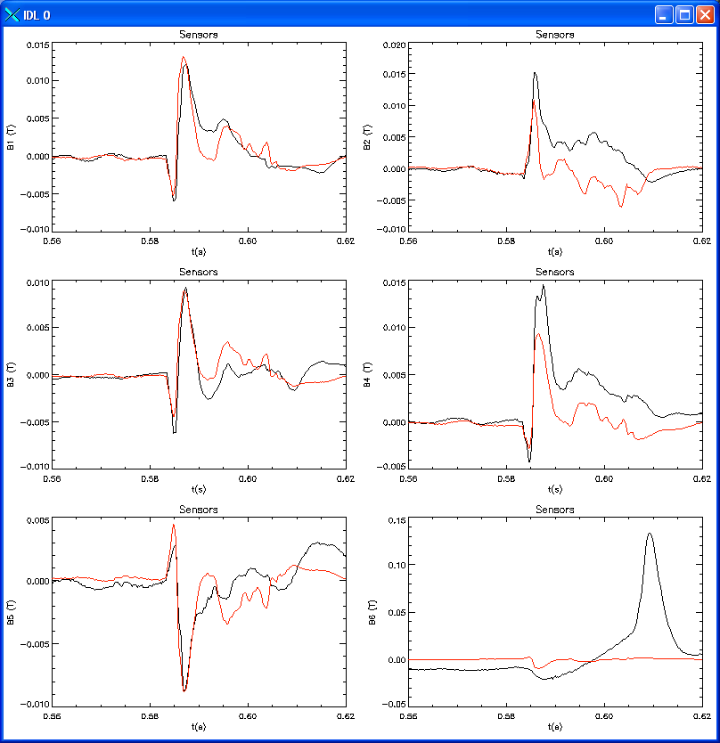
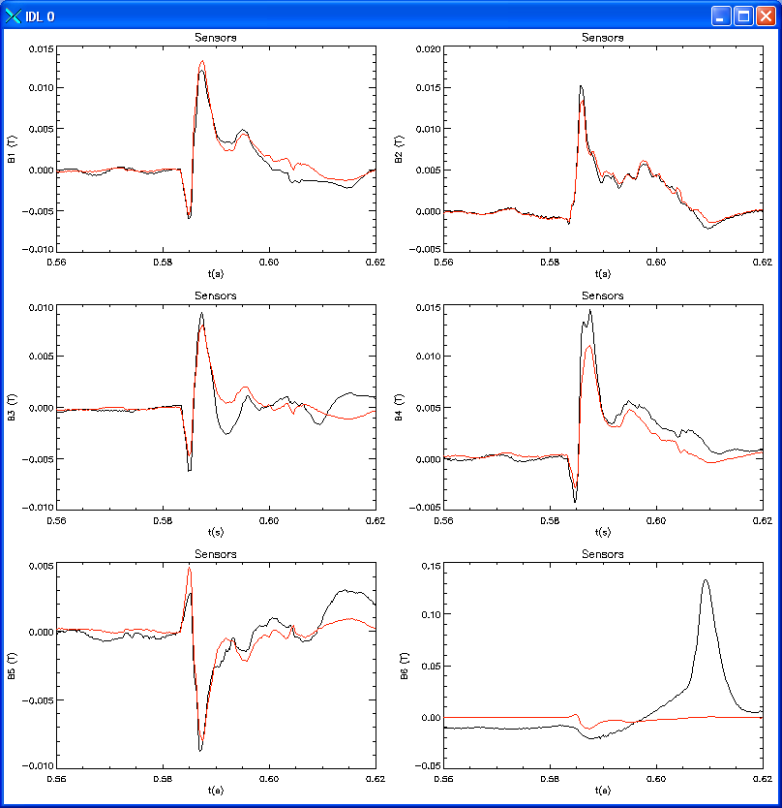
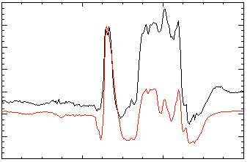
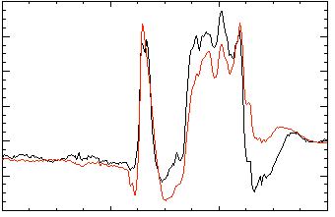
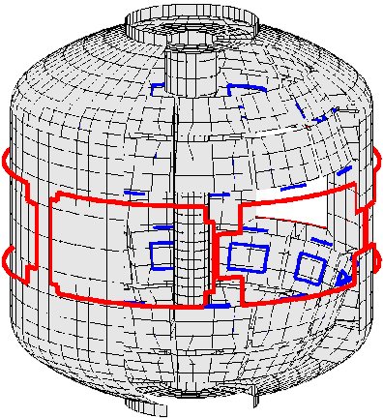
Model-based RWM state-space controller used on NSTX improves standard PID control
NSTX: RWM Upper B_{p} Sensor Differences (G)
Control approach proposed for ITER
Can describe n > 1, varied poloidal mode spectrum in model
3D mode and conducting hardware features described in real-time
  Greater detail measured by upgraded sensor coverage is better utilized than with PID
2 States (similar to PID)
7 States
200
δB_{p}¹⁸⁰
δB_{p}¹⁸⁰
(a)
(b)
100
0
-100
150
δB_{p}⁹⁰
δB_{p}⁹⁰
100
Sensor Differences (G)
50
0
-50
80
δB_{p}⁹⁰
(c)
δB_{p}⁹⁰
(d)
40
0
137722
137722
0.56
0.58
0.60
0.56
0.58
0.60
0.62
t (s)
t (s)
No NBI Port (c)
With NBI Port (d)

Slide 13
Discussion topics related to model-based RWM state-space control (RWMSC)
Present NSTX RWMSC will be upgraded by the Columbia U. group for NSTX-U
  Upgrade includes independent control of present 6 RWM coils on NSTX-U, multi-mode control capability (n = 1 – 3), upgrade path to NCC, etc.
Can real-time plasma response model be expanded?
  Present model is the Boozer (s, α) model
    E.g. kinetic stabilization effects can be included directly through this model
    However, basic eigenfunctions are chosen a priori and are then altered by this response model. Can this specification be made more generally?
  Present modes and plasma response model are for ideal linear eigenfunctions. Can more general eigenfunctions be specified? (e.g. non-linear saturated?)
    What would be the appropriate plasma response model in this case?

Slide 14
Analysis / code expansion driven by proposed research, NSTX-U device needs
Equilibrium
  NSTX-U EFIT: expand diagnostics/model, increase (R,Z,t) resolution, speed
  CHEASE: (w/Liu), etc.: equilibrium refinement / exchange
Stability
  DCON, PEST: ideal linear stability analysis (resistive DCON very close)
  MISK: continued quantitative development, driven by ITPA MDC-2 NSTX XP data
  M3D-C¹: resistive wall available soon / desire for kinetic effects (compare to MISK)
  NIMROD: resistive wall / kinetic effects available – collaborative initial tests on NSTX cases with resistive wall underway with S. Kruger and UW student.
3D Physics
  NTVTOK: once NSTX analysis completed, will compare with IPEC and POCA codes
  TRIP3D: ELM mitigation – use for NSTX-U as desired
  M3D-C¹ (Jardin, Ferraro): desire resistive wall, and kinetic stabilization effects
Control
  VALEN: continue NSTX-U RWM control analysis (that has already begun)
  Multi-mode VALEN: multi-mode spectrum NSTX-U, active control w/RWMSC
  RWMSC: n > 1 modeling + upgrades, control simulator w/expanded inputs
    Inputs: Device data, vacuum field, code results (VALEN, M3D-C¹, etc. )

