Slide 1




NSTX-U
Supported by
Present status and plans for
Non-axisymmetric Control Coil (NCC) design
J.-K. Park,
J. W. Berkery, A. H. Boozer,
J. M. Bialek, S. A. Sabbagh, J. M. Canik, K. Kim,
R. Maingi, T. E. Evans, S. P. Gerhardt, J. E. Menard
for the NSTX Research Team
Coll of Wm & Mary
Columbia U
CompX
General Atomics
FIU
INL
Johns Hopkins U
LANL
LLNL
Lodestar
MIT
Lehigh U
Nova Photonics
ORNL
PPPL
Princeton U
Purdue U
SNL
Think Tank, Inc.
UC Davis
UC Irvine
UCLA
UCSD
U Colorado
U Illinois
U Maryland
U Rochester
U Tennessee
U Tulsa
U Washington
U Wisconsin
X Science LLC
Culham Sci Ctr
York U
Chubu U
Fukui U
Hiroshima U
Hyogo U
Kyoto U
Kyushu U
Kyushu Tokai U
NIFS
Niigata U
U Tokyo
JAEA
Inst for Nucl Res, Kiev
Ioffe Inst
TRINITI
Chonbuk Natl U
NFRI
KAIST
POSTECH
Seoul Natl U
ASIPP
CIEMAT
FOM Inst DIFFER
ENEA, Frascati
CEA, Cadarache
IPP, Jülich
IPP, Garching
ASCR, Czech Rep
(From NSTX-U 5 Year Plan Review)
Theory – NSTX-U Joint Meeting for MS
LSB B233, PPPL
October 1, 2013

Slide 2
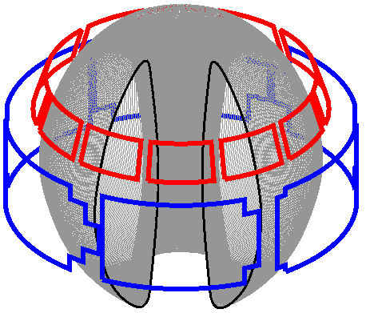
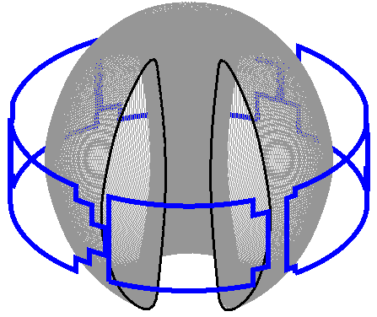
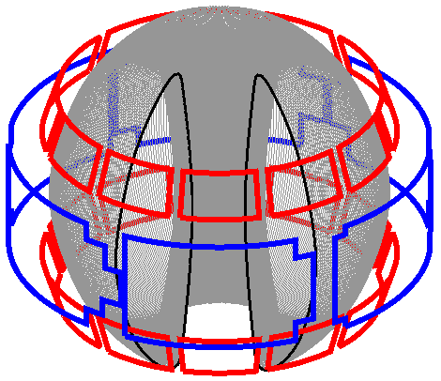
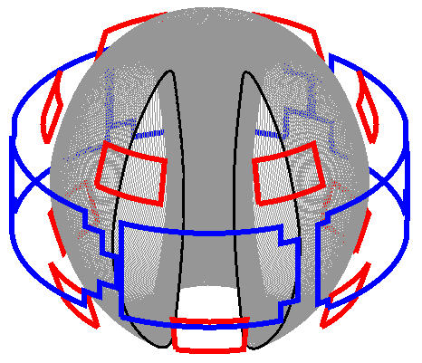
Present NCC proposal for NSTX-U 5yr plan
NCC proposal: Use two off-midplane rows of 12 coils toroidally
  To produce wide poloidal spectrum to vary resonant vs. non-resonant coupling
  To rotate n=1 – 4 fields to diagnose plasma response such as heat flux spreading in divertor
  Poloidal positions of 2x12 coils have been selected based on initial studies
Partial NCCs are also under active investigation
  Anticipate possible staged installation to the full 2x12
  3 best options will be discussed and compared with existing midplane coils
Existing
Midplane coils
12U
NCC Options
2x12
2x6-Odd

Slide 3
Summary of analysis done
Locking, RWM, NTV, Chirikov have been analyzed by IPEC, IPEC-RLAR, POCA, VALEN-3D with “possible” Figures of Merit (FOM)
Present conclusion: 2x6-Odd for partial NCC. Full NCC will have greater benefits for RWM and RMP studies
Figures of Merit | Favorable values | MID | 12U | 2x6-Odd | 2x12
EF (n=1): Non-resonant field / resonant field | High F_{N-R} | 0.017 | 0.025 | 0.13 | 0.13
RWM (n=1) : β gain | High F_{β} | 1.25 | 1.54 | 1.61 | 1.70
NTV (n≥3) : Variability of core to edge NTV | Wide ΔF_{N-N} | 1.00 | 2.00 | 3.97 | 19.6
RMP (n≥3) : Chirikov / NTV, and its variability | High F_{N-C} | 3.92 | 41.3 | 51.3 | 201
 | Wide ΔF_{N-C} | 1.00 | 10.5 | 22.1 | 252

Slide 4
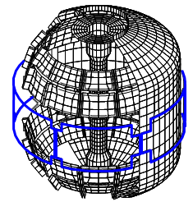
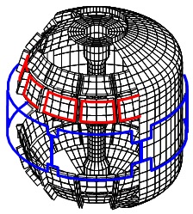
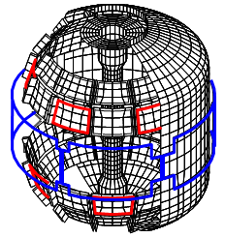
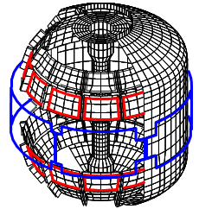
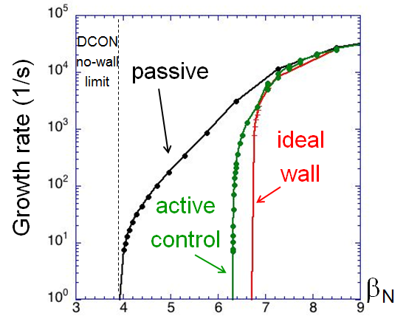
Example 1: RWM control capability increases and physics studies are expanded with NCC
VALEN3D analysis shows RWM control performance increases as NCC coils are added
  Can operate very close to the ideal-wall limit with full 2x12 NCC
  Can be quantified by β-gain
J. Bialek, S. Sabbagh
Midplane
12U
2x6-Odd
2x12
β_{N} = 4.9 ; F_{β} = 1.25
β_{N} = 6.1 ; F_{β} = 1.54
β_{N} = 6.3 ; F_{β} = 1.61
β_{N} = 6.6 ; F_{β} = 1.70

Slide 5
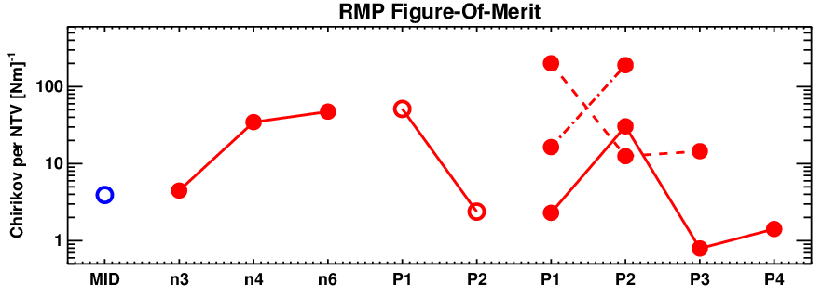
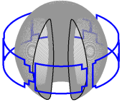
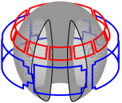
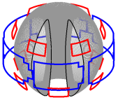
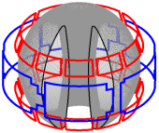
Example 2: NTV at fixed Chirikov can be varied by 1 order of magnitude with partial NCC, 2 orders of magnitude with full NCC
Empirical RMP characteristics: Chirikov overlap and pitch-alignment
  Chirikov overlap implies dominant stochastic transport in the edge
  Good pitch-alignment implies small non-resonant fields, which are related to small neoclassical 3D transport (NTV) in the core
  These mixed hypothesis can be quantified by
MID
12U
2x6-Odd
n=4
2x12
F_{N-C} [Nm]⁻¹
n=3
n=6
n=3
n=3
12U
Phase difference 2x6-Odd
Phase difference 2x12

Slide 6
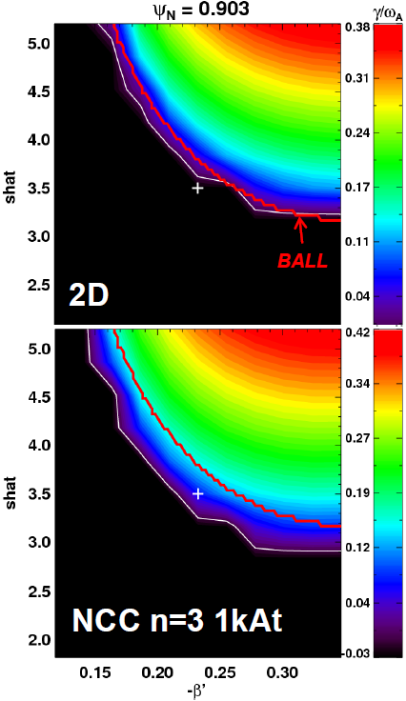
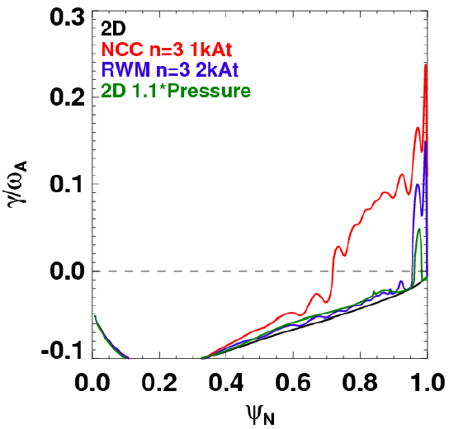
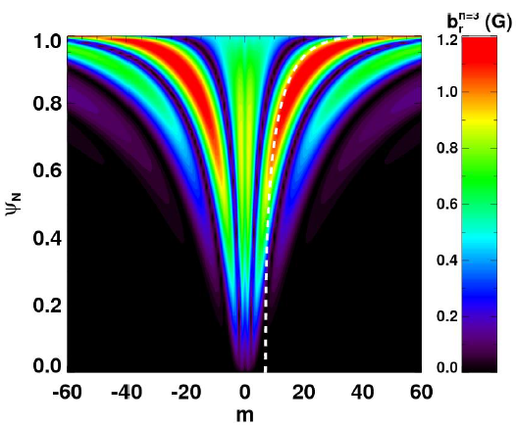
Example 3: Stability analysis using stellarator tools indicates 3D equilibrium effects are important for pedestal ballooning instability
Midplane coil applications in NSTX showed strong ELM triggering and pacing
VMEC+COBRA analysis for NSTX-U shows NCCs may significantly increase this capability
  NCCs can broaden ballooning unstable region by ~30% compared to midplane coils or 2D (benchmarked with BALL)
ISOLVER+VMEC+COBRA
Magnetic shear
J. Canik, S. Gerhardt
Full NCC n=3 (Up-down symmetric)
2D
NCC n=3 1kAt
Midplane n=3 2kAt
2D 1.1*Pressure
Increased ELM instability by NCC
Magnetic shear

Slide 7
It is important to improve analysis and confirm NCC design merits using present or new tools
Present Tool | Physics included | New physics needed | New Theory Tool
IPEC | Linear perturbed dB spectrum in ideal MHD | Kinetic self-consistent dB Two-fluid self-consistent dB | MARS-K M3D-C1
VALEN3D | Ideal MHD response with full eddy current model | Kinetic MHD response Two-fluid response | MISK M3D-C1
IPEC-PENT, MARS-K, NTVTOK | Bounce-averaged orbits | Full drift-kinetic orbits | POCA
All | No island dynamics | Island dynamics with plasma response | PEST3, Resisitive DCON, M3D
Vacuum field tool for RMP criterion | Vacuum field line tracing, Chirikov, loss fraction | Island overlap, Manifold characteristics | TRIP3D-MAFOT
All | The 0th order transport physics for RMP | The 1st order transport physics for RMP | M3D-C1, XGC0

Slide 8
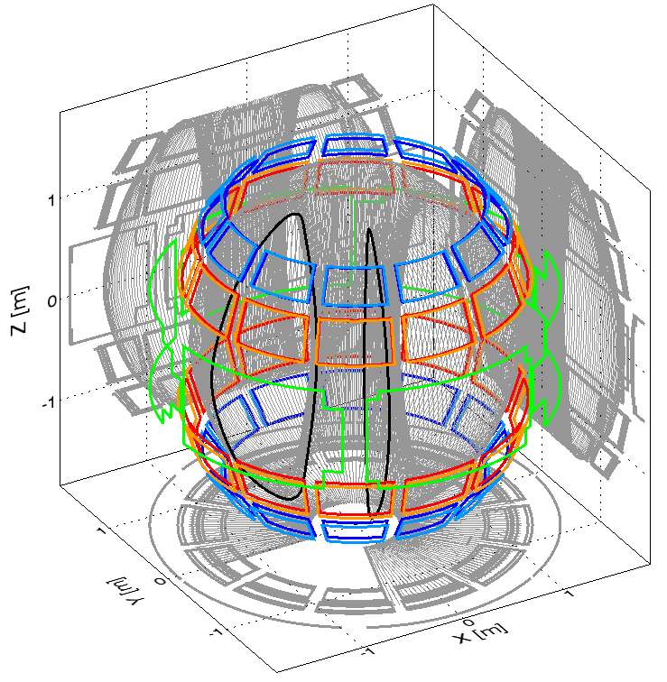
It will be important to investigate truly optimized coils including other option or by ‘inverse’ approach
secondary option:
  Present NCC design partially stemmed from engineering convenience with ‘48’ passive plates
  ’24’ secondary option is not under consideration due to their bad individual coupling
  However, various combinations with primary option or midplane coil were never seriously investigated - This configuration will be unique in the world with it’s full poloidal coverage
‘Inverse’ mapping from FOM to currents on the virtual surface
  Will yield a vector for Fourier spectrum (m,n) to ‘R’ FOM considered
  It can be solved by SVD (linear) or optimization (non-linear) for R by M mapping
  This theory project can give (1) truly optimized coil and (2) degree of optimization level of actual NCC coil
Secondary option
Primary option

