Slide 1



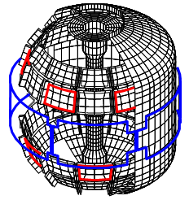
NSTX-U
Supported by
Summary of goals for NCC WG and
previous physics analysis
Jong-Kyu Park
For NCC Working Group
Columbia U
CompX
General Atomics
FIU
INL
Johns Hopkins U
LANL
LLNL
Lodestar
MIT
Nova Photonics
New York U
ORNL
PPPL
Princeton U
Purdue U
SNL
Think Tank, Inc.
UC Davis
UC Irvine
UCLA
UCSD
U Colorado
U Illinois
U Maryland
U Rochester
U Washington
U Wisconsin
Culham Sci Ctr
U St. Andrews
York U
Chubu U
Fukui U
Hiroshima U
Hyogo U
Kyoto U
Kyushu U
Kyushu Tokai U
NIFS
Niigata U
U Tokyo
JAEA
Hebrew U
Ioffe Inst
RRC Kurchatov Inst
TRINITI
NFRI
KAIST
POSTECH
ASIPP
ENEA, Frascati
CEA, Cadarache
IPP, Jülich
IPP, Garching
ASCR, Czech Rep
NSTX-U NCC WG Meeting
January 30th, 2015

Slide 2
NCC WG goals and deliverables
Charges:
  Specify required coil current, frequency, and location for NCC
    Consider full set (24 coils) and partial set (12 coils)
    Consider range of applications: NTV, EFC, RWM, RMP, ELM pacing, etc...
  Specify required number of independent SPA channels vs. applications and requested capabilities
Deliverables:
  Organize summary presentation(s) on IPECOPT analysis results
  Give presentation(s) making recommendations on NCC and SPA performance requirements, gather and incorporate team input
  Generate written report (5-20pp Word file) documenting NCC and SPA requirements for use in developing engineering requirements document (GRD) to drive engineering design
Due dates:
  Initial written report April 2015 if possible (no later than May)
  Consult with Project/engineers/designers as needed until implementation

Slide 3
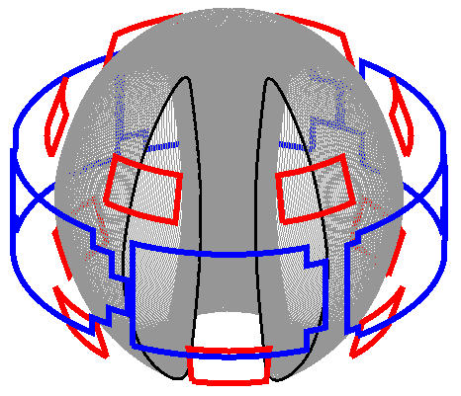
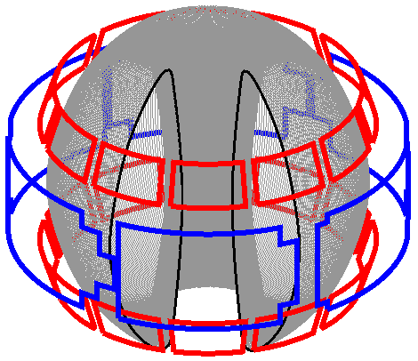
Coil shape and locations are largely fixed now, but inverse approach through optimization is yet on
Partial NCC
2x6 Odd
Full NCC
2x12
Action item for group: Perform physics analysis to see if these options can achieve what to be expected or required
  Should provide kA-turns and a range of frequency needed
  Priority 1. Partial NCC 2x6 Odd, 2. Partial NCC 2x6 even, 3. Full NCC
Action item for limited group members: Optimize coil shape/location by performing physics analysis without constraints
  Should provide coil capability to drive optimized 3D fields

Slide 4
Physics analysis with partial/full NCC options
Two equilibrium targets + TRANSP kinetic profiles were used
Figures of merit were defined for EF, RWM, NTV, RMP, and analyzed using readily available tools (IPEC, PENT, VALEN3D, TRIP3D, POCA) for NCC alone, compared to midplane alone
Figures of Merit | Favorable values | MID | 12U | 2x6-Odd | 2x12
EF (n=1) | High F_{N-R} | 0.07 | 0.13 | 1.24 | 1.24
RWM (n=1) | High F_{β} | 1.25 | 1.54 | 1.61 | 1.70
NTV (n≥3) | Wide ΔF_{N-N} | 1.00 | 1.44~6.08 | 1.75~11.33 | 6.38~59.4
RMP (n≥3) | High F_{N-C} | 0.25~0.30 | 0.31~1.04 | 0.43~0.77 | 1.18~3.53
 | Wide ΔF_{N-C} | 1.00 | 2.20~12.3 | 10.4~17.4 | 888~14400

Slide 5
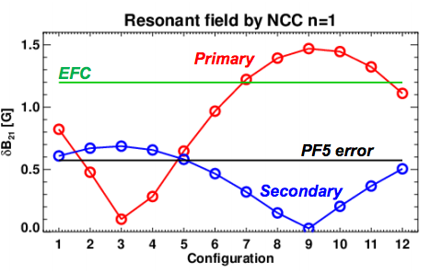
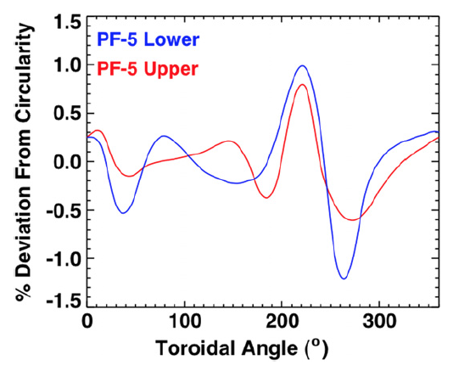
Partial or Full NCC for n=1-3 error field correction
It was more than enough when previous PF5 coil errors (with 20kA) were assumed
  Needed only a few hundred A-turns in midplane coil or NCC to minimize PF5-driven n=3 NTVs and n=1 error field
However, there are expectations for n=2 error field, and possibly larger n=1 error field in NSTX-U
  Can any assessment or model be arrived in the next 2 months (Myer)?
  Need to estimate how many coils and how much kAt from midplane and NCC are needed to correct n=1-3 simultaneously
Each by 1kAt
Present PF5 filamentary model

Slide 6
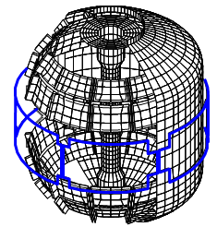
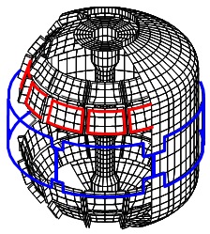
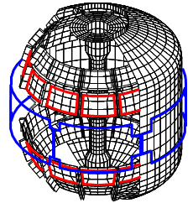
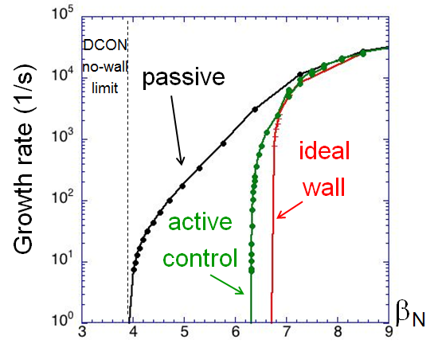
RWM active control capability with partial/full NCC
VALEN3D showed enhanced RWM control capability by NCC
Extended RWM control analysis with new sensors are underway
Midplane
12U
2x6-Odd
2x12
β_{N} = 4.9 ; F_{β} = 1.25
β_{N} = 6.1 ; F_{β} = 1.54
β_{N} = 6.3 ; F_{β} = 1.61
β_{N} = 6.6 ; F_{β} = 1.70
Will presented by S. Sabbagh in this meeting

Slide 7
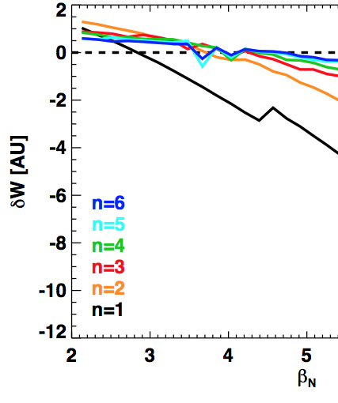
High-β plasma response analysis with kinetic effects
For IPEC modeling, target was chosen below no-wall limit, as ideal model is quantitatively unreliable beyond the stability limit
  For n=1, target β_{N} = 2.5
  For n>1, target β_{N} = 3.4
This relied upon the assumption on the rigid dominant response mode, but recently it was shown that kinetic effects can significantly change the mode structure
  Investigation of kinetic plasma response in high-β targets will be important especially for lower n (n=1)
n=1 limit
n>1 limit

Slide 8
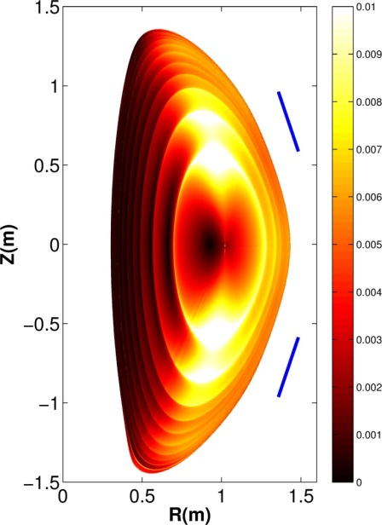
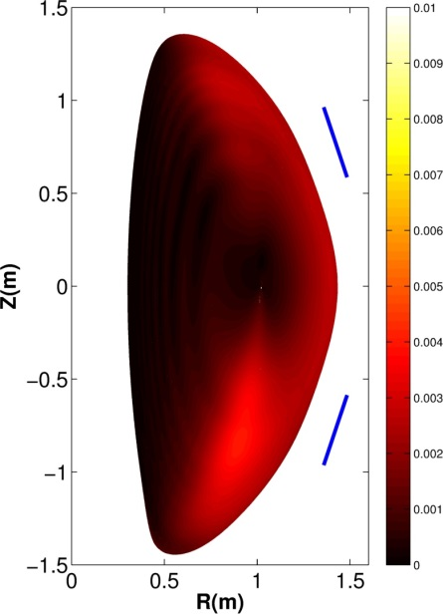
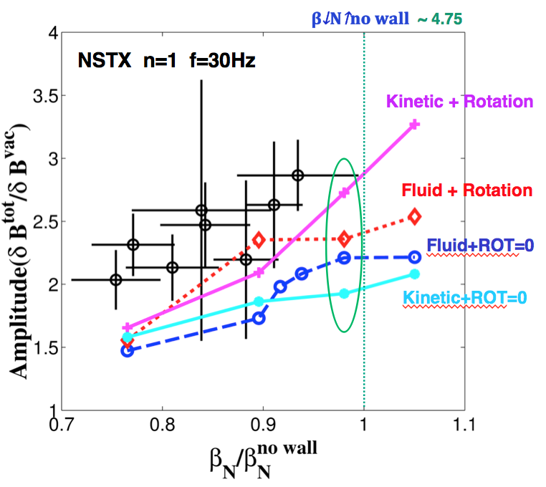
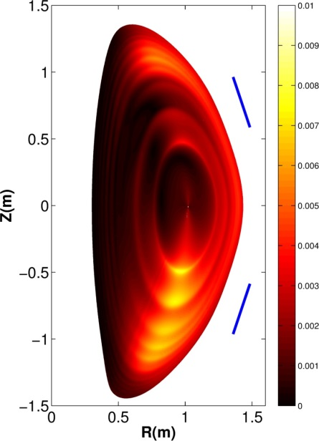
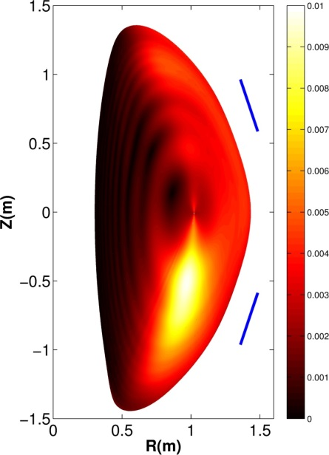
MARS-K shows fluid and kinetic plasma response to NCC can be substantially different
Normal displacement (a.u.)
MARS-K test for NSTX+NCC (240 phasing with 30kHz) shows strong up-down asymmetric modification of eigenmode structure
Will be extended to NSTX-U high-β targets + NCC, at least for n=1(Wang)
Fluid+ROT=0
Kinetic+ROT=0
NSTX+midplane
(APS talk by Wang)
NSTX+NCC
Fluid + Rotation
Kinetic + Rotation

Slide 9
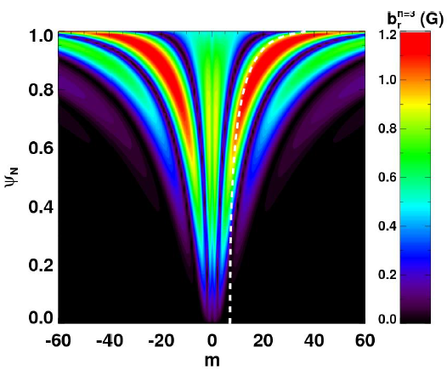
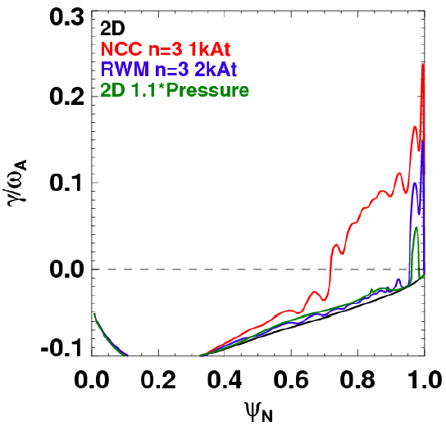
ELM stability analysis for 3D equilibrium by NCC
Midplane coil applications in NSTX showed strong ELM triggering and pacing
VMEC+COBRA analysis for NSTX-U shows NCCs may significantly increase this capability
  NCCs can broaden ballooning unstable region by ~30% compared to midplane coils or 2D (benchmarked with BALL)
Can this analysis be extended to partial NCC, or up-down asymmetric NCC applications, with relative phasing between upper and lower coils? (Canik)
Full NCC n=3 (Up-down symmetric)
2D
NCC n=3 1kAt
Midplane n=3 2kAt
2D 1.1*Pressure
Increased ELM instability by NCC

Slide 10
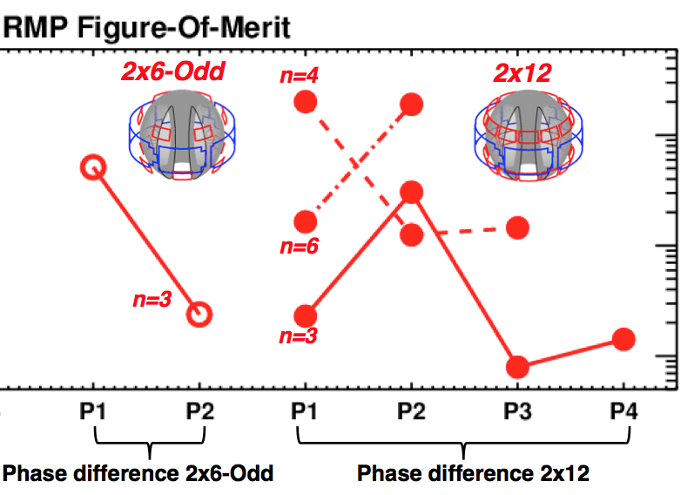
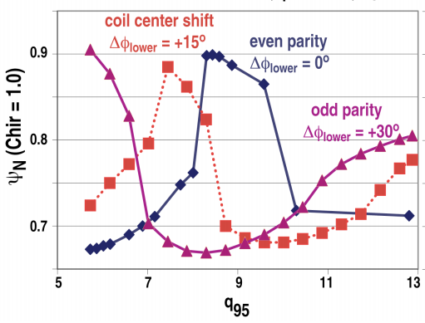
RMP characteristics beyond vacuum Chirikov
Vacuum Chirikov, TRIP3D, POCA-FLT all showed Chirikov overlap conditions can be satisfied with enhanced NTV variability
Revision of vacuum Chirikov analysis with TRIP3D with NSTX-U (Evans)?
Is it possible to deliver advanced non-linear modeling for NSTX-U + NCC using e.g. M3D-C1 (Evans, Nate)?
Vacuum + IPEC-NTV
SURFMN + TRIP3D (Evans)

Slide 11
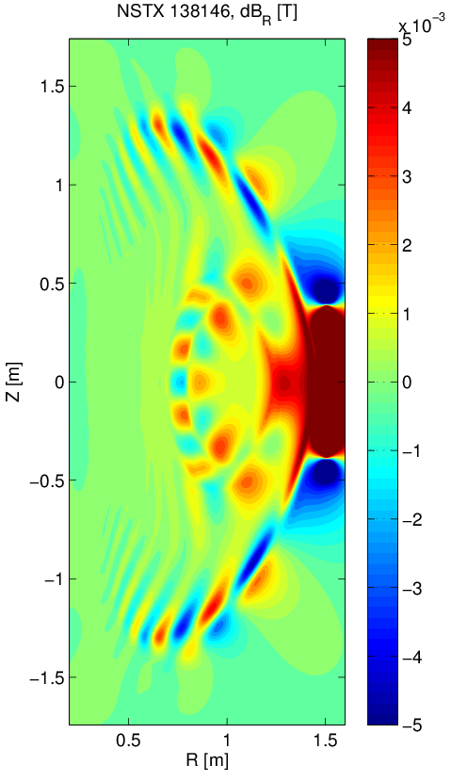
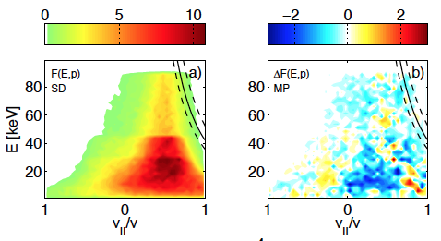
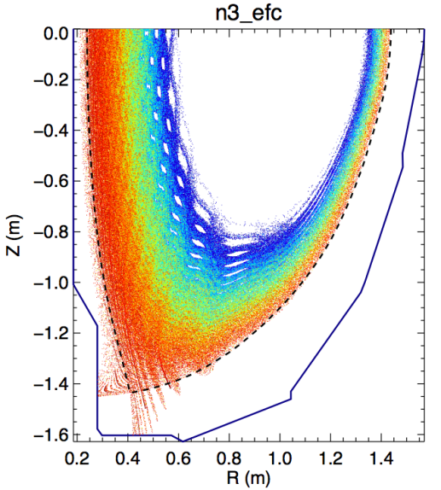
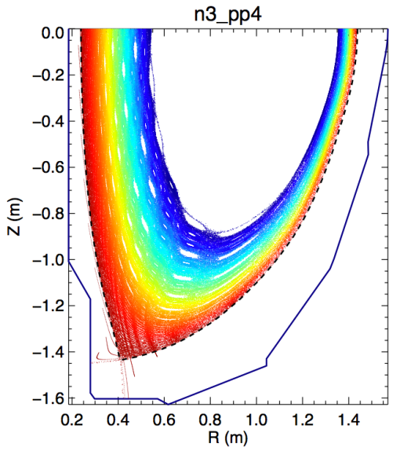
Particle, heat, and fast ion transport by NCC
POCA-FLT (vacuum) showed large modification of field line splitting is possible with NCC
M3C-C1 analysis, if possible, can provide this information too
Fast-ion distribution changes by NCC compared to midplane coils?
M3C-C1+SPIRAL would be ideal, but IPEC+SPIRAL is alternative (by sacrificing some accuracies)
Before 3D field
Midplane n=3
Less resonant
n=3 using NCC
After 3D field

Slide 12
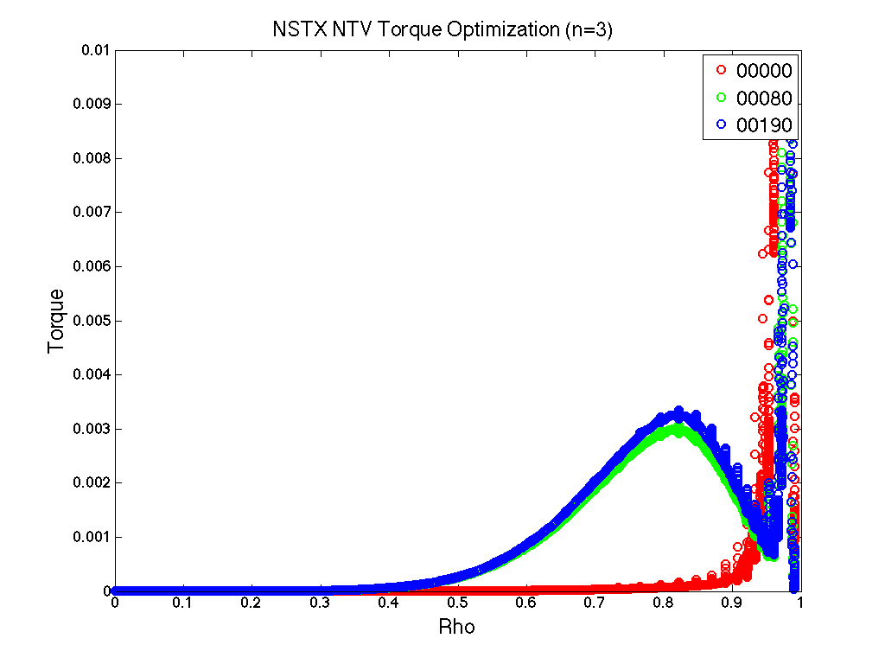
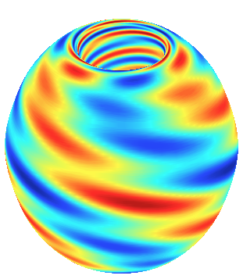
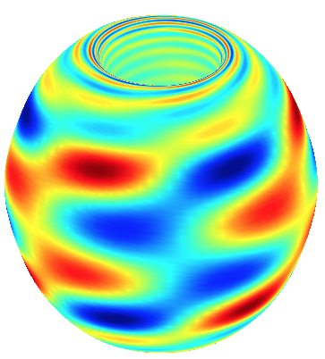
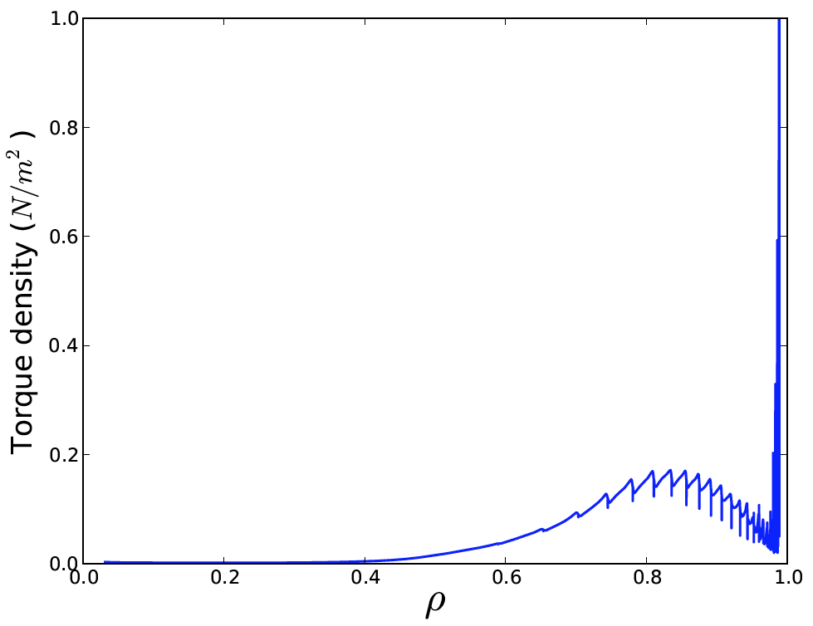
Coil optimization for NTV and RMP characteristics
IPECOPT found the best field driving n=3 NTV and partial NCC has reasonably good coupling to the theoretical optimum
Coil amplitude and phase optimization has also been done for full NCC
Can this work extended to partial NCC, and also for RMP characteristics?
Unconstrained
Constrained to partial NCC + Midplane coil
n=3
Levenberg-Marquardt (Modified) optimization
n=3
Partial NCC (2x6-only) 4kAt,
Midplane coil 4kAt
Total torque ~2Nm
Torque
Rho
Total normal δB
on the plasma boundary
Will be presented by S. Lazerson in this meeting

Slide 13
Discussion and action items
Follow-up meeting will be held in the middle of Feb and March
Action items to be discussed (with Partial NCC and midplane)
  Additional input for error fields (Myer) and corresponding n=1-3 correction analysis (Park)
  RWM control analysis with new sensors (Sabbagh, Bialek)
  Kinetic plasma response studies for n=1 (Wang)
  3D stability analysis with up-down asymmetric configuration (Canik)
  Field line tracing and RMP characteristics using linear codes (Park, Kim)
  RMP analysis using non-linear codes (Evans, Ferraro)
  Study of fast ion distribution modification by 3D fields
  …
Target equilibria, kinetic profiles, coil information, will be all updated and placed in NCC D&D area
  http://nstx.pppl.gov/DragNDrop/Five_Year_Plans/2014_2018/design_studies/ncc/
Deliverables will be prepared by early April (Park, Canik)

