Slide 1





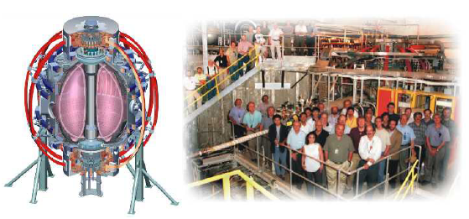
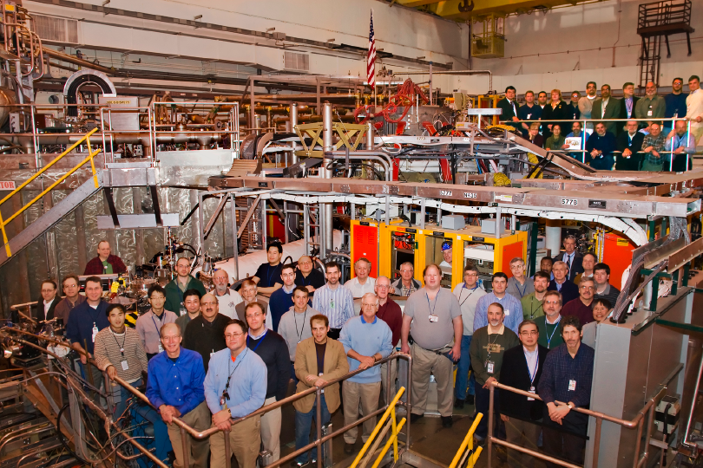
Supported by
Office of
Science
Transport and Turbulence TSG Mid-run Status
College W&M
Colorado Sch Mines
Columbia U
Comp-X
General Atomics
INL
Johns Hopkins U
LANL
LLNL
Lodestar
MIT
Nova Photonics
New York U
Old Dominion U
ORNL
PPPL
PSI
Princeton U
Purdue U
SNL
Think Tank, Inc.
UC Davis
UC Irvine
UCLA
UCSD
U Colorado
U Maryland
U Rochester
U Washington
U Wisconsin
Howard Yuh, TSG Leader
Stan Kaye, TSG Deputy Leader
Taik-Soo Hahm, Theory & Modeling
Culham Sci Ctr
U St. Andrews
York U
Chubu U
Fukui U
Hiroshima U
Hyogo U
Kyoto U
Kyushu U
Kyushu Tokai U
NIFS
Niigata U
U Tokyo
JAEA
Hebrew U
Ioffe Inst
RRC Kurchatov Inst
TRINITI
KBSI
KAIST
POSTECH
ASIPP
ENEA, Frascati
CEA, Cadarache
IPP, Jülich
IPP, Garching
ASCR, Czech Rep
U Quebec
FY10 NSTX mid-run assessment
Aug 27, 2010

Slide 2
Summary of T&T XPs having received runtime
XP1028 (0.5 ITER) - Density dependence of L-H threshold (Kaye)
Higher P_{LH} seems to increase with increasing n_{e}
Non-reproducibility precludes definitive conclusions
Not requesting more runtime
P_{LH} (MW)

Slide 3
Summary of T&T XPs having received runtime
XP1041 (0.5) - Joint NSTX DIII-D poloidal rotation experiment (R. Bell)
  XP compares measured and neoclassical poloidal velocities.
  Sensitive to gradient in impurity profiles.
  Good target plasmas were obtained, but due to vents just prior to XP, large but unknown amounts of nitrogen & argon present.
  Impurity content during run was uncertain, so comparison not possible.
XP1042 (0.5) - Intrinsic torque using torque transients (Solomon)
Unsuccessful Attempt To Measure Intrinsic Torque following LLD experiments
Infer effective torque associated with intrinsic rotation drive by applying NBI torque steps and looking for “missing” torque
Li “blob” resulted in poor plasma conditions
    Typically strong MHD throughout shot, with little or no quiescent phase, confusion with significant drag caused by low-n modes
    Highly irreproducible discharges
    Both moderate and high triangularity shots attempted
    Half day essentially spent trying to clean blob

Slide 4
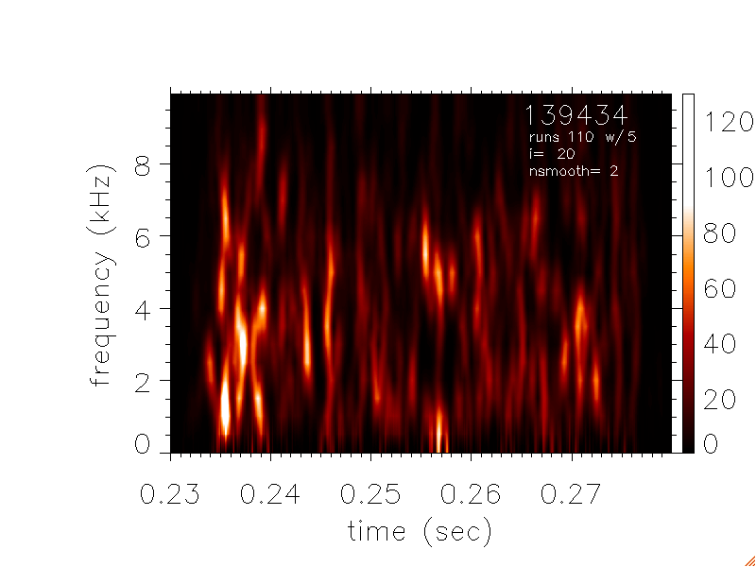
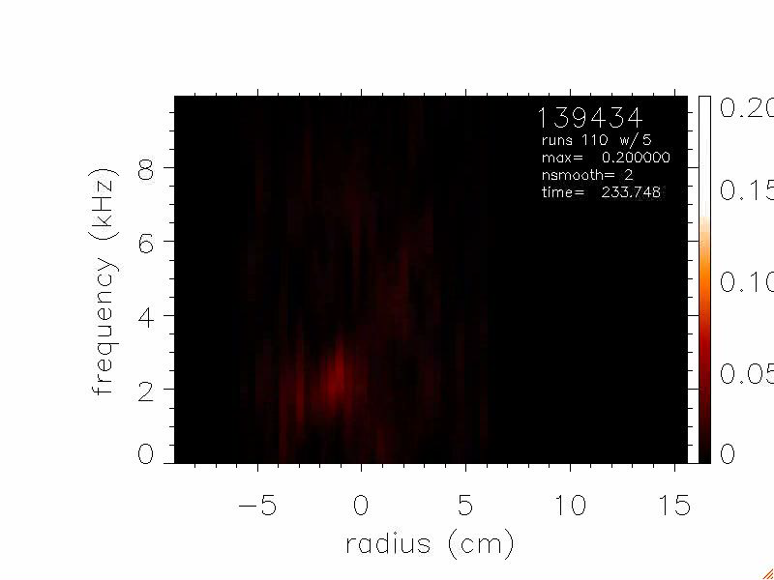
XP #1067: Edge Zonal Flows and Blob Formation
XP1067 (0.5) – Edge Zonal Flows and Blob Formation
(S.J. Zweben, R. Maqueda, T. Munsat, Y. Sechrest, S.M. Kaye et al)
Goal: Use GPI to determine scaling of edge zonal flows with B at fixed q(a)
Result: Obtained good GPI data, but ZF spectra more complex than expected
ZF spectra vs. time (ρ ~ -1 cm)
ZF spectra vs. radius vs. time
Need time to understand these results, not more run time !

Slide 5
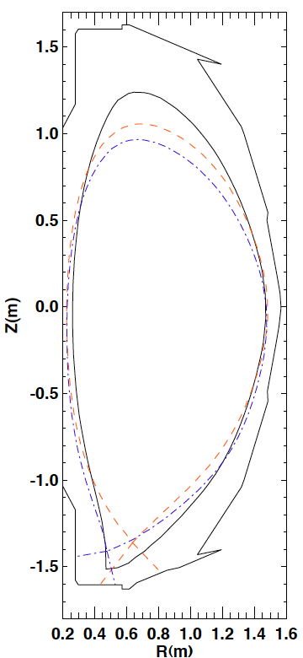
Three X-point geometries and triangularities achieved in XP1029, and P_{LH} measured in each
Goal was to measure P_{LH} for 2 or 3 different Rx at constant X-point height
P_{LH} was higher for the smaller R_{x} shape than the larger R_{x}, at least for transitions that produced stable H-modes afterwards
  Small R_{x}, low X-point shape didn’t have matched B_{t} or fueling
Propose to compare the P_{LH} with lower lithium (~50mg between discharges), that should result in a clearer change in P_{LH}, and/or do an intermediate R_{x} shape if time permits (XP was allocated 4 hrs but run only for 2.5 hrs) (ITER)
140180
140185
140185
t=0.27 sec

Slide 6
Remaining T&T Priority 1 XPs, Requirements (1 of 2)
XP1037 (1.0) - Parametric Dependence of High-k Turbulence (Ren)
High-k turbulence dependence on ν, B_{t}, I_{p}
Requires: high-k at R=135cm and 117cm
Desirable: BES, reflectometer, FIReTIP
XP1038 (0.5+0.5) - Investigation of multi-scale turbulence (Smith, Kubota)
Parameter scan affecting low-k turbulence that doesn’t overlap with XP936
Requires BES, reflectometer
Desirable: high-k, FIReTIP
XP936 (1.0+0.5) - Impact of rotation on energy and momentum transport (Kaye, Smith, Solomon)
Uses n=3 braking to affect rotation, adds BES this year.
Requires: BES (outboard only ok)
Desireable: reflectometer, high-k, FIReTIP
XP1042 (0.5) - Intrinsic torque using torque transients (Solomon)
Requires MHD quiescent phase to avoid additional drag sources

Slide 7
Remaining T&T Priority 1 XPs, Requirements (2 of 2)
XP1039 (0.5) - Comparison of turbulence in Ohmic H-mode (Kubota, Lee)
Fluctuation differences in L/H using correlation reflectometer, measure ion-neutral Renold’s number
Requires: reflectometer, FIReTIP, GPI
Desireable: BES, high-k
XP1040 (0.5+0.5) - Sustained reversed shear ITBs at reduced power (Yuh)
Turbulence/transport evolution as smooth function in shear
Requires: RF (1-2MW), high-k.
Desirable: BES, reflectometer, FIReTIP
XP1036 (1.0) - P_{L-H} for D and He plasmas using RF (Battaglia, Zweben)
Requires: RF ramps (2+MW), GPI
Desirable: BES, reflectometer, FIReTIP
XP1041 (0.5) - Joint NSTX DIII-D poloidal rotation experiment (R. Bell)
Initial half day unsuccessful due to high impurities
Requires: Low non-carbon impurity content

Slide 8
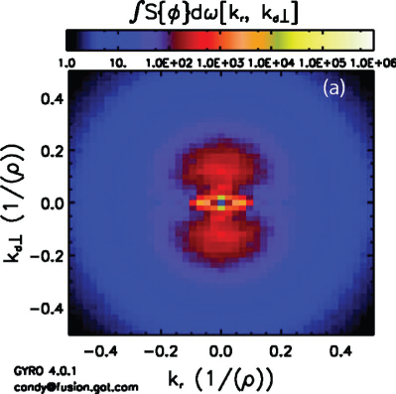
T&T Priority 2 XPs and additional XP ideas
XP1013 (0.5) - *AE induced electron transport (Tritz)
Requires: Inboard BES
Desireable: reflectometer, high-k, FIReTIP
Investigation of ETG turbulence isotropy (Smith)
Requires: High-k.
According to simulations, ETG turbulence is anisotropic when low-k fluctuations are linearly stable or when flow shear suppresses low-k fluctuations.
According to simulations, only anisotropic ETG turbulence can generate experimentally-relevant electron transport.
The NSTX high-k system is uniquely capable of confirming the existence of anisotropic ETG turbulence by adjusting k_{θ}/k_{r} ratio in measurements.
Measurement
locations in k-space

Slide 9
Fluctuation Diagnostics Status
BES
  16 channels operational (6/2010) at outer view (0.5 < r/a < 1+ ); 32 channels planned, 9/2010
  Currently, ops requires Bay F LiTER to be off to protect in-vessel optics
  Inner view (~0.1 < r/a < ~0.8) expected ~1 week, pending R130 shutter fix
High-k
  Using solid state source now, full availability
  Routinely operated and improved alignment allows 5 channel simultaneous ops
FIReTIP
  3 channels including one edge channel are operating with upgraded time resolution (12 MHz sampling rate/4 MHz band width)
Reflectometer
  Q-band fixed frequency reflectometer currently inoperable
  Availability estimated week of 9/6. Required / desired for several XPs

