Slide 1
Flow and Shear behavior in the Edge and Scrape-off Layer in NSTX L-Mode Plasmas
Y. Sechrest and T. Munsat
University of Colorado at Boulder
S. J. Zweben and R. J. Maqueda
Princeton Plasma Physics Laboratory
D. D’Ippolito, J. Myra, and D. Russell
Lodestar Research Corporation
PPPL Monday Meeting – Sept. 20, 2010

Slide 2
Overview
What we do: Extract/Analyze estimates of 2-D velocity field from image sequences obtained by Gas Puff Imaging
Purpose: Study behavior of plasma flow (2-D flow, shear, Reynolds stresses) in the NSTX edge region.
Why?
Turbulent transport:
significantly degrades confinement
Turbulence interactions with large scale (Zonal) flows
Self-generation of flow
suppression of turbulence through shearing
Explore flow organization and momentum transport in plasmas

Slide 3
Outline
Background
Basic flow characteristics
Quasi-periodic Turbulent bursts
Characterization of 3 kHz fluctuations
Shear, Reynolds stresses – Time permitting

Slide 4
Gas Puff Imaging: Basics
GPI:
images edge turbulence
manifold discharges gas puff into edge region
images visible light emission
emission complicated function of n_{e} and T_{e}
GPI on NSTX:
view centered 20 cm above the outboard midplane
~ 25 cm x 25 cm view
~4 mm resolution
D_{α} line emission (656 nm)
285,000 fps (3.5 μs per frame)

Slide 5
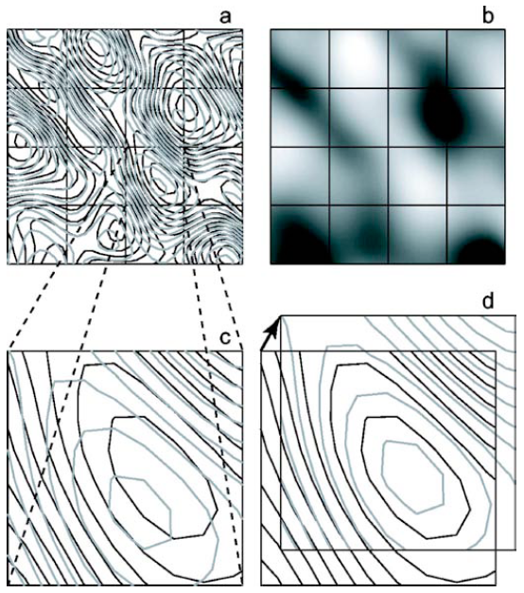
HOP-V Analysis: Basics
Hybrid Optical flow and Pattern-matching Velocimetry (HOP-V)
Optical Flow:
Solves continuity equation for image brightness:
assuming divergence free flow
Pattern Matching:
Subdivide image into tiles
Search for optimal displacement vector for each tile
Minimize global error function
Brightness difference
Velocity field smoothness

Slide 6
HOP-V Analysis: Basics

Slide 7
Time-Averaged Velocities
Ion diamagnetic
Radial profiles of poloidal velocity
Fluctuation levels are comparable to size of mean flow
V_{pol} Shear
10 ms time average
Cropped field to avoid edge effects
vignetting of optics
gas emission profile

Slide 8
Time Traces
GPI signal:
fluctuation amplitude as large as mean value
Poloidal flows:
On the order of several km/s
Large amplitude fluctuations
Bursty flow oscillations
Anti-correlated with GPI
Radial flow:
significantly smaller: 100 m/s
Large radial velocity usually associated with blobs
Blobs are spatially localized and intermittent
GPI intensity (normalized), Poloidal Velocity, and Radial Velocity poloidally averaged at x = -1 cm

Slide 9
Quasi-Periodic Bursts
R = -0.59
R = -0.61
R = -0.60
F_{SOL} = Fraction of D_{α} light in the SOL
Flow Reversals
High correlations
Periodic bursts

Slide 10
Spectral Characteristics
Spectrogram of F_{SOL}
time window: 256 points (~0.9 ms)
~1 kHz frequency resolution
Strong feature near 3 kHz
Sporadically appears between 2-4 kHz
Intermittent with duration of 1-2 ms

Slide 11
Spatial Structure of 3 kHz Oscillation

Slide 12
Phase of the ~3 kHz Mode
Phase profiles for sections of 4 shots with rotating mode.
GPI Phase:
Rapid phase change between x = -2 and x = 1
Nearly linear poloidal phase dependence
k_{pol} ~ 10 m⁻¹
V_{pol} Phase:
Vs. X – Mostly in phase for several centimeters. Rigid Rotation?
Vs. Y – Near linear phase dependence
k_{pol} ~ 5 m⁻¹

Slide 13
Coherence in Poloidal Direction
Coherence function and Phase vs. Frequency
V_{pol} signals at x = -1 cm
separated by ~12 cm in y
3 kHz mode:
Strong coherence peak near 3 kHz
Small phase difference
F > 10 kHz:
Coherence drops off
Phase differences become random
Turbulent

Slide 14
Coherence in Poloidal Direction
3 kHz:
Maintains high coherence values over full ~12 cm
Correlation length: 56 cm
20-30 kHz:
Background Turbulence
Correlation decays rapidly
Correlation length: 4 cm
Coherence of V_{pol} as a function of poloidal separation for shot 135042

Slide 15
Radial Dependence of Spectra
V_{pol} spectra for shot 135042 at 3 different radii
Frequency of peak approximately constant
Amplitude significantly smaller in SOL
Shot 135042, t: 240-243 ms

Slide 16
Recap: 3 kHz mode
What we see:
Strong mode seen intermittently in GPI, F_{SOL}, and V_{pol} fluctuations
Roughly 2 kHz spread in frequency space
Duration of 1-2 ms
Exhibits long poloidal wavelengths in both GPI, and V_{pol}
Long poloidal correlation lengths
- Large scale coherent flow oscillation
V_{pol} phase difference remains near zero over ~4 cm radial separation inside sep.
Frequency independent of radius
Amplitude of flow oscillations decays in the SOL
- Radial Size ≥ 4 cm

Slide 17
Possible Explanations for 3 kHz Behavior
SOLT simulations illustrated the importance of zonal flows in controlling turbulence. (Russell PoP 2009)
Shearing of flows suppress bursts
Flow damping a critical control parameter
Unclear what controls frequency of bursts
Geodesic Acoustic Mode (GAM):
Finite frequency zonal flow
n=0,m=0 velocity fluctuation – long poloidal wavelength/correlation
finite k_{r} , propagates radially
ω = C_{s}/R
Refilling of plasma along field line
Loss of plasma due to bursts
Scales like V||/R
f ~ 7 kHz for Te = Ti = 50 eV, R = 1.5 m

Slide 18
Acknowledgements
We would like to thank K. Hallatschek, and R. Hager for their communications.
We would also like to acknowledge the NSTX Team for their contributions.
This work was supported by US DOE Contracts #DE-FG02-08ER54995, DE- SC0001966, and DE-AC02-09CH11466.
My thanks to the co-authors for their work and support.
Thank you for your attention.

Slide 19
Shearing Rate and Reynolds Stresses
Shearing of poloidal flows predicted to modulate turbulent bursts
recent SOLT simultations illustrated this (Russell PoP 2009)
Find that shear is correlated with bursts
correlation = 0.52
However, relationship is not simple.
Other sections don’t show high correlation
shear threshold?
low shear doesn’t always lead to burst

Slide 20
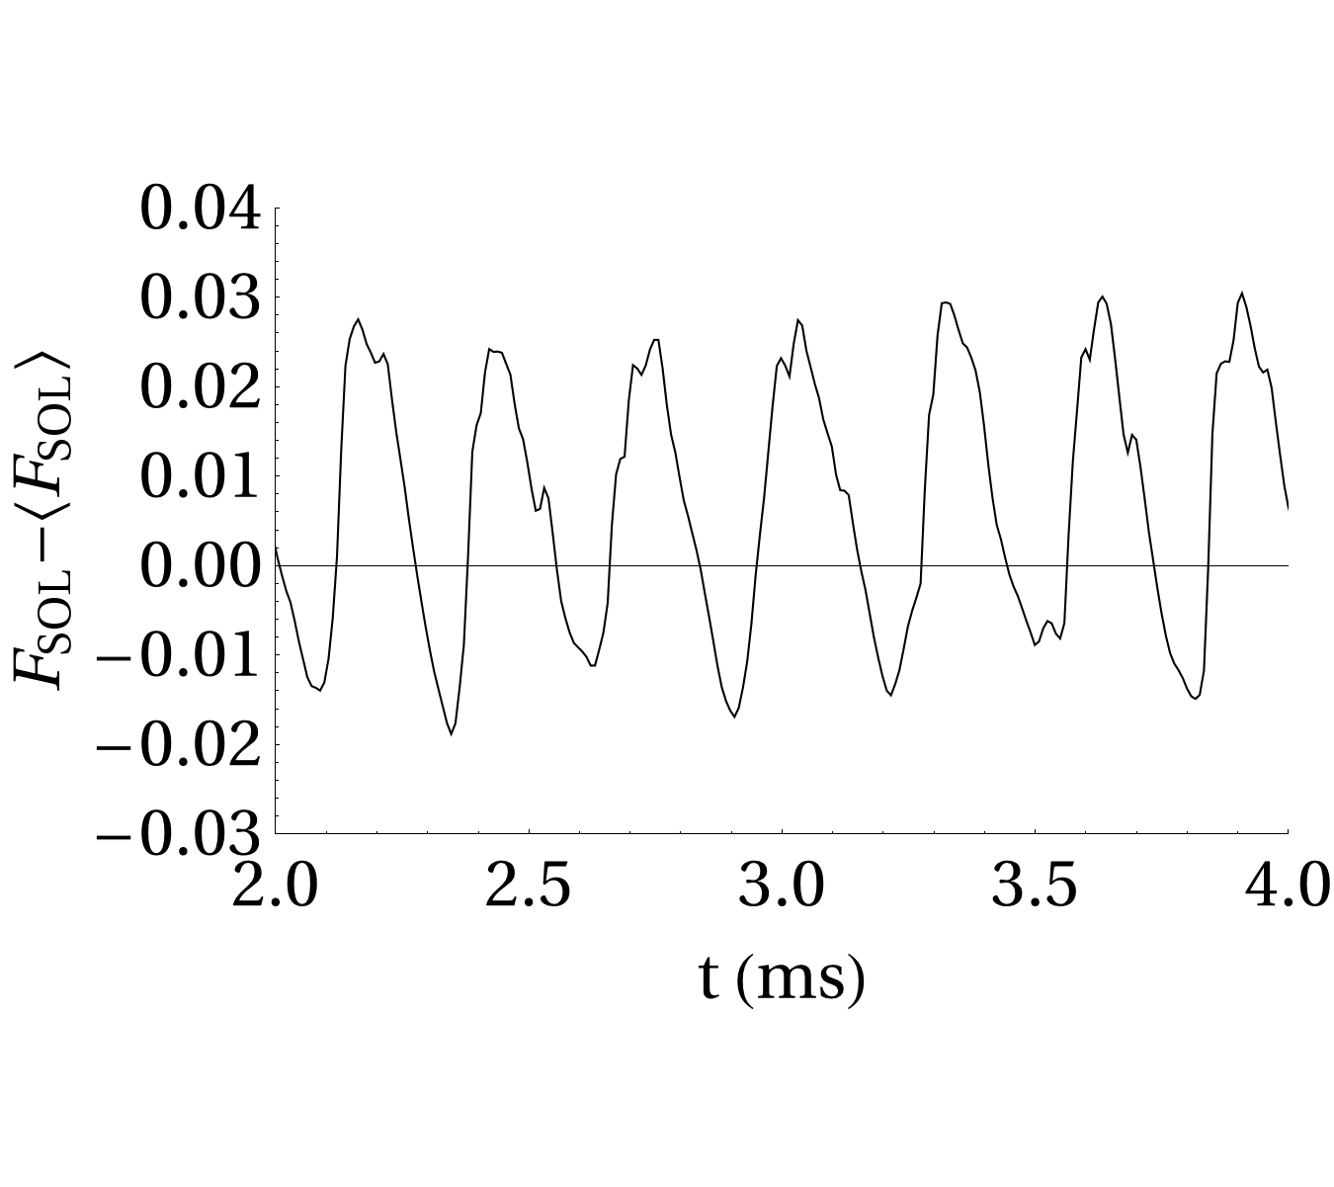
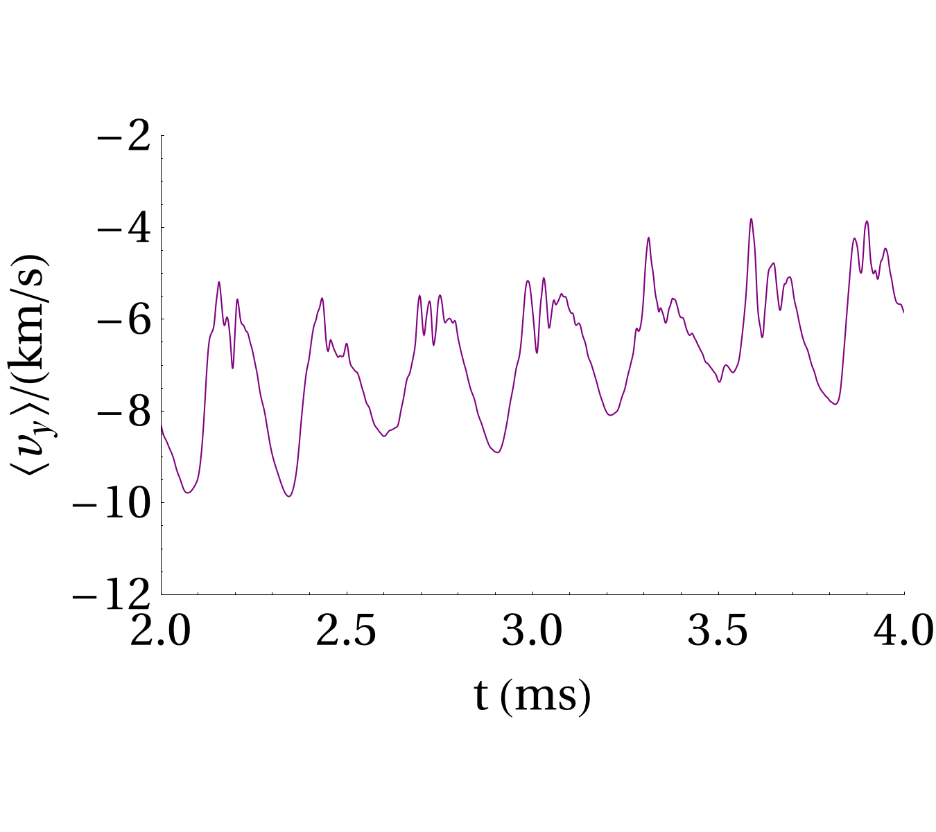
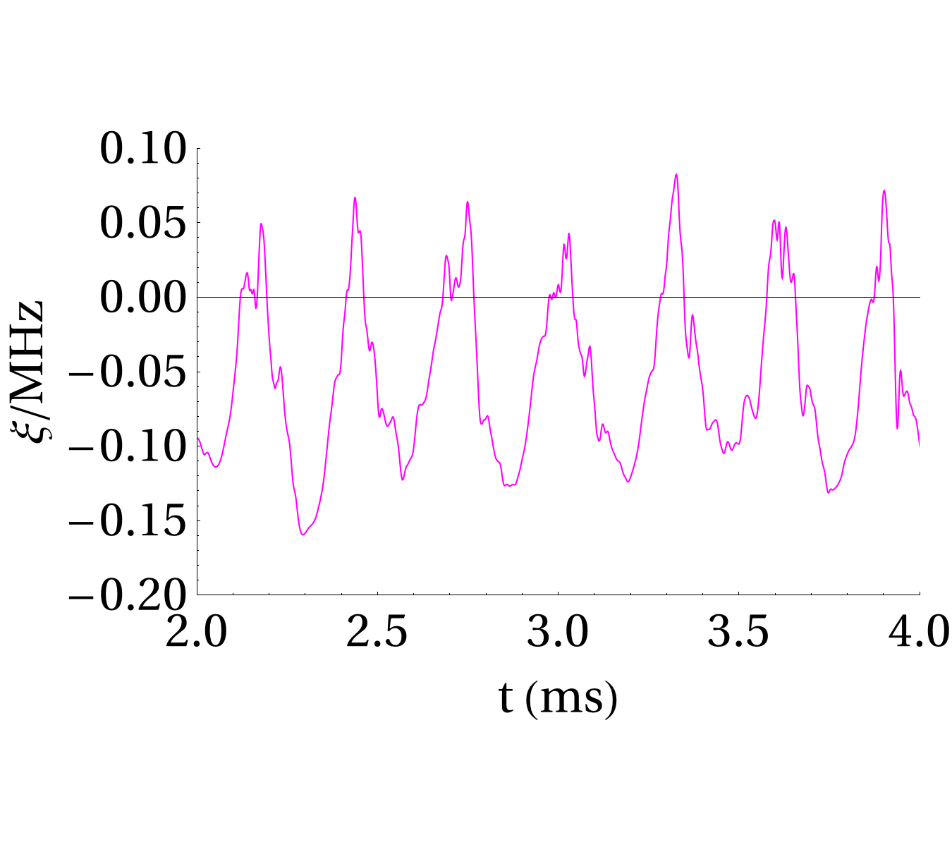
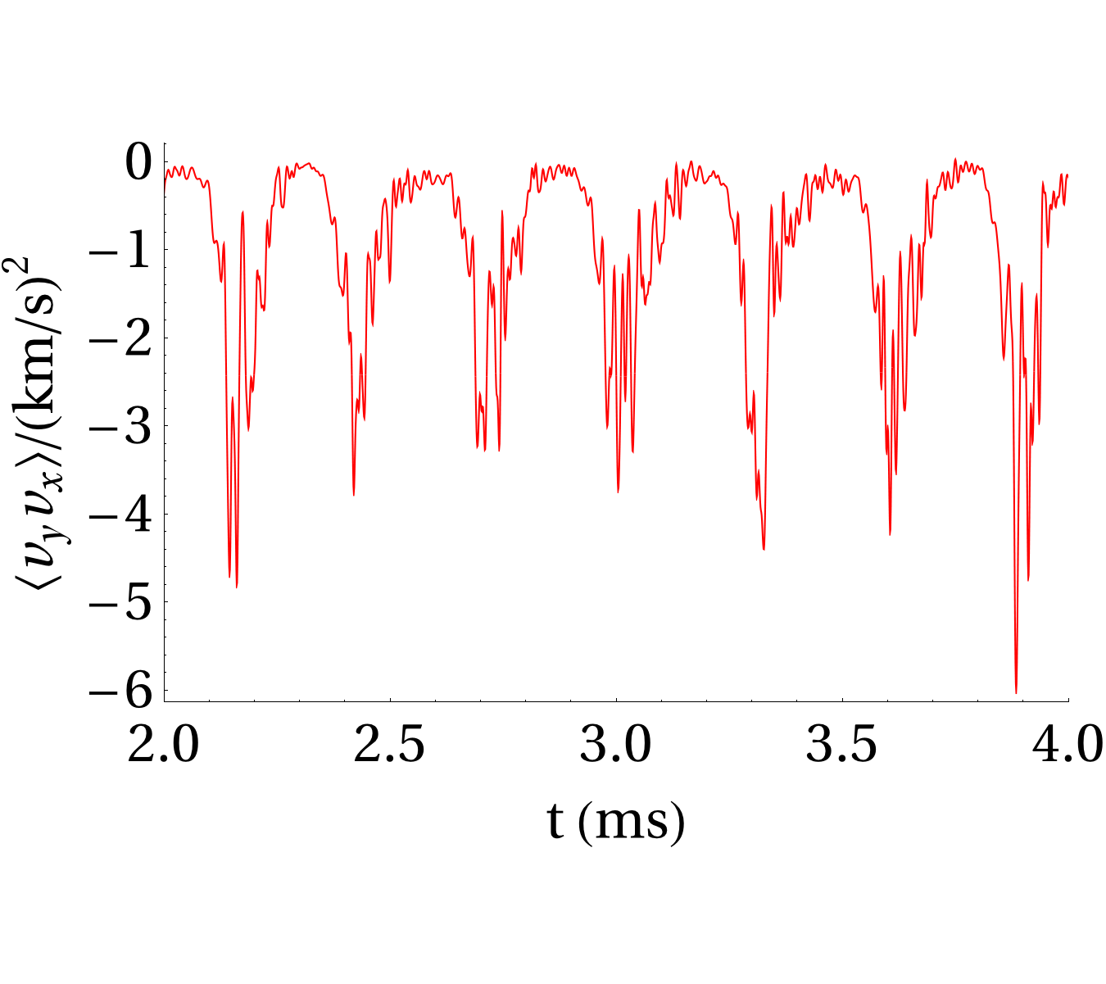
Shearing Rate and Reynolds Stresses

Slide 21
Shearing Rate and Reynolds Stresses
Radial profiles of Reynolds shear stresses
averaged poloidally and over 10 ms time period preceding H-mode
Similar features seen in each shot
local maximum near x = -1 cm
negative slow between x = -1 and x = 2

Slide 22
Phase of the ~3 kHz Mode
GPI
V_{pol}
GPI-V_{pol}
Rapid phase change between x= -2 and x= 1 cm
Phase changes slowly in poloidal direction
Slow phase change in both directions
Mostly in phase over entire view
Cross-Phase dominated by GPI signal

Slide 23
Phase of the ~3 kHz Mode
GPI
V_{pol}
GPI-V_{pol}
Rapid phase change between x= -2 and x= 1 cm
Phase changes slowly in poloidal direction
Slow phase change in both directions
Mostly in phase over entire view
Cross-Phase dominated by GPI signal

