Slide 1


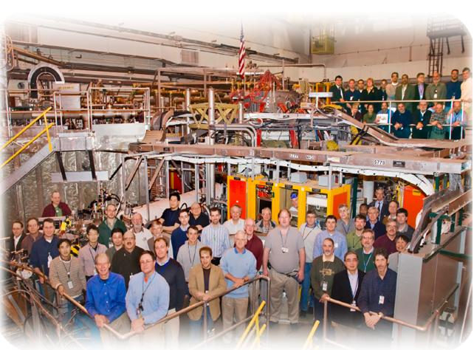

NSTX
Supported by
Equilibrium and Stability Modeling of NSTX-Upgrade Scenarios with Free-Boundary TRANSP and DCON
Status Report
College W&M
Colorado Sch Mines
Columbia U
CompX
General Atomics
INL
Johns Hopkins U
LANL
LLNL
Lodestar
MIT
Nova Photonics
New York U
Old Dominion U
ORNL
PPPL
PSI
Princeton U
Purdue U
SNL
Think Tank, Inc.
UC Davis
UC Irvine
UCLA
UCSD
U Colorado
U Illinois
U Maryland
U Rochester
U Washington
U Wisconsin
Culham Sci Ctr
U St. Andrews
York U
Chubu U
Fukui U
Hiroshima U
Hyogo U
Kyoto U
Kyushu U
Kyushu Tokai U
NIFS
Niigata U
U Tokyo
JAEA
Hebrew U
Ioffe Inst
RRC Kurchatov Inst
TRINITI
KBSI
KAIST
POSTECH
ASIPP
ENEA, Frascati
CEA, Cadarache
IPP, Jülich
IPP, Garching
ASCR, Czech Rep
U Quebec
Stefan Gerhardt
Thanks to TRANSP support (Doug, Marina, Tina, Rob) for lots of help.

Slide 2
Goals of This Study
PAC Request: “PAC recommends detailed modeling of non-inductive capability in NSTX-U”, from PAC-29 debrief.
  Of course, much has already been done, but we should show them something new next time around.
  Also study the effect of D_{FI}>0 on scenarios.
Develop reference target scenarios for NSTX-Upgrade for comparison to existing data.
  Inform the upcoming run.
Test free-boundary TRANSP at low-A and high-κ,β.

Slide 3
Outline
Free-Boundary TRANSP modeling of NSTX discharges.
Equilibrium and stability analysis of NSTX-U Scenarios.
  Effect of outer gap on beam loss and NBCD profiles.
  Long-pulse, ~100% non-inductive, H~1.0
    Effect of D_{FI}=1 m²/s.
  Highest stored energy scenarios.
    Including “sustained” (q_{min}>1) partial non-inductive cases.
  Highest sustained β_{T}.
    Equivalently, highest I_{N}=I_{p}/aB_{T} with q_{min}>1.
    Effect of D_{FI}=1 m²/s.
Comparison of these scenarios to existing data.
Important physics outside the scope of this modeling.
The divertor and impurity control.
Tearing (rotating or locked), kinetic stabilization of the RWM.
Details (E, pitch angle dependence) of steady and/or impulsive non-classical fast ion physics.
Pedestal physics and ELMs.
The actual physics of electron transport.
Much else…

Slide 4
Example of Free-Boundary TRANSP Simulation of an Existing Discharge

Slide 5
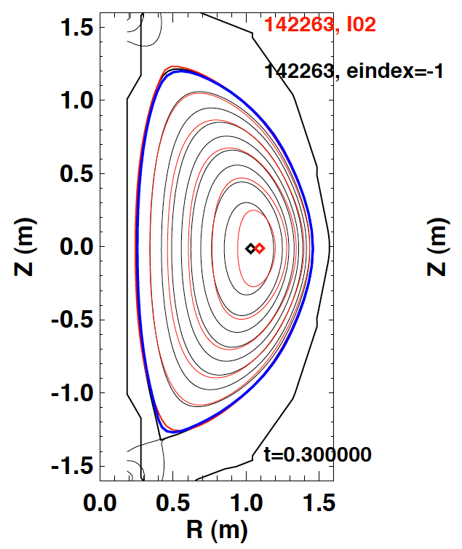
TRANSP+ISOLVER Computes Coil Currents to Best Match a Requested Boundary, Given P and q Profiles.
ISOLVER inputs:
  Pressure profile: typically input thermal pressure + NUBEAM fast ion pressure.
  q profile: Either from input equilibrium, or from current diffusion calculation.
  Requested boundary shape (mds+ tree or a g-eqdsk file).
  Which PF coils to use.
  Various name list options controlling the numerics of the calculation.
ISOLVER outputs:
  Achieved boundary and Ψ(R,Z)
  Coil currents for that boundary.
Other notes:
  No vessel currents in calculation.
  No “inductance” in the coils
  Can be finicky on occasion, intolerant of rapid changes in the equilibrium

Slide 6
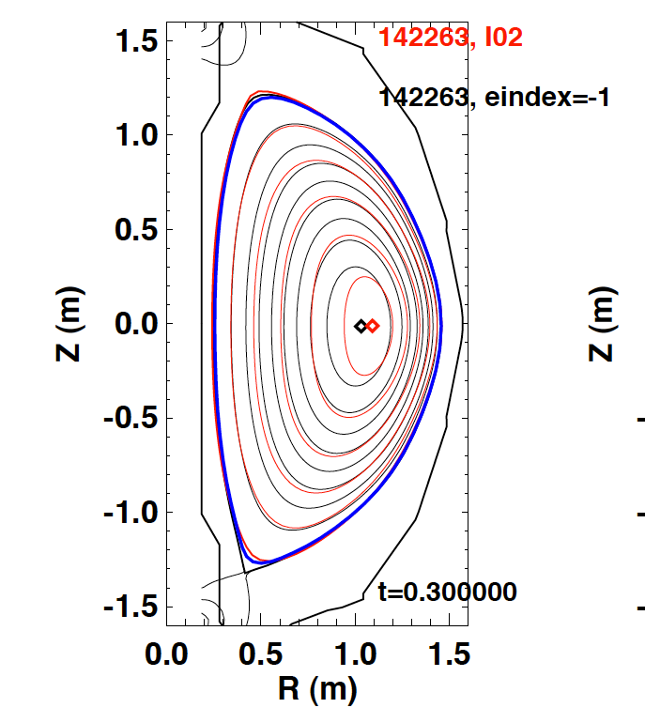
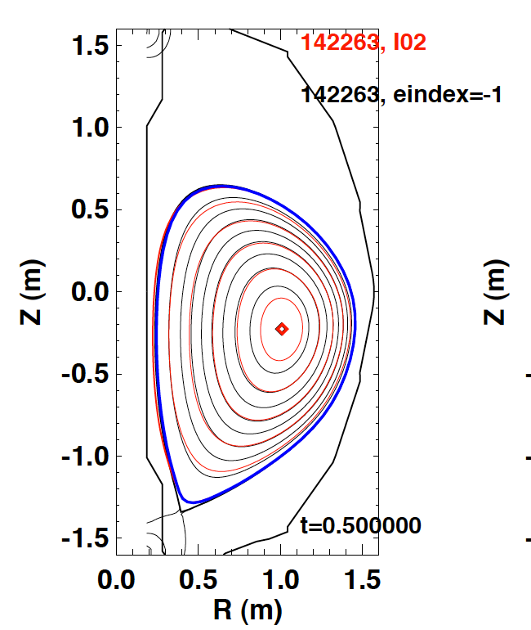
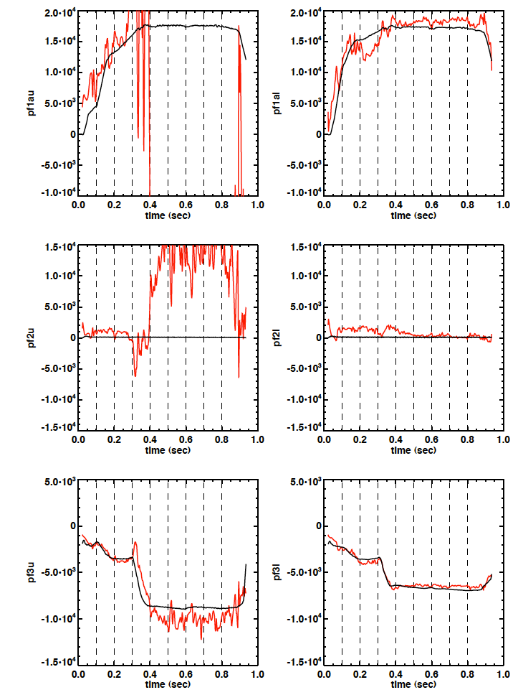
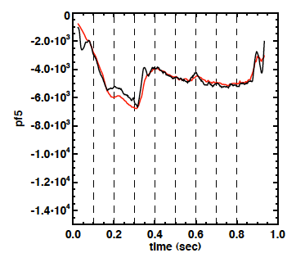
Code Can Achieve Good Matches for Coils That Strongly Impact the Plasma Shape
PF-1aU
PF-1aL
Early mismatch in axis radius due to differences in pressure profile.
TRANSP more peaked than LRDFIT
Good agreement on ALL coils until t~0.3, when plasma is shifted down.
Upper divertor coils then are poorly constrained.
Similar levels of agreement found in other shots.
Red: ISOLVER
Black: LRDFIT and measured I_{coil}.
PF-2U
PF-2L
PF-3U
PF-3L
PF-5

Slide 7
Methodology for NSTX-Upgrade Simulations

Slide 8
How To Navigate Through NSTX-Upgrade
Configuration Space?
Inputs
I_{P} & B_{T}
Thermal density and temperature profiles.
  These map to H₉₈, f_{GW}
Requested plasma boundary shape.
Z_{eff}, D_{FI}
Beam R_{tan}, voltages
Outputs
Equilibrium properties.
  Bootstrap fraction.
  NBCD fraction.
  Achieved shape & required coil currents
Stability properties
  q_{min}, q₀
  F_{P}, l_{i}, β_{N}
  δW_{no-wall}, δW_{with-wall},
Define a configuration:
  I_{P}, B_{T}, Z_{eff}, D_{FI}, Beam voltages and geometry, current and field, boundary shape, multiplier on neoclassical χ_{i}, T_{e} and n_{e} profile shapes.
Use neoclassical theory to predict the ion temperature.
Over a series of free-boundary TRANSP runs, scan input electron density and temperature profile magnitudes.
  Amounts to a scan in f_{GW} and H₉₈.
Run resulting equilibrium through CHEASE.
  Refine for small G.-S. error.
Use CHEASE equilibrium to compute n=1 & 2 stability with DCON.
Chosen Methodology

Slide 9
Effect of Outer Gap on Scenarios

Slide 10
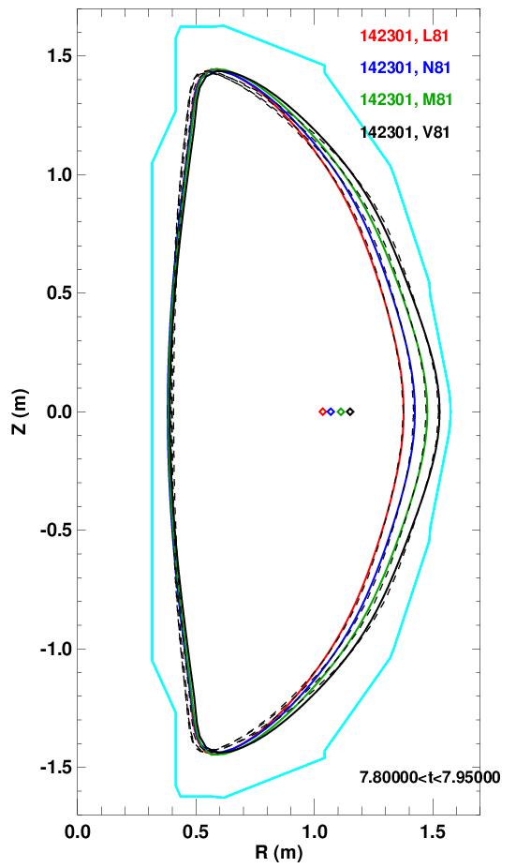
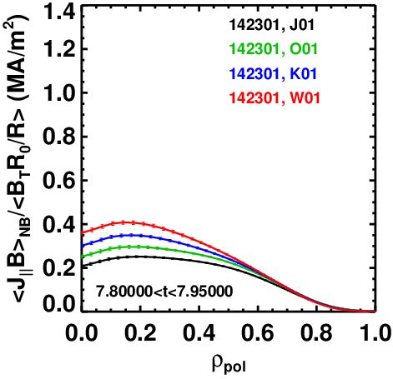
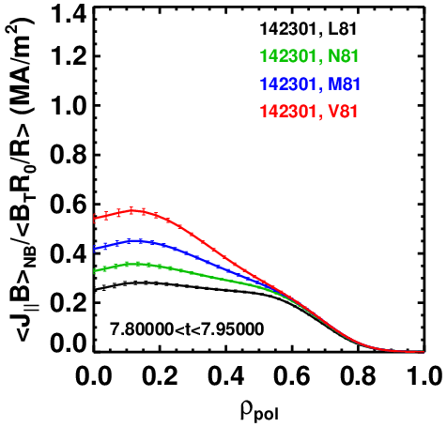
Outer Gap Plays a Key Role in Determining NBCD Profile
(& Beam Power Losses)
Fix the plasma height, requested inboard midplane separatrix radius.
Scan the outboard midplane separatrix radius.
  20 cm, 15 cm, 10 cm, 5 cm
  This scans the aspect ratio and elongation.
Large outer gap cases have the broadest driven current profile.
  Though it is always MORE peaked than the Ohmic profile
Requested Shapes
High-β_{T} at 0.55 T
High-f_{NI} at 1.0 T

Slide 11
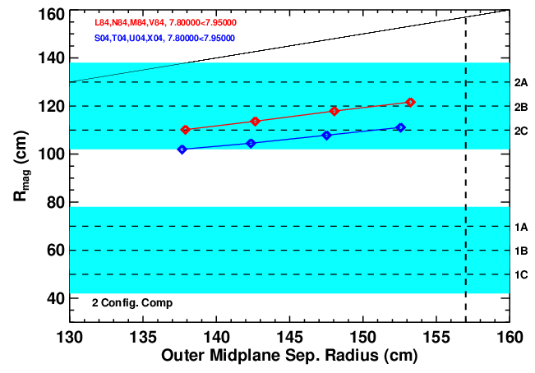
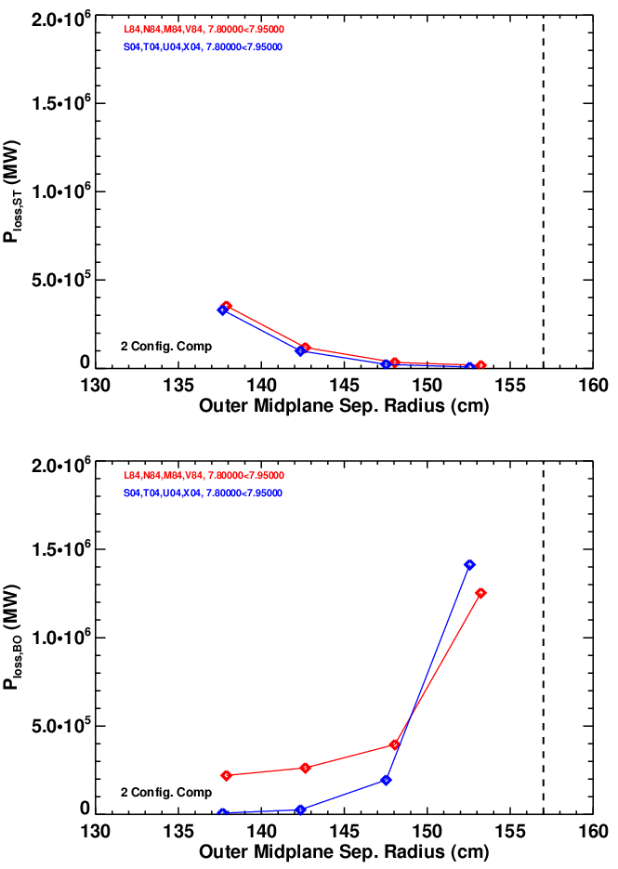
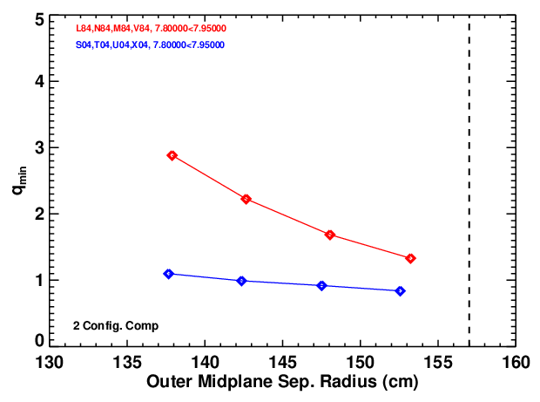
~10-15 cm Outer Gap Appears Desirable For
“Sustained” Scenarios
1 MA, 1T, 6-Source @ 90 kV, targeting f_{NI}~1 1.2 MA, 0.55 T, R_{tan}=[50,60,70,130] @ 90 kV, targeting sustained high-β_{T}

Slide 12
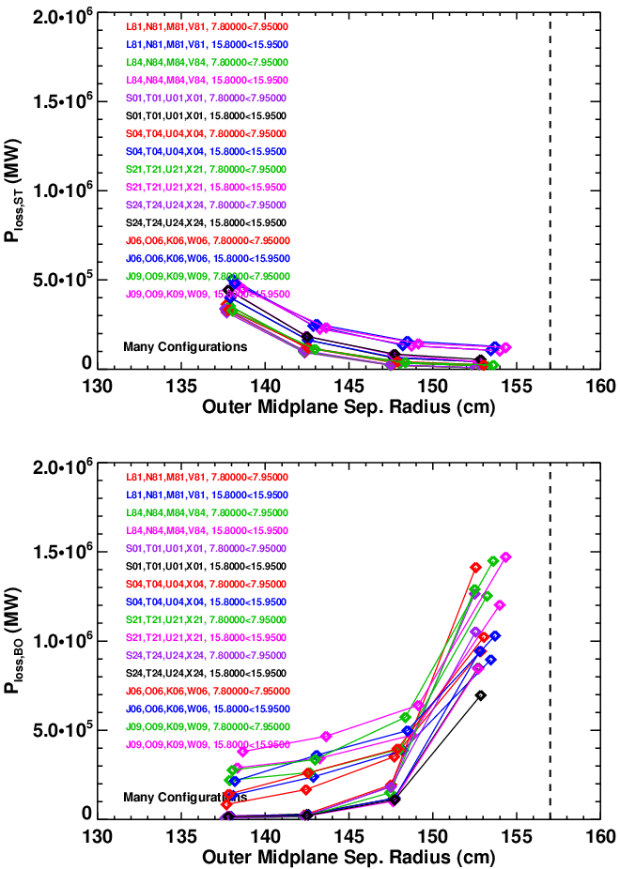
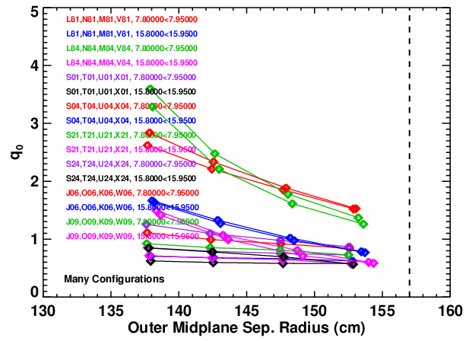
~10-15 cm Outer Gap Appears Desirable For
“Sustained” Scenarios
Some cases with 4 sources, others with 6.
  But always includes 1C and 2A.
90 kV, 1-1.2 MA, 0.55<f_{GW}<1.0
What sets the power limit?
  Energy on the antenna or beam armor?
    MSE calibrations do 2 MW for 0.4 sec.
  Or when impurity generation ruins the shot?

Slide 13
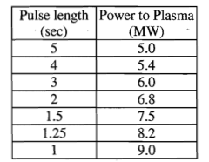
From Beam GRD
Study of ~100% Non-Inductive Scenarios in High-δ DN Shapes
Source Power vs. Voltage (from E. Fredrickson)
Source Voltage | Source Power | Source Duration
80 | 1.75 | 4.5
90 | 2 | 3
95 | 2.25 | 2
100 | 2.5 | 1.5
110 | 2.8 | 1.25

Slide 14
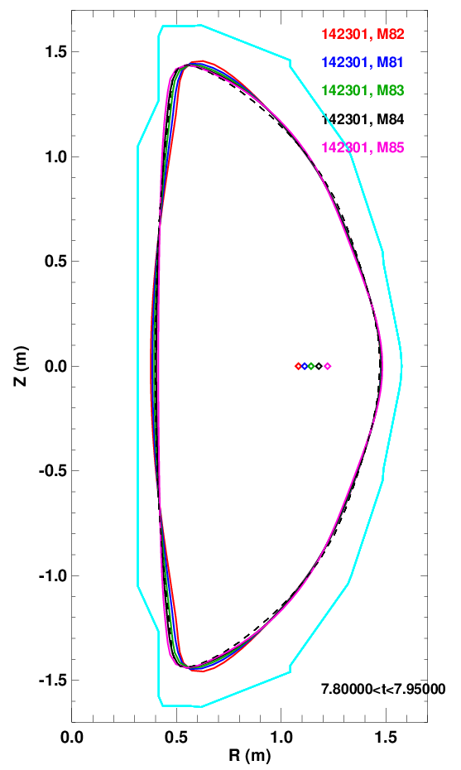
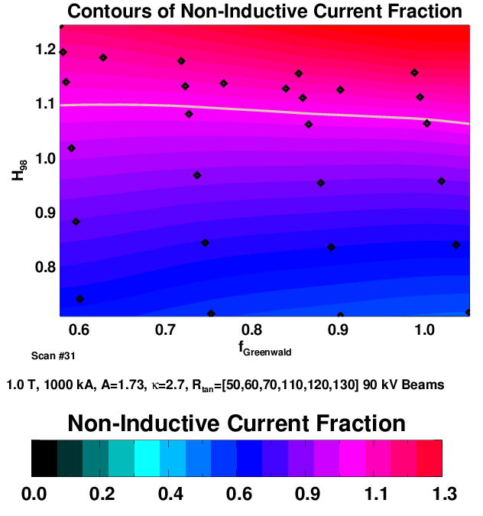
Vessel-Filling Plasmas at 1.0 MA Can Be Fully Non-Inductive With Modest Confinement Multipliers
1.0 T, 1.0 MA, κ=2.7, A=1.73, 10 cm outer gap, 90kV, 12 MW
Changes to shape as confinement changes at 0.85<f_{GW}<0.9
Inner gap changes, leading to a variation in A.
Feature is NOT captured in fixed boundary calculation.

Slide 15
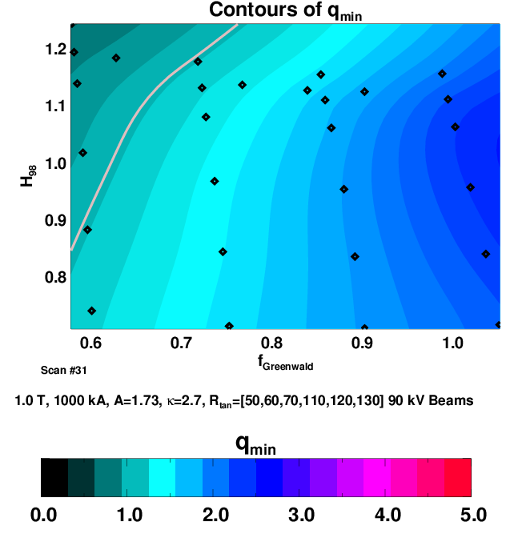
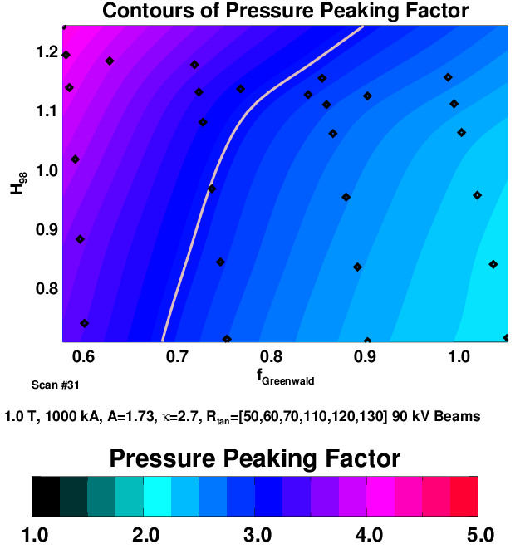
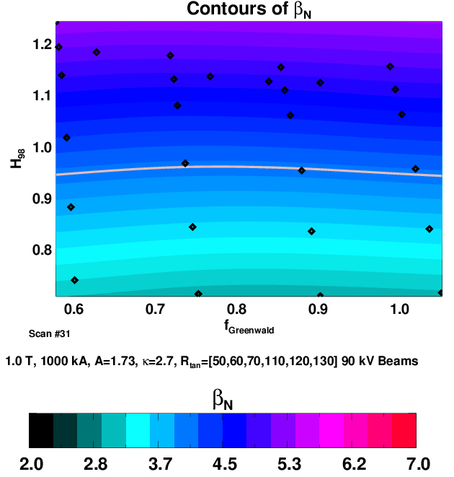
Significant Changes in Profiles Over
This Parameter Range
1.0 T, 1.0 MA, κ=2.7, A=1.73, 10 cm outer gap, 90kV, 12 MW
Low density, high confinement region has 30-40% fast ion pressure fraction.
  Drives down q_{min}.
  Increases F_{p}

Slide 16
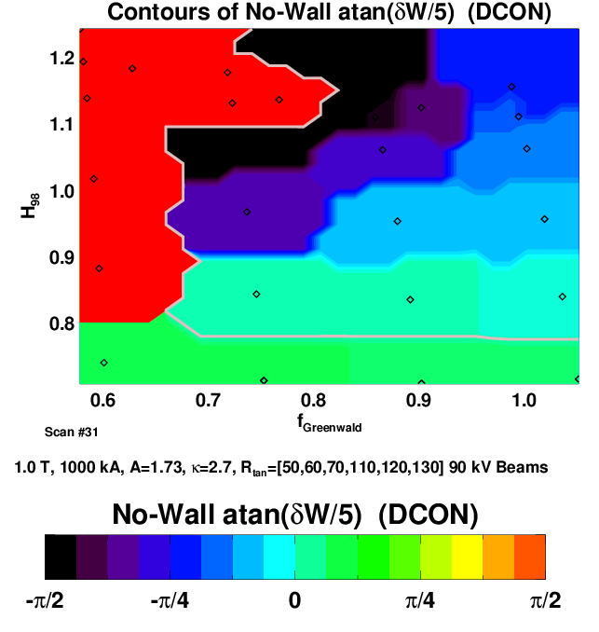
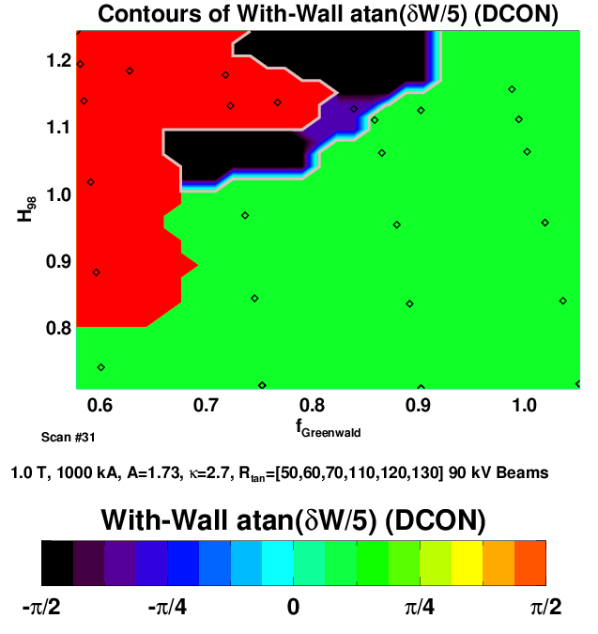
Stability Properties May Render This Scenario Problematic
1.0 T, 1.0 MA, κ=2.7, A=1.73, 10 cm outer gap, 90kV, 12 MW
Problems: 1)Too much central NBCD (drives down q_{min})
2) too much fast particle pressure on axis (drives up F_{P})
Solutions: 1) Increase the outer gap to make source 2A, 2B more off-axis.
2) Invoke some fast-ion diffusivity.

Slide 17
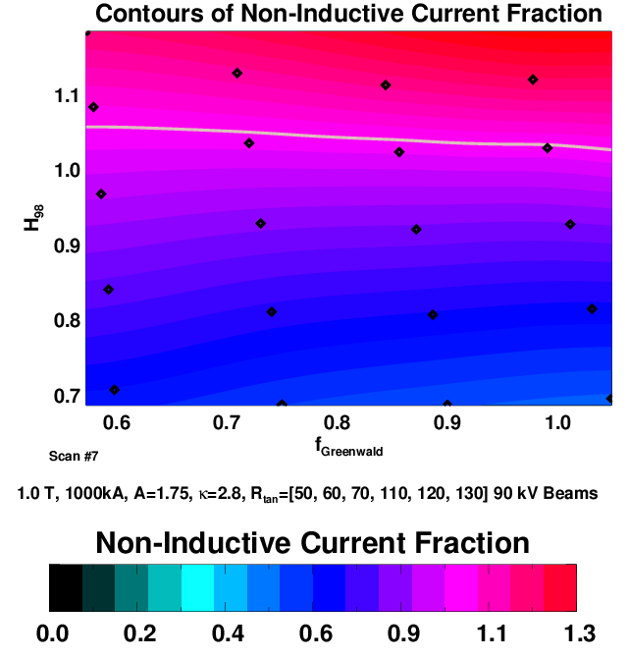
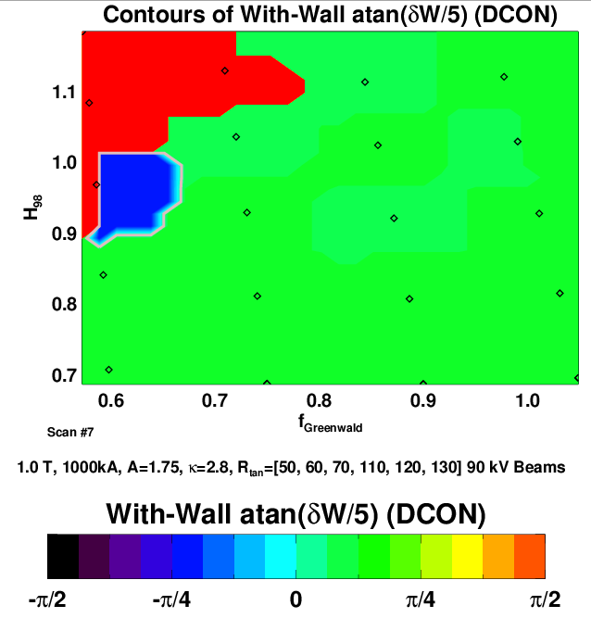
15 cm Outer Gap Case Has Better Properties
1.0 T, 1.0 MA, κ=2.7, A=1.73, 15 cm outer gap, 90kV, 12 MW
Elevated q_{min} is maintained

Slide 18
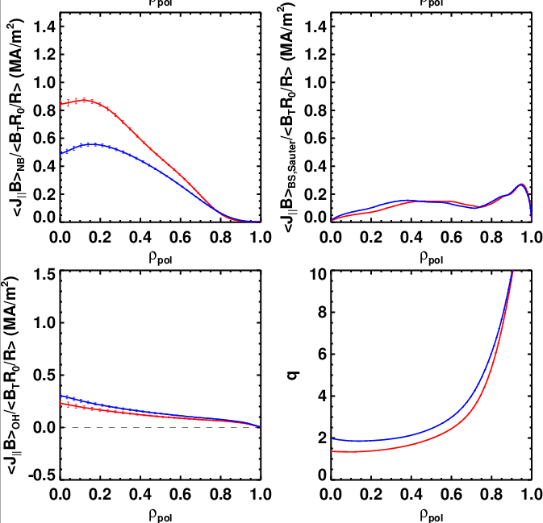
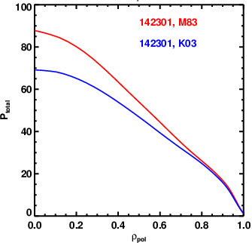
Invoking Anomalous Fast Ion Diffusivity Helps Elevate q_{min} and Reduce F_{P} in 10 cm Outer Gap Case
H=1, f_{GW}=0.7
D_{FI}=0 m²/s
D_{FI}=1 m²/s
Note: Ohmic current profile is broader than NBCD profile

Slide 19
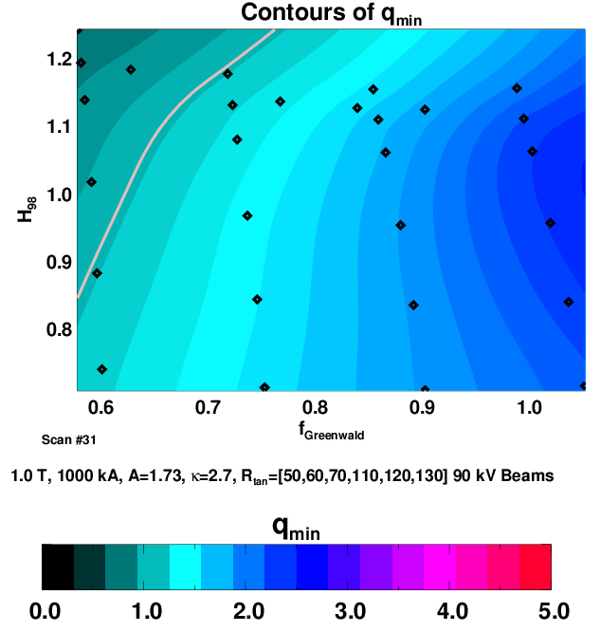
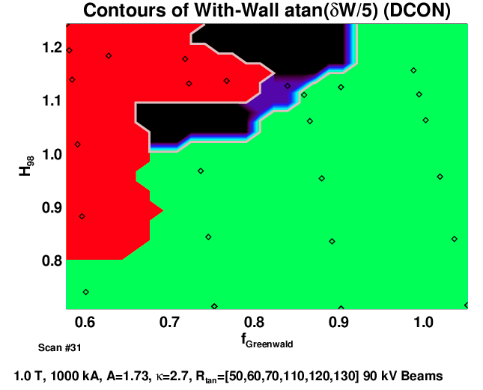
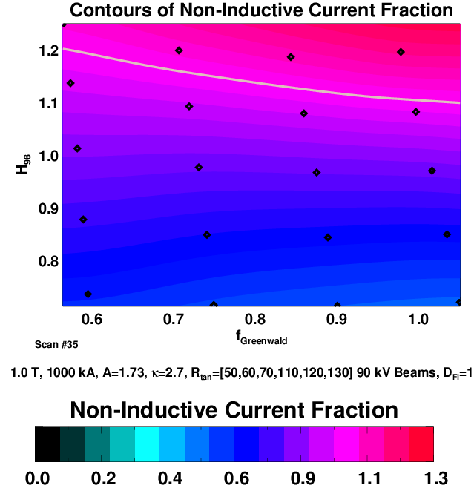
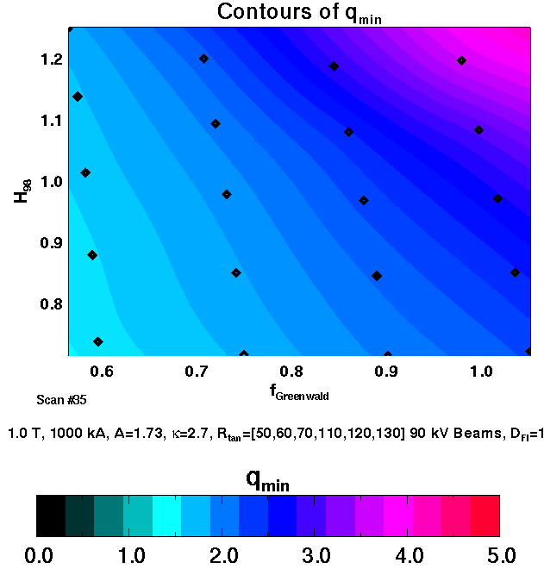
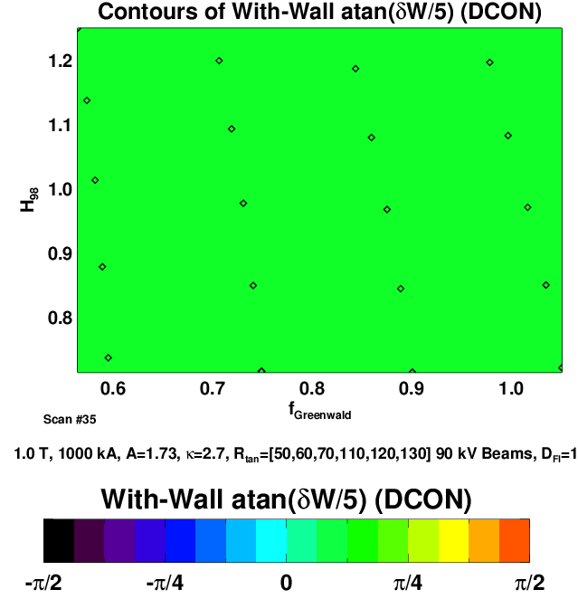
Elevated q_{min} and Reduced F_{P} with D_{FI}=1 Improves the
Ideal Stability (but required higher H₉₈ at low f_{GW})
D_{FI}=0 m²/s
D_{FI}=1 m²/s

Slide 20
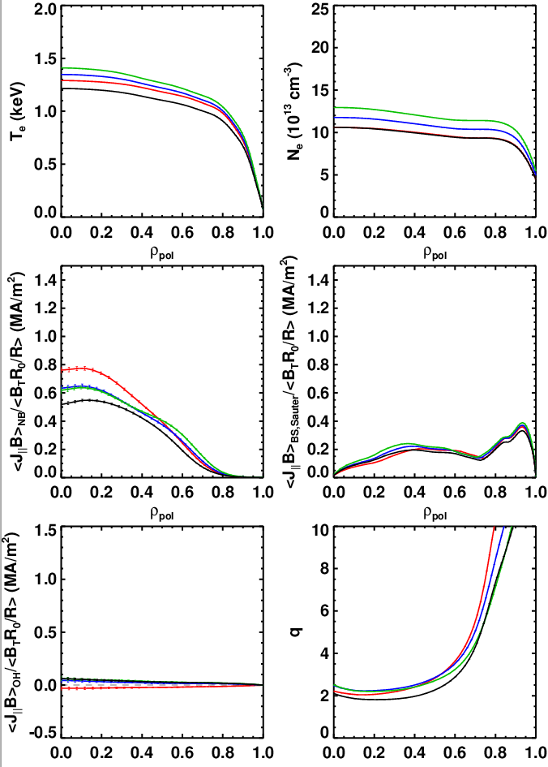
Changing Beam Voltage Raises or Lowers The Non-Inductive Current Level
TRANSP is run with predetermined constant I_{P}.
  This is how the experiment is typically operated.
  Must guess profiles and beams perfectly to achieve exactly 100% non-inductive.
  Small changes in confinement or plasma current would lead to f_{NI}=1.
Previous NSTX-U modeling was done with pre-determined constant V_{surf}=0.
  Plasma current relaxes to the non-inductive value.
  Hard to know the confinement level beforehand.
  Running TRANSP this way with ISOLVER crashed 100% of the time.
Near Non-Inductive Current Levels for 5 & 6 Source Scenarios at Various Beam Voltages, 15 cm Outer Gap
Run | I_{P}, B_{T} | Source Voltage | H₉₈/f_{GW} | Source Duration
O09 | 900, 1.0 | 80 | 1.04/0.85 | 4.5
N84 | 1000, 1.0 | 90 | 1.02/0.85 | 3
O64 | 1100, 1.0 | 100 | 0.99/0.86 | 1.5
Q39 | 900, 0.75 | 90 (5 sources) | 1.04,0.85 | 3

Slide 21
Maximum Achievable and Sustainable Stored Energies.

Slide 22
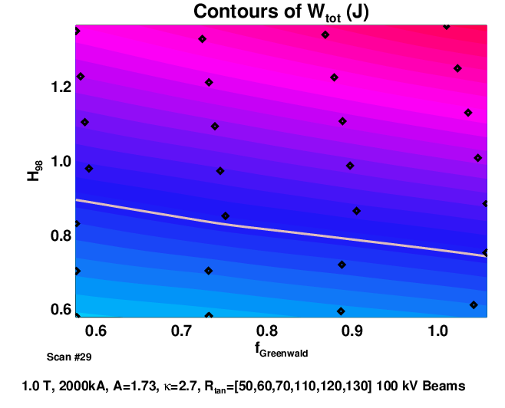
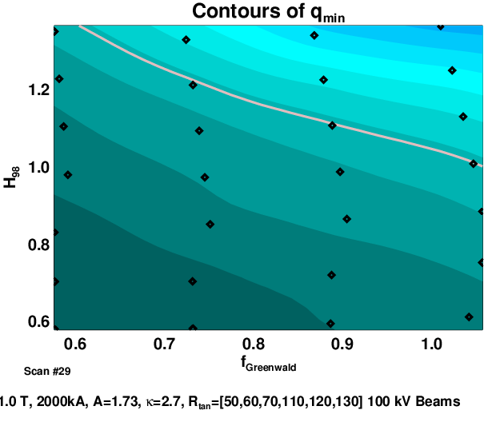
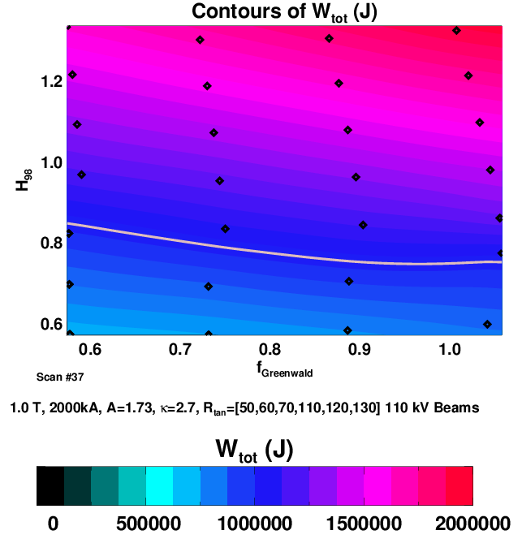
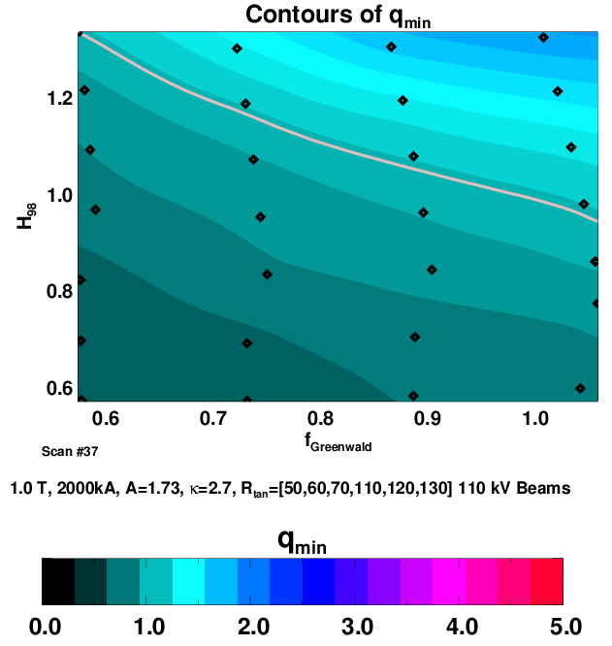
Plasmas With up to 1.5 MJ (or more) May Be “Transiently” Possible
2 MA, 1 T, 10 cm outer gap
110 & 100 kV beam cases shown.
Equilibrates to q_{min}<1.
  Probably OK since the beams have only ~1.2 sec pulse duration at this voltage.
1 stick of dynamite = 2MJ.
  What sort of machine protection/operational development will we required before we try this?
  Tendency for q₀->1 will tend to increase disruptivity.

Slide 23
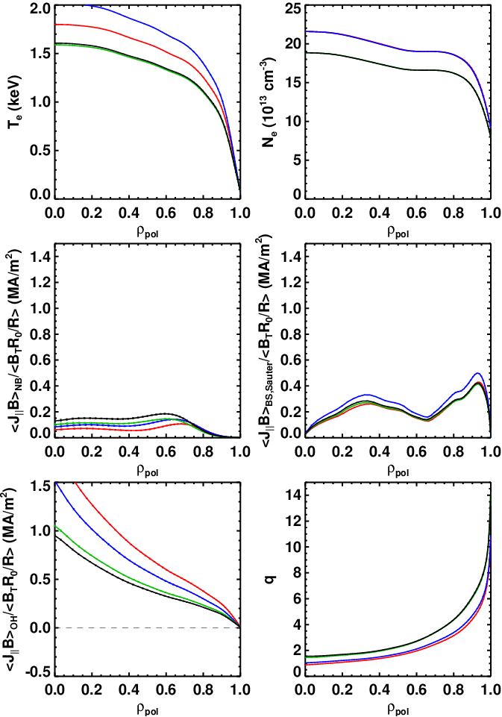
Should be Possible to Sustain Configurations with ~1000 kJ with H₉₈~1.
6-Source High-Current Partial Inductive Cases
Short beam duration and long τ_{CR} imply that relaxed q_{min} may not be relevant.
Run | Plasma Current | Source Voltage | H₉₈, f_{GW} | W_{tot} | Relaxed q_{min} | V_{surf}
M79 | 2000 | 100 | 0.99, 0.89 | 1200 | 0.88 | 0.217
K54 | 2000 | 110 | 1.05, 0.88 | 1440 | 1.03 | 0.148
O96 | 1800 | 100 | 0.99, 0.88 | 1080 | 1.2 | 0.172
O84 | 1600 | 90 | 1.02, 0.88 | 917 | 1.45 | 0.129
? | ? | 80 | ? | ? | ? | ?

Slide 24
Sustained High-β_{T} Scenarios
Or, what is the highest I_{P}/B_{T} possible with q_{min}>1?

Slide 25
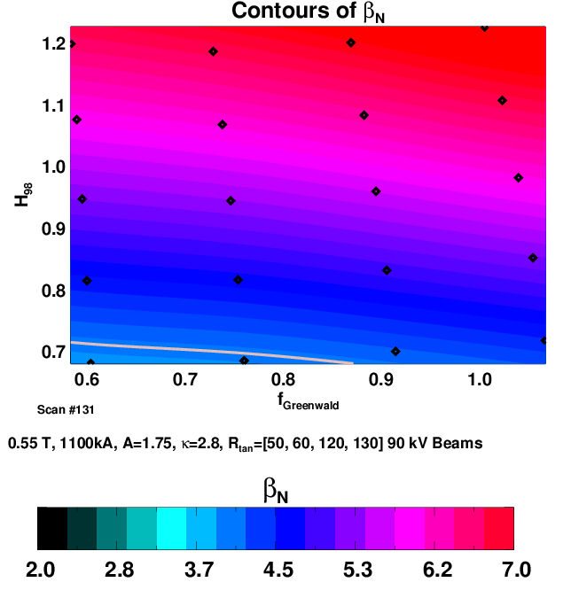
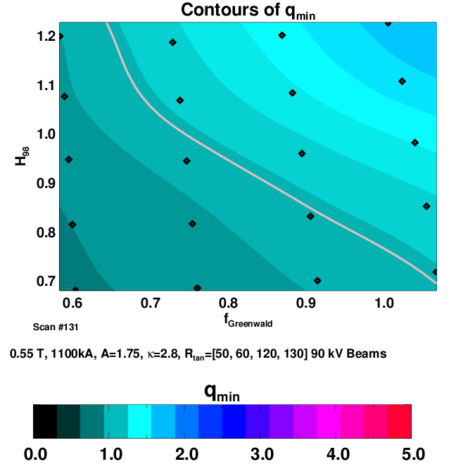
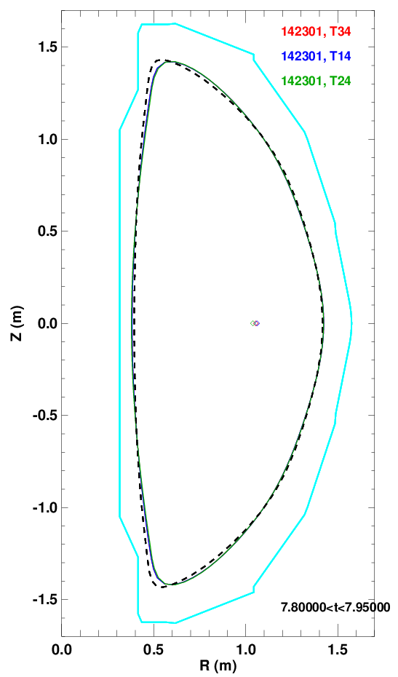
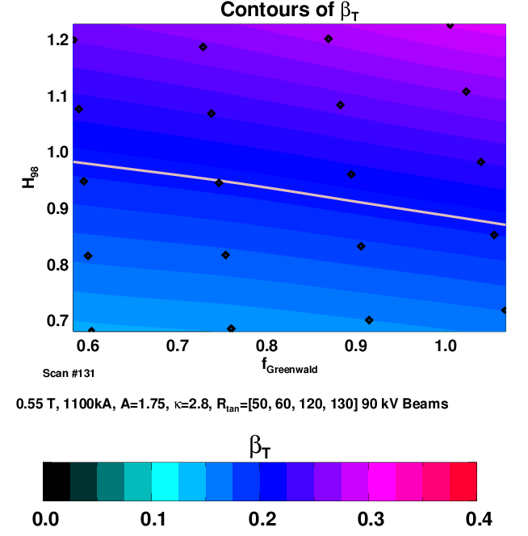
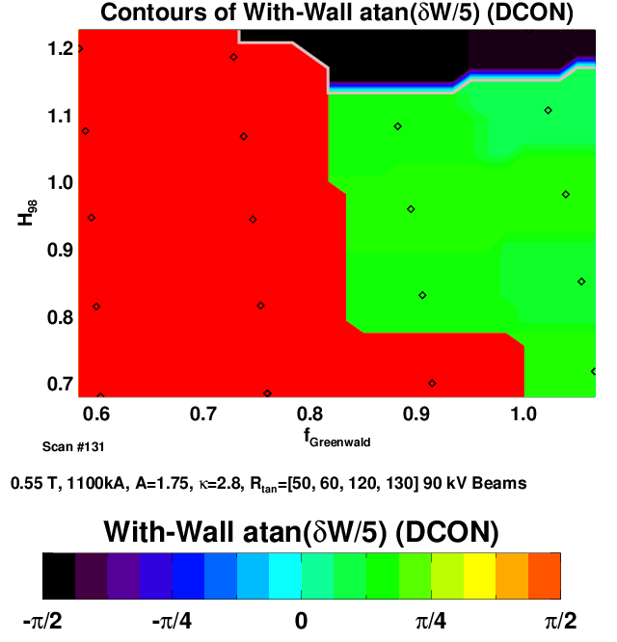
Limit Operating Space with β_{t}~25% is Possible?
B_{T}=0.55 T, I_{P}=1100 kA
R_{tan}=[50, 60, 120, 130] 90 kV
15 cm outer gap

Slide 26
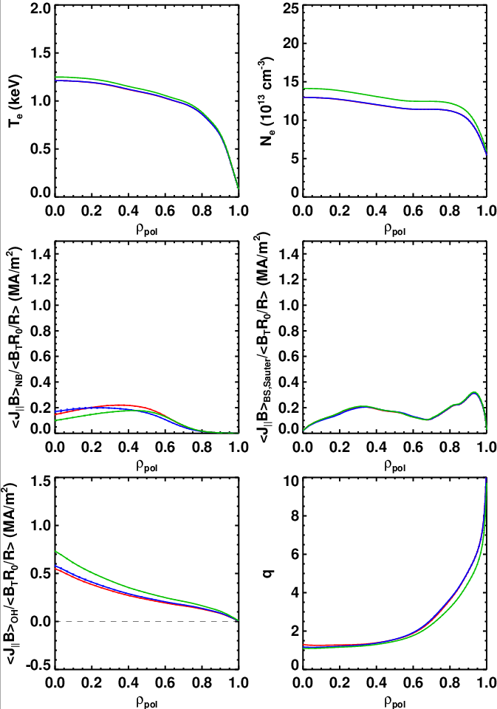
Sustained Scenarios With β_{T}~25% @ B_{T}=0.55 T
Appear Feasible
4 Source Elevated q_{min}, high-β_{T} Cases with B_{T}=0.55 T
Challenging to find beam configurations which result in q_{min}>1 and large I_{N}.
T64?
Run | Plasma Current | Source Voltage | R_{Tan} | H₉₈,f_{GW} | β_{N},β_{T} | q_{min} | V_{surf}
T34 | 1100 | 90 | 50,60,120,130 | 1.08, 88 | 6.3, 24% | 1.29 | 0.11
T14 | 1100 | 90 | 50,60,70,120 | 1.08, 0.88 | 6.2, 23% | 1.17 | 0.12
T24 | 1200 | 90 | 50,60,120,130 | 1.08, 0.88 | 6.3, 26% | 1.1 | 0.14

Slide 27
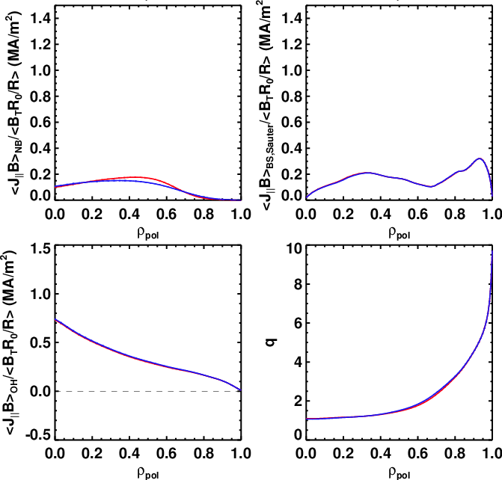
Additional Fast Ion Diffusion (D_{FI}=1m²/s) Has Little Impact on the Scenario
Example is the 1200 kA, R_{tan}=[50,60,120,130] case.
D_{FI}~1 m²/sec is the upper bound for values in quiescent discharges.
Has little discernable effect on the scenario.
D_{FI}=1 m²/sec
D_{FI}=0 m²/sec

Slide 28
Comparison to Existing Data

Slide 29
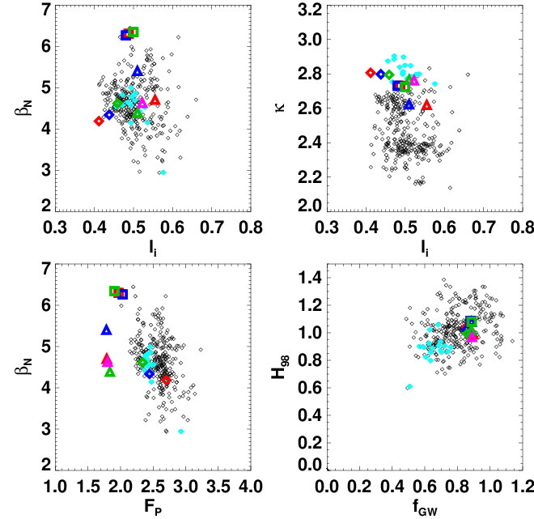
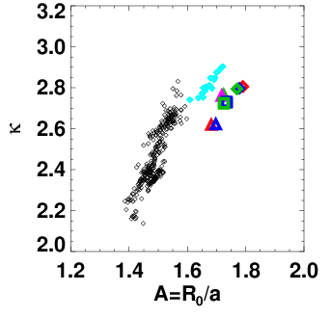
Identified Scenarios are a Small Change In Some Parameters…
Legend:
Small symbols
Black: Existing database with A<1.6
Cyan: Existing database with A>1.6
Other Colors: NSTX-U Scenarios
Squares: 0.55 T high-β_{T}
Triangles: 1.0 T Partial-Inductive
Diamonds: 1.0 T f_{NI}~1

Slide 30
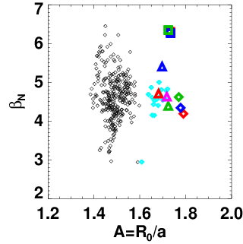
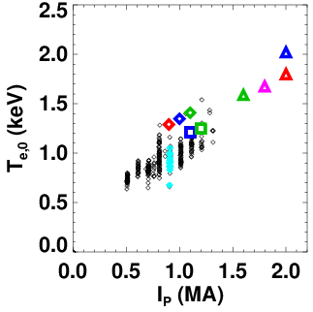
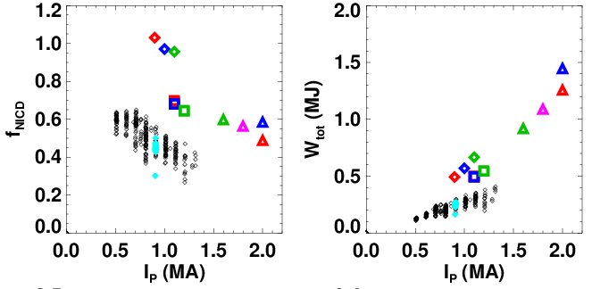
Identified Scenarios are a Small Change In Some Parameters…and a Big Change in Others
Legend:
Small symbols
Black: Existing database with A<1.6
Cyan: Existing database with A>1.6
Other Colors: NSTX-U Scenarios
Squares: 0.55 T high-β_{T}
Triangles: 1.0 T Partial-Inductive
Diamonds: 1.0 T f_{NI}~1

Slide 31
Summary
Free-Boundary TRANSP simulations are working fine for NSTX and NSTX-U.
  But can be tricky…see R. Andre of S. Gerhardt before trying it.
10-15 cm outer gaps appear to be optimal with respect to off-axis NBCD and beam power loss.
f_{NI}=1 scenarios are available over a range of currents and beam powers.
Stored energies up to 1.5 MJ may be possible.
Sustained configurations with β_{T}~25% may be possible.
Moderate levels of anomalous fast ion diffusion may be beneficial for some scenarios, irrelevant to others.
  Large levels of D_{FI}, like for TAE avalanches, not simulated, but likely to matter a lot more.
Biggest extrapolation appears to be high β_{N} and higher-A.
  We will work on this as part of R11-2.
Near term things to do:
  Continue to look for elevated q_{min} scenarios at high-β_{T}.
  Look for scenarios where the variation in NB sources results in the largest changes in the q-profile…these optimal for current profile control.
Long term:
  Need a validated electron transport model.

Slide 32
Study of 100% Non-Inductive Scenarios in LSN Shape

Slide 33
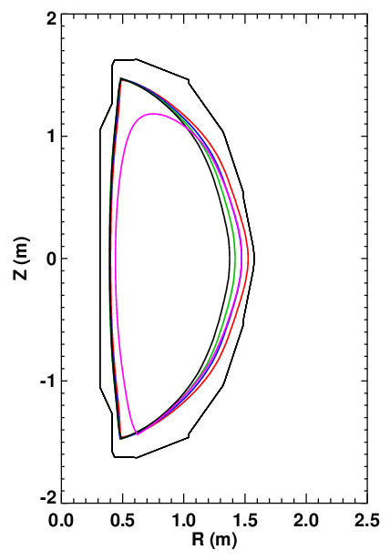


LSN Shape Requires Excellent Confinement for f_{NI}=1 @ 1 MA, and Stability May be a Problem
LSN shape with 10 cm outer gap.
  Elongation is 2.5
  A=1.86 due to the larger inner gap.
Might be typical of a shot with power on the LOBD.

Slide 34




Dropping Plasma Current and Source 2C Results in a Sustainable Scenario, if Confinement is Good.
12 MW, 800 kA
6 Sources
R_{tan}=[50,60,70,110,120,130]
Too much central NBCD drives down q₀.
10 MW, 800 kA
5 Sources
R_{tan}=[50,60,70, 120,130]

