Slide 1




NSTX-U
Supported by
Data Analysis Tools for NSTX-U
Bill Davis
Stan Kaye
Coll of Wm & Mary
Columbia U
CompX
General Atomics
FIU
INL
Johns Hopkins U
LANL
LLNL
Lodestar
MIT
Lehigh U
Nova Photonics
ORNL
PPPL
Princeton U
Purdue U
SNL
Think Tank, Inc.
UC Davis
UC Irvine
UCLA
UCSD
U Colorado
U Illinois
U Maryland
U Rochester
U Tennessee
U Tulsa
U Washington
U Wisconsin
X Science LLC
Culham Sci Ctr
York U
Chubu U
Fukui U
Hiroshima U
Hyogo U
Kyoto U
Kyushu U
Kyushu Tokai U
NIFS
Niigata U
U Tokyo
JAEA
Inst for Nucl Res, Kiev
Ioffe Inst
TRINITI
Chonbuk Natl U
NFRI
KAIST
POSTECH
Seoul Natl U
ASIPP
CIEMAT
FOM Inst DIFFER
ENEA, Frascati
CEA, Cadarache
IPP, Jülich
IPP, Garching
ASCR, Czech Rep
Physics Meeting
B-318
Aug. 26, 2013

Slide 2

Overview
Web Tools in depth
  Overlaying in different ways
  Browsing Fast Camera data
EFITmovies and EFITviewer
New ways to visualize data like MPTS
Databases at PPPL and DbAccess features
  Shot summaries and other tables of general interest available
  Creating your own
  Find shots based on EFIT parameters or other signals
  Search for entries in the NSTX Logbook
Other ways to visualize NSTX data
What other tools should be developed?

Slide 3
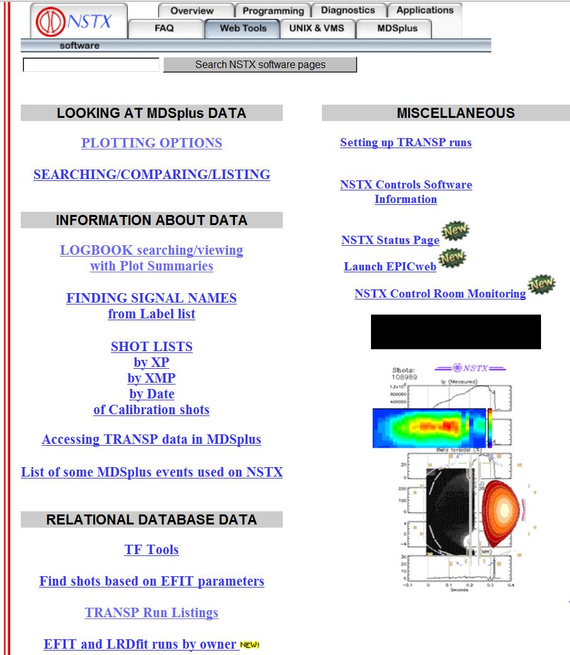

Web Tool access at http://nstx.pppl.gov/nstx/Software/WebTools
Designed for ease-of-use:
Notes:
If you click on “Plotting Options” you get the next screen

Slide 4
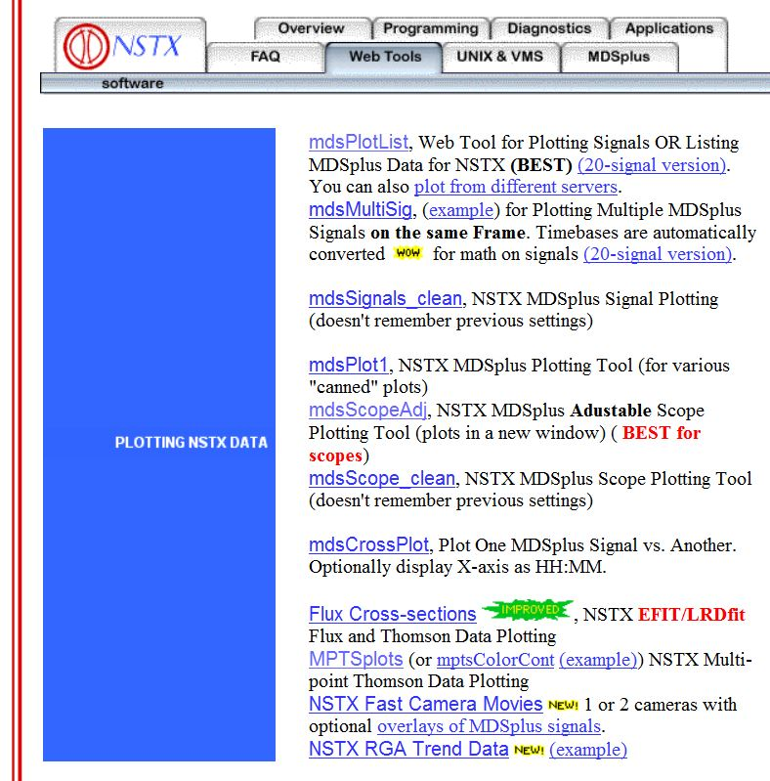
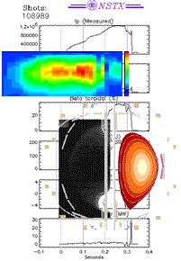
Access to Plotting Web Tools
Notes:
Then you see a menu of plotting options. Clicking on mdsMultiSig brings up the next screen.

Slide 5
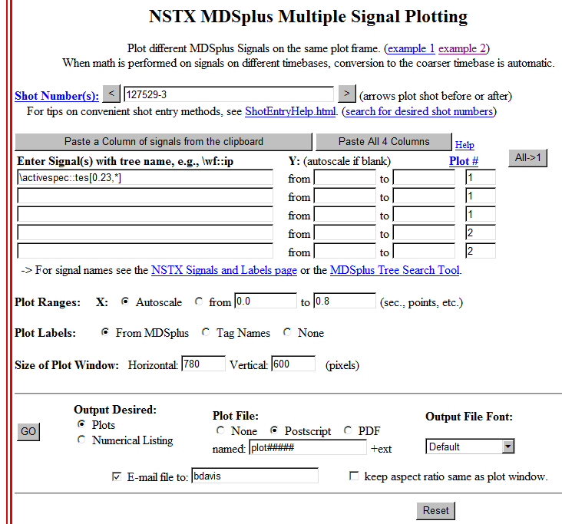
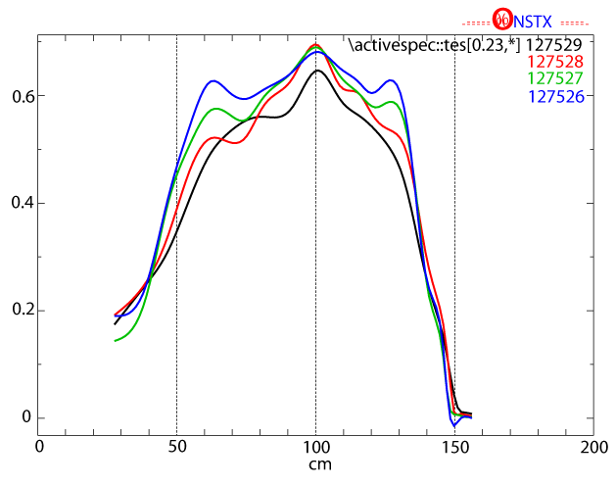
Overlaying Te Profiles from different shots
http://nstx.pppl.gov/nstx/Software/WebTools/mdsmultisig.html

Slide 6
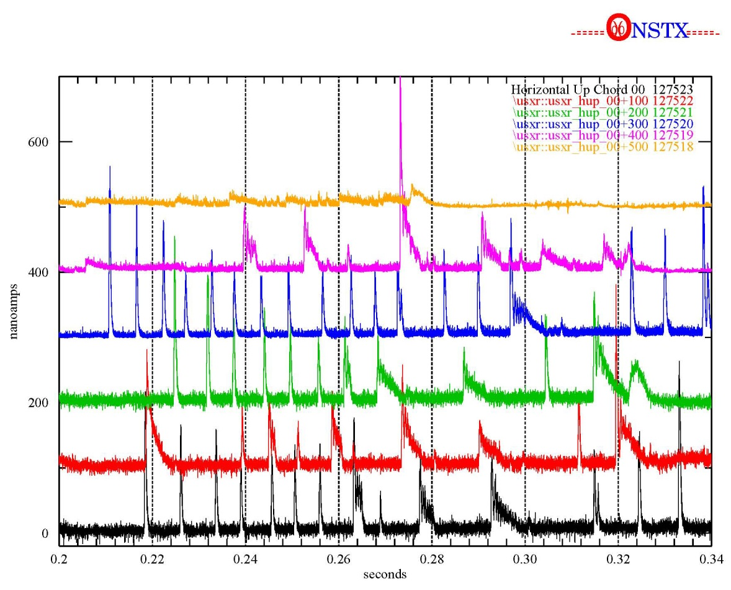
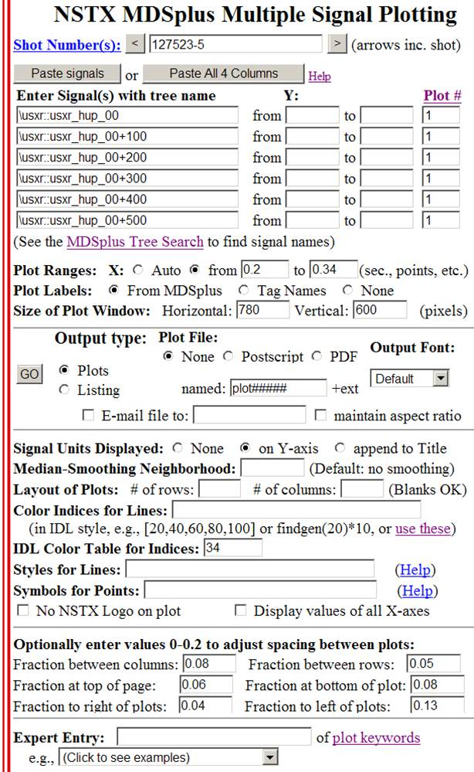
http://nstx.pppl.gov/nstx/Software/WebTools/mdsmultisig.html
Can overlay different shots of same signal, different signals of same shot, etc.
Notes:
Signals can be mathematical equations. Timebases are automatically converted. Names and ranges can be stored in a file and pasted into the page on Internet Explorer.

Slide 7
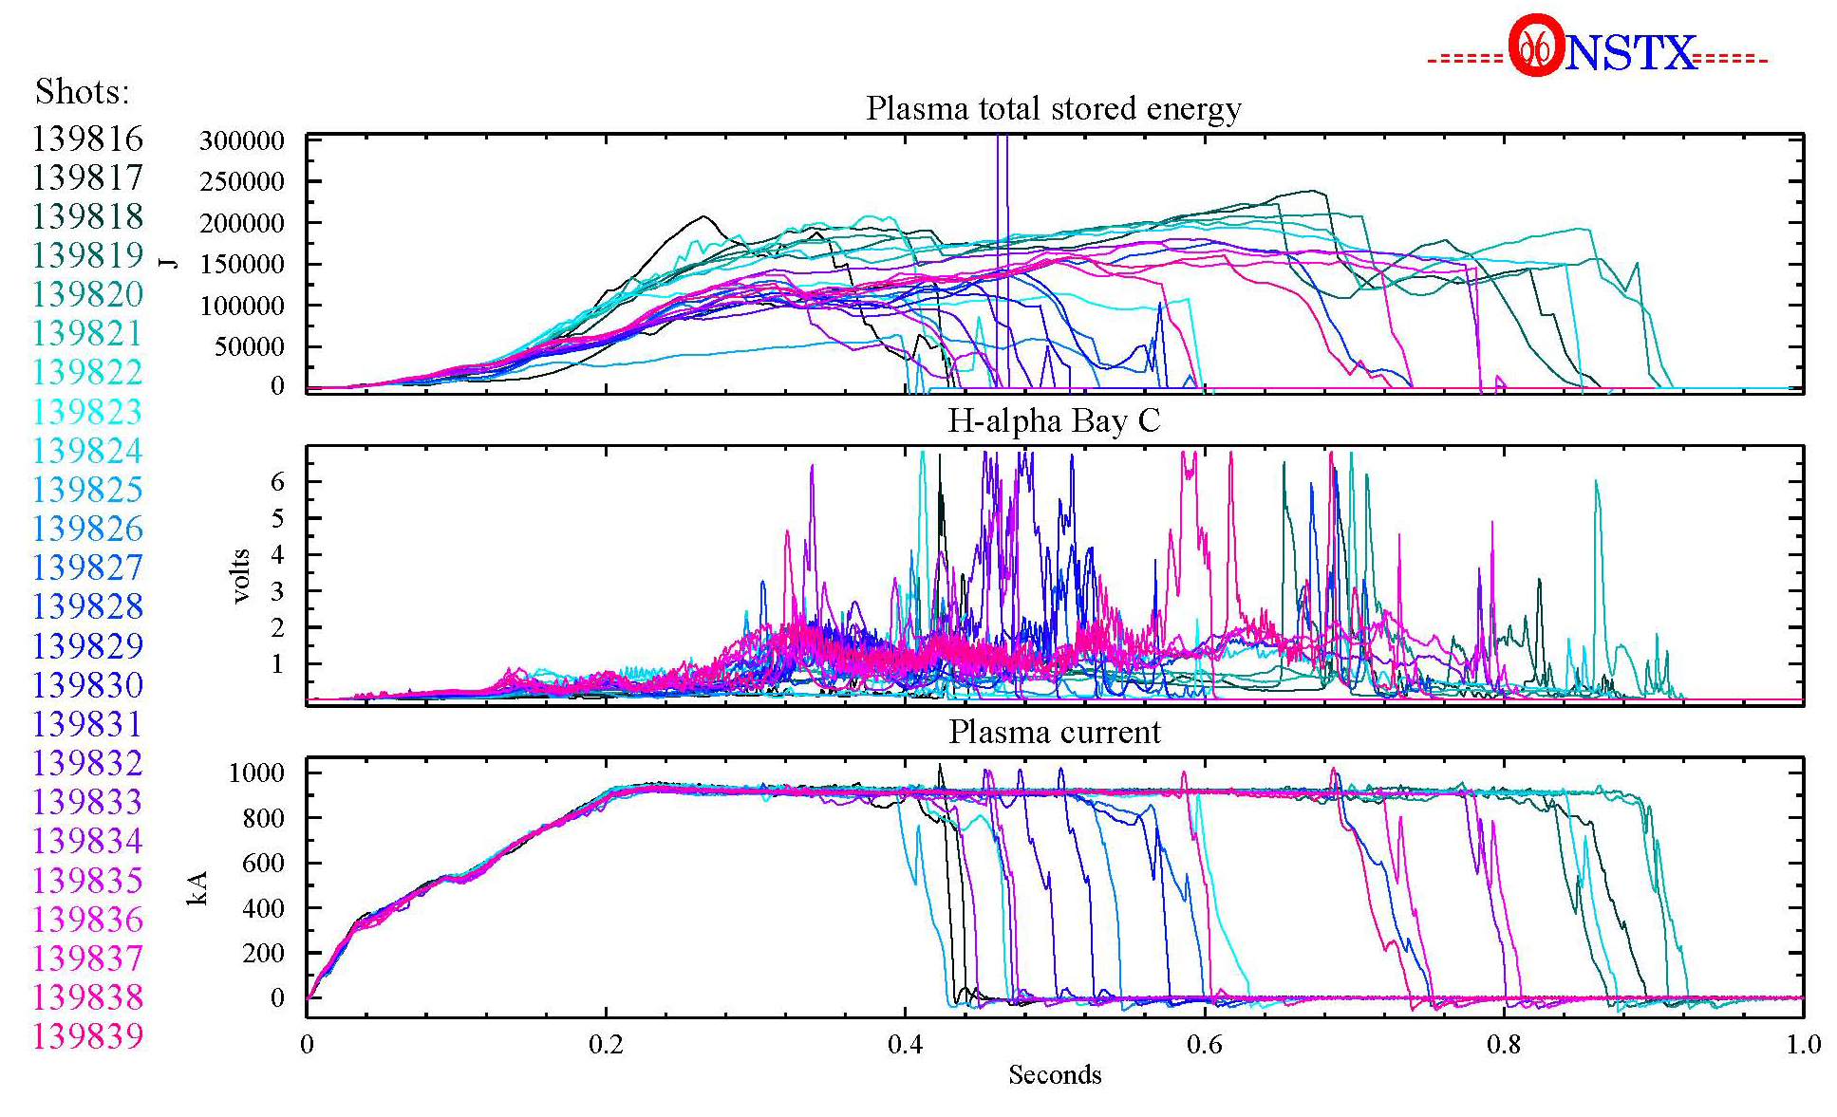
Web Tools plotting has many options
http://nstx.pppl.gov/nstx/Software/WebTools/mdsplotlist.html
Shot Number: “139816+23” Color Indices for lines: “findgen(24)/24*240”
Color Table: “10”
Notes:
You might use this scheme to see how shots evolve through a scan of some kind.

Slide 8
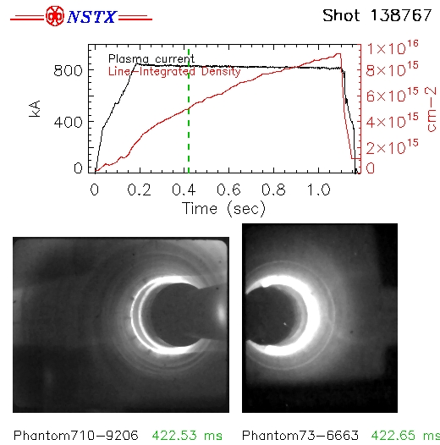
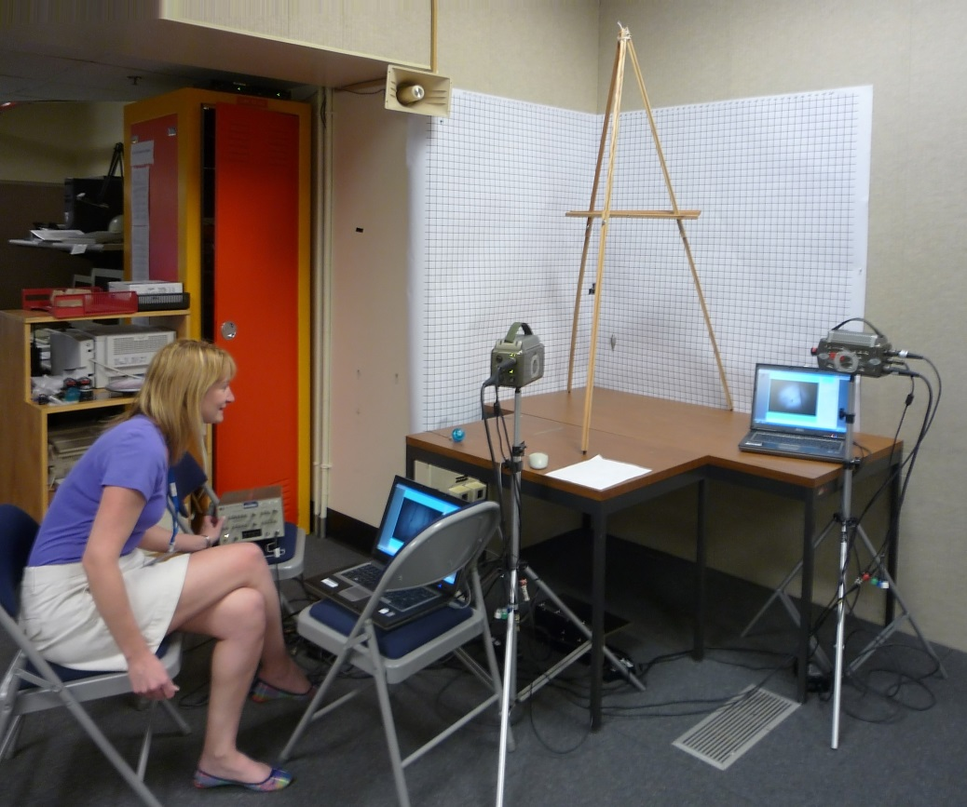
Multiple NSTX Camera images with plots
http://nstx.pppl.gov/nstx/Software/WebTools/nstxmovies.html
Notes:
Individual frames, or animations, can be output from nstxmovies.html

Slide 9
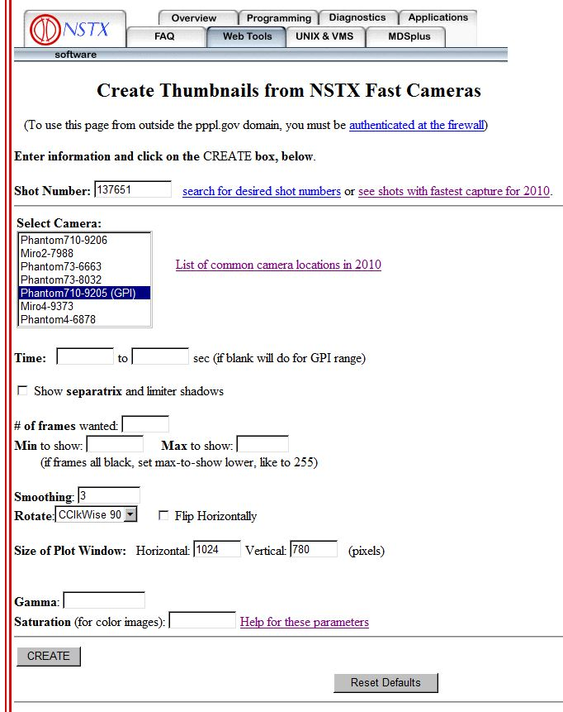
Thumbnail summaries of fast camera data
http://nstx.pppl.gov/nstx/Software/WebTools/fcthumbnails.html

Slide 10
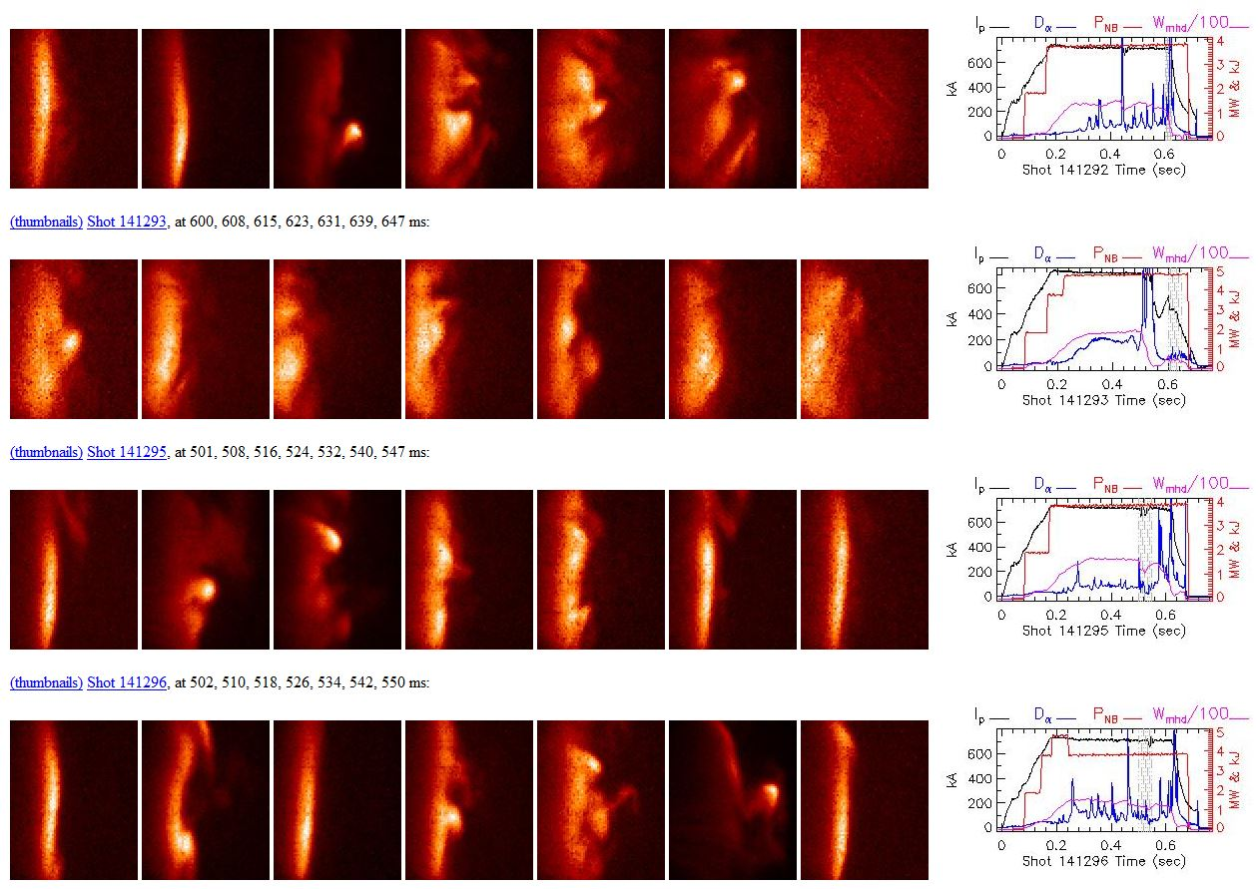
Sample from GPIthumbnails.pro
Notes:
Clicking n the (thumbnails) link for a shot brings up more detail

Slide 11
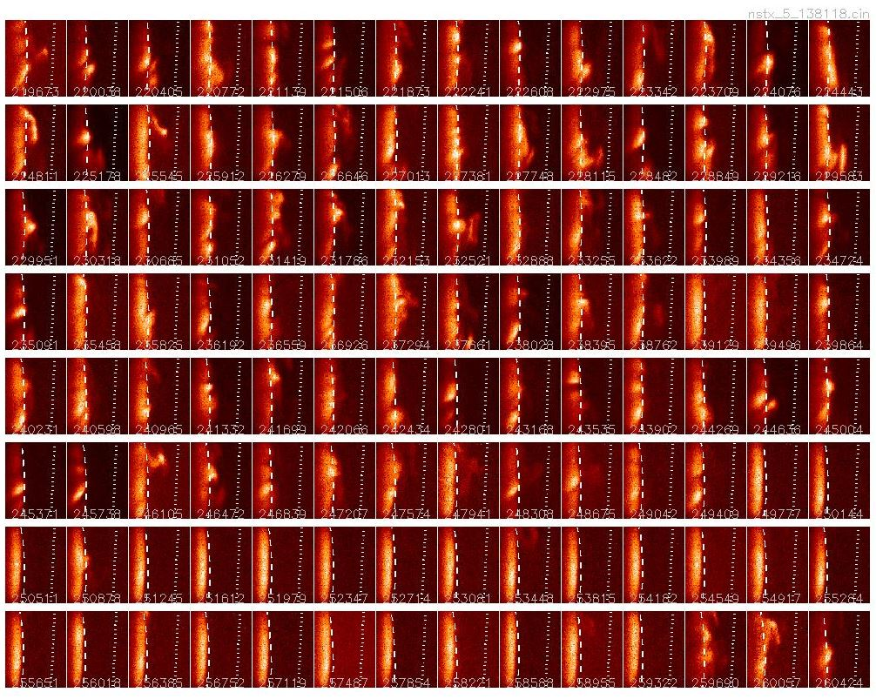
Sample from FCthumbnails.html
Easy to spot the
L-H transition,
indicated by the
suddenly stable
edge

Slide 12
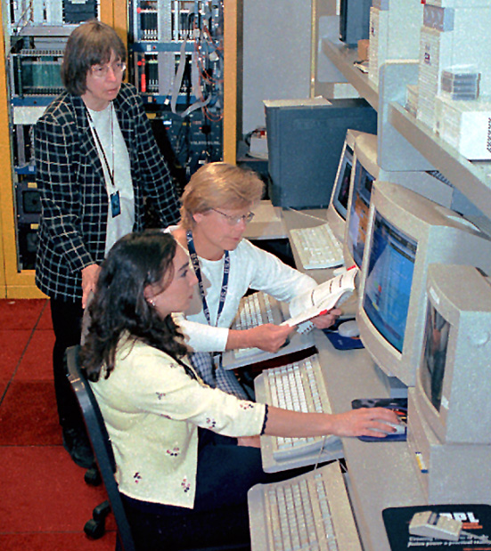
IDL analysis tools tend to be more detailed
Can be run directly on your PC or Mac, but easiest to run IDL on the PPPL Linux cluster
Start with “module load nstx”
Mouse can be used for zooming, examining data values, etc.
Be careful of appending additional directories to the IDL_PATH definition from others!

Slide 13
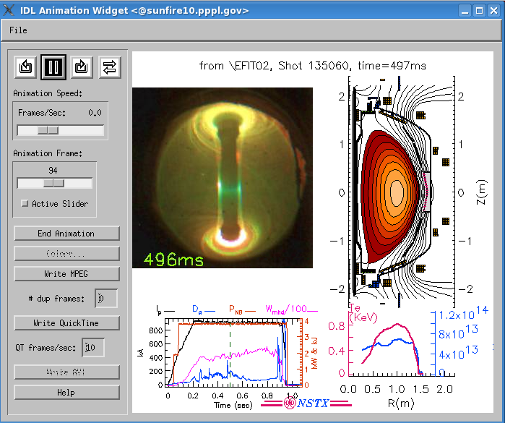
EFITmovies.pro plots many things synchronously
Created in IDL in X-windows on the PPPL Linux cluster by:
IDL> efitmovies,"miro*135060", /thomson, /summary
Notes:
This is an attempt to show many types of data concurrently so correlations might be noticed

Slide 14
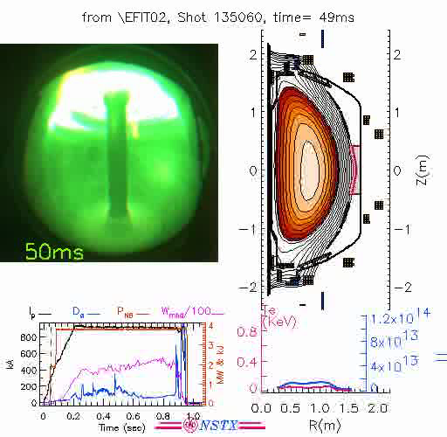
EFITmovies.pro plots many things synchronously
Movie saved from previous screen:
Click to
play

Slide 15
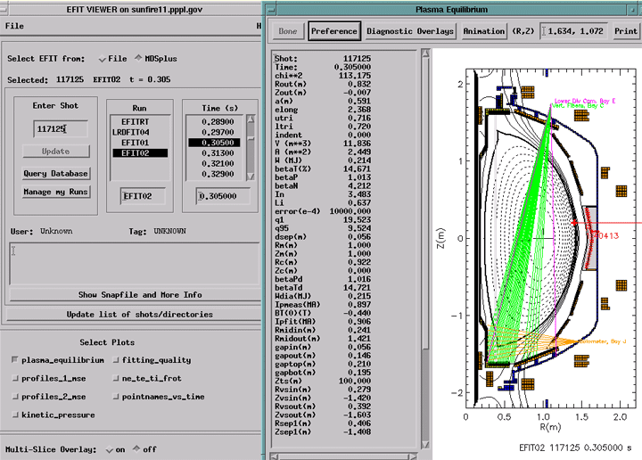
EFITviewer (from GA) shows plasma flux in relation to vessel and diagnostic site lines
% efitviewer # (entered at the Linux prompt)

Slide 16
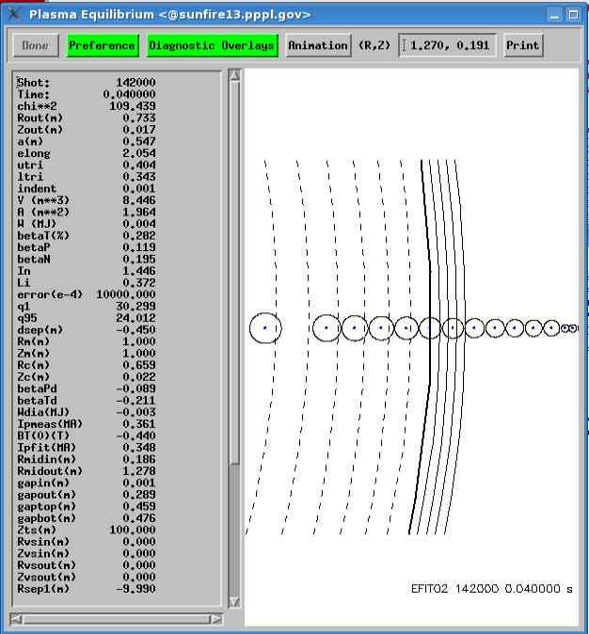
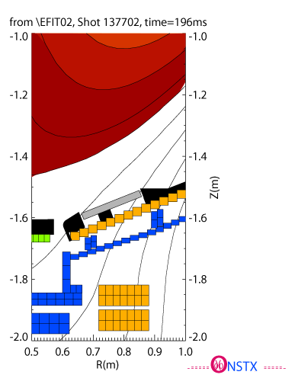
EFITviewer - zoom in to see
MPTS locations, strike points, e.g.
Ctl-clicking on the plot
will print out the
R and Z coordinates
Notes:
If the Thomson points are checked in “Diagnostic Overlays” you can see where the separatrix is in relation to the Thomson points. The zoom on the right lets you see the location of strike points in the divertor region.

Slide 17
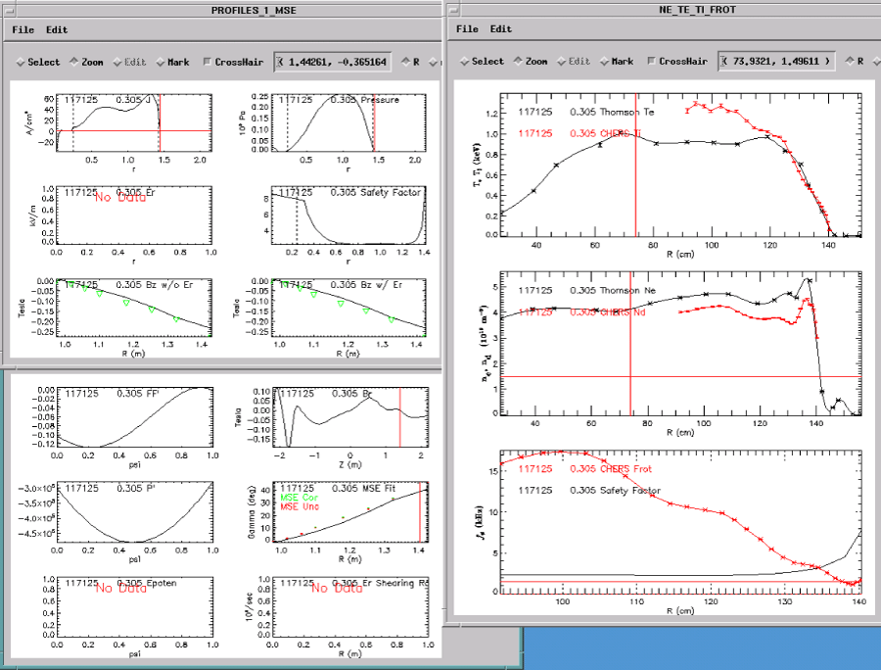
Other plots from EFITviewer, such has Thomson profiles vs. R, rho, or psi

Slide 18
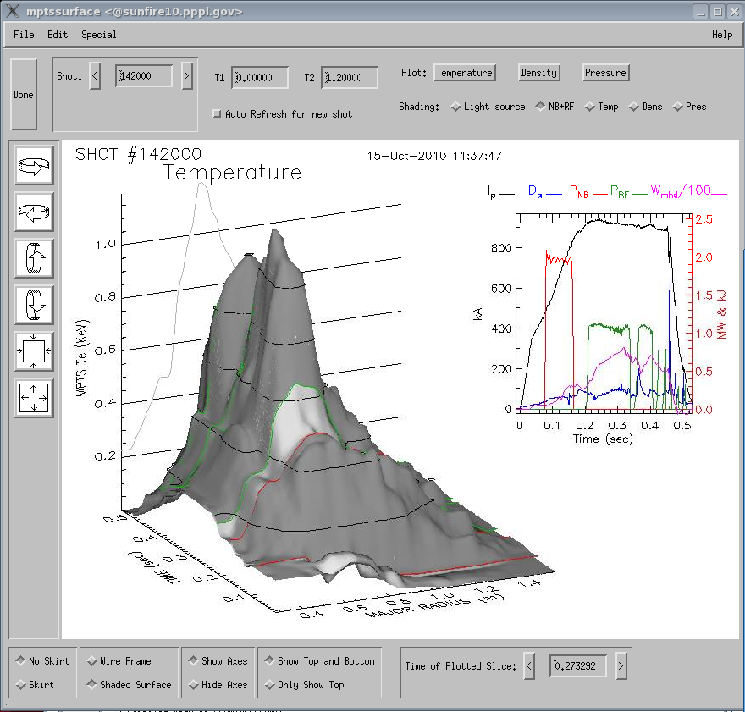
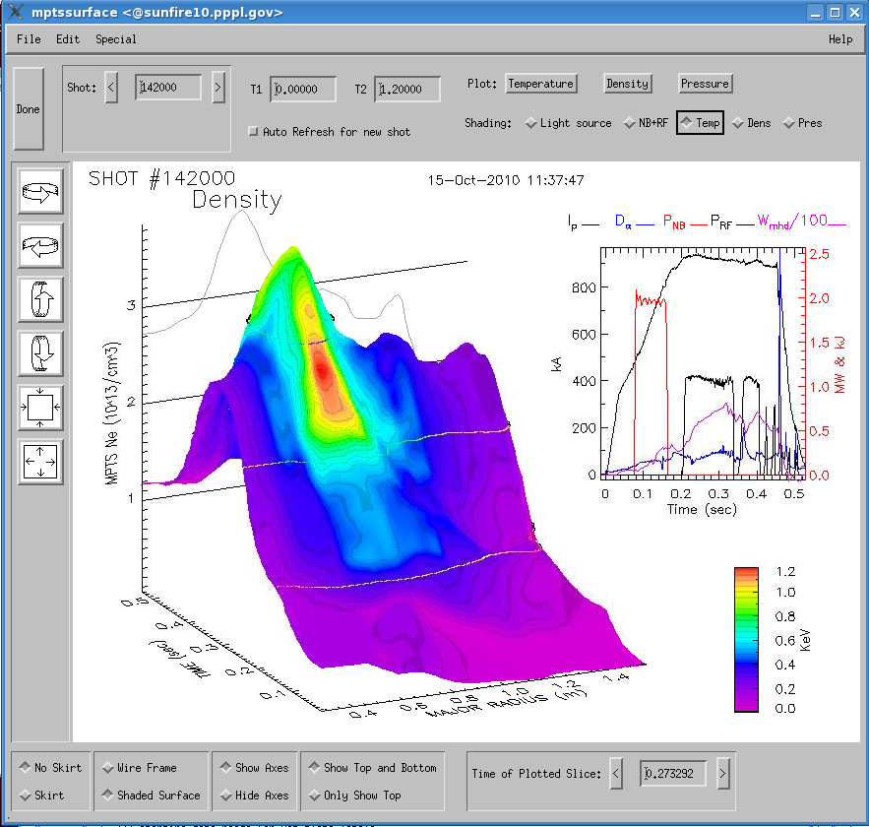
Various ways to look at Thomson Data
IDL> mptssurface, 142000, /project
After clicking on “Plot: Density” and
“Shading: Temp”:
Notes:
Initially, regions of heating with NB and RF are shown on the surface. The plot on the right was what Stewart Prager took to a fusion talk at a congressional luncheon (with a few edits).

Slide 19
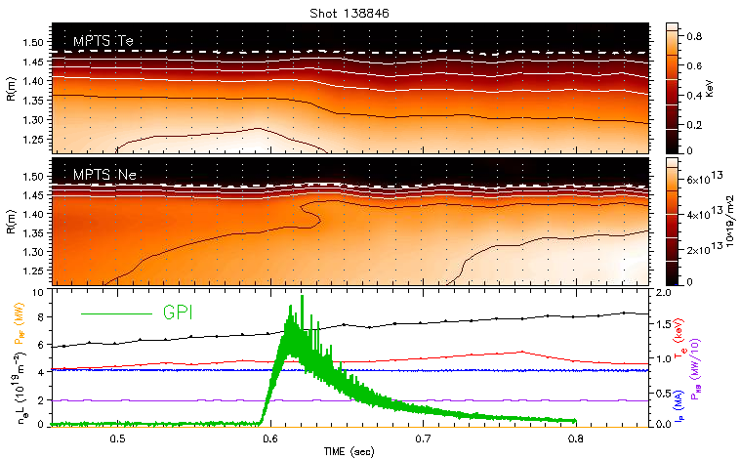
Thomson Data - Can zoom in,
e.g., to see edge effects
Created in IDL in X-windows on the PPPL Linux cluster by:
IDL> plot3_mpts,138846,/GPI,tmin=.45,tmax=.85,r1=1.2,r2=1.56,/contour,Plot_ip=0
Notes:
While examining the effects of Gas Puffing on the plasma edge, Stewart Zweben noticed some decrease in temperature and increase in density in this shot.

Slide 20
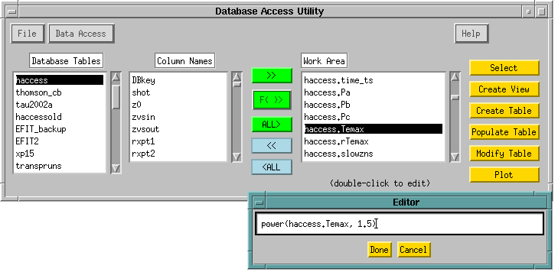
Database Access via Point-and-click
IDL> dbaccess
Manual available at:
http://nstx.pppl.gov/nstx/Software/Documents/dbaccess.html
Notes:
DbAccess has many features developed specifically for plasma physics data bases.

Slide 21

“Public” tables available in the NSTXLOGS Database
“Survey” table contains a few dozen parameters at 3 times of interest (FlatTop, MaxIp, RampUp) for each shot
EFITnn tables contain most of the EFIT parameters at 6 times of interest for each shot
Neutron production
XP-specific tables
“Haccess” table contains parameters related to H-mode
Blob database contains blob characteristics for NSTX and CMOD shots
(Better organization and documentation of existing public tables are needed)

Slide 22
Column descriptions can be described in the “Contents” table of the NSTXLOGS Database
Selection for the “Contents” table in DbAccess:
COLUMN | CONTENTS.DESCRIPTION | SOURCE | TABLE | UNITS
Table: Survey |  | D. Mastrovito/S. Kaye | Survey
baye_bii | Boron II emissivity from filterscope | \passivespec::baye_bii_fscope | Survey | AU
bt | Total TF current | \engineering::pc_tf_tot_cur | Survey | Amperes
bayc_cii | Carbon II emissivity from HAIFA | \passivespec::bayc_cii_haifa | Survey | AU
bayc_ciii | Carbon III emissivity from filterscope | \passivespec::bayc_ciii_fscope | Survey | AU
dalfal | Lower divertor Da emission | \passivespec::bayc_dalf_haifa | Survey | AU
dalfamp | Midplane Da emission | \passivespec::bayg_dalf_haifa | Survey | AU
dalfau | Upper divertor Da emission | \passivespec::baye_dalf_haifa | Survey | AU
bayg_heii | Helium II emissivity from filterscope | \passivespec::bayg_heii_fscope | Survey | AU
ichi | CHI injector current | \ENGINEERING::pc_chi_tot_cur_1 | Survey | Amperes
ip | Plasma current | \engineering::ip2 | Survey | Amperes
nel | Line integral density | \microwave::line_density | Survey | cm-2
baye_oii | Oxygen II emissivity from filterscope | \passivespec::bage_oii_fscope | Survey | AU
pinj | Total injected neutral beam power | \nbi::nb_p_inj | Survey | MW
prad | Total radiated power from bolometer | \passivespec::bolom_totpwr | Survey | MW
prf | Total injected HHFW power | \rf::hhfw_power | Survey | MW
shot | Shot number | mdsvalue(current_shot(nstx) | Survey
time | Time of beginning of store phase of shot | mdsvalue(shot_date($) shot) | Survey | sec
toi | Time of interest | nstx$:[db]times.dat | Survey
vchi | CHI injector voltage | \OPERATIONS::chi_voltage | Survey | Volts
vloop | Loop voltage | \operations::v_flohm | Survey | Volts
Table: XP19 |  | S. Kaye | xp19
bt | Vacuum toroidal field at the geometric center |  | xp19 | T
ip | Plasma current |  | xp19 | MA
nebar | Line averaged density |  | xp19 | 10^19 m^-3
phase | Phase of discharge |  | xp19
pnbi | Injected neutral beam power |  | xp19 | MW
poh | Ohmic heating power |  | xp19 | MW
q95 | q at 95% flux surface |  | xp19
Etc.

Slide 23
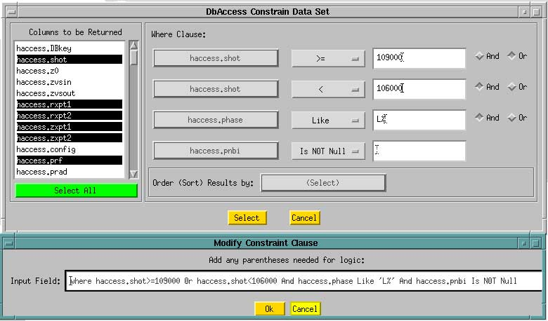
Flexible constraint specification in DbAccess
Notes:
This widget forms the SQL query for you, which can then be edited.

Slide 24
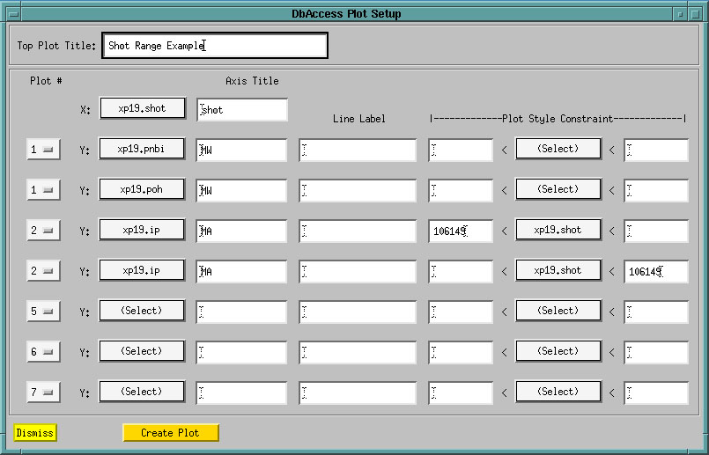
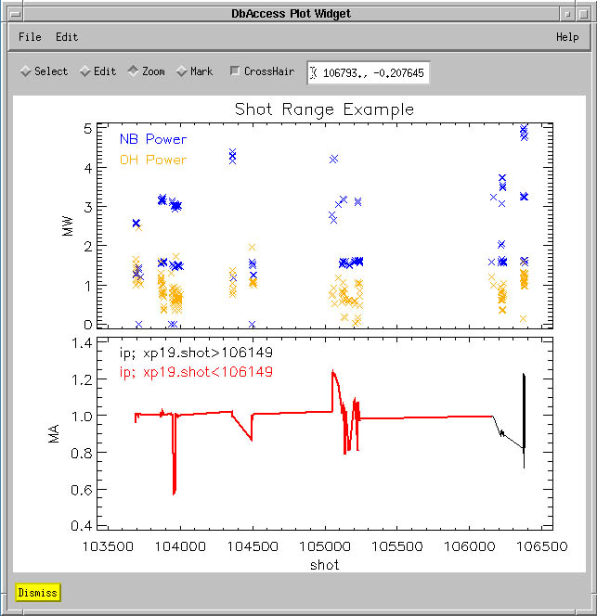
Flexible publication-quality graphics
Sample plot
from DbAccess
Notes:
Constraints can be easily added from this widget

Slide 25
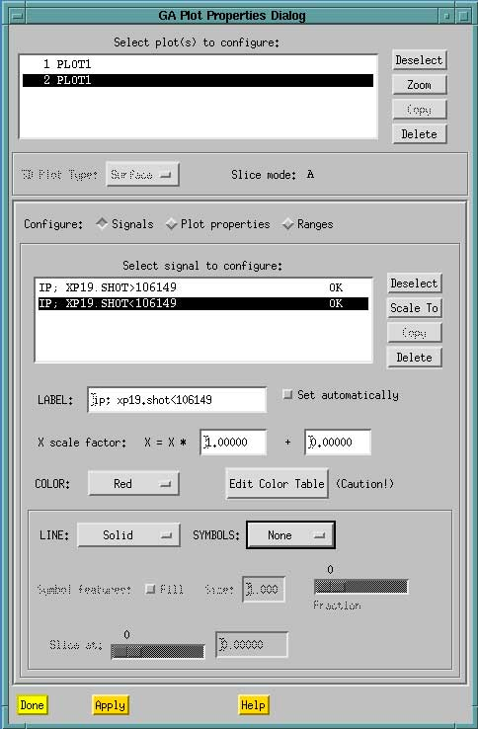
Plot
Properties are configurable in DbAccess
(Uses GA Plot Objects)
Notes:
See J. Schachter, Q. Peng, D.P. Schissel, Data analysis software tools for enhanced collaboration at the DIII-D National Fusion Facility, Fusion Engineering Design 48 (2000) 91-98, or http://web.gat.com/comp/analysis/uwpc/reviewplus/manual/customizingtheappearanceofplots.htm for more on GA Plot Objects

Slide 26
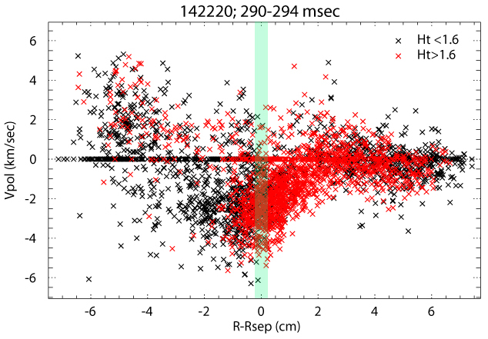
Example showing Poloidal velocity vs. distance from separatrix
A wide spread in poloidal velocity, even during a small time window in the same shot.
Downward flow >-1 cm evidence of shear in this shot.
Shear reverses between 2 & 4 cm.
Larger blobs (red) are more likely to be ejected through the separatrix.
(output from DbAccess.pro)
edd
idd
Notes:
Except for the green line and the idd & edd indications, this plot came right from DbAccess.

Slide 27
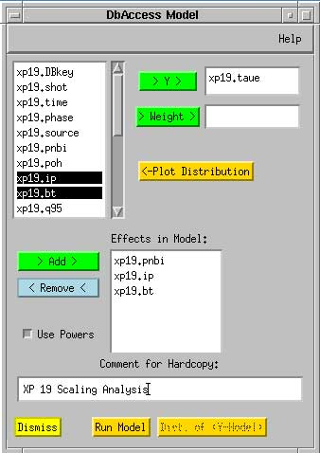
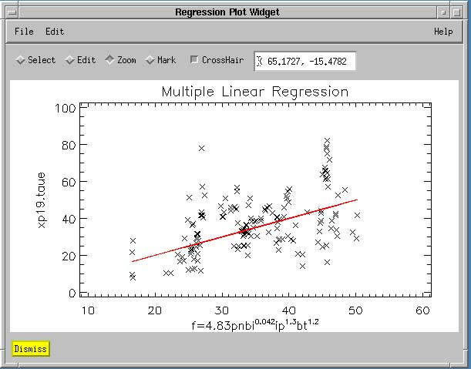
Statistical Interface in DbAccess
Multiple Linear Regression
Powers Optional
Weighting Optional
Distribution Plotting
Notes:
Especially good for creating scaling laws

Slide 28
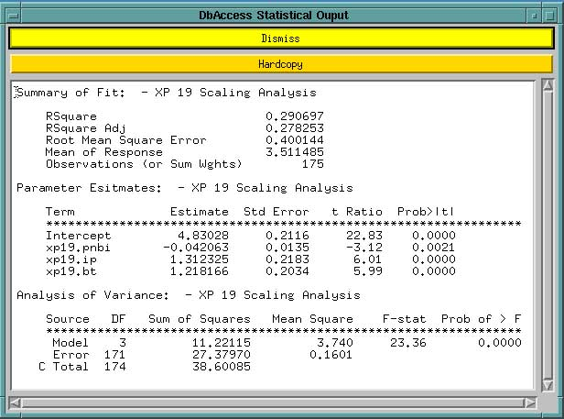
Statistical output from DbAccess
Notes:
From the JMP Manual:
Rsquare measures the proportion of the variation around the mean explained by the model
Rsquare Adj adjusts Rsquare to make it more comparable over models with different numbers of parameters
RMSE estimates the standard deviation of the random error
Mean of Response is the sample mean of the response variable
Intercept is a constant term in the model
Estimate lists the paramter estimates of the linear model
Std Error lists the estimates of the standard errors of the parameter estimates
T Ratio (test statistic) is the ratio of the parameter estimate to its standard error. (Sometimes called Students T Ratio)
Prob>|t| lists the observed significance probability calculated from each t ratio. It is the probability of getting, by chance alone, a t ratio greater than the computed value. Often, a value below 0.05 is interpreted as evidence that the parameter is significantly different than zero.
DF is the associated degrees of freedom for each source of variation
F-stat is the model mean square divided by the error mean square.
Prob of > F is the observed significance probability of obtaining a greater F value by chance alone. > 0.05 is often considered evidence of a regression effect.

Slide 29
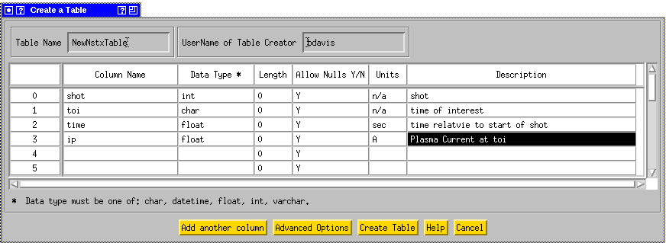
Creating an SQL table in DbAccess
Click on “Create Table” on the top widget
Point, click, and describe your fields:
The table can be populated from columns of data in a text file
Other IDL code is available for creating and filling SQL tables

Slide 30
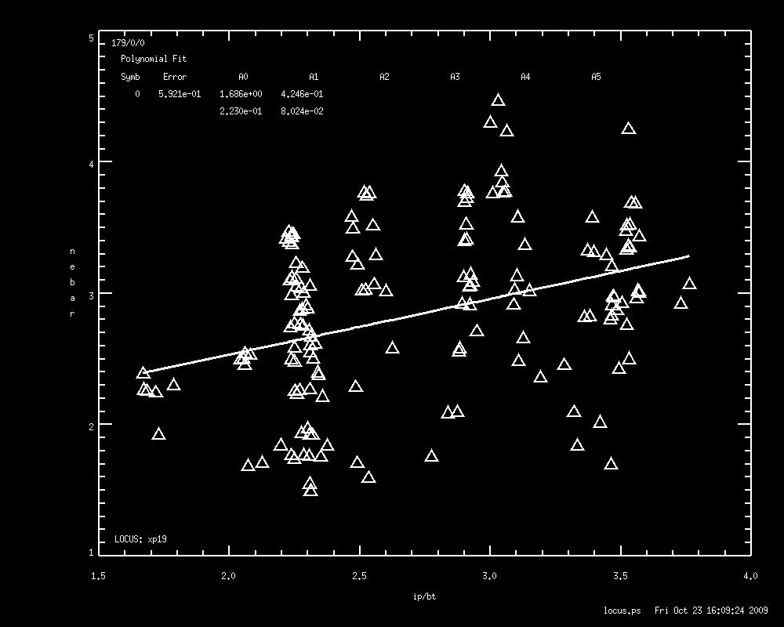
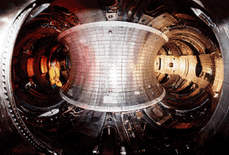
Locus plotting available for databases
Locus was used extensively on TFTR
Rewritten in IDL by Steve Scott and adapted for NSTX by Bill Davis
Instructions available at: http://nstx.pppl.gov/nstx/Software/pdf_files/locus_users_guide.pdf

Slide 31
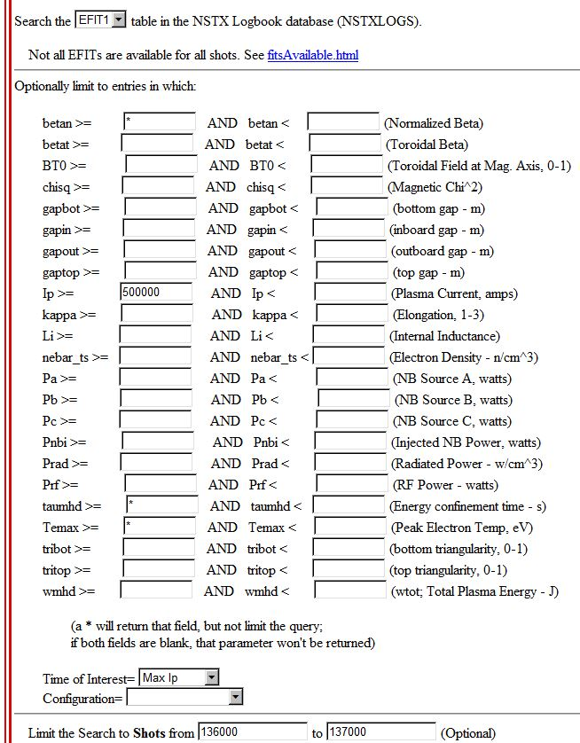
Search EFIT Database Table
http://nstx.pppl.gov/nstx/Software/WebTools/searchefitdb.html
Select shot, BETAN, IP, TAUMHD, TEMAX, TOI, TIME from EFIT
 | where shot>=136000 AND shot <=137000
 | AND IP>=500000 AND TOI='maxip' order by shot
shot | BETAN | IP | TAUMHD | TEMAX | TIME
136000 | 5.14471 | 751026 | -1.71009 | 177.696 | 0.553
136001 | 2.06752 | 775327 | -0.006489 | 0.923537 | 0.265
136002 | 3.32942 | 768031 | 0.03963 | 405.139 | 0.217
136003 | 3.50953 | 761056 | 0.057189 | 155.196 | 0.304
136004 | 1.64804 | 751014 | -0.021714 | 0.99357 | 0.249
136005 | 2.43354 | 775475 | -0.056866 | 0.739999 | 0.175
136006 | 3.56997 | 788279 | -0.077491 | 0.741862 | 0.193
136007 | 2.76261 | 781949 | -0.088126 | 1.34959 | 0.185
136008 | 1.66388 | 734348 | -0.048584 | 0.728282 | 0.583
136009 | 2.65181 | 779994 | -0.060781 | 0.681013 | 0.181
136010 | 2.23641 | 768482 | -0.067917 | 0.672851 | 0.169
136011 | 2.46628 | 772562 | -0.063587 | 0.668319 | 0.175
136012 | 2.72194 | 785012 | -0.053308 | 25.7932 | 0.18
136013 | 6.4532 | 744939 | -0.051581 | 345.731 | 0.535
136014 | 2.5175 | 776437 | -0.045682 | 238.921 | 0.175
136015 | 1.83123 | 757323 | -0.035338 | 0.695359 | 0.49
136016 | 0.99563 | 721911 | -0.019168 | 0.658756 | 0.41
136017 | 1.77389 | 760615 | -0.03144 | 0.836369 | 0.285
136018 | 1.85509 | 766116 | -0.065414 | 0.618252 | 0.169
136019 | 1.78315 | 767601 | 0.029537 | 1.18659 | 0.304
136020 | 2.95963 | 786564 | -0.065389 | 1.46719 | 0.185

Slide 32
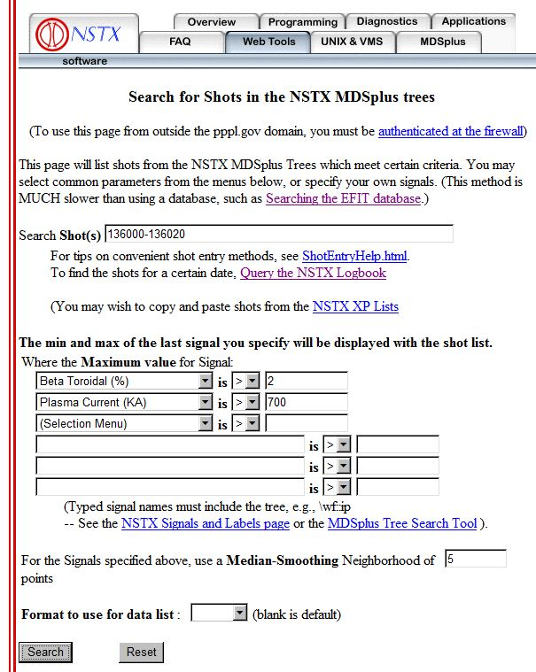
Search for shots with certain criteria
http://nstx.pppl.gov/nstx/Software/WebTools/mdsshots.html
Shots with a Max of \EFIT01::betat GT 2
and Shots with a Max of \wf::ip GT 700
SHOT | MIN | MAX | Units
------ | --------- | --------- | -----
136000 | -7.3507 | 800.045 | kA
136001 | -30.38 | 817.384 | kA
136002 | -27.772 | 853.651 | kA
136003 | -28.058 | 839.946 | kA
136004 | -32.09 | 819.479 | kA
136005 | -31.119 | 826.311 | kA
136006 | -31.303 | 808.516 | kA
136007 | -32.047 | 813.431 | kA
136008 | -27.533 | 825.746 | kA
136009 | -29.964 | 811.417 | kA
136010 | -32.703 | 810.815 | kA
136011 | -30.77 | 817.195 | kA
136012 | -32.254 | 807.92 | kA
136013 | -27.453 | 809.922 | kA
136014 | -26.624 | 806.96 | kA
136015 | -28.935 | 825.323 | kA
136016 | -31.572 | 846.212 | kA
136017 | -28.491 | 816.568 | kA
136018 | -30.761 | 805.05 | kA
136019 | -24.551 | 844.514 | kA
136020 | -28.067 | 813.223 | kA
Notes:
The columns shown are the min & max of the last signal specified

Slide 33
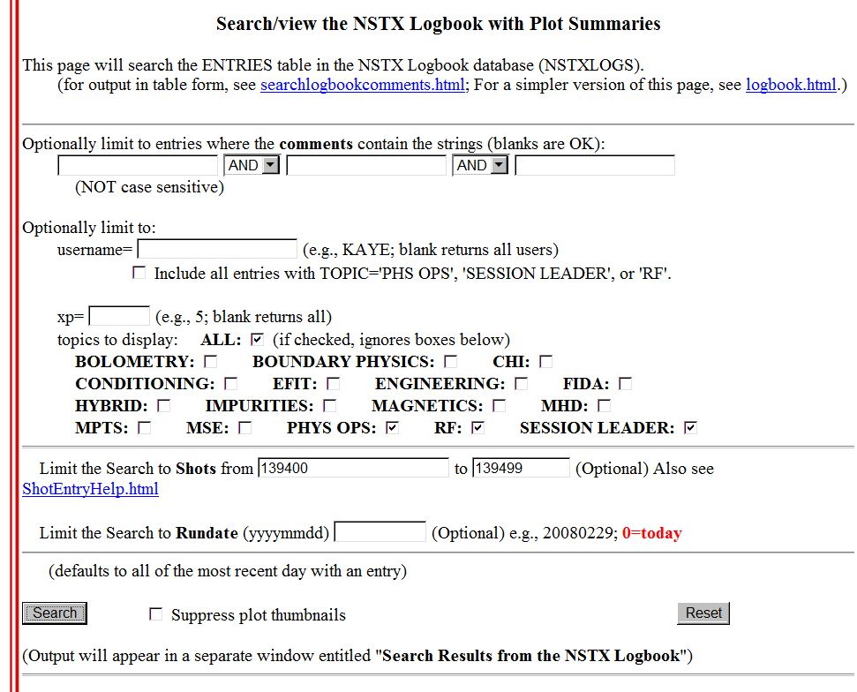

Search the NSTX Logbook
http://nstx.pppl.gov/nstx/Software/WebTools/weblogplus.html

Slide 34
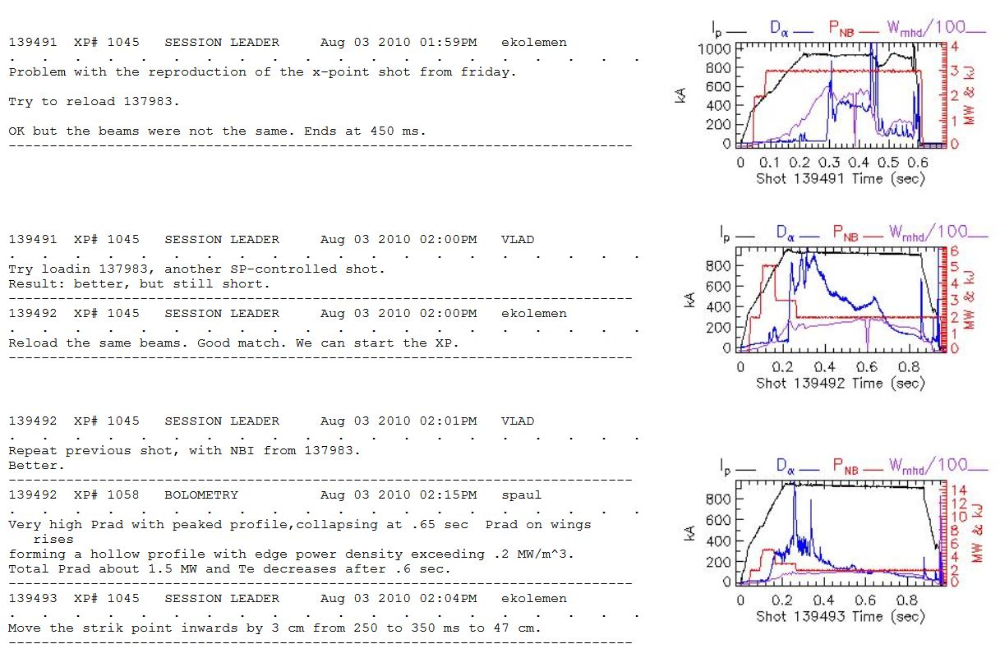
Output from Searching the NSTX Logbook

Slide 35
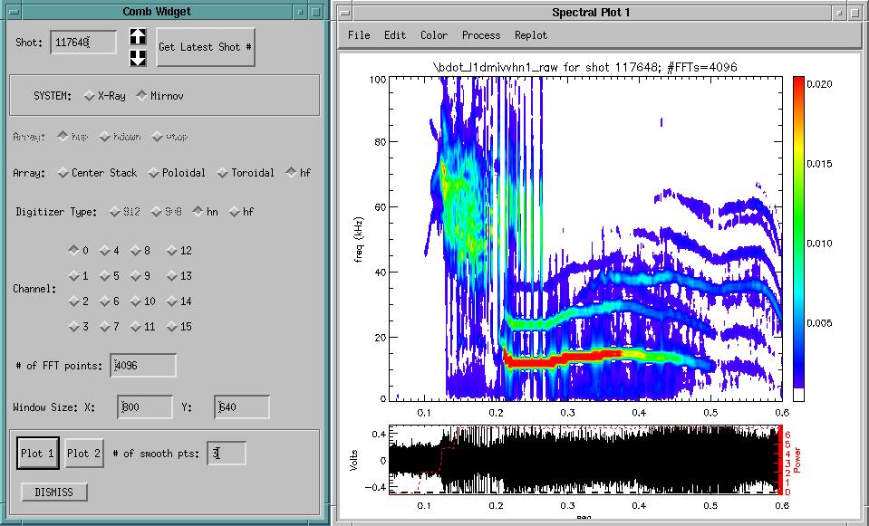
Combw.pro (from Eric F.)
IDL> combw
Notes:
The plot window has several other options for configuring and plotting under the menus

Slide 36
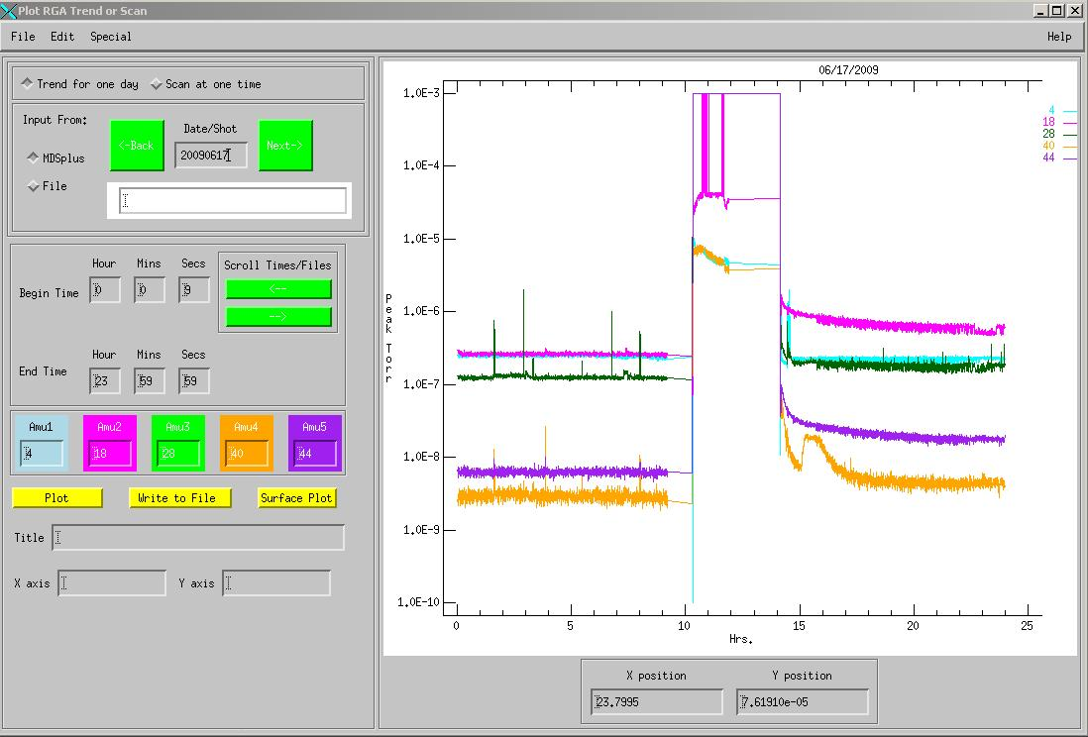
RGA data can be plotted as trends
IDL> rgaplot
Notes:
You can quickly browse by day by clicking the green squares

Slide 37
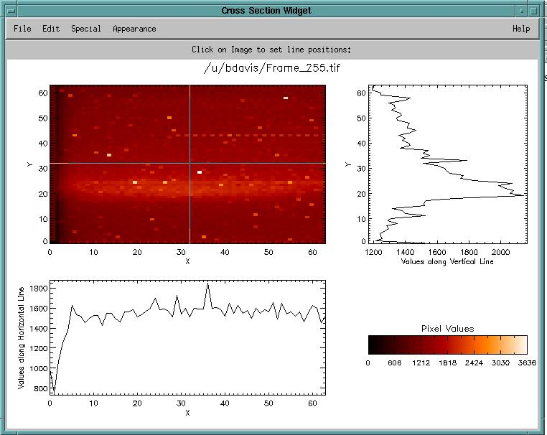
Xsectionw.pro shows cross sections of images
IDL> xsectionw, ‘Frame_255.tif’

Slide 38
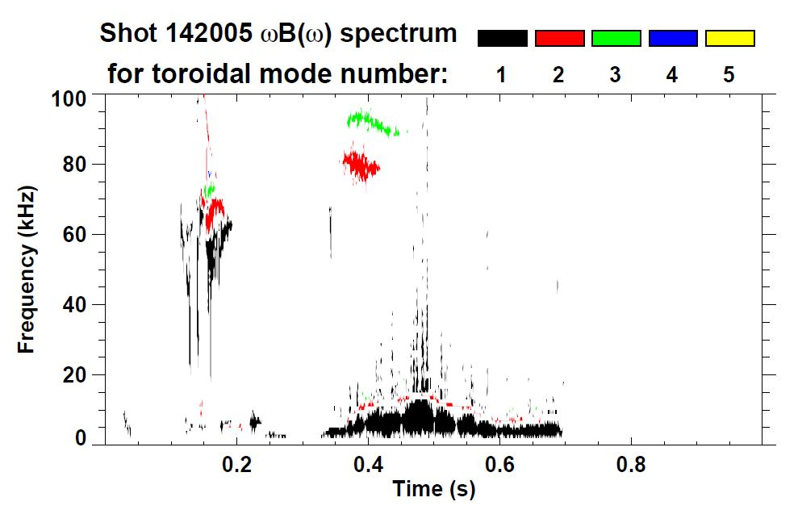
Toriodal Mode Numbers browsable from web
http://nstx.pppl.gov/nstx/Software/Diagnostics/SpecFit/...
(instructions on the web page for creating plots with different axes in IDL)

Slide 39

Summary
Web Tools have many features and options with intuitive interfaces
Tools available for “mining” the large amount of NSTX camera data
Databases seem underutilized on NSTX, but tools are available and can be supported
It is easy to search for shots with certain characteristics
There are various ways of visualizing data that could be explored to get more from your data
What new data analysis and visualization tools do we want for NSTX-U?

