Slide 1
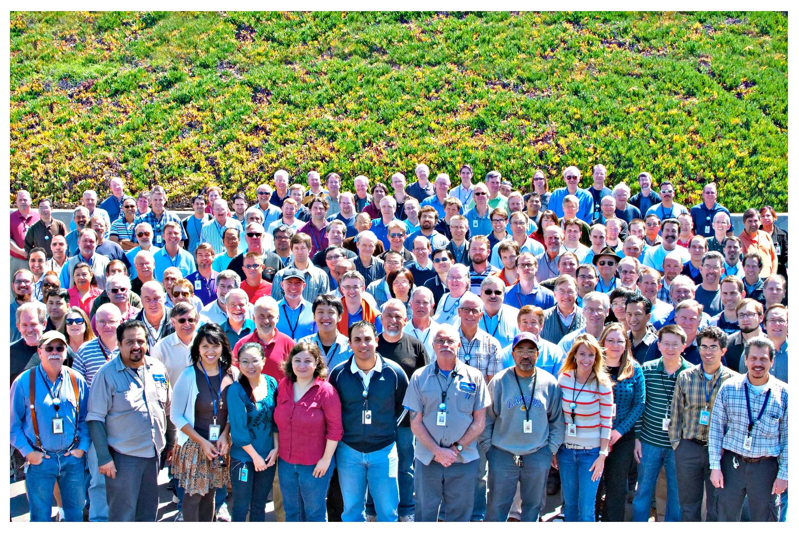
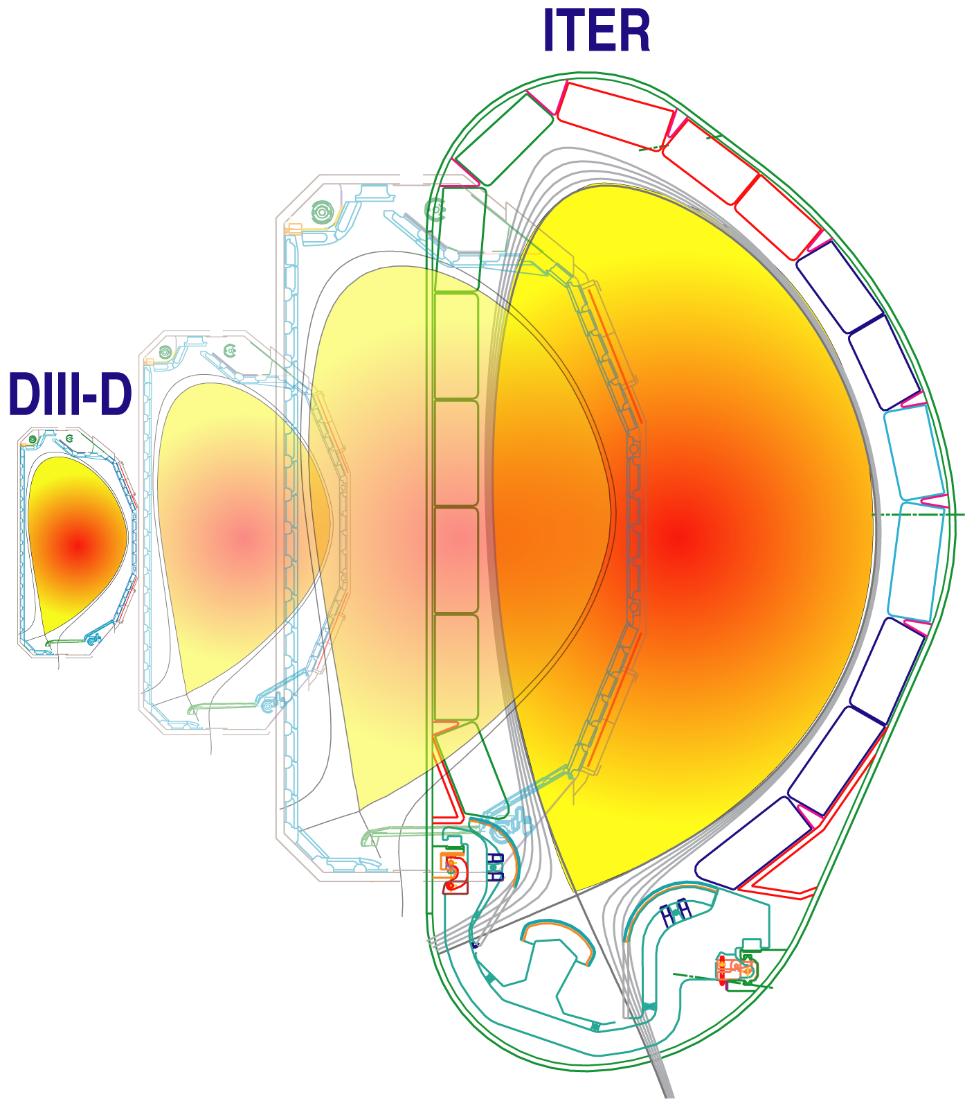
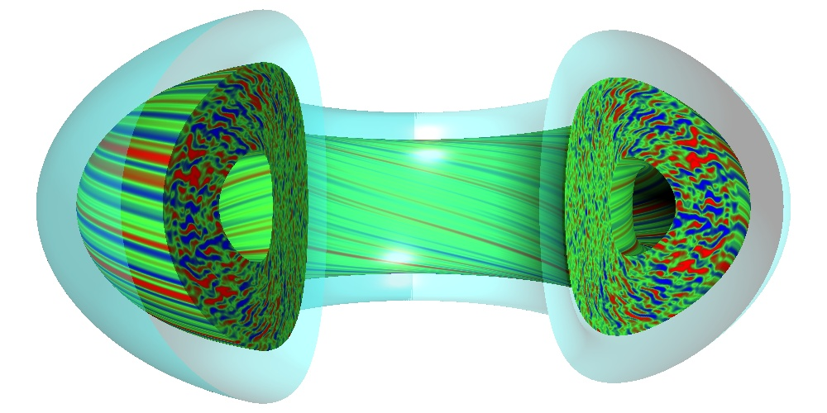
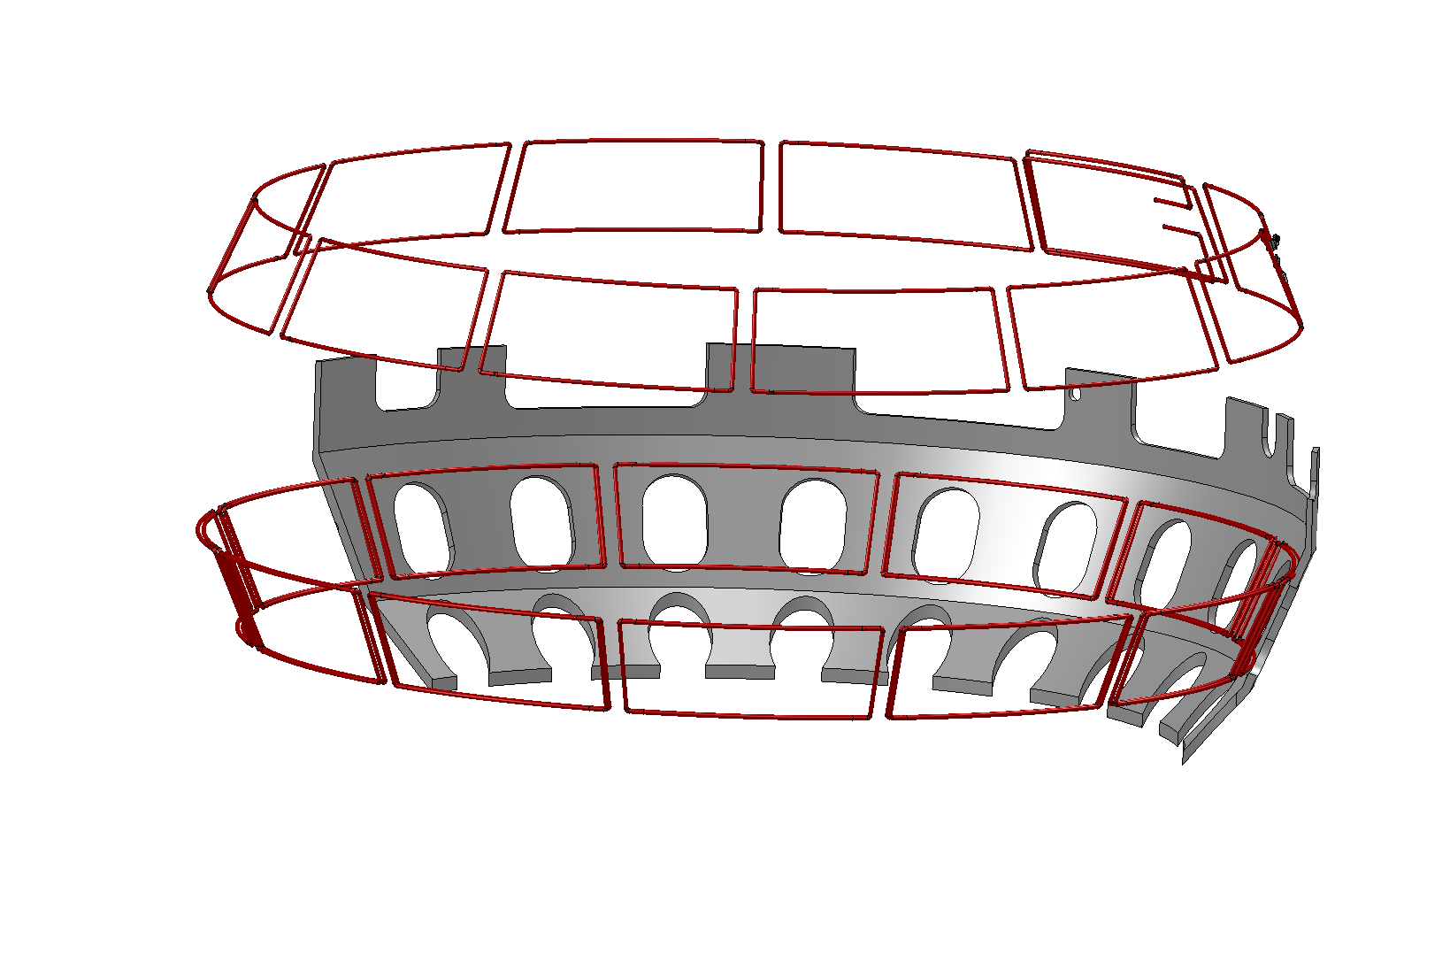
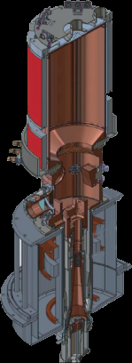
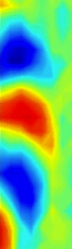
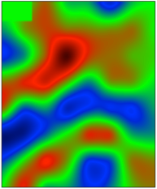
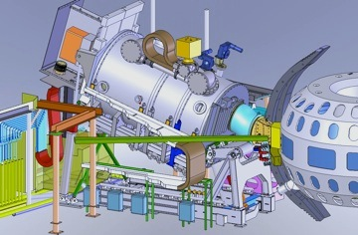
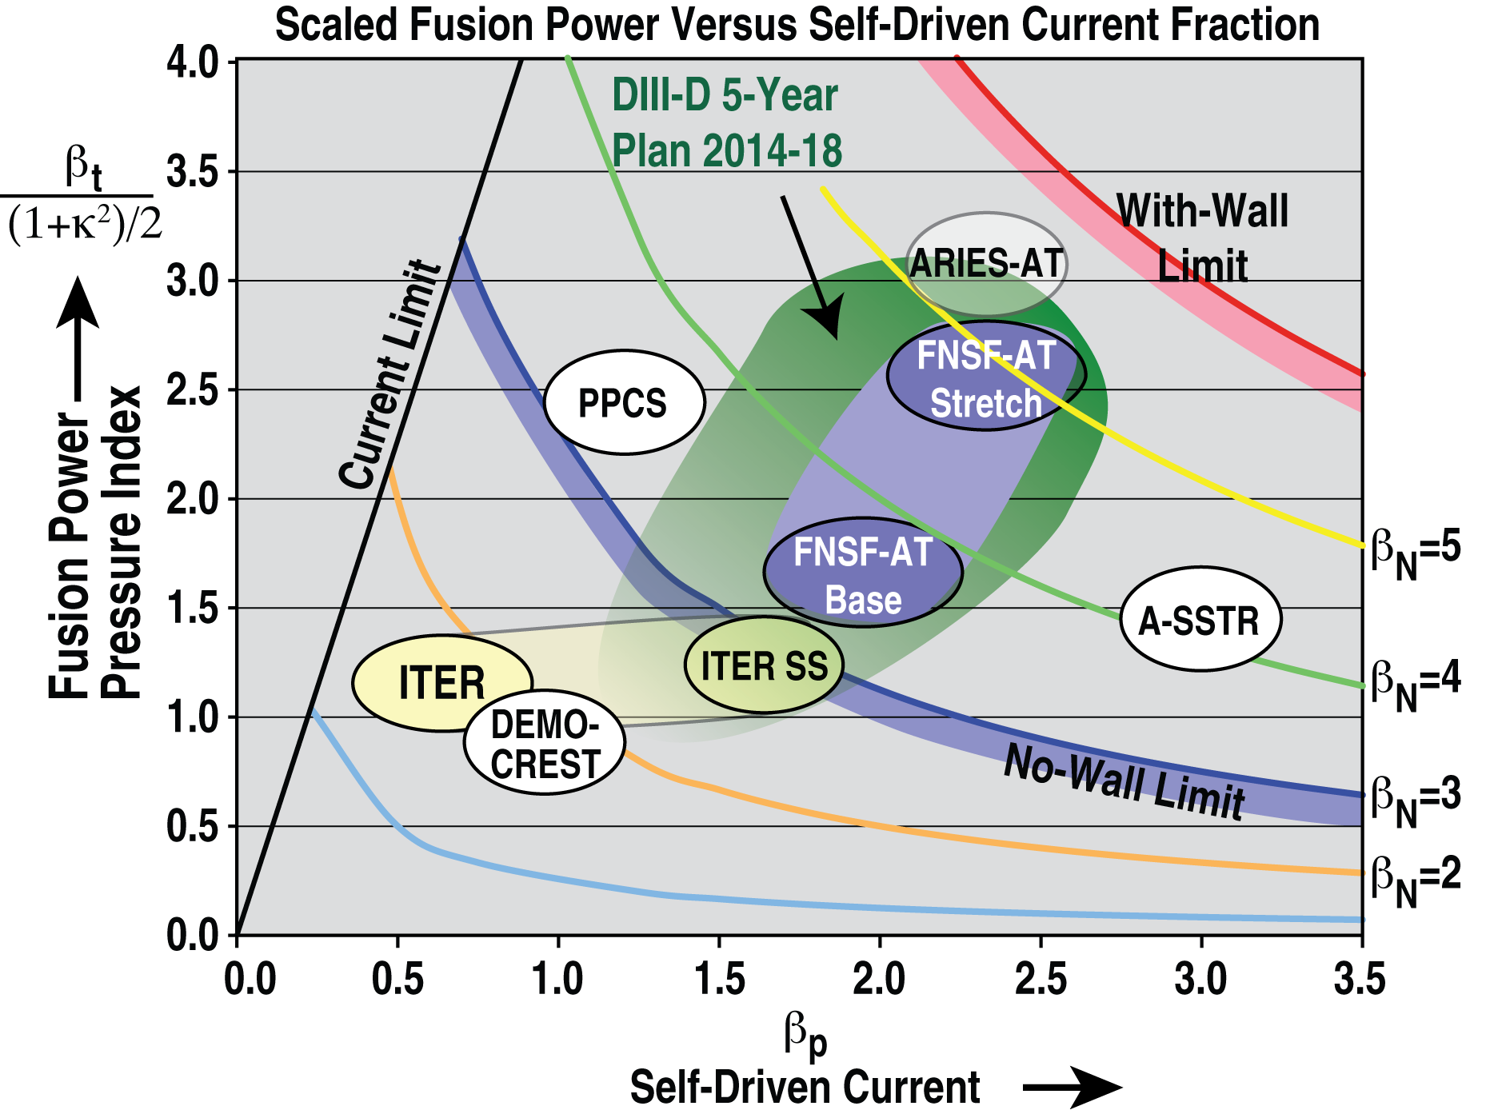


DIII-D Explorations of Fusion Science to
Prepare for ITER and FNSF
by
R.J. Buttery
Presented at the
Princeton Plasma
Physics Laboratory
Colloquium
June 12, 2013
ECE
Turbulence imaging
BES
Notes:
My pleasure..

Slide 2
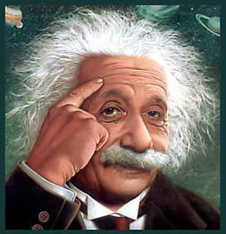
DIII-D 2014 Research Planning Underway
Tell us your Einstein moment idea!
Web submissions of proposals:
  https://fusion.gat.com/global/Rof2014
Research Opportunities Forum just
happened, Dec 5th
  Run time guidance due out this month
  on program priorities
Break out sessions to discuss and select
ideas starting Dec, into January
Program selection early February
Also ‘National Campaign’ likely for NSTX-U and CMOD proposal

Slide 3
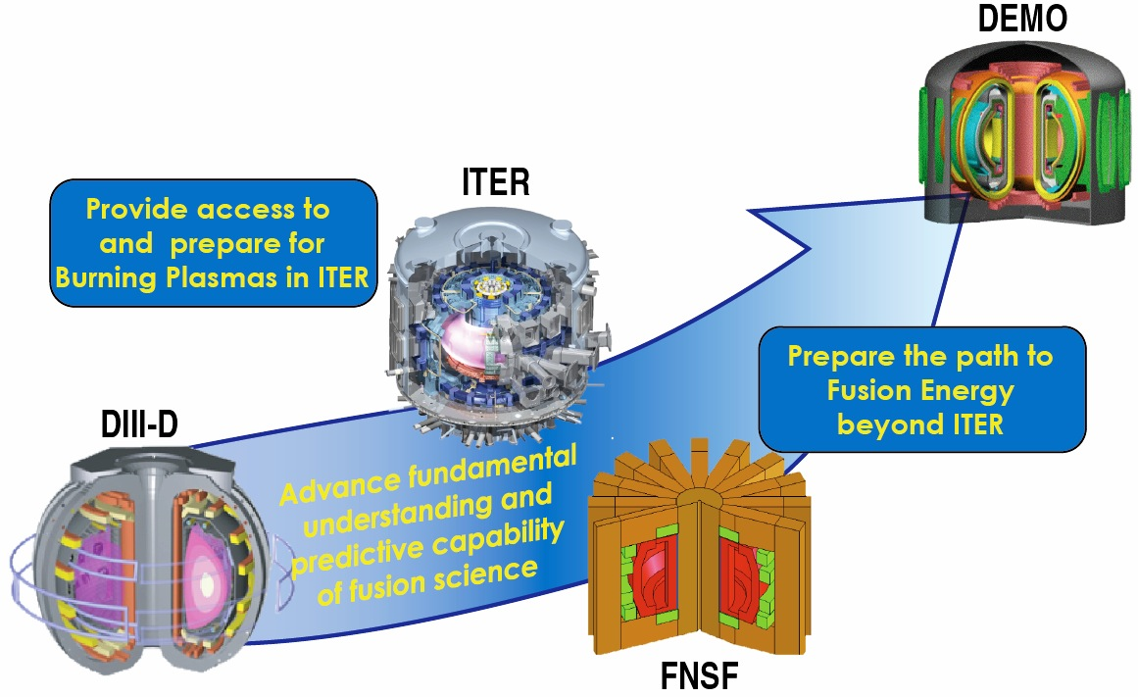
DIII-D Program Plan Targets Key Research Needs on Development Path of Fusion Energy

Slide 4
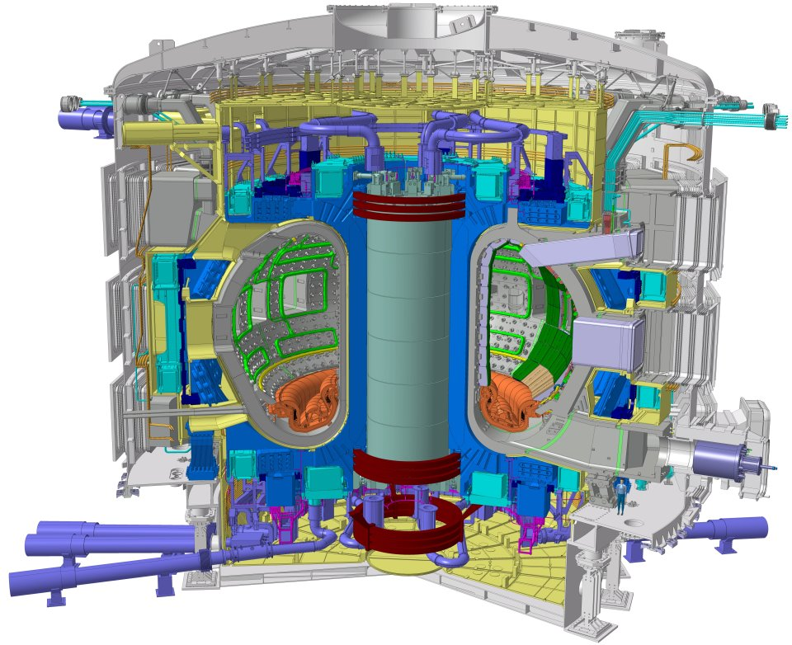
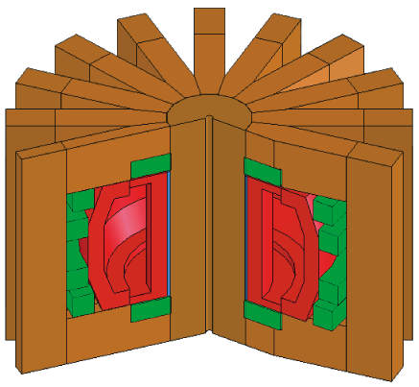
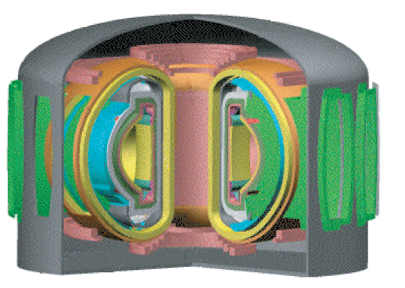
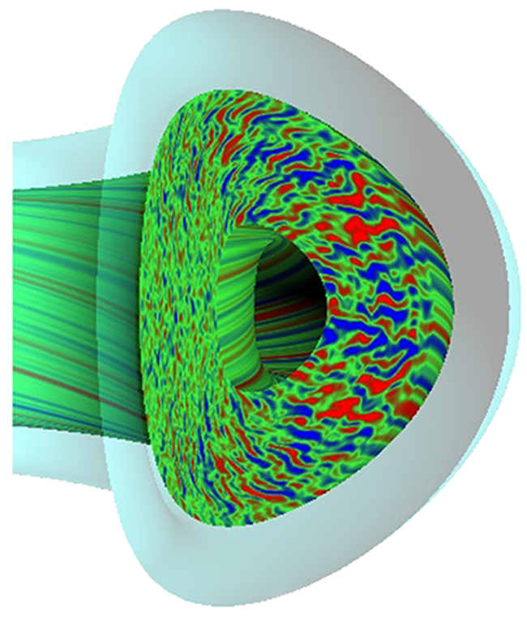
Three Pillars of DIII-D Program
Path to Steady State
Fusion Energy
ITER
Measurement
Fusion Science

Slide 5
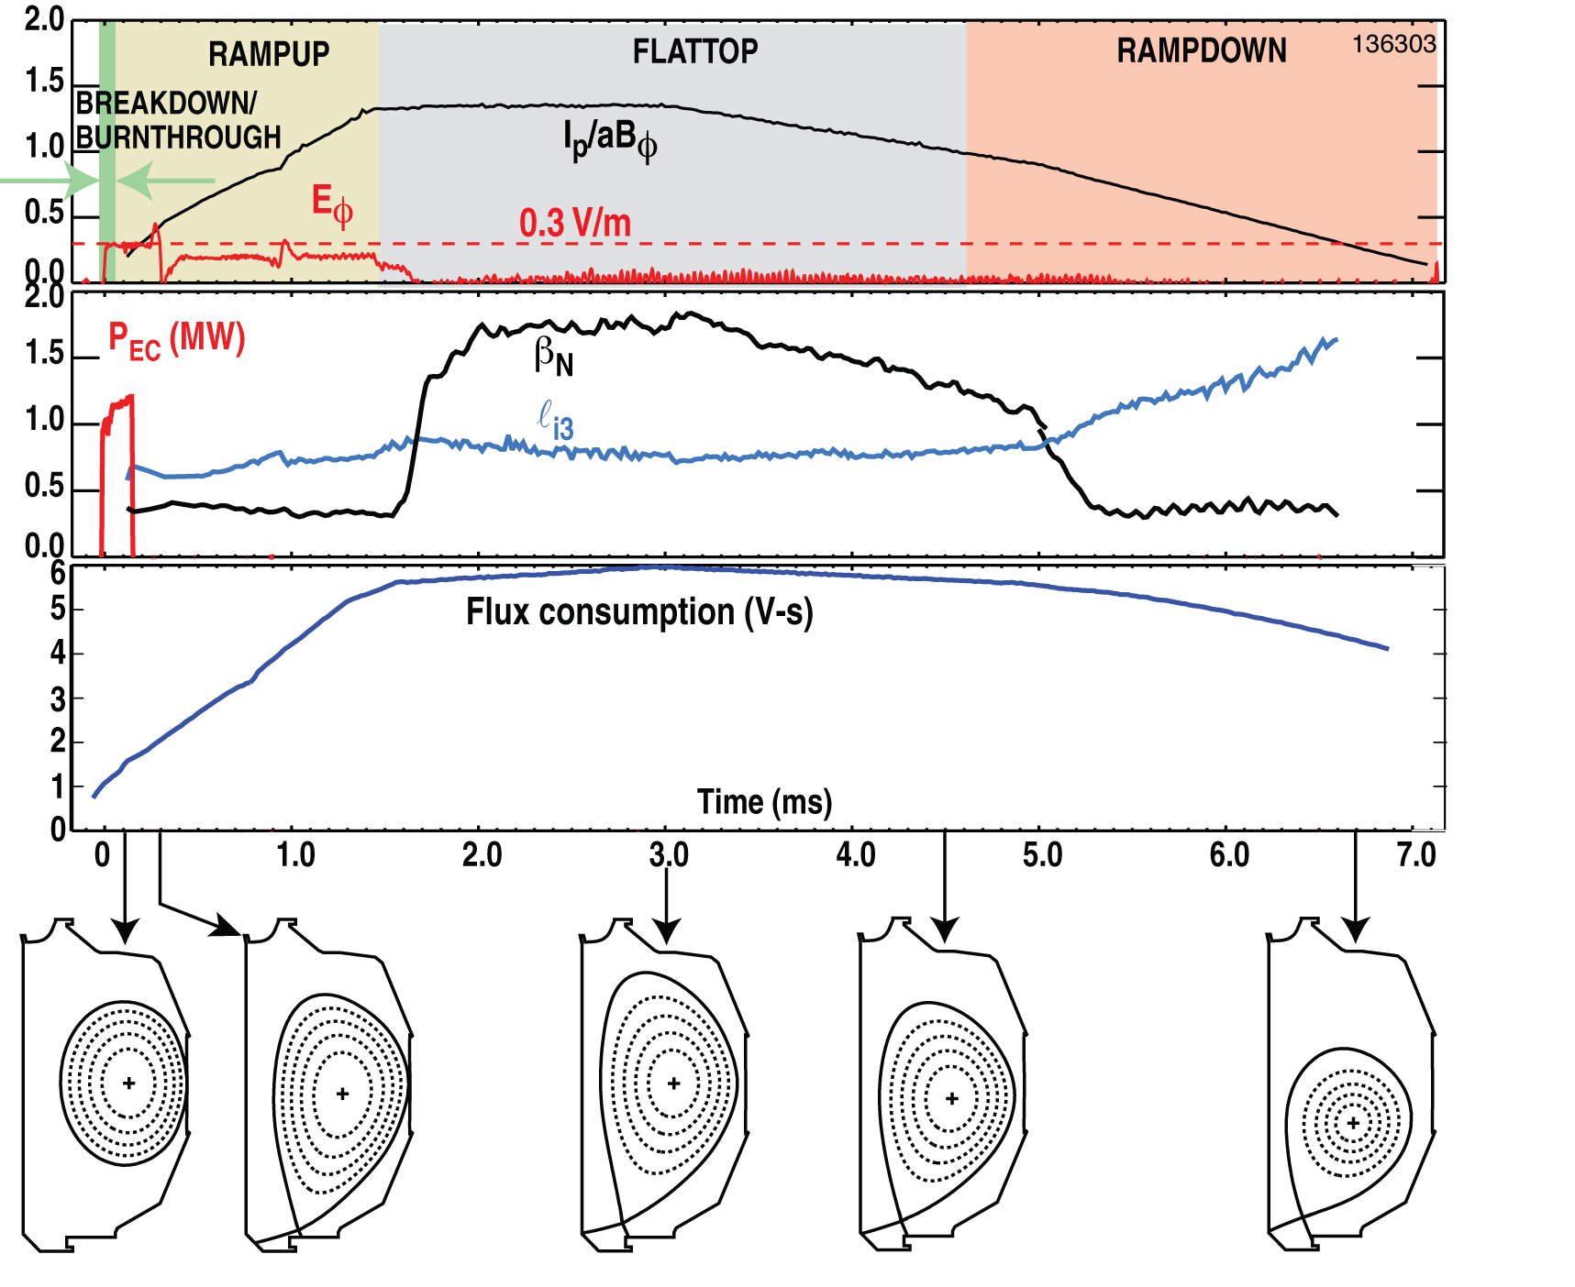
DIII-D is the U.S.’s ITER Simulator
Resolve design issues
Enable Q=10
Prepare for ITER science
ITER is our
number 1 priority

Slide 6
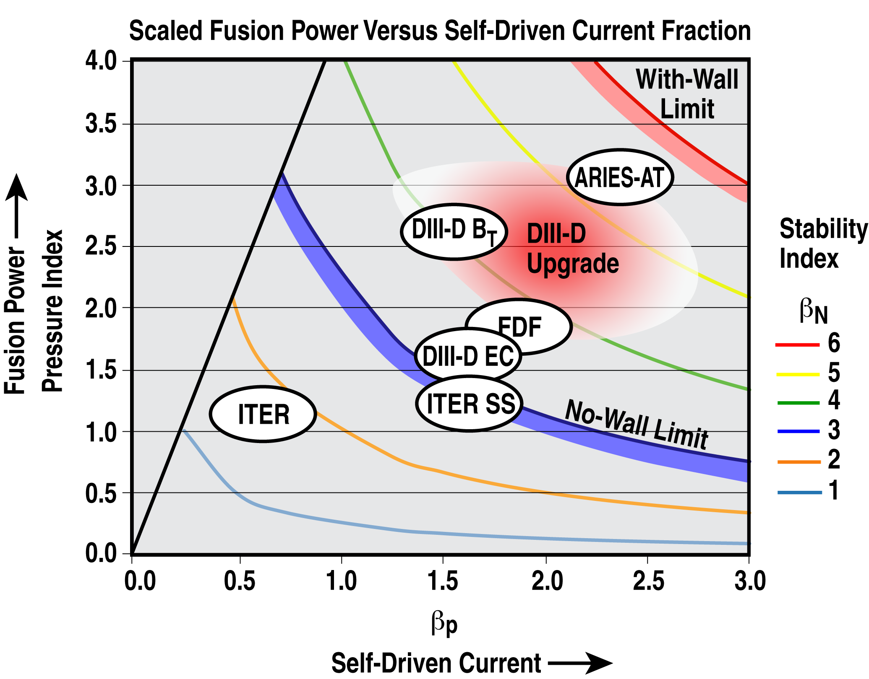
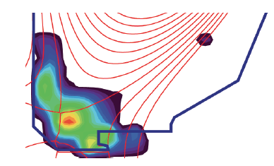
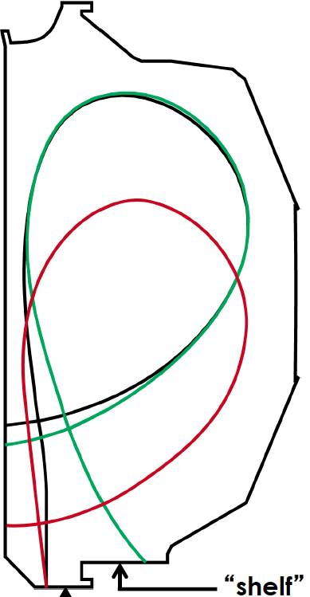
DIII-D Seeks to Map the Path to Fusion Energy
Beyond ITER
Advanced steady state regimes
Innovative boundary solutions
Extending control solutions
Snowflake
Exploring strike geometries

Slide 7
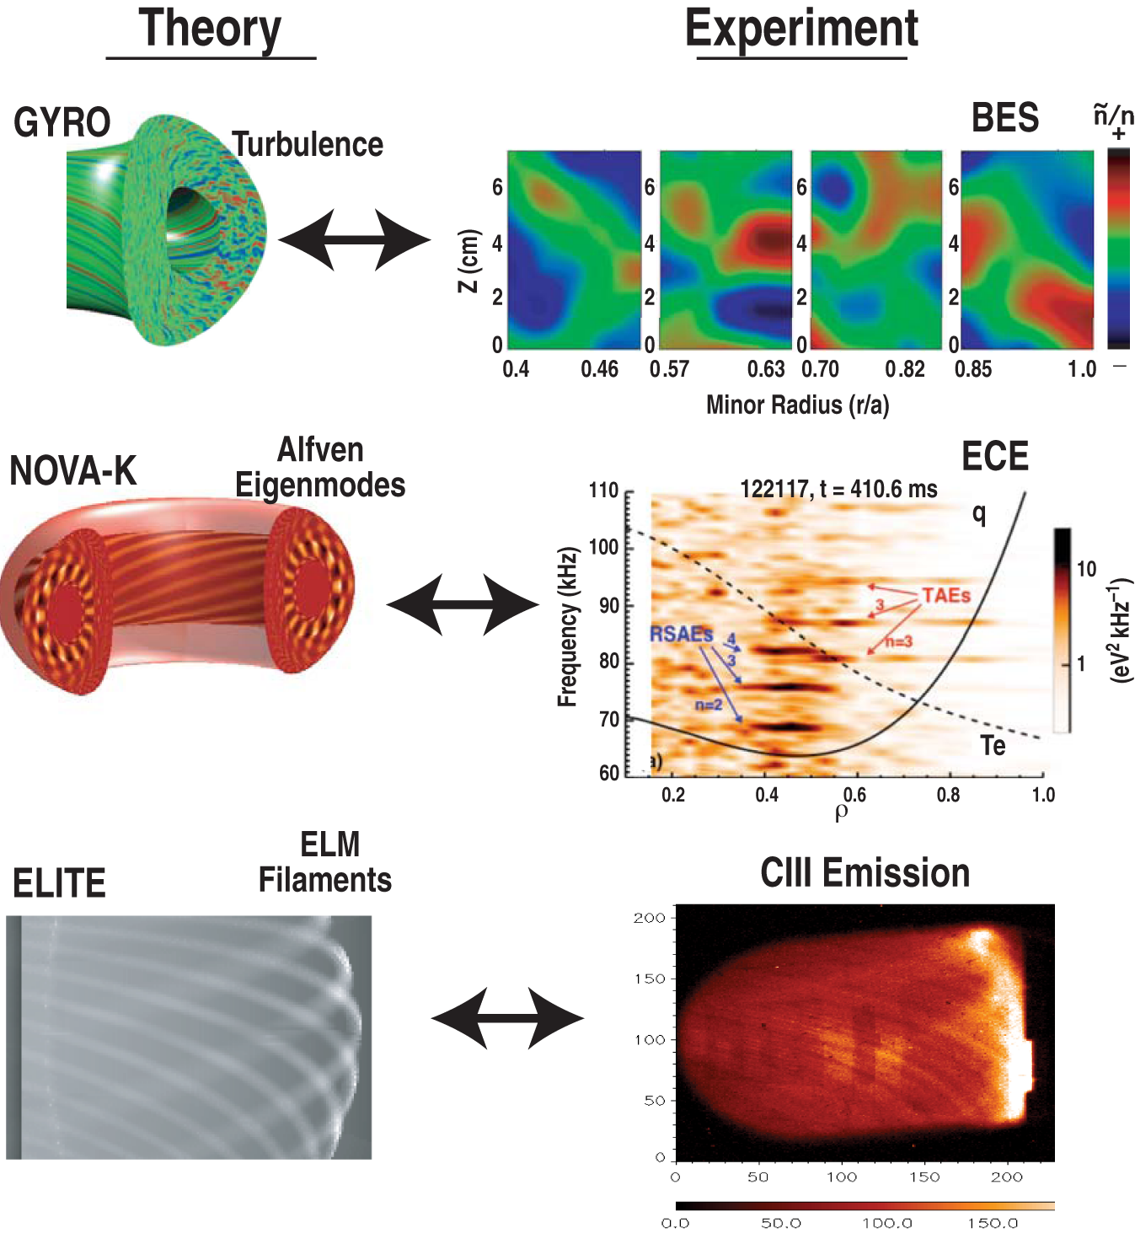
DIII-D Exploits Outstanding Diagnostics & Theory
To Understand the Science of Fusion Energy
• High resolution, comprehensive diagnostic set
• High speed computing plays crucial role
• Key part of our collaborative
efforts – e.g.:
– Turbulence: GA, UCLA,
Wisconsin, MIT, UCSD, etc.
– Alfvén eigenmodes: UCI,
PPPL, GA
– ELMs: UCSD, LLNL, ORNL,
SNL, GA
A vital part of the
DIII-D strategy

Slide 8
Scientific Understanding Underpins Projection to Future
Essential
pre-requisite to fusion energy
Path to Steady State
Fusion Energy
ITER
Measurement
Innovate to better solutions
Fusion Science
Basis to extrapolate
Guides innovation
Resolve physics to provide
confidence for future

Slide 9
SECTION 1: PREPARING FOR ITER
Resolve design issues
Enable Q=10
Prepare for ITER science
ITER is our
number 1 priority

Slide 10
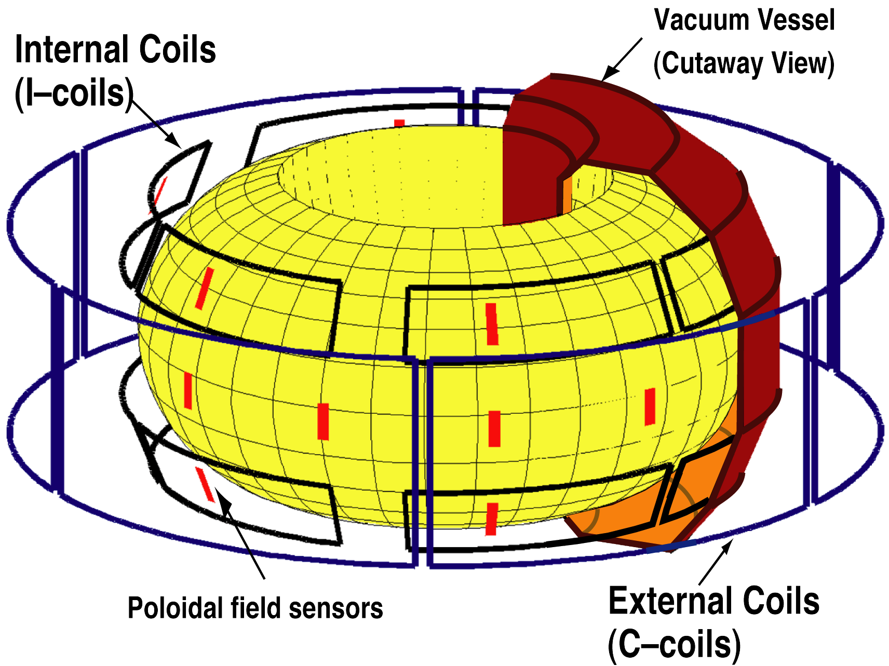
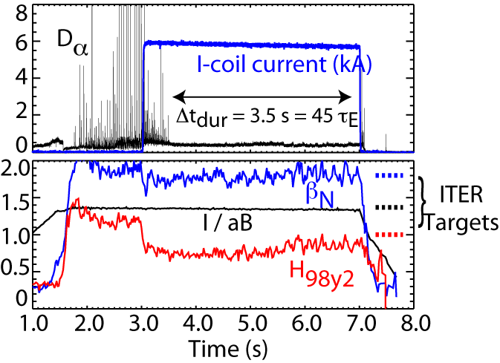
RMP ELM Suppression Sustained at ITER Parameters by Optimizing Spectrum of 3D Fields
Single row of n=3 coils optimizes
resonance for this q₉₅
Close match to ITER specs
Sustained for 45 τ_{E}
Further work needed to
optimize confinement
Understanding 3D interaction is vital to
optimization & projection of ELM control
 | I/aB | β_{N} | H₉₈ | ν_{*,ped}
DIII-D | 1.40 | 1.8 | 0.9 | 0.12
ITER | 1.41 | 1.8 | 1.0 | 0.10
[Wade, IAEA 2012]
Notes:
----- Meeting Notes (11/3/11 10:57) -----
ECCD
Mention ELMs
Add Shot number
Bigger Fonts on Figure
Say where previous range was
----- Meeting Notes (10/2/12 11:41) -----
Think about bottom panel and whether to include

Slide 11
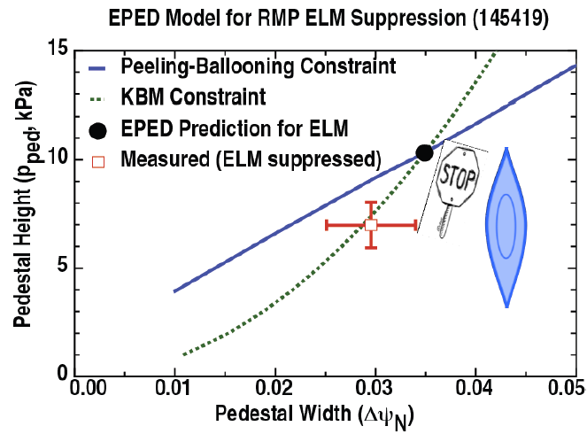
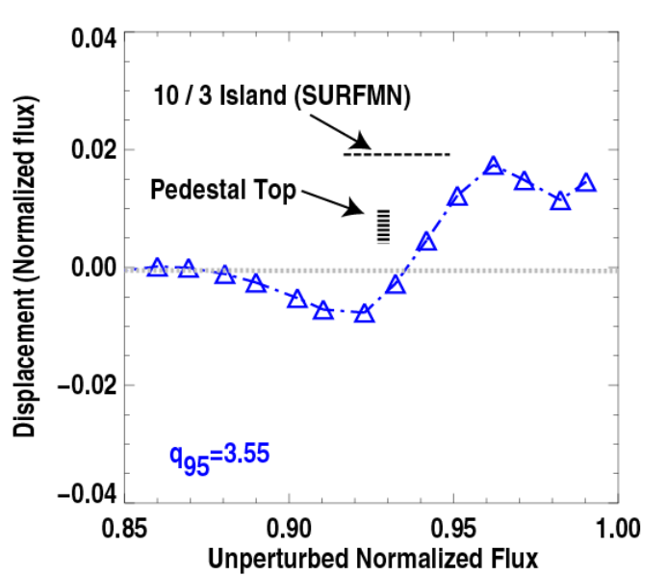

RMP ELMs Suppression Interpreted in Terms of a Resonance Near Pedestal Top
Peeling ballooning
Kinetic ballooning
EPED ELM prediction
Data: ELM suppressed
Pedestal stability model predicts ELM cycle
  Can be arrested by
  limiting pedestal growth
ELM cycle
(exaggerated)
Thomson scattering T_{e} displacements:
Temperature displacements in phase flip experiments suggests
island-like structures form
  Blocks pedestal growth,
  arresting ELM cycle
Opposing displacement
→ Flux surface splits
[Snyder, NF 2013]

Slide 12
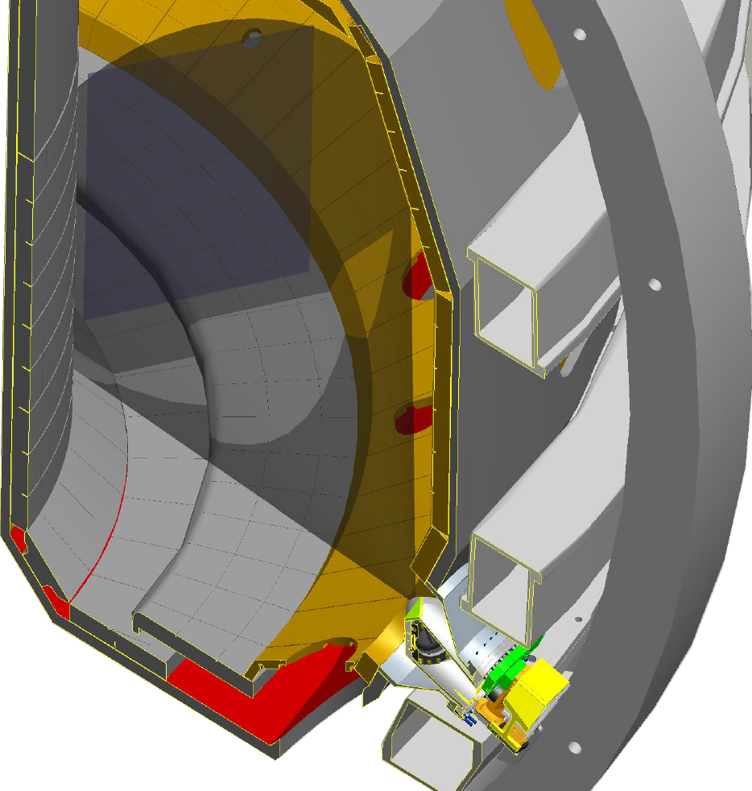
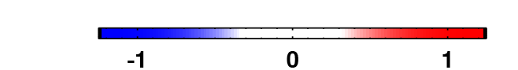
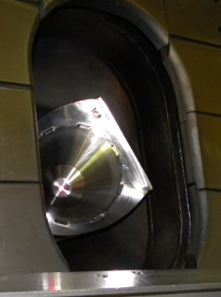
Tangential X-Ray Imaging Reveals Edge Kink Displacements Consistent with 2-fluid MHD Simulation
View
X-Ray Imaging
Simulation
Two fluid
Consistent
Camera
Vacuum
(will replace with better figure)
Inconsistent
Inconsistent
0.975
I-coil Only
Demonstrates a strong resonant behavior in plasma response
[Shafer]
Notes:
X-Ray data proves existance of significant helical response
Agreement with D3D-C1 shows plasma response is important compared to just vacuum fields
We have a tool to extrapolate to ITER.
----- Meeting Notes (10/2/12 11:41) -----
TRIP3D-MAFOT

Slide 13
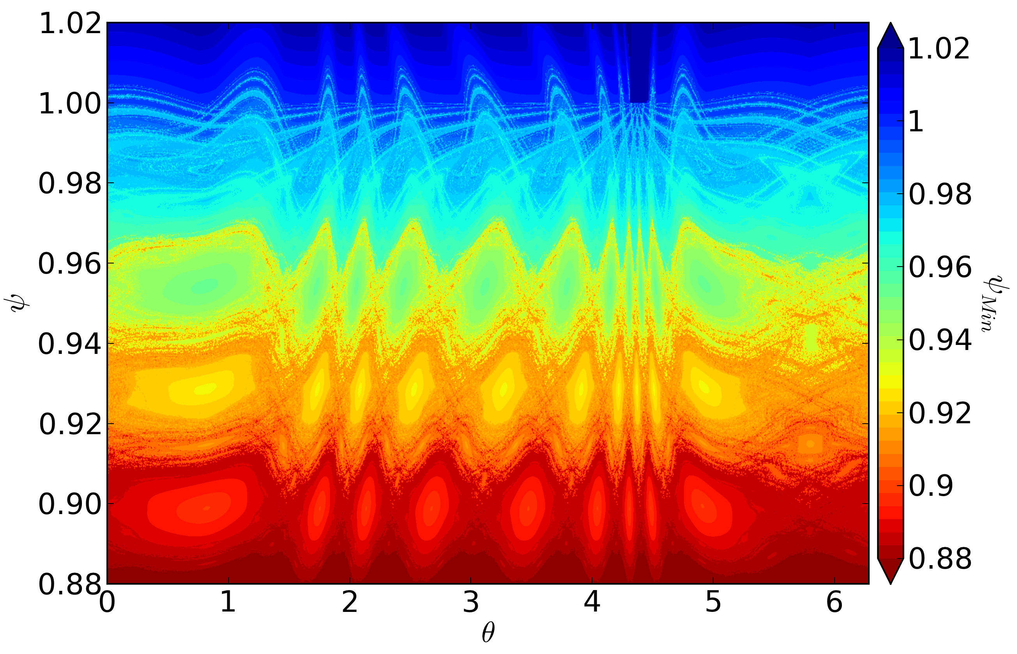
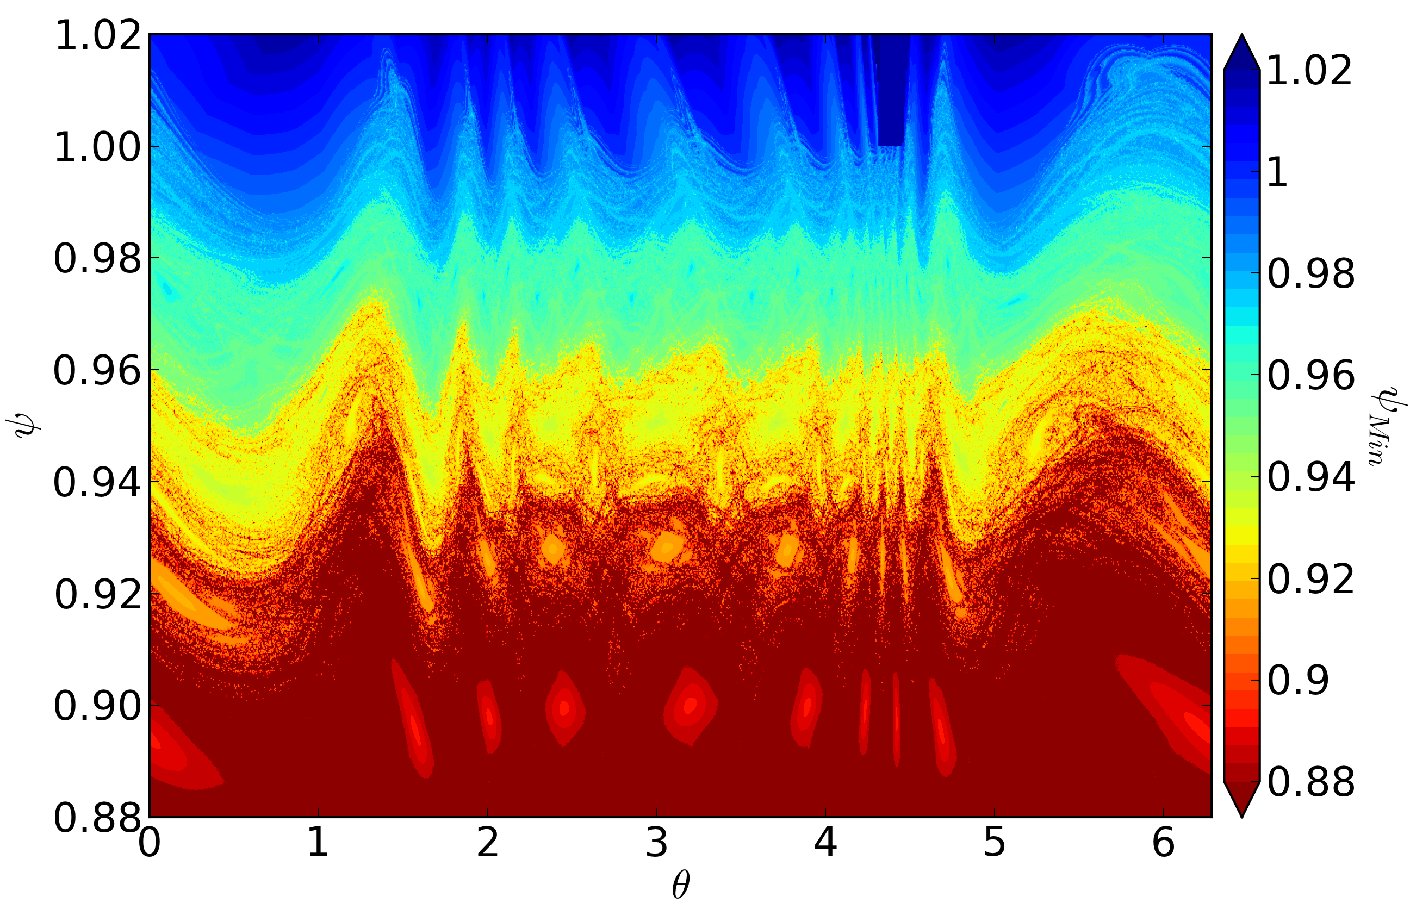
Plasma Response Can Create Kink that Dominates Edge Magnetic Structure
Magnetic Field Penetration
color = penetration depth
Vacuum
M3D-C1
11/3
10/3
9/3
Kink Pushes Island Away
Discharge: 148712 @ 4150 ms
Island chains dominate
  “Oscillation envelope” created by island chains
Large “oscillation envelope” via kink dominates edge structure
Does kink driving tearing or turbulence to regulate pedestal?
Wingen NF 2013

Slide 14
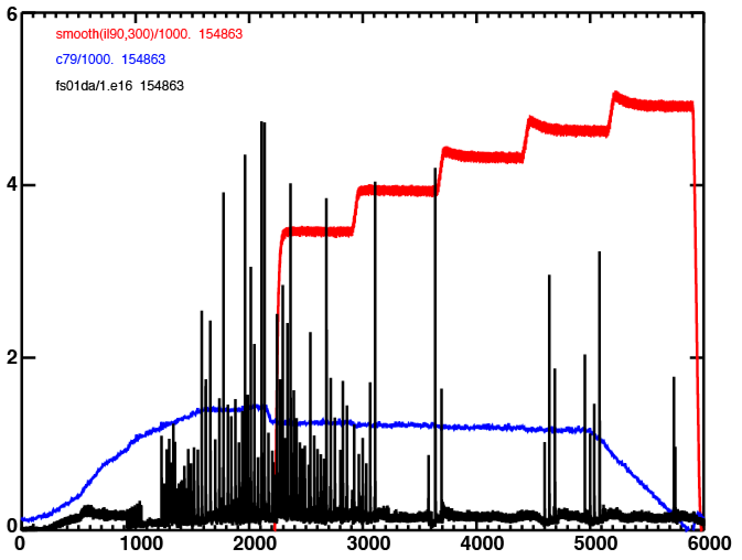

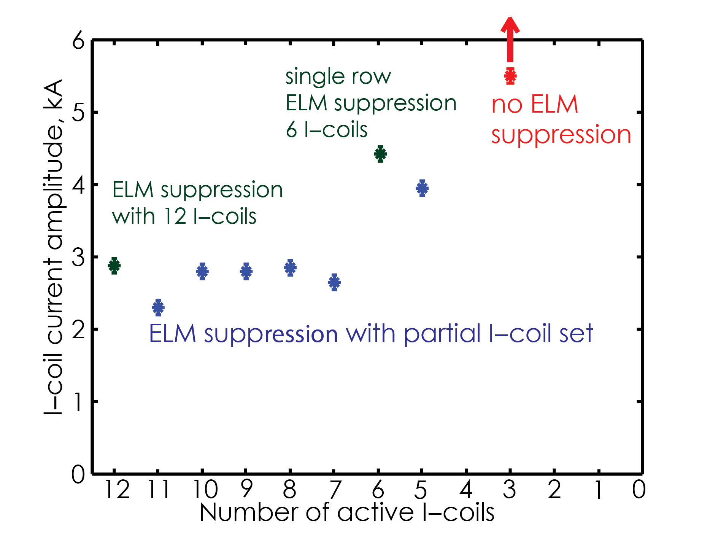
RMP ELM Suppression Extended from 12 down to 5 Coils
Without Loss of Performance
5-Icoils
Provides confidence of
technique for ITER
  Similar currents needed for
  suppression down to 7 coils
Applied coil current (kA)
C coil
EFC
?

Slide 15
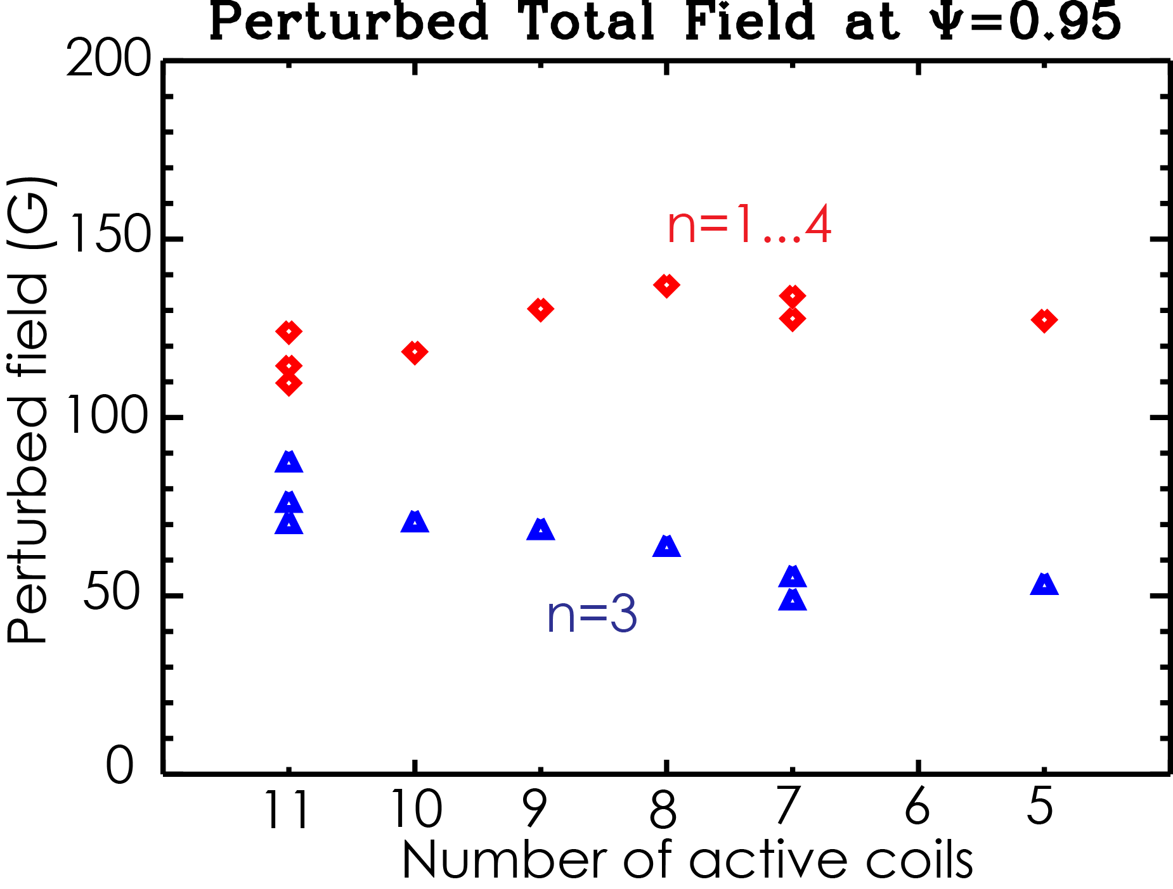
RMP ELM Suppression Extended from 12 Down to 5 Coils
Without Loss of Performance
5-Icoils
Provides confidence of
technique for ITER
  Similar currents needed for
  suppression down to 7 coils
Highlights key facet of
underlying physics
  Role of sidebands n=1,2
  increases as coils turn off
Applied coil current (kA)
C coil
EFC
M3D-C1 modeling at ped’l top
including plasma response
Key challenge remains:
Understand RMP action
at pedestal top

Slide 16
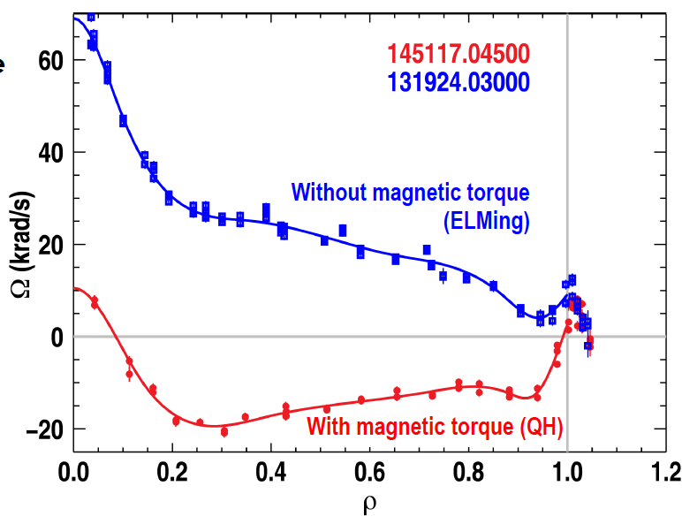
3D Fields Can Also Enable Higher Performance
QH Modes at ITER-Relevant Torques
3D fields generate ‘NTV’
torques and rotation shear
Edge rotation shear
suppresses ELM
[Burrell, NF 2013]
Notes:
16

Slide 17
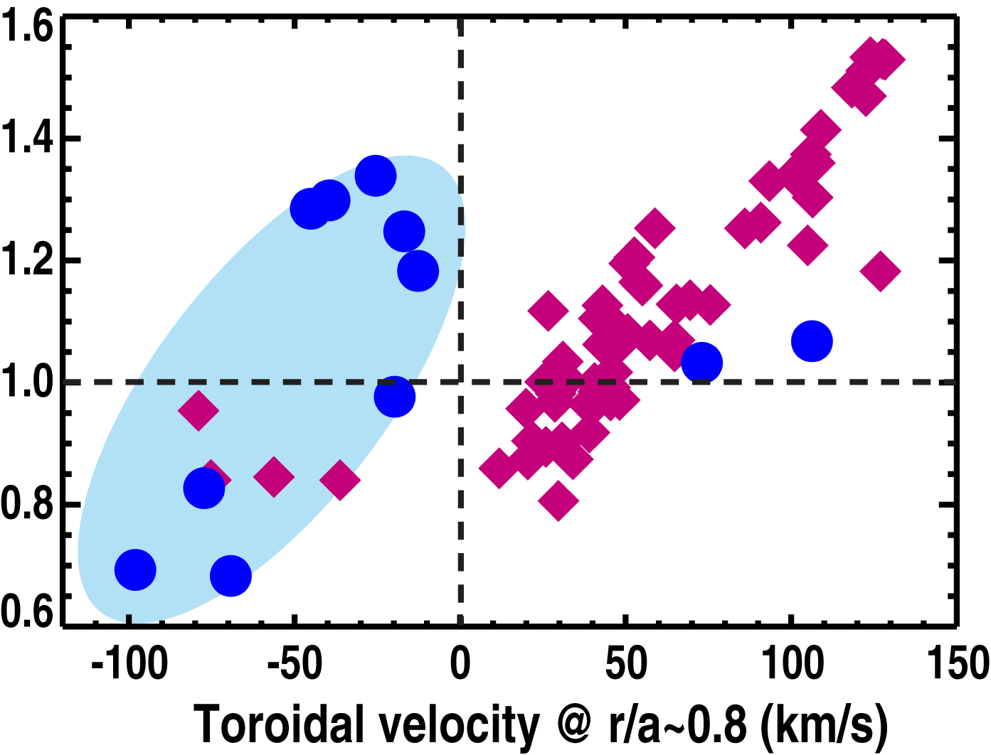
External 3D Field Coils Enable Higher Performance
QH Modes at ITER-Relevant Torques
3D fields generate ‘NTV’
torques and rotation shear
Excellent energy confinement quality at low rotation: H_{98y2}=1.3
H_{98y2}
ELMing
H-mode
QH-mode
low torque
Edge rotation shear
suppresses ELM
Fusion gain G=β_{N} H₈₉/q₉₅² ~0.4 meets ITER target
[Burrell, NF 2013]
Notes:
17

Slide 18
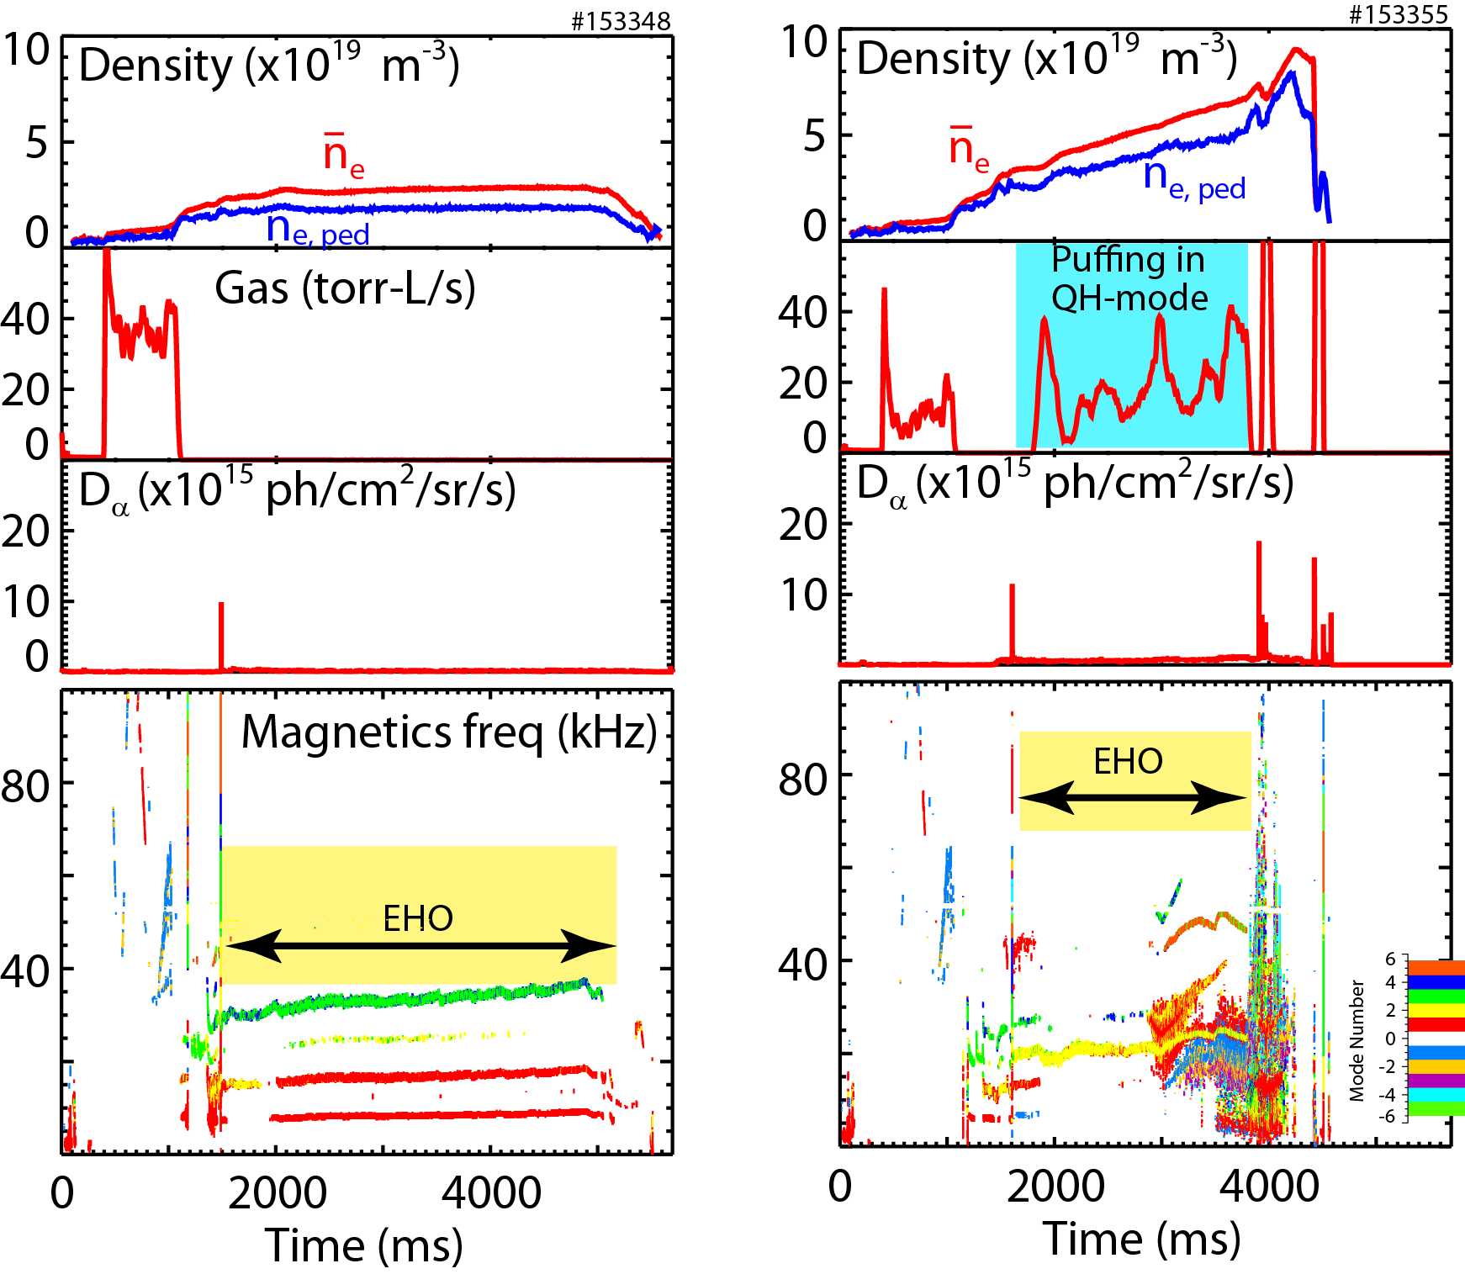
External 3D Field Coils Enable Higher Performance
QH Modes at ITER-Relevant Torques
3D fields generate ‘NTV’
torques and rotation shear
  ELMs replaced by Edge
  Harmonic Oscillation
Edge rotation shear
suppresses ELM
[Burrell, NF 2013]
Notes:
18

Slide 19
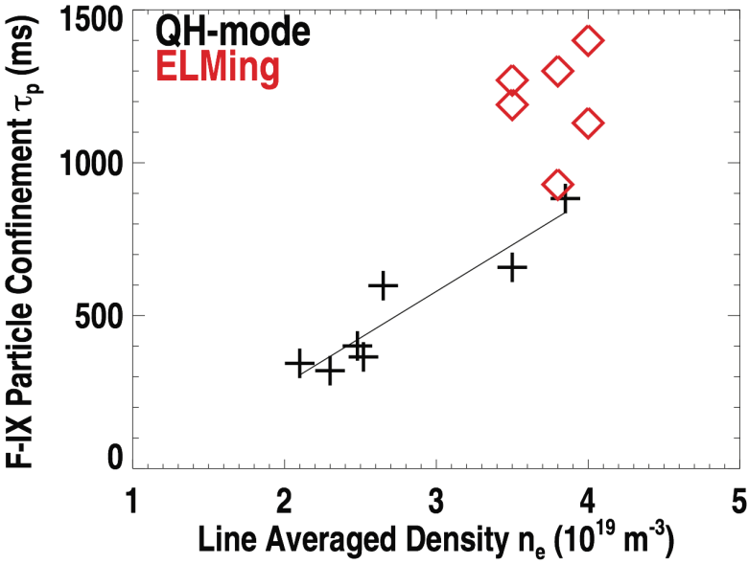
External 3D Field Coils Enable Higher Performance
QH Modes at ITER-Relevant Torques
3D fields generate ‘NTV’
torques and rotation shear
  ELMs replaced by Edge
  Harmonic Oscillation
Fluorine measurement show EHO flushes impurities better than ELMs
[Burrell, NF 2013]
Notes:
19

Slide 20
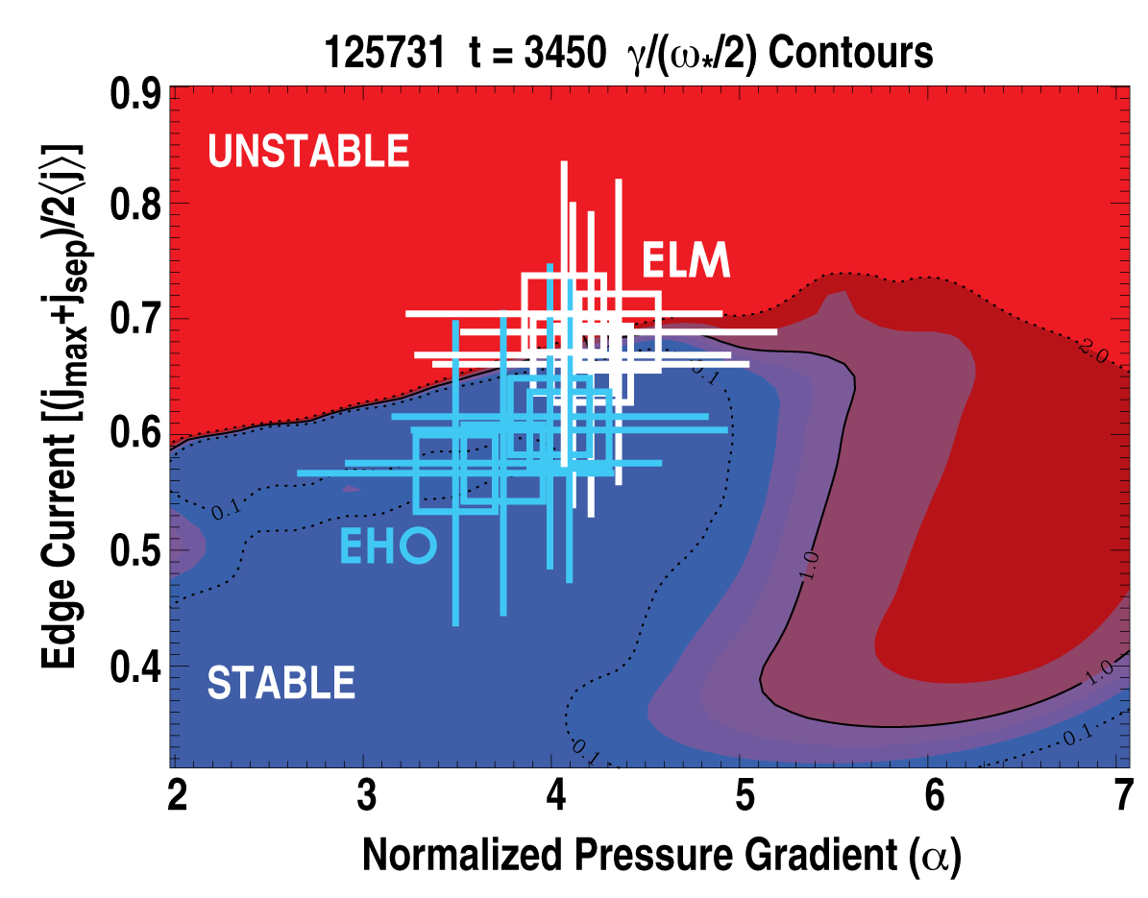
QH Mode has been Extended to High Greenwald Fraction, Validating Theoretical Predictions
Edge Harmonic Oscillation
exists just within usual ELM
trigger boundary

Slide 21
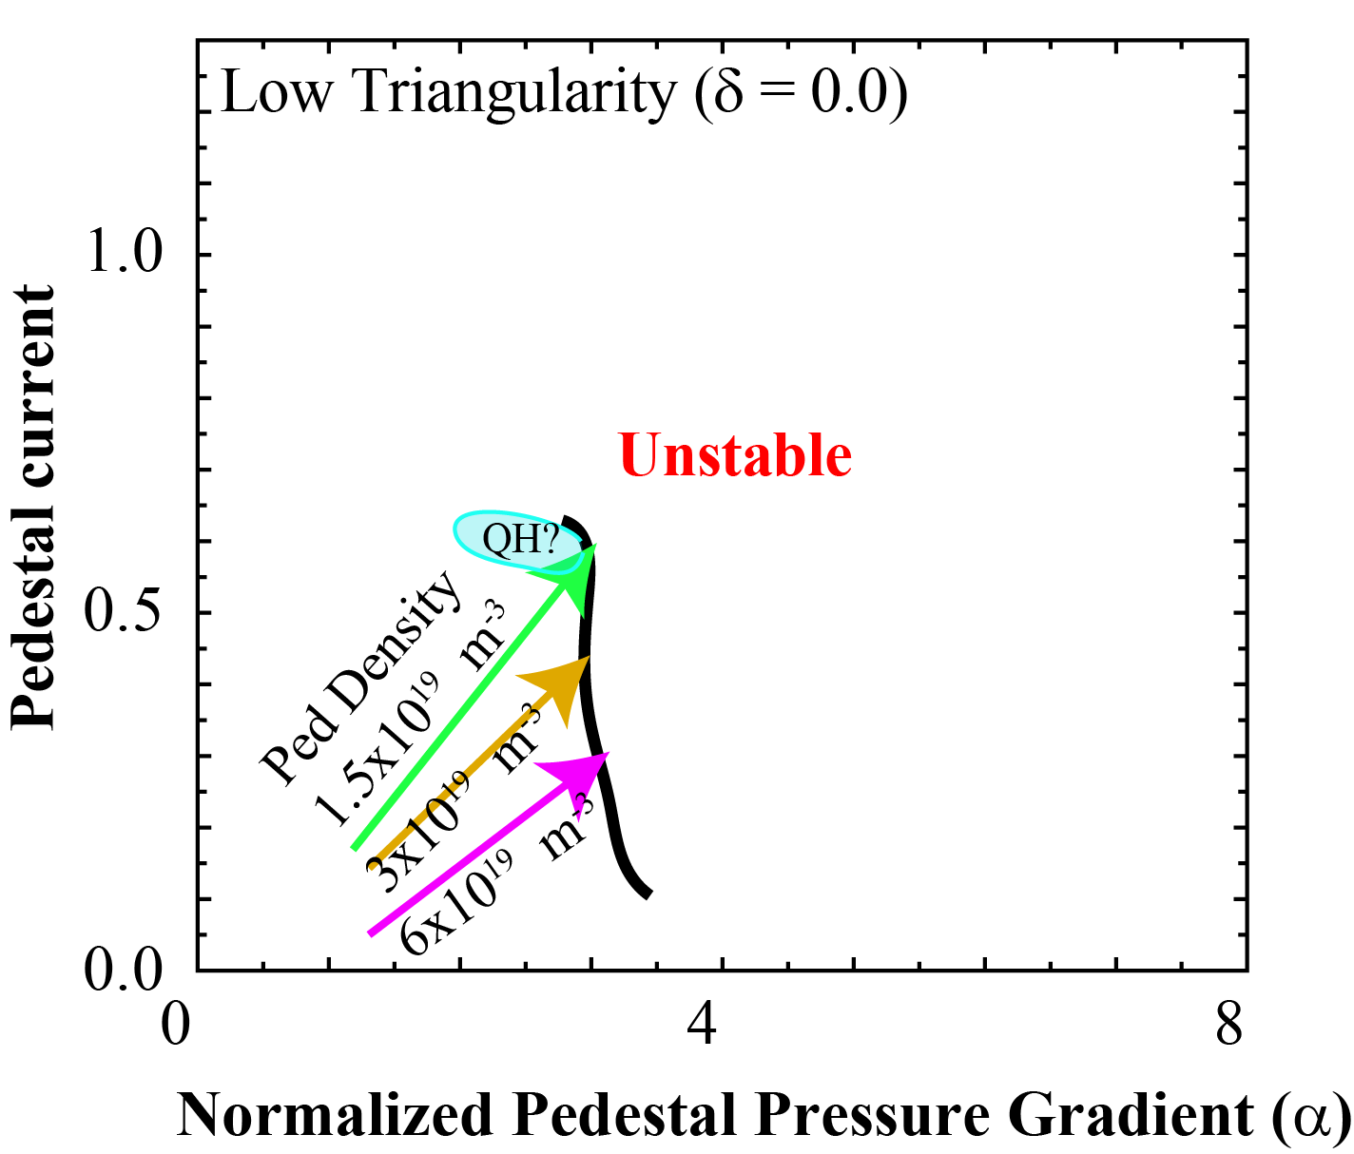
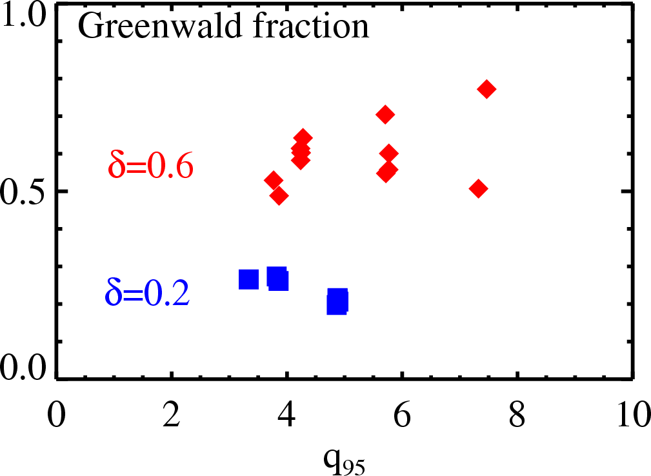
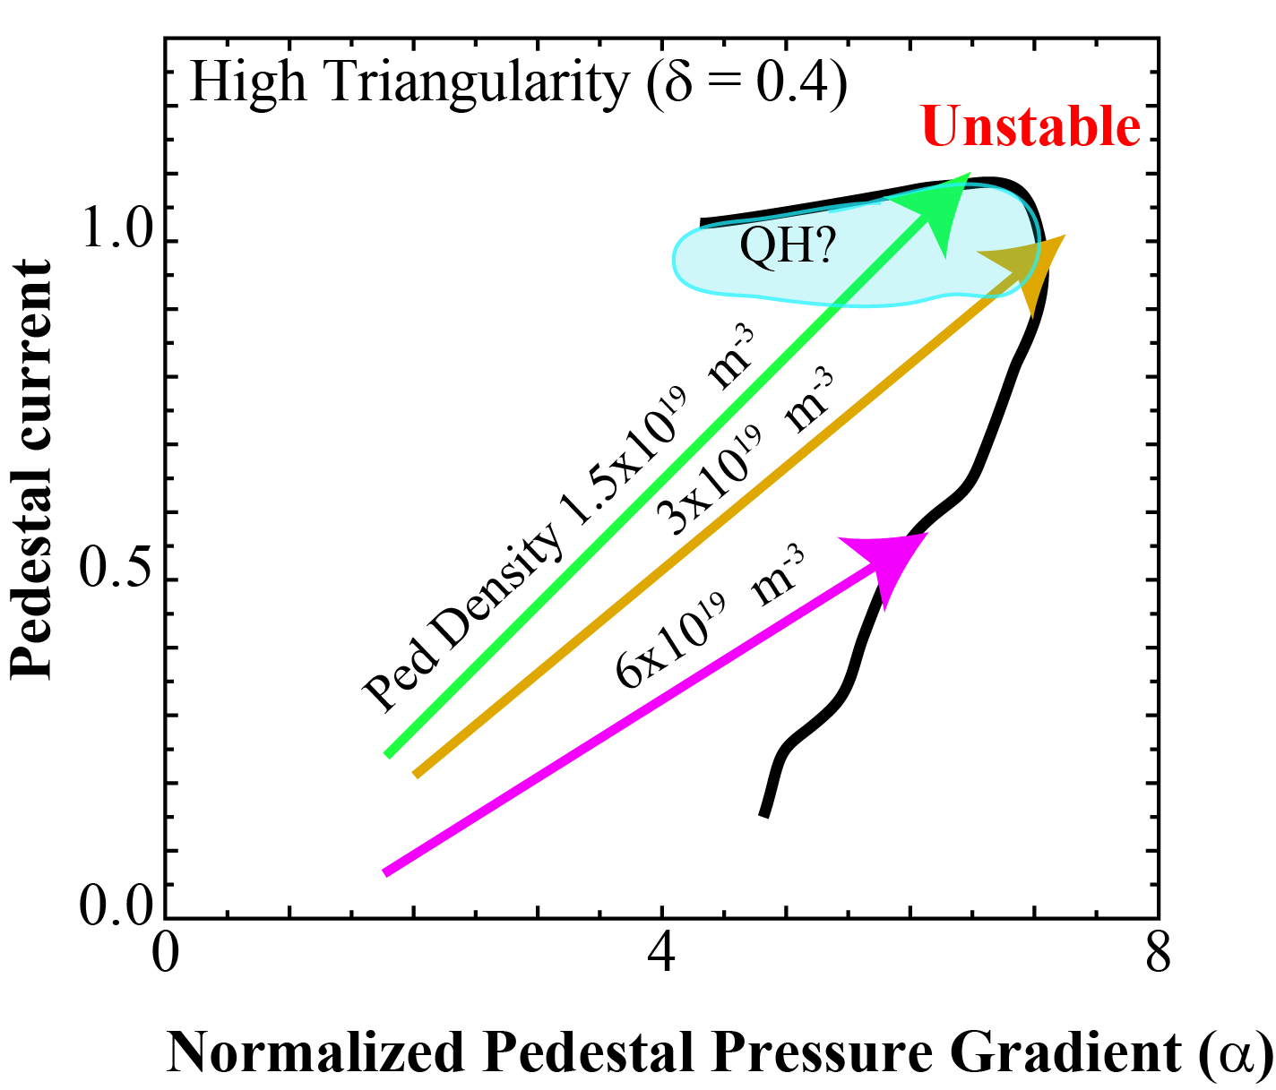
QH Mode has been Extended to High Greenwald Fraction, Validating Theoretical Predictions
Edge Harmonic Oscillation
exists just within usual ELM
trigger boundary
Boundary extended by shaping
  And optimized by varying density
  Access to high Greenwald
Promising regime for ITER

Slide 22
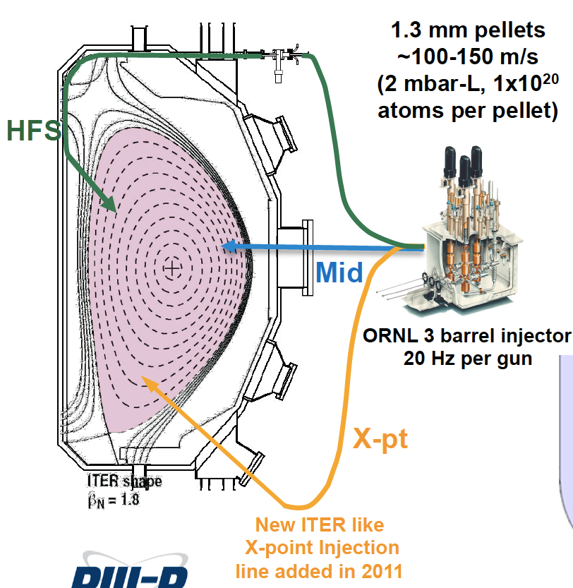
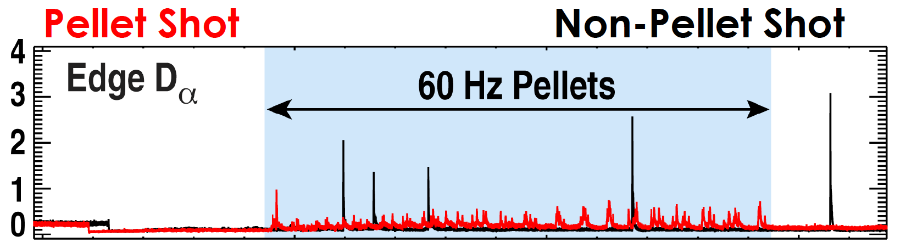
Pellet Pacing at ITER Parameters
ITER shape, launch
geometry
Pellets trigger ELMs
  Use to increase ELM
  frequency
  Decrease ELM energy?
  Limits to improvement?
β_{N}=1.8
1.3 mm pellets 100-150 m/s

Slide 23
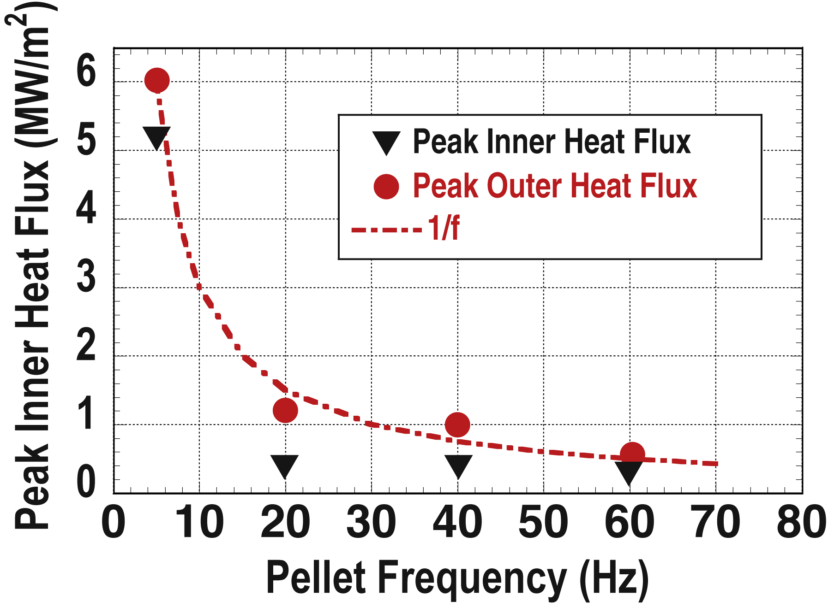
Pellet Pacing at ITER Parameters
Yields 12x Lower ELM Divertor Heat Pulse
ELM heat flux:
ITER shape, launch
geometry
β_{N}=1.8
f_{pellet} x Δq_{div} = const
1.3 mm pellets 100-150 m/s
No confinement reduction or
fuelling increase
Core impurities reduced
Minimum pellet size validates JOREK model of ELM triggering
[Baylor, PoP 2013]

Slide 24
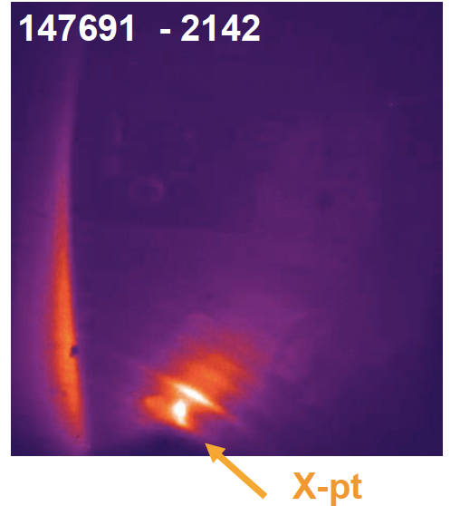
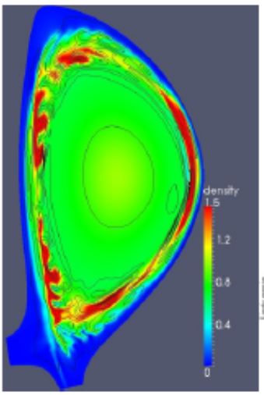
Pellets Act to Excite Filaments to Trigger ELM
ITER shape, launch
geometry
β_{N}=1.8
Filtered D_{α}
Pellet excites filament to trigger ELM
1.3 mm pellets 100-150 m/s
JOREK
Local pressure gradient triggers ballooning
← As in JOREK model
[Baylor, PoP + Futatani, NF 2013]

Slide 25
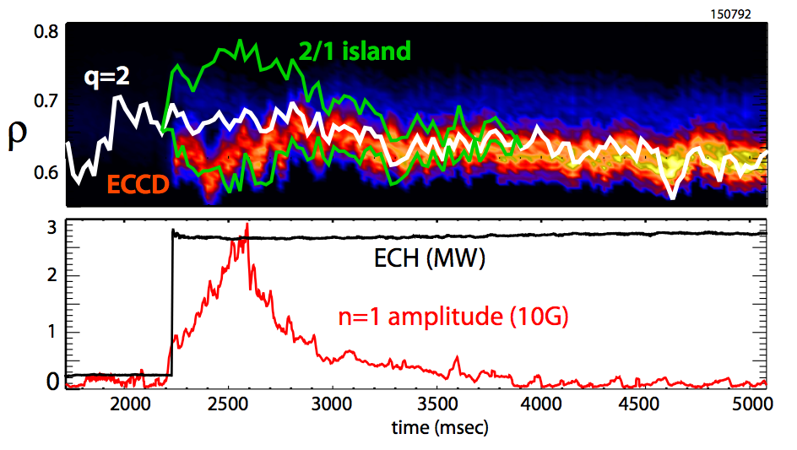
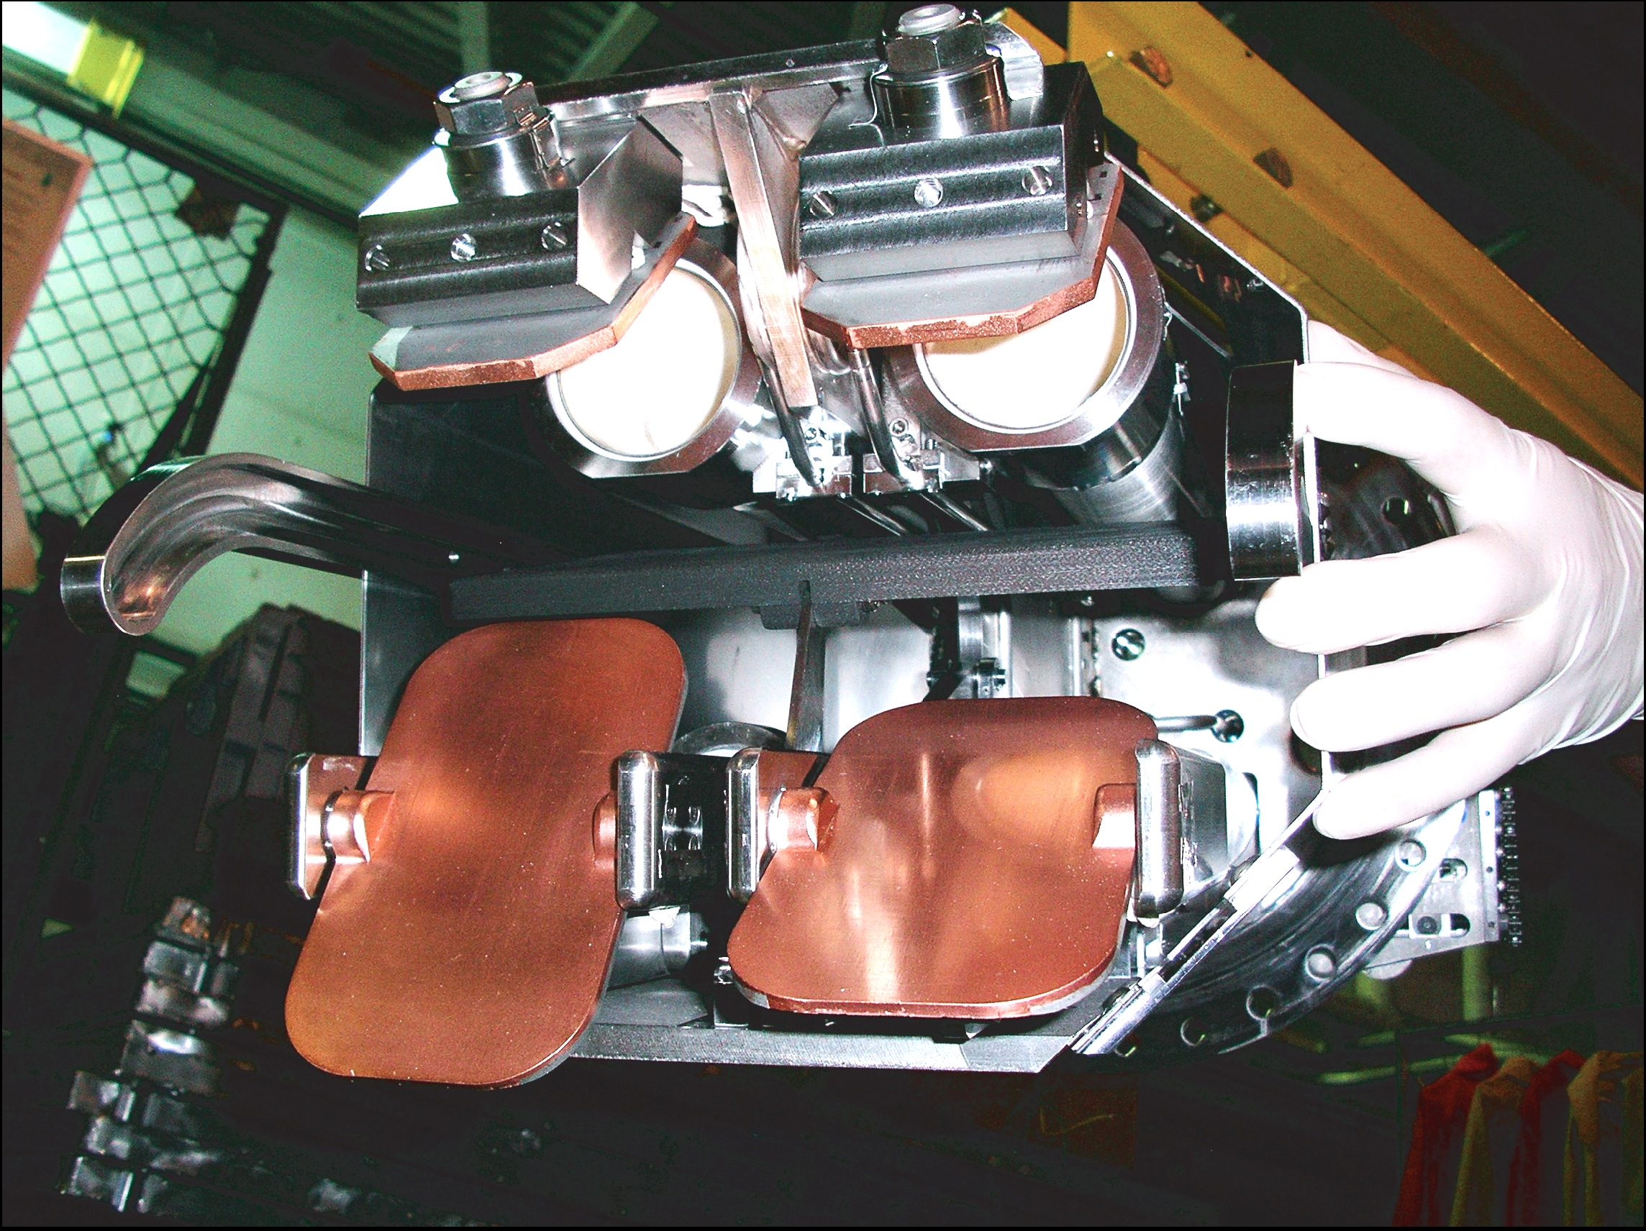
Disruption Avoidance: Real Time ECCD
Mirror Steering Removes Tearing Modes
Real time MSE equilibria &
EC deposition guide mirrors
Advanced control catches
mode early & applies ECCD
  Reduces power requirements
  Prevents locking & disruptions
  Avoids need for continuous
  pre-emptive ECCD stabilization
A multi-layered disruption strategy
is being developed
  Passive stability, Active control,
  Disruption mitigation (next)
Steerable mirror
[Kolemen IAEA 2012]

Slide 26
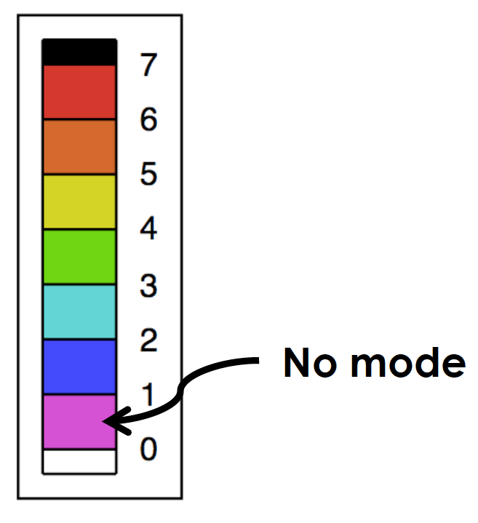
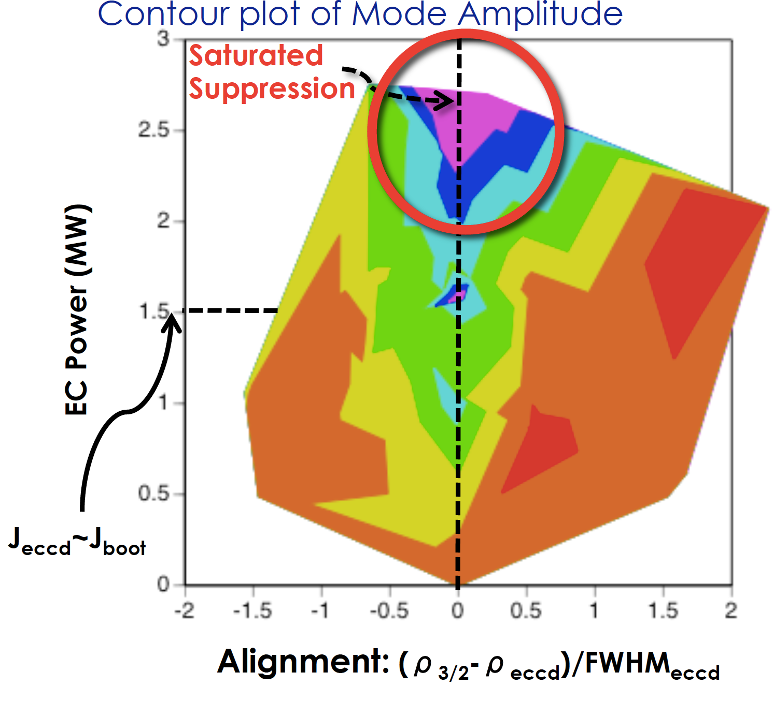
Catching Mode Early Reduces Stabilization Requirements
Saturated modes suppressed
with high well aligned power
  Catching sooner reduces
  power needed
  Pre-emptive power shows potential of technique
Steerable mirror
[Kolemen IAEA 2012]

Slide 27
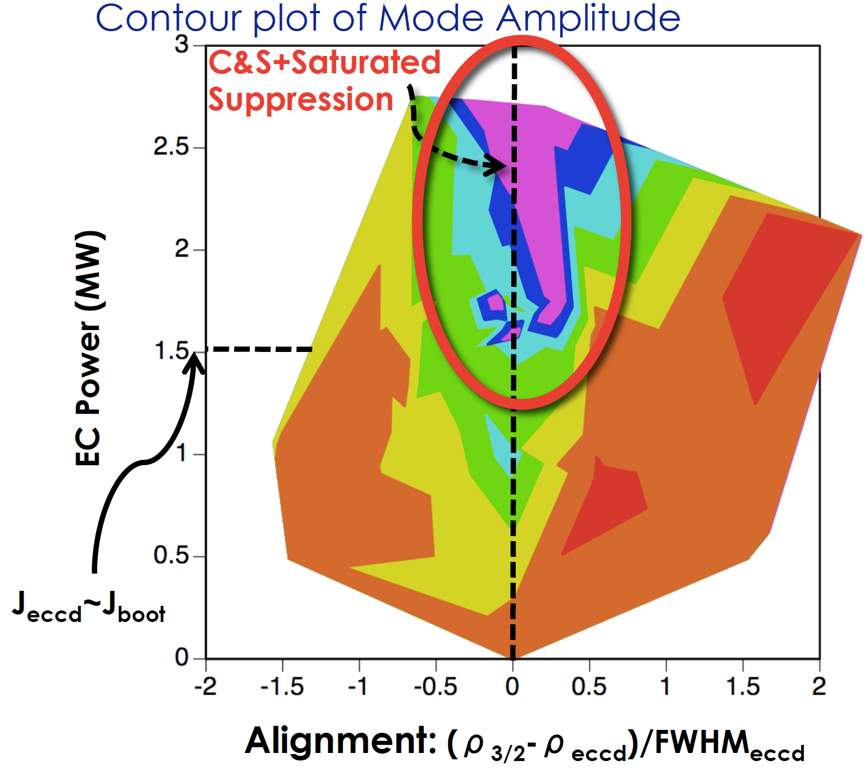
Catching Mode Early Reduces Stabilization Requirements
Saturated modes suppressed
with high well aligned power
  Catching sooner reduces
  power needed
  Pre-emptive power shows potential of technique
Steerable mirror
[Kolemen IAEA 2012]

Slide 28

Catching Mode Early Reduces Stabilization Requirements
Saturated modes suppressed
with high well aligned power
  Catching sooner reduces
  power needed
  Pre-emptive power shows potential of technique
Steerable mirror
[Kolemen IAEA 2012]

Slide 29

Catching Mode Early Reduces Stabilization Requirements
Saturated modes suppressed
with high well aligned power
  Catching sooner reduces
  power needed
  Pre-emptive power shows potential of technique
Current work improving
tracking and intercept:
  Real time TORBEAM
  Better NTM detection
  Multiple ECCD cycles
More physics to do:
Understand inherent tearing stability & island dynamics
Steerable mirror
[Kolemen IAEA 2012]

Slide 30
Disruptions Pose Critical Challenge to the Tokamak
Thermal
current
Thermal Quench (TQ) – heat loads
Current Quench (CQ) – forces
Runaway Electrons (RE)
– localized damage
Electron temperature
Current
Runaway Current
time
Key Challenges:
  Mitigate the heat loads, symmetrically, without shortening the current quench so much that large forces are induced
    Asymmetries introduce localized heat loads
  Prevent or control and dissipate the avalanching runaway beam

Slide 31
Heat Loads in Thermal Quench Phase Found to be Nearly Symmetric
MGI2 Only
2:1 Ratio
MGI1 Only
Compare / combine 2 locations
of Massive Gas Injection (MGI)
  Asymmetry is modest
  Does not vary with
  injector mix
ΔW_{rad} / ΣW_{rad}
MGI1
IR
periscope
2:1 Ratio
Δt between MGI triggers (ms)
MGI2

Slide 32



Heat Loads in Thermal Quench Phase Found to be Nearly Symmetric
Compare / combine 2 locations
of Massive Gas Injection (MGI)
  Asymmetry is modest
  Does not vary with injector mix
& no preferential heating at MGI port
  Same trend as region far away
MGI2
MGI2
Region 1
Region 1
MGI2
MGI2

Slide 33

Predictive “MHD Asymmetry” in Thermal Quench is Present But Weak
NIMROD: 1/1 mode during TQ will cause P_{rad} asymmetry even if MGI
is isotropic [Izzo 2012 IAEA]
DIII-D Test: Control 1/1 mode
with applied 3D field
  Mode did lock to applied field
  Variation observed but weak.
2:1 Ratio
Symmetric
ΔW_{rad} / ΣW_{rad}
2:1 Ratio
Applied n=1 phase (deg)

Slide 34
DIII-D Disruption Experiments Point Toward Controlled Dissipation of Runaway Electrons In ITER
RE Synchrotron Emission
Plasma termination decouples electrons
into an energetic runaway beam
  Contact with wall risks damage
EARLY BEAM
CONTACT
[Hollmann, NF 2013]

Slide 35
DIII-D Disruption Experiments Point Toward Controlled Dissipation of Runaway Electrons In ITER
Plasma termination decouples electrons
into an energetic runaway beam
  Contact with wall risks damage
New slide-away technique allows
precise exploration of RE onset
  Ramp down density until
  RE signature observed
[Hollmann, NF 2013]

Slide 36
DIII-D Disruption Experiments Point Toward Controlled Dissipation of Runaway Electrons In ITER
Plasma termination decouples electrons
into an energetic runaway beam
  Contact with wall risks damage
New slide-away technique allows
precise exploration of RE onset
  Ramp down density until
  RE signature observed
Runaway growth rate much lower
than avalanche prediction
  Increased density can
  dissipate runaways
Encouraging trends for ITER, but
viable technique still to be developed
[Hollmann, NF 2013]

Slide 37



DIII-D Forward Program Will Investigate the Physics & Benefits of Various Mitigators for ITER DMS
Existing
Fall 2014
Massive Gas Injection at multiple locations
Shattered Pellet Injection
➔ deep penetration
Shell Pellet Injection
MGI1: 6 valves
MGI2: 3 valves
UCSD
MGI1
ORNL
ORNL
MGI1 and MGI2 are separated both poloidally and toroidally
SPI: Frozen D₂ pellet (~size of wine bottle cork) strikes shatter plate
Shell: Inject boron powder in plastic shell
MGI2
Notes:
Short arrow for MGI, long for SPI?

Slide 38

Stationary Low-Torque ITER Baseline Discharges Are Maintained for Multiple Current Relaxation Times
Key Challenge: Stability and Confinement at Low Rotation
4.3 τ_{R}
ITER – equivalent
NBI torque
ITER parameters
  Shape & I/aB
  β_{N} & H₉₈
Stable access through
J profile tailoring
  No 2/1 modes
  Broad ECCD for 3/2
ITER Equivalent Torque
β_{N}
H_{98y2}
Future direction: Increased ECH → burning plasma conditions
[Jackson, IAEA 2012]

Slide 39



Plasma Behavior Changes in the Burning Regime –
DIII-D Will Explore with More ECH
Nature & scale of turbulence change ➔
with dominant α heating of electrons
  Heat, momentum & particle throughput differ
Dominant ECH will heat like fusion α’s
  Relevant T_{e}/T_{i}, collisionality, torque & fuelling
  Precise deposition perturb & study physics
  Drives current for stability & steady state
Fraction of transport through ETG
DIII-D ion heated fine scale turbulence
Turbulence simulation:
ITER low order
‘lumpy’ turbulence
[Gyro, Candy]
TGLF model
ETG
ITG-TEM
T_{e}/T_{i}:
Baseline β_{N}=1.7
AT β_{N}=3.7
(3MW fast wave)
Learn how to optimize performance, to prepare for next generation of devices
−− Average
--- Core
GLF23 model
Electron plasma power /MW

Slide 40
SECTION 2: PATH TO FUSION ENERGY
Advanced steady state regimes
Innovative boundary solutions
Extending control solutions
Snowflake
Exploring strike geometries

Slide 41



Steady State: New Off Axis Beam Sustaining Access to High β Regimes
Tilted beam drives off-axis heating and current:
Broadens current and pressure profiles improving stability
[Park, NF 2013]

Slide 42

Steady State: New Off Axis Beam Sustaining Access to High β Regimes
Tilted beam drives off-axis heating and current:
Broadens current and pressure profiles improving stability
[Park, NF 2013]

Slide 43

Steady State: New Off Axis Beam Sustaining Access to High β Regimes
Calculated ideal β_{N} limits
Broader profiles
Higher β limit
Broadens current and pressure profiles improving stability
[Park, NF 2013]

Slide 44

Steady State: New Off Axis Beam Sustaining Access to High β Regimes
Sustains ITER/FNSF equivalent levels of performance:
On-axis NBI
Off-axis NBI
G=β_{N}H₈₉/q₉₅²
ITER (Q ≈ 5)
[Ferron, PoP 2013]

Slide 45

Using On/Off Axis Beams to Explore a Range of
q-Profile Scenarios for DEMO and FNSF
Scenario | Advantages and Issues
q_{min}>2 | High ideal-wall β_{N} limit & high bootstrap fraction, low χ Fast ion confinement not so good
q_{min}>1.5 | Intermediate regime Better confinement (previous slide)
q_{min}>1 including “hybrid” | Efficient on-axis CD, f_{CD}≈0.5, f_{BS}≈0.5 Fully non-inductive demonstrated…
q_{min}~1 “high-li” | High β_{N} below no-wall limit, efficient on-axis CD Very high performance, but transient so far (limited run time)

Slide 46

“Hybrid” Scenario With q_{min}=1 Achieves f_{NI}=1 With Same β_{N} (≤ 3.7) as FNSF-AT Target
Pulse length limited by NBI duration
Efficient central ECCD
Good confinement
Reproducible zero loop voltage
τ_{R}

Slide 47


Steady State “Hybrid” Achieved by Going to β_{P} ≥ 1.9 & Using All Available ECCD Power Near the Axis
ECCD
m/n=3/2 mode redistributes current outward, avoiding sawteeth

Slide 48

Flexible Heating and Current Drive Systems Projected to Resolve Self-Consistent Fusion Steady States
Project fully non-inductive β_{N}~5 with new heating systems
  TGLF integrated transport
  & stability modeling
Plan 8.5MW ECCD
2nd off axis NB beam
& NBI energy rise
DIII-D

Slide 49
DIII-D is Developing the Physics Basis for Integrated Steady-State Divertor Solutions
Heat Flux Width:
Extrapolations indicate challenging ➔
heat fluxes in future fusion devices
[Eich, Makowski, IAEA 2012]

Slide 50
DIII-D is Developing the Physics Basis for Integrated Steady-State Divertor Solutions
Heat Flux Width:
Extrapolations indicate challenging ➔
heat fluxes in future fusion devices
DIII-D studies confirm theoretical
mechanisms governing width
  Upgraded TS confirm critical gradient
  model (such as Kinetic Ballooning Mode)
  Increases confidence in projection
Theory
Experiment
[Eich, Makowski, IAEA 2012]

Slide 51
DIII-D is Developing the Physics Basis for Integrated Steady-State Divertor Solutions
Heat Flux Width:
Extrapolations indicate challenging ➔
heat fluxes in future fusion devices
DIII-D studies confirm theoretical
mechanisms governing width
  Upgraded TS confirm critical gradient
  model (such as Kinetic Ballooning Mode)
  Increases confidence in projection
Devices beyond ITER may required
improved divertor solutions
  Need to avoid erosion by isolating
  divertor from core plasma
  DIII-D exploring radiation, new
  geometries, and materials…
Theory
Experiment
[Eich, Makowski, IAEA 2012]

Slide 52



q_{min}≈1.5 Scenario Appears Compatible with Radiating Mantle for Divertor Heat Flux Reduction
Peak divertor heat flux reduced ~35%
Neon
5.2 t l/s
Neon injection
P_{RAD} doubles without significant performance degradation
[Petrie, IAEA 2012]

Slide 53


Snowflake Divertor Sustained in Stationary Conditions: Reduces ELM and Steady-State Heat Fluxes
Snowflake
Increased
Divertor
Radiation
2nd X point expands flux
SF configuration reduces
heat flux by factor 2-3
∆W(ELM) reduced
Core confinement (H_{98y2} > 2) and pedestal maintained
ELM heat flux reduced dramatically with gas puffing
6
4
Reduced Divertor Heat Flux
SF
Time (s)
2
Snowflake
0
Snowflake
Snowflake
Major Radius
[Allen, IAEA 2012]

Slide 54
2013 Studies Have Demonstrated Integrated
AT – DN – Radiative Divertor – Snowflake Operation
AT snowflake has
60% lower heat flux
at outer strike
  Inner target similar
  to no snowflake
Radiating outer divertor offers less incremental benefit with snowflake
  Comparable benefit for inner divertor
RED – Before gas puffing
BLUE – Radiating divertor

Slide 55
Ongoing Program Exploring Physics of Detachment to Design an Improved Divertor Solution for DIII-D & FNSF
Feedback control with 2D Thomson scattering
Z
Z
Radiation Profile:
Control spreads
the peak at the
strike point
MW/m³
R
R
No Control (#153814)
Control (#153816)
Te profile:
Control achieves partial detachment shown in cold front
eV

Slide 56
DIII-D Ten Year Strategy Integrates Progress in
Core and Edge to Address ITER and FNSF Needs

Slide 57
DIII-D Facility Complements Other Partners to
Improve the Basis for Fusion Energy

Slide 58
DIII-D is Advancing the Physics Basis Needed to Enable Fusion Energy Development

Slide 59
Reserve Slides

Slide 60

Lower Single Null (Almost) Exact Snowflake Obtained and Studied
The new control
obtained long, stable,
close to exact SF
Studied D₂ and Ne
density scans
Initial Results:
  No confinement degradation
  Pedestal profile for SF has little change compared to regular divertor
  Observed broadening of heat flux profiles with snowflake
Exact snowflake
Heat flux at the outer divertor
R [m]
t [ms]
MW/m²
R [m]

Slide 61
Narrow Window for Stability at Low Torque
Navigated with Profile Control
Unstable / Stable
Requires careful tailoring
of current profile
Applying ECH expands access
  Pre-emptively stabilizes the NTM
[Jackson, IAEA 2012]

Slide 62

Stability Calculations Predict ITER Pedestal Will Operate on Peeling Boundary Where QH-mode can Exist
Theoretical calculations show that ITER edge will be on the kink-peeling stability boundary for pedestal densities up to 1.2 x 10²⁰ m⁻³
  Significantly higher than ITER design value
Accordingly, ITER’s
pedestal will be
in the QH-mode
parameter range of
density/collisionality
Burrell PoP 2012

Slide 63

External 3D Field Coils Enable Higher Performance
QH Modes at ITER-Relevant Torques
3D fields generate ‘NTV’
torques and rotation shear
  ELMs replaced by Edge
  Harmonic Oscillation
Edge rotation shear
suppresses ELM
[Burrell, NF 2013]
Notes:
63

Slide 64
Edge Harmonic Oscillation Acts to Flush Impurities
Better than ELMs!
EHO serves to replace role of ELM
in regulating the edge in QH mode
Fluorine measurement shows ELMing
discharges retain impurities more

Slide 65
Heat Loads in Thermal Quench Phase Found to be Nearly Symmetric
P_{rad} Asymmetry
Compare / combine 2 locations
of Massive Gas Injection (MGI)
  Asymmetry is modest
  Does not vary with
  injector type
Pre-TQ
2:1 Ratio
TQ
(W₉₀-W₂₁₀) / (W₉₀+W₂₁₀)
CQ
MGI 2 Only
2:1 Ratio
MGI 1 Only
Δt_{MGI2-MGI1} (ms)
MGI1
IR
periscope
MGI2

Slide 66

DIII-D Disruption Experiments Point Toward Controlled Dissipation of Runaway Electrons In ITER
RE Synchrotron Emission
Plasma termination decouples electrons
into an energetic runaway beam
  Contact with wall risks damage
DIII-D developed control over beam
to explore dissipation
  High Z gas jets increases dissipation
  Controlled ramp down possible
EARLY BEAM
CONTACT
[Hollmann, NF 2013]

Slide 67
DIII-D Disruption Experiments Point Toward Controlled Dissipation of Runaway Electrons In ITER
Plasma termination decouples electrons
into an energetic runaway beam
  Contact with wall risks damage
DIII-D developed control over beam
to explore dissipation
  High Z gas jets increases dissipation
  Controlled ramp down possible
Dissipation rates much faster than
predictions from Rosenbluth theory
  Control & dissipate likely to be
  required strategy in ITER
Theory
I_{RE} Growth Rate (s⁻¹)
Data
Dissipation stops
runaway growth
Applied – E_{crit} (V/m)
[Hollmann & Parks, NF 2011]

Slide 68



DIII-D Disruption Experiments Point Toward Controlled Dissipation of Runaway Electrons In ITER
Plasma termination decouples electrons
into an energetic runaway beam
  Contact with wall risks damage
DIII-D developed control over beam
to explore dissipation
  High Z gas jets increases dissipation
  Controlled ramp down possible
Dissipation rates much faster than
predictions from Rosenbluth theory
  Control & dissipate likely to be
  required strategy in ITER
DIII-D developing a range of tools to resolve
thermal quench & runaway mitigation for ITER
Multiple massive gas injectors to symmetrize loads
Shattered pellet
Rupture disk
Shell dust injection

Slide 69
Anomalous Dissipation of Quiescent RE (QRE) Measured During Low-density Ohmic Flattop
RE beams form under quiescent conditions in low n_{e} ohmic discharges
D2 puff added to dissipate QRE, measure decay rate
ohmic plasma
RE Growth
RE Decay
NW Eidietis/APS DPP/Nov 2013

Slide 70
QRE Exhibit Anomalously High Dissipation Rates
Dissipation exceeds collisional avalanche theory prediction
  Supports hypothesis that critical n_{e} for RE dissipation < “Rosenbluth” n_{e}
See
Paz-soldan (in submission)
Moyer, BP8.110
Granetz, BI2.03
NW Eidietis/APS DPP/Nov 2013

