Slide 1
Plan Flagged by Jon
After the colloquium, there will be a joint NSTX-U/DIII-D meeting to discuss
possible means of improving collaboration/coordination/discussion between
the teams on high-priority issues that would benefit from improved linkages.
This meeting will begin at 1:30PM Eastern and will be held in B318 at PPPL
until 4:30PM (or later if necessary).
The initial set of topics for discussion include:
- Disruptions - both mitigation and avoidance
- JRT2014 - plasma response to 3D fields
- JRT2015 - impact of broadened J, p profiles on confinement and stability
- Any other grass-roots ideas people come up with
There will be some short presentations from myself and several
NSTX TSG leaders/contributors and also DIII-D folks, and these
files will be downloadable from:

Slide 2
Suggested Topics By Richard – ordered to Jon…
- disruption mitigation
- disruption avoidance
- 3D plasma response - noting a JRT this year
- steady state plasmas with off axis current (JRT 2015)
- energetic particles
- snowflake
In addition to joint work, which we should pursue, we will likely have a 2nd National Campaign in FY14, which will help NSTX-U and DIII-D scientists build further understanding

Slide 3
Disruption Avoidance

Slide 4
Opportunities for D3D/NSTX-U Collaboration: Disruption Detection and Avoidance
Both D3D & NSTX-U are pursuing frameworks for disruption detection & response
Detection: D3D already planning on testing NSTX-U (S. Gerhardt) disruption detection methods for generality (Granetz collaboration + ITPA working group)
Elaborate contact & plan
Response: PCS Off-normal/Fault Response (ONFR) architectures, rather than being developed in blind parallel, should cross-pollinate to retain best ideas.
Ideas here?

Slide 5
Aspects Towards Controlled Disruption Avoidance?
Instabilities
Proximity sensors
Known limits
Real time calculations
Active sensing
Control to stay within limits
Event in progress sensors
Event response strategies to recover / amelioriate
A lot to integrate to make robust avoidance system
A lot of topics to fold in…
Needs to be physics issue by issues – or generic database mine-field plot??? (I doubt latter will work well).
Philosophies and plans on 2 facilities?

Slide 6
Other parts of Disruption Avoidance: Tearing Mode Physics (here) + Jack on RWM?
Tearing modes most ubiquitous limit to performance in tokamak
Underlying stability remains thorny issue
Many modes come out of the noise – intrinsically unstable, possibly related to ideal stability?
Low rotation an important factor in DIII-D
NSTX-U – field curvature plays important role
Use off axis beams to:
Vary current profile
Vary rotation profiles – get at rotation vs rotation shear
Impacts on both (rotating) TM stability and EF thresholds
Part of GA grant proposal to NSTX-U
Common interest to unravel effects of high beta (ideal instability) from tearing mode susceptibility
Degree of interest and people?

Slide 7
Disruption Mitigation

Slide 8
Opportunities for D3D/NSTX-U Collaboration: Disruption Mitigation (contact: Nick Eidietis)
Continued participation of R. Raman in the D3D DTF
D3D benefit: A valued “outside” voice in a small group
NSTX-U benefit:
Added experience to faster “boot-strap” the NSTX-U DMS
What are NSTX-U plans for DMS? Issues for FNSF-ST / ARIES-ST?
Need? Injector types likely?
Radiation asymmetry studies with multiple MGI
NSTX-U will have a unique poloidal distribution of injectors. That should be exploited to expand upon D3D asymmetry results
Value of joint studies or model comparisons?
Extra personnel / students to get involved?
Long-term: NSTX-U may be a more suitable test-bed for lithium-dust-based mitigation strategies than D3D
Potential for significant collaboration in future, if this moves forward
NSTX-U interests?
AB Author/Conference/Month Yr.

Slide 9
JRT and 3D

Slide 10
JRT – what joint work is needed?
Concentrate on n=1 – OK?
Magnetics + internal measurements
Explore linear response amp and structurel cf codes
Non-linear – braking and penetration
Is this right balance and mix?
Does it need to be made more practical (EF correctors… etc)?
What exchanges are needed to facilitate work and get meaningful joint comparison that adds value?
Leave our: RMP ELM suppression, density pumpout caused by 3D fields, and intrinsic rotation
Focus is the MHD response to 3D fields for all functions

Slide 11
Off Axis Beams & Steady State Plasmas

Slide 12
Steady State Ideas from Chris Holcomb draw out some specifics to get things going for 2015 JRT
Explore high beta and fast ion transport – look at issues we have (exps expected in 14), compare with NSTX in 15
Continue Podesta 1T EP transport studies for NSTX-U (from NC in 13) – find regime that works well & explore how to mitigate losses.
Benefits of ITBs in plasmas with higher density – confine FIs?
Model time evolution, developed improved sequence and tes experimentally
Learning how to evolve AT plasmas to make them work may be of value? Then explore transport & stability sensitivity to cf NSTXU
See next slide – mainstream to JRT 2015…

Slide 13
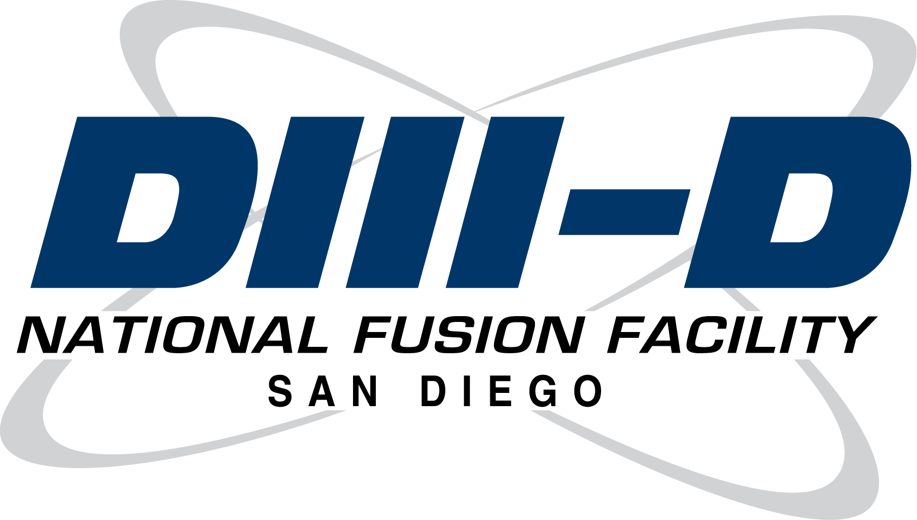
DIII-D & NSTX-U Collaboration Can Advance Physics of Steady State Scenarios With Off-Axis Current Drive
Off-axis current drive used to make broad j, high q_{min} on both machines
Physics Challenge | DIII-D capability | NSTX-U capability
Must control AE’s & energetic particle transport to reach high β_{N} with high q_{min} | Access to low v_{b}/v_{Alfven} W_{fast}/W_{total} up to 0.5 Extensive diagnostic set | Access to high v_{b}/v_{Alfven} W_{fast}/W_{total} up to 0.5 Extensive diagnostic set
Characterize thermal transport to understand impact on bootstrap and external current drive | Off-axis NBI heat electrons more; increasing ECH; low torque capability | Dominant electron heating, including new high R_{TAN} NBI
Identify consequences of broad j- and p-profiles for practical β_{N} stability limits (tearing, RWM, ideal,…) | High power off-axis current drive and transient B-field ramps | Higher ε^{0.5} for bootstrap current; Off-axis beams;

Slide 14
SS – form Chris
A few specific things I can imagine someone from NSTX doing here in 2014, assuming of course that a relevant experiment is run:
1. We spent considerable time taking moderate betaN (<2.3) MHD quiescent shots to confirm that the driven off-axis current matched the classical model in Nubeam. This included various techniques, like modulating different beams, doing onetwo analysis, and directly analyzing MSE data. Craig Petty and JM Park lead this. Last year we planned to do something similar as a step in a run plan but at higher betaN, in the regime with enhanced fast ion transport. But we never got to it. It's possible that this could be picked up again this year. I can imagine that NSTX-U will want to use similar techniques - and they don't all work equally as well, so they can learn from our mistakes. Someone could come here and participate in such an experiment or at least learn from Craig and JM how it was done. With 1 Tesla and MSE-LIF I expect they should be able to compare measurement to prediction in NSTX-U as well.
2. In the National Campaign, Mario Podesta tried to obtain data on fast ion transport in elevated qmin plasmas at 1 Tesla. I think he and Heidbrink are still analyzing this data, but my guess is they could use more. I remember a lot of problems in the experiment, and I don't think qmin was all that high. If we continue efforts this year to find acceptable parameter adjustments that mitigate fast ion transport, perhaps more low-B work can be included.
3. Plasmas with higher density and ITB's may also be relevant to NSTX-U and there are indications in the EAST/DIII-D joint experiment that this can help limit the fast ion diffusion to less than 1 m2/s. (Van Zeeland's time dependent Transp analysis of 154406). Therefore NSTX people might be interested in these experiments as well. In Gerhardt's 2012 NF paper it seems they are planning for similar high q95, high bootstrap fraction plasmas in NSTX-U.
4. Along the lines of what your wrote below on how to make AT discharges, how they evolve, etc., in January we discussed with Kessel and Poli the idea of them using their ISP tools to model the entire time evolution of a DIII-D shot with actual H&CD sources. The point was to use this to find the optimal evolution to get as close as possible to a stationary plasma at the start of the high beta phase. Chuck and Francesca were directed to inductive scenarios instead. We also suggested this task for the MIT people, but I think it was assigned a tiny fraction of S. Shiraiwa, and I've heard nothing more. JM Park and Brian Grierson have both mentioned to me the possibility of doing this sort of thing, JM somehow with Fastrans and Brian with PTRANSP. In any event, we could re-invite the NSTX modelers to take on this task for DIII-D, and participate in any experiment that seeks to test their predictions.
Below, I'm not sure which transport models you are referring to. Is this just TGLF?
---
On 12/5/13 1:33 PM, Richard Buttery wrote:
Thanks.
I suppose a key point will be testing off axis current drive models. They might want to look at what we did, and use similar approaches to see if differences emerge in the ST.
I think with their new OANB, they will have a strong interest in understanding how to control regimes to reach given targets - the whole evolution of profiles vs heating history. How do you make a target discharge?
Then comparing how discharges behave as profiles change - broader current profiles, effects on transport and MHD limits. Our interest, I suppose, is testing the transport models on NSTX (but that’s 2015), and especially electron heating.
I think 2014, is an opportunity for them to come and engage in D3D - learn how to make AT profiles, the behaviors and considerations (modes, transport degradation with q, AEs, etc). They may provide useful work to us, and lessons they can apply in NSTX in 2015, where we may get something from their program.
I would try to draw out ideas for 3-5 specific exchanges - person to come here to study xxx
Richard.

Slide 15
Energetic Particles

Slide 16
Energetic Particle Experiment and Diagnostic Collaboration is Ongoing Between NSTX and DIII-D Teams
Experiment
Effect of 3D fields on TAEs (2013 DIII-D experiment led by Podestà)
Effect of AEs on NBCD (2013 DIII-D experiment led by Podestà)
Effect of CAEs/GAEs on electron transport (2014 DIII-D experiment proposed by Crocker)
Critical gradient model for fast-ion transport (participation in 2014 DIII-D experiment by Gorelenkov)
Beam validation experiments (participation in NSTX-U experiment by Heidbrink)
Light ion beam probe experiments (participation in NSTX-U experiment by Heidbrink)
TBM + MHD induced fast ion transport (2014 DIII-D experiment proposed by Kramer)
Diagnostic software
FIDASIM used worldwide (UC Irvine)
Infer fast-ion distribution (Stagner UCI thesis)

Slide 17
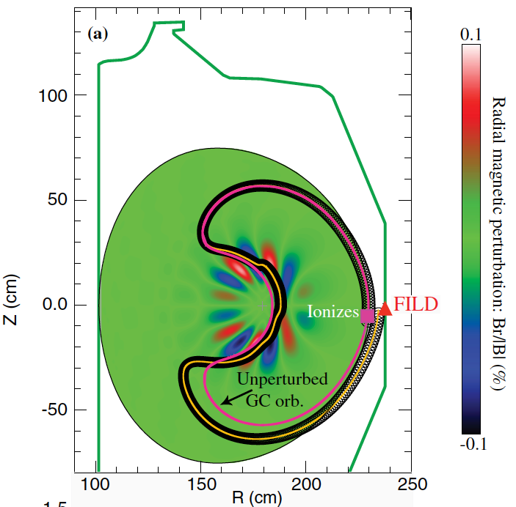
Several PPPL Tools are Used in Combination with DIII-D Experimental Data for Analysis and/or Code Validation Efforts
TRANSP NUBEAM & get_fbm support (PPPL)
Physics-based AE fast-ion transport in TRANSP (Podestà)
SPIRAL full-orbit calculations (Kramer)
NOVA and NOVA-K Alfven eigenmode and stability calculations (Kramer and Gorelenkov)
Hybrid simulations of AEs and Fishbones (G.Y. Fu, D. Liu)
Critical gradient model for AE transport (Gorelenkov)
IPEC simulations for DIII-D RMP cases to investigate EP loss (J.K. Park)
X. Chen, G.J. Kramer, et.al. PRL 110, 065004 (2013)

Slide 18
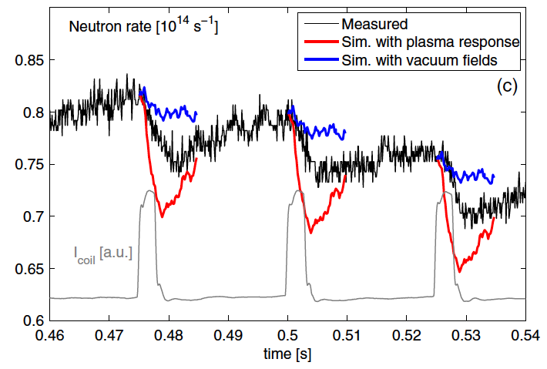
New Possibilities for Energetic Particle Collaboration
TRANSP improvements (TRANSP team):
Ionization in scrapeoff layer. Currently TRANSP does not consider profiles outside LCFS. Significant ionization can occur in SOL and may be important for input power, torque, and EP simulations that utilize get_fbm birth profiles.
2D edge neutral density model.
IPEC
Further Integration of M3D-C1 3D fields with SPIRAL orbit following
M3D-C1 analysis of 3D fields for Bortolon’s NSTX PRL case* (Ferraro)
NSTX data show significant impact of 3D fields on EP confinement. Measured impact falls between that calculated using IPEC and vacuum fields
Port GPU version of ORBIT to DIII-D (White et al.)
Would allow rapid analysis of MHD induced EP transport with excellent statistics
Design assistance on new DIII-D neutral particle analyzer (NPA) diagnostic (D. Liu)
*A. Bortolon, et.al., PRL 110, 265008 (2013)

Slide 19
Boundary – snowflake and more

Slide 20
Boundary Input from Rajesh – explore NSTX-U interest and views on collaboration
In boundary, snowflake divertors are an obvious overlap area, but as you say, the engagement there is quite good now. Radiative divertor and detachment research is a possible extra area of emphasis, including 3D field effects which we did as part of the National Campaign last year – likely possible in 2014 NC.
Assuming we do lithium conditioning experiments this year, that's an obvious area of overlap. Overall these could aim to clarify the role on Zeff and density in setting the pedestal structure. Personally I think there would be broad NSTX interest in enhanced pedestal scenarios, including e.g. access to super H-mode.
Because both devices deploy surface coatings, long term material migration and DIVIMP/WALLDYN modeling are common areas of interest. Since NSTX-U will deploy high-Z PFCs in the next 5 year plan, some work on high-Z sputtering and transport with the heated tile surface station (D3D) when available, would be productive.

Slide 21
Other / missing areas?
More integrated disruption avoidance strategy
With Stefan Gerhardt and Nick Eidietis

