Slide 1




NSTX-U
Supported by
Research Plans for JRT14 :
Plasma Response to 3D Fields
J.-K. Park^{1,} J. M. Canik², S. A. Sabbagh³
J. W. Berkery³, K. Kim¹, Z. Wang¹, N. Logan,
S. P. Gerhardt¹, J.-W. Ahn³, J. E, Menard¹,
the NSTX research team
Columbia U
CompX
General Atomics
FIU
INL
Johns Hopkins U
LANL
LLNL
Lodestar
MIT
Nova Photonics
New York U
ORNL
PPPL
Princeton U
Purdue U
SNL
Think Tank, Inc.
UC Davis
UC Irvine
UCLA
UCSD
U Colorado
U Illinois
U Maryland
U Rochester
U Washington
U Wisconsin
Culham Sci Ctr
U St. Andrews
York U
Chubu U
Fukui U
Hiroshima U
Hyogo U
Kyoto U
Kyushu U
Kyushu Tokai U
NIFS
Niigata U
U Tokyo
JAEA
Hebrew U
Ioffe Inst
RRC Kurchatov Inst
TRINITI
NFRI
KAIST
POSTECH
ASIPP
ENEA, Frascati
CEA, Cadarache
IPP, Jülich
IPP, Garching
ASCR, Czech Rep
¹ Princeton Plasma Physics Laboratory
2 Oak Ridge National Laboratory
3 Columbia University
GA Collaboration Meeting
LSB318, PPPL
December 10, 2013

Slide 2
Outline
JRT14 text summary
Action plans and items agreed
Joint research on plasma response physics
Joint research on island dynamics
Other joint research plans

Slide 3
FY14 Joint Research Target
Summary: Conduct experiments and analysis to investigate and quantify plasma response to non-axisymmetric (3D) magnetic fields in tokamaks… Dependence of response to multiple plasma parameters will be explored in order to gain confidence in predictive capability of the models.
Detailed Plan: The measured plasma response will be compared to ideal and non-ideal MHD models in order to validate the predicted roles of screening and kink-resonant responses, and their dependence on parameters such as plasma rotation and plasma pressure. Each of the three major US facilities (C-Mod, DIII-D and NSTX) has the capability to apply 3D fields with a non-axisymmetric coil set. Coordinated experiments, measurements, and analysis will be carried out to assess the 3D plasma configurations that are created by these coils. Exploiting the complementary parameters and tools of the devices, joint teams will aim to improve the predictive understanding of the role that 3D fields play in tokamak plasmas. The research will strengthen the basis for avoiding the undesirable effects of 3D fields (loss of rotation, locked tearing modes) and enhancing their beneficial effects (ELM suppression, rotation drive).
Responsible by T. Strait (Chair, DIII-D), J. Canik & J.-K. Park (NSTX), E. Marmar & J. Rice (CMOD)

Slide 4
Plans and action items agreed (Ted’s summary)
Focus will be made on:
  Response to n=1 magnetic perturbations (at least to begin with)
  Linear response: Amplitude and poloidal structure of the plasma response
    Screening vs. Kink response
    Rotation response: Resonant vs. non-resonant (NTV) torque
  Non-linear response: Rotation dynamics and island opening
  Measurement: Magnetics, CHERS, SXR, ECEI
  Model comparison: MARS, IPEC, VMEC, M3D-C1
    Synergy with theory JRT13?
  Note : RMP ELM modification and transport issues will be not the main focus, but could be important for measurement or synthetic diagnostics
Action items:
  Identify previously published results in these areas (to avoid overlap)
  Identify existing data that could be analyzed now
  Propose relevant experiments to DIII-D Research forum

Slide 5
Ideal response can provide a first-order kink and screening physics, but only in a limited parametric space
Theoretical bases (Incomplete list):
  Boozer (2001): Resonant Field Amplification (RFA)
  Park, Liu (2007-2010): Ideal response and amplification of 3D field, as well as resonant screening of magnetic islands
  Liu (2008) : Response change by self-consistent kinetic calculations
  Ferraro, Turbull (2012) : Breakdown of linear response calculations
  Turnbull (2013) : Discussion on dynamic responses
Experimental validation (Incomplete list):
  Hender, Reimerdes, Sabbagh, Garofalo.. (2002-2010) : Measured RFA and Kink response, which however increases linearly even beyond marginal β limit, bifurcates when islands open, differs by rotation
  Lanctot (2010) : Ideal Kink response validation, but only below marginal β limit
  Reimerdes, Berkery (2012) : RWM response change vs. Ω
Important remaining issues (Incomplete list):
  RFA vs (β, Ω) : Kinetic response? Linearly (perturbatively or self-consistently?) or non-linearly?
  Detailed measurement of response structure : SXR, ECEI?

Slide 6
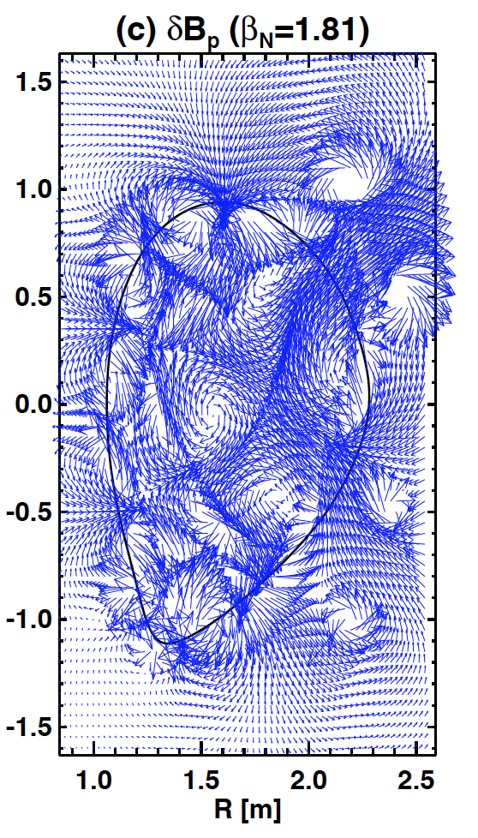
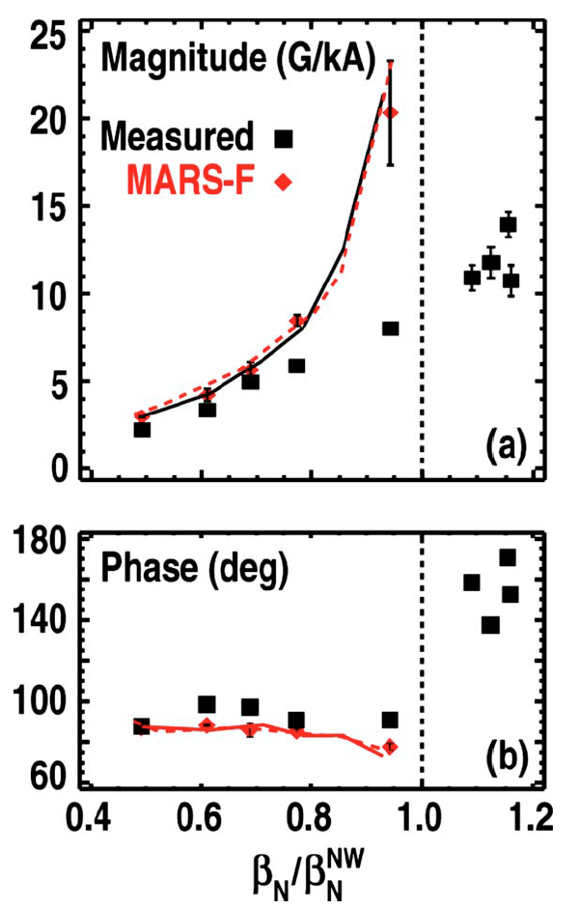
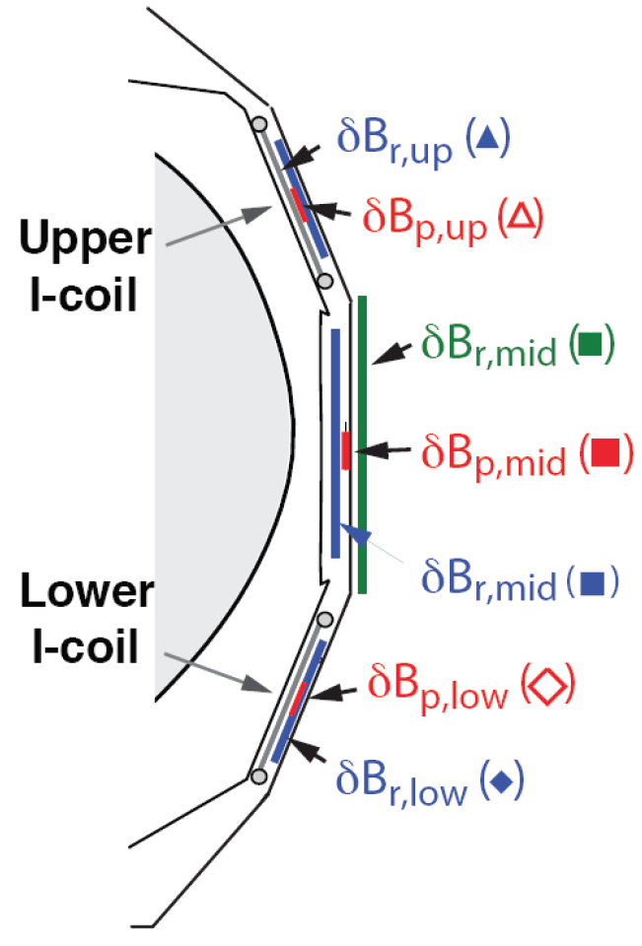
Example : Ideal response seems valid in low β but breaks down at marginally stable plasma
Ideal response agreed with magnetic measurements (in 7 different sensors) in amplitudes and phases, but only below the marginal β limit
Questions: How to explain RFA in high β? Kinetic response is more important in high β? Non-linear response? External measurement is enough to confirm plasma response?

Slide 7
Data analysis plans for plasma response
NSTX data including revision :
  n=1 high-beta RFA (#124800-, Published in 2009)
  Footprints with n=1 applied field, in 6 different phases (#140390-)
  RFA vs. Ω (Berkery, Submitted)
  Revisit and modify response perturbatively (PENT or POCA)
  Apply MARSK for self-consistent response calculations
  Apply VMEC to see non-linear response
  Compare eigenfunctions, and also with SXR if available
DIII-D data including revision :
  n=1 high-beta RFA (#135758-, Published in 2010)
  Apply MARSK for self-consistent response calculations, including fast ions
  Run linear and non-linear M3D-C1
  Compare eigenfunctions, and also with SXR or ECEI if available

Slide 8
Screening currents can provide a good measure of island opening threshold, but dynamics and parametric dependence is unresolved
Theoretical bases (Incomplete list):
  Fitzpatrick (1991-) : Error field instability, locking bifurcation from suppressed islands, parametric dependence in regimes, etc
  Boozer, Park (2007-) : Calculation of screening currents in ideal response, decomposition by overlap field instead of vacuum field
  Fitzpatrick (2012-) : Toroidal effects and density correlation by ion polarization currents
Experimental validation (Incomplete list):
  Hender, Buttery, La Haye, Menard, Wolfe, Schaffer (1991-) : Density correlation of error field threshold, parametric scaling
  Schaffer, Park, Paz-soldan (2007-) : Better correl. with total field than vacuum field
  Reimerdes, Buttery, Park (2009-) : Correlation changes vs. Ω (or torque)
  Buttery (2012) : Density correlation breaks down with increased non-resonant field
Important remaining issues (Incomplete list):
  Importance of non-resonant field in error field correction?
  Origin of density correlation and role of Ω (or torque)?
  True understanding of island dynamics and parametric scaling?

Slide 9
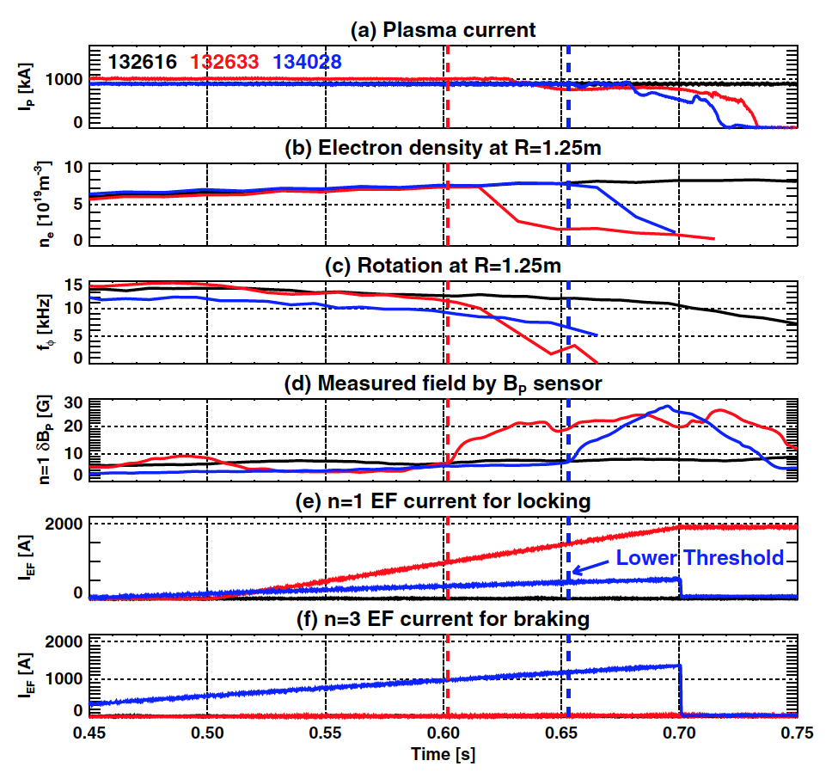
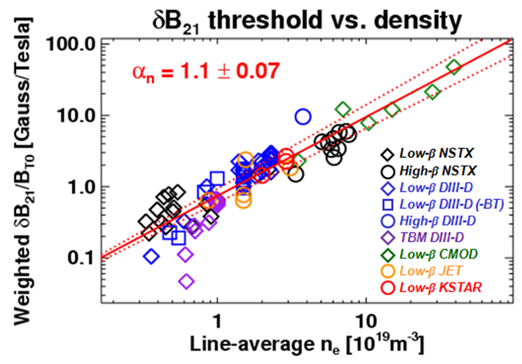
Example : Linear density correlation is robust in Ohmic plasmas, but breaks down with non-resonant field or external torque
When total field (representing screening currents) is used, linear density correlation becomes robust but only in conventional Ohmic plasmas
Questions: How to explain the density limit changes? Non-resonant field effects, directly or indirectly by rotation braking? Can we simulate island opening dynamics?
Injection torque by beam
Counter-torque by TBM
Resonant threshold decreases when non-resonant field is added

Slide 10
Data analysis plans for locking dynamics
NSTX data including revision :
  n=1 high-beta locking with n=3 (#134028-)
  NTM limit with n=1 resonant field (#134067-)
  Analyze and quantify NTV using PENT or POCA
  Apply resistive DCON or MARS to verify tearing mode stability
  Develop proper inner-layer model to predict error field threshold with various torques
DIII-D data including revision :
  n=1 proxy error field experiments (Published in 2012)
  n=1 TBM experiments (Published in 2010 and 2012)
  Analyze and quantify NTV using PENT or POCA
  Apply M3D-C1 to understand locking dynamics
  Compare eigenfunctions, and also with SXR or ECEI if available

Slide 11
Other Group Contributions Discussed (tentative)
Columbia U. (S. A. Sabbagh)
Focused task defined with Todd Evans, Nate Ferraro on determining realistic plasma response magnitudes/profiles in modeling when compared to experiment (w/M3D-C1) – Steve at GA this week for this
  Data from several NSTX experiments on NTV to determine bounds for the plasma response to different applied 3D field spectra: “n = 1”, “n = 2”, “n = 3” configurations
Bounds” on the RFA would be determined by NTV profile calculations in NSTX experiments using the NTVTOK code
  Note: NSTX NTV publications (~ 2006) have shown “n = 3” vacuum field is sufficient to calculate NTV, but plasma response needed for “n = 1”
ORNL (J. M. Canik)
  Apply VMEC to see non-linearity of plasma response
  Study ELM destabilization and triggering physics in NSTX and DIII-D, and apply VMEC and COBRA codes to see 3D stability characteristics

Slide 12
Experimental proposals to DIII-D (Incomplete list)
n=1 locking with n=2 braking (N. Logan, J.-K. Park)
  Motivated by 2013 KSTAR experiments (J. H. Kim)
  Shown that n=2 braking increases n=1 locking threshold in Ohmic plasmas
  Is different from other observations but consistent with A. Cole’s prediction
Finding Superbanana-plateau (N. Logan, J.-K. Park)
  Motivated by numerical benchmark between IPEC-PENT, MARS, POCA, FORTEC-3D
  All the codes except FORTEC-3D (Global code, PRL11) predicted SBP in a wide range of low collisionality
  Plans are to start with A. Cole’s rotational resonance experiments but to scan collsionality
ELM triggering in DIII-D (J. M. Canik)
…

