Slide 1




NSTX-U
Supported by
Plans / collaboration discussion – stability/ control theory/modeling (Columbia U. group)
S.A. Sabbagh¹, J.W. Berkery¹ J.M. Bialek¹, Y.S. Park¹, T.E. Evans², D.A. Gates³, S.P. Gerhardt³, I. Goumiri³, S. Jardin³, S. Kruger⁴, J.-K. Park³, Z. Wang³
¹Department of Applied Physics, Columbia University, NY, NY
²General Atomics, San Diego, CA
³Plasma Physics Laboratory, Princeton University, Princeton, NJ
⁴Tech-X, Boulder, CO
NSTX-U / DIII-D Collaboration meeting
December 10th, 2013
PPPL
Coll of Wm & Mary
Columbia U
CompX
General Atomics
FIU
INL
Johns Hopkins U
LANL
LLNL
Lodestar
MIT
Lehigh U
Nova Photonics
ORNL
PPPL
Princeton U
Purdue U
SNL
Think Tank, Inc.
UC Davis
UC Irvine
UCLA
UCSD
U Colorado
U Illinois
U Maryland
U Rochester
U Tennessee
U Tulsa
U Washington
U Wisconsin
X Science LLC
Culham Sci Ctr
York U
Chubu U
Fukui U
Hiroshima U
Hyogo U
Kyoto U
Kyushu U
Kyushu Tokai U
NIFS
Niigata U
U Tokyo
JAEA
Inst for Nucl Res, Kiev
Ioffe Inst
TRINITI
Chonbuk Natl U
NFRI
KAIST
POSTECH
Seoul Natl U
ASIPP
CIEMAT
FOM Inst DIFFER
ENEA, Frascati
CEA, Cadarache
IPP, Jülich
IPP, Garching
ASCR, Czech Rep

Slide 2
The Columbia U. group plans to contribute to JRT-14 (which is presently just being defined)
JRT-14
  Conduct experiments and analysis to investigate and quantify plasma response to non-axisymmetric (3D) magnetic fields in tokamaks
  Initial discussion focused on n = 1, considering both linear and non-linear response
Present planned Columbia contributions
  Focused task defined with Todd Evans, Nate Ferraro on determining realistic plasma response magnitudes/profiles in modeling when compared to experiment (w/M3D-C¹) – Steve at GA this week for this
  Use data from several NSTX experiments on NTV to determine bounds for the plasma response to different applied 3D field spectra: “n = 1”, “n = 2”, “n = 3” configurations
  “Bounds” on the RFA would be determined by NTV profile calculations in NSTX experiments using the NTVTOK code
    Note: NSTX NTV publications (~ 2006) have shown “n = 3” vacuum field is sufficient to calculate NTV, but plasma response needed for “n = 1”

Slide 3
The Columbia U. group plans to contribute to JRT-15 (which is also presently being defined)
JRT-15
  Experiments and analysis to quantify the impact of broad current and pressure profiles on tokamak plasma confinement and stability
  Initial discussion focused/defined JRT-15 along the lines of determining the effect of new actuators (NBI, NTV, etc.) in NSTX-U
Present planned Columbia contributions
  Kinetic RWM stability physics: impact of pressure, rotation profile changes from the new beam and also EP anisotropic distribution.
  Focus on NTV and NBI actuator results in pre-programmed plasma rotation control experiments on NSTX-U
  Compare experimental results with our present rotation control work (about 6 months work already) with I. Goumiri
    A significant part will be accuracy of NTV model developed in FY14 comparison to NTV theory in the NTVTOK code
  Also evaluate equilibrium reconstruction variation with NBI modification of J, q profile with varied NBI

Slide 4
NSTX-U is planning a disruption avoidance system, in which real-time MHD spectroscopy or kinetic physics can be used
Plasma Operations
Predictors
Disruption Warning System
Mitigation
γ contours
Control Algorithms
Avoidance Actuators (ω_{φ} , β_{N} control)
Both NSTX and DIII-D have a PCS based architecture
  Exception handling (Egemon)
  Active mode control
  Active profile control (rotation control via beams, NTV braking) informed by kinetic physics
  Real-time MHD spectroscopy

Slide 5
Columbia U. NSTX-U grant proposal research plans – drive collaborative research
Physics research areas on NSTX-U
  Global MHD mode stabilization physics (incl. kinetic RWM physics)
  Global MHD mode active control
  Non-resonant plasma rotation alteration / physics / control (NTV)
  NCC coil design
Related/coordinated research on DIII-D and KSTAR
  Aimed at verifying kinetic stabilization; limiting modes with TM stable
  Aimed at long-pulse, high beta; higher aspect ratio of KSTAR provides opportunity for comparison to NSTX-U to determine role of A
Quantitative analysis for ITER cases, future devices
  New ITPA MDC-21: global mode stabilization / disruption avoidance)
Near-term analysis: continue analysis / publication of NSTX results, with related device/code benchmarking

Slide 6
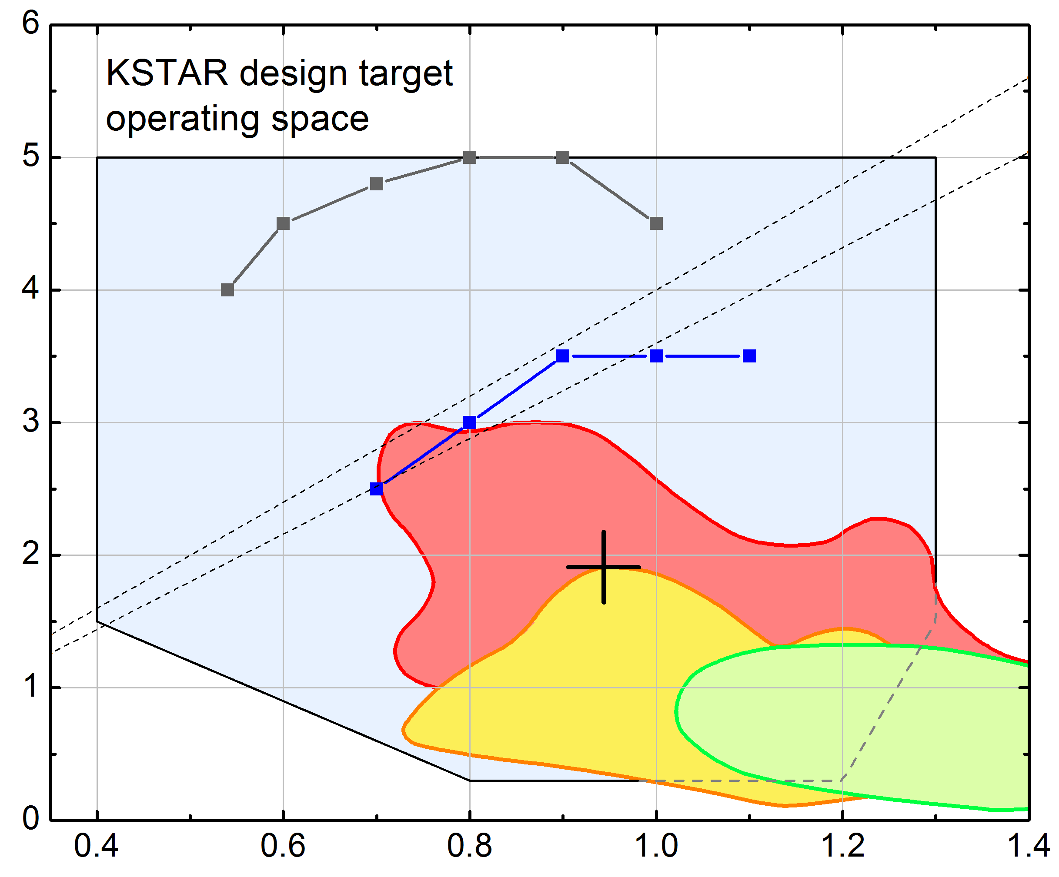
Plasmas have reached and exceeded the predicted “closest approach” to the n = 1 ideal no-wall stability limit
I_{p} scan performed to determine “optimal” β_{N} vs. I_{p}
  B_{T} in range 1.3 - 1.5T
  β_{N} up to 3.0
β_{N}/l_{i} > 3. (80% increase from 2011)
  a high value for advanced tokamaks, e.g. for DIII-D
Mode stability
  Target plasma is at published computed ideal n = 1 no-wall stability limit (DCON)
  Plasma is subject to RWM instability, depending on plasma rotation profile
  Rotating n = 1, 2 mode activity observed in core during H-mode
β_{N} /l_{i} = 4
β_{N} /l_{i} = 3.6
β_{N}
n = 1 with-wall limit
n = 1 no-wall limit
2012
operation
Previous max. β_{N}
(2011)
First
H-mode
(2010)
Plasma internal inductance (l_{i})

Slide 7
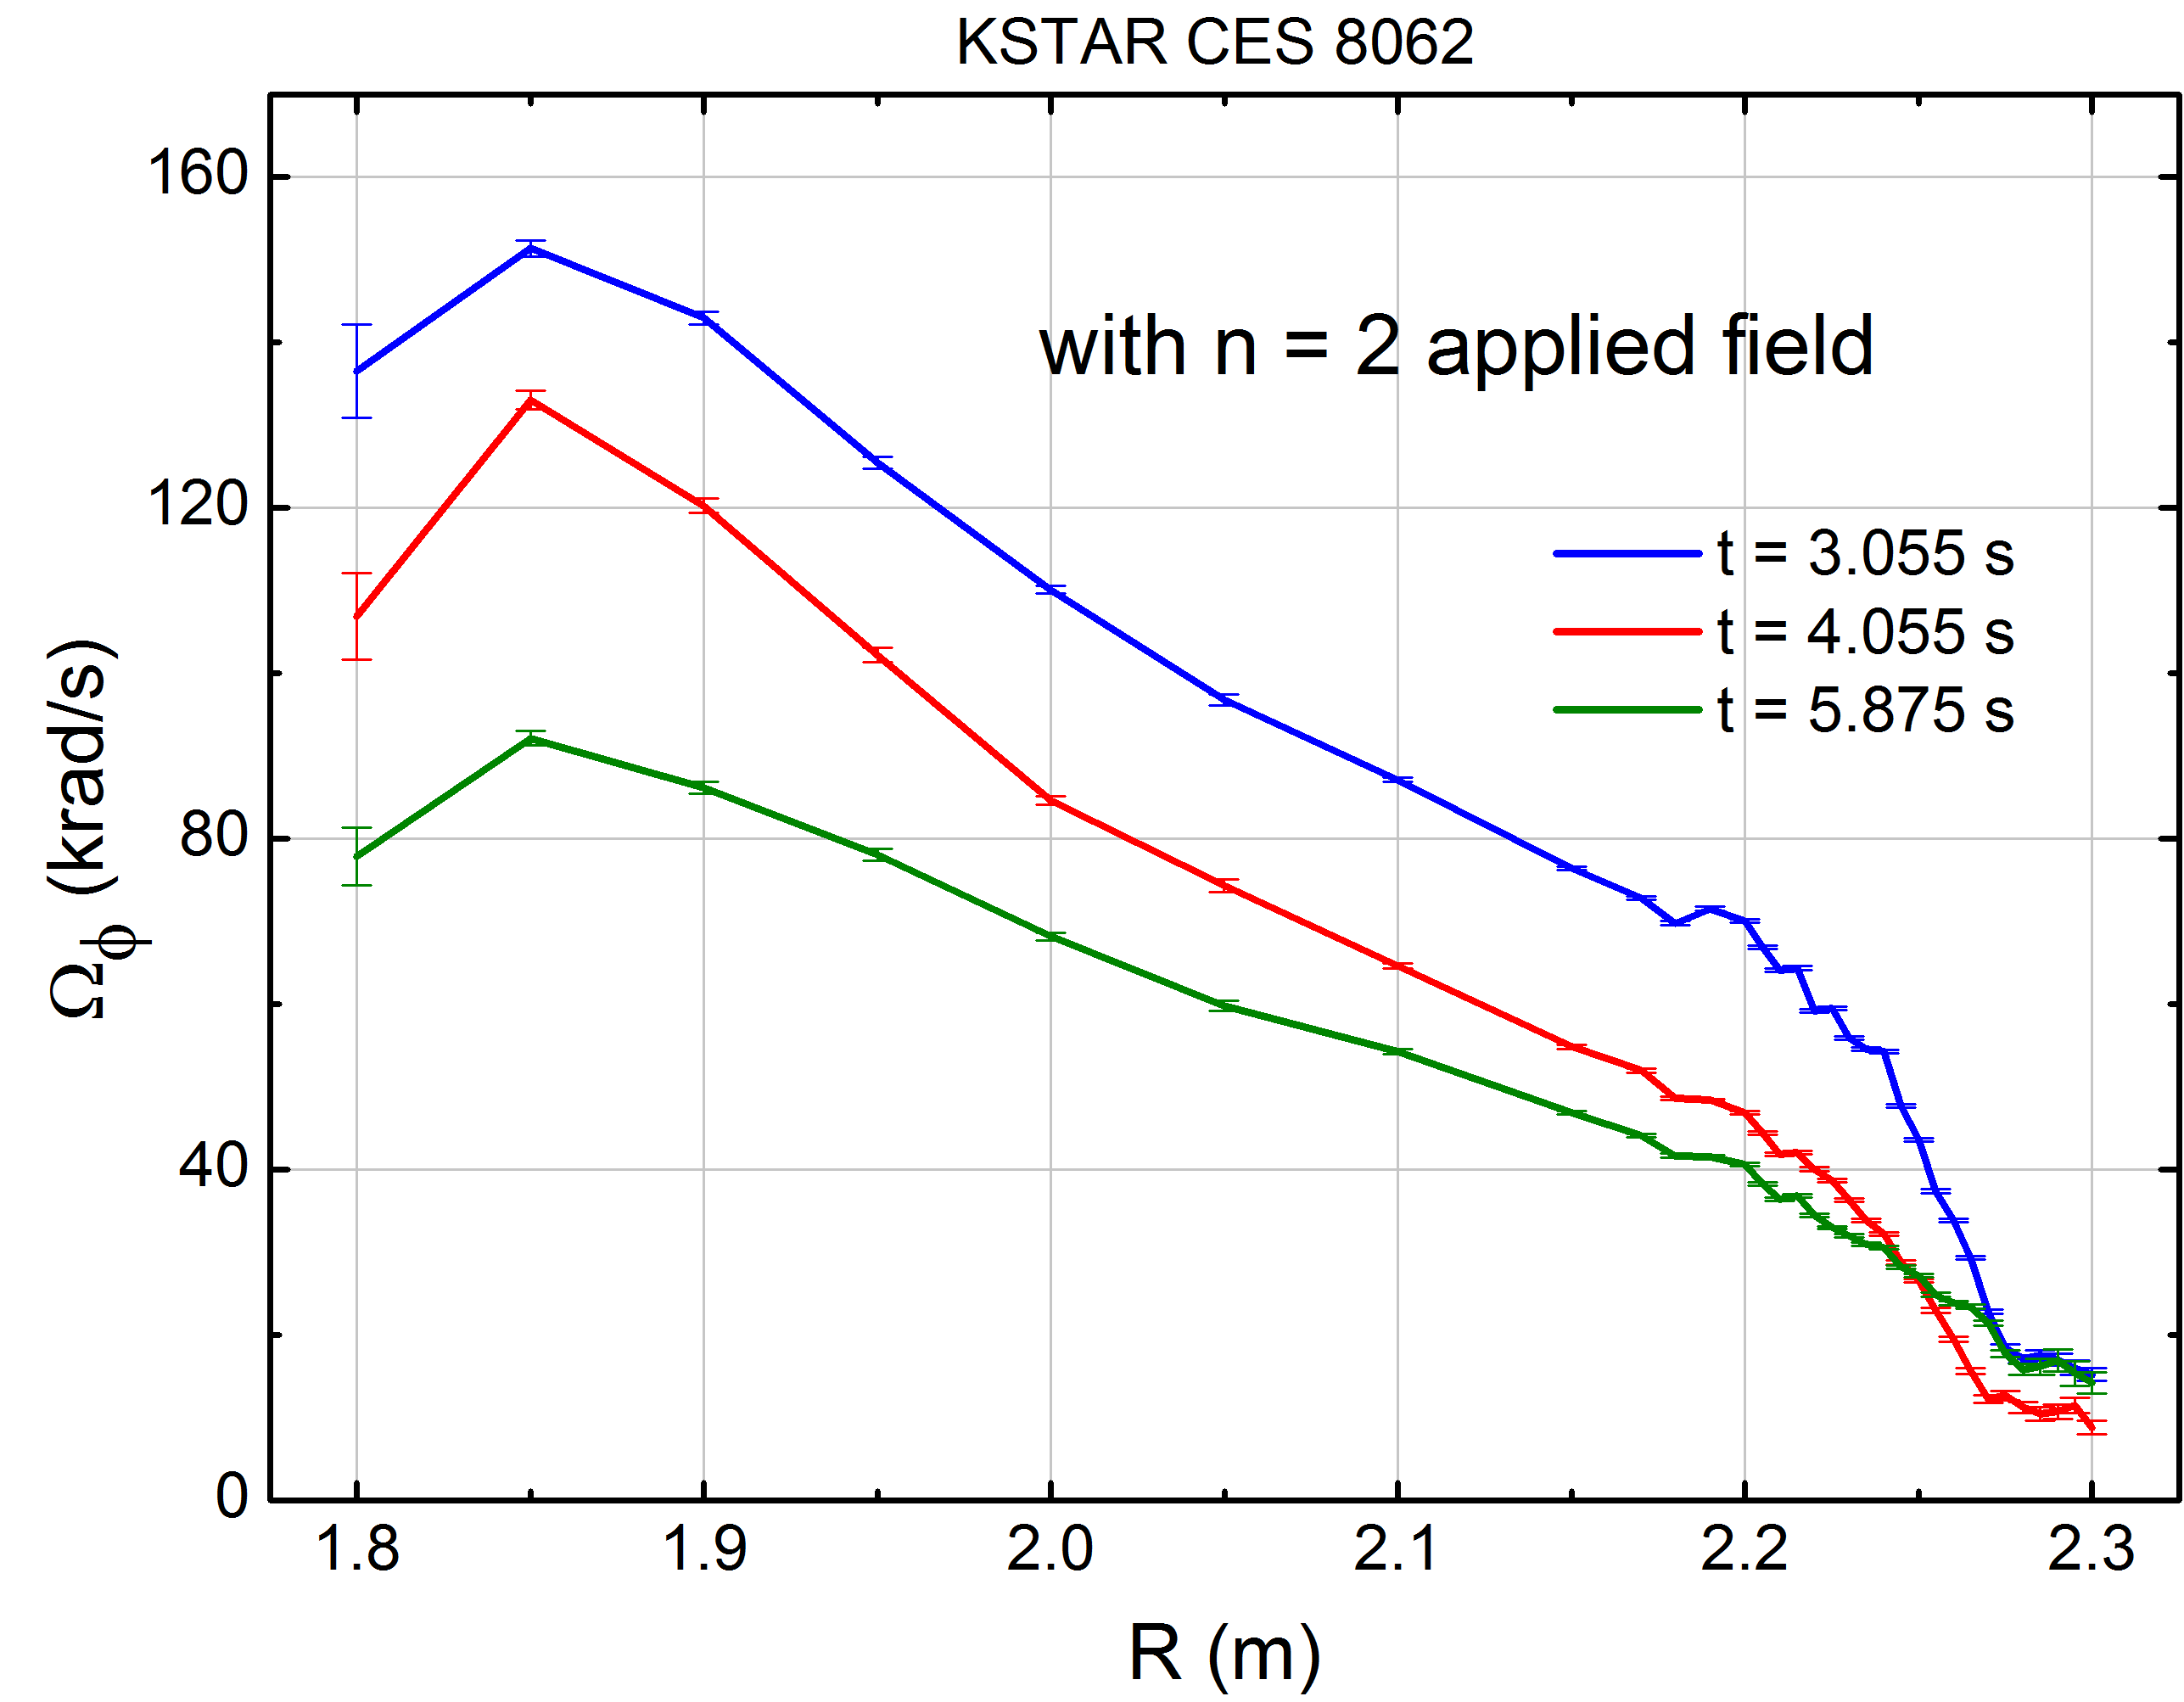
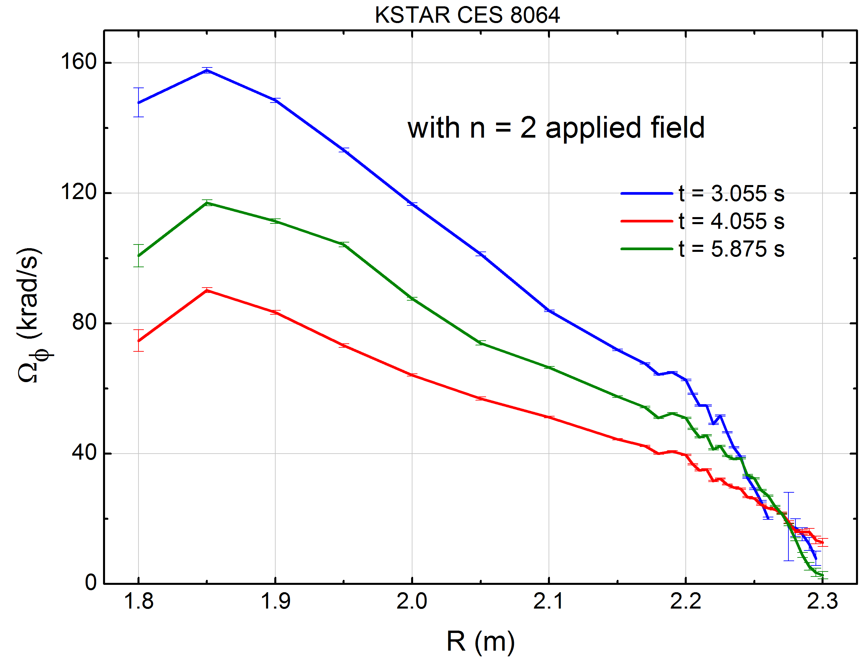
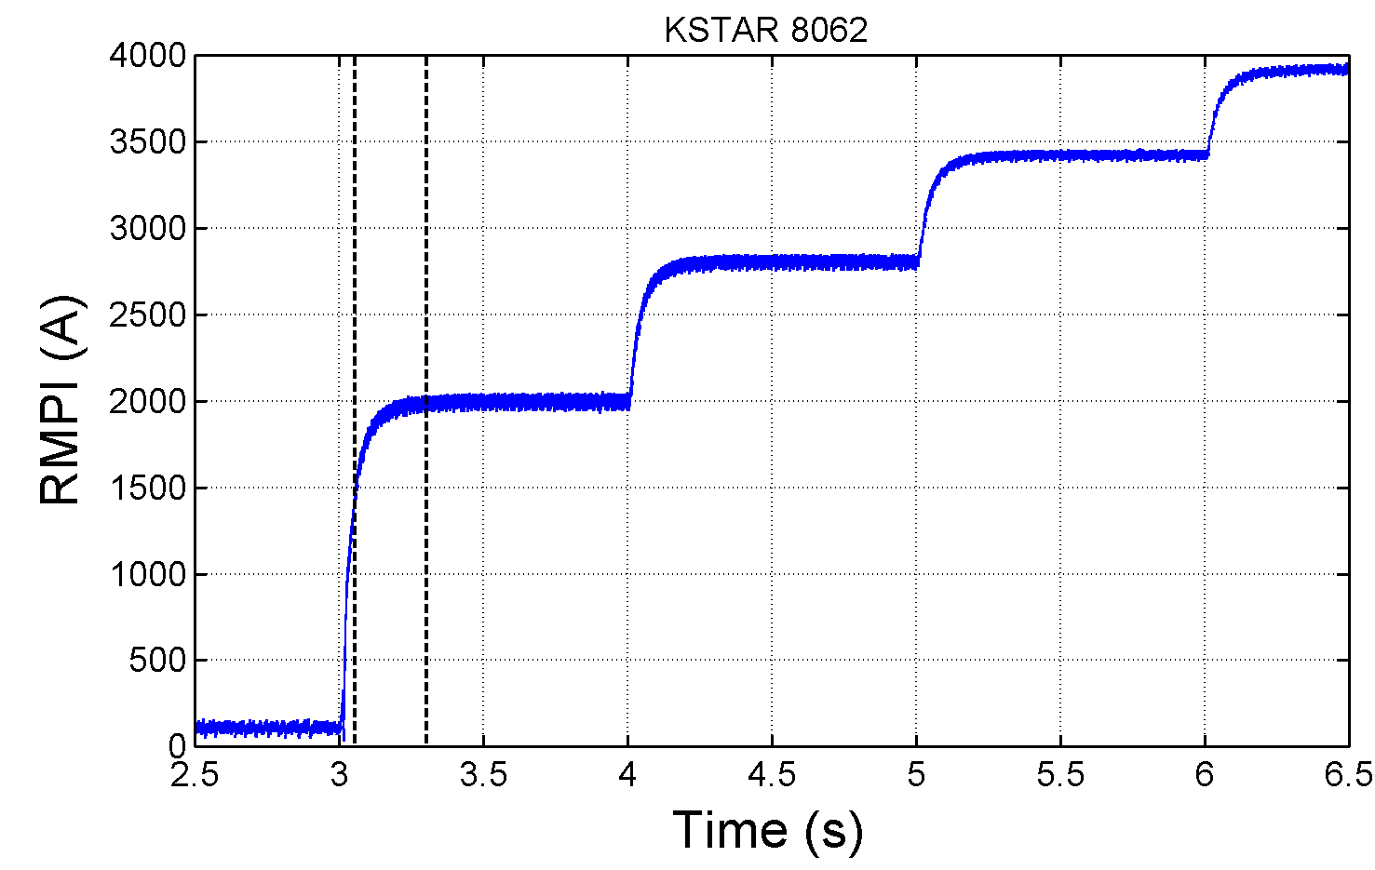
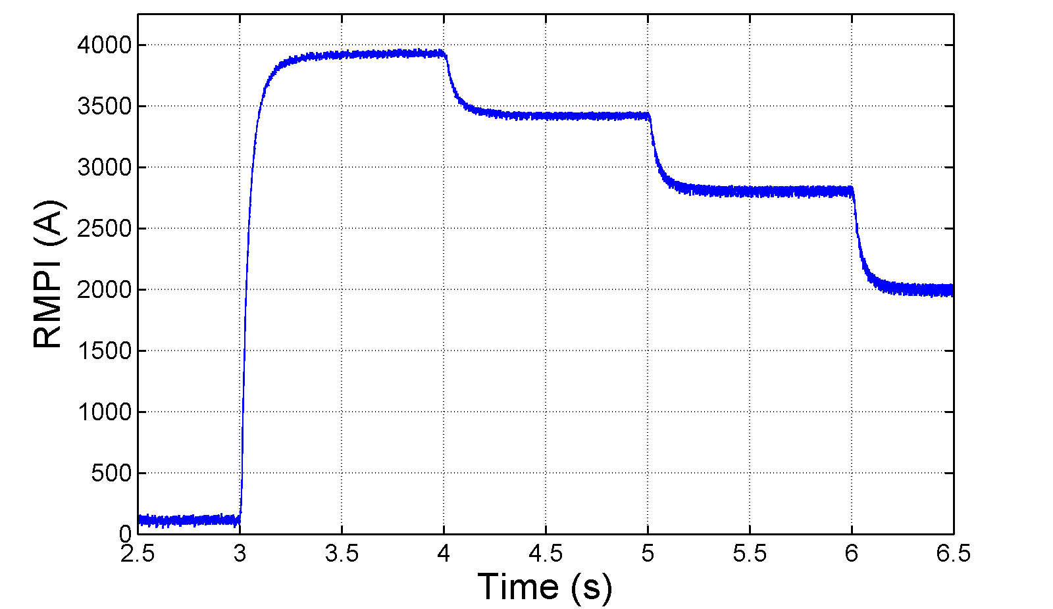
Measured toroidal plasma rotation profile shows non-resonant NTV rotation control using n = 2 field
1
With n = 2 field
(step current up)
With n = 2 field
(step current down)
1
2
3
3
2
8062
8064
IVCC n = 2 current
At same IVCC
current, rotation
profile shows no hysteresis – important for control
1
2
3
1
2
3

Slide 8
Discussion topics related to kinetic RWM stabilization
Stabilization physics due to fast particles should be further addressed
  Effects of anisotropic (e.g. NBI, RF) particle populations still not fully explored
  What are destabilization mechanisms (linear, or non-linear) that can be caused by fast particles?
  Is stabilization accounted due to Maxwellian distributions complete?
Long-standing issue – effect of key rational surfaces
  Generally, numerical integration of ideal eigenfunction very close to rational surfaces does not yield agreement with experiment
  In fact, omitting regions very close to key rationals yields results that compare better in quantitative comparison to experiment
  Major task with theory: develop an improved model of the plasma near key rationals – JRT14 should contribute to this

Slide 9
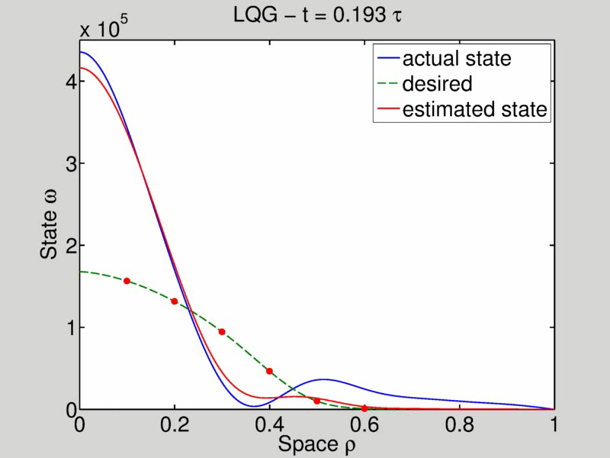
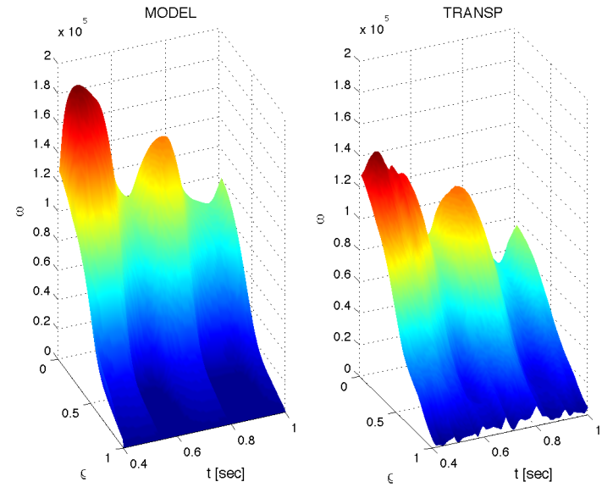
Model-based, state-space rotation controller designed to use Neoclassical Toroidal Viscosity (NTV) profile as an actuator
Momentum force balance – ω_{φ} decomposed into Bessel function states
NTV torque:
(non-linear)
Feedback using NTV: “n=3” δB(ρ) spectrum
State-space model
TRANSP run
133743
Desired
Plant
w/ Observer
Plasma rotation
NTV
region
radius
t(s)
t(s)
I. Goumiri

Slide 10
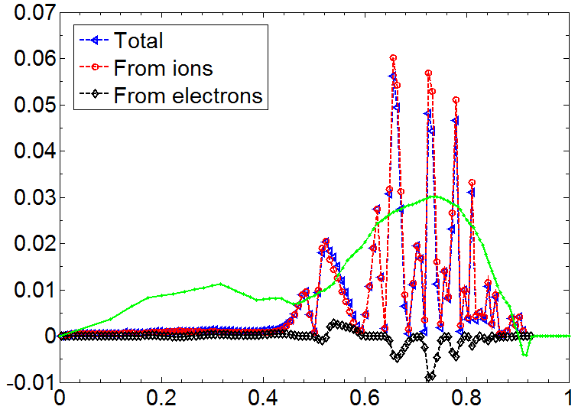
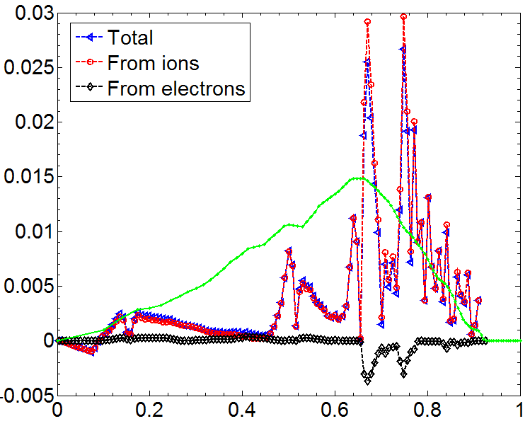
Expanded NTV torque profile model for control being developed from theory/comparison to experimental data
NSTX 3D coils used for rotation control
NTV torque profile (n = 3 configuration)
133726
(t=0.555s)
z(m)
Experimental
-dL/dt
(scaled)
-NTV torque density
y(m)
x(m)
NTVTOK
New analysis: NTVTOK code
  Shaing’s connected NTV model, covers all ν, and superbanana plateau regimes
  Past quantitative agreement with theory found in NSTX for plateau, “1/ν ” regimes
  Full 3D coil specification, ion and electron components considered, no A assumptions
(Sun, Liang, Shaing, et al., NF 51 (2011) 053015)
NTV torque profile (n = 2 configuration)
130723
(t=0.583s)
(Shaing, Sabbagh, Chu, NF 50 (2010) 025022)
Experimental
-dL/dt
(scaled)
-NTV torque density
(Zhu, Sabbagh, Bell, et al., PRL 96 (2006) 225002)
NTVTOK

Slide 11
Discussion topics related to model-based RWM state-space control (RWMSC)
Present NSTX RWMSC will be upgraded by the Columbia U. group for NSTX-U
  Upgrade includes independent control of present 6 RWM coils on NSTX-U, multi-mode control capability (n = 1 – 3), upgrade path to NCC, etc.
Can real-time plasma response model be expanded?
  Present model is the Boozer (s, α) model
    E.g. kinetic stabilization effects can be included directly through this model
    However, basic eigenfunctions are chosen a priori and are then altered by this response model. Can this specification be made more generally?
  Present modes and plasma response model are for ideal linear eigenfunctions. Can more general eigenfunctions be specified? (e.g. non-linear saturated?)
    What would be the appropriate plasma response model in this case?

Slide 12
Discussion topics related to non-linear MHD code analysis
Stability in the presence of a toroidal resistive wall
  Much experimental experience in NSTX – can test code using existing data
  M3D-C¹: resistive wall model is close (Steve meeting w/ Nate this week, beta test soon)
  NIMROD: collaboration with S. Kruger and student
    Model recently fixed, NSTX beta scan equilibria sent to Andi Becerra (met at APS 2013, plan defined with Hegna, Kruger, King)
Differential rotation between wall and mode is highly desired
  Physics studies of a fully locked mode are important, but differential rotation is needed to attempt to mimic kink stabilization dynamics
Kinetic stabilization physics is highly desired
  For comparison to present tested linear codes (implementation is obviously different!), as well as direct comparison to experiment
  M3D-C¹, NIMROD in different stages of development in this regard

Slide 13
Testing kinetic RWM stabilization theory at marginal stability in high β, TM stabilized plasmas (Idea #549)
Goals
  1. Test present kinetic RWM stability theory on plasmas very near to, or at RWM marginal stability in DIII-D for confident extrapolation to ITER, DEMO
  2. Determine RWM stability at high beta when TM is stable, or controlled
Deliverables
  Direct verification of DIII-D RWM marginal stability point vs. theory, testing kinetic stabilization theory that changes stability dependence on ω_{φ}, ν compared to earlier theory (changes extrapolation to future devices). Success would warrant a PRL-level publication.
  Improvement of DIII-D high β_{N}, high (β_{N}, q_{min}) steady-state plasmas, and best understanding/extrapolation to analogous ITER and DEMO scenarios
  Direct input for new ITPA joint experiment MDC-21 and ITER Organization urgent need - disruption avoidance (combined DIII-D, NSTX, theory effort)
General Approach
  Leverage plasmas at/near RWM marginal stability created in past MPS (150312, 149782)
  With plasma at RWM marginal stability, vary kinetic stabilization by varying plasma rotation speed and profile, and collisionality; Use targets to minimize (δW_{kin}/δW_{ideal}) (e.g. reduce δ)
  Apply ECCD TM stabilization to plasmas approaching RWM marginal stability that transition to TM instability instead of RWM instability
V1.1
  (run time request: 1 day)

Slide 14
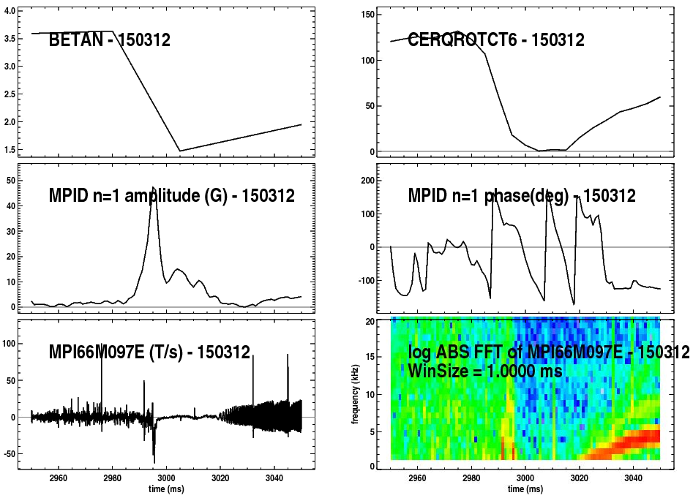
DIII-D High β_{N}, q_{min} shots show reproducible rotating RWM dynamics (target plasma #1)
Apparent unstable RWMs
  Mode growth time and phase evolution consistent with RWM dynamics
  Evolution to saturated mode activity (reaches 5 kHz at end of this time period)
  ECEI data indicates that a TM forms at t = 3.015s
    Significantly after apparent RWM destabilization
    Consistent with magnetics
  Request made for SXR data
A
B
A
B
A
B

Slide 15
Next steps for analysis / preparation for experiment
Determine key physical cause of difference in RWM stability of high β_{N}, high q_{min} plasmas vs. more stable high β_{N} plasmas
  Stability analysis of unstable shot (e.g. 150312) completed
  Compare to high beta, stable shots 133103 (l_{i} = 0.73, β_{N} = 3.9) and (RWM marginally stable?) shot 147634 (equilibria being prepared by J. Hanson)
Determine best high β_{N} target plasmas to test TM control
  Started discussion with Ege, Rob, Richard, Ted, Michio
    Minimum B_{T} may be ~ 1.5 T as in past high q_{min} targets, can raise B_{T} from here
  TM stabilization has been demonstrated in high β_{N} plasmas at 20% over the no-wall limit (e.g. M. Okabayashi, et al. NF 49 (2009) 125003 ); further development will be important part of this MP.
Follow general guidance to use mainline DIII-D operational scenarios if possible
  High β_{N}, q_{min} scenario is a main scenario for steady-state high β_{N} goals in 5 year plan

Slide 16
Grant Research

Slide 17
List of physics topics / codes in use / planned
Kinetic RWM stabilization
  MISK (linear kinetic RWM stability code)
  M3D-C¹, NIMROD: further linear benchmarking, and non-linear runs for NSTX-U (e.g. NIMROD: toroidal resistive wall tests)
Active RWM control
  RWM state-space controller development (incl. multi-mode)
  VALEN / mmVALEN (multi-mode)
Non-resonant NTV physics (focus on active rotation control)
  NTVTOK (Shaing et al. formulation, connecting collisionality regimes)
Equilibrium development
  NSTX EFIT – further development for NSTX-U
DIII-D/KSTAR data/analysis – closely coupled to NSTX-U
  Same analysis tools applied on related physics topics to investgate (i) aspect ratio dependence, (ii) long-pulse aspects

Slide 18
Planned analysis builds from present capabilities and collaborative work
Equilibrium
  Free-boundary: NSTX EFIT
  Fixed boundary: CHEASE (w/Liu), JSOLVER, etc.
Stability
  DCON, PEST: ideal linear stability analysis
  MISK (w/R. Betti): kinetic RWM stability analysis
  M3D-C¹ (w/S. Jardin, N. Ferraro): linear/non-linear stability
  NIMROD (w/S. Kruger): recent collaboration started - NSTX cases being run
3D Physics
  NTVTOK: NTV code on CU computer, used present NSTX data analysis
  TRIP3D (w/T. Evans): ELM mitigation – used for KSTAR, etc.
  M3D-C¹ (w/S. Jardin): global mode stability, effect of 3D field on stability, (w/ T. Evans, N. Ferraro, S. Jardin): plasma response
Control
  VALEN: RWM / dynamic error field control analysis
  Multi-mode VALEN: Unstable MHD mode spectrum and control
  RWMSC: State-space RWM analysis / feedback control

Slide 19
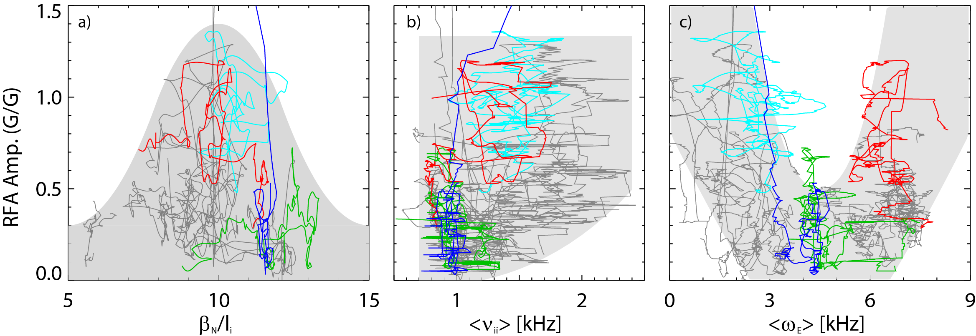
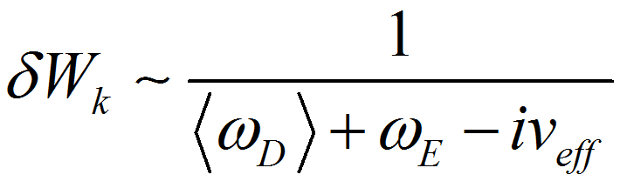
Experiments directly measuring global stability using MHD spectroscopy (RFA) support kinetic RWM stability theory
Resonant Field Amplification vs. β_{N}/l_{i}
RFA vs. rotation (ω_{E})
unstable
RWM
Most
stable
Stability at lower ν
  Collisional dissipation is reduced
  Stabilizing resonant kinetic effects are enhanced
  Stabilization when near broad ω_{φ} resonances; almost no effect off-resonance
(trajectories of 20 experimental plasmas)
Stability vs. rotation
  Largest stabilizing effect from ion precession drift resonance with ω_{φ}
Stability vs. β_{N}/l_{i}
  decreases up to β_{N}/l_{i} = 10, increases at higher β_{N}/l_{i}
  Consistent with kinetic resonance stabilization
Minimize |<ω_{D}> + ω_{E}|
S. Sabbagh et al., NF 53 (2013) 104007

Slide 20
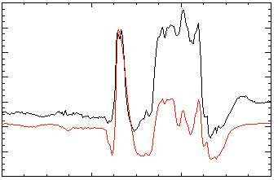
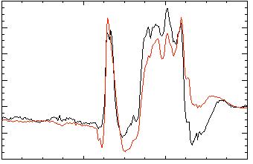
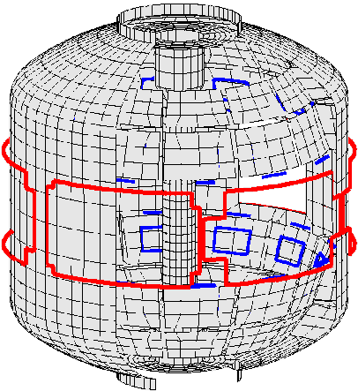
Model-based RWM state space controller including 3D plasma response and wall currents used at high β_{N} in NSTX
RWM state space controller in NSTX at high β_{N}
Effect of 3D Model Used
No NBI Port
80
δB_{p}⁹⁰
Measurement
40
Controller
(observer)
0
-40
137722
0.56
0.58
0.60
0.62
t (s)
With NBI Port
80
δB_{p}⁹⁰
40
Potential to allow more flexible control coil positioning
  May allow control coils to be moved further from plasma, and be shielded (e.g. for ITER)
0
137722
0.56
0.58
0.60
0.62
t (s)
3D detail of model is important to improve sensor agreement
Katsuro-Hopkins, et al., NF 47 (2007) 1157
S.A. Sabbagh, et al., Nucl. Fusion 53 (2013) 104007

Slide 21
RWM active control capability will increase significantly when Non-axisymmetric Control Coils (NCC) are added to NSTX-U
Using present midplane RWM coils
NCC 2x12 with favorable sensors, optimal gain
Full NCC
2x12 coils
Performance enhancement
  Present RWM coils: active control to β_{N}/β_{N}^{no-wall} = 1.25
  Add NCC 2x12 coils, optimal sensors: active control to β_{N}/β_{N}^{no-wall} = 1.67
  Partial NCC options also viable
Existing
RWM
coils
VALEN (J. Bialek)

Slide 22
Comments and discussion topics related to NCC design analysis for NSTX-U
The present approach of combining key figures of merit to produce a multi-use coil system is the correct one
We need to be careful that further analysis / results in the coming year that influences the NCC design doesn’t greatly decrease multi-use flexibility
  E.g. recent DIII-D ELM suppression results (Orlov APS ‘13) indicate that a subset of I-coils are adequate for ELM control – NCC coil design should (and can) expand to test this, rather than downsize
  Need to avoid similar potential issue based on unproven theory that might restrict physics studies rather than provide a coil to prove them
Next steps for NCC design for RWM active control (CU plan)
  Realistic sensors that minimize coupling to passive plates need to be designed and implemented in calculations of present NCC design
  NSTX-U should have sensors with both weak and strong coupling to passive plates for RWM state-space controller physics studies

Slide 23
Multi-year ITPA MDC-2 benchmarking of kinetic RWM codes reached the group’s goals
 | r_{wall}/a | Ideal δW/-δW∞ | Re(δW_{k}) /δW∞ | Im(δW_{k})/ (δW∞) | γτ_{wall} | ωτ_{wall} | δW_{k}/-δW∞ (ω_{E} = ∞)
Solov’ev 1 (MARS-K) (MISK) | 1.15 | 1.187 1.122 | 0.0256 0.0179 | -0.0121 -0.0117 | 0.803 0.861 | 0.0180 0.0189 | 0.157 0.160
Solov’ev 3 (MARS-K) (MISK) | 1.10 | 1.830 2.337 | 0.0919 0.0879 | -0.169 -0.090 | 0.471 0.374 | 0.114 0.051 | 1.98 1.10
ITER (MARS-K) (MISK) | 1.50 | 0.682 0.677 | 0.241 0.367 | -0.046 -0.133 | 0.817 0.581 | 0.090 0.202 | 6.11 6.67
Recent success in producing agreement between MISK and MARS-K
  PENT code development added in 2013
MISK code has been extensively used to quantitatively compare theory/experiment in NSTX
  6 publications from NSTX (first is from 2008)
MDC-2 process has altered both MISK and MARS-K a bit
  MISK comparison to NSTX RWM stability experiments continues to evaluate changes

Slide 24
Analysis / code expansion driven by proposed research, NSTX-U device needs
Equilibrium
  NSTX-U EFIT: expand diagnostics/model, increase (R,Z,t) resolution, speed
  CHEASE: (w/Liu), etc.: equilibrium refinement / exchange
Stability
  DCON, PEST: ideal linear stability analysis (resistive DCON very close)
  MISK: continued quantitative development, driven by ITPA MDC-2 NSTX XP data
  M3D-C¹: resistive wall available soon / desire for kinetic effects (compare to MISK)
  NIMROD: resistive wall / kinetic effects available – collaborative initial tests on NSTX cases with resistive wall underway with S. Kruger and UW student.
3D Physics
  NTVTOK: once NSTX analysis completed, will compare with IPEC and POCA codes
  TRIP3D: ELM mitigation – use for NSTX-U as desired
  M3D-C¹ (Jardin, Ferraro): desire resistive wall, and kinetic stabilization effects
Control
  VALEN: continue NSTX-U RWM control analysis (that has already begun)
  Multi-mode VALEN: multi-mode spectrum NSTX-U, active control w/RWMSC
  RWMSC: n > 1 modeling + upgrades, control simulator w/expanded inputs
    Inputs: Device data, vacuum field, code results (VALEN, M3D-C¹, etc. )

Slide 25
DIII-D experiments

Slide 26
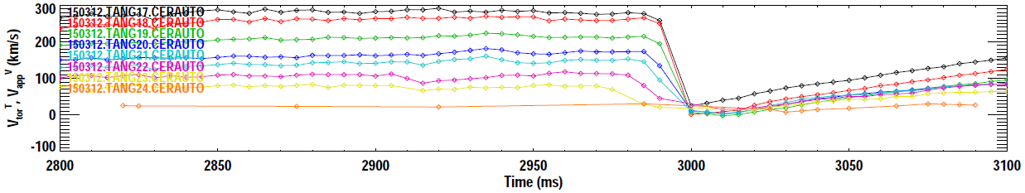
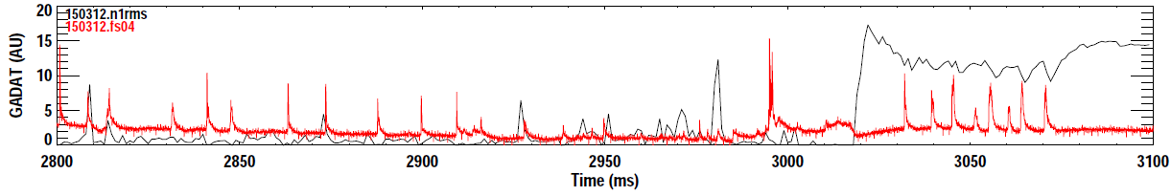
High β_{N}, q_{min} shots show reproducible minor disruptions, apparently caused by RWM activity (target plasma #1)
A
B
V_{φ} (150312)
A
B
1) Drop in V_{φ} corresponding RWM rotation, amplitude increase
4) ECEI shows TM phase inversion here, spins up as V_{φ} increases
2) V_{φ} collapse is global (consistent with non-res NTV, no TM at this time)
3) “ELM” appears AFTER V_{φ} collapse (apparently not causal)

Slide 27
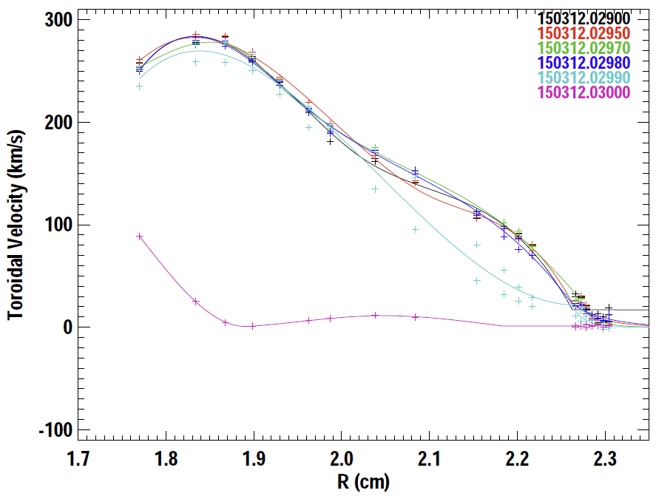
V_{φ} profile collapse at the time RWM growth appears to be a rapid, global collapse, rather than a resonant lock
2.98s
2.99s
3.00s
t = 2.980s
t = 2.990s
t = 3.00s
Rotation damping characteristic of global RWM rather than a TM which would initially damp near a key rational surface
(B. Grierson)

Slide 28
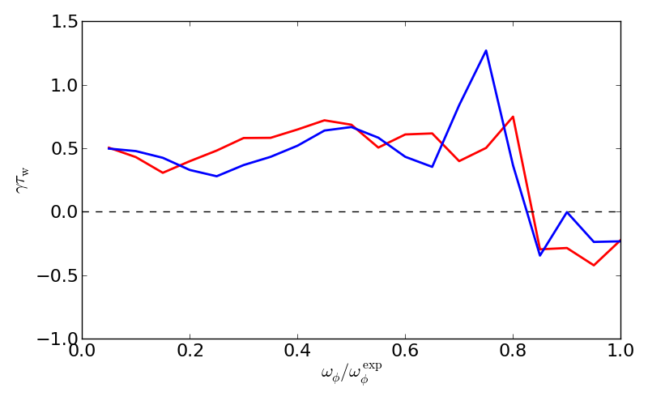
MISK kinetic RWM stability analysis of shot 150312 shows the plasma to be near marginal stability
t = 2.970s
(broader rotation profile)
Unstable
t = 2.990s
(more peaked rotation profile)
Stable
150312
(plasma rotation)
Rotation profile scaled from the experimental profile for the scan
MISK analysis shows that these equilibria are near marginal stability (RWM unstable when rotation is reduced by ~ 10 – 20%)

Slide 29
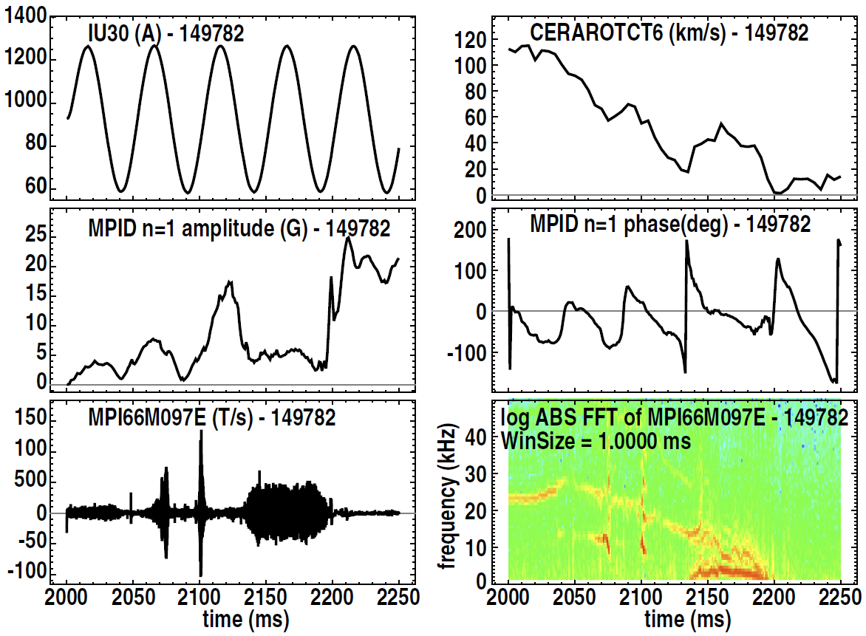
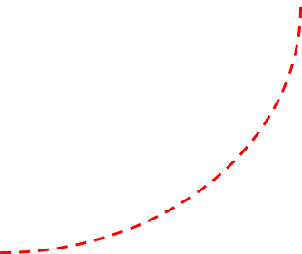
High β_{N} targets generated in past kinetic RWM run may become RWM unstable if TM is stabilized (Target plasma #2)
1
RFA of ~ 20Hz n = 1 increase to very high levels
  Greater than 30G/kA (past high values typically ~ 10-15 G/kA)
  Occurs at high β_{N} – pressure-driven
  Added counter-NBI power leads to slowing of plasma rotation (but no TM locking evident in V_{φ}(R))
  Rapidly rotating n = 1 appears (TM?), clamps RFA amplitude
  Such activity precludes RWM instability in NSTX
Experimental plan
  Stabilize TM plasmas like this via ECCD – run at higher B_{T} >= 1.5 T
  Vary NBI source balance to change RWM marginal point (proximity to broad kinetic resonances) by changing rotation speed, and rotation profile
1
2
1
2
2

Slide 30
Unstable modes with RWM characteristics often lead to strong thermal collapses in high β_{N}, q_{min} plasmas
High impact:
  Cause large, rapid stored energy collapse ΔW_{tot} ~ 60% (200 MJ in ITER)
    For comparison, large ELMs have ΔW_{tot} up to 6% (20 MJ in ITER)
High probability:
  RWMs and TMs cause these collapses in 82% of the plasmas examined, with an average of 3 collapses every 2 shots (50+ shots examined)
  RWMs cause collapse 60% of the time, TMs 40% of the time
The RWMs also destabilize TMs
  RWMs lead to large, rapid collapse of rotation, allowing EF penetration – TMs can be destabilized, typically spin up, but can then lock
  Plasmas are favorable targets for this kinetic RWM stabilization study

Slide 31
KSTAR experiments

Slide 32
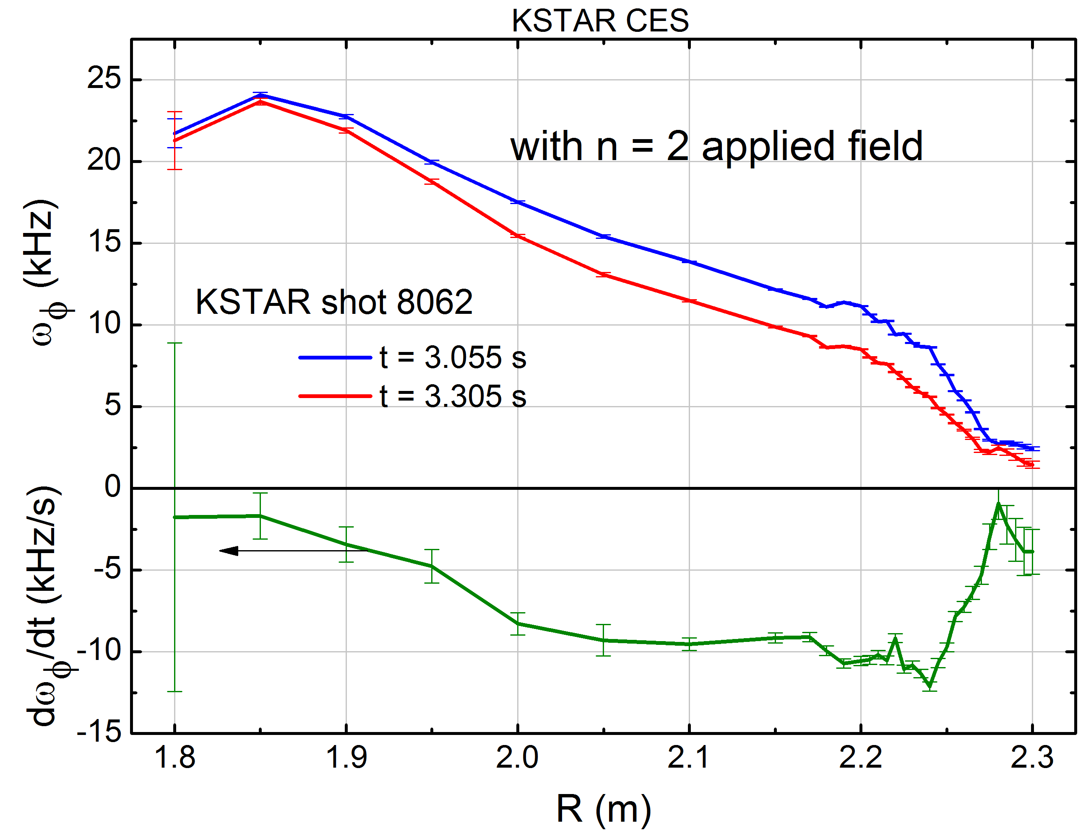
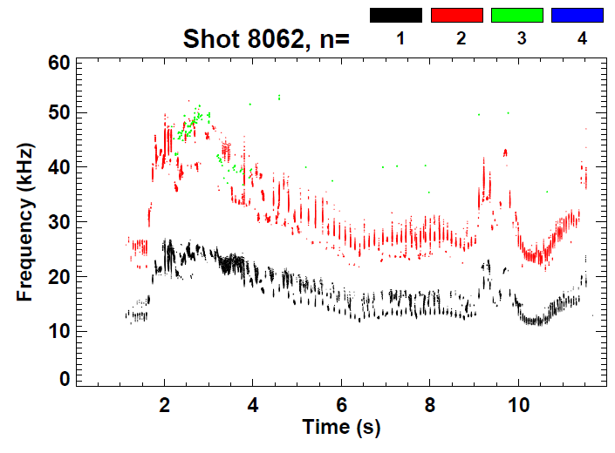
Rotation reduction by n = 2 applied field is global and appears non-resonant (NTV); no mode locking
t = 3.305s
t = 3.055s
IVCC n = 2 current
(“midplane coil”)
Damping rate
profile
magnetic spectrum
Rotating n = 1, 2 modes observed in core
  would not produce the observed rotation profile change (no change in core)

Slide 33
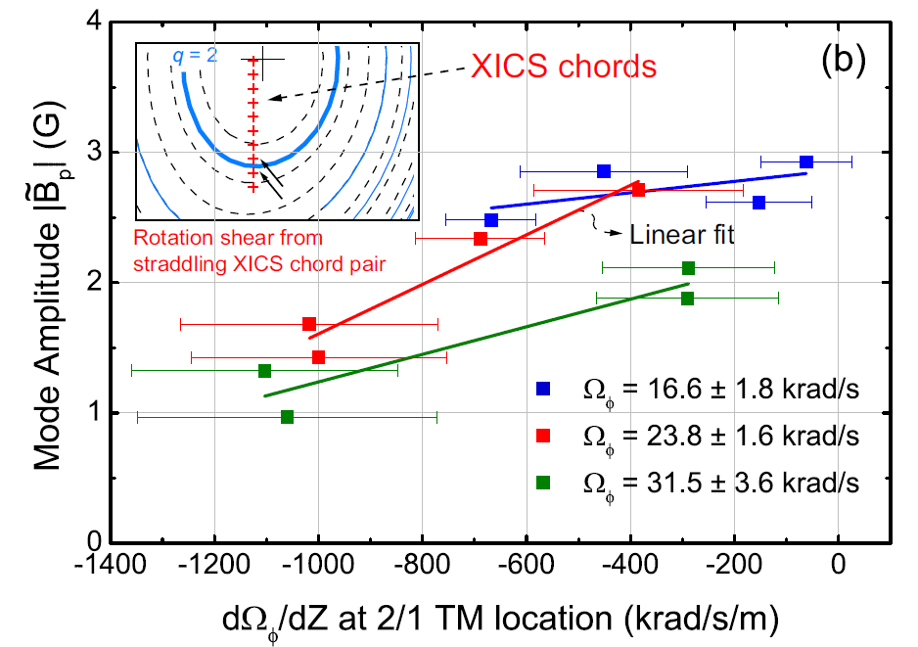
Correlation between plasma velocity shear and 2/1 TM amplitude found
Mode identification from ECE, ECEI systems
Observed increase of TM amplitude vs. Ω_{φ} shear decreases at reduced Ω_{φ}
Y.S. Park, S.A. Sabbagh, J.M. Bialek, et al. Nucl. Fusion 53 (2013) 083029

Slide 34
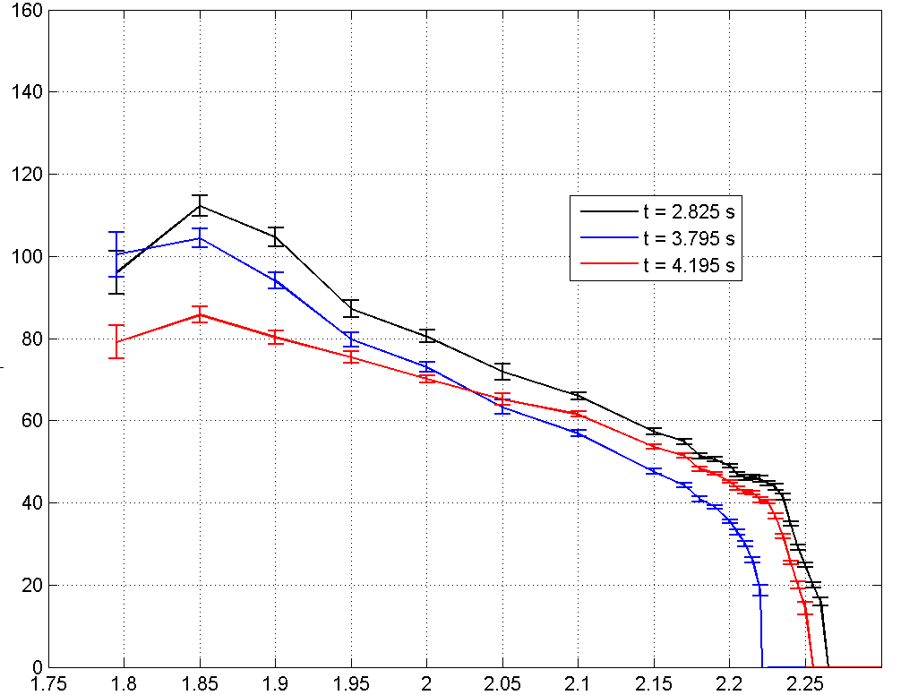
Rotation profile alteration observed with combined IVCC n = 2 NTV + ECH (110 + 170 GHz)
Rotation profile before n = 2 and ECH
Combination of effects / timing can change Ω_{φ} shear
  Note: n = 2 NTV current was run at only ½ maximum (not max. effect)
  n = 2 NTV shows global rotation damping
  Addition of ECH drops core rotation, increases edge Ω_{φ}, decreases shear
    Outward momentum transfer
Ω_{φ} (krad/s)
n = 2 NTV + ECH
n = 2 NTV alone
9281
R (m)

Slide 35
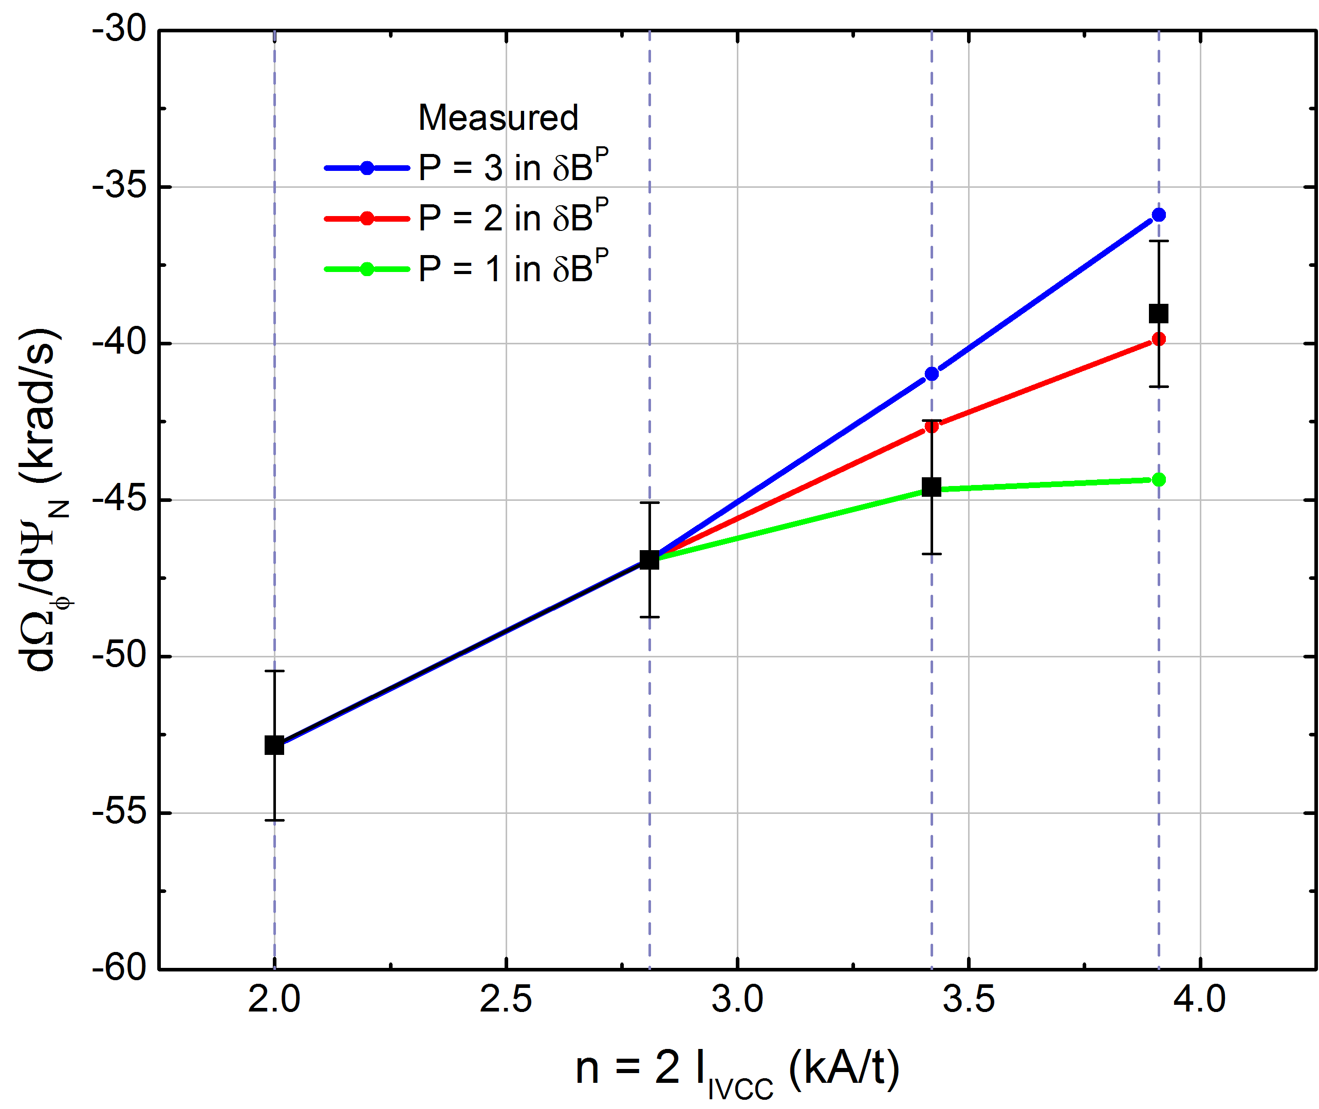
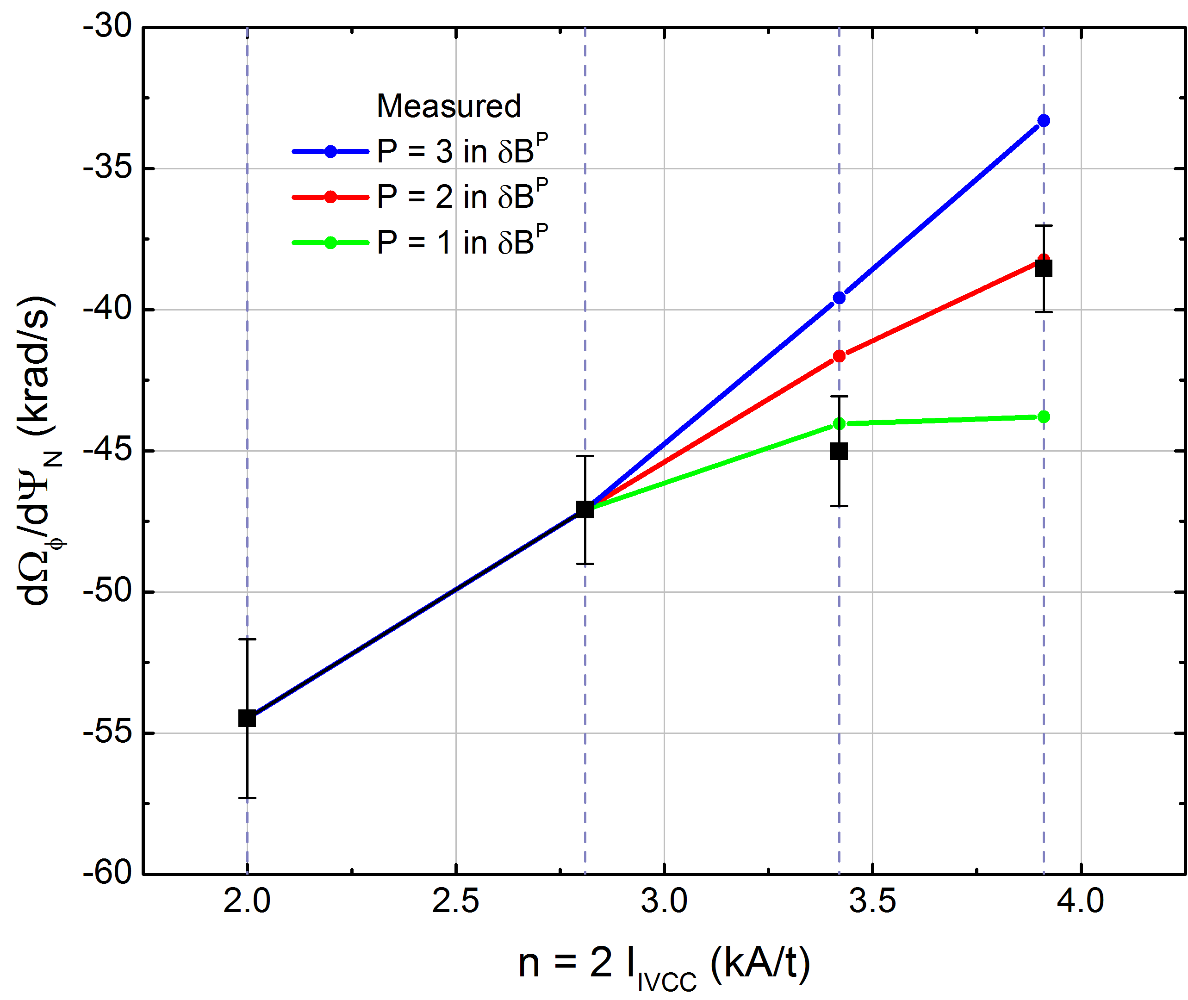
Steady-state profile analysis to examine NTV dependence on δB
Resulting NTV correlation with different power in δB^{P}
δB²
δB²
Ψ_{N}= 0.58
Ψ_{N}= 0.56
Estimate slope between step #1-2 (largest ΔI_{n=2})
then propagate it to other steps
Smaller number of samples
in step #3 may cause relatively
large deviation
Step #1
Step #2
Step #3
Step #4
Step #1
Step #2
Step #3
Step #4
  For the different normalized flux surfaces, T_{NTV} scales well with δB² as similar to collisionless “1/ν” regime in NTV theory
Y.S. Park, APS DPP 2013

Slide 36
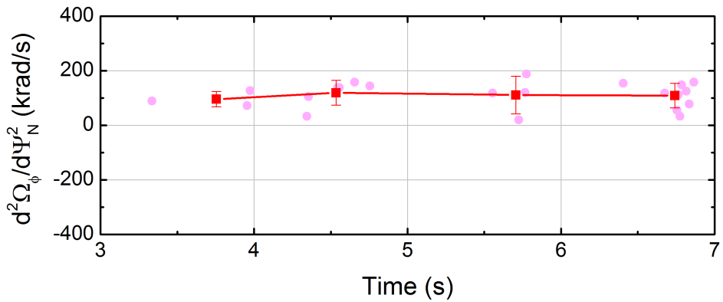
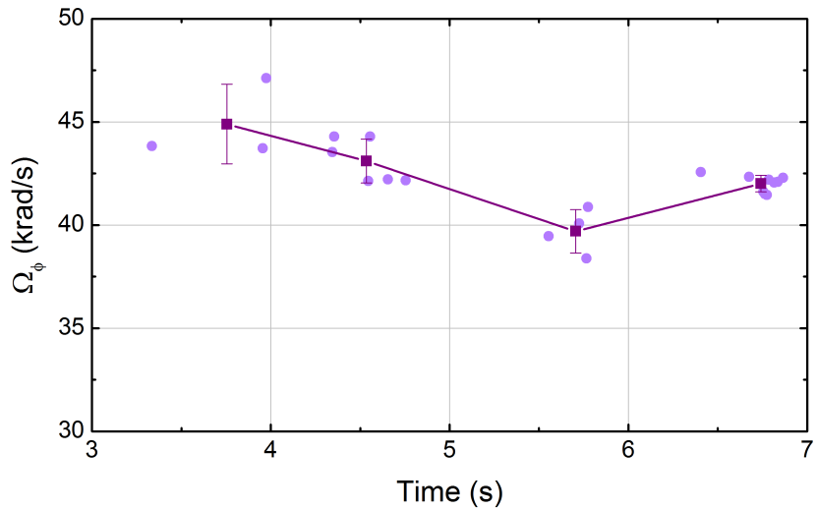
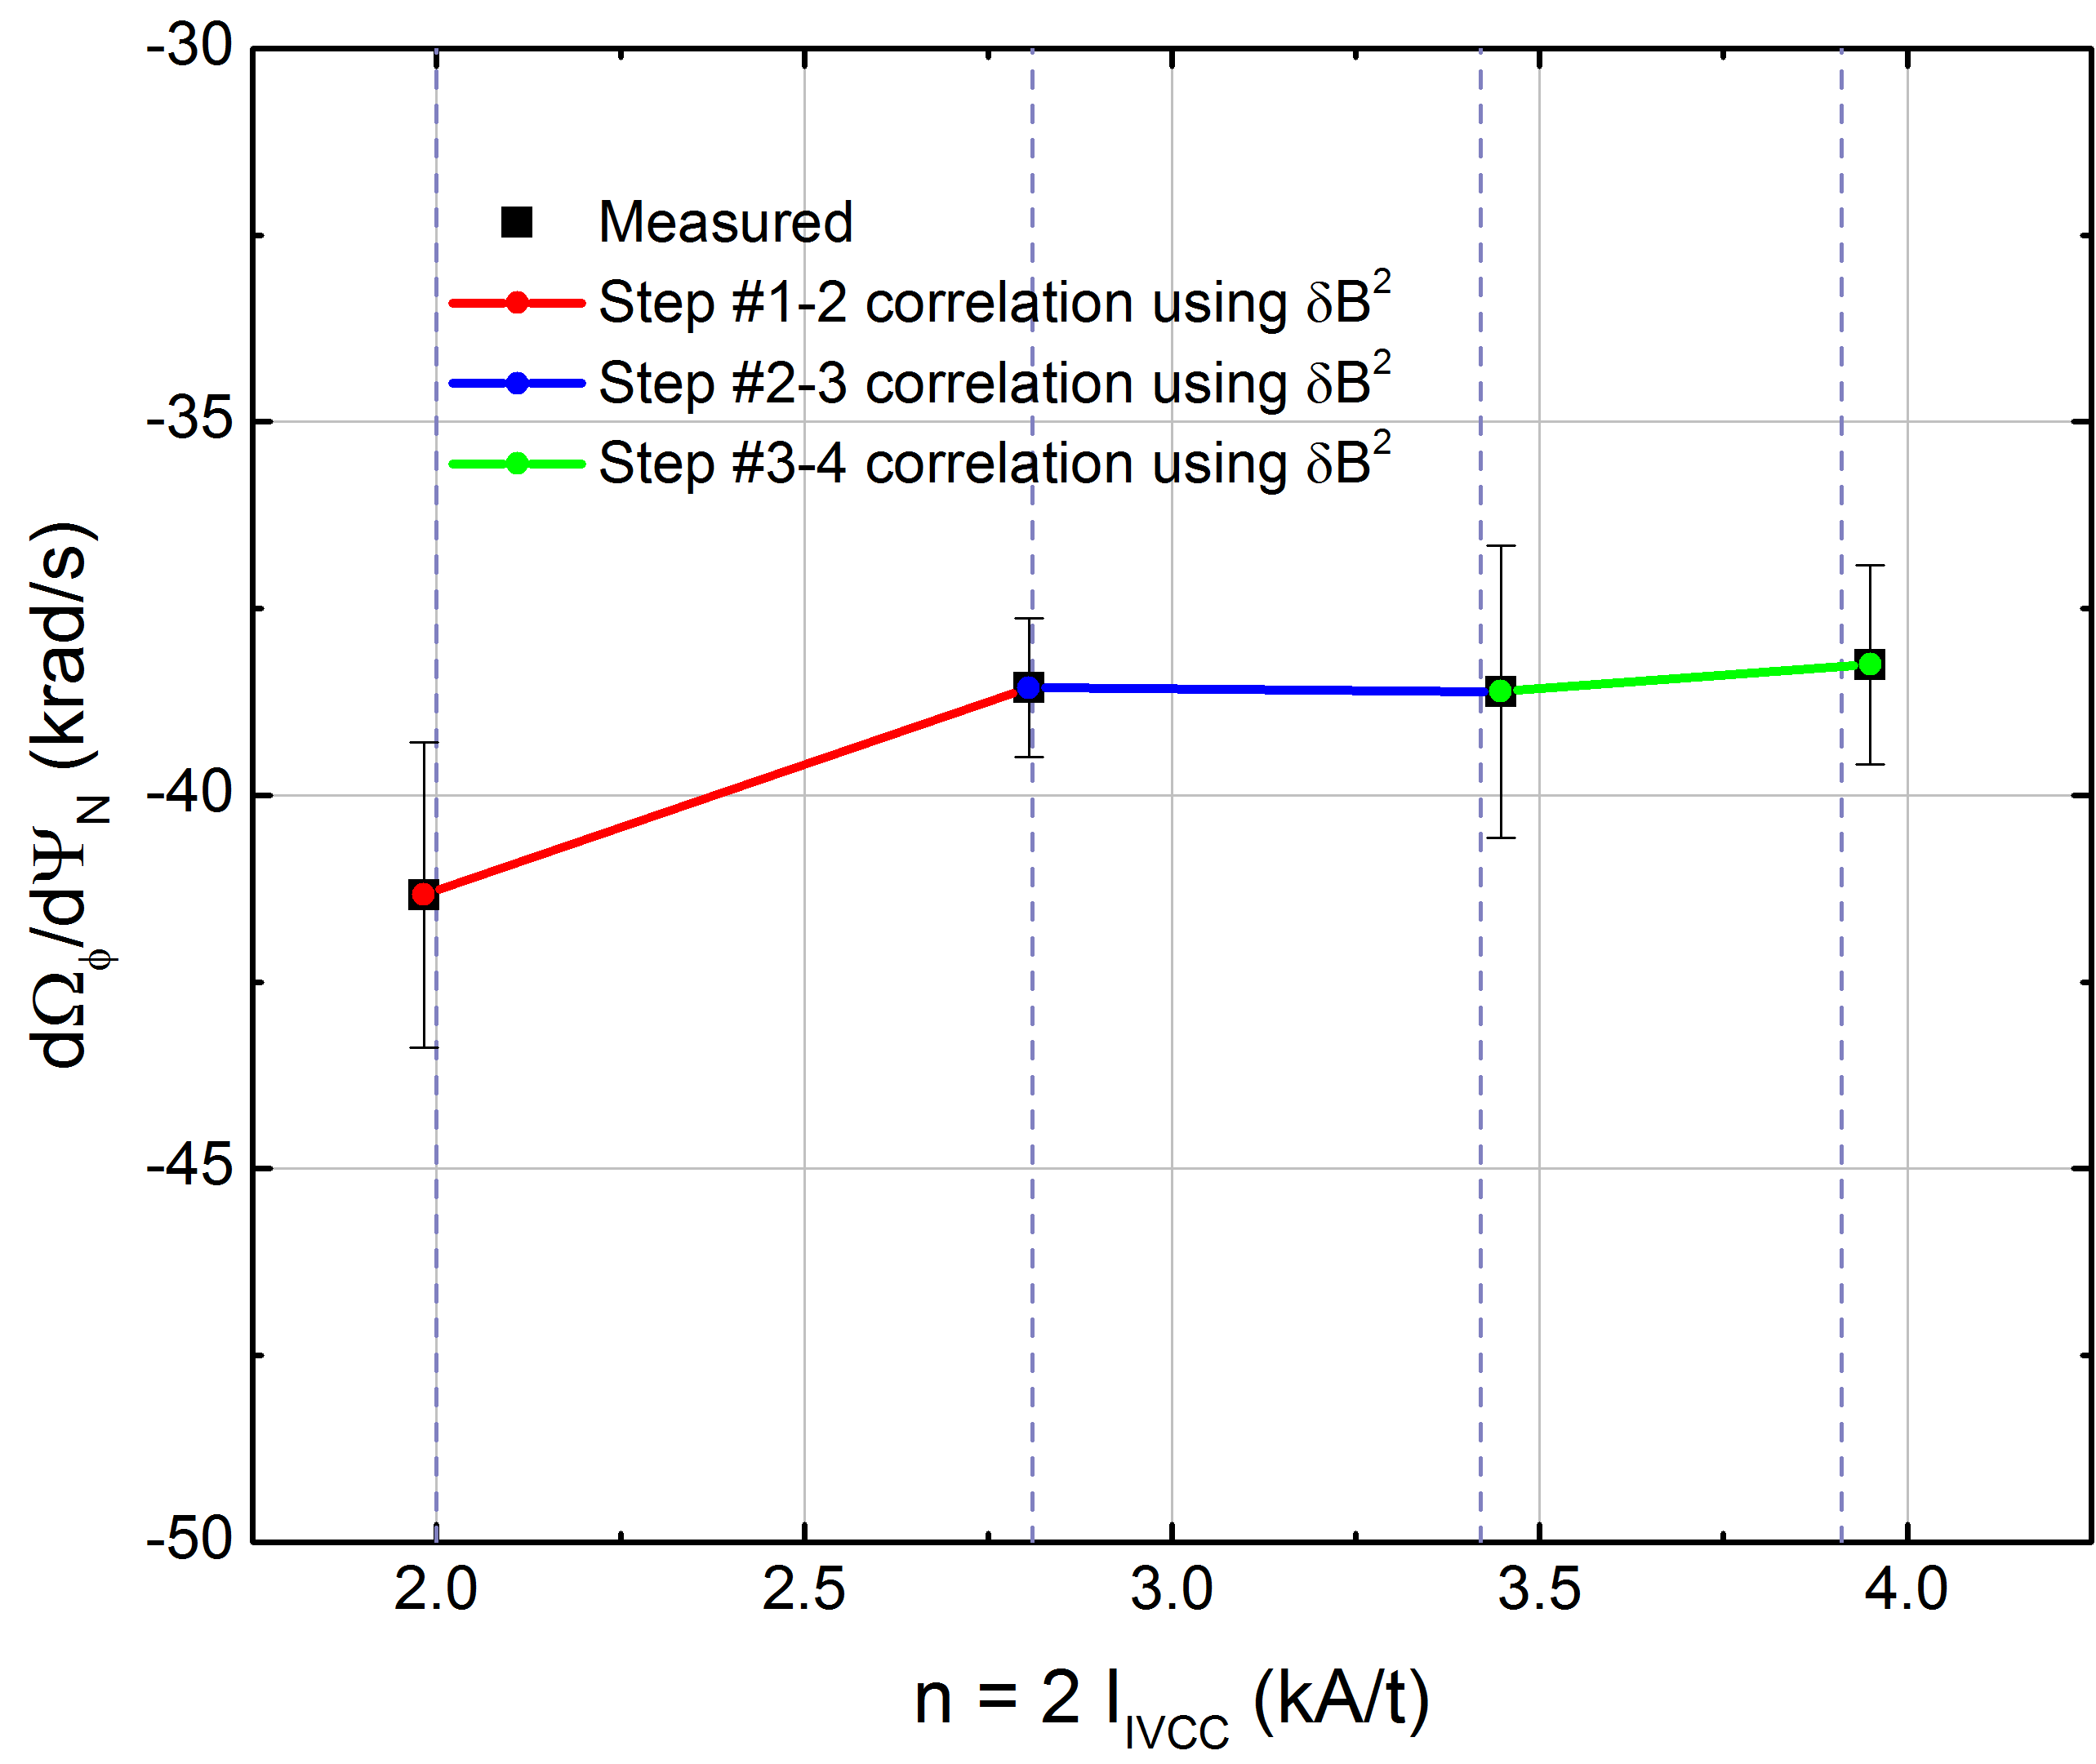
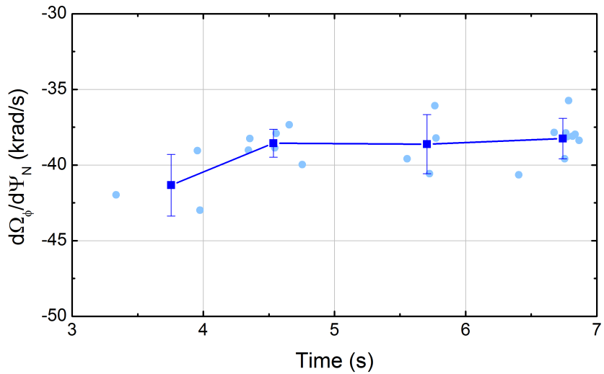
Reduced rotation braking correlates with lower T_{i}
when NTV scales as δB²
Analysis of increasing n = 2 current steps with lower T_{i} (shot 9199)
  Chosen profiles have |ΔT_{i}| < 50 eV
d²Ω_{φ}/dΨ²_{N} (Ψ_{N}= 0.58)
Ω_{φ} (Ψ_{N}= 0.58)
Step #1
2
3
4
Step #1
3
yErr = 1σ
→ Use “C5” dependence
2
4
Overall rotation damping is much weaker
2 kA/t
Increasing I_{n = 2}
3.9 kA/t
yErr = 1σ
dΩ_{φ}/dΨ_{N} (Ψ_{N}= 0.58)
K/C5_{step1-2}
K/C5_{step2-3}
K/C5_{step3-4}
Step #1
2
3
4
Due to relatively small profile variation compared to error, evaluate avg. “K/C5” using entire step data
yErr = 1σ
Step #1
Step #2
Step #3
Step #4
  By assuming the same C5_{ΨN=0.58} between two comparing shots,
2.27
Y.S. Park, APS DPP 2013

Slide 37
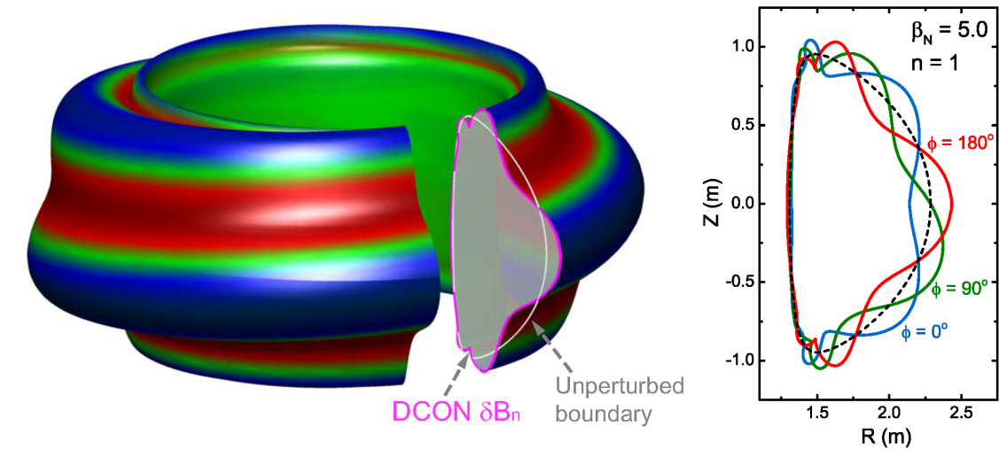
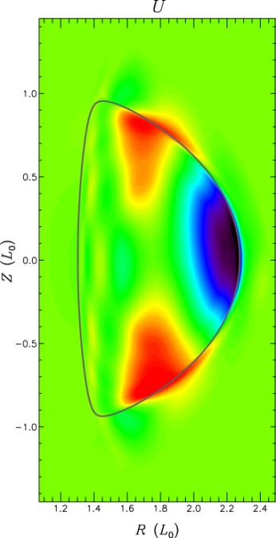
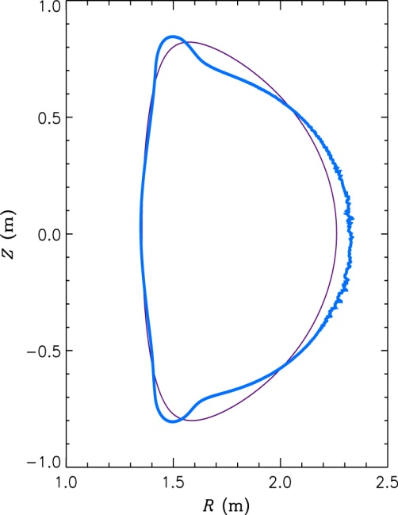
M3D-C¹ code example for KSTAR, comparison to DCON
KSTAR DCON n = 1 unstable mode eigenfunction
Linear stability analysis using M3D-C¹ code (collaboration with S. Jardin)
  Extended MHD code solving full two-fluid MHD equations in 3D geometry
  Non-linear code, presently being used in linear mode for initial runs
Ideal n = 1 stability limit from DCON and M3D-C¹ compare well
  For the same input equilibria, “equivalent” wall configurations compared
  With-wall n = 1 stability limit computed as β_{N} ~ 5.0 in both calculations
  Further M3D-C¹ calculations for KSTAR will include improved wall configurations (3D, resistive wall) and analysis for resistive instabilities
M3D-C¹ unstable mode velocity stream function and δB_{n}
δB_{n}
(q = 4)

