Slide 1




NSTX-U
Supported by
NSTX-U T&T TSG Contributions to FY15 JRT
Coll of Wm & Mary
Columbia U
CompX
General Atomics
FIU
INL
Johns Hopkins U
LANL
LLNL
Lodestar
MIT
Lehigh U
Nova Photonics
Old Dominion
ORNL
PPPL
Princeton U
Purdue U
SNL
Think Tank, Inc.
UC Davis
UC Irvine
UCLA
UCSD
U Colorado
U Illinois
U Maryland
U Rochester
U Tennessee
U Tulsa
U Washington
U Wisconsin
X Science LLC
Y. Ren, W. Guttenfelder, S.P. Gerhardt, S.M. Kaye
and the NSTX-U Team
Culham Sci Ctr
York U
Chubu U
Fukui U
Hiroshima U
Hyogo U
Kyoto U
Kyushu U
Kyushu Tokai U
NIFS
Niigata U
U Tokyo
JAEA
Inst for Nucl Res, Kiev
Ioffe Inst
TRINITI
Chonbuk Natl U
NFRI
KAIST
POSTECH
Seoul Natl U
ASIPP
CIEMAT
FOM Inst DIFFER
ENEA, Frascati
CEA, Cadarache
IPP, Jülich
IPP, Garching
ASCR, Czech Rep

Slide 2
T&T TSG Experimental Ideas
NSTX-U will have a set of experimental knobs to vary/control pressure and current profiles
  Two NBIs (6 independent sources), HHFW, 3D coils and lithium deposition
    Different pressure and current profiles from using a subset of the 6 NBI sources
    Heating/current drive from HHFW with NBI or used independently
    3D coils used to modify rotation profile coupled with NBI
    Different profiles with/without lithium
  Need to identify ways to decouple pressure and current profile variations
    Different time scales of pressure and current profile relaxation
    HHFW in heating mode

Slide 3
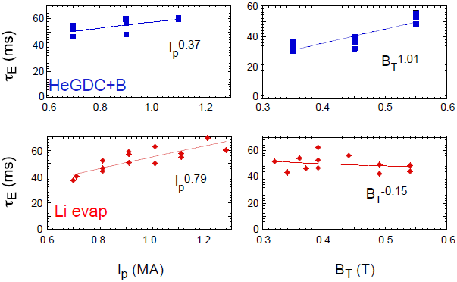
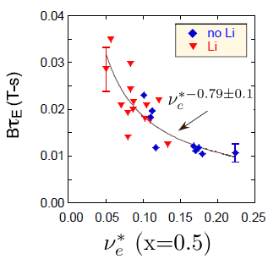
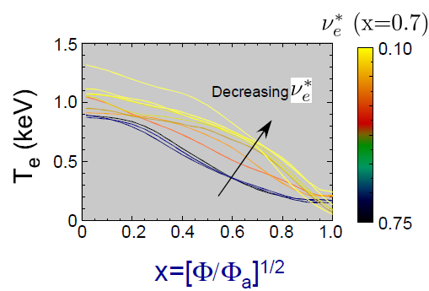
T&T TSG Experimental Ideas
T&T researches to support the FY15 JRT
  q_{min} dependence of confinement (fixed q₉₅)
    DIII-D observation of degraded confinement with broader current profile and with q₉₅ fixed
  B_{T}, Ip and collisionality scalings with different NBI source combinations and HHFW
    Try to decouple pressure and current profile
    3D coils to modify rotation profile
  Lithium scan to vary pressure and current profile
    Need to assess the coupling between pressure and current profile
  Lithiated and non-lithiated plasma comparison
    Confinement and pressure profiles are known to be different between the cases from NSTX experiments
  Also impurity and momentum confinement
Kaye (2007,2013)
Gerhardt(2011)

