Slide 1
Development of Tungsten Injection System for High Z Impurity Transport Study in KSTAR
Hyun Yong Lee^{1,2}*, Suk-Ho Hong³, Joohwan Hong^{1,2},
Seung Hun Lee^{1,2}, Siwon Jang^{1,2}, Juhyeok Jang^{1,2}
Taemin Jeon^{1,2}, Jae Sun Park^{1,2}, and Wonho Choe^{1,2}**
¹Korea Advanced Institute of Science and Technology (KAIST)
²Fusion Plasma Transport Research Center (FPTRC)
³National Fusion Research Institute (NFRI)
*leehy0816@kaist.ac.kr, joohwanhong@kaist.ac.kr
**Corresponding author: wchoe@kaist.ac.kr

Slide 2
Candidates for the W particle injector
Laser blow-off system (C-Mod)
- Well controlled temporal form of the source function
- Adjustable injecting amount of particles
- Difficulties : high cost (laser system), short preparation time
Pellet injection (LHD)
- Can deposit impurities deep inside the confined plasma
- Difficulties : designing of pellet, short preparation time
Particle dropper (NSTX)
- Simple design, easy to inject W dusts into plasmas
- Difficulties : A lack of install locations (need to modify passive stabilizer and upper
port of KSTAR)
It is required to try a simple injector system under the current condition for first W injection experiments on KSTAR.

Slide 3
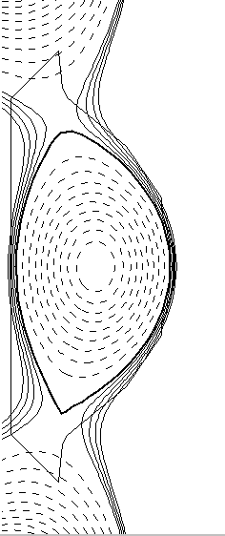
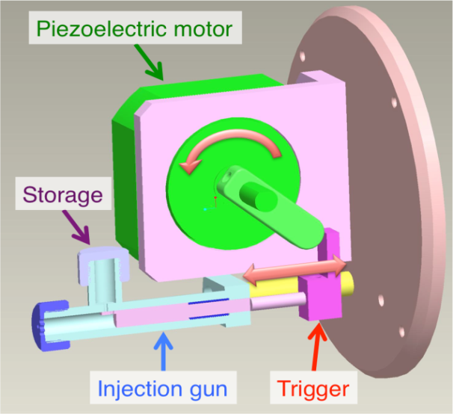
Design of Tungsten Injection System
Design goals
1) Flight-distance of particles > 10 cm
Injection system will be mounted on the manipulator
The manipulator is inserted into the vacuum vessel around 10 cm away from the LCFS.
2) Compact size
Gun: diameter ~ 8 mm, length ~ 50 mm
Piezo-electric motor (R40NM, Piezo technology©)
3) Tolerance for strong B-field & high vacuum environments
STS316
Piezo-electric motor (R40NM, Piezo technology©)
4) Reloadable system
5) Capability to inject a small amount of metal particles
10 cm

Slide 4
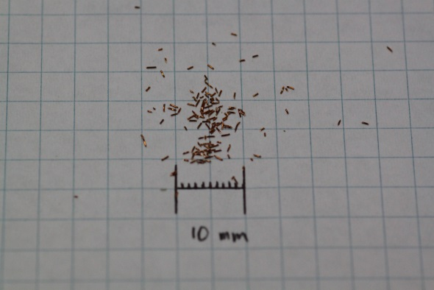
Performance Test
Performance test with Cu & W particles @ 1 atm
Source:
1) Cu Φ=0.2 mm, length~1 mm
- Cu: Z=29, Density ~ 8.94 g/cm³ (~20 ℃)
2) W Φ=0.2, 0.1 & 0.06 mm, length~1 mm
- W: Z=74, Density ~ 19.25 g/cm³ (~20 ℃)
Test menu
1) Particle amount (Cu Φ=0.2 mm, 5,10,15, 20 mg)
2) Particle size (W Φ=0.2, 0.1 & 0.06 mm, 10 mg)
3) Vacuum & B-field test
Cu 0.2 mm

Slide 5
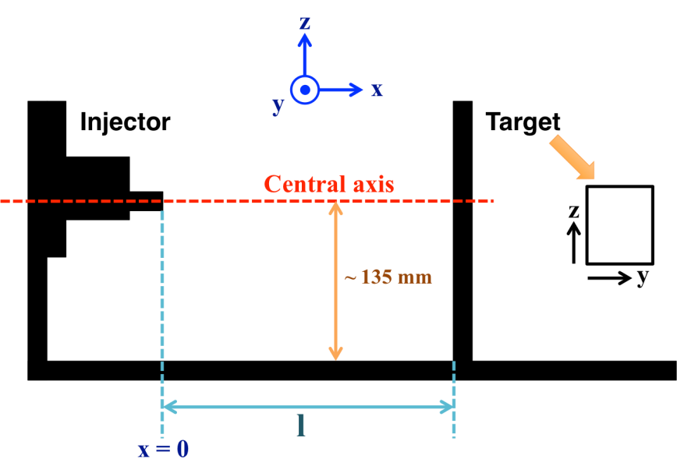
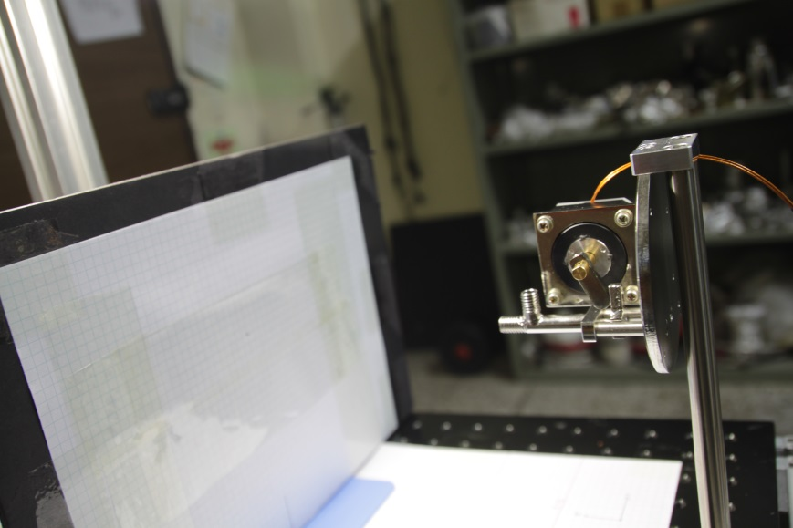
Experimental Set-up
Target plate position: l =100 mm
Central axis (y,z)=(0,0) on the target plate
A piezoelectric motor moves the trigger.
Pictures of deposited particles on the target plate are taken by a DSLR camera
(CANON EOS 500D).

Slide 6
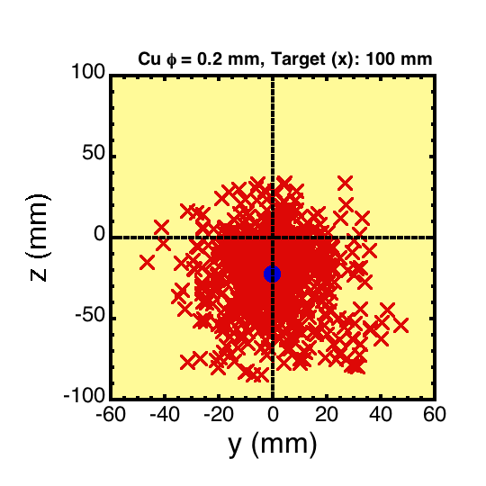
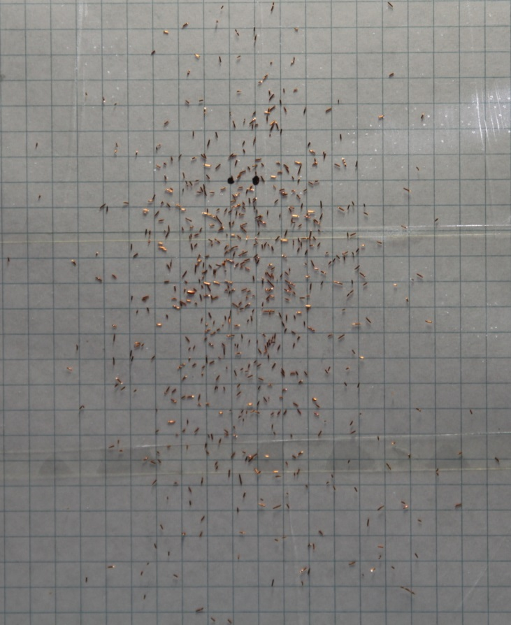
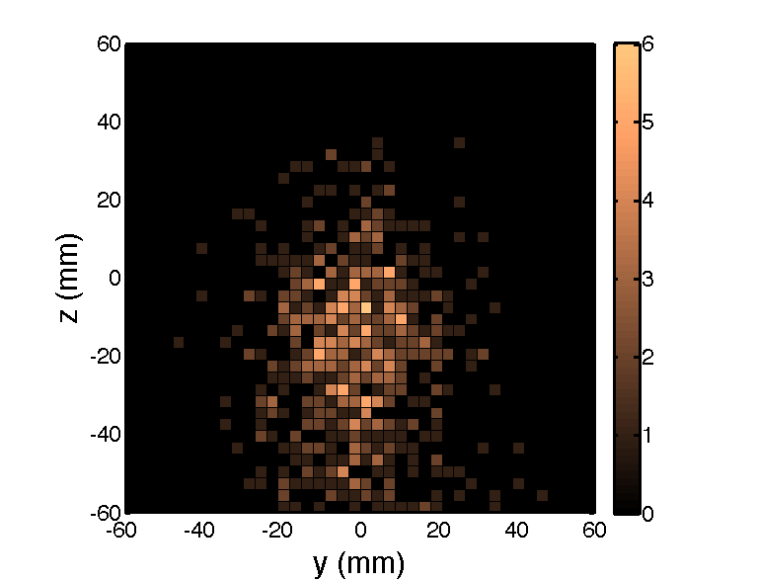
Example of Performance Test
(y,z)=(0,0): central axis
→ evaluated from edges of injection gun
(Injection gun’s diameter ~ 8 mm)
0.2 mm diameter of Cu, l = 100 mm
Deposited locations
Averaged drop
Cu particles on the target plate
Edges
To evaluate
deposited locations
10 mm
2-D distribution image
z
To estimate
2-D distribution
y

Slide 7
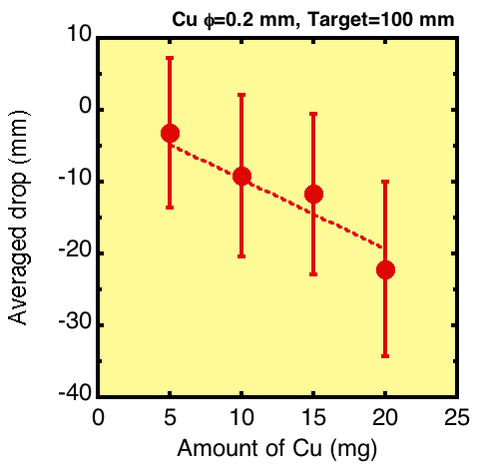
Amount of particles (Cu 5,10,15, 20 mg)
Target plate: 10 cm away from the injection gun
Launched Cu: 5,10,15, and 20 mg of 0.2 mm diameter particles
Amount of Cu reached to the target plate
5 mg: 93%, 10 mg: 88%, 15 mg: 84%, and 20 mg: 67%
Distribution of Cu particles @ l = 10 cm
1) Averaged vertical drop on the target plate
- 5 mg: Δz = -3.2 mm
- 10 mg: Δz = -9.1 mm
- 15 mg: Δz = -11.7 mm
- 20 mg: Δz = -22.2 mm
2) Average initial velocity (v₀)
- v₀ ~ 1.5~4.0 m/s
・ Amount of particles↑: averaged drop↑, Loss↑
Amount of Cu particles vs. Δz

Slide 8
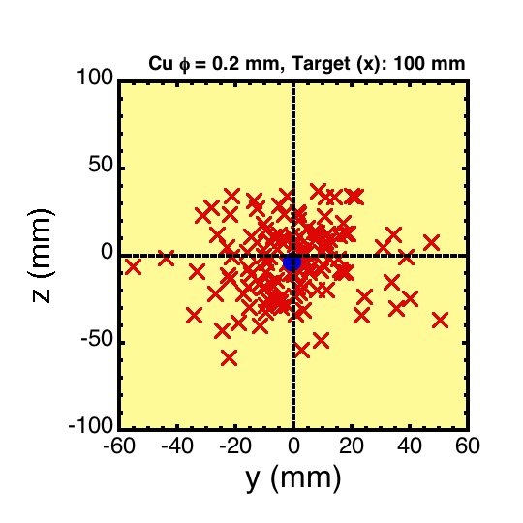
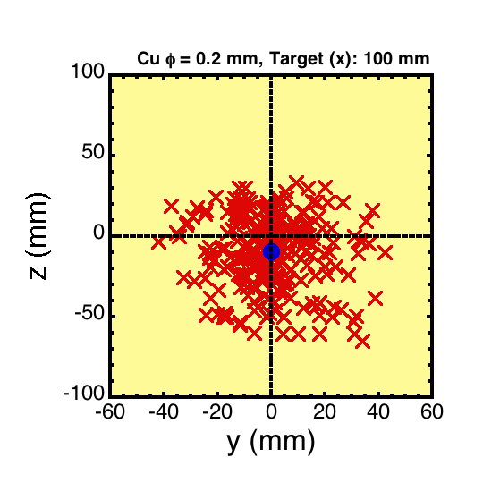
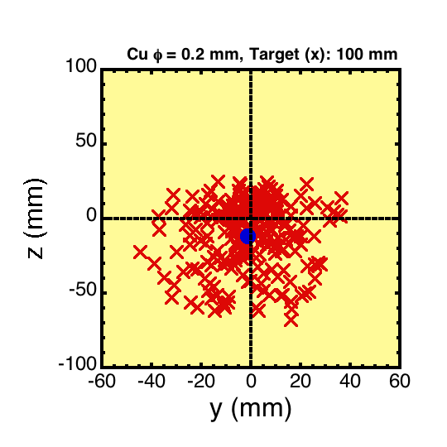
Distribution of Cu on the target plate I
(a)
(c)
5 mg
10 mg
(b)
(d)
15 mg
20 mg
Deposited locations of launched Cu particle on the target plate (a) 5 mg, (b) 10 mg (c) 15 mg, and (d) 20 mg

Slide 9
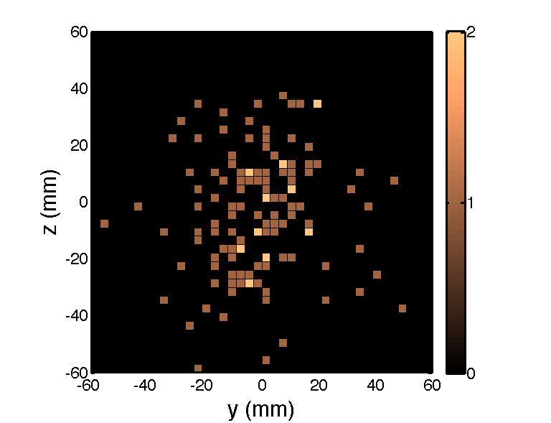
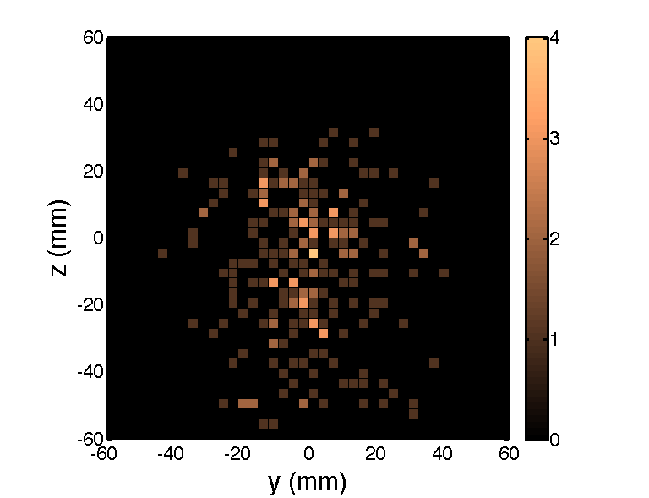
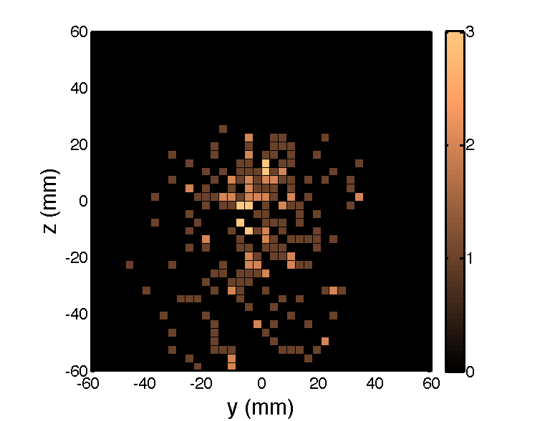
Distribution of Cu on the target plate II
(a)
5 mg
(c)
10 mg
(b)
15 mg
(d)
20 mg
Distribution of launched Cu particle on the target plate (a) 5 mg, (b) 10 mg (c) 15 mg, and (d) 20 mg

Slide 10
Particle size (W 0.2, 0.1 & 0.06 mm)
Target plate: 10 cm away from the injection gun
Launched W particles
0.2, 0.1 & 0.06 mm, (10 mg x 5 times = 50 mg)
Amount of particles reached to the target plate
Less than 2 mg (< 5%)
Distribution of particles @ l = 10 cm
1) Averaged vertical drop at the target plate
- 0.2 mm: Δz = - 9.7 mm
- 0.1 mm: Δz = - 9.8 mm
- 0.06 mm: Δz = - 9.9 mm
2) Average initial velocity (v₀): ignoring air resistance
- v₀ ~ 2.3 m/s
・ In the case of W, particle size does not affect change of averaged drop

Slide 11
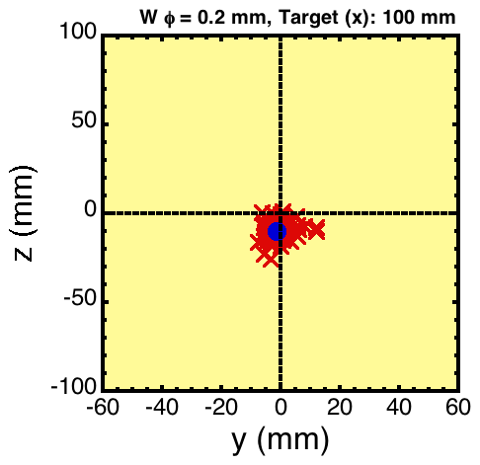
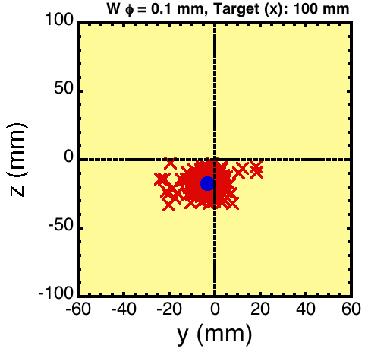
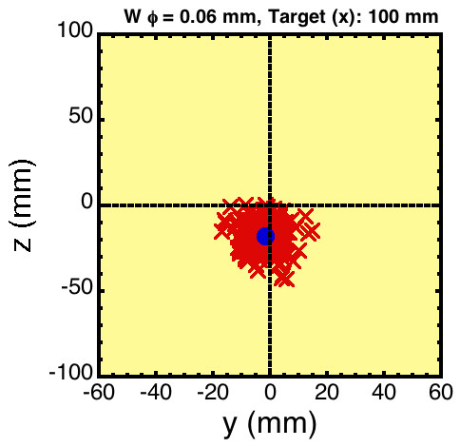
Distribution of W on the target plate I
(a)
0.2
(b)
0.1
(c)
0.06
Deposited locations of launched W particle on the target plate (a) 0.2 mm, (b) 0.1 mm, and (c) 0.06 mm

Slide 12
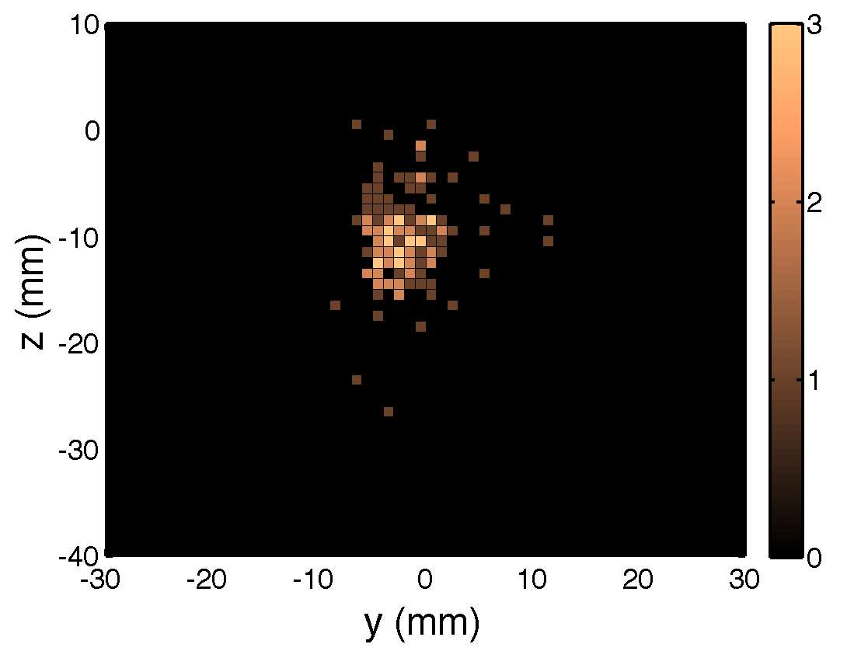
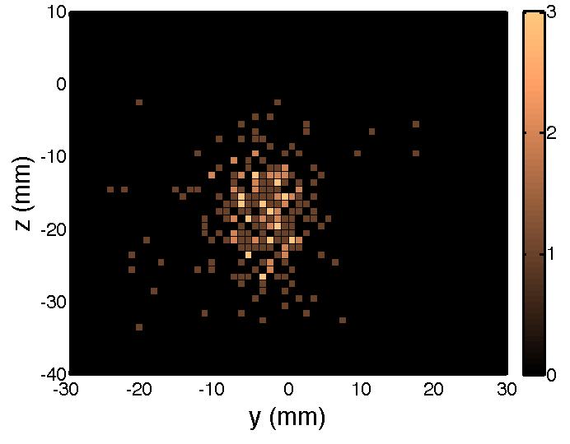
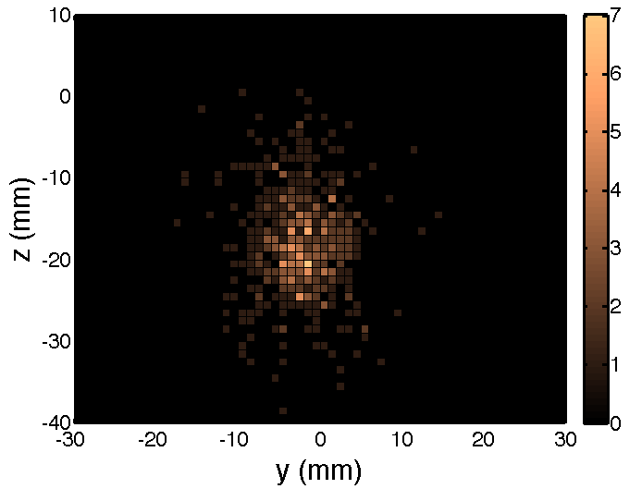
Distribution of W on the target plate II
(a)
(b)
0.2
0.1
(c)
0.06
Distribution of launched W particle on the target plate (a) 0.2 mm, (b) 0.1 mm, and (c) 0.06 mm

Slide 13
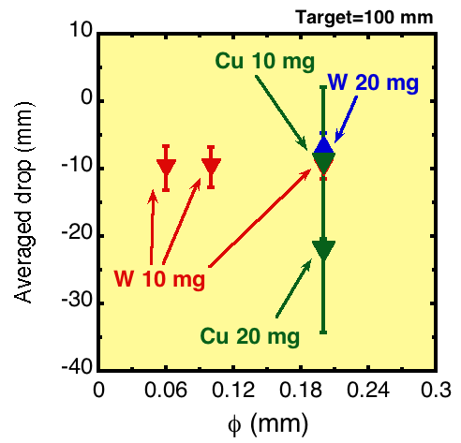
Discussion (Cu vs. W)
ϕ vs. averaged drop
Distribution
- Cu is much broaden than W
- The case of heavy particle has a narrow distribution (see error-bars)
Amount
1) Cu: amount ↑ averaged drop ↑
2) W: amount ↑ averaged drop →
W: Particle size does not affect increase of averaged drop

Slide 14
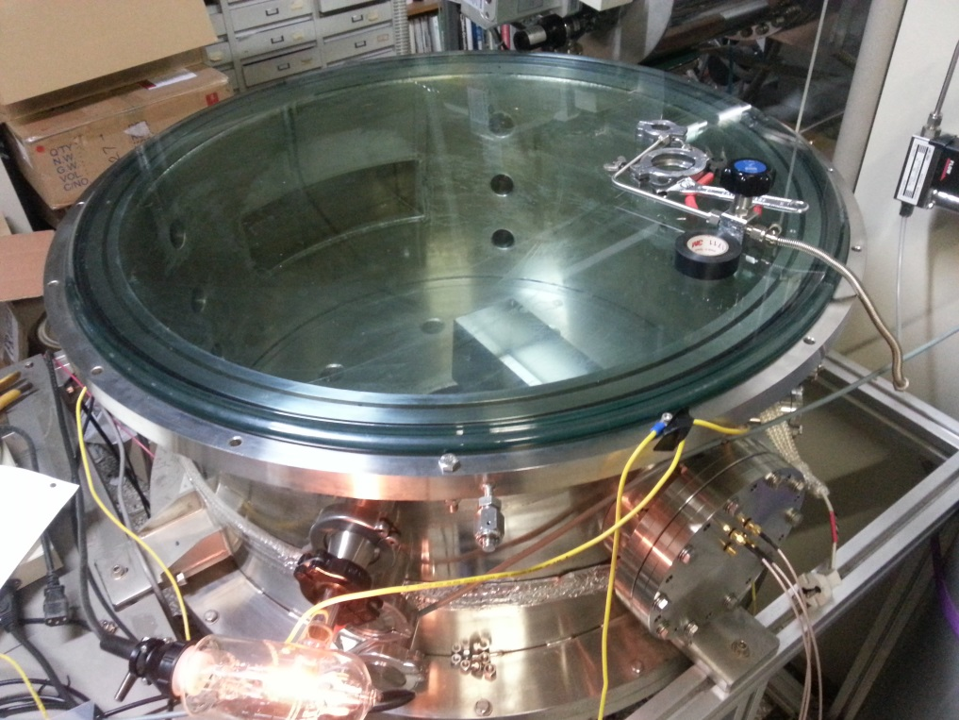
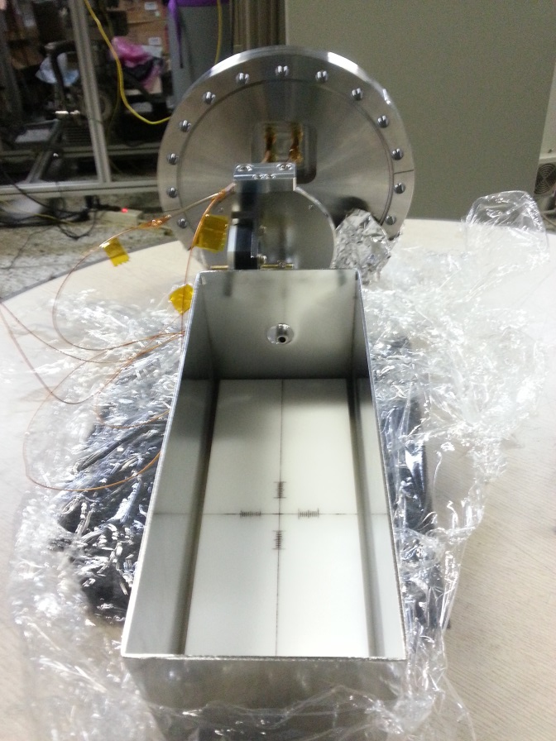
Vacuum test
Injection gun
(Torr) | ◯/☓
3.0x10⁻² | ◯
6.0x10⁻³ | ◯
5.0x10⁻⁵ | ◯
1.5x10⁻⁵ | ◯
5.6x10⁻⁶ | ◯
Injection gun was operated by ~ 6x10⁻⁶ Torr

Slide 15
B-field test
B-field test of piezo-electric motor was performed with a Nuclear Magnetic Resonance (NMR) device
A piezo-electric motor was operated under 7 Tesla of magnetic field
→ It is enough to use in KSTAR environment
Schematic view
Piezo-electric motor
NMR device
7 T @ Center
NMR device

Slide 16
Summary
A tungsten injection system for KSTAR plasma is under development and a performance test was carried out.
- Source: Cu (0.2mm diameter) & W (0.2, 0.1 & 0.06 mm diameter)
- Distance to the target plate: 100 mm @ 1 atm.
1) Flight-distance of particles > 10 cm ✔ (v₀ ~ 1.5-4.0 m/s)
- Distribution: narrow (heavy particle), broaden (light particle)
- Effect of amount & size of particles: small (heavy particle), large (light particle)
2) Compact size ✔
3) Tolerance for strong B-field (< 7 T) ✔
high vacuum (~ 6x10⁻⁶ Torr) environments ✔
4) Reloadable system Δ
5) Capability to inject a small amount of metal particles Δ

Slide 17
Future work & Discussion
Future work
1) Performance test in vacuum environment (W Φ = 24 & 12 μm)
2) Optimization of injection amount, position and impurity size (considering pellet type)
3) Finding reloadable injecting condition using tiny W dusts (0.4-0.5 μm)
Discussion
1) Amount of injecting particles
2) Adopting dropper system for future experiments
(vertical & horizontal injection at the same time)

