Slide 1
Impurity transport analysis & preparation of W injection experiments on KSTAR
February 18, 2014
Joohwan Hong*, Seung Hun Lee, H. Y. Lee, Juhyeok Jang,
Juhyung Kim, Siwon Jang, Taemin Jeon ,Jae Sun Park
and Wonho Choe**
Korea Advanced Institute of Science and Technology (KAIST), Daejeon, Korea
C. R. Seon, Suk-ho Hong, and KSTAR team
National Fusion Research Institute (NFRI), Daejeon, Korea
S. Henderson, M. O’Mullane
University of Strathclyde, UK
*joohwanhong@kaist.ac.kr
**wchoe@kaist.ac.kr

Slide 2
Outline
1. Introduction
- Current issues on W in tokamak plasmas
2. Current analysis tools for impurity transport study on KSTAR
- ADAS-SANCO impurity code analysis
- Diagnostics: SXR and VUV
- Example : ECH effects on Ar transport experiments
3. Preparation of W experiments
- Upgrading diagnostics : SXR and VUV
- Estimation of Ar & W emission power on KSTAR for designing SXR
filters
4. Summary & Discussions

Slide 3
Current issues on W in tokamak plasmas
  Influence of W divertor on the access to the H-mode
  Effect of W divertor on pedestal parameters and plasma confinement
  Predicted impacts of wall and divertor material on pedestal structure
  High radiation loss from W core accumulation
R. Neu, ADAS Workshop, 2007, Ringberg
  ITPA: “Transport of high Z impurities (including W) in the core plasma and possibilities for its control”
  W injection experiments on KSTAR (superconducting machine)

Slide 4
Current analysis tools for impurity transport study on KSTAR
- Focused on Ar injection experiments
Transport codes (ADAS-SANCO)
Diagnostics (SXR & VUV)
Experiments & analysis results

Slide 5
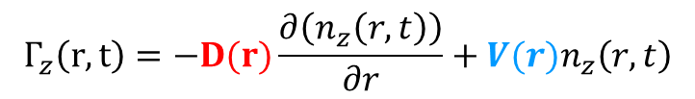
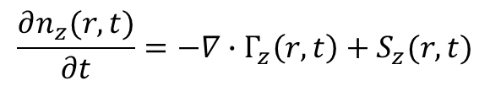
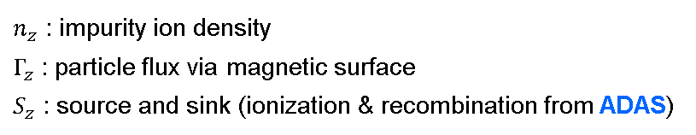
Impurity transport analysis
SANCO (collaboration with JET) 1D radial continuity equation
- Radial particle flux
$n_{z}$ : impurity ion density
$Γ_{z}$ : particle flux via magnetic surface
$S_{z}$ : source and sink (ionization & recombination from ADAS)
$$\frac{∂n_{z}(r,t)}{∂t}=−∇∙Γ_{z}\left(r,t\right)+S_{z}(r,t)$$
$$Γ_{z}\left(r,t\right)=−D(r)\frac{∂\left(n_{z}\left(r,t\right)\right)}{∂r}+{V(r)n}_{z}\left(r,t\right)$$
Diffusion coefficient
Convection coefficient
Impurity transport modelling
Experimental
data
Fitting
KSTAR diagnostics
Soft X-ray array
VUV spectrometer
X-ray imaging crystal spectrometer, etc…
- Impurity transport code SANCO
- Fitting analysis code
UTC
D, V
determination

Slide 6
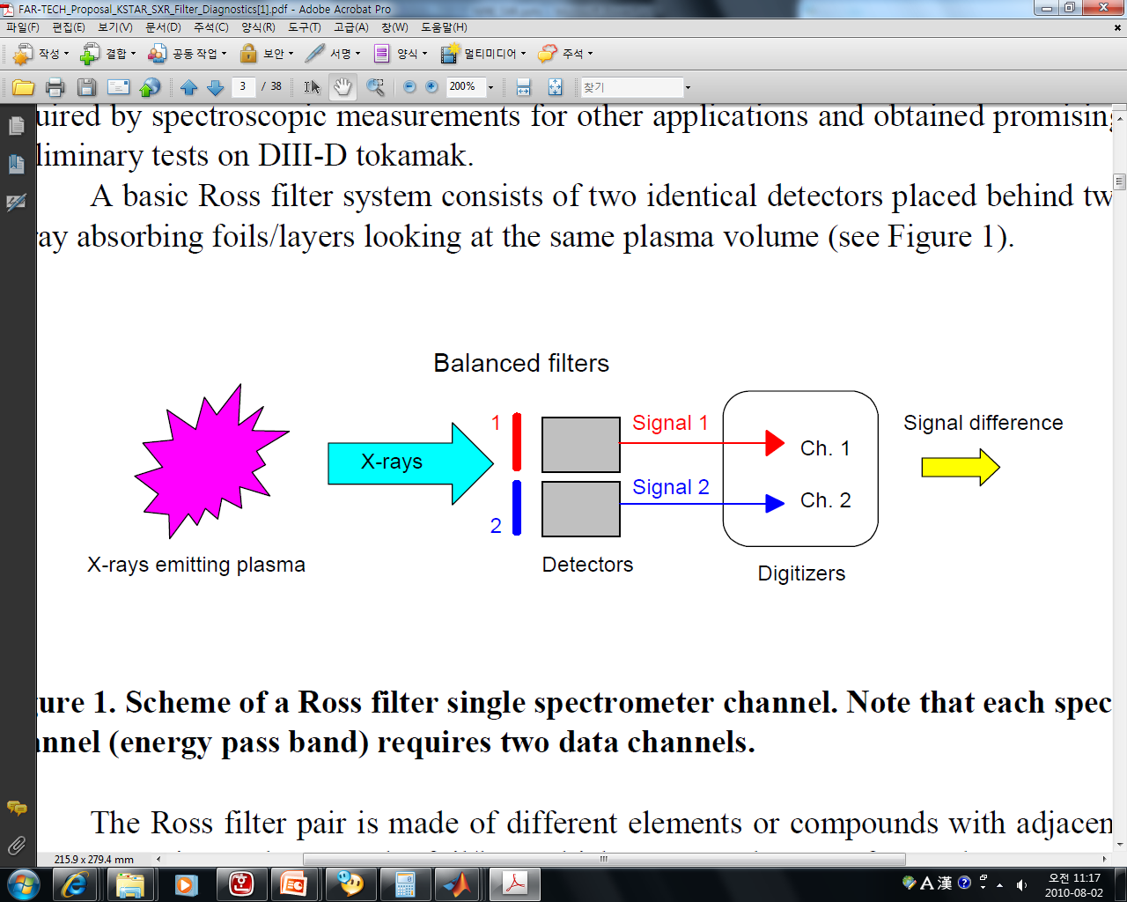
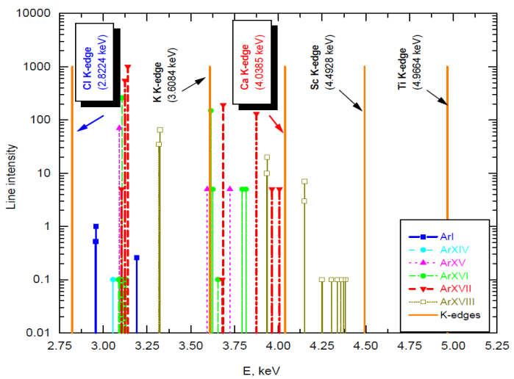
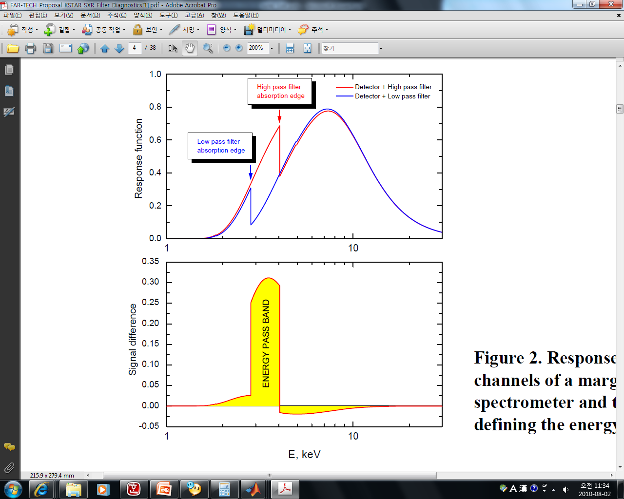
Soft X-ray arrays with Ar Ross filter
X-ray Ross Filter (XRF)
  NaCl and CaF₂
  Band pass filter within the narrow region between
  their L III or K absorption edges
KSTAR D-port
16 ch (32)
16 ch (32)
2.8-4.0 keV
Ar¹³⁺, Ar¹⁴⁺, Ar¹⁵⁺, mainly Ar¹⁶⁺, Ar¹⁷⁺

Slide 7
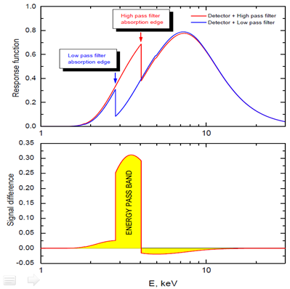
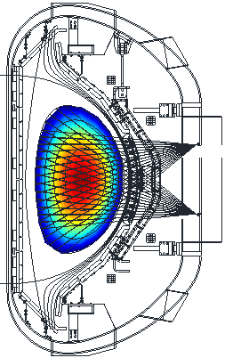
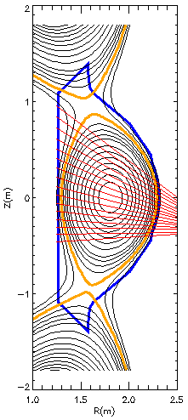
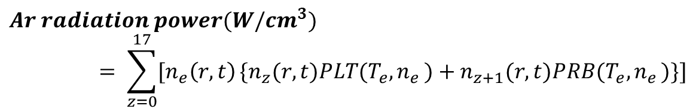
Model for Ar emission in soft X-ray range
(1) Calculation of local Ar radiation power (r,t)
$$Ar radiation power(W/{cm}^{3})= \sum_{z=0}^{17}{[n_{e}\left(r,t\right)}{\{n}_{z}(r,t)PLT(T_{e}{,n}_{e})+n_{z+1}(r,t)PRB(T_{e}{,n}_{e})\}]$$
Power coeffs of Line Transition
Power coeffs of RecomBination
- n_{e} from input data, n_{z} from SANCO, PLT & PRB from ADAS
(2) Response function of Ross filter
(3) LoS calculation and line integration
Obtaining
2.8~4 keV

Slide 8
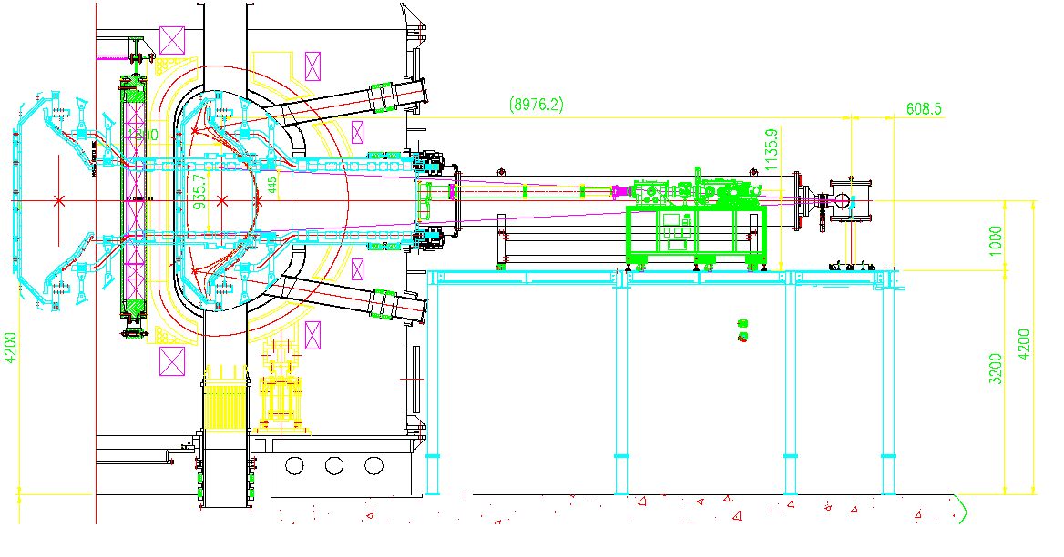
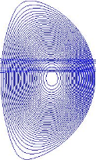
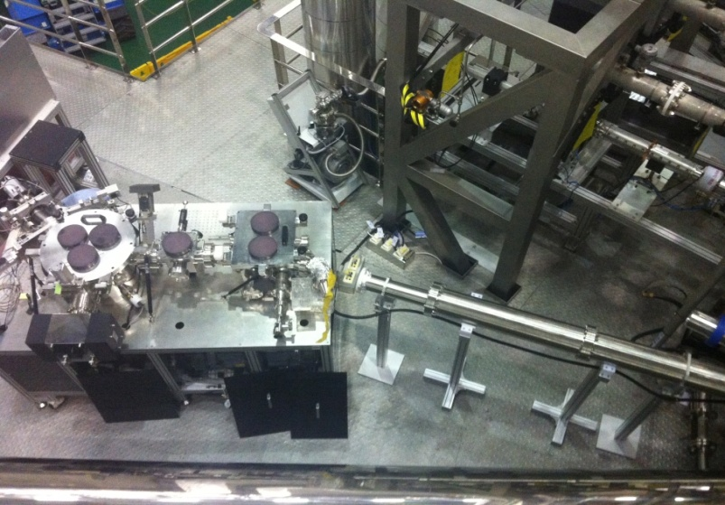
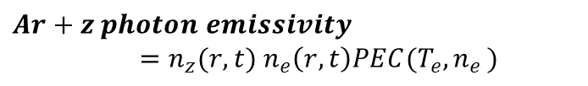
ITER VUV spectrometer prototype
Collaboration with ITER KO-DA (C.R. Seon)
Current (15-60 nm, ~13-40 ms)
(1) Measurable major line transitions
He I 53.70 nm
He II 25.63 nm
O V : 15.61, 19.28, 21.50 nm
O VI : 17.30, 18.40 nm
C III : 38.62 nm
C IV : 24.49, 38.41, 41.96 nm
C V : 22.72, 24.87 nm
Fe XV : 28.42 nm
Fe XVI : 33.54, 36.08 nm
Ar XIV 18.79 nm
Ar XV 22.11 nm
Ar XVI 35.39 nm
1 ch, survey
VUV spectrometer on the optical table
(2) Modeling of Ar line transitions
Vacuum extension
$$Ar+z photon emissivity=n_{z}(r,t) n_{e}\left(r,t\right)PEC(T_{e}{,n}_{e})$$
- All atomic coefficients are from ADAS

Slide 9
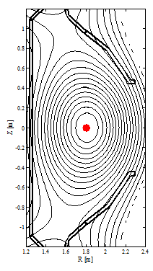
Ar transport experiments with ECH
L-mode plasmas, I_{p} = 400 kA, B_{t} : 2 T
Argon gas injection through a piezo valve (trace amount of Ar : n_{Ar}/n_{e} < 0.1%)
Different transport w/o and w/ ECH positions → Feasibility of impurity control?
Non ECH
On-axis ECH
Ar puffing
20 ms
Ar puffing
20 ms
0.4
0.2
0.4
0.2
On-axis ECH
Ip (MA)
Ip (MA)
Ar
ECH
110 GHz
300 kW
0 1 2 3 4
0 1 2 3 4
Time (sec)
Time (sec)
Ar puffing after ECH start → To see ECH effect on Ar

Slide 10
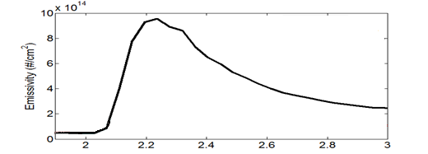
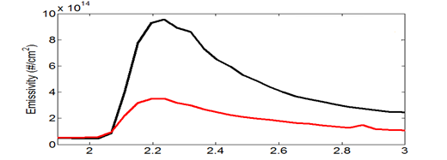
Less core Ar emissivity with ECH
Ar puff
VUV Ar¹⁵⁺
Non-ECH
ECH
r
SXR emissivity
(Non ECH)
2.8 – 4 keV photons
Mainly Ar¹⁶⁺ & Ar¹⁷⁺ emissions
r
t
SXR emissivity
(On-axis ECH)
ECH

Slide 11
ADAS-SANCO analysis results
L-mode
Non-ECH
Ch16
Ch1
Diffusion
Convection

Slide 12
Diffusion & convection with ECH
L-mode
On-axis ECH
Ch16
Ch1
Diffusion
Convection

Slide 13
Preparation of
W experiments
Upgrading current diagnostics (VUV & SXR)
Estimation of W & Ar emission power on KSTAR for designing filters of new SXR system

Slide 14
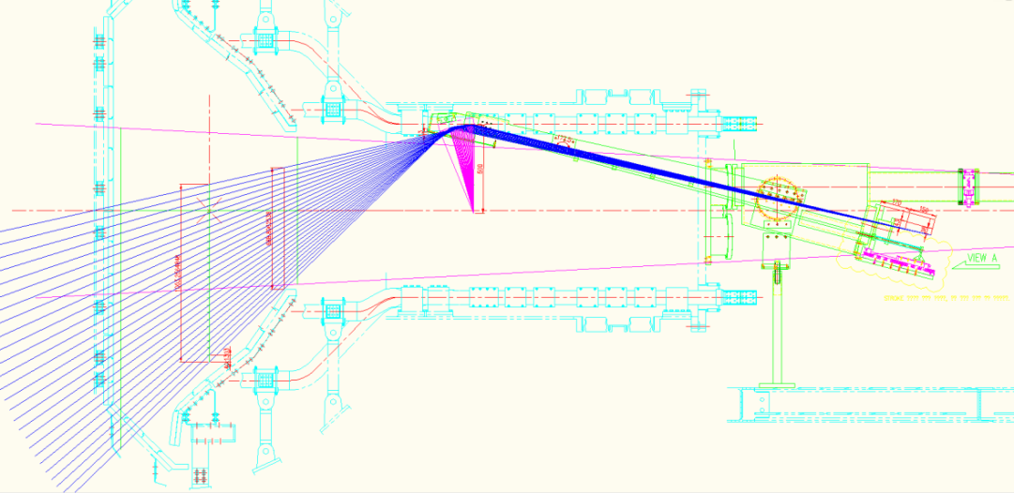
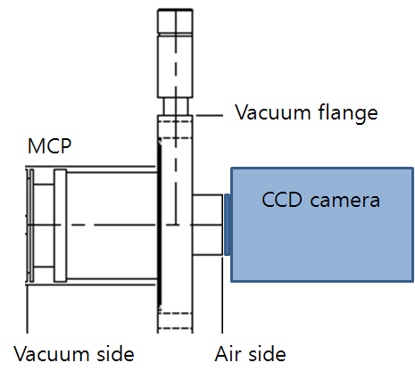
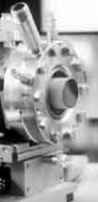
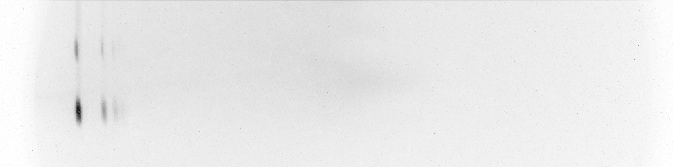
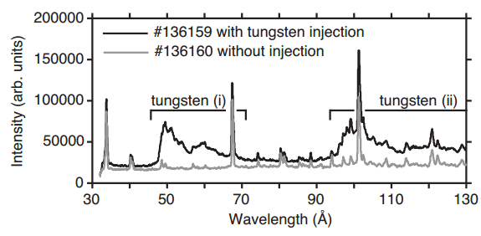
VUV imaging spectrometer
Collaboration with ITER KO-DA (C.R. Seon)
This summer(5-20 nm, 13-130 ms)
Preparation in laboratory
28 ch, imaging
• Active pixels: 1024 x 256
• Pixel size (W x H): 26 x 26 μm
• Image area: 40 mm x 12mm
of MCP adopted to CCD of 27.6
25.4 nm He II from Hollow Cathode Lamp
5~7 nm quasi-continuum
peaks of W are expected
~5.5 mm Slit Imaged to CCD
Slit Pattern Spacing ~ 2mm
24.6 nm
23.4 nm
Clementson et al. Rev. Sci. Instrum. 81, 10E326 2010

Slide 15
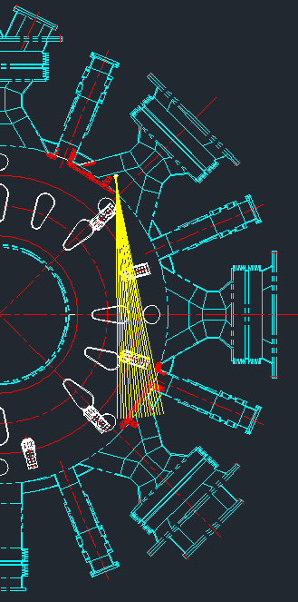
Soft X-ray array system
Current
This summer
2 arrays, 64ch
4 arrays, 256 ch
1 array, 48 ch
VU2
edge
HU
16 ch (32)
HD
16 ch (32)
VD2
4 arrays, 256 chs
→ 2D Tomography
→ Poloidal asym.
study
< 2 cm, 2 μs
3 filters
→ multi energy,
neural network
< 1.3 cm, 2 μs
Be filters (10, 50 um)
Ar Ross filters (2.8-4.0 keV Ar¹⁶⁺, Ar¹⁷⁺)
Bolometer (No filter)
→ 2D fast MHD & transport study

Slide 16
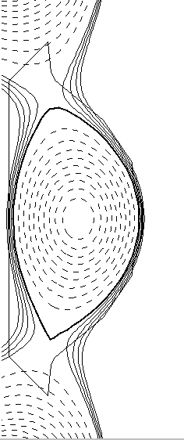
Estimation of W & Ar emission power
For designing new multi-array SXR filter to measure W & Ar emission,
ADAS-SANCO simulation has been done
Input
EFIT
Background
(T_{e}, n_{e})
D, V
(Trial value)
Impurity Influx
SANCO
Calculates…
n_{z}(r, t) for every charge states z of W & Ar
T_{e}, n_{e}
n_{z}(r, t)
ADAS
Calculates line emission for every line transition
$ε\left(r,t\right)=n_{z}(r,t) n_{e}\left(r,t\right)PEC(T_{e}{,n}_{e})$ $\#/{cm}^{3}s$
Line integration along LOS
→ Final power spectrum of W & Ar

Slide 17
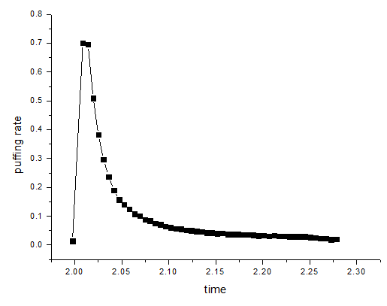
Input profiles for ADAS-SANCO
T_{e} & n_{e} profiles of typical KSTAR L-mode and H-mode
- Evaluated by ECE, TS, interferometer.
(2) Influx : flow meter signal for both W & Ar
(3) EFIT
#7566 @ 2 s
By S. Sabbagh
Recycling rate
Ar = 0.6
W = 0.0

Slide 18
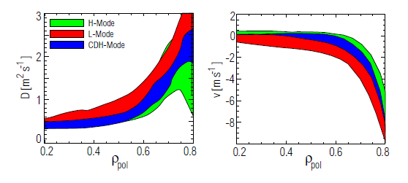
Input profiles for ADAS-SANCO
- D & V for L mode (experimentally obtained from KSTAR #7574 Ar)
- D & V for H mode (from ASDEX-U results)
T. Putterich, 2005, ‘Investigations on Spectroscopic Diagnostic of High-Z Elements in Fusion Plasmas’ , PhD Thesis University Augsburg

Slide 19
Time evolution of line-integrated spectra
(1) L-mode
Ar
W
Brightness (W cm-²)
Photon energy (keV)
Time (s)
(2) H-mode
Ar
W

Slide 20


W & Ar emission spectrum under KSTAR condition
L-mode case
H-mode case
W quasi-continuum
(VUV)
W peaks
W peaks
Ar peaks
(Ross filter)
W cm-² eV⁻¹
Ar peaks
(Ross filter)
W cm-² eV⁻¹
Continuum radiation was calculated by
where
Z_{eff} ~ 2.5
with C dominant situation
S. von Goeler et al., Nucl. Fusion 15, 301 (1975)

Slide 21
Summary
Impurity transport analysis tools on KSTAR
- ADAS-SANCO impurity transport code
- Soft X-ray array system and VUV spectrometer system
- It has well worked for KSTAR Ar injection experiments since 2012.
W injection experiment is under preparation on KSTAR
- Imaging VUV spectrometer having W quasi-continuum peaks is installed on KSTAR F-port.
- Additional SXR arrays will be installed on KSTAR D-port with Be filters for W and Ar measurement.
- ADAS database set is also ready for simulating W emissions in fusion plasmas.

Slide 22
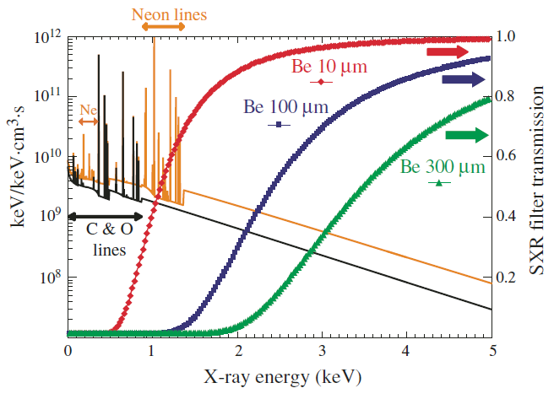
Discussions
(1) SXRA filter design for discriminating W and Ar emission
L-mode case
Be filters of
50 μm
250 μm
W cm-² eV⁻¹
400 μm
100 μm
300 μm
Delgado-Aparicio et al., Nucl. Fusion 49, (2009) 085028

Slide 23
Discussions
(1) SXRA filter design for discriminating W and Ar emission
L-mode case
H-mode case
Be filters of
50 μm
50 μm
250 μm
250 μm
W cm-² eV⁻¹
W cm-² eV⁻¹
400 μm
400 μm
100 μm
100 μm
300 μm
300 μm
Be 50 & 250 μm seem to be appropriate for L- & H- modes.

Slide 24
Discussions
(2) Estimation of amount of W injection
Estimation conditions
  - Injected # of atoms = 3.0 x 10¹⁷ for W & Ar
  Find out amount of W providing similar Ar radiation level ( W/cm² , > noise level of AXUV = 0.001 W/cm²) which was tested in previous Ar injection experiments.
Calculated Brightness filtered by 50 μm (in W/cm²)
Brightness from Continuum = 1.10 X 10⁻¹
Brightness from Ar emission = 1.12 X 10⁻¹
Brightness from W emission = 5.52 X 10⁻¹
W emission level is larger than Ar by 5
Injected W should be reduced by 5 ?
50 μm
W cm-² eV⁻¹
Estimated value ~ 6 X 10¹⁶ atoms (~ 18 μg) → Too small!
Particles should be injected more, in order to obtain the same Ar emission level, since all particles can not penetrate into LCFS.

Slide 25
Discussions
(3) W injector for KSTAR
- Gun-type injection system is under development
- Please see the other presentation material for W gun…
(4) Expected studies
- Z-dependence study of impurity transport with double injection (Ar & W)
- ECH power scan as well as other auxiliary heating (ICRH, LH) to control W & Ar impurities.
- Magnetic perturbation effects on impurity transport
- Asymmetric formation of impurity concentration with full 2-D tomography by new SXR system

Slide 26
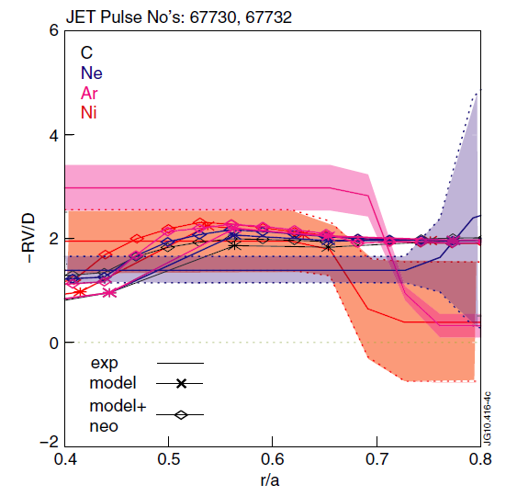
Expected studies
Z-dependence study of impurity transport
- Simultaneous injection of Ar & W for the 2014 campaign
JET
result
Giroud C. et al 13th ITPA Confinement Database & Modelling Topical Group, Naka, Japan
H Nordman et al, 2011 Plasma Phys. Control. Fusion
Various turbulent-based transport theories have been trying to estimate impurity transport with varying Z. Nevertheless, there is no theory explaining experimental results well.
It is required to have more experimental data to develop and revise impurity transport models.

Slide 27
Expected studies
2. Control impurity transport by applying auxiliary power
Controllability of Ar impurity was confirmed by ECH on KSTAR.
Applying ICRH, ECCD as well.
Effects on not only Ar but also W.
3. Effects of RMP on impurity transport
  Find out the relationship and mechanism between magnetic perturbation and impurity transport from edge (ELM) to core (impurity accumulation).
  - Applying MP after injection and before injection.

Slide 28
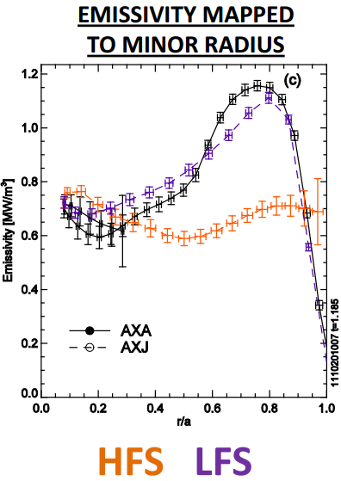
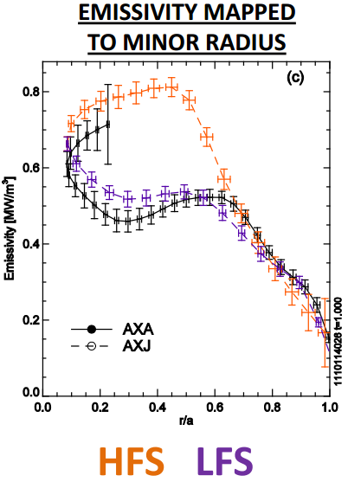
Expected studies
C-Mod
Mo injection
4. Impurity formation of poloidal asymmetry
H-mode
ICRH L-mode
C-Mod, Mo injection
M Reinke, et al., E1/E2 Task force meeting 2012
Full 2-D tomography reconstruction will be available with vertical arrays
→ Finding poloidal asymmetry of high-Z impurities such as W
→ Comparing between Ar & W cases
For various plasma modes and conditions

Slide 29
Appendix

Slide 30
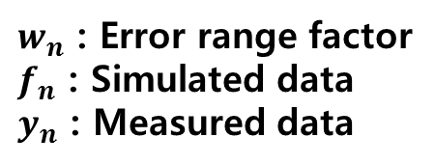
UTC-SANCO analysis
UTC (Universal Transport Code)
Input
Geometry
Background
(Te, Ti, Ne)
D, V
(Trial value)
Impurity Influx
Ar emission
diagnostic data
SANCO
→ Ar emission
calculate χ²
Find new
solution which
minimize χ²
Set proper derivative
to parameters
Parameterize Coeffs
D, V or Influx
No
Yes
Get
D, V
Proper?
Nonlinear least square fit
(Levenberg-Marquardt Method)
$w_{n}$ : Error range factor
$f_{n}$ : Simulated data
$y_{n}$ : Measured data

Slide 31
Ar transport control experiments using ECH on KSTAR

Slide 32
Ar transport experiments with ECH
L-mode plasmas, I_{p} = 400 kA, B_{t} : 2 T
Argon gas injection through a piezo valve (trace amount of Ar : n_{Ar}/n_{e} < 0.1%)
Different transport with varying ECH positions → Feasibility of impurity control?
Heating position
(r/a = 0, 0.16, 0.30, 0.59)
No ECH
On-axis ECH
Ar puffing
20 ms
Ar puffing
20 ms
0.4
0.2
0.4
0.2
Ip (MA)
#7574
Ip (MA)
#7566
ECH
110 GHz
300 kW
Ar
On-axis
0 1 2 3 4
0 1 2 3 4
Time (sec)
Time (sec)
Ar puffing after ECH start
→ To see ECH effect on Ar

Slide 33
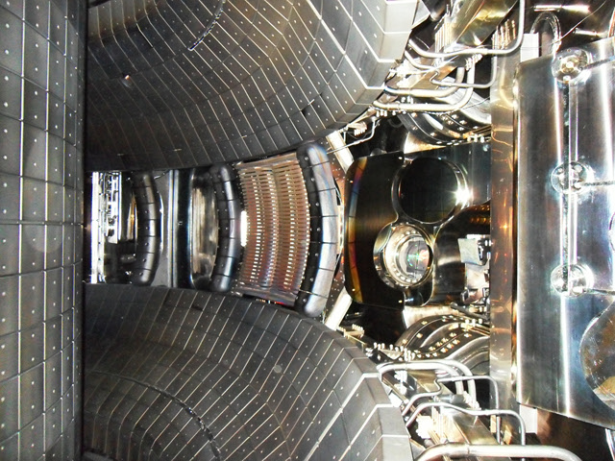
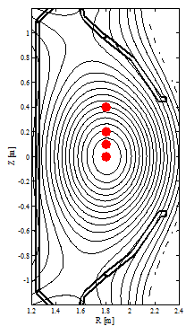
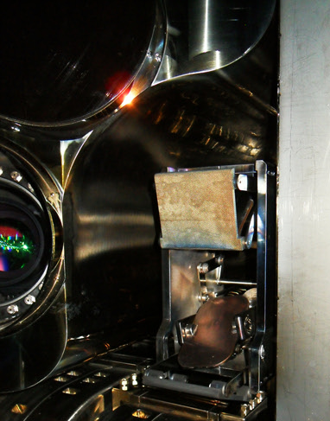
Ar transport experiments with ECH
Argon gas injection through a piezo valve (trace amount of Ar : n_{Ar}/n_{e} < 0.1%)
Different transport with varying ECH positions → Feasibility of impurity control?
Using 110 GHz ECH system
Heating positions
(r/a = 0, 0.16, 0.30, 0.59)
R=1.8m
N port
I_{p}
y
ECH
Launcher
~ 50°
x
40 cm
B_{t}
20
10
Ar
On-axis
Mi Joung, EC17, May 7-10, Deurne, Netherlands, 2012
- Target: R₀ = 1.8 m (B₀=1.964T), Tor = -5. deg.
- ECH power was fixed : 350 kW
- Heating position changed by tilting the lanching mirror

Slide 34
Less core Ar emissivity with ECH
Ar puff
VUV Ar¹⁵⁺
No-ECH
ECH
r
SXR emissivity
(No ECH)
2.8 – 4 keV photons
Mainly Ar¹⁶⁺ & Ar¹⁷⁺ emissions
r
t
SXR emissivity
(On-axis ECH)
ECH

Slide 35
Less core Ar emissivity with ECH
No ECH
r
No ECH
r
Core
ch #8
0.30, 0.59
On-axis
0.16
r/a = 0.16
On-axis
ECH
r/a = 0.30
r/a = 0.59
Most effective (i.e., least core impurity concentration) with on-axis ECH
Less effective with ECH heating position at larger radius

Slide 36
2-D Reconstructed Ar emissivity
Core-focused reconstruction (Cormack algorithm)
Emissivity images of mainly Ar¹⁶⁺ & Ar¹⁷⁺ impurities
No ECH
On-axis ECH
Z
R
Z
R

Slide 37
Modification of D & V by ECH
#7566: No ECH
Inward
#7574: On-axis ECH
Outward
Inward
With on-axis ECH, central (r/a = 0 ~ 0.3) diffusion and convection are increased.
For convection, the sign is reversed from – to +: Inward → Outward pinch

Slide 38
Effect on central impurity accumulation
◈ Radial distribution of total Ar density versus time by SANCO
No ECH (#7566)
On-axis ECH (#7574)
Time
Time
r/a
r/a
Total Ar
Peaked profile
Hollow profile

Slide 39
Neoclassical contribution of Ar transport
Neoclassical calculation of D and V was done by NCLASS
Exp
No ECH
(#7566)
NCLASS
10*NCLASS
On-axis
ECH
(#7574)
Exp
NCLASS
10*NCLASS
D, V by NLCASS is smaller by an order of magnitude than the experimental D, V. → The impurity transport is anomalous, rather than neoclassical.

Slide 40
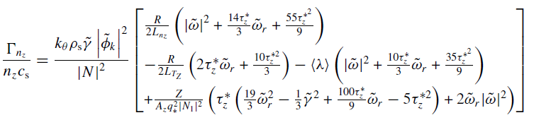
Possible mechanism of impurity pinch
From quasi-linear calculation of Weiland multi-fluid model
→ 3 impurity pinch terms^{[1, 2]}
Curvature pinch
Parallel
compression
pinch
Thermodiffusion pinch
Pinch type | Description | Pinch direction by turbulence type
Curvature pinch | Compressibility of ExB drift velocity | Inward
Thermodiffusion pinch | Compression of the diamagnetic drift velocity | ITG → Outward TEM → Inward
Parallel impurity compression | Parallel compression of parallel v fluctuations produced along the field line by fluctuating electrostatic potential | ITG → Inward TEM → Outward
Is the outward convection of Ar due to ITG or TEM?
[1] H. Nordman et al., 2011 Plasma Phys. Control. Fusion 53 105005
[2] Giroud C. et al 13th ITPA Confinement Database & Modelling Topical Group, Naka, Japan

