Slide 1
Design and tomography test of soft X-ray array diagnostics on KSTAR
PPPL, Feb. 17. 2014
Seung Hun Lee*, Juhyeok Jang, Joohwan Hong, H. Y. Lee,
Siwon Jang, and Wonho Choe**
Korea Advanced Institute of Science and Technology (KAIST), Daejeon, Korea
Fusion Plasma Transport Research Center (FPTRC), Daejeon, Korea
*leesh81@kaist.ac.kr **wchoe@kaist.ac.kr

Slide 2
Outline
KSTAR status & Motivation
Signal estimation & Tomography test
  Absolute calibration of AXUV
  KSTAR-like SXR images L- and H-modes
  Photocurrent of the detector with various filter sets
  Various reconstruction methods
  Reconstruction results of KSTAR-like phantoms with a P-T method
Available research fields
  Impurity transport (Ar, W)
  Sawtooth crash
  MHD mode identification
Engineering design
  Detector head & Installation scheme
  2-D map of LOS
  DAQ system
Discussion

Slide 3
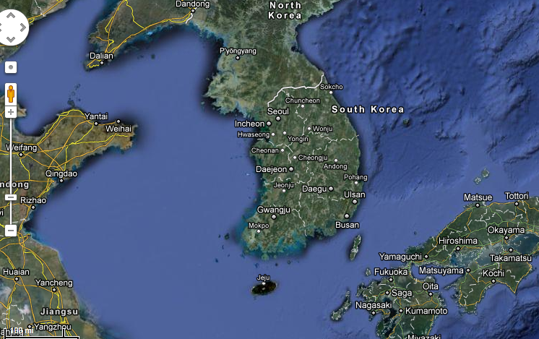
Daejeon - Korea
East sea
Daejeon
West sea

Slide 4
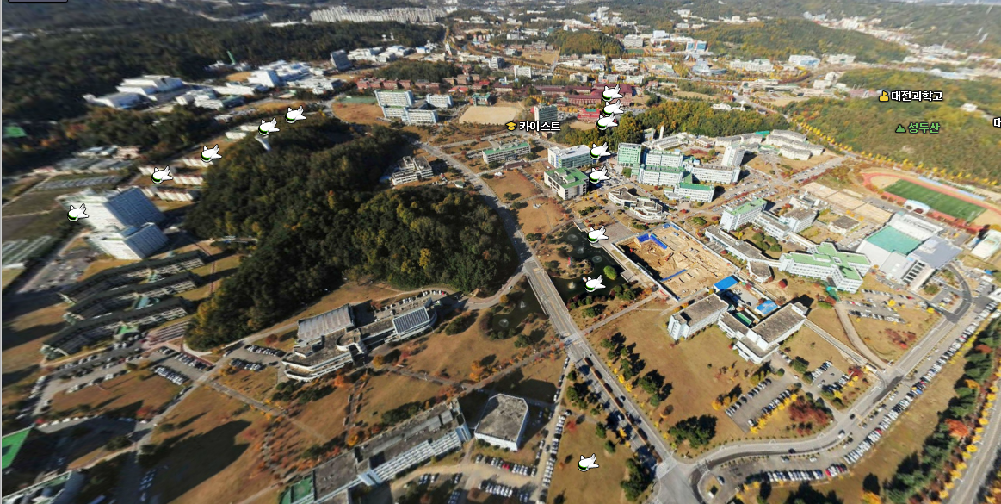



KAIST & NFRI

Slide 5
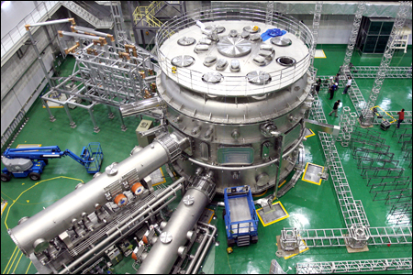
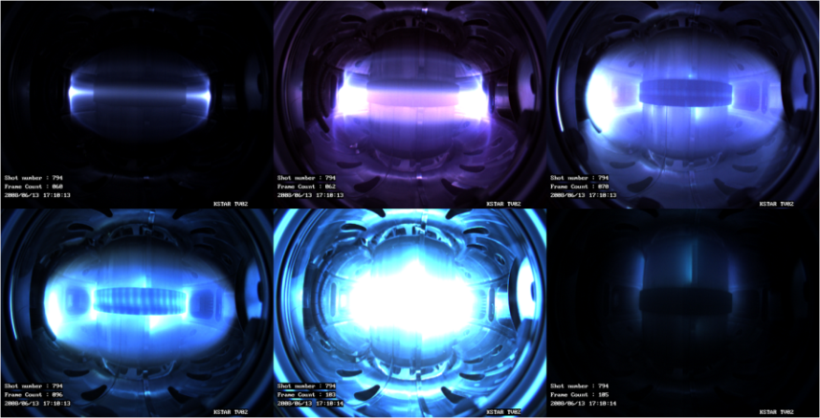
KSTAR
(Korea Superconducting Tokamak Advanced Research)
Superconducting Tokamak
Complete construction : Sep 14,
2007
Operation data : 2008 –
Major radius : 1.8m
Minor radius : 0.5m
Plasma volume : 17.8m³
Plasma current : >2.0MA (1MA)
Toroidal field : >3.5T (2T)
Pulse length : >300s (10s)
Plasma fuel : H, D-D
Auxiliary heating : ~ 28MW

Slide 6
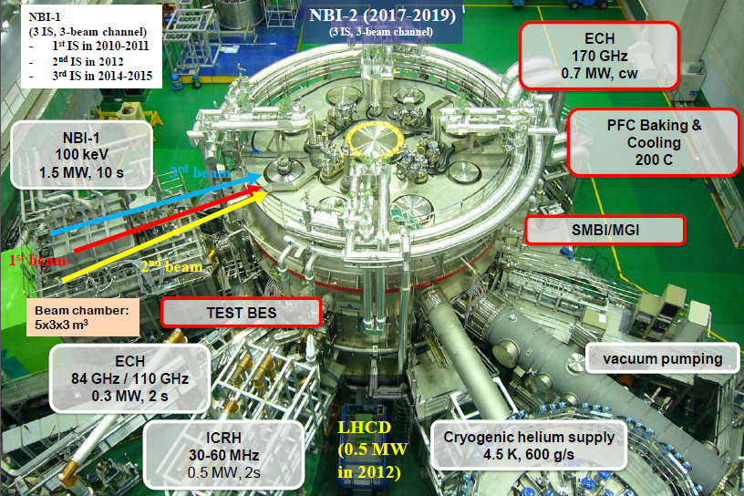
KSTAR for 2011 Campaign
W. C. Kim, et al., “Overview of the KSTAR 2011 experimental results”, 3th KSTAR conference, 2012

Slide 7
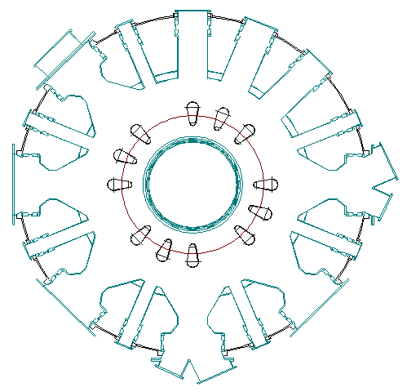
Map of KSTAR diagnostics
Illuminator (’08)
TV #2 (’08)
CES-background (8/50ch)
IRTV #2 (’11:tangential)
Installed
Planned from 2014
To be decided
XICS #1 (’09 : normal)
X-ray camera (MWPC ’11)
(u&l) Bolometer-divertor
TS - Optics (’10 : 5/42ch)
(u&l) IRTV (divertor)
Pumping Duct
IVCC Leads
LHCD
ICRF
CES (’10 : 8/50ch)
Coherence Imaging (’11)
MSE (’12)
BES (’12)
Recip. Langmuir probe
Fast-ion detector
Tangential X-ray camera (’11)
(t) Recip. Langmuir probe
GDC
ECH
IVCC Leads
A
P
O
B
N
Bolometer - resist (’09) (12ch)
TS - Laser (’10)(2J 10Hz)
CX-NPA (’12)
(t&b) Laser for D. Thomson
(t&b) Laser for LIF
Soft X-ray array (’09)
TV #3 (’10 : 1kfps)
IRTV #1 (’10)
Bolometer-imaging (’10)
Ellipsometry
mm-Interferometer (’12)
Reflectometer (’12~)
X-ray Pulse Height Anal.
C
M
NBI 1
Pellet Injector
D
L
ECE (’08)
ECE Grating Polychrometer
Diagnostic Neutral Beam
E
K
Fuel
Hall probe (’08)
IRTV (normal)
ECCD
H-alpha Monitor (’08)
Visible Spectrometer (’08)
Visible Filterscope (’08)
Visible Brems. Array
Multi-chord Vis. Spec.
(u&l) CES-poloidal
(l) Recip. Langmuir Probe
F
J
G
H
I
IVCC Leads
XICS #2 (’10 : tangential)
X-ray camera (GEM, ’12)
FIR Interferometer (’12 : 5ch)
VUV Survey Spec. (’12)
Edge SXRA (’14)
IVCC Leads
GDC
NBI 2
Inspection Illuminator
TV #1 (’08)
IRTV #3 (’12 : tangential)
MSE(II)
mm-Interferometer (’08~’11)
Reflectometer (’09~’11)
ECEI (’12)
MIR (’14)
(t&b) FIR (’11 : 1ch)
ECEI (’10~’11)
Hard X-ray (’09)
Neutron detector (’10)

Slide 8
Motivation
Demand
  A two-array system has a limitation to reconstruct the plasma with elongation κ and triangularity δ with high accuracy.
  At least 6 arrays are required to describe κ and δ .
In 2014, a four-array system of soft X-ray diagnostics is under preparation on KSTAR.
Phantom
2 arrays (2009)
4 arrays (2014)
6 arrays (TBD)
Elongation
Triangularity

Slide 9
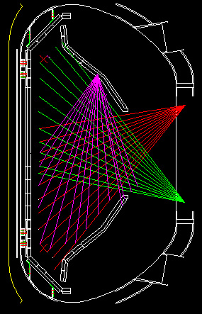
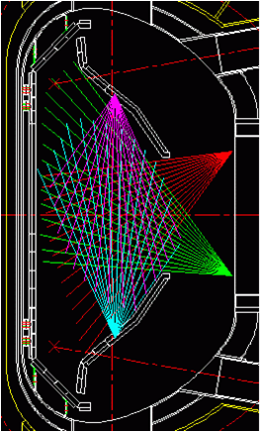
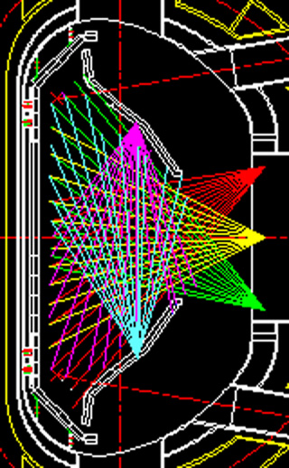
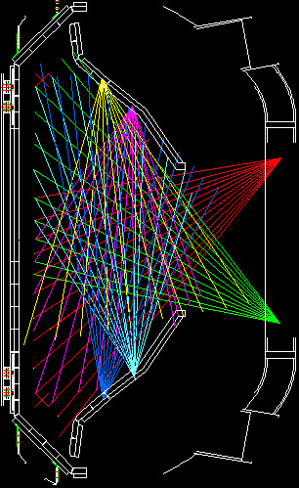
Coverage test for array system
3 arrays
4 arrays
5 arrays
6 arrays
VU
VU2
VU1
VU
VU
HU
HU
HU
HU
HC
HL
HL
HL
HL
VL
VL
VL1
VL2

Slide 10
Calculation for signal estimation &
Tomography reconstruction

Slide 11
Signal estimation
Properties of detector system
Absolute calibration
Bremsstrahlung calculation in KSTAR L- and H-modes
Incident photon rate & Photocurrent of the detector
Filter sets for Te measurement
  Be filters (10, 50, 250, 400 μm)

Slide 12
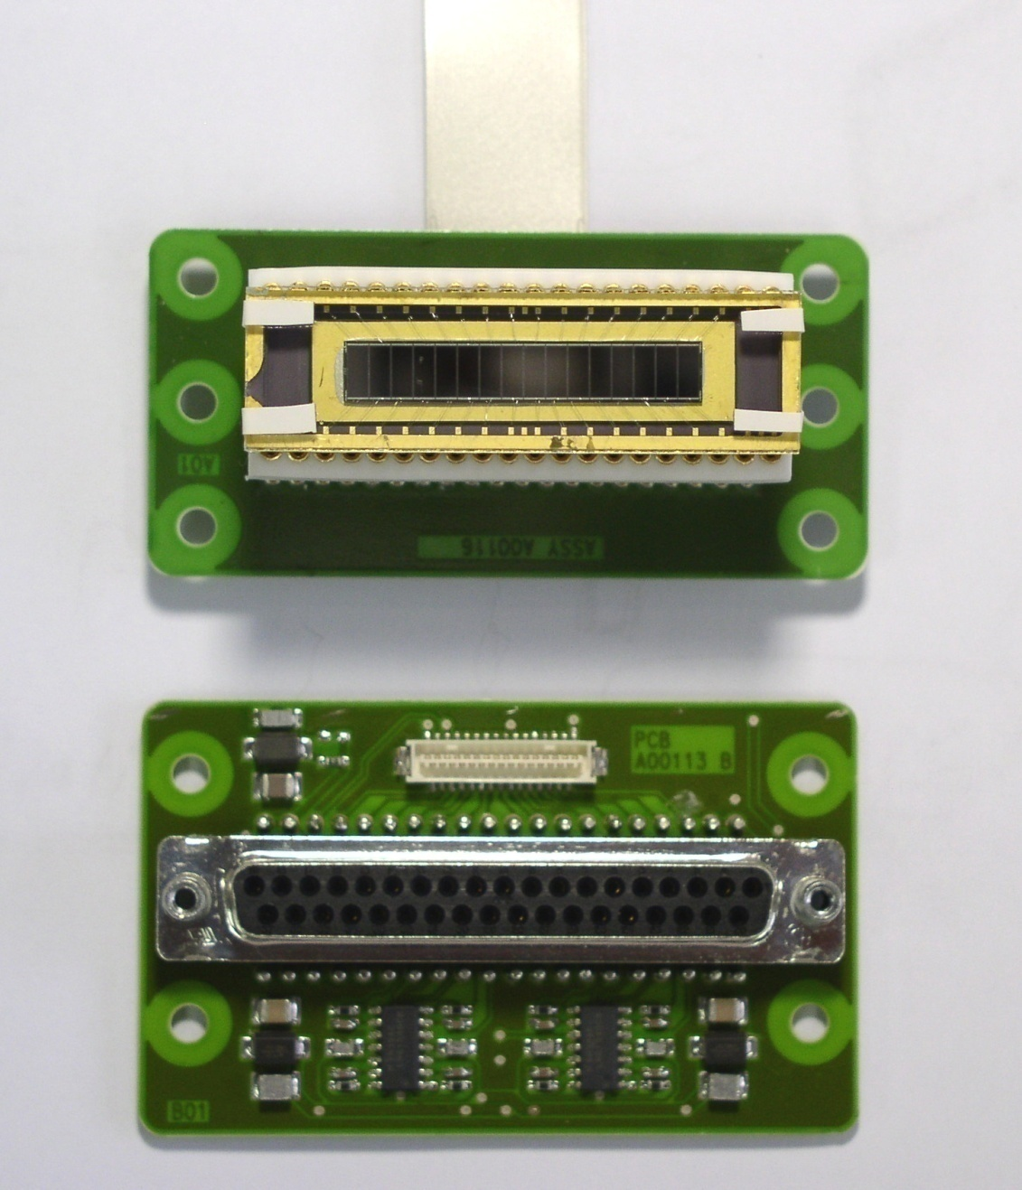
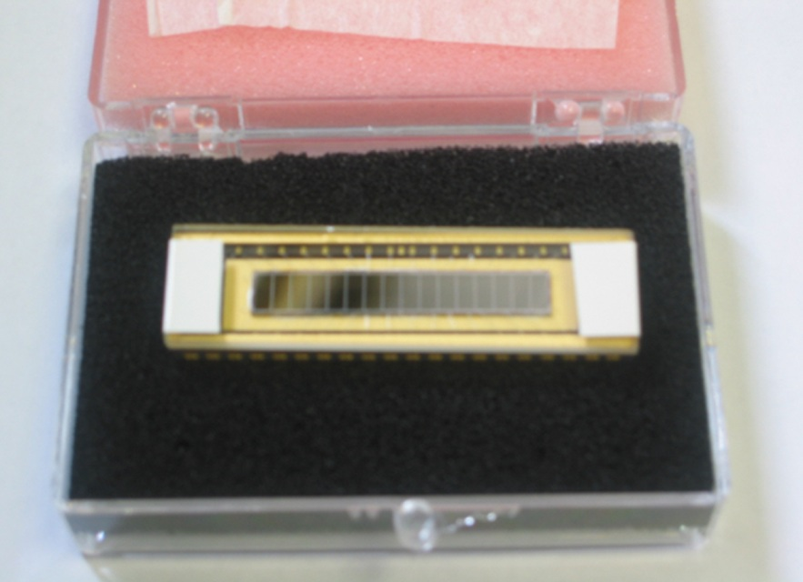
Photodiode detector & Pre AMP
Ribbon cable
AXUV-16ELG detector
AXUV-16ELG array
55 mm
15 mm
53 mm
Δt = 2 μs
Δr = 2 cm
73 mm
Requirement
  Fast response ~ MHz
  High sensitivity to XUV and soft X-ray
Specification
  Active area: 5 × 2 mm²
  Shunt resistance: 100 Ω⋅m
  Capacitance: 2 nF
  Rise time (10-90%): 0.5 μs
  Gain: 10⁶ V/A
  Detection efficiency: 0.27 A/W*
AMP-16 remote panel
AMP-16 main circuit
*See p.10

Slide 13
Solid angle
dP_{i} : measured power emitted from the plasma volume dV_{p}
h
d_{i}
5 × 2 mm²
Line of sight, L_{i}
92 mm
Detector, A_{det,i}
Aperture, A_{ap,i}
2.5 × 1 mm²
Thickness, dl_{i}
Plasma volume, dV_{p}
c_{i} : calibration factor

Slide 14
Absolute calibration
Collaboration with ENEA-Frascati
Spectrum of the source
Response vs I_{tube}
Response vs V_{tube}
Response vs Filter
Detection efficiency of AXUV
Distance
MOXTEK
X-ray source
Slit
Si p-i-n diode
(7 mm² × 0.3 mm)
Be window (0.254 mm)
Al filter
Be window (0.25 mm)
Fe-55
Experimental setup

Slide 15
Typical ne & Te in KSTAR L- & H-mode
ne profile
Te profile
Typical ne & Te profiles of L-mode and H-mode are prepared to calculate X-ray radiation spectrum.

Slide 16
ne, Te based SXR profile calculation (after filter)
L-mode
H-mode
X-ray continuum radiation and filtered radiation spectra by Be foils were calculated in each case.

Slide 17
Synthetic SXR image based on typical KSTAR L-mode
κ = 1.8
δ = 0.2
Δ_{max} = 0.1 m
Be 10 μm
Be 50 μm
Continuum
Be 250 μm
Be 400 μm

Slide 18
Synthetic SXR image based on typical KSTAR H-mode
κ = 1.8
δ = 0.2
Δ_{max} = 0.1 m
Be 10 μm
Be 50 μm
Continuum
Be 250 μm
Be 400 μm

Slide 19
Line of Sight (LOS)
Coverage test
VU
1
32
1
HU
32
Reconstruction region
HL
Spatial resolution: 2 cm
32 ch × 4 arrays = 128 ch
Total 128 chords
VL

Slide 20
Expected photo-current of AXUV
L-mode
H-mode
Vertical
Vertical
Horizontal
Horizontal
Photo-current level is ~0.03 μA in L-mode and 0.15 μA in H-mode, which means the voltage signal is ~30 mV in L-mode and 150 mV in H-mode.

Slide 21
Te from multi-energy SXRA
Assumption
  Maxwellian distribution of electron energy
  Continuum radiation only
Te can be derived from signal ratio.
Thick
filter
Plasma
Signal 1
SXR
(n_{e}, T_{e}, Z_{eff})
depends only on
T_{e}
Thin
filter
Signal 2
Continuum radiation

Slide 22
Four Be filter sets
ε_{D}, P_{rad}, and transparency of Be filters
X-ray spectra after Be filter (Te = 2 keV)
Be filters of 10 μm, 50 μm, 250 μm, and 400 μm
Detection efficiency (ε_{D}) is same with absorption probability of 400 μm Si (AXUV).
Each photon spectra arriving at the detector can be calculated.

Slide 23
Signal ratio & Dynamic range of the detector
10 & 50 μm
10 & 250 μm
10 & 400 μm
0.4-2.0 keV
1.2-6.0 keV
1.5-9.0 keV
50 & 250 μm
50 & 400 μm
250 & 400 μm
0.7-3.5 keV
1.0-5.5 keV
0.2-1.0 keV
A set of 50 μm and 250 μm is best for KSTAR plasma.

Slide 24
Tomography test
Reconstruction methods
Prepared phantoms
  (L-mode, H-mode, m/n = 1/1, m/n = 2/2, and m/n = 3/2)
Reconstruction results
2-D Te reconstruction by ME-SXR
MHD mode analysis

Slide 25
Tomography
Tomography :
A non-invasive imaging tool for observing the inner structure of the plasmas
Acquiring soft x-ray signal ( f(p, φ) )
from many lines of sight
y
Detector
Dashed line : Viewing Cone
Solving inverse problem
(ill-posed problem) :
r
p
φ
θ
x
Plasma
Line of sight
Reconstruction of 2-D local
emissivity ( g(r, θ) )
Coordinate system for defining tomography system

Slide 26
Tomographic reconstruction codes developed at KAIST
Analytic method
Bessel function
Zernike polynomial
J₀
m = 0
Cormack
J₁
m = 1
J₂
J₃
J₄
m = 2
Discrete method
Classified by objective functional O(g)
Minimum norm: Phillips-Tikhonov
Entropy: Maximum entropy
Multi-order smoothness: Minimum Fischer Information

Slide 27
6 array reconstruction test
P-T
MEM
6 array system
Single peak
Method | Relative error, σ (%) |  | Cal time (s)*
 | Single | Hollow
P-T | 0.59 (b) | 1.55 (e) | 20
MEM | 6.90 (c) | 5.72 (f) | 15
Hollow
*under Pentium 2.67GHz, Windows platform
P-T performance is better than conventional MEM in accuracy.

Slide 28
4 array reconstruction test (P-T)
L-mode phantom
Continuum
Be 10 μm
Be 50 μm
Be 250 μm
Be 400 μm
Reconstruction

Slide 29
4 array reconstruction test (P-T)
L-mode phantom
Continuum
Be 10 μm
Be 50 μm
Be 250 μm
Be 400 μm
Reconstruction

Slide 30
2-D Te reconstruction by ME-SXR
L-mode
Be 10/50 μm
Be 10/250 μm
Be 10/400 μm
Be 50/250 μm
Be 50/400 μm
Be 250/400 μm
Good agreement of Be 10/50 μm in low temperature
It contains reconstruction error.

Slide 31
2-D Te reconstruction by ME-SXR
H-mode
Be 10/50 μm
Be 10/250 μm
Be 10/400 μm
Be 50/250 μm
Be 50/400 μm
Be 250/400 μm
Good agreement in r/a < 0.6
It contains reconstruction error.

Slide 32
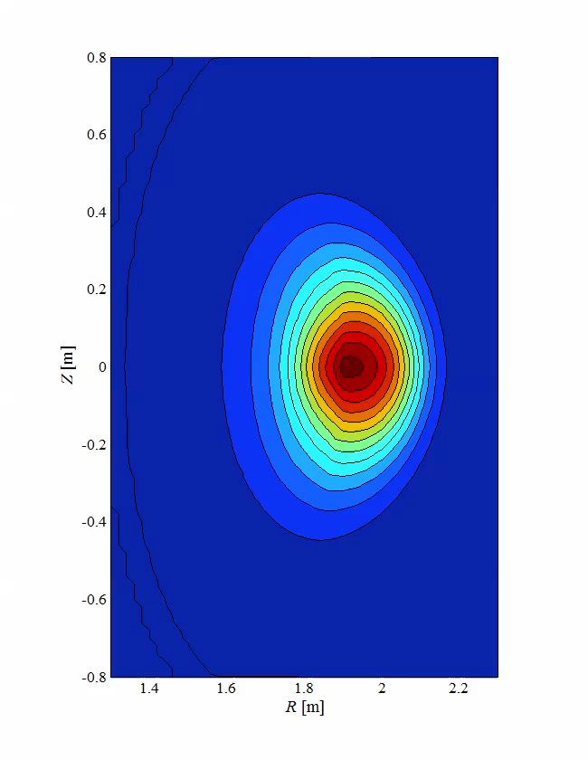
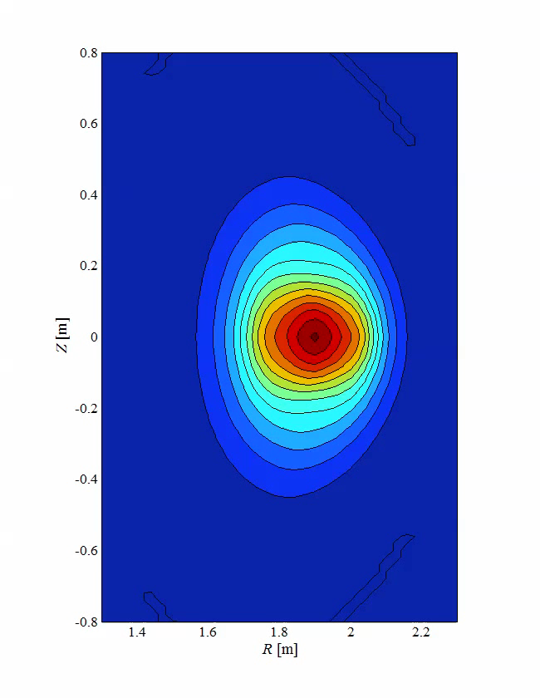
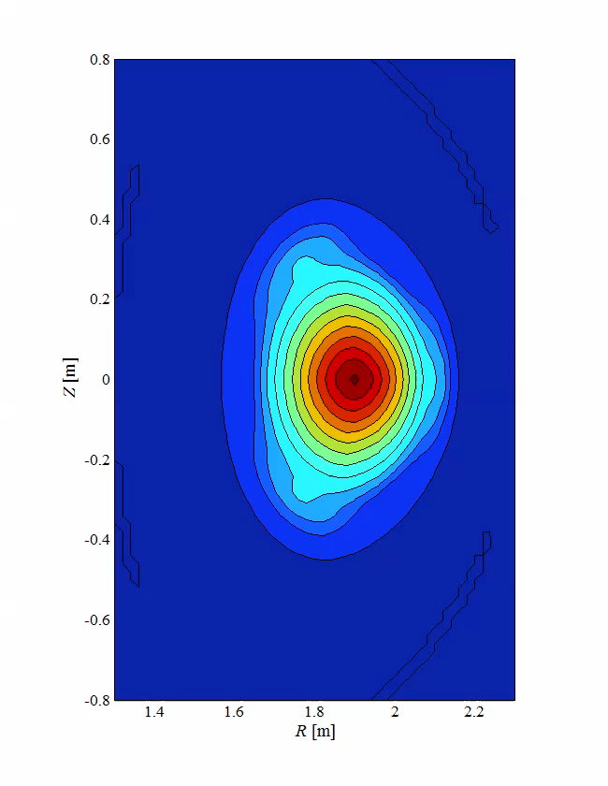
Phantoms with MHD modes
m/n = 1/1
@ r/a = 0.3
m/n = 2/2
@ r/a = 0.3
m/n = 3/2
@ r/a = 0.5

Slide 33
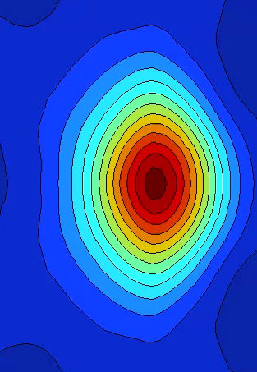
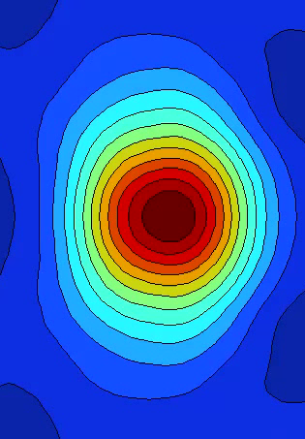
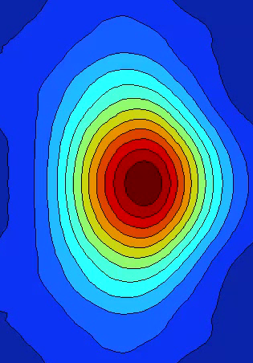
Reconstruction results (P-T)
m/n = 1/1
@ r/a = 0.3
m/n = 2/2
@ r/a = 0.3
m/n = 3/2
@ r/a = 0.3

Slide 34
MHD mode identification by SVD analysis (m/n = 1/1)
k = 1
k = 2
k = 3
MHD m/n = 1/1 mode is clearly seen by the SVD method.
Two phases are distinguishable with π/2 difference.

Slide 35
MHD mode identification by SVD analysis (m/n = 2/2)
k = 1
k = 2
k = 3
MHD m/n = 2/2 mode can be analyzed by the SVD method.
Two phase of π/2 can be distinguished.

Slide 36
MHD mode identification by SVD analysis (m/n = 3/2)
k = 1
k = 2
k = 3
MHD m/n = 3/2 mode can be analyzed by the SVD method.
Two phase of π/2 can be distinguished.

Slide 37
Expected studies

Slide 38
Impurity transport research (Ar, W)
J. Hong
KSTAR X-ray spectrum by calculation (Te = 2 keV, ne = 10¹⁹ m⁻³)
Transport coefficients of impurities by SANCO
50 μm
W cm-² eV⁻¹
W
Ar
Continuum radiation
Two filter sets can distinguish the different species of impurities.
SANCO can provide transport coefficients of impurities

Slide 39
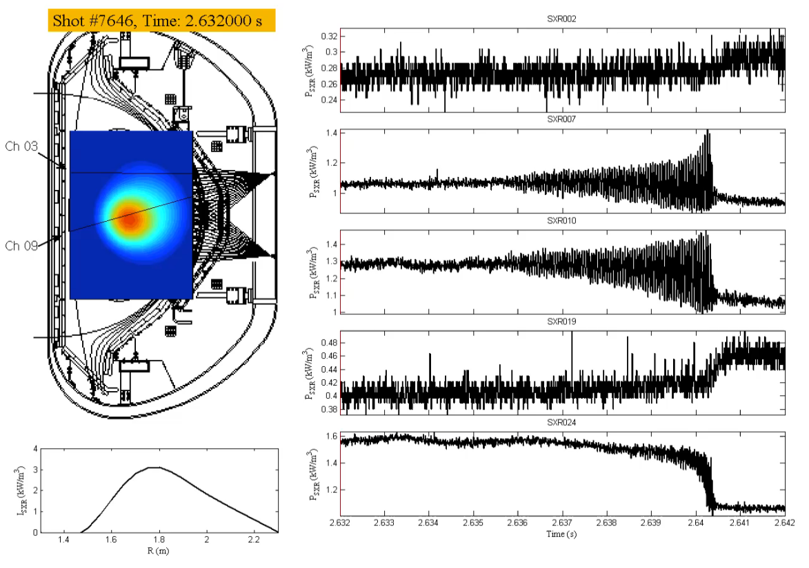
Sawtooth crashes (example)
KSTAR
Trajectory of the hot core (rtEFIT)
Spectrogram
m = 1 (f = 19 kHz) is shown by spectrogram.
Maximum displacement from the initial position: 0.13 m
Maximum rotation speed: 10.7 km/s
m = 1
f = 19 kHz
Notes:
마찬가지로 H-mode에서 결과입니다. 주파수는 19 kHz로 L-mode보다는 더 높았고 최대 속도 10.7 km/s였습니다. 중심의 이동 거리는 0.13 m로 L-mode와 거의 같았습니다.

Slide 40
Comparison between L- & H-mode
KSTAR
L-mode, low v_{Ф}
H-mode, high v_{Ф}
Crash
Crash
Displacement from central position
Displacement from central position
Up to 0.1 m
Up to 0.1 m
Poloidal velocity
Up to 5 km/s
Poloidal velocity
Up to 10 km/s
Crash in one step
Crash in three steps
Notes:
L-mode와 H-mode 비교를 하자면, crash가 일어나는 양상이 앞서와 같이 다릅니다. 확대한 신호를 보면 L-mode 에서는 crash가 한 번에 일어나 oscillation 피크값이 최대가 되었다가 바로 잠잠해지는 모양이고, H-mode에서는 최대 피크점이 있고 그 이후에도 oscillation이 세 번에 걸쳐 그 진폭이 잦아드는 모양입니다. (9, 11 페이지 그림과 일치)

Slide 41
Correlation between m=1 frequency & v_{Ф}
KSTAR
The m=1 frequencies are compared with toroidal velocity for all the sawtooth crashes.
Rotation frequency can be calculated by
The m=1 frequency is determined by rotation velocity
Notes:
이러한 m=1 모드의 주파수와 토로이달 회전 속도와 비교해보면 이와 같습니다. 6개의 실험에서 일어난 모든 sawtooth crash를 fft하여 알아낸 주파수와 그 시간에 해당하는 토로이달 회전속도와 비교한 값입니다. 이에 따르면 m=1 모드의 주파수는 토로이달 회전 속도에 의해 결정된다고 할 수 있겠습니다.

Slide 42
MHD mode analysis with SVD
KSTAR
Singular Value
Spatial structures
Temporal evolution
Time sequences of reconstructed emissivity
k = 1
k = 2
k =3
k = 4
k = 5
k = 6
k =7
k = 8
No m=2
Notes:
이것은 SVD로 모드 알아내는 그림입니다. m=2 모드는 보시다 시피 나타나지 않았습니다.

Slide 43
4 array SXRA preparation
Detector head
  AXUV16-ELG
  Filter wheel
Installation scheme
  Vertical & Horizontal arrays
2-D map of LOS

Slide 44
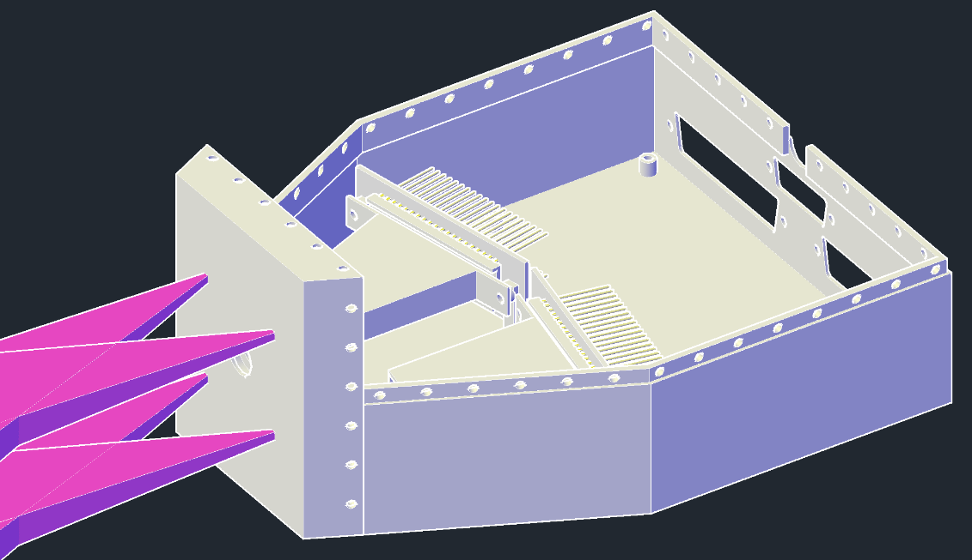
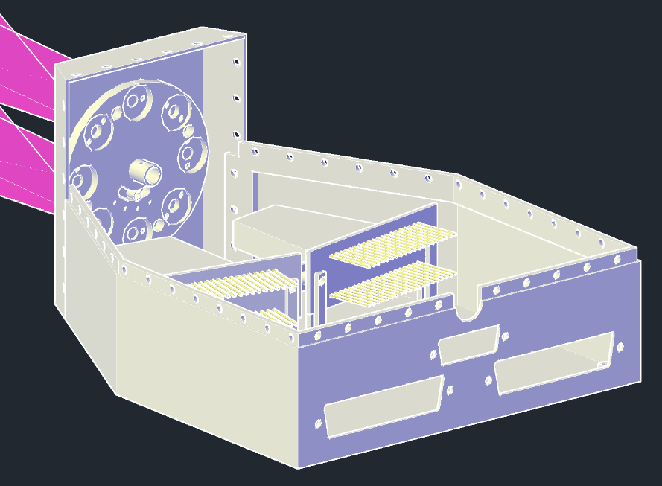
Detector Head
AXUV-16ELG detector
15 mm
Viewing cone
Cover
Preamp
53 mm
Specification
  Active area: 5 × 2 mm²
  Shunt resistance: 100 Ω⋅m
  Capacitance: 2 nF
  Rise time( 10-90%): 0.5 μs
  Preamp gain: 10⁶ V/A
  Bandwidth: 600 kHz
AXUV
Δt = 2 μs
Δr = 2 cm
Filter wheel
Four AXUV detectors in a detector head
  Two for thin Be filter, and the others for thick Be filter
Preamp (10⁶ V/A) close to the detectors
Filter wheel can provide other filter sets.
  (e.g.) Ar Ross filter, Bolometer mode
  Not to be used in 2014
Different filter sets

Slide 45
Position of Vertical & Horizontal arrays
Vertical array
Passive stabilizer
Reconstruction area
Horizontal array
Vertical array should be attached behind the passive stabilizer.
Horizontal array will be mounted on vessel wall (exit of a cassette).

Slide 46
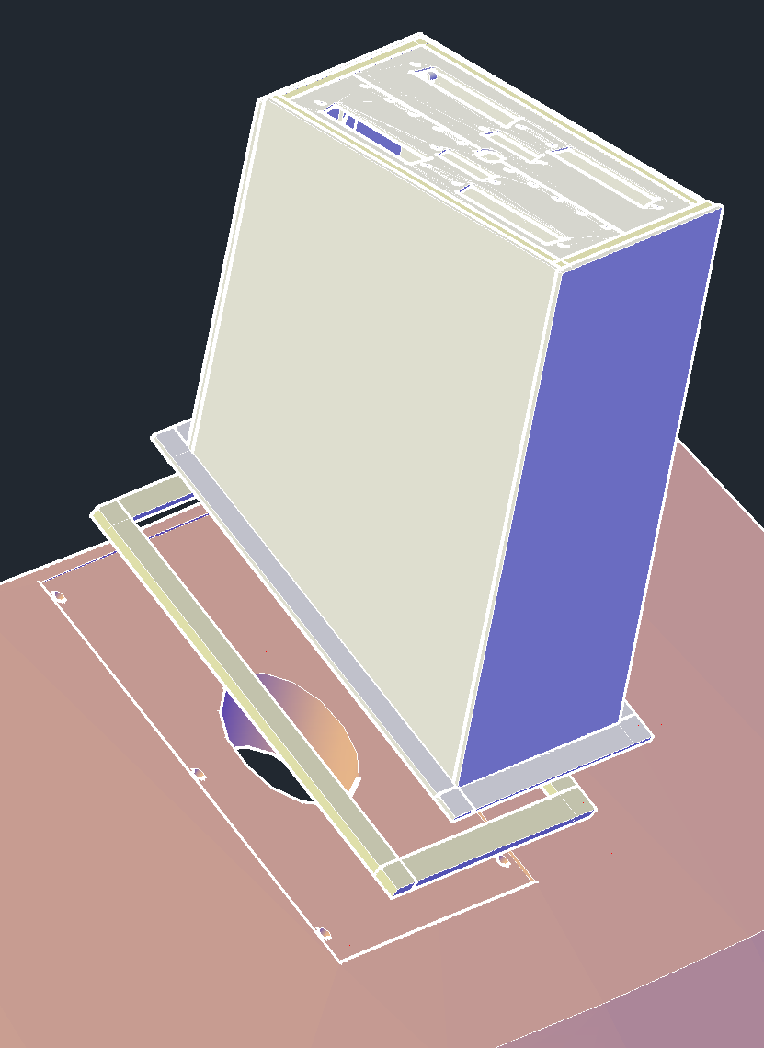
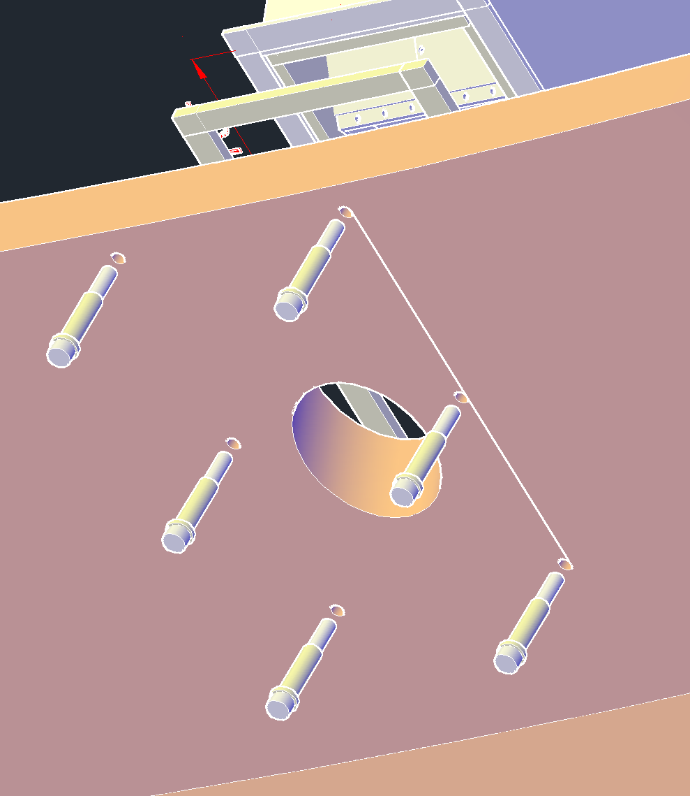
Installation Scheme (Vertical)
Signal outlet
Detector head
M6 × 6 Bolts
ϕ65 Hole
Flattened
Passive stabilizer
Insulator
Through-hole (ϕ65) on passive stabilizer for viewing cone
Insulation between P/S and Detector head is needed.

Slide 47
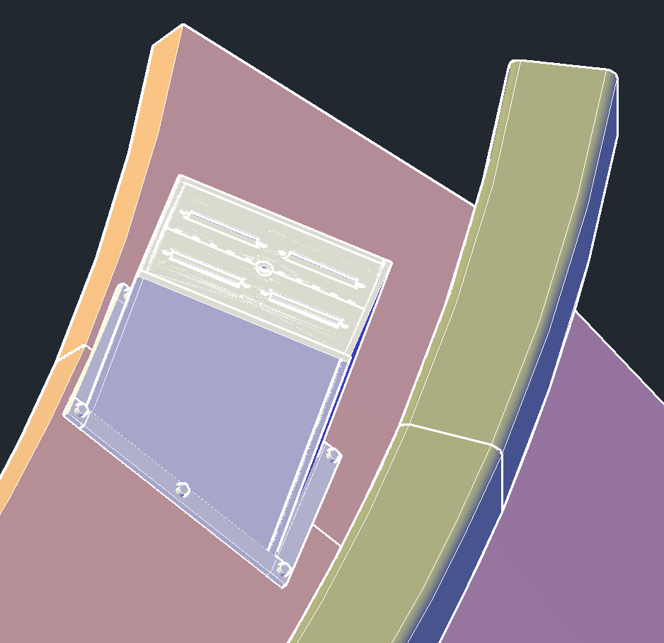
Specific measurements (Vertical)
Size in mm
IVCC
130 mm
Detector head
50 mm
IVCC
C tile
M6 × 6
202 mm
Passive stabilizer
Distance between the detector head and IVCC is 50 mm.
Mechanical vibration due to the disruption

Slide 48
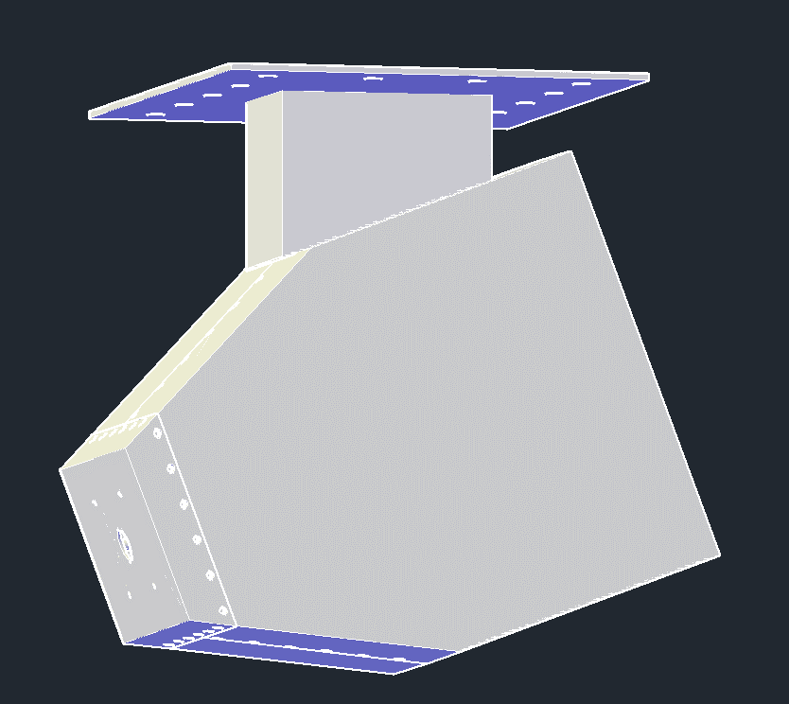
Installation Scheme (Horizontal)
Mounting pad
Vessel wall
Apertures
Detector head
Cassette
Installation on the vessel wall with tapped holes (M4 × 12)
Horizontal array will be mounted on vessel wall (exit of a cassette).

Slide 49
Line of Sight (LOS)
Coverage test
VU
HU
Reconstruction region
HL
Spatial resolution: 2 cm
32 ch × 4 arrays = 128 ch
Each chord has two different filter sets (e.g. 50 μm & 250 μm).
Total 256 channels
VL

Slide 50
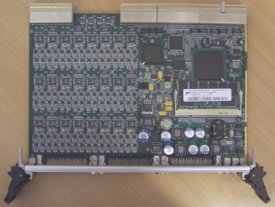
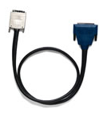
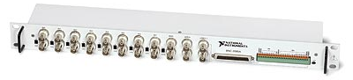
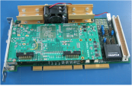
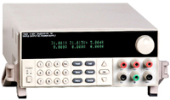
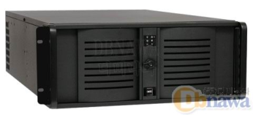
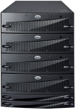
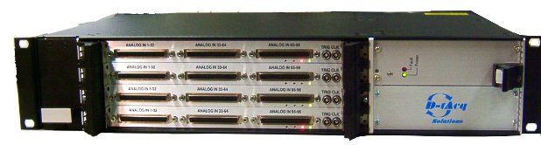
Data flow of DAQ system
Preamp (10⁶ V/A)
Photo diode
Coaxial cable in differential input
BNC-2090A
SHC68-68-EPM
Main Control
Optical signal
Trigger × 8
LTU + carrier
Power supply
Controlled by RS232
Torus hall
D-tAcq
ACQ196CPCI 96 ch × 4
Data (256 ch, 500 kS/s)
Optical cable
Ethernet
Data (256 ch, 500 kS/s)
MDS+ Server
Controller (Linux)
Chassis
Diagnostic room

Slide 51
Location of Diagnostic devices
P
A
O
B
N
C
M
Coaxial Cable 15 m
Detector & Preamp
D
L
E
K
19” Rack
19” Rack
F
J
G
I
Controller (Linux)
PXIe Chassis (NI DAQ)
Power Supply
Controller (Linux)
D-tAcq (SXRA)
H
Optical Cable 100 m
Main Room
Diagnostic Room
Entrance

Slide 52
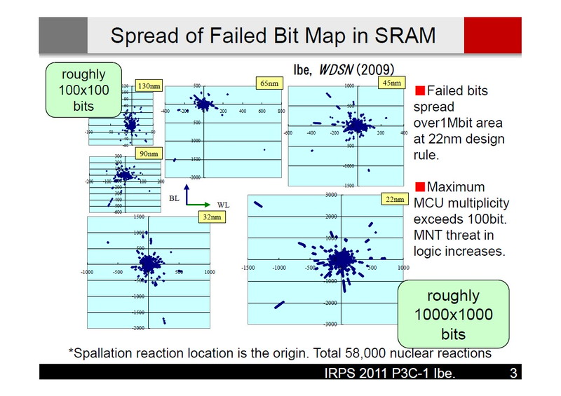
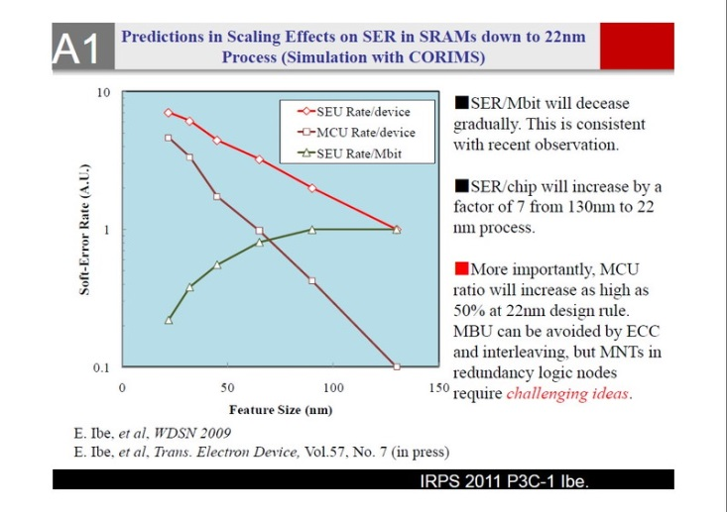
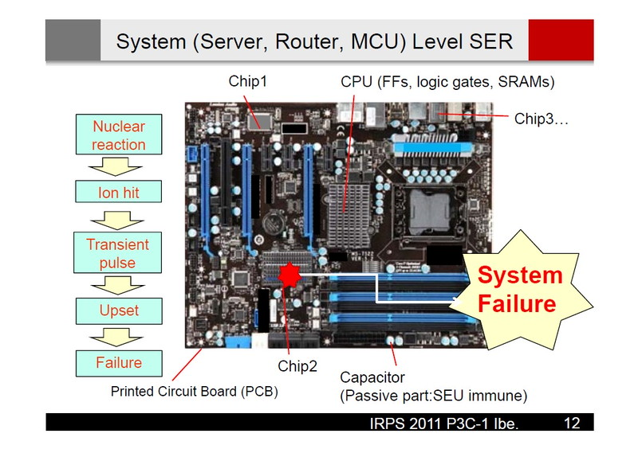
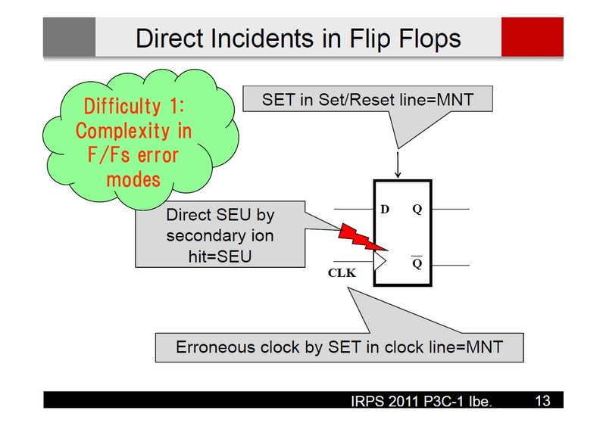
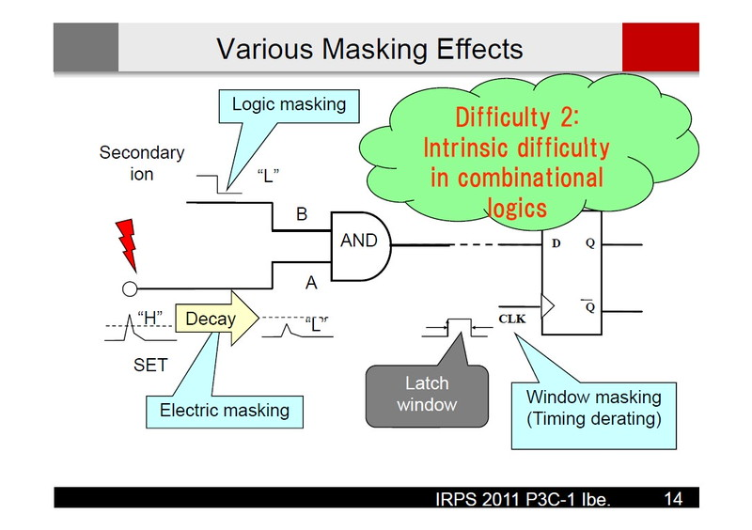
Software error by neutron radiation
http://gigglehd.com/zbxe/newsreport/5713195
2011 International Reliability Physics Symposium

Slide 53
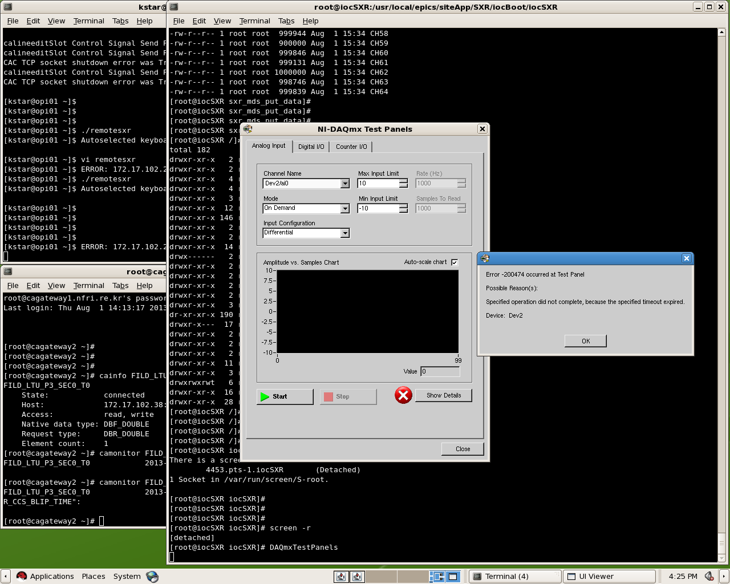
DAQ error (2012-13 KSTAR campaign)
NI-6123 (500 kS/s, 8 ch)
3 of 8 boards are failed in digital I/O.
Repairing charge: $700/eh

Slide 54
Discussion
Signal level of SXRA
I_{det} ~ 0.02-0.12 μA, V ~ 20-120 mV in L-mode
I_{det} ~ 0.05-0.45 μA, V ~ 50-450 mV in H-mode
Choice of Be filter sets for Te measure
(10 μm, 50 μm, 250 μm, 400 μm, etc.)
Tomography reconstruction quality with 4 array system
Capability of MHD mode identification (m/n = 1/1, 2/2, 3/2)
Installation of in-vessel SXRA diagnostics
Neutron damage to DAQ system

Slide 55
Supplementary

Slide 56
Cormack method (analytic)
Decomposed by harmonics
Expansion by basis function(Bessel function)
J₀
J₁
J₂
J₃
J₄
Measured signals
Coefficient
Calculating f components of each coefficient
Converting to linear equations

Slide 57
Phillips-Tikhonov (P-T) method
Laplacian of g
Set
minimize J by
regularization parameter
error
number of detectors
Solution is
To find out optimized
Goodness byGCV
should be minimized by

Slide 58
Iterative solution
3 iteration
6 iteration
Single peak
Relative Error
Iteration Number
Hollow

Slide 59
Modified P-T method
P-T method is modified for withstanding to the noisy data by nonlinearising the weight matrix
The difference between measured signal from solution g is defined by
Talyor expansion
The step size solution
The k^{th} iterative solution
step size of g, h << g
0
Jacobian matrix of D
Lee et al., Curr. Appl. Phys. 893, 10 (2010)

Slide 60
Maximum entropy method
Bayesian rule
Prior and Likelihood probability density function
Posterior probability density function
Lagrange Multiplier method
Iterative calculation until the maximum entropy of reconstruction result meets

Slide 61
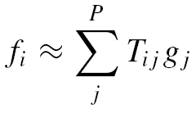
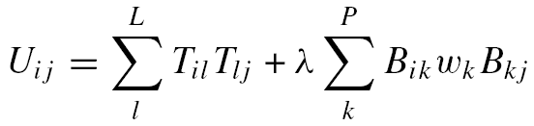
Minimum Fisher information
M = U⁻¹T
f _{i} = signal from the i^{th} detector
g_{jτ} = local emissivity of the j^{th} pixel at the τ^{th} time slice
T = geometrical weight matrix
B = gradient matrix
λ = regularization parameter
S = total number of time slices
L = number of detectors
M = transfer matrix
U = functional matrix
P = number of pixels
w_{k} = inverse of the k^{th} image pixel
σ_{i} = standard deviation of the i^{th} measurement
Minimizing the functional matrix U →
Minimum Fisher Information method
chi-square
Fisher Information
The regularization parameter is iterated until .

Slide 62

MHD mode in TCV
Identification of poloidal modes using SVD
Identification of m/n using poloidal array combined with tangential 2-D array
m=1
m=2
Tomogaphic
Plane
Tangential 2D array
Ray-tracing with a rectangular 3-D weight matrix
Toroidal mode (n = 1) from the emissivity along the red line
Tangential
Tomography
Relative Intensity
Toroidal direction
Integrated relative intensity

Slide 63
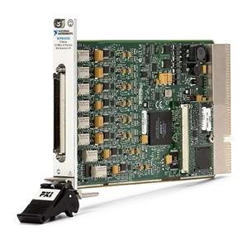

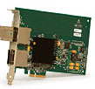
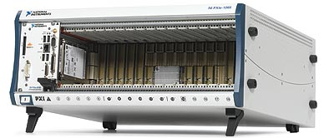
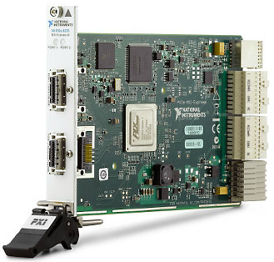
Data acquisition system
Preamp (10⁵ V/A)
Photo Diode
Coaxial Cable in Differential Input
BNC-2090A
SHC68-68-EPM
Main Control
Optical Signal
Trigger × 8
LTU + carrier
Power Supply
Controlled by RS232
Data (64 ch, 500 kS/s)
PXI-6123 × 8
PXIe-8372
Data (64 ch, 10 kS/s)
Ethernet
MDS+ Server
Controller (Linux)
PXIe-1065

