Slide 1
Design and tomography test of edge multi-energy soft X-ray diagnostics on KSTAR
PPPL, Feb. 18, 2014
Juhyeok Jang*, Seung Hun Lee, H. Y. Lee, Joohwan Hong,
Juhyung Kim, Siwon Jang, Taemin Jeon, Jae Sun Park
and Wonho Choe**
Korea Advanced Institute of Science and Technology (KAIST), Daejeon, Korea
Fusion Plasma Transport Research Center (FPTRC), Daejeon, Korea
*jjh4368@kaist.ac.kr **wchoe@kaist.ac.kr

Slide 2
Outline
Motivation
  Expected research topics
Engineering design
  Installation position
  Array design
  Detector specification
Expected signal level & Tomography test
  Calculation method
  Test for trial n_{e}, T_{e} profiles
  Test for KSTAR L, H-mode n_{e}, T_{e} profiles
  Time resolution test
Summary & Discussions

Slide 3
Motivation
Multi-energy soft X-ray (ME-SXR)
Tangential measurement
Multiple filter mode : bolometer, Be filters, etc
High spatial / time resolution : spatial ~ 1 cm, time > 10 kHz
Possible studies
Edge plasma physics : ELM, MHD instabilities
Edge electron temperature calculation by Neural Network
NSTX*
* Kevin Tritz, KAIST seminar (2013)

Slide 4
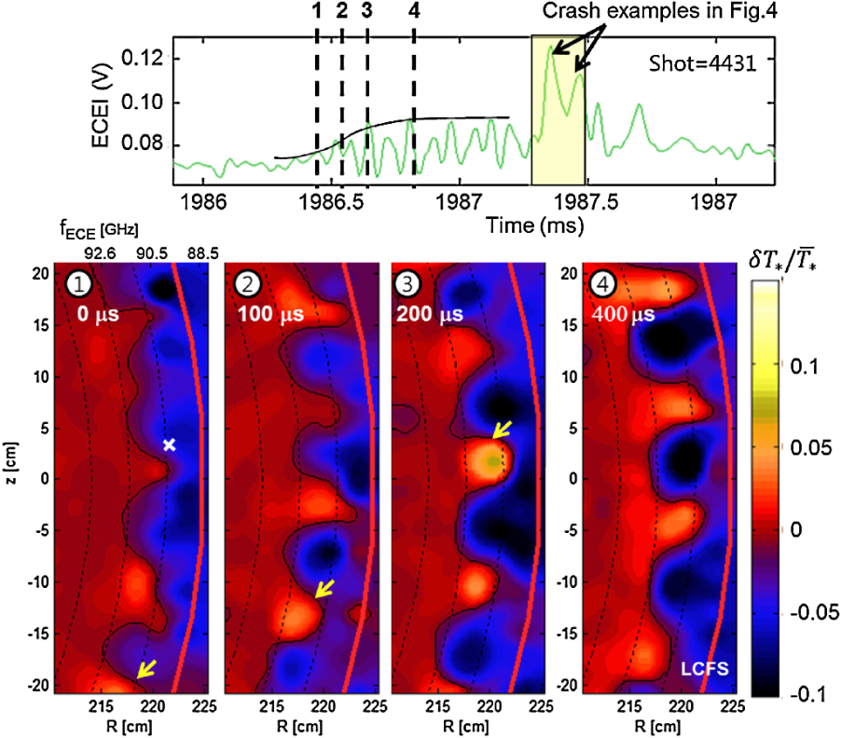
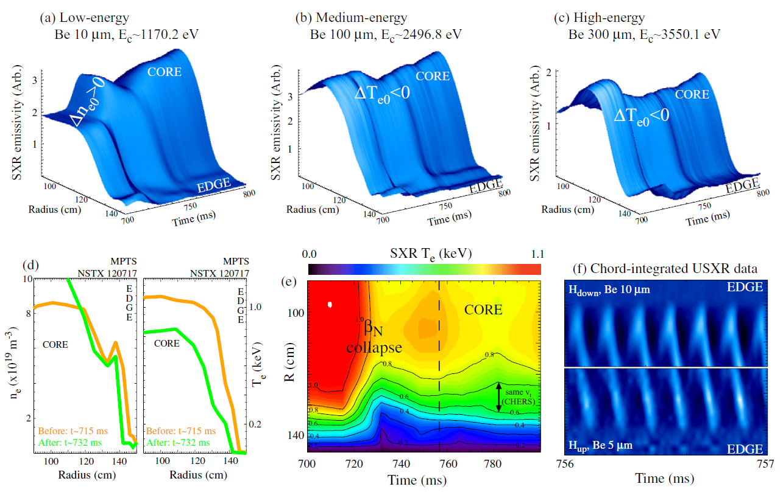
Edge plasma physics
High time resolution measurement of MHD activities
ELM cycle dynamics → Comparison with ECEI results
Impurity transport → SANCO calculation constrained by edge SXR signal
Resistive Wall Mode (NSTX) *
ELM filament (KSTAR ECEI) **
* L Delgado-Aparicio, Plasma Phys. Control. Fusion, 53 (2011)
** G. S. Yun, PRL 107, 045004 (2011)

Slide 5
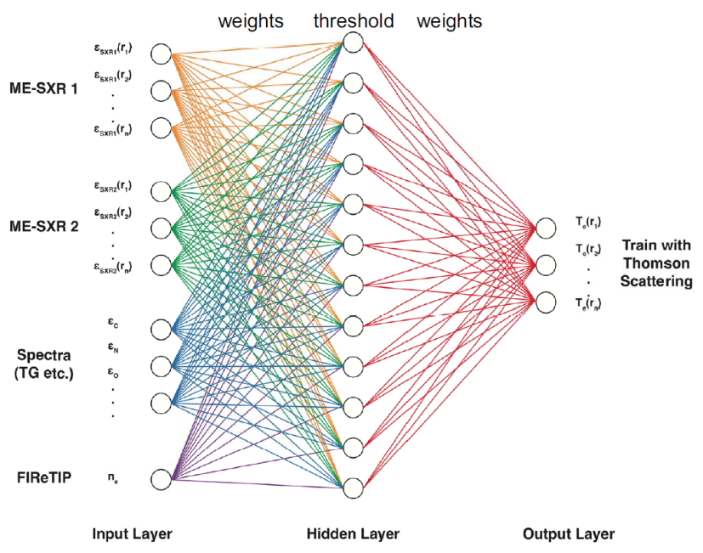
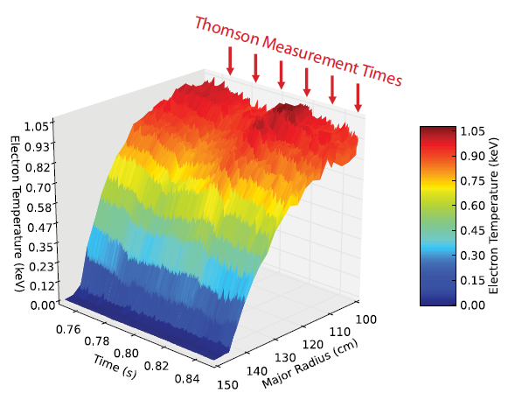
Electron temperature measurement
Neural Network: Three layer technique
Fast, real-time data analysis
T_{e} profile measurement without atomic modelling
Three-layer Neural Network *
T_{e} measurement (NSTX) **
* Kevin Tritz, KAIST seminar (2013)
** D. J. Clayton, Plasma Phys. Control. Fusion, 55 (2013)

Slide 6
Engineering Design
            Installation position
            Viewing range
            Array design
            Detector specification

Slide 7
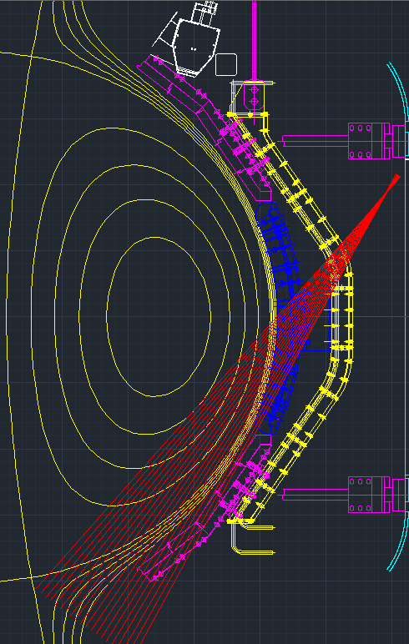
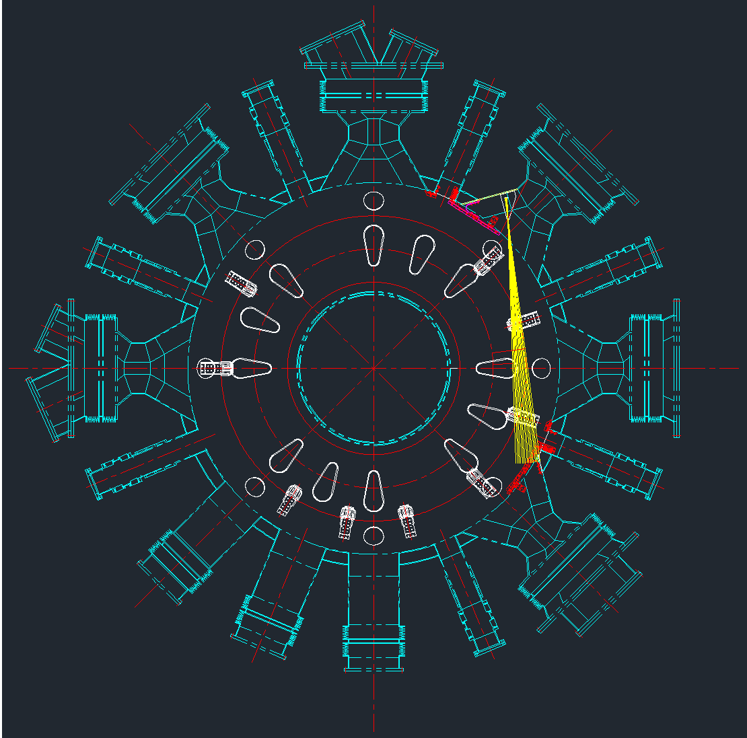
Installation position (1)
poloidal
tangential
F-port
Poloidal edge array → Tangential edge array
  KSTAR F-port : possible location of tangential array design
  Fixed boundary, higher signal level

Slide 8
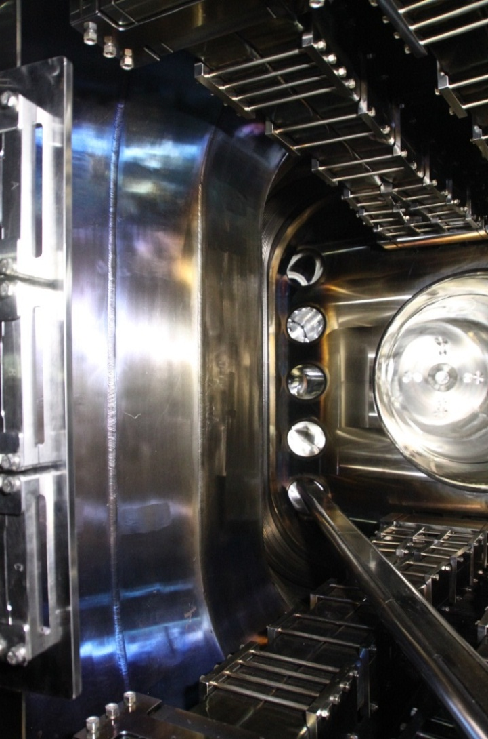
Installation position (2)
KSTAR top view
F-port
NBI
armor
F-port
Possible position
F-port
Position : KSTAR F-port

Slide 9
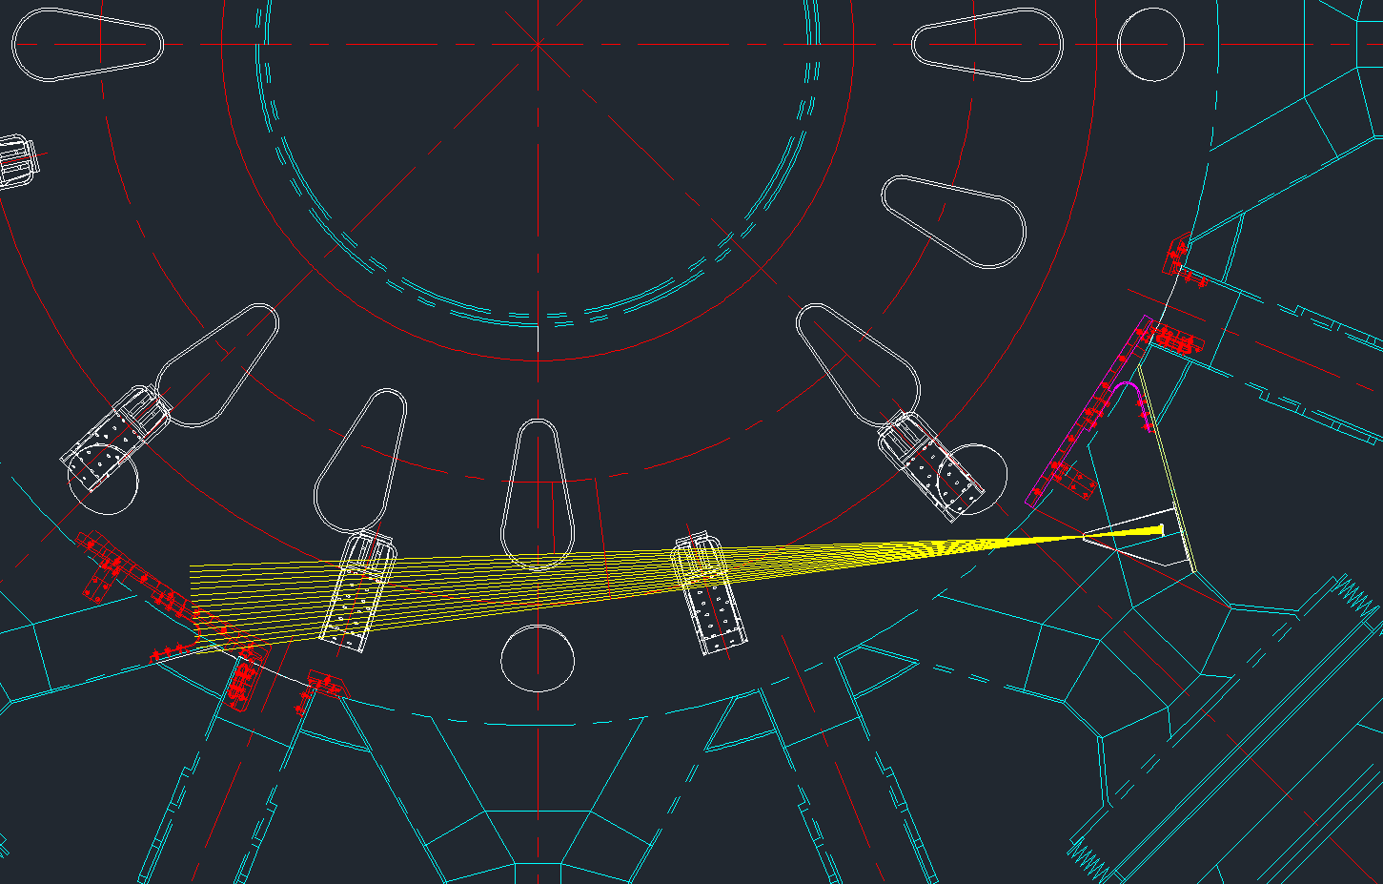
Viewing range
Line of sight
30 - 50 cm from core
(r/a = 0.6-1.0)
F-port
D-port
Range : r/a = 0.6~1.0
Resolution ~ 1.3 cm

Slide 10
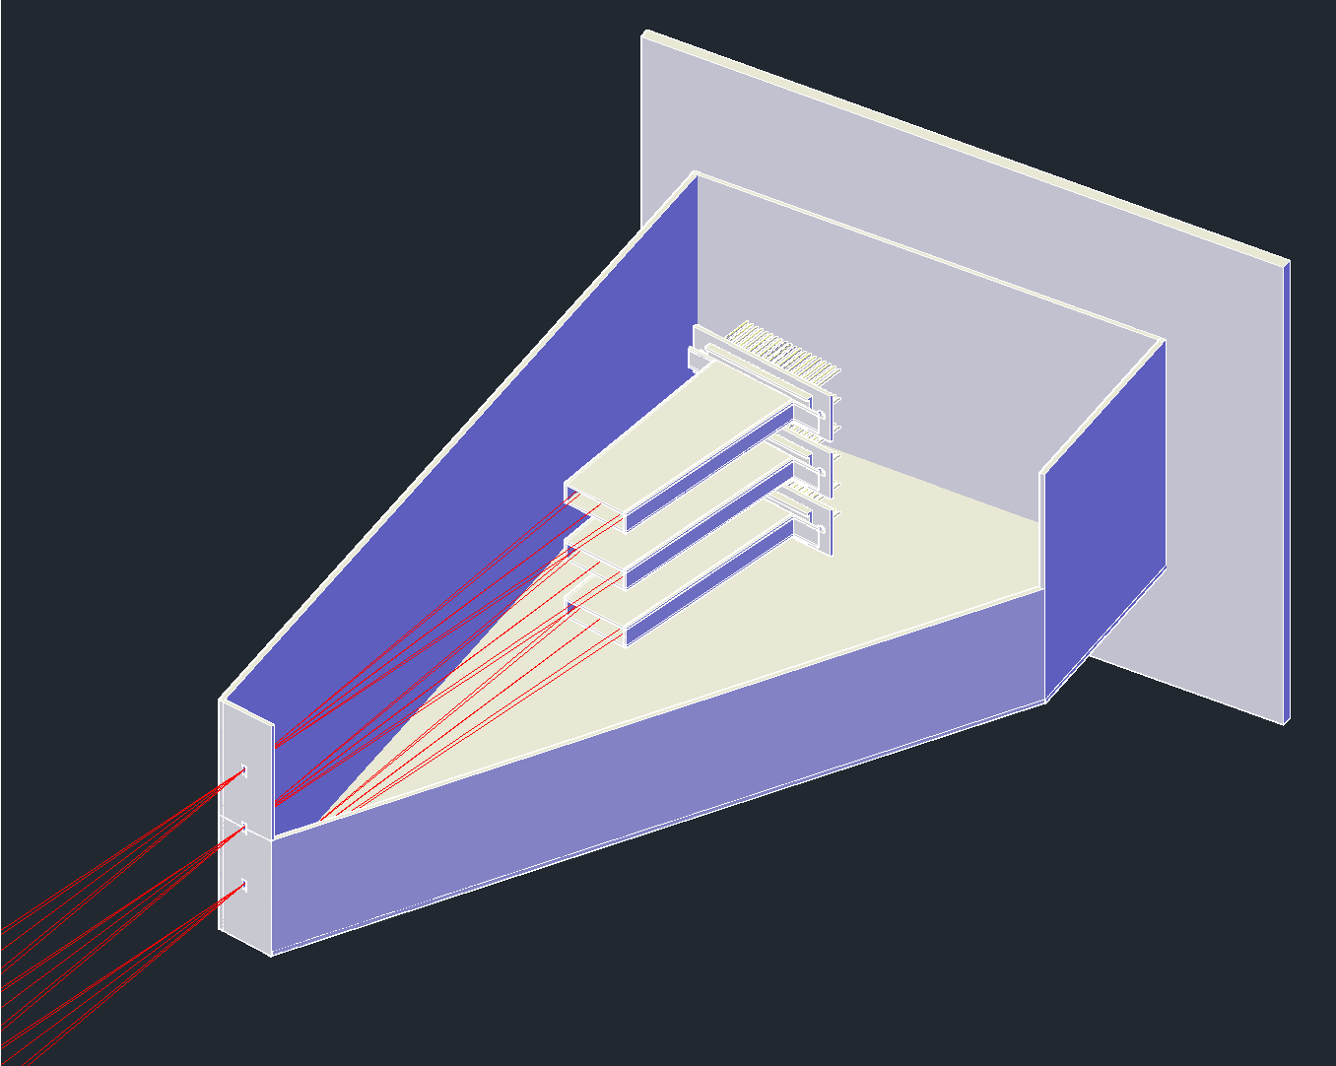
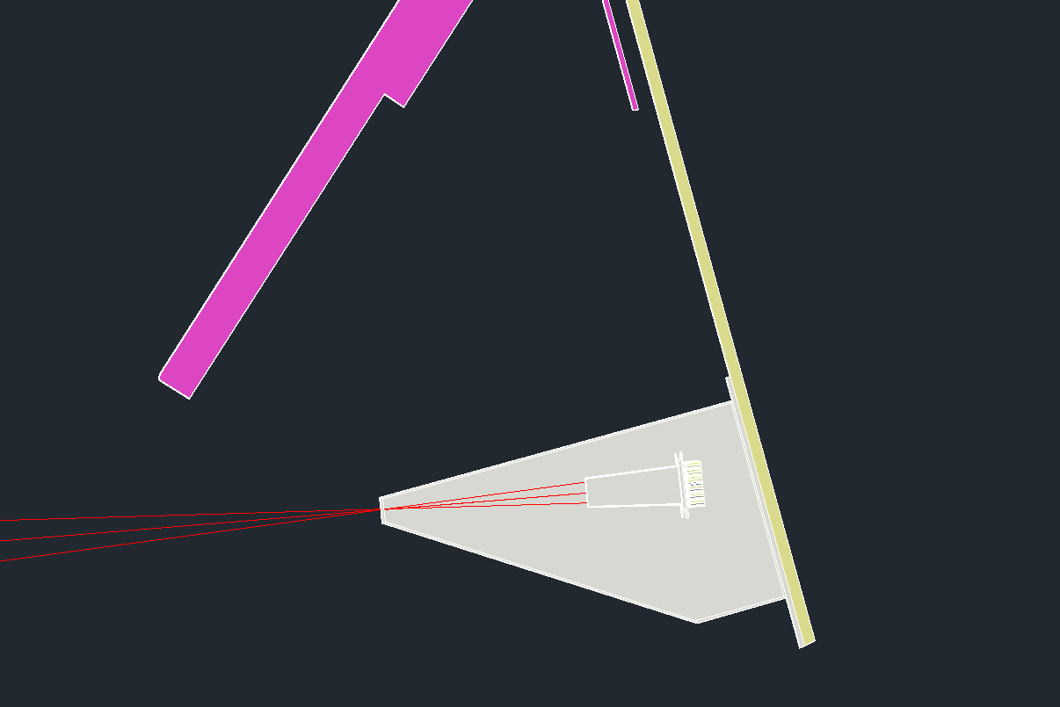
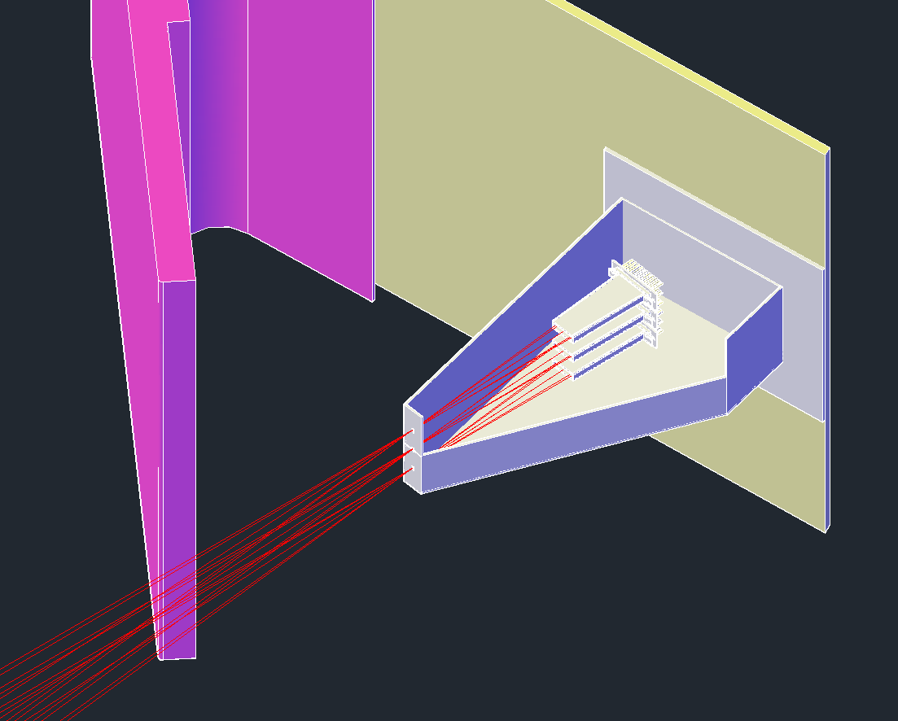
Array Design (1)
AXUV
photodiode
NBI
armor
Welding plate
KSTAR wall
Sight guide
Preamp
case
KSTAR wall
Sight
line
NBI
armor
pinhole
3 AXUV photodiodes
  1 bolometer mode, 2 Be filters
Preamp (10⁶V/A) close to the detectors

Slide 11
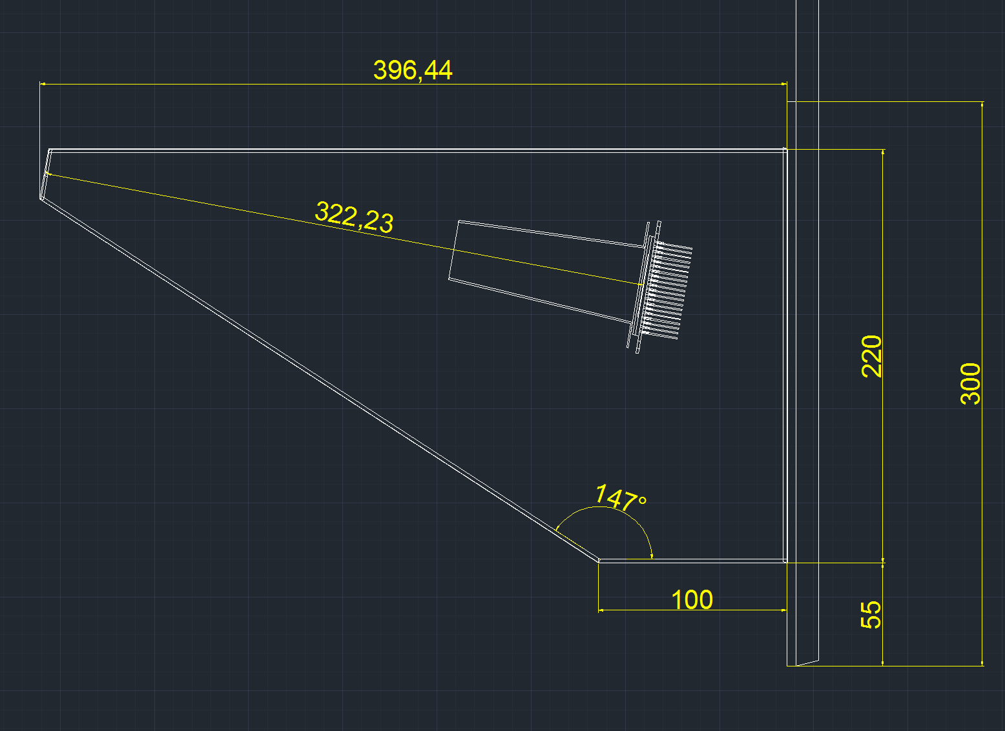
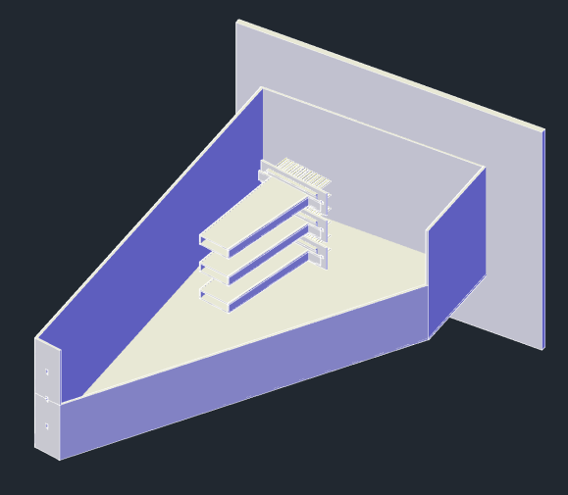
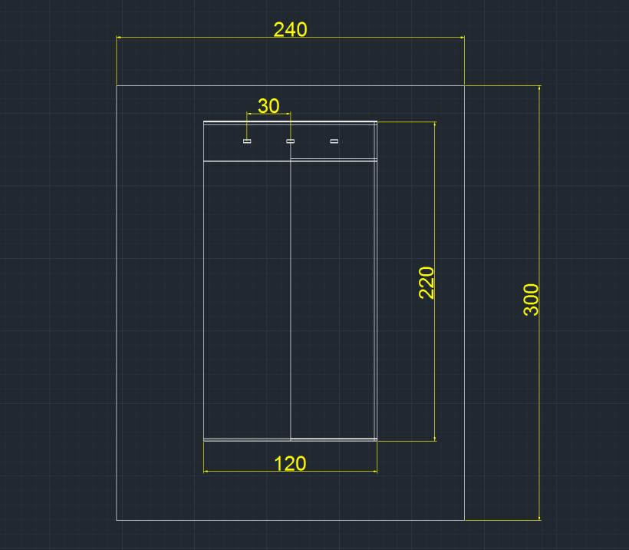
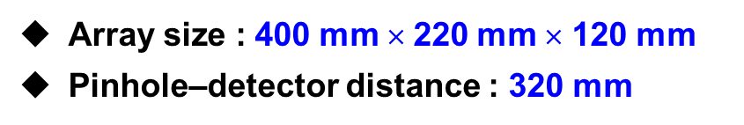
Array Design (2)
1
1
2
2
Array size : 400 mm × 220 mm × 120 mm
Pinhole–detector distance : 320 mm

Slide 12
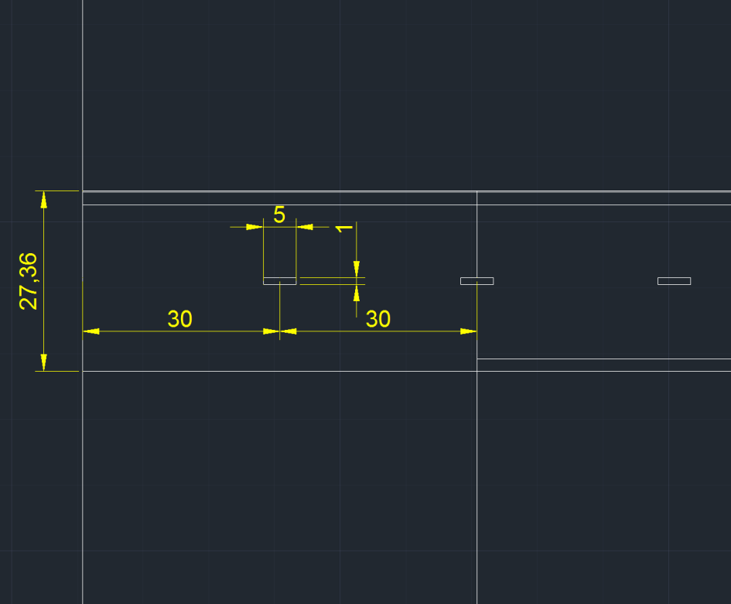
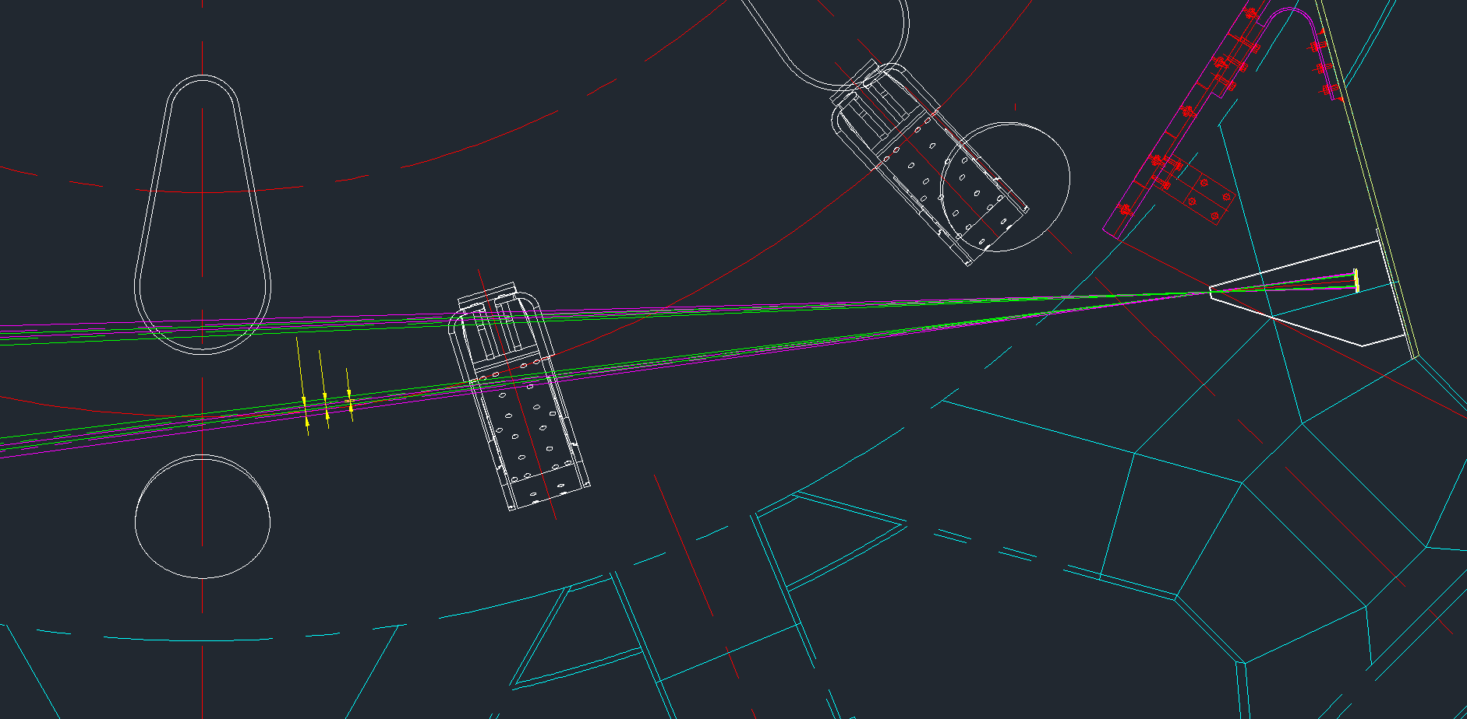
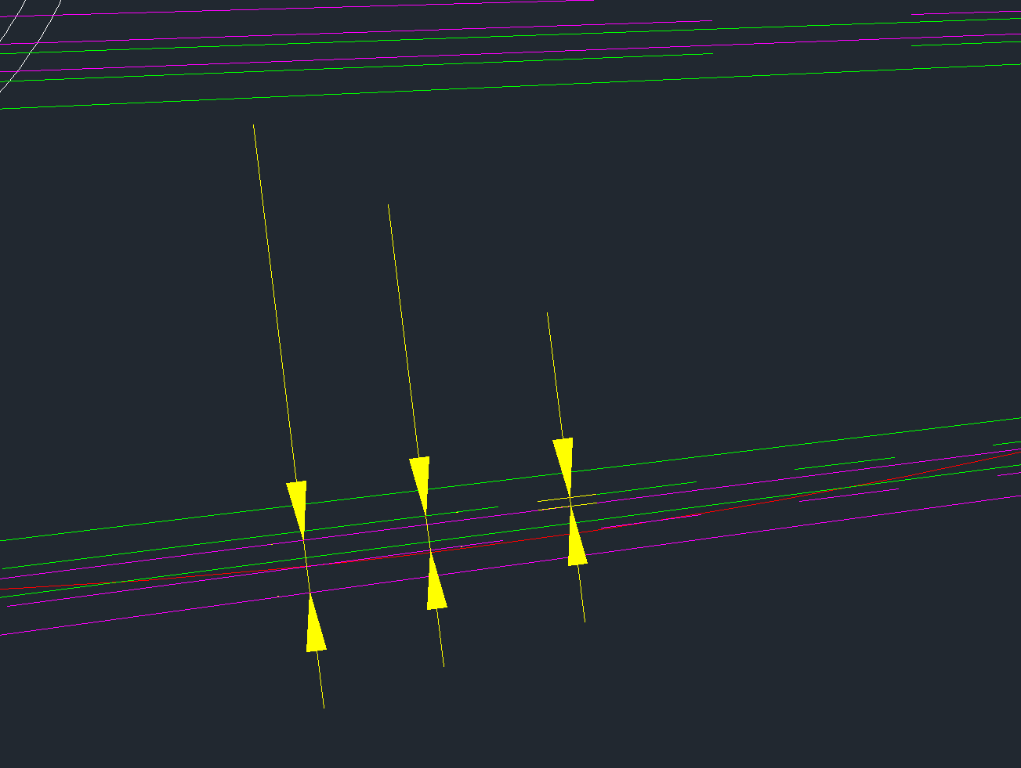
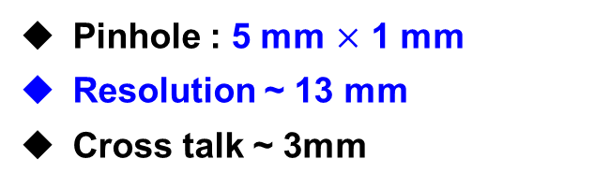
Pinhole & Crosstalk
30 - 50 cm from core
(r/a = 0.6-1.0)
pinhole
19 mm
13 mm
3 mm
Pinhole : 5 mm $×$ 1 mm
Resolution ~ 13 mm
Cross talk ~ 3mm

Slide 13
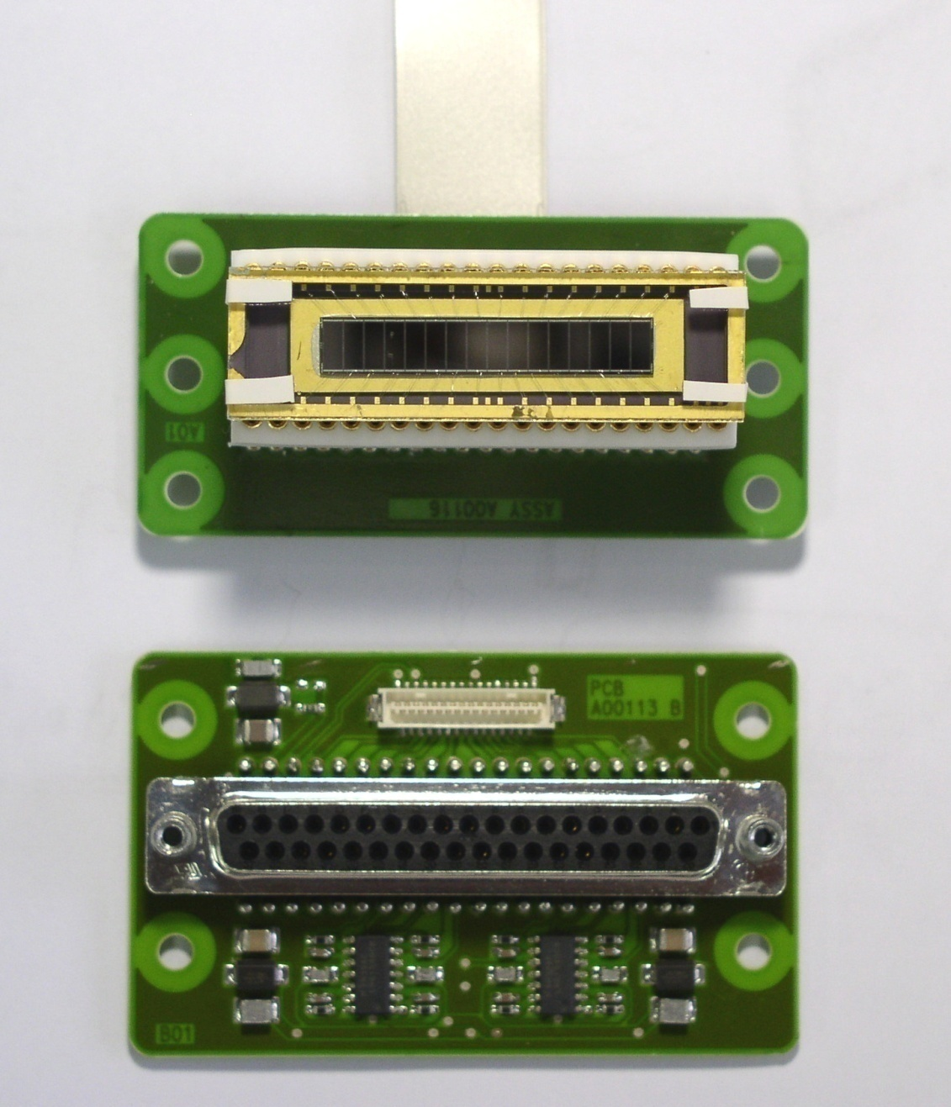
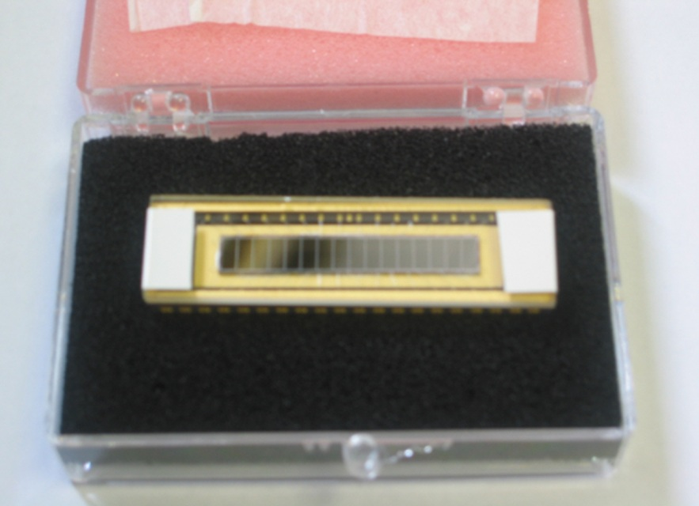
Detector specification
AXUV-16ELG photodiode
Ribbon cable
15 mm
AXUV-16ELG array
55 mm
53 mm
Δt = 2 μs
Δr = 2 cm
Requirement
  Fast response ~ MHz
  High sensitivity to XUV and soft X-ray
Specification
  Active area: 5 × 2 mm²
  Shunt resistance: 100 Ω⋅m
  Capacitance: 2 nF
  Rise time (10-90%): 0.5 μs
  Gain: 10⁶ V/A
  Detection efficiency: 0.27 A/W
73 mm
AMP-16 remote panel
AMP-16 main circuit

Slide 14
Expected signal level
& Tomography test
          Filter selection
          Calculation method
          Expected signal & tomography test
            trial n_{e}, T_{e} profiles
            KSTAR L, H-mode n_{e}, T_{e} profiles
          Filament structure calculation

Slide 15
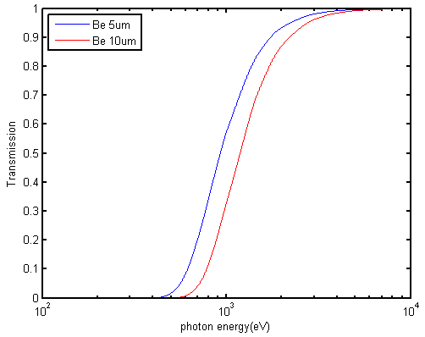
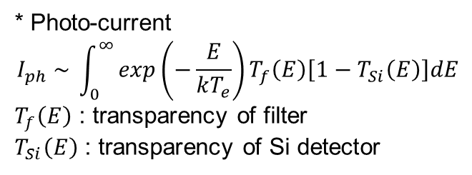
Filter selection
Edge SXR : 3 mode
1 bolometer mode (no filter)
2 Be filter modes (Be 5 μm, 10 μm)
Cutoff energy of Be filters
  Be 5 μm : 0.5 keV
  Be 10 μm : 0.6 keV
* Photo-current
$$I_{ph} \sim \int_{0}^{∞}{exp\left(−\frac{E}{kT_{e}}\right)T_{f}\left(E\right)\left[1−T_{Si}\left(E\right)\right]dE}$$
$T_{f}\left(E\right)$ : transparency of filter
$T_{Si}\left(E\right)$ : transparency of Si detector
Be filter transparency
bolometer
Be 5 μm
Be 10 μm

Slide 16
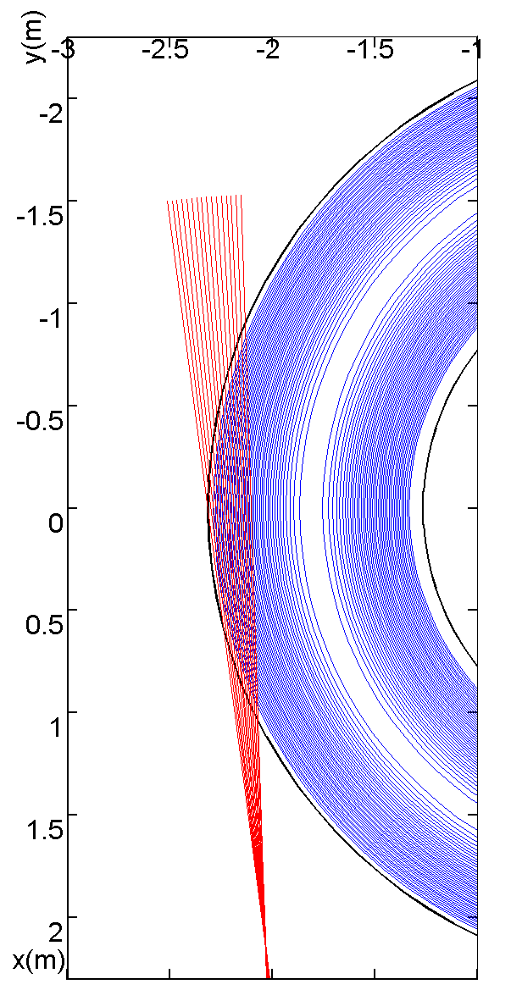
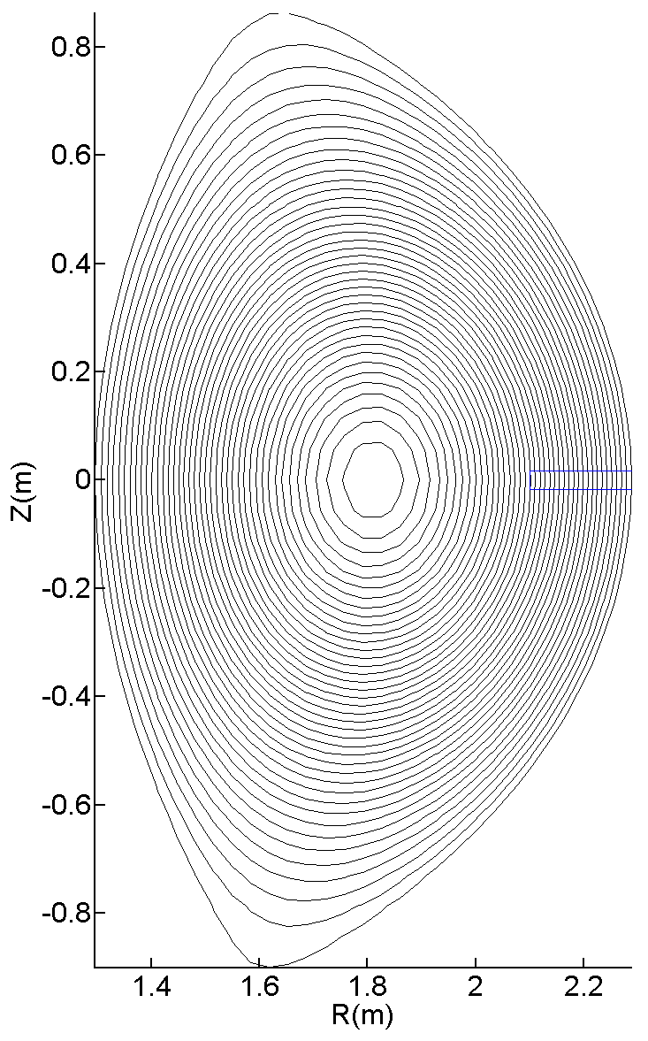
Calculation condition
KSTAR magnetic flux #7566, 2.0 s
Toroidal symmetry
Edge SXR chord
r/a = 0.6~1.0
resolution ~ 1.3 cm
Continuum radiation
Brems. + Recomb.
Photon 0.1-100 keV
Mode
Bolometer, Be 5 μm, Be 10 μm
Top view
Poloidal view
3 cm

Slide 17
Solid angle calculation
dP_{i} : measured power emitted from the plasma volume dV_{p}
d_{i}
5 × 2 mm²
h
Line of sight, L_{i}
322 mm
Detector, A_{det,i}
Aperture, A_{ap,i}
5 × 1 mm²
Thickness, dl_{i}
Plasma volume, dV_{p}
c_{i} : calibration factor

Slide 18
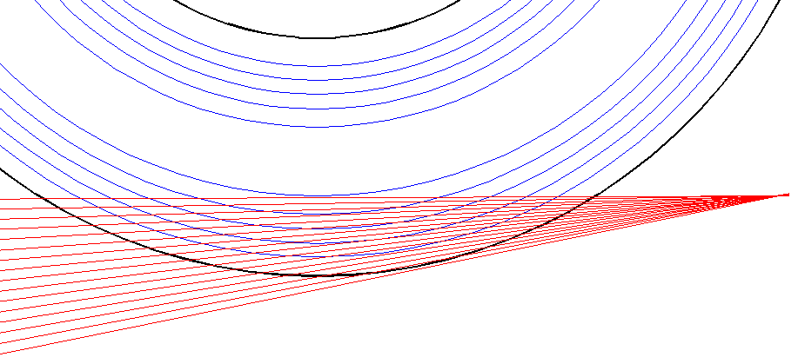
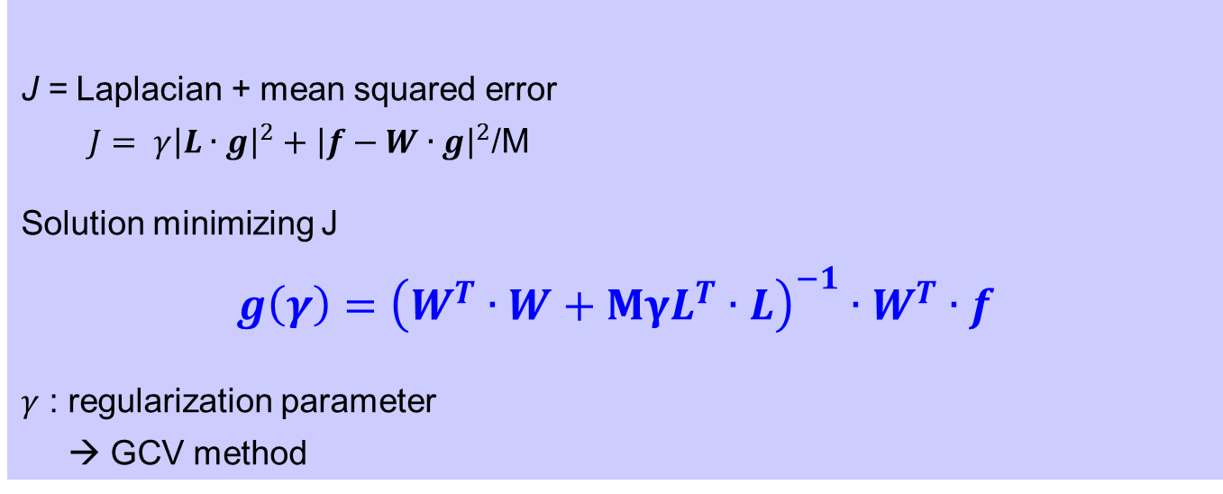

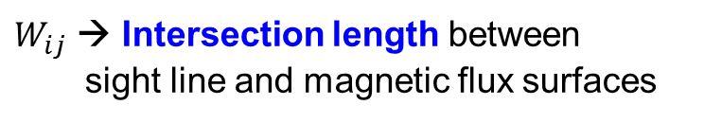

Tomography
Weight matrix
$$f_{i}=\sum_{j=1}^{N}{W_{ij}}g_{j}$$
flux j
channel i
$W_{ij}$ → Intersection length between
  sight line and magnetic flux surfaces
$$W_{ij}$$
J = Laplacian + mean squared error
  $J= γ{\left|L∙g\right|}^{2}+{\left|f−W∙g\right|}^{2}$/M
  Solution minimizing J
  $$g\left(γ\right)={\left(W^{T}∙W+MγL^{T}∙L\right)}^{−1}∙W^{T}∙f$$
$γ$ : regularization parameter
→ GCV method
Phillip-Tikhonov method

Slide 19
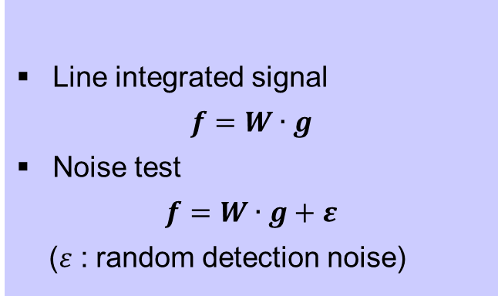
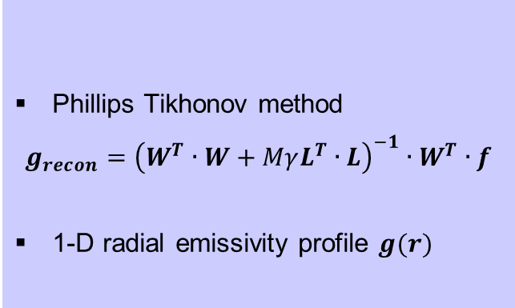
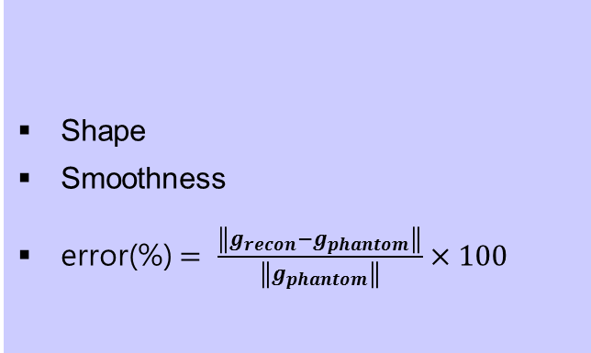
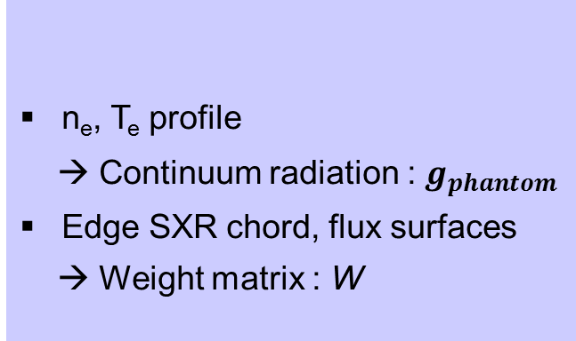
Tomography test sequence
Input
n_{e}, T_{e} profile
→ Continuum radiation : $g_{phantom}$
Edge SXR chord, flux surfaces
→ Weight matrix : W
Signal level
Line integrated signal
$$f=W∙g$$
Noise test
$$f=W∙g+ε$$
($ε$ : random detection noise)
Evaluation
Output
Shape
Smoothness
error(%)$= \frac{\left\|g_{recon}−g_{phantom}\right\|}{\left\|g_{phantom}\right\|}×100$
Phillips Tikhonov method
$$g_{recon}={\left(W^{T}∙W+MγL^{T}∙L\right)}^{−1}∙W^{T}∙f$$
1-D radial emissivity profile $g(r)$

Slide 20
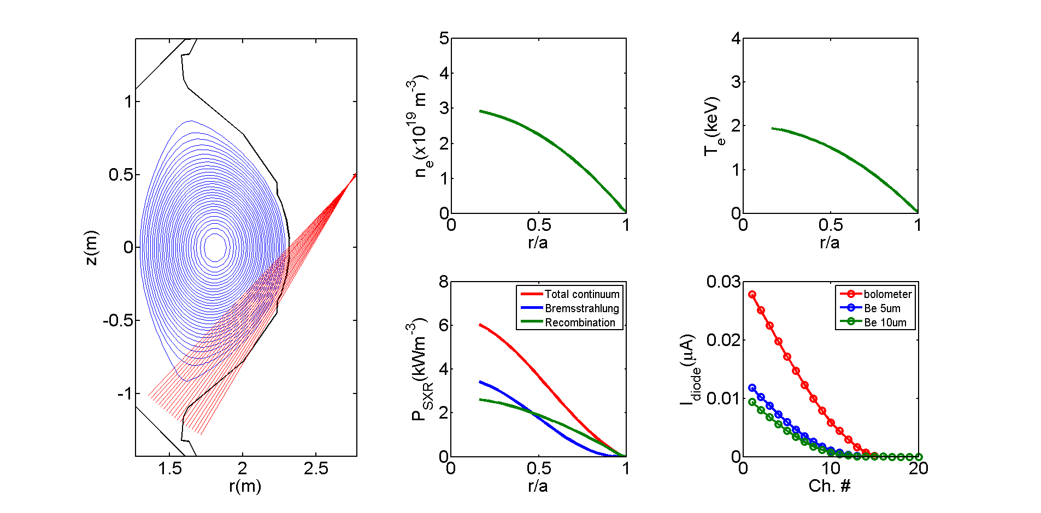
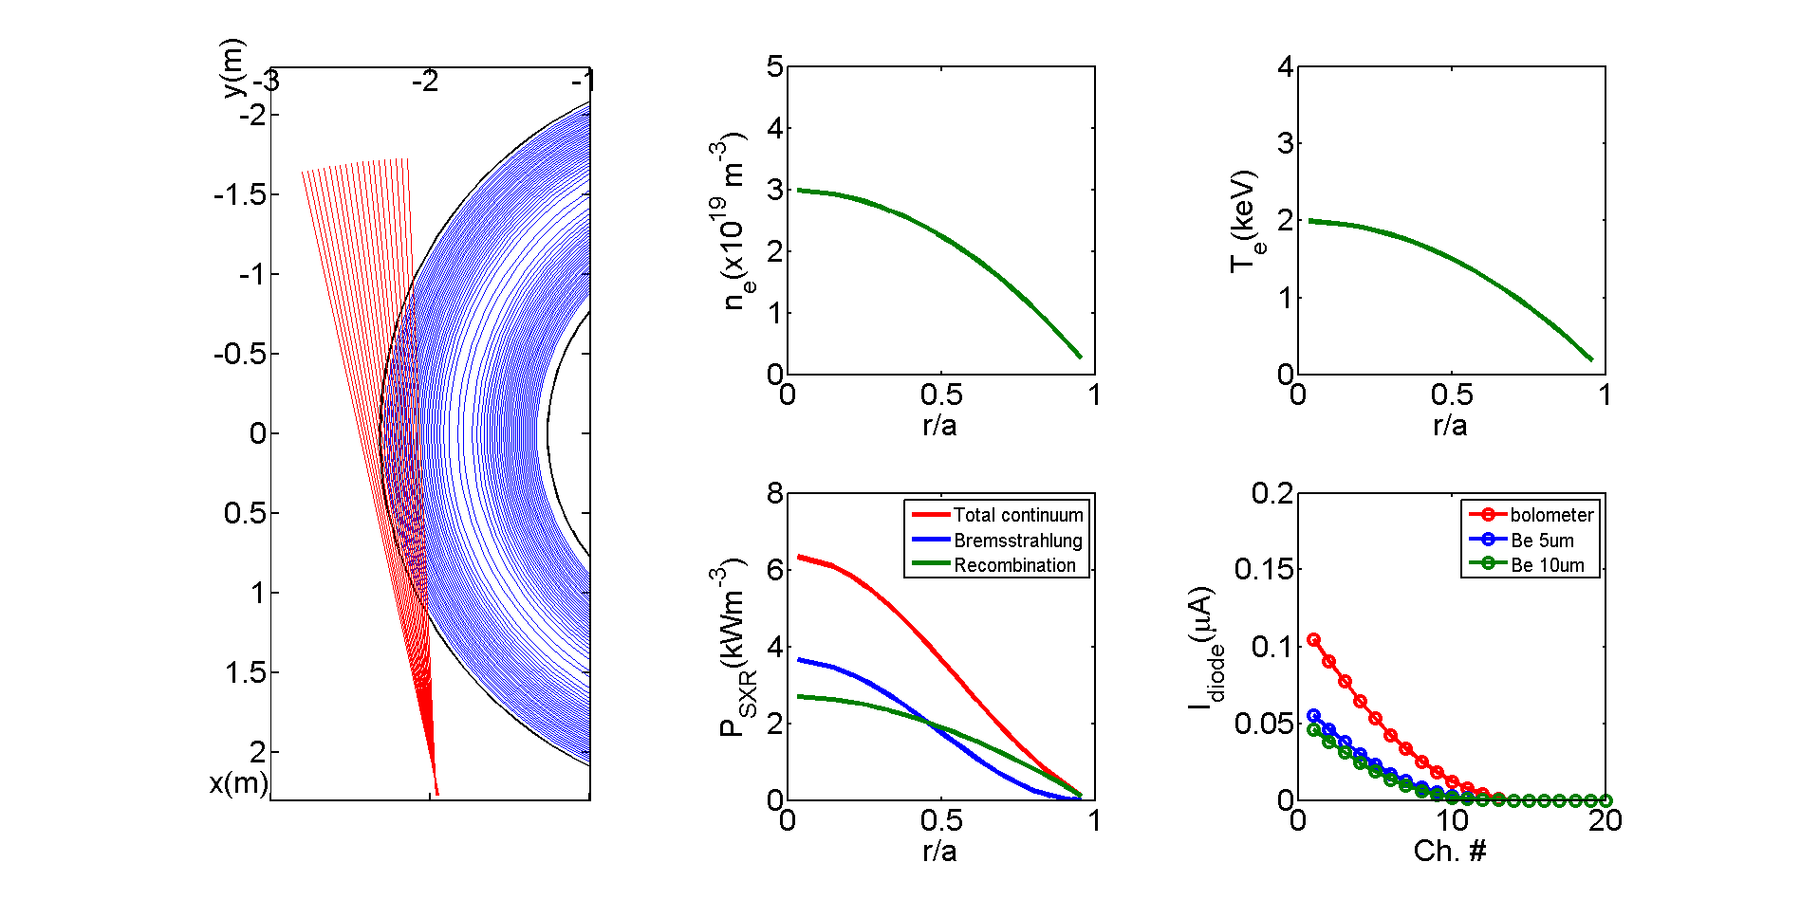
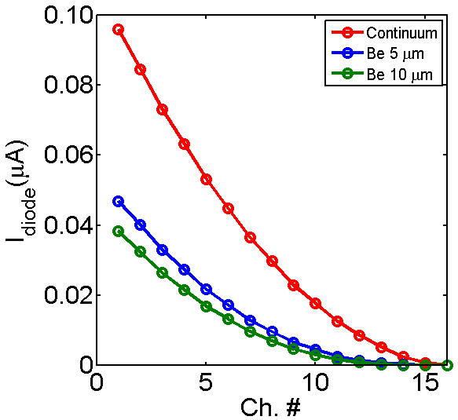
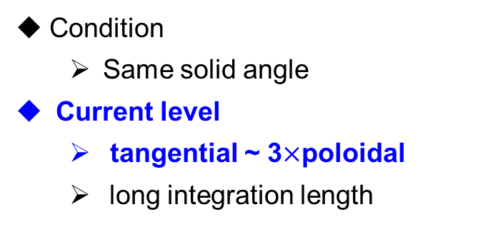
Poloidal vs Tangential
Poloidal
Tangential
Radiation
Condition
  Same solid angle
Current level
  tangential ~ 3$×$poloidal
  long integration length

Slide 21
Trial n_{e}, T_{e} profile

Slide 22
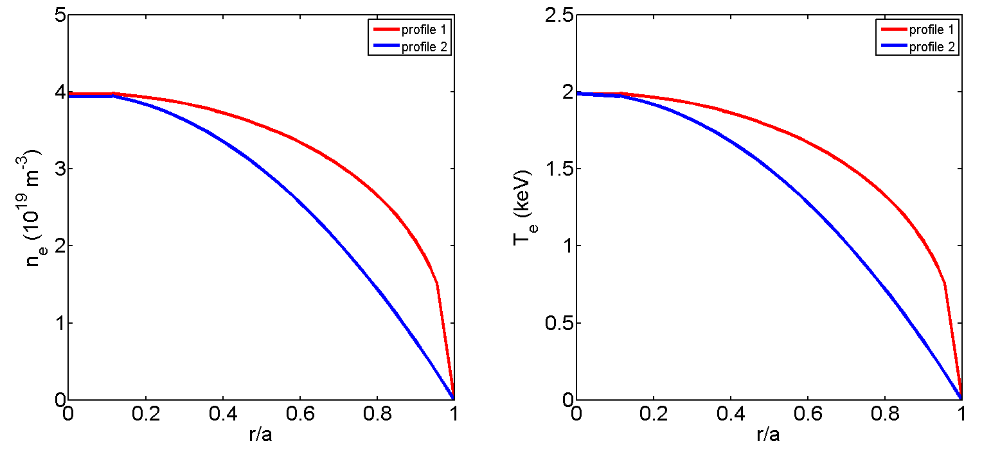
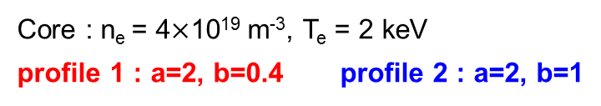
Trial profiles
n_{e}, T_{e} ~${ (1−{(r/a)}^{a})}^{b}$
Core : n_{e} = 4$×$10¹⁹ m⁻³, T_{e} = 2 keV
profile 1 : a=2, b=0.4 profile 2 : a=2, b=1
Electron density (10¹⁹m⁻³)
Electron temperature (keV)
Signal level and tomography test with parabolic n_{e}, T_{e} profile

Slide 23
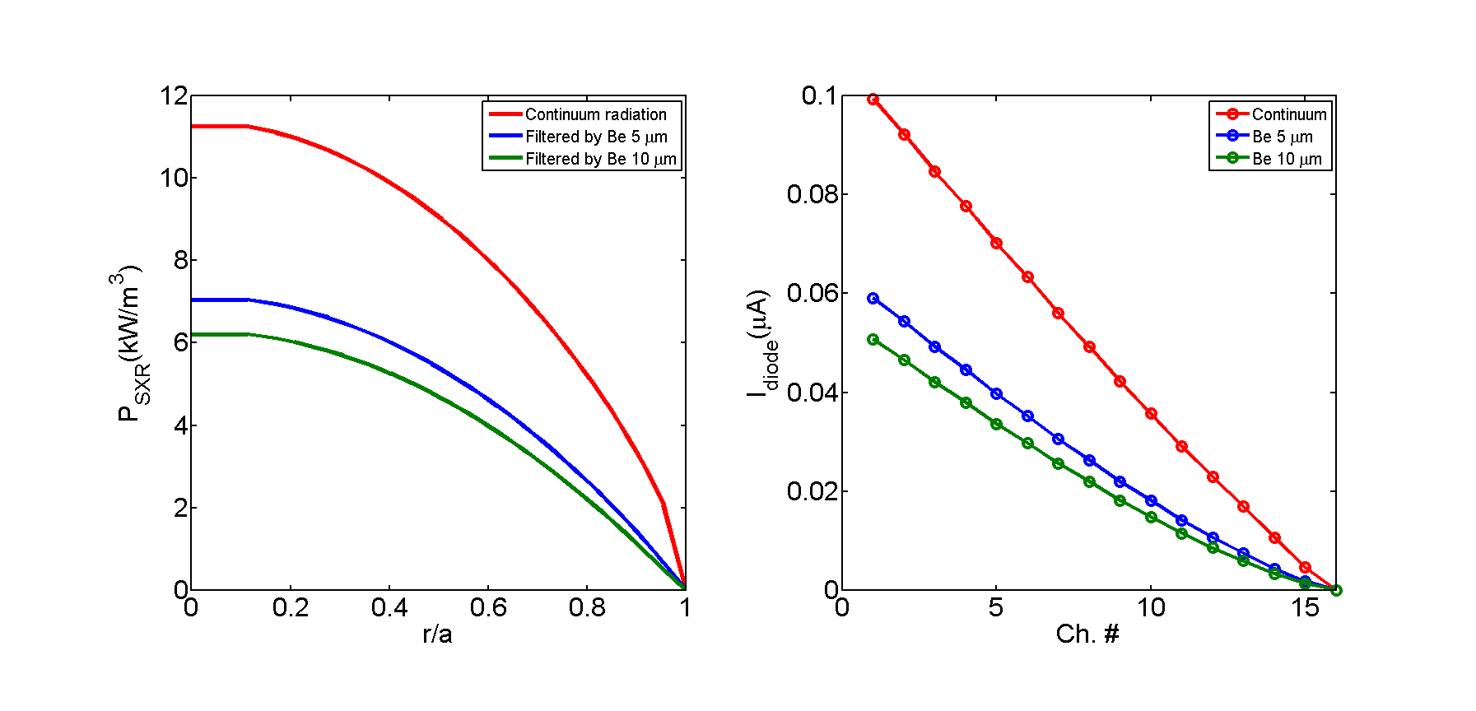
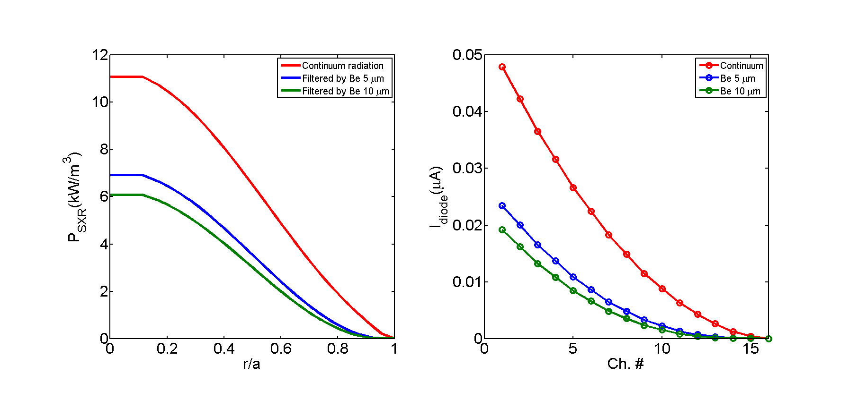
Continuum radiation
Profile1 radiation (kW/m³)
Profile2 radiation (kW/m³)
Viewing range
Viewing range
Radiation @ r/a~0.6 (kW/m³) | Detection mode
 | Continuum | Be 5 μm | Be 5 μm
Profile 1 | 8.0 | 4.6 | 4.0
Profile 2 | 4.9 | 2.4 | 2.0
Notes:
Profiles
1. a=2, b=0.4
2. a=2, b=1

Slide 24
Expected photo-current
Profile1 photo-current (μA)
Profile2 photo-current (μA)
Profile1 current (μA) | ch #
 | 1 | 5 | 10
Continuum | 0.10 | 0.070 | 0.036
Be 5 μm | 0.059 | 0.040 | 0.018
Be 10 μm | 0.051 | 0.034 | 0.015
Profile2 current (μA) | ch #
 | 1 | 5 | 10
Continuum | 0.048 | 0.027 | 8.8e-3
Be 5 μm | 0.023 | 0.011 | 2.2e-3
Be 10 μm | 0.019 | 8.4e-3 | 1.5e-3
Notes:
Profiles
1. a=2, b=0.4
2. a=2, b=1

Slide 25
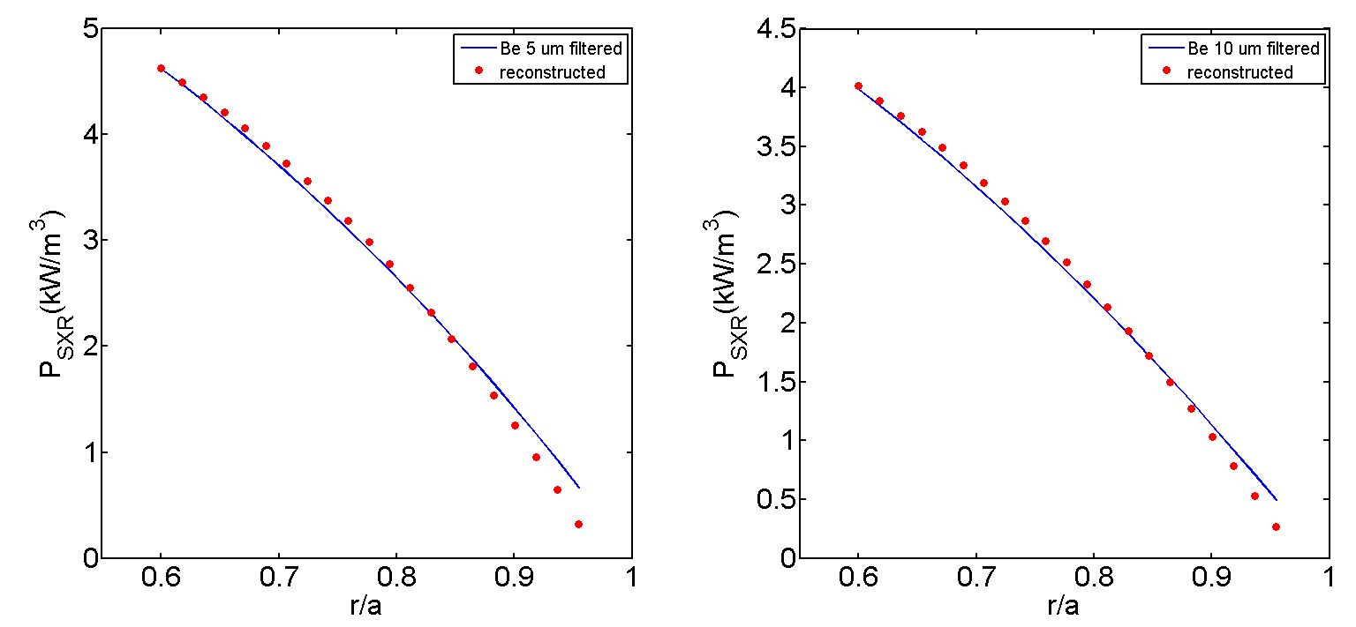
Tomography test (1)
Be 5 μm
Be 10 μm
Phatnom
Reconstruction
Phatnom
Reconstruction
Random noise test
: Chord signal + Random noise
→ Stability of reconstruction solution
Reconstruction Error (%) | Noise (%)
 | 0 | 5 | 10
Be 5 μm | 4.3 | 4.7 | 6.4
Be 10 μm | 3.7 | 4.1 | 6.0
Notes:
Random noise test ~ 30 times

Slide 26
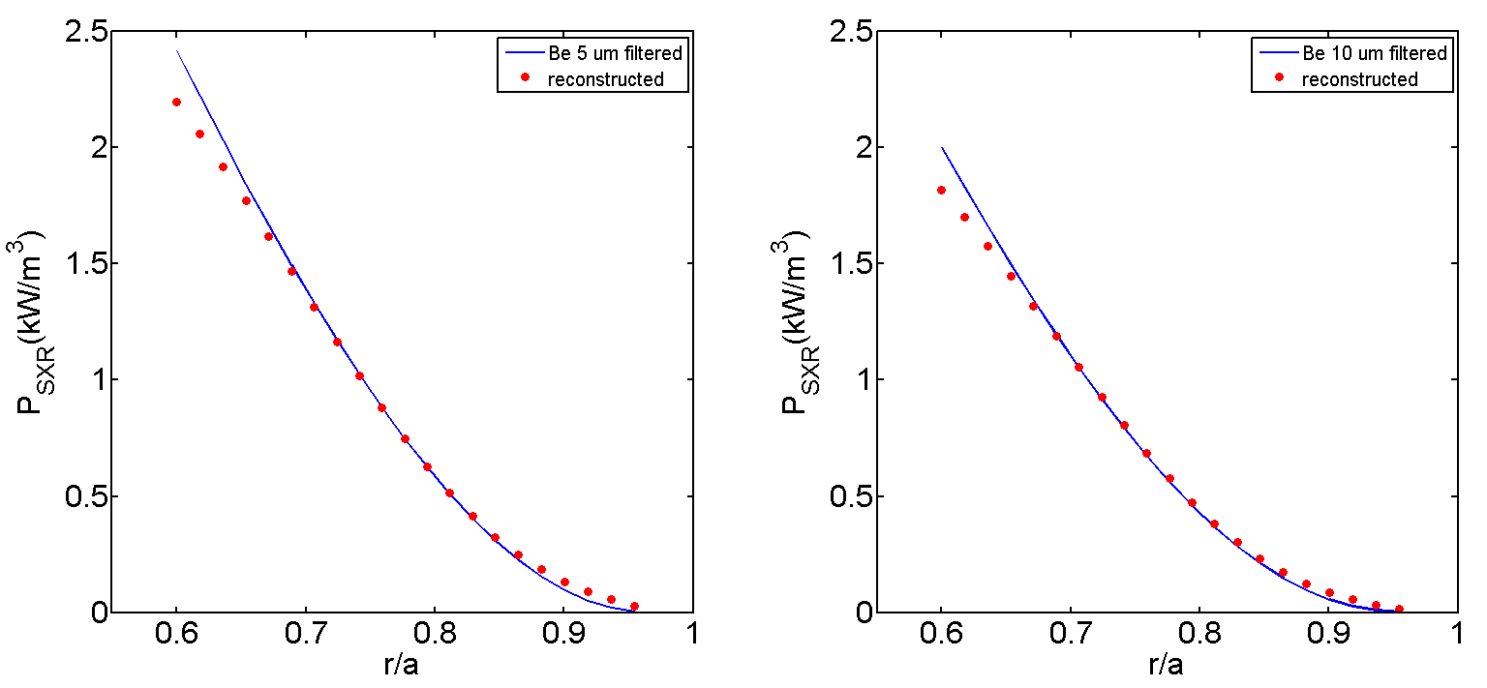
Tomography test (2)
Be 5 μm
Be 10 μm
Phatnom
Reconstruction
Phatnom
Reconstruction
Reconstruction Error (%) | Noise (%)
 | 0 | 5 | 10
Be 5 μm | 5.8 | 8.2 | 9.2
Be 10 μm | 5.8 | 8.5 | 9.4
Reconstruction results agree with parabolic profiles.
Notes:
Profiles
1. a=2, b=0.4
2. a=2, b=1

Slide 27
KSTAR L, H-mode

Slide 28
KSTAR L, H-mode
Electron density (10¹⁹m⁻³)
Electron temperature (keV)
Signal level and tomography test with KSTAR L, H mode n_{e}, T_{e} profile

Slide 29
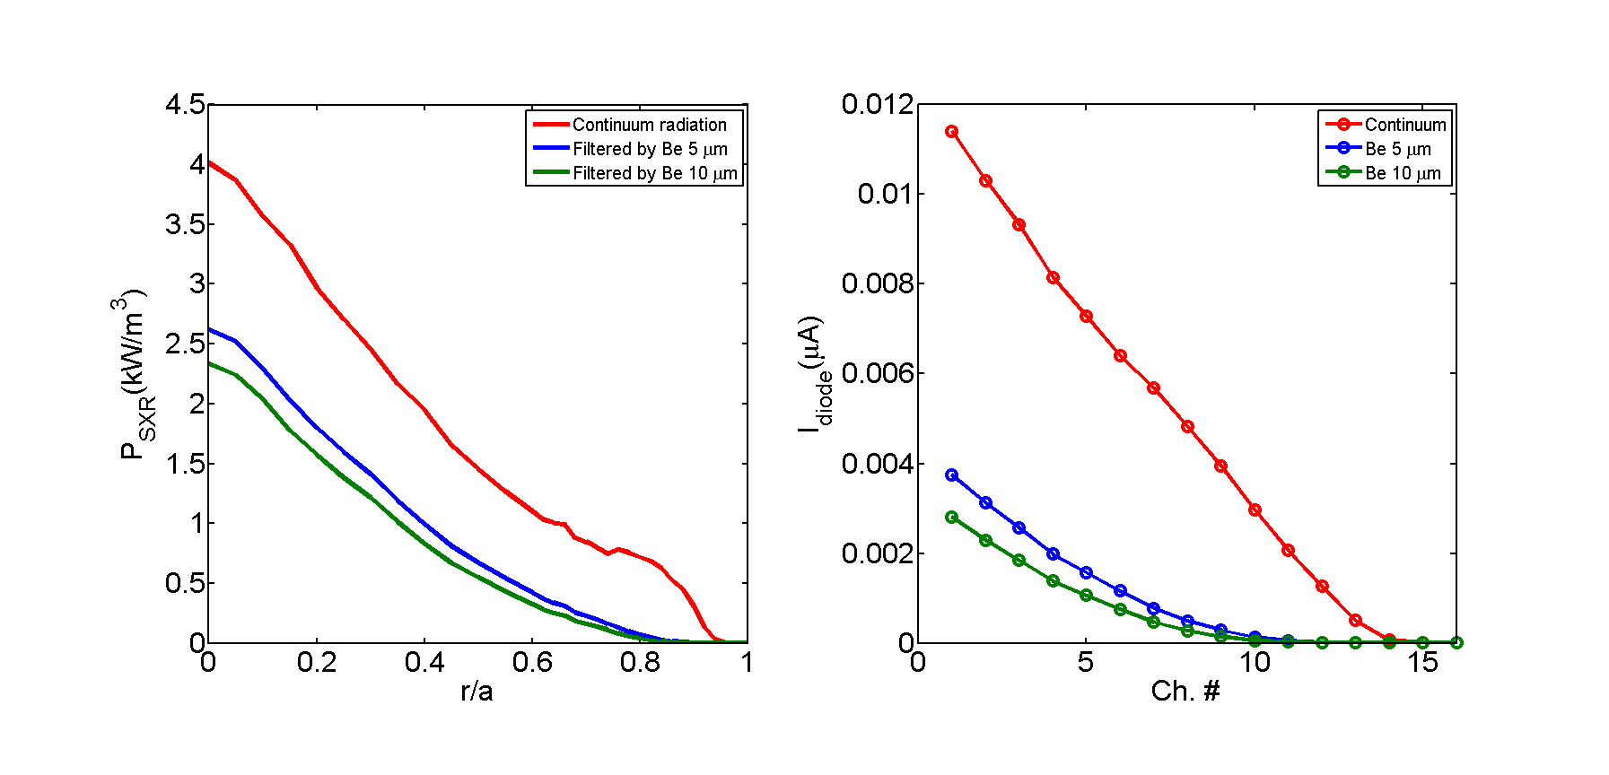
Continuum radiation
L-mode radiation (kW/m³)
H-mode radiation (kW/m³)
Viewing range
Viewing range
Power density @ r/a~0.6 (kW/m³) | Detection mode
 | Continuum | Be 5 μm | Be 5 μm
L-mode | 1.1 | 0.42 | 0.32
H-mode | 6.5 | 3.3 | 2.7

Slide 30
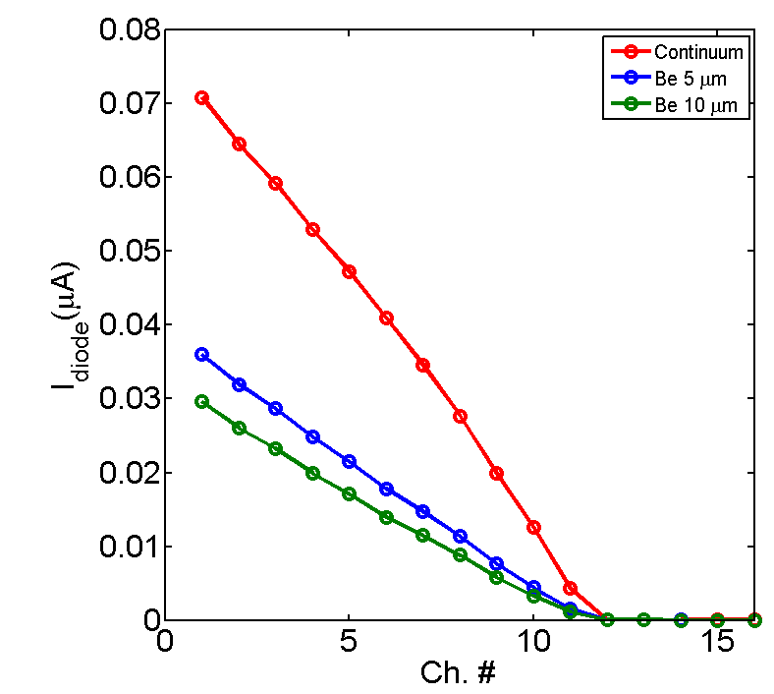
Expected photo-current
L-mode photo-current (μA)
H-mode photo-current (μA)
L-mode current (μA) | ch #
 | 1 | 5 | 10
Continuum | 0.011 | 7.0e-3 | 2.8e-3
Be 5 μm | 3.5e-3 | 1.6e-3 | 2.9e-4
Be 10 μm | 2.6e-3 | 1.0e-3 | 7.0e-5
H-mode current (μA) | ch #
 | 1 | 5 | 10
Continuum | 0.071 | 0.048 | 0.013
Be 5 μm | 0.036 | 0.022 | 4.4e-3
Be 10 μm | 0.030 | 0.018 | 3.9e-3

Slide 31
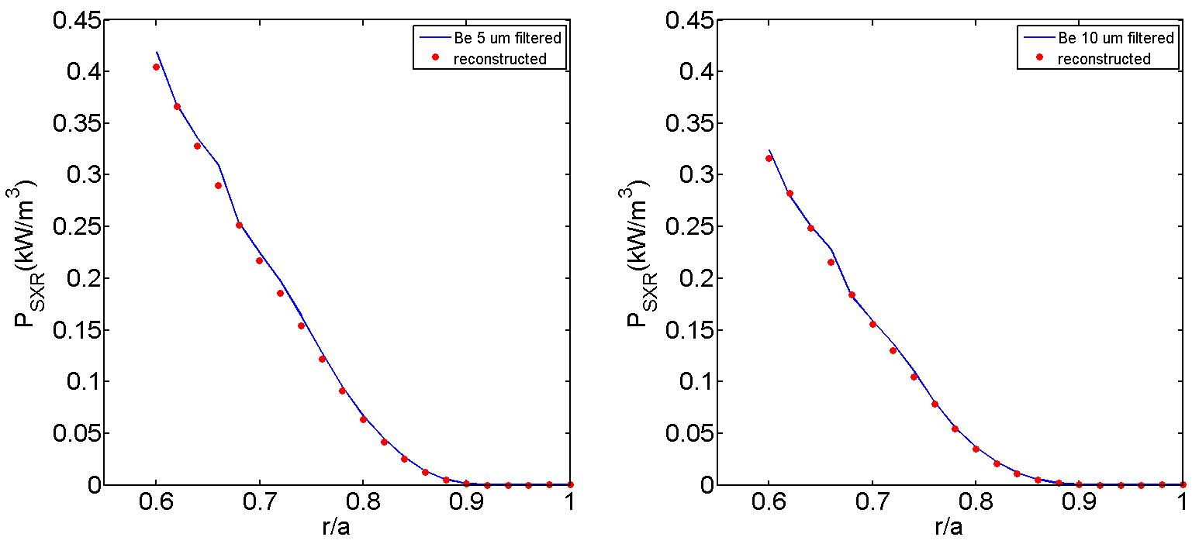
L-mode tomography test
Be 5 μm
Be 10 μm
Phatnom
Reconstruction
Phatnom
Reconstruction
Reconstruction results match with L-mode phantoms.
Reconstruction error increases with random detection noise.
Reconstruction Error (%) | Noise (%)
 | 0 | 5 | 10
Be 5 μm | 3.8 | 7.8 | 14.0
Be 10 μm | 2.9 | 7.5 | 14.1
Notes:
Random noise test ~ 30 times

Slide 32
H-mode tomography test
Be 5 μm
Be 10 μm
Phatnom
Reconstruction
Phatnom
Reconstruction
Reconstruction Error (%) | Noise (%)
 | 0 | 5 | 10
Be 5 μm | 4.2 | 8.3 | 13.9
Be 10 μm | 3.7 | 8.1 | 14.0
Pedestal structure is well reconstructed.
Notes:
Pedestal structure is well reconstructed!
Random noise test ~ 30 times

Slide 33
Filament structure
calculation

Slide 34
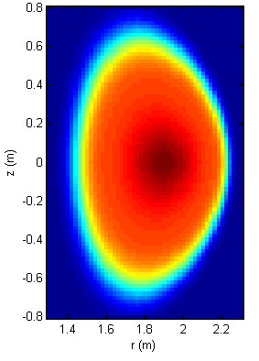
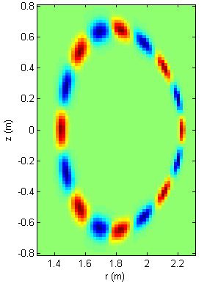

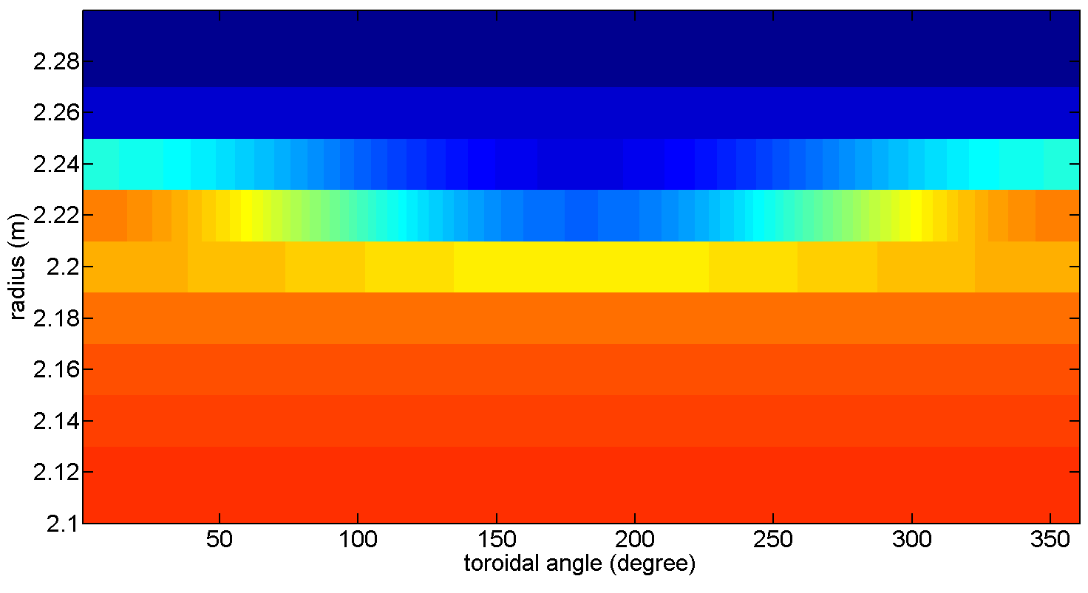
ELM filament calculation
D-shape
Filament
Phantom
Goal : possibility of investigation of
high frequency edge dynamics
  ELM cycle dynamics
  Edge MHD activity
Phantom
  = ELM filament structure (m/n=8/1)
  + toroidal rotation
Toroidal
rotation
Notes:
D-shape : KSTAR L-mode, elongation 1.8, triangularity 0.2, Shafranov shift 0.1m
core 4000 W/m3
filament : 20% of core

Slide 35
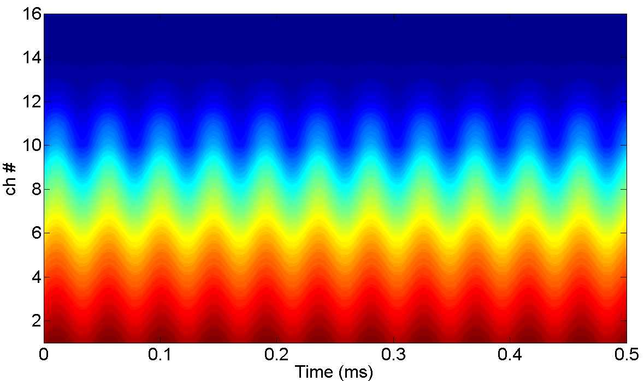


Expected signal
Line-integrated signal
MHD activity in NSTX *
Line-integrated signal
: ~40 μs fluctuation observed
rotation velocity $v_{φ}$ ~ 250 km/s
time resolution ~ 500 kHz (2 μs)
Signal change due to filament ~ 5 %
Possible studies
Possibility of high time resolution
(~500 kHz) measurement
Neural Network
→ fast T_{e} fluctuation measurement
* Kevin Tritz, KAIST seminar (2013)

Slide 36
Summary & Discussion

Slide 37
Summary
Edge tangential soft X-ray design
  KSTAR F-port
  r/a = 0.6~1, spatial resolution ~ 1.3 cm
  Three modes will be available (bolometer, Be 5 μm, Be 10 μm)
Expected photo-current level (bolometer, Be 5, 10 μm)
  L-mode profile ~ 10 nA, 3.5 nA, 2.6 nA
  H-mode profile ~ 70 nA, 36 nA, 30 nA
Tomography tests
  Reconstruction results match with phantoms.
  Error increases with random detection noise.
Filament structure calculation
  ~ 40 μs fluctuation observation possible

Slide 38
Discussion
Signal level
  Proper photo-current level for detection of edge soft X-ray
  NSTX ME-SXR signal level : S/N ratio of AXUV 20ELG…
  Optimized design for increasing signal level
Spatial resolution
  Proper spatial resolution for investigation of edge plasma physics
T_{e} calculation by Neural Network
  Be filter selection for Neural Network method : energy range?
  Mode number : 3 modes are enough?
  Emissivity profile without tomography

