Slide 1
PPPL Visit
Research Activities in
KAIST-FPTRC
February 18, 2014
Wonho CHOE
Fusion Plasma Transport Research Center (FPTRC)
Korea Advanced Institute of Science and Technology (KAIST)

Slide 2
SXR & VUV imaging diagnostics on KSTAR (as of now)
Soft X-ray array (SXRA)
  2 arrays, 32 ch (64 ch)
  Δt = 2 μs, Δr = 5 cm
  Ar Ross filters (Cl & Ca K-edge): 2.8 – 4.0 keV
  Be filters (10, 50 μm: 0.5, 1.0 keV): 2 color
VUV spectroscopy
  28 ch for imaging (5 - 20 nm), Δt = 13 ms
  1 ch for survey (15 - 60 nm), Δt = 13 ms
2-D Tangential X-ray pinhole camera (TXPC)
  Duplex (2 color), 50x50 ch
  Δt = 0.1 ms, Δr = 2 cm
GEM detector for 2-D X-ray camera
  12x12 pixels, 128 ch
  Δt = 1 ms, Δr = 2 - 6 cm
  3 – 30 keV
Tomographic reconstruction codes developed
Max. Entropy Method
Phillips-Tikhonov
Min. Fisher Information
Cormack

Slide 3
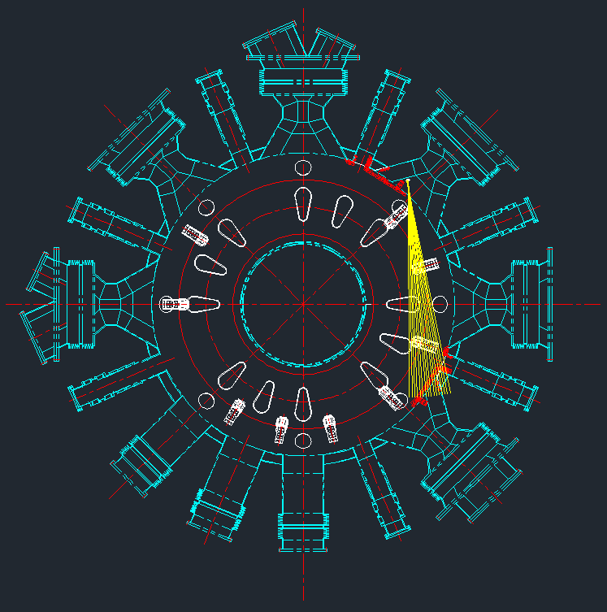
(1) SXR array diagnostic system
2013
2014
2 array, 64 ch
4 array, 256 channels
1 array, 60 ch
S.H. Lee
J. Jang
VU2
edge
16 ch (32)
HU
HD
16 ch (32)
VD2
Be filters (10, 50 μm)
Ar Ross filters (Ar transport)
Bolometer (No filter)
4 arrays, 256 ch
2 cm, 2 μs
2 filters → multi energy, neural network
1.3 cm, 2 μs

Slide 4
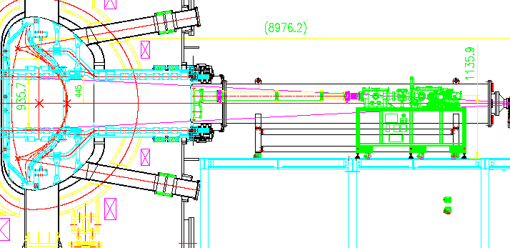
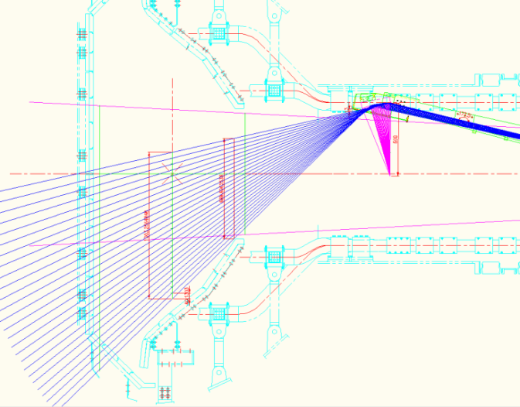
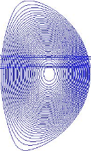
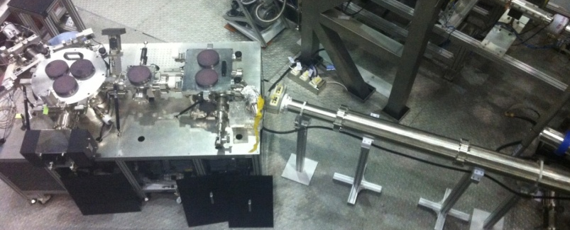
(2) Imaging VUV spectroscopy
ITER prototype on KSTAR (5 – 60 nm)
In collaboration with ITER KO-DA (C.R. Seon)
2012 (15-60 nm, 13-40 ms)
2013 (5-20 nm, ~3 ms)
1 ch, survey
28 ch, imaging
VUV spectrometer on the optical table
He I : 53.70 nm
He II : 25.63, 30.37 nm
O V : 15.61, 19.28, 21.50 nm
O VI : 17.30, 18.40 nm
C III : 38.62 nm
C IV : 24.49, 38.41, 41.96 nm
C V : 22.72, 24.87 nm
Fe XV : 28.42 nm
Fe XVI : 33.54, 36.08 nm
W : 5-20 nm
Vacuum extension
Ar XIV 18.79 nm
Ar XV 22.11 nm
Ar XVI 35.39 nm

Slide 5
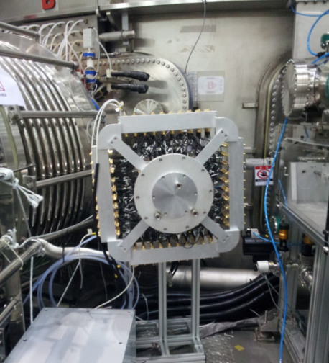
(3) ‘Tangential’ X-ray pinhole camera
In collaboration with KAERI (M. Moon)
‘Duplex (2-color) Multi-Wire Proportional Counter (MWPC) detector
Sawtooth crash in #7640
(a)
(b)
(b) - (a)
(a)
(b)
Channel
Outboard
Outboard
Channel
Channel

Slide 6
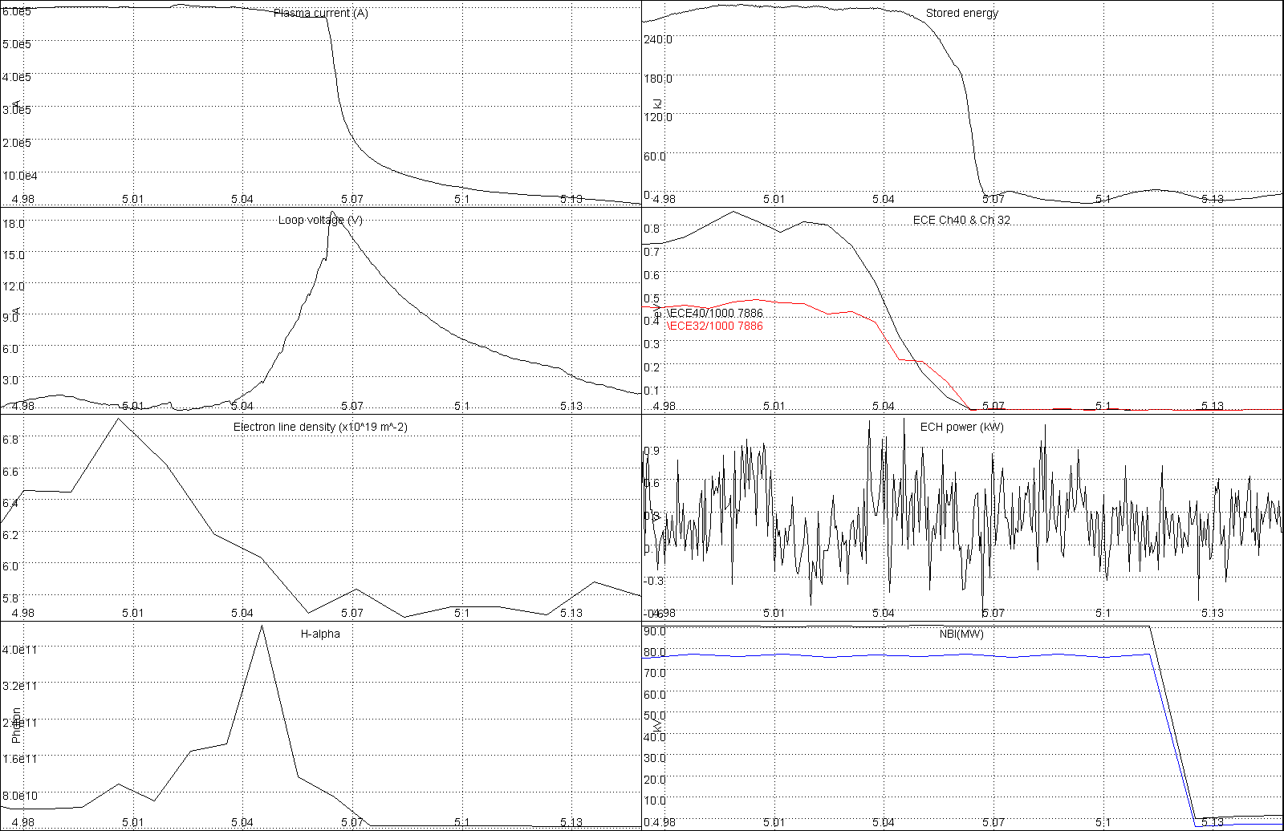
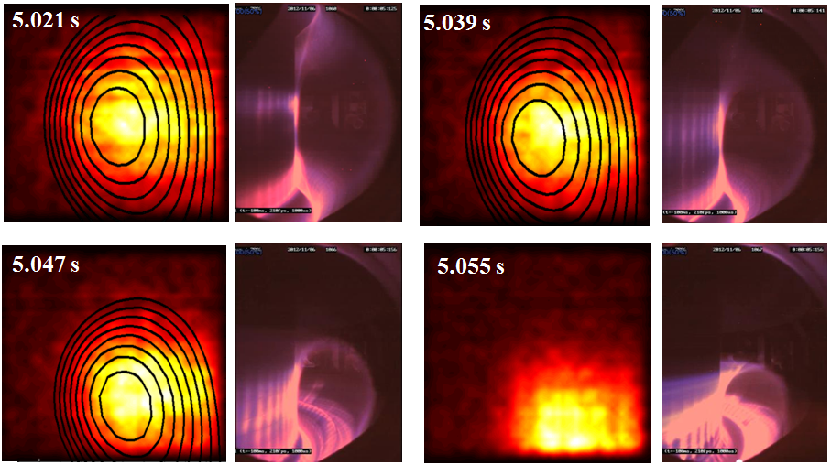
X-ray imaging of VDE
Shot 7886
TXPC, RT-EFIT
Visible camera
I_{p}
V_{loop}
D_{α}
Stored energy
ECE
Major radius, R
Major radius, R
Consistent with RT-EFIT and visible camera
Tangential reconstruction on-going
S. Jang et al., CAP 13, 819 (2013)

Slide 7
Te by TXPC (PHA mode)
Pulse Height Analyzer mode

Slide 8
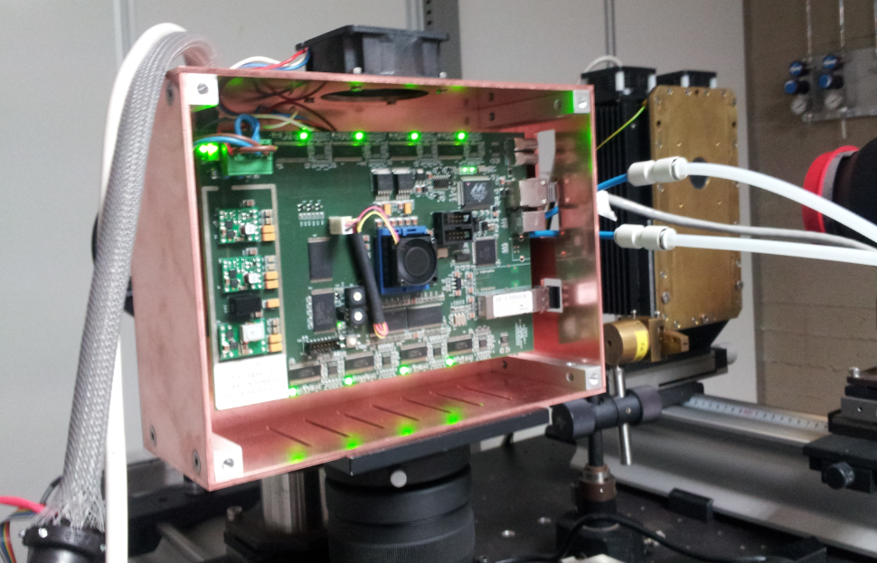
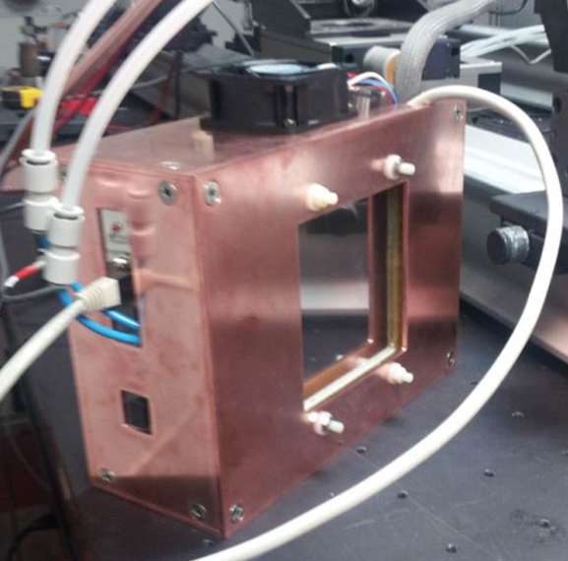
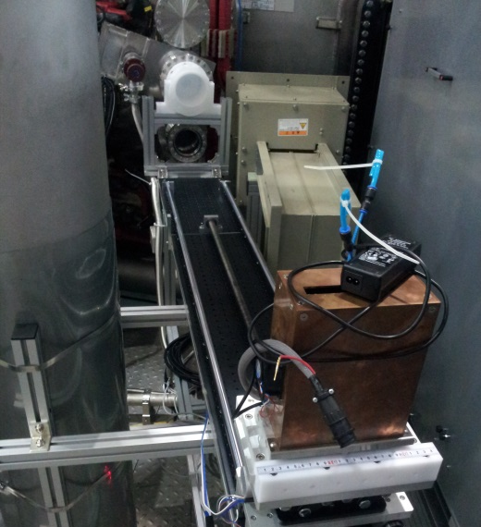
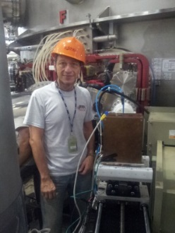
(4) GEM detector for TXPC
In collaboration with ENEA (D. Pacella)
  GEM foils: 50 µm thick kapton foil, copper clad on each side
  Triple-GEM geometry: 3/1/2/1 mm
  Front-end electronics: CARIOCA micro chips by LNF and CERN [4]
  Active area: 10 x 10 cm²
  Channels: 12 x 12 pixels
  (each pixel has 0.8 x 0.8 cm²)
  Temporal: 10 µs (up to 255 frames), 1 ms (60k frames)
  Mixed gas (flow): 70% Ar, and 30% CO2 at 1 atm
  Movable system
  (zoom in & out and horizontally movable)
Front
Back
FPGA
Gas in
Gas out
128 ch in 12x12 cm²
Spatial & time resolution: 2-6 cm, 1 ms
HV cable
Zoom in & out
Lan cable
GEM
⁵⁵Fe Source
X-position movable
[4] W. Bonivento et al., Nucl. Instr. and Meth. A, 491, 233 (2002)

Slide 9
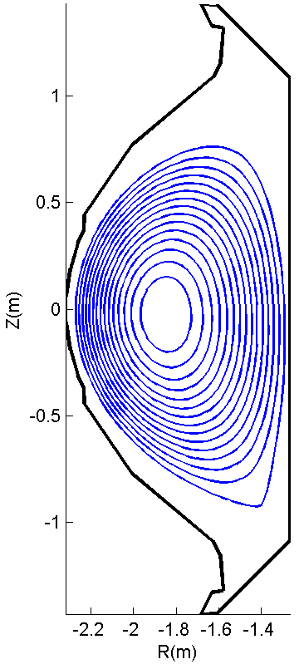
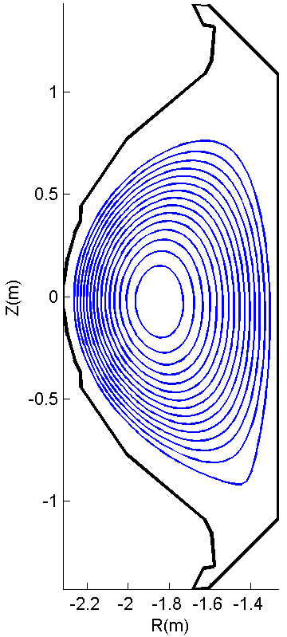
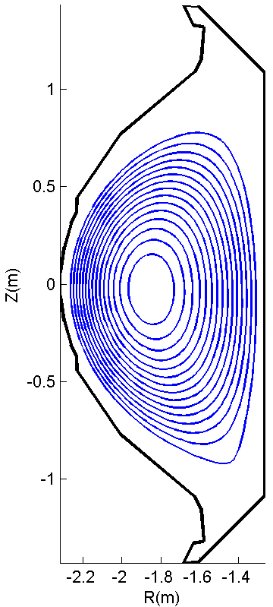
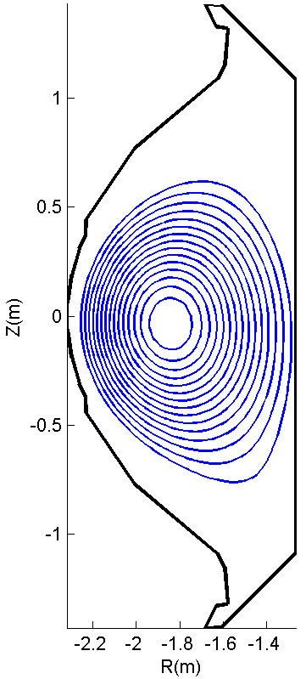
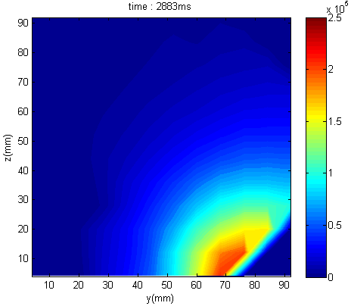
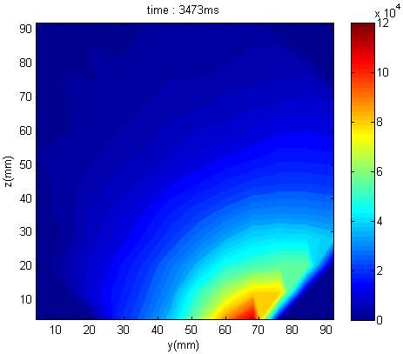
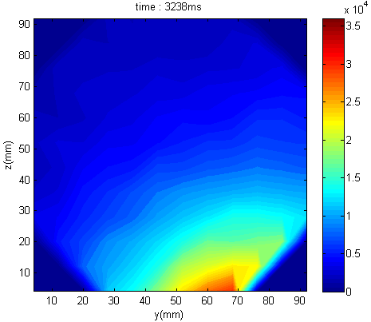
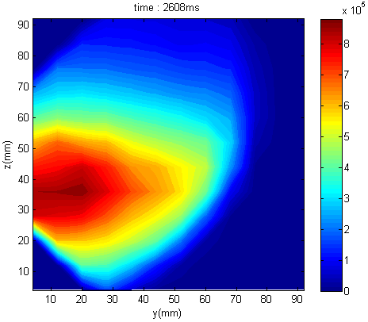
Preliminary result of GEM detector
Zoom in & out
Zoom in
shot 9033
shot 9034
shot 9035
shot 9056

Slide 10
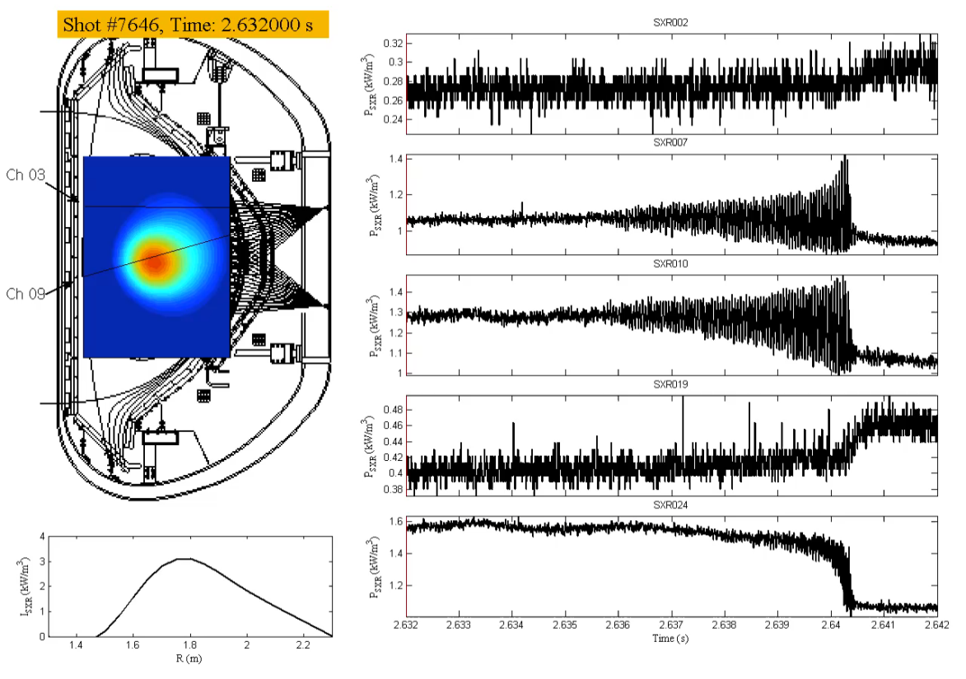
Sawtooth crash in H-mode
Trajectory of the hot core
rtEFIT
Spectrogram
m = 1 (f = 19 kHz) is shown by spectrogram.
Maximum displacement from the initial position: 0.13 m
Maximum rotation speed: 10.7 km/s
m = 1
f = 19 kHz

Slide 11
Comparison between L- & H-mode
L-mode, low v_{Ф}
H-mode, high v_{Ф}
Crash
Crash
Displacement from central position
Displacement from central position
< 0.1 m
0.1 m
Poloidal velocity
< 5 km/s
Poloidal velocity
< 10 km/s
Crash in a single step
Crash in multi steps
Notes:
L-mode와 H-mode 비교를 하자면, crash가 일어나는 양상이 앞서와 같이 다릅니다. 확대한 신호를 보면 L-mode 에서는 crash가 한 번에 일어나 oscillation 피크값이 최대가 되었다가 바로 잠잠해지는 모양이고, H-mode에서는 최대 피크점이 있고 그 이후에도 oscillation이 세 번에 걸쳐 그 진폭이 잦아드는 모양입니다. (9, 11 페이지 그림과 일치)

Slide 12
Correlation between
SXR rotation speed & v_{Ф} (XICS)
The m=1 SXR rotation speed is compared with toroidal rotation speed (XICS).
Toroidal rotation frequency
Notes:
이러한 m=1 모드의 주파수와 토로이달 회전 속도와 비교해보면 이와 같습니다. 6개의 실험에서 일어난 모든 sawtooth crash를 fft하여 알아낸 주파수와 그 시간에 해당하는 토로이달 회전속도와 비교한 값입니다. 이에 따르면 m=1 모드의 주파수는 토로이달 회전 속도에 의해 결정된다고 할 수 있겠습니다.

Slide 13
ECH effect on Ar transport
Argon gas injection through a piezo valve (n_{Ar}/n_{e} < 0.1%)
Different transport with varying ECH positions → Feasibility of impurity control?
Analysis of Ar transport coefficients in L-mode (#7566, #7574) & H-mode (#7745, #7863) by using UTC-SANCO code with diagnostic results (SXR, VUV, XICS)
Heating positions
(r/a = 0, 0.16, 0.30, 0.59)
w/o ECH
w/ ECH
L-mode
Ar puffing
20 ms
Ar puffing
20 ms
0.4
0.2
0.4
0.2
40 cm
20
Ip (MA)
#7574
Ip (MA)
10
Ar
#7566
#7863
0
ECH
110 GHz
350 kW
0 1 2 3 4
0 1 2 3 4
Time (sec)
Time (sec)
Ar puffing after ECH start

Slide 14
Depending on ECH position
L-mode
No ECH
No ECH
r/a = 0.59
On-axis ECH
0.30
ECH @
r/a = 0.16
0.16
0.30
On-axis ECH
0.59
Less core accumulation of Ar impurity with ECH
Most effective (i.e., least core impurity concentration) with on-axis ECH
Less effective with resonance layer position at larger radius

Slide 15
2-D Reconstructed Ar emissivity
Core-focused reconstruction (Cormack algorithm)
Emissivity images of mainly Ar¹⁶⁺ & Ar¹⁷⁺ impurities
No ECH
On-axis ECH

Slide 16
Modification of D & V by ECH
Non ECH (#7566)
Inward
On-axis ECH (#7574)
Outward
Inward
With ECH, central diffusion and convection are increased.
The pinch direction reverses at r/a < 0.3.

Slide 17
Hollow Ar density profile by ECH
◈ Total Ar density
No ECH (#7566)
On-axis ECH (#7574)
◈ Radial profile of total Ar density at peak time (2.3 s)
Total Ar
Total Ar

Slide 18
Neoclassical contribution of Ar transport
Neoclassical calculation of D and V by NCLASS
- The same input (Te, ne) of SANCO calculation
- Ar¹⁶⁺ (dominant charge state) distribution at the peak time is used.
No ECH
(#7566)
Exp
NCLASS
On-axis ECH
(#7574)
D, V calculated by NLCASS is smaller by an order of magnitude than the experimental D, V.
→ The impurity transport is anomalous, rather than neoclassical.

Slide 19
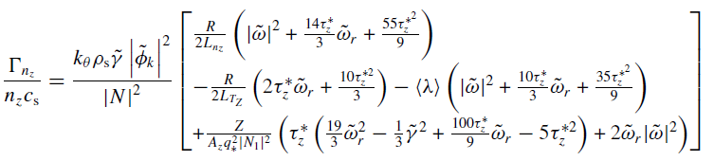
Impurity pinch
3 impurity pinch terms^{[1]} in Weiland multi-fluid model
Curvature pinch
Parallel
compression
pinch
Thermodiffusion pinch
Pinch type | Description | Pinch direction by turbulence type
Curvature pinch | Compressibility of ExB drift v | Inward
Thermodiffusion pinch | Compression of the diamagnetic drift v | ITG → Outward TEM → Inward
Parallel impurity compression | Parallel compression of parallel v fluctuations produced along the field line by fluctuating electrostatic potential | ITG → Inward TEM → Outward
GYRO and XGC simulations are on-going to find the dominant turbulence mode of No ECH and on-axis ECH cases.
→ It is expected that TEM is the dominant mode because of ECH effect on Te profile.
It may be due to parallel impurity compression driven by increased R/L_{Te}^{[2]}
[1] H. Nordman et al., 2011 Plasma Phys. Control. Fusion 53 105005 [2] C. Angioni et al.,2006 Phys. Rev. Lett. 96 095003

Slide 20
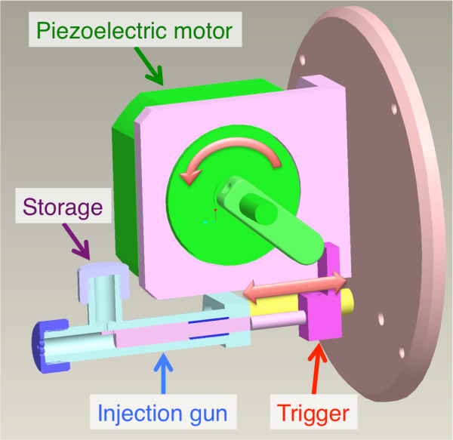
Diagnostics & analysis tools ready for W injection experiment
5 - 20 nm wavelength range is mainly used for measurement of W emission spectra.
ASDEX-U: VUV (~5 nm)
JET: VUV (~5 nm) & SXR
JT-60U: VUV (6.23 nm)
LHD: EUV (6.09, 6.23 & 12.7 nm)
KSTAR
  - VUV (5 – 60 nm): ITER prototype
  - SXR
Simulation & Atomic data: SANCO-ADAS
W test particle injector under preparation/consideration
  Particle gun (under preparation on KSTAR)
  Laser blow-off system (C-Mod)
  Particle dropper (NSTX)
  Pellet injection (LHD)

Slide 21
Presentations and discussions
Design and tomography test of Soft X-ray Array diagnostics on KSTAR (Seung Hun LEE)
Design and tomography test of Edge Multi energy Soft X-ray Array diagnostics on KSTAR (Juhyeok JANG)
Impurity transport analysis and preparation of W injection experiments (Joohwan HONG)
Development of a tungsten injection injector for high Z impurity study (Joohwan HONG)

