Slide 1

Three-Dimensional Edge Transport and Impact on Plasma Surface Interactions with Resonant Magnetic Perturbation Fields in Tokamaks
Oliver Schmitz
University of Wisconsin – Madison,
Department of Engineering Physics, Madison, WI, USA
Acknowledgements to
M. Becoulet, P.Cahyna, T.E. Evans, Y.Feng, N.Ferraro, M.E. Fenstermacher, H. Frerichs, G. Huijsmans, M. Jakubowski, A.Kirschner, L. Lao, C.L. Lasnier, M. Lehnen, A.Loarte, R.Nazikian, D. Orlov, H. Reimerdes, D.Reiter, G.Saibene, U. Samm, P.Snyder, H. Stoschus, M. Wade and the DIII-D and TEXTOR Teams
PPPL General Seminar, May 13, 2014

Slide 2

Executive summary as structure of talk
Three-Dimensional effects are significant in tokamaks during application of resonant magnetic perturbation fields for ELM control
The perturbed separatrix defines 3D edge topology and transport
Connection length in helical scrape off layer governs transport features
Magnetic islands act as radial transport actuator on transport and exhaust
Plasma surface interaction is directly affected by 3D boundary
Plasma response defines extension and actual shape of the 3D boundary
Extrapolation capability of these effects towards ITER is progressing but still controversial
1

Slide 3
Executive summary as structure of talk
Three-Dimensional effects are significant in tokamaks during application of resonant magnetic perturbation fields for ELM control
The perturbed separatrix defines 3D edge topology and transport
Connection length in helical scrape off layer governs transport features
Magnetic islands act as radial transport actuator on transport and exhaust
Plasma surface interaction is directly affected by 3D boundary
Plasma response defines extension and actual shape of the 3D boundary
Extrapolation capability of these effects towards ITER is progressing but still controversial
1

Slide 4
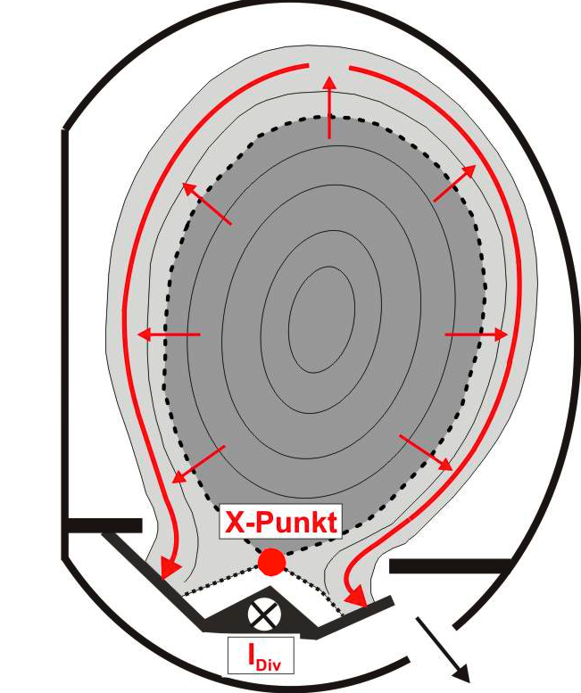
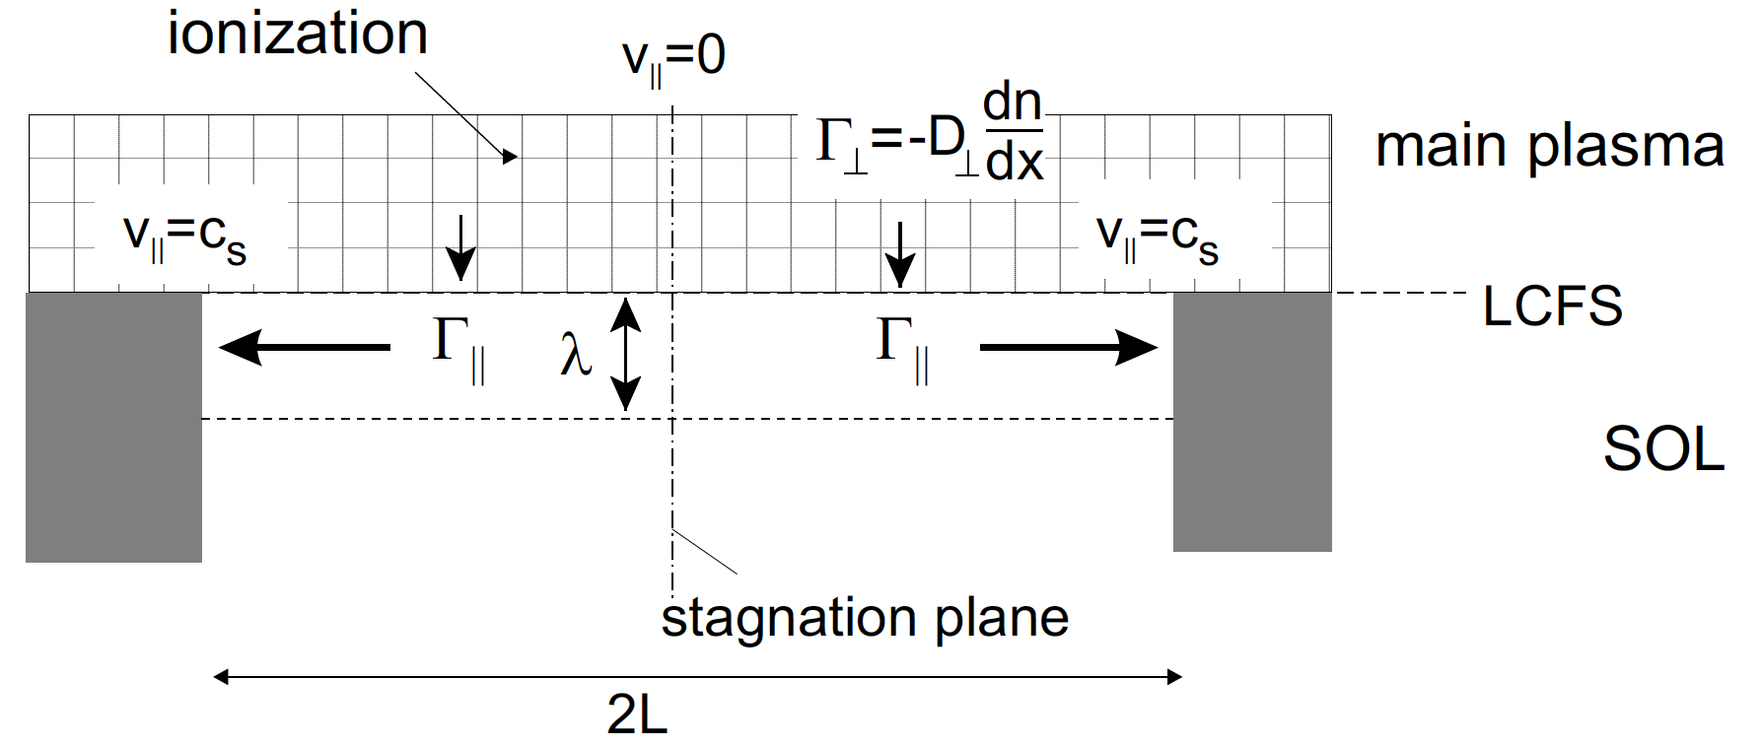


Position of open field line domain and fueling front determine location and width of plasma boundary and wall interaction domain
Simplified Example for Calculation of Deposition Width
Parallel Heat q|| and Particle Γ|| Fluxes to Target
Radial Transport into SOL
D⊥, χ⊥
[B. Unterberg and U. Samm, Transact. Fusion Science and Technology 45 (2004) 229-236]
Mass conservation in open field line region:
Radial constant diffusion, parallel flow with
Exponential decay in SOL
Thin deposition width
2
Strong symmetry assumptions are used!

Slide 5
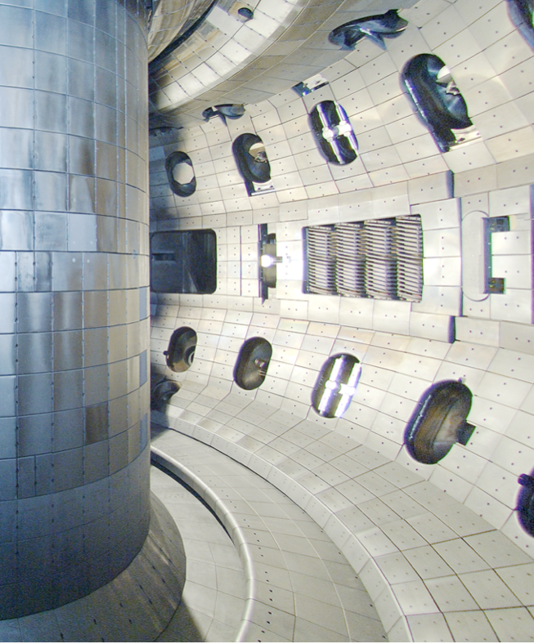
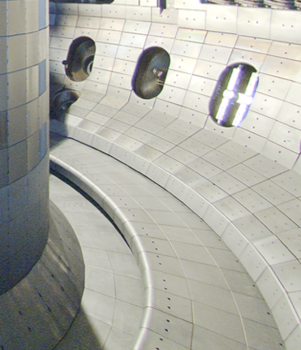
A 3D plasma edge magnetic topology is detected at DIII-D
3

Slide 6
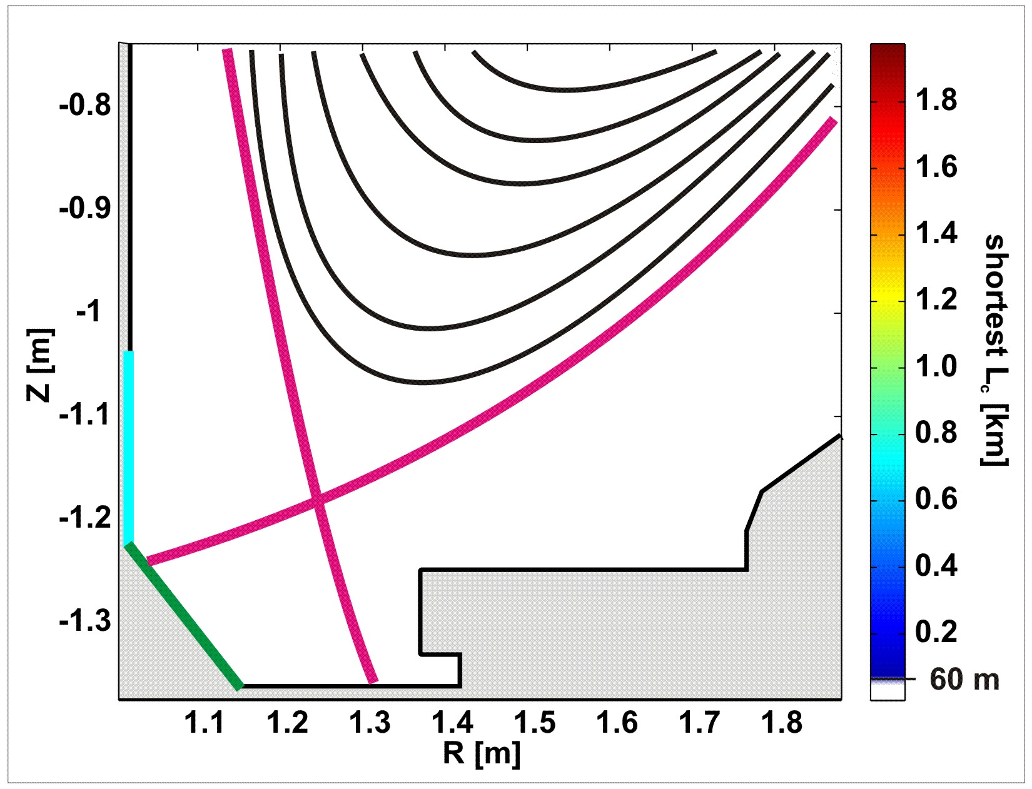
A 3D plasma edge magnetic topology is detected at DIII-D
The separatrix is very sensitive to external and internal perturbation fields
3

Slide 7
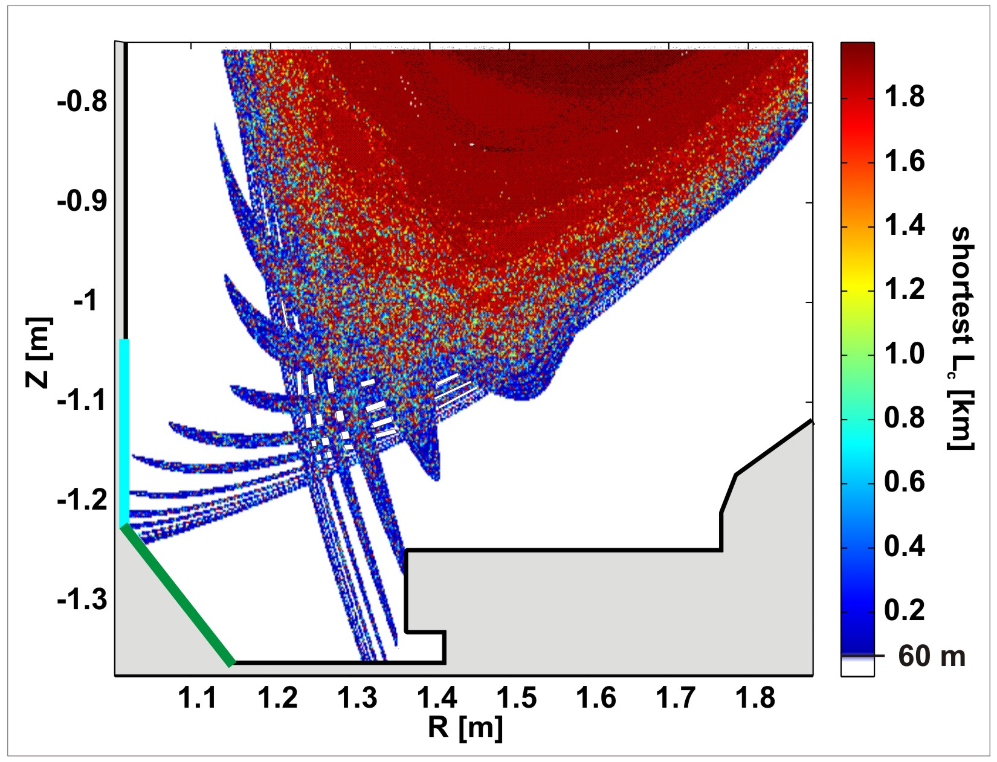
A 3D plasma edge magnetic topology is detected at DIII-D
The separatrix is very sensitive to external and internal perturbation fields
O. Schmitz et al. PPCF 50 (2008) 124029
Separatrix lobes show interaction of RMP with separatrix
T.E.Evans et al. J. Phys.: Conf. Series 7 (2005) 174
4

Slide 8
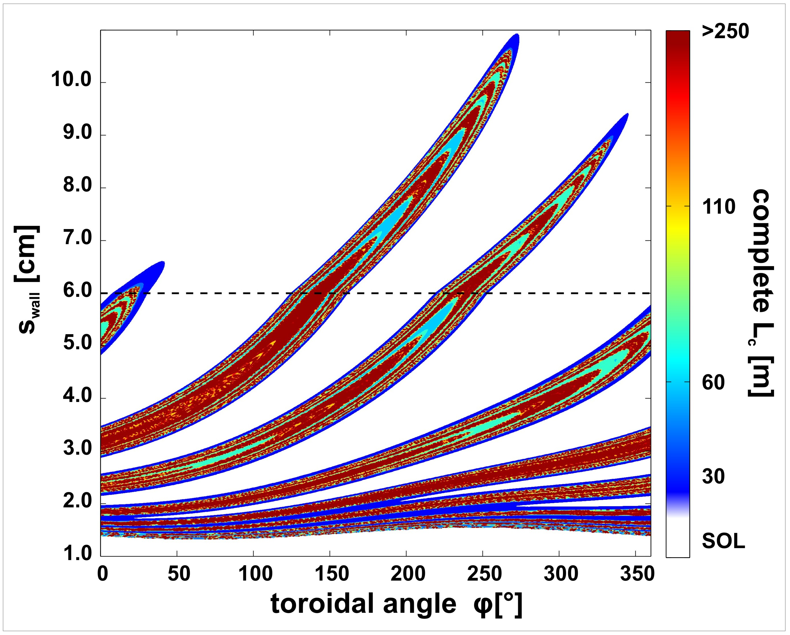
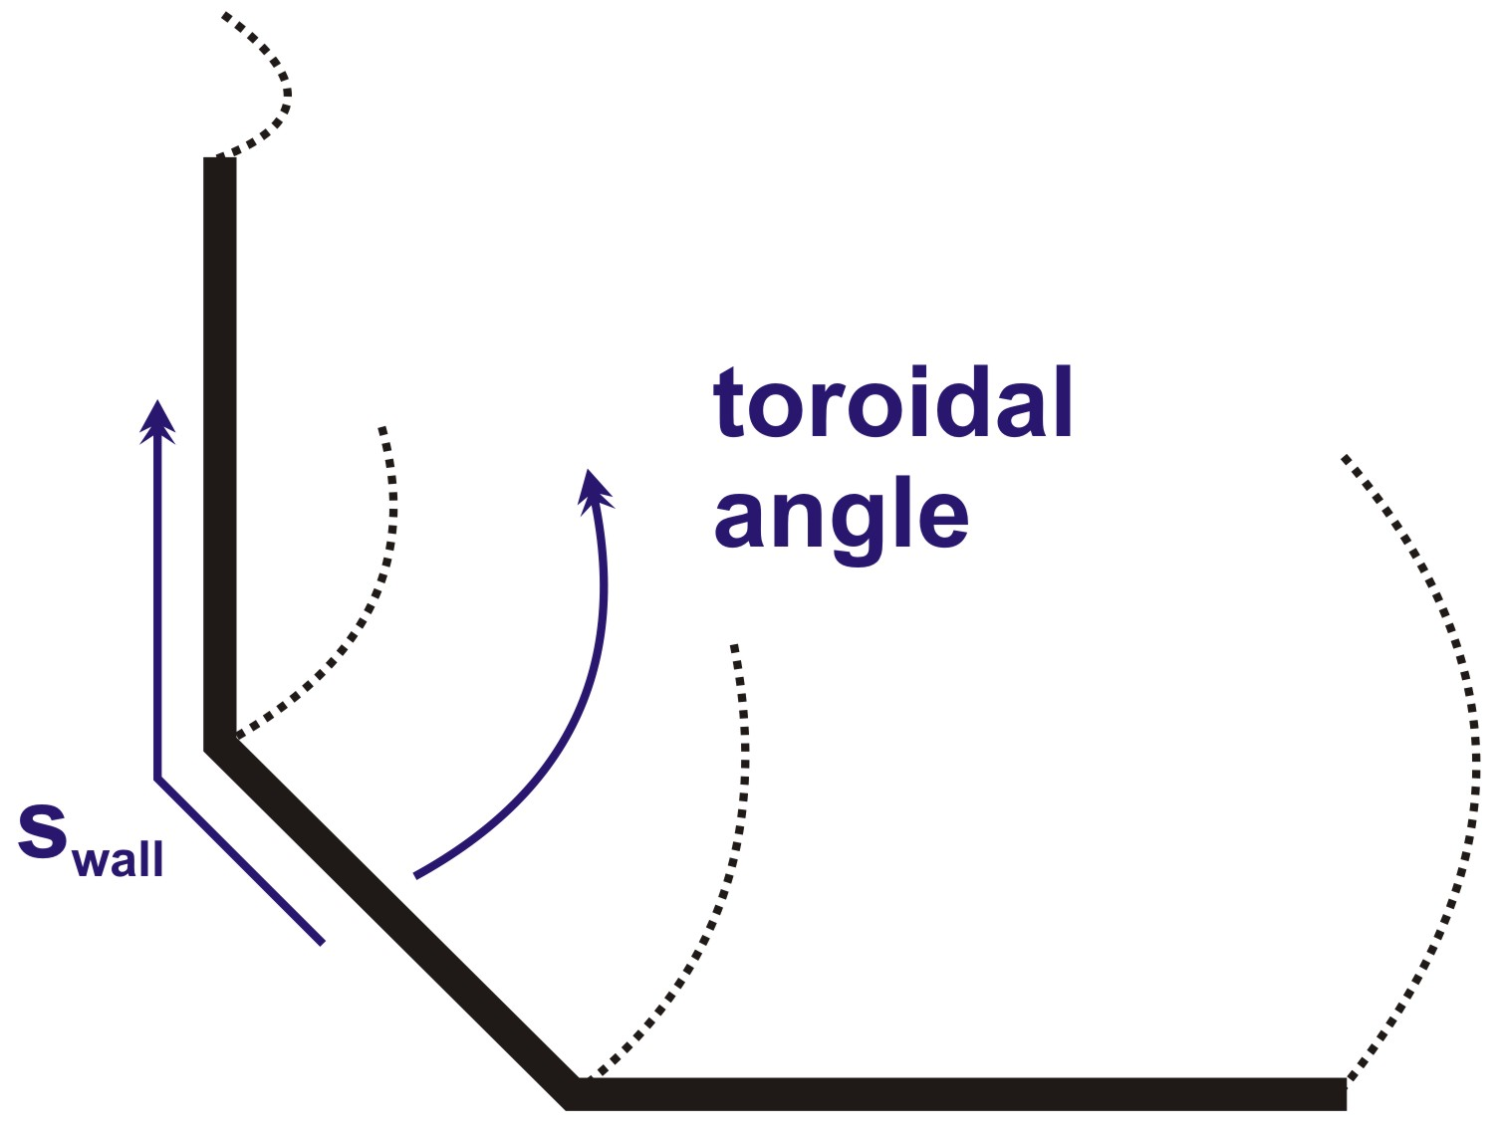
“Stochastic edge layer” is a heterogeneous helical scrape off layer
Perturbed separatrix represents envelope for stochastic interior
5

Slide 9
EMC3-Eirene modeling reflects 3D edge structures
H. Frerichs et al. Nuclear Fusion 50 (2010) 034004
Fluid plasma and kinetic neutral transport modeling predicts 3D boundary in electron and ion temperature and density fields
6

Slide 10
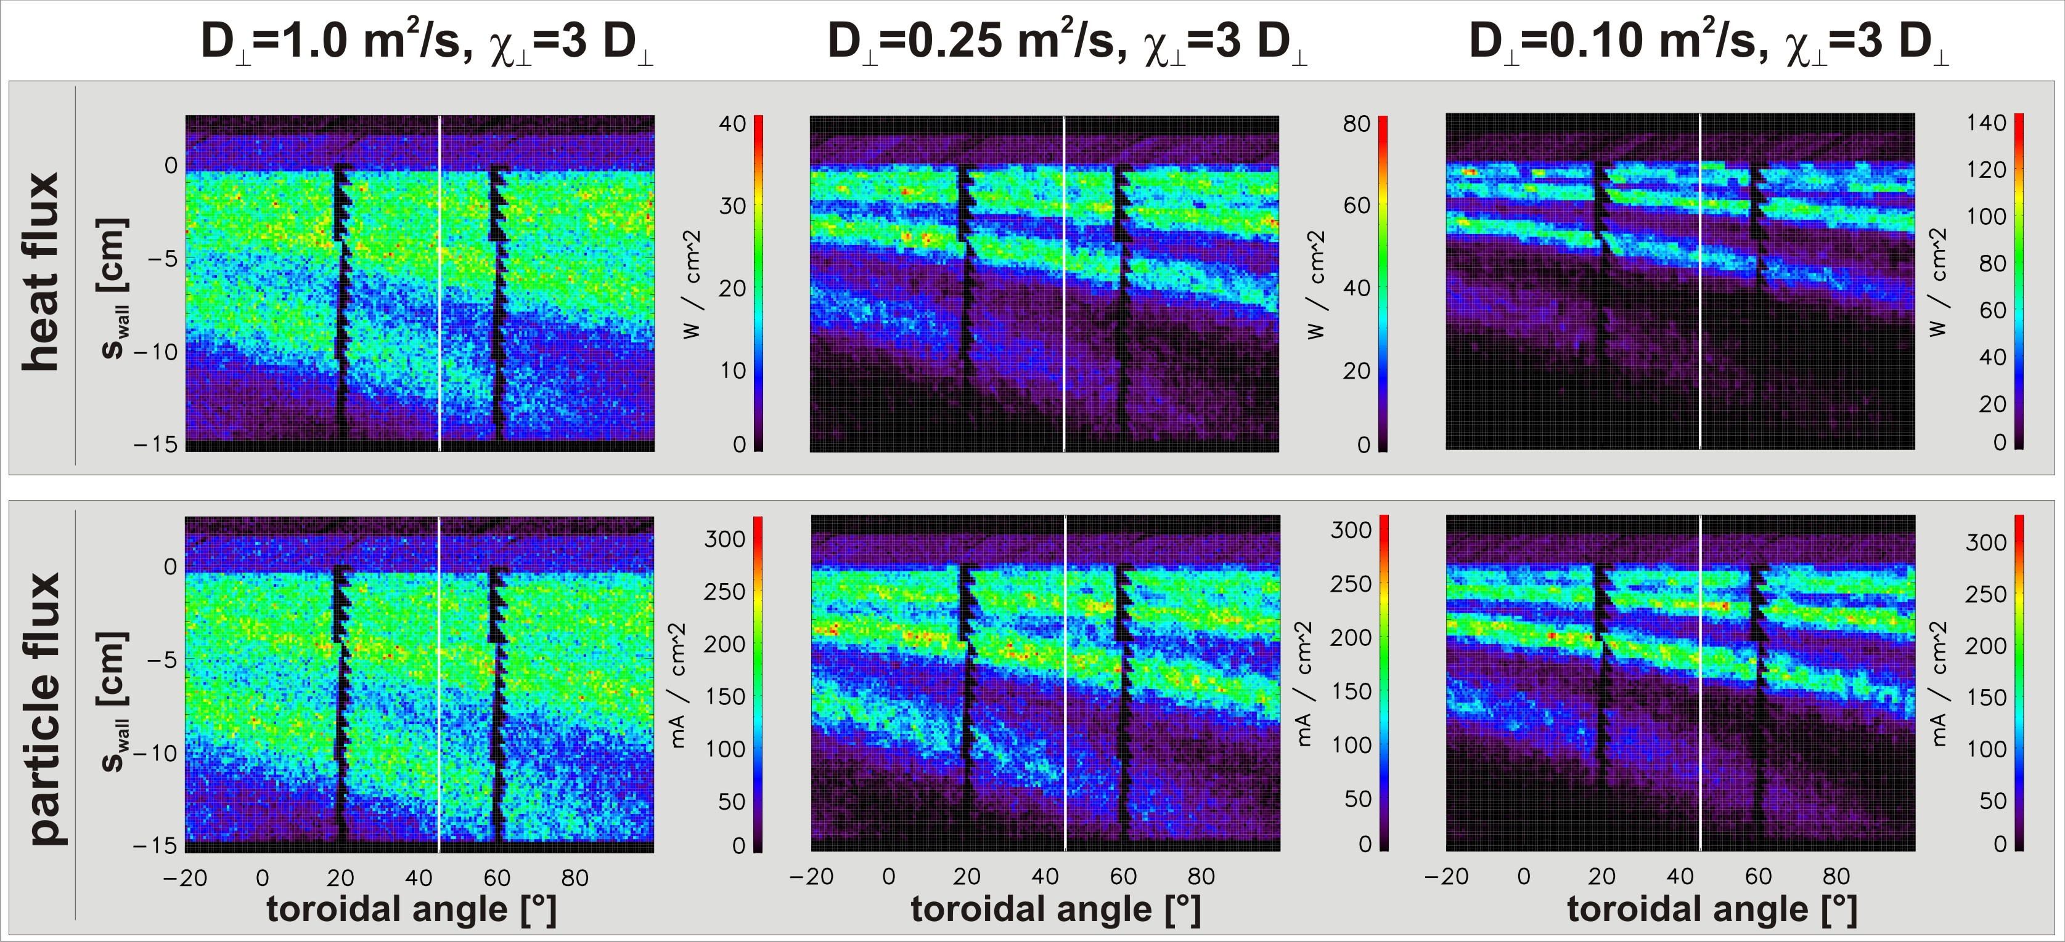
Qualitative appearance of strike line striation is proxy for effective level of perpendicular transport
Low level of diffusive perpendicular transport is required to see striated magnetic footprints
Parallel transport along open field lines prevails similar to SOL
7

Slide 11
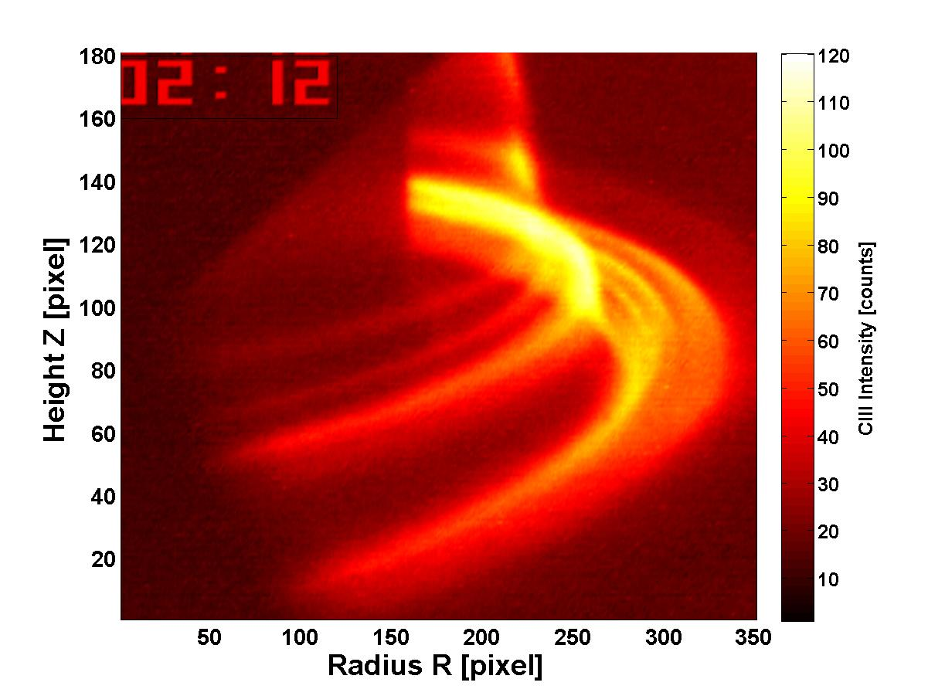
Striation of target particle fluxes is a reliable signature during RMP ELM suppression at DIII-D
[T.E. Evans et al., Journ. Phys. 7, 174 (2005)]
[O. Schmitz et al., PPCF 50 (2008) 124029]
[M. Jakubowski et al., Nucl. Fusion 49 (2009) 095013]
Center post
Outer shelf
45° tile
floor
Shows existence of the separatrix lobes as new definition for 3D plasma boundary
This is a reliable finding during RMP application on other devices, e.g. NSTX, MAST, Asdex-Upgrade
8

Slide 12
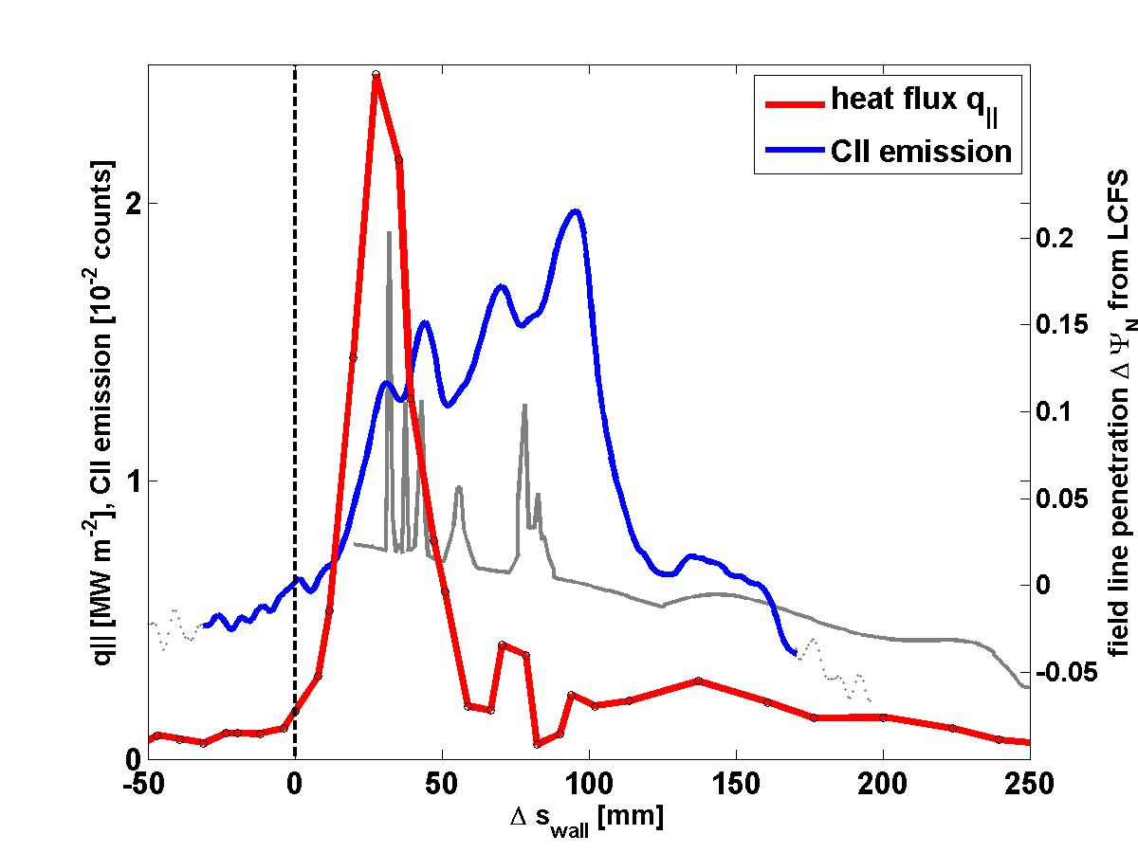
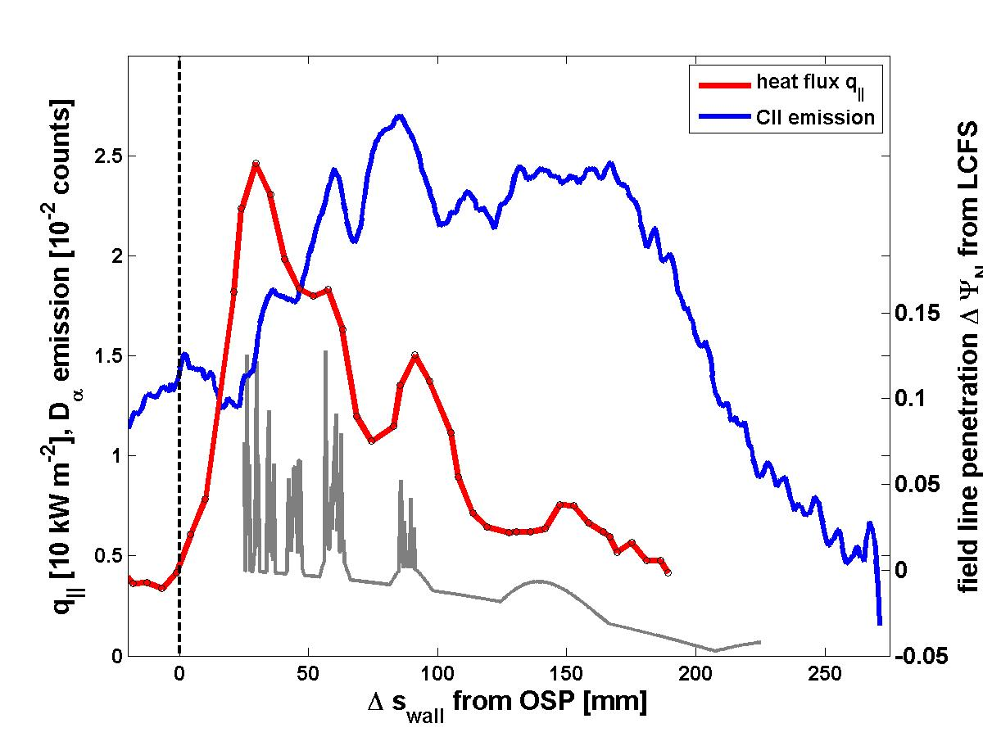
Heat and particle fluxes into 3D boundary appear to be very different
H-mode plasma
L-mode plasma
heat flux
heat flux
CII emission
CII emission
Field line penetration
Field line penetration
[O. Schmitz et al., JNM 415 (2011) 886-893]
Striation is always clearly seen in particle flux
Weak heat flux filling of lobes
Plasma response: Exact shape is determined by sum of all radial perturbations at the separatrix
Good match between modeling and experiment found in L-mode, in H-mode measured striation is consistently 10-13% wider then modeled
Recycling features in lobes have been suggested recently as possible explanation
9

Slide 13
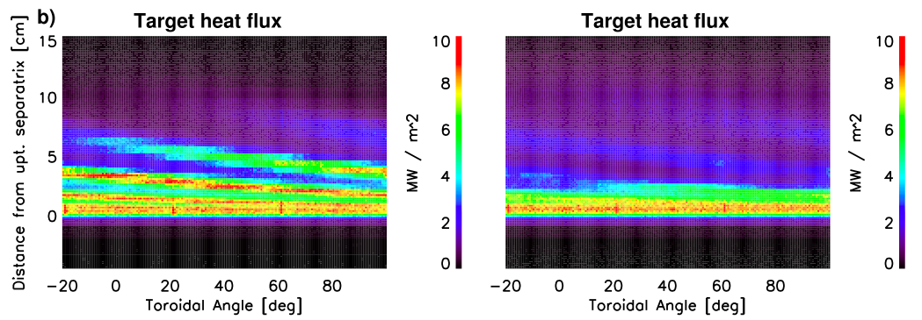
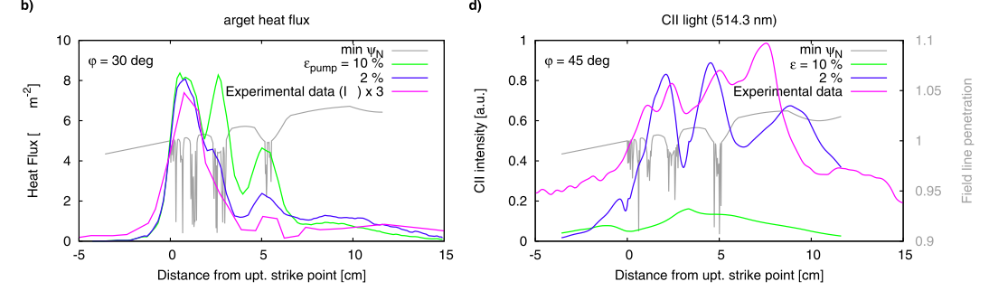
High density divertor solution reproduces small outward heat influx due to localized high recycling
[H. Frerichs et al., PoP 21 (2014) 020702]
ε=10%
ε=2%
1
10

Slide 14
Executive summary as structure of talk
Three-Dimensional effects are significant in tokamaks during application of resonant magnetic perturbation fields for ELM control
The perturbed separatrix defines 3D edge topology and transport
Connection length in helical scrape off layer governs transport features
Magnetic islands act as radial transport actuator on transport and exhaust
Plasma surface interaction is directly affected by 3D boundary
Plasma response defines extension and actual shape of the 3D boundary
Extrapolation capability of these effects towards ITER is progressing but still controversial

Slide 15
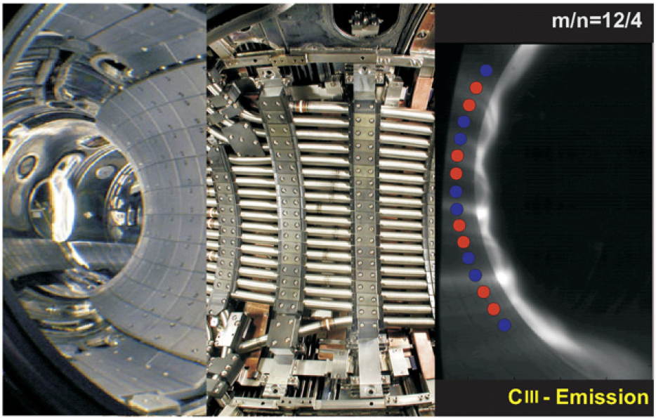
Dynamic Ergodic Divertor at TEXTOR as flexible tool to generate different mode number & rotating RMP fields
3 pitch resonant base mode spectra: m/n=12/4, 6/2, 3/1
AC operation: 1,2,5,10 kHz
11

Slide 16
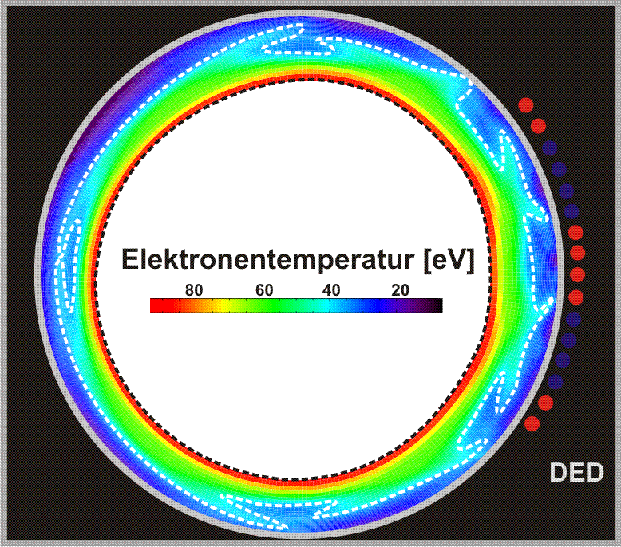
The perturbed edge layer consists out of SOL like field lines and stochastic domains
O. Schmitz et al. Nucl. Fusion 48 (2008) 025009
T. Eich et al. Nucl. Fusion 40 (2000) 1757
Stochastic layer
Laminar flux tubes as helical SOL
12

Slide 17
The helical SOL acts as a chanel of strong parallel transport to the wall
O. Schmitz et al. Nucl. Fusion 48 (2008) 025009
Short connection length, laminar flux tubes represent helical SOL
13

Slide 18
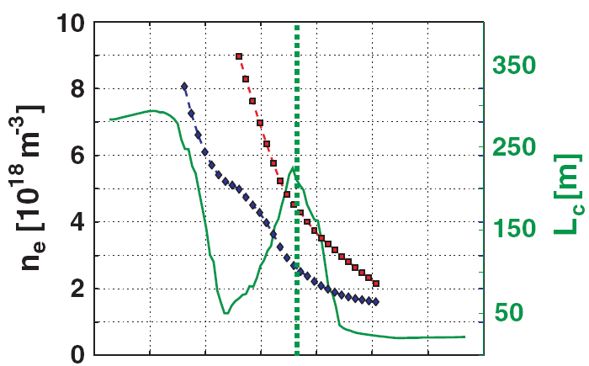
The helical SOL acts as a chanel of strong parallel transport to the wall
O. Schmitz et al. Nucl. Fusion 48 (2008) 025009
Short connection length, laminar flux tubes represent helical SOL
The “stochastic edge” is not a region of dominant magnetic braiding but governed by SOL like transport
13

Slide 19
Executive summary as structure of talk
Three-Dimensional effects are significant in tokamaks during application of resonant magnetic perturbation fields for ELM control
The perturbed separatrix defines 3D edge topology and transport
Connection length in helical scrape off layer governs transport features
Magnetic islands act as radial transport actuator on transport and exhaust
Plasma surface interaction is directly affected by 3D boundary
Plasma response defines extension and actual shape of the 3D boundary
Extrapolation capability of these effects towards ITER is progressing but still controversial

Slide 20
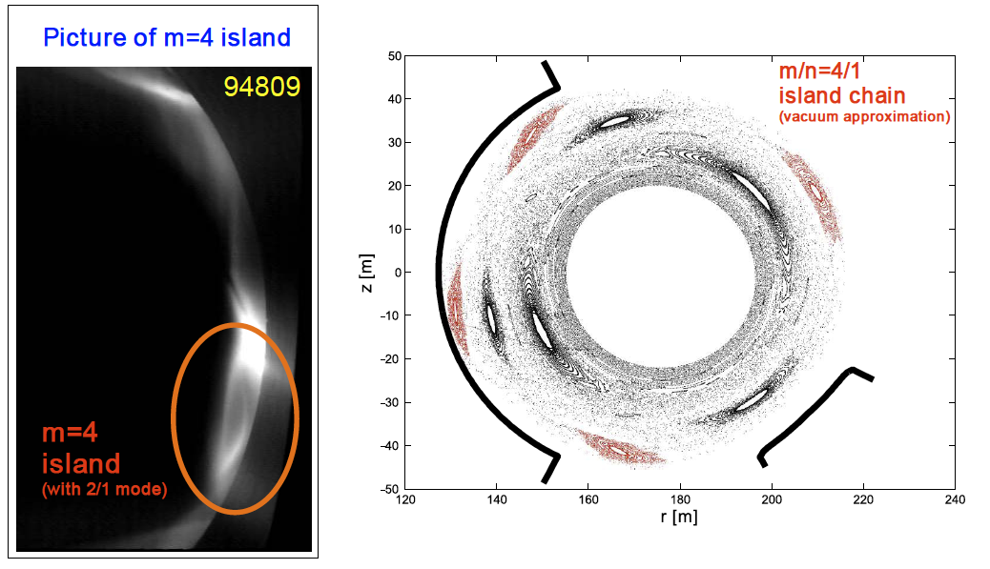
Edge magnetic islands were identified in C-III light and in transport features
Edge island can be invoked on demand in a very controlled and reliable manner
14

Slide 21
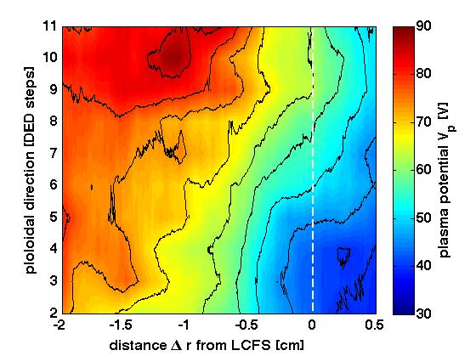
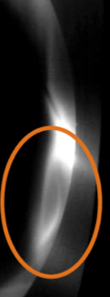


Magnetic island can act as convective cell and enhance outward transport
O-point
2cm
O-point
X-point
X-point
Electric fields towards
island center ~ 2-20 V/cm
τ_{p} drops by 30% with island -refuel of plasma hardly possible
15

Slide 22
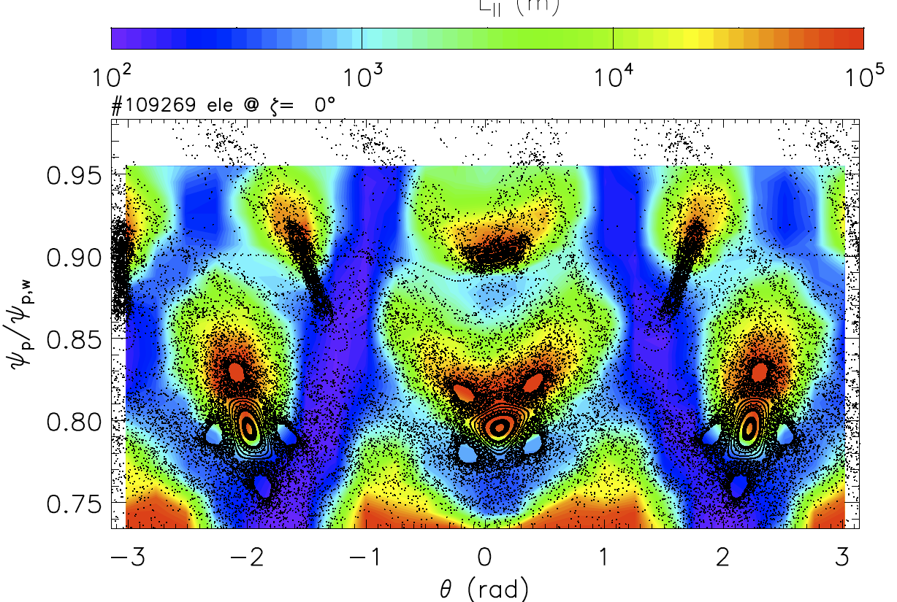
Hamiltonian guiding center code ORBIT shows poloidal structure in connection length …
Parallel Connection Length
16
G. Ciaccio et al. Nucl. Fusion submitted (2014)

Slide 23
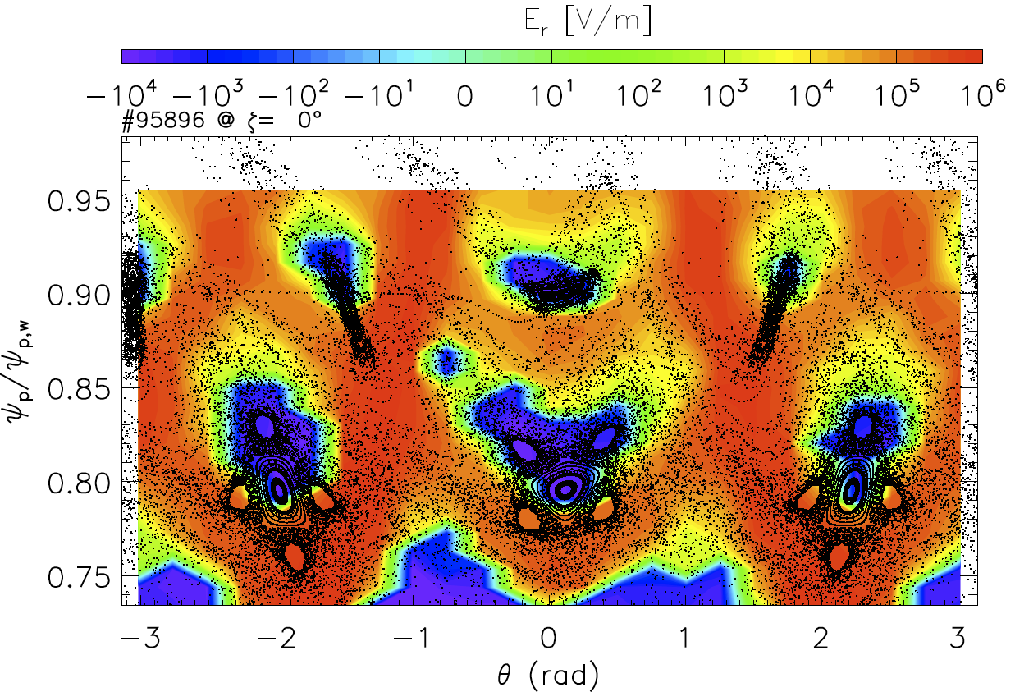
… and correlated structure in radial electric field (based on plasma potential from electron and ion separation)
17
G. Ciaccio et al. Nucl. Fusion submitted (2014)

Slide 24
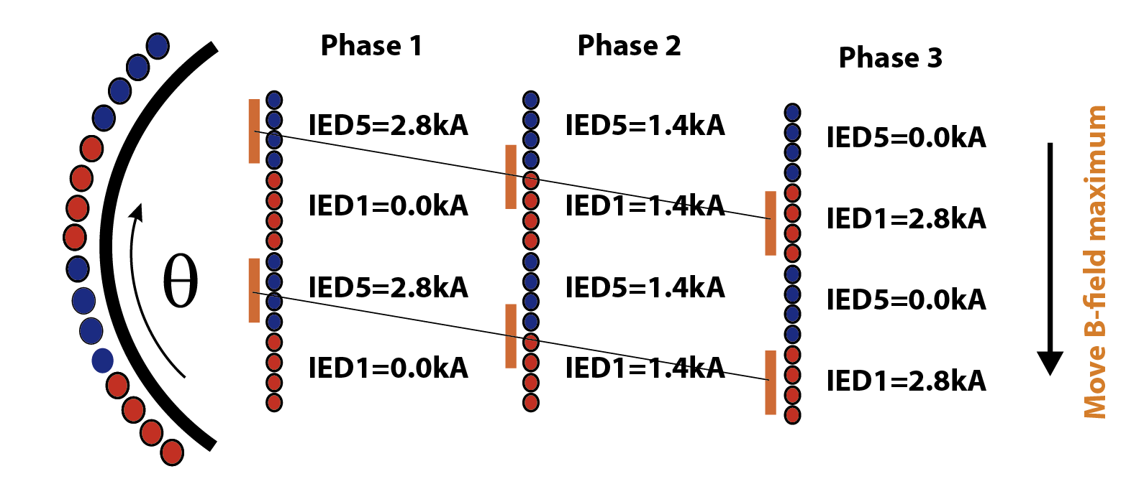
Island location can be fine tuned relative to exhaust system by DED current phase sweeps
This method was shown to move island poloidally by about 15 degree at the outer mid plane
Toroidal movement will determine position relative to ALT-II ducts and pumps
18

Slide 25
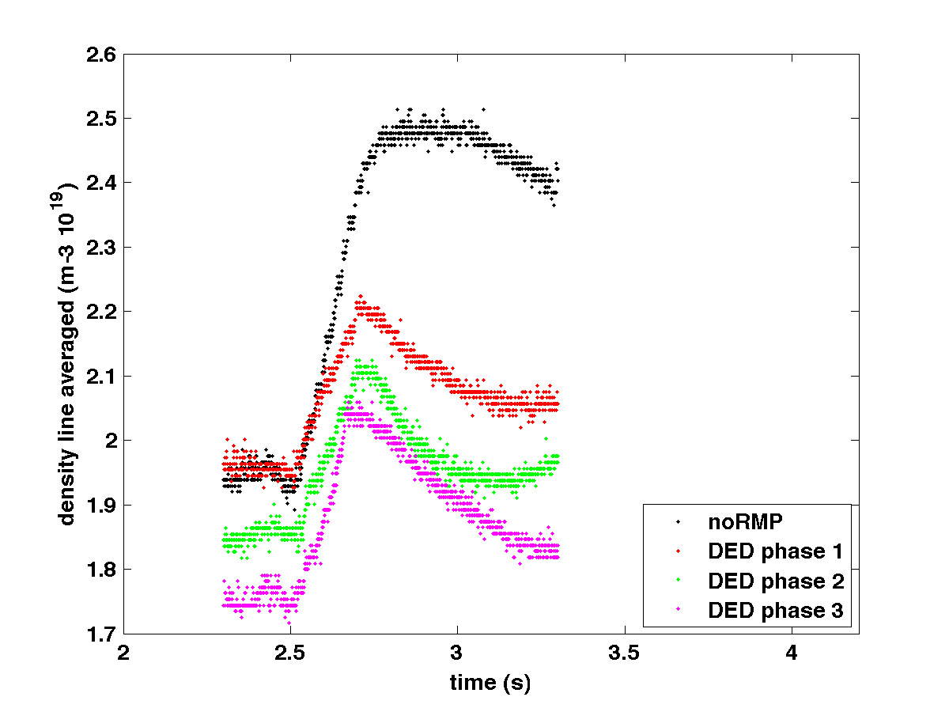
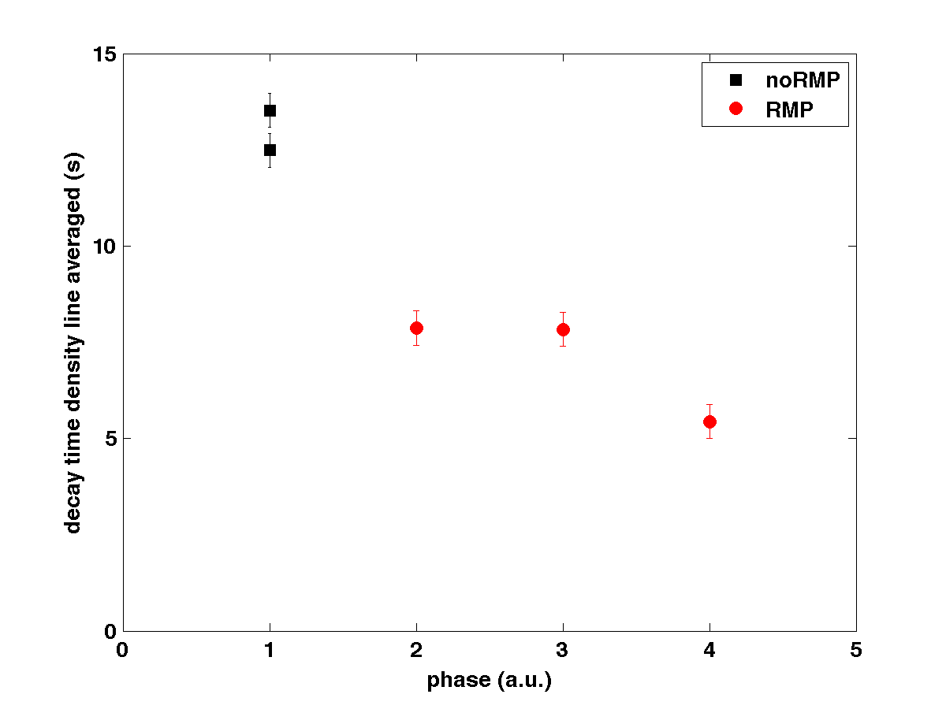
Helium confinement in plasma is largely reduced with island present
Line averaged density
Density decay rate
Fueling less efficient
Density decay rate is reduced by 50% with island present
Shallow increase for island cases shown reduced effective fueling efficiency
Island acts as effective outward transport interface yields reduced fueling efficiency
19

Slide 26
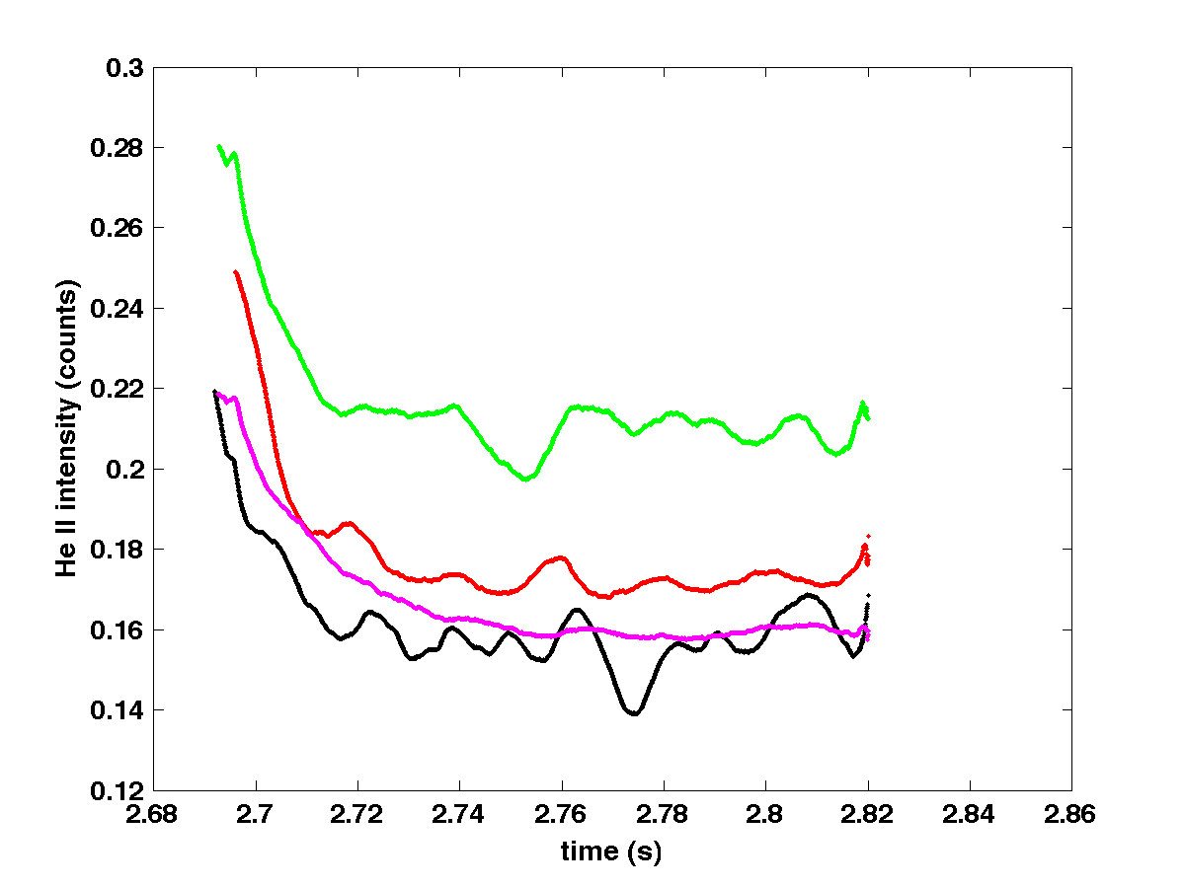
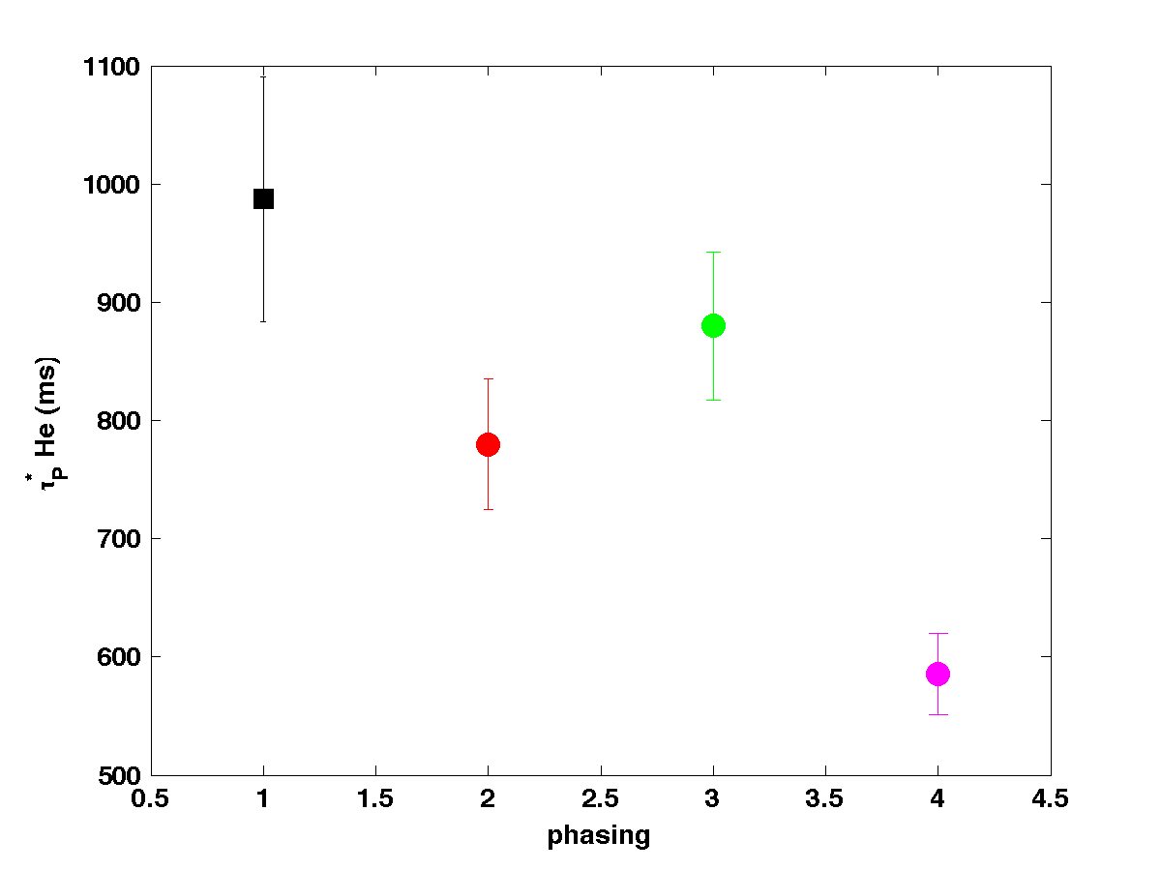
Helium is flushed out into plasma edge with overall reduced helium confinement times
He-II (468nm) intensity in edge
τp* for He in edge
Increase of He level in SOL
τp* for He in edge is reduced with some dependence on DED phase
Accumulation of He in edge due to reduced core fueling efficiency
Helium exhaust is enhanced with 3D boundary
20

Slide 27
Executive summary as structure of talk
Three-Dimensional effects are significant in tokamaks during application of resonant magnetic perturbation fields for ELM control
The perturbed separatrix defines 3D edge topology and transport
Connection length in helical scrape off layer governs transport features
Magnetic islands act as radial transport actuator on transport and exhaust
Plasma surface interaction is directly affected by 3D boundary
Plasma response defines extension and actual shape of the 3D boundary
Extrapolation capability of these effects towards ITER is progressing but still controversial

Slide 28
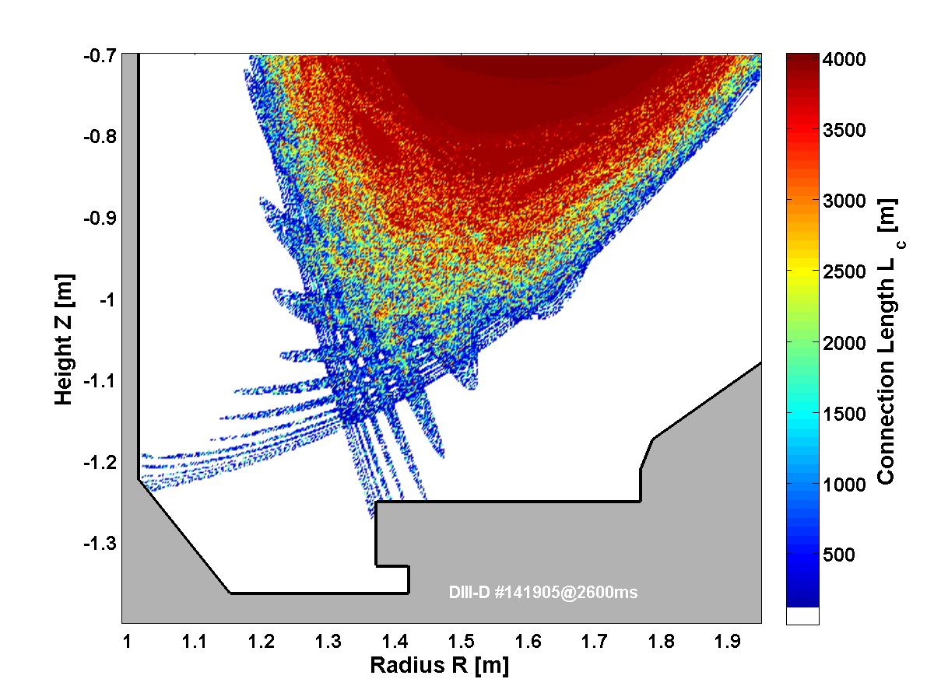

Impact of 3D boundary on erosion properties was teased with DiMES facility at DIII-D
Graphite cap with 4.8 cm diameter
PPI
Γ_{CH4} _{PPI} = 4.7x10¹⁷ s⁻¹
UNIVERSITY OF TORONTO
Institute for Aerospace Studies
Measure chemical erosion within lobes by slow sweeping of the outer strike point
A. McLean et al. Rev. Scientific Inst. 80 (2009) 043501 c
Measure directly the chemical erosion properties within the 3D boundary
A. McLean et al. Journal Nucl. Mater. 390-391 (2009) 160-163
21

Slide 29
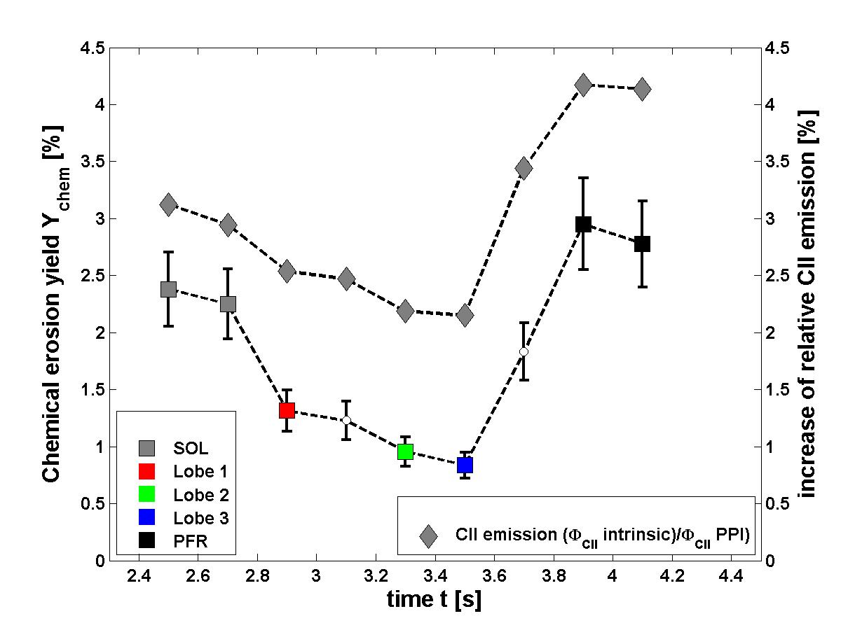
A significant reduction of the chemical erosion was measured
CII emission
Y_{chem}
[O. Schmitz et al., JNM 415 (2011) 886-893]
Evidence for decrease of chemical and increase of physical sputtering with separatrix lobes as end point of open field lines from stochastic boundary
Coupling of EMC3-Eirene with ERO ongoing to assess relevance for ITER divertor
22

Slide 30
Executive summary as structure of talk
Three-Dimensional effects are significant in tokamaks during application of resonant magnetic perturbation fields for ELM control
The perturbed separatrix defines 3D edge topology and transport
Connection length in helical scrape off layer governs transport features
Magnetic islands act as radial transport actuator on transport and exhaust
Plasma surface interaction is directly affected by 3D boundary
Plasma response defines extension and actual shape of the 3D boundary
Extrapolation capability of these effects towards ITER is progressing but still controversial

Slide 31
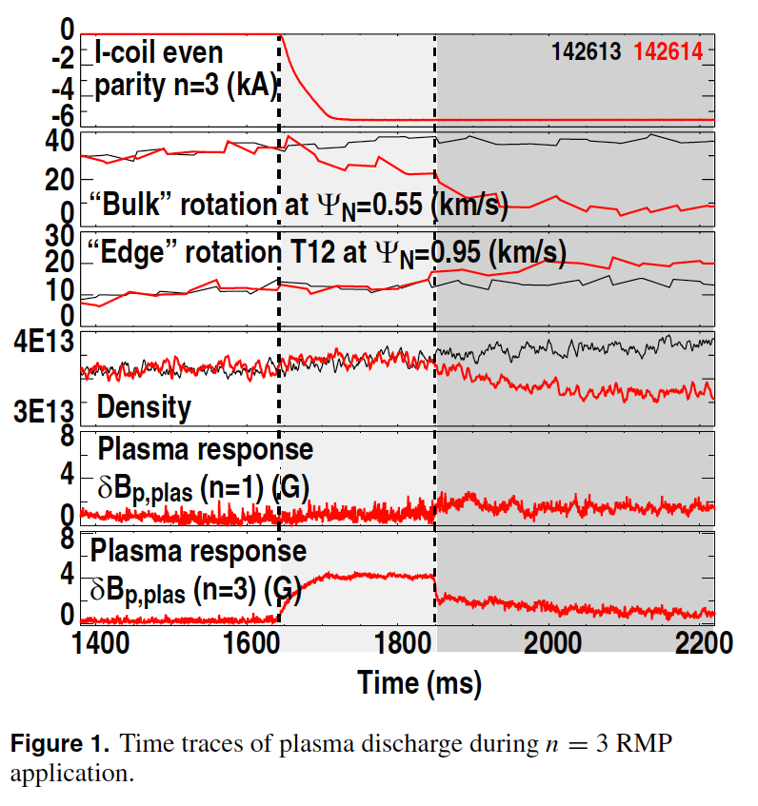
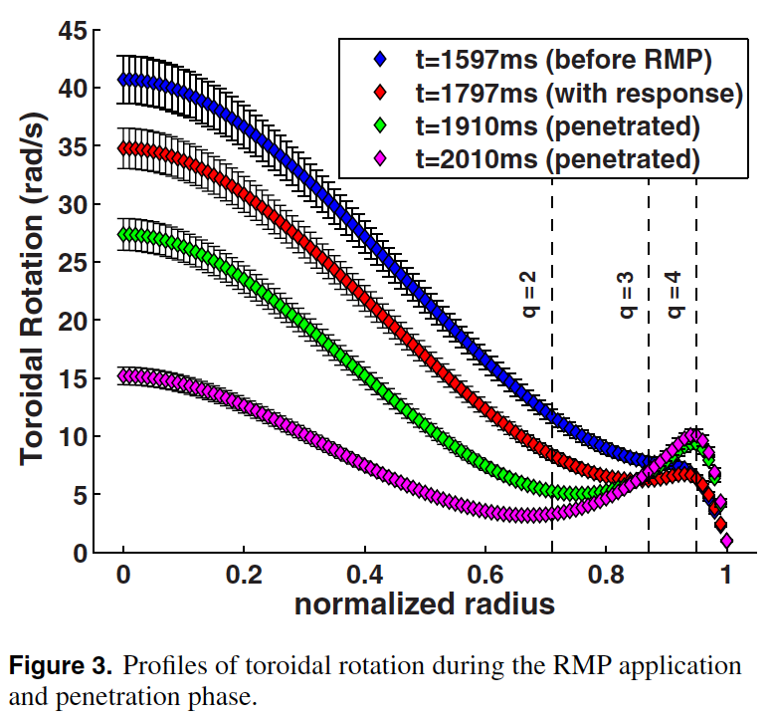
Decay of plasma response yields stochastic edge signatures
LSN L-mode discharge with decay of n=3 response
Toridal rotation profiles
Braking
Spin-Up
23
[O. Schmitz et al., Nucl. Fusion, 54 (2014) 012001]

Slide 32
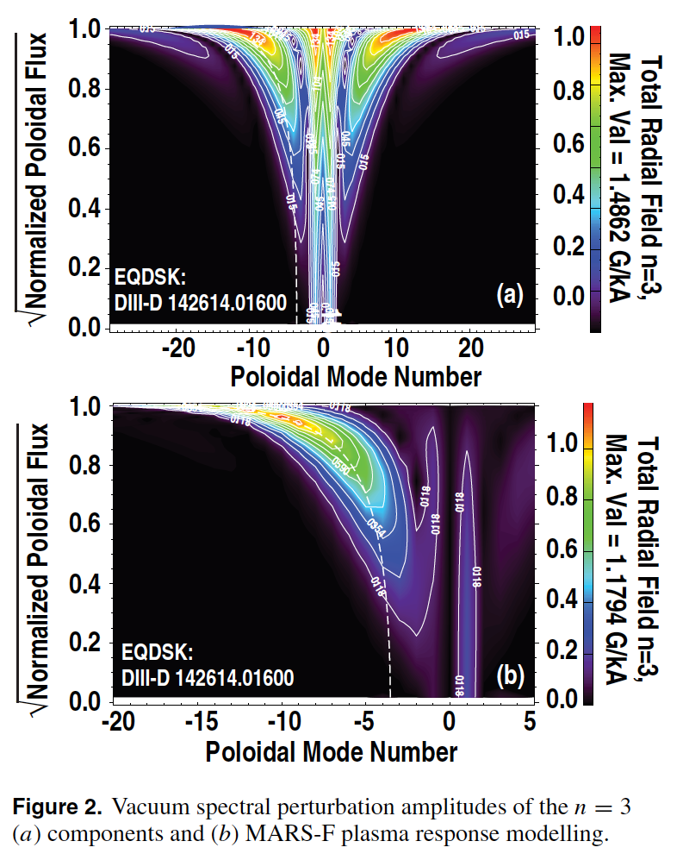
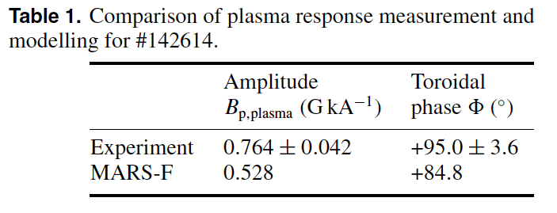
MARS-F modeling predicts resonant screening response
Local resonant sheet currents reduce n=3 resonant mode amplitude
[O. Schmitz et al., Nucl. Fusion, 54 (2014) 012001]
Plasma response commences with intuitive understanding and in agreement with modeling
Ideal MHD type response with RFA not detected
[M. Lanctot et al., PoP 18 (2011) 056121]
24

Slide 33
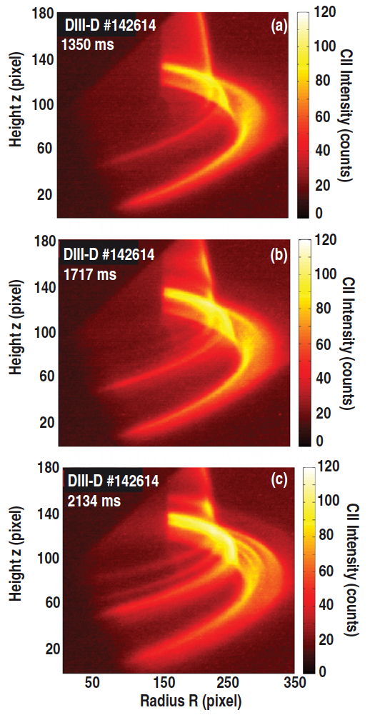
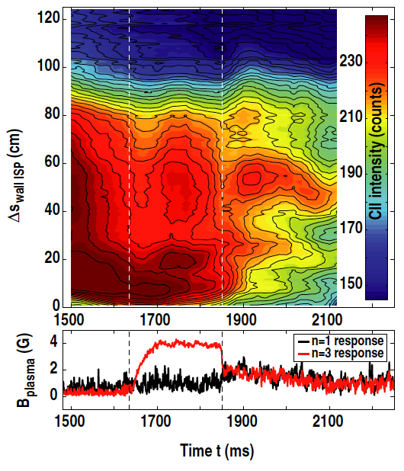
Strike line splitting is strongly enhanced after response decayed
[O. Schmitz et al., Nucl. Fusion, 54 (2014) 012001]
Note residual splitting with low influx during screening phase!
25

Slide 34
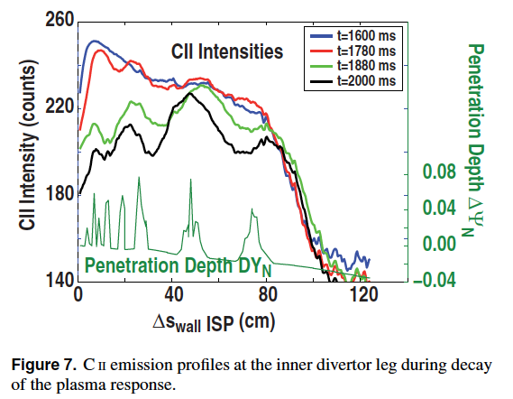
Strike line splitting is strongly enhanced after response decayed
Lobe location agree (for this case) with vacuum prediction
[O. Schmitz et al., Nucl. Fusion, 54 (2014) 012001]
This is a result particular to this case!
We also saw cases with much wider striation widths!
26

Slide 35
Executive summary as structure of talk
Three-Dimensional effects are significant in tokamaks during application of resonant magnetic perturbation fields for ELM control
The perturbed separatrix defines 3D edge topology and transport
Connection length in helical scrape off layer governs transport features
Magnetic islands act as radial transport actuator on transport and exhaust
Plasma surface interaction is directly affected by 3D boundary
Plasma response defines extension and actual shape of the 3D boundary
Extrapolation capability of these effects towards ITER is progressing but still controversial

Slide 36
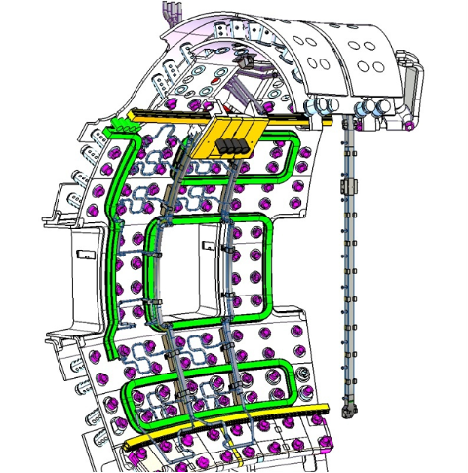
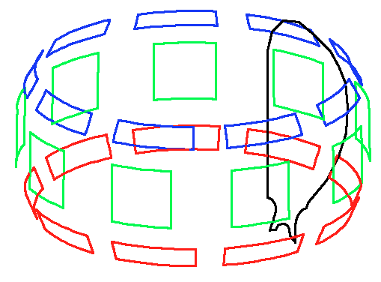
ELM coil set at ITER gives large flexibility
In vessel coils mounted behind blanket
9x3 coils with single power supplies
Coil set with wide spectral flexibility
Toroidal mode number n=3 and n=4 fields seem to be advantageous at the moment
In vessel coil set for ITER
27

Slide 37
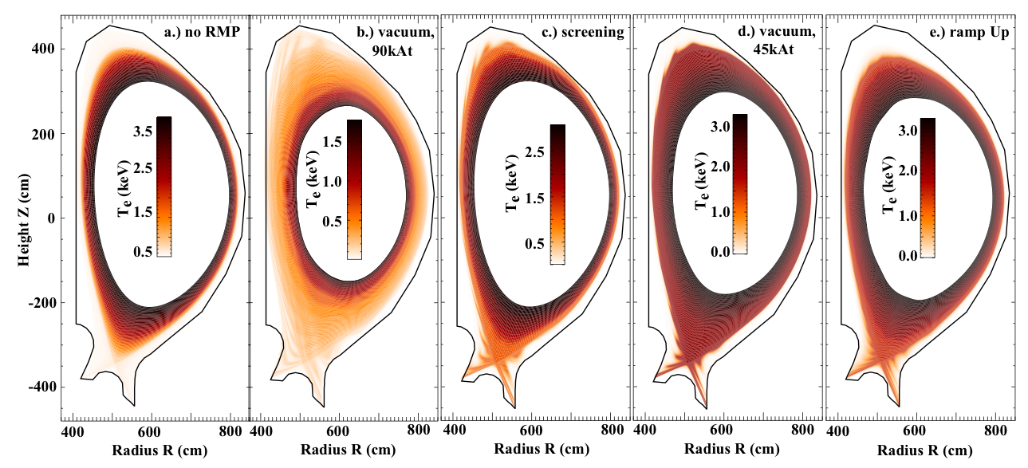
RMP amplitude is a fine tuned actuator for plasma edge transport
O. Schmitz et al., IAEA FEC 2012, San Diego, USA
Implementation of screening and linear reduction of RMP amplitude have similar impact on plasma edge
High q₉₅=4.2 case shows compression of invariant manifolds
28

Slide 38
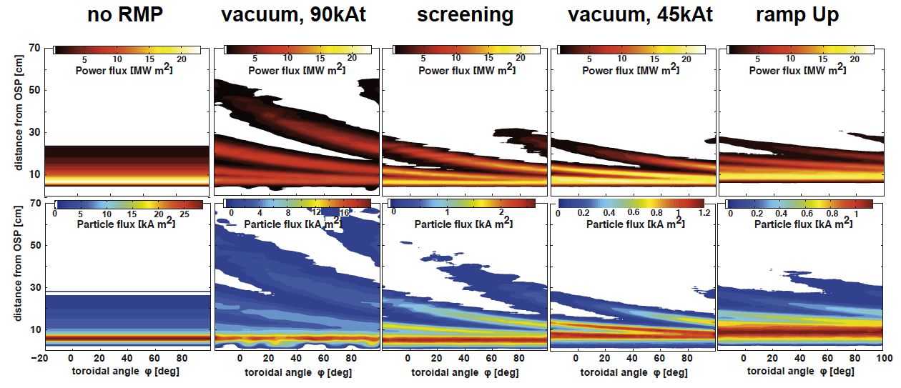
Overall shape of divertor fluxes and magnitudes is controlled by RMP field
O. Schmitz et al., IAEA FEC 2012, San Diego, USA
Implementation of screening and linear reduction of RMP amplitude have similar impact on plasma edge
High q₉₅=4.2 case shows compression of invariant manifolds
29

Slide 39
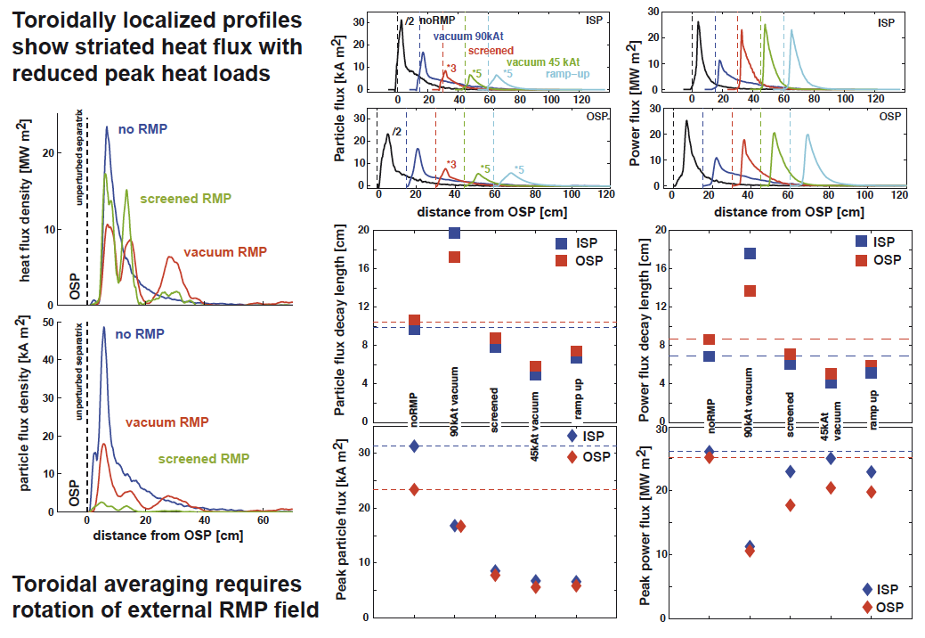
Toroidal average of profiles is comparable for all cases but the high current vacuum case
[O. Schmitz et al., JNM 415 (2011)]
30

Slide 40
Toroidal average of profiles is comparable for all cases but the high current vacuum case
30

Slide 41
Toroidal average of profiles is comparable for all cases but the high current vacuum case
30

Slide 42
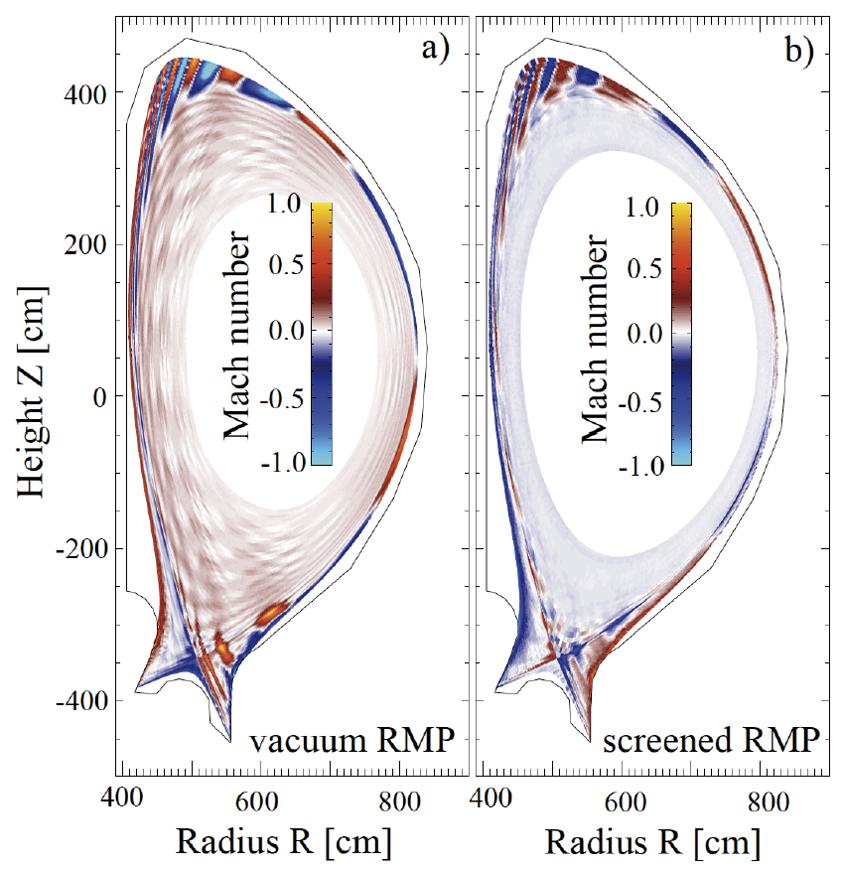


Helical SOL flux bundles establish helical sonic flows with direct impact on particle balance
[O. Schmitz et al., JNM 415 (2011)]
90kAt vacuum case
screened case
Screened case: can be compensated with ITER pellet fueling capability
31

Slide 43
Helical SOL flux bundles establish helical sonic flows with direct impact on particle balance
3D flow channels
Radial outflow with flattening of density profile
Increase pressure in 3D SOL equivalent
Downstream n up
Downstream T down
3D flow channels as candidate for enhanced outward particle flux and reduced fueling
32
[O. Schmitz et al., JNM 415 (2011)]

Slide 44
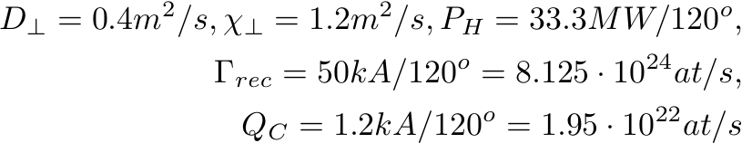
Magnetic fields from M3D-C1 solutions was included and solutions were compared to previous results
M3D-C1 solutions used
Non-linear, one fluid M3D-C1 solution
Vacuum field as used in M3D-C1
equdsk: 4.4keVm, time step 5 was used, ~ 500 τ_{A}
Linear, two fluid M3D-C1 solution
Vacuum field as used in M3D-C1
equdsk: 3.8keVm, time step 1 was used, linear response
EMC3-Eirene boundary conditions
33

Slide 45
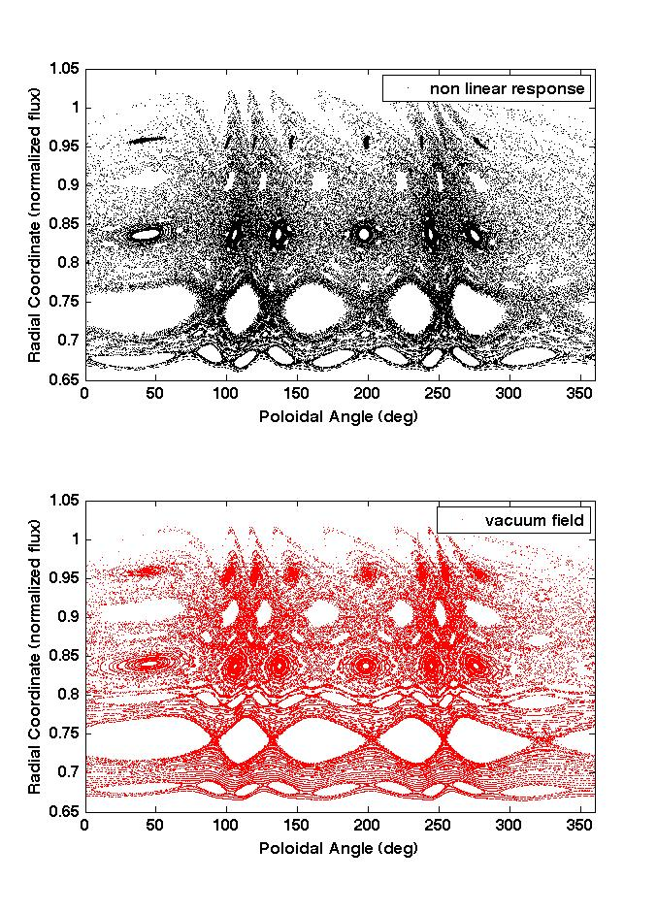
Magnetic topology is vacuum-like for both M3D-C1 cases
Wider extension of helical lobes with stronger deformation
Additional high order mode number resonant components
Stochasticity prevails at 5/3 surface
Only saddle differences between
non-linear response and vacuum field
Outermost island chain present inside helical boundary
Clean 6/3 resonant island
Good flux surfaces in between 5/3 and next inner resonant island chain
34

Slide 46
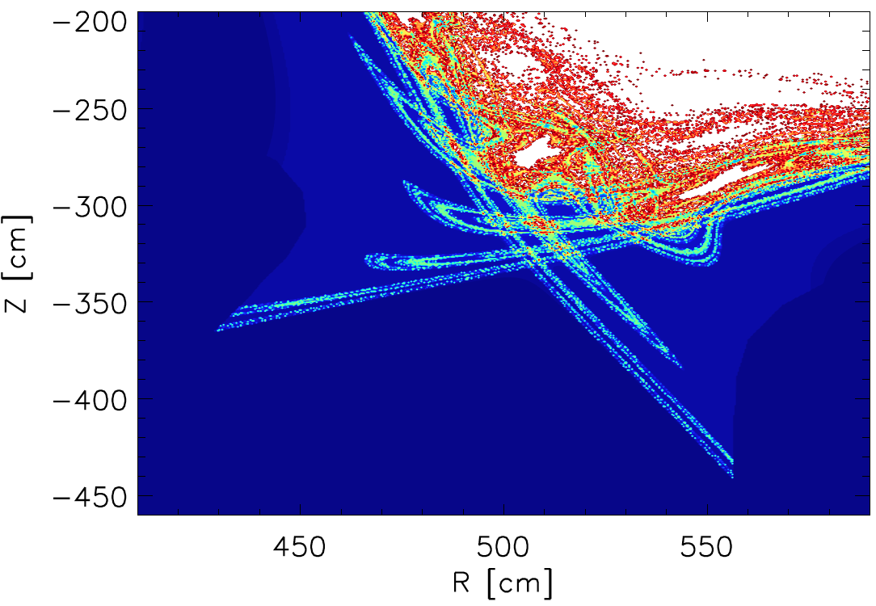
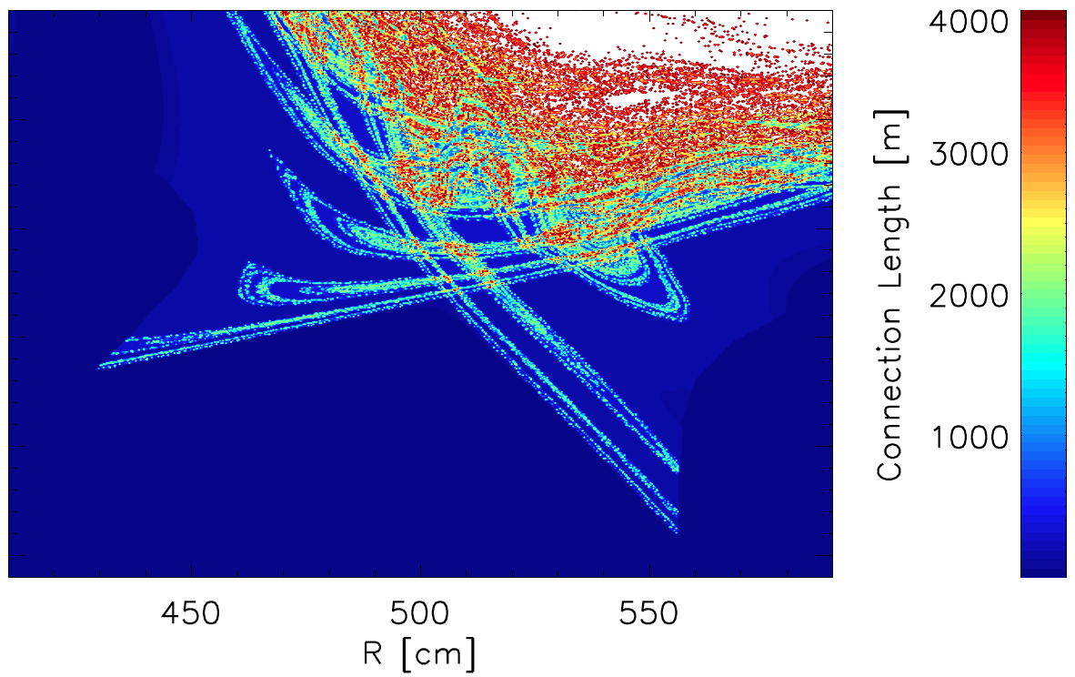
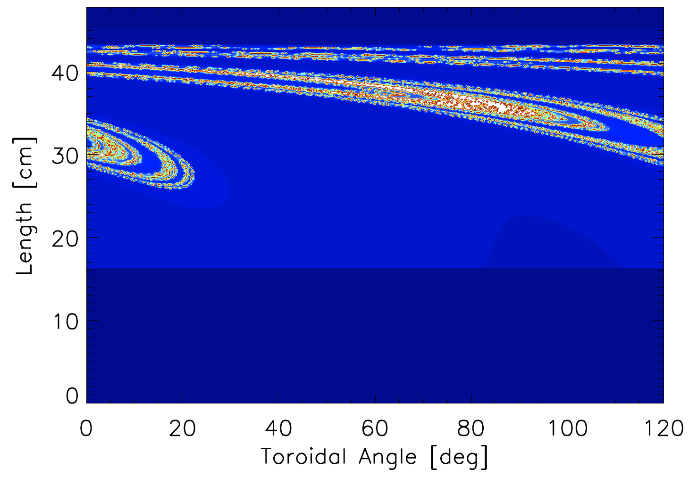
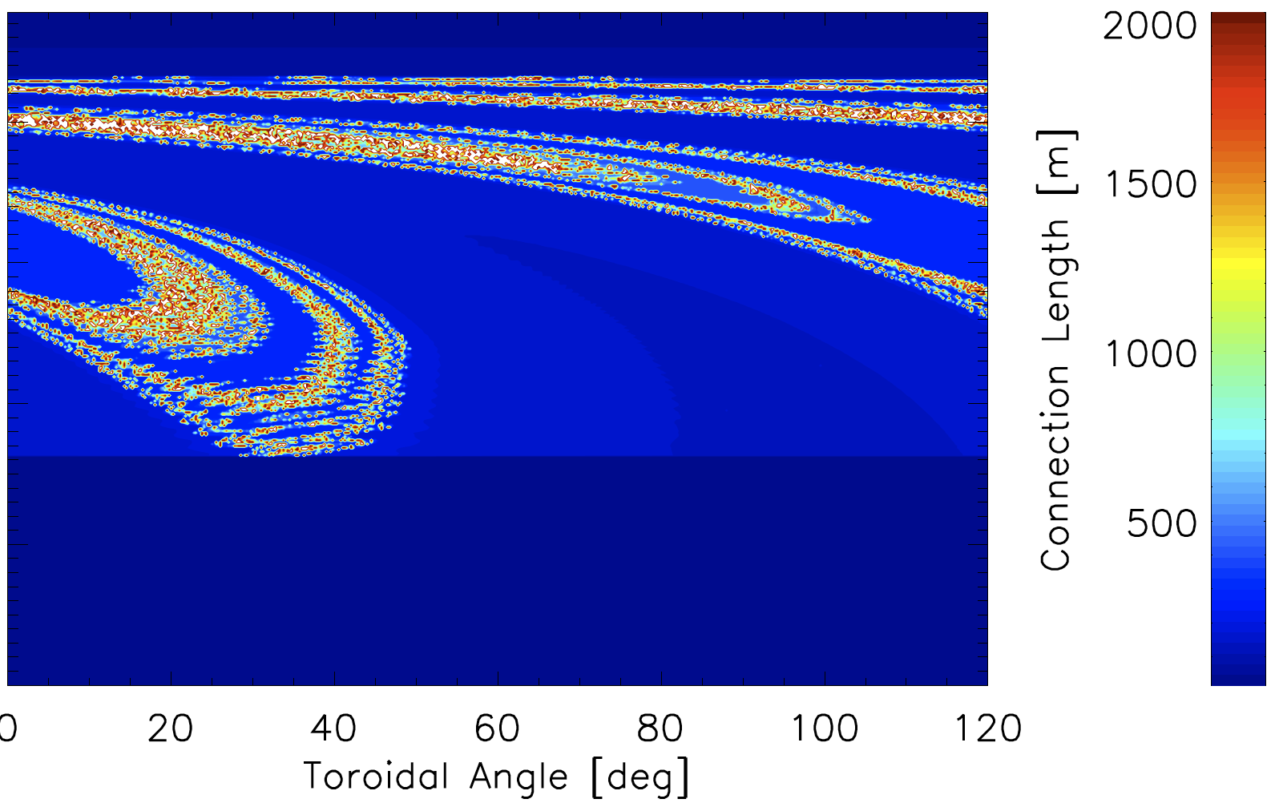
Marginal modification of field line connection length pattern with non-linear response from M3D-C1
Vacuum field as used in M3D-C1
Non-linear response from M3D-C1
35

Slide 47
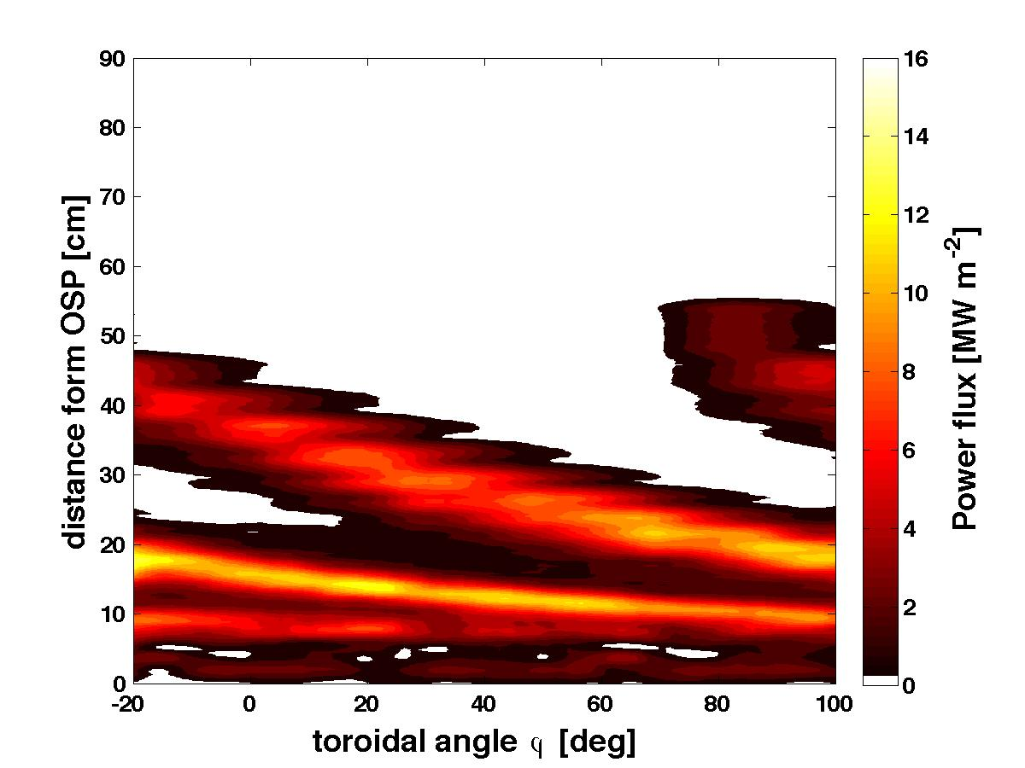
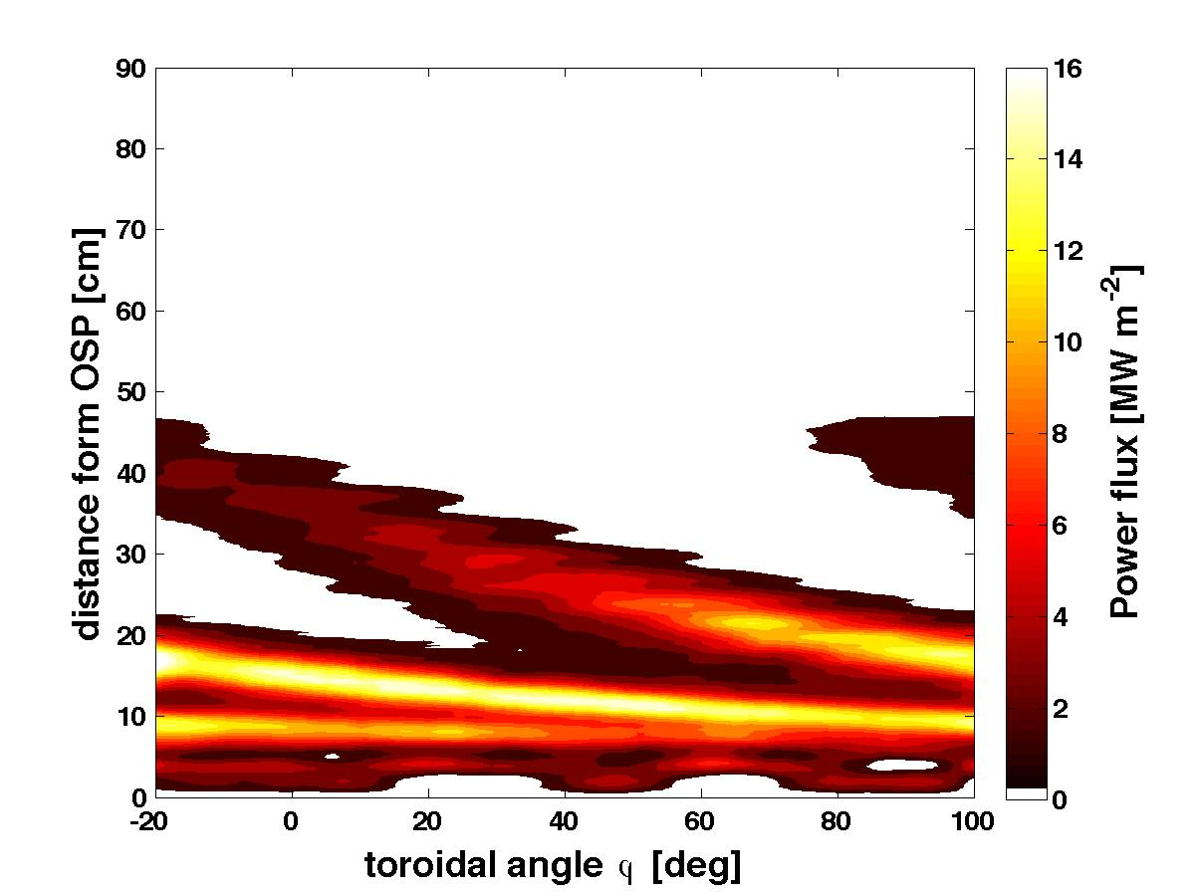
Non-linear response causes only a small shift of heat flux towards outer lobes
Non-linear M3D-C1 response
Vacuum in M3D-C1
Non-linear response yield higher heat outflow into outer tips and 3D SOL domain of perturbed edge layer
Almost no difference in extension and width of heat flux pattern!!
36

Slide 48

Radial profiles show small outward shift of divertor fluxes
37

Slide 49




Enhanced lobe excursion with with linear response from M3D-C1
Vacuum field as used in M3D-C1
Linear response from M3D-C1
ISP
ISP
38

Slide 50

Linear response causes only a shift of heat flux towards outer lobes with some form of flux brodening
Vacuum in M3D-C1
Linear M3D-C1 response
Linear response yield higher heat outflow into outer tips and 3D SOL domain of perturbed edge layer
Small difference only in extension and width of heat flux pattern!!
39

Slide 51

Linear response causes more significant shift of divertor fluxes towards outer lobes
Strong reduction of splitting width is not seen!
40

Slide 52

There is controversy in plasma response modeling results, e.g. plasma response predicted with JOREK is very different
F. Orain et al., SFP 2013, JOREK modeling
22

Slide 53
Executive summary as structure of talk
Three-Dimensional effects are significant in tokamaks during application of resonant magnetic perturbation fields for ELM control
The perturbed separatrix defines 3D edge topology and transport
Connection length in helical scrape off layer governs transport features
Magnetic islands act as radial transport actuator on transport and exhaust
Plasma surface interaction is directly affected by 3D boundary
Plasma response defines extension and actual shape of the 3D boundary
Extrapolation capability of these effects towards ITER is progressing but still controversial

