Slide 1
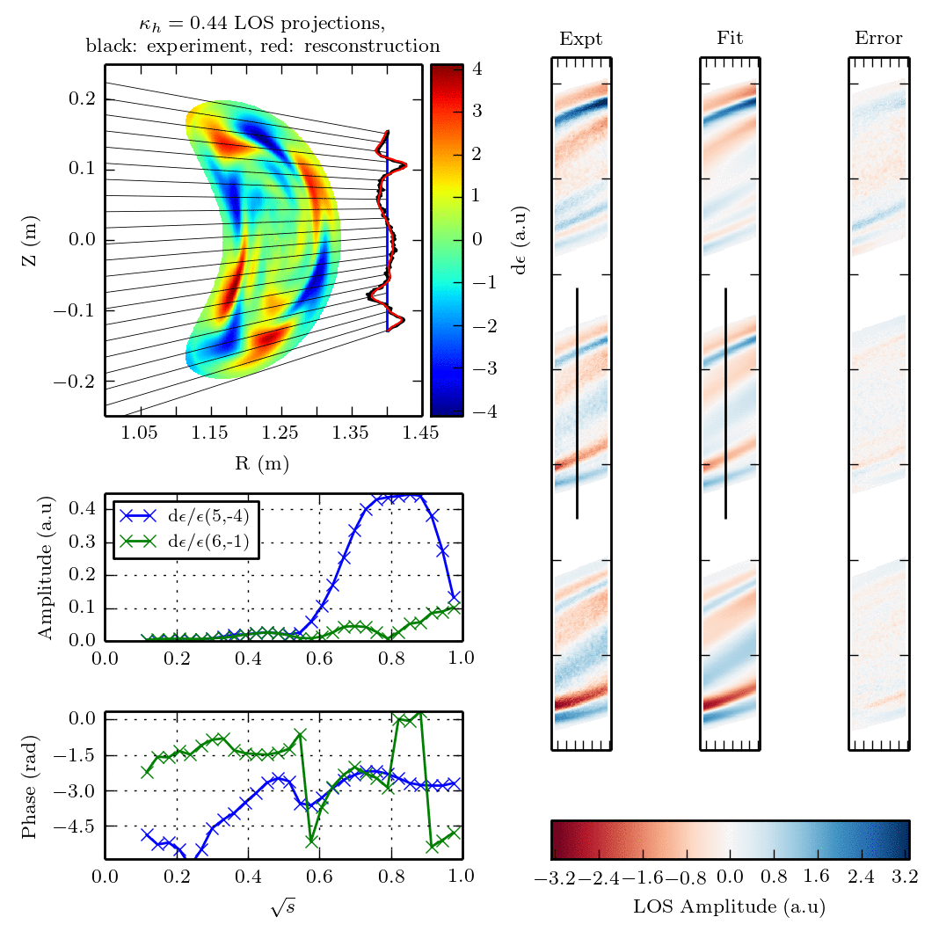
Modelling and measurement of 3D fields in tokamaks and stellarators
Shaun Haskey

Slide 2
3D fields in stellarators: Measuring and analyzing Alfvén waves on the H-1NF stellarator
Part 1
Work with B. Blackwell, J. Howard, D. Pretty, B. Seiwald, M. Hole, N. Thapar, J. Wach
[S. Haskey et al, A multichannel magnetic probe system…, RevSciIns, 2013]
[S. Haskey et al, Clustering of periodic multichannel…, CompPhysComms, 2014]
[S. Haskey et al, Synchronous imaging of coherent …, RevSciIns, 2014]
[S. Haskey et al, Visible light tomography…, accepted for publication, Nuclear Fusion, 2014]

Slide 3
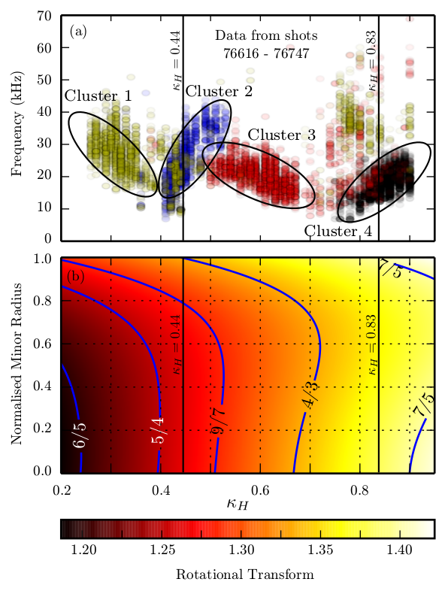
H1-NF is a flexible helical axis stellarator which is well suited to studying parameter dependences of Alfvén waves
Clusters identified using
datamining techniques¹
Frequency (kHz)
Norm radius
3 field period HELIAC, Major radius: 1m, Minor radius: 0.1-0.2m, Magnetic Field: <1T, q: 0.5 -1 (rot transform 1~2), n_{e}: 1-3x10¹⁸ , T_{e}: 20eV, β: 0.01 - 0.1%, ICRH: 4-20MHz, 2x200kW, H/He plasmas
κ_{h} = I_{h}/I_{t}
Rotational Transform
1. [S. Haskey et al, Clustering of periodic …, CompPhysComms, 2014]

Slide 4
Motivation
Spontaneously excited modes are observed on H-1NF
What is the nature of these modes?
What is driving these modes?
We require:
Details of their dispersion relations
i.e ω = v_{A}|n-ιm|/R
Datamining
Toroidal and poloidal mode numbers
Helical Mirnov Array
Radial structure
Synchronous imaging
3D tomography
Allowing for accurate comparisons with theory
(for example normal modes from CAS3D3)
Frequency (kHz)
0.2
0.4
0.6
0.8
κ_{h} = I_{h}/I_{t}

Slide 5
Motivation
Spontaneously excited modes are observed on H-1NF
What is the nature of these modes?
What is driving these modes?
We require:
Details of their dispersion relations
i.e ω = v_{A}|n-ιm|/R
Datamining
Toroidal and poloidal mode numbers
Helical Mirnov Array
Radial structure
Synchronous imaging
3D tomography
Allowing for accurate comparisons with theory
(for example normal modes from CAS3D3)
Frequency (kHz)
0.2
0.4
0.6
0.8
κ_{h} = I_{h}/I_{t}

Slide 6
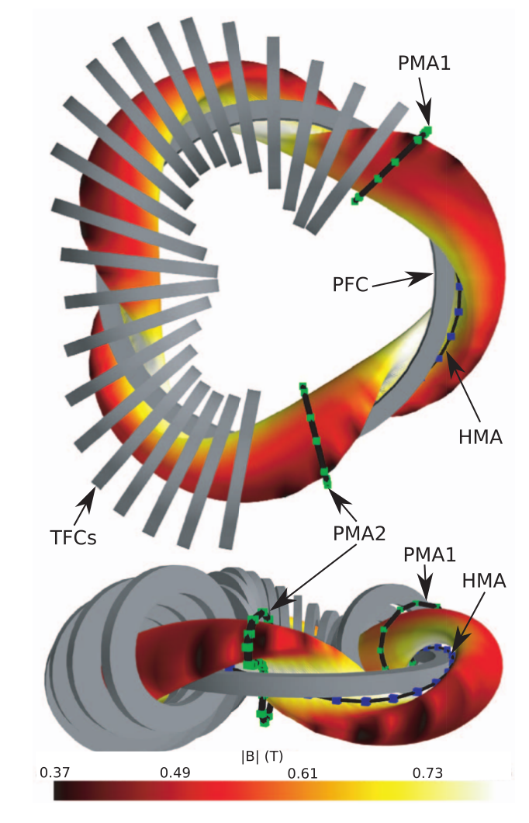
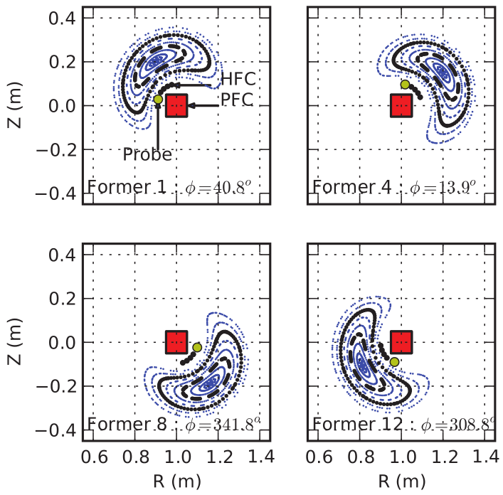
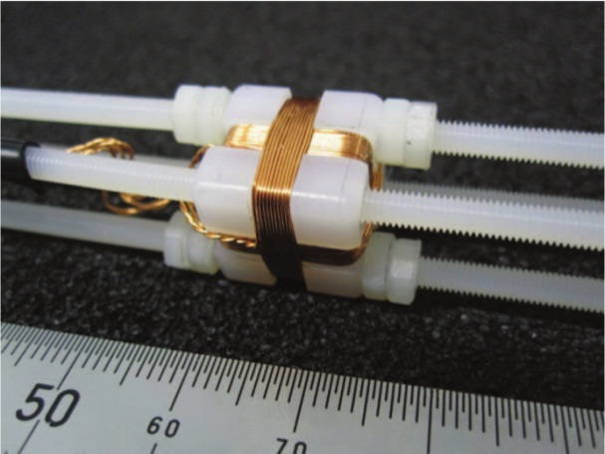
A Helical Mirnov Array¹ (HMA) was installed to improve measurement of 3D magnetic fluctuations
HMA
HMA
48 probe (16 x tri-axis) array compliments two existing poloidal arrays.
Motivation : provide frequency, toroidal and poloidal mode numbers, and polarization
1. [S. Haskey et al, A multichannel magnetic probe …, RevSci, 2013]

Slide 7
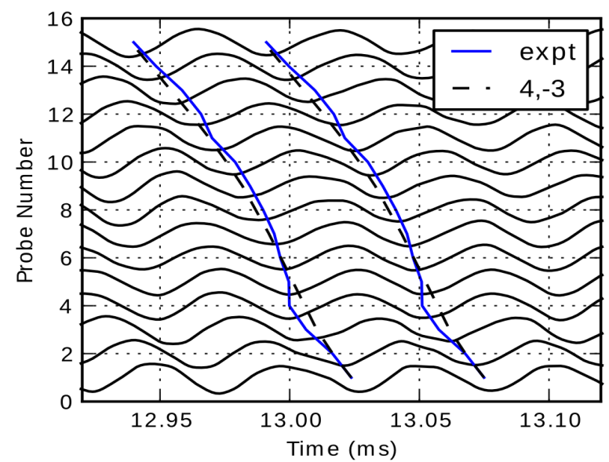
The design of the HMA compliments existing PMAs and allows for unique mode number identification
HMA has more consistent LCFS-probe
distances and stronger signals
HMA has even spacing in Boozer coordinates
(nearest point on LCFS)
PMA2
HMA
PMA1,2
PMA1
HMA
n,m mode number
Consistent signals across the array that are simpler to analyze compared with the PMAs
Band pass filtered HMA signals
1. [S. Haskey et al, A multichannel magnetic probe …, RevSci, 2013]

Slide 8
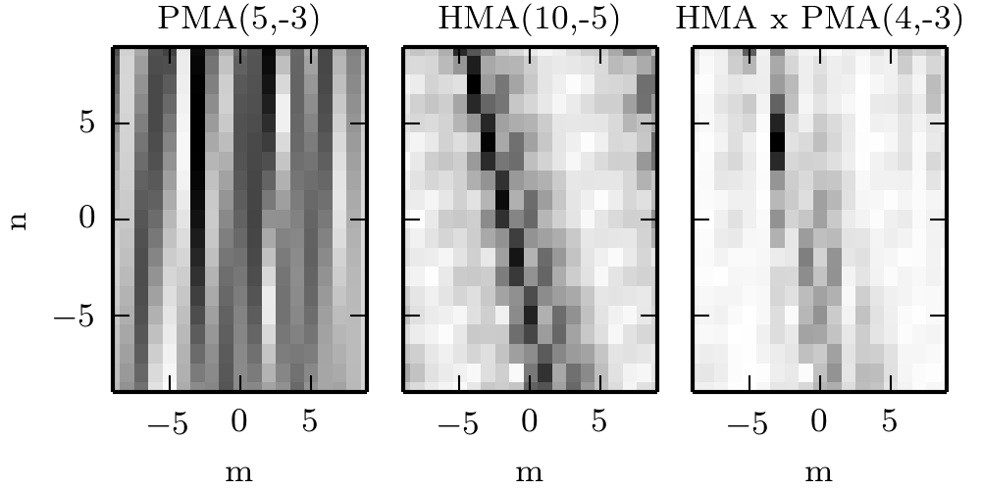
The HMA in combination with a PMA provides accurate toroidal and poloidal mode number identification
The darker, the better the fit
Mode number analysis using the non uniform DFT in two dimensions
This is the result the HMA was designed to provide
[S. Haskey et al, to be submitted]

Slide 9
Motivation
Spontaneously excited modes are observed on H-1NF
What is the nature of these modes?
What is driving these modes?
We require:
Details of their dispersion relations
Datamining
Toroidal and poloidal mode numbers
Helical Mirnov Array
Radial structure
Synchronous imaging
3D tomography
Allowing for accurate comparisons with theory
(for example normal modes from CAS3D3)
Frequency (kHz)
0.2
0.4
0.6
0.8
κ_{h} = I_{h}/I_{t}

Slide 10
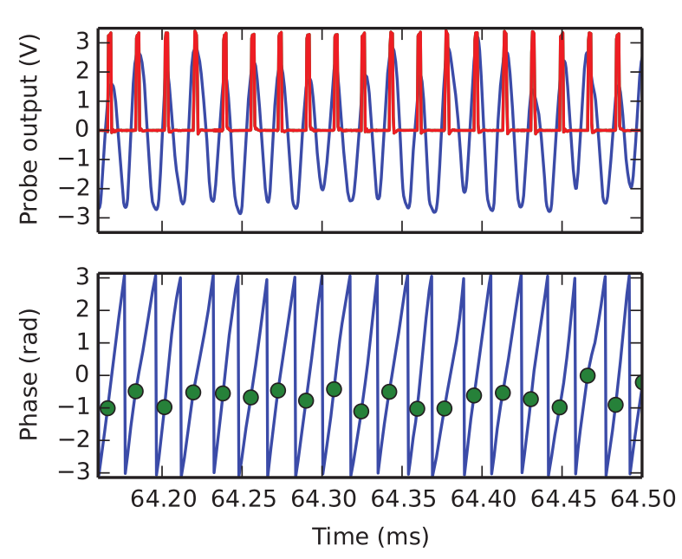
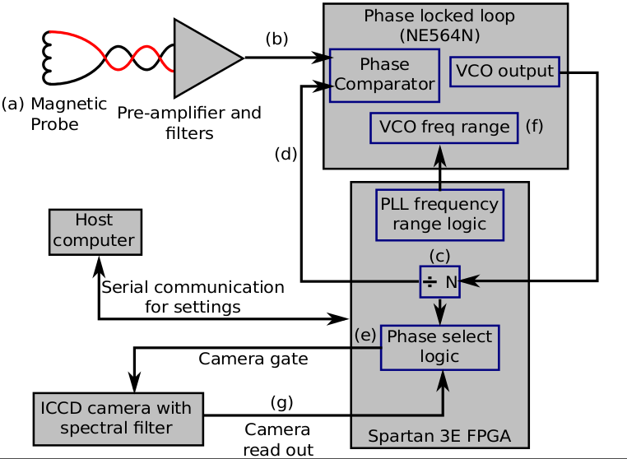
Synchronous imaging¹ of Alfven waves is not frame rate or readout noise limited - can be used to infer the radial structure of waves in the kHz – MHz range
HMA probe reference signal
Mirnov signal and PLL pulses
Camera gate/exposure
Technique benefits
High resolution using ICCD cameras
Can be adapted to Bremsstrahlung or soft x-rays
Many exposures per readout increased SNR (shot noise is less important)
Not frame rate limited
Minimal quantity of data (i.e 16 readouts)
Phase (rad)
Phase (rad)
Before phase lock
1. [S. Haskey et al, Synchronous imaging of coherent…,RevSci, 2014]
Strong coherent reference signal is required
Notes:
- Describes how the technique works, and an example of it working for a high frequency mode

Slide 11
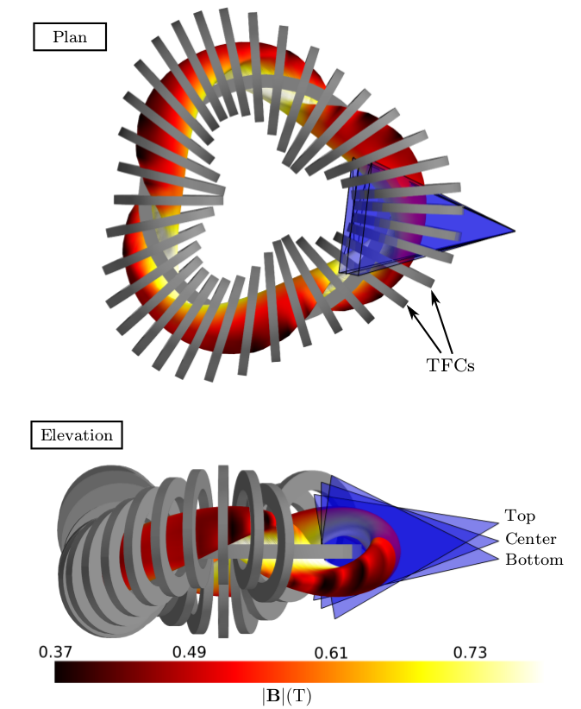
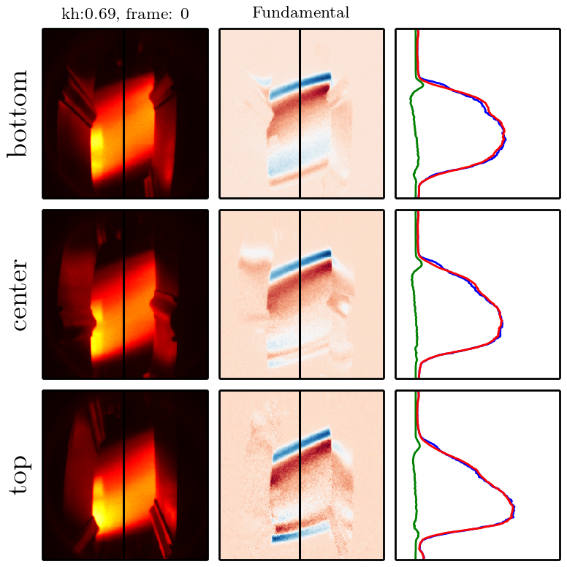
Spectrally filtered synchronous imaging produces high resolution images of emissivity changes due to the waves
Data acquired using 3 views
514nm CII emission is mainly dependent on δne at H-1 Te
HMA probe signal
S. Haskey et al, Synchronous imaging of coherent…,RevSci, 2014
25kHz mode, 16 frames/cycle is the equivalent of 400,000 fps
Notes:
Example of the technique applied to imaging.
Three views,
The mode we are trying to image in the magnetic signal
The data acquired with the imaging technique – DC, AC, slice.

Slide 12
Motivation
Spontaneously excited modes are observed on H-1NF
What is the nature of these modes?
What is driving these modes?
We require:
Details of their dispersion relations
Datamining
Toroidal and poloidal mode numbers
Helical Mirnov Array
Radial structure
Synchronous imaging
3D tomography
Allowing for accurate comparisons with theory
(for example normal modes from CAS3D3)
Frequency (kHz)
0.2
0.4
0.6
0.8
κ_{h} = I_{h}/I_{t}

Slide 13
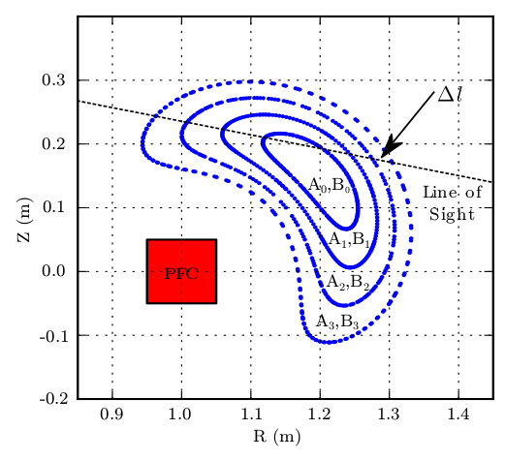
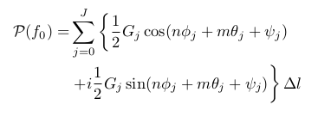
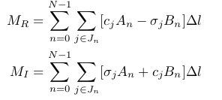
3D (+ time) tomography using Fourier basis modes in magnetic coordinates¹
Mode representation
Discretised LOS measurement
Fourier Transform (wrt time) of P
Includes all three spatial coordinates (+ time)
LOS -> Boozer coordinates
Well suited to unconventional viewing geometries
Can be solved using pseudo inverse, ART, SIRT,..
S is a 70,000 x 60 matrix in our application
1. [S. Haskey et al, Visible light tomography…, accepted for publication, Nuclear Fusion, 2014]

Slide 14
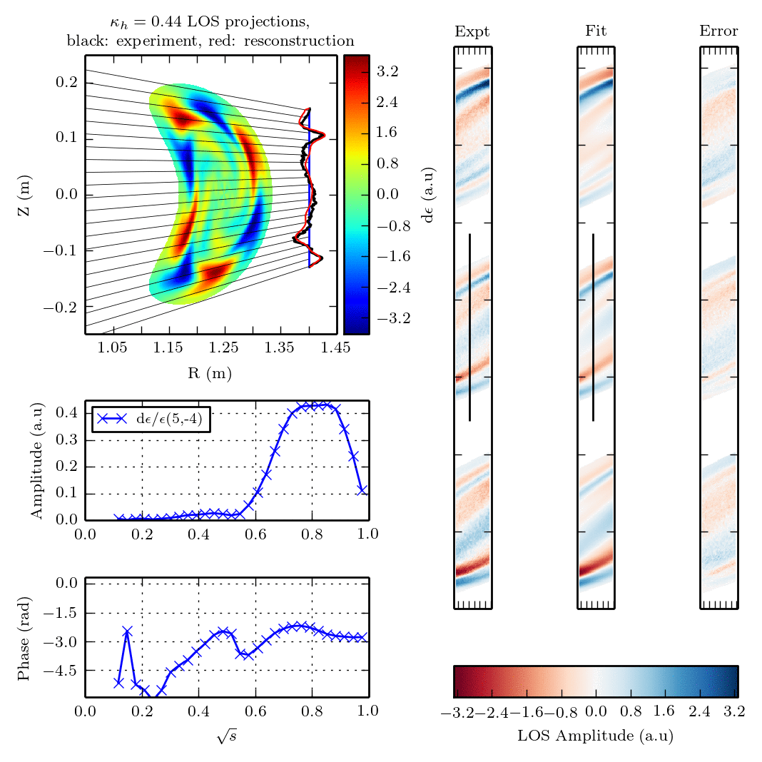
Tomographic reconstruction error can also be used to determine mode numbers
Excellent inversion is obtained with high resolution radial structure using a single Fourier mode in Boozer coordinates with 30 flux regions
Radial Structure
EXPT
FIT
ERROR
3 views, 35,000 lines of sight
Amplitude
dε/ε (5,−4)
Phase
[S. Haskey et al, Visible light tomography…, accepted for publication, Nuclear Fusion, 2014]
Notes:
Same as the last slide, however, now back in the time domain.
Gives a better understanding of what is going on.
Describe each of the sub figures

Slide 15
Inversion is improved using 2 basis modes
Radial Structure
EXPT
FIT
ERROR
Structure of dominant basis mode is unchanged
Which 2nd basis mode to choose? Probably not worth including without good a priori reasons (i.e HAE).
Single dominant mode number : GAE, BAE?
3 views, 35,000 lines of sight
Amplitude
This provides the radial mode structure which was the main goal of the synchronous imaging and tomography
Phase
[S. Haskey et al, Visible light tomography…, accepted for publication, Nuclear Fusion, 2014]
Notes:
Same as the last slide, however, now back in the time domain.
Gives a better understanding of what is going on.
Describe each of the sub figures

Slide 16
Motivation
Spontaneously excited modes are observed on H-1NF
What is the nature of these modes?
What is driving these modes?
We require:
Details of their dispersion relations
Datamining
Toroidal and poloidal mode numbers
Helical Mirnov Array
Radial structure
Synchronous imaging
3D tomography
Allowing for accurate comparisons with theory
(for example normal modes from CAS3D3)
Frequency (kHz)
0.2
0.4
0.6
0.8
κ_{h} = I_{h}/I_{t}
Rotational Transform

Slide 17
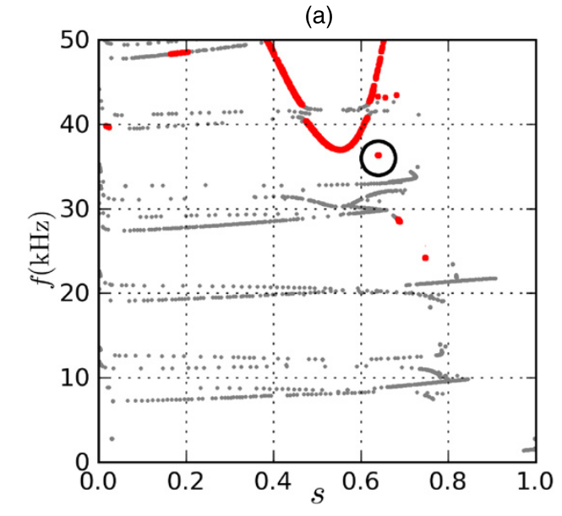
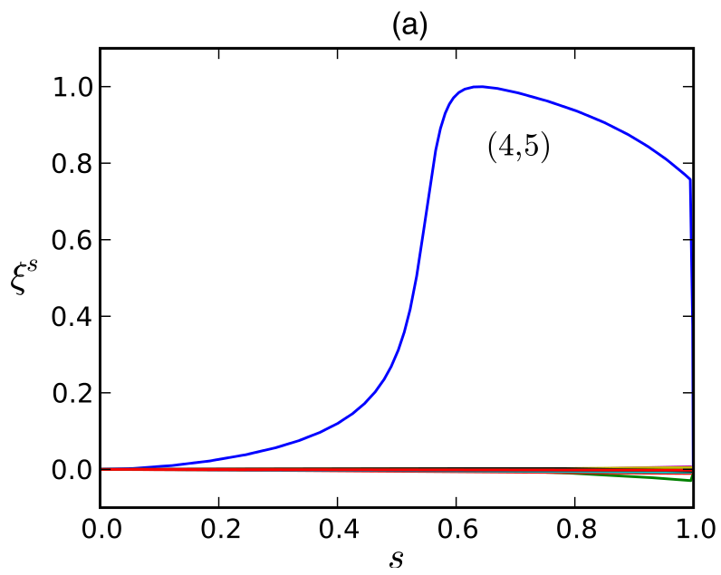
Current work : Comparison with mode structures from CAS3D3
Frequencies of these modes suggest they may be BAEs or BAAEs (Beta Alfvén-Acoustic Eigenmode)
CONTI (continua only)
CAS3D3
CAS3D3
5,-4
Red: shear Alfvén branch based on polarisation classification
Continua and eigenvector images from Bertram et al, PPCF, 2012

Slide 18
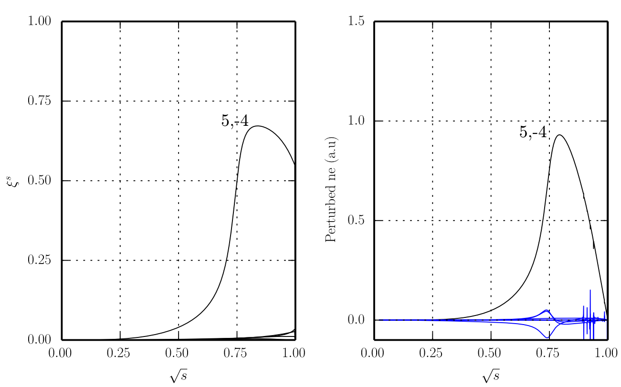
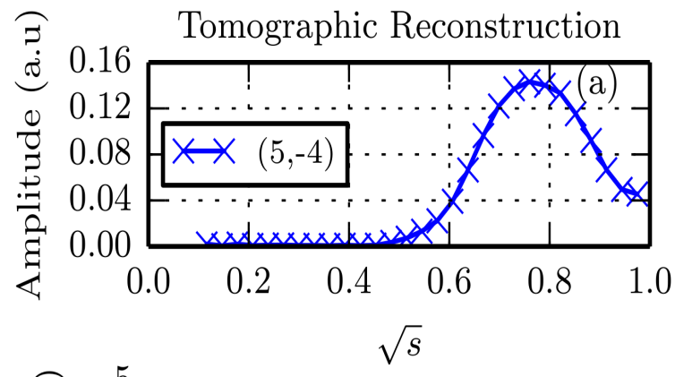
Current work : Comparison with mode structures from CAS3D3
Normal displacement (CAS3D3)
δne (CAS3D3)
Using δne and δTe from CAS3D3 the next step is to forward model the CII 514nm emissivity to compare with the tomographic inversions
Now that we have a suitable mode from CAS3D3, we can calculate drive with CAS3DK – What is driving these modes?
dε/ε
Amplitude

Slide 19
Summary
3D fields in stellarators: Measuring and analyzing Alfvén waves on the H-1NF stellarator
A new Mirnov array, datamining techniques, synchronous imaging and 3D tomography have provided mode numbers, radial mode structure and dispersion relation information for spontaneously excited modes on H-1
Comparisons with theory have been extended and look promising - (BAE/BAAE) type modes?
The next question : What is driving these modes?

Slide 20
3D fields in tokamaks: Tailoring the plasma response using 3D fields (RMPs) (Single fluid linear MHD analysis of RMPs on DIII-D using MARS-F)
Part 2
Work with M. Lanctot (GA) and Y. Liu (CCFE)
[Haskey et al, Linear ideal MHD predictions…, PPCF, 2014]
[Lanctot et al, Sustained suppression…, Nuclear Fusion, 2013 ]
[Haskey et al, Effects of resistivity and rotation…, Currently under DIII-D internal review, 2014]

Slide 21
Motivation
ELM suppression depends on the applied field structure. Is ELM suppression correlated with pitch-resonant fields, kink-resonant fields (RFA), or a combination?
n=2 ELM suppression window on DIII-D¹
RFA
How does upper-lower array phasing modify the applied fields structure?
What effect do β_{N} and q₉₅ have on the plasma response?
What effect does upper-lower I-coil phasing have on the plasma response + experimental comparison?
Res
+180
+90
-90
-180
m=-11 related to RFA, m=-8 is pitch resonant
1. [M. Lanctot et al, NF, 2013]

Slide 22
Motivation
ELM suppression depends on the applied field structure. Is ELM suppression correlated with pitch-resonant fields, kink-resonant fields (RFA), or a combination?
n=2 ELM suppression window on DIII-D¹
RFA
How does upper-lower array phasing modify the applied fields structure?
What effect do β_{N} and q₉₅ have on the plasma response?
What effect does upper-lower I-coil phasing have on the plasma response + experimental comparison?
Res
+180
+90
-90
-180
m=-11 related to RFA, m=-8 is pitch resonant
1. [M. Lanctot et al, NF, 2013]

Slide 23
The applied field structure can be varied considerably using the internal coils (I-coils) on DIII-D
Can apply dominant toroidal mode numbers n = 1,2 or 3
Phasing between upper and lower arrays modifies the applied field spectrum
MARS-F does not include the full geometry of the I-coils. The MARS-F applied fields have a single n (limiting case of many separate coils).

Slide 24
Clear RFA plasma response for even parity n=2
0⁰ Phasing
Equilibrium is from
shot 146382 @ 3200ms
H-mode LSN,
ITER similar shape
q₉₅ = 4.0, β_{N} = 1.87
Total δBn
Vac δBn
Plas δBn
The MARS-F code¹ is used to solve the linearized single fluid MHD equations to find the plasma response to these perturbations
n=2
Upper: | 0 | | 1/2 | | -1/2 | | 0 | | 1/2 | | -1/2 |
----------------------------------------------------------->phi
Lower: | 0 | | 1/2 | | -1/2 | | 0 | | 1/2 | | -1/2 |
1. [Liu et al., Phys. Plasmas 2000]

Slide 25
Weak RFA plasma response for odd parity n=2
180⁰ Phasing
Total δBn
Vac δBn
Plas δBn
The MARS-F code¹ is used to solve the linearized single fluid MHD equations to find the plasma response to these perturbations
n=2
Upper: | 0 | | 1/2 | | -1/2 | | 0 | | 1/2 | | -1/2 |
-------------------------------------------------->phi
Lower: | 0 | | -1/2| | +1/2| | 0 | | -1/2| | +1/2|
1. [Liu et al., Phys. Plasmas 2000]

Slide 26
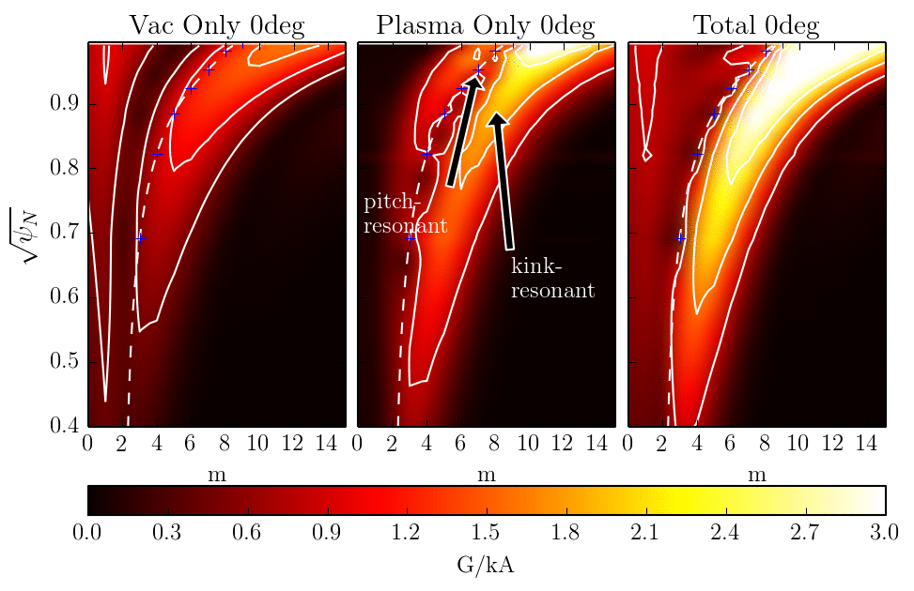
The plasma response can be tailored by varying the applied field structure
kink
The pitch-resonant and kink-resonant responses as we
vary plasma parameters and the applied field structure?
[Haskey et al, Linear ideal MHD predictions…, PPCF, 2014]

Slide 27
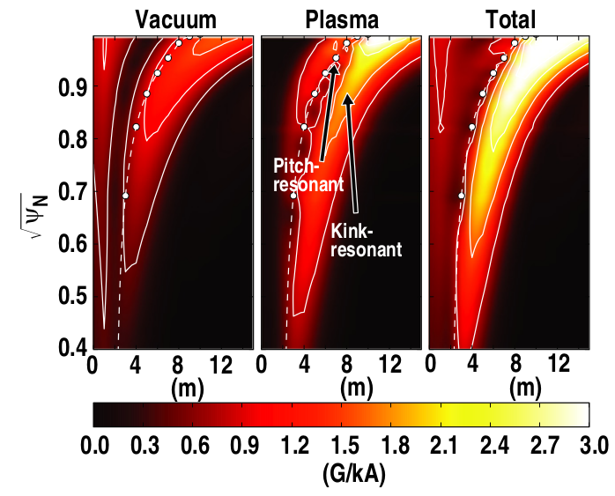
The plasma response is described using a pitch resonant metric and a RFA metric
Pitch resonant : Screening Response Metric
Islands, stochastic regions, braking torque,
ELM suppression?
RFA metric
Disruptions, braking torque (NTV), ELM suppression?
[Haskey et al, Linear ideal MHD predictions…, PPCF, 2014]

Slide 28
Motivation
ELM suppression depends on the applied field structure. Is ELM suppression correlated with pitch-resonant fields, kink-resonant fields (RFA), or a combination?
n=2 ELM suppression window on DIII-D¹
RFA
How does upper-lower array phasing modify the applied fields structure?
What effect do β_{N} and q₉₅ have on the plasma response?
What effect does upper-lower I-coil phasing have on the plasma response + experimental comparison?
Res
+180
+90
-90
-180
m=-11 related to RFA, m=-8 is pitch resonant
1. [M. Lanctot et al, NF, 2013]

Slide 29
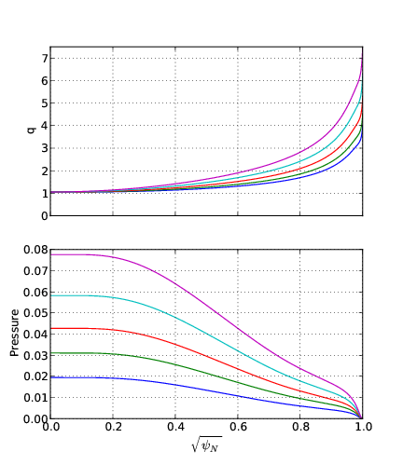
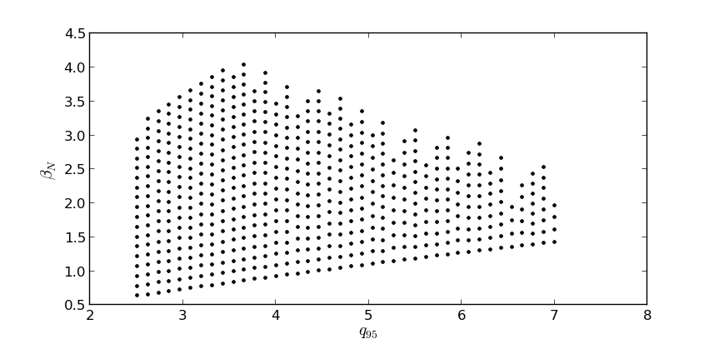
Multi-step workflow developed to obtain reliable MARS-F results over wide parameter range
Shot 146382 @ 3200ms
ITER similar shape
q₉₅ = 4.0, β_{N} = 1.87
Scaled q profiles
CORSICA
DCON
CHEASE
Scaled
pressure profiles
β_{N}
MARS-F
+
Post processing
δB_{RFA}
q₉₅
β_{N}
q₉₅
[Haskey et al, Linear ideal MHD predictions…, PPCF, 2014]

Slide 30
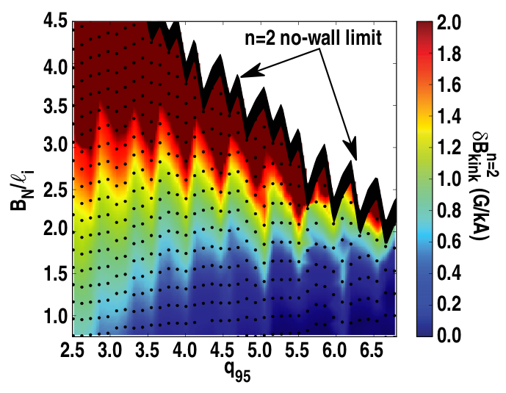
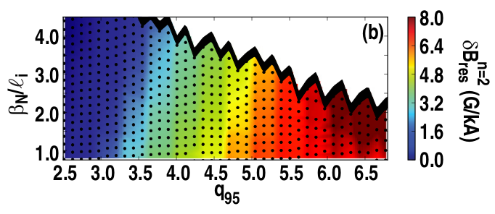
Effects of safety factor, plasma pressure have on the ideal single fluid linear plasma response
RFA, even parity phasing
RFA increases with β_{N}
Minimal dependence on q₉₅
Periodic maxima, low-n peeling mode?
Vac pitch-res, even parity phasing
Weak β_{N} dependence (Shafranov shift)
Strong dependence on q₉₅
[Haskey et al, Linear ideal MHD predictions…, PPCF, 2014]

Slide 31
Motivation
ELM suppression depends on the applied field structure. Is ELM suppression correlated with pitch-resonant fields, kink-resonant fields (RFA), or a combination?
n=2 ELM suppression window on DIII-D¹
RFA
How does upper-lower array phasing modify the applied fields structure?
What effect do β_{N} and q₉₅ have on the plasma response?
What effect does upper-lower I-coil phasing have on the plasma response + experimental comparison?
Res
+180
+90
-90
-180
m=-11 related to RFA, m=-8 is pitch resonant
1. [M. Lanctot et al, NF, 2013]

Slide 32
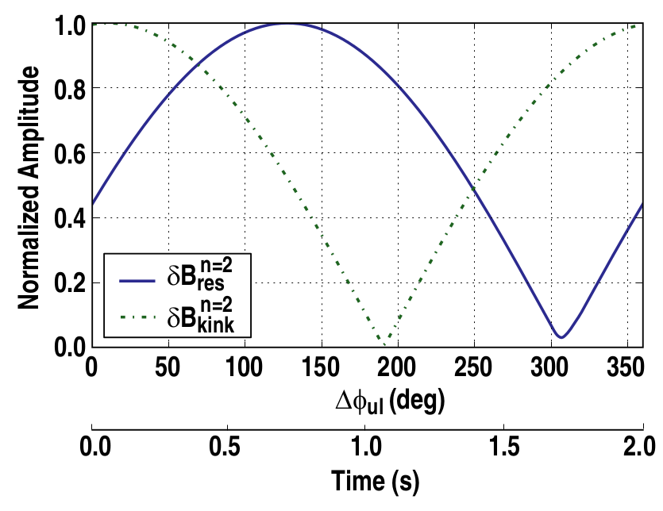
The applied field structure is a dominant driver of the ideal single fluid linear plasma response
Low-n peeling mode?
Related to narrow
ELM suppression windows?
RFA
A similar experiment is being tried this week at DIII-D
ELM suppression
The control we have over this dominant parameter depends on flexible RMP coil sets
Only pitch res
Only RFA
Vac Pitch-res
ELM suppression
It is possible to apply one dominant type of field
Phasings that maximise each response change with q95
[Haskey et al, Linear ideal MHD predictions…, PPCF, 2014]

Slide 33
Motivation
ELM suppression depends on the applied field structure. Is ELM suppression correlated with pitch-resonant fields, kink-resonant fields (RFA), or a combination?
n=2 ELM suppression window on DIII-D¹
RFA
How does upper-lower array phasing modify the applied fields structure?
What effect do β_{N} and q₉₅ have on the plasma response?
What effect does upper-lower I-coil phasing have on the plasma response + experimental comparison?
Res
+180
+90
-90
-180
m=-11 related to RFA, m=-8 is pitch resonant
1. [M. Lanctot et al, NF, 2013]

Slide 34
Summary
3D fields in stellarators: Measuring and analyzing Alfvén waves on the H-1NF stellarator
A new Mirnov array, datamining techniques, synchronous imaging and 3D tomography have provided mode numbers, radial mode structure and dispersion relation information for spontaneously excited modes on H-1.
Comparisons with theory have been extended and look promising - (BAE/BAAE) type modes?
What is driving these modes?
3D fields in tokamaks: Tailoring the plasma response using 3D fields (RMPs)
Applied field structure is a dominant determinant in the plasma response. Need flexible RMP coil sets to take advantage of this.
Max/min pitch-res/RFA responses are dependent on q₉₅ and upper-lower array phasing – be careful if q₉₅ is different!
n=2 ELM suppression windows on DIII-D are correlated with the strongest RFA, and medium pitch-res applied field structures.
It is possible to apply one type of field – good for experiments to find out what is going on.
Future work - include resistivity and rotation and further experimental comparisons.

Slide 35
Backup Rot/Res n2

Slide 36
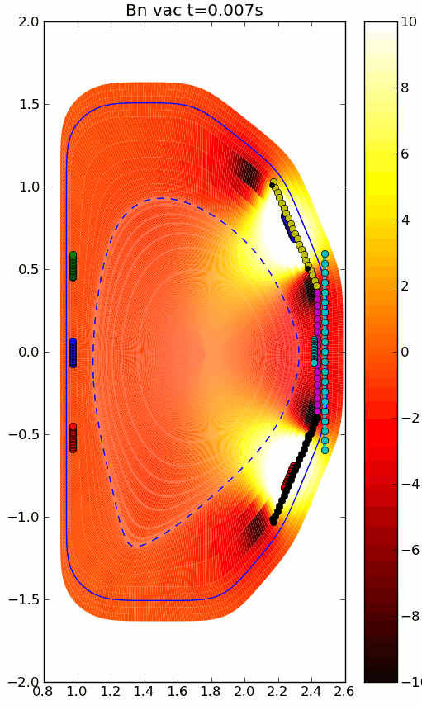
Fourier decomposition into PEST coordinates provides a more straightforward identification of plasma response components
δB_{N}(r,z,t)
δB_{N(n,m)}(Ψ)
m=nq

Slide 37
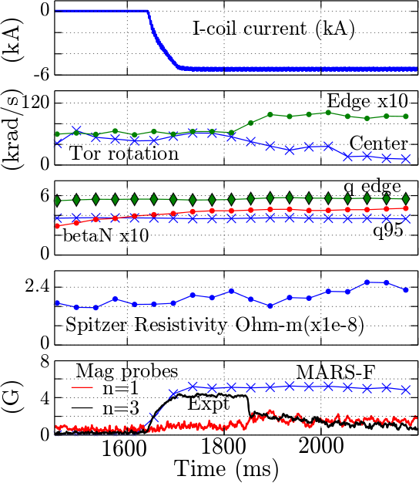
Experimental comparison (n=3 L-mode LSN DIII-D #142614)
Good agreement, but drop in magnetic probe not reproduced
Good agreement with magnetic probe array data from 1600ms-1800ms
From 1830ms, central toroidal rotation decreases and edge rotation increases
n=3 magnetic probe output drops significantly in a short time – this is not captured in the MARS-F modelling
n=1 is as large as n=3 -> non-linear effects?
Need to include two fluid, non linear, or kinetic effects to capture what is occurring at 1830ms
MARS-F, expt comparison
Shot is originally described in [Schmitz et al, Nuclear Fusion, 2014]

Slide 38
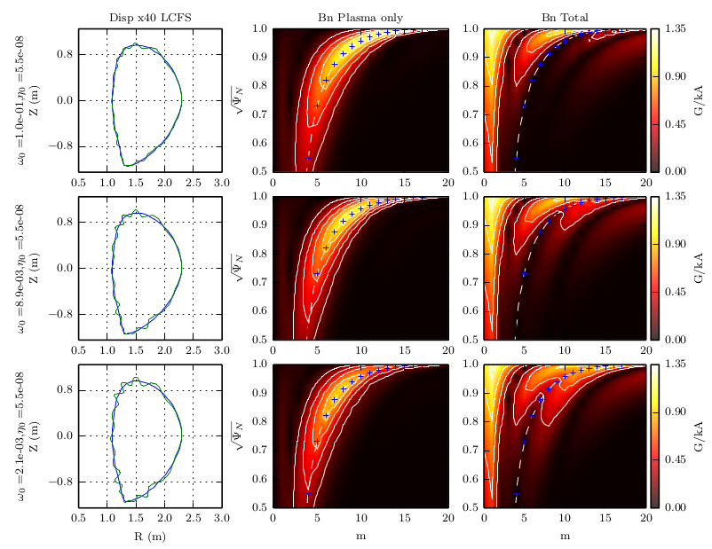
Current work : Effects of toroidal rotation on the plasma response
Displacement
Plas only
Plas + vac
Decreasing
Toroidal
Rotation
Reduced
Screening
Field penetrates further
Increased
Displacement

Slide 39
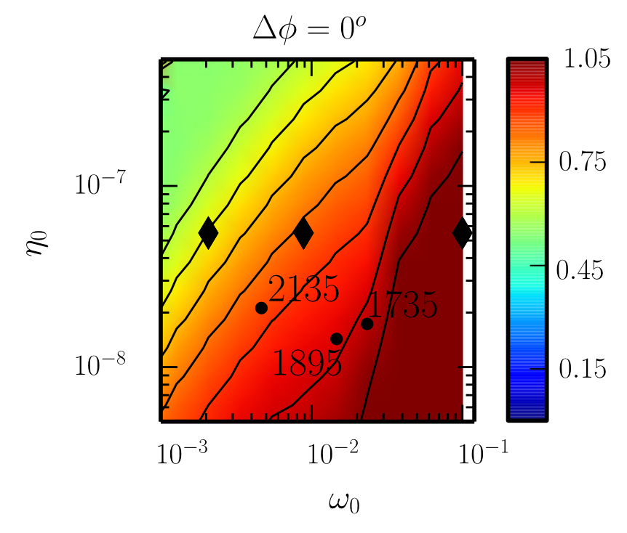
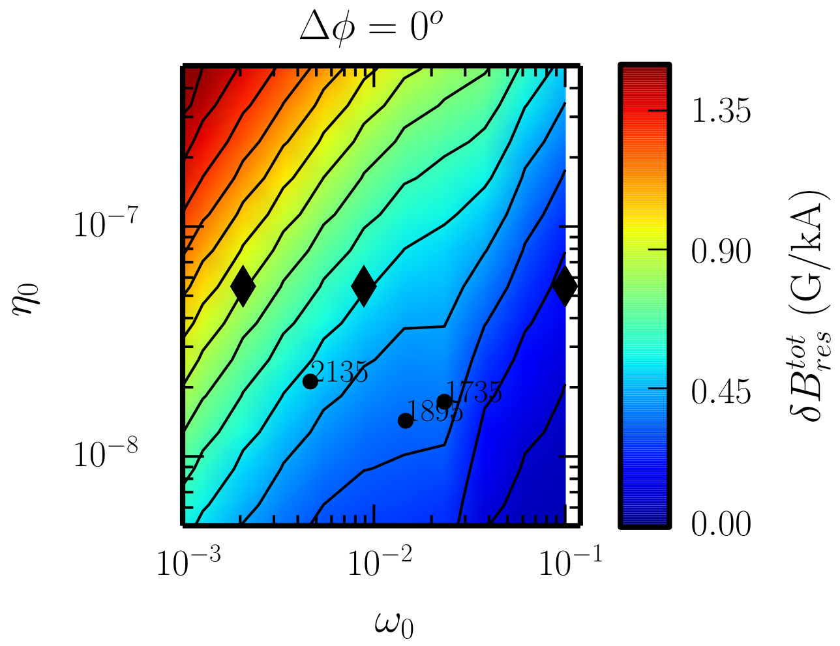
Further investigation using parameter scans show a transition from ideal to a resistive-inertial type plasma response
Poloidal Probe output
Residual pitch-resonant field
Resistive response
(1/S)
(1/S)
(1/S)
G/kA
ω/ω_{a}
ω/ω_{a}
Ideal-like response
Large toroidal rotation can offset the effects of plasma resistivity on plasma screening.
There are no ‘sudden’ magnetic probe drops like those seen in shot #142614.
Magnetic probe output depends mainly on plasma screening in L-mode.

Slide 40
The effect of applied field structure (upper-lower I-coil phasing) is large
Residual pitch-resonant field
(1/S)
90deg and 270deg n=3 are not accessible with the current I-coils.
270deg provides the strongest residual resonant field
Upgrade from 2x6 to 2x12?
(1/S)
ω/ω_{a}
ω/ω_{a}

Slide 41
Backup HMA

Slide 42
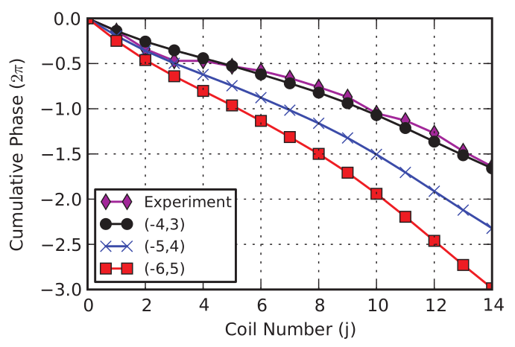
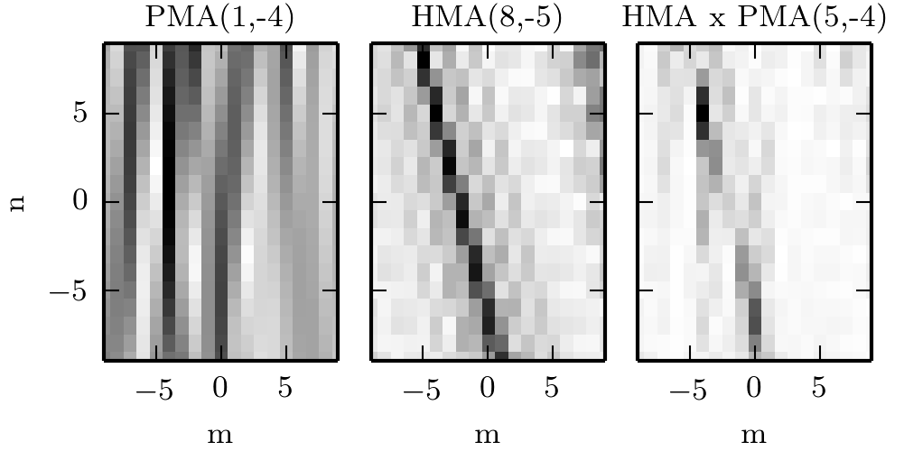

Slide 43
Polarisation of the cluster change considerably with frequency and κ_{h}
δB_{perp}
The “polarisation” as measured by the unshielded coil shows variation with frequency and κ_{h}, with the parallel component increasing with lower frequency
δB||
δB_{perp}
κ_{h} space

Slide 44
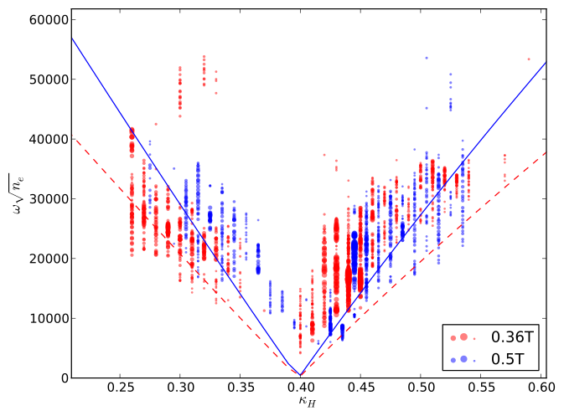
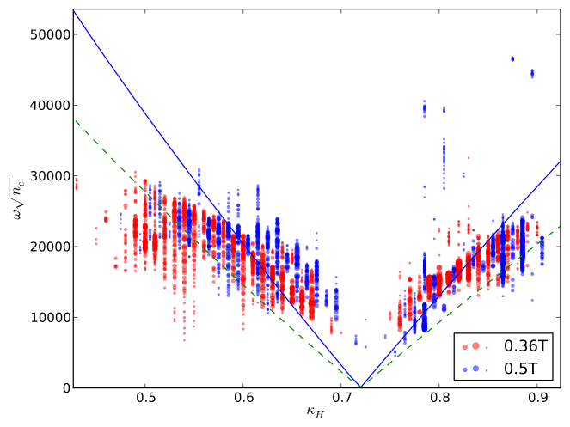
Magnetic field strength dependence is stronger when the resonant surface is still in the plasma
Variation with field strength is suggestive of dependence on the low κ_{H} side (NGAE side) but less dependence on high κ_{H} side (GAE side)
κ_{H}
κ_{H}

Slide 45
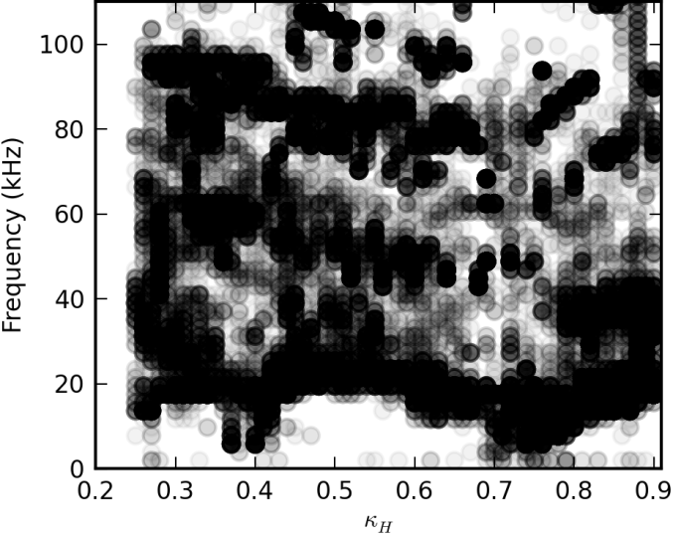
Datamining techniques¹ provide insight into large databases of timeseries signals (i.e Mirnov arrays)
No a-priori mode ‘structure’ required – good for stellarators where the mode structure is difficult to calculate (complex 3D fields and probe locations)
Clustered using 15 dimensional
data from the HMA
40,000 interesting datapoints
130 shot
parameter scan
Datamining/clustering is about knowledge discovery in (large) high dimensional datasets
Each cluster is a ‘class’ of fluctuation with different spatial structure
1. [S. Haskey et al, Computer Physics Communications, 2014]

Slide 46
Backup Synch

Slide 47
Backup Tomo

Slide 48
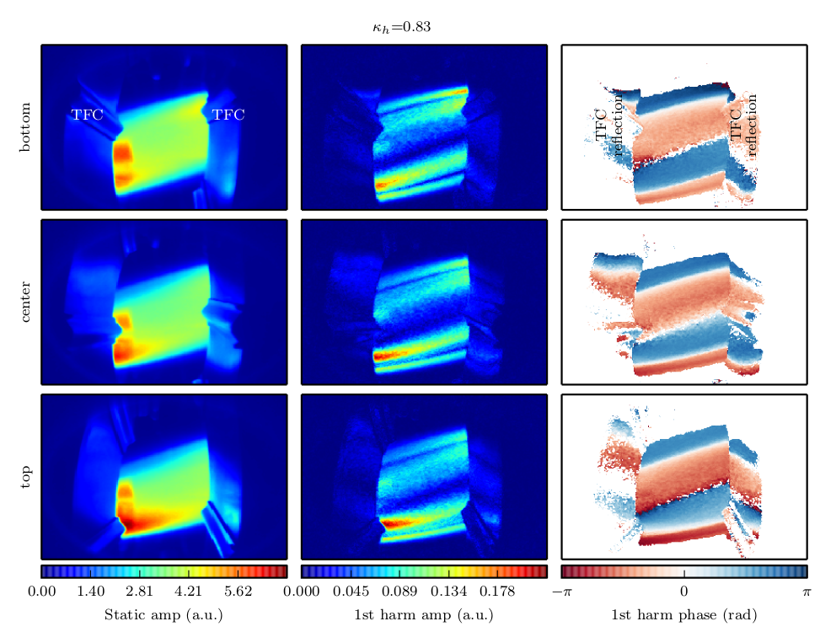
The 16 images are decomposed into a Fourier series in time in preparation for tomographic inversion
BOTTOM
CENTER
TOP
DC
|FUNDAMENTAL|
Arg(FUNDAMENTAL)
Several modes have been imaged using 514nm CII emissions from 3 views to provide the input data for the tomographic inversions
Notes:
We can can convert the series of images into a fourier series with DC, 1st harmonic, 2nd harmonic etc…
1st harmonic is f0, and each pixel has an amplitude and phase (or real and imaginary part)
2nd harmonic would contain 2f0 etc…, based on mag signal don’t expect it to be very large
This is the data that is used in the tomographic reconstructions
The views are not hugely different, but unfortunately restricted by port window

Slide 49
Overview of modelling and validation of RMPs using the single fluid linearised MHD code MARS-F
RMP uses: ELM suppression, rotation, RWM control, etc…
Optimal use/design requires: accurate models, experiment model validation, ability to predict the regions of parameter space with the desired plasma response (i.e ELM suppression)
Single fluid linearised MHD
Parameter scans
-Applied structure
-Plasma pressure
-Safety factor profile
-Toroidal rotation
-Resistivity
Region of
validity
RMP coil design
Experiment design
MARS-F¹
Plasma Response
Experimental
Comparison
1. [Liu et al., Phys. Plasmas 2000]

Slide 50
Advances in measuring and analyzing Alfvén waves
Measurements
Analysis
Helical Mirnov Array
dB/dt, polarisation, growth rates, mode #s
Datamining
-Dispersion info
Improved
Understanding
Comparison
with theory
Waves
21 ch n_{e} interferometer
Synchronous Imaging
-Many LOS meas
-n_{e} and T_{e} (spectral meas)
3D Tomography
-Radial structure
-Mode numbers
Improved understanding of Alfven waves is important due to interactions with fast particles (i.e α particles). Advances in measurement and analysis techniques are critical to achieving this.

