Slide 1
MP 2015-05-23-001: Isolation of NTV torque profile: Dependence on plasma collisionality and NTV offset rotation – BRIEF summary
S.A. Sabbagh¹, Y.-S. Park¹, Y. Jeon², Y.S. Bae², J.G. Bak², J. Chung², S.H. Hahn², H. Han², Y. In², J.H. Kim², J.Y. Kim², J. Ko², W. Ko², J.G. Kwak², J. Lee², Y.K. Oh², H.K. Park³, K.C. Shaing⁴, H.L. Yang², S.W. Yoon², G. Yun³
¹Department of Applied Physics, Columbia University, New York, NY, USA
²National Fusion Research Institute, Daejeon, Korea
³UNIST, Ulsan, Korea
⁴National Cheng Kung University, Tainan, Taiwan
presented at the
NSTX-U Physics Meeting
PPPL
October 6th, 2015
Princeton, NJ
Special thanks!
(those marked in red)
V1.0

Slide 2
MP2014-05-02-007 aims to compute NTV profile accurately using IPS, also ν dependence, and offset
Motivation
  For the first time on KSTAR, the new IPS will allow the accurate isolation of the non-resonant NTV torque profile, with quantitative comparison of experiment to theory
  Additional attention to NTV parameters:
    Dependence of NTV profile on plasma collisionality and q variation
    Measurement of NTV offset rotation
Overall Goals (see full MP write-up for all detail)
  Use KSTAR’s new IPS power supply to perform an isolated measurement of the NTV torque profile for the first time ➔test multiple applied field spectra
  Complete our long-standing proposal in KSTAR to determine the dependence of the isolated NTV torque profile on plasma collisionality
    Use SMBI to maximize ν* variation in a unique way with the IPS
    Compare this directly to past NSTX XPs, and new a joint NSTX-U experiment (NSTX-U XP1517 Sabbagh, et al.) as part of our international collaboration
  Use an innovative technique to measure the NTV offset rotation on KSTAR for the first time

Slide 3
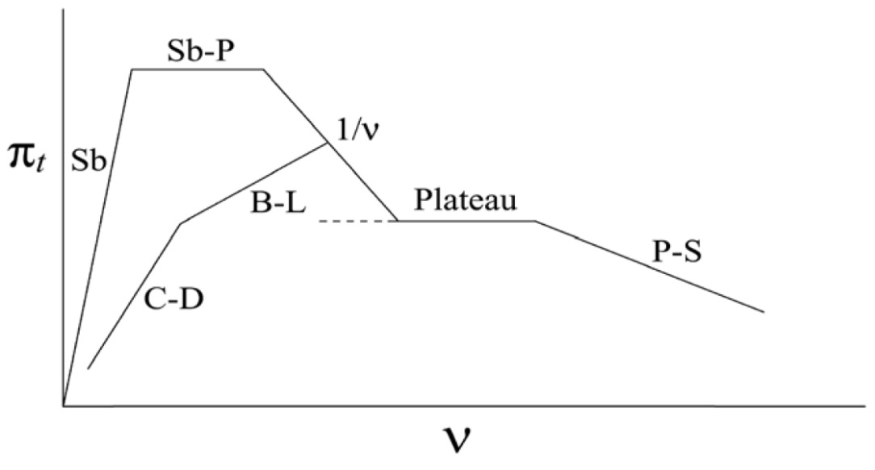
NSTX-U XP1517: Neoclassical toroidal viscosity at reduced collisionality “on deck” as joint experiment
NTV strength varies with plasma collisionality ν, δB², rotation
Motivation
  Experimentally, the dependence of neoclassical toroidal viscosity (NTV) at low collisionality needs further study
  Understanding important for NSTX-U V_{φ} control, other tokamaks, future devices
Goals / Approach
  Examine the dependence of NTV on ion collisionality
    expected to increase with decreasing ν_{i} from present experiments, and theory
  Determine if superbanana plateau increase of NTV depends on ν_{i}
  Operate with pre-programmed n = 2, 3 applied fields for V_{φ} feedback control testing at reduced ν_{i}
Addresses
  NSTX Milestones R(15-3), closed-loop rotation control with 3D fields
  Joint experiment with KSTAR
NSTX-U
NSTX
ν_{i}* ~ 1
K.C. Shaing, M.S. Chu, C.T. Hsu, et al., PPCF 54 (2012) 124033
“offset” rotation
NTV force in “1/ν” collisionality regime
K.C. Shaing, et al.,
PPCF 51 (2009) 035004
T_{i}^{5/2}
plasma rotation
1/aspect ratio (compare to KSTAR)

Slide 4
KSTAR experiment to be compared to experiments on NSTX/NSTX-U, part of our international collaboration
n = 3 coil configuration
n = 2 coil configuration
NSTX
NSTX
x0.6
x1.7
Experimental
-dL/dt
NTVTOK code
Experimental
-dL/dt
NTVTOK
ψ_{N}
ψ_{N}
(S.A. Sabbagh, R.E. Bell, T.E. Evans, et al., IAEA FEC 2014 paper EX/1-04)
Utilize technique similar to pioneering NSTX experiments, most recent validated analysis, using full Shaing theory

Slide 5
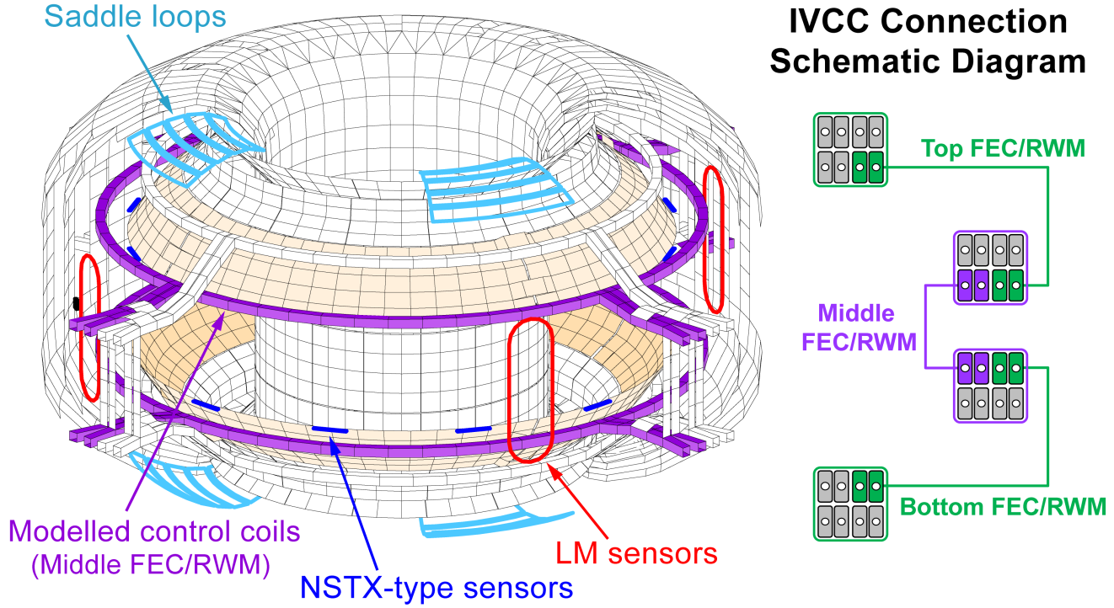
KSTAR In-Vessel Control Coil (IVCC) + new power supply in 2015 enabled this experiment
KSTAR IVCC, vessel, sensors (VALEN model)
New high bandwidth power supply (IPS) for 2015
  4 SPAs for 3D field control; 1 SPA for n = 0 control
  Each SPA can deliver 5 kA current (~ coil rating); 500V
  DC to 1 kHz bandwidth
  Can run steady-state
  PCS control
  Physics / engineering design strongly guided by Columbia U. / PPPL collaboration
~8,000 finite elements
MPs

Slide 6
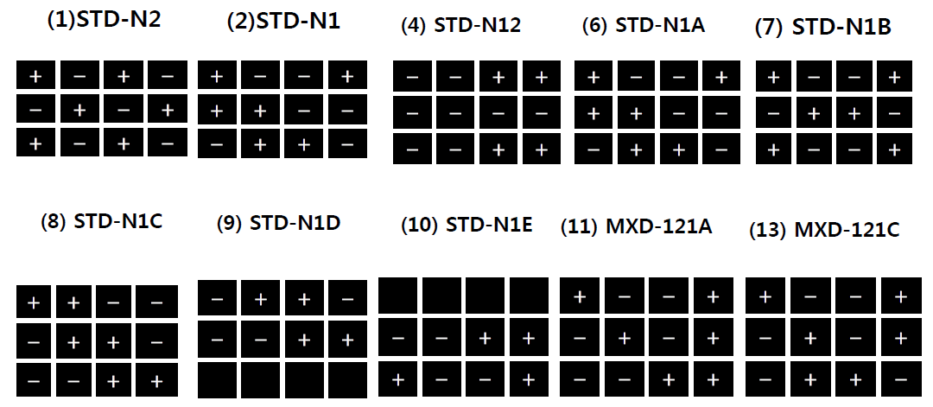
KSTAR IVCC and the IPS: Subset of the patch panels set up for 2015
Coil Arrays
TOP
MIDDLE
BOTTOM
n = 1
TOP
MIDDLE
n = 2 or 1
BOTTOM
n = 1
This patch panel was used
(applied 6 different spectra including n = 1 pitch-aligned and non-pitch-aligned)

Slide 7
MP 2015-05-23-001: Isolation of NTV torque profile: Brief summary
20 “clean” shots with ~ 20s pulse duration taken in total
  Gives 20 x 9 x 2 = 360 opportunities to measure the isolated NTV torque profile
  Rotating MHD not apparent, so resonant braking by modes not an issue
  Could be the most comprehensive NTV database – still, we almost, but did not fully complete shot list (due to time constraint)
  Data / analysis could compete for an IAEA 2016 oral presentation
Significant variation of key parameters
  (δB_{3D}/B), q₉₅ (from 5.0 - 8.2), collisionality (T_{i} altered significantly), V_{φ}
  Six 3D field spectra run (n = 2 and n = 1 pitch-aligned/non-pitch-aligned)
Key diagnostics – with some pleasant (significant) surprises!
  CES (absolutely required); also MSE and Thomson available

Slide 8
MP2014-05-02-007 Isolation of NTV torque profile, plasma collisionality and offset rotation: shot plan
Task Number of Shots
1) Use KSTAR’s new IPS power supply to perform an isolated measurement of the NTV torque profile
(Target: Bt = 2.0T ➔ 13300), 13300 (INCREASE Bt = 2.6T), 13300 (DECREASE Bt = 1.5T); MXD-121C patch panel)
A) Generate H-mode target plasma at Bt = 2.6T (reload shot 13300) 1
B) Reload 13308 (increasing IVCC steps, separate spectra) run at Bt = 2.6 1
C) Reload 13299 (decreasing IVCC steps, separate spectra) run at Bt = 2.6 1
D) Reload 13303 (increasing IVCC steps, combined spectra) run at Bt = 2.6 1
E) Reload 13304 (decreasing IVCC steps, combined spectra) run at Bt = 2.6 1
(With Bt = 2.6T, GO TO step 2 first, then: F) Repeat steps A) – E) with B_{T} = 1.5T 5
2) Determine the dependence of the isolated NTV torque profile on plasma collisionality, using SMBI
(use target plasma established from above step)
A) Reload 13305, (set Bt = 2.6T) use divertor gas puffing to increase density 1
B) Reload 13305, (set Bt = 2.6T) but move SMBI timing back to 120 ms before the IVCC pulse 1
C) Repeat steps (2A) and (2B) at Bt = 2.0T and 1.5T 4
(NOTE: These shots will have CONSTANT IVCC current step levels determined by step (1C) above; also
rerun steps (1D and 1E) with CONSTANT IVCC current step levels, but at a different IVCC current value)
3) Use an innovative technique to measure the NTV offset rotation on KSTAR for the first time
A) Generate control shot that will start up with OH and ECH only (targets: 13379, 13412) 1
B) Control shot using specific ECH and NBI waveforms, no 3D applied field 1
C) Vary 3D applied field (one IVCC level per shot is expected) – HIGHEST IVCC current first 3
1.7 T (2 shots
only)
Not needed
1.7 T
(not enough time to run)
V1.6

Slide 9
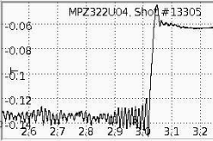
MP2014-05-02-007 Isolation of NTV torque profile: Considerations for run (illustration of SMBI + 3D field)
Setting up varied 3D field spectra (MXD-121C patch panel)
  δB/B variation with IVCC current steps
  Vary the spectrum in each group of steps
  Take shots with combined non-resonant spectra
Varying collisionality
  B_{T}, I_{p} variation; natural density evolution
  SMBI (cold); divertor gas puffing
NTV offset rotation – target plasma
  2015 shots: 13379, 13412
Accomplished (q₉₅ ~ 5.0, 6.2, 8.2)
Still to do (in red)
SMBI delivery successful, increased small mode, then 3D field applied 40ms later apparently leads to mode lock
SMBI
3D field
dB/dt from one of the new (2015) RWM sensors

Slide 10
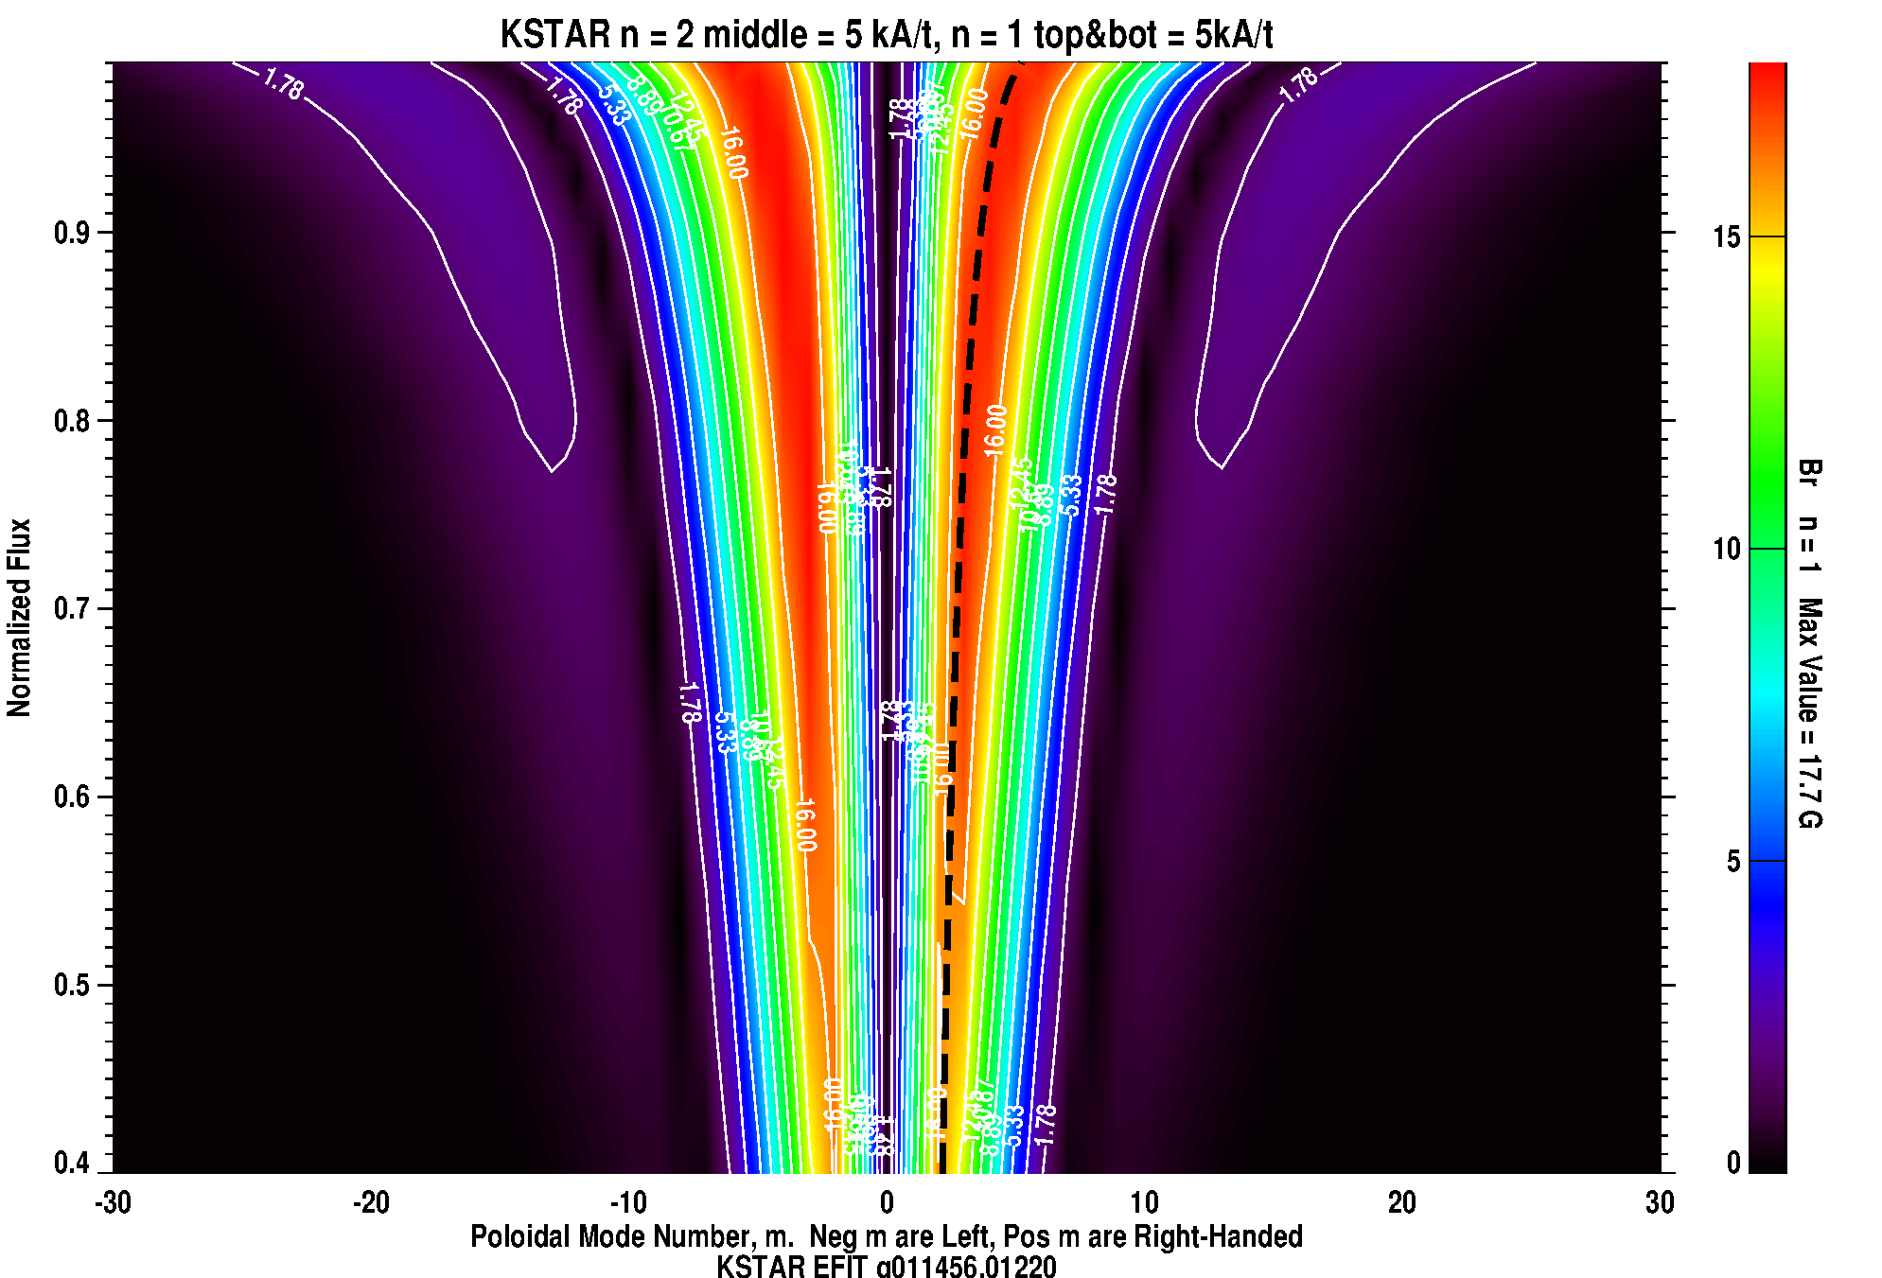
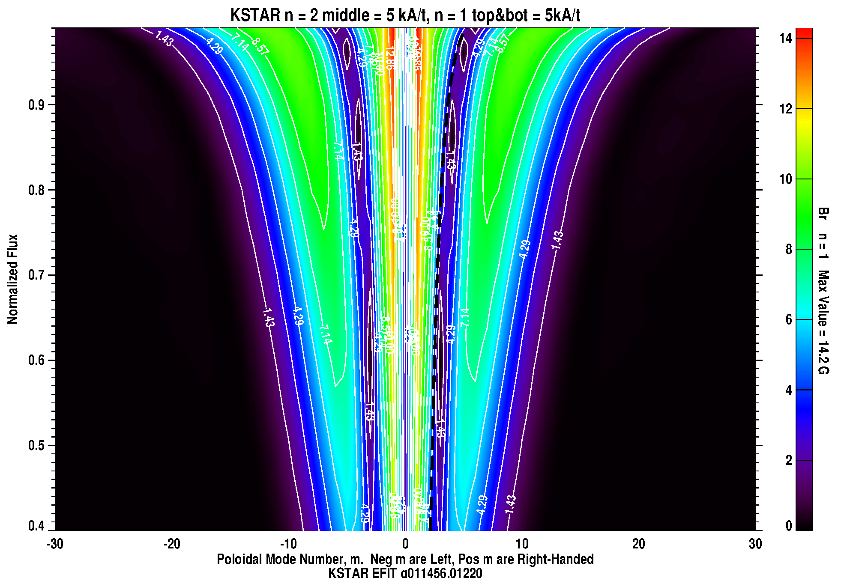
MXD-121C patch panel chosen to allow wide investigation of 3D field spectra, including relative alignment to 2D field pitch
Combined n = 2 + 1
“Field pitch aligned” (+180deg phasing)
Combined n = 2 + 1
“Field pitch non-aligned” (0 deg phasing)
n = 1
n = 2
n = 1
T
+
+
–
–
T
+
+
–
–
M
+
–
+
–
M
+
–
+
–
B
–
–
+
+
B
+
+
–
–
Non-pitch aligned has lower Br n = 1 field overall, broad region ~ 10G

Slide 11
Single spectrum waveforms run to isolate NTV profile
n = 2 mid
(4.5s duration)
n = 1: 0 deg
(4.5s duration)
n = 1: 180 deg
(4.5s duration)
Three IVCC levels per spectrum; Three spectra / shot were run
0.75s steps
0.75s steps
0.75s steps
A
Ip (MA)
NBI
t(s)
NBI dropouts for CES (~ 0.66 Hz)
B
n = 1: 0 deg
(4.5s duration)
n = 1: 180 deg
(4.5s duration)
n = 2 mid
(4.5s duration)
Ip (MA)
NBI
t(s)
NBI dropouts for CES (~ 0.66 Hz)
IPS provided fast IVCC current rise time
  ~ 3 ms to maximum current << momentum diffusion time
Step the IVCC as many times as plasma pulse length allows
  Vary applied field magnitude and spectrum (2 or three steps using n = 2 midplane; n = 1 non-pitch-aligned; n = 1 pitch-aligned ➔ ALL in one shot if possible)
  Take second shot, changing the order of the IVCC current steps
A
B

Slide 12
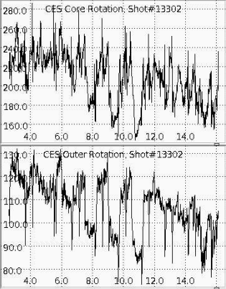
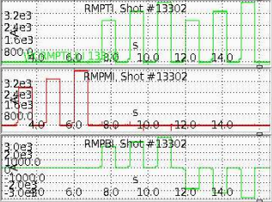
NTV effect has been successfully isolated with the new IPS!
n = 2 mid
n = 1: 0 deg
“non-aligned”
n = 1: 180 deg
“pitch-aligned”
Channel 2
Channel 12
Increasing field strength = stronger NTV
  Shown by change in |dVp/dt|
  |dVp/dt| changes vs. R – NTV PROFILE
Altered field spectrum alters NTV
“Non-pitch-aligned” n = 1 field apparently provides stronger braking (!)

Slide 13
Combined spectrum waveforms run: isolate NTV profile
n = 2 mid, n = 1, 0 deg (non-pitch-align)
(4.5s duration)
n = 2 mid, n = 1, 180 deg (pitch align)
(4.5s duration)
n = 2 mid, n = 1, 0 deg (non-pitch-align)
(4.5s duration)
Three IVCC levels per spectrum; Three spectra / shot were run
0.75s steps
0.75s steps
0.75s steps
A
Ip (MA)
NBI
t(s)
NBI dropouts for CES (~ 0.66 Hz)
B
Ip (MA)
NBI
t(s)
NBI dropouts for CES (~ 0.66 Hz)
Shots with COMBINED non-resonant field spectra (n = 2 + n =1 non-pitch-aligned
  Vary applied field magnitude fixed combined spectrum (n = 2 midplane; n = 1 non-pitch-aligned: ➔ ALL in one shot if possible)
  Take second shot, changing the order of the IVCC current steps
A
B

Slide 14
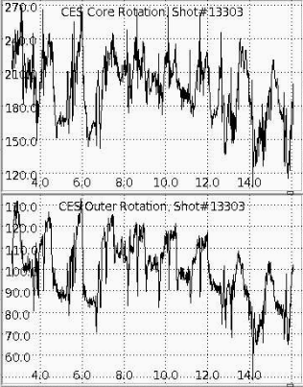
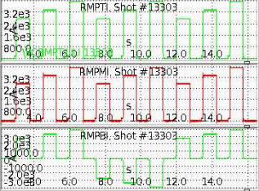
NTV successfully isolated for COMBINED n = 2 + n = 1 spectra
n = 2 mid, n = 1, 0 deg (non-pitch-aligned)
n = 2 mid, n = 1, 180 deg (pitch aligned)
n = 2 mid, n = 1, 0 deg (non-pitch-aligned)
Channel 2
Channel 12
Increasing field strength = stronger NTV
  Shown by change in |dVp/dt|
  |dVp/dt| changes vs. R – NTV PROFILE
Altered field spectrum alters NTV
Again, “non-pitch-aligned” n = 1 field apparently provides stronger braking
saturation indicates
non-resonant NTV

Slide 15
Isolate NTV torque profile: collisionality scan waveforms
n = 2 mid, n = 1, 0 deg (non-pitch-align)
(4.5s duration)
n = 2 mid, n = 1, 180 deg (pitch align)
(4.5s duration)
n = 2 mid, n = 1, 0 deg (non-pitch-align)
(4.5s duration)
Three IVCC levels per spectrum; Three spectra / shot were run
0.75s steps
0.75s steps
0.75s steps
Ip (MA)
NBI
t(s)
NBI dropouts for CES
Ip (MA)
Changed levels
Divertor Gas Injection
t(s)
Shots with COMBINED non-resonant field spectra (n = 2 + n =1 non-pitch-aligned)
  Varied collisionality through director gas puffing
  Varied profiles with H-L transitions

Slide 16
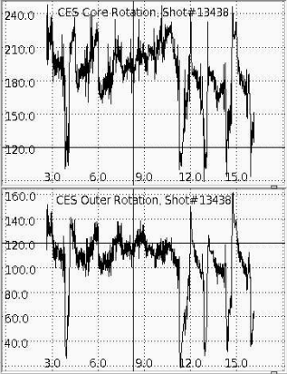
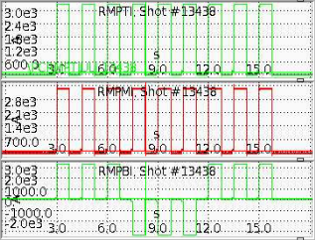
NTV for COMBINED n = 2 + n = 1 spectra, q₉₅=8.2, NO gas puff
n = 2 mid, n = 1, 0 deg (non-pitch-aligned)
n = 2 mid, n = 1, 180 deg (pitch aligned)
n = 2 mid, n = 1, 0 deg (non-pitch-aligned)
Channel 2
Channel 12
Increasing field strength = stronger NTV
Altered field spectrum alters NTV
Some H-L transitions – can take NTV before, and sometimes after transition
Again, “non-pitch-aligned” n = 1 field apparently provides stronger braking
H-L transition

Slide 17
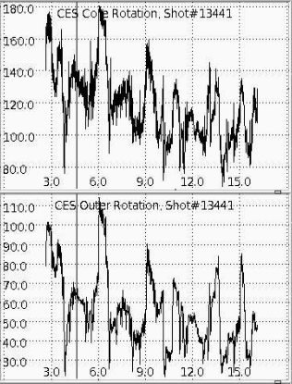
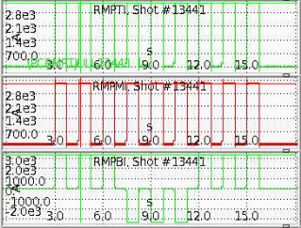
NTV for COMBINED n = 2 + n = 1 spectra, q₉₅=8.2, w/gas puff
n = 2 mid, n = 1, 0 deg (non-pitch-aligned)
n = 2 mid, n = 1, 180 deg (pitch aligned)
n = 2 mid, n = 1, 0 deg (non-pitch-aligned)
Channel 2
Channel 12
Increasing field strength = stronger NTV
Altered field spectrum alters NTV
Some H-L transitions – can take NTV before, and sometimes after transition
Generally effect of gas puff is noticeable in NTV braking (need further analysis)
H-L transitions

Slide 18
Innovative technique to measure the NTV offset rotation on KSTAR for the first time - waveforms
(time did not allow us to run this)
Determine NTV offset velocity profile using an innovative approach with ECH and NBI
  Also, to be compared to an experiment proposed on NSTX-U (2016)
Run with two 3D field spectra and compare
  Run n = 2 field at midplane
  Run n = 1 non-pitch-aligned off-midplane
Target plasmas
  2015 shots: 13379, 13412
Schematic of approach to measure NTV offset rotation profile

Slide 19
Brief summary of “control room” observations and hypotheses
KSTAR NTV as observed in these new, isolated NTV shots
  Initial observation: strong resonant MHD modes have been avoided
  Initial observation: pitch aligned 3D field does not have stronger NTV
  Observation indicates no strong amplification due to kink response
  Observation: NTV profile is global, non-resonant, no huge variations
  Initial observation: NTV profile of combined spectra might be understood by simple superposition of applied field (analysis needed)
  Working Hypothesis: NTV depends primarily on |δB|, ν, not on resonant effects, particulars of resonances, or alignment with 2D field
Experience from NSTX (theory/experiment verification 10 years old!)
  Non-resonant NTV is robust, not strongly dependent on profile details
  No strong resonant effects – unless strong resonant MHD is present
Essential plan to complete this data was (nearly) completed! Great data!
Further detailed comparison to past dedicated NSTX, and new joint NSTX-U NTV experiments, will yield further understanding of NTV in tokamaks

Slide 20
MP 2015-05-23-001: Isolation of NTV torque profile – Diagnostics
Required diagnostics / capabilities
  Equilibrium magnetics, ECH, full NBI power
  IVCC coils in Mixed 1/2/1C patch panel (n = 2 (mid), n = 1 (top/bot))
  Toroidal rotation measurement (CES, X-ray crystal)
  Ion temperature (CES)
  Toroidal Mirnov array / between-shots spectrogram with toroidal mode number analysis
  SMBI (cold)
  ECE, ECEI
Desired diagnostics / capabilities
  Thomson scattering (T_{e}, n_{e}); MSE
  Interferometer (line avg. n_{e} evolution)
  Locked mode detectors (all positions)
  fast camera
Acquired. Density profile will help provide a reasonably accurate NTV profile calculation
MSE acquired for all
shots taken

Slide 21
Supporting Slides Follow

Slide 22
Resonant effects, hypothesized in some publications, are not observed in NSTX – due to finite gryo-radius/banana width
n = 3 coil configuration
Theory without banana-width averaging
NSTX
with banana-width averaging
Experimental
-dL/dt
Published in Sabbagh, et al., IAEA FEC 2014 paper EX/1-4
Can explain why strong resonances are not observed
Further analysis of KSTAR data from this experiment should provide further support, or different understanding
  Present “control room” analysis seems to support non-resonant nature of NTV
NTVTOK
code
ψ_{N}
T_{NTV} (theory) scaled to match peak value of measured -dL/dt
  Scale factor ((dL/dt)/T_{NTV}) = 0.6 (for case shown above) – O(1) agreement
  NO plasma amplification of 3D field in these calculations

