Slide 1
Core Plasma Particle Transport Benchmark Activities in International Tokamak Physics Activity (ITPA) Integrated Operation Scenario (IOS) Group
Yong-Su Na
(Deputy Chair )
on behalf of ITPA IOS TG
Department of Nuclear Engineering, Seoul National University
Acknowledgement: C.E. Kessel, Dong-Hyun Na, A. Fukuyama, J. Garcia, N. Hayashi, F. Koechl, A. Polevoi, A. Wisitsorasak, X. Yuan

Slide 2
Outline
Goal of modelling activities in ITPA IOS TG
Motivation of particle transport benchmarking
Overview of particle transport benchmarking activity
  Benchmarking guideline
  Participating 1.5-D transport codes and modellers
First results of particle transport benchmarking
Discussion
Next-step work

Slide 3
Goal of modelling activities in IOS
Establish reliable integrated operation scenarios in ITER
    Address ITER urgent issues related with IOS
    Simulate and optimise ITER operation scenarios
    Model and simulate integrated control for ITER
Improve predictive capability of integrated modelling
    Benchmark and verify existing models, modules, and codes
    Integrate models, modules, and codes for better prediction

Slide 4
Short-term partially collaborative activities
Establish reliable integrated operation scenarios in ITER
    Address ITER urgent issues related with IOS
    - Development of H, He scenarios
    - Ramp-down and plasma termination modelling
    - W transport modelling
    Simulate and optimise ITER operation scenarios
    Develop integrated control schemes for ITER
    - Burn control simulation
    - Integrated control simulation with actuator sharing
Improve predictive capability of integrated modelling
    Benchmark and verify existing models, modules, and codes
    - Bootstrap current model benchmarking
    Integrate models, modules, and codes for better prediction
    - Pedestal modelling
    - Core-edge-SOL integrated modelling

Slide 5
Long-term fully collaborative activities
sources (actuators)
other
ITPA
TGs
IMAS
heat
transport
particle
transport
impurity &
alpha
transport
momentum
transport
MHD
(sawtooth, NTM, ELM, …)
operation scenarios in ITER and beyond

Slide 6
Long-term fully collaborative activities
sources (actuators)
other
ITPA
TGs
IMAS
heat
transport
particle
transport
impurity &
alpha
transport
momentum
transport
Benchmarking
MHD
(sawtooth, NTM, ELM, …)
operation scenarios in ITER and beyond

Slide 7
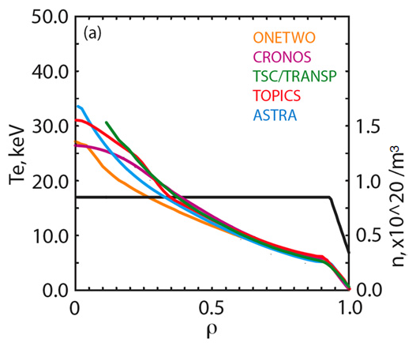
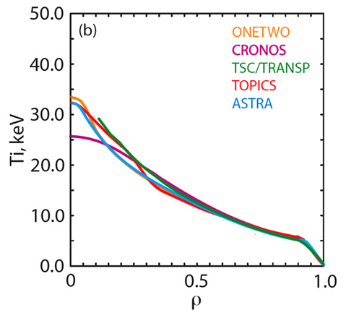
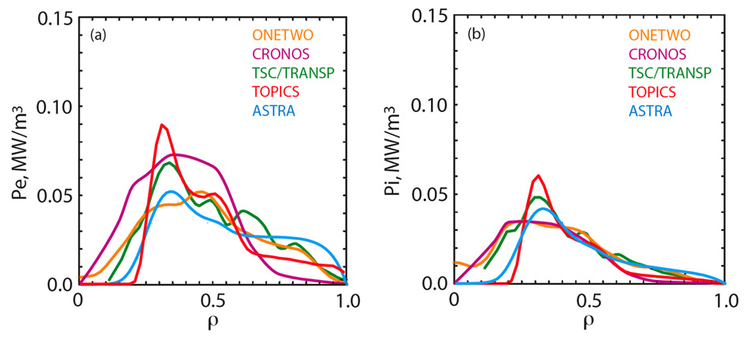
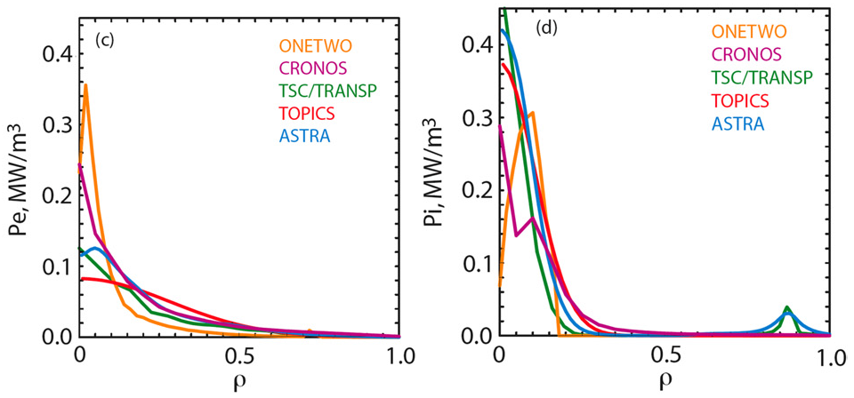
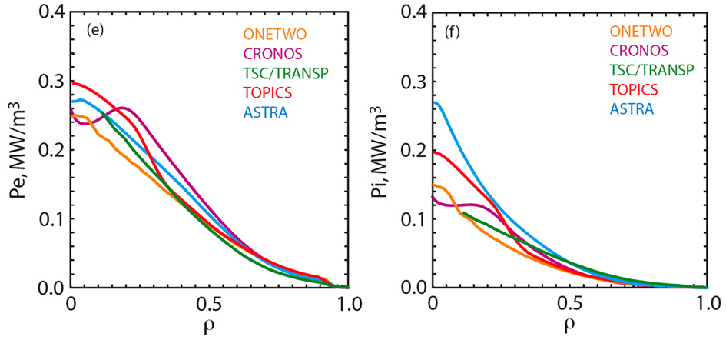
Heat transport benchmarking
C.E. Kessel et al, NF 47 1274 (2007)

Slide 8
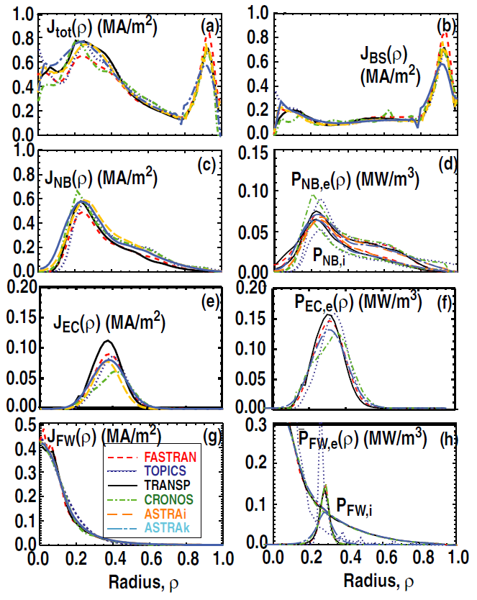
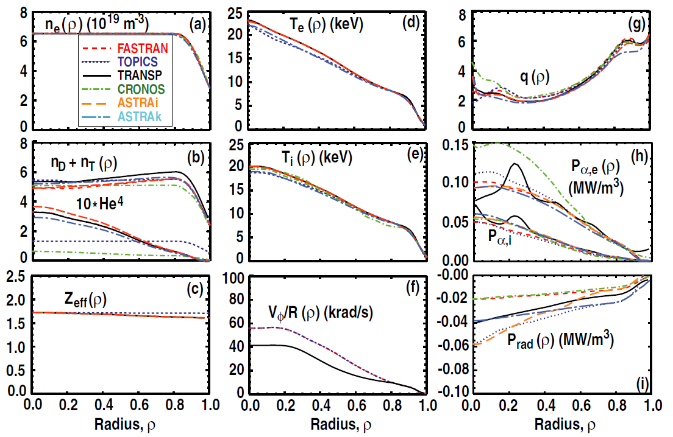
Heat transport benchmarking
M. Murakami et al, NF 51 103006 (2011)

Slide 9
Long-term fully collaborative activities
sources (actuators)
other
ITPA
TGs
IMAS
heat
Transport
particle
transport
impurity &
alpha
transport
momentum
transport
Detailed validation of physics models,
Development of theoretical models and codes
are out of scope of these activities.
MHD
(sawtooth, NTM, ELM, …)
operation scenarios in ITER and beyond

Slide 10
Plan for benchmarking activities
-2011
2015-2017
2017-2020
2020-2022
sources (actuators)
heat
transport
particle
transport
impurity &
alpha
transport
momentum
transport
ITER Scenarios + Predictability
MHD (sawtooth, NTM, ELM, …)
control simulations (burn, profile, MHD, …)
Reassess performance of ITER operation scenarios

Slide 11
Outline
Goal of modelling activities in ITPA IOS TG
Motivation of particle transport benchmarking
Overview of particle transport benchmarking activity
  Benchmarking guideline
  Participating 1.5-D transport codes and modellers
First results of particle transport benchmarking
Discussion
Next-step work

Slide 12
Importance of particle transport in ITER prediction
How is the density established in L-mode and does affect the L-H transition, and ultimately controlled in flattop H-mode?
What is the density and density profile evolution at the L-H transition which has significant implications for entering and staying in H-mode?
How to set credible burn control strategies for the H-mode in the flattop phase which depends sensitively on the particle balance of the mixed D-T fuels, He and impurities?
How is the density and density profile evolution during the I_{p} ramp-down phase and the H-L transition phase?
How much is the particle screening effect, charge exchange, recycling, and penetration of He and fuel into the core plasma which are central to understanding the dilution and tritium burnup?
How much is the core fueling by pellet injection?
How is the SOL/divertor plasma and its interactions with plasma facing components which sets the boundary conditions for the core transport?
…

Slide 13
Particle transport modelling in ITER prediction
Ultimate goal: modelling of integrated control of
- Core density (burn control for DT)
- Mode of operation (L, H)
- ELM pacing
- Divertor detachment
- Impurity accumulation
Responsibility of ITPA TGs:
  - Core transport models (T&C)
  - Pedestal models (PED)
  - Core boundary conditions (SOL/DIV)
  - Core transport solvers + integrated modelling (IOS)
Core transport solvers:
- Electron/ion transport simulation
- Core fueling by pellets (permanent/instant models)
- Sink with ELMs (permanent/instant models)
- Core impurity transport (including control by ELM pacing)
- Impact of boundary conditions (from SOL/DIV transport and control)
- Efficiency of core fueling by gas puffing (penetration through the SOL)

Slide 14
Status of particle transport modelling
Particle transport in the core plasma is often not treated regardless of its importance in integrated scenario simulations.
  uncertainties of measurements to determine the separatrix density and the fuel sources (3-Dimentional) to validate transport models
  complexity of multi-species impurity transport
  complicated relationship with the SOL, divertor, and plasma facing materials

Slide 15
Particle transport benchmarking
Goal
  Verify agreement among various integrated modelling codes by approximating closely the expected scenario on ITER
  Predict ITER plasmas more accurately based on knowledge accumulated from the benchmarking
  Address the critical issues of ITER

Slide 16
Outline
Goal of modelling activities in ITPA IOS TG
Motivation of particle transport benchmarking
Overview of particle transport benchmarking activity
  Benchmarking guideline
  Participating 1.5-D transport codes and modellers
First results of particle transport benchmarking
Discussion
Next-step work

Slide 17
Steps in benchmarking
STEP 1: Benchmarking of particle transport solvers with prescribed transport
coefficients and sources at one time point in the current flattop
Purpose: to ensure agreement and understand differences among particle
transport solvers
STEP 2: Benchmarking of particle sources & sinks with prescribed transport
coefficients at one time point in the current flattop
Purpose: to compare source & sink models
STEP 3: Sensitivity scans of transport coefficients at one time point
in the current flattop
Purpose: to evaluate the impact of particle transport to fusion performance
STEP 4: Benchmarking of time-evolution in whole discharge with
prescribed transport coefficients and sources in time
Purpose: to evaluate the impact of particle transport to scenario evolution
STEP 5: Application of physics-based transport models
Purpose: to predict particle transport in ITER

Slide 18
Steps in benchmarking
STEP 1: Benchmarking of particle transport solvers with prescribed transport
coefficients and sources at one time point in the current flattop
Purpose: to ensure agreement and understand differences among particle
transport solvers
STEP 2: Benchmarking of particle sources & sinks with prescribed transport
coefficients at one time point in the current flattop
Purpose: to compare source & sink models
STEP 3: Sensitivity scans of transport coefficients at one time point
in the current flattop
Purpose: to evaluate the impact of particle transport to fusion performance
STEP 4: Benchmarking of time-evolution in whole discharge with
prescribed transport coefficients and sources in time
Purpose: to evaluate the impact of particle transport to scenario evolution
STEP 5: Application of physics-based transport models
Purpose: to predict particle transport in ITER
Integrating with heat transport!

Slide 19
Guideline for Benchmarking
Solving n_{e} and T_{e}, T_{i}
ITER baseline scenario at the plasma current flattop phase
  I_{p} = 15.0 MA, B_{T} = 5.3 T at R = 6.2 m
Basic assumptions
  n_{Z} = f_{z}n_{e}, quasi-neutrality
  Set Helium density profile as
n_{He}(Φ) = n₀ [1 - (Φ/Φ_{edge})²]² Φ: toroidal magnetic flux
n₀ = 0.95x10¹⁹ /m³
  Ignore NB fueling and current drive
  Zero toroidal rotation
  No sawtooth
Plasma equilibrium: using a TSC result or approximate geometric values
R₀ (m) | a (m) | κ | δ | Z_{mag} (m) | Volume (m³)
6.20 | 1.99 | 1.85 | 0.45 | 0.50 | 819.4

Slide 20
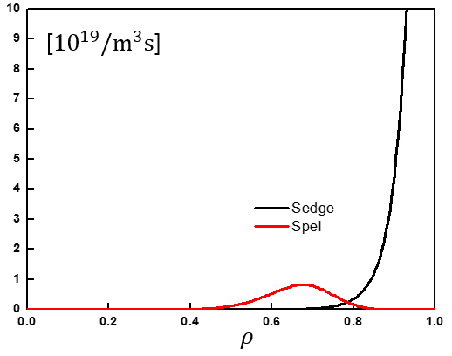
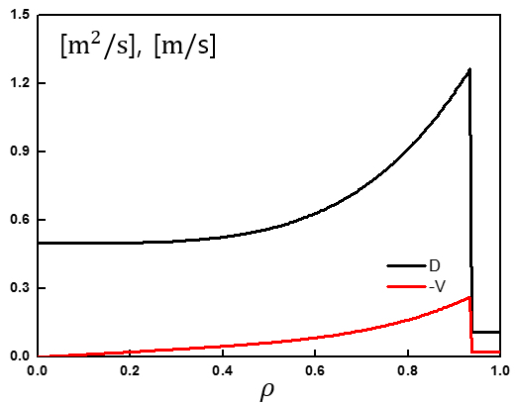
Guideline for Benchmarking
Transport model setup
  Edge particle source
S(Φ) = S₀ exp{15 (Φ - Φ_{edge})/Φ_{edge}}
S₀ = 7.5x10²⁰ atom/m³
  Core particle source by pellet fueling (continuous)
S(Φ) = C*d²*(Φ/Φ_{edge})^{6.5}*[1-(Φ/Φ_{edge})]^{8.5}/{d²+[(Φ/Φ _{edge})-0.5]²}
C = 0.25x10²⁴, d = 0.225
Pellets injected every 50 ms, so continuous source is ~ 50x smaller
  Particle transport
D(Φ) = D₀ + D₁(Φ/Φ_{edge})² for Φ < Φ_{ped}
D(Φ) = D₂ for Φ > Φ_{ped}
R₀*v/D = V₀*(Φ/Φ_{edge})^{1/2}
D₀ = 0.5 m²/s, D₁ = 1.0 m²/s, D₂ = 0.11 m²/s
V₀ = 1.385 (positive is inward pinch)

Slide 21
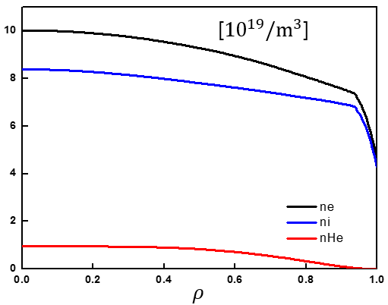
Guideline for Benchmarking
Transport model setup
  Impurity specification
Be: n_{Be}/n_{e} = 0.02, profile same as electrons
Ar: n_{Ar}/n_{e} = 0.0005, profile same as electrons
W: n_{W}/n_{e} = 0.0
  Boundary condition
n_{e}(a) = 4.6x10¹⁹ /m³

Slide 22
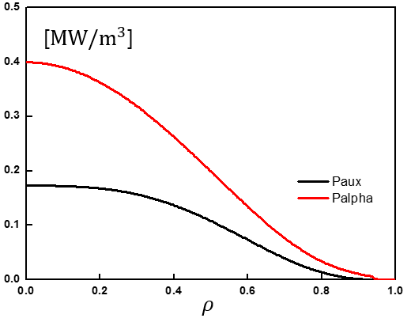
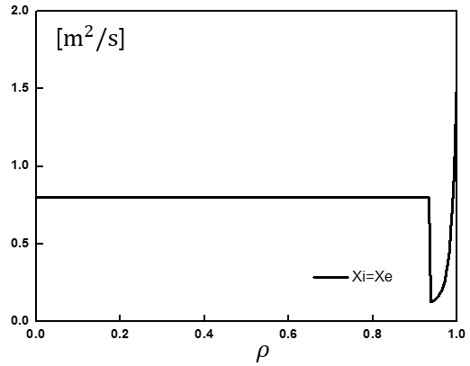
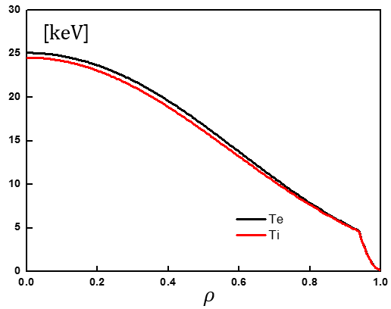
Guideline for Benchmarking
Transport model setup
  Heat source
P(Φ) = P₀[1 - (Φ/Φ_{edge})^{1.5}]^{3.5}
Normalise P₀ to match P_{total} = 53.0 MW
P_{elec}/P_{total} = 0.7, P_{ion}/P_{total} = 0.3
  Heat transport
χ_{e,i}(Φ) = χ₀ for Φ < Φ _{ped}
χ_{e,i}(Φ) = χ_{ped} exp{2.5 [(Φ - Φ_{ped}) / (Φ_{edge} - Φ_{ped})]² } for Φ > Φ_{ped}
χ₀ = 0.802 m²/s
χ_{ped} = 0.13 m²/s
Φ_{ped}/Φ_{edge} = 0.88
  Boundary condition
T_{e} (a) = T_{i} (a) = 150 eV

Slide 23
Main plasma parameters (reference)
β_{N} | 2.0 | n_{e}/n_{GW} | 0.74
τ_{E} | 3.0 (including radiation) | n_{e}(0) | 1.0x10²⁰ /m³
H₉₈ | 1.1 (including radiation) | <n_{e}> | 0.85x10²⁰ /m³
W_{th} | 403 MJ | n_{e} | 0.9x10²⁰ /m³
T_{i}(0) | 24.6 keV | n_{e}(0)/<n_{e}> | 1.18
T_{e}(0) | 25.1 keV
T_{i,ped} | 4.6 keV
T_{e,ped} | 4.7 keV | <Z_{eff}> | 1.51
P_{α} | 106 MW | <n_{He}>/<n_{e}> | 0.062
P_{line} | 5.1 MW | <n_{DT}>/<n_{e}> | 0.786
P_{cycl} | 6.0 MW
P_{brem} | 17.1 MW
P_{net} | 135 MW
ASTRA v.6

Slide 24
Participants of the activity
1.5-D transport Code | Modeller
ASTRA (v.6 + α) | Dong-Hyun Na (Seoul National University) Yong-Su Na (Seoul National University)
ASTRA (v.6x + v.7) | A. Polevoi (ITER IO)
CRONOS | J. Garcia (CEA)
FASTRAN | J.M. Park (ORNL) Kyungjin Kim (Seoul National University)
JINTRAC (JETTO) | F. Koechl (CCFE)
TASK/TR | A. Wisitsorasak (King Mongkut's University of Technology Thonburi, Thailand) A. Fukuyama (Kyoto University)
TOPICS | N. Hayashi (JAEA)
TRANSP | X. Yuan (PPPL) Yong-Su Na (Seoul National University)

Slide 25
Outline
Goal of modelling activities in ITPA IOS TG
Motivation of particle transport benchmarking
Overview of particle transport benchmarking activity
  Benchmarking guideline
  Participating 1.5-D transport codes and modellers
First results of particle transport benchmarking
Discussion
Next-step work

Slide 26






Particle transport
n_{e} [${10}^{19}/m^{3}$]
$$ρ$$
[$m^{2}/s$], [$m/$s]
[${10}^{19}/m^{3}s$]
$$ρ$$
$$ρ$$

Slide 27

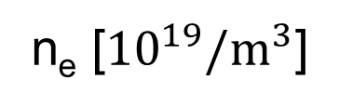
Particle transport
n_{e} [${10}^{19}/m^{3}$]
$$ρ$$

Slide 28
Particle transport
n_{e} [${10}^{19}/m^{3}$]
$$ρ$$
[$m^{2}/s$], [$m/$s]
[${10}^{19}/m^{3}s$]
$$ρ$$
$$ρ$$

Slide 29





Particle transport
n_{DT} [${10}^{19}/m^{3}$]
n_{He} [${10}^{19}/m^{3}$]
$$ρ$$
$$ρ$$
[${10}^{19}/m^{3}$]
Z_{eff}
$$ρ$$
$$ρ$$

Slide 30
Outline
Goal of modelling activities in ITPA IOS TG
Motivation of particle transport benchmarking
Overview of particle transport benchmarking activity
  Benchmarking guideline
  Participating 1.5-D transport codes and modellers
First results of particle transport benchmarking
Discussion
Next-step work

Slide 31
Possible reasons for disagreement
Errors in the transport solver?
Different equilibrium?
  some using the prescribed one but the others solving the current diffusion equation
Radial grid?
Solving ion transport?
Different definition of transport coefficients?
Different treatment of impurities?
…

Slide 32
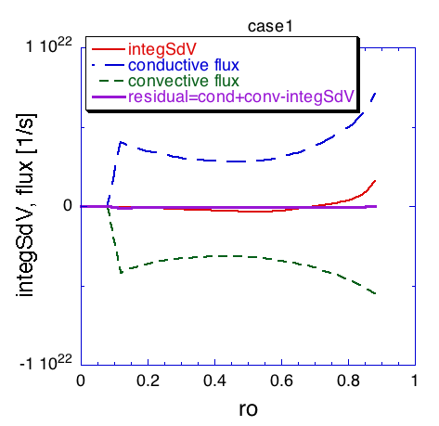


Check particle flow balance
$$[{10}^{23}{ s}^{−1}]$$
$$ρ$$
ASTRA v.6
TOPICS

Slide 33
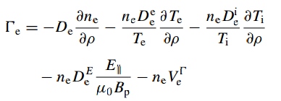






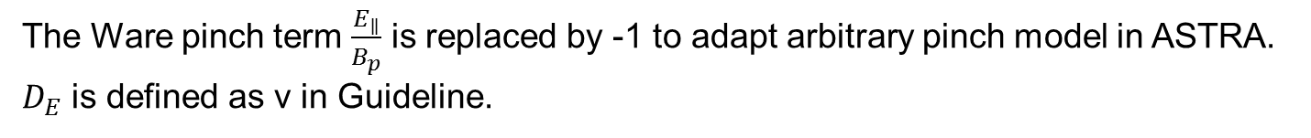


Transport equations being solved
ASTRA
$$\frac{Γ_{e}}{n_{e}}={−V}^{′}G_{1}\left(D_{n}\frac{1}{n_{e}}\frac{∂n_{e}}{∂ρ}+D_{e}\frac{1}{T_{e}}\frac{∂T_{e}}{∂ρ}+D_{i}\frac{1}{T_{i}}\frac{∂T_{i}}{∂ρ}+D_{E}\frac{E_{∥}}{B_{p}}\right)$$
$\frac{1}{V^{′}}\left(\frac{∂}{∂t}−\frac{\dot{B_{0}}}{2B_{0}}\frac{∂}{∂ρ}ρ\right)\left(V^{′}n_{e}\right)+\frac{1}{V^{′}}\frac{∂}{∂ρ}Γ_{e}=S_{e}$
$$G_{1}≡\left\langle {\left(∇ρ\right)}^{2}\right\rangle$$
$$V^{′}=\frac{∂V}{∂ρ}$$
The Ware pinch term $\frac{E_{∥}}{B_{p}}$ is replaced by -1 to adapt arbitrary pinch model in ASTRA.
$D_{E}$ is defined as v in Guideline.
CRONOS
TRANSP (PTSOLVER)

Slide 34
Some codes solve ion transport
TOPICS
JINTRAC

Slide 35
Some codes solve ion transport
TOPICS
JINTRAC
- Simulation rerun with the following modified settings:
  Additional pinch terms to accommodate for differences between solutions obtained with electron vs. ion particle transport equations in case of different impurity density profile shape:
  That way, the electron flux that would be obtained with an electron transport equation with fixed impurities can be calculated with the ion particle transport equations.
- The boundary condition of main ion densities at the separatrix has been adjusted in order to match n_{e}(a) = 4.6x10¹⁹ /m³.

Slide 36




Some codes solve ion transport
n_{e} [${10}^{19}/m^{3}$]
n_{e} [${10}^{19}/m^{3}$]
$$ρ$$
$$ρ$$
JINTRAC without correction
JINTRAC with correction

Slide 37
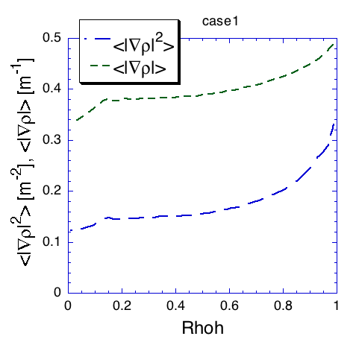
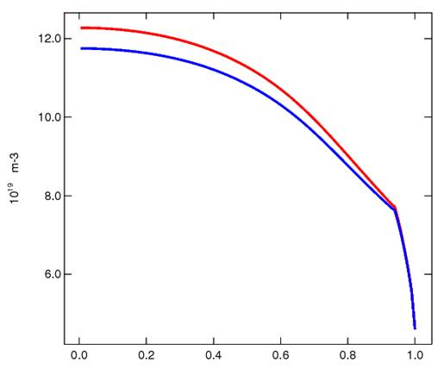
Effect of .vs. in pinch term
Blue:
Red:
TOPICS
JINTRAC

Slide 38







Treatment of impurities
TRANSP solved impurity ionisation so that non-full striped impuritis (Be, Ar) are used.
n_{DT} [${10}^{19}/m^{3}$]
[${10}^{19}/m^{3}$]
$$ρ$$
$$ρ$$
[${10}^{19}/m^{3}$]
Z_{eff}
$$ρ$$
$$ρ$$

Slide 39






Resulting heat transport (example)
[$keV$]
[$m^{2}/s$]
$$ρ$$
$$ρ$$
[$MW/m^{3}$]
[$MW/m^{3}$]
$$ρ$$
$$ρ$$

Slide 40
Outline
Goal of modelling activities in ITPA IOS TG
Motivation of particle transport benchmarking
Overview of particle transport benchmarking activity
  Benchmarking guideline
  Participating 1.5-D transport codes and modellers
First results of particle transport benchmarking
Discussion
Next-step work

Slide 41
Steps in benchmarking
STEP 1: Benchmarking of particle transport solvers with prescribed transport
coefficients and sources at one time point in the current flattop
Purpose: to ensure agreement among particle transport solvers
STEP 2: Benchmarking of particle sources & sinks with prescribed transport
coefficients at one time point in the current flattop
Purpose: to compare source & sink models
STEP 3: Sensitivity scans of transport coefficients at one time point
in the current flattop
Purpose: to evaluate the impact of particle transport to fusion performance
STEP 4: Benchmarking of time-evolution in whole discharge with
prescribed transport coefficients and sources in time
Purpose: to evaluate the impact of particle transport to scenario evolution
STEP 5: Application of physics-based transport models
Purpose: to predict particle transport in ITER

Slide 42
STEP 2
STEP 2: Benchmarking of particle sources & sinks with prescribed transport
coefficients at one time point in the current flattop
Purpose: to compare source & sink models
Particle pinch verification
Particle source verification
  Core source
    Pellet source: size, frequency, velocity (limits from hardware…)
    .vs
    Continuous core source: atoms/m³/s and profile shape
  Edge source
    How large and how deep should edge source be in H-mode
Edge density specification, what do we base this on?
D and v magnitudes, target τ_{p} and τ_{P}*, relate to τ_{E}
n_{e}(a), S_{edge}, S_{core}, D, v → solutions (uniqueness) n_{e}(Φ), …..
  Examine range from flat n_{e} to n_{e0}/n_{e} < 1.4-1.5
Probable usage of ITER Baseline discharges from various devices to identify particle transport terms and behaviors.

Slide 43
Summary
Goal of modelling activities in ITPA IOS TG
Motivation of particle transport benchmarking
Overview of particle transport benchmarking activity
  Benchmarking guideline
  Participating 1.5-D transport codes and modellers
First results of particle transport benchmarking
Discussion
Next-step work

Slide 44








[${10}^{19}/m^{3}$]
[$keV$]
$$ρ$$
$$ρ$$
[$MW/m^{3}$]
[$MW/m^{3}$]
$$ρ$$
$$ρ$$

Slide 45






[$m^{2}/s$], [$m/$s]
[$m^{2}/s$]
$$ρ$$
$$ρ$$
[${10}^{19}/m^{3}s$]
$$ρ$$
$$ρ$$

Slide 46


CRONOS
The particle source term results from the following contributions:
respectively, ionization source from neutrals (wall recycling, gas puffing, etc), NBI, optional additional source ‘EXT’, particle losses induced by toroidal magnetic field ripple.
The electron flux can be calculated either as the sum of a diffusive and a convective terms:
or as a full transport matrix formulation:

Slide 47
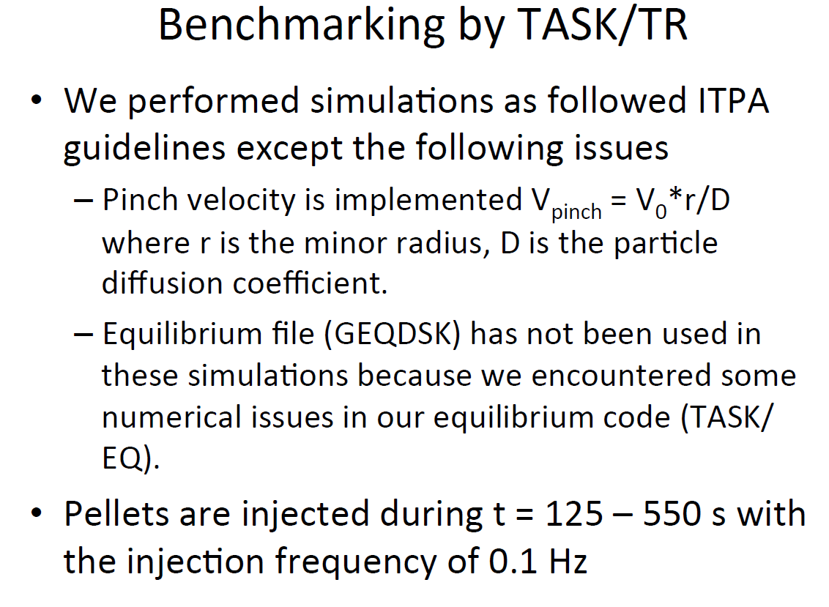
TASK/TR

Slide 48
Simulation conditions in TOPICS
Solve density (n_{DT}=2n_{D}=2n_{T}) and Obtain stationary-state profile at flattop phase, as a first step
ρ : normalized minor radius defined by square root of toroidal flux
V_{pinch} = 0.3 D / r ( r : volume-averaged minor radius )
Pellet source : Gaussian at ρ=0.675, FWHM Δρ=0.225, 3.75e20 /s
MHD equilibrium : read G-EQDSK file
Other conditions are same as given ones.
Fusion cross section : Bosh-Hale (used in previous ITPA benchmark)

Slide 49
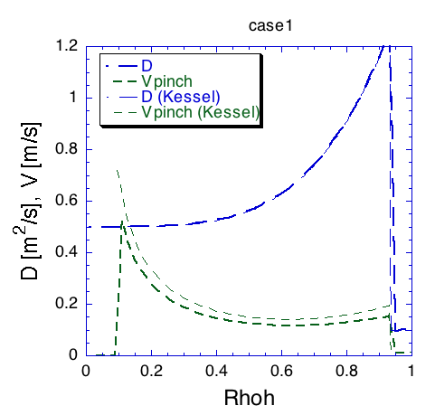

Settings in TOPICS
Normalized radius defined by square root of toroidal flux
cut diverging pinch in ρ<0.1
small difference due to "r" definition difference

Slide 50
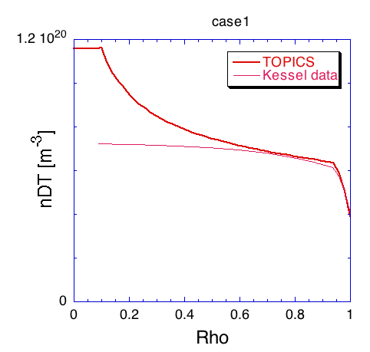
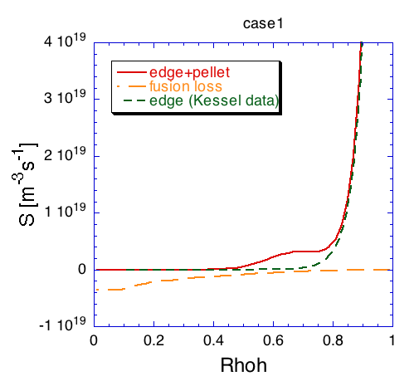
Results in TOPICS
More peaked density profile than Kessel data ??
given
It is confirmed that Bosh-Hale reaction model can produce almost the same α-heating power as Kessel data.

Slide 51
Other questions on the Kessel data
Difference of Z_{eff} value between one in the data and re-evaluated value from n_{e}, n_{He}, n_{Be}, n_{Ar} (δZ_{eff} ~ 0.02 (core) - 0.1 (edge))
Non full striped impuritis (Be, Ar) assumed ?

Slide 52
JINTRAC
Simulation rerun with the following modified settings:
  Additional pinch terms to accommodate for differences between solutions obtained with electron vs. ion particle transport equations in case of different impurity density profile shape:
  That way, the electron flux that would be obtained with an electron transport equation with fixed impurities can be calculated with the JETTO ion particle transport equations:

Slide 53
JINTRAC core particle transport equations
Main ion transport equations (JETTO):
where n_{i} is the density of the i-th hydrogenic species, V’ = dV/dρ,
S_{i} includes sources and sinks (neutrals, pellets, fusion losses etc.).
Impurity transport equations (SANCO):
where are ionisation and recombination sources and sinks for impurity species with indices i and the charge z

Slide 54
Pinch velocity has appeared as a definition issue among codes (maybe just TSC)
Particle transport eqn in TSC:
dN/dt = d/dΦ [ D V’ |grad(Φ)|² ( dn/dΦ +
V_{o} n/Φ) ] + S(Φ)
V_{o} = dimensionless = v*r/D
N = V’n
d’s are actually partials
From Irina V. for ASTRA:
d/dt(V’f) = d/dρ [ V’<(grad(ρ))²> ( D df/dρ – v f ) ] + V’S_{ρ}
d’s are actually partials
reference

