Slide 1

Update on NSTX-U
Plasma Operations
Devon Battaglia
On Behalf of the NSTX-U team
NSTX-U Monday Physics Meeting
March 7, 2016

Slide 2
Summary of NSTX-U Plasma Operations
3 weeks of operations December - January
  Neutral beam heating: typically 3MW total from four sources
  Diverted L-mode and H-mode operations at I_{p} = 600 kA
  Gap and I_{p} control, simple vertical position control
  Followed by 2 weeks of maintenance
3 weeks of operations in February – early March
  Neutral beam heating: up to 4MW total from three sources
    Beamline 1B routinely runs at 90kV
  Diverted L-mode (0.8 – 1.0MW) and H-mode (I_{p} = 0.8 MA)
  ISOFLUX, vertical position improvements, error field correction commissioned
  Now starting another 2 weeks of maintenance

Slide 3
Achieved H-mode scenarios at larger I_{p}, kappa and stored energy
Steady progress toward 1.4MA ELMy H-mode goal
202946: Best H-mode in January period
203655 and 203679: Best H-mode in Feb-March period
efit02

Slide 4
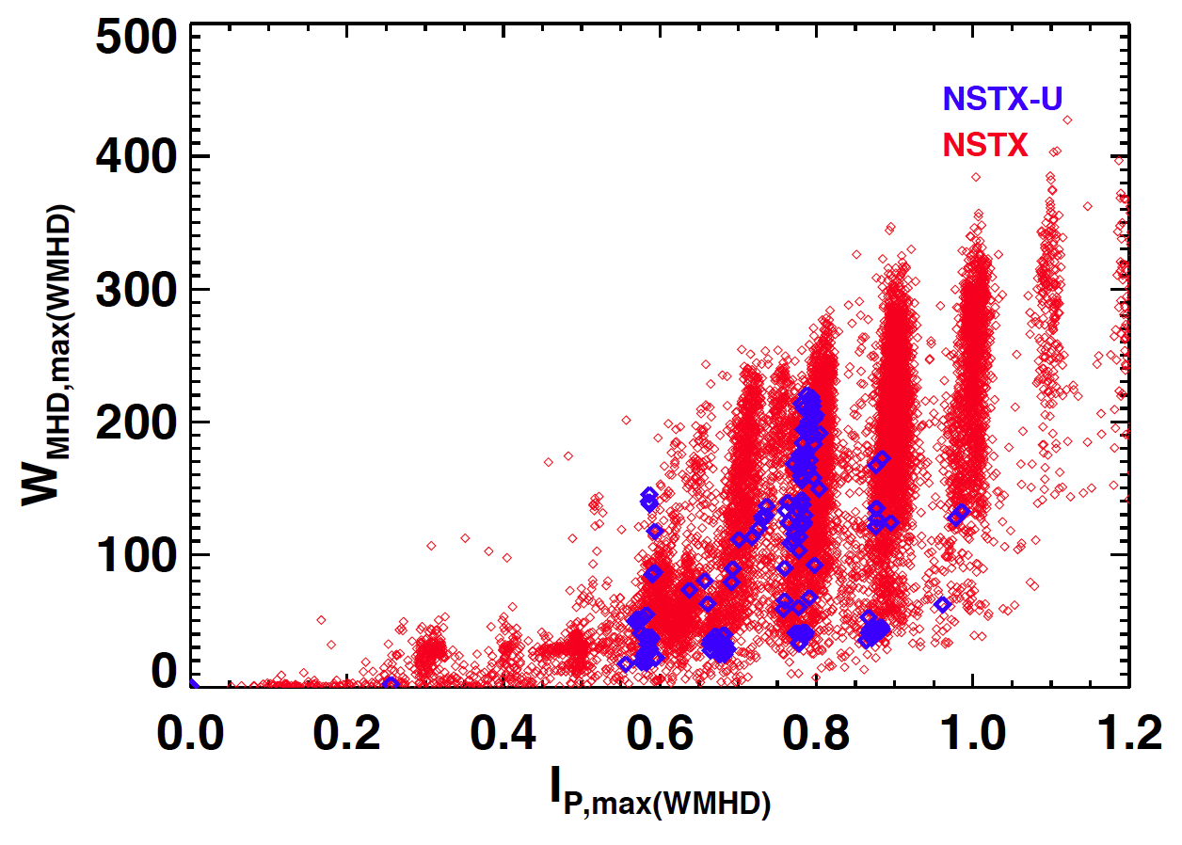
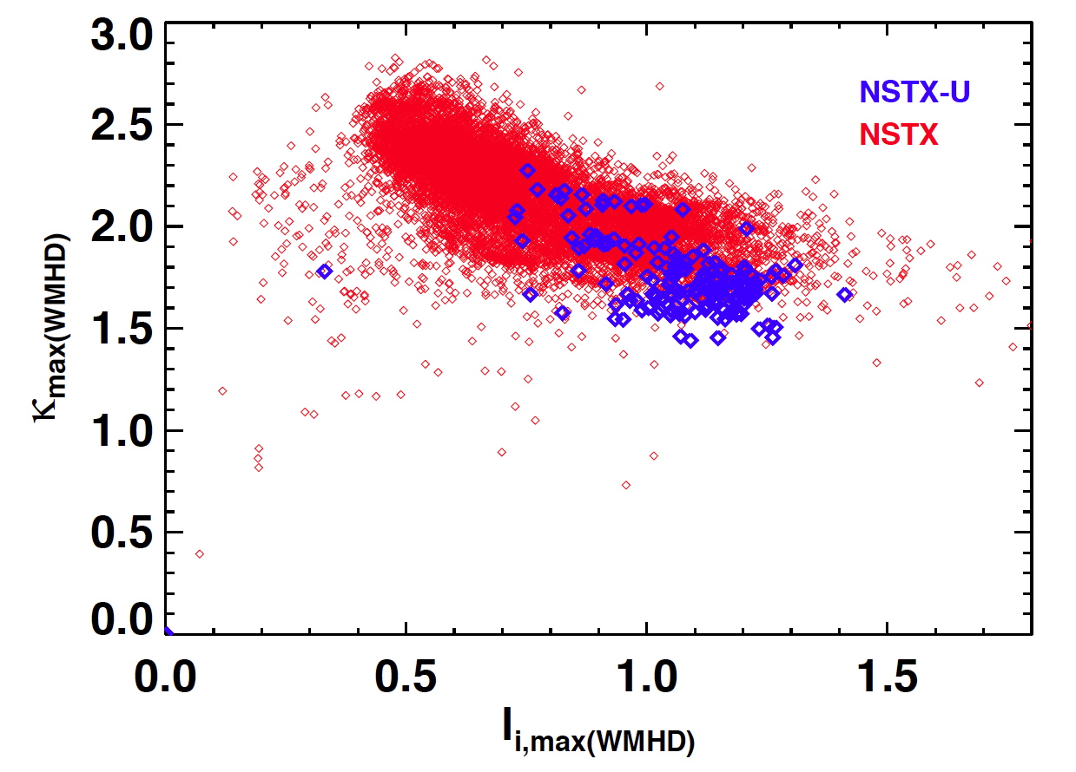
Making Progress in Shaping And High Stored Energy
Are approaching vertical stability boundaries similar to NSTX
(but at higher A)
Nearly Matching the NSTX Stored Energy for the Same Plasma Current
(at higher B_{T}, but lower volume)
NSTX-U Team!

Slide 5
ELMy H-mode shot with quiescent period achieved with highly-shaped LSN discharge
I_{p} | 0.78 MA
B_{T0} | 0.61 T
P_{NBI} | 4 MW
P_{OH} | 0.2 MW
A | 1.58
κ | 2.18
l_{i} | 0.83
δ_{lower} | 0.64
W | 206 kJ
β_{T} | 7.84%
β_{P} | 1.14%
β_{N} | 3.58
τ_{e} | 50 ms
EFIT02 now available between shots

Slide 6
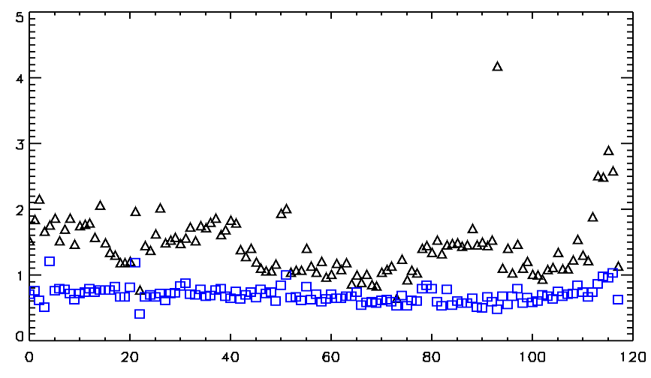
But, putting power on new divertor surfaces requires some “clean up” time
Average AXUV diode signal (A.U.)
20 – 70ms
70 – 120ms
Second H-mode shot after half-day of ohmic shots
Shots following first shot on inner div
Two H-mode shots following first shot with strike in CHI gap
Shots since last boronization

Slide 7
Stationary diverted L-mode operations have been extended to flattops > 1s
0.9 MW NBI
Sawteeth oscillations
203577
DN plasma boundary is steady for > 1 second as OH swings:
0.66 seconds 1.73 seconds
OH swings ± 19 kA
(80% of maximum flux)

Slide 8
L-Mode discharges have run with I_{p} = 1MA for a 700ms flattop
203577
203582
Both discharges have sawteeth and use the full OH flux swing
Plasma Current [MA]
elongation
Internal inductance
Stored Energy [kJ]
Injected Power [MW]

Slide 9
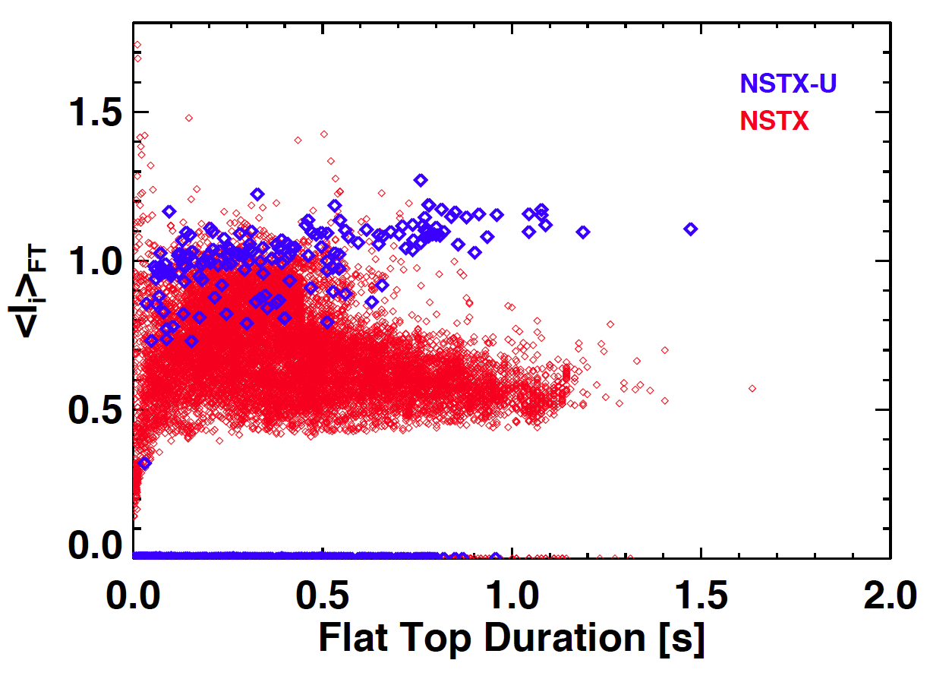
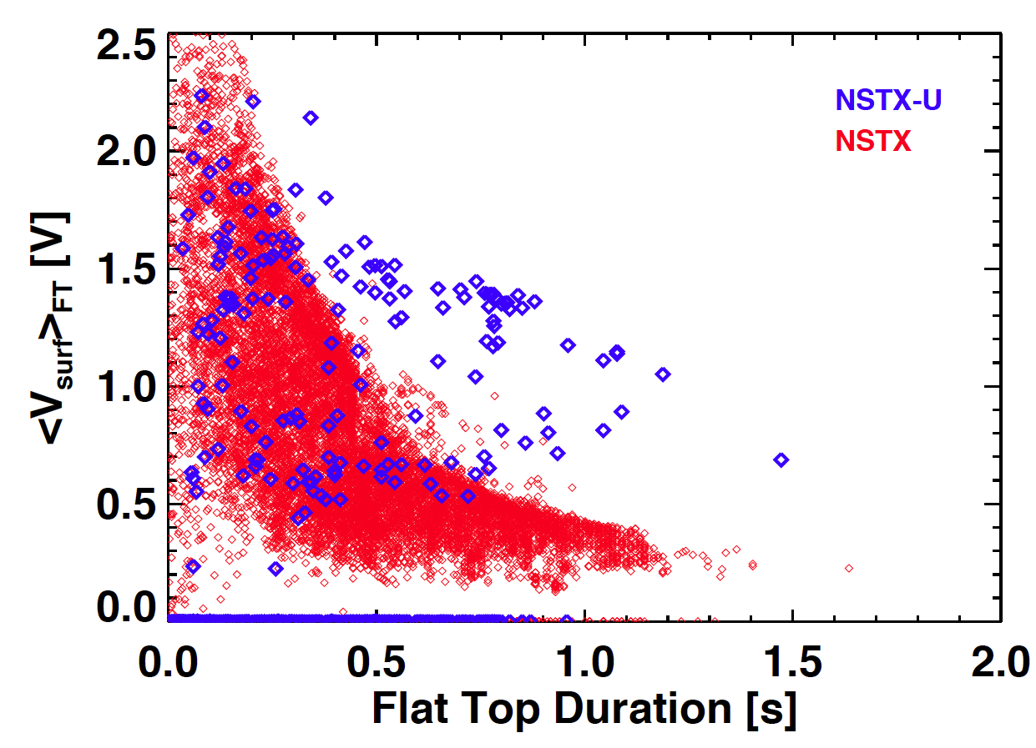
New Capabilities Already Evident When Flat-Top Averages Are Plotted
New solenoid has much greater capability
(and we are only allowing use of 80% of the available flux)
Can sustain L-mode plasma for physics studies much longer
NSTX-U Team!

Slide 10
Scenario development enabled by commissioned control tools
rtEFIT / ISOFLUX shape control
  See Dan Boyer’s Science talk from 2/22
  PF5 and PF3s control outboard boundary (outer gap, kappa)
  X-points, inner gap controlled via PF1As and PF2s versus I_{p} and I_{OH}
Improved vertical control tools
  Multi-sensor Z*dZ/dt measurement
  Filtering to remove power supply noise
  Signal conditioning to improve signal-to-noise
  Tools have not been fully exploited
EFIT02
rtEFIT

Slide 11
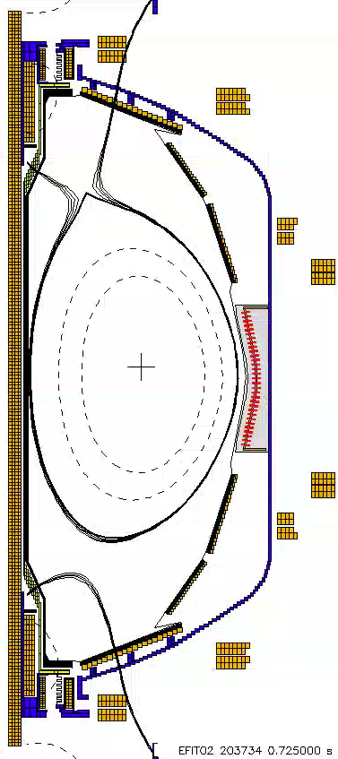
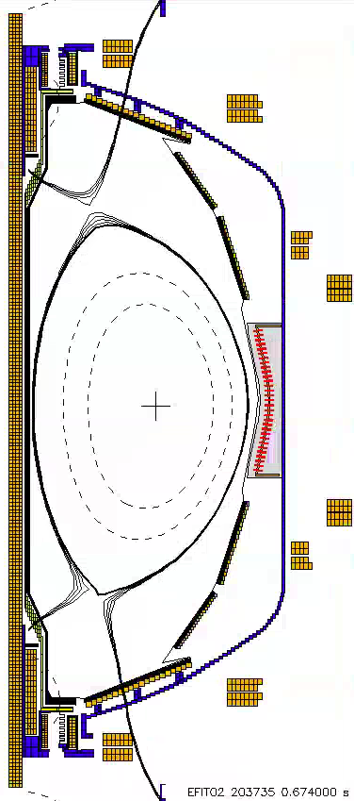
On Friday, dr-sep control was demonstrated
dr-sep controls bias of plasma toward X-points
  Critical parameter for boundary and pedestal physics studies
Biased Up
Biased Down

Slide 12
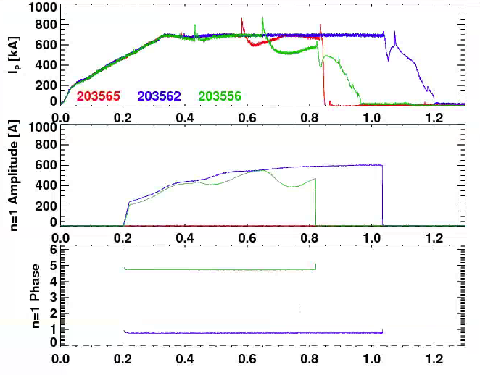
n=1 Error Field Correction Has Shown Success
EFC proportional to PF5
  See Clayton Myers Science meeting talk from 2/29
  Correct for PF5 out-of-roundness
n=1 fields applied with various phases
  Reference shot 203565 disrupts at t=0.6
  203562 uses correcting phase, extended duration.
  203556 uses anti-correcting phase, shorter discharge.

Slide 13
Key Accomplishments of Second
Operations Period
Made rtEFIT a reliable tool every shot
Commissioned ISOFLUX plasma control
  Outer-gap control through the PF-5 coil.
  Elongation control via PF-3 coils.
  Vertical position and dr-sep control via PF-3 coils
Improved fast vertical position control
Developed error field correction strategy
Developed long pulse and high current L-mode scenarios with ISOFLUX control
Developed H-mode scenarios with ISOFLUX control, at higher elongation and reduced internal inductance

