Slide 1
Inter-ELM pedestal evolution in ASDEX Upgrade: Magnetic activity correlated with the recovery of the edge profiles
NSTX-U Seminar, Princeton, November 14th, 2016
F. M. Laggner¹
E. Wolfrum², M. Cavedon^{2,3}, M. G. Dunne², F. Mink^{2,3}, G. Birkenmeier^{2,3},
R. Fischer², E. Viezzer², M. Willensdorfer², F. Aumayr¹,
the ASDEX Upgrade Team² and the EUROfusion MST1 Team
¹Institute of Applied Physics, TU Wien, Fusion@ÖAW, Wiedner Hauptstr. 8-10, 1040 Vienna, Austria
²Max-Planck-Institut für Plasmaphysik, Boltzmannstr. 2, 85748 Garching, Germany
³Physik-Department E28, Technische Universität München, James-Franck-Str.1, 85748 Garching, Germany

Slide 2
Outline
Introduction to pedestal stability
Pedestal recovery and onset of magnetic fluctuations
  Localization, poloidal and toroidal mode structure
Comparison of the pedestal recovery for different main ion species
  Similar sequence of recovery phases in different species
Connecting the evolution of the outer divertor to the pedestal recovery
  High recycling regime connected to density evolution
Summary & conclusions

Slide 3
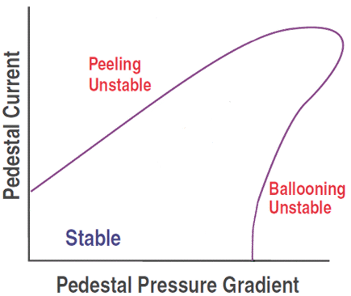
Pedestal stability
Peeling-ballooning P-B theory:
[P. B. Snyder et al., POP 2009]

Slide 4
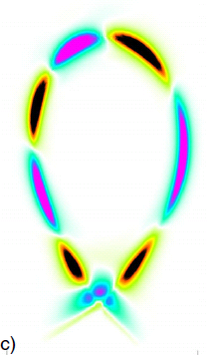
Pedestal stability
Peeling-ballooning P-B theory:
  Peeling Mode
    Current driven instability
[G. Huysmans, PPCF 2005]
[P. B. Snyder et al., POP 2009]

Slide 5
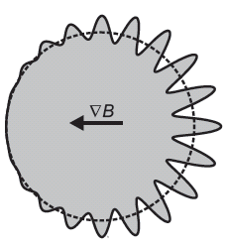
Pedestal stability
Peeling-ballooning P-B theory:
  Peeling Mode
    Current driven instability
  Ballooning Mode
    Pressure driven instability
[G. Huysmans, PPCF 2005]
[U. Stroth, 2011]
[P. B. Snyder et al., POP 2009]

Slide 6
Pedestal stability
Peeling-ballooning P-B theory:
  Peeling Mode
    Current driven instability
  Ballooning Mode
    Pressure driven instability
[G. Huysmans, PPCF 2005]
[U. Stroth, 2011]
P-B gives a ‘hard’ limit for the edge pressure
[P. B. Snyder et al., POP 2009]

Slide 7
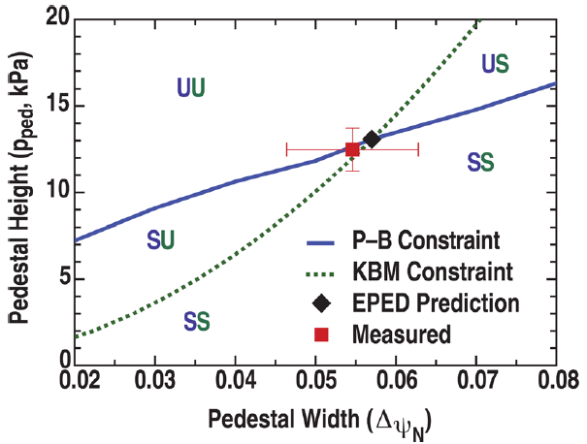
Pedestal evolution – ELM cycle
Model for type-I ELM cycle
width
pressure
height
radius
[P. B. Snyder et al., POP 2012]

Slide 8
Pedestal evolution – ELM cycle
Model for type-I ELM cycle
  Pedestal height and width increase till kinetic ballooning mode (KBM) boundary (‘soft limit’) is reached
width
pressure
height
radius
(1)
[P. B. Snyder et al., POP 2012]

Slide 9
Pedestal evolution – ELM cycle
Model for type-I ELM cycle
  Pedestal height and width increase till kinetic ballooning mode (KBM) boundary (‘soft limit’) is reached
  Pedestal gradient is clamped and height and width evolve along the KBM limit
width
pressure
height
radius
(2)
(1)
[P. B. Snyder et al., POP 2012]

Slide 10
Pedestal evolution – ELM cycle
Model for type-I ELM cycle
  Pedestal height and width increase till kinetic ballooning mode (KBM) boundary (‘soft limit’) is reached
  Pedestal gradient is clamped and height and width evolve along the KBM limit
  ELM crash when P-B (‘hard’) limit is reached
width
pressure
height
radius
(2)
(3) ELM
(1)
[P. B. Snyder et al., POP 2012]

Slide 11
Pedestal evolution – ELM cycle
Model for type-I ELM cycle
  Pedestal height and width increase till kinetic ballooning mode (KBM) boundary (‘soft limit’) is reached
  Pedestal gradient is clamped and height and width evolve along the KBM limit
  ELM crash when P-B (‘hard’) limit is reached
width
pressure
height
radius
  Limitation of pedestal evolution (‘soft limit’) observed in several experiments
  [A. Burckhart et al., PPCF 2010]
  [D. Dickinson et al., PRL 2012]
  [A. Diallo et al., PRL 2014]
  [A. Diallo et al., POP 2015]
  [X. Gao et al., NF 2015]
  [X. Zhong et al., PPCF 2016]
(2)
(3) ELM
(1)
[P. B. Snyder et al., POP 2012]

Slide 12
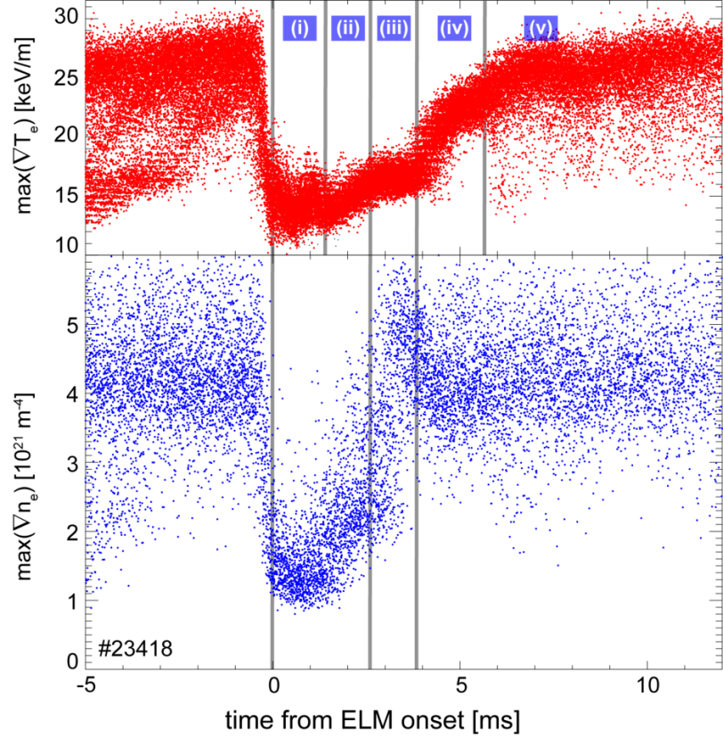
Previous observations at AUG…
ASDEX Upgrade
[A. Burckhart et al., PPCF 2010]

Slide 13
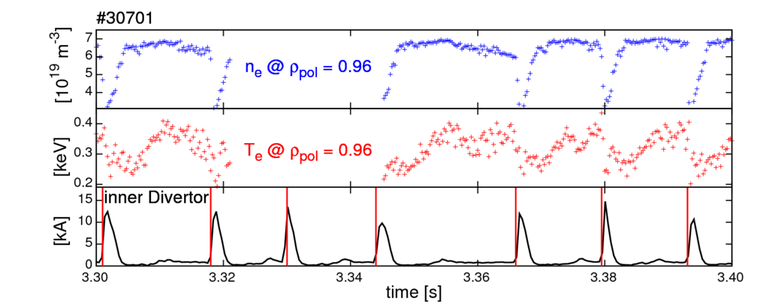
ELM synchronization
ELMs are quasi-periodic events
  Increase amount of data by averaging over several ‘equal’ ELMs

Slide 14
ELM synchronization
ELMs are quasi-periodic events
  Increase amount of data by averaging over several ‘equal’ ELMs
Procedure:
  Determination of individual ELM onset

Slide 15
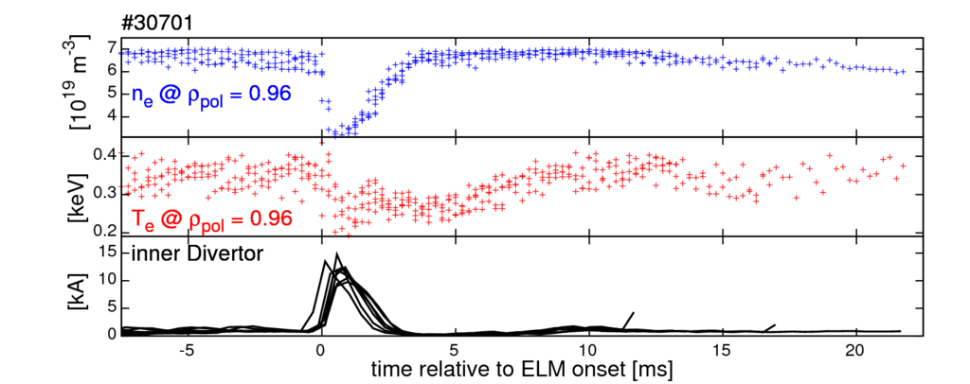
ELM synchronization
ELMs are quasi-periodic events
  Increase amount of data by averaging over several ‘equal’ ELMs
Procedure:
  Determination of individual ELM onset
  Collapse time base relative to ELM onset
Statistically significant effects are conserved

Slide 16
Previous observations at AUG…
n_{e} and T_{e} recover on different timescales
  First, max(∇ ne) recovery, then max(∇Te)
max(∇Te) established several milliseconds before onset of ELM crash
ASDEX Upgrade
[A. Burckhart et al., PPCF 2010]

Slide 17
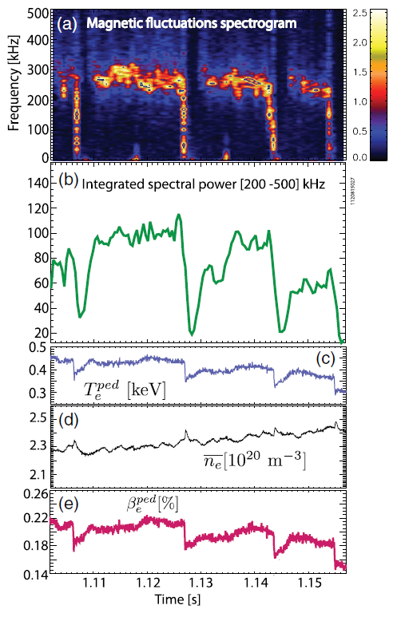
…in the US…
Magnetic fluctuations when pedestal top Te is recovered
DIII-D
Alcator
C-Mod
[A. Diallo et al., POP 2015]
[A. Diallo et al., PRL 2014]

Slide 18
…and in Asia
HL-2A
EAST
[W. L. Zhong et al., PPCF 2016]
[X. Gao et al., NF 2015]

Slide 19
…and in Asia
HL-2A
EAST
[W. L. Zhong et al., PPCF 2016]
[X. Gao et al., NF 2015]
Can we get deeper insight in the underlying instabilities?

Slide 20
Profile measurements at AUG
Electron density (n_{e}) and electron temperature (T_{e})
  Utilisation of integrated data analysis (IDA)
    [R. Fischer et al., FST 2010]
    Li-Beam and interferometry for n_{e}
    ECE for T_{e}
      ECFM to model ECE propagation in the optically thin plasma
      [S.K. Rathgeber et al., PPCF 2013]
  Profiles evaluated 250 μs time resolution

Slide 21
Outline
Introduction to pedestal stability
Pedestal recovery and onset of magnetic fluctuations
  Localization, poloidal and toroidal mode structure
Comparison of the pedestal recovery for different main ion species
  Similar sequence of recovery phases in different species
Connecting the evolution of the outer divertor to the pedestal recovery
  High recycling regime connected to density evolution
Summary & conclusions

Slide 22
Two discharges having similar p_{e}
High (#30701) and low (#30721) pedestal top electron collisionality ν*e,ped
Motivation for comparison:
  Pressure (gradient) driven instabilities should not change their behavior

Slide 23
Two discharges having similar p_{e}
High (#30701) and low (#30721) pedestal top electron collisionality ν*e,ped
Motivation for comparison:
  Pressure (gradient) driven instabilities should not change their behavior
In both discharges gradients are clamped before the ELM onset (‘soft limit’)

Slide 24
Similar recovery of n_{e} and T_{e}
High ν*e,ped (#30701) case
First ne,ped recovery (Δtn_{e}), then Te,ped (ΔtT_{e})
  [A. Burckhart et al., PPCF 2010]
Fluctuations start after ΔtT_{e}
LFS
midplane

Slide 25
Similar recovery of n_{e} and T_{e}
High ν*e,ped (#30701) case
First ne,ped recovery (Δtn_{e}), then Te,ped (ΔtT_{e})
  [A. Burckhart et al., PPCF 2010]
Fluctuations start after ΔtT_{e}
Low ν*e,ped (#30721) case
Similar phases
High frequency fluctuations also start after ΔtT_{e}
Fluctuations correlated to the recovery of ne,ped & Te,ped/pe,ped

Slide 26
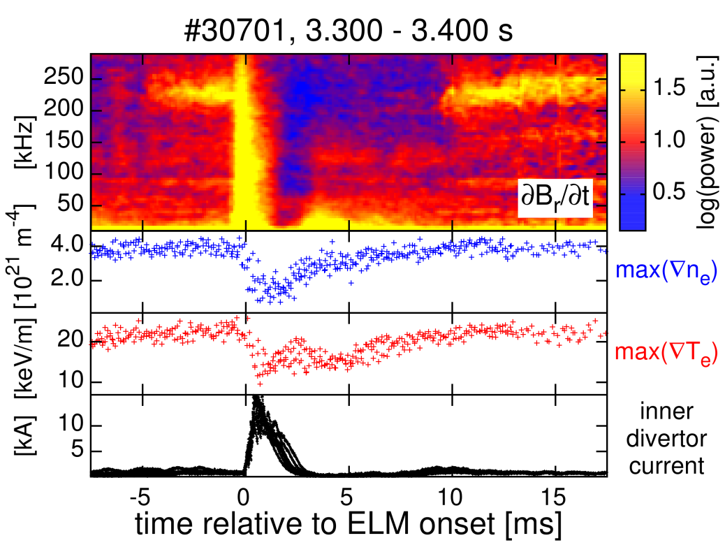
∇n_{e} and ∇ T_{e} clamped before ELM
High ν*e,ped (#30701) case
max(∇ne) and max(∇Te) evolve till high frequency fluctuation onset

Slide 27
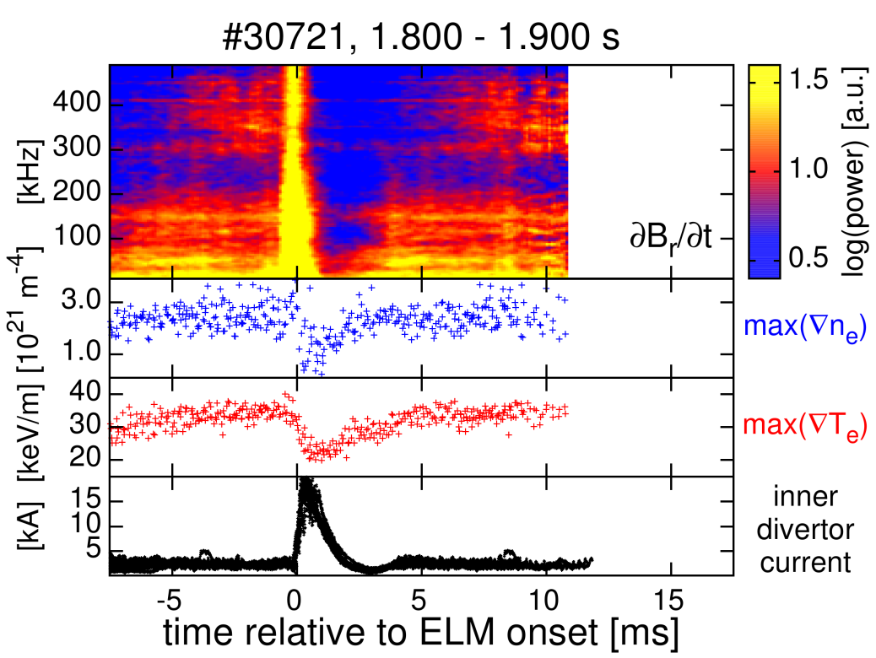
∇n_{e} and ∇ T_{e} clamped before ELM
High ν*e,ped (#30701) case
max(∇ne) and max(∇Te) evolve till high frequency fluctuation onset
Low ν*e,ped (#30721) case
Gradients are also clamped after onset of fluctuations
Fluctuations have much higher frequency
What determines the detected fluctuation frequency?

Slide 28
Mode propagation – E×B velocity
H-mode → strong E×B background velocity at the edge
In the steep gradient region Er is well described by estimation ∇pi/eni
[E. Viezzer et al., NF 2014]
Er and ∇pe/ene agree within their errors in the analyzed cases
  Estimation of background velocity by ∇pe/ene valid

Slide 29
Mode propagation – E×B velocity
H-mode → strong E×B background velocity at the edge
In the steep gradient region Er is well described by estimation ∇pi/eni
[E. Viezzer et al., NF 2014]
Er and ∇pe/ene agree within their errors in the analyzed cases
  Estimation of background velocity by ∇pe/ene valid

Slide 30
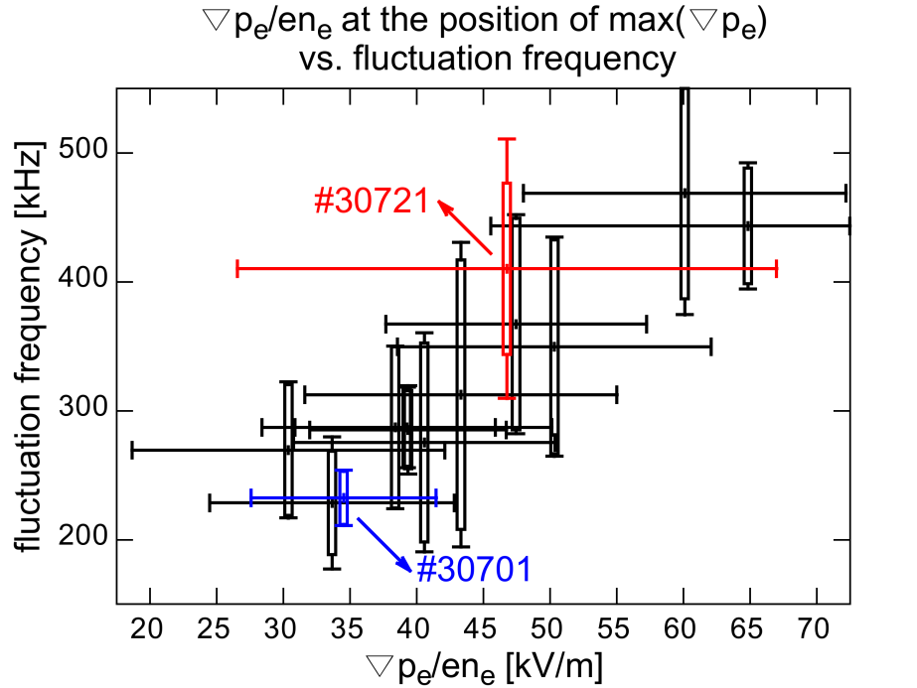
Mode propagation – E×B velocity
11 discharge intervals:
  Selected to span wide range of ∇pe/ene
  Clear magnetic fluctuations (onset correlated to Te,ped recovery)
Detected fluctuation frequency increases with ∇pe/ene at position of max(∇pe)
Mode is located in the steep gradient region

Slide 31
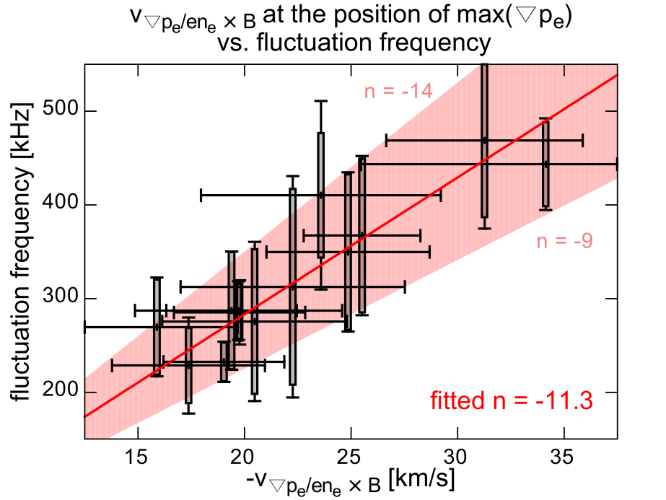
Toroidal mode structure
Fit of n using the discharge intervals with different ∇pe/ene
Fit of toroidal mode number:
  n ~ Utor·fmagn/(v∇p_{e/}en_{e}·q·Utor/Upol+vtor)
Fitted n ~ -11
  Negative n
    Counter-current or propagation in elec-tron diamagnetic direction

Slide 32
Mode number analysis
Top down view on AUG
Transfer functions of Br coils are required
[L. Horvath et al., PPCF 2015]
  Especially for high toroidal mode numbers n and at high fluctuation frequencies
Bt
Ip

Slide 33
Mode number analysis
Top down view on AUG
Transfer functions of Br coils are required
[L. Horvath et al., PPCF 2015]
  Especially for high toroidal mode numbers n and at high fluctuation frequencies
Negative n:
    Counter-current propagation or propagation in electron diamagnetic direction
Bt
Ip
n < 0
v⊥ (e,dia)
vtor (counter-current)
vtor (co-current)
B
v ⊥ (i,dia)
n > 0

Slide 34
Mode number analysis
Top down view on AUG
Transfer functions of Br coils are required
[L. Horvath et al., PPCF 2015]
  Especially for high toroidal mode numbers n and at high fluctuation frequencies
Negative n:
    Counter-current propagation or propagation in electron diamagnetic direction
Mode number fitted for every individual ELM cycle in time interval → fits superimposed → mode number histogram
Bt
Ip
n < 0
v⊥ (e,dia)
vtor (counter-current)
vtor (co-current)
B
v ⊥ (i,dia)
n > 0

Slide 35
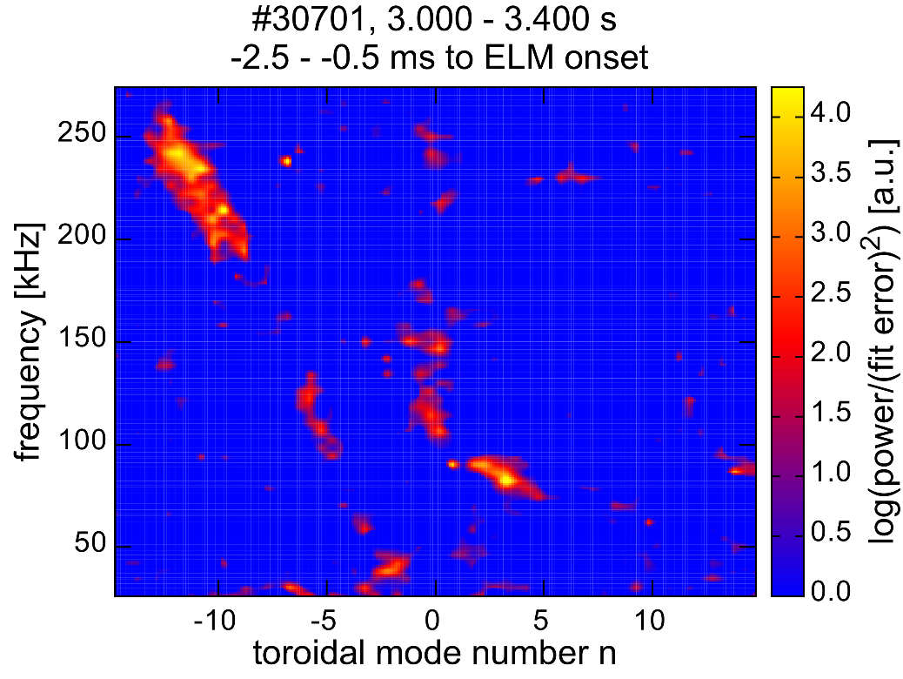
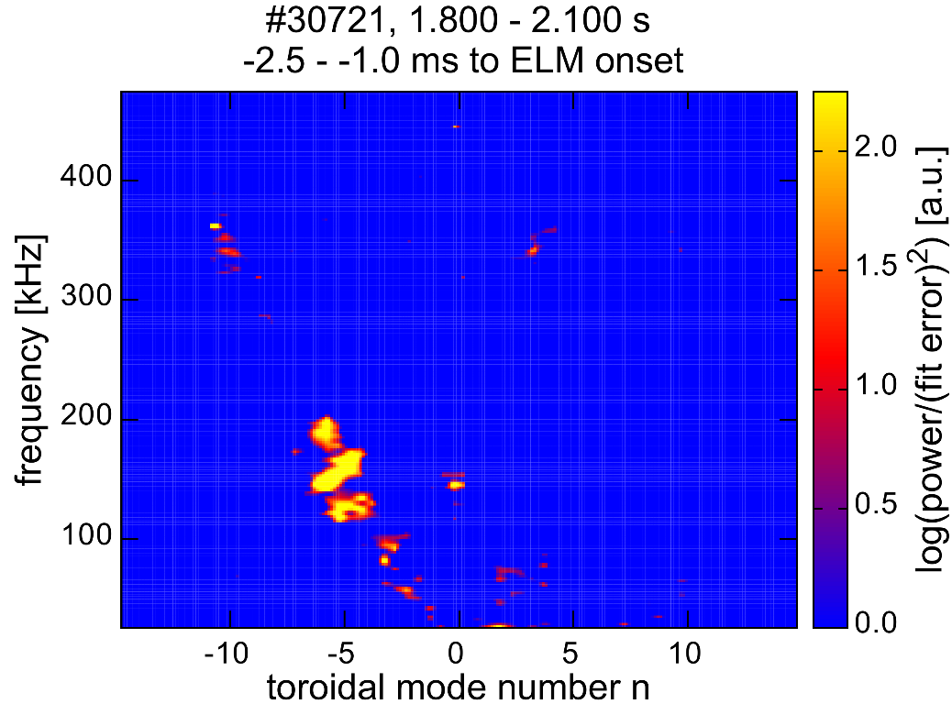
Similar n for both discharges
In both cases n ~ -11 for the high frequency fluctuations
  Similar mode structure
    Different frequency due to different background vE×B

Slide 36
Similar n for both discharges
In both cases n ~ -11 for the high frequency fluctuations
  Similar mode structure
    Different frequency due to different background vE×B
Mode structure aligns with low frequency fluctuations < 200 kHz
  Same propagation velocity → same location?

Slide 37
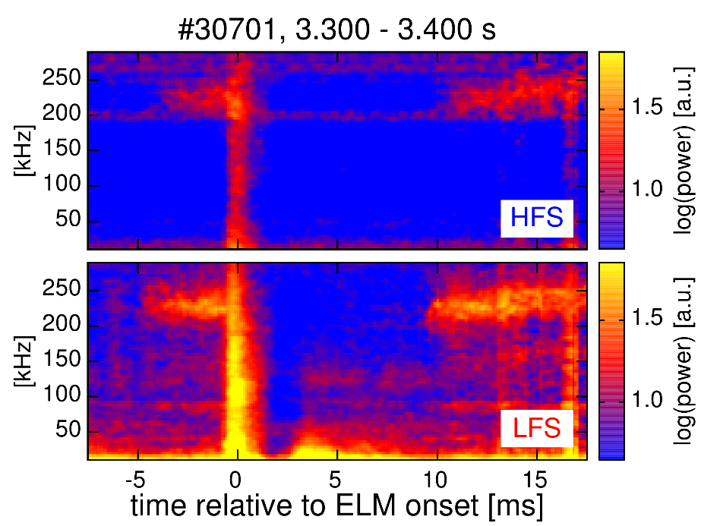
Fluctuations are seen on the HFS
Fluctuation signature visible on the HFS
  Similar onset as on the LFS
  Same frequencies as on LFS
[F. M. Laggner et al., PPCF 2016]
HFS
LFS
HFS
LFS
HFS
LFS

Slide 38
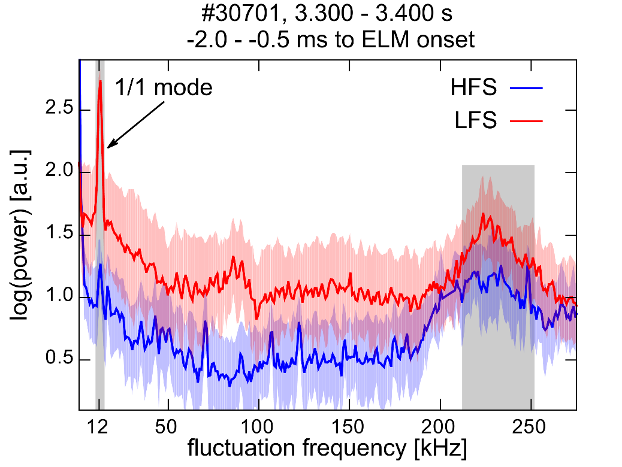
Fluctuations are seen on the HFS
Fluctuation signature visible on the HFS
  Similar onset as on the LFS
  Same frequencies as on LFS
[F. M. Laggner et al., PPCF 2016]
HFS
LFS
HFS
LFS

Slide 39
Fluctuations are seen on the HFS
Fluctuation signature visible on the HFS
  Similar onset as on the LFS
  Same frequencies as on LFS
[F. M. Laggner et al., PPCF 2016]
HFS
LFS
HFS
LFS
Supports large peeling component of mode structure

Slide 40
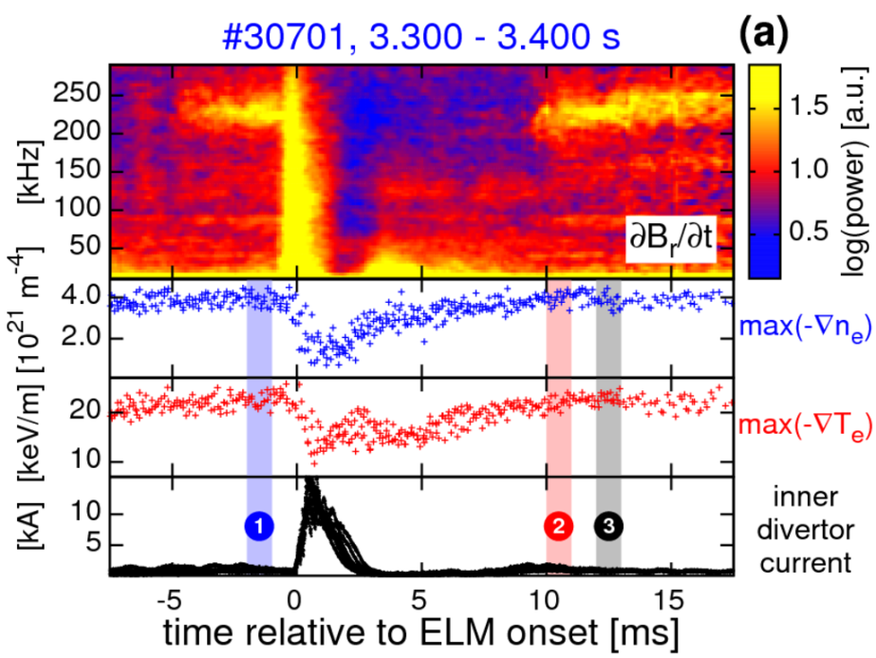
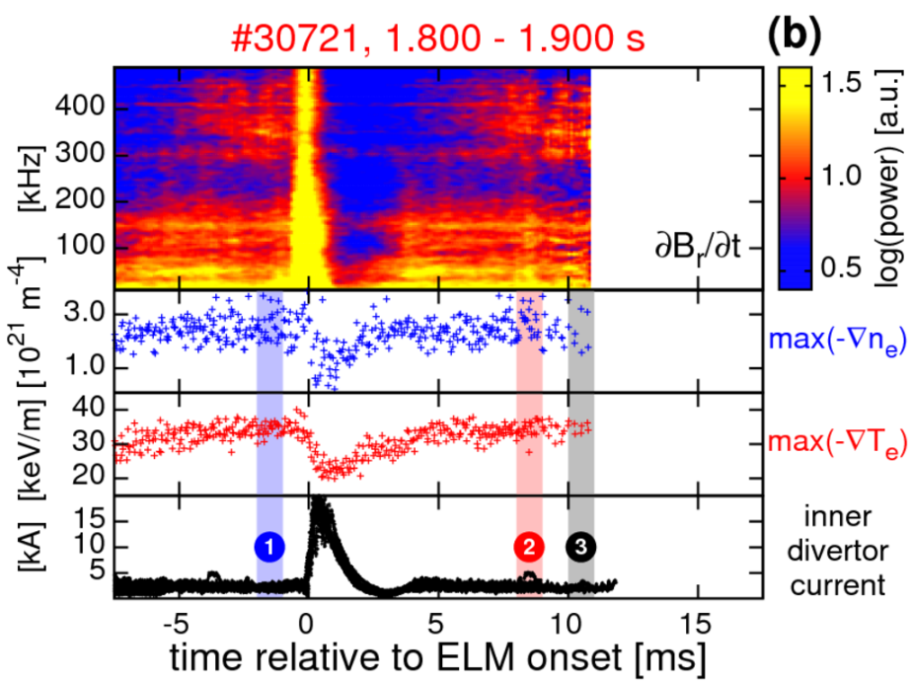

Linear ideal MHD stability analysis
Investigate possible drives for instabilities (peeling vs. ballooning)
  3 phases with presence of high frequency fluctuations & clamped gradients

Slide 41
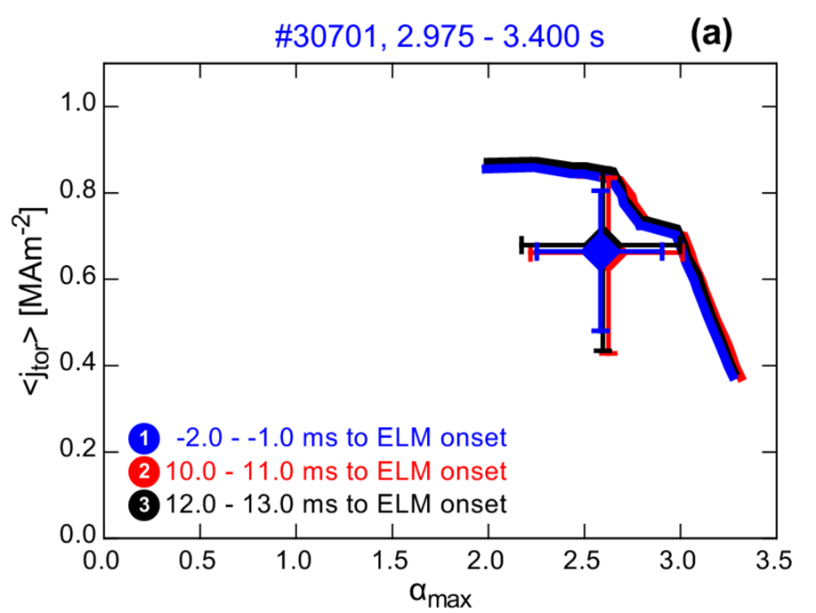
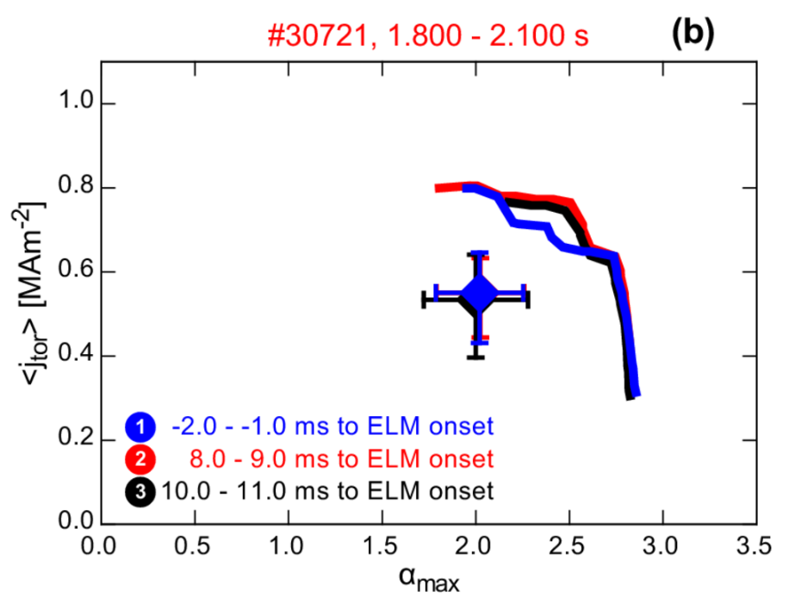
Linear ideal MHD stability analysis
Investigate possible drives for instabilities (peeling vs. ballooning)
  3 phases with presence of high frequency fluctuations & clamped gradients
No evolution of operational point
No evolution of the stability boundary

Slide 42
Linear ideal MHD stability analysis
Investigate possible drives for instabilities (peeling vs. ballooning)
  3 phases with presence of high frequency fluctuations & clamped gradients
No evolution of operational point
No evolution of the stability boundary
While high frequency fluctuations, pedestals consistent with P-B

Slide 43
Outline
Introduction to pedestal stability
Pedestal recovery and onset of magnetic fluctuations
  Localization, poloidal and toroidal mode structure
Comparison of the pedestal recovery for different main ion species
  Similar sequence of recovery phases in different species
Connecting the evolution of the outer divertor to the pedestal recovery
  High recycling regime connected to density evolution
Summary & conclusions

Slide 44
Pedestal top match in D and H
Match of the edge profiles
  Ip ~ 1.0 MA, Bt ~ -2.5 T, q95 ~ 3.8
factor of ~2 higher heating power in H
factor of ~10 higher gas fueling rates in H required
Steeper pedestal ne profile in D
D
gas puff
1.5·10²¹ s⁻¹
Pheat
~3.9 MW
H
gas puff
12·10²¹ s⁻¹
Pheat
~7.5 MW

Slide 45
He discharges
Main ion density (ni) ~ 0.5 ne
When comparable ne to D and H
  ELM free
    Edge pressure gradient not critical
Higher pedestal top ne required to get ELMs
He
gas puff
0.1·10²¹ s⁻¹
Pheat
~8.5 MW

Slide 46
Inter-ELM pedestal evolution similar
Pedestal recovery phases
  ne pedestal (Δtn_{e})
  Te pedestal (ΔtT_{e})
Different timescales
  attributed to changes in Pheat, gas puff and neutral velocity
Ti evolves on
timescale of ne

Slide 47
Inter-ELM pedestal evolution similar
Pedestal recovery phases
  ne pedestal (Δtn_{e})
  Te pedestal (ΔtT_{e})
Different timescales
  attributed to changes in Pheat, gas puff and neutral velocity
Ti evolves on
timescale of ne
Indication for similar mechanisms acting in the pedestal recovery

Slide 48
Pre-ELM toroidal mode structures
Negative n:
  Similar to the one observed in the ν*_{e,ped} variation
Two mode number branches with similar n
  [F. Mink et al., accepted in PPCF]
Slope represents
different rotation
velocity relative
to the lab frame

Slide 49
Pre-ELM toroidal mode structures
Negative n:
  Similar to the one observed in the ν*_{e,ped} variation
Two mode number branches with similar n
  [F. Mink et al., accepted in PPCF]
Slope represents
different rotation
velocity relative
to the lab frame
E×B velocity affected by changes in ∇ne

Slide 50
Frequencies consistent with E×B
Data from pedestal parameter variation
  Selected to span wide range of ∇p_{e}/en_{e}
Transformed into E×B velocity
[F. M. Laggner et al., PPCF 2016]

Slide 51
Frequencies consistent with E×B
Data from pedestal parameter variation
  Selected to span wide range of ∇p_{e}/en_{e}
Transformed into E×B velocity
D,H and He plasmas have different rotation, therefore detected frequency is different

Slide 52
Outline
Introduction to pedestal stability
Pedestal recovery and onset of magnetic fluctuations
  Localization, poloidal and toroidal mode structure
Comparison of the pedestal recovery for different main ion species
  Similar sequence of recovery phases in different species
Connecting the evolution of the outer divertor to the pedestal recovery
  High recycling regime connected to density evolution
Summary & conclusions

Slide 53
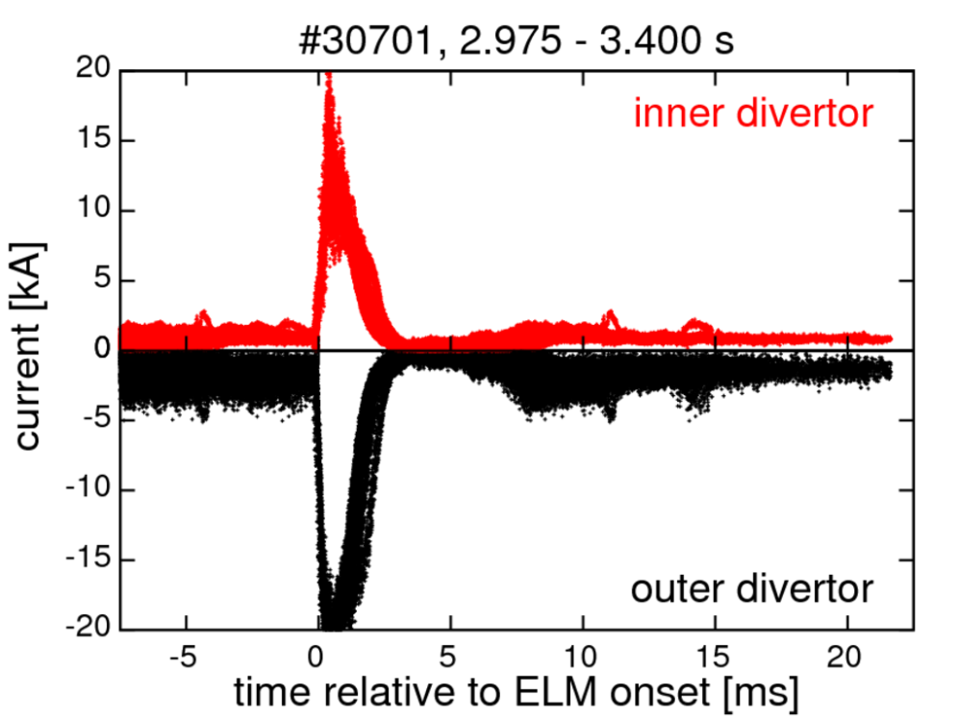
Change of the divertor conditions
Outer divertor in high recycling regime after the ELM crash
Occurrence depends on the gas puff

Slide 54
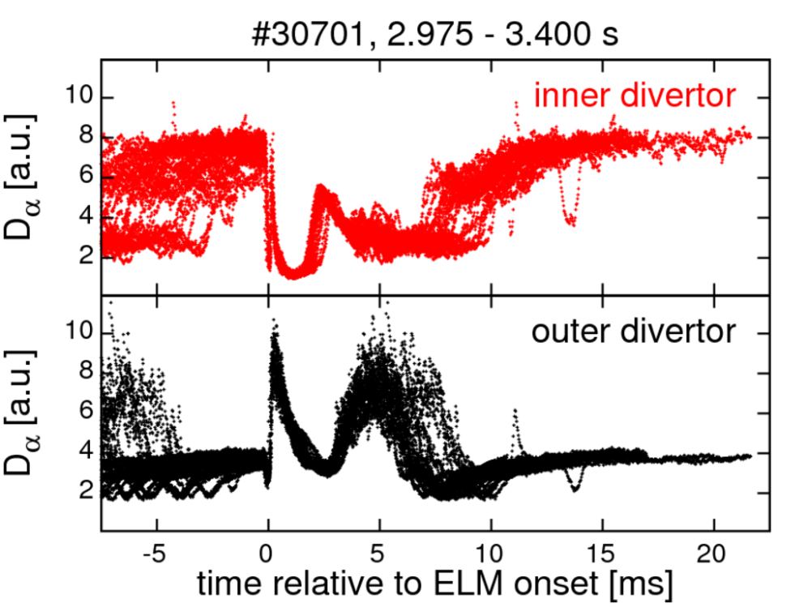
Change of the divertor conditions
Outer divertor in high recycling regime after the ELM crash
Occurrence depends on the gas puff
[M. Wischmeier et al., JNM 2007]

Slide 55
Change of the divertor conditions
Outer divertor in high recycling regime after the ELM crash
Occurrence depends on the gas puff
Post-ELM n_{e} increase at the outer target
[M. Wischmeier et al., JNM 2007]
[S. Brezinsek et al., Phys. Scr. 2016]

Slide 56
Connecting divertor to pedestal

Slide 57
Connecting divertor to pedestal

Slide 58
Connecting divertor to pedestal

Slide 59
Connecting divertor to pedestal

Slide 60
Simple 1D-estimation of transport
Continuity equation:
Estimation of the source (Si) by 1D neutral transport code KN1D
[B. LaBombard, PSFC report 2000]

Slide 61
Particle transport dynamic after ELM
Continuity equation:
Diffusive particle flux assumed
Prior ELM
  reference scale for Si
    D assumed 0.25 m²/s (ρpol 0.96)
    Determination of α
Post ELM
  D significantly decreases when magnetic activity is low
  D increase when fluctuations set in

Slide 62
Particle transport dynamic after ELM
Continuity equation:
Diffusive particle flux assumed
Prior ELM
  reference scale for Si
    D assumed 0.25 m²/s (ρpol 0.96)
    Determination of α
Post ELM
  D significantly decreases when magnetic activity is low
  D increase when fluctuations set in
Indication for change of particle transport

Slide 63
Summary & conclusions
Magnetic fluctuations correlated with pedestal evolution
  Onset correlated to the recovery of Te,ped (clamping of ∇ne and ∇Te)
  Detected frequency scales with background velocity
  Toroidal mode structure with n ~ -11 in all investigated cases
  Fluctuations are detectable on the HFS
    Instability located in the steep gradient region, large scale toroidal structure with significant peeling component

Slide 64
Summary & conclusions
Magnetic fluctuations correlated with pedestal evolution
  Onset correlated to the recovery of Te,ped (clamping of ∇ne and ∇Te)
  Detected frequency scales with background velocity
  Toroidal mode structure with n ~ -11 in all investigated cases
  Fluctuations are detectable on the HFS
    Instability located in the steep gradient region, large scale toroidal structure with significant peeling component
Identified in D, H and He plasmas
  Similar sequence pedestal recovery phases
  Pre-ELM toroidal mode structure comparable
    Mechanisms in pedestal recovery independent of main ion species

Slide 65
Summary & conclusions
Magnetic fluctuations correlated with pedestal evolution
  Onset correlated to the recovery of Te,ped (clamping of ∇ne and ∇Te)
  Detected frequency scales with background velocity
  Toroidal mode structure with n ~ -11 in all investigated cases
  Fluctuations are detectable on the HFS
    Instability located in the steep gradient region, large scale toroidal structure with significant peeling component
Identified in D, H and He plasmas
  Similar sequence pedestal recovery phases
  Pre-ELM toroidal mode structure comparable
    Mechanisms in pedestal recovery independent of main ion species
Divertor evolution during ELM-cycle
  High recycling regime in the outer divertor connected to ne recovery
    Indication for change of particle transport

Slide 66
Backup

Slide 67
Comparison to results from JOREK
With diamagnetic rotation (tauIC>0) high n are stabilized
  Most unstable: 4 ≤ n ≤ 12 (here: n = 12)
[F. Orain, A. Lessig et al., EPS 2016]

Slide 68
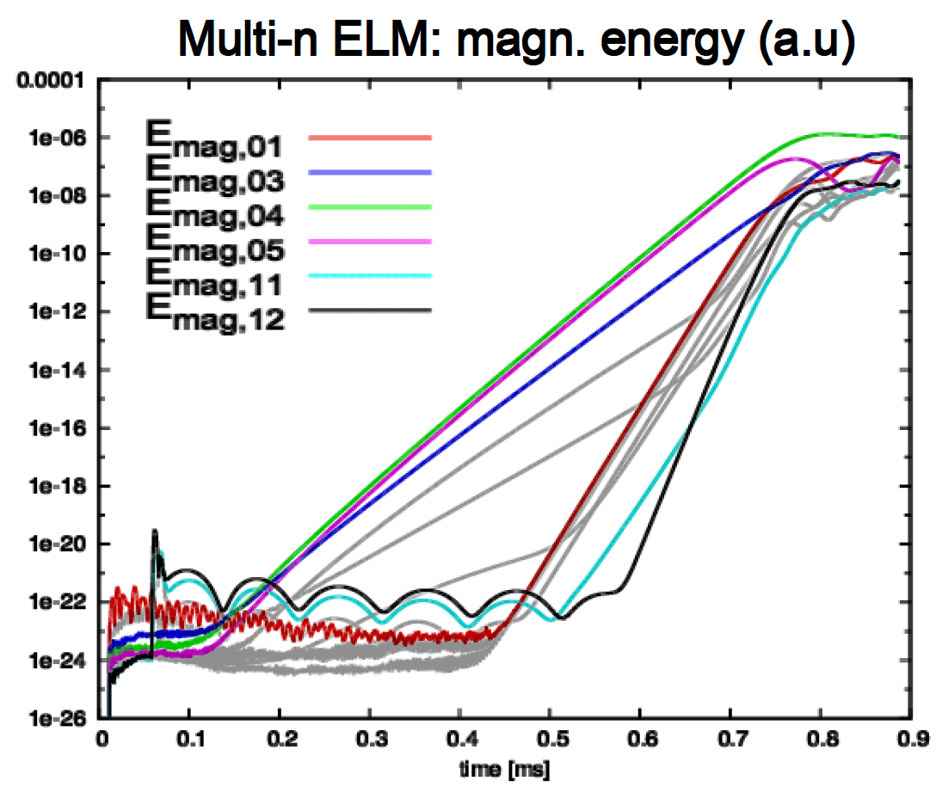
Comparison to results from JOREK
With diamagnetic rotation (tauIC>0) high n are stabilized
  Most unstable: 4 ≤ n ≤ 12 (here: n = 12)
Multi n simulation
  Medium n pre-ELM structures
  Non-linear coupling of medium n
    Low n structures
  [I. Krebs et al., PoP 2013]
  Saturation of modes
    Clamping of ∇p (‘soft limit’)
[F. Orain, A. Lessig et al., EPS 2016]

Slide 69
More frequent & larger ELMs in H
fELM doubles from D to H
    ELM frequency (fELM)
ΔWMHD in H twice as large as in D
    ELM energy loss (ΔWMHD)
PELM 4 times higher in H than in D
    Power loss by ELMs (PELM)
Pnet-PELM-Prad,sep 1.8 times larger in H
    Corrected heating power (Pnet)
    Radiated power inside the separatrix (Prad,sep)
D
fELM ~ 50 Hz
ΔWMHD
~20 kJ
Pnet
~3.8 MW
Prad,sep
~1.3 MW
H
fELM ~100 Hz
ΔWMHD
~37 kJ
Pnet
~7.3 MW
Prad,sep
~0.7 MW

Slide 70
More frequent & larger ELMs in H
fELM doubles from D to H
    ELM frequency (fELM)
ΔWMHD in H twice as large as in D
    ELM energy loss (ΔWMHD)
PELM 4 times higher in H than in D
    Power loss by ELMs (PELM)
Pnet-PELM-Prad,sep 1.8 times larger in H
    Corrected heating power (Pnet)
    Radiated power inside the separatrix (Prad,sep)
Larger power flux across the pedestal in H
D
fELM ~ 50 Hz
ΔWMHD
~20 kJ
Pnet
~3.8 MW
Prad,sep
~1.3 MW
H
fELM ~100 Hz
ΔWMHD
~37 kJ
Pnet
~7.3 MW
Prad,sep
~0.7 MW

Slide 71
n_{e} pedestal evolution
Δtn_{e} longer in D in comparison to H
  ne pedestal recovery time (Δtn_{e})
Possible reasons
  Gas fueling rate differs by a factor of ~10
  Velocity of neutrals faster in H
    Deeper neutral penetration
  Increased outward particle transport from the core to the pedestal top
D
gas puff 1.5·10²¹ s⁻¹
H
gas puff 12·10²¹ s⁻¹

Slide 72
T_{e} pedestal evolution
ΔtT_{e} faster in H
  Te pedestal recovery time (ΔtT_{e})
Explanation
  Larger heat flux to the pedestal in H
    Higher Pnet-Prad,sep
D
Pnet
~ 3.8 MW
H
Pnet
~ 7.3 MW

Slide 73
Magnetic signature
∂Br/∂t measured at the LFS midplane
  Radial magnetic fluctuations (∂Br/∂t)
Core modes
  Frequency < 40 kHz
Lower magnetic activity during Δtn_{e}
  40 kHz < frequency < 200 kHz
After ΔtT_{e} activity at high frequencies
  Frequency > 200 kHz
D
H

