Slide 1
Recovery Project Update
Stefan Gerhardt
Acknowledgements to the Engineering Team that Did all the Work
NSTX-U Physics Meeting
B-318
8/7/17

Slide 2
Overview
CDR
Overview
Inner-PF Coils
Vessel “Polar Region”
PFCs
Bakeout Improvements
Vessel Instrumentation
Test Cell Shielding
Next Steps

Slide 3
Overview
CDR
Overview
Inner-PF Coils
Vessel “Polar Region”
PFCs
Bakeout Improvements
Vessel Instrumentation
Test Cell Shielding
Next Steps

Slide 4
CDR Has Been a Major Focus of the Recovery Project
Chaired by Valeria Riccardo, Engineering Department Head
Three Days, Tues-Thurs last week
2 for presentations, 1 for parallel breakout sessions and debrief
Six major topics:
Inner-PF Coils
Vessel “Polar Region”
PFCs
Bakeout Improvements
Vessel Instrumentation
Test Cell Shielding
These are most of the major mechanical engineering design scope of the Recovery
External Reviewers
R. Bamber
B. Beck
R. Parker
R. Haange
A. Kellman
D. Kellman
T. Todd
R. Vieira
C. Vorpahl
D. Youchison

Slide 5
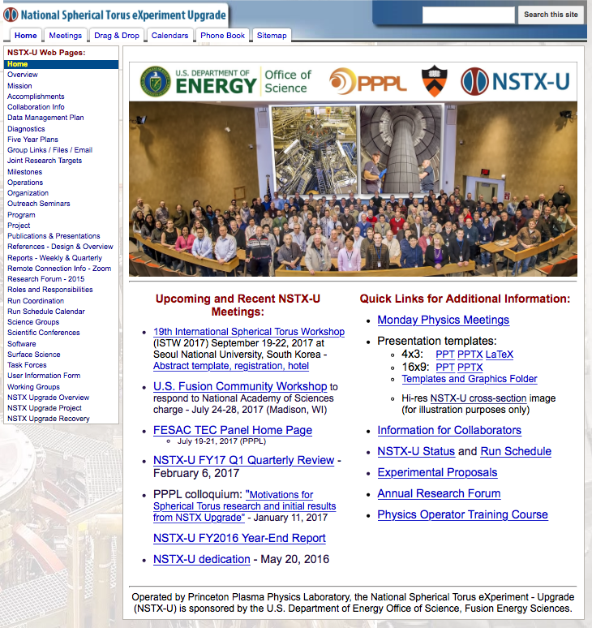
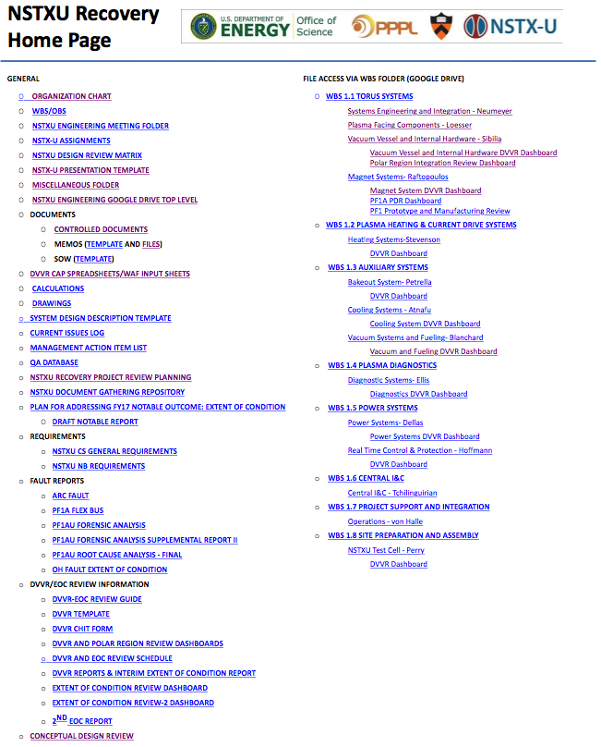
You Have Access to the Presentations

Slide 6
You Will Find the CDR Homepage

Slide 7
Overview
CDR
Overview
Inner-PF Coils
Vessel “Polar Region”
PFCs
Bakeout Improvements
Vessel Instrumentation
Test Cell Shielding
Next Steps

Slide 8
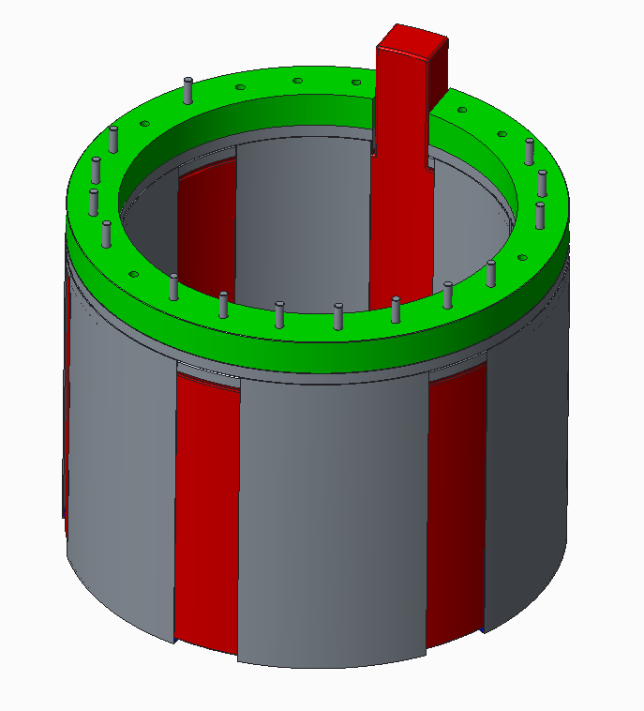
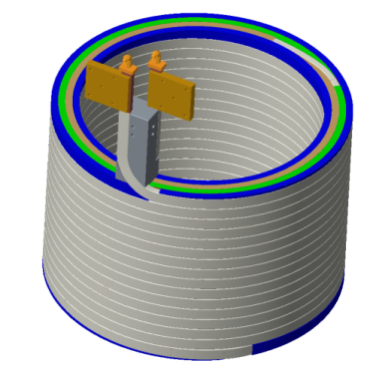
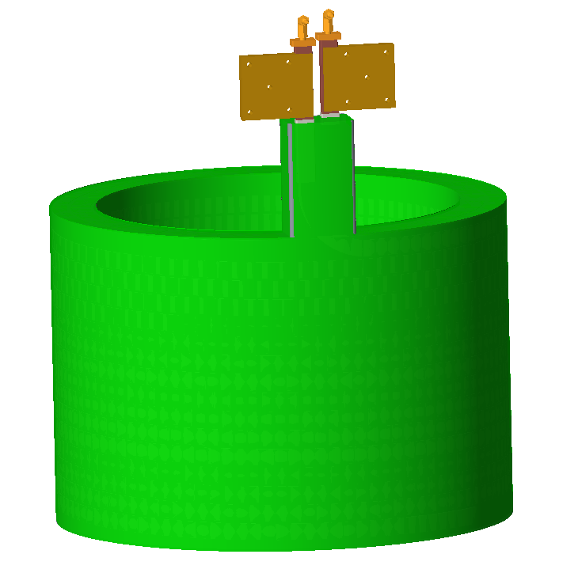
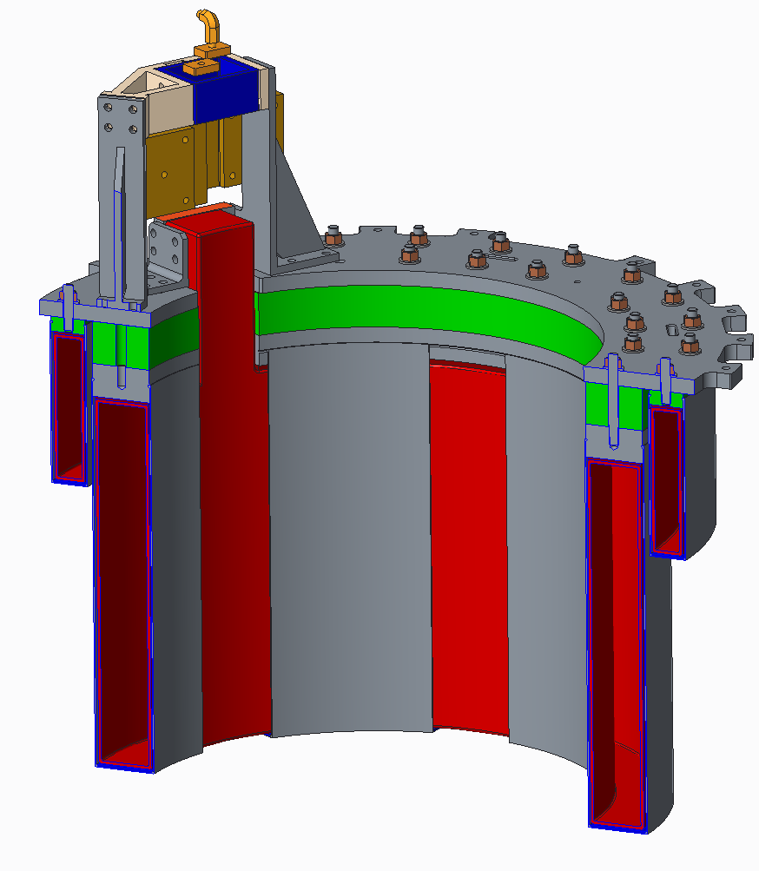
Day 1 Coil Presentations: Design
Discussed designs for coils w/o permanent mandrels
Discussed turn-turn & turn-ground insulation
Discussed support structures for coils based on “slings”
Presented analysis showing acceptable EM stresses in slings & coils, acceptable thermal stresses for required coil heating.
Kalish, M. Smith, Raftopoulos, Titus

Slide 9
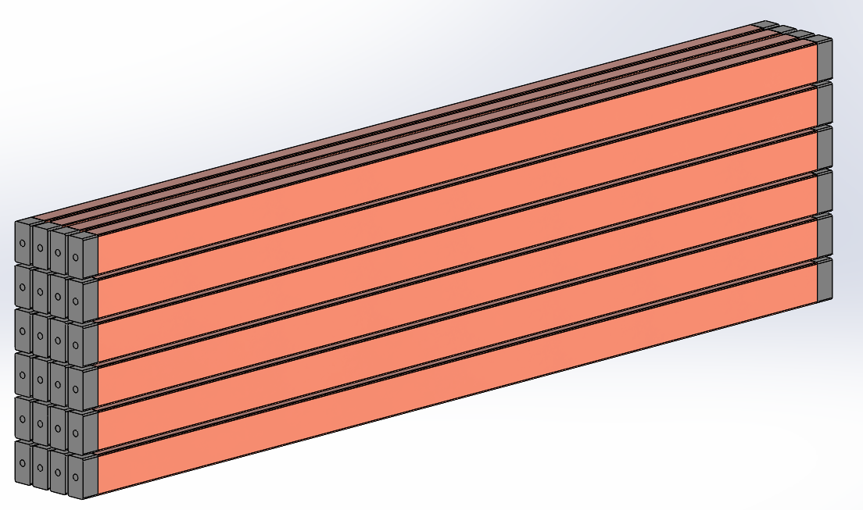
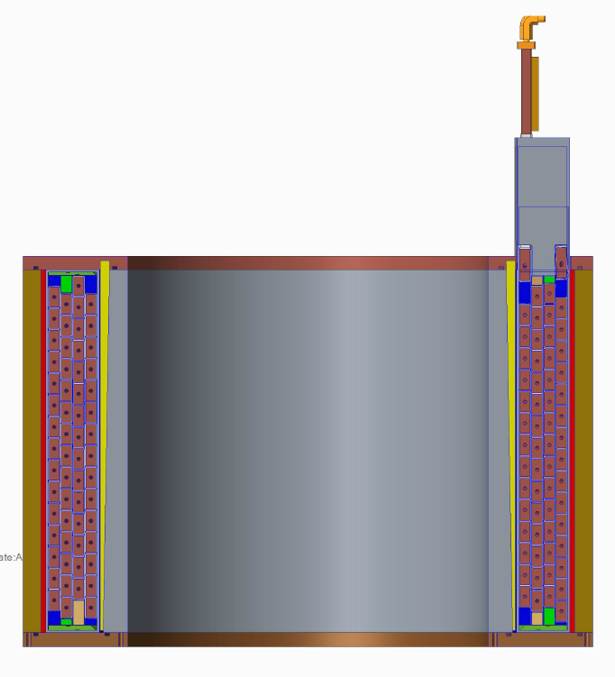
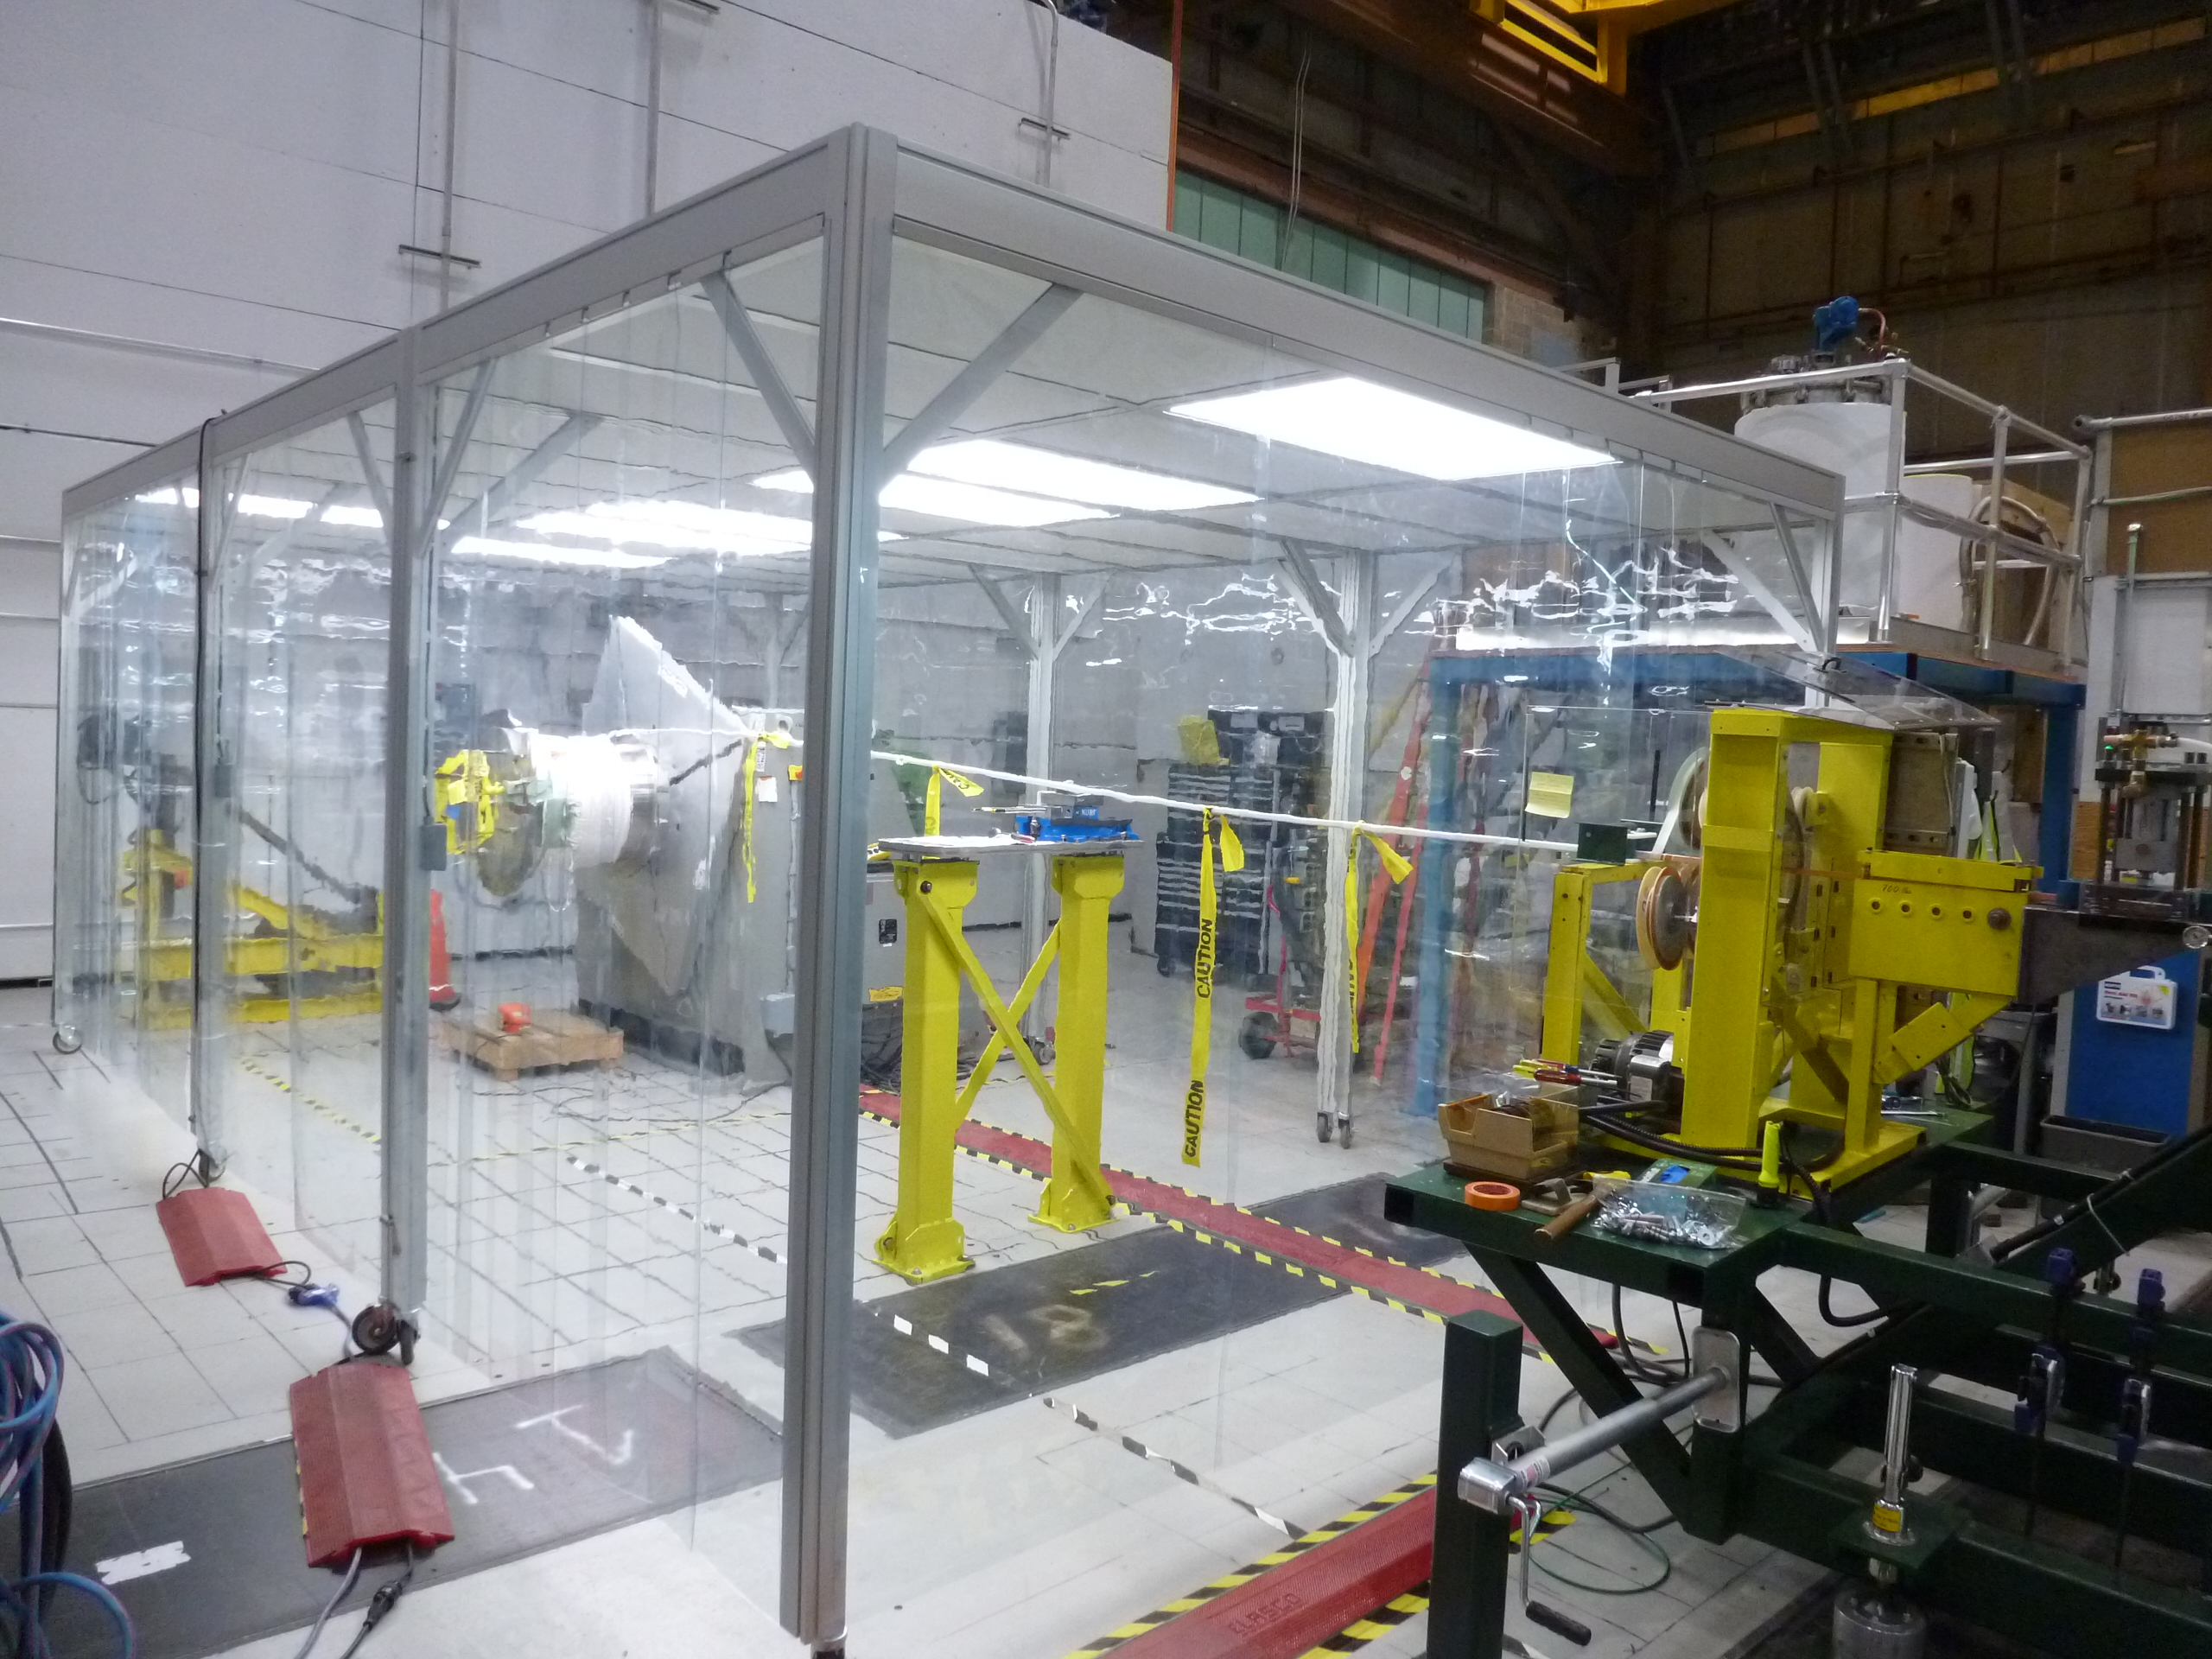
Day 3 Coil Presentations: Fabrication and Testing
Straight log bundle for electrical and mechanical testing
Winding and VPI molds for mandrel-free coils
PPPL manufacturing facility
Turn-to-turn testing
Procurement strategies
In general, reviewers seemed content with progress on the coils.
Ciummo, Burke, Dudek, Gao, Que, Raftopoulos

Slide 10
Overview
CDR
Overview
Inner-PF Coils
Vessel “Polar Region”
PFCs
Bakeout Improvements
Vessel Instrumentation
Test Cell Shielding
Next Steps

Slide 11
Many Design Choices Made Previously as Boundary Conditions for the CDR Design
Retain the -1b coil
Mandrel-free coils
Single ceramic break
More robust -1c flange assembly
Load path on outside of PF-1b
No single O-ring seals
These provide the boundary conditions for the proposed design.

Slide 12
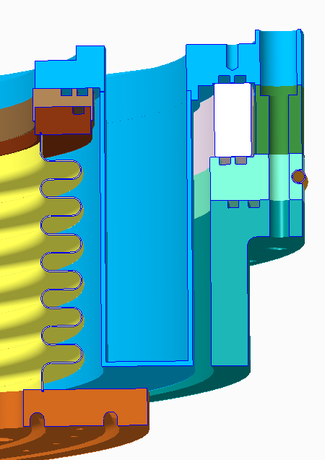
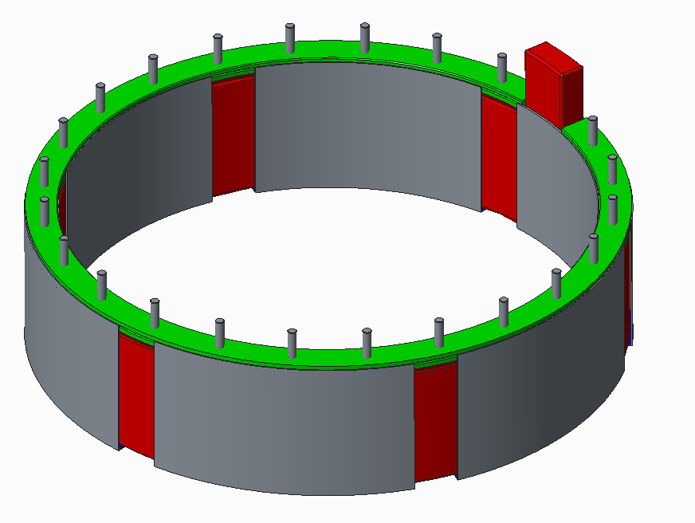
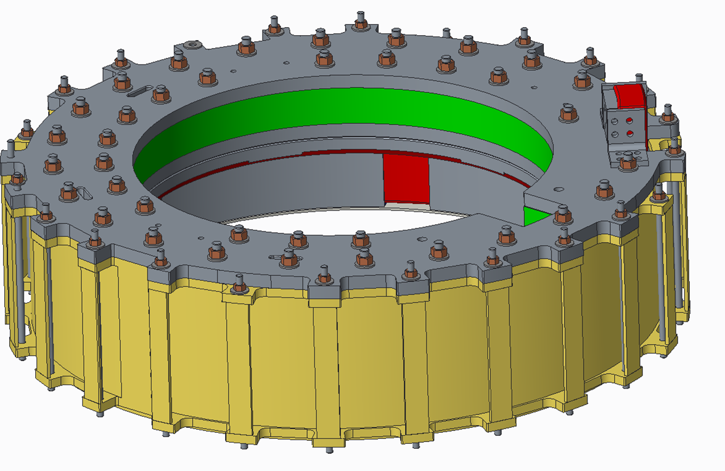
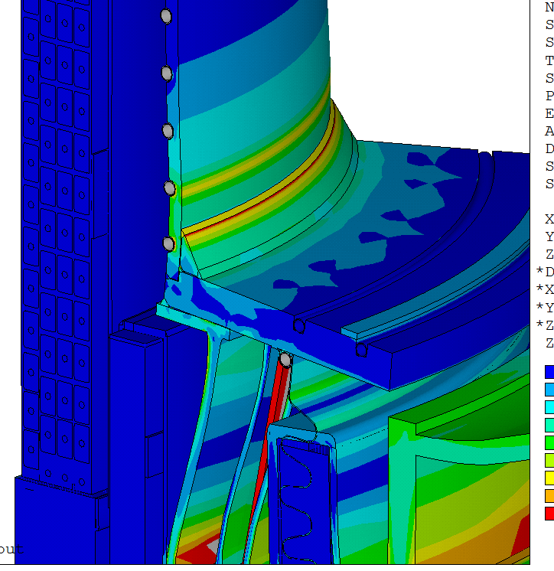
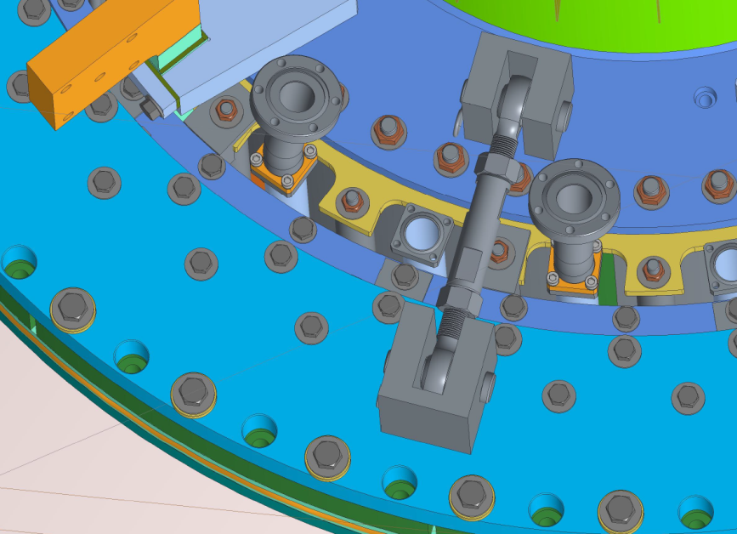
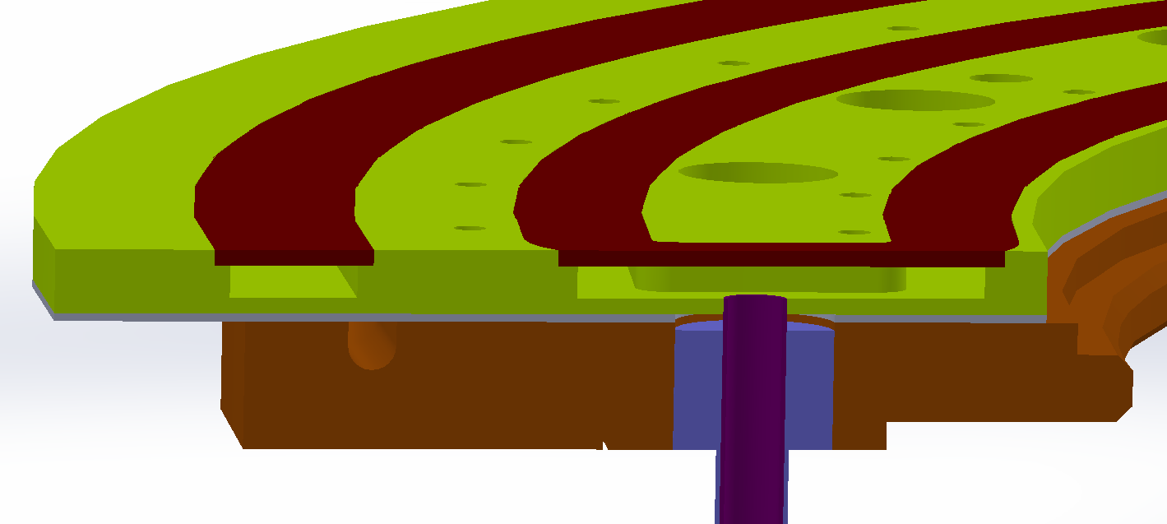
Polar Region Design Components
Smith: Coil Supports
Sibilia: Casing Support Structure
Sibilia: Revised Ceramic Break
Titus: Gusset on Casing Flange Weld
Titus: New Casing Lateral Supports
Cai: IBDV and IBDH Cooling Features

Slide 13
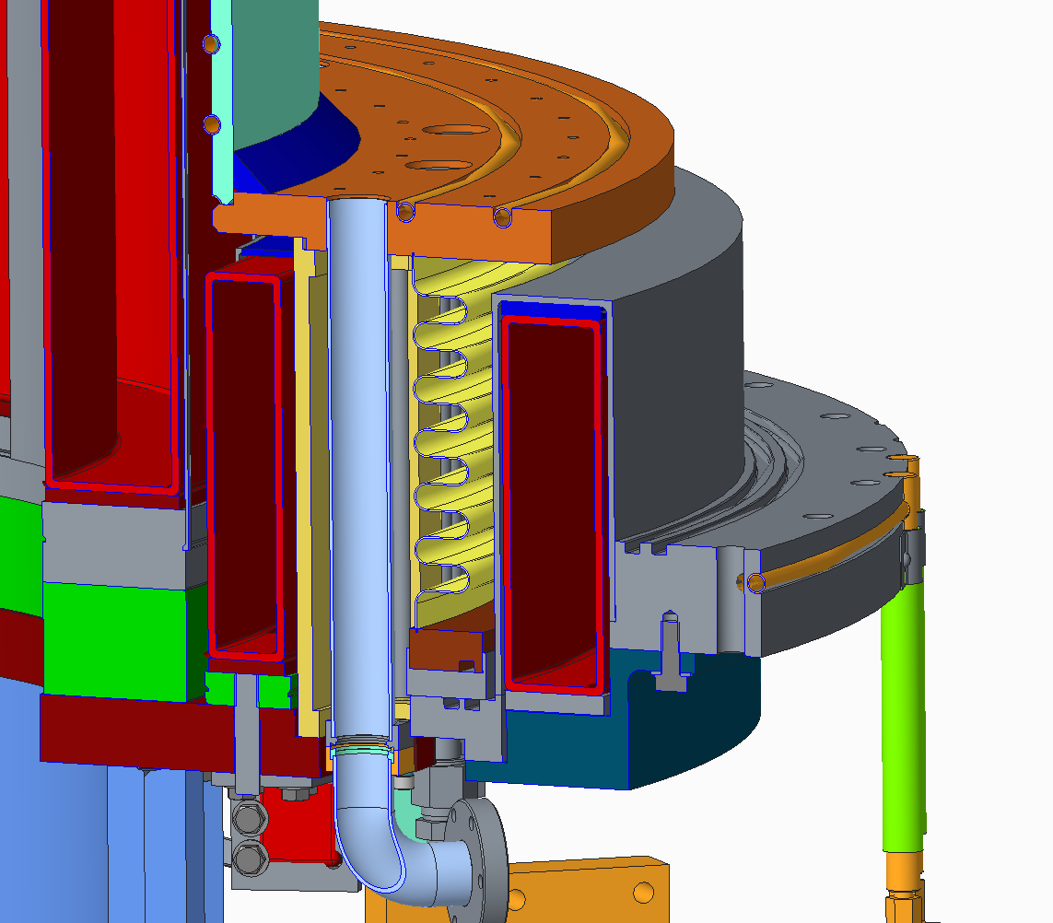
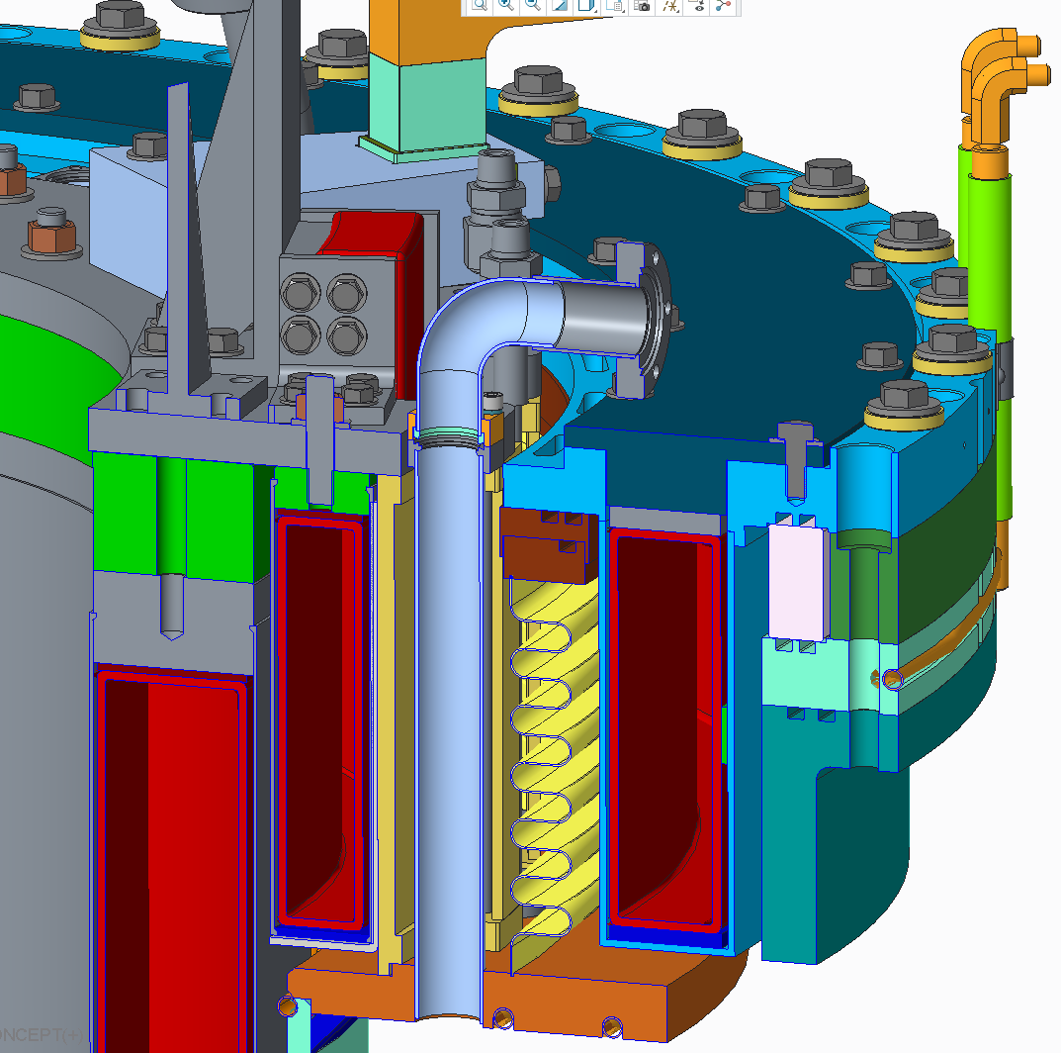
Top & Bottom in Present Concept
Bottom
Cooling plate would sit here.
Top
M. Siblilia

Slide 14
Conclusions from Polar Region
Committee was in general quite happy with the conceptual design that was shown.
Lots of detailed questions:
Optimizing radial sliding mechanisms within coil slings.
Welding or bolting the casing supports? Or both?
Lateral load capability of the upper insulator assembly?
Details of the weld on the casing gusset.

Slide 15
Overview
CDR
Overview
Inner-PF Coils
Vessel “Polar Region”
PFCs
Bakeout Improvements
Vessel Instrumentation
Test Cell Shielding
Next Steps

Slide 16
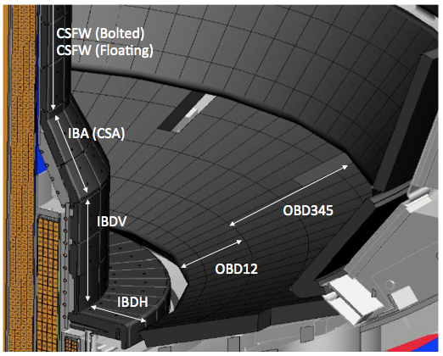
Scope of Work for PFCs
Section | Option Selected
CSFW | Modest Improvements
CSAS (IBDA) | Modest Improvements
IBDV | Re-design
IBDH | Re-design
OBD12 | Re-design
OBD345 | Modest Improvements
Re-design
New tile shapes allowed, typically with small surface features.
Tile ramping allowed
Design for 2 MA, 1T disruptions
Likely to have 5-6 MW/m²/5s handling, with many details depending on field line angle.
Modest Improvements
Use the basic tile shape of existing design
Optimize the fixturing to improve halo current tolerance for 2 MA, 1T disruptions
Typically by using a shear key
Likely to have ~3.5 MW/m²/5s heat load capability if well aligned

Slide 17
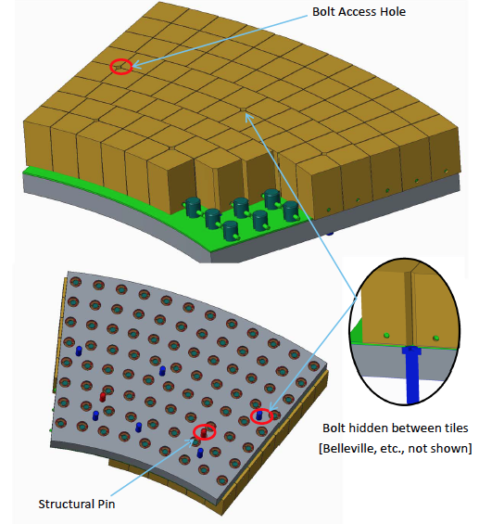
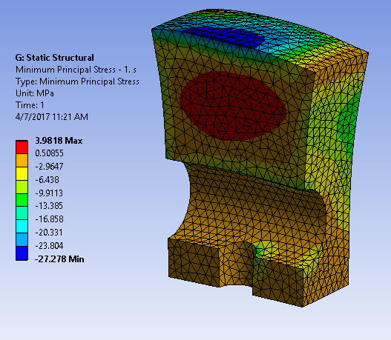
Three Design Options Still on the Table for the High Heat Flux Regions
Tendency for small cubes to allow free expansion w/ reduced thermal stresses
Floating Cubes
M. Mardenfeld

Slide 18
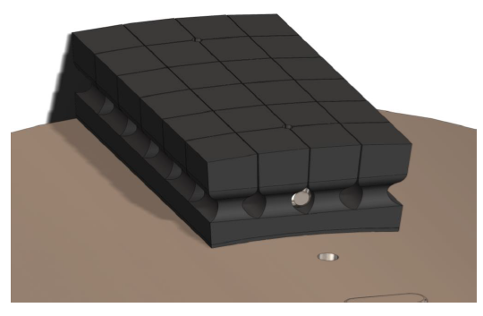
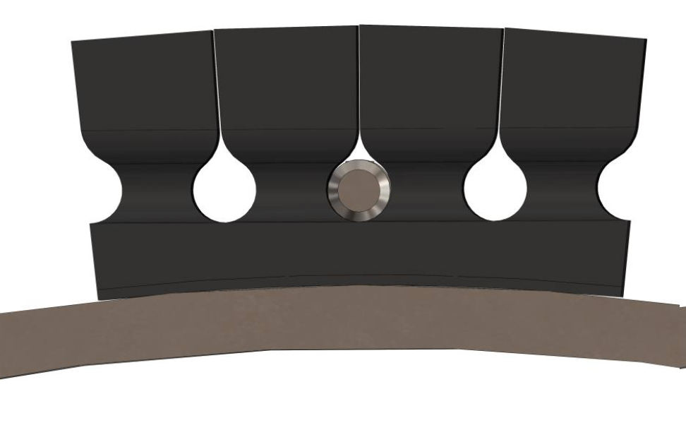
Three Design Options Still on the Table for the High Heat Flux Regions
Castellation
Small cubes are formed from a larger graphite block, leaving a solid sub-structure
A. Khodak

Slide 19
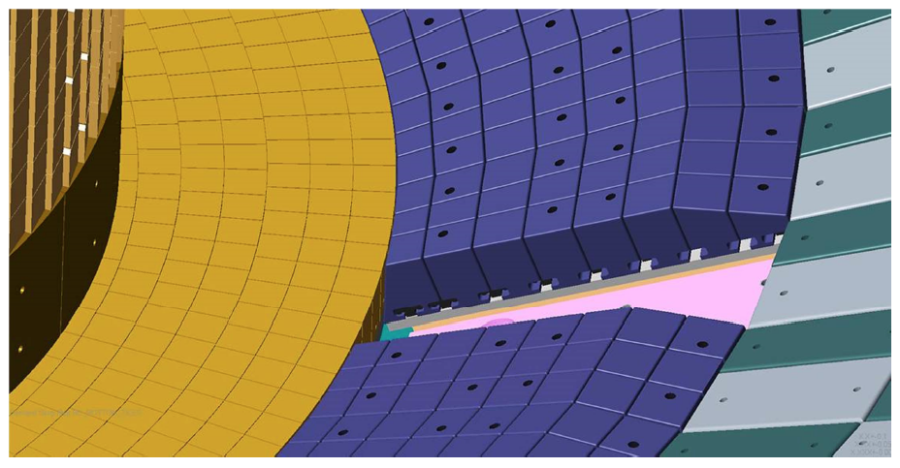
Three Design Options Still on the Table for the High Heat Flux Regions
R. Ellis
Rotated T-Bar
Deciding between these options is a key near-term decision for the project

Slide 20
Overview
CDR
Overview
Inner-PF Coils
Vessel “Polar Region”
PFCs
Bakeout Improvements
Vessel Instrumentation
Test Cell Shielding
Next Steps

Slide 21
Bakeout- Key Scope
Many topics discussed, will only highlight a few here
He feedthrough: Redesign and replace
Helium gas flow distribution, instrumentation & power balance
Propose to install flow control and flow monitoring equipment
Propose to install radiation shields – need to evaluate disruption loads, global power balance
Remediate safety concerns with 150 degC Vessel Water System: Redesign and modify existing system
Center Stack DC Current Injection Relocation: Relocate and permanently install power supplies

Slide 22
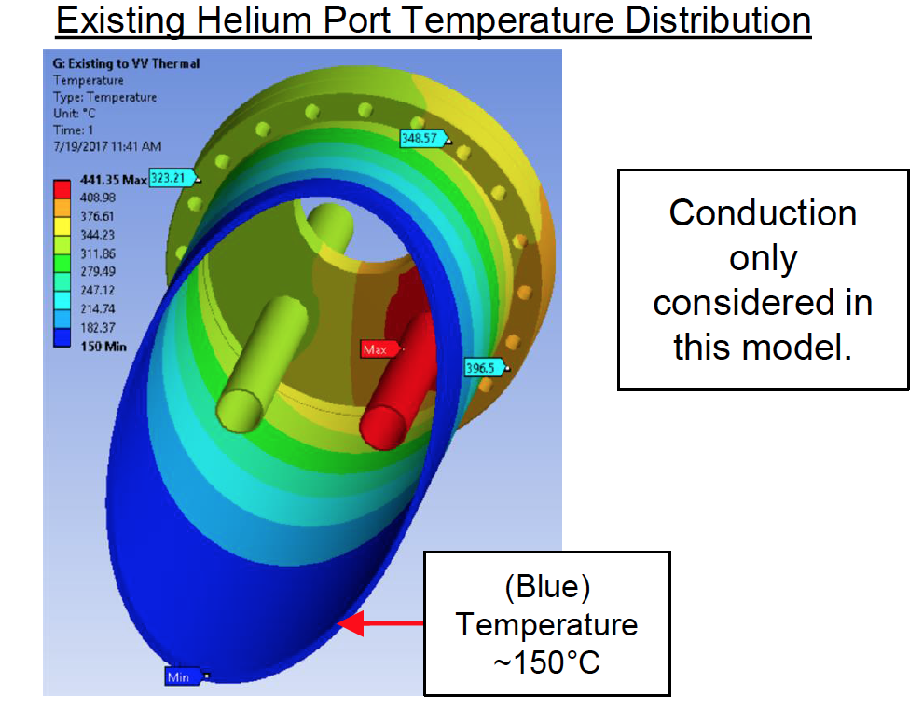
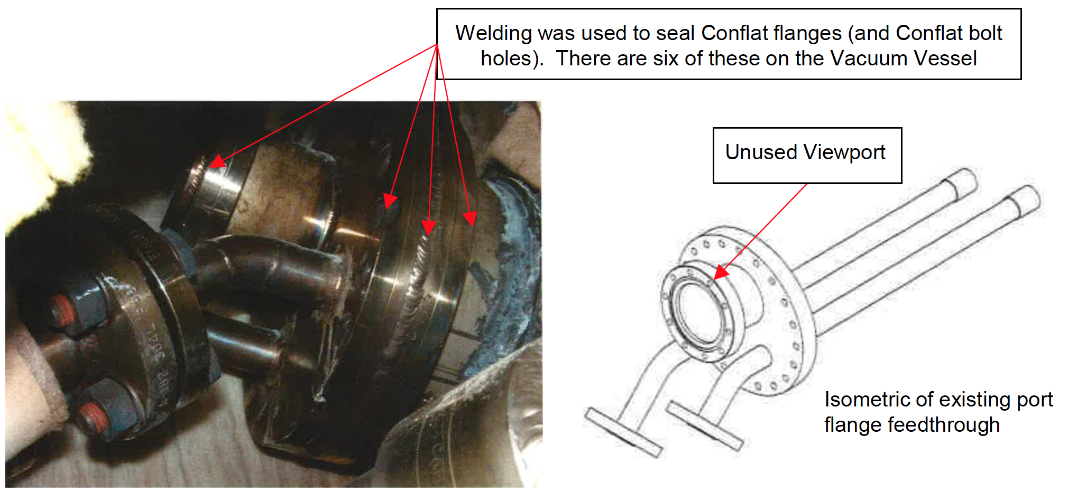
He Feedthroughs are Thermo-Mechanically Challenged
CF flange welded shut early in NSTX life following leaks on gasket
J. Petrella

Slide 23
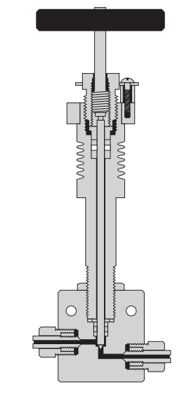
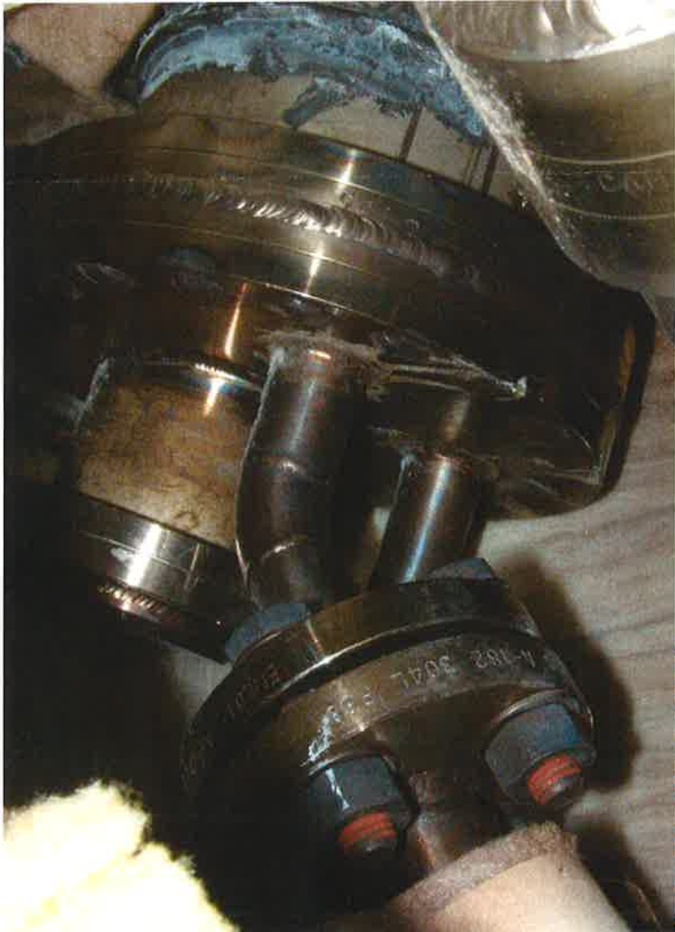
Some Proposed Solutions & Improvements
1: Proposed Double Re-Entrant Port Temperature Distribution
2: Metering Valves on the Helium Feedthroughs
(Blue) Temperature ~150°C
Image is Conceptual!
3: Proposed Radiation Shields on the Back of Plates
J. Petrella

Slide 24
Overview
CDR
Overview
Inner-PF Coils
Vessel “Polar Region”
PFCs
Bakeout Improvements
Vessel Instrumentation
Test Cell Shielding
Next Steps

Slide 25
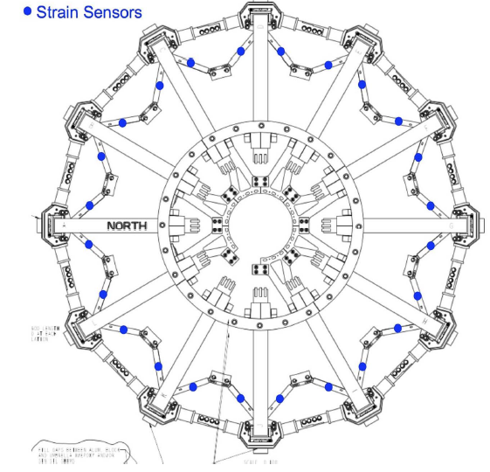
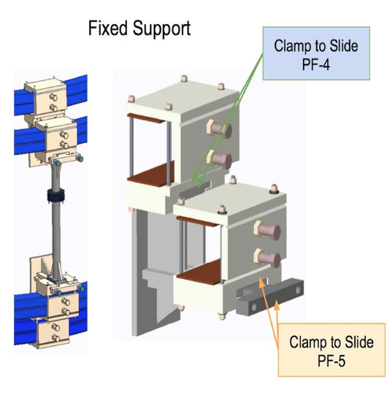
Machine Instrumentation
Needed to benchmark mechanical models & assess the coil and structure performance
Detect degraded performance of machine
Will use a combination of sensor technologies:
Fabry-Perot sensors
Fiber-Bragg Sensors
Linear displacement sensors
Key questions:
Curing of glue!
Can we treat these as constraints on a true inverse problem?
R. Ellis

Slide 26
Overview
CDR
Overview
Inner-PF Coils
Vessel “Polar Region”
PFCs
Bakeout Improvements
Vessel Instrumentation
Test Cell Shielding
Next Steps

Slide 27
Test Cell Shielding
Neutron generator measurements identified areas requiring additional shielding
Generate neutrons in the NTC and detect them outside
The 10 primary areas of interest are (in order of severity)
South East door. Entrance to the NSTX High Bay
South High Bay Tritium Seal Door
North NSTX-U test cell door vestibule
Lower large window, North East corner
6” Penetration adjacent to South East NSTX High Bay Door
10” Penetration in mezzanine laser room
Three cable penetrations east wall north
RF Feed thru Penetrations at 119’ level
Bake out Penetrations in floor to MER
NB Water Penetration in floor to MER

Slide 28
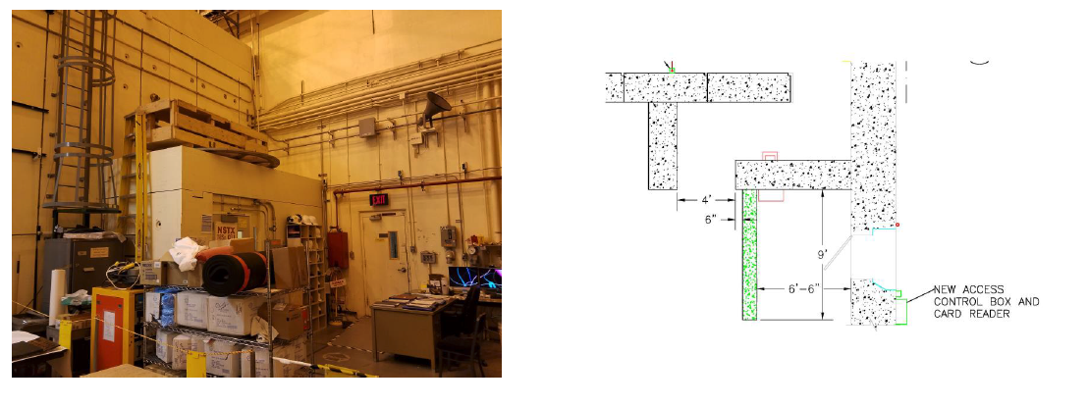
Example: Southeast Door
Add a labyrinth to the door to the gallery, while retaining existing labyrinth
Use borated concrete panes from TFTR north door free-standing shield wall
Combinations of concrete, shield blocks, poly beads & “neutron putty” in other locations
1’ thick ceiling not shown
E. Perry

Slide 29
Overview
CDR
Overview
Inner-PF Coils
Vessel “Polar Region”
PFCs
Bakeout Improvements
Vessel Instrumentation
Test Cell Shielding
Next Steps

Slide 30
Next Steps
Resolve the final major scope questions:
Passive plate bracket motion remediation
Can we remediate with high strength shear pins, or do we need to fabricate and install new Cu bracket parts?
Optimal concepts for high heat flux regions
Cost and Schedule Review
First week of September
Continue to PDR in each area
Staggered throughout the fall months

