Slide 1
QUEST Non-Inductive Plasma Current
Ramp-up Experiments with 28 GHz Heating and a Focusing Mirror Launcher
Gary Taylor
Report on my visit to QUEST, July 18 - 28, 2017
During my visit I collaborated with
Prof. Hiroshi Idei & Dr. Takumi Onchi
Advanced Fusion Research Center, Kyushu University
NSTX-U Physics Meeting
August 14, 2017

Slide 2
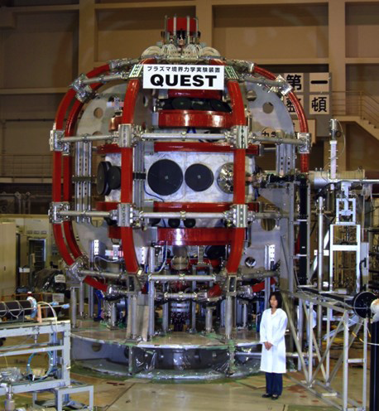
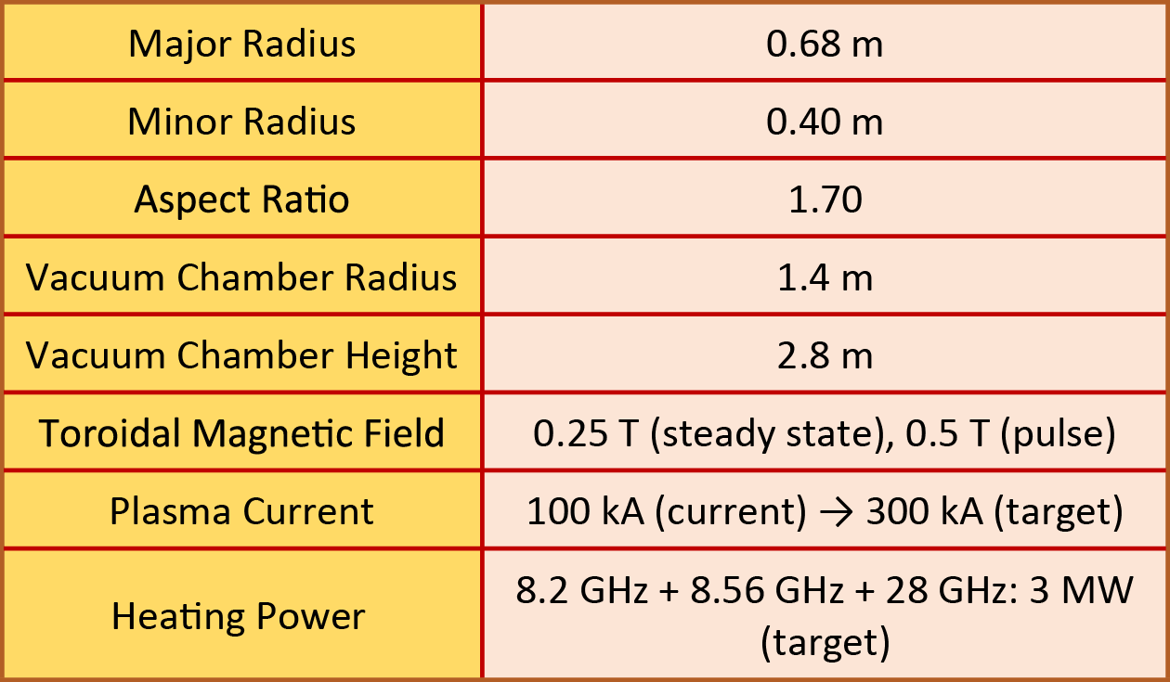
The goal of the QUEST program is generate steady-state fully non-inductive plasmas
QUEST will ultimately use a combination of 2.45, 8.2, 8.56 and 28 GHz heating to generate steady-state, fully non-inductive plasmas with 3 MW of RF power:
  Present capability:
  ~ 50 kW of 2.45 GHz
  ~ 400 kW of 8.2 GHz
  ~ 250 kW of 28 GHz
The QUEST CHI system has been commissioned by University of Washington team and will be used with 28 GHz heating later this year
QUEST
Spherical
Tokamak
QUEST Parameters

Slide 3
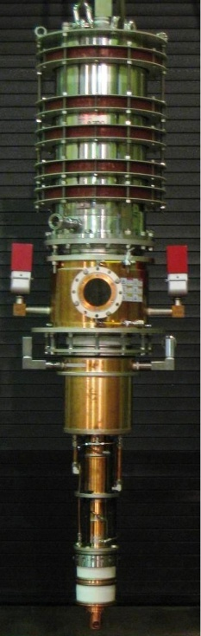
QUEST uses a 28 GHz Gyrotron developed by Tsukuba University
28 GHz gyrotron had been developed for Gamma-10/PDX projects at Tsukuba University
28 GHz Gyrotron Design Parameters
Frequency 28GHz Output Power 1 MW Pulse Width 1 s Output Efficiency 35% (W/O CPD) Beam Voltage 80 kV Beam Current 40 A Cavity Oscillation mode TE_{8,3} Output mode Gaussian like Output Window Sapphire Single Disk Aperture diameter 112 mm

Slide 4
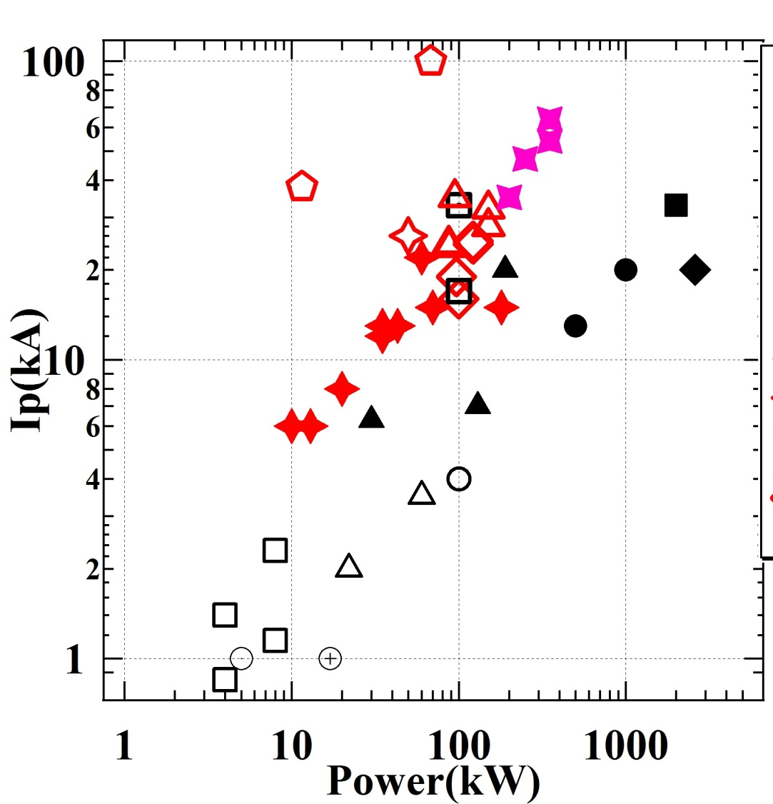
28 GHz gyrotron system was initially configured with an open ended waveguide launcher
Initial QUEST 28 GHz heating experiments used an open ended waveguide launcher and there was no polarization rotator
At QUEST toroidal field,
B_{T}(0) = 0.25 T, the 2nd harmonic EC resonance is just 10 cm from the center stack, so the beam size was large at the resonance
Nevertheless up to 66 kA of non-inductive current was generated with 270 kW of 28 GHz power
Initial 28 GHz plasma current ramp-up experiments on QUEST
Other QUEST - red points
Other Devices – black points

Slide 5
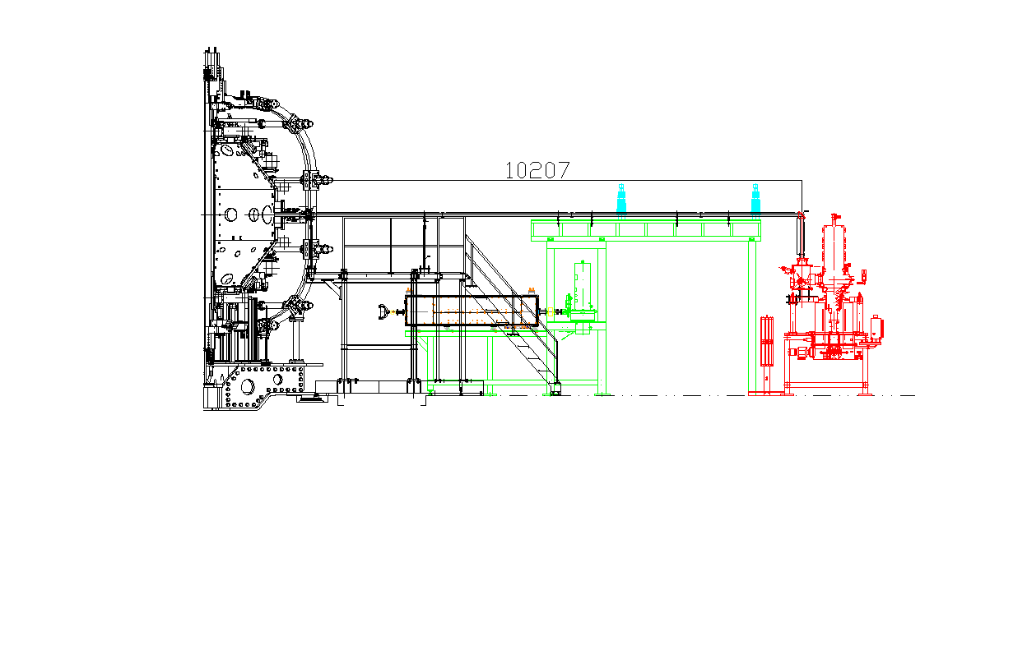
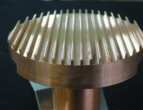
28 GHz gyrotron system has been upgraded with a focusing mirror launcher and polarizer
Added quasi-optical polarization control to provide the desired
X-mode polarization to obtain good single pass absorption
Added focusing mirror launcher to obtain a narrow beam
This new 28 GHz transmission line was commissioned in July
Launcher
with a
focusing
mirror
λ/4
polarizer
λ/8
polarizer
X-mode Injection
for 2fce ECCD

Slide 6
The upgraded 28 GHz heating system was commissioned during the period July 18 - 30
There was no coupling of 28 GHz power into QUEST plasmas during the first week of my visit (July 18 - 21)
The water-cooled dummy load can now be switched remotely into the transmission line, previously the transmission line had to be disconnected from the machine and connected to the dummy load
After fixing some water leaks on the dummy load we spent July 19-20 firing 75 ms 150-200 kW pulses into the dummy load while they discharge cleaned QUEST with 10 kW of 2.45 GHz power
  Power was initially limited to ~ 150 kW by arcs in the dummy load
  By the end of the first week of my visit we were conditioning into the dummy load at a power level ~ 200 kW, we were still getting arcs in the transmission line above that power
  On Monday, July 24 there was no gyrotron operation

Slide 7
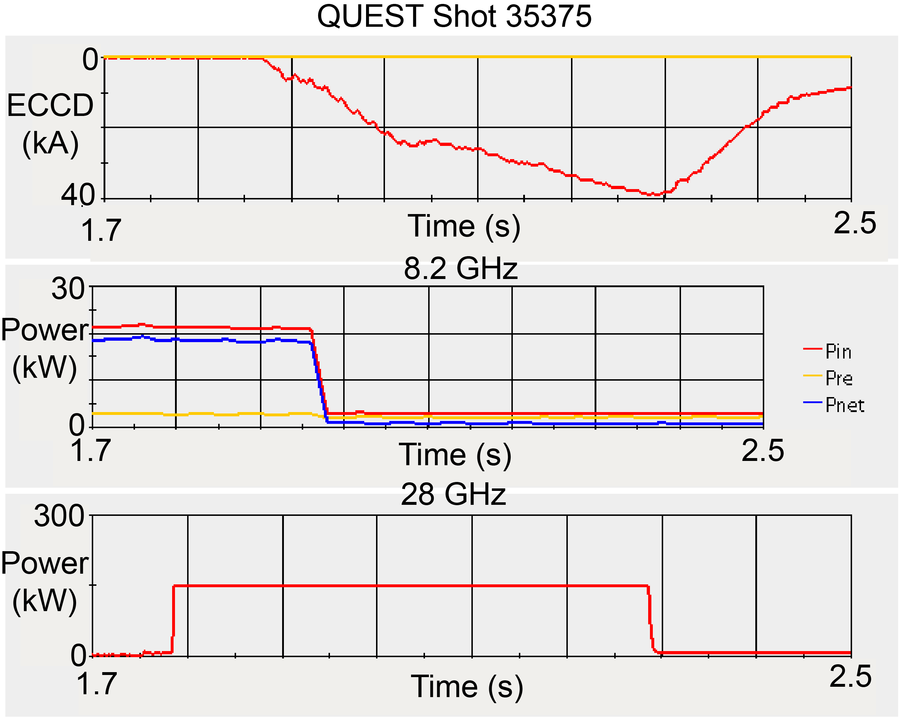
We began injecting 28 GHz power into the QUEST plasma on July 25
By the end of the day on July 25 we were injecting 500 ms, 150 kW pulses into the QUEST plasma and driving 40 kA of ECCD

Slide 8
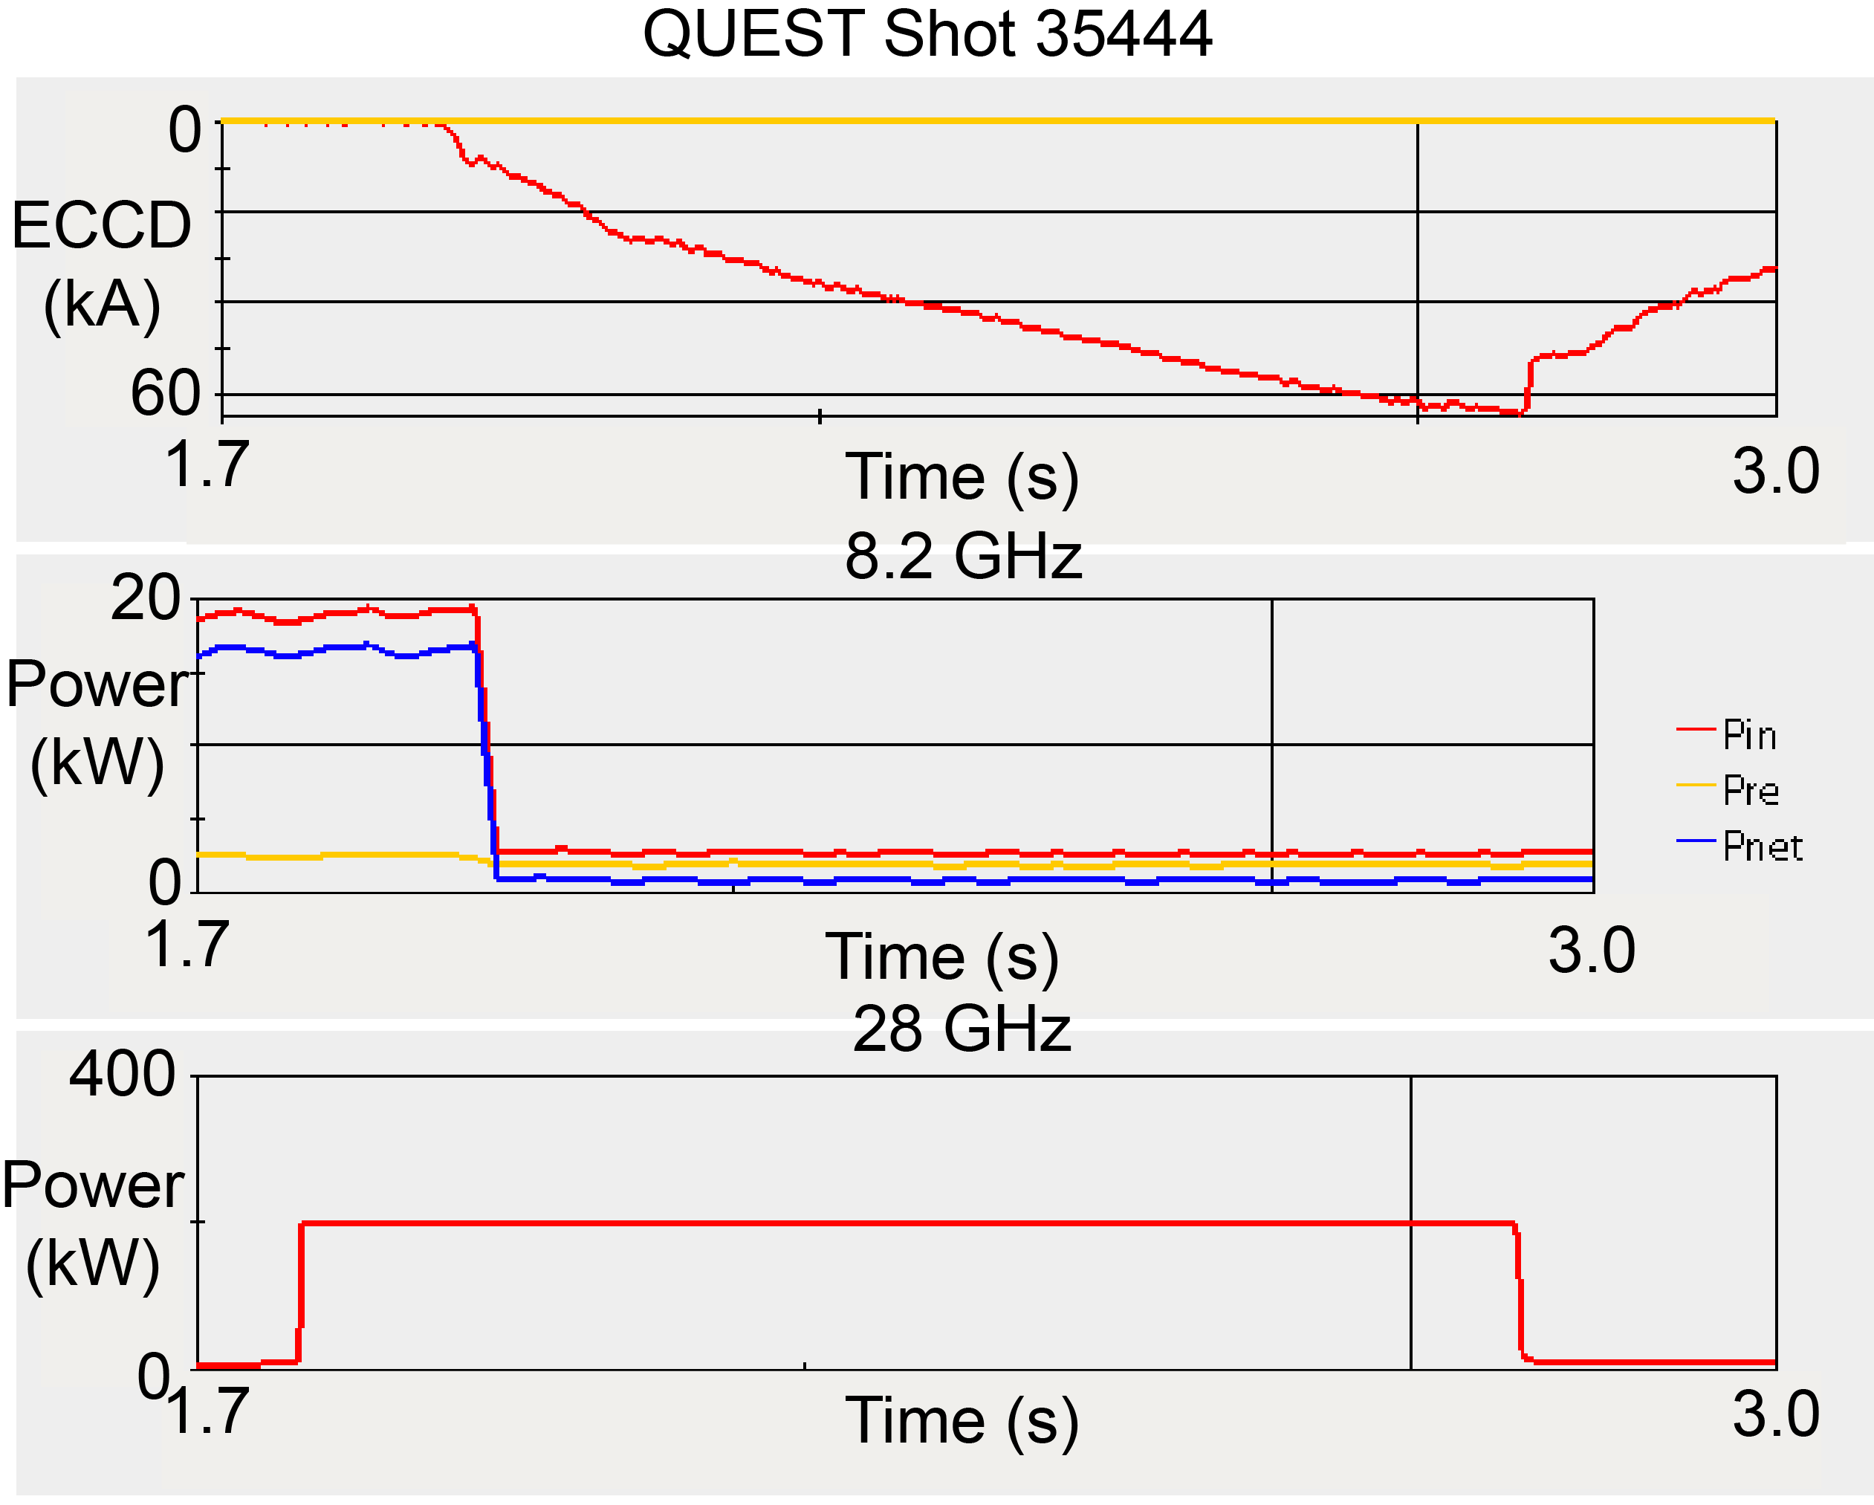
On July 26 we increased the power to 200 kW for
one second, generating up to 65 kA of ECCD
Current ramped up throughout the RF pulse, so we hoped to generate more current by stretching the pulse and raising the power

Slide 9
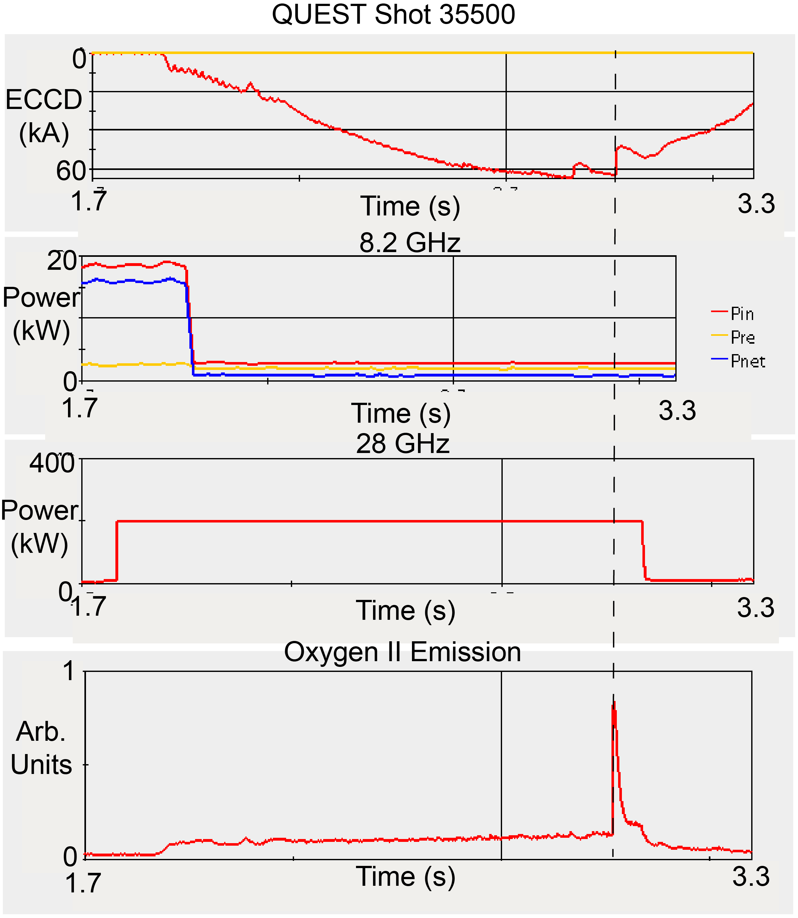
On July 27 we injected 210 kW for 1.25s but generated current was limited to 65 kA
Stretching the pulse to 1.25 s did not increase the non-inductive current beyond 65 kA
Non-inductive current dropped several times during the last 200 ms of the RF pulse
Burst in Oxygen-II emission coincident with the last current drop

Slide 10
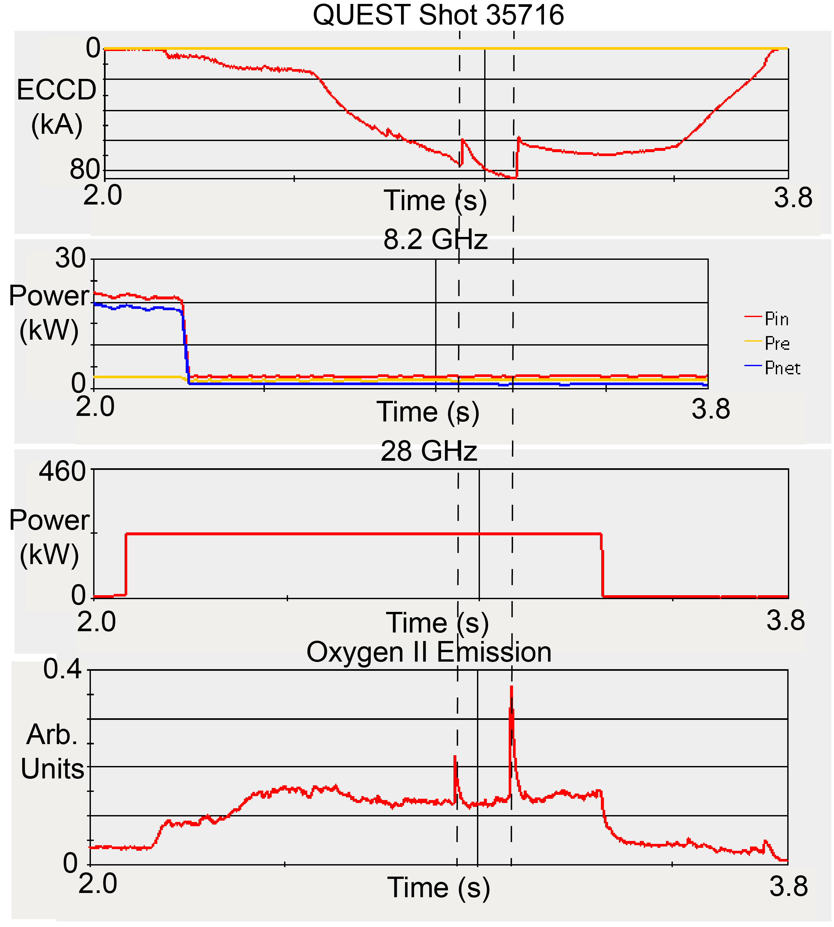
Experiments continued July 28-30, eventually generating up to 85 kA with 230 kW
We made no progress on July 28
July 29 I returned to the US, experiments continued July 29-30
Eventually they generated 85 kA with 230 kW, but there were several large drops in generated current, once again coincident with bursts in the Oxygen-II emission

Slide 11
Upgrades to the QUEST 28 GHz heating system resulted in improved ECCD performance
Generated more current (85 kA) with less 28 GHz power (230 kW) compared to earlier experiments that used an open ended waveguide and no polarizer, that generated up to 66 kA with 270 kW
There were sudden drops in the ECCD that limited the rise in current when we increased the power and pulse length, these drops were often associated with bursts of Oxygen II emission
Sudden drops in generated current may result from an instability driven by the non-thermal electrons created by the ECCD, but this is still under investigation
28 GHz experiments, focused on combining 28 GHz heating with CHI, will resume during the QUEST October – December campaign:
  It is unlikely the 8.56 GHz system will be commissioned by then

