Slide 1


Summary of paper to be submitted to NF special issue on IAEA TM EP
‘ORBIT modeling of fast particle redistribution induced by sawtooth instability’
D. Kim¹, M. Podestà¹, D. Liu² and F. M. Poli¹
¹Princeton Plasma Physics Laboratory
²University of California, Irvine
NSTX-U meeting, 28 Nov 2017

Slide 2
Outline
Introduction and motivation
Simulation setting and perturbation model
Simulation results
Conclusion

Slide 3
Outline
Introduction and motivation
Simulation setting and perturbation model
Simulation results
Conclusion

Slide 4
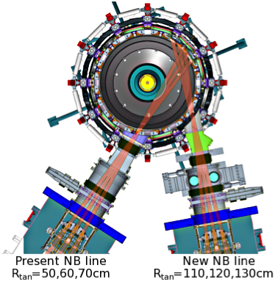
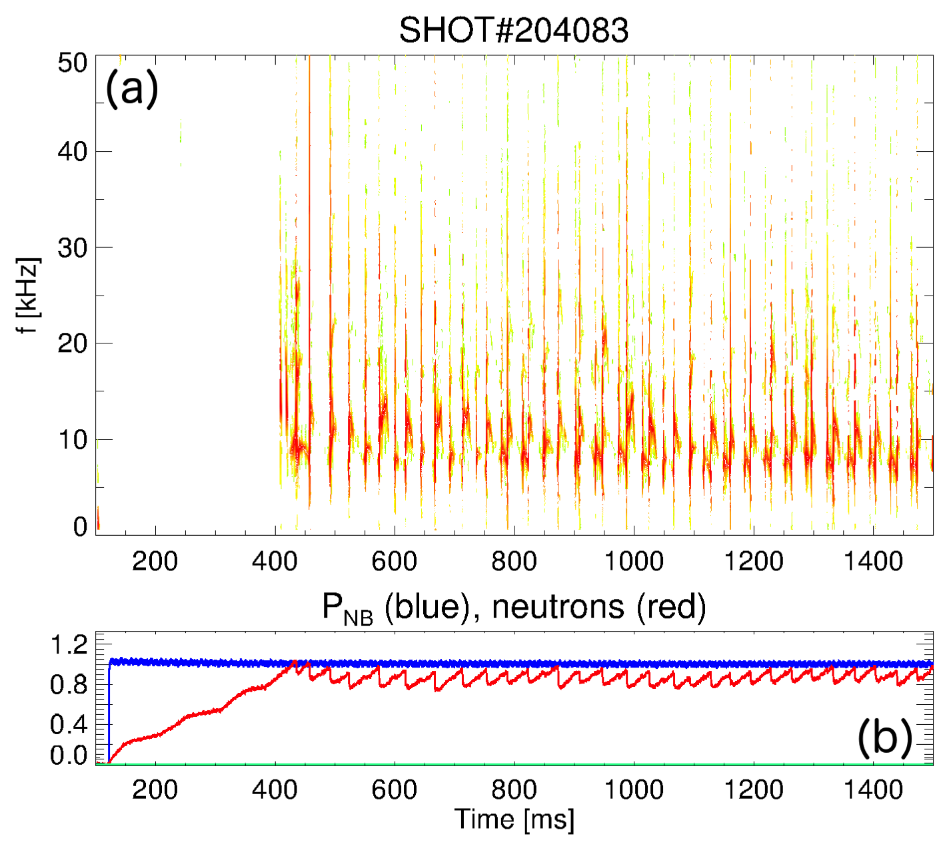
Long Sawtoothing Discharges on
NSTX-U with the new 2nd NBI
Major radius: 0.95 m
Aspect ratio: 1.5
Elongation: 2.7
Triangularity: 0.8
Plasma current: < 2 MA
Toroidal field: < 1.0 T
Pulse length: ~ 1 - 5 s
6 Neutral Beam sources:
P_{NBI} ≤ 12 MW, E_{injection} ≤ 95 keV
[Menard, NF 2012]
[Gerhardt, NF 2012]
Reproducible sawtoothing L-mode discharges are obtained on NSTX-U
  Neutron rate can drop as large as ~15% at sawtooth crash
  Flattening of T_{e} in the core indicated by MPTS and Soft x-ray diagnostics
  No MSE measurement is available for these discharges

Slide 5
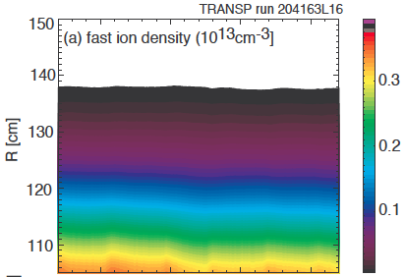
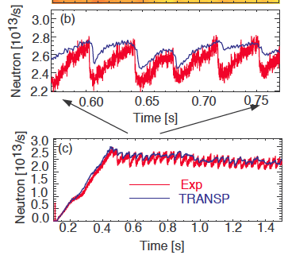
TRANSP results indicate significant effect of thermal profile evolution on neutron rate
[Liu, to be submitted to NF]
TRANSP run using thermal profiles from conditional average reconstruction
  Sawtooth model ON for q-profile evolution
  Sawtooth model OFF for fast ions: Little/no modulation of fast ion profile
Thermal plasma variation can account for up to 50% of neutron rate drops
  What are the effects of fast ions?

Slide 6
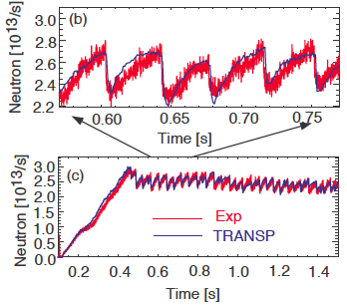
TRANSP results can match experimental ones by adjusting free parameters
[Liu, to be submitted to NF]
Adjusting free parameters in TRANSP sawtooth model can bring reproduction of the experimental result
  Sawtooth model ON for both q-profile and fast ion evolution
  Need to find a proper free parameter sets
    Reconnection type, (partial) reconnection fraction, fraction of fast ions involving in sawtooth mixing, etc.

Slide 7
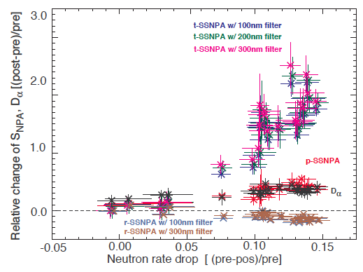
Sawtooth model in TRANSP brings the same effect of sawtooth on different orbit types
[Liu, to be submitted to NF]
Experiments show that passing particles are more affected by sawtooth than trapped ones
TRANSP sawtooth model treats particles with different orbit type in the same way as thermal particles
  No pitch angle or energy dependence on present sawtooth model

Slide 8
Can effect of fast particle transport improve sawtooth model?
Sawtooth modelling in TRANSP [transpweb.pppl.gov]
  Several free parameters (e.g. partial reconnection fraction) in the model
  ➔ need to find an optimum set for each case
  Need to determine self-consistent parameter setting for predictive simulation
Improvement of sawtooth model for fast ion redistribution in phase space?
  ORBIT simulations can be a guidance to develop a more comprehensive model for fast particle transport by sawteeth
  Implementation of a fast particle model into TRANSP is expected to enable self-consistent modelling including more physics
  NSTX-U data can guide model development and be used for validation

Slide 9
Outline
Introduction and motivation
Simulation setting and perturbation model
Simulation results
Conclusion

Slide 10
Simulation setting
Simulation code: ORBIT [White PoF84]
  Hamiltonian guiding center particle motion code
  Use of numerical equilibrium, field perturbations in flux coordinates (Boozer coordinate in this work)
  Analyzing test particle transport (especially energetic ions)
Target discharge: NSTX-U #204083
  Equilibrium data (eqdsk file from TRANSP) from one time slice before sawtooth crash (1093ms)
  Initial distribution of fast particles from TRANSP (NUBEAM)
  Number of particle for calculation: 10,000
  Radial displacement for the application of linear perturbation from sawtooth instability (constant in time)

Slide 11
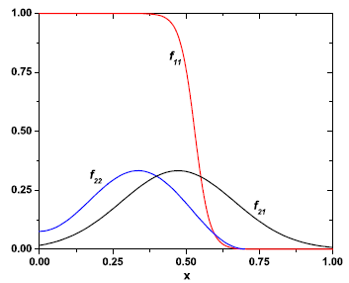
Displacement from sawtooth crash induces perturbed magnetic field δB
Perturbation magnetic field from displacement
Radial displacement model [Farengo NF13, ZhaoPoP97]
  ξ(ρ, t, θ, ζ) = Σξ_{m,n}(ρ, t)cos⁡(nζ – mθ – ωt)
  (m, n): poloidal and toroidal mode numbers
  (θ, ζ): poloidal and toroidal angles
  (1,1) mode is applied
  Tested on cylindrical coordinate in Farengo NF13
  ➔ toroidal geometry effect, e.g. toroidal mode
  coupling, may need to be considered
q = 1 surface
Figure from [Farengo NF13]

Slide 12
Radial profile is modified and the temporal variation of the amplitude is set
Modification on radial profile
  Central region is modified to avoid numerical problem in ORBIT
  Perturbation outside the q=1 surface is ignored (not sensitive)
Temporal variation of amplitude based on (average) exp results
  Perturbation grows from 10% to 100% of the maximum perturbation amplitude during 1.5ms
  Amplitude goes to zero (full reconnection) after the crash during 50μs

Slide 13
Relative change of neutron rate – comparison with experimental result
Estimate relative neutron rate change
  Using deuterium density at each fast particle position, cross section, particle energy of each particle energy and volume element
Relative neutron rate change from experiment
  Difference between neutron rate post and pre crash is normalized by neutron rate before sawtooth crash
  Depending on calibration parameter, values are slightly different

Slide 14
Measurement of neutron rate drop is used to determine perturbation amplitude in simulations
Determination of perturbation amplitude
  Δ calculation using ξ amplitude of [0.001 to 0.1m]
  In lower amplitude case, Δ is almost constant since fast particles are not
  redistributed much
  Amplitude of between [0.055, 0.097m] can reproduce experimental value
  Amplitude of 0.075m is taken for the further analysis
Δ neutron_rate_TRANSP [900 – 1300ms]
[0.125 – 0.394]

Slide 15
Outline
Introduction and motivation
Simulation setting and perturbation model
Simulation results
Conclusion

Slide 16
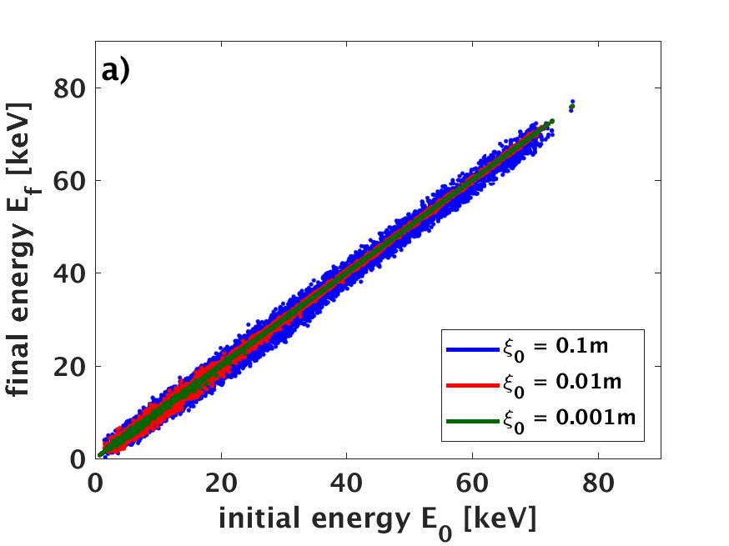
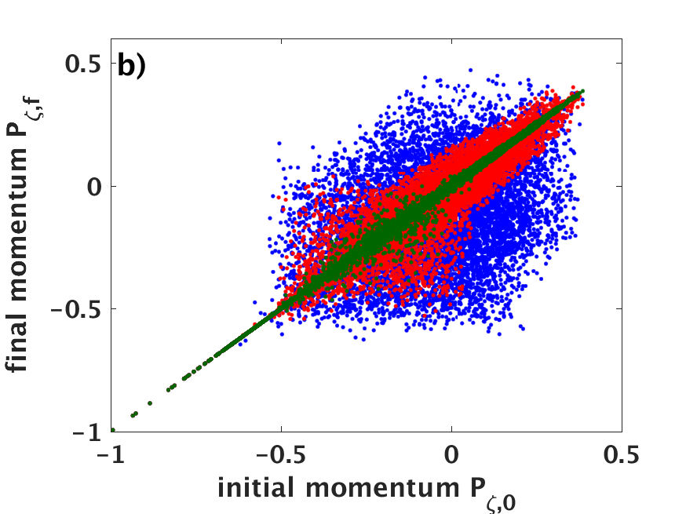
Fast ion energy is not changed significantly by sawtooth
ORBIT calculation shows the final energy is not deviated much from the initial energy
  With 100 times different amplitude (0.001 to 0.1), the change is little
As perturbation amplitude increases, particle redistribution in phase space becomes more significant
  Need to focus on particle redistribution

Slide 17
Classification of orbit type allows to identify particle redistribution
Movement of particle movement of each orbit type and the change of orbit type due to sawtooth
Based on the initial energy and pitch angle, the boundaries of orbit types are determined using the Hamiltonian equation of motion and conservation of canonical angular momentum P_{ζ}

Slide 18
Redistribution of different types and energy level particles in phase space
Applying the perturbation (amplitude = 0.075m) results in the redistribution of particle in phase space and the change of orbit type in low and high initial particle energy case
Initially all the particles are well located within each boundary while particles with initial orbit type flag move around after the crash

Slide 19
Redistribution of different orbit type particles in real space
The number of fast ions is changed along the minor radius by sawtooth crash
Co- and counter-passing particles experience larger effect from sawtooth crash on the radial redistribution than trapped particle
Consistent with previous experimental results [Liu NF to be submitted, Muscatello PPCF12]

Slide 20
During redistribution, particles experience the change of orbit type
Orbit type 1: co-pass confined | Orbit type 3: ctr-pass confined | Orbit type 5: trapped confined | Orbit type 7: stagnation
Orbit type 2: co-pass lost | Orbit type 4: ctr-pass lost | Orbit type 6: trapped lost | Orbit type 8: potato confined
Amplitude = 0.075
26.0% of 10k particles’
orbit type change
(i,f) = (a,b) : initially a type
turns into b type
The largest orbit type changes from co-passing/stagnation to trapped particle as well as large amount of counter-passing and potato particles
Trapped particles mostly become co- or counter-passing particles
Orbit type change is relevant for quantitative comparison with phase space resolved measurements (e.g. FIDA, SSNPA)

Slide 21
Redistribution of particles
– comparison with theory [Kolesnichenko PoP97]
Criteria for sawtooth induced fast particle redistribution
Trapped particle
Passing particle
Δr_{b} = orbit width, r_{mix} = sawtooth mixing radius assuming full reconnection
ε_{mix} = inverse aspect ratio at r_{mix}, τ_{cr} = crash time, ω_{B} = ion cyclotron frequency

Slide 22
Redistribution of particles
– comparison with theory
Radial position change (Δr) vs initial orbit width (Δr_{b}) – Comparison with critical value for different particle energy level and orbit type
  Passing particles: criterion is well satisfied
    Radial position change occurs only for orbit width smaller than the critical one
    Co-passing: Δr decreases with energy
    Counter-passing: Δr increases with energy
  Trapped particle: not clear
    Particles with orbit width bigger than the critical one experiences radial position change with lower energy while higher energy cases shows almost zero Δr

Slide 23
Conclusions and outlook
Sawtooth perturbation model implementation in the ORBIT code
Relative change of neutron rate induced by sawtooth crash is compared with experimental value
  Relative change of neutron rate drop increases as mode amplitude grows from amplitude
  Experimental value can be reproduced by amplitude range of [0.055, 0.097]
Energy and particle redistribution due to sawtooth crash is investigated
  Regardless the amplitude of perturbation, E is not changed significantly while P_{ζ} variation becomes significant with increase of mode amplitude
  With a sufficiently large perturbation amplitude, particles are redistributed by sawtooth in phase space and orbit types are also changed
  The effect of sawtooth crash is stronger on passing particles and trapped ones
Redistribution of Passing particle is well explained by theory while trapped particle redistribution does not well agree with theory
  Need to find better way to apply the theory
  This part will be extended to set a model for TRANSP sawtooth model

Slide 24
Back up slides

Slide 25
Relative change of neutron rate – comparison with experimental result
Determination of perturbation amplitude
  With perturbation outside the q=1 surface, the result is almost the same
  Conditional average of the input experimental profiles in TRANSP due to insufficient temporal resolution of diagnostics
  Re-sample the experimental plasma profiles on the 1ms time scale after conditional average
Δ neutron_rate_TRANSP [900 – 1300ms]
[0.125 – 0.394]

Slide 26
In ORBIT code, perturbation is defined using α, not ξ
Linearized perturbation in ORBIT:
  ξ can be transformed into α [White PoP13]
  Radial component of resultant perturbation is equivalent to ξ model
  Mode amplitude is prescribed for ξ and is used for α after normalisation
  The resultant a shape is similar to that from [Zhao PoP97]

Slide 27
Redistribution of different types and energy level particles in phase space
Applying the perturbation (amplitude = 0.075m) results in the redistribution of particle in phase space and the change of orbit type in low and high initial particle energy case
Initially all the particles are well located within each boundary while particles with initial orbit type flag move around after the crash

Slide 28
