Slide 1
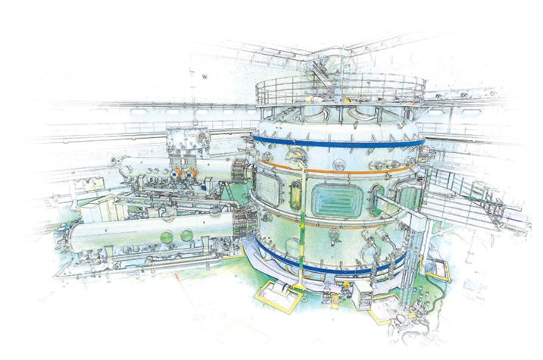
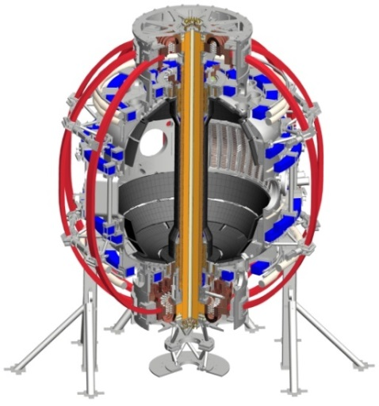
Automated Identification of MHD Mode Bifurcation and Locking in Tokamaks
S.A. Sabbagh¹, J.D. Riquezes¹, R.E. Bell², Y.-S. Park¹, C. Myers², L.A. Morton³
¹Department of Applied Physics, Columbia University, New York, NY, USA
²Princeton Plasma Physics Laboratory, Princeton, NJ, USA
³Oak Ridge Associated Universities, Oak Ridge, TN, USA
NSTX-U Physics Meeting
PPPL
November 30th, 2017
Princeton, NJ
Columbia U. student
Supported by US DOE grant DE-SC0016614
V1.0
V1.0

Slide 2
An algorithm has been created to automatically identify aspects of MHD activity supporting disruption prediction
Motivation
Identify time-evolving rotating MHD instabilities in a tokamak plasma
Automate detection of key mode characteristics with the purpose of connecting them to plasma disruptions
Create portable code for general use on tokamaks as a module for the disruption event characterization and forecasting code (DECAF)
Outline
Standard analysis of rotating MHD modes by FFT
Automation of MHD characteristics analysis for DECAF
Testing on various plasma scenarios
Simple torque balance model of bifurcations to test in DECAF

Slide 3
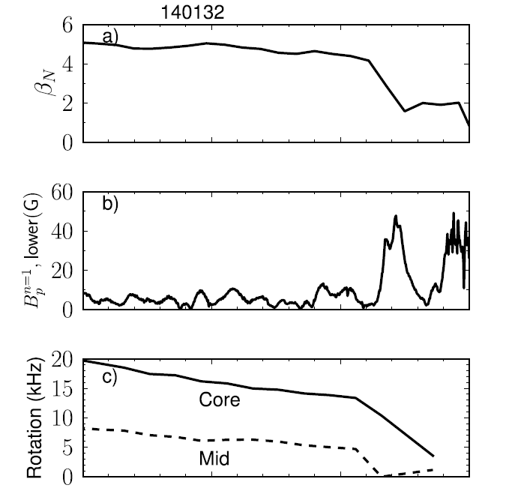
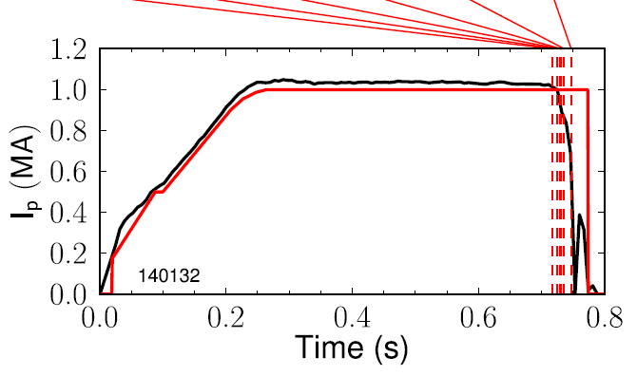
DECAF uses threshold tests and more sophisticated models to declare events and create event chains
Disruption event chain
RWM
VDE
WPC
LON
IPR
LOQ
DIS
(0.717s)
(0.724s)
(0.729s)
(0.731s)
(0.736s)
(0.747s)
0.60
0.65
0.70
t (s)
0.75
LON: low density warning
IPR: not meeting Ip request
LOQ: low q warning
DIS: disruption
Events
RWM: resistive wall mode
VDE: vertical instability
WPC: wall proximity control
Critical need for new code objects that identify rotating/locking MHD events

Slide 4
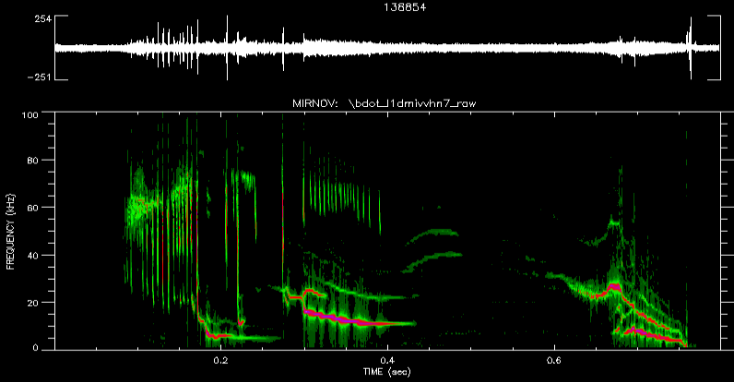
Automated mode identification starts with FFT analysis of magnetic probe data
Mirnov signal & FFT amplitude
shot 138854
Channel at φ = 302.8°
Consecutive FFTs give the phase and amplitude of a signal in frequency and time

Slide 5
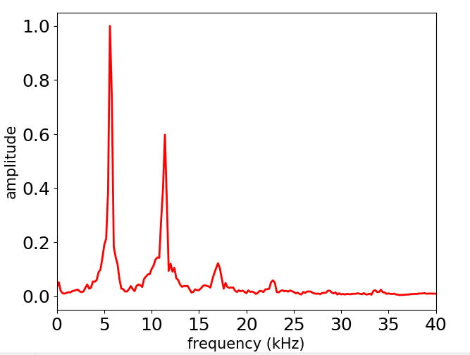
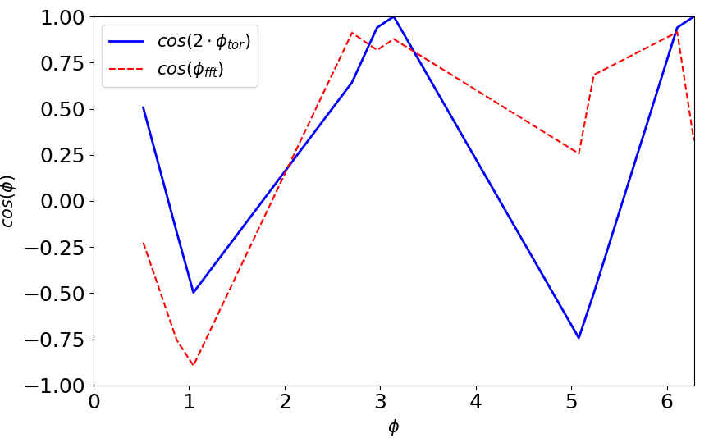
Toroidal mode numbers are determined by toroidal phase matching of peaks in FFT
Single channel FFT
Input data from a toroidal array of magnetic probes
Toroidal mode number determined by best match to measured phase
Created a portable Python code for general use in tokamaks (e.g. NSTX/-U, KSTAR, etc.)
Diagnostic configuration files allow easy setup for any tokamak
shot 138854
time = 0.72 s
Match to n = 2
(rad)

Slide 6
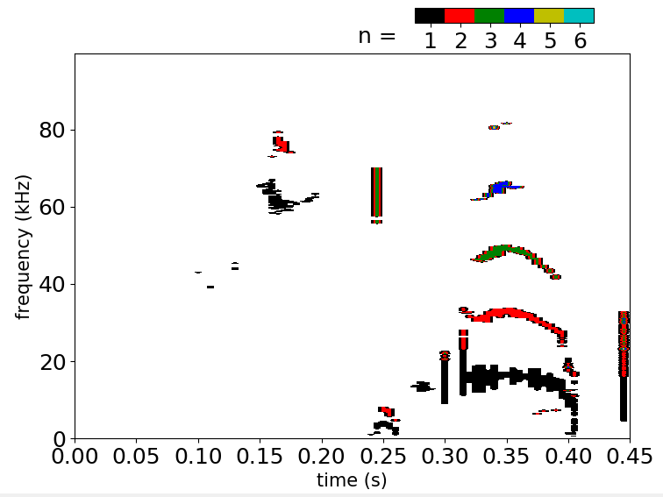
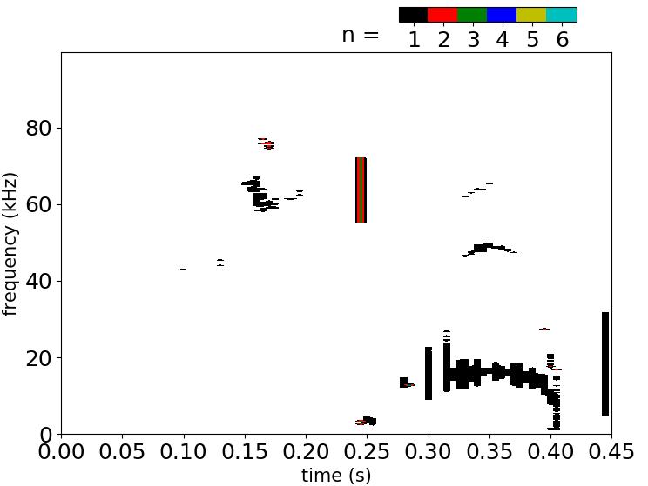
Principal components can be optionally selected by SVD
SVD allows for decomposition of signals into principal components
Can be used to pre-condition data for analysis (e.g. noise reduction, or to analyze dominant activity
Capability to be tested in DECAF to determine advantages
Toroidal mode number
Toroidal mode number
Magnetic spectrograms
shot 109810
shot 109810
Choosing only first two principal components

Slide 7
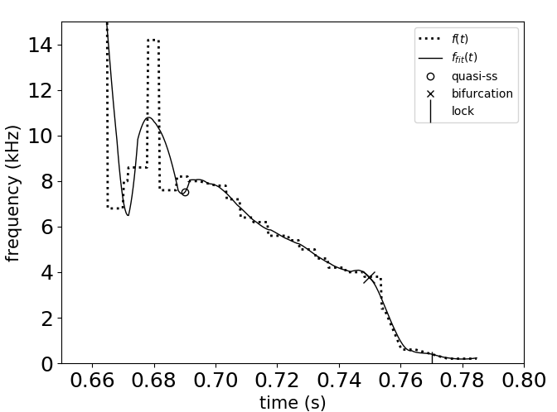
Discrete modes are processed as objects, key mode characteristics are determined and tracked
“Quasi-steady-state” frequency
bifurcation
Fit frequency
mode lock
Measured frequency
shot 138854
n = 1 mode
Frequency vs. time determined for continuous mode activity defines an object, fit for analytic determination of f’(t)
Quasi-steady state, rotation (bifurcation), and mode locking are automatically flagged for use by the DECAF code

Slide 8
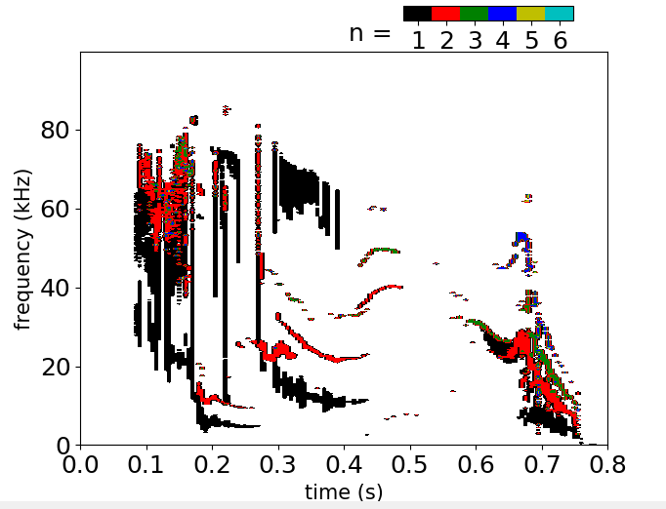
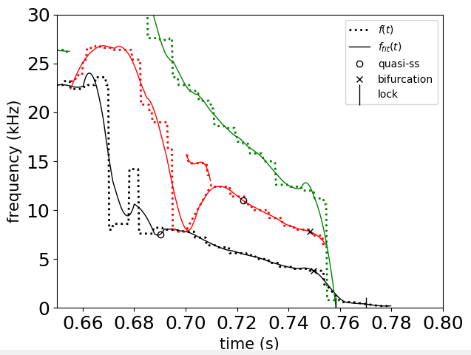
Algorithm tracks each mode as desired, searching for bifurcations, locking
Zoomed-in View
NSTX 138854
bifurcation
lock
Each “separate” mode considered a separate object in DECAF
Ongoing work to determine best ways to fully distinguish activity

Slide 9
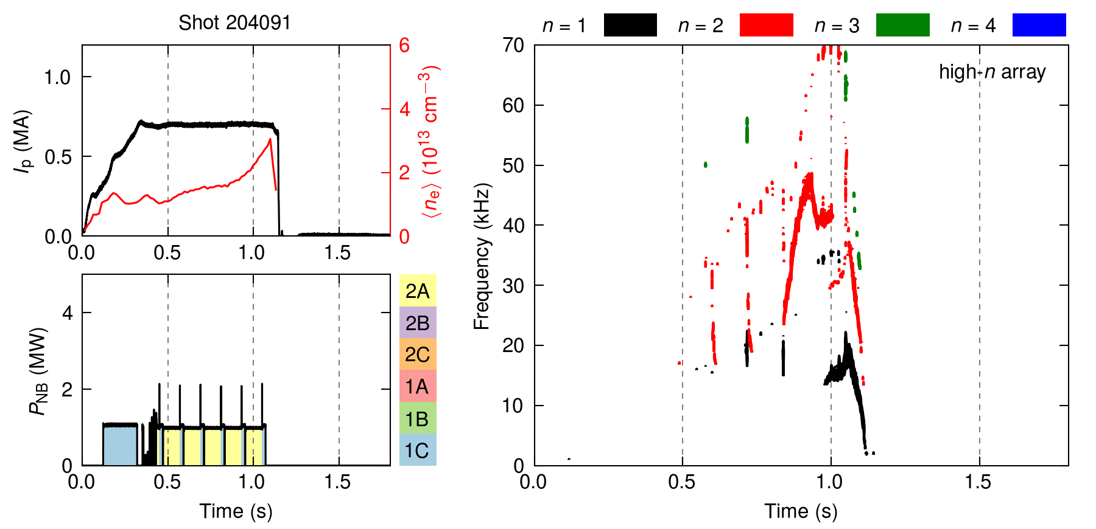
Examine mode locking in NSTX-U H-mode plasma
Experiment switching NBI and using beam blips leads to mode lock at insufficient plasma rotation

Slide 10
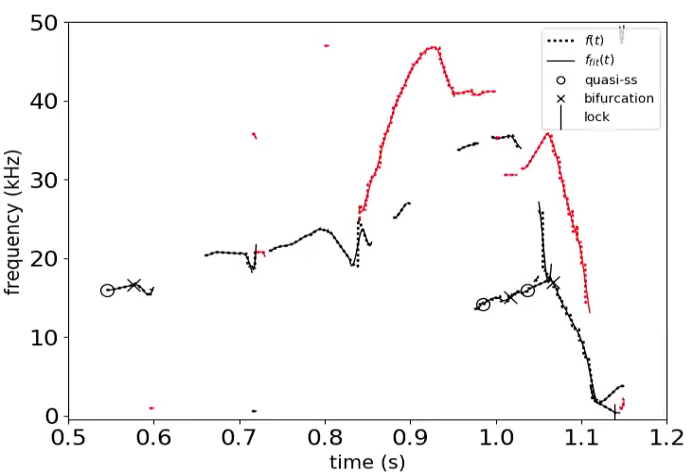
Mode bifurcation and locking identified well in NSTX-U H-mode plasma
Magnetic spectrogram
Mode object and event analysis
mode spin down
NSTX-U 204091
mode spin up
Lock (separation)
Code shows two n = 1 modes match frequency near time of bifurcation, apparently separate at mode lock

Slide 11
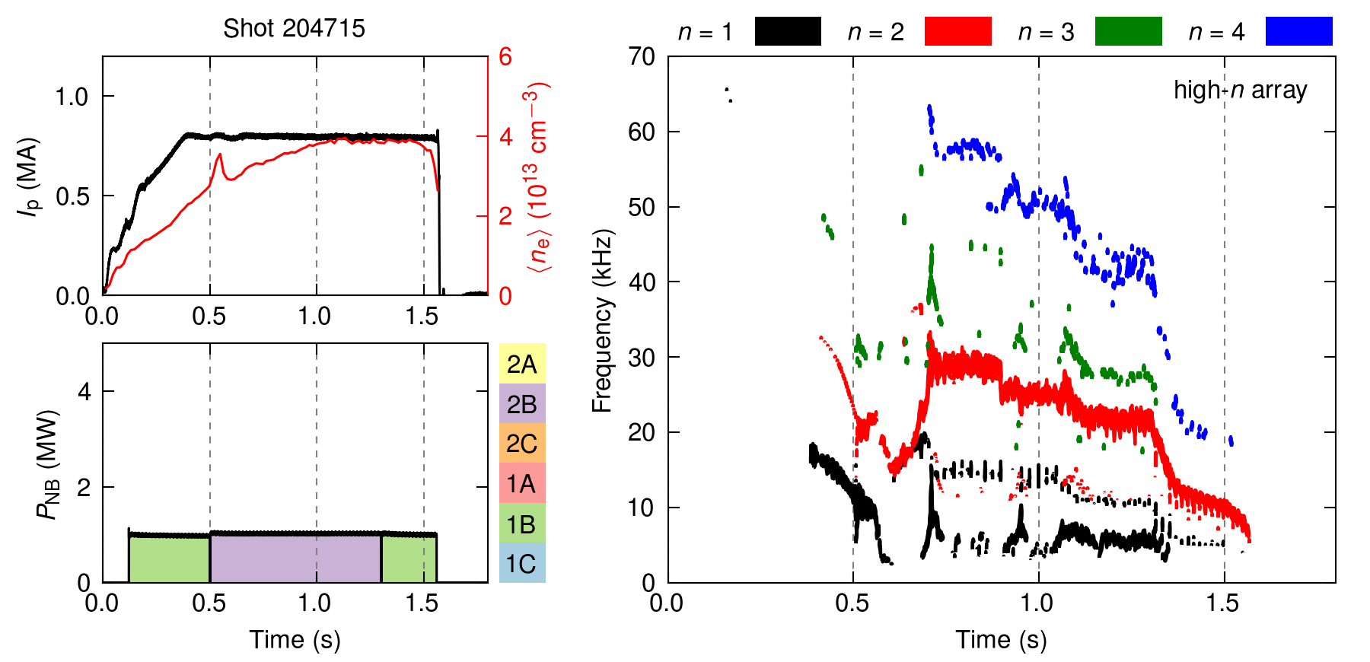
Richer mode activity somewhat more difficult to handle – concentrate on most dangerous modes
NSTX-U 204715
NSTX-U 204715
Code to ignore n = 3, 4 modes here due to high frequency, discontinuity
What will happen to frequency-separated n = 1 activity?

Slide 12
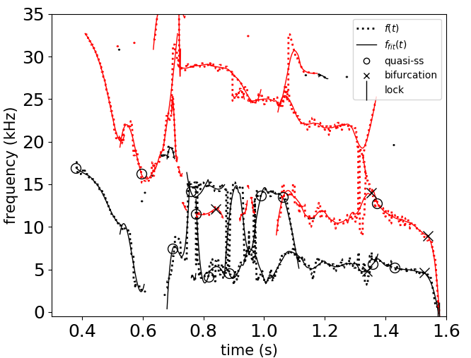
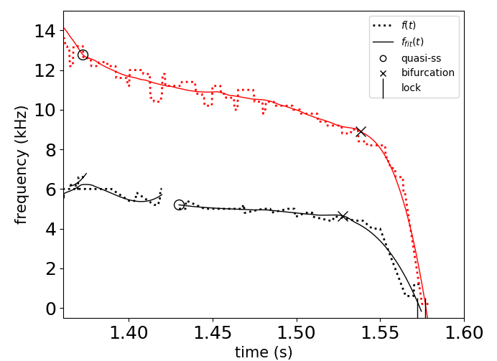
n = 1, 2 modes are tracked, bifurcations and locking identified
Zoomed-in View
bifurcations
lock
Steady-state frequency
NSTX-U 204715
Frequency separated n = 1 modes ~ 0.8s – 1.0s sometimes joined
Good identification of bifurcation and lock (most important)

Slide 13
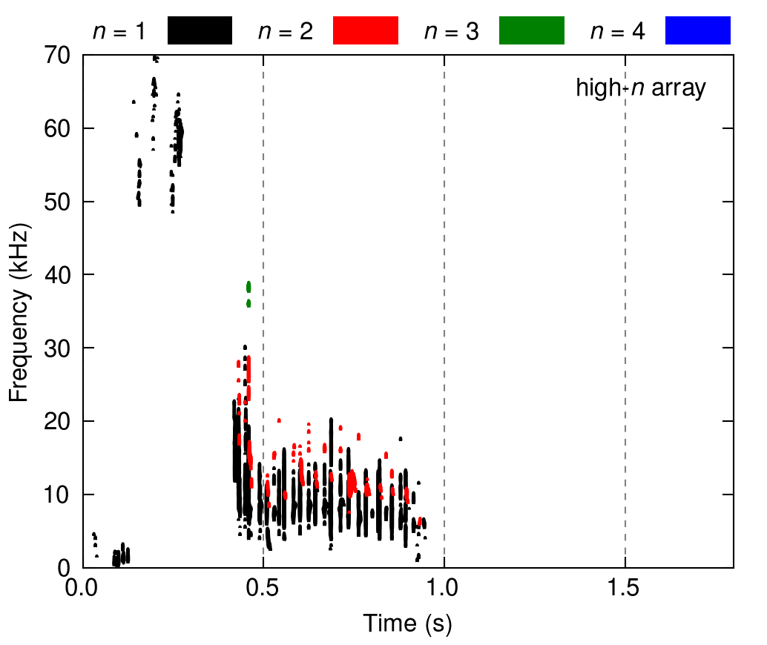
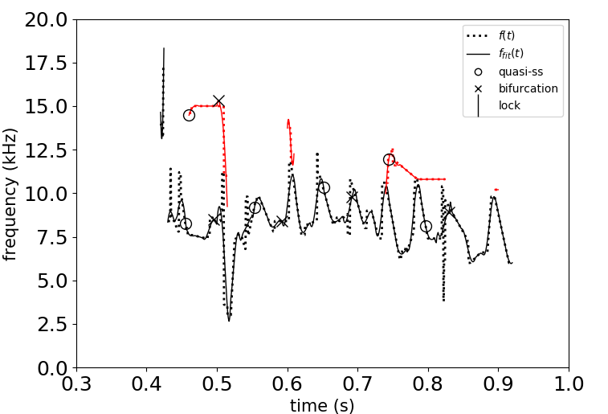
Sawteeth reveal that bifurcation algorithm needs somewhat greater intelligence
Spectrogram
Automated processing
steady-state f
errant bifurcations
NSTX-U 204077
Algorithm does identify sawtooth activity as continuous
Inflections in frequency presently interpreted as bifurcations (to be fixed)

Slide 14
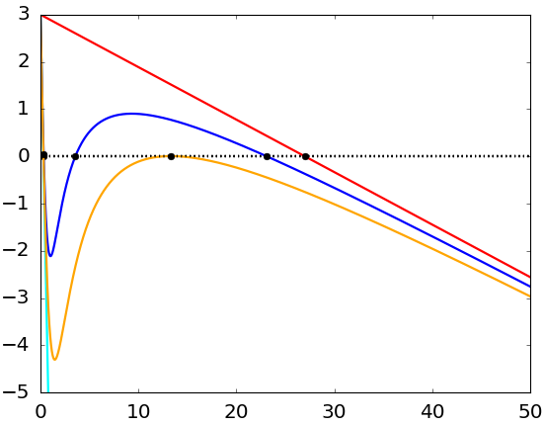
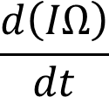
Simple physics model for mode rotation evolution / mode lock forecasting derived, can be tested in DECAF as next step
Model derived to allow island drag for both “slip” and a “no slip” condition
Simple “Ω₀” defines steady state
Robust way to define this using the automated code?
Simple “Ω₀/2” defines bifurcation point
$$\frac{d\left(IΩ\right)}{dt}=T_{aux}−\frac{k_{2}Ω}{1+k_{3}Ω^{2}}−\frac{\left(IΩ\right)}{τ_{2D}}$$
$$T_{mode}=\frac{k_{2}Ω}{1+k_{3}Ω^{2}}$$
$$k_{2}=0$$
Model based on
R. Fitzpatrick et al., NF 33 (1993) 1049
~ Ω₀/2
“steady-state”
Ω₀
Bifurcation frequency
mode frequency

Slide 15
Automated characterization of rotating MHD modes is a key capability for disruption analysis, forecasting goal
Automated algorithm developed to characterize rotating MHD modes, spot their bifurcation and locking
A critical capability to process general tokamak databases (ubiquitous rotating MHD activity)
General algorithm in portable Python code discriminates toroidal mode number, tracks modes as objects for DECAF
The algorithm was tested on a set of expected plasma scenarios in NSTX/-U
Code reads and can process KSTAR data. Needed next step to improve reading speed for long pulse data with high sampling rate

