Slide 1
Progress on Disruption Event Characterization and Forecasting (DECAF) in Tokamaks
S.A. Sabbagh¹, J.W. Berkery¹, Y.S. Park¹, J.H. Ahn¹, Y. Jiang¹, J.D. Riquezes¹, R.E. Bell², M.D. Boyer², A.H. Glasser³, J. Hollocombe⁴, J. Kim⁵, A. Kirk⁴, J. Ko⁵, W. Ko⁵, L. Kogan⁴, B. LeBlanc², J.H. Lee⁵, Y.K. Oh⁵, F. Poli², S.D. Scott², A. Thornton⁴, L. Terzolo⁵, S.W. Yoon⁵, S.J. Wang⁵, Z.R. Wang²
¹Department of Applied Physics, Columbia University, New York, NY
²Princeton Plasma Physics Laboratory, Princeton, NJ
³Fusion Theory and Computation, Inc., Kingston, WA
⁴Culham Centre for Fusion Energy, UKAEA, Abingdon, UK
⁵National Fusion Research Institute, Daejeon, Republic of Korea
NSTX-U / Magnetic Fusion Science meeting
24 Sep 2018
PPPL
Princeton, NJ USA
V2.1

Slide 2
A broadened disruption prediction and avoidance analysis is progressing for ITER and future tokamaks
Motivation: Disruption prediction/avoidance is a critical need
  A highest priority DOE FES (Tier 1) initiative - present “grand challenge” in tokamak stability research:
    Can be done! (JET: < 4% disruptions w/C wall, < 10% w/ITER-like wall)
    ITER disruption allowance: < 1 - 2% (energy + E&M loads); << 1% (runaways)
Talk Outline
  Disruption Event Characterization and Forecasting (DECAF) review
  Present DECAF development and initial multi-device examination (now including MAST)
  Key related analysis (e.g. long pulse, high beta KSTAR kinetic equilibrium reconstruction, stability analysis, high non-inductive plasmas)
  “Predict-first” TRANSP analysis: 2018/2019 KSTAR operation with 2nd NBI system
  Summary / next steps

Slide 3
International collaborative research on disruption prediction/avoidance expands effort to MAST-U, KSTAR
US DOE supports our efforts
  Multi-institutional collaborative grant on KSTAR, new grant on MAST-U
  Multi-faceted physics research includes equilibrium, stability, transport, control, diagnostic hardware elements
    Research originated on the NSTX spherical torus
Personnel
  Columbia U.:
    S.A. Sabbagh* (Lead PI), Y.S. Park, J.H. Ahn*, Y. Jiang* (post-doctoral)
    J.W. Berkery*, J. Bialek (part time); J.D. Riquezes* (Columbia student)
  PPPL: S. Scott (~full time, inst. PI), M. Boyer, B. LeBlanc (part time)
  MIT/ORISE: E.S. Marmar (inst. PI), B. Mumgaard
*PPPL TSDW meeting speakers

Slide 4
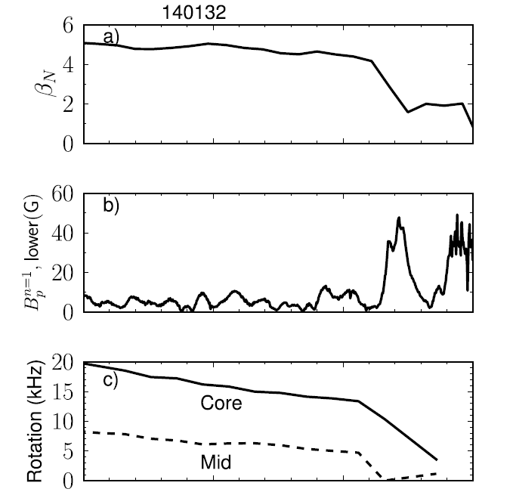
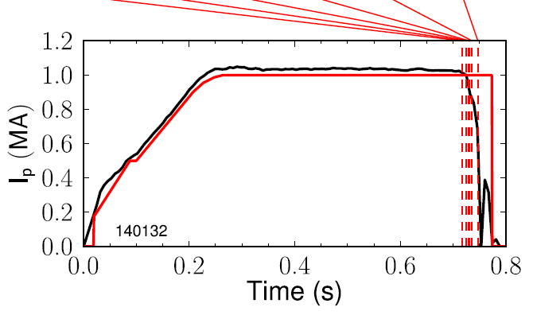
Brief review: the DECAF code automatically computes events + disruption event chains leading to disruption
NSTX
β_{N}
Disruption event chain
RWM
VDE
WPC
LON
IPR
LOQ
DIS
(0.717s)
(0.724s)
(0.729s)
(0.731s)
(0.736s)
(0.747s)
n = 1 RWM amplitude
Plasma rotation
0.60
0.65
0.70
t (s)
0.75
Events (in this chain)
  RWM: resistive wall mode
  VDE: vertical instability
  WPC: wall proximity control
  LON: low density warning
  IPR: not meeting I_{p} request
  LOQ: low q warning
  DIS: disruption

Slide 5
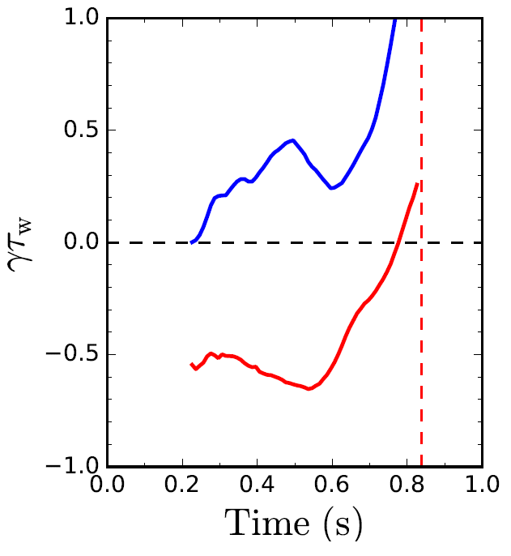
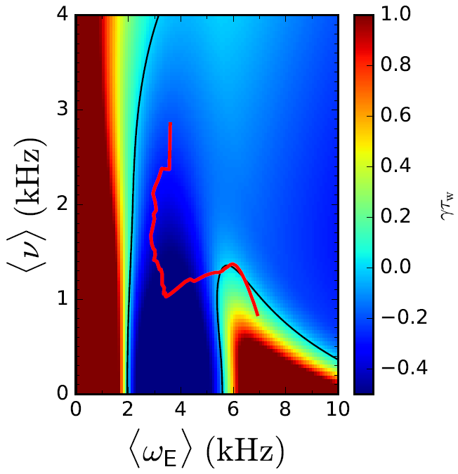
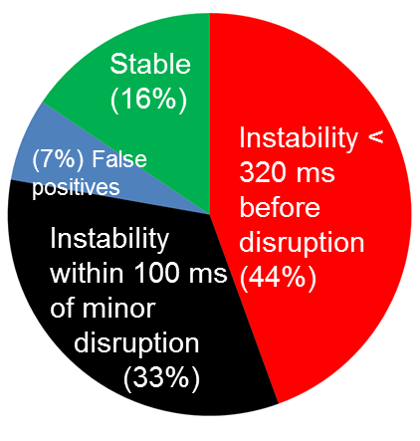
      DECAF reduced kinetic MHD model computations forecast the instability boundary to unstable global MHD modes
Norm. growth rate vs. time
Disruption forecasting
Predicted instability statistics
γτ_{w}
unstable
Increasing time
ideal
γτ_{w}
Collisionality (kHz)
stable
Global kinetic MHD mode growth
Ideal + kinetic
disruption
NSTX
139514
Rotation
predicted instability
84% of shots are predicted unstable (stringent evaluation)
44% predicted unstable < 320 ms (approx. 60τ_{w}) before current quench
33% predicted unstable within 100ms of a minor disruption
Favorable characteristics
  Stability contours CHANGE for each time point
  Possible to compute growth rate prediction in real time
J.W. Berkery, S.A. Sabbagh, R. Bell, et al., Phys. Plasmas 24 (2017) 056103

Slide 6
DECAF code and initial successful research/results is now advancing to a new level
DECAF brief highlights of prior results
  First automated event chain analysis (followed deVries’ manual work)
  Excellent performance on smaller, targeted databases (NSTX)
    DIS event always found (100%), VDE event appeared in 90% of cases
    Computed events accurately represented experiment (~ 10 events)
    Physics model forecasted global MHD disruptions with ~ 85% reliability
  Disruption chains often repeated, e.g.:
Recent progress
  New DECAF MHD events allow analysis of general databases
  Coupling of new physics analysis tools and DECAF events
  Multi-machine databases (analysis now starting)
  Large database processing with small number of verified events
RWM
VDE
WPC
IPR
DIS
Very rapid progress on DECAF in these directions occurring day-to-day at the moment

Slide 7
Progress on DECAF now moving to processing of multi-machine databases
Analysis
  Kinetic equilibrium / stability analysis on KSTAR; planned for MAST
DECAF database started
  Requires storage of DECAF analysis
Device / Capability | KSTAR | MAST | NSTX | DIII-D | TCV
Full database access (type) | Yes (MDSplus) | Yes (UDA) | Yes (MDSplus) | Yes (MDSplus) | Yes (MDSplus)
Database analysis | started | started | started |  | started
Equilibrium analysis | Kinetic + MSE | scheduled | Kinetic + MSE | available
Stability | Ideal, Resistive Kinetic MHD | scheduled | Ideal, kinetic MHD (resistive) | Ideal, kinetic MHD
shot*seconds (for kinetic analysis) | 1,886 (2016+2017) | 2,667 (est) (M7,M8, M9 runs) | 2,000 / year (est)
Aim to bring in ASDEX-Upgrade, JET, and C-Mod databases

Slide 8
Initial analysis of large databases further supports published result that disruptivity doesn’t increase with plasma β
MAST
KSTAR
NSTX
DIS
DECAF analysis of event
  Similar to a “standard” disruptivity analysis
  Shots analyzed at 10 ms intervals
Analysis during I_{p} flat-top
  MAST: 8902 plasmas analyzed
  NSTX: 4706 plasmas analyzed
  KSTAR: 750 plasmas analyzed (so far)

Slide 9
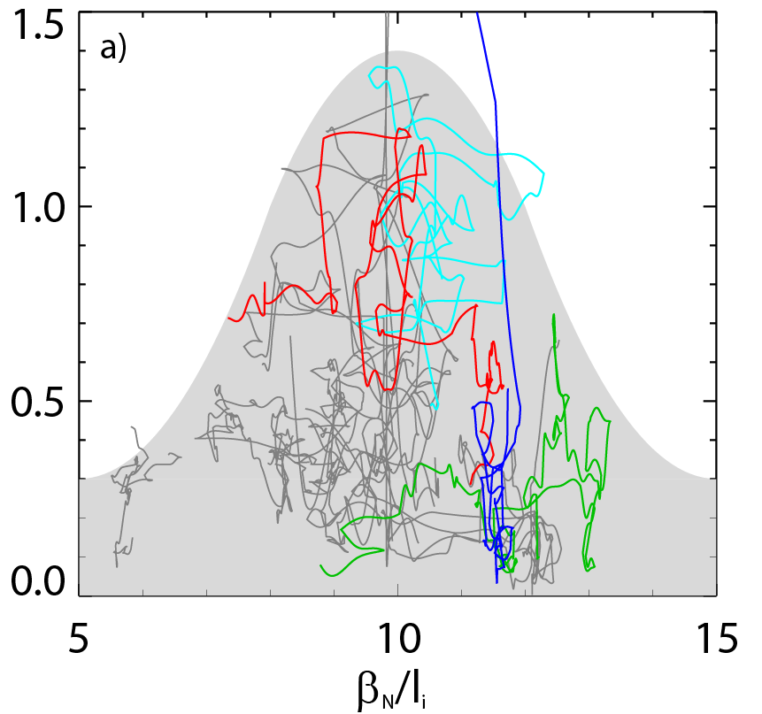
Experiments directly measuring global MHD stability verify that highest β_{N}/l_{i} is not the least stable scenario (NSTX)
Resonant Field Amplification (RFA) measurement of stability
Non-intuitive stability increase at high β_{N}/l_{i}
  decreases up to β_{N}/l_{i} = 10, increases at higher β_{N}/l_{i}
Understanding: Results consistent with kinetic stabilization theory invoking physical resonances
RFA Amp. (G/G)
Less stable
More stable
Less stable
J. Berkery, et al., PoP 21 (2014) 156112
S. Sabbagh,et al., 2016 EPS Landau-Spitzer Award lecture

Slide 10
Initial analysis of large databases further supports published result that disruptivity doesn’t increase with β_{N}
MAST
KSTAR
NSTX
DIS
DECAF analysis of event
  Shots analyzed at 10 ms intervals
  NEXT STEP: DECAF event chain analysis
Analysis during I_{p} flat-top
  MAST: 8902 plasmas analyzed
  NSTX: 4706 plasmas analyzed
  KSTAR: 750 plasmas analyzed (so far)

Slide 11
DECAF density limit analysis started: global, local density limits examined, correlation of MHD onset near limits
Disruptivity vs. density
DIS
Magnetic spectrogram
(toroidal array)
GWL
GWL
Greenwald limit
  Approaches 1 near mode lock
Rad. island power balance
  Examining utility of this physics model for disruption warning
IPB
See talk by J. Berkery, Wednesday

Slide 12
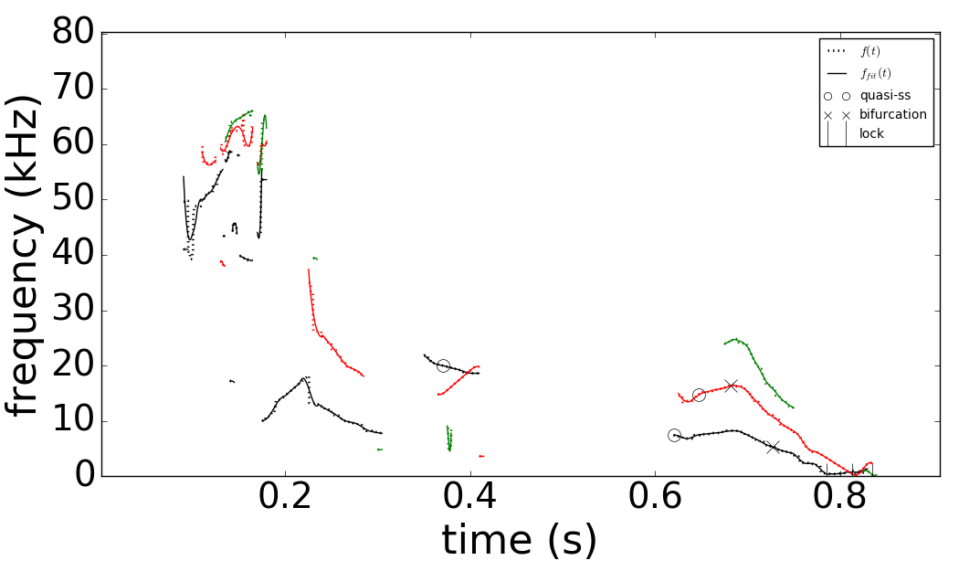
More powerful automated MHD event objects have been developed for DECAF
DECAF automated MHD events
Magnetic spectrogram
(toroidal array)
MHD-n3
MHD-n2
MHD-n1
GWL
More capable MHD event objects required for analysis of wider tokamak databases
DECAF MHD events now include
  Mode number (n) discrimination
  Full history of mode evolution, including bifurcation and locking
  Many disruption warning criteria
IPB

Slide 13
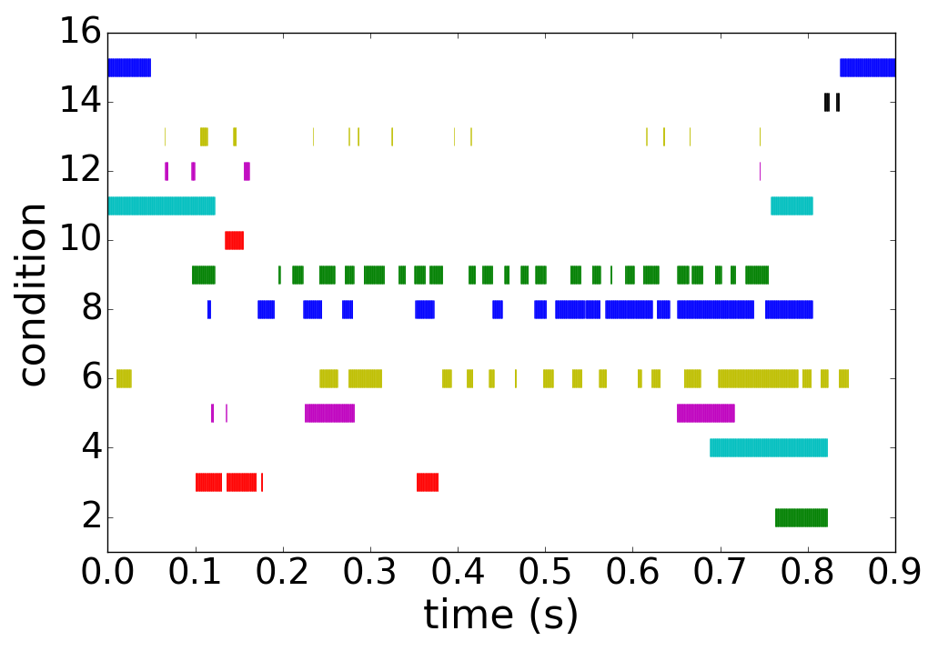
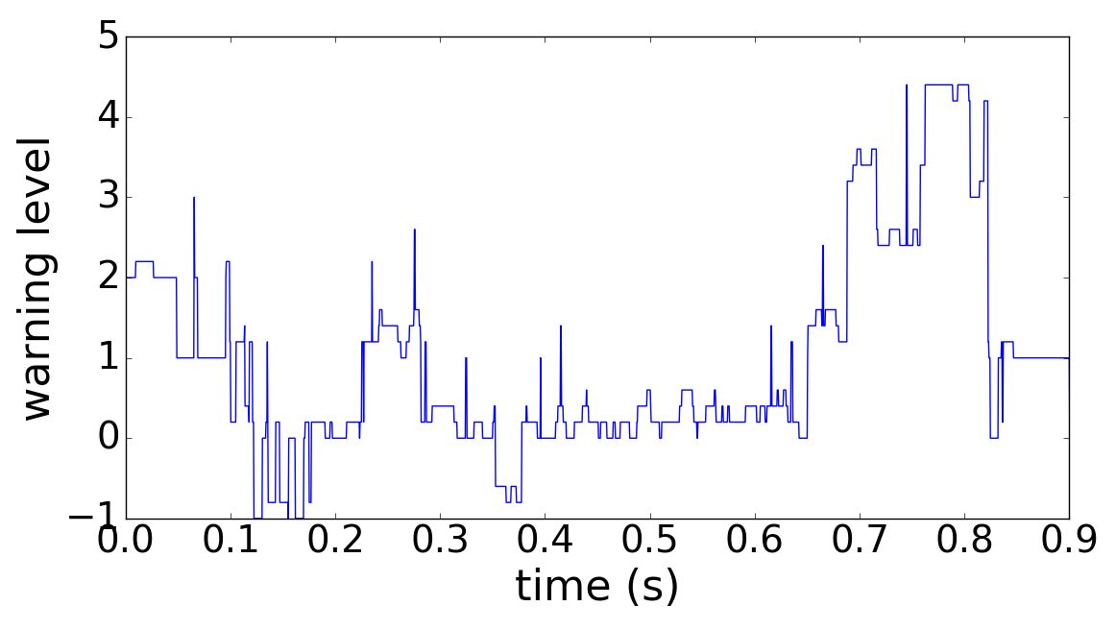
New DECAF MHD events utilize history of 15 criteria to define time evolving disruption warning level
DECAF automated MHD events
DECAF “heat map” (for MHD)
MHD-n3
MHD-n2
MHD-n1
BIF-n2
“quasi-steady
state (O)”
BIF-n1
LTM-n1
LTM-n2
DECAF MHD warning level
Initial findings
  Clear “safe” and “unsafe” periods of MHD appear in warning level
  Criterion history of wider range of plasma parameters improved the disruption warning reliability ➔ illustrated by “Heat Map”

Slide 14
MHD heat map illustration summarizes understanding of disruption warning level
DECAF automated MHD objects
DECAF “heat map” (for MHD)
MHD-n3
Locked mode > 25G ➔
MHD-n2
MHD-n1
⬅ Core plasma rotation < 6 kHz ➔
BIF-n2
“quasi-steady
state (O)”
BIF-n1
Decreasing plasma rotation ➔
LTM-n1
⬅ High amplitude ➔
LTM-n2
f below bifurcation ➔
Very low f mode ➔
DECAF MHD warning level
Some notables for this heat map
  Mode frequency below bifurcation, decreasing plasma rotation key
  Early, slow warning level evolution
  Locked mode amplitude important, but warning comes in late
See TSDW talk by J. Riquezes

Slide 15
While disruptivity plots provide important information, they can be misleading when used incorrectly
Example: What are the most important regions to study on this plot?
NSTX

Slide 16
While disruptivity plots provide important information, they can be misleading when used incorrectly
Example: What are the most important regions to study on this plot?
  A human might focus on the high disruption probability regions
  What causes the disruptions? (low β_{N}, mid-l_{i} ???)
NSTX

Slide 17
While disruptivity plots provide important information, they can be misleading when used incorrectly
Example: What are the most important regions to study on this plot?
  A human might focus on the high disruption probability regions
  Black-box machine learning might segregate disruptive from non-disruptive regions of the plot and learn from that division
NSTX

Slide 18
While disruptivity plots provide important information, they can be misleading when used incorrectly
Example: What are the most important regions to study on this plot?
  A human might focus on the high event probability regions
  A machine learning algorithm might segregate disruptive from non-disruptive regions of the plot and learn from that division
  Problem ➔plasma conditions can change significantly between first problem detected and when disruption happens
NSTX
DIS
DIS

Slide 19
While disruptivity plots provide important information, they can be misleading when used incorrectly
Example: What are the most important regions to study on this plot?
  A human might focus on the high event probability regions
  A machine learning algorithm might segregate disruptive from non-disruptive regions of the plot and learn from that division
  Problem ➔plasma conditions can change significantly by the time the disruption happens
NSTX
Answer: the circles mark the key region to study!
  The shots suffer different “events” that are started in this region, and end up far from that region when they disrupt (at the crosses )

Slide 20
While disruptivity plots can provide information, they can be highly misleading when used incorrectly
Example: What are the most important regions to study on this plot?
  A human might focus on the high event probability regions
  A machine learning algorithm might segregate disruptive from non-disruptive regions of the plot and learn from that division
  Problem ➔plasma conditions can change significantly by the time the disruption happens
NSTX
Key Lessons:
  Using a “disruption database” that only contains data near the disruption time is misleading for disruption forecasting
  Only analyzing plasma conditions near the disruption time is not useful in many cases, even if one can figure out a way to forecast 100% accurately

Slide 21
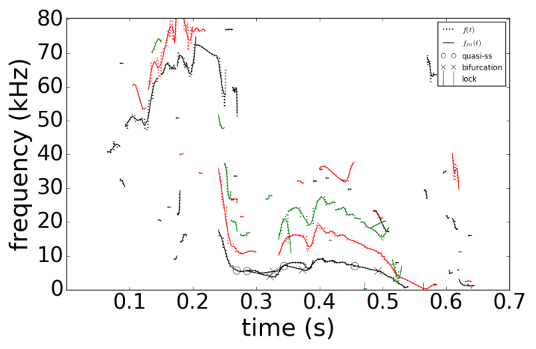
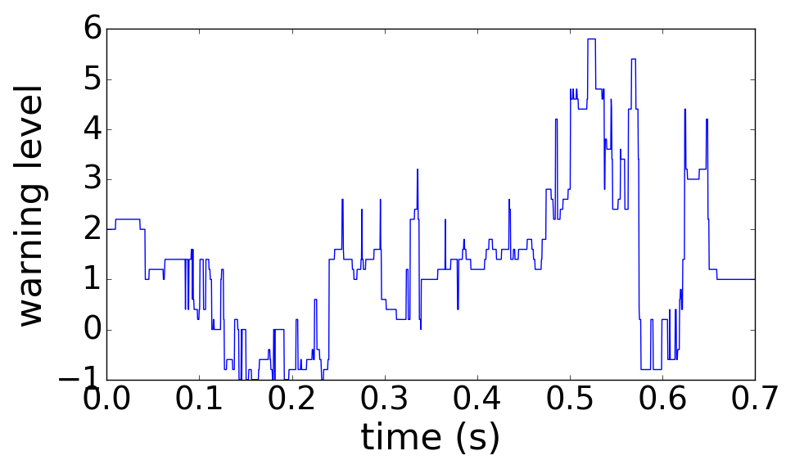
Standard disruptivity plots give no insight into physics; DECAF reveals the physics to provide improved forecasting
NSTX
DECAF automated MHD events
n =
1
2
3
126962
DECAF MHD warning level
Long interval leading up to disruption
  Rotating MHD slows, bifurcates, and locks
  Then, plasma has an H-L back-transition (pressure peaking warning PRP) before DIS
DECAF event chain
MHD-n1
BIF-n1
LTM-n1
PRP
IPR
WPC
DIS
VDE
(0.490s)
(+.005s)
(+.045s)
(+.068s)
(+.073s)
(+.073s)
(+.077s)
(+.080s)

Slide 22
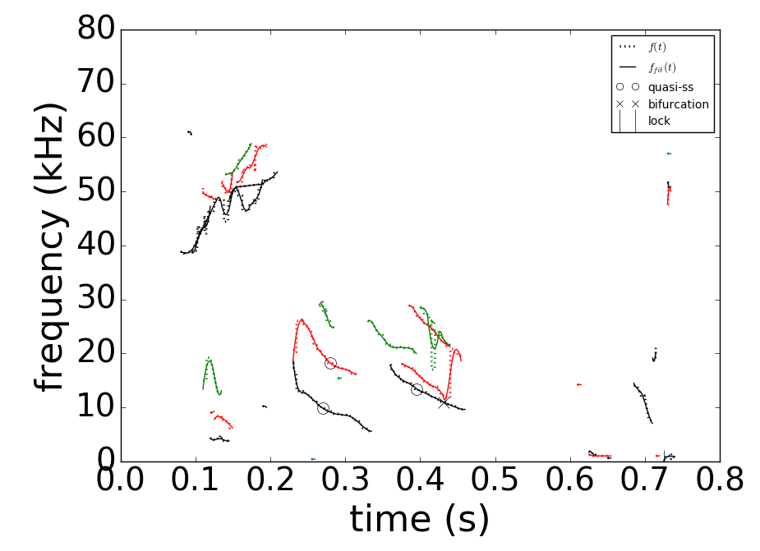
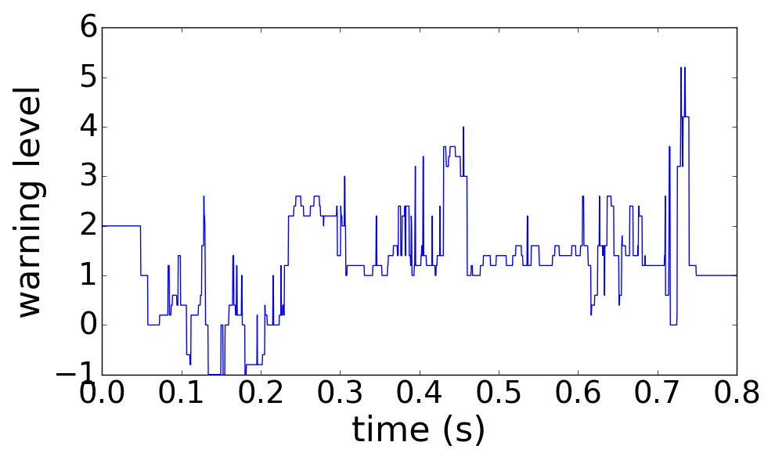
Standard disruptivity plots give no insight into physics; DECAF reveals the physics to provide improved forecasting
NSTX
DECAF automated MHD events
n =
1
2
3
DECAF MHD warning level
123856
Global MHD (RWM) can also be “slow”
  Rotating MHD warning level decreases after 0.46s ➔ DANGEROUS for RWM onset
  H – L back transition (PRP) drags out time to disruption (> 100 ms)
DECAF event chain
RWM
IPR
PRP
VDE
DIS
MHD-n1
LTM-n1
WPC
LOQ
(0.629s)
(+.010s)
(+.012s)
(+.058s)
(+.101s)
(+.101s)
(+.101s)
(+.106s)
(+.107s)

Slide 23
DECAF is fueled by coordinated research that continues to validate/develop physics models
Global MHD
  Detection: available magnetic diagnostics, plasma rotation, equilibrium
  Forecasting: Kinetic MHD model has high success in NSTX, DIII-D
Resistive MHD
  Detection / forecasting: available magnetic diagnostics, plasma rotation
  Forecasting: starting examination of MRE ➔ start with Δ’ evaluation
Density limits
  Detection: rad. power, global empirical limit
  Forecasting: starting examination of rad. island power balance model
Physics analysis / experiments to build DECAF models
  Interpretive and “predict-first” analysis of KSTAR long-pulse, high beta plasmas with high non-inductive fraction
See TSDW 2018 talk by J. Riquezes
See TSDW 2018 poster by Y. Jiang
See talk by J. Berkery in 2 weeks
See TSDW 2018 poster by J.H. Ahn

Slide 24
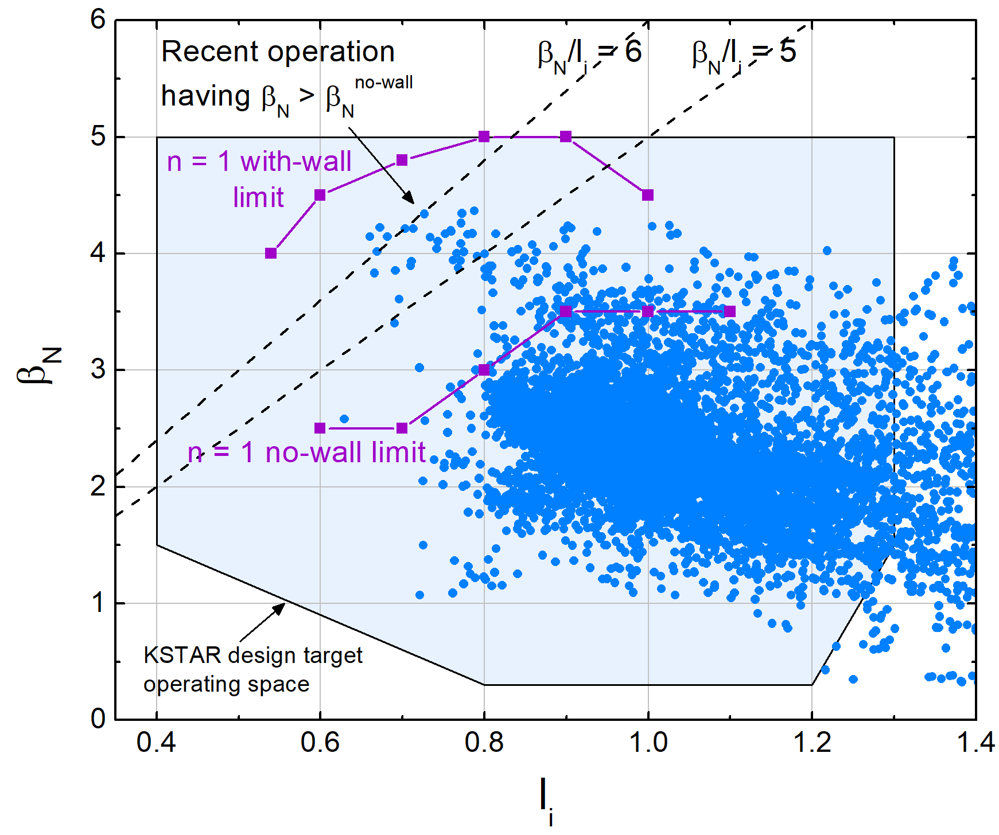
KSTAR kinetic equilibria w/ MSE are examined in the context of past published database
Examples in talk
16295
  High β_{N} plasma
16325
  Higher B_{T} (q₉₅)
  Higher edge bootstrap current
18476 & 16498
  Internal Transport Barrier (ITB)
16295
(high β_{N})
16325
18476 & 16498 (ITB)
Many thousands of kinetic equilibria run during testing
Y.S. Park, S.A. Sabbagh, et al., Nucl. Fusion 53 (2013) 083029 (magnetics-only)

Slide 25
Kinetic equilibria with MSE produces greater detail in P and q profiles than magnetics-only
16325 @5.975s
16325 @5.975s
Global parameter | χ² | Error | R_{axis} (cm) | Z_{axis} (cm) | κ | δ_{TOP} | δ_{BOT} | β_{T} | β_{p} | β_{n} | l_{i} | q₉₅
Magnetic only | 202 | 1.60E-07 | 186.1 | -0.7 | 1.68 | 0.54 | 0.80 | 0.95 | 1.86 | 1.89 | 1.05 | 6.39
Kinetic | 231 | 9.70E-05 | 185.6 | -2.4 | 1.68 | 0.50 | 0.80 | 1.09 | 1.95 | 2.10 | 0.97 | 5.91
See TSDW 2018 poster by Y. Jiang

Slide 26
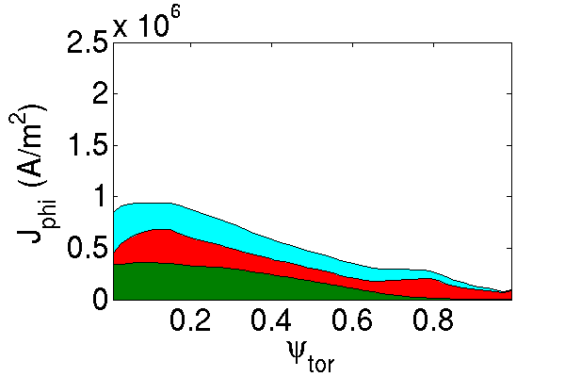
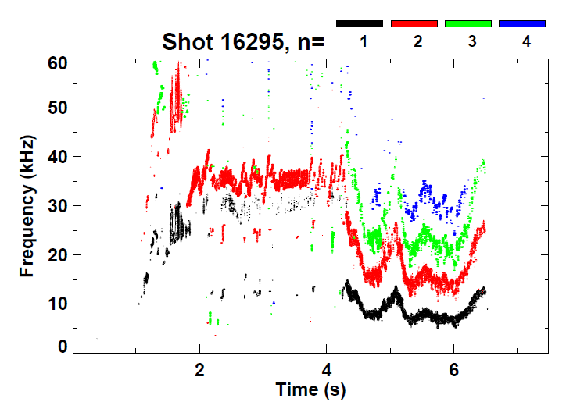
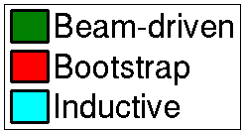
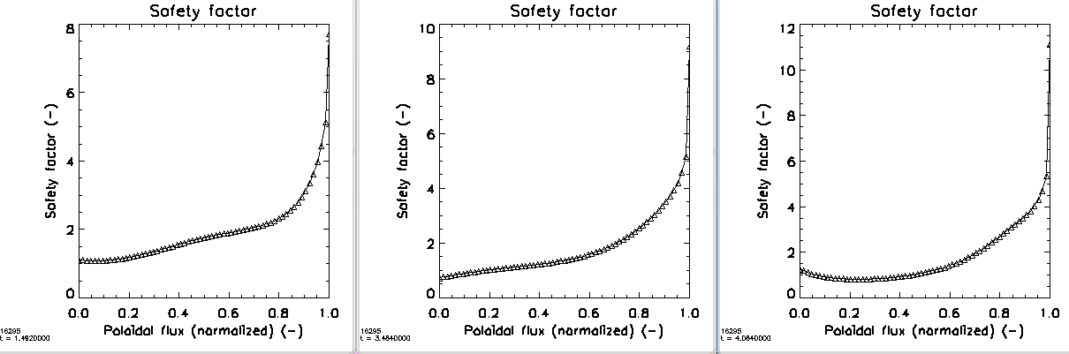
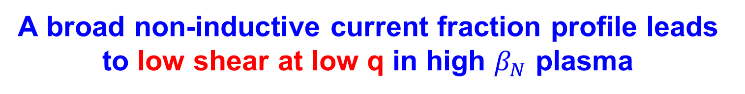
A broad non-inductive current fraction profile leads to low shear at low q in high $β_{N}$ plasma
10⁶
Current profile components
TRANSP
(67% non-inductive)
Magnetic spectrogram
Weak n = 2 mode
16295 t=1.75s
β_{N}>3
Kinetic + MSE reconstructed q profile evolution
8
10
12
10
8
6
4
2
0
t=1.482s
t=3.484s
t=4.084s
6
8
q
q
q
6
Evolves to low shear at low q
4
4
2
2
0
0
0.0 0.2 0.4 0.6 0.8 1.0
ψ_{N}
0.0 0.2 0.4 0.6 0.8 1.0
ψ_{N}
0.0 0.2 0.4 0.6 0.8 1.0
ψ_{N}

Slide 27
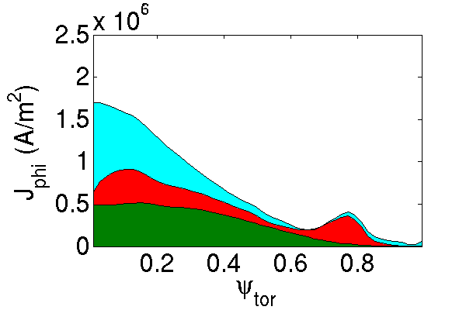
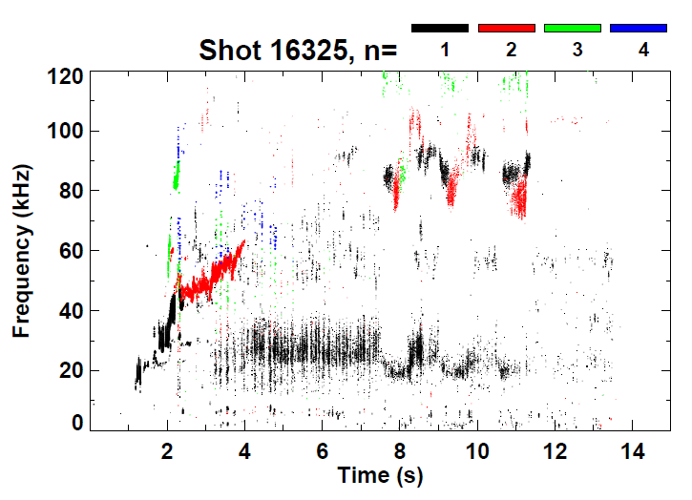
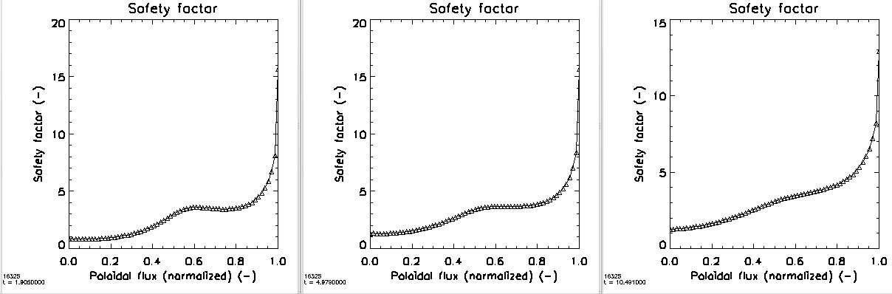

Kinetic EFIT reconstructed again shows evolution to low-sheared q-profiles but now at high q
10⁶
Current profile components
Magnetic spectrogram
TRANSP
(71% non-inductive)
16325 t=2.05s
Tearing modes absent
Kinetic + MSE reconstructed q profile evolution
20
20
15
t=1.906s
t=4.979s
t=10.491s
15
15
q
q
10
Low shear forms again, but at high q
q
10
10
$$q_{min}<1$$
5
5
5
0
0
0
0.0 0.2 0.4 0.6 0.8 1.0
ψ_{N}
0.0 0.2 0.4 0.6 0.8 1.0
ψ_{N}
0.0 0.2 0.4 0.6 0.8 1.0
ψ_{N}

Slide 28
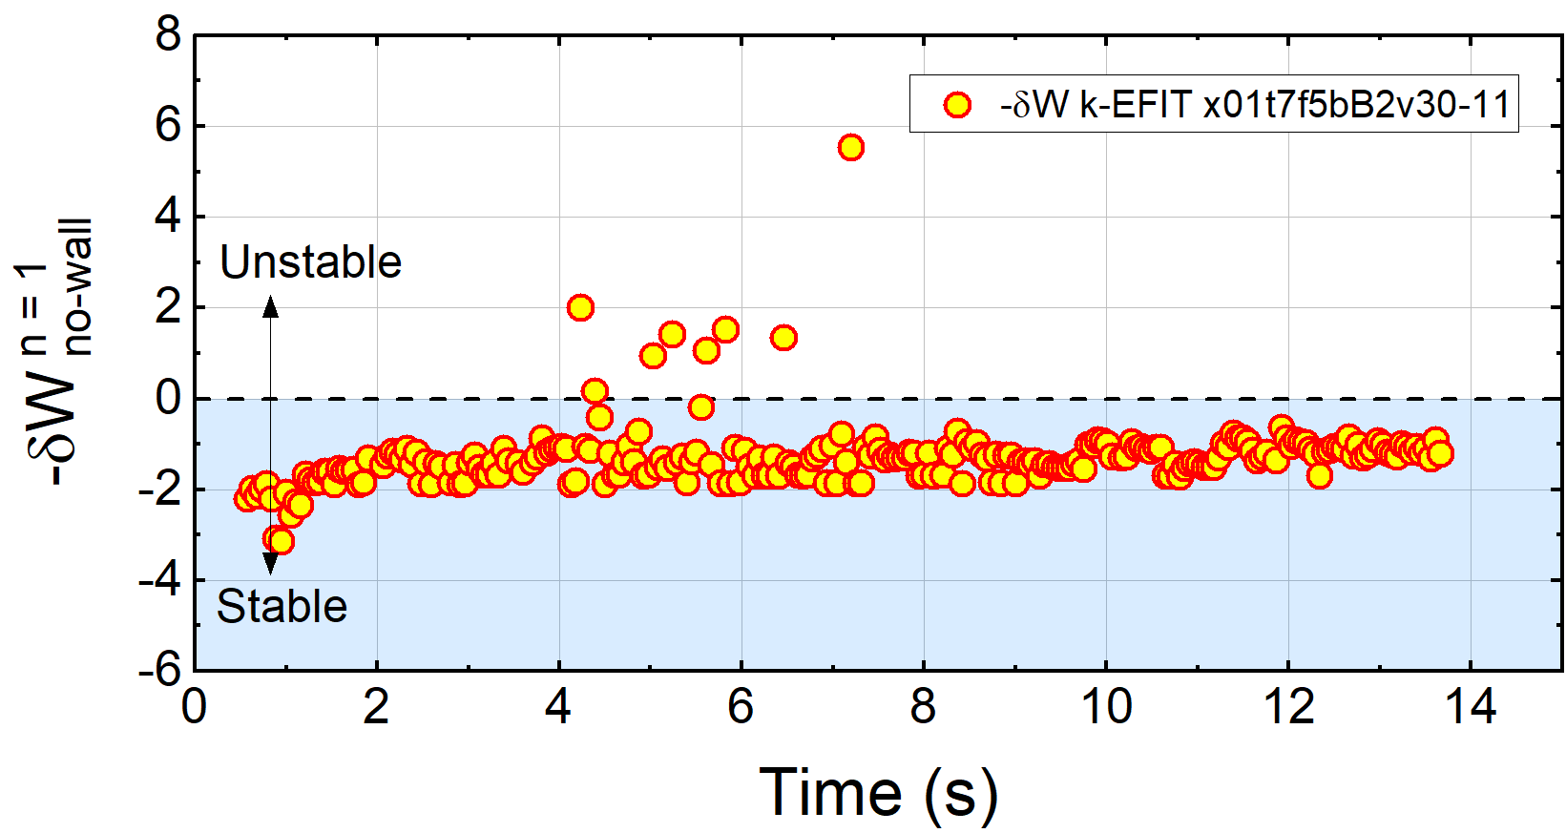
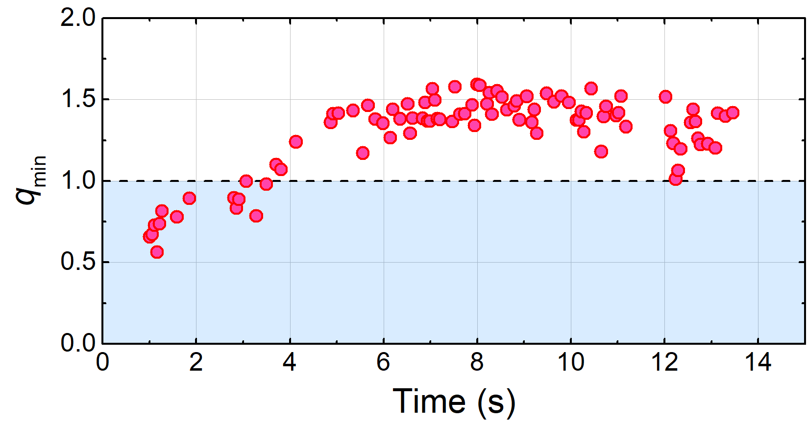
Higher q₉₅ plasma has greater ideal n = 1 no-wall stability in DCON, closer to marginal stability
KSTAR 16325
Unlike higher β_{N} plasma, equilibria is mostly stable to n = 1 ideal modes in DCON
  Note generally smooth evolution of stability criterion – reached with improved kinetic equilibria
The q-profile at higher B_{T} evolves higher q_{min} above 1
  Sawteeth disappear
Reconstructed lower q shear at higher values of q does not lead to n = 1 instability in DCON
High q₉₅ equilibria
DCON
}
High q₉₅ equilibria
q_{min} (w/ MSE)

Slide 29
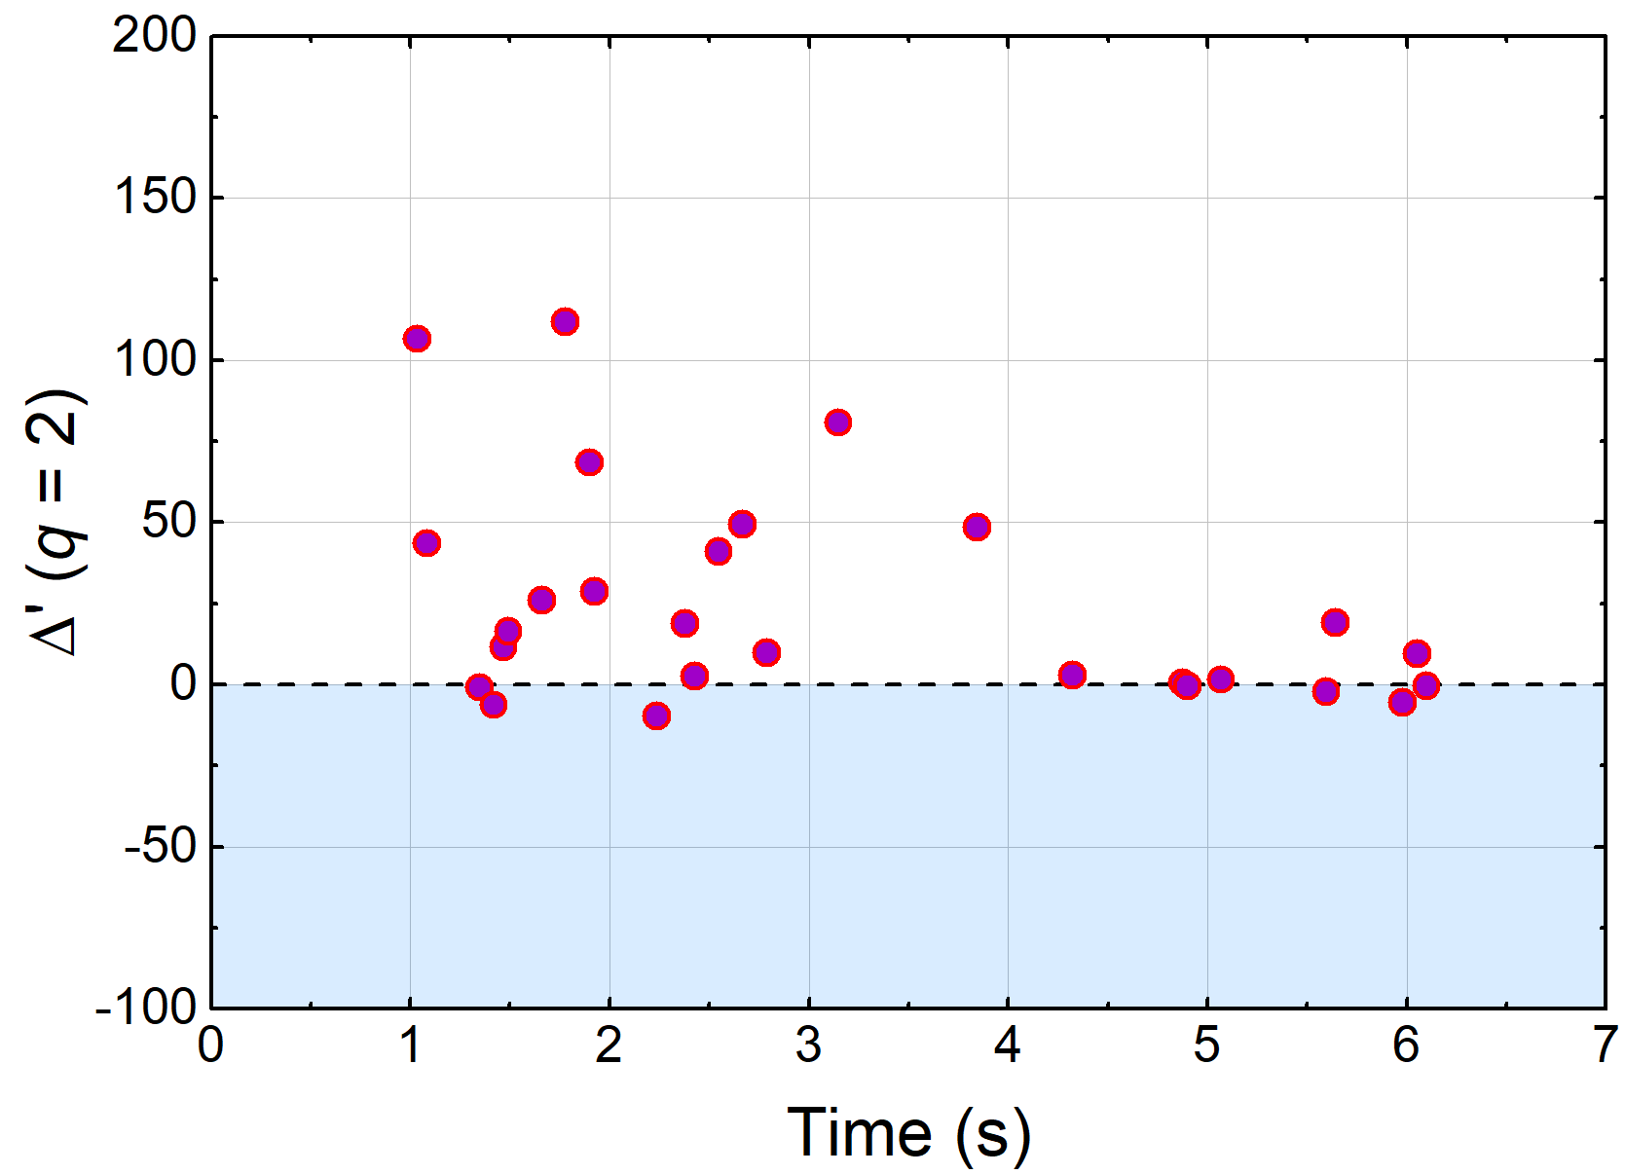
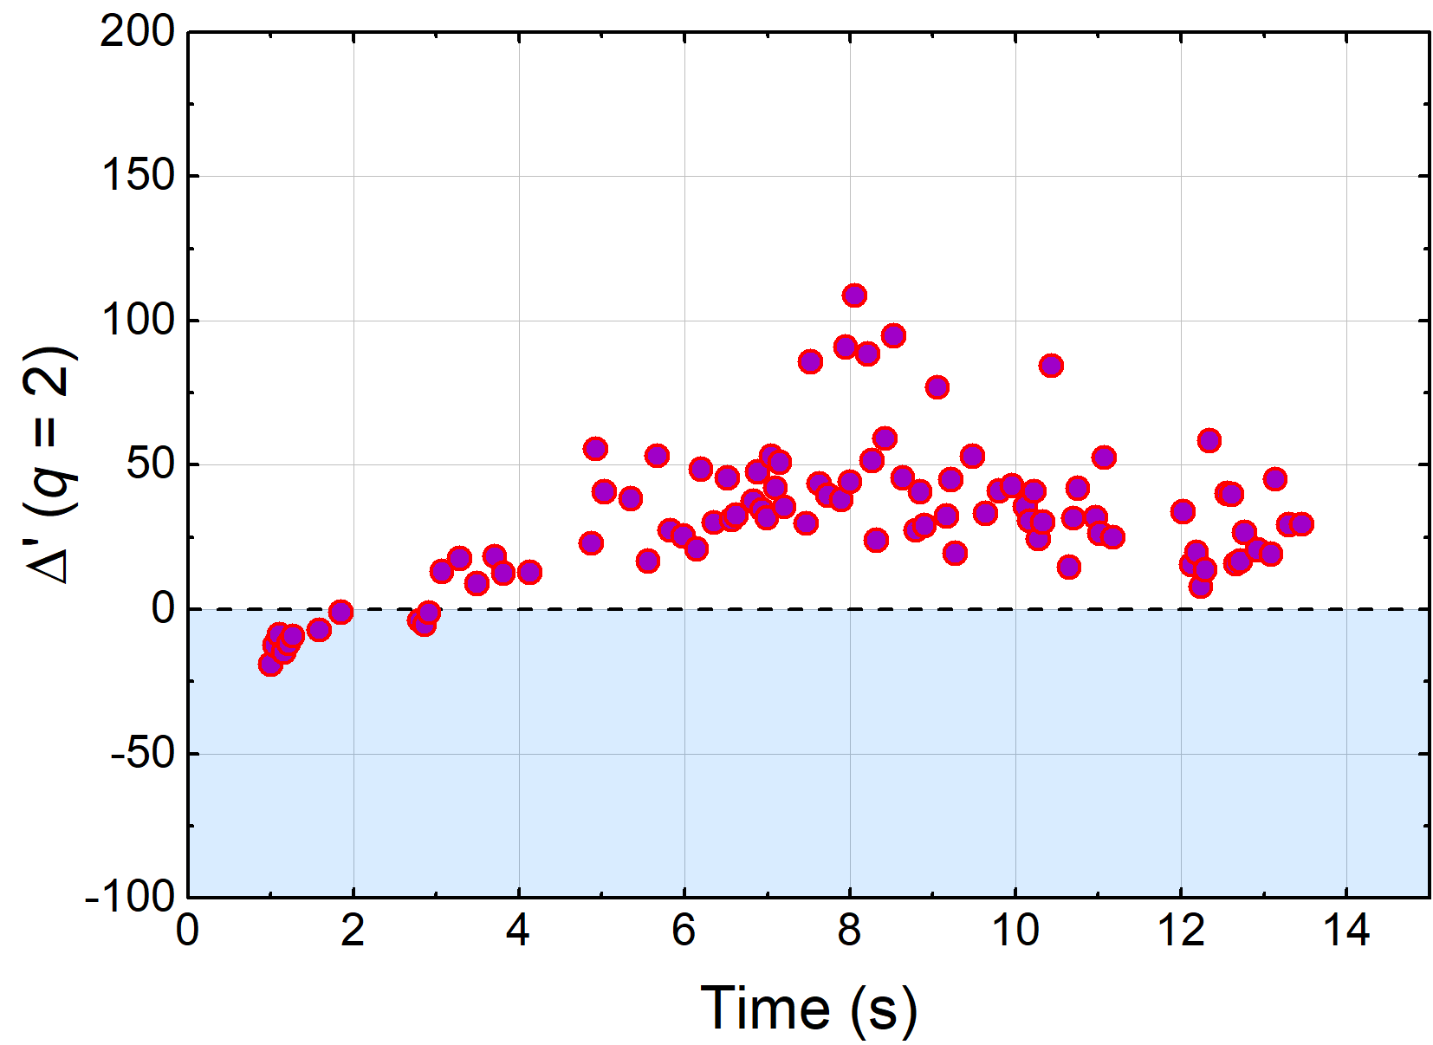
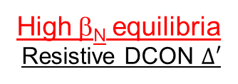
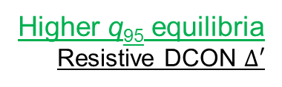
Classical tearing stability examined using resistive DCON code for high β_{N} and higher q₉₅ plasmas
16295
High β_{N} equilibria
Resistive DCON $Δ′$
16325
Higher q₉₅ equilibria
Resistive DCON $Δ′$
Experimentally
Unstable 2/1
Experimentally
2/1 stable
Classical tearing stability index, Δ′, computed at the q = 2 surface using outer layer solutions
At higher q₉₅, Δ′ is mostly positive predicting unstable classical tearing mode
  Indicates that neoclassical effects or wall effects need to be invoked to produce stability
A.H. Glasser, et al., Phys. Plasmas 23 (2016) 112506

Slide 30
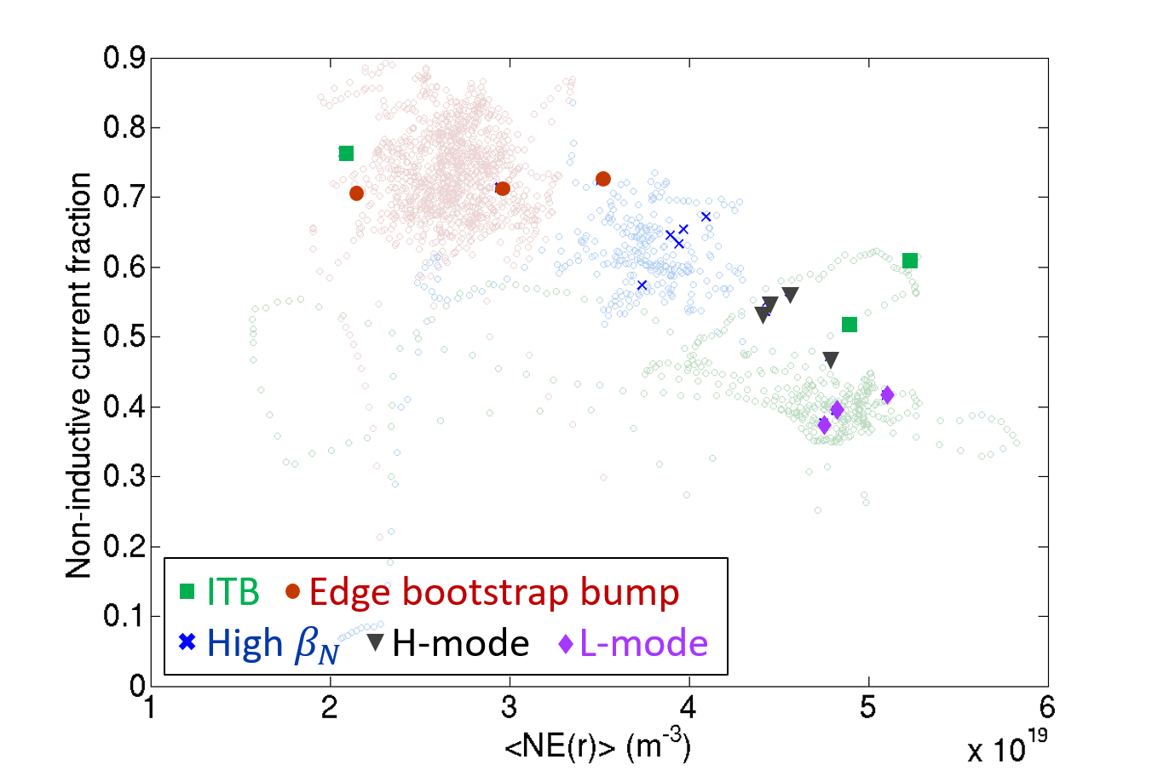
Kinetic reconstructions focused first on KSTAR plasmas with high-non-inductive fraction
TRANSP analysis
Non-inductive fraction
  Beam-driven
  Bootstrap
Non-inductive fraction is key for stable high beta steady state operation
16498
16325
16295
18476
18492
Volume average electron density (m⁻³)
➔See TSDW 2018 poster by J.H. Ahn (Columbia U.)

Slide 31
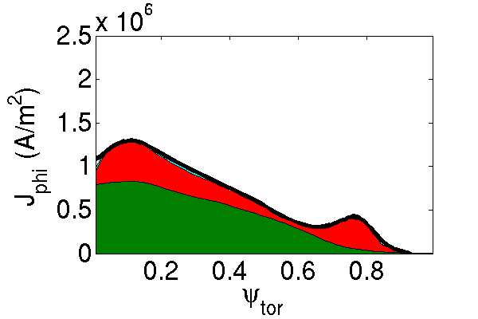
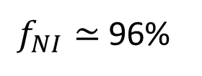
Predictive transport capability (TRANSP) allows “predict-first” projections for upcoming runs
6.5 MW NBI (2018)
TRANSP 16325 | 2016 actual | 2018 NBI | 2019 NBI
NIC fract. (%) | 71% | 96% | 130%
β_{N} | 2.7 | 3.4 | 4.4
l_{i} | 0.9 | 0.91 | 0.95
T_{i}(0) (keV) | 4.5 | 5.5 | 7.2
T_{e}(0) (keV) | 4.6 | 3.3 | 3.3
n_{e}(0) (10²⁰m⁻³) | 5.2 | 5.6 | 5.5
f_{Greenwald} | 0.5 | 0.5 | 0.5
H_{98y2} | 1.25 | 1.25 | 1.25
$f_{NI}≃$96%
16325 projection
Project from existing KSTAR plasmas
  Set fraction of Greenwald density and confinement factor ITER H_{98y2}
    Neoclassical ion transport, electron transport set to match H_{98y2}
  KSTAR 1st and 2nd NBI systems are modeled (incl. aiming angles); power levels set realistically based on MSE needs, etc.
➔See TSDW 2018 poster by J.H. Ahn (Columbia U.)

Slide 32
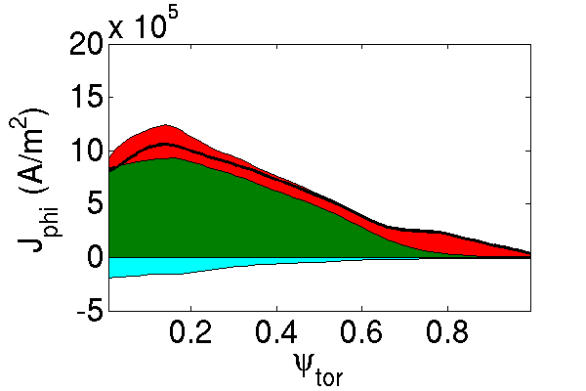
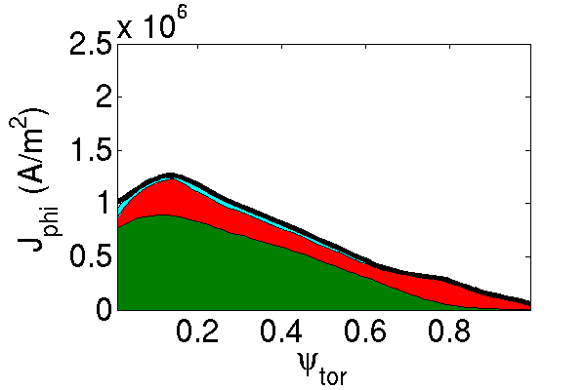
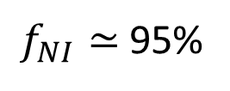
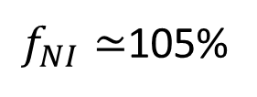
Transport analysis projections allow for variations of plasma parameters to meet targets
6.5 MW NBI (2018)
TRANSP 16295 (B_{T}; I_{p}) | 2016 actual (1.2T) | 2018 NBI (1.2T) | 2018 NBI | 2019 NBI
NIC fract. (%) | 67% | 105% | 95% | 126%
β_{N} | 3.5 | 5.4 | 3.5 | 4.4
l_{i} | 0.9 | 0.83 | 0.95 | 0.84
T_{i}(0) (keV) | 3.6 | 4.8 | 5.4 | 7.3
T_{e}(0) (keV) | 2.3 | 2.8 | 3.2 | 3.3
n_{e}(0) (10¹⁹m⁻³) | 6.0 | 4.8 | 5.6 | 5.6
f_{Greenwald} | 0.6 | 0.5 | 0.5 | 0.5
H_{98y2} | 1.25 | 1.25 | 1.25 | 1.25
$f_{NI}≃$105%
(2T, 0.5 MA)
16295
B_{T}=1.2T, I_{p}=0.44 MA
6.5 MW NBI (2018)
$f_{NI}≃$95%
B_{T} = 2T, I_{p} = 0.5 MA

Slide 33
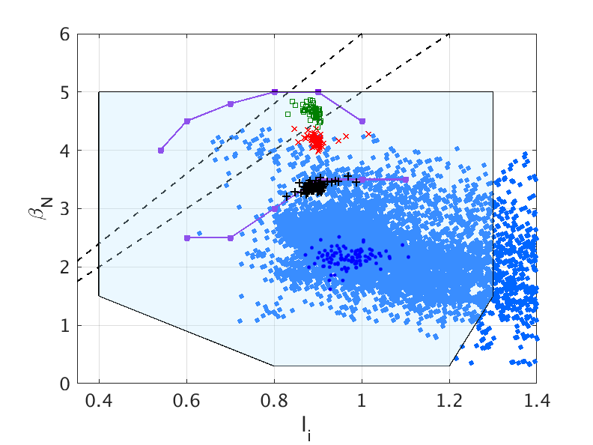
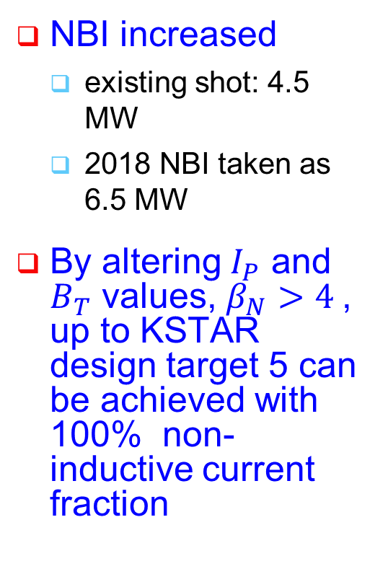

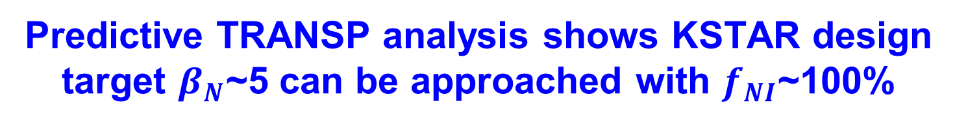




Predictive TRANSP analysis shows KSTAR design target $β_{N}$~5 can be approached with $f_{NI}$~100%
NBI increased
  existing shot: 4.5 MW
  2018 NBI taken as 6.5 MW
By altering $I_{P}$ and $B_{T}$ values, $β_{N}>4$, up to KSTAR design target 5 can be achieved with 100% non-inductive current fraction
$β_{N}$/$l_{i}$=6
$β_{N}$/$l_{i}$=5
$B_{T}$=1.5T
Predicted
n=1 with-wall limit
$B_{T}$=1.7T
$B_{T}$=2.0T
n=1 no-wall limit
Interpretive

Slide 34
Rapidly-expanding DECAF approach provides a new paradigm for disruption prediction research
Multi-faceted, integrated approach to disruption prediction and avoidance with several key characteristics
  Physics-based approach yields understanding that is needed for confident extrapolation of disruption forecasting
  Physics-based DECAF events can guide how to avoid disruption
  Full multi-machine databases used (full databases needed!)
  Open to all methods of data analysis (physics, machine learning, etc.)
Automated determination of disruption event chains teach us the important regions of operating space to study
  Disruption DB “boundaries” are often NOT the important regions
Next steps
  Couple new MHD events to other events to reduce false positives
  Expand number of DECAF events evaluated in large database analysis
  Begin evaluation of simple quantitative figures of merit on large databases ➔ aim for APS DPP 2018 meeting for these results

Slide 35
Announcement: Research Activity RA(19-1): “Expand disruption prediction and avoidance capability for tokamaks”
NSTX-U Research Activity milestone for FY19
  Research activity will allow for communication of continuing DECAF analysis on multiple devices, interaction with interested researchers
    follows from prior NSTX disruption prediction/avoidance Working Group effort)
  Expand disruption event characterization, prediction, avoidance to more tokamaks (KSTAR, MAST expansion, continue NSTX, DIII-D, etc.)
Some subjects
  Continued improvement of the accuracy of disruption event warnings, disruption event chains vs. experiment, while reducing false positives
  Discussion/development of new physics, empirical, AI/ML models to improve disruption prediction performance
  Assessment of technical causes for disruptions, relation to physics
Format
  Monthly meetings planned discussing DECAF research progress
  Open to NSTX-U Team + all interested (contact: sabbagh@pppl.gov)

Slide 36
Supporting slides follow

Slide 37
Disruption event characterization is a critical and logical step in a disruption avoidance plan
Disruption prediction/avoidance framework (from DOE “Transient Events” report (2015))
Approach to disruption prevention
  Identify disruption event chains
  Predict events in disruption chains
  Cue disruption avoidance systems to break event chains
    Attack events at several places with active control
Expand analysis to more tokamak data
  Requires expansion of code analysis tools
t

Slide 38
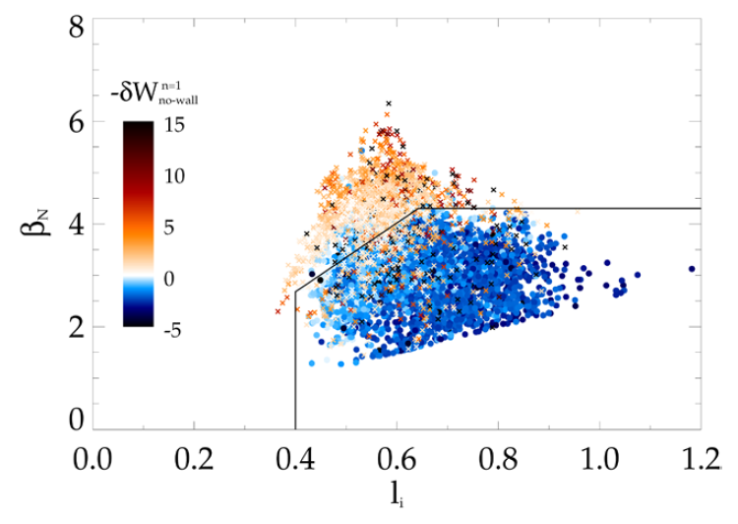
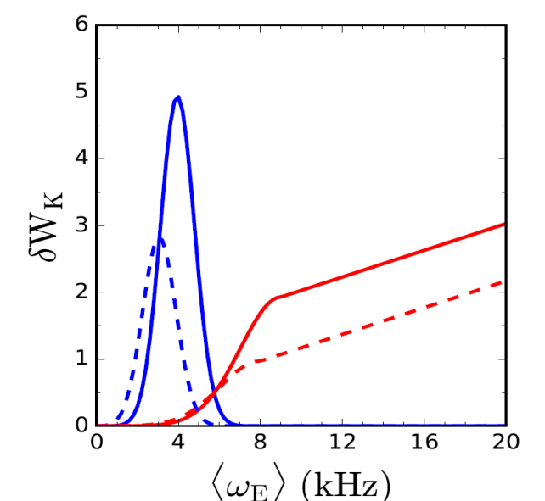
      A reduced kinetic RWM model was created for DECAF code analysis
Elements: mode growth rate calculation
DCON calculation of n=1 no-wall limit
Ideal component δW
  Equilibrium quantities including l_{i}, p₀/<p>, A, used in beta limit models for δW_{b}, δW_{inf}
Kinetic component δW_{k}
  Functional forms (mainly Gaussian) used to reproduce precession and bounce/transit resonances
  Height, width, position of peak depend on collisionality
J.W. Berkery, S.A. Sabbagh, R.E. Bell, et al., NF 55 (2015) 123007
Precession resonances
Bounce/transit resonances
<ν> = 1 kHz

Slide 39
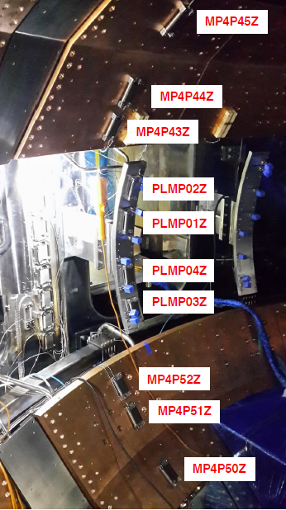
KSTAR magnetic diagnostics provide the basis for “magnetics-only” equilibrium reconstruction
KSTAR equilibrium magnetics
  Flux loops (45)
  Magnetic probes (105)
  Plasma currents (1)
  Coil currents (18)
  Loop voltage monitors (5)
  Vessel wall current groups (12)
Stabilizing plates / divertor plates included in model
PF, IVC, IVCC currents in model
S.A. Sabbagh, et al., Nucl. Fus. 41 (2001) 1601
Y.S. Park, et al., Nucl. Fus. 51 (2011) 053001
- Magnetic probes on the passive
plates and outboard limiter
(Photo courtesy of J.G. Bak and S.H. Hahn)

Slide 40
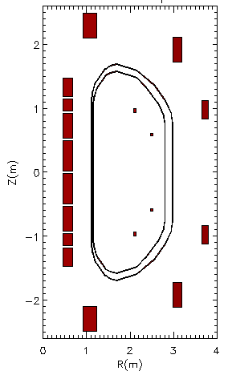
Kinetic data supplements magnetics input for KSTAR kinetic equilibrium reconstructions
2
1
0
-1
-2
Motional Stark Effect (MSE)
  MSE (up to 25 channels) measuring plasma magnetic field pitch angle
Thomson scattering (TS)
  TS 27 channels
  Electron density & temperature (N_{e}, T_{e})
Charge exchange spectroscopy (CES)
  CES 32 channels
  Ion Temperature (T_{i})
MSE
Z (m)
TS
Measured along Z=0
CES
0 1 2 3 4
R (m)

Slide 41
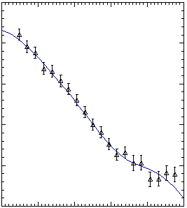
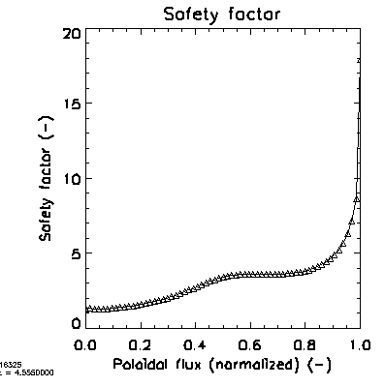
Motional stark effect data provides magnetic pitch angle, q-profile constraint
0.10
0.05
0.00
-0.05
-0.10
-0.15
20
15
10
5
0
Pitch angle at z=0
Safety factor
△ data
— fitted
16325
4.555s
Angle (rad)
q
16325
4.555s
1.7 1.8 1.9 2.0 2.1 2.2
R (m)
0.0 0.2 0.4 0.6 0.8 1.0
ψ_{N}
Systematic and statistical error estimates included in error bars
  E.g. background light subtraction (w/ Jinseok Ko, S. Scott)

Slide 42
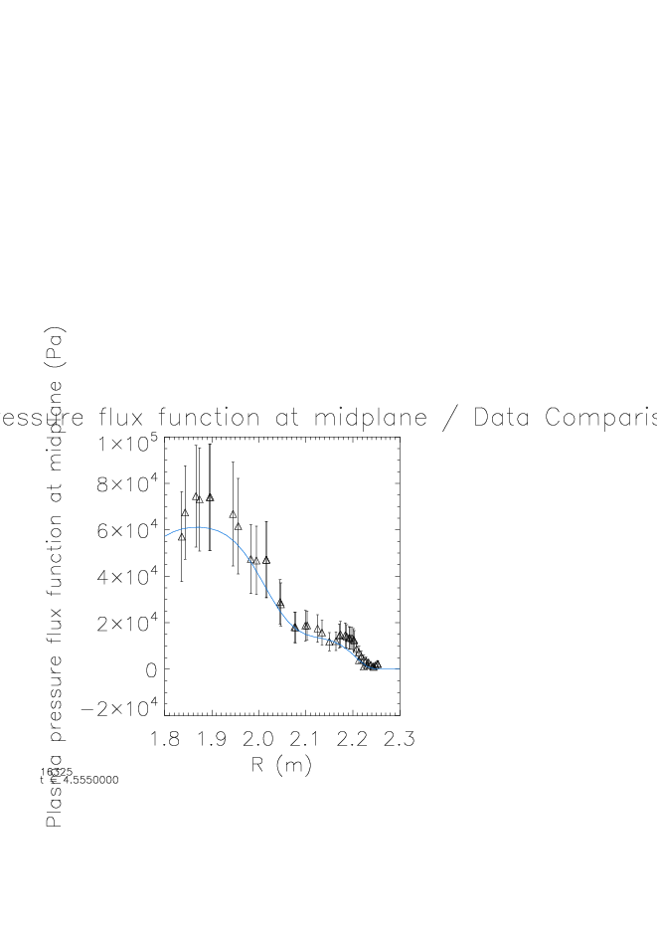
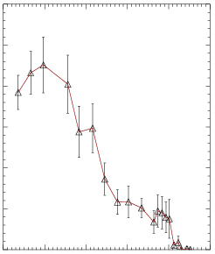
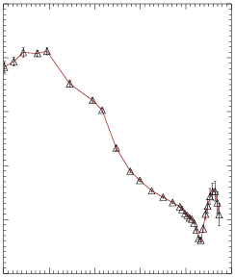
“Partial kinetic” approach for total pressure allows greater flexibility in profile shape
Electron Pressure P_{e} ← 27 Thomson scattering (T_{e} & N_{e}), systematic error
Ion Pressure P_{i} ← 32 CES (T_{i} & N_{i} estimated from N_{e})
Fast particle pressure P_{fast} “based” on P_{e} with 100% error bar
Total pressure P_{tot} = P_{e} + “P_{i}” + “P_{fast}” with large total error
5
4
3
2
1
0
10
8
6
4
2
0
Total Pressure profile
3.0
2.5
2.0
1.5
1.0
0.5
0.0
Electron pressure profile
Ion temperature profile
△ data
△ data
△ data
— fitted
boundary
T_{i} (10³eV)
boundary
boundary
P_{e} (10⁴Pa)
Total Pressure (10⁴Pa)
Total Pressure (10⁴Pa)
16325
4.555s
16325
4.555s
16325
4.555s
1.8 1.9 2.0 2.1 2.2 2.3
R (m)
1.8 1.9 2.0 2.1 2.2 2.3
R (m)
1.8 1.9 2.0 2.1 2.2 2.3
R (m)

Slide 43
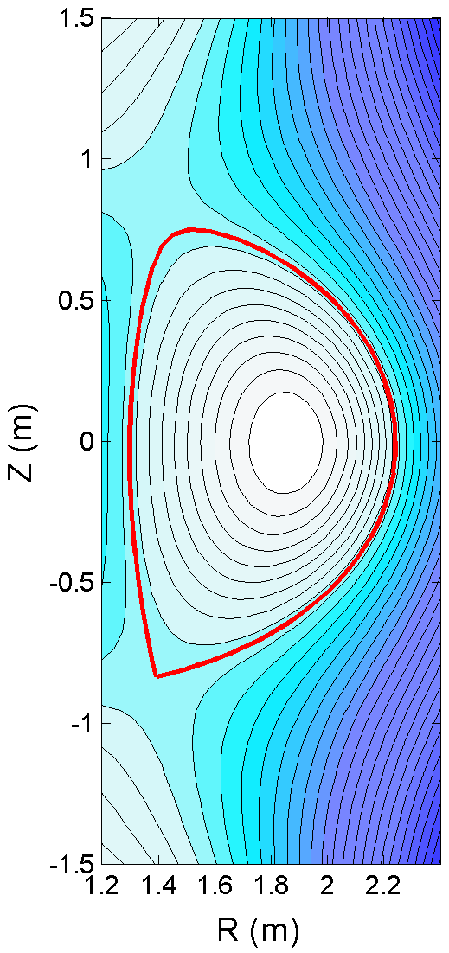
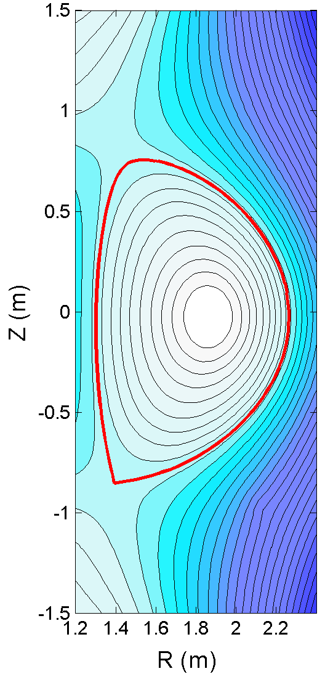
Kinetic equilibrium with MSE has similar global parameters to magnetic-only equilibrium, some differences do occur
Poloidal flux contours
Magnetic only | Global parameter | Kinetic
202.4 | χ² | 222.6
1.86 | R_{axis}(m) | 1.86
-0.01 | Z_{axis}(m) | -0.02
1.68 | κ | 1.68
0.54 | δ_{TOP} | 0.51
0.80 | δ_{BOT} | 0.81
0.95 | β_{T} | 1.04
1.86 | β_{p} | 1.86
1.89 | β_{n} | 1.99
1.05 | l_{i} | 0.96
6.39 | q₉₅ | 5.96
Poloidal flux contours
LCFS
LCFS
g016325.05975 (TST53b1)
g016325.05986 (1013B2v15a2)
16325 5.975s
16325 5.986s

Slide 44
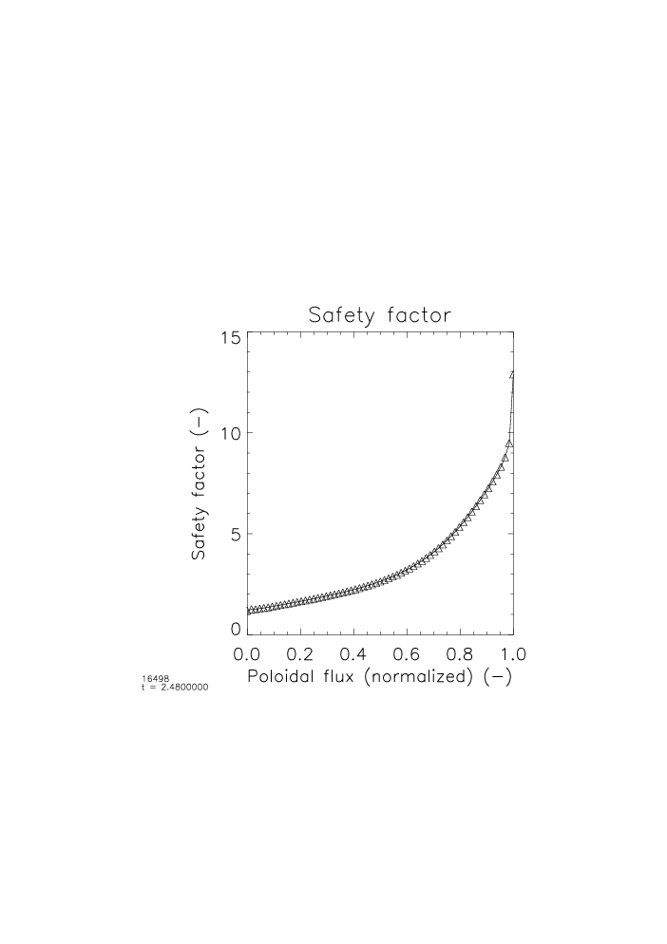



Clear pressure profile distinction between Internal Transport Barrier and H-mode phases
15
10
5
0
15
10
5
0
ITB phase
H-mode phase
t = 2.5s
t = 4.8s
Safety factor
t = 2.5s
Safety factor
t = 4.8s
Safty factor q
ITB
H-mode
L-mode
0.0 0.2 0.4 0.6 0.8 1.0
ψ_{N}
0.0 0.2 0.4 0.6 0.8 1.0
ψ_{N}
1.2
1.0
0.8
0.6
0.4
2
0.0
-0.2
1.2
1.0
0.8
0.6
0.4
2
0.0
-0.2
Total Pressure
t = 2.5s
Total Pressure
t = 4.8s
Total Pressure (10⁵Pa)
2.5
4.8
△ data
— fitted
△ data
— fitted
16498
1.8 1.9 2.0 2.1 2.2 2.3
R (m)
1.8 1.9 2.0 2.1 2.2 2.3
R (m)
Broad pedestal pressure reconstructed in H-mode is not observed in earlier ITB phase
➔ see poster by Y. Jiang (CU) Tuesday
Xp by Jinil Chung

Slide 45




In contrast, kinetic equilibrium reconstruction with MSE produces substantial detail in P and q profiles
8
6
4
2
0
8
6
4
2
0
Pressure profile
Pressure profile
Pressure profile
P (10⁴Pa)
Magnetics only
P (10⁴Pa)
16325 5.975s
8
6
4
2
0
8
6
4
2
0
Safety factor
Safety factor
q
q
16325 5.986s
Kinetic + MSE
1.2 1.6 2.0 2.4
R (m)
1.2 1.4 1.6 1.8 2.0 2.2 2.4
R (m)

Slide 46


DCON ideal stability of kinetic equilibria with good convergence yield steady analysis evolution
DCON stability calculations of δW indicate if plasma exceeds the ideal no-wall beta limit
Analysis of new KSTAR kinetic equilibria indicates ideal stability (below no-wall limit) during period shown (as expected)
4
3
2
1
0
-1
Plasma total stored energy vs. time
KSTAR
18476
Stored energy (10⁵J)
ITB
Limited plasma
0 2 4 6 8 10
Time (s)
DCON: (A. H. Glasser, Physics of Plasmas 23 (2016) 072505

Slide 47


Strong 2/1 tearing mode onset terminated high β_{N}
Mode amplitude and toroidal magnetic probe spectrum in high β_{N} discharge
Weak n = 2 activity during high β_{N} phase
  |δB_{p}| ~ 2 G
High β_{N} operation was limited by strong 2/1 tearing mode onset
  Measured mode amplitude > 20 G
  Both W_{tot} and β_{N} were reduced by ~35% but maintained H-mode
Plasma rotation profile significantly reduced by > 20% due to the 2/1 mode onset
Weak n = 2 mode
16295

Slide 48


Resistive tearing mode stability of higher q₉₅ plasma examined using M3D-C¹
Perturbed toroidal current
Perturbed poloidal flux
Kinetic equilibrium 16325 at t = 5.668s
  β_{N} = 2.0, β_{p} = 1.9, q_{min} = 1.4
  DCON ➔ ideal stable)
Resistive MHD computed to be stable by M3D-C¹
  Consistent with experiment
  Initial analysis showing capability – will be continued
1.0
1.0
0.5
0.5
q = 2
q = 2
Z (m)
0
0
-0.5
-0.5
-1.0
g016325.05668
M3D-C¹
-1.0
g016325.05668
16325
1.2
1.4
1.6
1.8
2.0
2.2
2.4
1.2
1.4
1.6
1.8
2.0
2.2
2.4
(M3D-C¹: S.C. Jardin, et al., J. Comput. Phys. 226 (2007) 2146)
R (m)
R (m)

Slide 49

High β_{N} > 3 equilibria limited by rotating MHD
High β_{N} plasmas were significantly extended to longer pulse by utilizing improved plasma control
Sustained high β_{N}^{avg} = 3.3 achieved for 3 s
  I_{p} ~ 450 kA, B_{T} = 1.2 T, q₉₅ = 4.0-4.5, W_{tot} = 270 kJ
2/1 tearing mode onset at high β_{N} phase
  Consequently reduces β_{N} and W_{tot} by ~35%
  Measured mode amplitude >20 G (2G at weak activity)
β_{N} > 3
q₉₅ ~ 4
Stored energy (magnetics only)

Slide 50


Comparative equilibria having higher q₉₅ shows significantly different MHD stability (shot 16325)
Magnetic probe spectrogram
KSTAR 16325
β_{N} ~ β_{p} > 2
Tearing modes absent
q₉₅ > 6
Plasma operation at elevated B_{T} produced equilibria having higher q₉₅ and β_{p}
Unlike shot 16295, discharge doesn’t experience major beta-limiting MHD activity
Stored energy

Slide 51
Several stability codes are being used to analyze KSTAR kinetic equilibrium reconstructions
Ideal MHD analysis (kink/ballooning, resistive wall modes)
  Ideal DCON
  PEST
Kinetic MHD analysis (kinetic kink, resistive wall modes)
  MISK
Tearing modes
  Resistive DCON
  M3D-C¹
(A. H. Glasser, Phys. Plasmas 23 (2016) 072505)
(R.C. Grimm, J.M. Greene, and J.L. Johnson, Methods in Comp. Phys. 16 (1976) 253
(B. Hu, R. Betti, and J. Manickam, Phys. Plasmas 12 (2005) 057301)
(J.W. Berkery, S.A. Sabbagh, et al., Phys. Rev. Lett. 104 (2010) 035003)
(A.H. Glasser, et al., Phys. Plasmas 23 (2016) 112506)
(S.C. Jardin, et al., J. Comput. Phys. 226 (2007) 2146)
INITIAL EMPHASIS on determining the quality of equilibrium convergence needed for reliable stability analysis
➔ see poster by Y. Jiang (CU) Tuesday

Slide 52


DCON stability calculation shows high β_{N} equilibria are subject to n = 1 ideal instability
DCON analysis, ideal n = 1 mode, no-wall boundary condition
DCON computed δB_{n} of unstable n = 1 mode at t = 2.356 s
KSTAR 16295
High β_{N} equilibria
DCON δW
Unperturbed
boundary
β_{N} > 3 phase
n = 1
β_{N} = 3.2
At observed high β_{N} phase, DCON calculates unstable n = 1 mode with no-wall (β_{N} > β_{N} ^{no-wall})
Hypothesis: global kink / resistive wall modes stabilized by kinetic effects
DCON: A.H. Glasser, Phys. Plasmas 23 (2016) 072505

Slide 53

Calculations of kinetic modifications to ideal stability examined with the MISK code
Kinetic modification to ideal MHD
Stability depends on
  Trapped / circulating ions, trapped electrons
  Particle collisionality
  Energetic particle (EP) population
  Integrated ω_{φ} profile matters: broad rotation resonances in δW_{K}
Trapped particle orbit precession drift
Trapped orbit 2D
projections
Trapped particle
orbit
ion gyro-orbit
and trajectory
(Fig. adapted from R. Pitts et al., Physics World (Mar 2006))
plasma integral over particle energy
NSTX CALCULATIONS: Some references:
J. Berkery et al., PRL 104 (2010) 035003
S. Sabbagh, et al., NF 50 (2010) 025020
J. Berkery et al., PRL 106 (2011) 075004
S. Sabbagh et al., NF 53 (2013) 104007
J. Berkery et al., PoP 21 (2014) 056112
J. Berkery et al., NF 55 (2015) 123007
J. Berkery, et al., NF 24 (2017) 056103
precession drift
bounce
collisionality
ω_{φ} profile (enters in ω_{E})

Slide 54
MISK kinetic RWM stability analysis shows stability, significant stabilizing effect of energetic particles
Unstable region
experimental V_{φ} profile
unstable
Without EPs
Without
EPs
stable
With EPs
With EPs
16325
t = 11.975s
Resistive wall modes (RWM) computed to be stable (consistent with experiment)
  Close to marginal stability when examining variation of experimental rotation profile and without considering energetic particles
  Additionally, energetic particles contribute large stabilizing effect

Slide 55

TRANSP analysis shows new off-axis NBI sources can broaden current profile somewhat
TRANSP 16325 | 2016 actual | 4 NBI (mid- plane) | 4 NBI (2 off axis)
NIC fract. (%) | 71% | 103% | 110%
β_{N} | 2.7 | 3.65 | 3.65
l_{i} | 0.9 | 0.96 | 0.92
T_{i}(0) (keV) | 4.5 | 6.3 | 5.6
T_{e}(0) (keV) | 3.6 | 3.3 | 3.3
n_{e}(0) (10¹⁹m⁻³) | 3.2 | 5.5 | 5.5
f_{Greenwald} | 0.5 | 0.5 | 0.5
H_{98y2} | 1.25 | 1.25 | 1.25
7 MW NBI (2 off-axis)
$f_{NI}≃$110%
16325
projection
➔ see poster by J.H. Ahn (Columbia U.) on Tuesday for further KSTAR TRANSP analysis

Slide 56

      Kinetic equilibrium / stability analysis will continue to improve thru Columbia / PPPL / MIT Collaboration
Transferred 10 channel MSE background light polychrometer from C-Mod to KSTAR (4/2017)
  Investigating improvement of MSE measurement by background light subtraction
  DOE has funded 15 additional BL polychrometer channels (for 2018)
Collaborative interaction to further improve Thomson scattering data
Continued improvement of kinetic equilibrium reconstruction / stability analysis
  E.g. Improved modeling / planned neural net delivery of fast particle pressure P_{fast}
(S.D. Scott (PPPL), et al.,)
Pitch angle can be troublesome on some channels due to neglect of background light subtraction
1.5
1.0
0.5
0.0
pitch angle error (deg)
-0.5
-1.0
-1.5
➔ All supporting the main disruption prediction and avoidance research goals
1.7
1.9
2.1
2.3
R (m)
Notes:
Poly krou meter; In-vessel control coils(IVCC)

Slide 57
Broadened disruption prediction and avoidance research centered around DECAF is progressing for future tokamaks
DECAF code is rapidly developing
  Initial published results showed strong promise of new, automated “event chain-based” research paradigm
  DECAF event objects expanded in capability now include event criteria histories; innovation continues (e.g. direct coupling of events)
  Models defining events are highly flexible (e.g. can include diagnostic comparisons, physics models, machine learning tools/techniques)
Physics-based approach on multiple devices key to success
  Understanding is key to disruption forecasting extrapolability, reliability
  New DOE funding for disruption prediction/avoidance on MAST; KSTAR research including kinetic equilibria, stability, TRANSP analysis
  Research includes active mode detection/control, directed experiments
“DECAF database” has begun
  Storage of intermediate results, est. growth to 100’s of TB (“big data”!)

