Slide 1

A scalable real-time framework for Thomson scattering analysis: Application to NSTX-U
F. M. Laggner¹, A. Diallo², B. P. LeBlanc², R. Rozenblat²,
G. Tchilinguirian², E.Kolemen¹ and the NSTX-U team
¹Department of Mechanical and Aerospace Engineering, Princeton University, Princeton, New Jersey, USA
²Princeton Plasma Physics Laboratory, Princeton, New Jersey, USA
NSTX-U / Magnetic Fusion Science meeting, Princeton, Dec. 3, 2018

Slide 2
Motivation - Real-time (rt) profile measurements for advanced plasma control
Real time (rt) Thomson scattering (TS) beneficial for
  Rt equilibrium reconstruction (rt-Efit) with pressure constraint
  Rt profile availability for control purposes
    ELM control (timescale ~ 10 ms)
    Core transport (timescale > 10ms)
    Resistive wall mode (timescale ~ 1 ms)
Rt-upgrade of the existing TS diagnostic at NSTX-U
  Rt capable data acquisition (hardware)
  Rt TS analysis (software)
Develop a prototype ‘small’ system that is scalable
  Demonstrate rt capability of data acquisition and TS analysis
[E. Kolemen, et al., IAEA FEC, 2016]

Slide 3
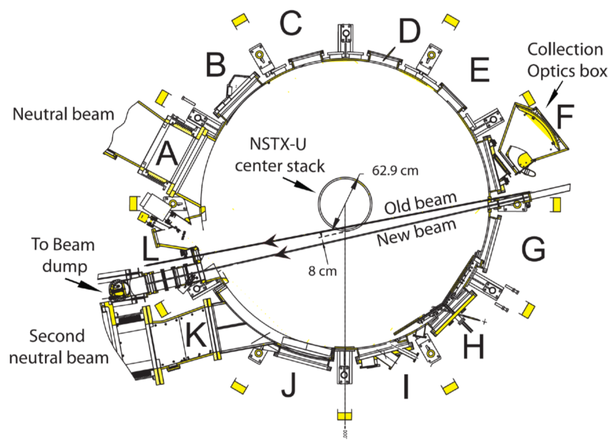
Setup of the multi point Thomson Scattering (MPTS) diagnostic at NSTX-U – Determines rt system specs
Currently two 30 Hz Nd:YAG lasers
  repetition rate of 60 Hz
    ~17 ms in between the laser pulses
Polychromators and avalanche photodiode (APD) detectors
  4 or 6 interference filters
    6 rt digitizer channels per radial channel
Post-discharge analysis
    Current analysis should stay unaffected
[D. W. Johnson, et al., RSI, 2001]
[B. P. LeBlanc, et al., RSI, 2012]
[B. P. LeBlanc, et al., RSI, 2003]
[A. Diallo, et al., RSI, 2012]
[D. J. D. Hartog, et al., JINST, 2017]

Slide 4
MPTS at NSTX-U measures T_{e} and n_{e} profiles across the full plasma cross section
Prototype rt TS analysis framework
  8 radial channels
    Measures electron temperature (T_{e}) and electron density (n_{e})
  Independent of Plasma Control System (PCS) servers
    Analysis performed on separate rt server

Slide 5
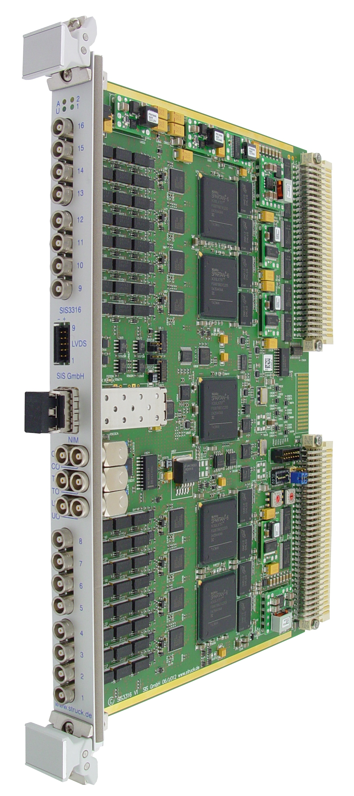
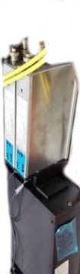
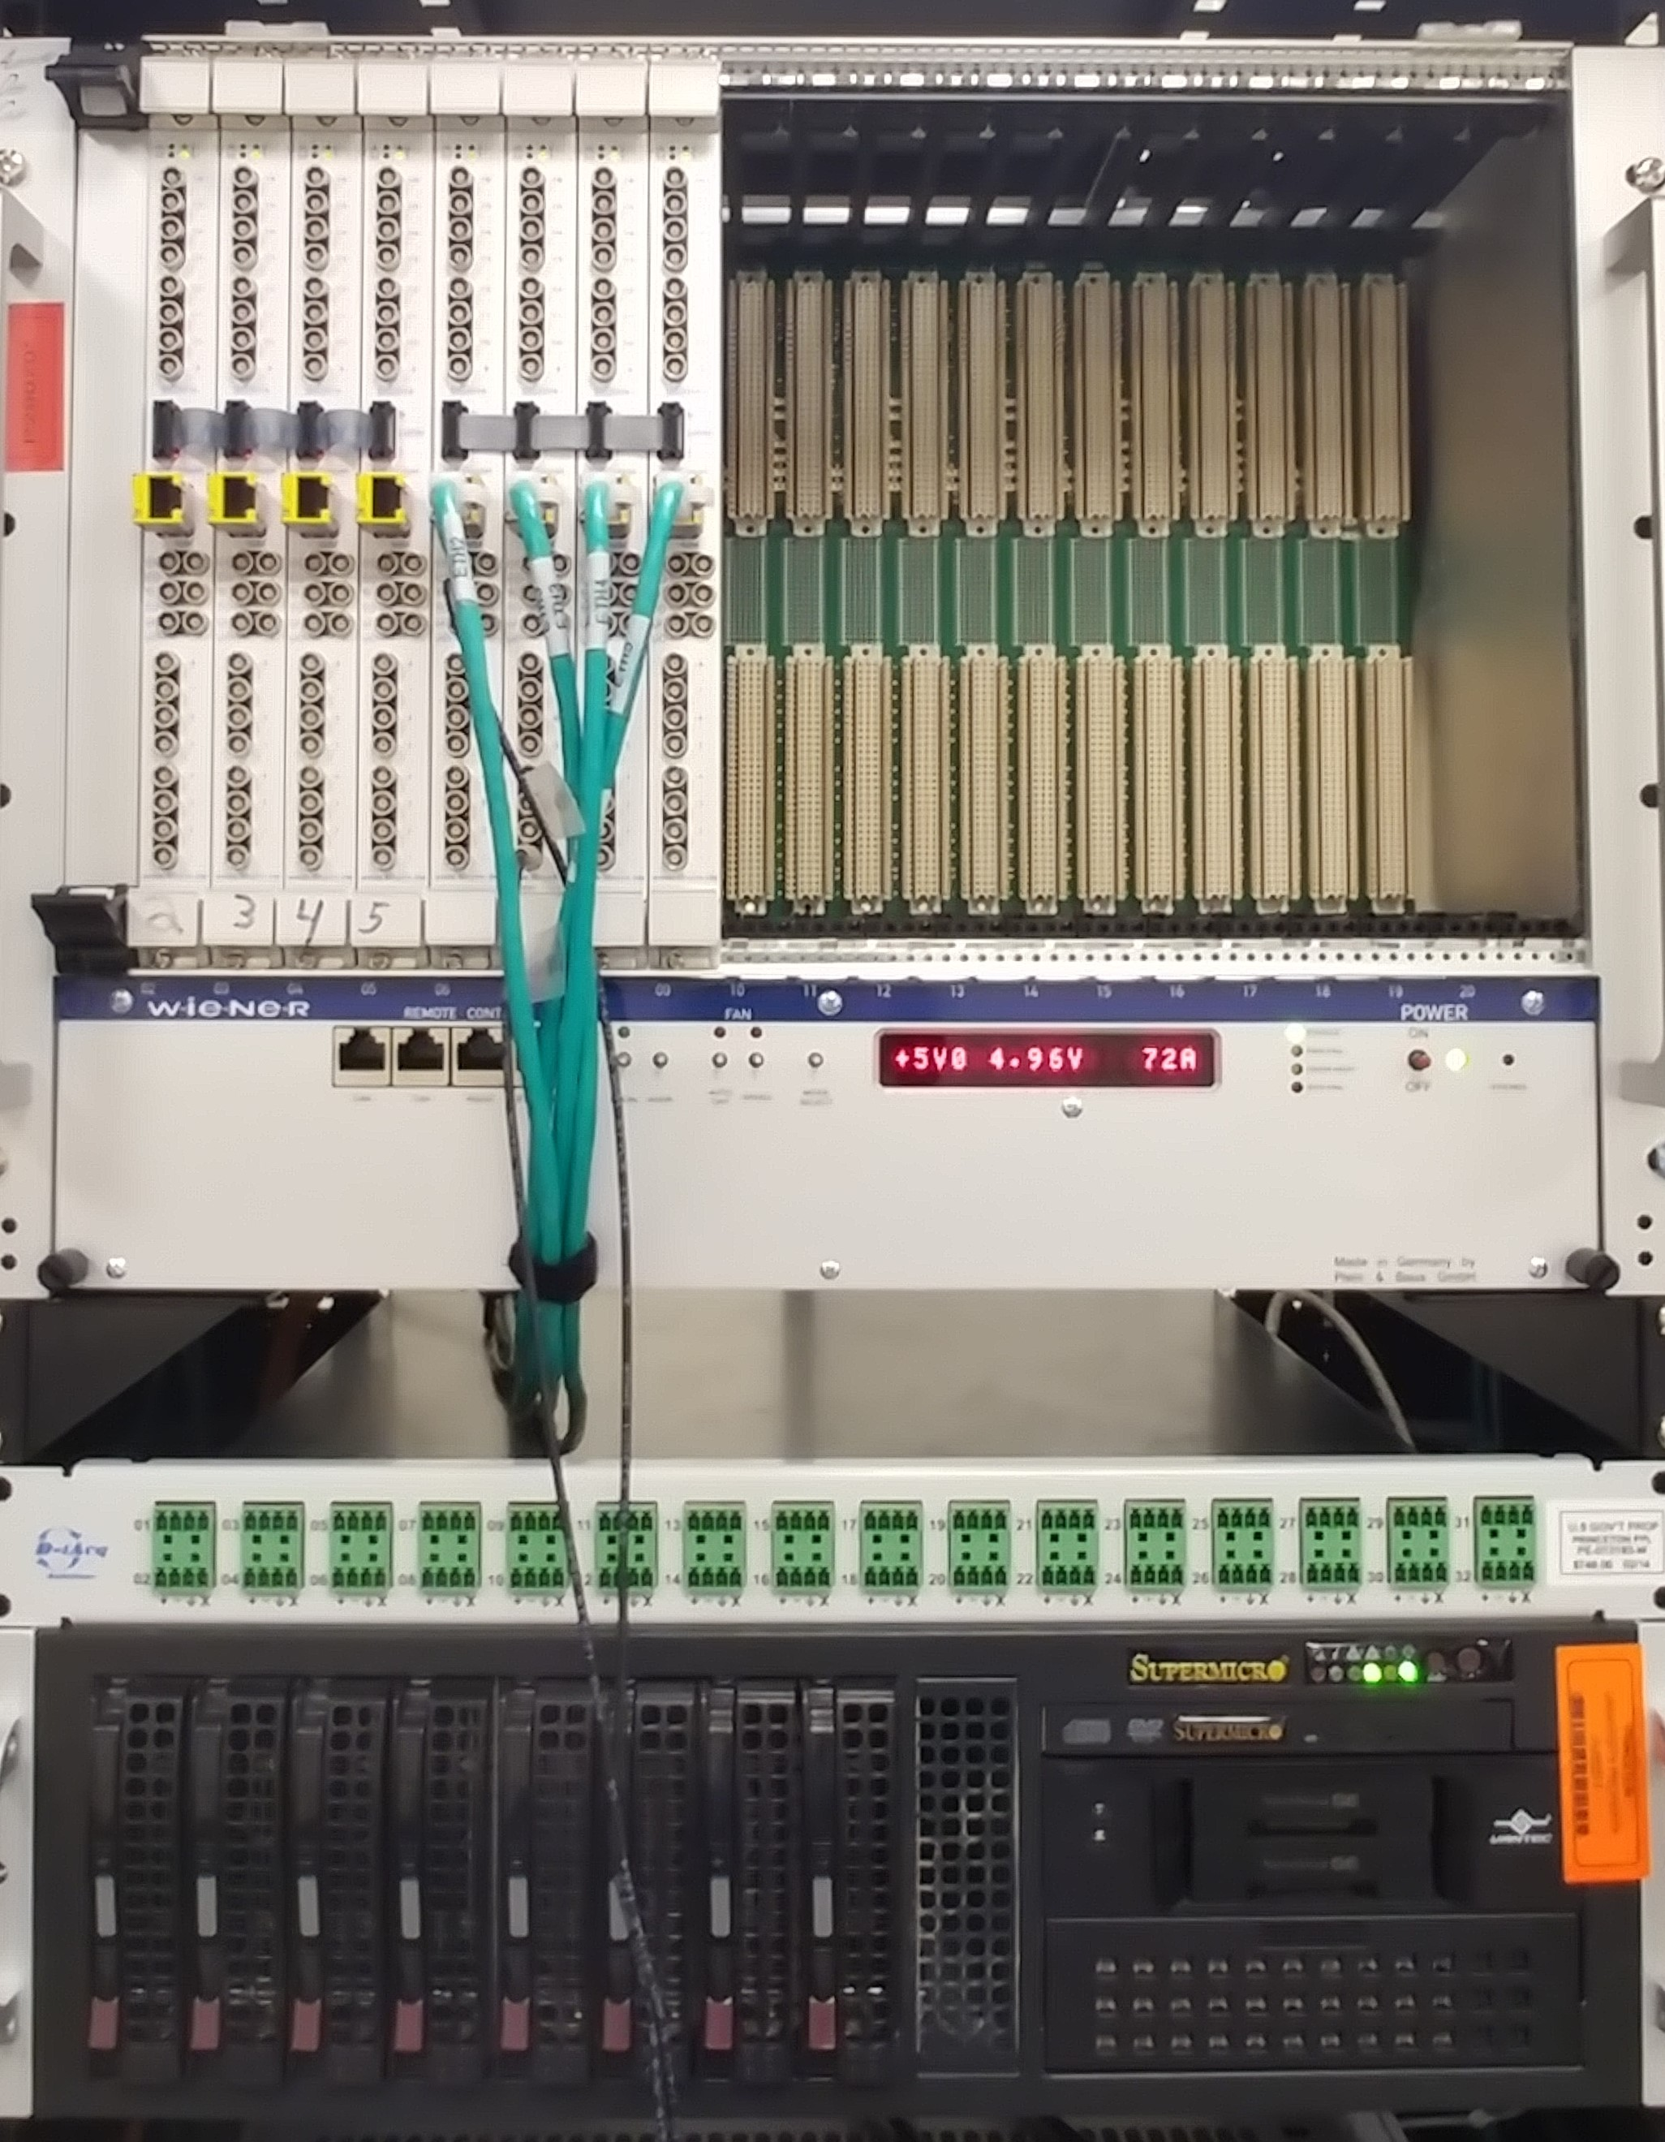
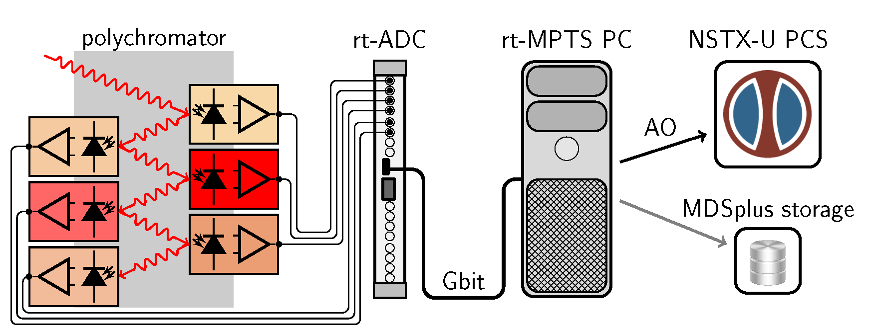
Rt hardware setup – Commercially available electronics utilized and designed to scale towards larger system
SS3316
polychromator
APD amplifiers
SuperMicro RT server

Slide 6
Rt hardware setup – Commercially available electronics utilized and designed to scale towards larger system
Struck SS3316
SuperMicro RT server

Slide 7
Rt-ADC capable of sampling the full signal pulse – Previously used CAMAC digitizes only 1 point
Sampling rate
  (250 MSamples/s)
Test measure-
ments in gas
filled torus
  Raman scattering
Currently only pulse peak amplitudes (PA) used for analysis
Advanced pulse fitting could be done
  Better amplitude estimation at low signal levels
  Deconvolving amplifier response function from detected signal

Slide 8
Rt-software – Streamlined analysis workflow in C++ that offloads expensive calculations before the discharge
Full MDSplus storage
  Calibrations, raw data and analyzed T_{e} and n_{e}
Continuous data acquisition
  Circular buffer
    Analysis triggered by TS laser pulse
Analog output
[R. Rozenblat, et al., FED, in prep.]

Slide 9
Analysis speedup achieved - Pre-computation of expected signal intensity (lookup table)
Selden model
  Describes spectral
  distribution of TS
    Depends on T_{e} and
    laser energy
Interference filters
  Used to detect the TS spectrum
Calculation of expected intensity at each spectral channel
  Variation of T_{e} from 0 to 10 keV and storage in lookup table
    Rt-process compares measurement and expectation and determines best T_{e}
[A. C. Selden, PL A, 1980]

Slide 10
Rt analysis 10 times faster than post shot calculation – Excellent agreement of results from both methods
Rt analysis time
  <2.5 ms per
  time slice
8 radial chan-
nels tested
  Parallel execution
  of analysis from different radial channels
    Scales favorably to higher amount of radial channels (analysis time still 2.5 ms)
End to end processing time of <17 ms achieved (for ~30 min)
T_{e}
n_{e}
[F. M. Laggner, et al., RSI, in prep.]

Slide 11
Summary - Successful implementation of rt TS analysis
Real-time prototype system for TS analysis designed, developed and offline tested
  New rt hardware and software
    Framework could be also used at
    other diagnostics
  Scalable, reliable and
  deterministic setup
Benchmark of rt analysis against post shot analysis code
System meets a 60 Hz laser pulse deadline for 30 min
  Applicable to TS systems of long pulse machines

Slide 12

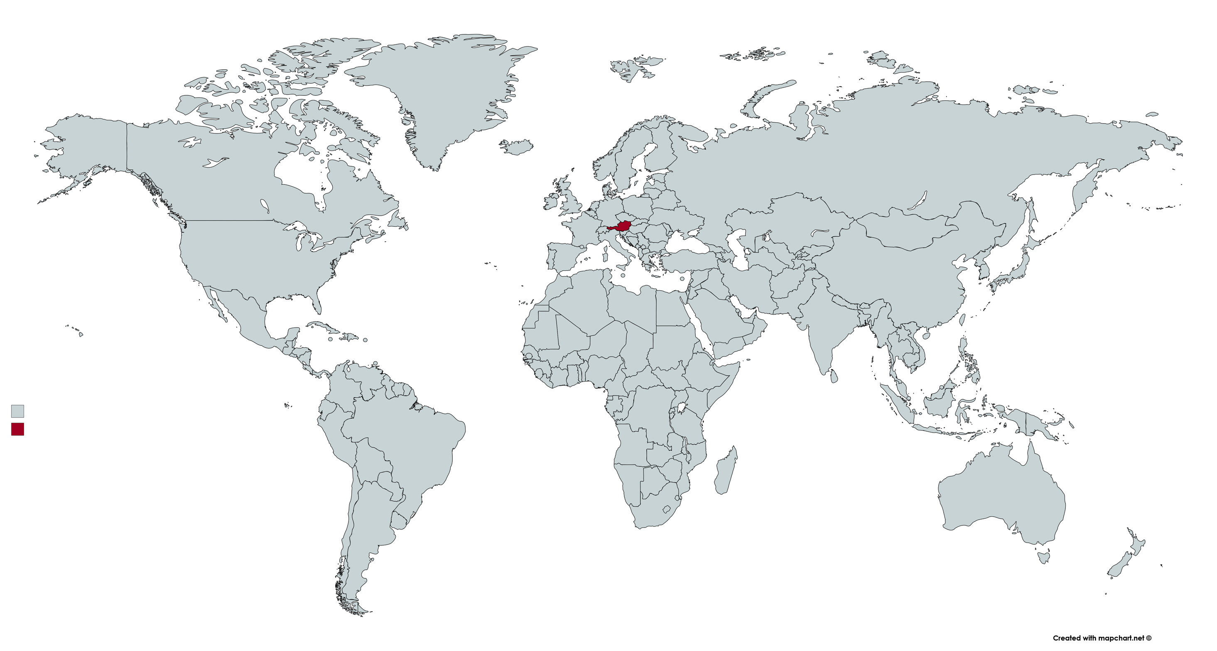
Outlook – Deployment at the large helical device (LHD)
LHD needs rt TS system
  n_{e} profiles in long pulse operation
  with ECH to track density cutoff
    Intended use as important system
    for machine protection
ASDEX Upgrade interested in an ‘off-the-shelf’ solution
  Rt TS as sensor for advanced plasma control
Benefit for NSTX-U
  Experience for routine system operation will be gained
    Ready to go after the recovery period
  Speed-up possible: Upgrading rt-ADC firmware and code optimization

