Slide 1
Overview of Experimental Studies on
Inter-ELM Pedestal localized Fluctuations and
Challenges for their Modeling
F. M. Laggner¹, A. Diallo², E. Wolfrum³, M. Cavedon³, B. Vanovac³, E. Kolemen¹
with contributions of
the ASDEX Upgrade Team, the DIII-D team and the EUROfusion MST1 Team
¹Department of Mechanical and Aerospace Engineering, Princeton University, Princeton, New Jersey, USA
²Princeton Plasma Physics Laboratory, Princeton, New Jersey, USA
³Max-Planck-Institut für Plasmaphysik, Boltzmannstr. 2, 85748 Garching, Germany
NSTX-U / Magnetic Fusion Science meeting, Princeton, Dec. 03, 2018

Slide 2

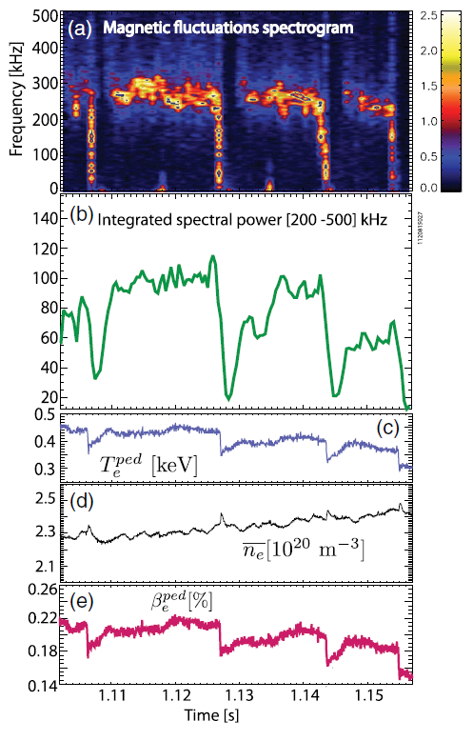

Long effort to characterize pedestal instabilities…
C-Mod, 1120815026
PBX-M
[F. M. Poli et al., PPCF 2008]
[S. M. Kaye et al., PPCF 1994]
Now is the time to achieve fundamental understanding of them using sophisticated modelling
[A. Diallo, et al., PRL 2014]

Slide 3
Challenge - Diagnosing the pedestal
Profiles & fluctuations required for good interpretation
Uncertainties are associated with every measurement
  Awareness necessary when interpreting
Understand and to consider the fundamental limitations of the utilized diagnostics
  Some examples:
    ECE: shine through
    BES: radial widening of emission profile
    CER: assumption of equilibrium temperature

Slide 4
Theory - pedestal stability
Peeling-ballooning P-B theory:
  Peeling Mode
    Current driven instability
  Ballooning Mode
    Pressure driven instability
P-B gives a ‘hard’ limit for the edge pressure
[P. B. Snyder et al., POP 2009]

Slide 5
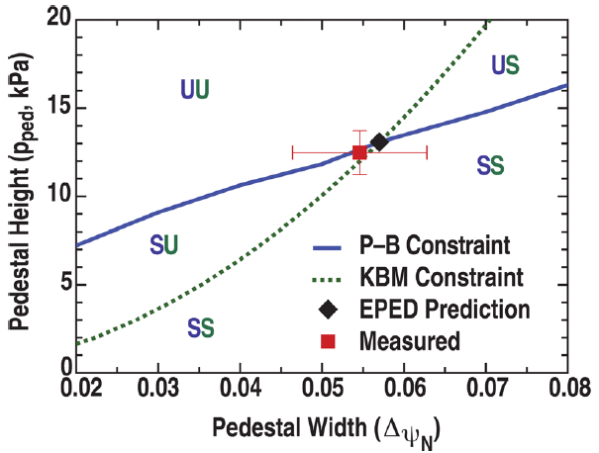
Theory - pedestal evolution
Model for ELM cycle
  Pedestal height and width increase till kinetic ballooning mode (KBM) boundary (‘soft limit’) is reached
  Pedestal gradient is clamped and height and width evolve along the KBM limit
  ELM crash when P-B (‘hard’) limit is reached
  Limitation of pedestal evolution (‘soft limit’) observed in several experiments
  [A. Burckhart et al., PPCF 2010]
  [D. Dickinson et al., PRL 2012]
  [A. Diallo et al., PRL 2014]
width
pressure
height
radius
(2)
(3) ELM
(1)
[P. B. Snyder et al., POP 2012]

Slide 6
Drive and suppression of pedestal instabilities
Pressure gradient (∇p)
  Typically drives ballooning-type instabilities
    ∇p linked to density (n) and temperature
Edge current density (j_{tor})
  Main contribution is bootstrap current (j_{BS})
    Order: ∇n ~ 0.5, ∇Te ~ 0.15 and ∇Ti ~ 0.1
  Modifies the safety factor profile (q)
    Region of high magnetic shear
E×B rotation (v_{E×B})
  Radial electric field (Er)
    Sheared flows suppress instabilities

Slide 7
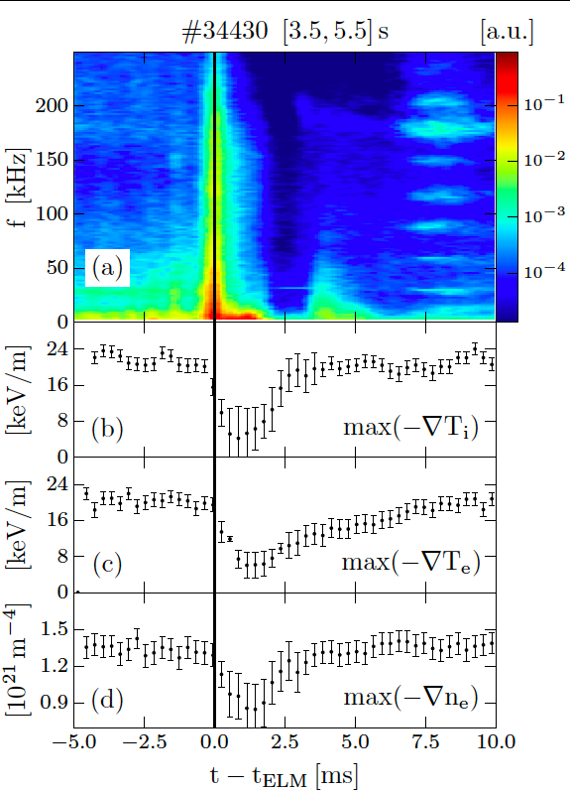

Distinct pedestal recovery phases & fluctuations
Phase (I):
  Electron density (n_{e}) gradient and ion Temperature (T_{i}) gradient
    Fluctuations absent!
Phase (II):
  Electron temperature (T_{e}) gradient
    Medium frequency range fluctuations
Phase (III):
  Gradient saturation
    High frequency fluctuations
    Low frequency fluctuations and precursor modes
ELM
Phase (I)
(II)
(III)
[M. Cavedon et al., PPCF 2017, PSI 2018 & JNM submitted]
[5]

Slide 8
Abstract picture of the pedestal evolution
Phase (I):
  Electron density (n_{e}) gradient and ion Temperature (T_{i}) gradient
    Fluctuations absent!
Phase (II):
  Electron temperature (T_{e}) gradient
    Medium frequency range fluctuations
Phase (III):
  Gradient saturation
    High frequency fluctuations
    Low frequency fluctuations and precursor modes

Slide 9
Three instability categories – An Overview
Category 1
  Separatrix localized
    Appears at medium frequency range (30 kHz to 150 kHz)
    Onset after pedestal recovery phase I
    ‘Ballooned’ mode structure
Category 2
  Localized towards the E_{r,min}
    Appear at high frequency range (> 200 kHz)
    onset connected to T_{e} pedestal evolution (after recovery phase II)
    HFS magnetic response
Category 3
  Localized at the pedestal top
    Appear at low frequency range (< 30 kHz)
[F. M. Laggner et al., PSI 2018 & JNM submitted]

Slide 10

Saturated instabilities – Present for tens of ms
Category 1
Category 2
Category 3
Coupling has to occur to get into saturated states
[F. M. Laggner et al., IAEA FEC 2018]

Slide 11
Test: Collsionality dependence – pressure match
High (#30701) and low (#30721) pedestal top electron collisionality ν*_{e,ped}
Motivation for comparison:
  Pressure (gradient) driven instabilities should not change their behaviour
In both discharges gradients are clamped before the ELM onset (‘soft limit’)

Slide 12
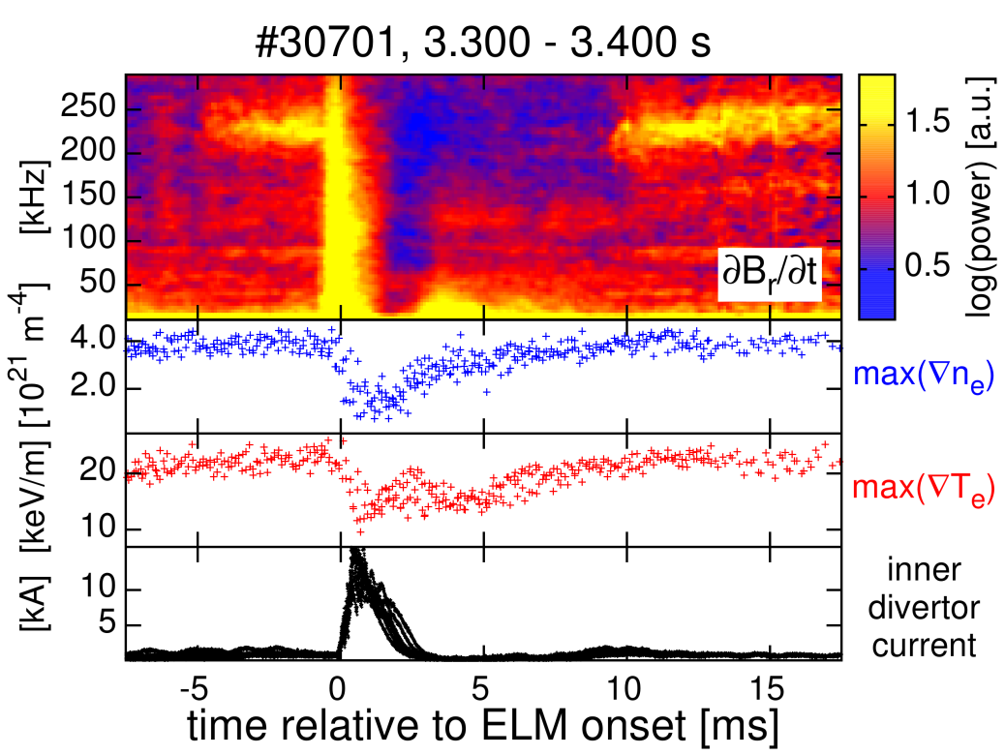
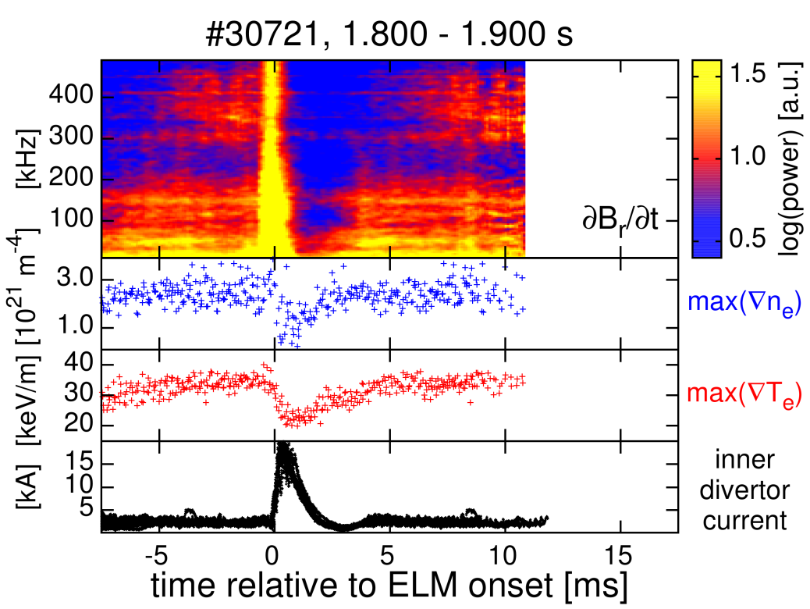
Sequence of pedestal recovery phases remains
Category 2
Category I
First ne,ped recovery, then Te,ped
High frequency fluctuations start afterwards
High ν*e,ped (#30701) case
max(∇ne) and max(∇Te) clamped when high frequency fluctuations
Detected fluctuation frequency differs in both cases
Low ν*e,ped (#30721) case
LFS
midplane
What determines the detected fluctuation frequency?

Slide 13
Plasma rotation adds to frequency in lab frame
H-mode → strong E×B background velocity at the edge
ASDEX Upgrade: Er is well described by estimation ∇pi/eni in the steep gradient region
[E. Viezzer et al., NF 2014]
Er and ∇pe/ene agree within their errors in the analyzed cases

Slide 14
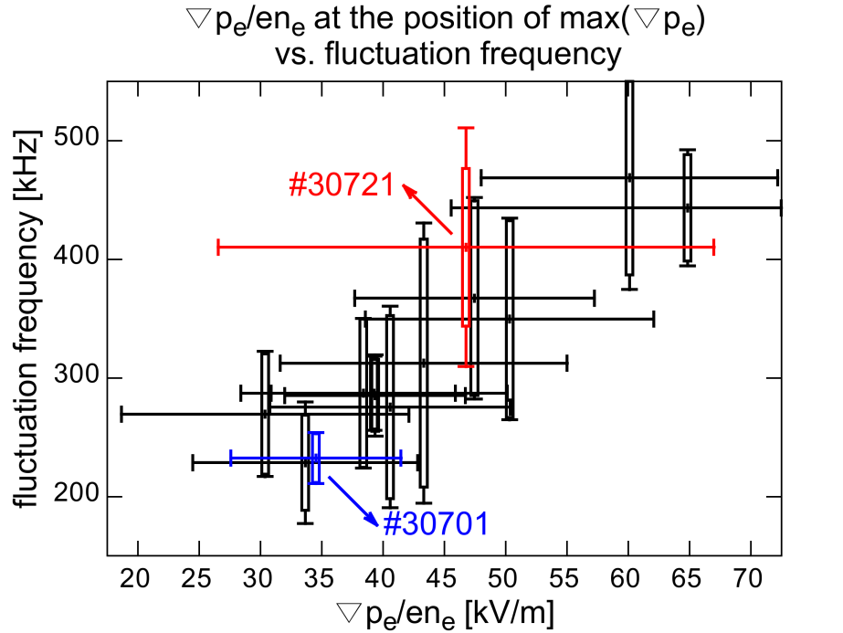
Lab frame frequency depends E×B rotation
Category 2
11 discharge intervals:
  Constant Ip and Bt
  Selected to span wide range of ∇pe/ene
  Clear magnetic fluctuations
    Onset correlated to Te,ped recovery
Detected fluctuation frequency increases with ∇pe/ene at position of max(∇pe)
Mode is located in the steep gradient region

Slide 15
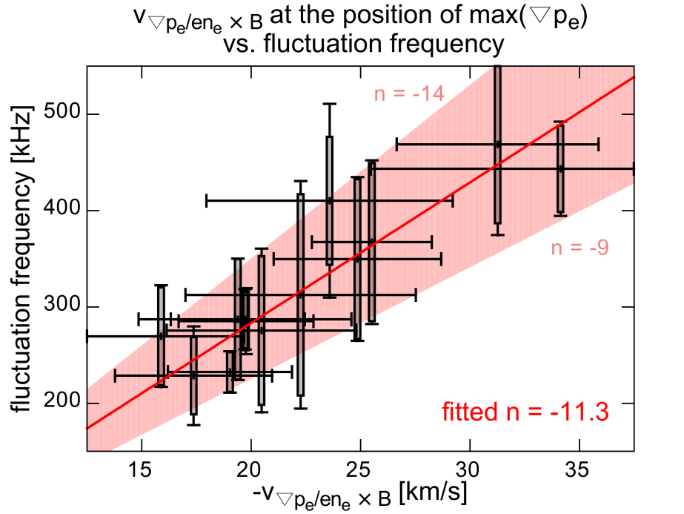
Toroidal mode structure of n ~ 11
Category 2
Fit of n using the discharge intervals with different ∇pe/ene
Fit of toroidal mode number:
  n ~ Utor·fmagn/(v∇p_{e/}en_{e}·q·Utor/Upol+vtor)
Fitted n ~ -11
    In agreement with n numbers determined from magnetic pickup coils

Slide 16
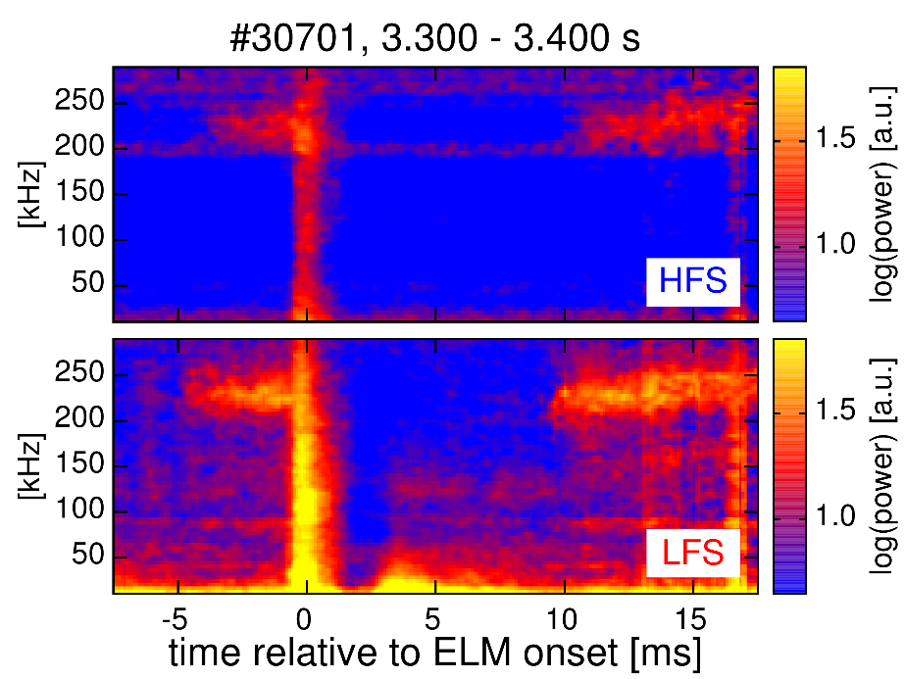
HFS signature suggests peeling like mode structure
Category 2
Fluctuation signature visible on the HFS
  Similar onset as on the LFS
  Same frequencies as on LFS
HFS
LFS
HFS
LFS
HFS
LFS
[F. M. Laggner et al., PPCF 2016]

Slide 17
Test: Main ion dependence – D, H and He plasmas
Category 2
Mode propagation with the background E×B velocity
  Toroidal mode structure with n ~ -11 in all investigated cases
Comparison of D, H and He plasmas
  Similar sequence of pedestal recovery phases
    Dominant mechanisms in the pedestal recovery are not changed by a change of the main ion species
[F. M. Laggner et al., APS invited 2016 & POP 2017]

Slide 18
Test: Shape dependence – Triangularity variation
Category 1
Category 2
ELM frequency (f_{ELM}) and PB boundary affected
  Reduction of f_{ELM}
    Pedestal recovery phases extended at high triangularity
  Extension of PB stable area
BUT: Sequence of pedestal recovery phases remains
  Fluctuation onsets stay correlated
[F. M. Laggner et al., IAEA FEC 2018]

Slide 19
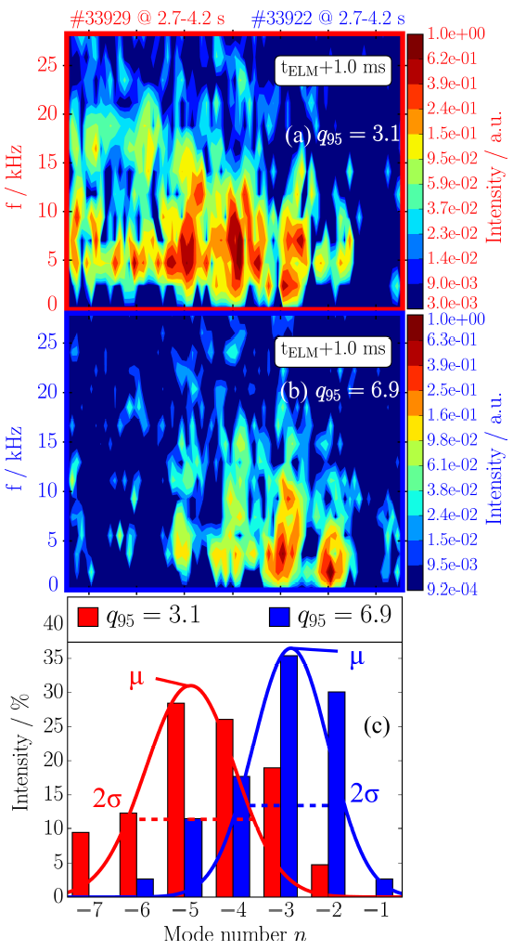
Test: Safety factor dependence – I_{p} variation
Category 1
Study focused on the structure of the ELM crash
BUT: pre-ELM and ELM structure are correlated
Average toroidal mode number <n> decreases with increasing q₉₅
    Poloidal structure conserved
[A. F. Mink, et al., PPCF 2018]

Slide 20
Category III localized at the pedestal top
Category 3
Category 2
Analysis from ECE & magnetics
  Category III at low frequency in the ECE & magnetics
  Category II visible in magnetics
Change Category III frequency with PNBI
  Decrease of pedestal top rotation
[B. Vanovac, et al., NF 2018]

Slide 21
Matching condition for Category I and III
Category 1
Category 3
Suggested to be
related to the ELM
onset
  Non-linear coupling of inter-ELM instabilities
Fluctuation band amplitudes tracked
through ELM cycle
  Change in the spectral power of individual bands
Radial localization of bands using BES
  Category III (green) further inwards
[A. Diallo, et al., PRL 2018]

Slide 22
Summary - Three instability categories
Category 1
  Separatrix localized
    Appears at medium frequency range (30 kHz to 150 kHz)
    Onset after pedestal recovery phase I
    ‘Ballooned’ mode structure
Category 2
  Localized towards the E_{r,min}
    Appear at high frequency range (> 200 kHz)
    onset connected to T_{e} pedestal evolution (after recovery phase II)
    HFS magnetic response
Category 3
  Localized at the pedestal top
    Appear at low frequency range (< 30 kHz)
MODELLING CHALLANGED TO
REPRODUCE ‘ROBUST’
INSTABILITIES
[F. M. Laggner et al., PSI 2018 & JNM submitted]

Slide 24
Why n changes with q₉₅
Category I
Minimization of n for a given distance of resonances
[A. F. Mink, et al., PPCF 2018]

Slide 25
Inter-ELM pedestal evolution in AUG
Distinct recovery phases of n_{e} and T_{e} profiles
  max(-∇n_{e}) saturates with onset of medium frequency fluctuations
  max(-∇T_{e}) evolves till high frequency fluctuation onset
Fluctuation signature visible on the HFS
[F. M. Laggner et al., PPCF 2016]

Slide 26
Pedestal recovery phases in D and H
  ne pedestal
  Te pedestal
Different timescales
  attributed to changes in Pnet, gas puff and neutral velocity
Indication for similar mechanisms acting in the pedestal recovery
D
Pnet
~ 3.8 MW
gas puff 1.5·10²¹ s⁻¹
H
Pnet
~ 7.3 MW
gas puff 12·10²¹ s⁻¹
26

Slide 27
∂Br/∂t measured at the LFS midplane
  Radial magnetic fluctuations (∂Br/∂t)
Core modes
  Frequency < 40 kHz
Lower magnetic activity during Δtne
  40 kHz < frequency < 200 kHz
After ΔtTe activity at high frequencies
  Frequency > 200 kHz
D
H

Slide 28
Negative n:
  Counter-current propagation or propagation in electron diamagnetic direction
  Direction of the E×B background flow
    Er at the edge approximated by ∇p/en
      [E. Viezzer et al., NF 2014]
Two mode number branches with similar n
  [F. Mink et al., accepted in PPCF]
Slope represents different rotation velocity relative to the lab frame
  E×B velocity affected by shallower ∇ne
D
H

Slide 29
∇Ti recovers during Δtne
  Established before the recovery of ∇Te
Consistent with recent findings in D plasmas
  Poster on Friday
    M. Cavedon et al., Session YP10: YP10.00057
  [M. Cavedon et al., PPCF in preparation]
He

Slide 30
Lower magnetic activity during Δtne
  40 kHz < frequency < 200 kHz
Two mode number branches
Slope shallower than for D and H
  Low rotation velocity relative to the lab frame
He

