Slide 1
The Role of Edge Locked Modes in ELMs Suppression and Density Pump-out in the DIII-D Tokamak

Slide 2
N=2 RMP Used to Achieve ELM Suppression in Low Collisionality ITER Shape Plasmas in DIII-D
RMP causes ELM suppression and density pump-out
Hard to separate the two phenomena with fast RMP turn on

Slide 3
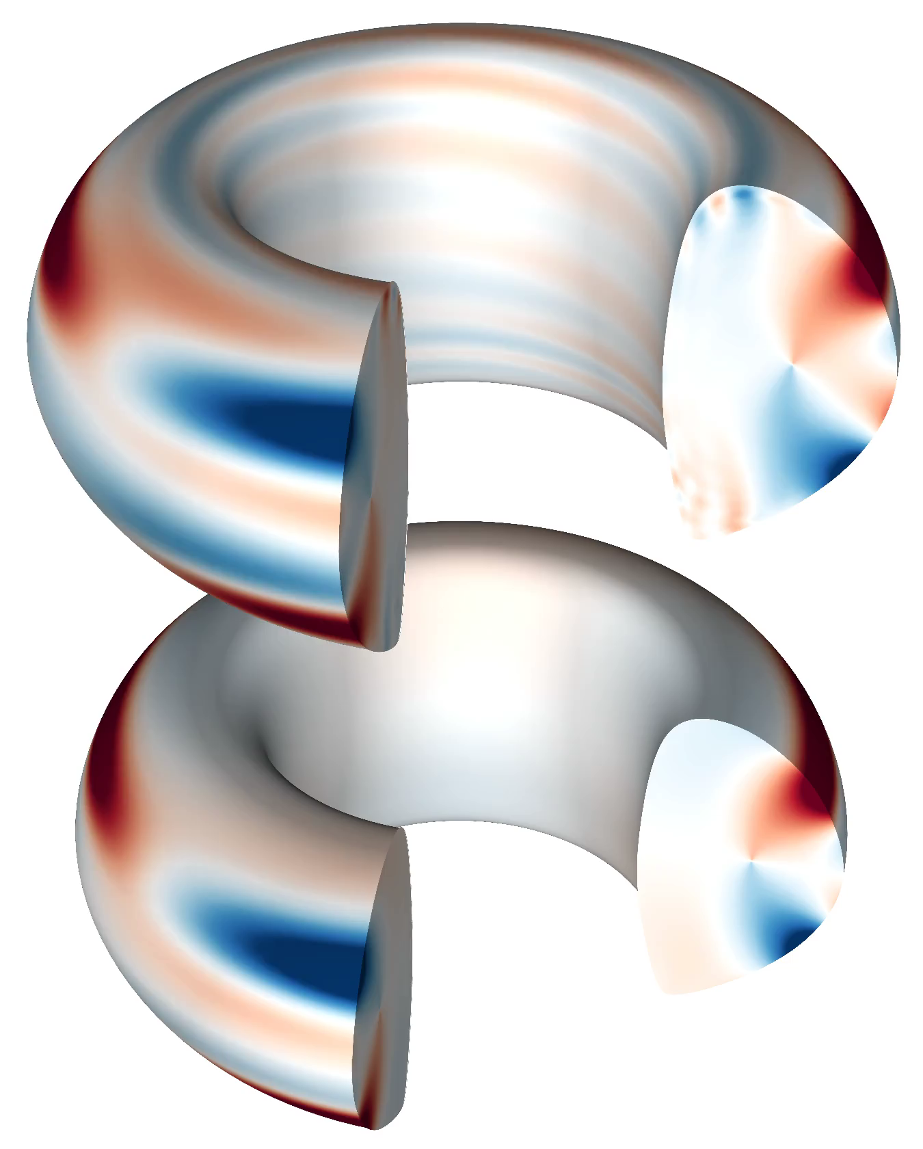
Slow Phasing Scan Allows Exploration of Density Pump-out and ELM Suppression Dependence on RMP Spectrum
Plasma
Response
rotating
ΔΦ_{UL}
static
Vacuum
The varying coil phase changes the resonant coupling and amplitude of edge 3D magnetic field
MARS-F (S. Haskey)

Slide 4
Slow Spectral Scan Separates Time Scales of ELM Suppression and Density Pump-out
ELM suppression requires low density, higher RMP amplitude
Density pump-out appears continuous with RMP amplitude
C. Paz-Soldan, et al., PRL 114, 105001 (2015)
R. Nazikian, et al., PRL 114, 105002 (2015)

Slide 5
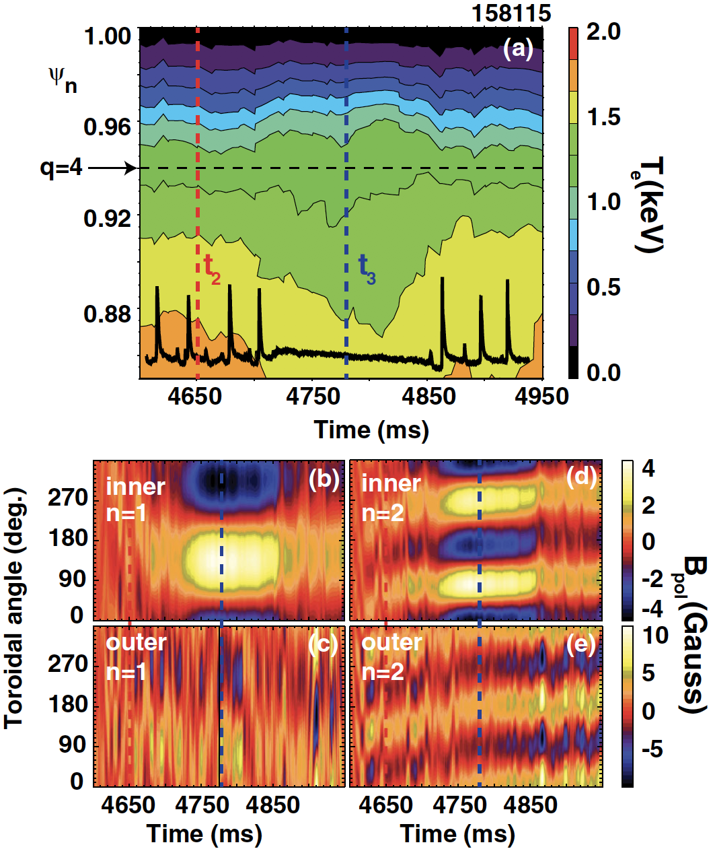
Locked-mode-like events are observed to coincide with onset of ELM suppression
Flattened T_{e} at pedestal top
Locked mode like magnetic
response
R. Nazikian, et al., PRL 114, 105002 (2015)

Slide 6
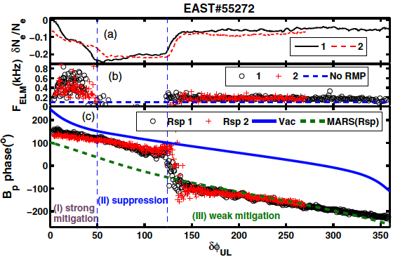
Locked modes like events are also observed to correlate with ELM suppression and density pump-out in EAST
Phase jump in magnetic response suggests locked mode formation at the onset of ELM suppression in EAST
Y. Sun, et al., PRL 117, 115001 (2016)

Slide 7
Main results
Simple nonlinear two-fluid MHD model used to identify the role of edge locked modes in density pump-out and ELM suppression
  Locked modes at the bottom of pedestal cause main density pump-out
  Locked modes at the top of the pedestal consistent with onset of ELM suppression
  Edge penetration threshold decreases for ITER due to lower perpendicular plasma flow
Field penetration
Screening

Slide 8
Outline
Introduction of non-linear MHD code-TM1
Edge locked modes versus ELM suppression
Density pump-out due to edge locked modes
Scaling of the field penetration threshold
Summary

Slide 9
TM1 - nonlinear MHD model
Cylindrical geometry, circular cross-section
Nonlinear, resistive, two-fluid equations
Q. Yu, et al., POP 10, 797 (2004); NF 48, 024007 (2008);
NF 50, 025014, (2010); NF 51, 073030 (2011)

Slide 10
Source terms are derived by initial profiles
The sources of momentum (S_{m}), particle (S_{n}) and energy (S_{e}) are determined by the initial ω_{E}, n_{e} and T_{e} profiles and fixed in the time evolution to maintain the initial profiles
The parallel current density gradient term comes from the two-fluid Braginskii equation
S.I. Braginskii, in Review of Plasma Physics, edited by M.A. Leontovich (Consultants Bureau, New York, 1965), Vol. 1, p. 205

Slide 11
Source terms are derived by initial profiles
The sources of momentum (S_{m}), particle (S_{n}) and energy (S_{e}) are determined by the initial ω_{E}, n_{e} and T_{e} profiles and fixed in the time evolution to maintain the initial profiles
The parallel current density gradient term comes from the two-fluid Braginskii equation
S.I. Braginskii, in Review of Plasma Physics, edited by M.A. Leontovich (Consultants Bureau, New York, 1965), Vol. 1, p. 205

Slide 12
Capability of TM1
Effects do not include compared to real tokamak
  Toroidal geometry:
    Toroidal mode coupling effect
    strong flow shear in pedestal region will suppress this effect
    Toroidal curvature effect
    will be canceled due to thermal transport
  Shape effect
  Finite ion temperature effect (Δr ~ W)
  Wall condition (free boundary or ideal wall in TM1)
TM1 is capable
  Nonlinear and two-fluid effects
  Able to run for high S (up to 10¹⁰) and (up to 10¹²) with good numerical convergence
  Runs faster even with tens of harmonics

Slide 13
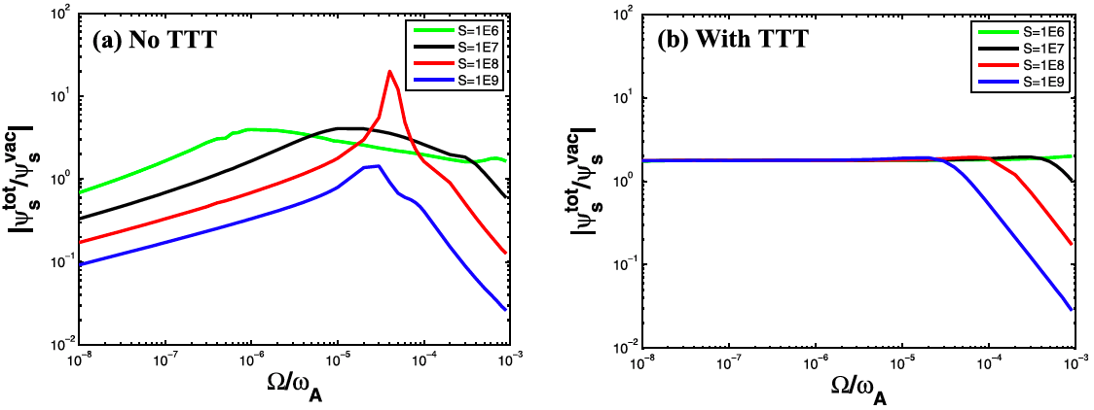
Thermal transport cancels the stabilizing effect of toroidal curvature
No thermal transport
With thermal transport
Y.Q. Liu, J.W. Connor, S.C. Cowley, et al., POP 19, 072509 (2012)
X. Bai, Y.Q. Liu., Z. Gao, POP 24, 102505 (2017)
Toroidal curvature causes screening at low rotation
RMP caused thermal transport will cancel it

Slide 14
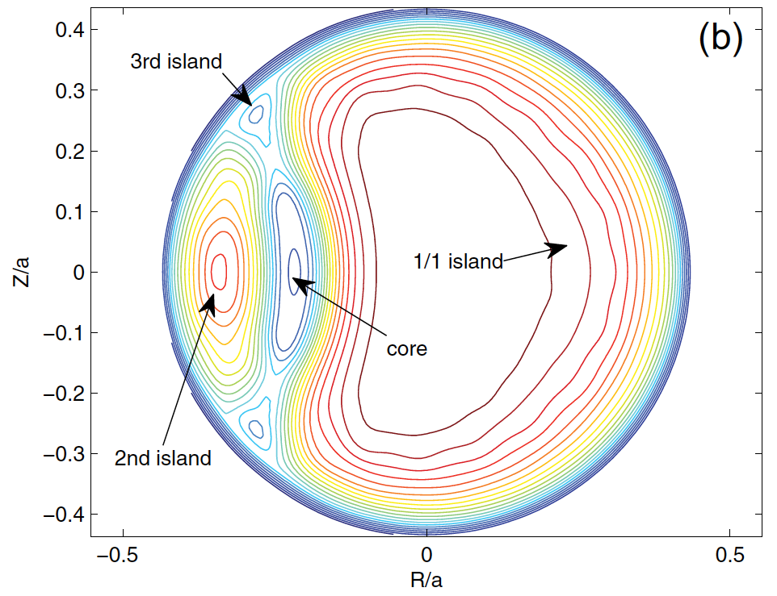
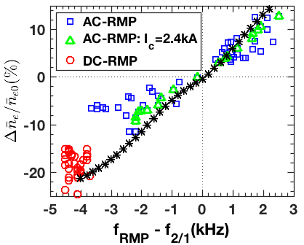
Some key results from TM1
Plasmoid
TM1 prediction
TM1 predicted density pump-out/pump-in by RMP, confirmed by J-TEXT experiment
TM1 simulation found that both two-fluids effect & plasmoid formation speed up magnetic reconnection, being consistent with AUG experiment
Q. Hu, et al., NF 54, 122006 (2014)
Cooperation: Max-Planck/Princeton Center for Plasma Physics
Q. Yu, S. Gunter, K. Lackner, NF 072005 (2014), 113008 (2015)
S. Gunter, Q. Yu, et al., PPCF 014017 (2015)

Slide 15
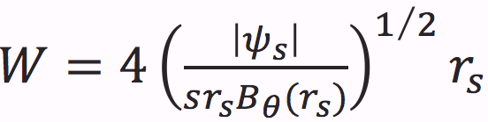
Input & output of TM1 for DIII-D analysis
Input parameters | Profiles: q, ω_{E}, n_{e}, T_{e} ← kineticEFIT Transport coefficients: ← TRANSP * RMP amplitude at plasma edge ← GPEC (B_{v}+B_{res}) Other parameters derived from the profiles
Output parameters m/n=0 & ≠0 | Profiles: j, ω_{E}, n_{e}, T_{e}, ψ Other derived quantities: island width W, growth rate γ, phase, plasma response, etc
=1 m²/s are used in TM1 simulation based on TRANSP analysis
Porter method* is used to derive (τ_{p}~300 ms~2τ_{E})
Definition of island width:
Porter, G. D. POP 5, 4311 (1998)

Slide 16
Outline
Introduction of non-linear MHD code-TM1
Edge locked modes versus ELM suppression
  Locked modes at both the top and bottom of pedestal cause similar phenomena with ELM suppression
Density pump-out due to edge locked modes
Scaling of the field penetration threshold
Summary

Slide 17
Shot 158115: input profiles for TM1 taken at a time when the RMP amplitude is at a minimum
Initial profiles
Profiles at minimum RMP strength are used as initial profiles
m/n=7/2, 8/2, 9/2, 10/2 and 11/2 helicities are included

Slide 18
Shot 158115: Multiple helicity fields taken from GPEC for each ΔΦ as initial condition for TM1
B_{r} from GPEC
rotating
ΔΦ_{UL}
static
GPEC calculation based on equilibrium at 3.3s

Slide 19
TM-1 shows formation of top and bottom of pedestal locked modes
Locked modes (LMs) occur gradually when increasing B_{r}
  7/2 LM appears
  → 11/2 LM appears, 7/2 decays
  → 8/2 LM appears, coexists with 11/2 LM
@ 1.1ψ_{N}

Slide 20
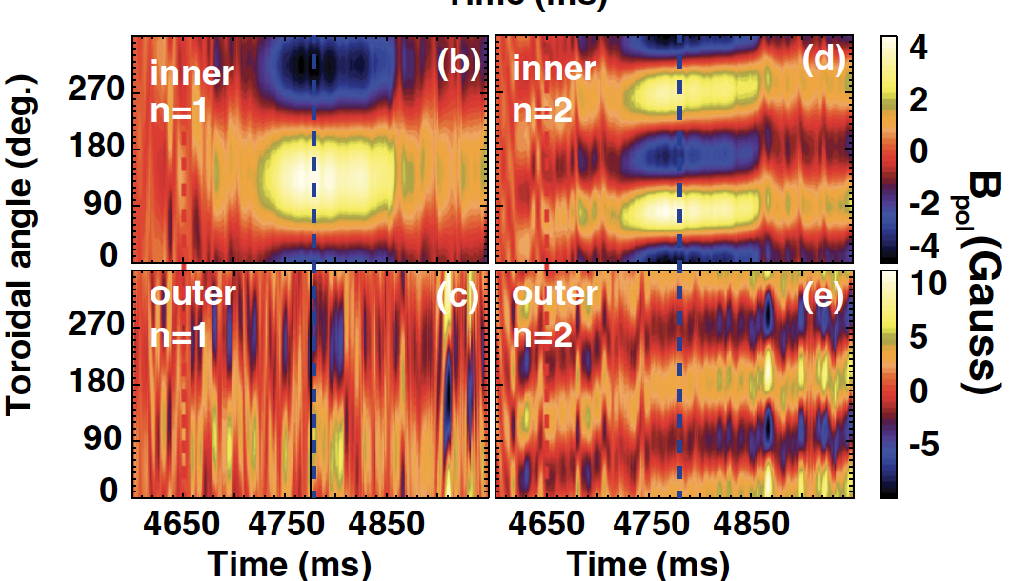
TM-1 shows formation of top and bottom of pedestal locked modes
Locked modes (LMs) occur gradually when increasing B_{r}
  7/2 LM appears
  → 11/2 LM appears, 7/2 decays
  → 8/2 LM appears, coexists with 11/2 LM
@ 1.1ψ_{N}
R. Nazikian, et al., PRL 114, 105002 (2015)

Slide 21
Locked modes cause change in density, temperature and rotation
11/2 LM has low threshold
  causes continuous decrease in n_{e}, T_{e} and ω_{E}
8/2 LM has high threshold
  causes sharp decrease in n_{e}, T_{e} and ω_{E}

Slide 22
Modeled parameters are consistent with experiment
The 8/2 LM window is wider than ELM suppression window
  →B_{r} is lower when β_{N} is lower
  → 1/L_{n}=-n_{e}’/n_{e}
Experimental density changes more than simulation
  → Other transport effect beyond TM1 model ?
Separatrix density does not change significantly
  → 1/L_{n}=-n_{e}’/n_{e}

Slide 23
Change in density and temperature profiles consistent with experiment at the top of pedestal
initial
ELM supp.

Slide 24
Change in density and temperature profiles consistent with experiment at the top of pedestal
Modeled n_{e} and T_{e} profiles are quantitatively consistent with experiment
Modeled ω_{E} profile is different to experiment
  → The change in ω_{E} due to the change in P_{i} gradient is not included in TM1 model
  ω_{E} ≈ 0 at q=4 surface
Enhanced fluctuations at top of pedestal may play a role in E_{r} profile
initial
ELM supp.
Sim
Exp
R. Nazikian, et al., PRL 114, 105002 (2015)
G. Mckee, et al., NF 53, 113011 (2013)

Slide 25
Predicted island width is larger than ion orbit width, so some density flattening is expected
Unit: cm
 | Vacuum island width | TM1 Island width |  | LFS midplane |  | Averaged minor radius |  | Ion orbit width
 | W (ψ_{N}%) | W (ψ_{N}%) |  | r | W | r | W | Δr | ρ_{i}
8/2 | 3.4 | 2.2 |  | 47 | 0.9 | 79 | 3.8 | 1.2 | 0.3
11/2 | 1.4 | 1.34 |  | 49 | 0.5 | 90 | 3.2 | 0.55 | 0.1
Passing ion orbit width Δr=qρ_{i}
  T_{i} ≈ T_{e} is assumed based on main ion CER results *
  Main ion CER is resolving the anomaly in the negative power balance
* S.R. Haskey, et al., PPCF 60, 105001 (2018)

Slide 26
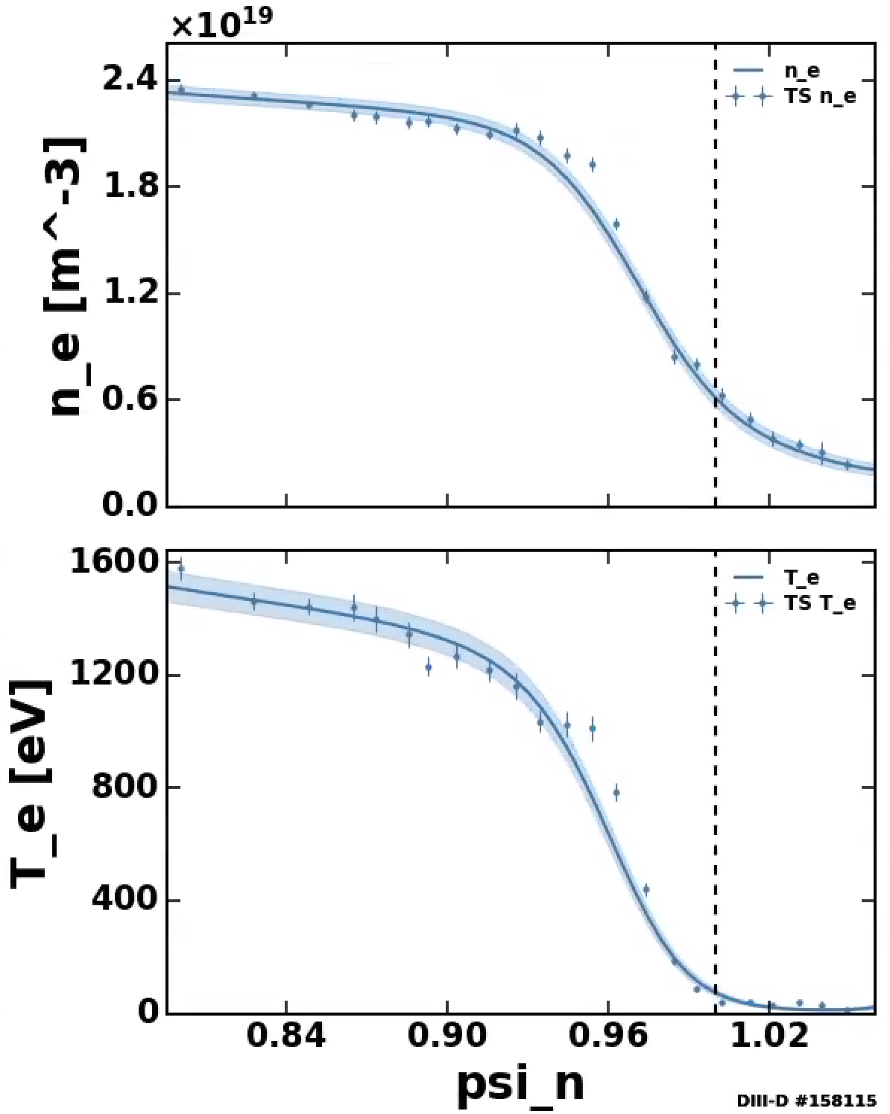
Predicted island width is challenging to detect with Geometry of Thomson scattering system
Spatial resolution is not high enough to detect the predicted island width
11/2 island
8/2 island

Slide 27
Outline
Introduction of non-linear MHD code-TM1
Edge locked modes versus ELM suppression
Density pump-out due to edge locked modes
  Locked modes at the bottom of pedestal cause main density pump-out
Scaling of the field penetration threshold
Summary

Slide 28
TM-1 shows that at higher density there is no ELM suppression, consistent with experiment
158115
159326
Higher n_{e}, lower T_{e}, other parameters are the same
Higher moment of inertia requires higher torque for penetration

Slide 29
Simulation shows single 11/2 locked mode at pedestal bottom causes density pump-out
Single 11/2 LM occurs in most of the period with maximum island width of 1.5%ψ_{N}
Causes modulation in n_{e}, T_{e} and ω_{E}

Slide 30
Simulation shows single 11/2 locked mode at pedestal bottom causes density pump-out
Single 11/2 LM occurs in most of the period with maximum island width of 1.5%ψ_{N}
Causes modulation in n_{e}, T_{e} and ω_{E}
The modeled evolution of n_{e}, T_{e} and ω_{E} are consistent with experiment
  →Δt=t-3.4s
• Higher collisionality reduces
parallel transport, pumpout

Slide 31
Simulation shows single 11/2 locked mode at pedestal bottom causes density pump-out
Single 11/2 LM occurs in most of the period with maximum island width of 1.5%ψ_{N}
Causes modulation in n_{e}, T_{e} and ω_{E}
The modeled evolution of n_{e}, T_{e} and ω_{E} are consistent with experiment
    →Δt=t-3.4s
Modeled n_{e} and T_{e} profiles are consistent with experiment
11/2 LM flattened n_{e} and T_{e} profiles at q=11/2 surface

Slide 32
Reminder: Predicted 11/2 island width is too small to detect using Thomson scattering system
Spatial resolution is not high enough to detect the predicted island width
11/2 island

Slide 33
RMP causes even weaker density pump-out at higher collisionality (density) due to smaller χ||
Simulation for shot 161202 is also consistent with experiment
n_{e,ped} = 7.5, more than two times of shot 158115 and 159326
11/2 LM causes much weaker density pump-out (4%)
Higher collisionality reduces
parallel transport, pump-out

Slide 34
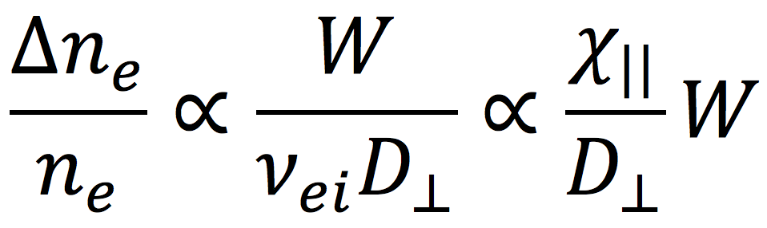
What parameters govern the locked modes causing density pump-out ?
The electron continuity equation
governs the particle transport due to LM, and hence*
Locked mode causes less density pump-out for higher collisionality, higher particle diffusivity and smaller island width
Higher collisionality leads to lower and weaker flattening on density
 | 158115 | 159326 | 161202
n_{e,ped} | 2.8 | 3.5 | 7.5
Exp: Δn_{e}/n_{e} | -20% | -15% | -4%
TM1: Δn_{e}/n_{e} | -18% | -14% | -4%
* Q. Yu, et al., NF 51, 073030 (2011); F.L. Waelbroeck, et al., NF 52, 074004 (2012)

Slide 35
Outline
Introduction of non-linear MHD code-TM1
ELM suppression versus edge locked modes
Density pump-out due to edge locked modes
Scaling of the field penetration threshold
Summary

Slide 36

Scaling of 8/2 Penetration threshold for ELM suppression studied using 21x15 TM1 simulations
Scaling* power law obtained by fitting
Penetration is easier to happen for a lower density or less negative ω_{E}
* Profiles of n_{e} and ω_{E} are shifted up and down (21×15)
n_{e} in unit of 10¹⁹m⁻³, rotation in krad/s, B_{t} in T

Slide 37
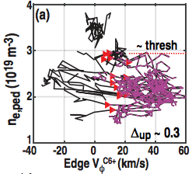
Predicted scaling consistent with experiment on DIII-D for rotation and density threshold
Scaling* power law obtained by fitting
Penetration is easier to happen for a lower density or less negative ω_{E}
n_{e} in unit of 10¹⁹m⁻³, rotation in krad/s, B_{t} in T
C. Paz-Soldan, R. Nazikian, et al., NF (just accepted)

Slide 38
Simulation reproduced the density threshold (≈2.6e19) for ELM suppression seen in DIII-D
Scaling agrees with TM1 for different plasmas
  → TM1 simulations are based on equilibrium & profiles prior to ELM suppression or at minimum density
There is an upper n_{e} limit for threshold due to the limit of RMP strength

Slide 39
TM1 simulated threshold for ITER n=3 penetration at pedestal top is an order of magnitude lower
Equilibrium profiles are generated based on EPED and TGLF prediction *
  q₉₅=3.1
  Zero toroidal rotation
The onset threshold for 9/3 locked mode is B_{r}/B_{t}=2.1×10⁻⁵
  → An order lower than DIII-D
• Reason due to much lower expected
ω_{E} and ω_{*e} in ITER
* O. Meneghini, et al., POP 23, 042507 (2016)

Slide 40
The edge locked mode onset threshold for ITER is consistent with DIII-D scaling
 | ITER | DIII-D 158115
B_{t} (T) | 5.15 | 1.98
n_{e} (10¹⁹ m⁻³) | 9 | 3
T_{e} (keV) | 4 | 1.5
ω_{E} (krad/s) | -3 | -25
ω_{*e} (krad/s) | -3 | -40
The penetration threshold for ITER n=3 RMP will be an order lower than DIII-D due to lower flow frequencies

Slide 41
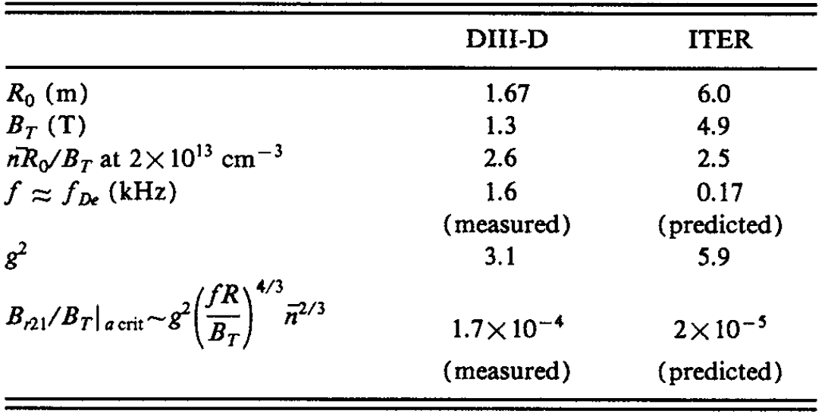
The much lower rotation and diamagnetic drift frequency in ITER leads to the lower field penetration threshold
Our conclusions for edge resonant field penetration consistent with core locked mode studies for ITER
[R.J. La Haye, et al., Phys. Fluids B 4, 2098 (1992)]

Slide 42
Smaller island width at penetration threshold will cause less main ion density pump-out in ITER
Unit: cm
 | TM1 Island width |  | LFS midplane |  | Averaged minor radius |  | Ion orbit width
 | W (ψ_{N}%) |  | r | W | r | W | Δr | ρ_{i}
9/3 | 0.8 |  | 172 | 1.0 | 316 | 4.0 | 0.72 | 0.24
11/3 | 0.5 |  | 178 | 0.6 | 348 | 3 | 0.2 | 0.05
Lower penetration threshold leads to smaller island width and less density pump-out
Ion orbit width is even smaller than island width
  TM1 model should work better in ITER parameters than DIII-D
TM1 simulation does not address impurity transport

Slide 43
Outline
Introduction of non-linear MHD code-TM1
ELM suppression versus edge locked modes
Density pump-out due to edge locked modes
Scaling of the field penetration threshold
Summary

Slide 44
Summary
Locked mode at pedestal bottom causes the main density pump-out
The formation of locked modes at both the top and bottom of pedestal causes similar phenomenon of ELM suppression
The scaling power law implies that the penetration threshold for ITER will be an order lower than present devices

Slide 45
Model limitations and next steps
Model limitation
  → Cylindrical geometry, circular cross-section
    Toroidal coupling effect (almost updated)
    Shape effect
  Does not include NTV or finite orbit width effects
  Utilizing constant transport coefficients
    Update to radial transport profiles
Next step work
  Compare with more complete models (M3D-C1, XGC)
  Extend to n=1 on KSTAR & EAST and n=3 on DIII-D
  Explore q₉₅ windows of ELM suppression

Slide 46
Thanks for your attention

Slide 47
Shot 158115: transport coefficients input from TRANSP
=1m²/s are used in TM1 simulation based on TRANSP analysis
Porter method is used to derive particle diffusivity

Slide 48
11/2 locked mode enhances parallel transport to produce density pump-out
The density gradient is mainly changed around 11/2 island region
→ LM enhances parallel transport to produce density pump-out
  → 8/2 screening current also causes slight decrease in n_{e}
The change in density linearly depends on the 11/2 island width
8/2 screening
current induced
11/2 island

Slide 49
Hysteresis effect is observed in ELM suppression experiment and simulation
The required RMP amplitude to cause ELM suppression (and jump in ω_{E}) is stronger than that for exiting ELM suppression
Similar hysteresis loop appears in the simulation

Slide 50
Sensitivity study on transport coefficients
Smaller (larger) transport coefficients lower (increase) the penetration threshold
Penetration is hard to happened when turning off the parallel transport due to RMP

Slide 51
Density and ω_{E} of shot 158115 are shifted up and down to scan penetration threshold
8/2 penetration threshold is scanned at each density and ω_{E} profiles (21×15 points)

Slide 52
8/2 Penetration threshold depends on density and ω_{E}
TM1 simulation
Reproduced by scaling
Scaling power law obtained by fitting
n_{e} in unit of 10¹⁹m⁻³, rotation in krad/s, B_{t} in T

