Slide 1

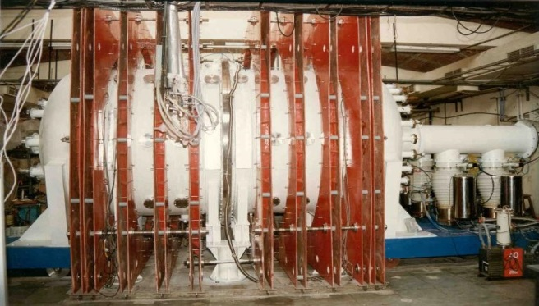
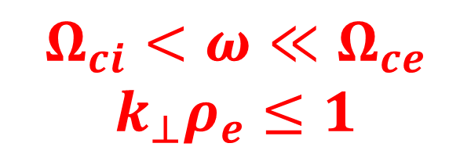
Institute for Plasma Research, Gandhinagar, India
Large Volume Plasma Device
Experimental Study on ETG Turbulence Induced Plasma
Transport in Large Volume Plasma Device
Prabhakar Srivastav
*e-mail: prabhakar.srivastav@ipr.res.in
$$Ω_{ci}<ω≪Ω_{ce}$$
$$k_{⊥}ρ_{e}≤1$$
Talk at PPPL (August 28, 2019)

Slide 2
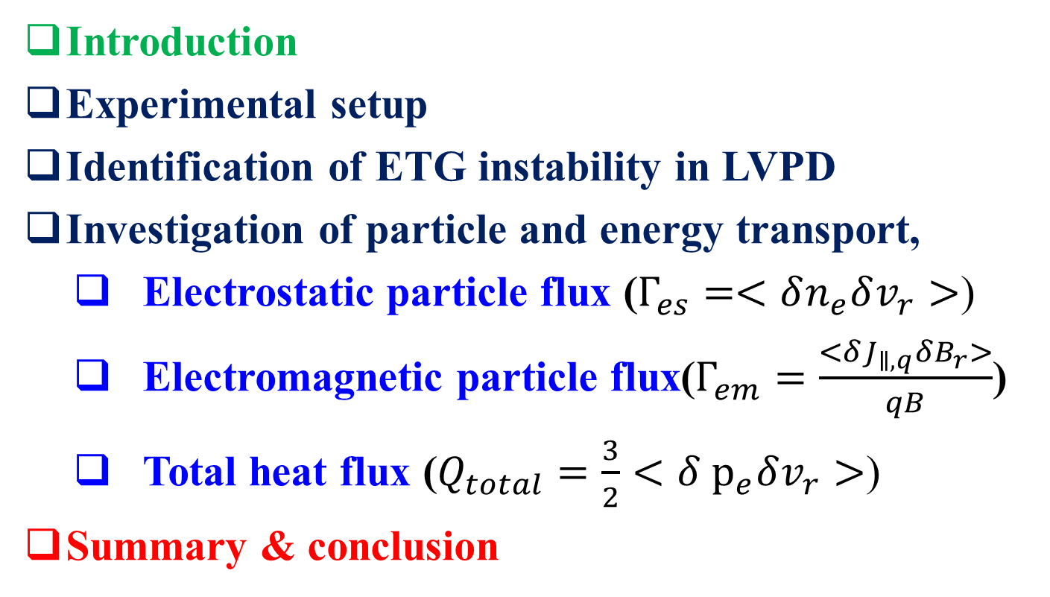
Outline
Introduction
Experimental setup
Identification of ETG instability in LVPD
Investigation of particle and energy transport,
  Electrostatic particle flux ($Γ_{es}=<δn_{e}δv_{r}>$)
  Electromagnetic particle flux($Γ_{em}=\frac{<δJ_{∥,q}δB_{r}>}{qB}$)
  Total heat flux ($Q_{total}=\frac{3}{2}<{δ p}_{e}δv_{r}>$)
Summary & conclusion

Slide 3
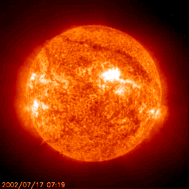
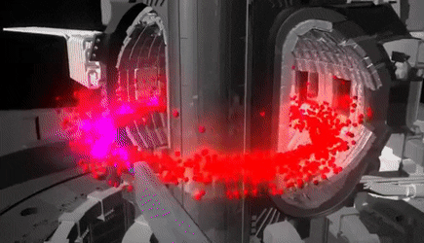
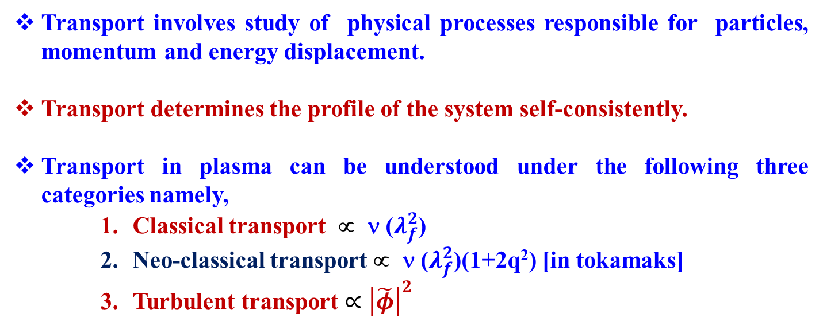
Introduction
Transport involves study of physical processes responsible for particles, momentum and energy displacement.
Transport determines the profile of the system self-consistently.
Transport in plasma can be understood under the following three categories namely,
    Classical transport ∝ ν ($λ_{f}^{2}$)
    Neo-classical transport ∝ ν ($λ_{f}^{2}$)(1+2q²) [in tokamaks]
    Turbulent transport $∝{\left|\tilde{φ}\right|}^{2}$

Slide 4

Introduction
Turbulent Transport is a universal phenomenon present in laboratory, space and astrophysical systems.
Turbulence leads to generation of particle as well as heat transport of the order of magnitudes higher than the classical and neoclassical flux predictions in fusion devices.
This anomalous flux is attributed to turbulent fluctuations due to various instabilities inherent in the system.
Confined systems are naturally inhomogeneous which act as source of free energy to drive the system, any perturbations can evolve over a wide range of scale, from electron to ion and up to system scale.
Large scale perturbations are easy to probe in tokamaks and tremendous progress has already been made on ion temperature gradient driven micro-turbulent mode ($k_{⊥}ρ_{i}≤1$) and MHD modes.

Slide 5
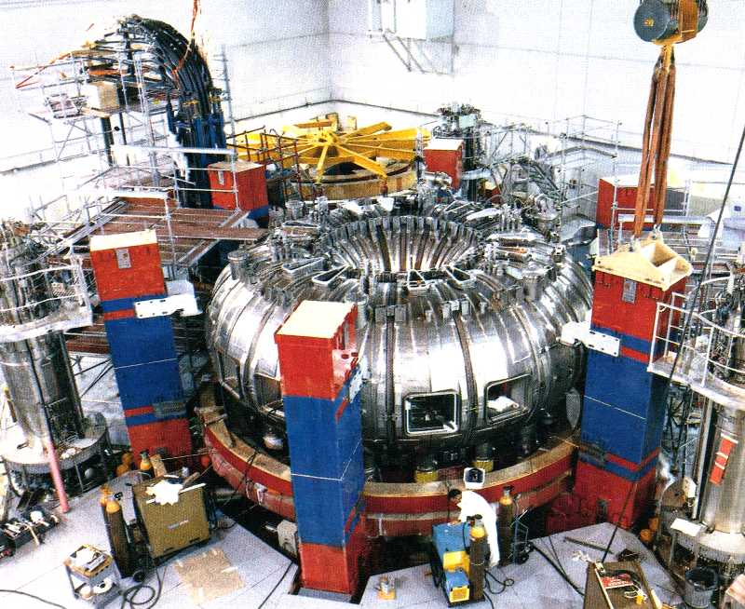
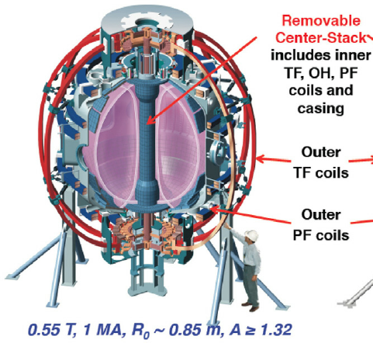
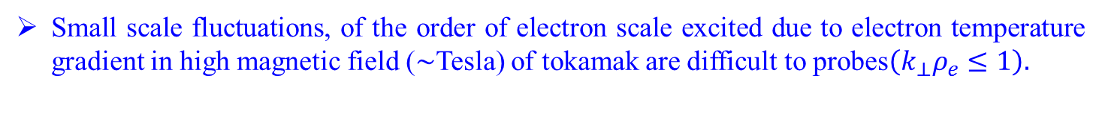
Introduction
Small scale fluctuations, of the order of electron scale excited due to electron temperature gradient in high magnetic field ($∼$Tesla) of tokamak are difficult to probes$\left(k_{⊥}ρ_{e}≤1\right).$
Tore Supra (WEST)
NSTX
Tore Supra, (Horton et al. Phys. Plasmas, Vol. 11, No. 5, (2004))
NSTX , ( Mazzucato et al. Phys. Rev. Lett. 101, 075001 (2008))

Slide 6
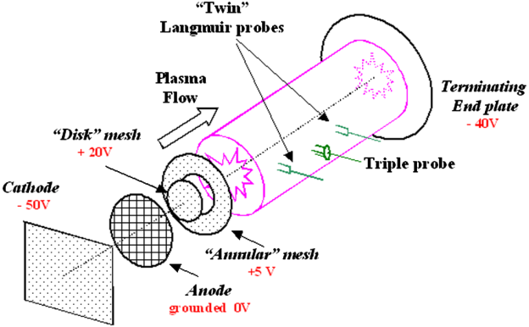
Introduction
To understand such small scales fluctuation some linear devices like Columbia Linear Machine (CLM), Large Volume Plasma Device (LVPD) have taken initiatives.
X. Wei et. al. Phys. Plasmas 17, 042108 (2010)
V. Sokolov and A. K. Sen, Phys. Rev. Lett. 107, 155001 (2011)
Fu et al. Phys. Plasmas 19, 032303 (2012)

Slide 7
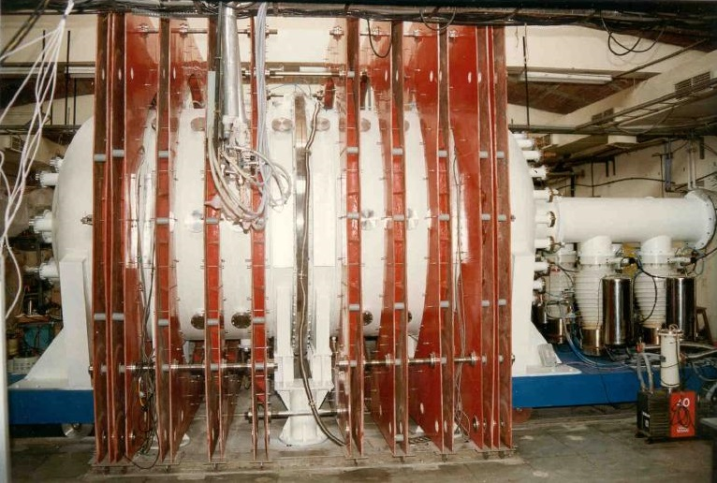
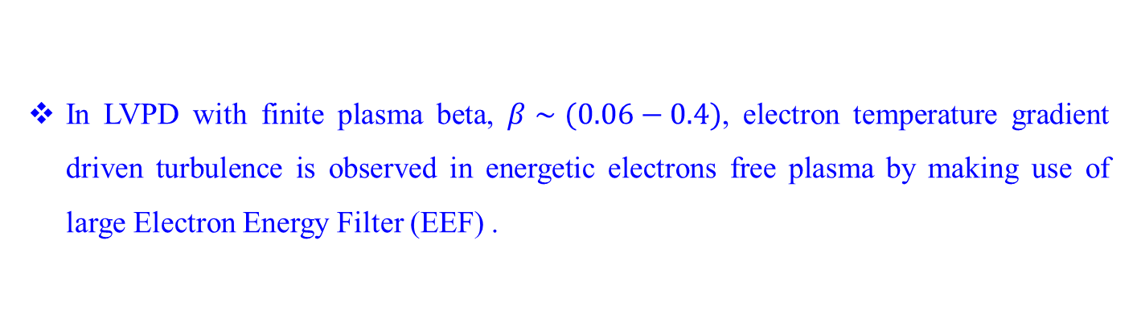

Introduction
In LVPD with finite plasma beta, $β∼(0.06−0.4)$, electron temperature gradient driven turbulence is observed in energetic electrons free plasma by making use of large Electron Energy Filter (EEF) .
$$Ω_{ci}<ω≪Ω_{ce}$$
$$k_{⊥}ρ_{e}≤1$$
3 m
2 m
Mattoo et. al. Phys. Rev. Lett. 108, 255007 (2012)
Singh et. al. Rev. Sci. Instrum. 85, 033507 (2014)
What is the role of ETG scale fluctuation on plasma transport in LVPD?

Slide 8
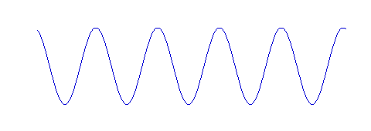


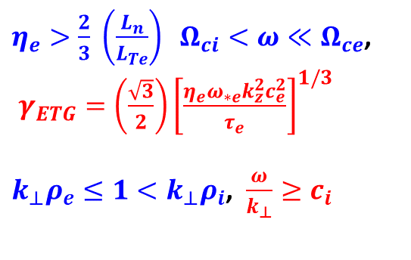
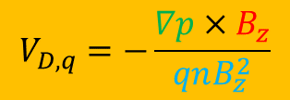

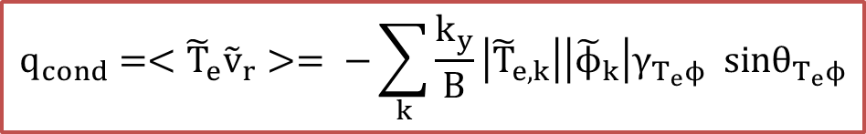




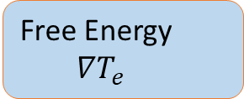
Turbulent Transport Mechanism
Free Energy
$∇T_{e}$
$$Γ=<{\tilde{n}}_{e}{\tilde{v}}_{r}> =−\sum_{k}{\frac{k_{y}}{B}\left|{\tilde{n}}_{e,k}\right|\left|{\tilde{ϕ}}_{k}\right|γ_{nϕ} sinθ_{n_{e}ϕ}}$$
$$B_{z}$$
$$V_{D,q}=−\frac{∇p×B_{z}}{qnB_{z}^{2}}$$
1. Particle Flux,
$\tilde{n}$
$\tilde{T_{e}}$
$$\tilde{n}=−\frac{T_{e}}{T_{i}}\tilde{φ}$$
$\tilde{φ}$
$J_{θ}×B_{z}=∇p$
$η_{e}>\frac{2}{3} \left(\frac{L_{n}}{L_{Te}}\right) Ω_{ci}<ω≪Ω_{ce}$,
$γ_{ETG}=\left(\frac{\sqrt{3}}{2}\right){\left[\frac{η_{e}ω_{∗e}k_{z}^{2}c_{e}^{2}}{τ_{e}}\right]}^{1/3}$
$k_{⊥}ρ_{e}≤1<k_{⊥}ρ_{i}$, $\frac{ω}{k_{⊥}}≥c_{i}$
2. Heat Flux
$$q_{cond}=<{\tilde{T}}_{e}{\tilde{v}}_{r}>= −\sum_{k}{\frac{k_{y}}{B}\left|{\tilde{T}}_{e,k}\right|\left|{\tilde{ϕ}}_{k}\right|{γ_{T_{e}ϕ} sinθ}_{T_{e}ϕ}}$$

Slide 9
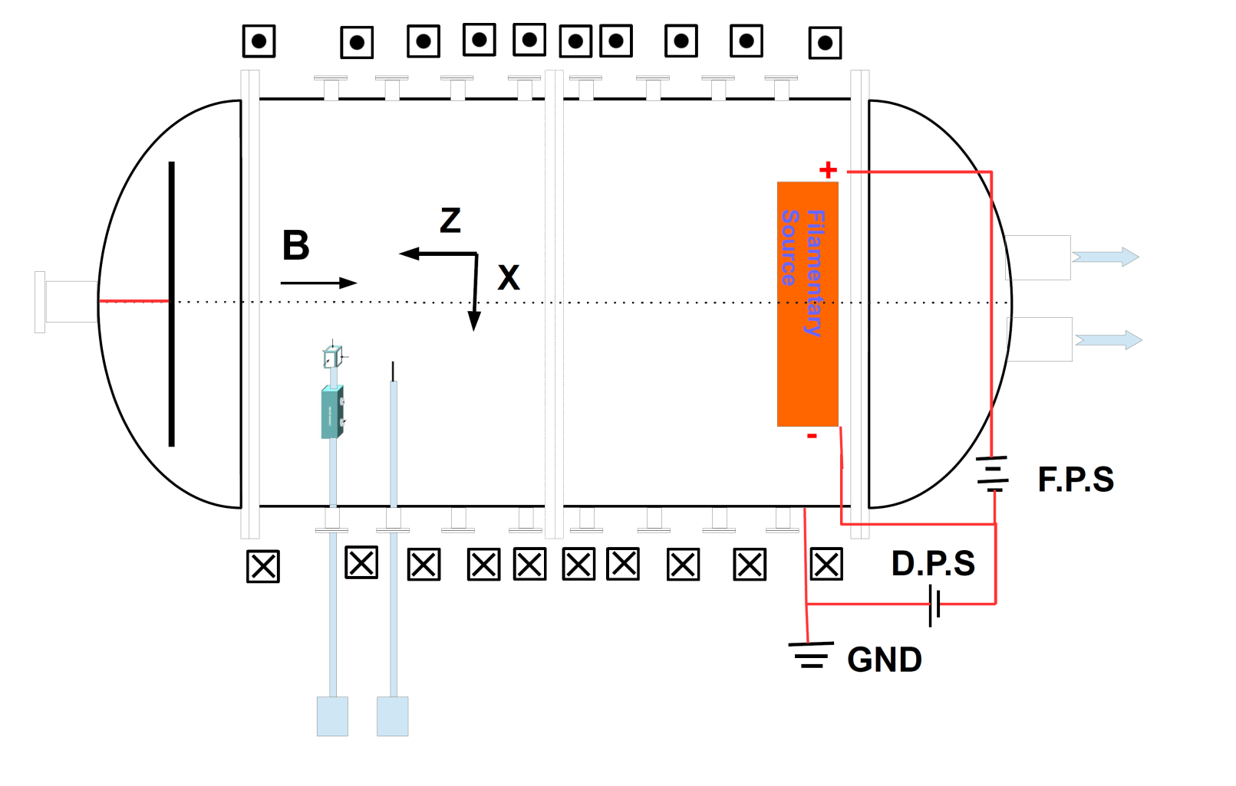
Experimental setup
Experimental Setup
300 cm
200 cm

Slide 10
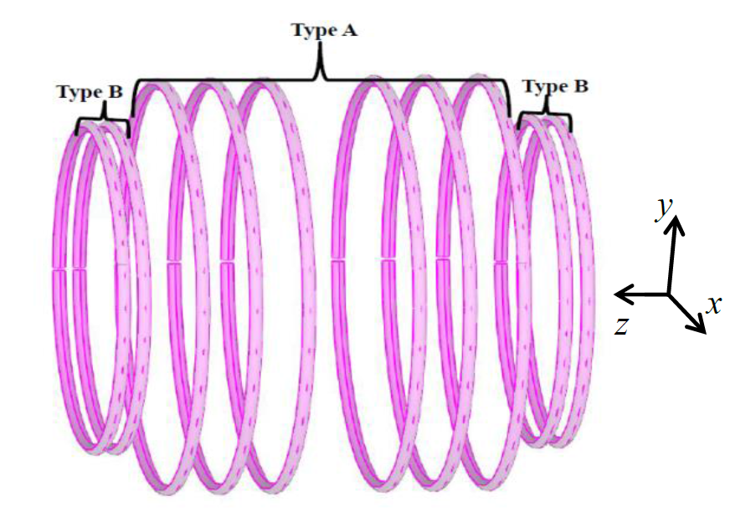
Experimental setup
Experimental Setup
Coil arrangement for axial magnetic field ($B_{z}$)
200 cm
300 cm

Slide 11
Experimental setup
Experimental Setup
Radial confinement
Axial confinement

Slide 12
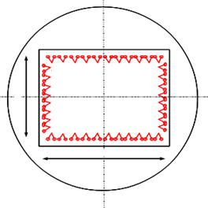
Experimental setup
Experimental Setup
300 cm
200 cm
900 mm
1300 mm

Slide 13
Experimental setup
300 cm
200 cm
900 mm
1300 mm

Slide 14
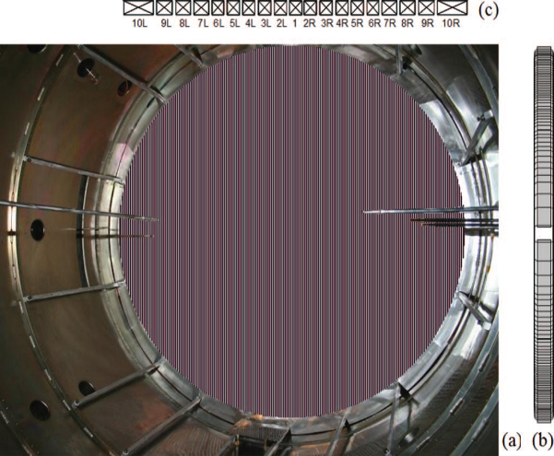
Experimental setup
Experimental Setup
300 cm
Target
Source
200 cm
900 mm
EEF
1300 mm
Photo Graph of EEF

Slide 15
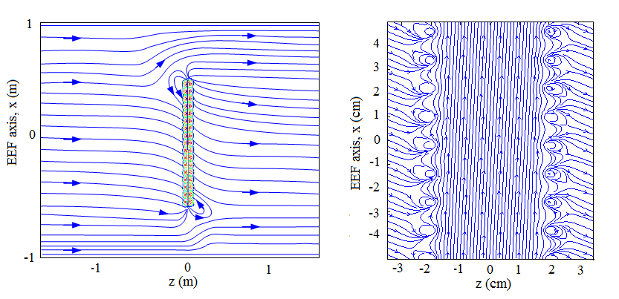
Experimental setup
Experimental Setup
300 cm
Target
Source
4 cm
900 mm
200 cm
EEF
1300 mm
Photo Graph of EEF

Slide 16
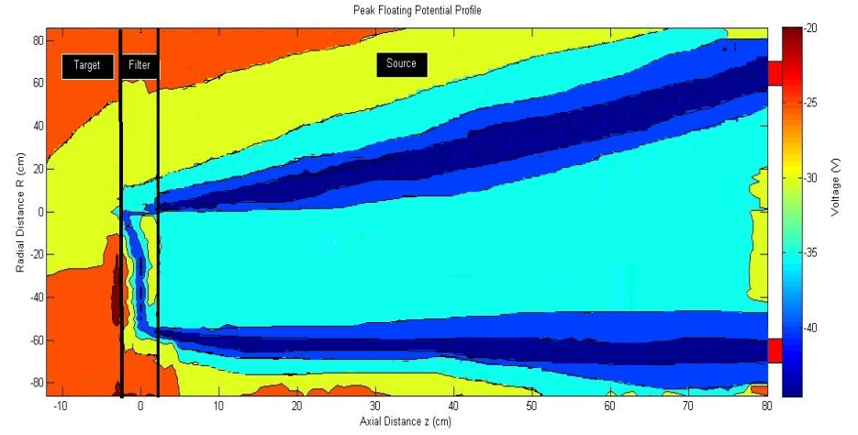
Experimental setup
300 cm
Target
Source
200 cm
900 mm
EEF
1300 mm
Photo Graph of EEF

Slide 17
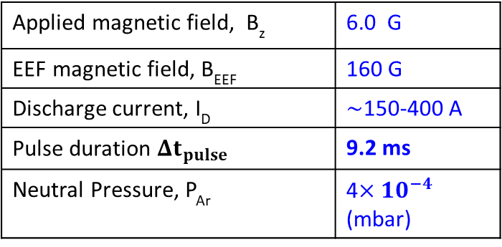
Experimental setup
Experimental Setup
300 cm
Target
Source
200 cm
900 mm
EEF
1300 mm
Applied magnetic field, B_{z} | 6.0 G
EEF magnetic field, B_{EEF} | 160 G
Discharge current, I_{D} | $∼$150-400 A
Pulse duration $Δt_{pulse}$ | 9.2 ms
Neutral Pressure, P_{Ar} | 4$×{10}^{−4}$ (mbar)

Slide 18
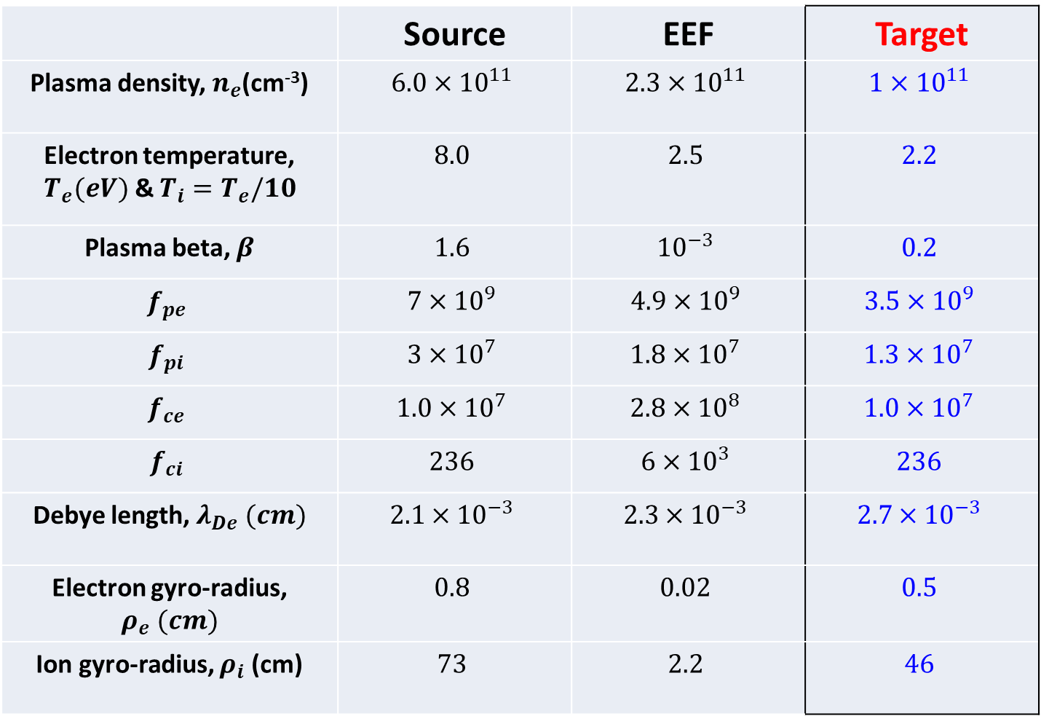
Experimental plasma parameters
 | Source | EEF | Target
Plasma density, $n_{e}$(cm⁻³) | $$6.0×{10}^{11}$$ | $$2.3×{10}^{11}$$ | $$1×{10}^{11}$$
Electron temperature, $T_{e}(eV)$ & $T_{i}=T_{e}/10$ | $$8.0$$ | $$2.5$$ | $$2.2$$
Plasma beta, $β$ | $$1.6$$ | $${10}^{−3}$$ | $$0.2$$
$$f_{pe}$$ | $$7×{10}^{9}$$ | $$4.9×{10}^{9}$$ | $$3.5×{10}^{9}$$
$$f_{pi}$$ | $$3×{10}^{7}$$ | $$1.8×{10}^{7}$$ | $$1.3×{10}^{7}$$
$$f_{ce}$$ | $$1.0×{10}^{7}$$ | $$2.8×{10}^{8}$$ | $$1.0×{10}^{7}$$
$$f_{ci}$$ | $$236$$ | $$6×{10}^{3}$$ | $$236$$
Debye length, $λ_{De} (cm)$ | $$2.1×{10}^{−3}$$ | $$2.3×{10}^{−3}$$ | $$2.7×{10}^{−3}$$
Electron gyro-radius, $ρ_{e} (cm)$ | $$0.8$$ | $$0.02$$ | $$0.5$$
Ion gyro-radius, $ρ_{i}$ (cm) | $$73$$ | $$2.2$$ | $$46$$

Slide 19
Experimental Investigations on ETG
Pulse characteristic of plasma shot

Slide 20
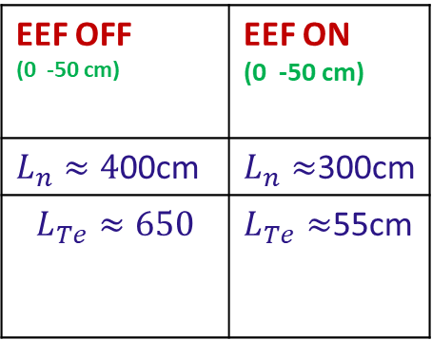
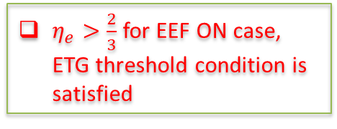
Experimental Investigations on ETG
Mean plasma profile
EEF OFF (0 -50 cm) | EEF ON (0 -50 cm)
$L_{n}≈4$00cm | $L_{n}≈$300cm
$$L_{Te}≈650$$ | $L_{Te}≈$55cm
$η_{e}>\frac{2}{3}$for EEF ON case, ETG threshold condition is satisfied

Slide 21
Experimental Investigations on ETG
Temporal Evolution of Fluctuation

Slide 22
Experimental Investigations on ETG
Radial Profile of fluctuation and Power Spectra of fluctuation
Fluctuation enhances when EEF is ON in the core
Density and Potential fluctuation share common frequency band of spectrum

Slide 23
Experimental Investigations on ETG
Correlation between $\tilde{n}$ and $\tilde{φ}$

Slide 24
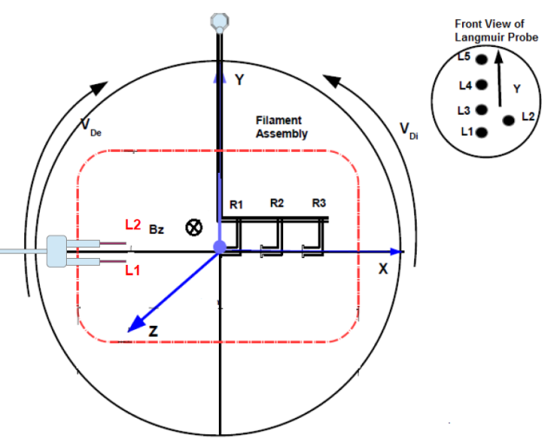
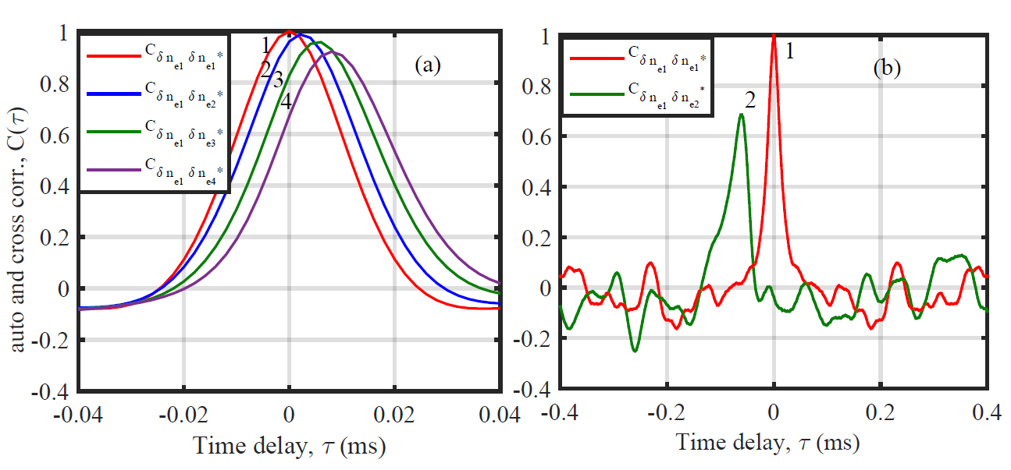

Experimental Investigations on ETG
Diamagnetic Drift Direction and Poloidal Rotation of the mode
Mode propagation is in positive y-direction, similar to $V_{di}$
Measured poloidal propagation velocity, $V_{θ}=2.5×{10}^{3}m/sec$

Slide 25
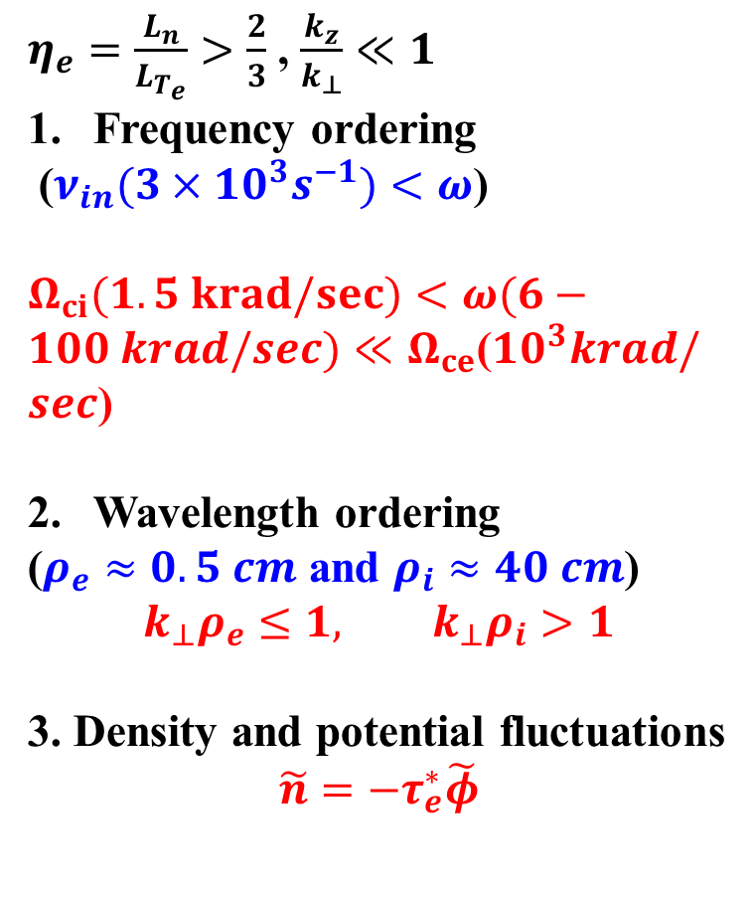
Experimental Investigations on ETG
Characterization of ETG turbulence
$η_{e}=\frac{L_{n}}{L_{T_{e}}}>\frac{2}{3}$ , $\frac{k_{z}}{k_{⊥}}≪1$
Frequency ordering
($ν_{in}(3×10^{3}s^{−1})<ω$)
$Ω_{ci}(1.5 krad/sec)<ω(6−100 krad/sec)≪Ω_{ce}$(${10}^{3}krad/sec$)
Wavelength ordering
($ρ_{e}≈0.5 cm$ and $ρ_{i}≈40 cm$)
$$k_{⊥}ρ_{e}≤1, k_{⊥}ρ_{i}>1$$
3. Density and potential fluctuations
$$\tilde{n}=−τ_{e}^{∗}\tilde{φ}$$

Slide 26
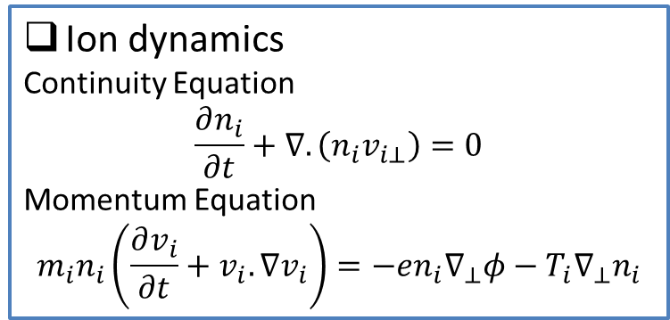
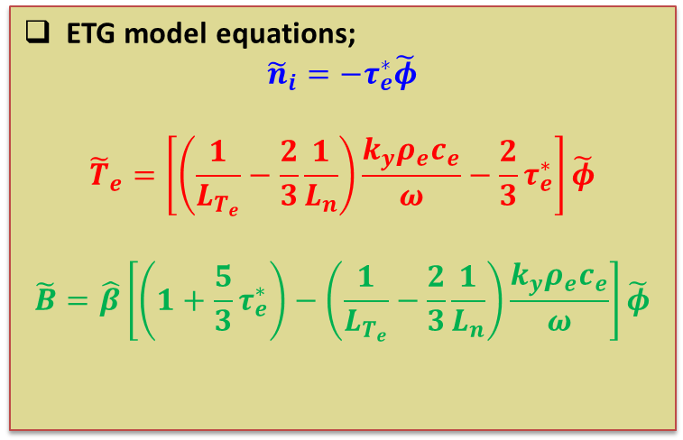

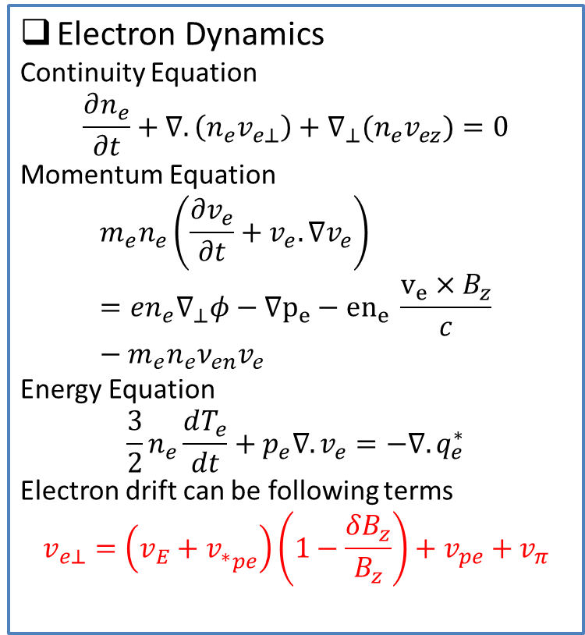
Theoretical Understanding of slab ETG
Electron Dynamics
Continuity Equation
$$\frac{∂n_{e}}{∂t}+∇.\left(n_{e}v_{e⊥}\right)+∇_{⊥}(n_{e}v_{ez})=0$$
Momentum Equation
$$m_{e}n_{e}\left(\frac{∂v_{e}}{∂t}+v_{e}. ∇v_{e}\right)=en_{e}∇_{⊥}φ−∇p_{e}−{en}_{e} \frac{v_{e}×B_{z}}{c}−m_{e}n_{e}ν_{en}v_{e}$$
Energy Equation
$$\frac{3}{2}n_{e}\frac{dT_{e}}{dt}+p_{e}∇.v_{e}=−∇.q_{e}^{∗}$$
Electron drift can be following terms
$$v_{e⊥}=\left(v_{E}+{v_{∗}}_{pe}\right)\left(1−\frac{δB_{z}}{B_{z}}\right)+v_{pe}+v_{π}$$
Ion dynamics
Continuity Equation
$$\frac{∂n_{i}}{∂t}+∇.\left(n_{i}v_{i⊥}\right)=0$$
Momentum Equation
$$m_{i}n_{i}\left(\frac{∂v_{i}}{∂t}+v_{i}. ∇v_{i}\right)=−en_{i}∇_{⊥}φ−T_{i}∇_{⊥}n_{i}$$
ETG model equations;
$${\tilde{n}}_{i}=−τ_{e}^{∗}\tilde{φ}$$
$${\tilde{T}}_{e}=\left[\left(\frac{1}{L_{T_{e}}}−\frac{2}{3}\frac{1}{L_{n}}\right)\frac{k_{y}ρ_{e}c_{e}}{ω}−\frac{2}{3}τ_{e}^{∗}\right]\tilde{φ}$$
$$\tilde{B}=\hat{β}\left[\left(1+\frac{5}{3}τ_{e}^{∗}\right)−\left(\frac{1}{L_{T_{e}}}−\frac{2}{3}\frac{1}{L_{n}}\right)\frac{k_{y}ρ_{e}c_{e}}{ω}\right]\tilde{φ}$$
Ampere’s Law
$$∇×B=\frac{4π}{c}j≈\frac{4πen_{e}}{c} v_{e}$$

Slide 27
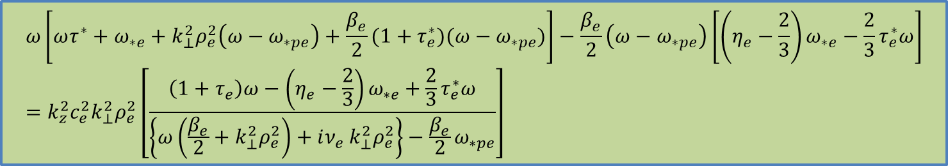
Theoretical Understanding of slab ETG
Numerical Solution of W-ETG dispersion relation and comparison with experimental data
$$ω\left[ωτ^{∗}+ω_{∗e}+k_{⊥}^{2}ρ_{e}^{2}\left(ω−ω_{∗pe}\right)+\frac{β_{e}}{2}(1+τ_{e}^{∗})(ω−ω_{∗pe})\right]−\frac{β_{e}}{2}\left(ω−ω_{∗pe}\right)\left[\left(η_{e}−\frac{2}{3}\right)ω_{∗e}−\frac{2}{3}τ_{e}^{∗}ω\right]=k_{z}^{2}c_{e}^{2}k_{⊥}^{2}ρ_{e}^{2}\left[\frac{\left(1+τ_{e}\right)ω−\left(η_{e}−\frac{2}{3}\right)ω_{∗e}+\frac{2}{3}τ_{e}^{∗}ω}{\left\{ω\left(\frac{β_{e}}{2}+k_{⊥}^{2}ρ_{e}^{2}\right)+iν_{e} k_{⊥}^{2}ρ_{e}^{2}\right\}−\frac{β_{e}}{2}ω_{∗pe}}\right]$$

Slide 28
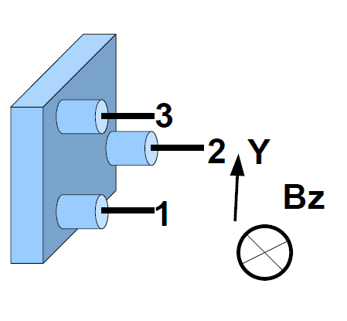
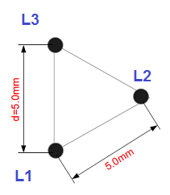
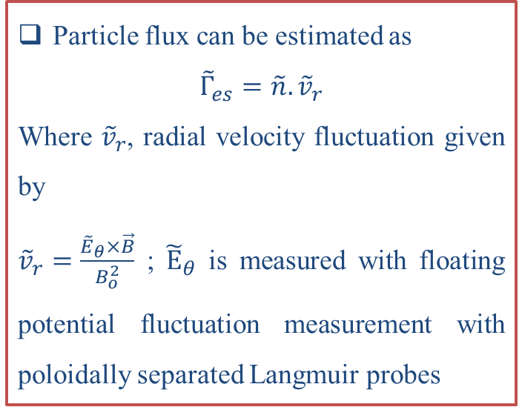
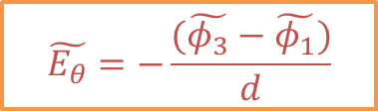
  Study of electrostatic particle flux
Flux Probe Assembly and Fluctuation Measurement
The 3- pin LP assembly is used for measuring turbulent particle flux
Particle flux can be estimated as
$${\tilde{Γ}}_{es}=\tilde{n}.{\tilde{v}}_{r}$$
Where ${\tilde{v}}_{r}$, radial velocity fluctuation given by
${\tilde{v}}_{r}=\frac{{\tilde{E}}_{θ}×\vec{B}}{B_{o}^{2}}$ ; ${\tilde{E}}_{θ}$ is measured with floating potential fluctuation measurement with poloidally separated Langmuir probes
$$\tilde{E_{θ}}=−\frac{(\tilde{φ_{3}}−\tilde{φ_{1}})}{d}$$
Schematic of Langmuir Probe for flux measurement

Slide 29

  Study of electrostatic particle lux
Particle flux, $Γ_{es}$ measurement
Particle flux for (a) EEF OFF and (b) EEF ON case is shown. The flux is enhanced in EEF ON case and is prominently negative. In EEF OFF plasma insignificantly low level of flux is observed.

Slide 30
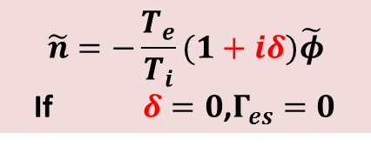
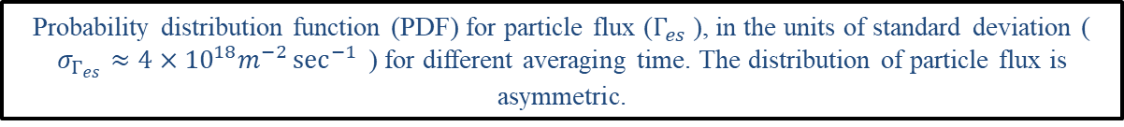
  Study of electrostatic particle flux
Probability Distribution Function (PDF)
$$\tilde{n}=−\frac{T_{e}}{T_{i}}(1+iδ)\tilde{φ}$$
If $δ=0$,$Γ_{es}=0$
Probability distribution function (PDF) for particle flux ($Γ_{es}$ ), in the units of standard deviation ( $σ_{Γ_{es}}≈4×{10}^{18}m^{−2}\sec^{−1}{ }$) for different averaging time. The distribution of particle flux is asymmetric.

Slide 31
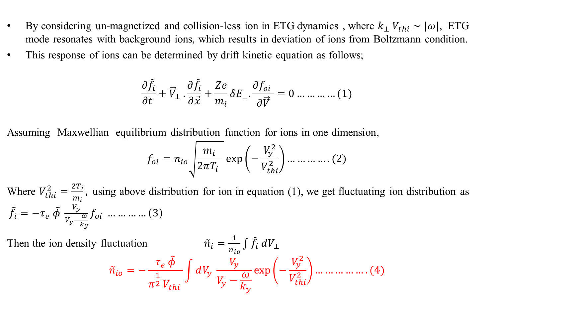
  Study of electrostatic particle flux
Recalculation of ion response on ETG mode
By considering un-magnetized and collision-less ion in ETG dynamics , where $k_{⊥} V_{thi}∼|ω|$, ETG mode resonates with background ions, which results in deviation of ions from Boltzmann condition.
This response of ions can be determined by drift kinetic equation as follows;
$$\frac{∂{\tilde{f}}_{i}}{∂t }+{\vec{V}}_{⊥} .\frac{∂{\tilde{f}}_{i}}{∂\vec{x}}+\frac{Ze}{m_{i}}δE_{⊥}.\frac{∂f_{oi} }{∂\vec{V}}=0…………(1)$$
Assuming Maxwellian equilibrium distribution function for ions in one dimension,
$$f_{oi}=n_{io}\sqrt{\frac{m_{i}}{2πT_{i} } }\exp\left(−\frac{V_{y}^{2}}{V_{thi}^{2}}\right)………….(2)$$
Where $V_{thi}^{2}=\frac{2T_{i}}{m_{i}},$using above distribution for ion in equation (1), we get fluctuating ion distribution as ${\tilde{f}}_{i}=−τ_{e} \tilde{φ} \frac{V_{y}}{V_{y}−\frac{ω}{k_{y}}}f_{oi} …………\left(3\right)$
Then the ion density fluctuation ${\tilde{n}}_{i}=\frac{1}{n_{io}}\int{{\tilde{f}}_{i} dV_{⊥} }$
$${\tilde{n}}_{io}=−\frac{τ_{e} \tilde{φ}}{π^{\frac{1}{2}} V_{thi} }\int{dV_{y} \frac{V_{y}}{V_{y}−\frac{ω}{k_{y}}}\exp\left(−\frac{V_{y}^{2}}{V_{thi}^{2}}\right)…………….(4)}$$

Slide 32
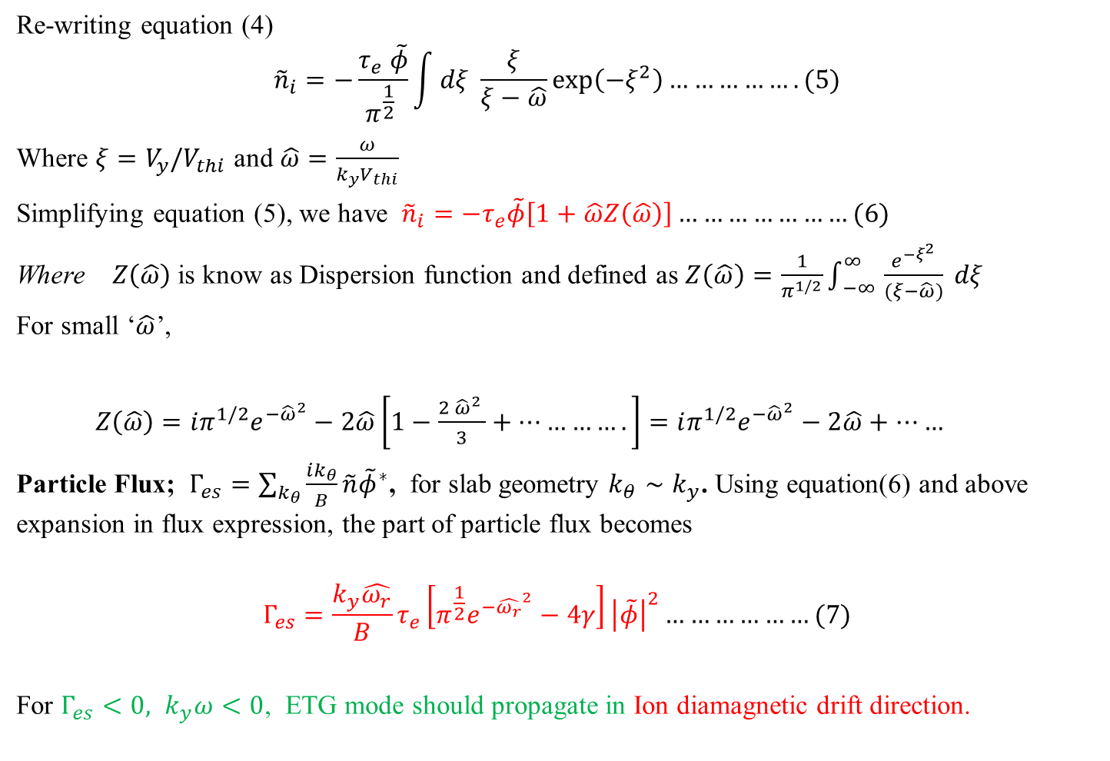
  Study of electrostatic particle flux
Re-writing equation (4)
$${\tilde{n}}_{i}=−\frac{τ_{e} \tilde{φ}}{π^{\frac{1}{2}} }\int{dξ \frac{ξ}{ξ−\hat{ω}}\exp\left(−ξ^{2}\right)…………….(5)}$$
Where $ξ=V_{y}/V_{thi}$ and $\hat{ω}=\frac{ω}{k_{y}V_{thi}}$
Simplifying equation (5), we have ${\tilde{n}}_{i}=−τ_{e}\tilde{φ}\left[1+\hat{ω}Z\left(\hat{ω}\right)\right]…………………(6)$
Where $Z\left(\hat{ω}\right)$is know as Dispersion function and defined as $Z\left(\hat{ω}\right)=\frac{1}{π^{1/2}}\int_{ −∞ }^{∞}{\frac{e^{{−ξ}^{2}}}{(ξ−\hat{ω})}} dξ$
For small ‘$\hat{ω}$’,
$Z\left(\hat{ω}\right)=iπ^{1/2}e^{−{\hat{ω}}^{2}}−2\hat{ω}\left[1−\frac{2 {\hat{ω}}^{2} }{3}+………….\right]=$ $iπ^{1/2}e^{−{\hat{ω}}^{2}}−2\hat{ω}+……$
Particle Flux; $Γ_{es}=\sum_{k_{θ}}{\frac{ik_{θ}}{B}}\tilde{n}{\tilde{φ}}^{∗}$, for slab geometry $k_{θ}∼k_{y}$. Using equation(6) and above expansion in flux expression, the part of particle flux becomes
$$Γ_{es}=\frac{k_{y}\hat{ω_{r}}}{B}τ_{e}\left[π^{\frac{1}{2}}e^{−{\hat{ω_{r}}}^{2}}−4γ\right]{\left|\tilde{φ}\right|}^{2}………………(7)$$
For $Γ_{es}<0, k_{y}ω<0$, ETG mode should propagate in Ion diamagnetic drift direction.

Slide 33
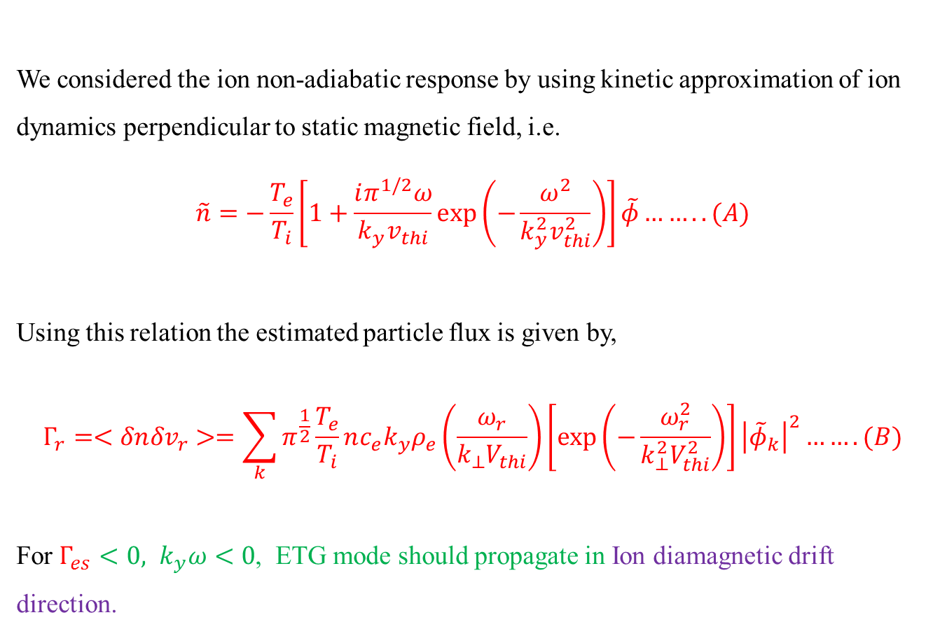
  Study of electrostatic particle flux
We considered the ion non-adiabatic response by using kinetic approximation of ion dynamics perpendicular to static magnetic field, i.e.
$$\tilde{n}=−\frac{T_{e}}{T_{i}}\left[1+\frac{iπ^{1/2}ω}{k_{y}v_{thi}}\exp\left(−\frac{ω^{2}}{k_{y}^{2}v_{thi}^{2}}\right)\right]\tilde{φ}……..(A)$$
Using this relation the estimated particle flux is given by,
$$Γ_{r}=<δn{δv}_{r}>=\sum_{k}{π^{\frac{1}{2}}\frac{T_{e}}{T_{i}}nc_{e}k_{y}ρ_{e}\left(\frac{ω_{r}}{k_{⊥}V_{thi}}\right)\left[\exp\left(−\frac{ω_{r}^{2}}{k_{⊥}^{2}V_{thi}^{2}}\right)\right]{\left|{\tilde{φ}}_{k}\right|}^{2}…….(B)}$$
For $Γ_{es}<0, k_{y}ω<0$, ETG mode should propagate in Ion diamagnetic drift direction.

Slide 34
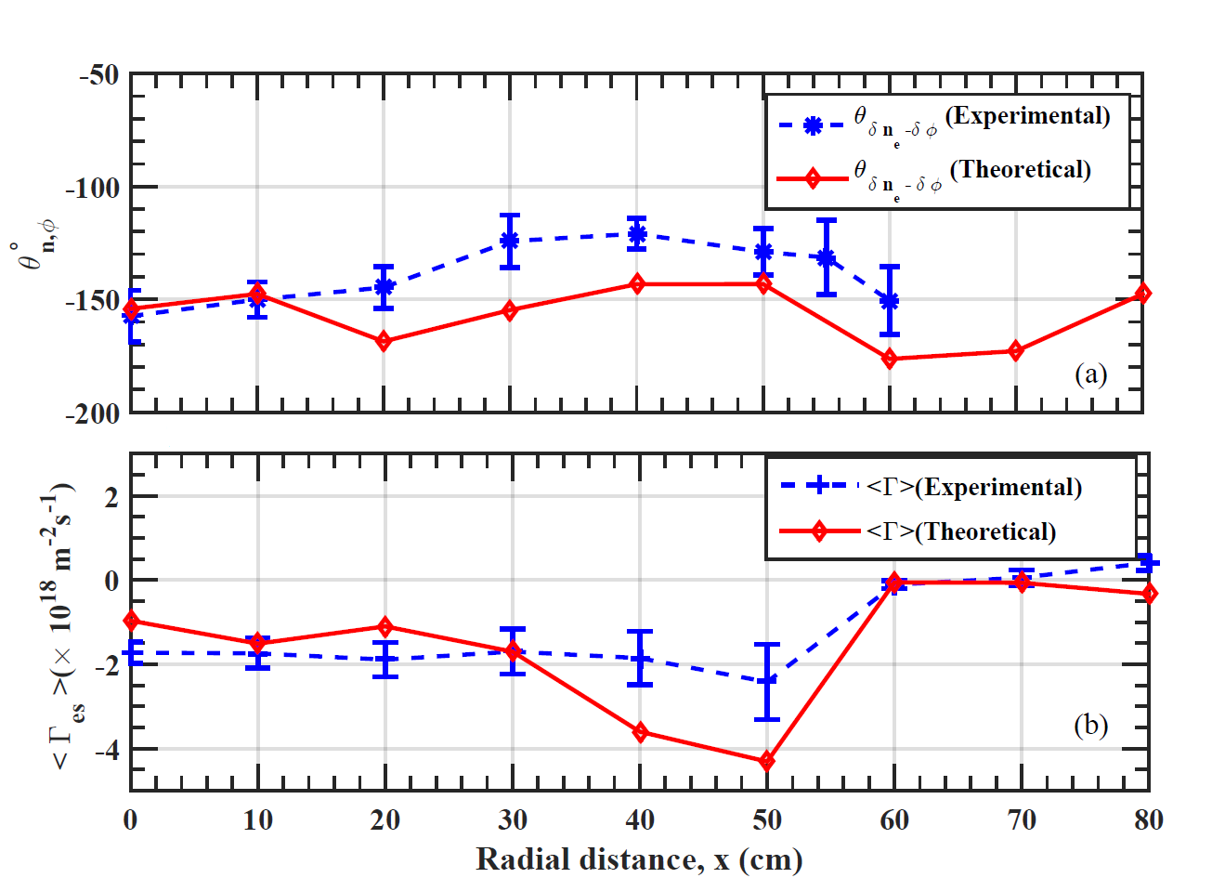
  Study of electrostatic particle flux

Slide 35
  Study of electromagnetic particle flux

Slide 36
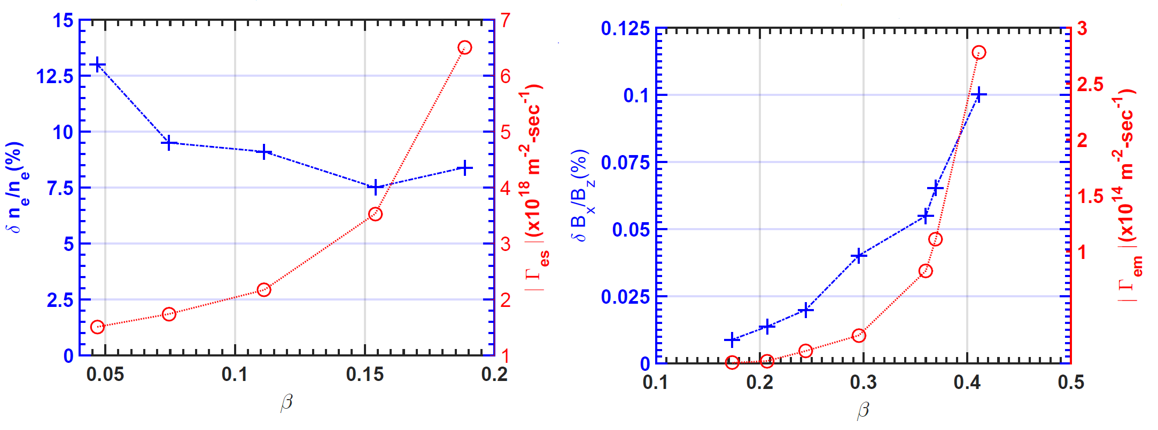
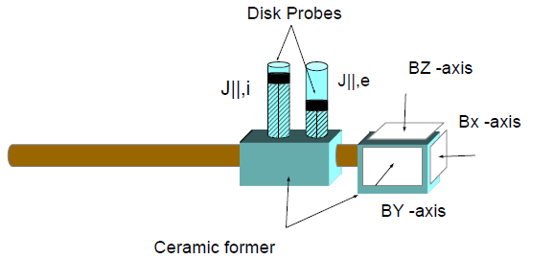
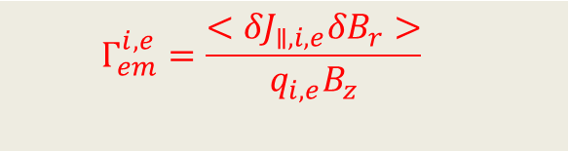

  Study of electromagnetic particle flux
Plasma beta, $β$ effect on electrostatic and electromagnetic flux
 | $$Γ_{es}=<δn_{e}δv_{r}>$$
 | $$Γ_{em}^{i,e}=\frac{<{δJ}_{∥,i,e}δB_{r}>}{q_{i,e}B_{z}}$$

Slide 37
  Study of electromagnetic particle flux
Temporal and Spectral Characteristics of Fluctuations

Slide 38
  Study of electromagnetic particle flux
A comparison of particle flux due to electrostatic and electromagnetic fluctuations
The obtained ratio of EM to Electrostatic flux is , $\left|\frac{Γ_{em}}{Γ_{es}}\right|≈{10}^{−5}$ ??

Slide 39
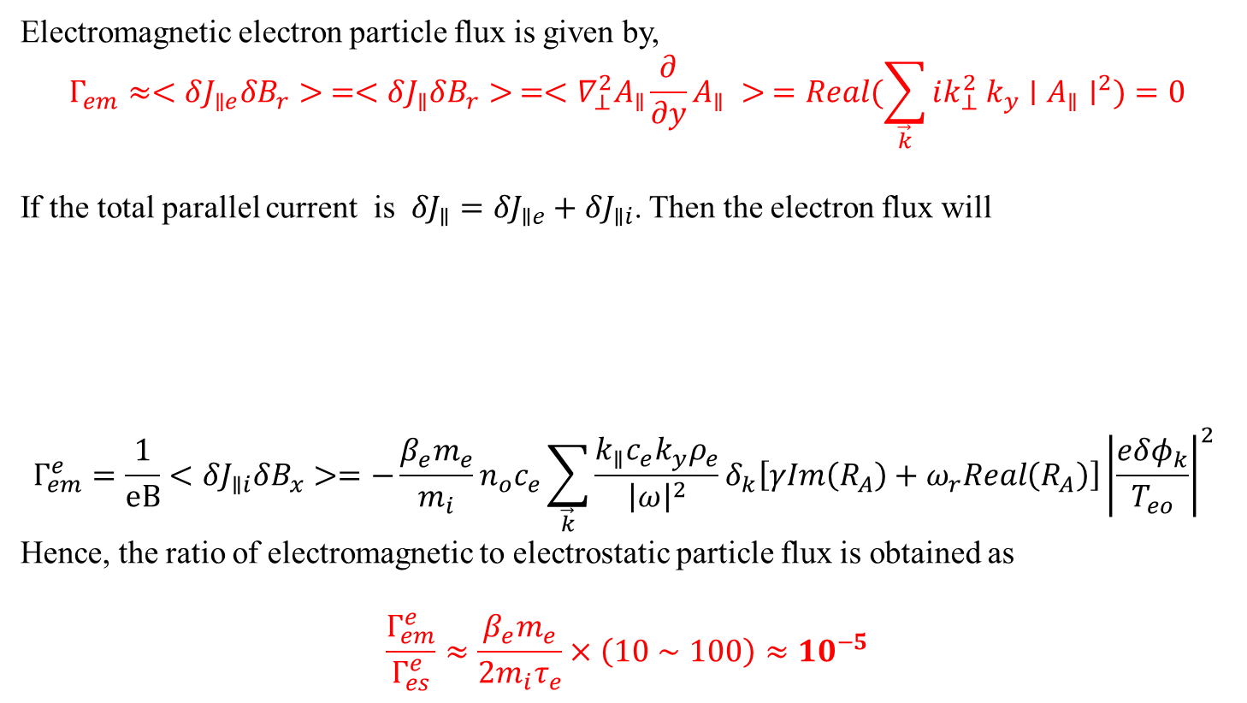
  Study of electromagnetic particle flux
Understanding of electromagnetic particle flux
Electromagnetic electron particle flux is given by,
$$Γ_{em}≈<δJ_{∥e}δB_{r}> =<δJ_{∥}δB_{r}> =<∇_{⊥}^{2}A_{∥}\frac{∂}{∂y}A_{∥} > =Real(\sum_{\vec{k}}{ik_{⊥}^{2} k_{y}∣A_{∥}∣^{2})=0}$$
If the total parallel current is ${δJ}_{∥}={δJ}_{∥e}+δJ_{∥i}$. Then the electron flux will
$$Γ_{em}^{e}=\frac{1}{eB}<δJ_{∥i}δB_{x}>=−\frac{β_{e}m_{e}}{m_{i}}n_{o}c_{e}\sum_{\vec{k}}{\frac{k_{∥}c_{e}k_{y}ρ_{e}}{{\left|ω\right|}^{2}}δ_{k}\left[γIm\left(R_{A}\right)+ω_{r}Real\left(R_{A}\right)\right]{\left|\frac{eδφ_{k}}{T_{eo}}\right|}^{2} }$$
Hence, the ratio of electromagnetic to electrostatic particle flux is obtained as
$$\frac{Γ_{em}^{e}}{Γ_{es}^{e}}≈\frac{β_{e}m_{e}}{2m_{i}τ_{e}}×\left(10∼100\right)≈10^{−5}$$
 | $Γ_{em}^{e}=\frac{1}{eB}<δJ_{∥i}δB_{x}>−\frac{1}{eB}\frac{c}{4π}\frac{∂}{∂x}<δB_{x}δB_{y}>$- $\frac{1}{eB}\frac{c}{4π}<δB_{y}\frac{∂}{∂z}δB_{z}>$
(Srivastav et al., Plasma Phys. Control. Fusion 61, 055010 (2019))

Slide 40

  Study of electromagnetic particle flux
 | $$Γ_{em}^{i}=−\frac{β_{e}m_{e}}{m_{i}}n_{o}c_{e}\sum_{\vec{k}}{\frac{k_{∥}c_{e}k_{y}ρ_{e}}{{\left|ω\right|}^{2}}δ_{k}\left[γIm\left(R_{A}\right)+ω_{r}Real\left(R_{A}\right)\right]{\left|\frac{eδφ_{k}}{T_{eo}}\right|}^{2} }$$
$Γ_{em}^{e}=\frac{1}{eB}<δJ_{∥i}δB_{x}>−\frac{1}{eB}\frac{c}{4π}\frac{∂}{∂x}<δB_{x}δB_{y}>$- $\frac{1}{eB}\frac{c}{4π}<δB_{y}\frac{∂}{∂z}δB_{z}>$

Slide 41

  Study of heat flux
Study of total flux due to fluctuations in the background of ETG turbulence leads to the study of turbulent particle flux and heat flux simultaneously.
Since particle flux is already characterised for ETG turbulence, hence we will be measuring the heat flux.
Energy/heat flux is basically defined as
$$Q_{e}=\frac{3}{2}<{\tilde{v}}_{r}\left(n_{o}\tilde{T_{e}}+\tilde{n}T_{e}\right)=\frac{3}{2}n_{o}<{\tilde{T}}_{e}{\tilde{v}}_{r}>+\frac{3}{2}T_{e}<\tilde{n}\tilde{v_{r}}>$$
Investigation Activity for Study of heat flux can be subdivided in following category:
  Diagnostic Development for accurate measurement of real time temperature fluctuations and Heat flux
  Validation for $T_{e}$and $δT_{e}$
  Investigation of Heat flux in ETG background
  Theoretical Estimation and its Comparison with experimental observations
Conductive Heat flux (q)
Convective Heat flux (q)

Slide 42









  Study of heat flux
$δE_{θ}=−\frac{(δφ_{f6}−δφ_{f4})}{d_{64}}$
$δT_{e}=\frac{V_{+}−V_{f}}{log⁡(2)}$ where
$V_{f}=\frac{V_{f1}+V_{f4}}{2}$
Particle flux
$Γ =<δn_{e}δv_{r}>$
Conductive flux
$q=\frac{3}{2}n_{e}<δT_{e}δV_{r}>$
where
$δV_{r}=\frac{δE_{θ}×\vec{B_{z}}}{{ B}_{z}^{2}}$
$$d_{64}$$
$$V_{f6}$$
$$I_{sat}$$
$$V_{f4}$$
$$V_{+}$$
$$V_{−}$$
$$V_{f1}$$
Schematic of Probe assembly for simultaneous measurement of particle flux, $Γ_{es}$ and heat flux, $q$

Slide 43

  Study of heat flux
Selection of Bias voltage for $T_{e}$ measurement with TLP
For proper selection of fixed bias voltage $V_{d3}$ we perform the $T_{e}$ measurement for different $V_{d3}$ and compared it with Single and Double probes measurement
It is fond that the $T_{e}$ measured with TLP is very close SLP and DLP measurement for 6.0V to 15.0 V i.e. $5V_{d2}<V_{d3}>10V_{d2}$ where $V_{d2}≈T_{e}/1.44$T

Slide 44


  Study of heat flux
Comparison of mean $T_{e}$ and fluctuations with other diagnostics
Radial Comparison of Mean $T_{e}$ with SLP and TLP diagnostic
Temperature fluctuation comparison of TLP and Two probe diagnostic

Slide 45

  Study of heat flux
Fluctuation Measurement
Typical Fluctuations time profile for steady state at R=0 cm
Radial profile of fluctuation observed

Slide 46


  Study of heat flux
Fluctuation Characterization
Correlation Temperature and density fluctuations with potential fluctuations
Power spectra, phase angle and coherency plot of Temperature fluctuations and potential fluctuations

Slide 47

  Study of heat flux
Phase angle comparison with ETG turbulence
Further justification for temperature fluctuation is done with phase angle measurement with respect to potential fluctuations
Basic Equations for W-ETG is as follows;
$$\tilde{n}=−τ^{∗}\tilde{φ}$$
$${\tilde{T}}_{e}=\left[\left(\frac{1}{L_{T_{e}}}−\frac{2}{3}\frac{1}{L_{n}}\right) \frac{k_{y}ρ_{e}c_{e}}{ω}−\frac{2}{3}τ^{∗}\right]\tilde{φ}$$
Where
$τ^{∗}=\frac{T_{e}}{T_{i}} [1+i\sqrt{π}\frac{ω}{k_{⊥}v_{thi}}\exp\left(−\frac{ω^{2}}{k_{⊥}^{2}v_{thi}^{2}}\right)]$
By considering ion non-adiabatic response.
Phase Angle comparison between temperature fluctuation and potential fluctuations

Slide 48

  Study of heat flux
Conductive heat flux and its comparison
$q=\frac{3}{2}n_{o}<δT_{e}δV_{r}>=−\frac{3}{2}\sum_{k}{\frac{k_{y}}{B}n_{o}\left|{\tilde{T}}_{e,k}\right|\left|{\tilde{φ}}_{k}\right|sinθ_{T_{e}φ}}$ where $θ_{T_{e}φ}=θ_{T_{e}}−θ_{φ}$
$q_{e}=\frac{3}{2}n_{o}c_{e}T_{eo}\sum_{k}{\left(η_{e}−\frac{2}{3}\right)\frac{c_{e}γ_{k}{\left(k_{y}ρ_{e}\right)}^{2}}{L_{n}{\left|ω\right|}^{2}}}{\left|\frac{eδφ_{k}}{T_{eo}}\right|}^{2}+T_{eo}Γ_{e}$

Slide 49
  Study of heat flux
(a) Radial variation of total heat fluxes and (b) Comparison of convective heat fluxes.
Electron thermal conductivity due to temperature fluctuations present in the system.
Observation shows that thermal conductivity exhibits a quadratic dependency for the normalized fluctuations for levels between 5% and 20%.

Slide 50

  Summary & Conclusion
  Inward particle transport due to electrostatic fluctuations is observed (Srivastav et al., Physics of Plasmas 24, 112115 (2017))
    Net particle flux results from the phase difference between the density and potential fluctuations, other than 180 degrees for ETG driven modes.
    The experimental cross phase angle and flux have been compared with the cross phase and flux resulting due to the non-adiabatic ion response due to the resonant interaction of the ions with the ETG mode $k_{⊥}V_{thi}∼ω$.
    The experiment and theoretical results quantitatively follow the same trend across the radius and match within 20% with each other.

Slide 51
  Summary & Conclusion
  Particle transport due to electromagnetic fluctuations is experimentally estimated observed and theoretical model is proposed
  (Srivastav et al., Plasma Phys. Control. Fusion 61, 055010 (2019))
  Theory for particle flux due to electromagnetic fluctuation is developed and we found the ratio of electromagnetic flux to electrostatic flux is in agreement with our experimental findings in ETG background .
  Experimentally obtained ion flux values agrees well with numerically obtained values using theoretical model of electromagnetic flux.
  Non-ambipolar EM flux is observed at R=40 cm which may be one cause of change in potential profile at R=40cm that leads us to create a shear flow in poloidal direction.

Slide 52

  Summary & Conclusion
  Heat transport due to electrostatic fluctuations is measured and compared with theoretical model
  (Srivastav et al., Physics of Plasmas 26, 052303 (2019))
  Mean temperature measurements using TLP are validated with SLP and temperature fluctuation is validated by two probe technique before applying for real time temperature fluctuations.
  Radial measurement of phase angle is supported by theoretical model of ETG turbulence for $R≤50 cm$.
  Radial measurement of heat flux is obtained by simultaneous measurement of fluctuations in $T_{e}$ and $φ_{f}$ which is in good agreement with theoretical estimations.

Slide 53



  Summary & conclusion
(Srivastav et al., Physics of Plasmas 24, 112115 (2017))
$$Γ_{es}$$
900 mm
  (Srivastav et al., Physics of Plasmas 26, 052303 (2019))
$$Q_{total}$$
1300 mm
$$Γ_{em}^{e}−Γ_{em}^{i}=−\frac{∂}{∂x}<δB_{x}δB_{y}>$$
(Srivastav et al., Plasma Phys. Control. Fusion 61, 055010 (2019))

Slide 54



Acknowledgement
Collaborators
Late Prof. P.K. Kaw
Dr. Lalit Mohan Awasthi
Scientific Officer – G, Head of LVPD
Dr. Amulya Kumar Sanyasi
Scientific Officer - D
Mr. Pankaj Kumar Srivastava
Scientific Officer - D
Dr. Ritesh Sugandhi
Scientific Officer - F
Prof. Raghvendra Singh
Senior Professor (Retired)
Senior Researcher, NFRI, Republic of Korea
Dr. Rameshwar Singh
Postdoctoral Researcher — University of California San Diego

Slide 55

Thank you for your kind attention

Slide 56
Backup slide
Diffusion of electrons across magnetic field of EEF
Cold Electrons :
Hot Electrons
56

Slide 57
Since majority of the experimental studies shows that the floating potential fluctuation measurement with conventional Langmuir probe can be approximated with plasma potential fluctuation measurement as
$$φ_{pl}=φ_{fl}+μ\frac{T_{e}}{e}$$
For fluctuation
${\tilde{φ}}_{pl}={\tilde{φ}}_{fl}+μ\frac{{\tilde{T}}_{e}}{e}$
In absence of temperature fluctuations
${\tilde{φ}}_{pl}={\tilde{φ}}_{fl}$
So, poloidal electric field fluctuation can be calculated with floating potential fluctuations.
Hence, in presence of temperature fluctuation, above relation can't be considered as accurate
Continue…….

Slide 58


New Probe assembly for $Γ_{es}$ measurement, for $φ_{f}$ and $φ_{p}$fluctuation measurement
Emissive Probe assembly to measure particle flux with plasma potential fluctuation along with ion-saturation fluctuation with conventional Langmuir probe[ Diameter =0.2 mm, Length=10mm]
E1
L4
E2
L1
Triple Probe assembly to measure particle flux with floating potential fluctuation measurement[ Diameter =0.5mm, Length=10mm]
L3
L2

Slide 59


Validation of Plasma Potential measurement: Varying Heating current
The floating potential measurement with $≥$2.0 Amp heating current shows no significant change.
Implies heated filament works as emissive probe as it floats now at plasma potential.
At I_{emissive}$≈$2.1 Amp, we measured plasma potential fluctuation for particle flux estimation.
Simultaneous measurement of floating potential with two emissive probe with different heating current

Slide 60


Comparison Plot for Electrostatic particle flux estimated with floating potential fluctuation ($δφ_{f}$) and plasma potential fluctuation ($δφ_{p}$)
No significant deviation is observed in particle flux measurement with $φ_{p}$and $φ_{f}$ fluctuation measurement .
This is only possible when Temperature fluctuations are completely cancels out in poloidal electric field fluctuation calculations .
Particle flux measured with floating potential fluctuation and plasma potential fluctuation for comparison.

