Slide 1

IEA Spherical Torus TCP Annual Briefing
Jack Berkery, Chair of the ST TCP Executive Committee
IEA FPCC Annual Meeting, Greifswald, Germany, January 24-25, 2024 (presented remotely)

Slide 2
ST TCP work conducted under three annexes
Annex I – “Co-operation on ST Science R & D”:
  Joint publications
  Exchange of equipment and personnel
  Information exchange at workshops and conferences
  Organization of the International Spherical Tokamak Workshop
  Outreach, communication and dissemination to the wider community etc…
Annex II – “Co-operation on the Physics and Technology of Future Spherical Torus Devices”
Annex III – “Co-operation on the Steady State Operation of Fusion Devices”

Slide 3
ST TCP Executive Committee 2024
Chair: Jack Berkery (PPPL)
China: Gao Zhe (Tsinghua U.), Tan Yi (Tsinghua U.)
EU: Manuel Garcia Munoz (U. Sevilla), Darius Ancius (European Commission)
Japan: Zensho Yoshida (NIFS), Akira Ejiri (U. Tokyo), Yasushi Todo (NIFS)
S. Korea: Yong Seok Hwang (SNU)
UK*: James Harrison (UKAEA) (*membership in process, almost complete)
US: Stephanie Diem (U. Wisconsin), Rajesh Maingi (PPPL), Jon Menard (PPPL), Josh King (U.S. DOE)

Slide 4
Growing number of STs worldwide, both public and private
China: EXL-50(U), NCST, SUNIST-2
EU: Proto-Sphera, SMART, NORTH
Japan: LATE, QUEST, TST-2, TS-6, TS-4U, UTST
S. Korea: VEST
UK: MAST-U, ST40, STEP
US: LTX-β, NSTX-U, PEGASUS-III
Others (may be incomplete and status unknown):
Brazil: ETE
Costa Rica: MEDUSA-CR
Kazakhstan: KTM
Pakistan: GLAST-III, PST
Russia: Globus-M2

Slide 5
ST TCP very active in 2023
TCP was renewed in 2022 for 5 years
Outline
International ST Workshop will return in-person for the first time in 5 years
Highlights from experiments (by country/region)
Backup: Detailed contributions from worldwide facilities

Slide 6
ST Workshop will return in person, bring together the worldwide community
Year | Location
1994 | Oak Ridge, TN
1995 | Princeton, NJ
1996 | Culham, UK
1997 | St. Petersburg, Russia
1998 | Tokyo, Japan
1999 | Seattle, WA
2001 | Sao Jose dos Campos, Brazil
2002 | Princeton, NJ
2003 | Culham, UK
2004 | Kyoto, Japan
2005 | St. Petersburg, Russia
2006 | Chengdu, China
2007 | Fukuoka, Japan
2008 | Frascati, Italy
2009 | Madison, WI
2011 | Toki, Japan
2013 | York, UK
2015 | Princeton, NJ
2017 | Seoul, Korea
2019 | Frascati, Italy
2022 | (Virtual) (hosted by Tsinghua U.)
2024 | Oxford/Culham, UK
ST Workshop (virtual) held Nov. 2022
ISTW 2024 will be in person!
Details to come…
Met every year
Every two years
Five years since an in-person meeting!

Slide 7
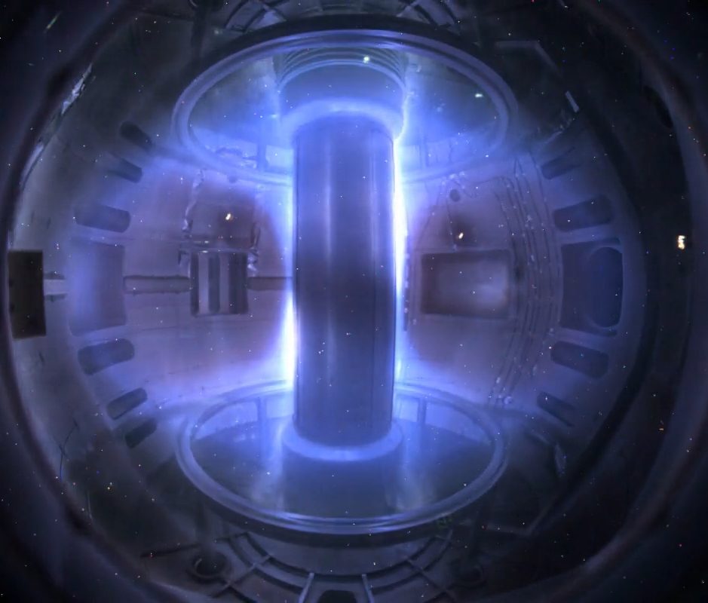
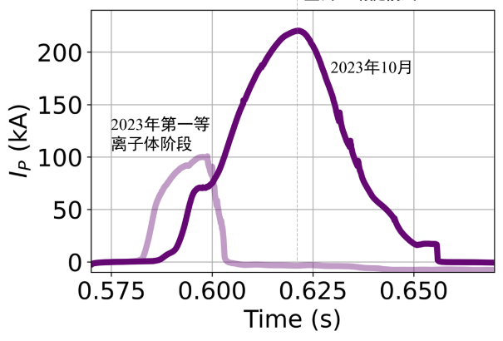
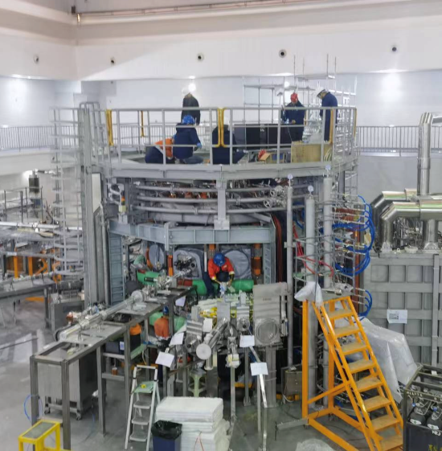
China: rapid progress in upgrades and new facilities
SUNIST-2
SUNIST-2
  First plasma achieved in May 2023, up to 220 kA, 0.72 T by October, C limiter in December, and merging-compression start-up obtained
NCST
  After a power supply upgrade, NCST reached 20kA,100ms in 2022; 2023 mainly focused on diagnostics development
EXL-50U
  ENN Energy Holdings Ltd has closed EXL-50 and built EXL-50U with a centerstack coil and stronger B_{T}, will operate in 2024 with aim of studying the physics basis for p-B fusion
EXL-50U

Slide 8
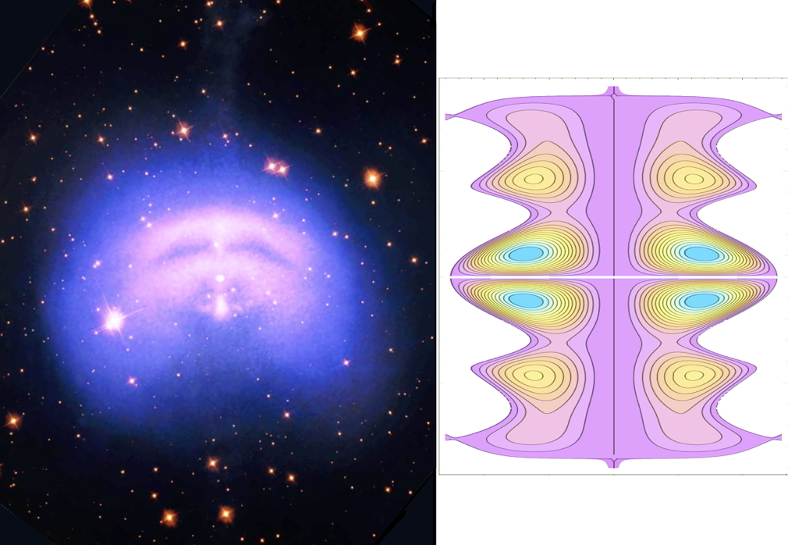
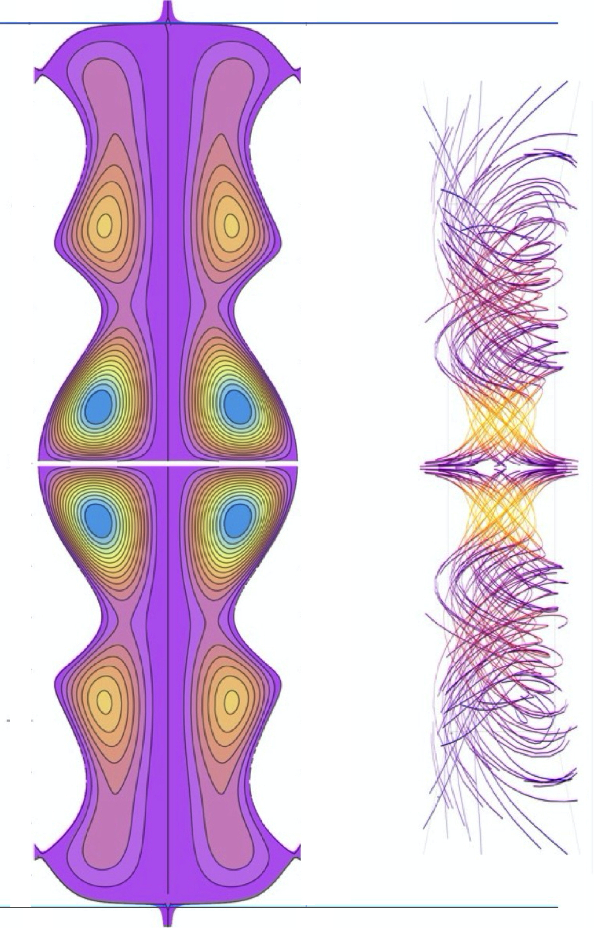
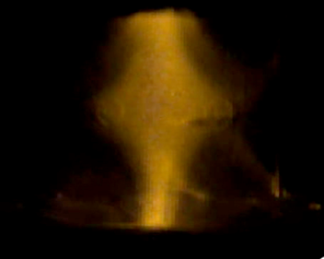
The European Union: specialized facilities investigating unique ST aspects
Spain
  SMART: Construction complete, glow discharges achieved. A set of diagnostics is being developed to characterize the initial plasmas:
    Magnetic reconstruction, Fast line integrated electron density, Impurity and electron temperature and density profiles, Radiated power, Impurity monitoring
Italy
  PROTO-SPHERA: progress on 3D tomography. Jet + tori serves as model for Pulsar Wind Nebulae
    experimental campaign in spring 2024 before transfer to new exp. hall
Denmark: NORTH tabletop device
Gas puff charge exchange diagnostic
SMART
Negative δ
Positive δ
PROTO-
SPHERA
(one torus around jet)
Pulsar Wind Nebula (2)

Slide 9
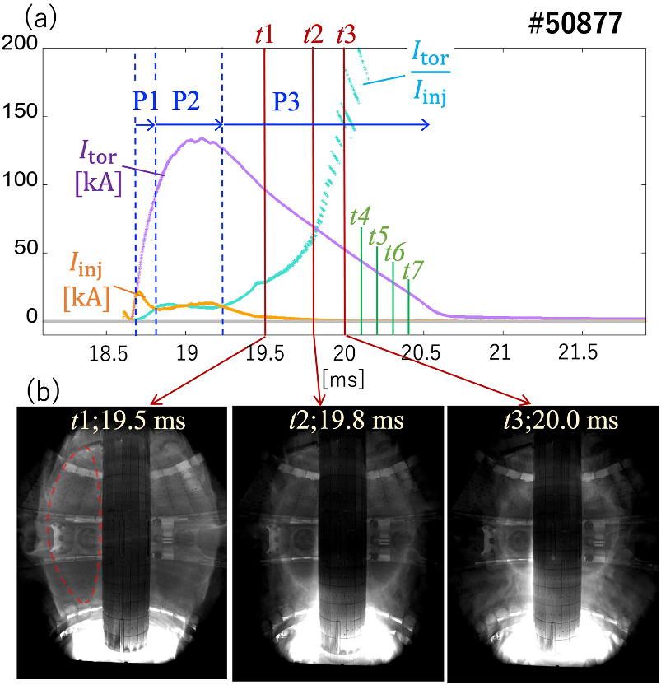
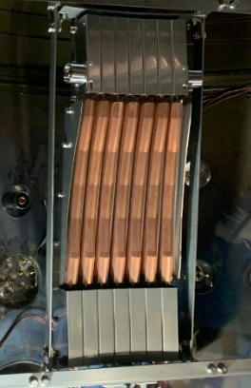
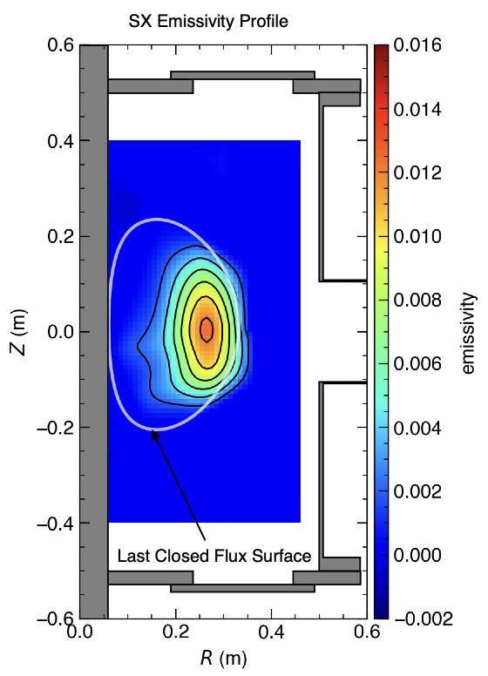
Japan: multiple university STs investigating various physics topics
QUEST CHI plasma formation
Kyushu University
  QUEST: remodeled coaxial helicity injection achieved 135 kA startup, closed flux surfaces Big data system implemented
University of Tokyo
  TST-2: new lower hybrid wave current drive antenna
  TS-6, TS-4U, UTST: reconnection heating physics being explored, including collaboration with ST40
Kyoto University
  LATE: non-inductive overdense plasmas created with electron Bernstein wave heating, diagnosed with heavy ion beam probe and soft X-ray
TST-2 LHW antenna
LATE SXR

Slide 10
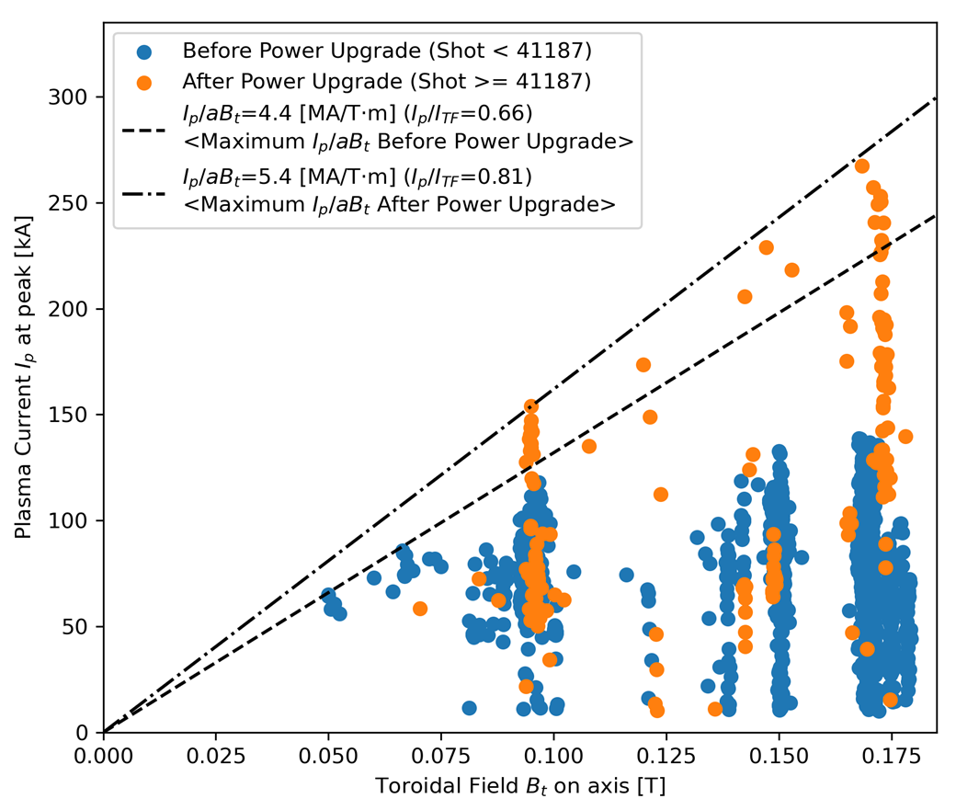
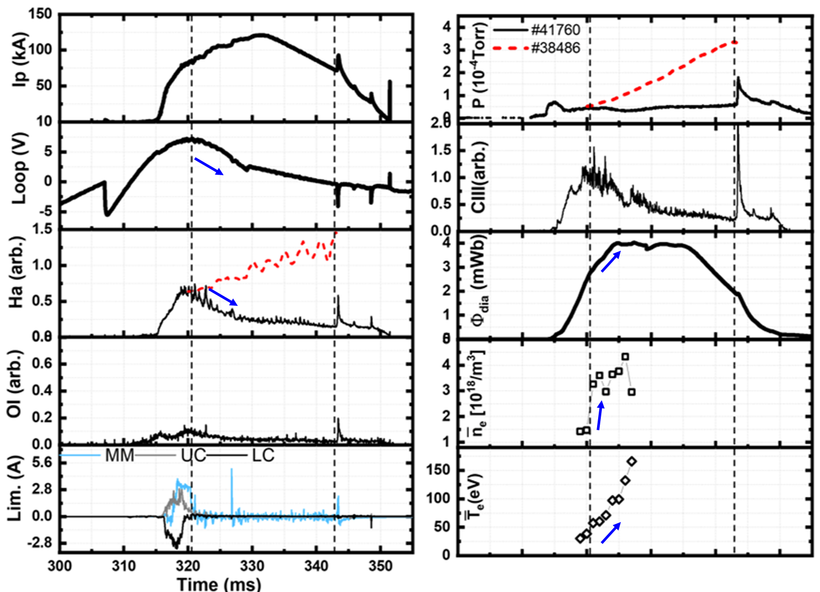
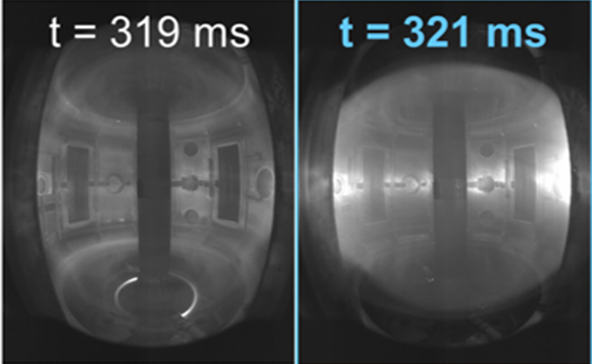
Korea: VEST improvements producing more capable plasmas
VEST
  Ohmic power upgrade and intensive Boronization led to higher plasma current, improved confinement
Before
After

Slide 11
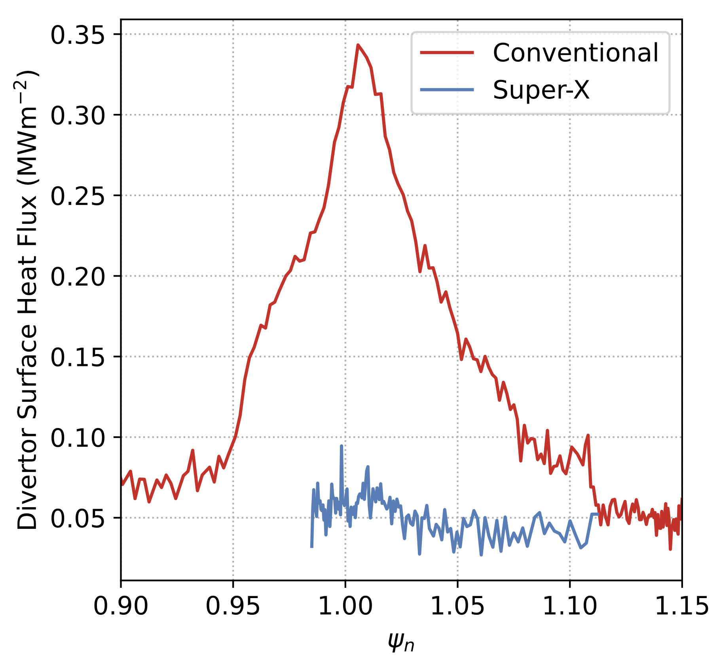
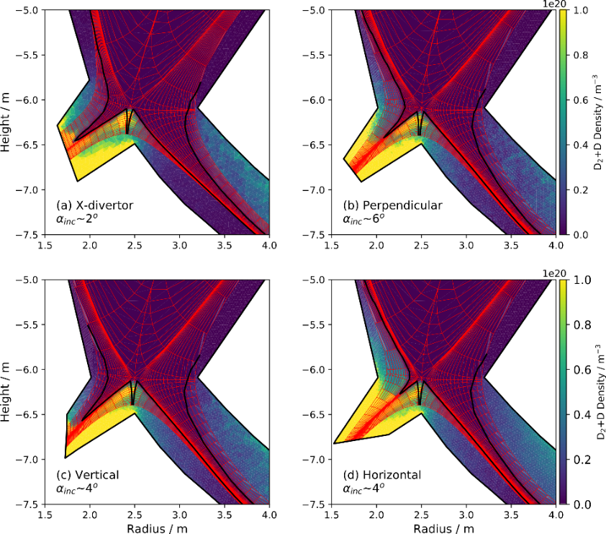
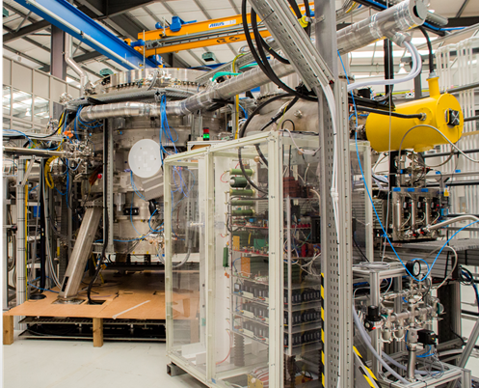
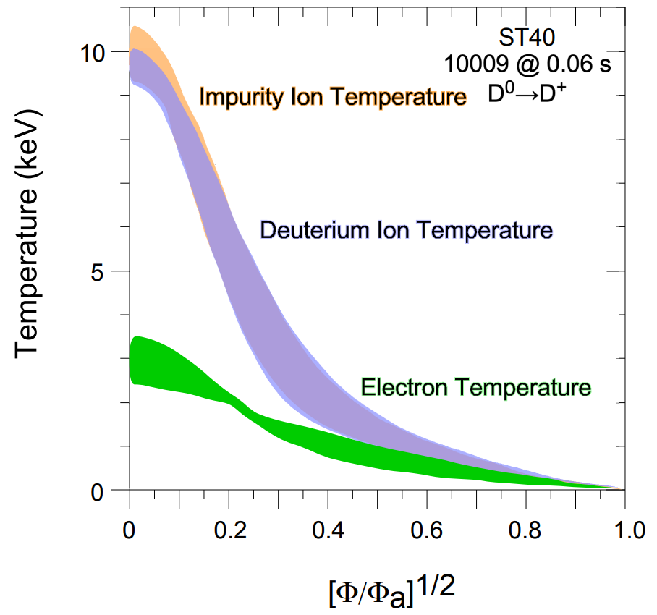
The United Kingdom: a focal point of ST research with MAST-U, ST40, and the STEP program; will host the ISTW 2024
MAST-U Outer Divertor Heat Flux
UKAEA
  MAST-U: In H-modes with ~3MW NBI, outer divertors are attached in conventional configuration, detached in Super-X with no impact on core or pedestal profiles
  STEP: fully non-inductive operating points defined, divertor configurations investigated with SOLPS, converged non-linear local gyrokinetic simulations for KBM turbulence in high 𝛽_{𝑒} slow rotating plasmas
Tokamak Energy
  ST40: after ~10 keV T_{i} in 2022, installed Thomson diag., established H-mode, dev. non-inductive ops.
  Commencing design of FPP, with U.S. DOE Milestone program
ST40 record central T_{i}
STEP SOLPS neutral density simulations

Slide 12
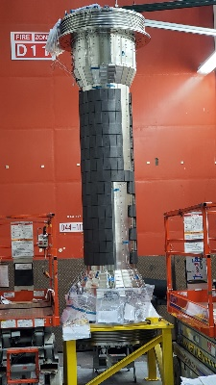
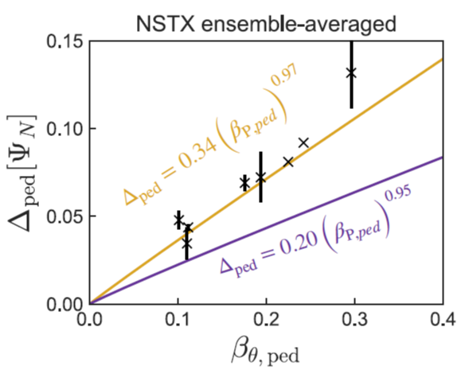
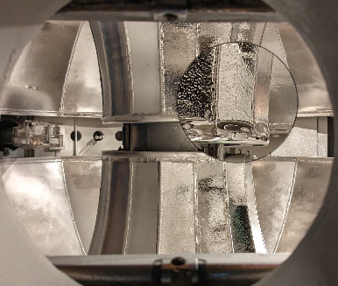
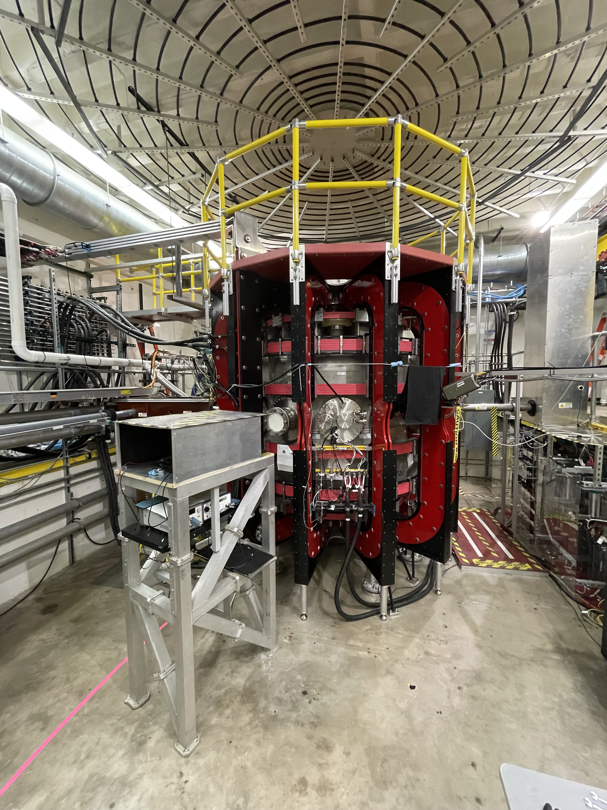
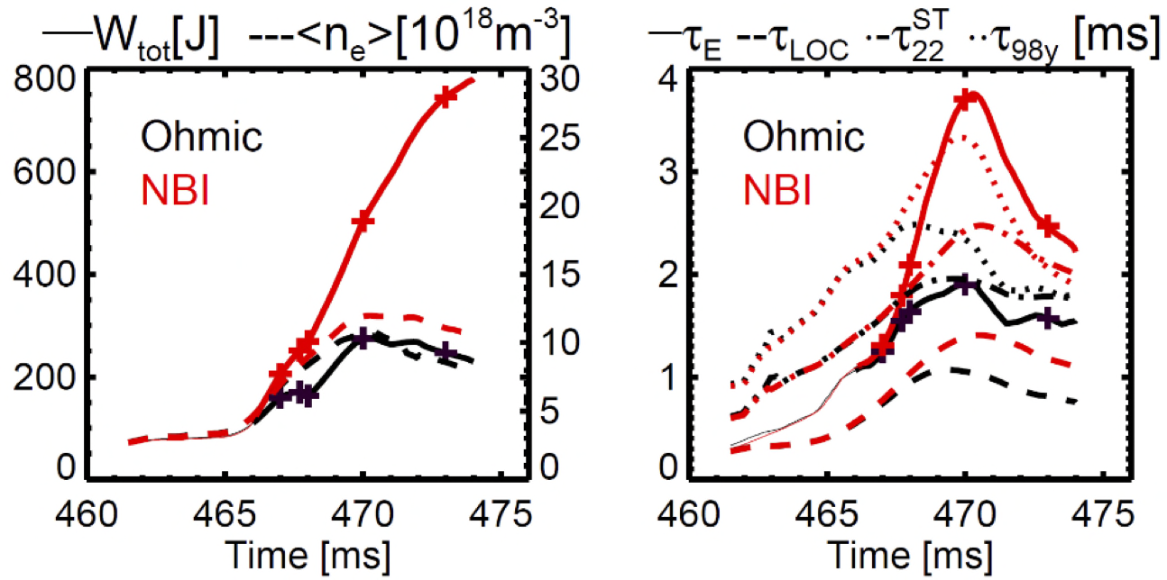
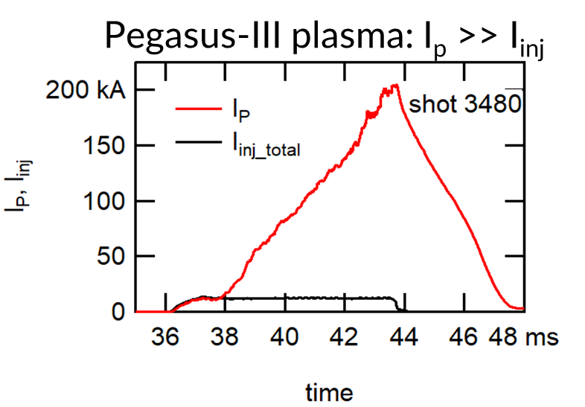
The United States: continuing upgrades of multiple facilities
PPPL
  NSTX-U: Recovery project 80% complete New bundle delivery fall 2024. Research continues, highlight: gyrokinetic model matches pedestal height and width
NSTX gyrokinetic pedestal model
LTX-β
  LTX-β: operated with full liquid lithium walls. Confinement improves, significant fueling with modest NBI
University of Wisconsin
  Pegasus-III: New facility with no solenoid completed in July
  Developing validated physics & tech basis for MA startup with helicity injection and microwave assist
Pegasus-III plasma with I_{p} >> I_{inj}

Slide 13
ST TCP 2024 Briefing: Very productive year
Looking forward to 2024, and first in-person workshop in five years

Slide 14
China
SUNIST-2

Slide 15
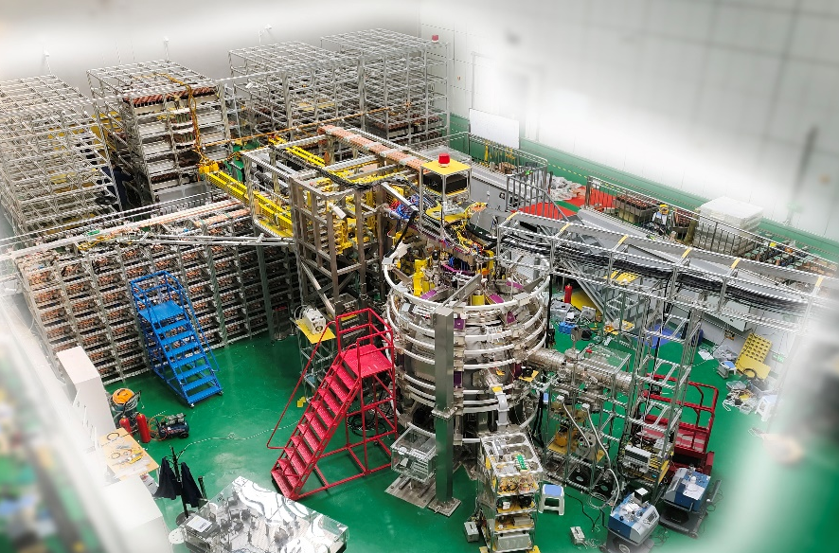
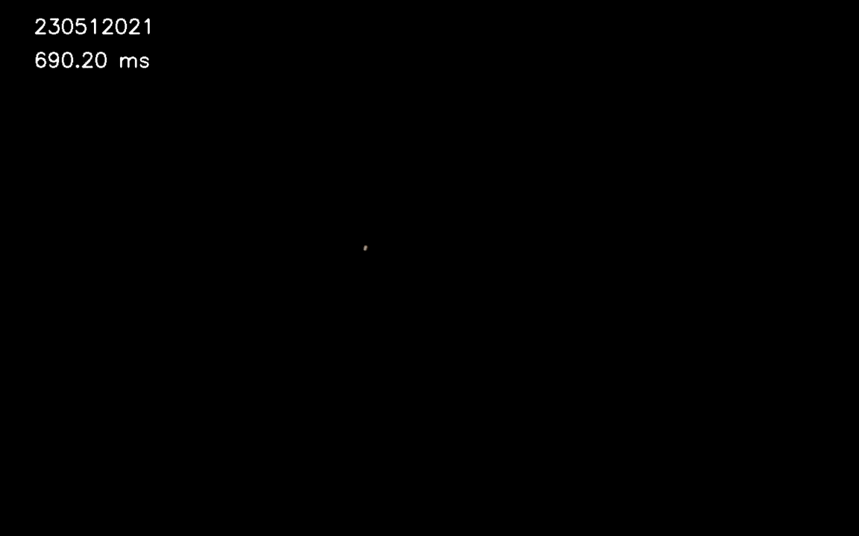

First plasma on SUNIST-2
In May 2023, first plasma obtained （~100kA）
In October, Ip ~ 220kA, Bt ~0.72T
In December, C limiter installed

Slide 16
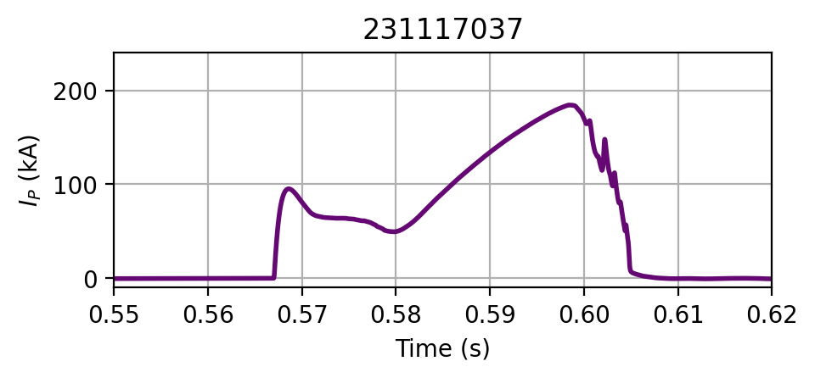
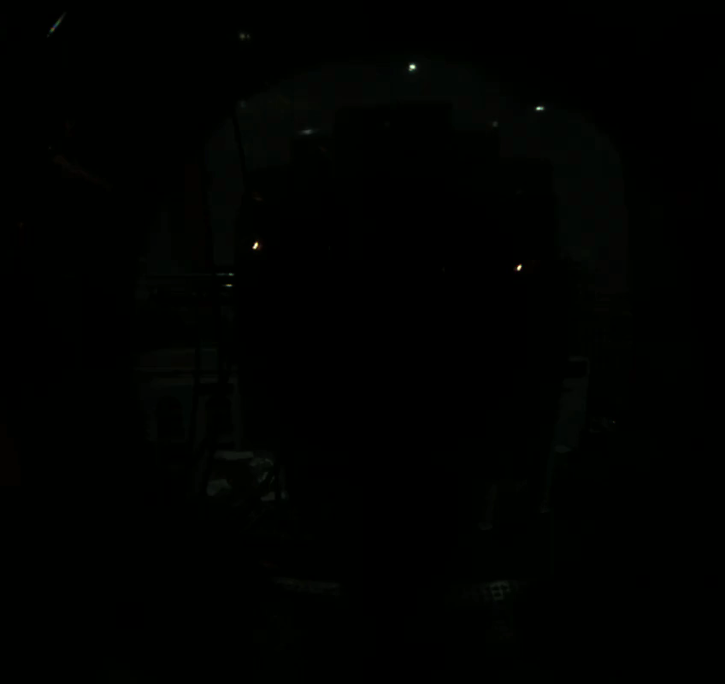
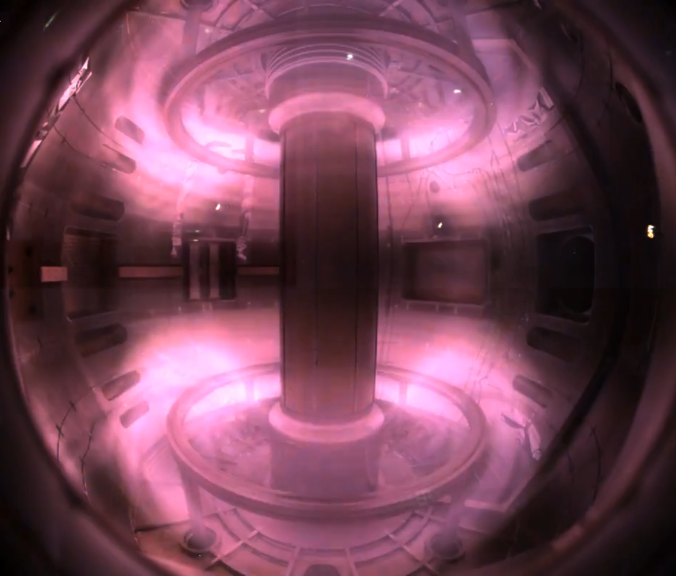
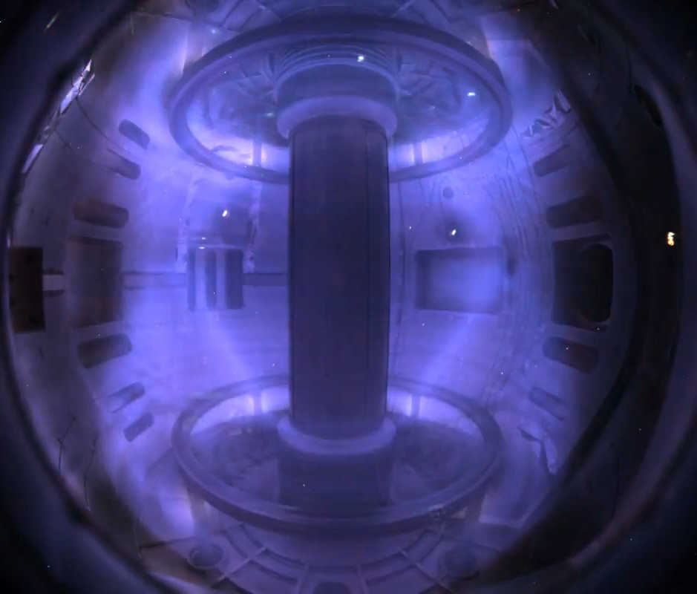
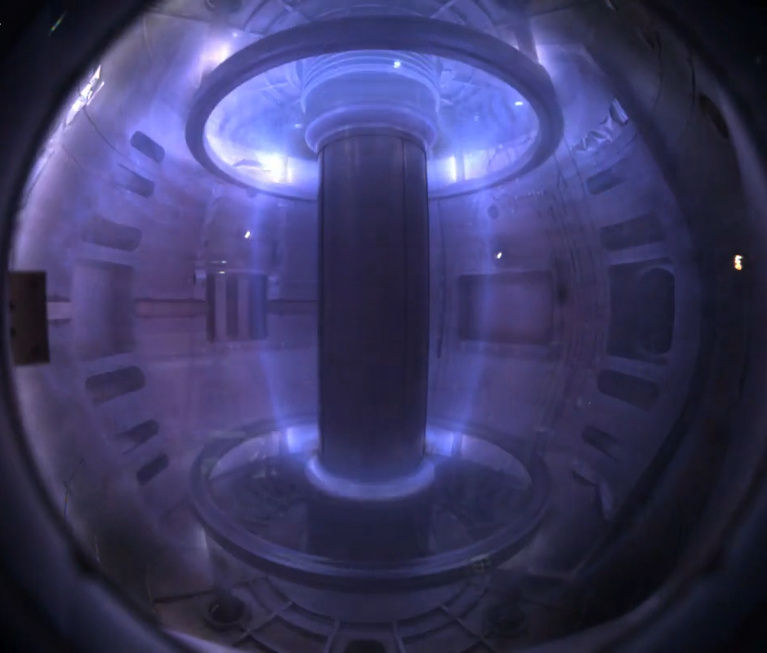
Merging-compression startup obtained
1 2 3
4

Slide 17
European Union
SMART
PROTO-SPHERA

Slide 20
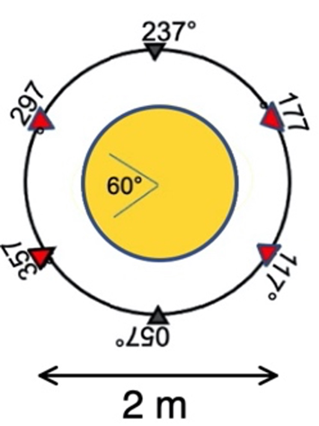
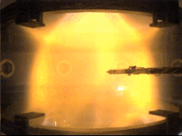
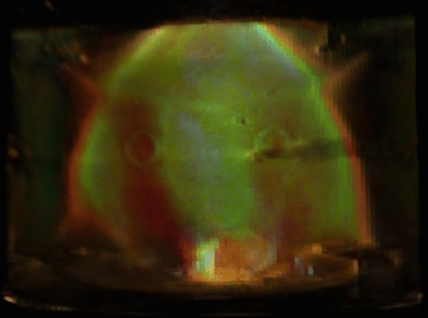
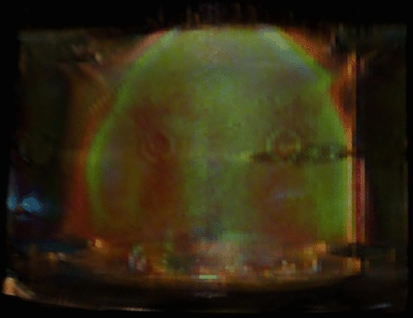
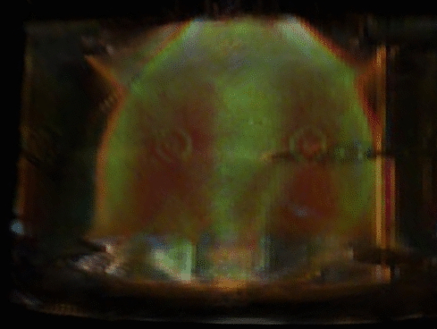
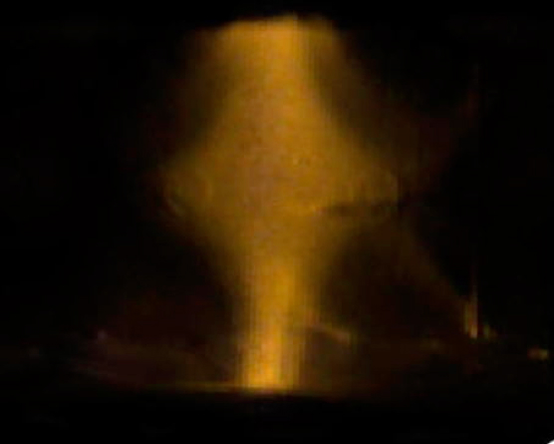
2023 - 3D tomography steals a glance inside the PROTO-SPHERA cross-sections
Helium plasma yellow-gold 3D tomographic inversion indicates that Helium plasma is green inside the torus
3cm ø copper bars
well reconstructed
From visible light of
single 600 fps camera
3 different time-slices in 1 sec discharge
poloidal cross section of Helium plasma from 6 cameras 3D tomography: temperature is higher inside the torus than at the orange-brown outer egde
2023 - PROTO-SPHERA (1 torus around jet) not a perfect emulation of Astrophysics
Model of jet + tori for Pulsar Wind Nebulae (PWN) shows that the tori are 2: 1 up & 1 down the equator,
by cross-sections of flux surfaces
not 1 as in PROTO-SPHERA
by enlarged field-line-tracing
double tori for PWN separated
by a discontinuity on the equator of
B_{radial} & a singular j_{tor} current layer
combined wavelength
Vela PWN
poloidal cross section movie from 3D tomography
elongation reduced by ~2
to correct for perspective

Slide 21
Japan
QUEST
TST-2, TS-6, TS-4U, UTST
LATE

Slide 22
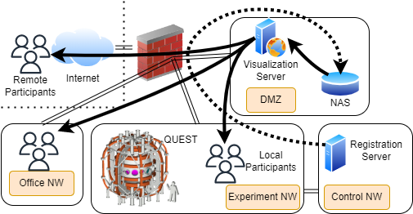
QUEST (Kyushu University)
plasma start-up and SSO
TST-2 (Univ. Tokyo)
LHW current drive
Coaxial Helicity Injection (CHI) system was largely remodeled to the developed designs of gas injector and electrode configuration for higher injector flux formation. The driven current up to 135 kA and formation of closed flux were obtained by the system.
A big data system was constructed to efficiently analyze and understand the complex physical phenomena of plasma discharge, including SSO, and to share them.
A new capacitively-coupled combline antenna (200 MHz) was fabricated and installed at the off-midplane in TST-2.
Comparison of the three antennas shows a superior coupling to core bulk electrons (T_{e0} ~8 eV -> 16 eV), and reduction in electron orbit loss shown by the thick-target X-ray (see fig.) for the new antenna.
https://doi.org/10.1088/1741-4326/ad0dd6
https://doi.org/10.1007/s10894-022-00338-4
https://doi.org/10.1585/PFR.18.1305048
Y. Ko, et al., Nucl. Fusion 63, 126015 (2023)

Slide 23
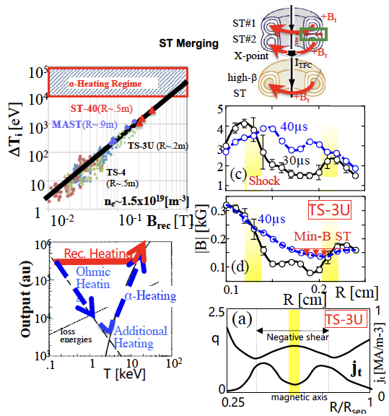
TS-6, TS-4U, UTST (Univ. Tokyo)
The ST reconnection heating experiments TS-6 and TS-4 studied the ion temperature scaling Δw_{ion}∝Β_{rec}²∝Β_{p}²
for direct access to the alpha heating region without using any additional heating like NBI / RF.
Based on collaboration between TSs and ST-40, high-field merging experiment is being made in TS-40 and documented 3keV ion temperature using merging based on the B_{rec}²-scaling.
The high-power reconnection heating experiments TS-6 successfully formed high beta STs with hollow plasma current /reversed shear profiles and ultra-high beta STs with absolute minimum-B profiles, by controlling the reconnection ion outflow speed and heating.

Slide 24
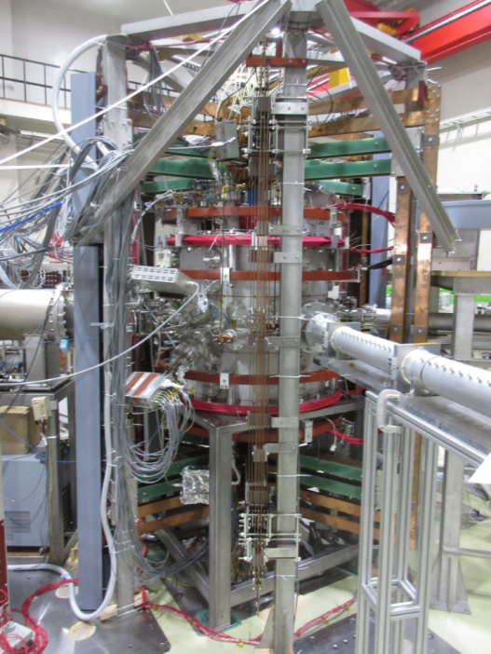
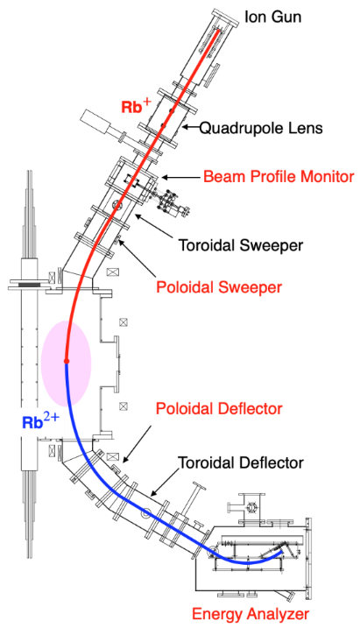
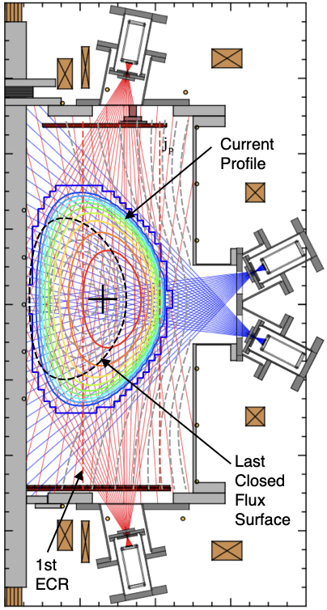
LATE (Kyoto University)
* Non-inductive formation of overdense spherical tokamak (ST) plasma by exciting electron Bernstein wave (EBW) via O-X-B mode conversion process.
* Soft X-ray CT system and heavy ion beam probe (HIBP) system were developed to investigate the plasma ejection phenomena in the overdense ST plasma.

Slide 25
Korea
VEST

Slide 26
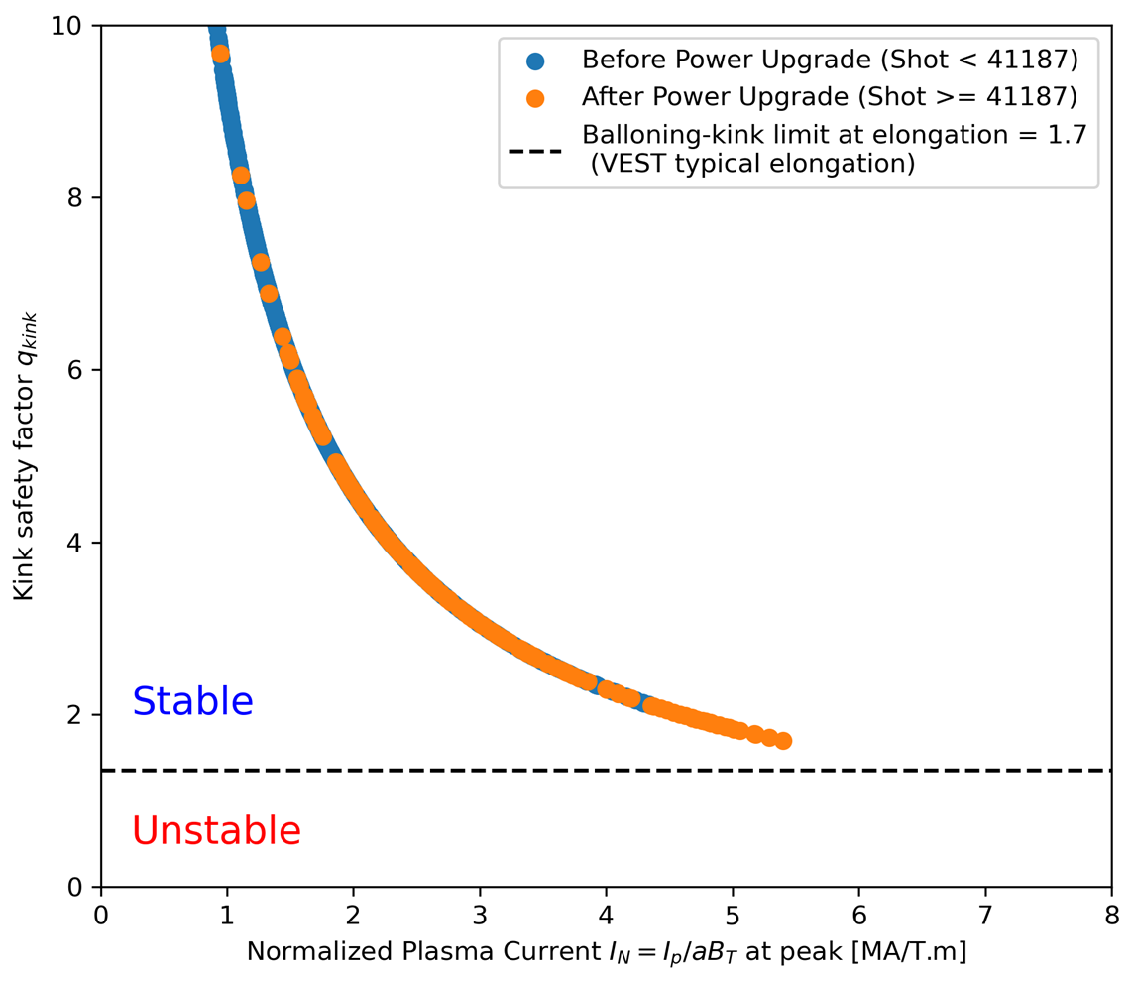




High Normalized Plasma Current with Ohmic Power Upgrade
VEST Ohmic power upgrade (50mVsec → 100mVsec)
High normalized currents of up to 5.4 (I_{p}/I_{TF}=0.8)
Comparison with Ballooning-Kink limit
$$\frac{I_{p}}{aB_{T}}=5.4$$
$$q_{kink}=\frac{2πa}{μ_{o}R_{o}}\sqrt{\frac{1+κ^{2}}{2}}/\left(\frac{I_{p}}{aB_{T}}\right)$$
$$q_{kink}≥\frac{1+κ}{2}$$
$$\frac{I_{p}}{aB_{T}}$$
MHD activities near stability boundary with low q_{a} are under investigation
Sufficient plasma currents for effective NBI heating without significant fast particle orbit loss

Slide 27
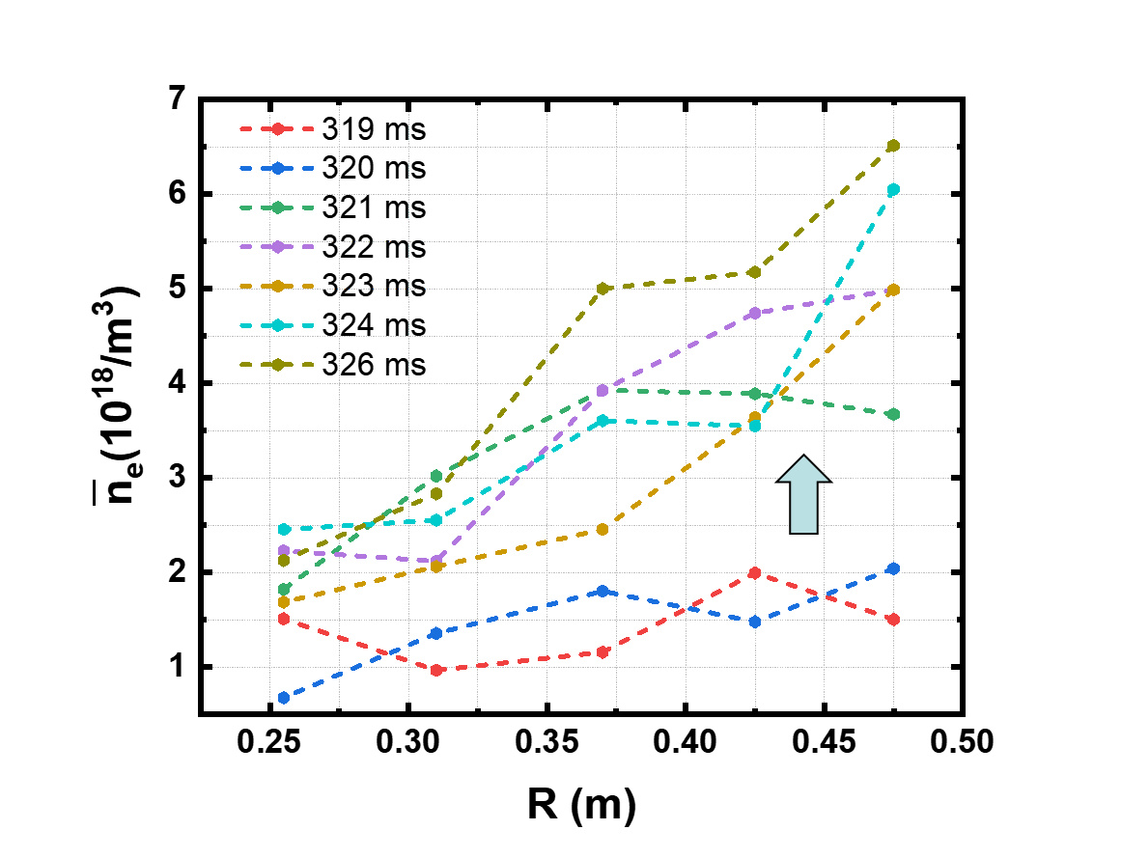
Improved Confinement with Intensive Boronization after Ohmic Power Upgrade
Reduced wall recycling with intensive Boronization (#41670)
→ Density jump and temperature increase (Improved confinement, Ohmic H-mode?)
Before
After
Normal Boronization shot (high wall recycling)

Slide 28
The United Kingdom
MAST-U
ST40
STEP

Slide 29
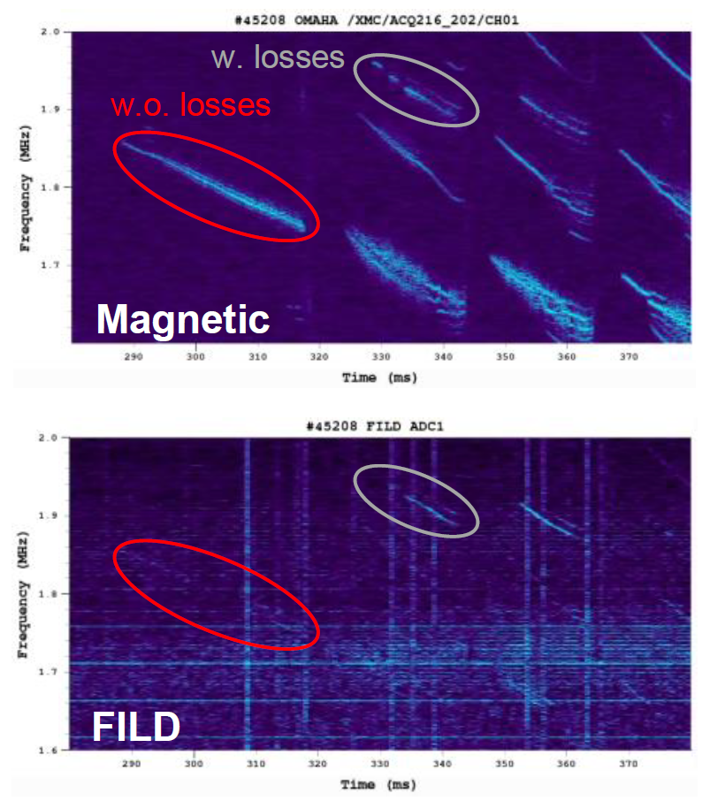
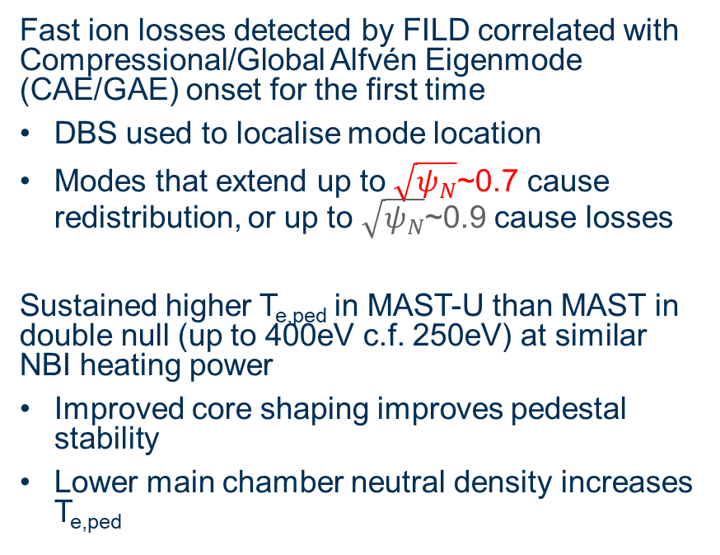
MAST-U Highlights
Fast ion losses detected by FILD correlated with Compressional/Global Alfvén Eigenmode (CAE/GAE) onset for the first time
DBS used to localise mode location
Modes that extend up to $\sqrt{ψ_{N}}$~0.7 cause redistribution, or up to $\sqrt{ψ_{N}}$~0.9 cause losses
Sustained higher T_{e,ped} in MAST-U than MAST in double null (up to 400eV c.f. 250eV) at similar NBI heating power
Improved core shaping improves pedestal stability
Lower main chamber neutral density increases T_{e,ped}
Frequency (MHz)
2.0
1.9
Frequency (MHz)
1.8
1.7

Slide 30
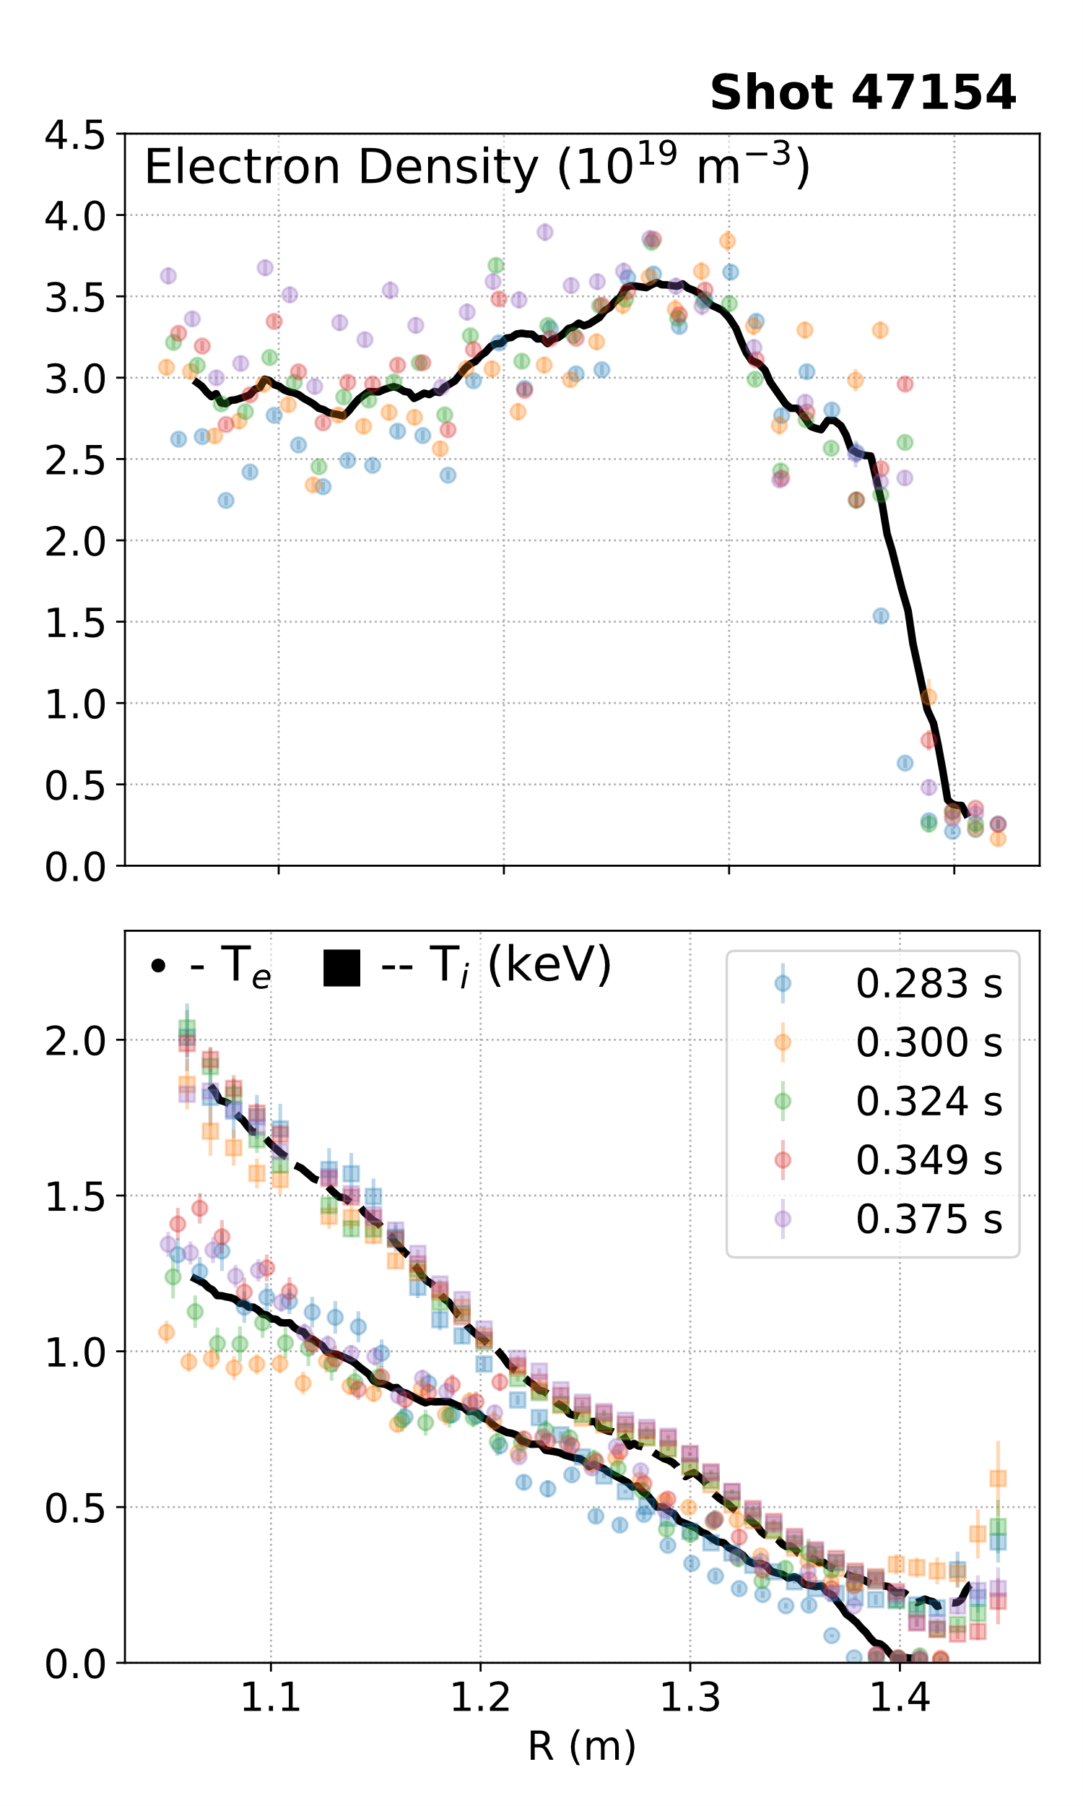
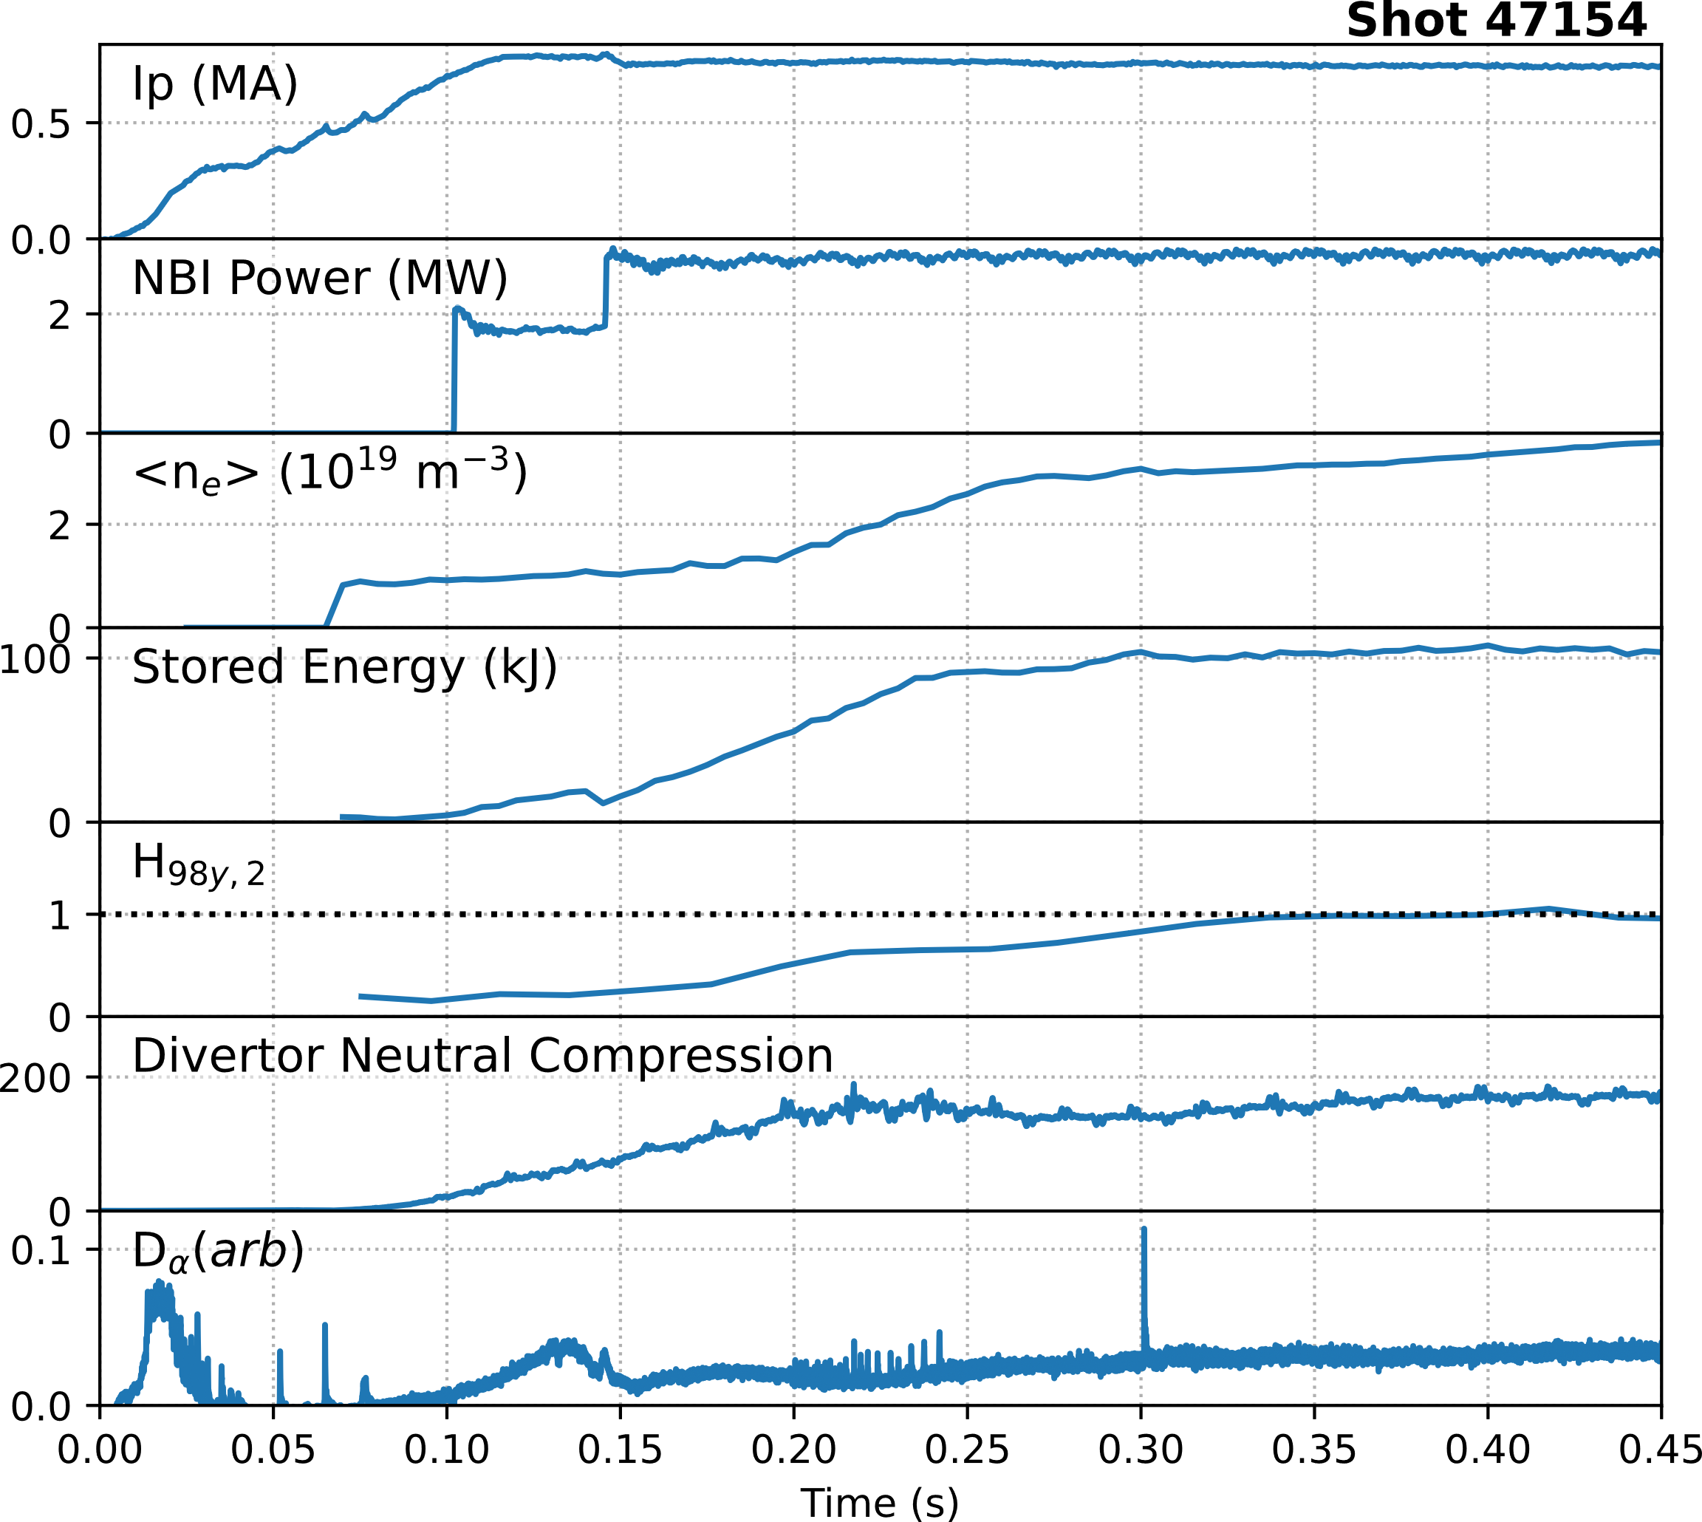
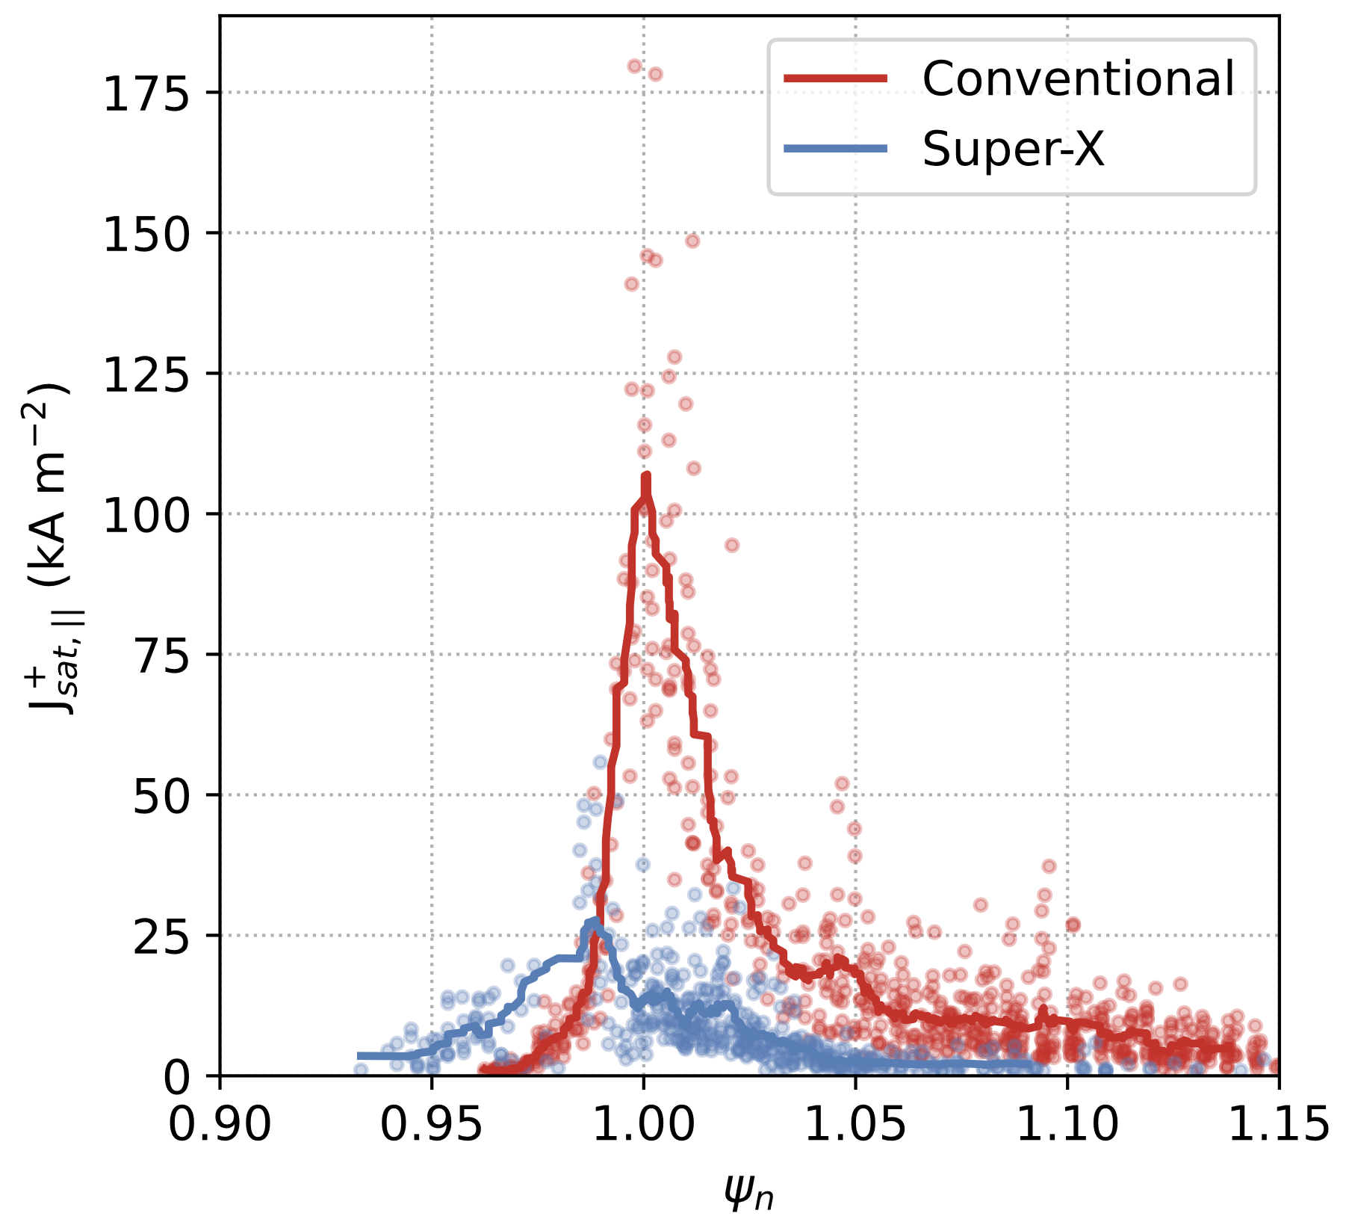
MAST-U Highlights
In H-modes with ~3MW NBI, outer divertors are attached in conventional divertor configuration, detached in Super-X with no impact on core or pedestal profiles
Outer Divertor Heat Flux
conventional
Super-X
Outer Divertor Particle Flux

Slide 31
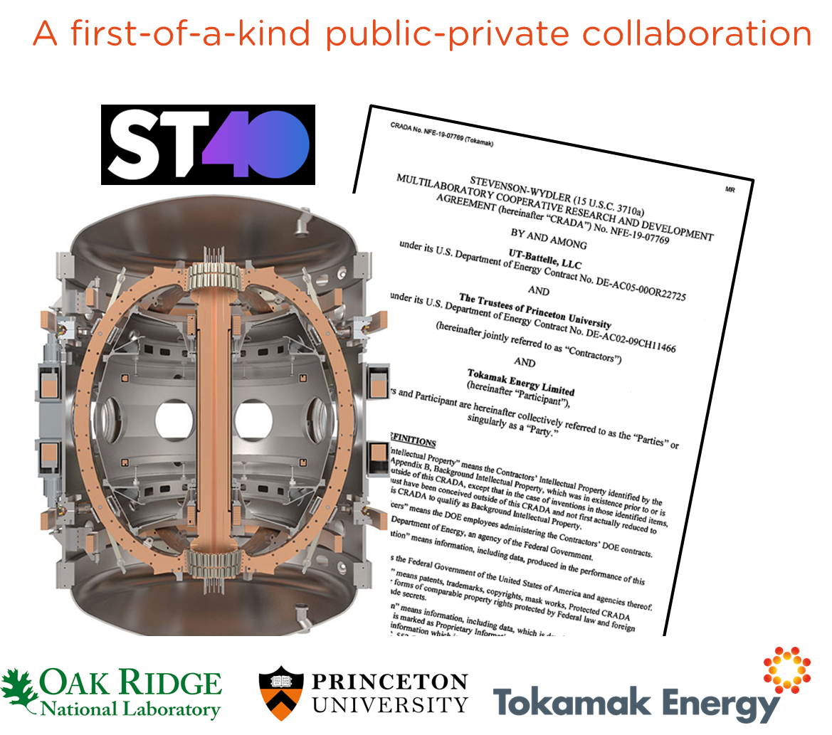
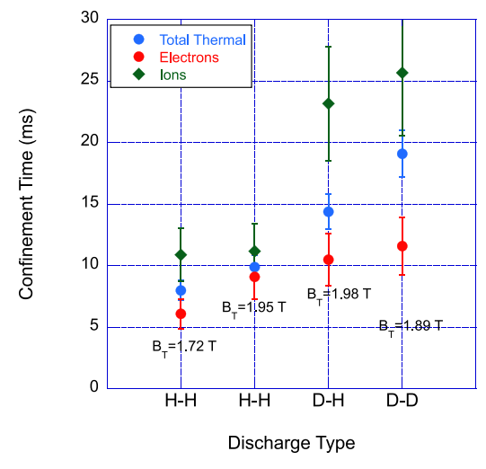
ST40: Expanding the physics & technology basis for the high-field spherical tokamak route to fusion power
Parameter | Range
B_{T} [T] | 0.9 – 2.1
I_{P} [MA] | 0.3 – 0.8
R_{Geo} [m] | 0.4 – 0.5
A / κ | 1.6 – 1.9 / ≤ 2
P_{NB}/E_{NB} [MW/kV] | 0.8/24, 1.0/55
Start-up | Merging-compression
ψ_{sol} [mWb] | 200
Programme focuses:
  Confinement, stability, and plasma exhaust in compact high-field ST
  Solenoid free start-up (1MW 105/140GHz gyrotron in 2025)
Recent highlights:
  Achieved record central ion temperatures of 9.6±0.4keV in 2022
  Installed Thomson scattering and divertor diagnostics (IR + LP)
  Established H-modes with sustained ELM free period
  Developed non-inductive scenarios at I_{p}=300kA with V_{loop}~0 and β_{N}~4.4
  First investigation of confinement time mass dependence in ST
  Investigated energetic particle interaction with microturbulence

Slide 32
Recent ST40 publications
Andrew Y. et al 2022 H-mode dithering phase studies on ST40 Philosophical Transactions of the Royal Society A 381 20210225 https://doi.org/10.1098/rsta.2021.0225
Bland J. et al 2022 Interplay between beam-driven chirping modes and plasma confinement transitions in spherical tokamak ST40 Nuclear Fusion 63 01602 https://doi.org/10.1088/1741-4326/aca54d
Duarte V.N. et al 2023 Perturbative analysis of low-frequency instabilities in high-field ST40 experiments Nuclear Fusion 63 036018 https://doi.org/10.1088/1741-4326/acb5af
du Toit E.J. and Shevchenko V.F. 2022 Development of an electron cyclotron resonance heating and electron Bernstein wave current drive system on ST40 Plasma Physics and Controlled Fusion 64 115015 https://doi.org/10.1088/1361-6587/ac97bf
Kaye, S. M. et al 2023 Isotope dependence of transport in ST40 hot ion mode plasmas Plasma Physics and Controlled Fusion 65 095012 https://doi.org/10.1088/1361-6587/ace849
McNamara S.A.M. et al 2023 Achievement of ion temperatures in excess of 100 million degrees Kelvin in the compact high-field spherical tokamak ST40 Nuclear Fusion 63 054002 https://doi.org/10.1088/1741-4326/acbec8
Ono M. et al 2022 Multi-harmonic electron cyclotron heating and current drive scenarios for non-inductive start-up and ramp-up in high field ST-40 spherical tokamak Nuclear Fusion 62 106035 https://doi.org/10.1088/1741-4326/ac8be2
Ren Y. et al 2023 Linear instabilities in the hot-ion regime in a high-field spherical tokamak Plasma Physics and Controlled Fusion 65 075007 https://doi.org/10.1088/1361-6587/acc890
Wood J. et al 2023 Characterisation of ion temperature and toroidal rotation on the ST40 tokamak Journal Instrumentation 18 C03019 https://doi.org/10.1088/1748-0221/18/03/C03019
Willett H.V. et al 2023 TriWaSp: a multi-faceted visible spectroscopy diagnostic on the ST40 tokamak Journal of Instrumentation 18 C03023 https://doi.org/10.1088/1748-0221/18/03/C03023

Slide 33
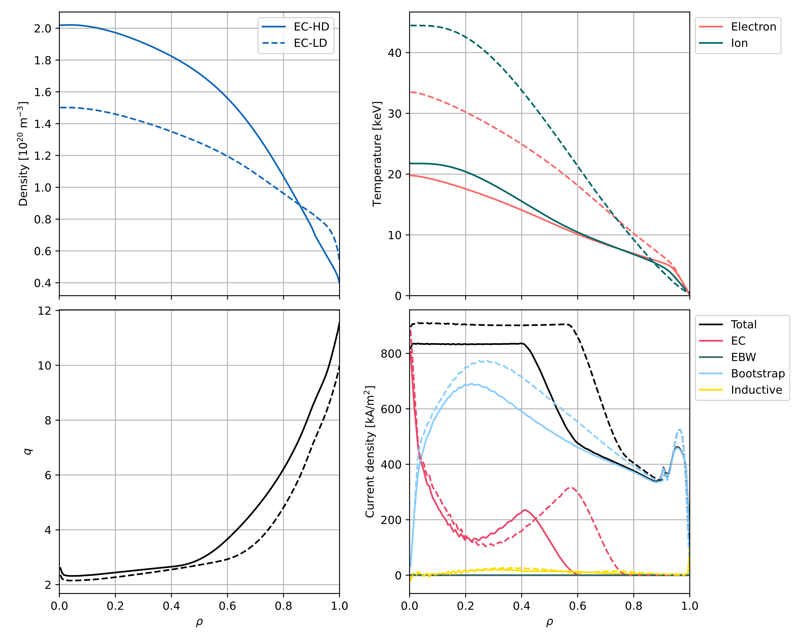


Spherical Tokamak for Energy Production (STEP)
H. Meyer et.al. IAEA FEC 2023
EBCD: Electron Bernstein wave Current Drive
ECCD: Electron Cyclotron wave Current Drive
ECCD only
 | EC-HD | EC-LD | EB-CC | EB-HQ
HCD | ECCD only |  | ECCD + EBCD
$$I_{p} (MA)$$ | 21 | 25 | 23 | 21
$$f_{BS}$$ | 0.9 | 0.8 | 0.8 | 0.9
$$f_{GW}$$ | 0.95 | 0.61 | 0.96 | 0.98
$$Q$$ | 10 | 9 | 12 | 30
$$β_{N}$$ | 4.4 | 5.1 | 3.9 | 4.3
Density
Temperature
4 different fully non-inductive flat-top operating points defined ($R=3.6 m, A=1.8, B=3.2 T,P_{fus}\sim 1.5−1.6 GW,f_{rad}^{core}\sim 0.7, κ\sim 3, δ\sim 0.5)$ [E. Tholerus et.al in prep]
Fully detached divertor with $P_{sep}≤150 MW$ in double null with alternative divertor leg configurations.
  4 inner leg configurations assessed
First SOLPS-ITER simulations with drifts and kinetic neutrals [J. Karhunen et.al. IAEA FEC 2023].
First converged non-linear local gyrokinetic simulations for dominant KBM turbulence in high $β_{e}$ slow rotating plasmas. [D. Kennedy et.al. IAEA FEC 2023, M. Giacomin sub. to Nucl. Fusion].
safety factor q
Current Density
Profiles from JETTO assumption integration with Xe, Ar and He as impurities and scaled gyro Bohm transport and dominant transport through the electron channel

Slide 34


Spherical Tokamak for Energy Production (STEP)
H. Meyer et.al. IAEA FEC 2023
EBCD: Electron Bernstein wave Current Drive
ECCD: Electron Cyclotron wave Current Drive
Central ECCD + off-axis EBCD
 | EC-HD | EC-LD | EB-CC | EB-HQ
HCD | ECCD only |  | ECCD + EBCD
$$I_{p} (MA)$$ | 21 | 25 | 23 | 21
$$f_{BS}$$ | 0.9 | 0.8 | 0.8 | 0.9
$$f_{GW}$$ | 0.95 | 0.61 | 0.96 | 0.98
$$Q$$ | 10 | 9 | 12 | 30
$$β_{N}$$ | 4.4 | 5.1 | 3.9 | 4.3
Density
Temperature
4 different fully non-inductive flat-top operating points defined ($R=3.6 m, A=1.8, B=3.2 T,P_{fus}\sim 1.5−1.6 GW,f_{rad}^{core}\sim 0.7, κ\sim 3, δ\sim 0.5)$ [E. Tholerus et.al in prep]
Fully detached divertor with $P_{sep}≤150 MW$ in double null with alternative divertor leg configurations.
  4 inner leg configurations assessed.
First SOLPS-ITER simulations with drifts and kinetic neutrals [J. Karhunen et.al. IAEA FEC 2023].
First converged non-linear local gyrokinetic simulations for dominant KBM turbulence in high $β_{e}$ slow rotating plasmas [D. Kennedy et.al. IAEA FEC 2023, M. Giacomin sub. to Nucl. Fusion].
safety factor q
Current Density
Profiles from JETTO assumption integration with Xe, Ar and He as impurities and scaled gyro Bohm transport and dominant transport through the electron channel

Slide 35

Spherical Tokamak for Energy Production (STEP)
H. Meyer et.al. IAEA FEC 2023
 | EC-HD | EC-LD | EB-CC | EB-HQ
HCD | ECCD only |  | ECCD + EBCD
$$I_{p} (MA)$$ | 21 | 25 | 23 | 21
$$f_{BS}$$ | 0.9 | 0.8 | 0.8 | 0.9
$$f_{GW}$$ | 0.95 | 0.61 | 0.96 | 0.98
$$Q$$ | 10 | 9 | 12 | 30
$$β_{N}$$ | 4.4 | 5.1 | 3.9 | 4.3
4 different fully non-inductive flat-top operating points defined ($R=3.6 m, A=1.8, B=3.2 T,P_{fus}\sim 1.5−1.6 GW,f_{rad}^{core}\sim 0.7, κ\sim 3, δ\sim 0.5)$ [E. Tholerus et.al in prep]
Fully detached divertor with $P_{sep}≤150 MW$ in double null with alternative divertor leg configurations.
  4 inner leg configurations assessed.
First SOLPS-ITER simulations with drifts and kinetic neutrals [J. Karhunen et.al. IAEA FEC 2023].
First converged non-linear local gyrokinetic simulations for dominant KBM turbulence in high $β_{e}$ slow rotating plasmas [D. Kennedy et.al. IAEA FEC 2023, M. Giacomin sub. to Nucl. Fusion].
Neutral density from SOLPS-ITER simulations without drifts.

Slide 36





Spherical Tokamak for Energy Production (STEP)
H. Meyer et.al. IAEA FEC 2023
 | EC-HD | EC-LD | EB-CC | EB-HQ
HCD | ECCD only |  | ECCD + EBCD
$$I_{p} (MA)$$ | 21 | 25 | 23 | 21
$$f_{BS}$$ | 0.9 | 0.8 | 0.8 | 0.9
$$f_{GW}$$ | 0.95 | 0.61 | 0.96 | 0.98
$$Q$$ | 10 | 9 | 12 | 30
$$β_{N}$$ | 4.4 | 5.1 | 3.9 | 4.3
increasing drive
stabilising
Increasig $β_{e}⇒$ increasing $β_{e}^{′}$
4 different fully non-inductive flat-top operating points defined ($R=3.6 m, A=1.8, B=3.2 T,P_{fus}\sim 1.5−1.6 GW,f_{rad}^{core}\sim 0.7, κ\sim 3, δ\sim 0.5)$ [E. Tholerus et.al in prep]
Fully detached divertor with $P_{sep}≤150 MW$ in double null with alternative divertor leg configurations.
  4 inner leg configurations assessed.
First SOLPS-ITER simulations with drifts and kinetic neutrals [J. Karhunen et.al. IAEA FEC 2023].
First converged non-linear local gyrokinetic simulations for dominant KBM turbulence in high $β_{e}$ slow rotating plasmas [D. Kennedy et.al. IAEA FEC 2023, M. Giacomin sub. to Nucl. Fusion].
stabilising
Heat flux at $ρ=0.5$from nonlinear, local gyrokinetic simulations as function of electron $β$ (no flow) and $E×B$ shear.

Slide 37
The United States
NSTX-U
LTX-β
Pegasus-III

Slide 38



Status of NSTX-U: recovery progressing, physics research continuing
NSTX-U Recovery Project
Recovery project is ~80% complete
Prototyping new central magnet fabrication process in parallel with production conductor fabrication
Installing new PFCs on casing
New bundle delivery forecast in fall of 2024
NSTX-U Research continues to advance the physics of spherical tokamaks
[Berkery et al, IAEA 2023, submitted to Nucl. Fusion]
Brief highlights:
Gyrokinetic model matches NSTX pedestal height and width much better than ideal ballooning
Lithium vapor box designed to handle the very high heat fluxes NSTX-U will produce

Slide 39




Recent results from LTX-β
Low recycling + high confinement with full lithium walls
  R~0.6 measured
  1.5 – 2✕ H98 in ohmic discharges without a pedestal
LTX-β operated with full liquid lithium walls and modest NBI
  Confinement improves with NBI
  Significant neutral beam fueling

Slide 40

Pegasus-III*: New Facility Completed in July 2023 and Operational
New Pegasus-III facility: Developing validated physics & tech basis for MA startup with:
  Advanced Local Helicity Injection (LHI)
  Floating Coaxial Helicity Injection (CHI)
  Microwave assist, sustainment and startup
Initial campaign utilizes advanced LHI, explores scaling of system with increased B_{T}
Pegasus- III features:
No solenoid
B_{T} < 0.6 T
Advanced control
Expanded diagnostics
Pegasus-III plasma: I_{p} >> I_{inj}
*Work supported by U.S. DOE grant DE-SC0019008

