Slide 1
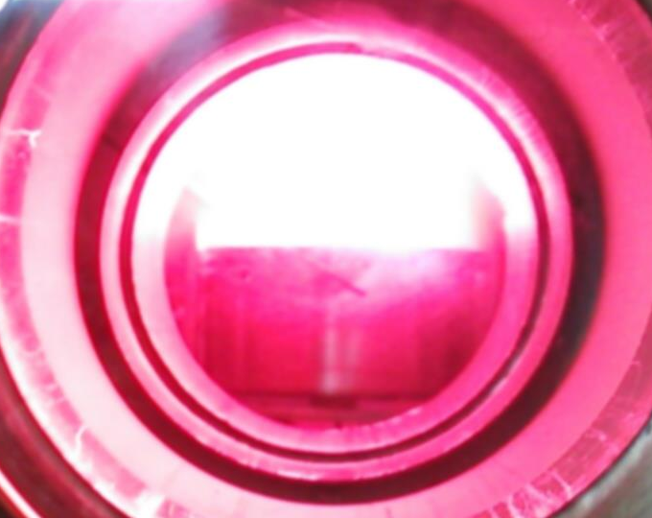
Present status and future prospects of the application of liquid metals for plasma-facing components in magnetic fusion devices
TOFE-2014
Nov. 9-14th
Anaheim, USA
Yoshi Hirooka（NIFS), G. Mazzitelli (ENEA), S. Mirnov (TRINITY),
M. Ono (PPPL), M. Shimada (JAEA), F. L. Tabares (CIEMAT)

Slide 2
Table of contents
Background
  Plasma-wall boundary control effects
  Technical issues with solid metal PFCs (for ITER and beyond)
  Potential issues with liquid metal PFCs
Liquid metal PFCs in fusion device and lab. experiments
  Confinement experiments with liquid metal PFCs
  Laboratory experiments with liquid metal samples
Innovative liquid metal PFC concepts
  TEMHD-concept driven by JxB
  ACLMD-concept driven by JxB
  Conclusion

Slide 3
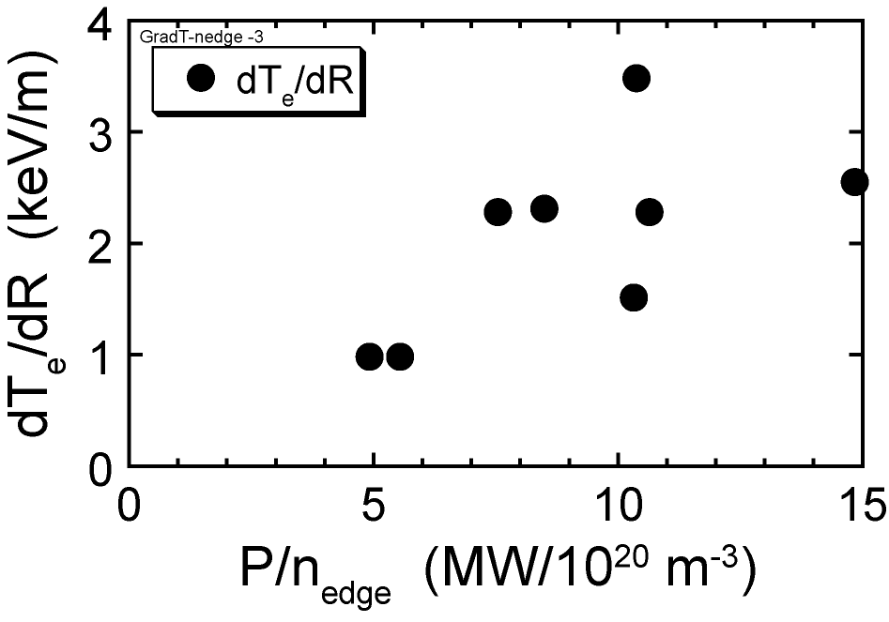
“Chicken-Egg” Boundary control effect ①
Reduced edge density => improved core confinement
Supershots in TFTR
Super dense core in LHD
After J.D.Strachan, Nucl. Fusion 39(1999)1093.
After N. Ohyabu et al., PRL97(2006)055002.

Slide 4
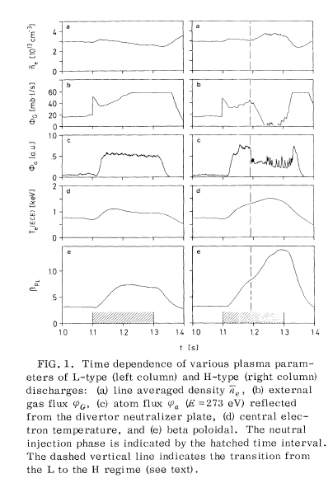
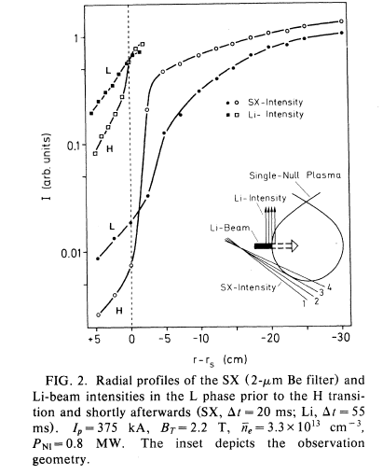
“Chicken-Egg” Boundary control effect ②
Improved core confinement => reduced edge density
L-to-H mode transition with ETB in ASDEX
Density increase
Edge density
decrease
ETB
Temperature
increase
NBI-heating start
Edge transport barrier
After F. Wagner et al. PRL 49(1982)1408
After F. Wagner et al. PRL 53(1984)1408

Slide 5
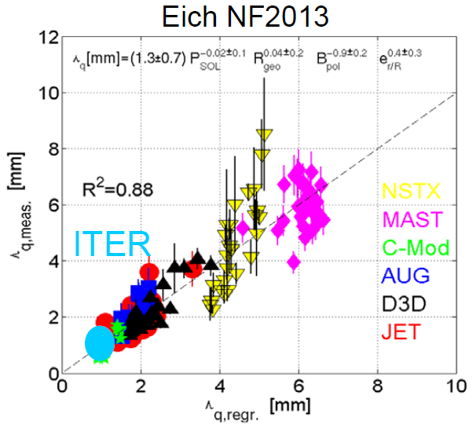
Technical issues with present-day PFCs
ITER-divertor
DEMO-divertor
W-armor + Cu alloy heat sink
  Divertor heat flux：10~20MW/m²
Plasma current~15MA
Heating power～100MW
  PFC power width: λ_{q}= ~ 5㎜
W-armor + F82H heat sink
  Max. heat flux：～8MW/m²
  Plasma current~20-30MA
  Heating power~500MW
  PFC power width: λ_{q}= ~ 1㎜
Need for an innovative PFC ! !
Possible metals and/or alloys:
Ga（T_{m}=29.8℃, Z=31）
Li(T_{m}=186℃, Z=3）
Sn（T_{m}=231℃, Z=50）
Li₁₇Pb₈₃（T_{m}=235℃, Z=69*）
After Loarte presented at 2014 PSI-conf.

Slide 6
DBTT(~400ｄ℃) cracking on tungsten-PFC
Thermal cycle cracking
Low H retention =>high recycling
Hydrogen-implantation cracking
50MW/m²
15MW/m²

Slide 7
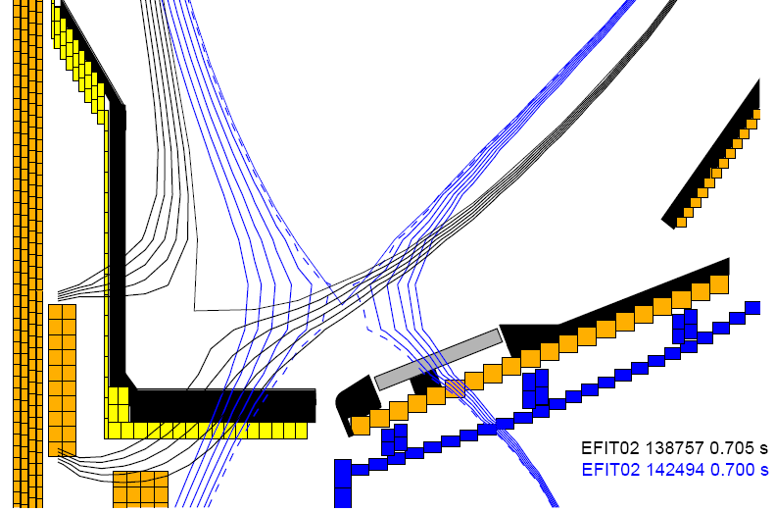
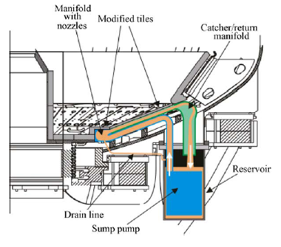


Potential issues on liquid metal PFC concepts
After A. Ying (UCLA)
After M. Ono (PPPL NSTX-U)
B
B
Divertor Heat and Particle Flux
MHD drag
v
?
Lithium Radiative Mantle
Liquid Lithium Divertor Tray (LLDT)
200°C – 450°C
Valves
Impurities
EM Pumps

Slide 8
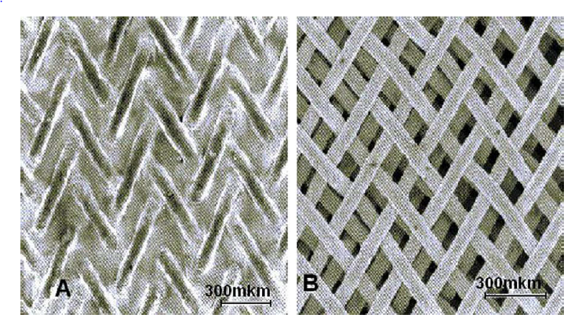
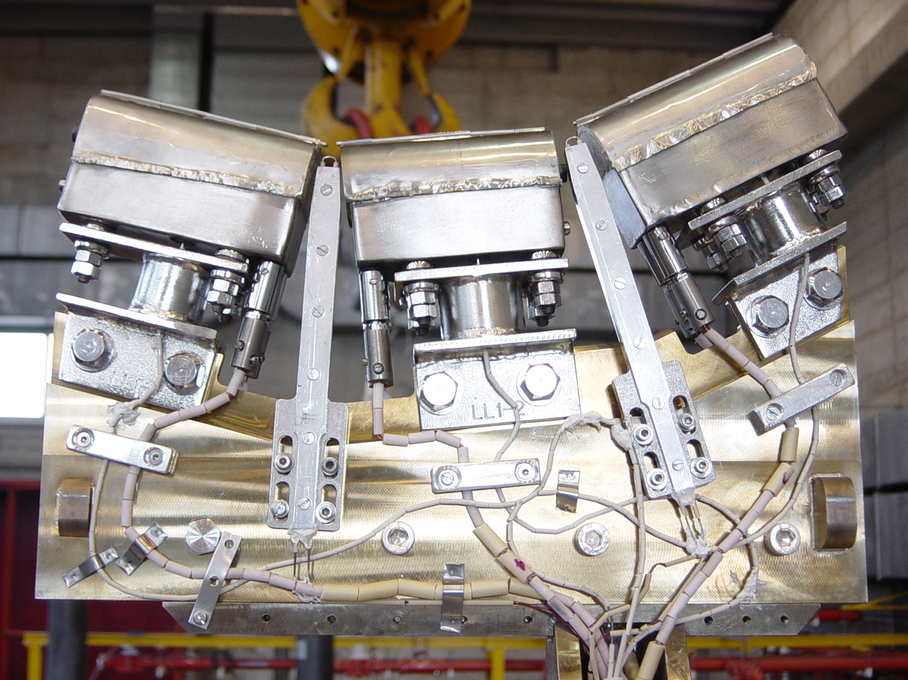
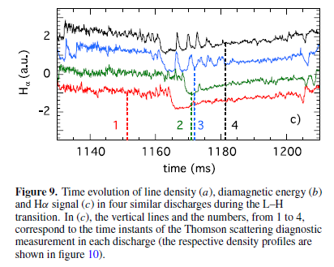
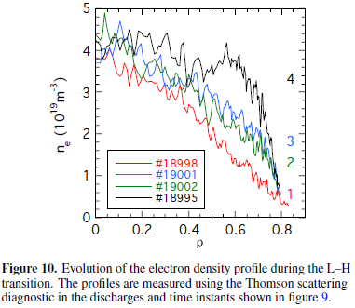
CPS-limiter(s) in T11, FTU, TJ-II, etc.
Capillary effect to pump liquid lithium from the reservoir behind the mesh
Spray vaporized lithium over a large area of the first wall for gettering (reduced recycling)
Li-coatings have induced H-mode in TJ-II
Langmuir probes
Thermocouples
ETB(?)
Heater electrical cables
After Sanchez et al. Nucl. Fusion4(2009)104018.

Slide 9
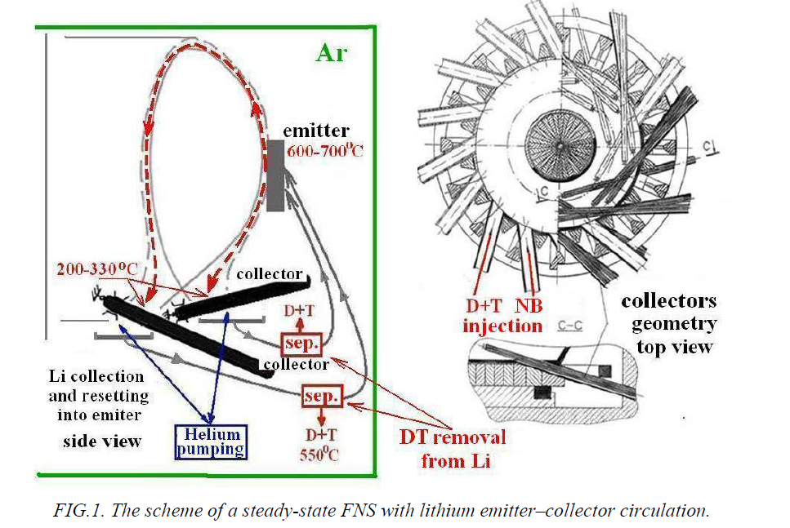
Lithium emission-collection “loop” in T11
After Mirnov, paper presented at the IAEA-FEC 2014

Slide 10
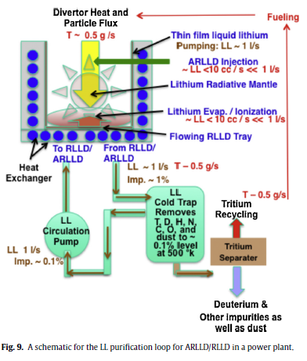
Active radiative liquid lithium divertor
After Ono et al. FED(2014)in press.
Radiative Liquid Lithium Divertor
“RLLD” implemented in a reactor

Slide 11
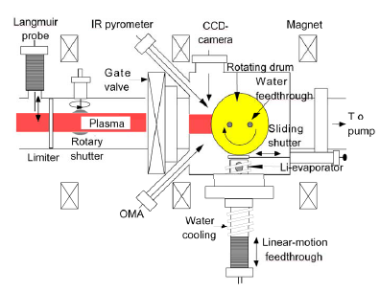
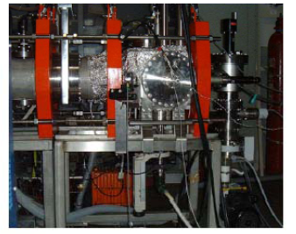
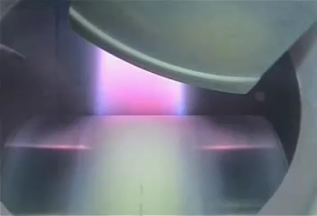
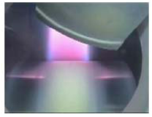
POP on particle control by Li-gettered MS-PFC
(Presented at ANS-TOFE, 2002)

Slide 12
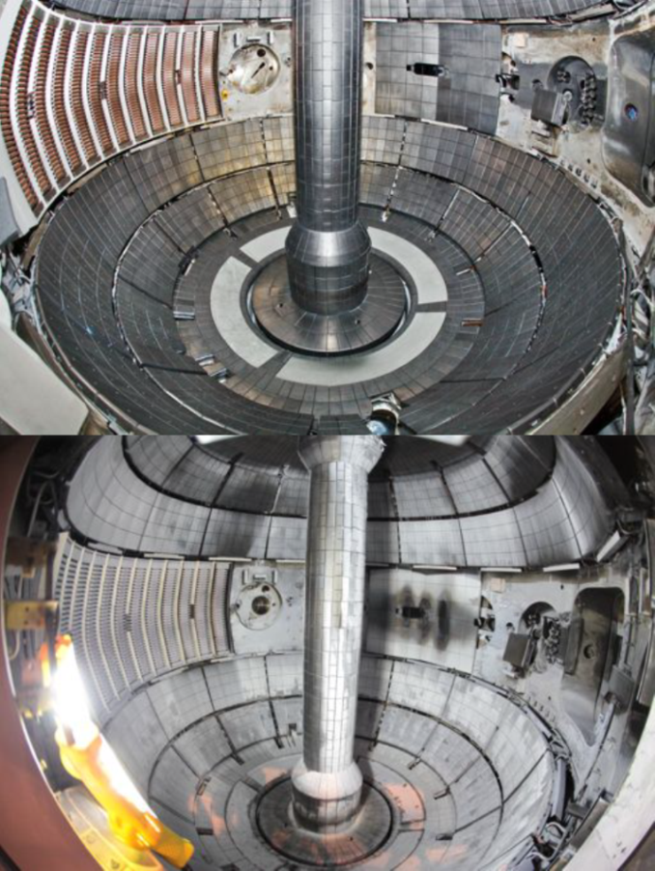
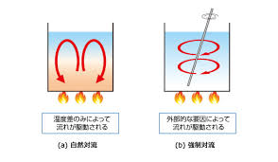
Power/particle handling issues with the Liquid Lithium Divertor
LLD in NSTX
Buoying impurities: LiO2, LiOH
Li + O₂ ⇒ LiO₂
H₂+ 1/2O₂ ⇒ H₂O
Li + H₂O ⇒ Li(OH) + 1/2H₂
LLD
=> High recycling
Surface heating->Natural convection
Natural
convection
Forced
convection
Kugel et al. Fusion Eng. Des. 87(2012)1724

Slide 13
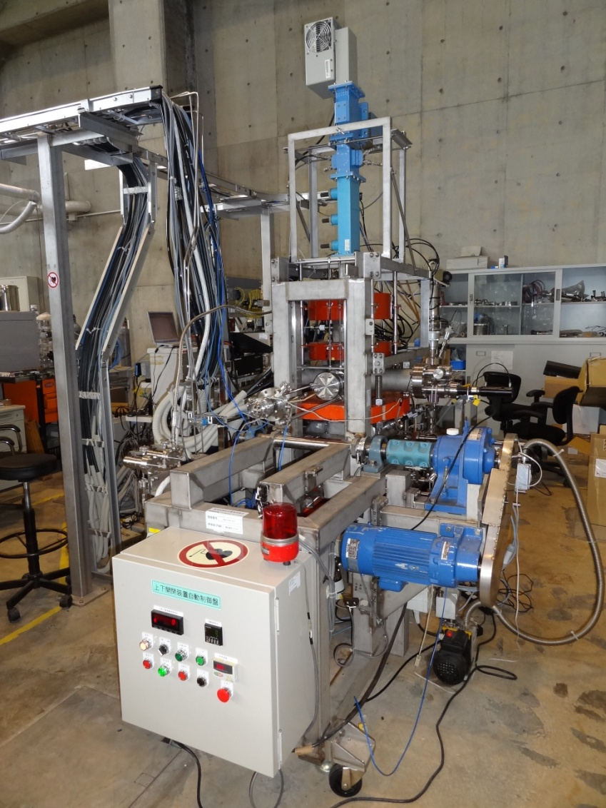
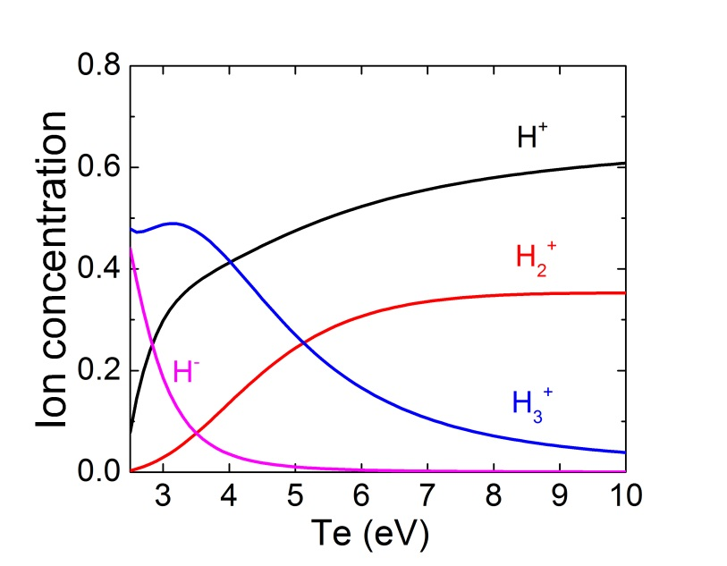
Steady state plasma device at NIFS: VEHICLE-1
Species mix modelling
Plasma parameters:
n_{e}: ~10¹⁰ cm⁻³
T_{e}: 3~4 eV
Ion flux : ~1 x10¹⁶ cm⁻²s⁻¹

Slide 14
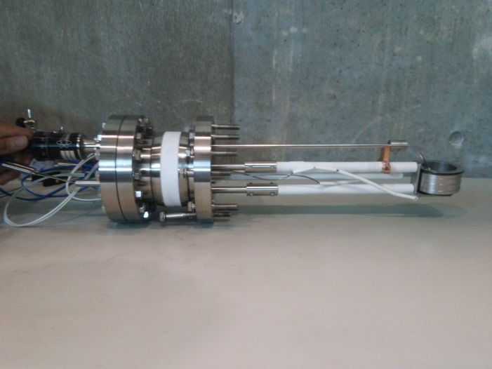
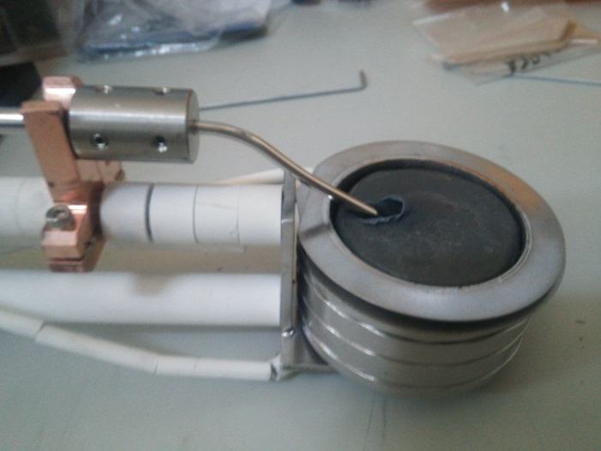
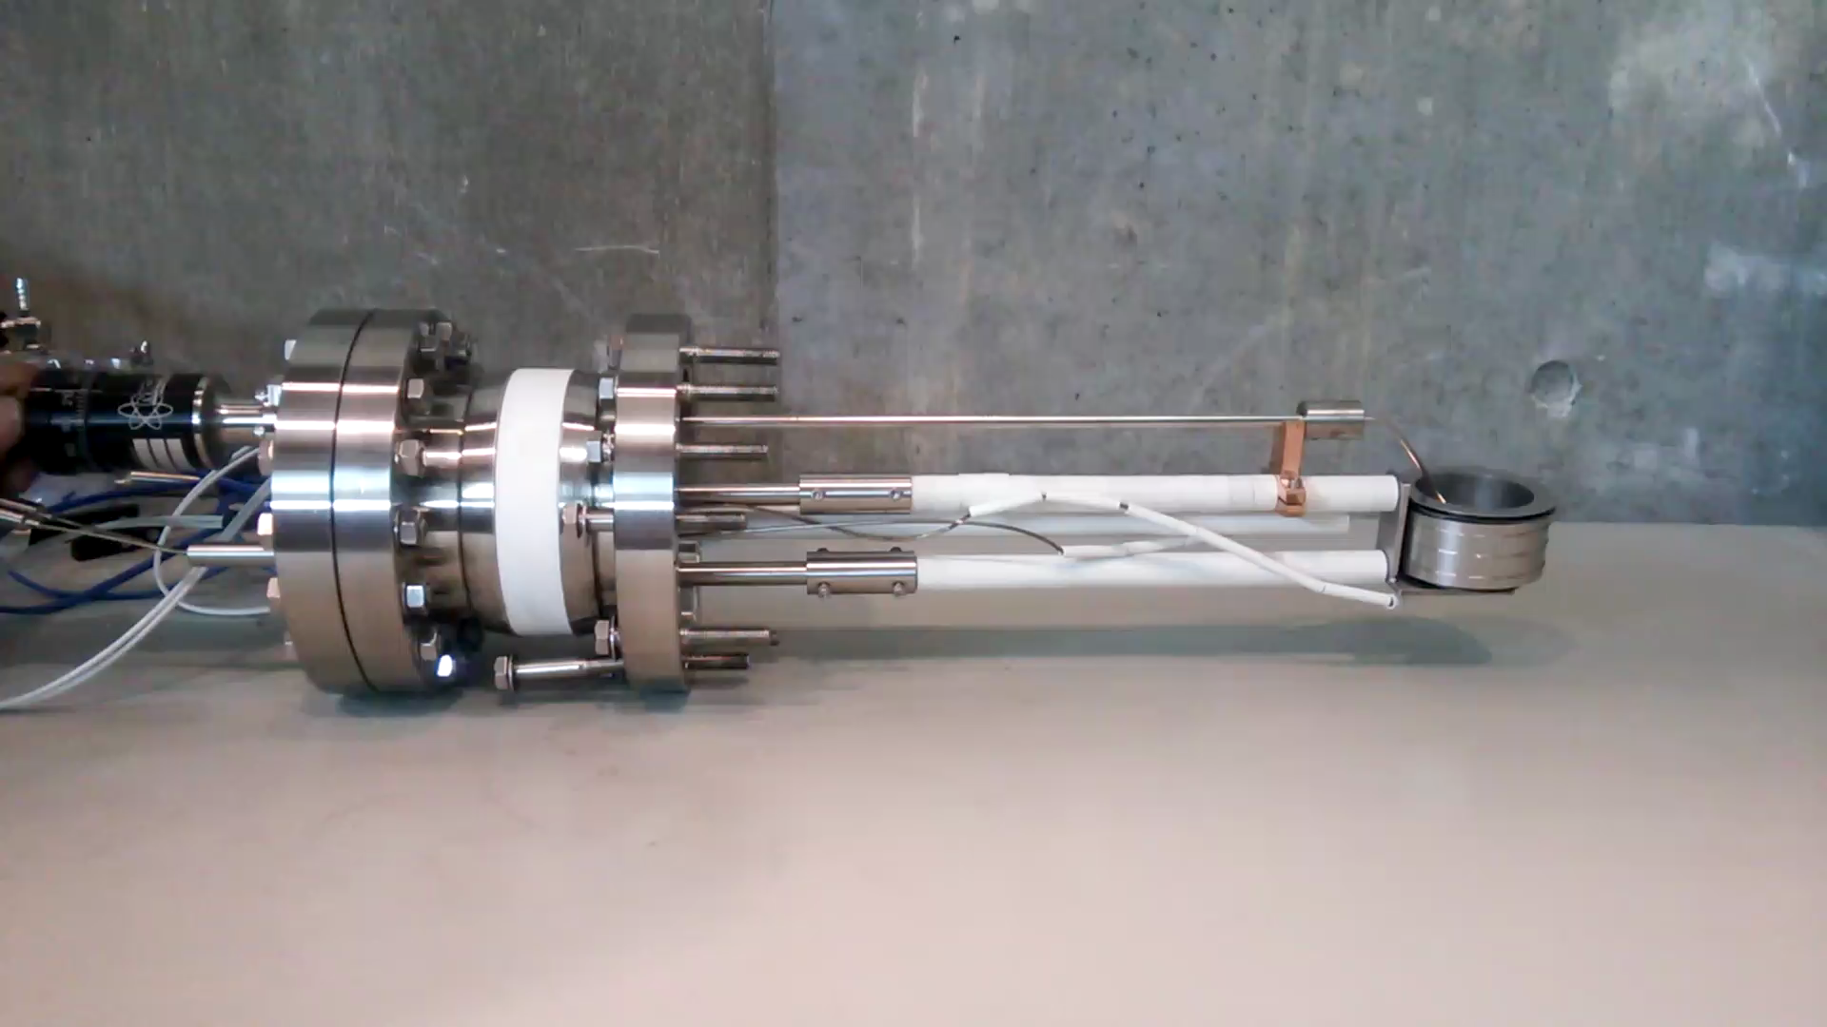
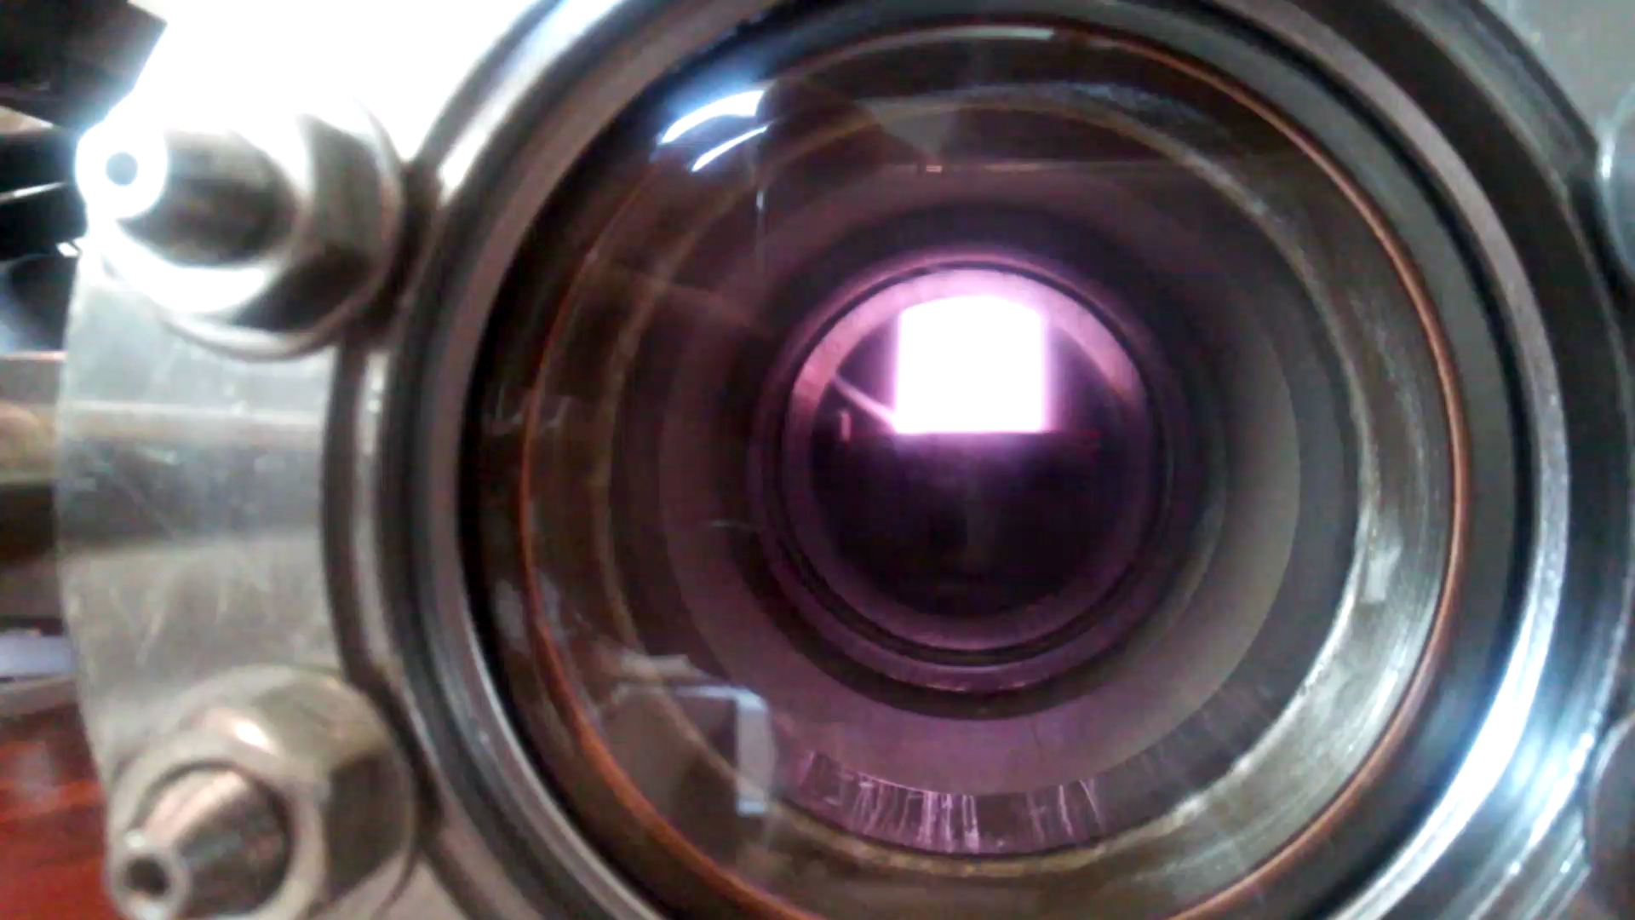
Liquid metal stirring experimental setup

Slide 15
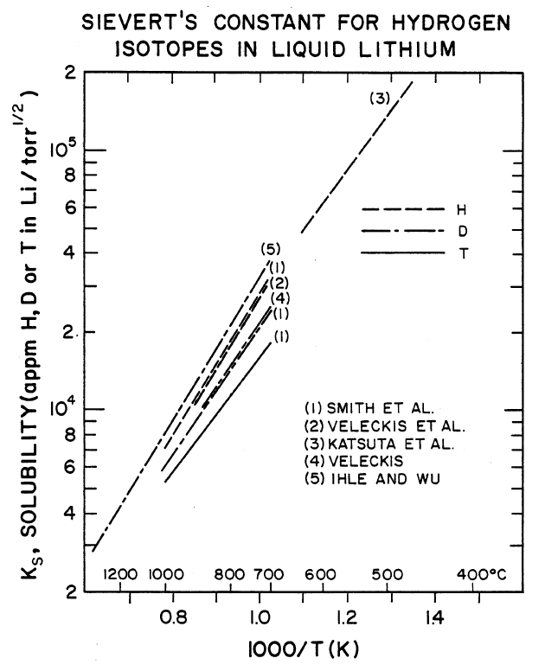
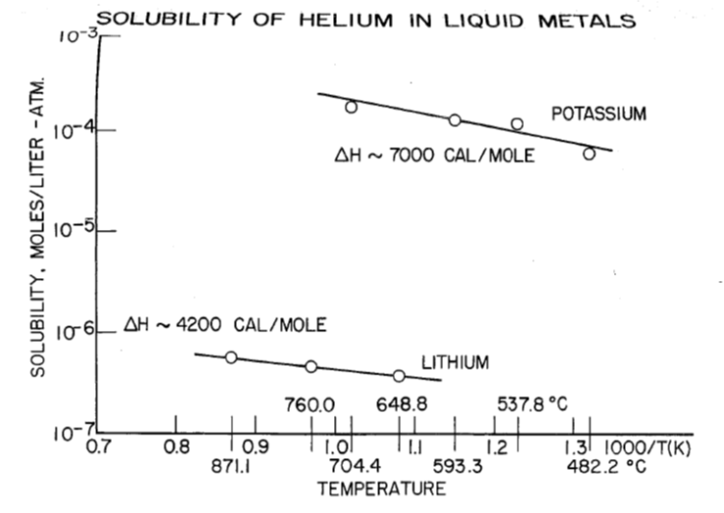
Hydrogen and helium solubility in lithium
Hydrogen solubility in lithium
Helium solubility in lithium

Slide 16
Liquid stirring effects on hydrogen recycling
Hirooka et al. Fusion Eng. Des. (2014) in press

Slide 17
Liquid stirring effects on helium recycling
Hirooka et al. Fusion Eng. Des. (2014) in press

Slide 18
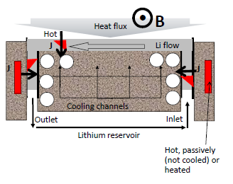
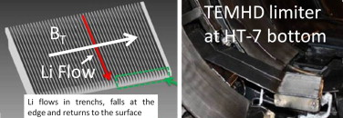
TE-MHD: JxB force-driven liquid metal PFC
After Jaworski (PPPL)
PoP experiments in HT-7(@AS-IPP)
JxB force
Zuo et al. Fusion Eng. Des. (2014) in press

Slide 19
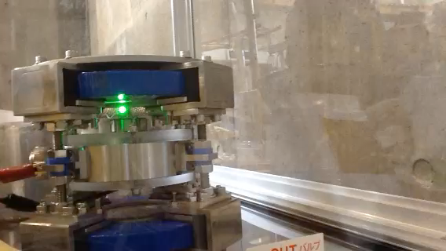
ACLMD: JxB forced convection liquid metal PFC
After Shimada and Hirooka
PoP experiment at NIFS
Current externally controllable!!
Liquid temp. externally controllable!!
Convection externally controllable!!
Nucl. Fusion 54 (2014) 122002
Liquid metal: Ga₆₇ In_{20.5} Sn_{12.5}

Slide 20
Potential issues with ACLMD
Electro-chemistry effects
Joule heating effects
Standard electrode potential*: Eº
Li Eº=-3.045V
Al Eº=-1.67V
Cr Eº=-0.74V
Fe Eº=-0.44V
Ni Eº=-0.24V
W Eº=-0.58V
Sn Eº=-0.14V
H Eº=0.0V
Ag Eº= +0.79eV
Au Eº= +1.52eV
* ΔGº =-zFEº ( z: # of electrons
F: Faraday’s const.)
JxB force heating power: J・V
In the case of our PoP exps. on ACLMD:
  J~20[A]
  V~2.9[V] when rotation starts at 6 rpm
  P~60[W]
The temperature of Ga₆₇ In_{20.5} Sn_{12.5} alloy (320cc) was felt about 50ºC. After a while, however, the rotation stops, which indicates a temperature effect on electrochemical properties of (liquid) metals.

Slide 21
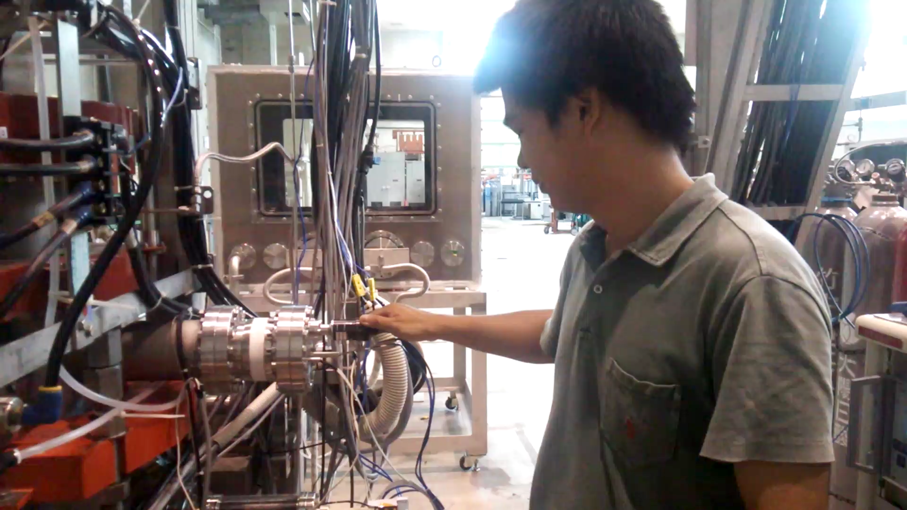
Summary and technical implications
Present status of liquid metals and/or their vapor/deposits to be used as PFCs has been reviewed with the emphasis on power and particle handling requirements.
Implications are: liquid metals needs to be flowing with forced convection for better temperature control and hydrogen absorptivity.
Several Innovative concepts to overcome the MHD drag have been proposed, showing successful PoP. However, there is a long way to go to reach the same level of technical maturity as the present-day divertor concept. We must count on the next generation scientists!

