Slide 1
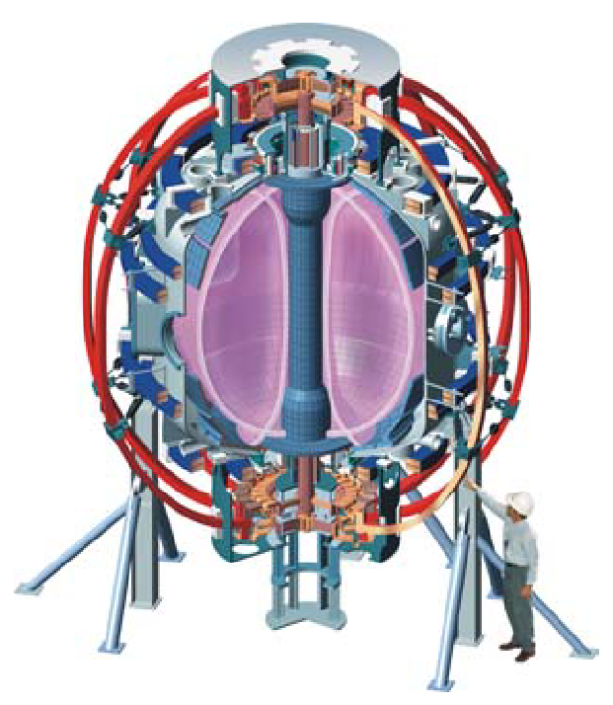
Supported by
NSTX 2010 experimental proposals: LQG controller for RWM stabilization
Columbia U
Comp-X
General Atomics
INEL
Johns Hopkins U
LANL
LLNL
Lodestar
MIT
Nova Photonics
NYU
ORNL
PPPL
PSI
SNL
UC Davis
UC Irvine
UCLA
UCSD
U Maryland
U New Mexico
U Rochester
U Washington
U Wisconsin
Culham Sci Ctr
Hiroshima U
HIST
Kyushu Tokai U
Niigata U
Tsukuba U
U Tokyo
JAERI
Ioffe Inst
TRINITI
KBSI
KAIST
ENEA, Frascati
CEA, Cadarache
IPP, Jülich
IPP, Garching
U Quebec
Oksana Katsuro-Hopkins¹, A. Sabbagh¹, J.M. Bialek¹, J.W. Berkery¹, S.P. Gerhardt²
¹Department of Applied Physics and Applied Mathematics, Columbia University, New York, NY, USA ²Princeton Plasma Physics Laboratory, Princeton, USA
NSTX Research Forum
December 1-3, 2009
Princeton Plasma Physics Laboratory
V1.0

Slide 2
Linear Quadratic Gaussian controller (LQG) is theoretically capable of reaching higher beta limits
Motivation
To examine stabilization of RWM using the newly-implemented LQG controller.
Goals
Suppress RWM using LQG controller
Test the theory of state space based approach to RWM stabilization
Investigate the parameters of LQG implementation
Determine achievable beta normal for slow rotating plasma with LQG turned on
Estimate RMS of currents and voltages with LQG
Compare to PID performance
Addresses
Milestone: NSTX R(10-01)
ITPA: NSTX R(10-01)

Slide 3
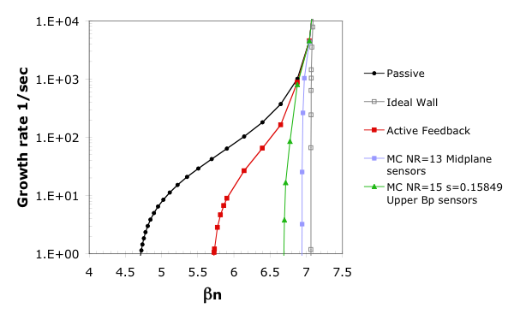
Advanced control techniques suggest significant feedback performance improvement for NSTX up to = 95%
Experimental (control off)
(β collapse)
Experimental (control on)
With-wall limit
DCON
no-wall
limit
Advanced
Feedback
M-P sensors
passive
growth
active control
Growth rate (1/s)
active
feedback
Advanced
Feedback
Bp sensors
β_{N}

Slide 4
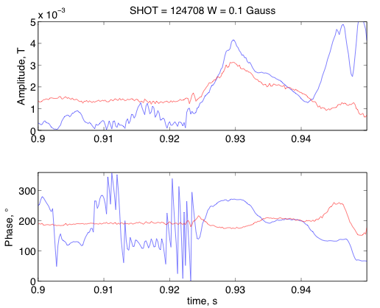
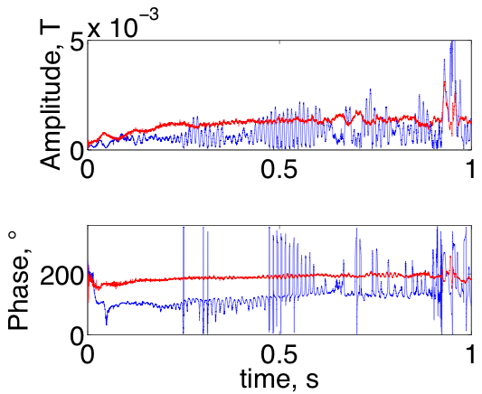
Preliminary results for mode amplitude and phase reconstructed by optimal observer for NSTX
NSTX Fourier Analysis
Optimal observer
SHOT=124708
Optimal observer parameters:
Sensor noise 0.1 Gauss
Number of states 7
NSTX Fourier Analysis
Optimal observer

Slide 5
LQG controller performance Run plan
Task Number of Shots
1) Create a fiducial H-mode plasma or equivalent plasma (e.g. low l_{i} plasma) subject to an unstable n = 1 RWM to be used as a target, with n =3 magnetic braking used to create reduced plasma rotation.
2) Slow rotating plasma
A) Test various number of states 2
B) Test various noise amplitude x 2
C) Test different filtered or non filtered Bp sensor data x 2
3) Fast rotating plasma
A) Test various number of states 2
B) Test various noise amplitude x 2
C) Test different filtered or non filtered Bp sensor data x 2
4) Comparison shots with PID controller 4
Total: 20
1.5 run days requested

Slide 6
RWM XPs: Required / Desired Diagnostics
The state-space LQG controller software available in PCS
Required diagnostics
Internal RWM sensors
CHERS toroidal rotation measurement
Thomson scattering
Diamagnetic loop
Desired diagnostics
USXR
MSE
Toroidal Mirnov array
Fast camera

