Slide 1




NSTX-U
Supported by
Software and Analysis Tools Overview
Bill Davis
Coll of Wm & Mary
Columbia U
CompX
General Atomics
FIU
INL
Johns Hopkins U
LANL
LLNL
Lodestar
MIT
Lehigh U
Nova Photonics
ORNL
PPPL
Princeton U
Purdue U
SNL
Think Tank, Inc.
UC Davis
UC Irvine
UCLA
UCSD
U Colorado
U Illinois
U Maryland
U Rochester
U Tennessee
U Tulsa
U Washington
U Wisconsin
X Science LLC
Culham Sci Ctr
York U
Chubu U
Fukui U
Hiroshima U
Hyogo U
Kyoto U
Kyushu U
Kyushu Tokai U
NIFS
Niigata U
U Tokyo
JAEA
Inst for Nucl Res, Kiev
Ioffe Inst
TRINITI
Chonbuk Natl U
NFRI
KAIST
POSTECH
Seoul Natl U
ASIPP
CIEMAT
FOM Inst DIFFER
ENEA, Frascati
CEA, Cadarache
IPP, Jülich
IPP, Garching
ASCR, Czech Rep
Physics Meeting
B-318
Jan. 28, 2015

Slide 2

Overview
Status of MDSplus
Various plotting options
What’s new in Web Tools
EFITviewer
XPC for Postscript output and scrolling
SigAlert to watch for bad/missing signals
Databases at PPPL
What other training or tools are needed?

Slide 3
Status of MDSplus
MDSplus has had an extensive workout for DCPS testing
We plan to minimize changes before CD-4 to reduce risk of delays
Network trunks have increased from 1 Gb/s to 10 Gb/s
Disks and CPUs will be beefed up before Physics Ops
  CMOD is acquiring 15 GB/shot with straightforward architecture
UDP events will be used (after CD-4) with a relay to TCP/IP when needed

Slide 4
Plotting Options
Scope family
  DWScope (solid; many examples available to start from)
  jScope (uses java; color, overlays, contours, animations)
Web Tools
  Now can run from file input
  Actively maintained, e.g., Open Science options coming
ReviewPlus from GA
  Bugs will be fixed
  Difficult to add features
Custom written programs
  IDL (most widely used here)
  Matlab (a more modern choice)
  Python (free and being used more and more in fusion community)

Slide 5
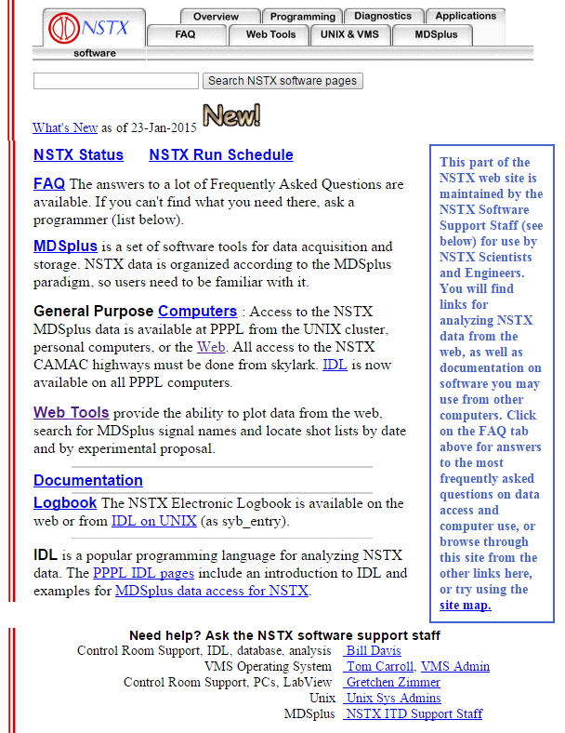
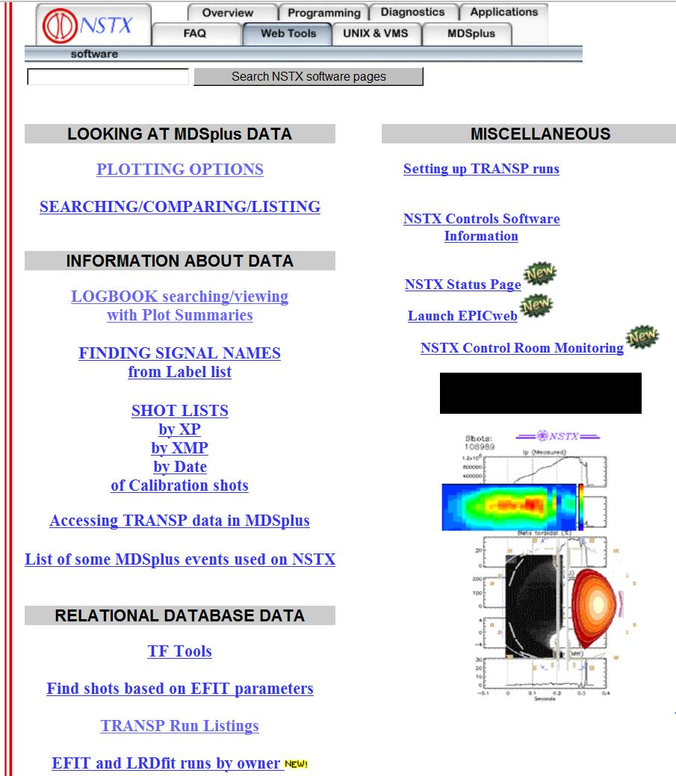
Documentation and Web Tools found at http://nstx.pppl.gov/nstx/Software
Notes:
If you click on “Plotting Options” you get the next screen

Slide 6
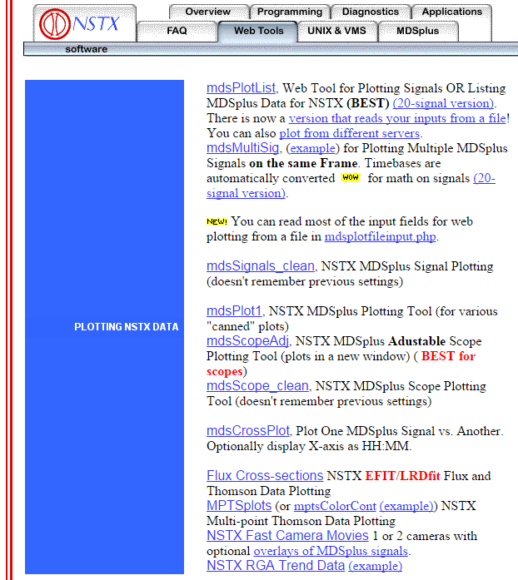
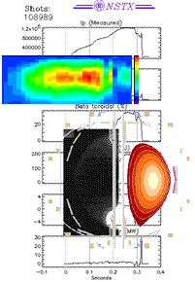
What’s New in WebTools
Web Plotting Tool can read settings from a file
IDL code can be called within a web plotting tool (like in ReviewPlus)
Plot directly from search results output, e.g., http://nstx.pppl.gov/nstx/Software/WebTools/treesearch.html
Fast Camera and Blob Tracking pages enhanced

Slide 7
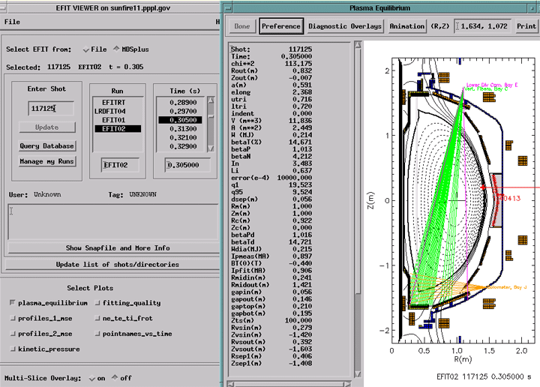
EFITviewer Enhancements
Vessel geometry drawn based on shot number
Devon Battaglia helping with diagnostic sight lines
DCPS and various test versions of EFIT trees supported

Slide 8
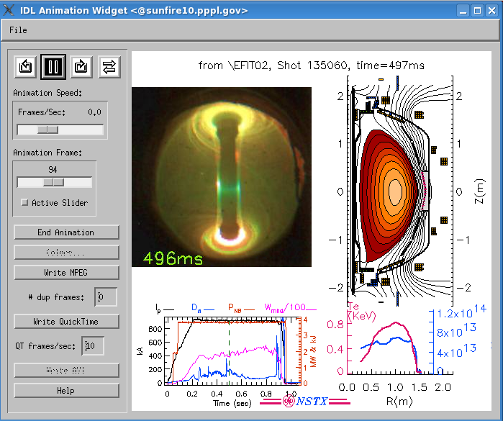
Always looking for ways to show diverse data synchronously
Created in IDL in X-windows on the PPPL Linux cluster by:
IDL> efitmovies,"miro*135060", /thomson, /summary
Notes:
This is an attempt to show many types of data concurrently so correlations might be noticed

Slide 9
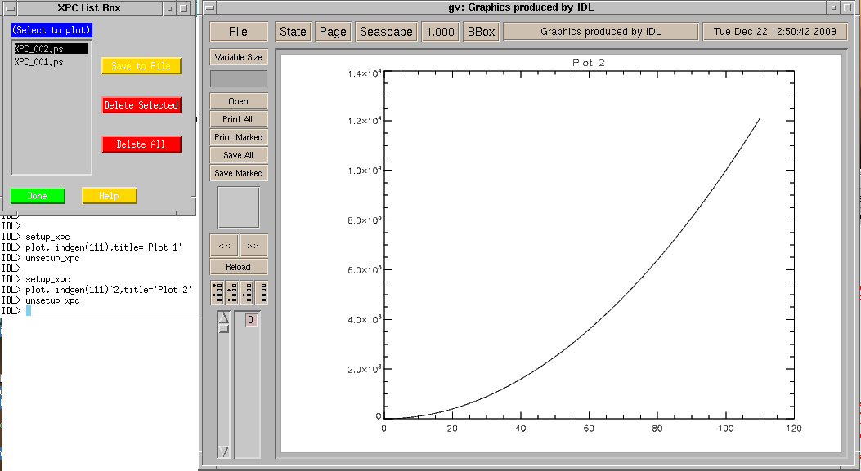
X-window Postscript Plot Control
XPC allows you to "scroll back" to earlier plots created from IDL,
as well as print or save them, without having to resend all the plot commands.

Slide 10
SigAlert identifies signal problems
An automatic task reads specified signals after a shot , and sends email if:
  The signal does not exist for the current shot.
  (Optional) No part of the signal reaches a minimum required value.
  (Optional) Any part of the signal exceeds a maximum allowed value.
Sample input file:
Signal email checkEvent nsmooth max min idlCall setEvent epicsAlarm
\wf::pnb bdavis NSTX_SOP 5 800 -10 none none none
\wf::prf bdavis NSTX_SOP 3 1e38 -1e38 none none none
If you want an IDL routine to be executed before checking the min or max,
you can specify it in the "idlCall" column with the "data" variable operated on, e.g.,
data=smooth2d(data,/edge_truncate)
If you want an MDSplus event declared when an alarm is raised by sigalert.pro,
specify that in the "setEvent" column.
See http://nstx.pppl.gov/nstx/Software/Applications/SigAlert.html for details

Slide 11
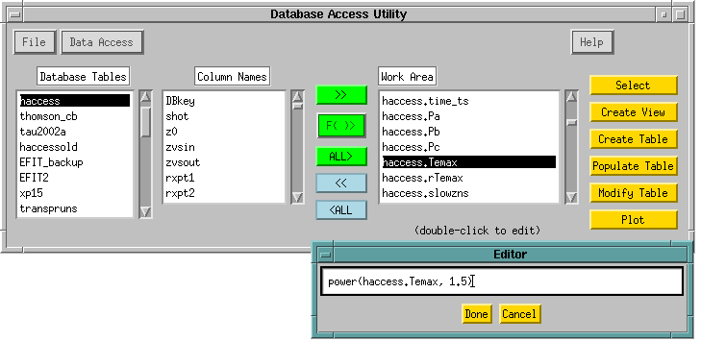
Database Tools are supported
IDL> dbaccess
Manual available at:
http://nstx.pppl.gov/nstx/Software/Documents/dbaccess.html
Notes:
DbAccess has many features developed specifically for plasma physics data bases.

Slide 12

“Public” tables available in the NSTXLOGS Database
“Survey” table contains a few dozen parameters at 3 times of interest (FlatTop, MaxIp, RampUp) for each shot
EFITnn tables contain most of the EFIT parameters at 6 times of interest for each shot
Neutron production
XP-specific tables
“Haccess” table contains parameters related to H-mode
Blob database contains blob characteristics for NSTX and CMOD shots
(Better organization and documentation of existing public tables are needed)

Slide 13

Summary
MDSplus and computer support is a bit challenged at the moment, but no significant risk seen
Web Tools continue to increase in utility
We should expand our expertise in Matlab and Python in future years
Public Databases for NSTX-U make results accessible and archivable; tools are available and can be supported
We need to know about increased data loads, especially for camera data
Let us know what training and tools will help your research

Slide 14
Backup Slides Follow
Questions to Bill Davis, x-2546, or bdavis@pppl.gov
For time-critical notification or questions, send email to nstxops@pppl.gov

Slide 15
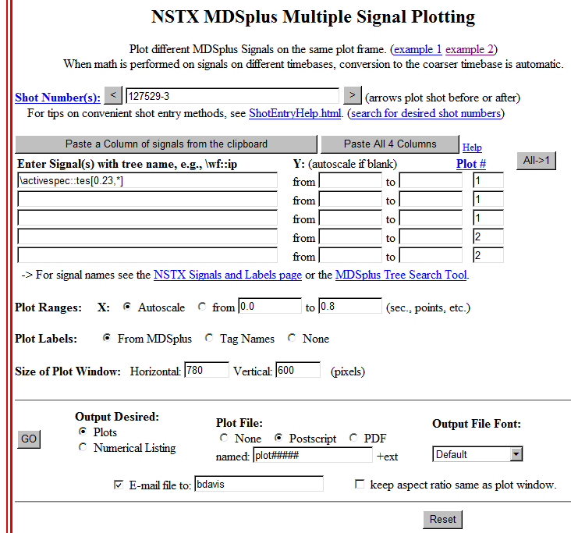
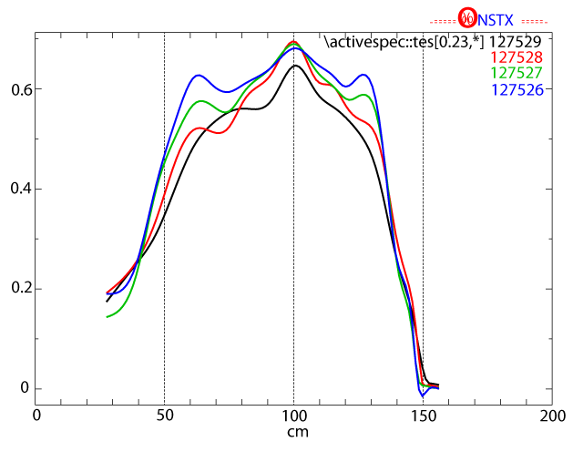
Overlaying Te Profiles from different shots
http://nstx.pppl.gov/nstx/Software/WebTools/mdsmultisig.html

Slide 16
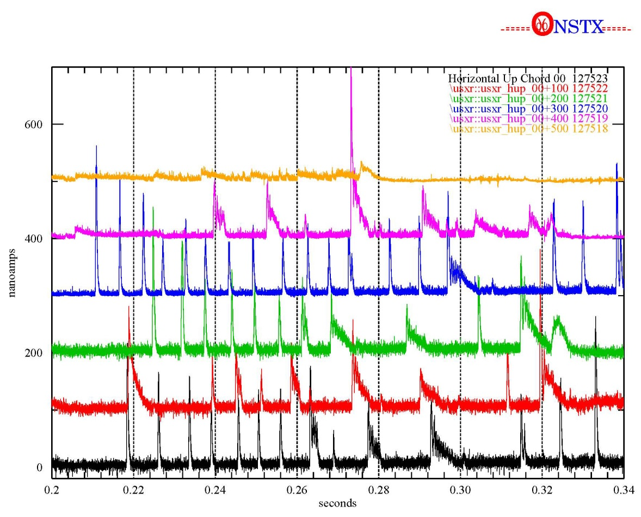
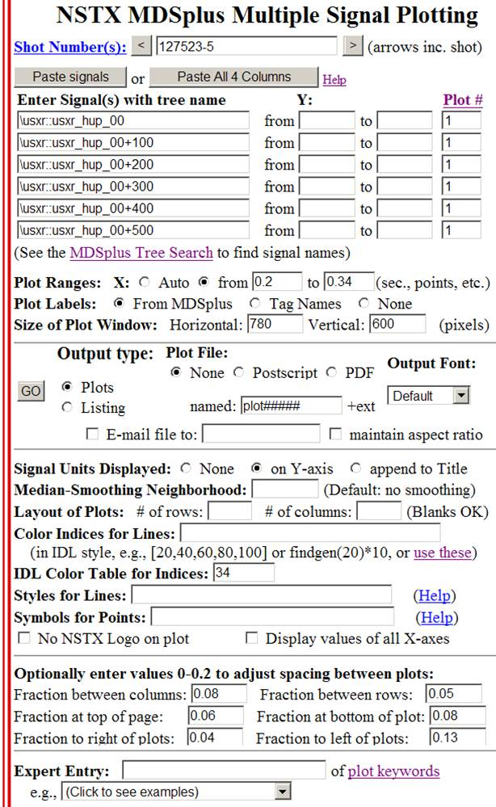
http://nstx.pppl.gov/nstx/Software/WebTools/mdsmultisig.html
Can overlay different shots of same signal, different signals of same shot, etc.
Notes:
Signals can be mathematical equations. Timebases are automatically converted. Names and ranges can be stored in a file and pasted into the page on Internet Explorer.

Slide 17
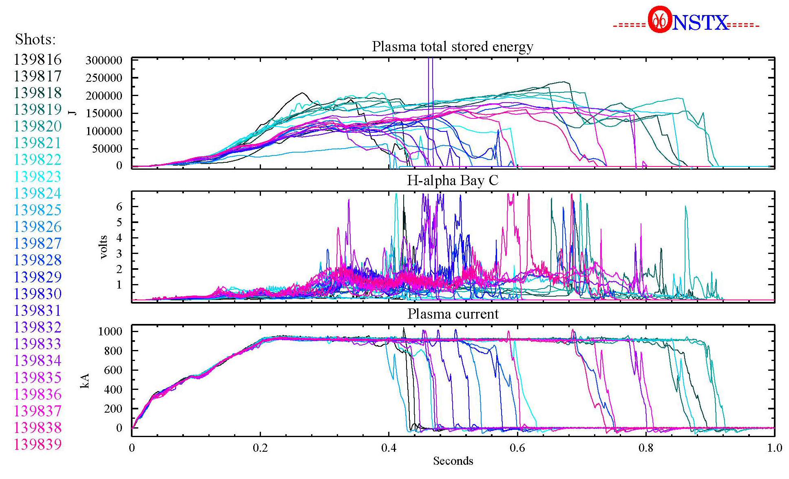
Web Tools plotting has many options
http://nstx.pppl.gov/nstx/Software/WebTools/mdsplotlist.html
Shot Number: “139816+23” Color Indices for lines: “findgen(24)/24*240”
Color Table: “10”
Notes:
You might use this scheme to see how shots evolve through a scan of some kind.

Slide 18
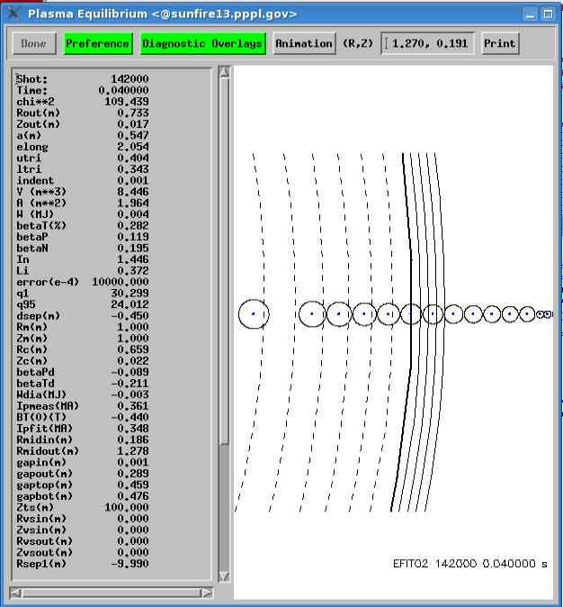
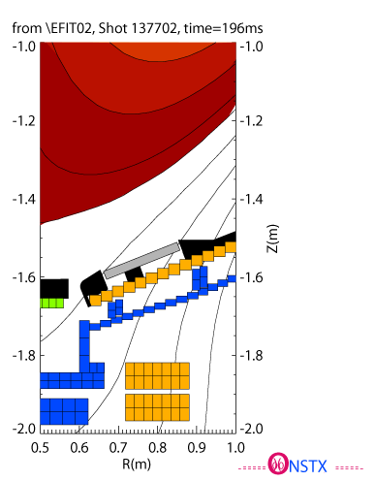
EFITviewer - zoom in to see
MPTS locations, strike points, e.g.
Ctl-clicking on the plot
will print out the
R and Z coordinates
Notes:
If the Thomson points are checked in “Diagnostic Overlays” you can see where the separatrix is in relation to the Thomson points. The zoom on the right lets you see the location of strike points in the divertor region.

Slide 19
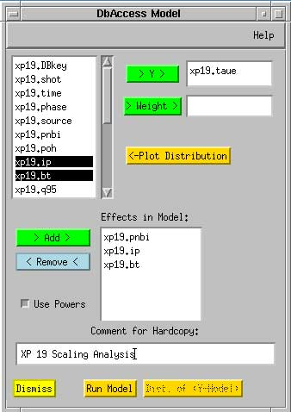
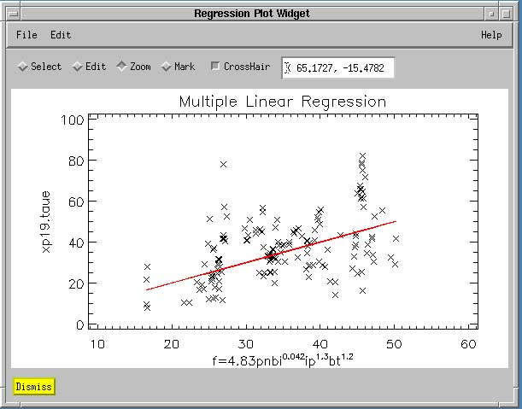
Statistical Interface in DbAccess
Multiple Linear Regression
Powers Optional
Weighting Optional
Distribution Plotting
Notes:
Especially good for creating scaling laws

Slide 20
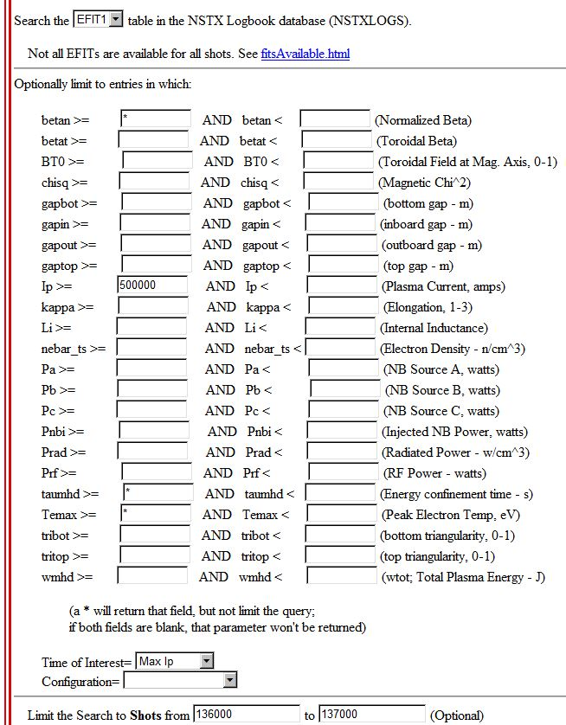
Search EFIT Database Table
http://nstx.pppl.gov/nstx/Software/WebTools/searchefitdb.html
Select shot, BETAN, IP, TAUMHD, TEMAX, TOI, TIME from EFIT
 | where shot>=136000 AND shot <=137000
 | AND IP>=500000 AND TOI='maxip' order by shot
shot | BETAN | IP | TAUMHD | TEMAX | TIME
136000 | 5.14471 | 751026 | -1.71009 | 177.696 | 0.553
136001 | 2.06752 | 775327 | -0.006489 | 0.923537 | 0.265
136002 | 3.32942 | 768031 | 0.03963 | 405.139 | 0.217
136003 | 3.50953 | 761056 | 0.057189 | 155.196 | 0.304
136004 | 1.64804 | 751014 | -0.021714 | 0.99357 | 0.249
136005 | 2.43354 | 775475 | -0.056866 | 0.739999 | 0.175
136006 | 3.56997 | 788279 | -0.077491 | 0.741862 | 0.193
136007 | 2.76261 | 781949 | -0.088126 | 1.34959 | 0.185
136008 | 1.66388 | 734348 | -0.048584 | 0.728282 | 0.583
136009 | 2.65181 | 779994 | -0.060781 | 0.681013 | 0.181
136010 | 2.23641 | 768482 | -0.067917 | 0.672851 | 0.169
136011 | 2.46628 | 772562 | -0.063587 | 0.668319 | 0.175
136012 | 2.72194 | 785012 | -0.053308 | 25.7932 | 0.18
136013 | 6.4532 | 744939 | -0.051581 | 345.731 | 0.535
136014 | 2.5175 | 776437 | -0.045682 | 238.921 | 0.175
136015 | 1.83123 | 757323 | -0.035338 | 0.695359 | 0.49
136016 | 0.99563 | 721911 | -0.019168 | 0.658756 | 0.41
136017 | 1.77389 | 760615 | -0.03144 | 0.836369 | 0.285
136018 | 1.85509 | 766116 | -0.065414 | 0.618252 | 0.169
136019 | 1.78315 | 767601 | 0.029537 | 1.18659 | 0.304
136020 | 2.95963 | 786564 | -0.065389 | 1.46719 | 0.185

Slide 21
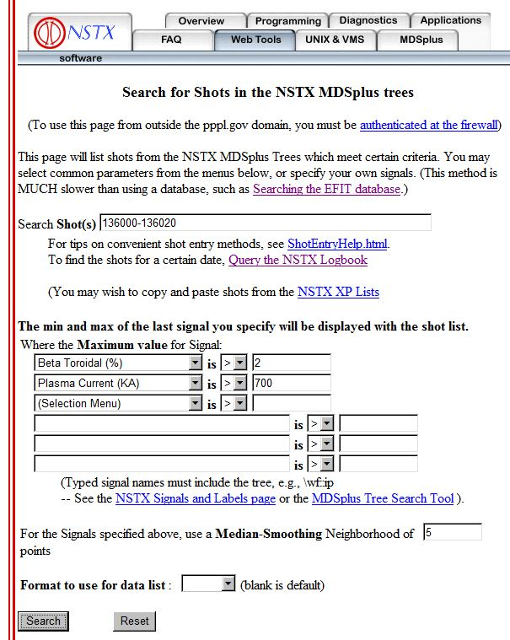
Search for shots with certain criteria
http://nstx.pppl.gov/nstx/Software/WebTools/mdsshots.html
Shots with a Max of \EFIT01::betat GT 2
and Shots with a Max of \wf::ip GT 700
SHOT | MIN | MAX | Units
------ | --------- | --------- | -----
136000 | -7.3507 | 800.045 | kA
136001 | -30.38 | 817.384 | kA
136002 | -27.772 | 853.651 | kA
136003 | -28.058 | 839.946 | kA
136004 | -32.09 | 819.479 | kA
136005 | -31.119 | 826.311 | kA
136006 | -31.303 | 808.516 | kA
136007 | -32.047 | 813.431 | kA
136008 | -27.533 | 825.746 | kA
136009 | -29.964 | 811.417 | kA
136010 | -32.703 | 810.815 | kA
136011 | -30.77 | 817.195 | kA
136012 | -32.254 | 807.92 | kA
136013 | -27.453 | 809.922 | kA
136014 | -26.624 | 806.96 | kA
136015 | -28.935 | 825.323 | kA
136016 | -31.572 | 846.212 | kA
136017 | -28.491 | 816.568 | kA
136018 | -30.761 | 805.05 | kA
136019 | -24.551 | 844.514 | kA
136020 | -28.067 | 813.223 | kA
Notes:
The columns shown are the min & max of the last signal specified

Slide 22
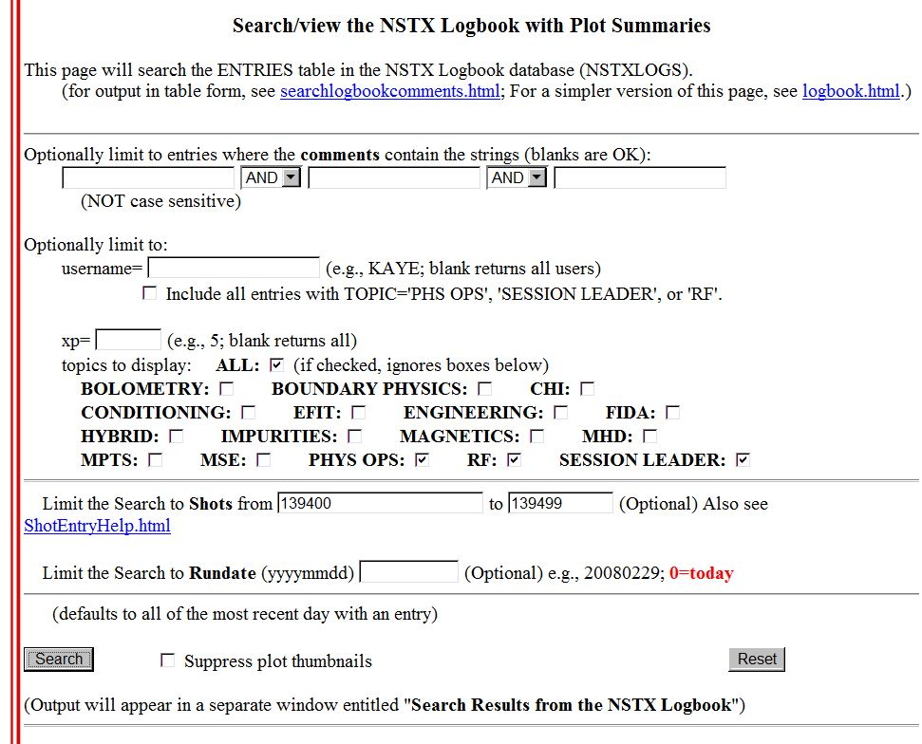

Search the NSTX Logbook
http://nstx.pppl.gov/nstx/Software/WebTools/weblogplus.html

Slide 23
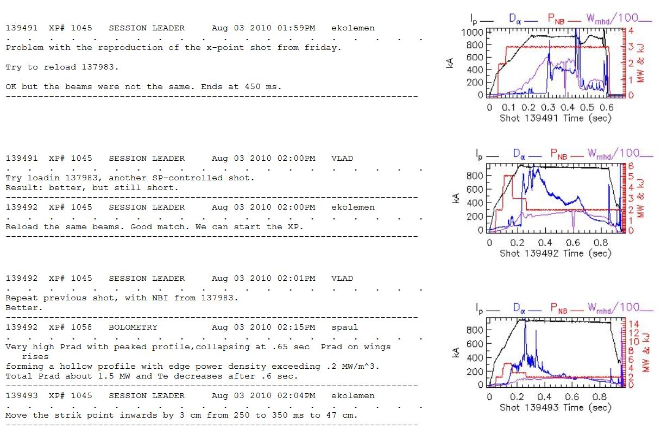
Output from Searching the NSTX Logbook

