Slide 1




NSTX-U
Supported by
Materials and Plasma-Facing Components (M&P) TSG Prioritization for FY2015 and campaign startup
Coll of Wm & Mary
Columbia U
CompX
General Atomics
FIU
INL
Johns Hopkins U
LANL
LLNL
Lodestar
MIT
Lehigh U
Nova Photonics
Old Dominion
ORNL
PPPL
Princeton U
Purdue U
SNL
Think Tank, Inc.
UC Davis
UC Irvine
UCLA
UCSD
U Colorado
U Illinois
U Maryland
U Rochester
U Tennessee
U Tulsa
U Washington
U Wisconsin
X Science LLC
Culham Sci Ctr
York U
Chubu U
Fukui U
Hiroshima U
Hyogo U
Kyoto U
Kyushu U
Kyushu Tokai U
NIFS
Niigata U
U Tokyo
JAEA
Inst for Nucl Res, Kiev
Ioffe Inst
TRINITI
Chonbuk Natl U
NFRI
KAIST
POSTECH
Seoul Natl U
ASIPP
CIEMAT
FOM Inst DIFFER
ENEA, Frascati
CEA, Cadarache
IPP, Jülich
IPP, Garching
ASCR, Czech Rep
M.A. Jaworski, C.H. Skinner,
J.-P. Allain, B. Wirth, R. Kaita
and R. Maingi
NSTX-U Pre-Forum Meeting #2
Jan 29, 2015 – B318, PPPL

Slide 2
Boron->Lithium transition input
Initial discussions indicate a lot of desire for boron campaign and establishment of boronized baseline performance
  Have unique opportunity to get surface science information on B vs. Li conditions – what is really happening?
  Could complement end-of-campaign Li->B experiment and address this question for future run campaigns
MAPP provides key capabilities not yet utilized on NSTX-U
We recommend gauging demand for B-conditions before deciding a transition date
  XP authors will be asked to specify B, or Li, or both conditions in the experiment
  XP authors will also be asked to develop a contingency plan (if possible) if Li-transition occurs early and no B data can be obtained

Slide 3
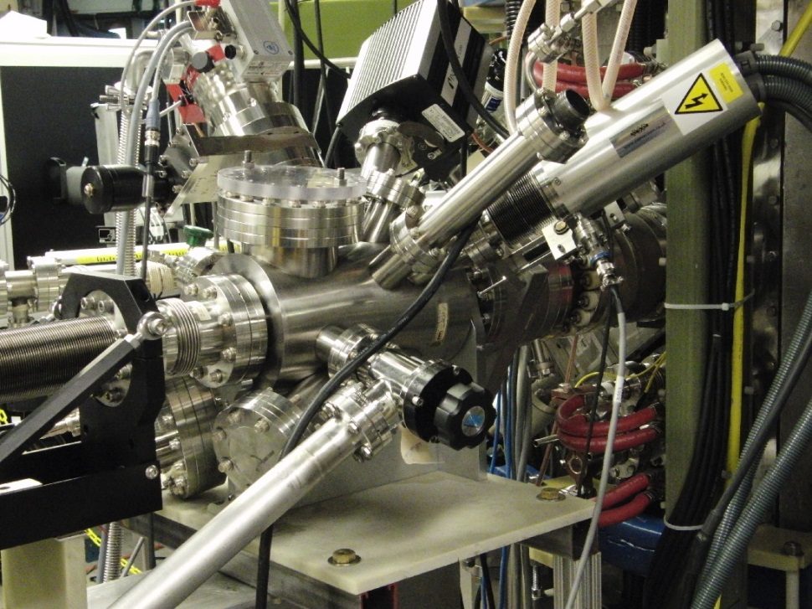
Materials Analysis and Particle Probe – enabling more than “waving dead chickens”
Turbopump
Residual gas analyzer
Hemispherical analyzer and microchannel plate detector
X-ray source (Mg Ka, Al Ka)
Translation bellows with attached rotary feedthrough
Ion source (He, Ne, Ar)
Analysis Technique | Fundamental Information | Status
X-ray photoelectron spec. (XPS) | Elemental/chemical state analysis | Operational
Thermal desorption spec. (TDS)* | Binding E of surface volatiles | Operational
Low-E ion scattering spec. (LEISS) Direct Recoil Spectroscopy (DRS) | Impurities with LEISS and H with DRS in forward scattering geometry | In development
*Possible XP – use sample heating capability to investigate effect of boronization with dTMB on PFC material at elevated temperature

Slide 4
Initial cut at XP/XMPs for run and B demand
Red Text = first 2 run months, Blue Text = experiments before Li transition
No. | Title | XP/XMP | Candidate Lead | First 2 months? | Candidate Theorist | Surf. Sci. | B and/or Li | Purpose
MP1 | MAPP operational readiness | XMP | Allain | Yes |  |  | B | Demonstration/model MAPP inter-discharge anaylsis
MP2 | Effect of B conditioning | XP | Skinner/Allain/ Bedoya | Yes | Wirth | yes | B | Correlate B-zation PFCs with discharge performance
MP3 | Effect of B->Li | XP | Skinner/Allain/ Bedoya | Maybe | Wirth | yes | and | Characterize surface conditions during transition to Li
MP4 | B vs. Li material migration | XP | Nichols | Maybe | Wirth | yes | and | Compositional variation at MAPP and QCM mass flux with WallDYN sim.
MP5a | High-Z reference discharge development | XMP | Jaworski | Maybe |  |  | B prefer. | Develop high-Z reference shape for future experiments. MP5a-can likely develop contingency for Li-only data
MP5b | Impact of B vs. Li on divertor conditions | XP | Jaworski | Maybe | SOLPS/UEDGE modeler? | yes? | and | Compare B vs. Li lifetimes and divertor impact for high-Z reference shape
MP6 | Far-SOL particle fluxes DSOL-34 | XP | Zweben/ Jaworski | No | Myra/?? | ?? | Or* | Examine far-sol filling and turbulence changes due to SP condition
MP7 | Leading edge heat fluxes DSOL-31 | XP | Gray | Maybe | Jaworski PFC/kinetic ?? | ?? | B prefer. | Determine leading edge heating with existing graphite gaps. Compare with JET-ILW.
MP8 | Li -> B transition | XP | ?? | No | ?? | yes? | Li | Determine if B-conditions can be re-established mid-run
MP9 | …

Slide 5
Old slides

Slide 6
FY2016 milestone R16-2 needs baseline data before high-Z upgrade
Tile design process has commenced
  Still evaluating pros/cons between W vs. Mo
  Targeting row-2 of NSTX-U with minimal divertor height changes
Development of reference, high-Z discharge proposed at previous meeting alongside reference parameter scans (e.g. power, connection length, current)
  Already expect useful information comparing B vs. Li conditions on graphite substrates (e.g. erosion vs. erosion + diffusion)
  Expect to repeat discharges with high-Z to simultaneously get 4-point experimental matrix in substrates and coatings
Reference shape will also provide closer strike-point to MAPP location for material transport and evolution studies

Slide 7
ITPA-DSOL activities have a lot of leverage with high-Z programme at this time
DSOL-31: Leading edge power loading and monoblock shaping
  High-spatial resolution IR measurements of existing carbon tile gaps to determine whether heat flux is “missing” in NSTX-U as in JET-ILW
  Start determining “threat level” to NSTX-U PFCs
DSOL-34: Far-SOL fluxes and link to detachment
  Diagnose whether conditions at strike-point enhance cross-field transport into far-SOL to better predict first-wall power loading (e.g. LPs + GPI)
  Also impinges Particle Control TF and cryo-pump calculations
DSOL-35: In/out divertor ELM-energy density asymmetries
  Determine power splitting during ELMs and impact on design margins for PFCs during ELMy discharges

Slide 8
Guidance for writing strong-XPs in the M&P TSG
Goal: move away from “kitchen physics” branding
Having the following items indicated in the XP idea submission will get you extra consideration from M&P TSG leadership group
  Clear, hypothesis-driven experimental proposals
  Strong partnering with theorists/modelers informing experimental scans/conditions
  Partnering with surface-science and other materials groups who can supplement tokamak studies with lab measurements
  Well-defined initial publication strategy including XP partners and diagnosticians
M&P TSG leadership is here to help!
  Discussions to date have already started finding potential sticky parts in this, but we are here to help clarify and help make connections

Slide 9
MAPP and LGI presentations…

Slide 10
Ye Olde Slides from pre-forum meeting #1 beyond here

Slide 11
FY 2016 research milestone will drive XP/XMP development (ITPA-DSOL experiments relevant to high-Z upgrade)
R(16-2): Assess high-Z divertor PFC performance and impact on operating scenarios (joint with divertor-SOL TSG)
  Carbon-only baseline needed in FY2015 for comparison
  Validate high-Z PFC design in actual operation
  Establish additional heat-flux mitigation schemes needed for whole-machine high-Z conversion
  Determine high-Z impurity production/influx and impact on operations and mitigate if necessary
DSOL-31: Leading edge power loading and monoblock shaping
  High-spatial resolution IR measurements of existing carbon tile gaps to determine whether heat flux is “missing” in NSTX-U as in JET-ILW
DSOL-34: Far-SOL fluxes and link to detachment
  Diagnose whether conditions at strike-point enhance cross-field transport into far-SOL to better predict first-wall power loading (e.g. LPs + GPI)
DSOL-35: In/out divertor ELM-energy density asymmetries
  Determine power splitting during ELMs and impact on design margins for PFCs during ELMy discharges

Slide 12
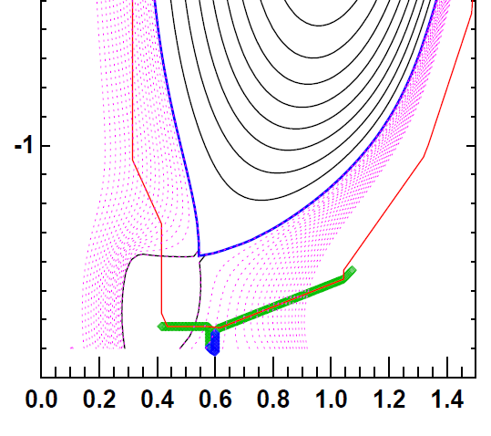
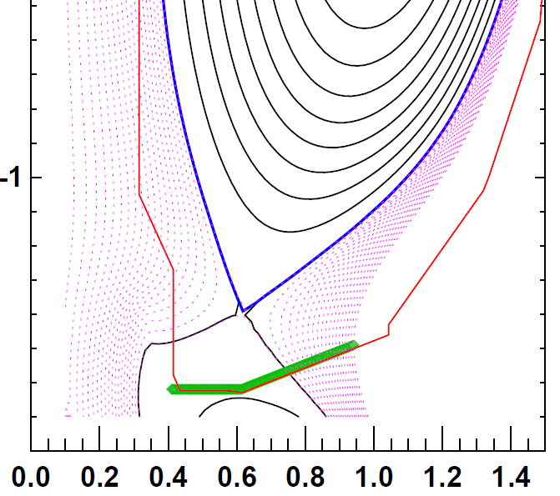
Develop high-Z relevant baseline discharge in FY2015
Incremental upgrade to high-Z proposed for outboard row 2 tiles
Proposed figure-of-merit (FOM) for divertor PFC is unmitigated heat-flux to divertor surfaces
  High-delta NSTX-U reference discharge: P_{inj}~12MW FOM up to 60MW/m²
  Medium-delta, high-Z discharge: P_{inj}~9MW FOM up to 40MW/m²
FY2015 development of medium-delta shape and create “standardized” parameter scans
  P_{inj}, q95, divertor gas puffing, B-field and angle-of-incidence, other mitigation
  Duplicate scans in FY2016 (single variable experiment!)
High-delta “fiducial”
discharge FOM ~ 60 MW/m²
Medium-delta high-Z fiducial discharge
FOM ~ 40 MW/m²
Row 2 Tile location

Slide 13
Critical diagnostics for milestone and DSOL activities
ASC-support with wall conditioning experiments
  MAPP characterization of boronization and lithiumization
Critical diagnostics/capabilities for milestone R16-2:
  IR thermography for heat flux, including high-spatial resolution view (DSOL-31)
  Langmuir probe for particle fluxes to divertor under different operating conditions (low-high density, detached, etc.) (also DSOL-34)
  Visible and X-ray emission spectroscopy to characterize impurity production, SOL and core conditions
  Managing plasma-surface interactions of boronized and lithiumized high-Z PFCs with MAPP and standard plasma diagnostics
Additional diagnostics/capabilities would be beneficial:
  IR view on vertical target for DSOL-35 (or new plasma shape)
  GPI to support far-SOL effects (DSOL-34)
  Divertor bolometry for power-balance evaluation
  MAPP measurements and post-run coupon analysis for material transport studies (support new model capabilities with WallDYN)
  Surface science studies, e.g. mixed-material sputtering and detailed plasma-exposed sample characterization

