Slide 1




NSTX-U
Supported by
Program Update on Roles, Responsibilities, Goals for Task Forces and Working Groups
Coll of Wm & Mary
Columbia U
CompX
General Atomics
FIU
INL
Johns Hopkins U
LANL
LLNL
Lodestar
MIT
Lehigh U
Nova Photonics
Old Dominion
ORNL
PPPL
Princeton U
Purdue U
SNL
Think Tank, Inc.
UC Davis
UC Irvine
UCLA
UCSD
U Colorado
U Illinois
U Maryland
U Rochester
U Tennessee
U Tulsa
U Washington
U Wisconsin
X Science LLC
J. Menard
For the NSTX-U Research Team
Culham Sci Ctr
York U
Chubu U
Fukui U
Hiroshima U
Hyogo U
Kyoto U
Kyushu U
Kyushu Tokai U
NIFS
Niigata U
U Tokyo
JAEA
Inst for Nucl Res, Kiev
Ioffe Inst
TRINITI
Chonbuk Natl U
NFRI
KAIST
POSTECH
Seoul Natl U
ASIPP
CIEMAT
FOM Inst DIFFER
ENEA, Frascati
CEA, Cadarache
IPP, Jülich
IPP, Garching
ASCR, Czech Rep
NSTX-U Pre-Forum Meeting #2 – Day 2
PPPL LSB B318
January 29, 2014

Slide 2
Agenda
Roles, responsibilities, charges of groups
Recap of guidance on run schedule, operational capability (near and long-term)
Research Forum website
  Open for idea submissions Feb 1
  Request all ideas to be submitted by Feb 22

Slide 3
Roles / Responsibilities for Science Groups
Work with Program/TSGs to set run-time allocation guidance
Coordinate research of TSGs within the SG – promote experiments / plans that achieve multiple scientific goals
  Critical to maximizing scientific output per shot
  “Coordinated” XPs will receive higher priority / more run time
Inform Run Coordinator when XP is ready for final review
Provide summaries and highlights of scientific progress at/for NSTX-U team meetings, FES/quarterly reviews, other venues
Aid dissemination of results with Physics Analysis Division
  Journal publications, invited talks, seminars, colloquia, conferences, ITPA, BPO
Coordinate / down-select milestone ideas from TSGs in SG
Provide feedback / comment on annual Field Work Proposal
Assist / report to the NSTX-U Program and Project directors

Slide 4
Roles / Responsibilities for Topical Science Groups
Lead brainstorming, organization, writing of 5 year plan topics
Determine and address highest priority scientific issues through discussion and consensus at open meetings
Organize the NSTX-U Research Forum sessions for the TSG
Draft scientific milestone ideas utilizing expertise of the TSG
Propose and execute experiments to achieve milestones and address priorities
With SG leaders, define facility and theory resources to achieve research goals
Present TSG / SG results and plans at NSTX-U PAC meetings
Assist / report to the NSTX-U Science Group leaders

Slide 5
Roles / Responsibilities for University Representatives
Contribute to prioritization within TSGs
  Help decide/draft milestones, XMP/XP prioritization
  Help identify how your tools/codes/diagnostics/personnel can contribute to the group and the larger NSTX-U program
  Advocate for your own research and for the needs of the larger NSTX-U research program
Advocate for your TSG research outside of NSTX-U
  Seek input/interest from those not funded by NSTX-U
    Particularly from your own University and other universities
    Includes giving seminars at other Universities / institutions describing NSTX-U and/or your research
Help identify best tools for remote participation, and remote experimentation

Slide 6
Roles / Responsibilities for Task Forces
Address specific operational and/or scientific goal that cuts across or impacts multiple SGs / TSGs
Goal must be very high priority within research program
Receives dedicated run-time, and has dedicated session at Research Forum
  Similar to a TSG, but may not necessarily have theory/modelling or university representatives – depends on duration or scope
Organizes experimental proposals to achieve goal
Finite duration - nominally 1-2 years, renewable if necessary
TF leadership should nominally have a leader and a deputy, and should include at least 1 collaborator if possible
Reports directly to Program / Project

Slide 7
Roles / Responsibilities for Working Groups
Responds to specific programmatic or technical charge from NSTX-U Program or Project
Addresses issues that cross-cut more than one SG or TSG
Nominal lifetime = 1-2 years, can be extended/renewed
Provides points of contact between NSTX-U and other groups as necessary (e.g. PPPL theory, FESAC, ITPA)
Does not have dedicated NSTX-U run time, but provides recommendations on XP prioritization, other resource needs
WG leadership should nominally have a leader and a deputy, and should include at least 1 collaborator if possible

Slide 8
Goals / Charges to Task Force(s) and Working Group(s)
Please see subsequent slides

Slide 9
Particle Control Task Force (PC-TF)
Leader/Deputy: Rajesh Maingi, John Canik
Task force goal:
  “Develop pumping and fueling tools, operating scenarios, and control systems to achieve main-ion and impurity density control for long-pulse”
Scope includes XPs related to:
  Main-ion fueling optimization via PCS and/or real-time control
  Wall coating and preparation optimization for increased particle pumping
  Reduction / control of impurity ion source rates
  Natural and paced ELMs for impurity and main ion flushing
  Real-time density measurements for density feed-back control
  Physics design and performance characterization of divertor cryo-pump (if/as resources permit implementation of cryo-pump)
Due date: ASAP, end of FY16 run for non-cryo elements

Slide 10
Non-axisymmetric Control Coil Specification Working Group (NCC-WG)
Leader/Deputy: Jong-Kyu Park, John Canik
Charges:
  Specify required coil current, frequency, and location for NCC
    Consider full set (24 coils) and partial set (12 coils)
    Consider range of applications: NTV, EFC, RWM, RMP, ELM pacing, etc...
  Specify required number of independent SPA channels vs. applications and requested capabilities
Deliverables:
  Organize summary presentation(s) on IPECOPT analysis results
  Give presentation(s) making recommendations on NCC and SPA performance requirements, gather and incorporate team input
  Generate written report (5-20pp Word file) documenting NCC and SPA requirements for use in developing engineering requirements document (GRD) to drive engineering design
Due dates:
  Initial written report April 2015 if possible (no later than May)
  Consult with Project/engineers/designers as needed until implementation

Slide 11
Disruption Prediction/Avoidance/Mitigation Working Group (DPAM-WG)
Leader/Deputy: Steve Sabbagh, Roger Raman
Charges:
  How will NSTX-U interface to the upcoming FES workshops, and longer-term, address the FESAC/FES Tier 1 issue of “Transients" generally?
    In which disruption research areas can NSTX-U make leading contributions?
    What are the associated long-term resource needs from NSTX-U?
  What are the leading/highest priority NSTX-U contributions to JRT-16?
    What are the required resources during FY15-16 to support JRT-16?
  How can NSTX-U minimize disruptivity rates?
    What are leading causes of disruptions in NSTX & during initial NSTX-U ops?
    What prerequisites / tools are needed to prepare NSTX-U to operate a large # of sequential shot-seconds (say 1-5 shot minutes) without a disruption?
Tasks: Organize meetings/reports to address above charges
Due dates:
  1a – March/April 2015, 1b May/June 2015
  2a – April 2015, 3a – end of CY 2015, 3b – TBD/long-term

Slide 12
Run schedule assumptions
FY15
Early FY16
Run Weeks 1-4
Run Weeks 5-8
Run Weeks 9-12
Run Weeks 13-16
17-18
Commissioning
Science
Science
Science
Mid-run assessment
Scope of pre-forum meeting #2 - see next page for additional details
Scope of Research Forum
Pre-forum meeting #2 emphasized XMP/XP title, goal, author identification to cover first 2 run months (Weeks 1-8)
Forum should emphasize prioritization of XPs for weeks 3-18, but also document commissioning XMP/XP goals + run-time
Mid-run (re-)assessment after first 6-8 Science run-weeks

Slide 13
Operations assumptions for first 2 run-months
Machine Commissioning…assume 1 month (run weeks 1-4)
  Develop basic breakdown, current ramp, shape/position control, diverted plasmas, H-mode access, basic fuelling optimizations.
  Goal: 1 MA, 0.5 T, NBI-heated H-mode (i.e. ~NSTX fiducial levels)
  Diagnostic commissioning
  Boronized PFCs
  Mostly XMPs
  What science (aka XPs) can be done during this phase?
1st Month of Science Campaign (run weeks 5-8)
  Boronized PFCs, possibly begin lithium coatings
  Operations and basic profile diagnostics, neutron rate,…
  Operation up to 1.4 MA and 0.65 T, 2 seconds
  6 beam sources up to 90 kV
  HHFW available for commissioning
  What critical XPs can/should be done during this phase?

Slide 14
Strategy / staging for achieving full NSTX-U parameters
Parameter | NSTX (Max.) | FY 2015 NSTX-U Operations | FY 2016 NSTX-U Operations | FY 2017 NSTX-U Operations | Ultimate Goal
I_{P} [MA] | 1.2 | ~1.6 | 2.0 | 2.0 | 2.0
B_{T} [T] | 0.55 | ~0.8 | 1.0 | 1.0 | 1.0
Allowed TF I²t [MA²s] | 7.3 | 80 | 120 | 160 | 160
Longest I_{P} Flat-Top at max. I²t, I_{P}, and B_{T} [s] | ~0.4 | ~3.5 | ~3 | 5 | 5
1st year goal: operating points with forces up to ½ the way between NSTX and NSTX-U, ½ the design-point heating of any coil
  Will permit up to ~5 second operation at B_{T}~0.65
2nd year goal: Full field and current, but still limiting the coil heating
  Will revisit year 2 parameters once year 1 data has been accumulated
3rd year goal: Full capability

Slide 15
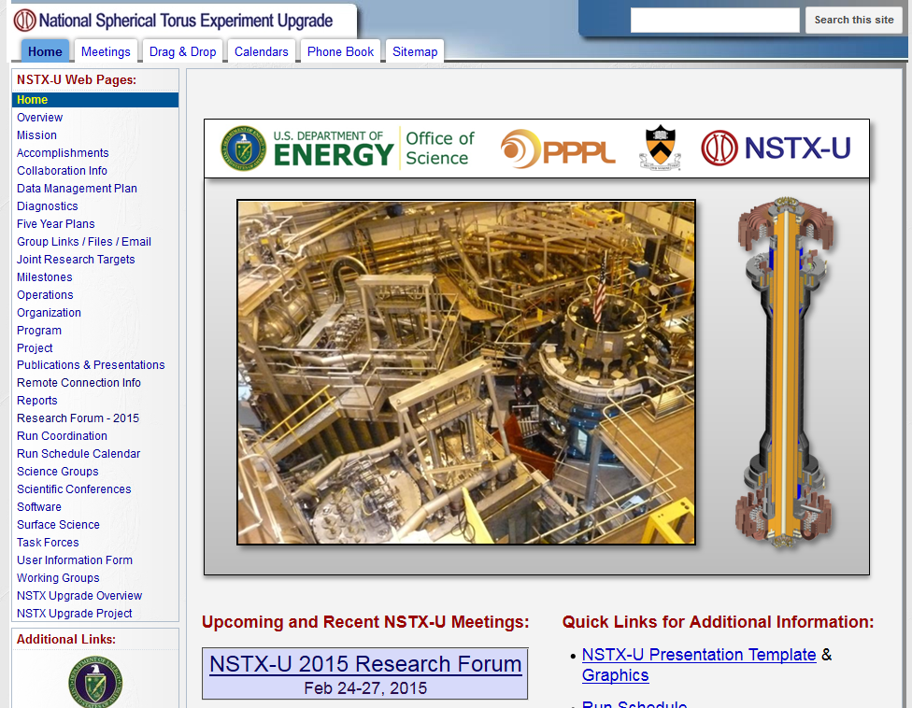
Forum website now functional
Form for XP idea submissions will open Feb 1

