Slide 1


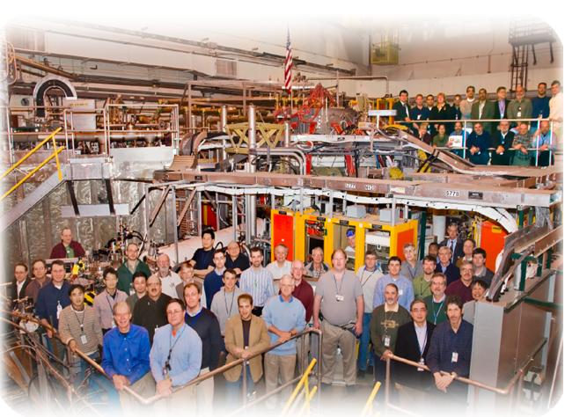

NSTX
Supported by
Relay Feedback and X-point Height Control
College W&M
Colorado Sch Mines
Columbia U
CompX
General Atomics
INL
Johns Hopkins U
LANL
LLNL
Lodestar
MIT
Nova Photonics
New York U
Old Dominion U
ORNL
PPPL
PSI
Princeton U
Purdue U
SNL
Think Tank, Inc.
UC Davis
UC Irvine
UCLA
UCSD
U Colorado
U Illinois
U Maryland
U Rochester
U Washington
U Wisconsin
Egemen Kolemen
S. Gerhardt and D. A. Gates
Culham Sci Ctr
U St. Andrews
York U
Chubu U
Fukui U
Hiroshima U
Hyogo U
Kyoto U
Kyushu U
Kyushu Tokai U
NIFS
Niigata U
U Tokyo
JAEA
Hebrew U
Ioffe Inst
RRC Kurchatov Inst
TRINITI
KBSI
KAIST
POSTECH
ASIPP
ENEA, Frascati
CEA, Cadarache
IPP, Jülich
IPP, Garching
ASCR, Czech Rep
U Quebec
2010 Results Review
Nov/30/2010

Slide 2
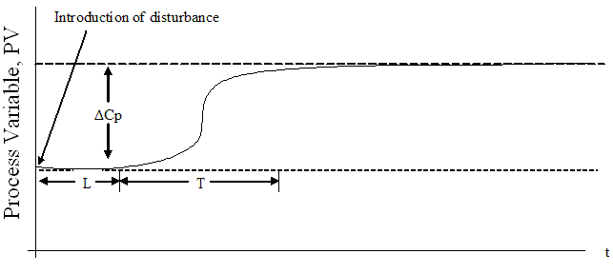
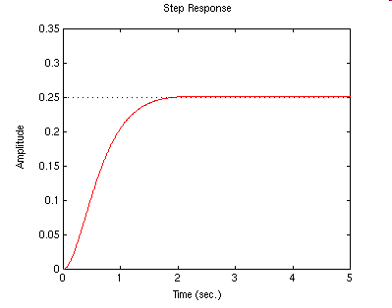
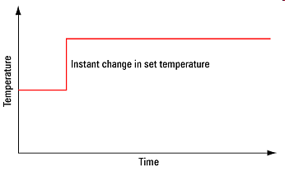
2009 Run: Experimental System ID (Open Loop)
System Id: Identify the effect of the actuator on the boundary shape.
Reaction Curve Method
From Step Response obtain:
  Time delay, rise time
  and size of change gives
  the control tuning parameters.
ΔP
Time

Slide 3
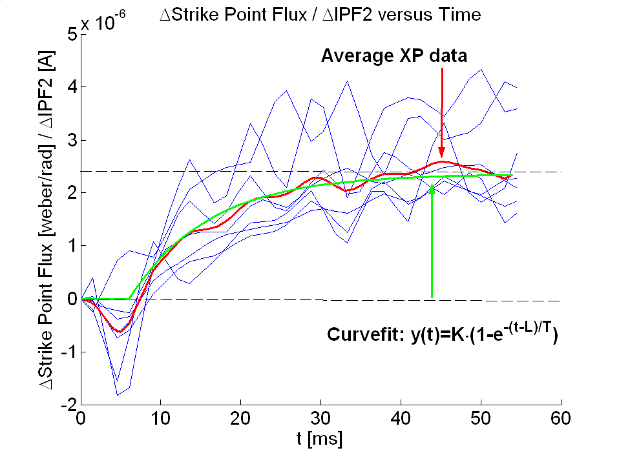
2009 Run: Experimental System ID (Open Loop)
System Id: Identify the effect of the actuator on the boundary shape.
Reaction Curve Method
Problem:
  Many shots needed
  Need the actuator in open loop.
  Not precise
ΔP
System Id results from 2009 run

Slide 4
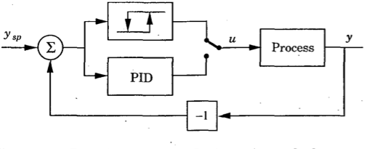
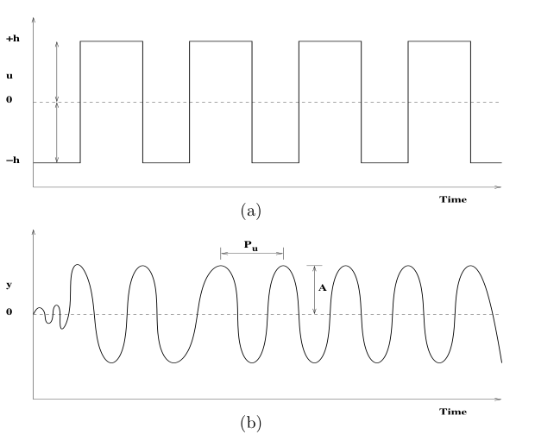
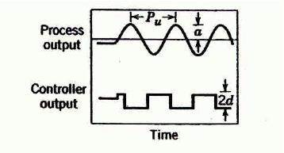
Experimental System ID:
Closed Loop Auto-tune with Relay Feedback
Advantages:
  Only a single experiment is needed.
  Closed loop:
    More stable
    Enable system ID for actuators that can’t be open loop (for example: vertical control)
Control
Output
→
The closed-loop plant response period (P_{u}) & amplitude (A) are used for PID controller tuning.
Process
Output

Slide 5
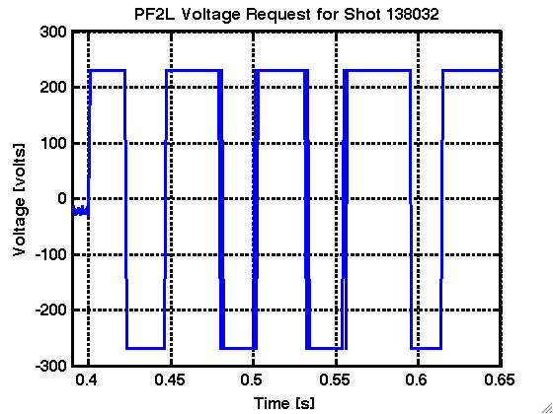
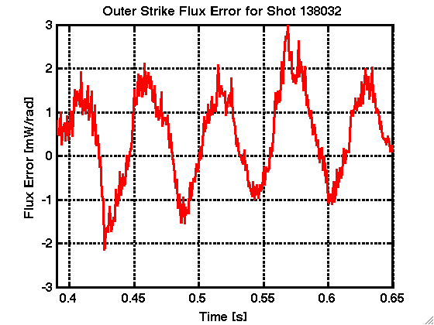
Experimental System ID:
Closed Loop Auto-tune with Relay Feedback
Advantages:
  Only a single experiment is needed.
  Closed loop:
    More stable
    Enable system ID for actuators that can’t be open loop (for example: vertical control)
h
Control
Output
→
The closed-loop plant response period (P_{u}) & amplitude (A) are used for PID controller tuning.
Process
Output
A
P_{u}

Slide 6
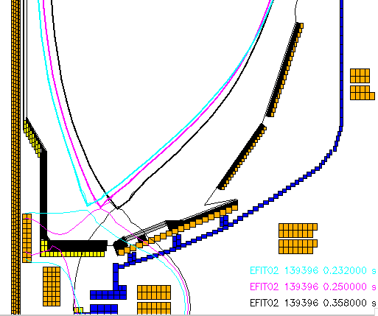
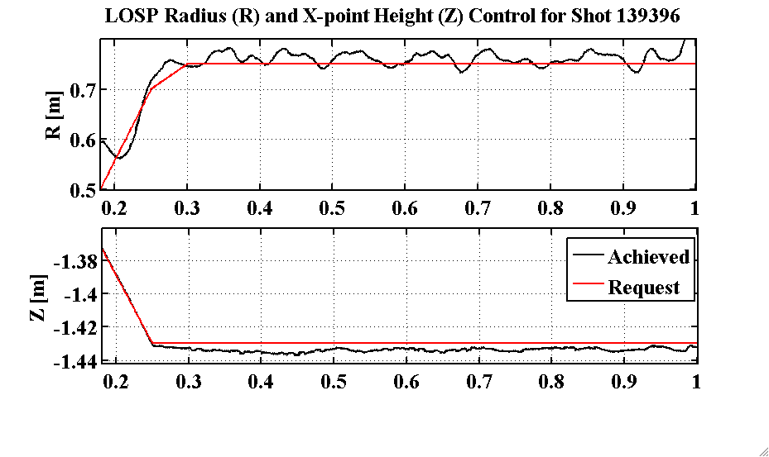

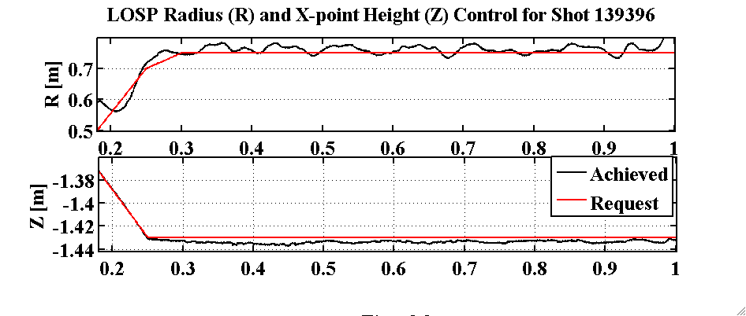
Successful Developed Combined X-point Height / SP Control
Tuned via Relay-Feedback.
Achieved RMS <1 cm X-point height error and <2 cm SP.
Scenario used for LLD experiments.
Evolution of Plasma Boundary: X-point height roughly constant as OSP ramps

Slide 7
For 2011: Solution to “Hand-off” Problem
Problem when changing between control phases.
Normal Control has two parts:
  Trajectory control: Scenario Development (Feed forward)
  Feedback control: Controlling parameters close to the defined scenario.
Need: Ability to add these two waveforms.
  Simply be able to add PID output to the Voltage from the last phase. (We have this capability only for Relay Feedback but not for regular PID).
Then, we will avoid “hand-off” problem

Slide 8
NSTX
Supported by
Squareness XP
College W&M
Colorado Sch Mines
Columbia U
CompX
General Atomics
INL
Johns Hopkins U
LANL
LLNL
Lodestar
MIT
Nova Photonics
New York U
Old Dominion U
ORNL
PPPL
PSI
Princeton U
Purdue U
SNL
Think Tank, Inc.
UC Davis
UC Irvine
UCLA
UCSD
U Colorado
U Illinois
U Maryland
U Rochester
U Washington
U Wisconsin
Egemen Kolemen
S. Gerhardt and D. A. Gates
Culham Sci Ctr
U St. Andrews
York U
Chubu U
Fukui U
Hiroshima U
Hyogo U
Kyoto U
Kyushu U
Kyushu Tokai U
NIFS
Niigata U
U Tokyo
JAEA
Hebrew U
Ioffe Inst
RRC Kurchatov Inst
TRINITI
KBSI
KAIST
POSTECH
ASIPP
ENEA, Frascati
CEA, Cadarache
IPP, Jülich
IPP, Garching
ASCR, Czech Rep
U Quebec
2010 Results Review
Nov/30/2010

Slide 9
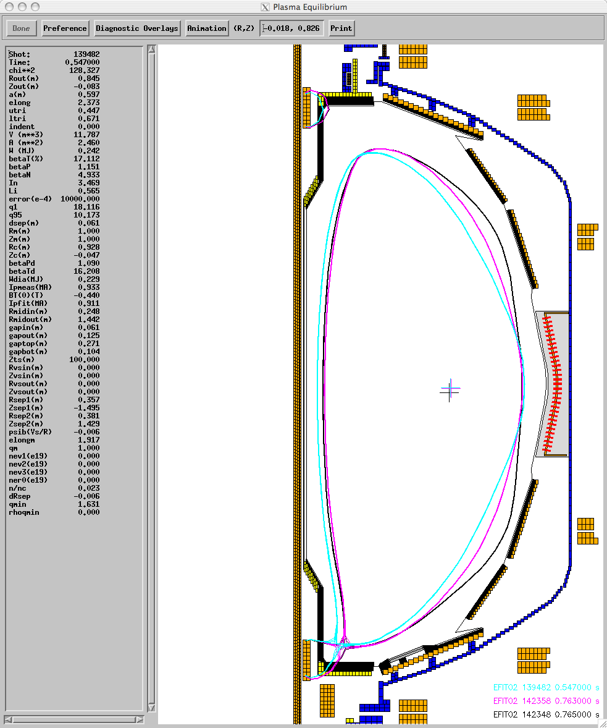

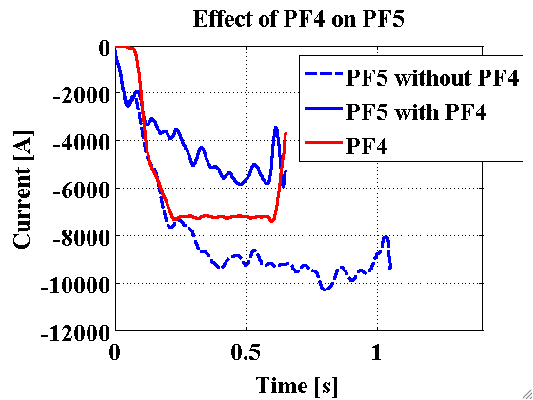
First Ever Use of PF4 for Shape Optimization
  Motivation 1: Increased current capability of NSTX Upgrade may require vertical field from the PF4 in addition to PF5.
    Preprogram PF4 with PF5 for outer gap control
Pos. PF4
PF5
PF4
Neg. PF4
Without PF4

Slide 10
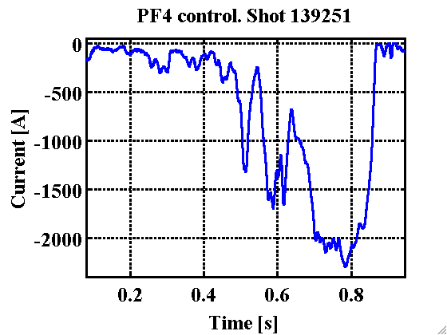
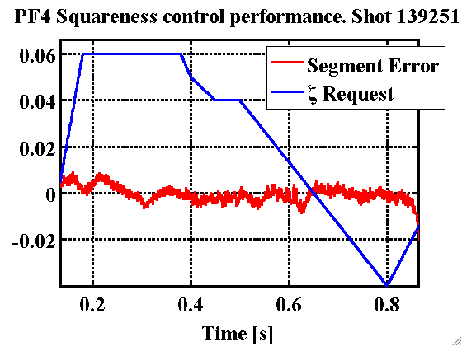
Squareness, ζ, Control with PF4
Motivation: Assess the physics impact of squareness variation while other shape parameters are fixed.
PF4 best ζ control candidate. PF3/PF4 effect ζ but PF3 used for vertical stability.
Achieved stable ζ tracking via PF4.
Effect of ζ on plasma is being studied.
Pos. PF4
PF5
PF4
Neg. PF4
Without PF4

Slide 11
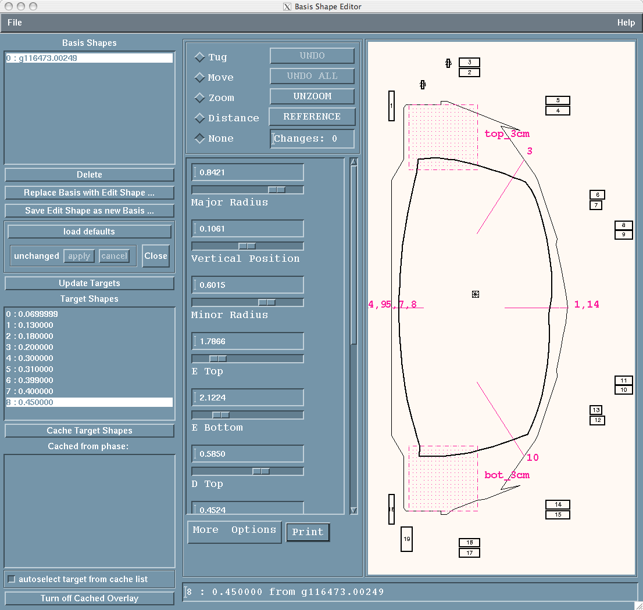
XMP Control Results: PF3-PF4 interaction
To solve this problem, move the PF3 and PF4 control segment.
Could not do this:
  Problem with PCS Segment Editor.
  Hopefully will be fixed for 2011.
To overcome the problem without changing the segments:
Hand adjust a non-realistic looking shape request.
Squareness Request of +0.4 from the normal request.
Works but don’t use the squareness in these shots.

Slide 12
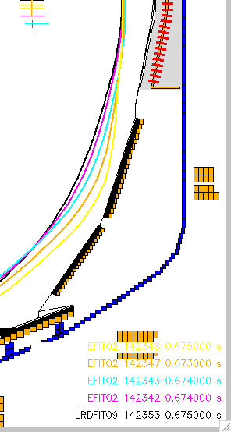
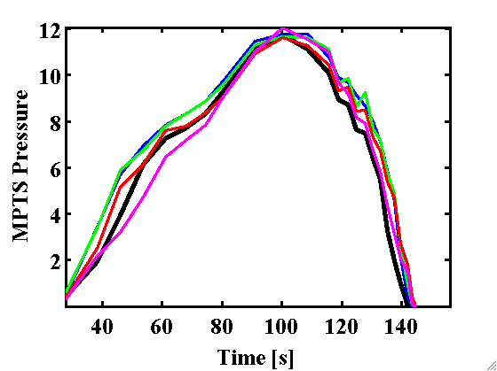
Pressure Profile Change as PF4 Increases
PF4= 0, 1, 4, 6, 8
PF4 (opposing PF5) up to 5 kA (~2 inches in figure) increases pressure
Too high PF4 interacts with the wall and plasma is not as good.

Slide 13
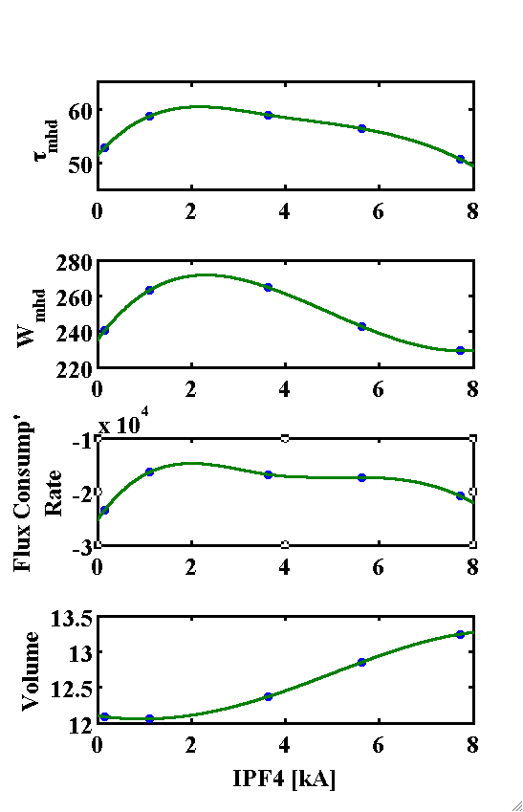
Higher Performance: PF4 of 1-4 kA
Optimal PF4 ~1-4 kA for performance.
Confinement time increases
Energy confinement increases
Flux consumption reduces.
Too high PF4 interacts with the wall and plasma is not as good.
Note for comparison:
Negative squareness results were all worse than PF4=0 fiducial case.
[142353,142342,142343,142347,142348]

Slide 14
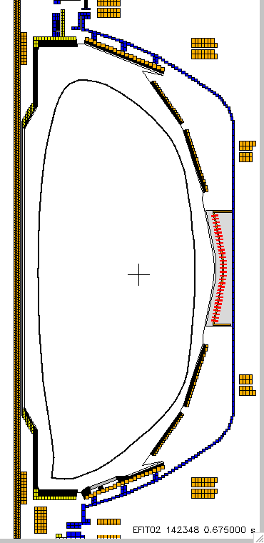
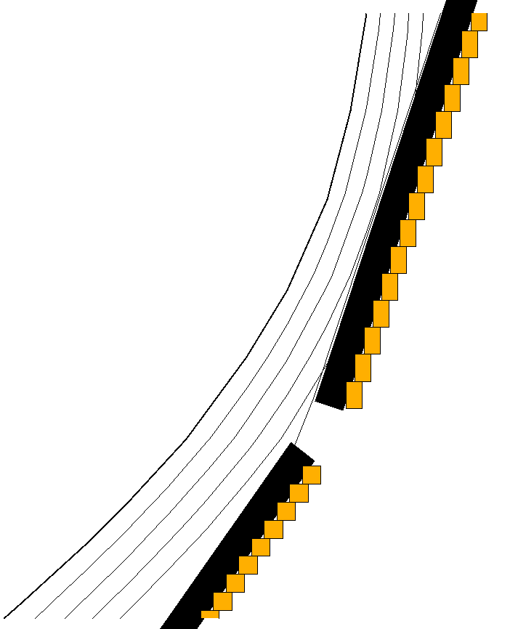
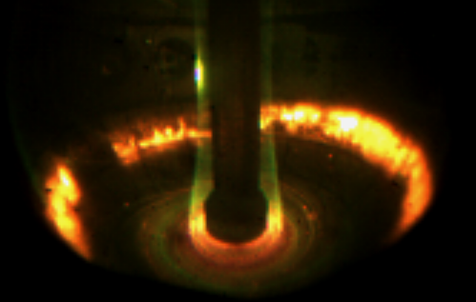
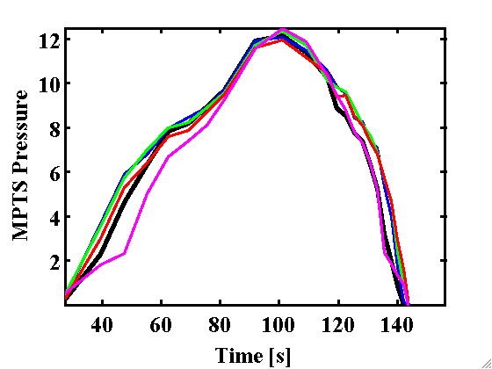
PF4 at 8 kA, High Squareness
Each Line is 1 cm apart
As PF4 gets close to 8 kA:
Last closed flux surface gets 3-4 cm close to the wall.
Pressure profile degrades
PF4= 0, 1, 4, 6, 8

Slide 15
NSTX
Supported by
Vertical Stability for NSTX and NSTX-U
College W&M
Colorado Sch Mines
Columbia U
CompX
General Atomics
INL
Johns Hopkins U
LANL
LLNL
Lodestar
MIT
Nova Photonics
New York U
Old Dominion U
ORNL
PPPL
PSI
Princeton U
Purdue U
SNL
Think Tank, Inc.
UC Davis
UC Irvine
UCLA
UCSD
U Colorado
U Illinois
U Maryland
U Rochester
U Washington
U Wisconsin
Egemen Kolemen
D. A. Gates, S. Gerhardt
Culham Sci Ctr
U St. Andrews
York U
Chubu U
Fukui U
Hiroshima U
Hyogo U
Kyoto U
Kyushu U
Kyushu Tokai U
NIFS
Niigata U
U Tokyo
JAEA
Hebrew U
Ioffe Inst
RRC Kurchatov Inst
TRINITI
KBSI
KAIST
POSTECH
ASIPP
ENEA, Frascati
CEA, Cadarache
IPP, Jülich
IPP, Garching
ASCR, Czech Rep
U Quebec
Monday Physics Meeting
PPPL, NJ
Nov/15/2010

Slide 16
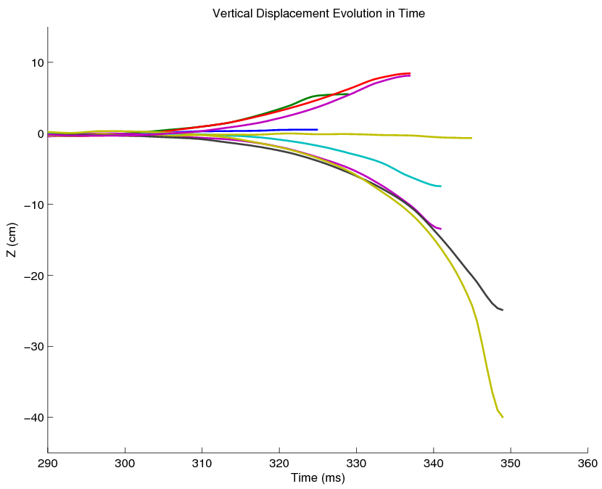
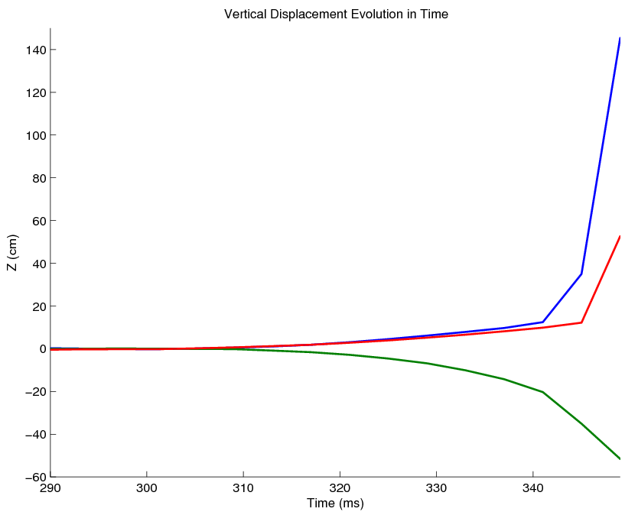
2008 Run: Vertical Displacement Measurements
Vertical displacement for controllable shots
(Cut off at the point of return)
Vertical displacement for uncontrollable shots
At 300 ms, we turned the controller off and let the plasma drift.
When we turned the control back on some of the shots recovered while others hit the wall.

Slide 17
Experimental LRDFIT Growth Rate (Gamma) 54-95 s^-1
 |  |  |  | Control Turned Off |  |  | Control Turned On |  |  | Peak Plasma Displacement |  |  | Gamma | Voltage
 | Egemen # | Shot | ms | t_0 | z_0 | li_0 | t_turn | z_turn | li_turn | t_f | z_f | li_f | s^-1 | ave Pf3U&2L
VDE +Z | 1 | 127074 | 20 | 0.301 | -0.0018 | 1.3436 | 0.32 | 0.0046 | 1.3865 | 0.325 | 0.005 | 1.3939 | no vde at all
 | 2 | 127075 | 20 | 0.301 | 0.0005 | 1.3774 | 0.32 | 0.0344 | 1.4927 | 0.329 | 0.0552 | 1.61 | 95 | 600
max controlled | 3 | 127076 | 30 | 0.301 | -0.0025 | 1.4768 | 0.33 | 0.0663 | 2.1936 | 0.337 | 0.0845 | 3.5009 | 70 | 1400
 | 14 | 127087 | 30 | 0.301 | -0.003 | 1.3482 | 0.33 | 0.0587 | 1.6485 | 0.337 | 0.0814 | 2.0792 | 74 | 1200
un-controlled | 10 | 127083 | 40 | 0.301 | -0.002 | 1.378 | 0.34 | 0.1176 | 3.5021 | 0.341 | 0.1244 | 3.7423 | 78 | 1600
un-controlled | 13 | 127086 | 40 | 0.301 | -0.0025 | 1.3885 | 0.34 | 0.0943 | 3.3401 | 0.349 | 0.5268 | 6.3724 | 64 | 1600
VDE -Z | 5 | 127078 | 35 | 0.301 | -0.0013 | 1.3602 | 0.335 | -0.0509 | 1.1928 | 0.341 | -0.0746 | 1.1584 | 61 | 800
 | 6 | 127079 | 35 | 0.301 | -0.0009 | 1.3592 | 0.335 | -0.0865 | 1.1954 | 0.341 | -0.1347 | 1.1683 | 73 | 1300
 | 7 | 127080 | 40 | 0.301 | -0.0037 | 1.4283 | 0.34 | -0.005 | 1.46 | 0.345 | -0.0066 | 1.4403 | no vde - control made unstable
 | 8 | 127081 | 40 | 0.301 | -0.0034 | 1.4129 | 0.34 | -0.1369 | 1.1969 | 0.349 | -0.2491 | 1.0877 | 69 | 1500
max controlled | 12 | 127085 | 40 | 0.301 | 0.0027 | 1.3899 | 0.34 | -0.1504 | 1.1748 | 0.349 | -0.4006 | 0.9388 | 54 | 1600
un-controlled | 11 | 127084 | 40 | 0.301 | 0.0001 | 1.3759 | 0.34 | -0.1879 | 1.1783 | 0.353 | -0.6069 | 0.7328 | 67 | 1600
straight VDE | 4 | 127077 | none |  |  |  |  |  |  |  |  |  | 74
Notes:
{\mathcal J} = \kappa_1 \int_t \int_\psi \left[ v_t(\psi,t) - v_t^*(\psi,t)\right]^2 d\psi\,dt + \kappa_2 \int_t \int_\psi f_\text{NBI}^2(\psi,t) d\psi\,dt
17

Slide 18
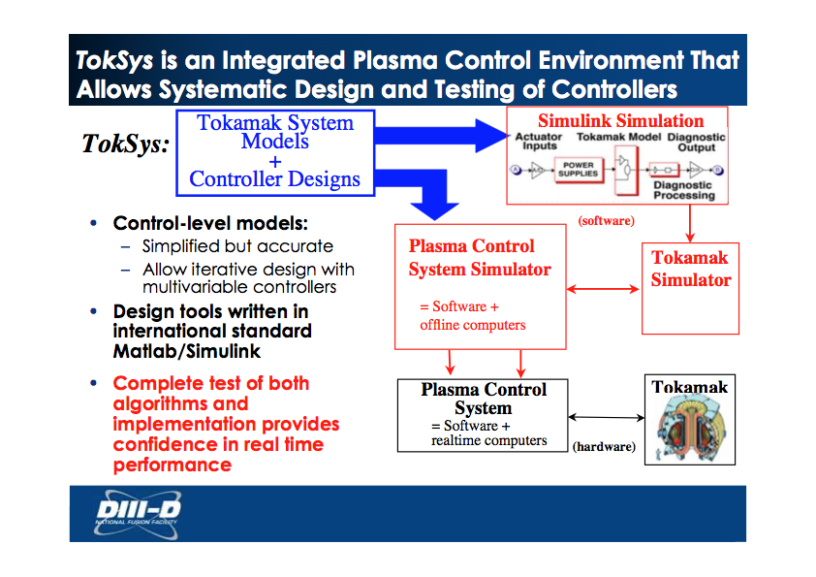

Vertical Displacement Measurements
Vertical displacement for controllable shots
(Cut off at the point of return)
Vertical displacement for uncontrollable shots
At 300 ms, we turned the controller off and let the plasma drift.
When we turned the control back on some of the shots recovered while others hit the wall.

Slide 19
Toksys Results Growth Rate (Gamma) 20-25 s^-1
Shot # Gamma s^-1
127077 23
127078 25
127079 24
127080 22
127081 24
127082 22
127083 20
127084 20
127085 21
127086 23
127087 21
Notes:
{\mathcal J} = \kappa_1 \int_t \int_\psi \left[ v_t(\psi,t) - v_t^*(\psi,t)\right]^2 d\psi\,dt + \kappa_2 \int_t \int_\psi f_\text{NBI}^2(\psi,t) d\psi\,dt
19

Slide 20
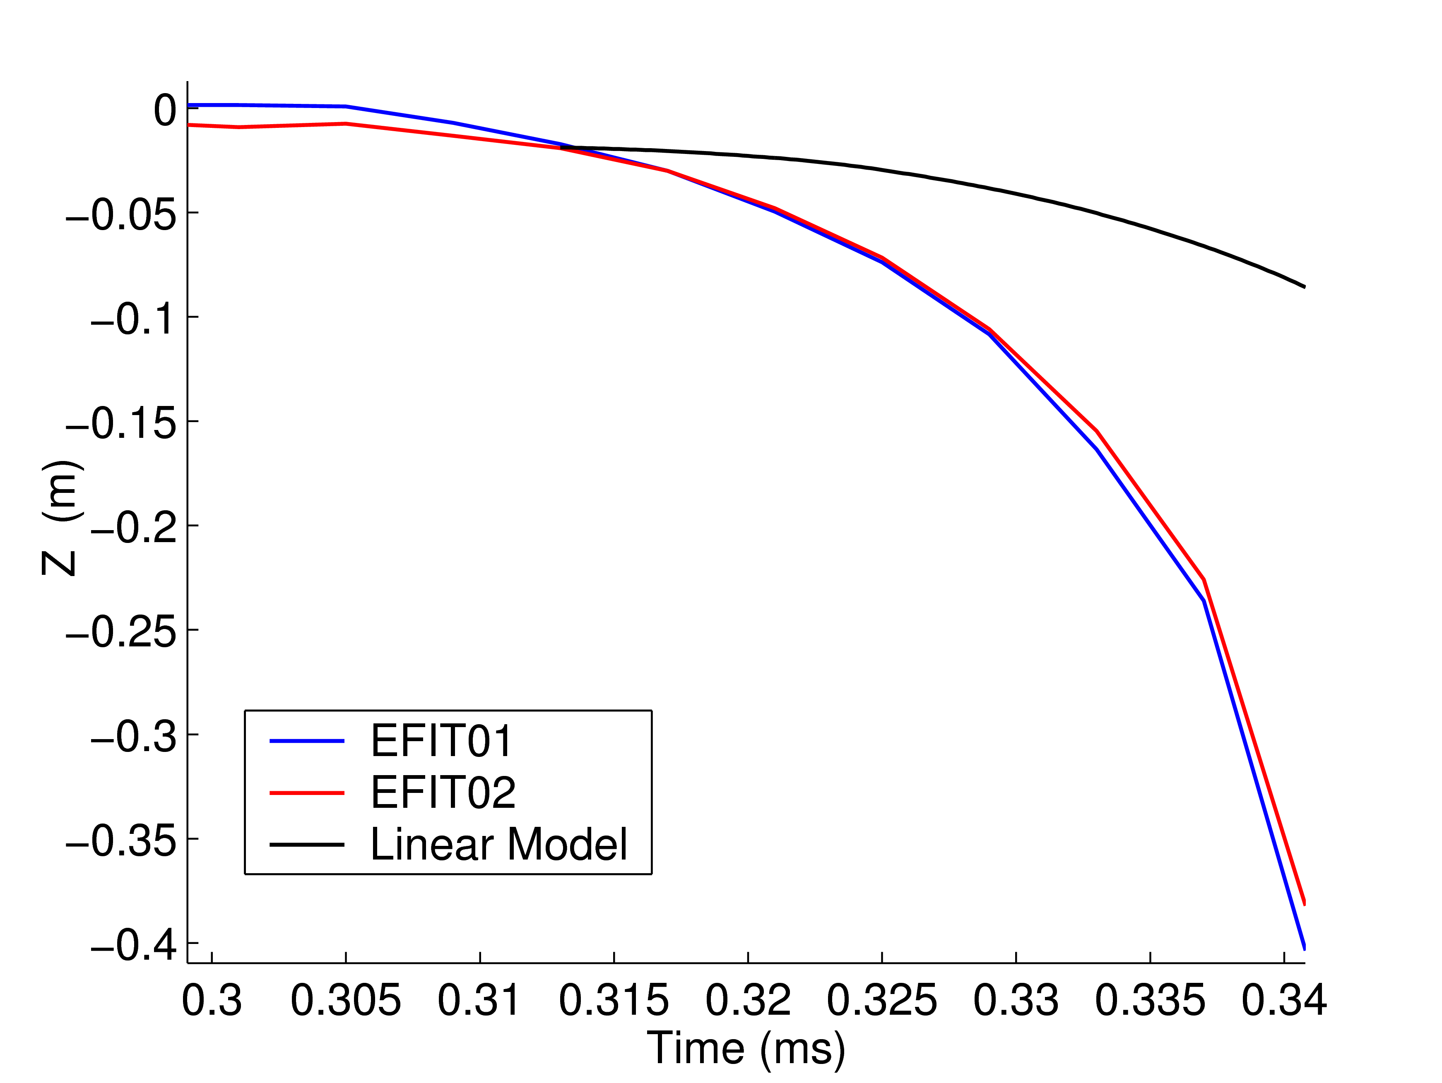
Mismatch Between XP and Toksys
XP data more unstable (3-4 times) than the model
Example of a mismatch between TokSys numerical plasma model and the experimental data. Depending on how the model is used plasma or te coil model.

Slide 21
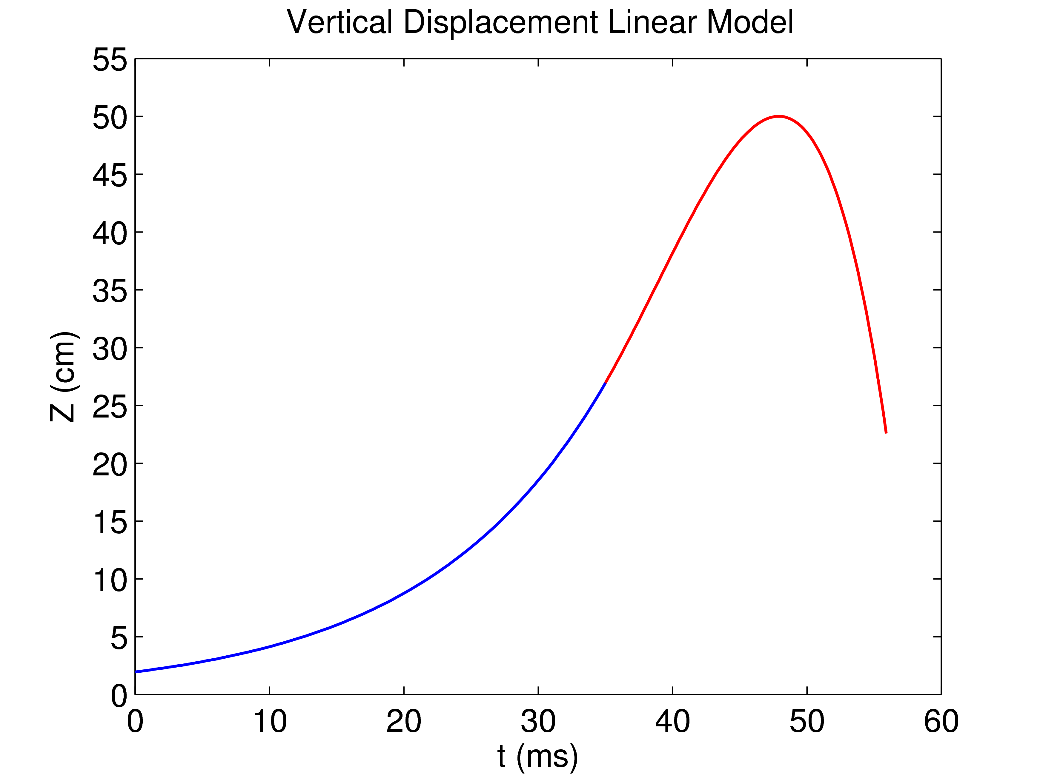
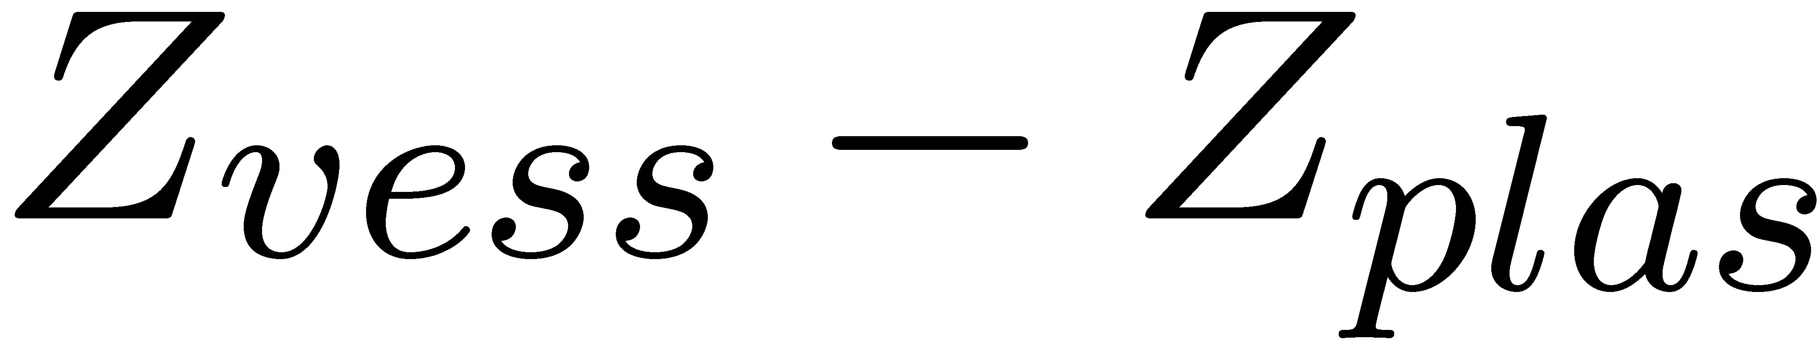
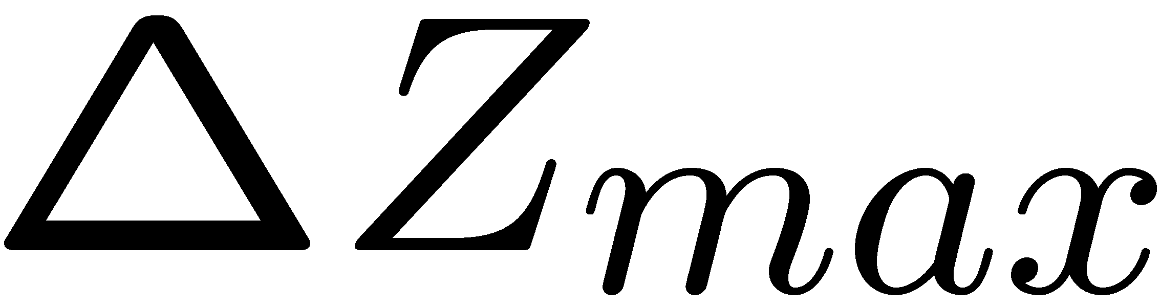
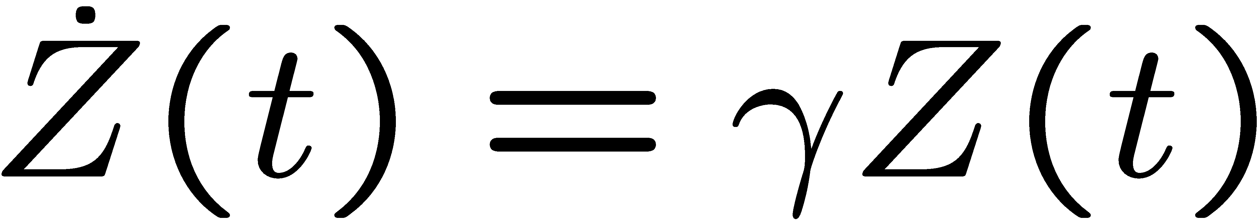
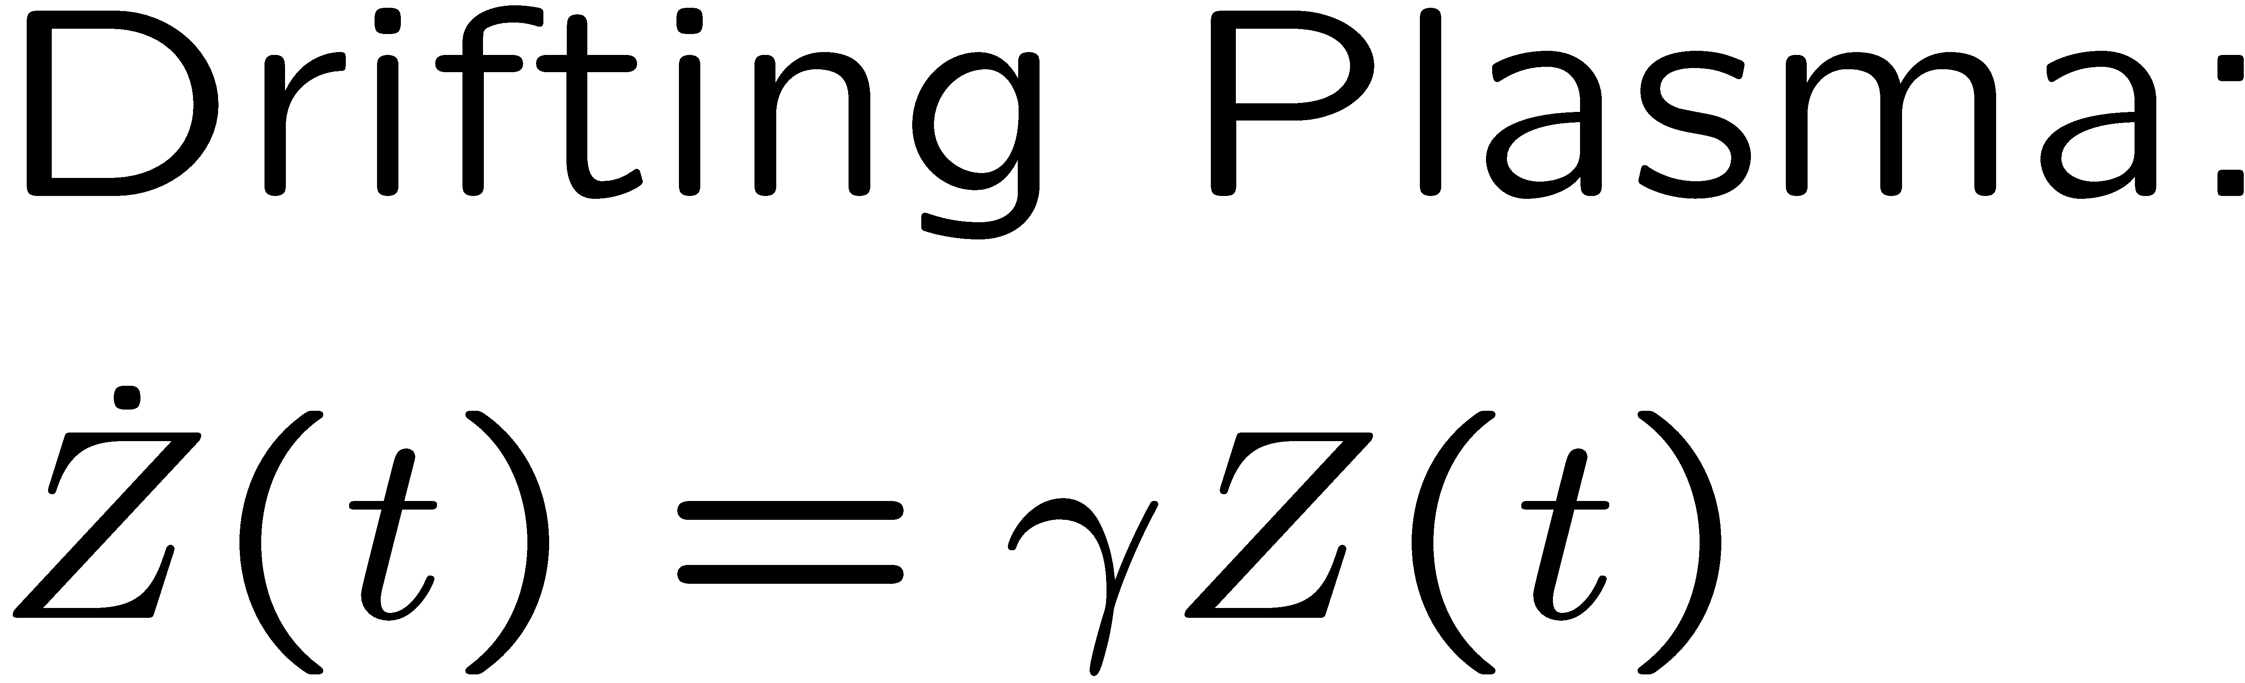
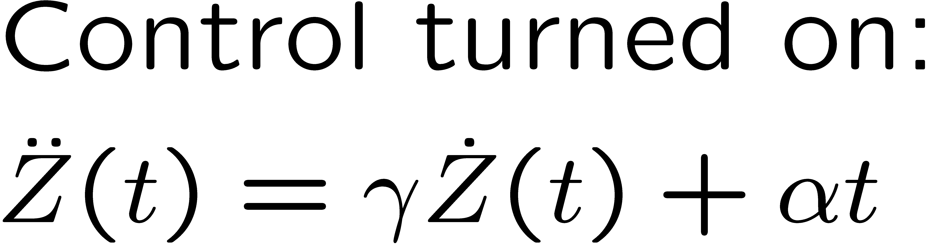
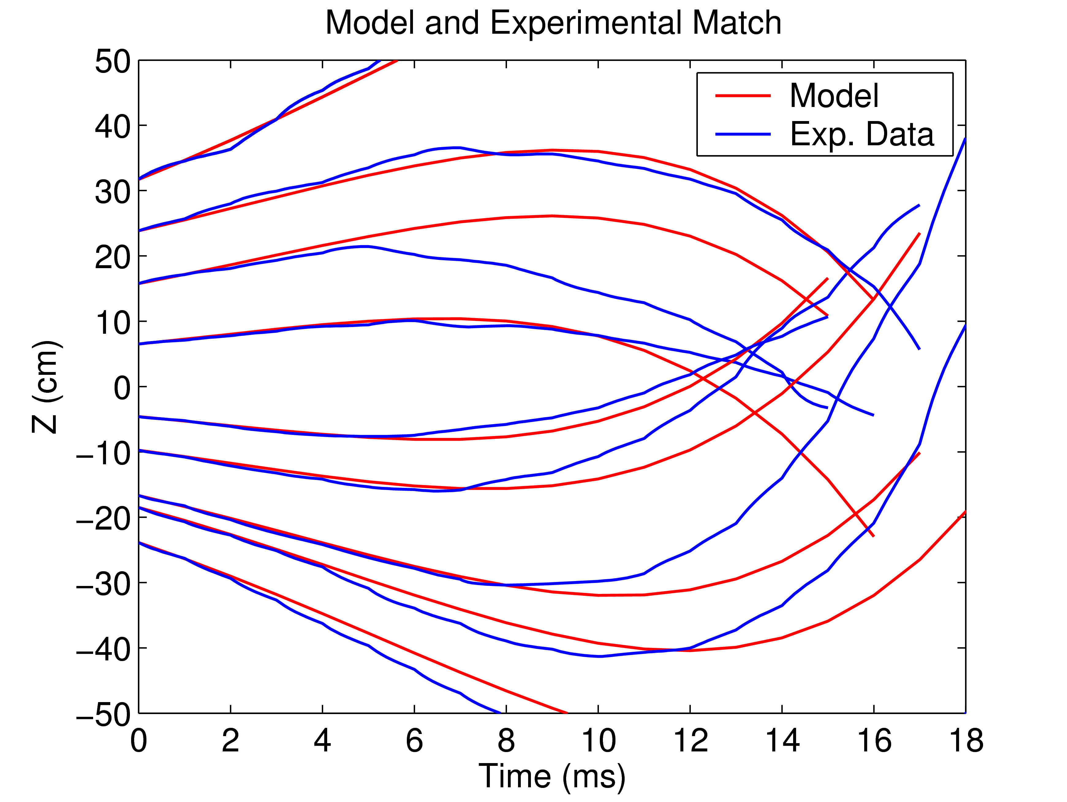
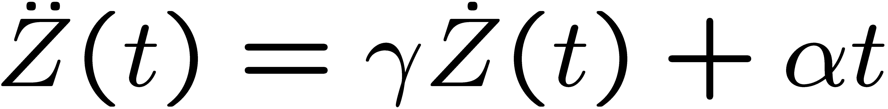
All XPs Can Be Modeled with the Same Two Parameters
Where γ =75s⁻¹. The first order effect of the coils on the vertical motion is assumed to be:
i.e. the current changes the velocity of the rigidly moving plasma. Also during the ramp up I is proportional to t. Combining these two effects, we can find an approximation for the dynamics of the vertical motion after the control is turned on as:
α is found by data fitting as 4.5e5
x
x
Notes:
{\mathcal J} = \kappa_1 \int_t \int_\psi \left[ v_t(\psi,t) - v_t^*(\psi,t)\right]^2 d\psi\,dt + \kappa_2 \int_t \int_\psi f_\text{NBI}^2(\psi,t) d\psi\,dt
21

Slide 22
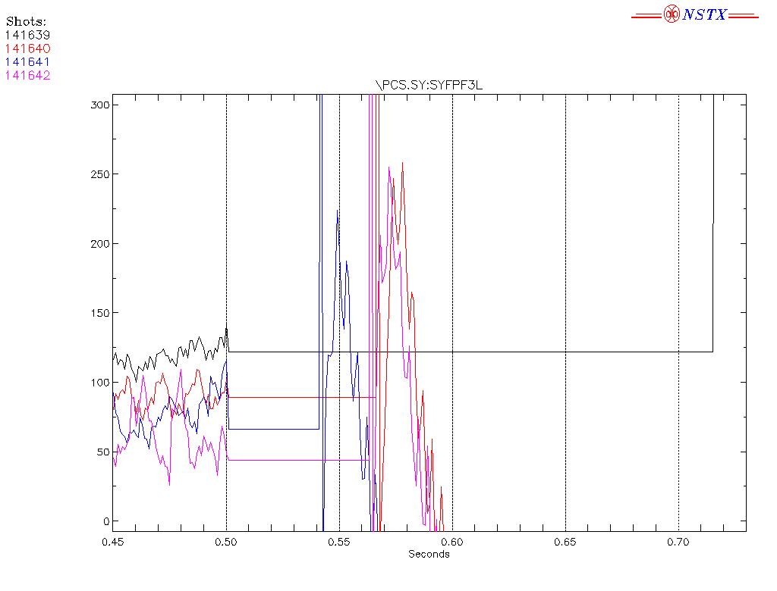
2010 Experiment: High Aspect Ratio Vertical Growth Rate
Thanks to Relay Feedback, we were able to freeze voltage request in Isoflux for the first time.
This enabled vertical growth rate measurements
Notes:
{\mathcal J} = \kappa_1 \int_t \int_\psi \left[ v_t(\psi,t) - v_t^*(\psi,t)\right]^2 d\psi\,dt + \kappa_2 \int_t \int_\psi f_\text{NBI}^2(\psi,t) d\psi\,dt
22

Slide 23
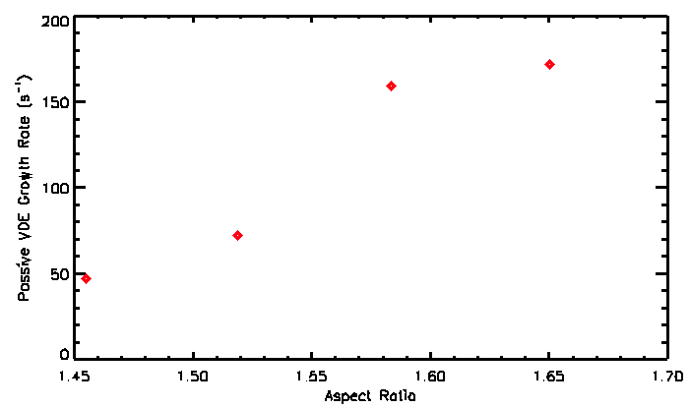
New Experimental Growth Rate (Gamma) 45-170 s^-1
versus 10-42 s^-1 for Model
High Aspect Ratio More Unstable
Need better vertical control for Upgrade
Trying to fix the TokSys model
Also, trying to update the Power Supply model (with R. Hatcher)
Probably need better models (3D?).
RED: Data, BLUE: Model
Notes:
{\mathcal J} = \kappa_1 \int_t \int_\psi \left[ v_t(\psi,t) - v_t^*(\psi,t)\right]^2 d\psi\,dt + \kappa_2 \int_t \int_\psi f_\text{NBI}^2(\psi,t) d\psi\,dt
23

Slide 25
Slide title
Important main point
  Important detail
    Another important sub-detail

Slide 26
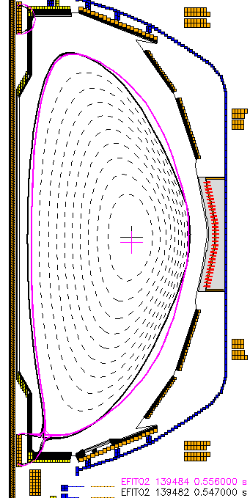
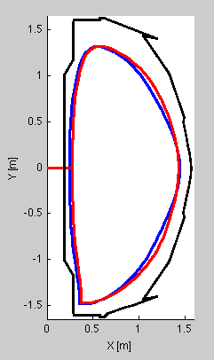
First Ever Use of PF4 for Shape Optimization
Ramp PF4 to 7 kA
  PF1A decreased to give the same kappa.
PF5 decreases as PF4 increases.
Squareness decreases.
Keep other things the same.

Slide 27
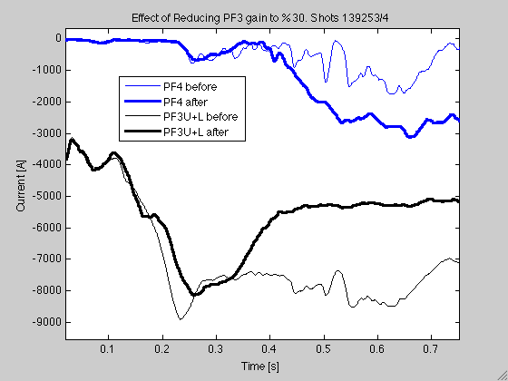
XMP Control Results: PF3-PF4 interaction
With PF4 control on, we reduced the gain for PF3 %30 at 360 ms.
PF4 compensated for the loss of inward pushing effect of PF3.
  PF4 can offset both PF3 and PF5.

Slide 28
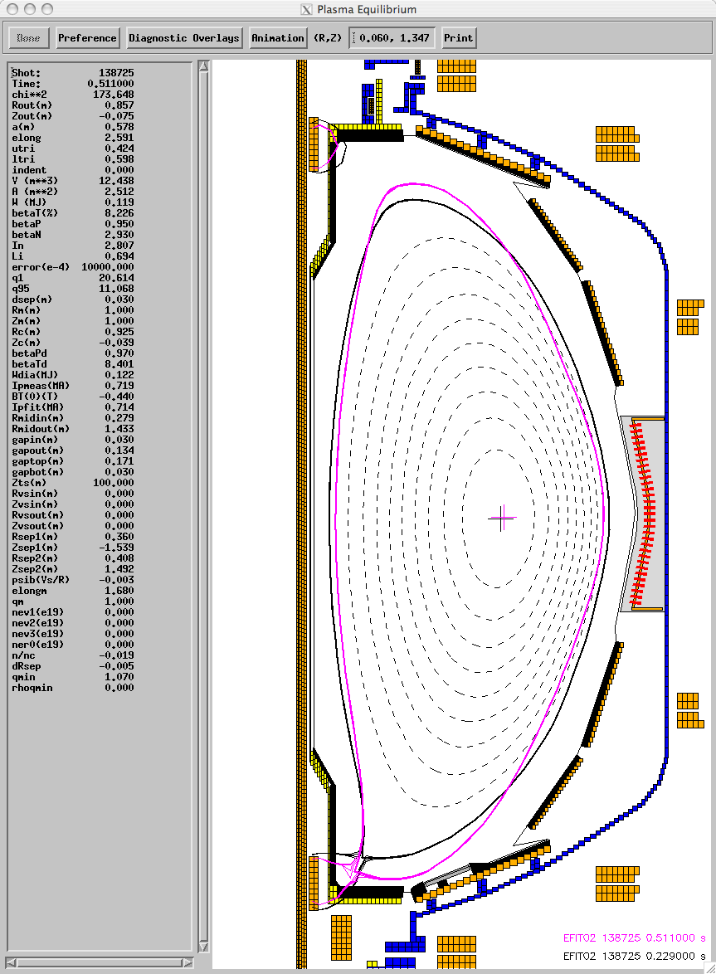
XMP Control Results: PF3-PF4 interaction
Figure show the result of a ramp on PF4 from 0 to 2.6 kA.
As PF4 increases, squareness change.
In order to align, PF3/4/5 control points (shown in dashed black, dashed red and blue) X-point moves down.
To solve this problem, move the PF3 and PF4 control segment. Shown in solid red, black.
Could not do this:
  Problem with PCS Segment Editor.
  Hopefully will be fixed for 2011.

Slide 29
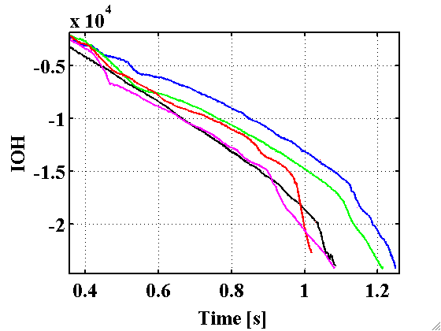
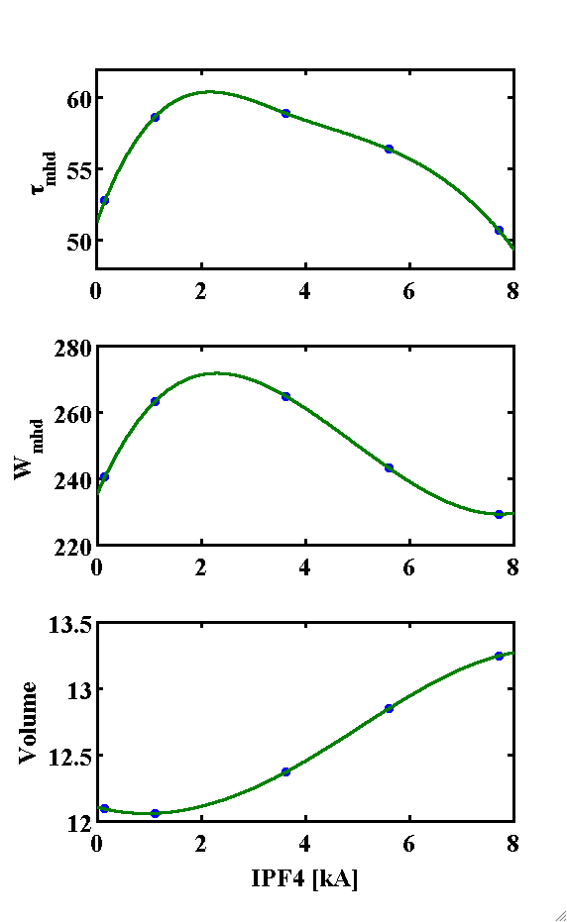
Higher Performance: PF4 of 1-4 kA
PF4= 0, 1, 4, 6, 8
Optimal PF4 ~1-4 kA for performance.
Confinement time increases
Energy confinement increases
Flux consumption reduces.
Too high PF4 interacts with the wall and plasma is not as good.
[142353,142342,142343,142347,142348]

Slide 30
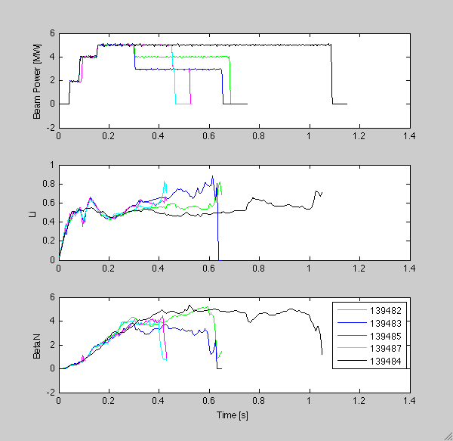
Lower BetaN Limit for PF4 in the positive direction
No PF4
5 MW till 450 ms
5 MW till 300 ms

