Slide 1

XMP-151: L-mode development results
W. Guttenfelder, D. Battaglia, D. Mueller, R. Raman, M.D. Boyer, N. Ferraro, S.P. Gerhardt, C. Myers, S.A. Sabbagh, …
NSTX-U Results Review
9/21/2016

Slide 2
Summary: Goal of XMP-151 was to establish expanded L-mode scenarios for core and boundary XPs
Four parts of XMP based on desires expressed in meeting on April 4, 2016
Establish higher power L-mode
  Stationary, sawtoothing discharges with 2.5-2.9 MW achieved using HFS fueling and various NBI 1 combinations
  Strong n=2 mode (3/2 tearing?) often develops
  Edge rotation also likely locked by 2/1 mode
  Wanted to try using LFS fueling (influence on inner wall “dancing rings”/MARFEs & MHD?)
Assess beam tangency radii
2A) Try individual sources at ~ 1 MW on a shot-by-shot basis
  Clear changes in MHD, but unreliable HFS fueling and beams that afternoon (→L-H-L)
  Was planning to repeat
2B) Try 2-source combinations (~1+1 MW): peaked vs. broad; tan. vs. perp.
  Not done
Establish upper Ip limit
  Achieved up to 1 MA
  Did not have time to find upper limit
Establish lower BT scenarios (0.55, 0.45, 0.35 T)
  Not done

Slide 3
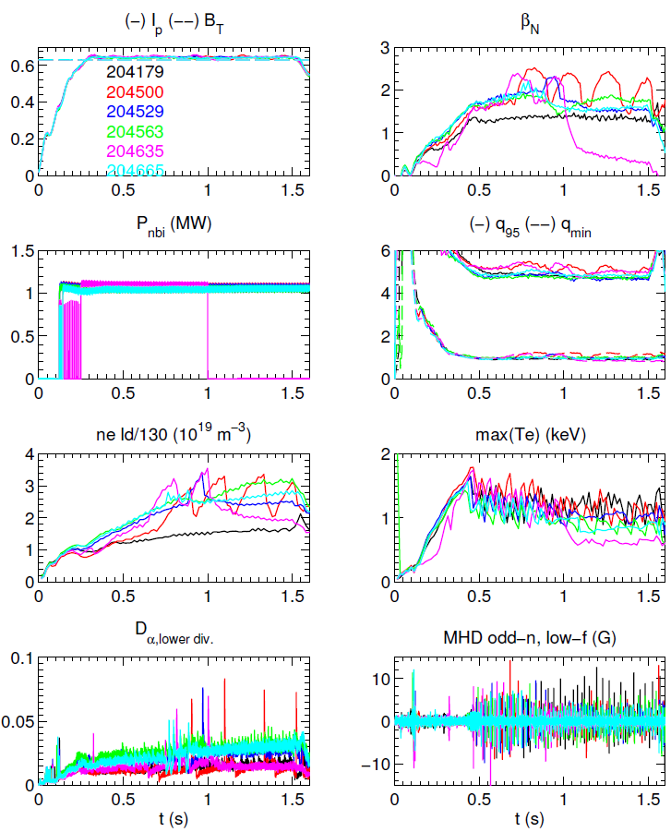
All May L-mode fiducials (204500+) exhibit L-H/H-L and/or n=2 MHD
204179 was last fiducial prior to April 11-29 maintenance period
All fiducials May 2-20 exhibited L-H/H-L transitions
  Only showing fiducials with ~1 MW
  A couple ohmic cases (missed beams) ran OK
β_{N}, q₉₅, q_{min} from EFIT01 in these slides
All May
fiducials
April fiducial

Slide 4
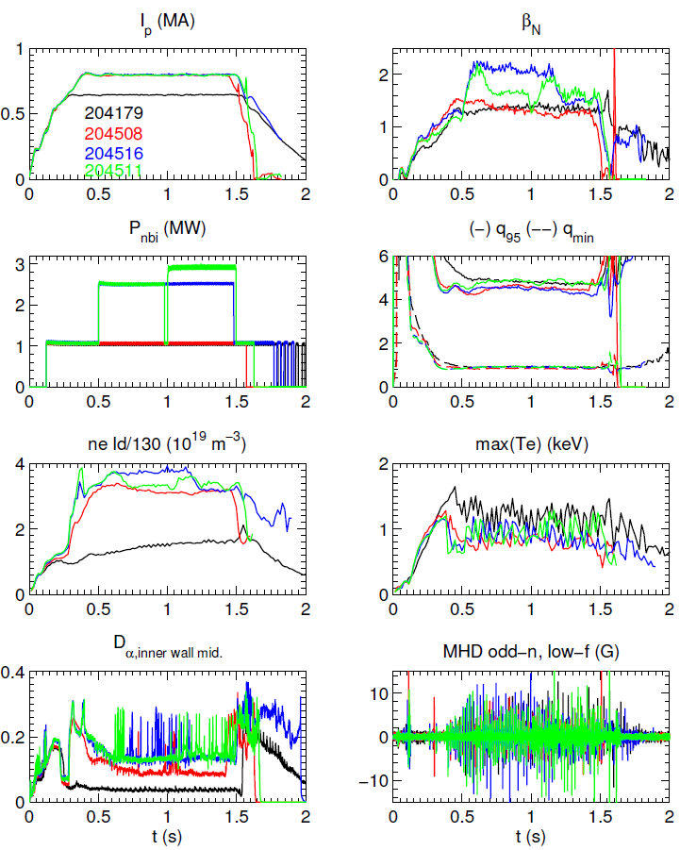
Part 1 (5/5/2016) – 800 kA w/ increased HFS fueling & NBI 1 power
Increased I_{p} from 650 to 800 kA
Increased HFS fueling to eliminate L-H
  Initial increases in LFS had little effect – wanted to revisit this
Sustained shots with up to 2.5 MW (1B+1A) and 2.9 MW (1B+1C), β_{N}≥2
  Tried up to 3.5-4.3 MW but shots die from MHD (often associated with L-H/H-L)
Crazy MARFE-like “dancing rings” observed in inner wall midplane spectroscopy (D_{α}, O II, C II)
All shots sawtoothing (Δt~35 ms, R_{inv}~125 cm)
  Faster, weaker sawteeth (Δt~20 ms) with higher density and/or NBI 1C?
Drop in n_{e}, β_{N} often seen due to strong n=2 MHD (e.g ~1.2 s in 204516)
HFS
fueling

Slide 5
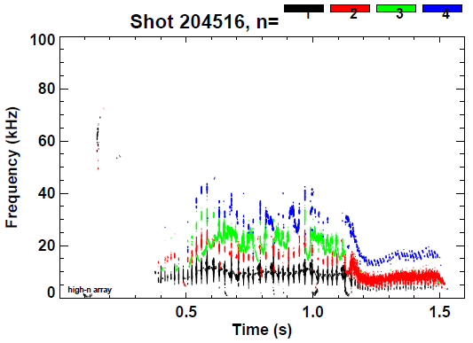
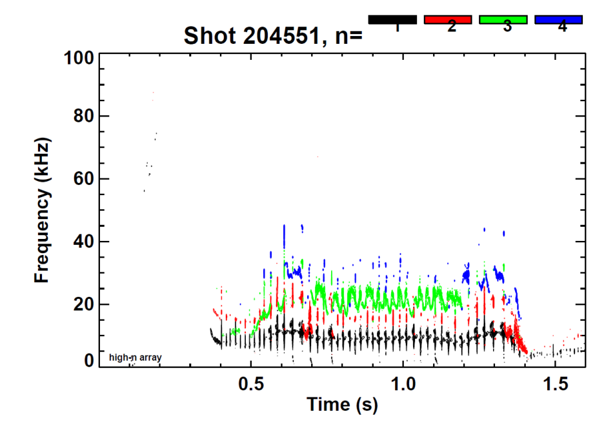
Otherwise duplicate 800 kA shots, 204516 develops n=2 earlier than 204551 (clamps core rotation and density)
Strong n=2 often develops after L-H-L

Slide 6
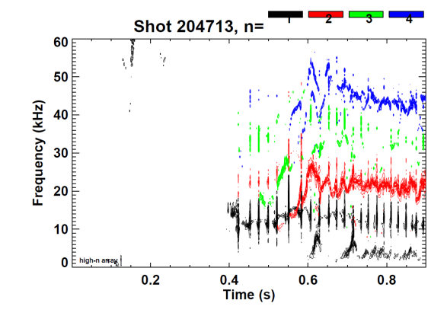
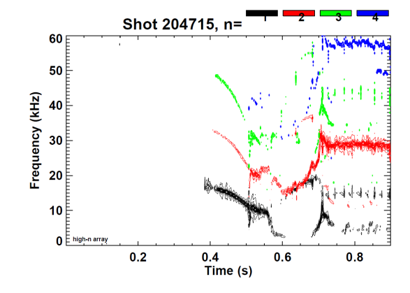
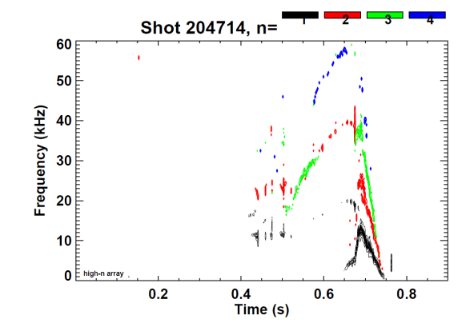
Part 2A (5/13/2016) – First attempt trying all 6 NBI sources individually (1 MW)
Incorrect fueling (lots of L-H-L) and an unreliable beams that afternoon – planned to repeat

Slide 7
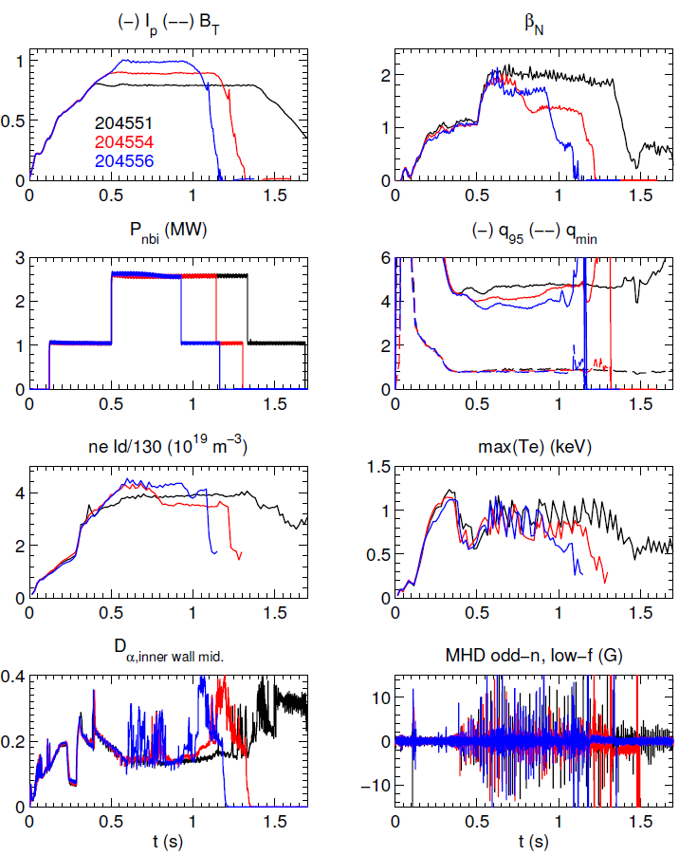
Part 3 (5/6/2016): Was able to increase plasma current to 0.9 & 1.0 MA at higher density, fueling
To recover high density (following boronization & numerous short H-mode attempts) required HFS @ 1300 Torr for one shot
  Returned to 900 Torr after
Easily moved to 0.9 MA & 1.0 MA (q₉₅~3.7)
  Did this in a couple shots at the end of a day – did not clearly identify Ip limit
n=2 MHD always develops eventually

Slide 9
Some of my favorite XMP-151 shots
(5/5/2016) 800 kA w/ increased HFS fueling & power
  204499-507 – fiducial, then increased fueling to prevent H-mode
  204508 – 1 MW, 1B (0.12 s), lasts >1.5 s (3×10¹⁹ m⁻³)
  204510 – 2.5 MW, 1B+1A (0.5-1.15 s)
  204511 – 2.5 MW, 1B+1A (0.5-0.98 s), 2.9 MW, 1B+1C (1-1.5 s)
  204512-515 – 3.5-4.3 MW attempts (1A+1B+1C) that die from H-mode/MHD
  204516 – 2.5 MW, 1B+1A (0.5-1.5 s)
  204519 – 1A (0.12), 1B (0.5 s), lost 1A early (0.6 s)
(5/6/2016) 0.8, 0.9, 1.0 MA (1B, 1.1 MW, 0.12 s + 1A, 1.5 MW, 0.5 s)
  204547-550 – increase fueling to establish density & prevent H-mode
  204551 – 800 kA (ST → n=2 MHD @ 1.35 s)
    0.9-1.2 sec best conditions for T&T analysis?
  204554 – 900 kA (ST → n=2 MHD @ 0.68 s???)
  204556 – 1.0 MA (ST → n=2 MHD @ 0.9 s, after 1A turn-off)

Slide 10
Some of my favorite XMP-151 shots
(5/13/2016) 800 kA, 1 beam (1 MW) tangency scan
  204709 – 1C (1 MW), first shot, n=3 (2 kA), t>1.0 s (L-H-L, MHD, slow vert. osc.)
  204710 – 1C (1 MW), long shot but no SPAs
  Following shots use 1B t<0.5 s & t>1.3 s, swap source between 0.5-1.3s
    Also had very weak HFS fueling due to gas pressure reading issue, issues with L-H-L, vert. osc.
  204713 – 2C (drops out 0.95-1.09 s)
  204714 – 2A (ends at 650 ms from locked mode)
  204715 – 2B (good, 1 L-H-L at 520 ms)
  204716 – 1A (good, 2 L-H-L)
  204717 – 1C (good, 1 L-H-L)
  204718 – 1B (good, L-H-L, vert. osc. that slowly grows)
    Finally realized we were getting almost no additional fueling
  204719 – 1B – higher fueling, too much, cools edge, plasma dies

Slide 11
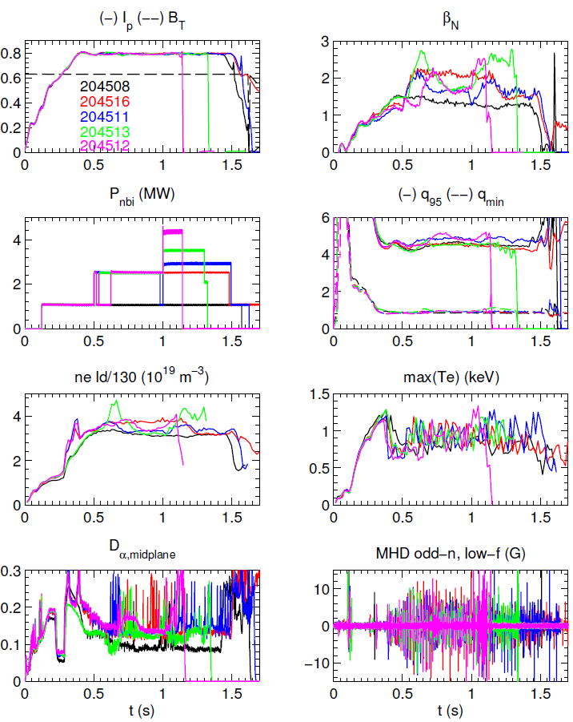
(5/5/2016) Many shots testing increased power up to 4.3 MW
Many shots to vary NBI 1 power
  2.5 (1B+1A & reversed order)
  2.9 MW (1B+1C)
  3.5-4.3 MW (1B+1A+1C) – too high to avoid H-mode and/or shot-ending MHD
Crazy MARFE-like “dancing rings” (D. Battaglia) observed in innerwall midplane spectroscopy (D_{α}, O2, C2)
Drop in n_{e}, β_{N} often seen due to transition from sawteeth to n=2 MHD (e.g ~1.2 s in 204516)

Slide 12
Late Friday afternoon (5/13) it was observed that HFS plenum pressure reading was no longer accurate
204710 – FPDP Watchdog timer tripped at end of shot
204711-712 – no shots (didn’t reset FOMS; clock cycle)
204713-718 → faulty HFS pressure reading
  Fueling very late & weak based on plasma TV & EIES inner wall D_{α}
Using data from previous days, fit Δt_{Dα-CS}~1/P_{HFS}^{1/2} – implies HFS pressures between 60-200 Torr for rest of Friday afternoon (we were requesting 400 Torr)
  This is based on requested pressure in the Logbook, no measurement signal available in MDSplus?
HFS fueling
Data from days with known HFS plenum pressure
Δt ~ P^{-1/2} fit

