Slide 1


2D BES Commissioning and Initial Results
Matt Kriete, Dave Smith
R. Fonck, G. McKee
NSTX-U Results Review 2016

Slide 2
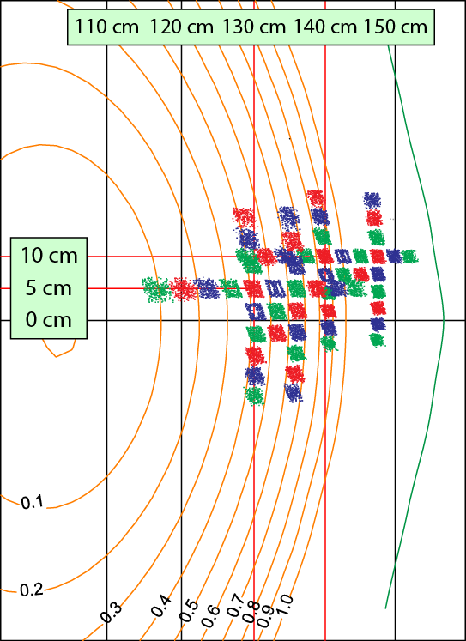
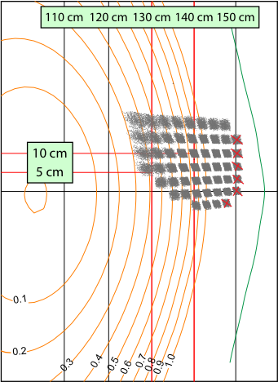
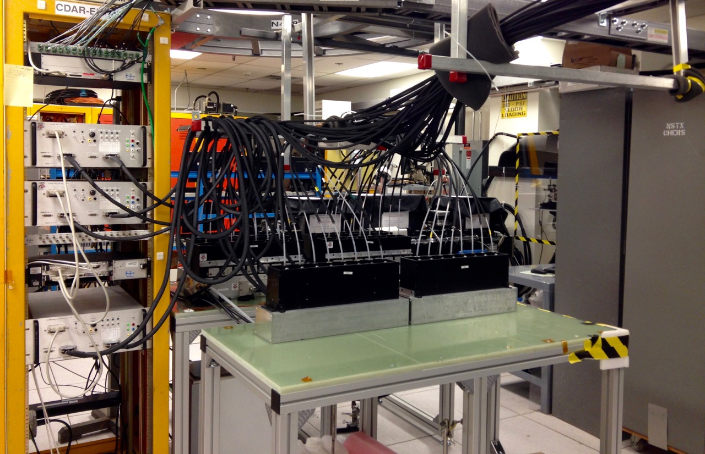
BES system was reconfigured
BES system expanded from 32 to 48 channels
  2D turbulence imaging
  2D flow analysis

Slide 3
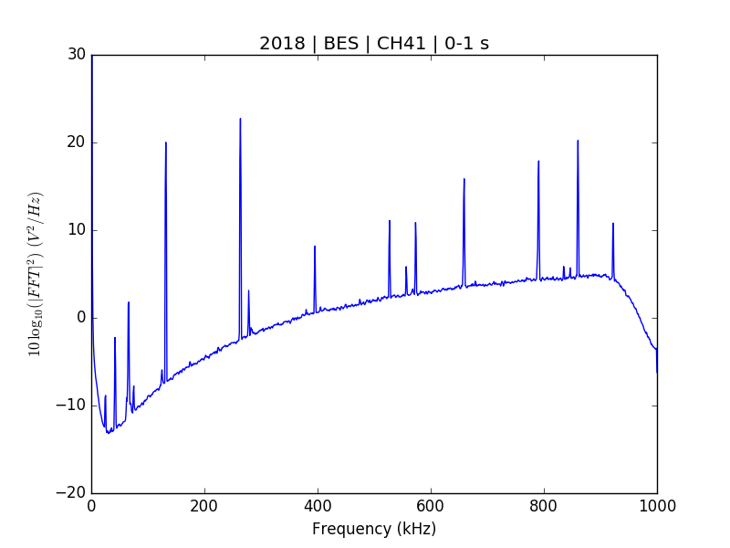
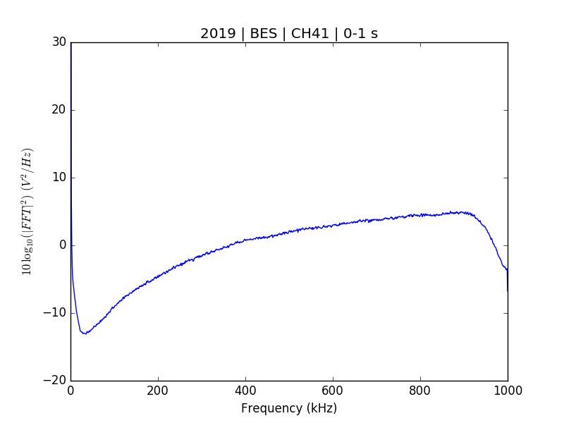
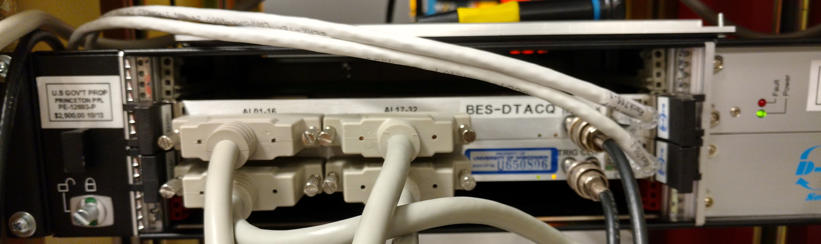
Expanded BES system has been debugged
Noise pickup on most channels
  8 noise-free, 8 low-noise channels
  Found proper grounding configuration after end of plasma ops
f_{sample} mismatch between digitizers
  Debugged by Greg Tchilinguirian

Slide 4
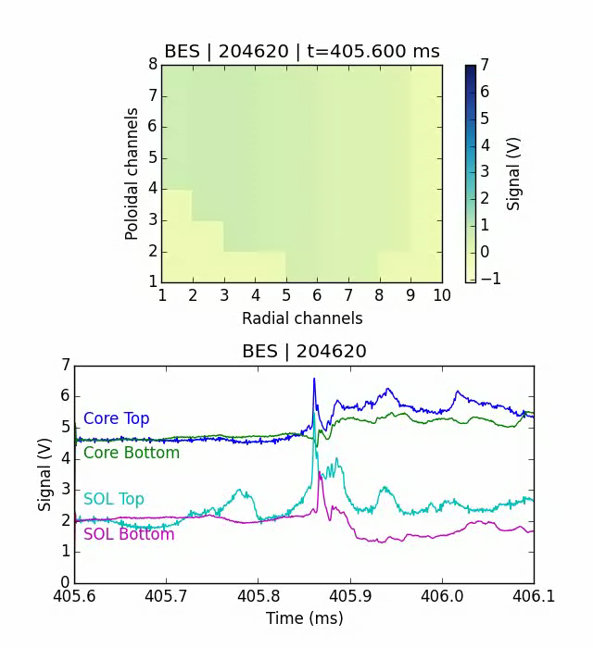
2D ELM structure observed
D. R. Smith, HTPD 2016 Invited Talk
Investigation of ELM Evolution Patterns on
NSTX-U with Beam Emission Spectroscopy Measurements
D. R. Smith, IAEA FEC 2016

Slide 5
Bimodal turbulence seen in a L-mode shot
ΔZ = 3 cm
R = 142 cm
Δt = 24 ms
13 km/s in electron
diamagnetic direction
11 km/s in ion
diamagnetic direction
Modes propagate in opposite directions
  Similar spectra seen with DIII-D and TFTR BES
  Potential link to grad B direction

Slide 6
Turbulence amplitudes decrease after L-H transition
Fluctuation comparison between near and far edge
  6x reduction at pedestal top
  3x reduction inward of pedestal
MHD modes
D. M. Kriete, APS DPP 2016
Shot 204990, I_{p} = 0.65 MA, P_{NB} = 1 MW

