Slide 1




NSTX-U
Supported by
NSTX-U Program Update
Coll of Wm & Mary
Columbia U
CompX
General Atomics
FIU
INL
Johns Hopkins U
LANL
LLNL
Lodestar
MIT
Lehigh U
Nova Photonics
Old Dominion
ORNL
PPPL
Princeton U
Purdue U
SNL
Think Tank, Inc.
UC Davis
UC Irvine
UCLA
UCSD
U Colorado
U Illinois
U Maryland
U Rochester
U Tennessee
U Tulsa
U Washington
U Wisconsin
X Science LLC
J. Menard
For the NSTX-U Research Team
Culham Sci Ctr
York U
Chubu U
Fukui U
Hiroshima U
Hyogo U
Kyoto U
Kyushu U
Kyushu Tokai U
NIFS
Niigata U
U Tokyo
JAEA
Inst for Nucl Res, Kiev
Ioffe Inst
TRINITI
Chonbuk Natl U
NFRI
KAIST
POSTECH
Seoul Natl U
ASIPP
CIEMAT
FOM Inst DIFFER
ENEA, Frascati
CEA, Cadarache
IPP, Jülich
IPP, Garching
ASCR, Czech Rep
NSTX-U Team Meeting
PPPL LSB B318
December 4, 2014

Slide 2
Outline
FESAC strategic planning update
NSTX-U Organizational Structure
Preparation for Research Forum

Slide 3
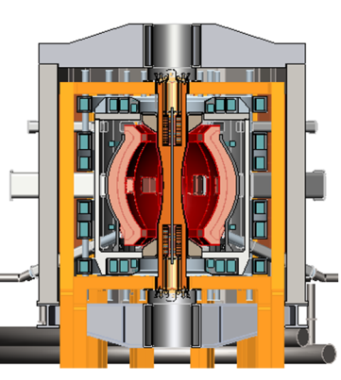
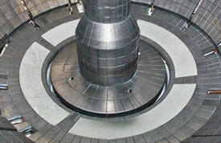
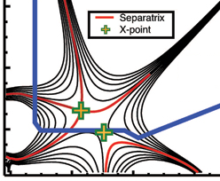

NSTX Upgrade mission elements
Advance ST as candidate for Fusion Nuclear Science Facility (FNSF)
Develop solutions for the plasma-material interface (PMI) challenge
Explore unique ST parameter regimes to advance predictive capability - for ITER and beyond
Develop ST as fusion energy system
ST-FNSF
Liquid metals/Li
“Snowflake”
ITER

Slide 4
Thank you for your FESAC SPP presentations + white-papers - they did actually influence the FESAC report
FNSF
Menard, NSTX-­U: ST research to accelerate fusion development
Majeski, LTX: Exploring the advantages of liquid lithium walls
Fonck, Initiatives in non-­solenoidal startup and edge stability dynamics at near-­unity aspect ratio in the PEGASUS experiment
Raman, Simplifying the ST & AT concepts (CT injection fueling/momentum + EBW)
Maingi, A liquid‐metal plasma-­facing-­component initiative
Jaworski, Liquid metal plasma-­material interaction science and component development toward integrated demonstration
Allain, Establishing the surface science and engineering of liquid-­metal plasma-­facing components
Podestá, Development of tools for understanding, predicting and controlling fast­ion‐driven instabilities in burning plasmas
Sabbagh, Critical need for disruption prediction, avoidance, mitigation in tokamaks
Crocker / Guttenfelder, Validating electromagnetic turbulence and transport effects for burning plasmas
PMI
Burning plasmas, discovery science

Slide 5
NSTX-U missions aligned with FESAC SPP report
Quotes from the report:
“The primary mission of the NSTX-U subprogram element is to evaluate the potential of the low-aspect ratio tokamak, or spherical torus, to achieve the sustained high performance required for a FNSF.”
“Innovative plasma-material-interaction (PMI) solutions are another important element of this program”
“ITER-relevant research on NSTX-U includes energetic particle behavior and high-beta disruption control”
“NSTX-U should primarily focus on resolving the technical issues underpinning the FNSF-ST design.”
  “Key issues: non-solenoidal startup, sustainment of the plasma current, and scaling of confinement with collisionality.”
  LTX, Pegasus: important support for PMI and current initiation

Slide 6
FESAC SPP Report Priorities:
Tier 1
  Control of deleterious transient events: This Initiative combines experimental, theoretical, and simulation research to understand highly damaging transients and minimize their occurrence in ITER-scale systems.
  Taming the plasma-material interface: This Initiative combines experimental, theoretical, and simulation research to understand and address the plasma-materials interaction (PMI) challenges associated with long-pulse burning plasma operation.
Tier 2
  Experimentally validated integrated predictive capabilities: This Initiative develops an integrated “whole-device” predictive capability, and will rely on data from existing and planned facilities for validation.
  A fusion nuclear science subprogram and facility: This Initiative will take an integrated approach to address the key scientific and technological issues for harnessing fusion power.
Tier 1 Initiatives are higher priority than Tier 2 Initiatives. Within a tier, the priorities are equal.
In concert with above Initiatives, Discovery Plasma Science will advance the frontiers of plasma knowledge to ensure continued U.S. leadership.

Slide 7
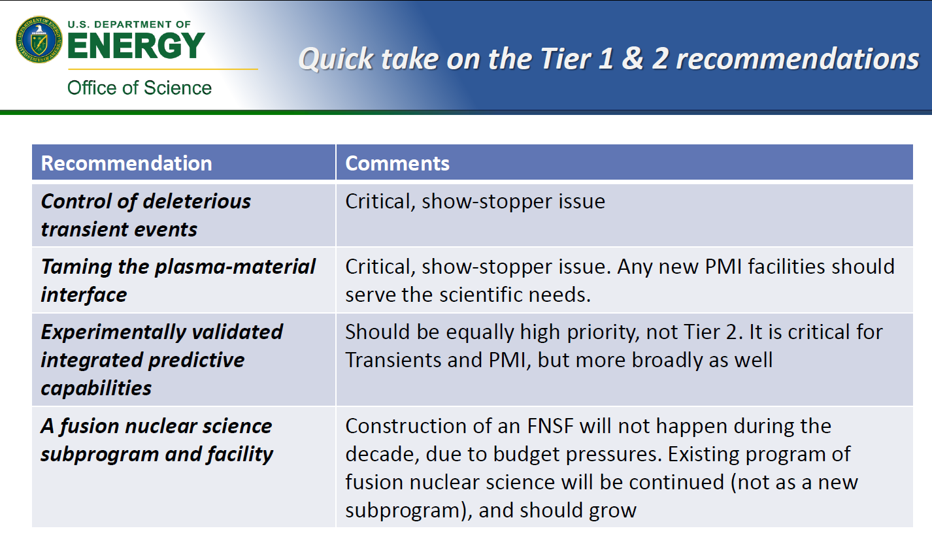
FES comments on FESAC SPP Report (1)
From “FES Considerations for Strategic Planning” by Edmund Synakowski – Associate Director, Office of Science, Fusion Energy Sciences – UFA Meeting – October 27, 2014

Slide 8
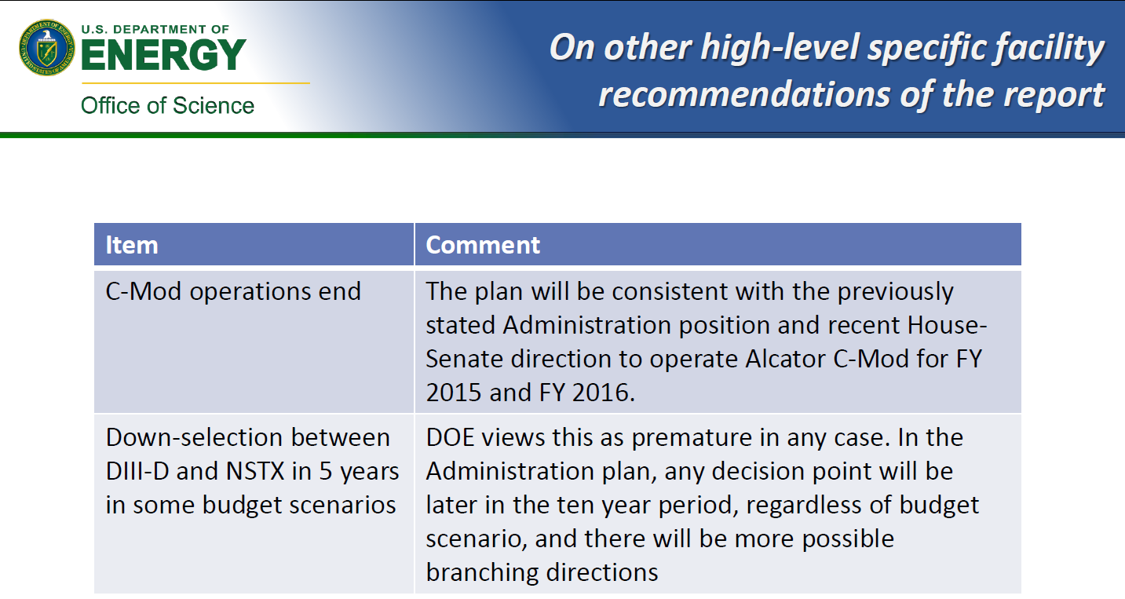
FES comments on FESAC SPP Report (2)
From “FES Considerations for Strategic Planning” by Edmund Synakowski – Associate Director, Office of Science, Fusion Energy Sciences – UFA Meeting – October 27, 2014

Slide 9
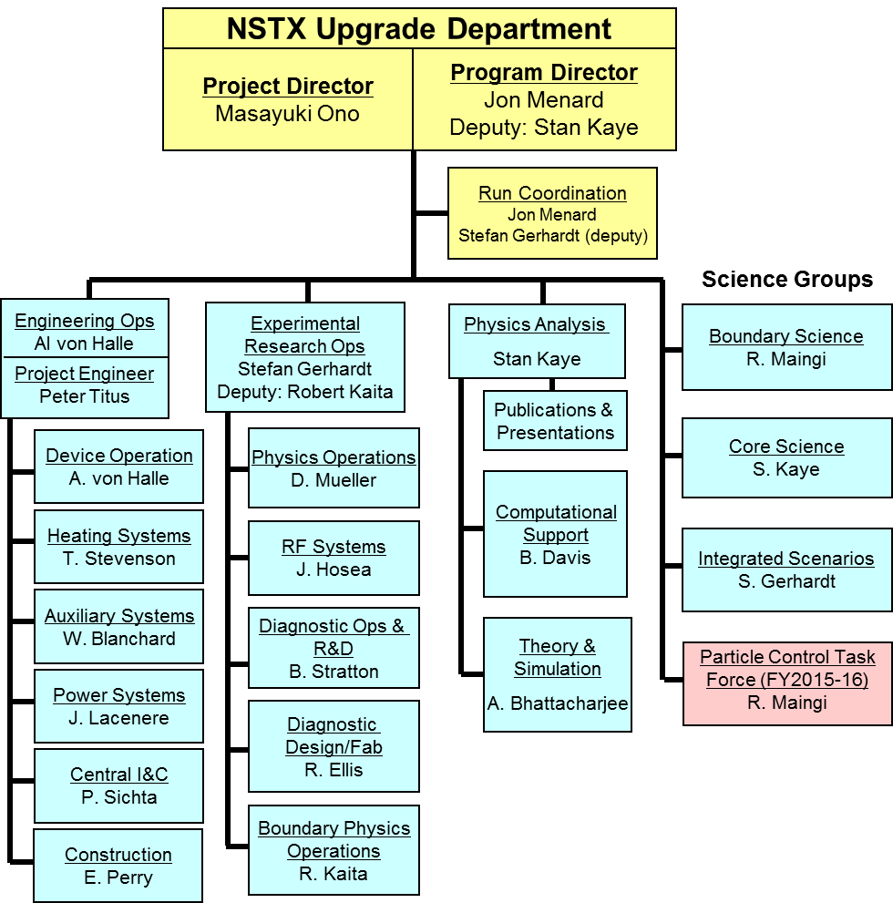
NSTX-U Organization for FY2015

Slide 10
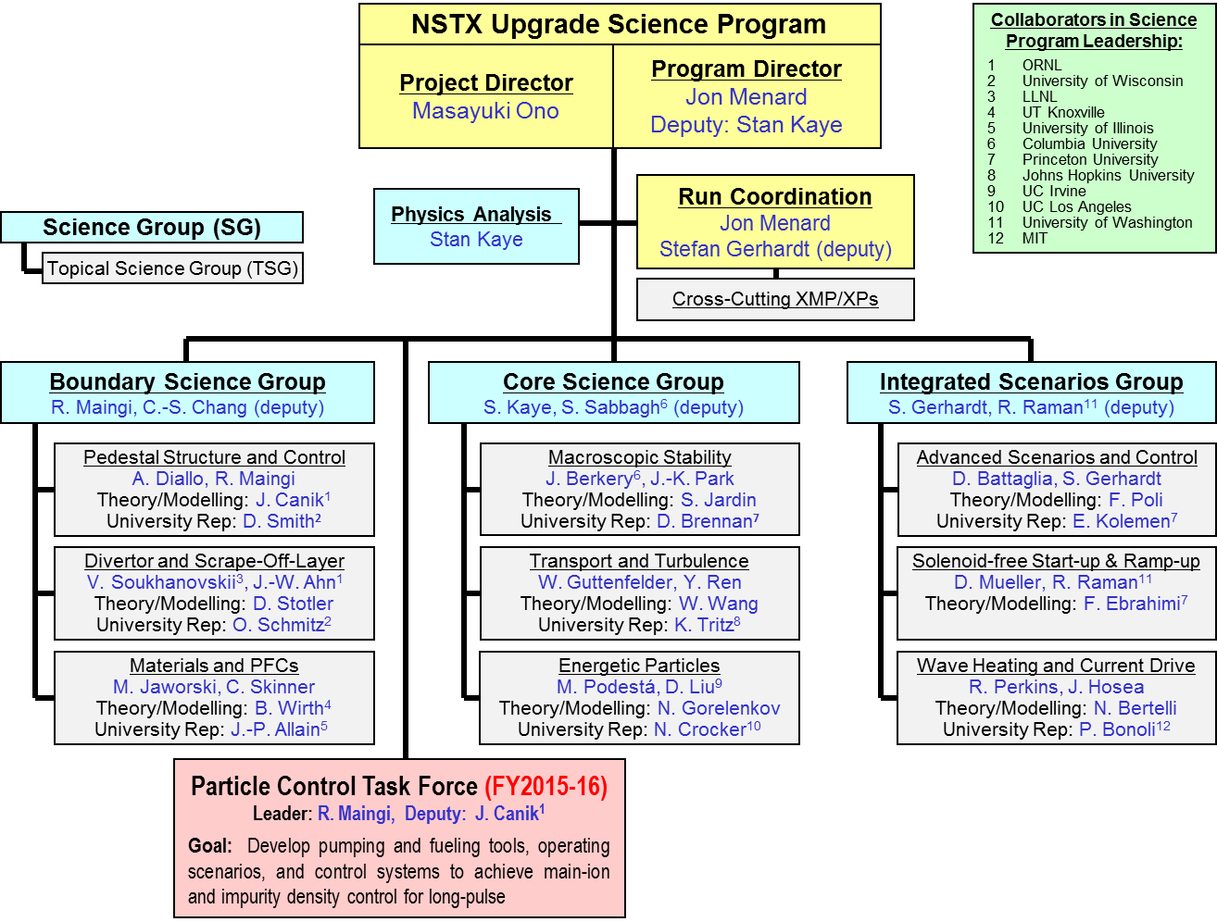
NSTX-U research program will be (re-)organized along 3 “Science Groups” starting with FY15 run
Each TSG will have a leader, deputy, theory rep, and at least 1 university rep to enhance university participation

Slide 11
Motivations for restructuring science program
TSGs provide expertise in broad range of topics, but program would benefit from better coordination between TSGs
  SG leader responsibility: Coordinate TSG physics research plans, experimental/shot plans, diagnostic coverage & usage
Experiments that engage more than one TSG will receive increased priority for run-time
  Example: experiment on 3D fields generating data for: plasma response, turbulence, energetic particle loss
Efficient shot usage especially important during first run year (many systems need to be re-commissioned)
Incorporate much wider set University researchers/PIs in planning + coordination of research program (FES/PPPL goal)
NEW: Task-force for long-pulse particle control → cross-cutting goal supporting entire research program

Slide 12
Upcoming research planning/advisory activities
Pre-forum meeting #1 – Mid Dec (~1 day) (most likely Dec 16)
  Discuss new SG/TSG structure, roles, responsibilities, “other issues”
  Discuss actions/experiments needed for restart, initial physics-ops
Pre-forum meeting #2 – January 28-29, 2015 (Wed, Thu)
  Goal: Provide up-to-date operations status to aid scheduling
  Day 1: Diagnostics/operations readiness meeting
    Status updates and projections for all systems needed for research ops
  Day 2: Update from SG/TSGs on XMP/XP solicitations
Research Forum – Feb 24-27th (Tue-Fri) at PPPL
  Plenary session, TSG break-outs, SG sessions, team joint session, summary (also safety session and team photo)
NSTX-U PAC-36 – Sept/Oct 2015 (end of/after FY15 run)

Slide 13


FY2015-16 research milestones target exploitation of new capabilities, exploration of new regimes
Incremental (full ops)
FY2015
FY2016
Expt. Run Weeks:
12
14
16
20
Previous
center-stack
New
center-stack
R15-1
Assess H-mode confinement, pedestal, SOL characteristics at higher B_{T}, I_{P}, P_{NBI}
R16-1
Boundary Science
Assess heat-flux mitigation and PFC response using advanced divertor configurations + radiation at high q_{||-div}
Develop snowflake configuration, study edge and divertor properties
IR15-1
R15-2
IR16-1
TF OD = 20cm
TF OD = 40cm
Core Science
Characterize effects of NBI injection angle on fast-ion distribution and NBI-CD profile
Assess confinement and local transport and turbulence at low ν* with full range of B_{T}, I_{P}, and NBI power
R16-3
R15-3
Develop high-non-inductive fraction NBI H-modes for ramp-up & sustainment
Integrated Scenarios
Develop physics+operational tools for high-performance discharges (κ, δ, β, EF/RWM)
Present NBI
New 2nd NBI
R16-2
Assess fast-wave SOL losses and core thermal / fast ion interactions at increased B_{T}, I_{P}
FES 3 Facility Joint Research Target (JRT)
NSTX-U leads JRT
C-Mod leads JRT
Quantify impact of broadened J(r) and p(r) on tokamak confinement and stability
Assess disruption mitigation, initial tests of real-time warning and prediction techniques

Slide 14
Backup slides

Slide 15
Research Forum Overview
Science groups will nominally follow priorities/detailed plans developed for 5 year plan (until they are obsolete…)
Abbreviated eXperimental Proposals (XPs) (developed in Dec-Jan) will be presented at the forum
  Motivation, goal, shot plan, # of run days, diagnostics, analysis…
Prioritization carried out at forum using abbreviated XPs
~70-90% of prioritization completed by end of forum
  Highest priority research in research milestones / task forces
  Proposals that address milestones will receive the most run time
  If abbreviated proposal idea is “priority 1”, the author is asked to develop full proposal for operational + program review/approval
Expect ~1/3 of all XPs for year to be approved, ready at start of physics campaign (April 2015), then roll forward
  Typically schedule XPs ~1-2 months in advance

Slide 16
Update on increasing University engagement in the NSTX-U program
Increasing engagement was FY2014 “Notable Outcome”
Previously developed ideas to enhance participation:
  Expand Early Career Research (ECR) awards to University Scientists
    No support within DoE Office of Science to extend this beyond tenure-track
  Support students with coordinated senior projects and targeted run-time
    Will consider once NSTX-U resumes routine/full operation (late FY15)
  Implementing enhanced collaboration tools (remote control rooms)
    Will engage NSTX-U Science Groups to determine optimal tools (during FY15)
  Implement “NSTX-U Innovative Research Award (NIRA)” with funding targeting primarily university researchers
    No FES funding available, consider funding from NSTX-U post-Upgrade
  Consider direct financial support for start-up and initial salary for tenure-track professor positions (Same answer as previous question)
  More strongly engage University Principal Investigators and researchers in the management of the NSTX-U scientific program
    Implementing this for FY2015 run

Slide 17
10 year goal: Integrate high-performance core + metal walls
NSTX-U 5 year goal: Establish ST-FNSF physics/scenarios
Plan presented at FESAC:
2015-2019
2020-2024
Establish ST physics / scenarios:
High-performance + metal walls
Non-inductive start-up, ramp-up
Confinement vs. β , collisionality
Sustain high β with advanced control
Mitigate high heat fluxes
Test high-Z divertor, Li vapor shielding
Convert all PFCs from C to high-Z
Static → flowing Li divertor module(s), full toroidal flowing Li divertor, high T_{wall}
5s → 10-20s for PFC/LM equilibration
Assess ST with high-Z, high-Z + Li
Inform choice of
FNSF configuration:
Inform choice of FNSF / DEMO
plasma facing materials:
Lower A or higher A?
Standard, snowflake, Super-X (MAST-U)?
High-Z acceptable? or need high-Z + Li?
Assess for both divertor and first-wall

Slide 18
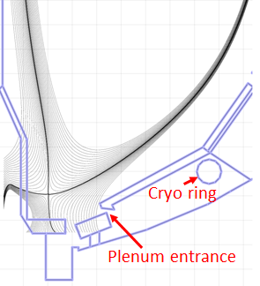
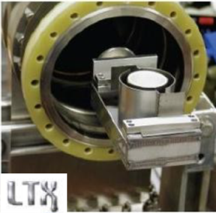
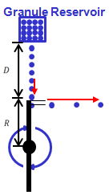
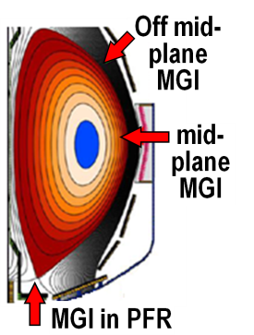

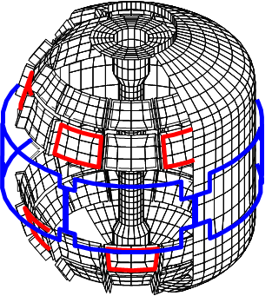
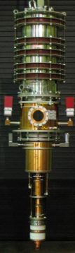
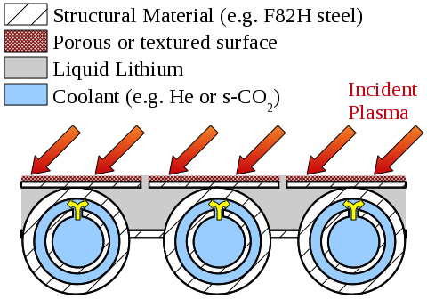

NSTX-U facility enhancements proposed for 5 year plan support FESAC Tiers/Priorities
Improved particle control tools
  Control D inventory, rapidly trigger ELMs to expel impurities
  Low ν* to understand ST confinement to support FNSF, validation
Disruption avoidance, mitigation
  Massive gas injection, detect halos, disruptions, control v_{φ}, RWM, ELM
ST start-up and ramp-up tools
  ECH to raise start-up plasma T_{e} to enable FW + NBI + BS I_{P} ramp-up
  Test EBW-CD start-up, sustainment
  Start-up/ramp-up critical for ST-FNSF
Begin transition to high-Z PFCs, assess flowing liquid metals
  Plus divertor Thomson, spectroscopy
Upward Li evaporator
Divertor cryo-pump
Li granule injector (LGI)
(Transients, PMI)
(FNSF, Predictive)
(Transients, Predictive)
Midplane + off-midplane non-axisymmetric control coils (NCC)
Extended low-f MHD sensor set
(FNSF)
1MW
28 GHz
gyrotron
High-Z tiles
(PMI, FNSF)
Actively-supplied, capillary-restrained, gas-cooled LM-PFC

