Slide 1
NSTX-U Program Update
Jon Menard
NSTX-U Program Director
NSTX-U Team Meeting
PPPL - MGB
August 14, 2015
This work supported by the US DOE Contract No. DE-AC02-09CH11466

Slide 2
Outline
Updated PPT template, logos, etc…
Outreach Seminars
Diagnostic Solicitation
Updated Research Milestones
XP Review Status, Draft Run Schedule
International ST Workshop

Slide 3
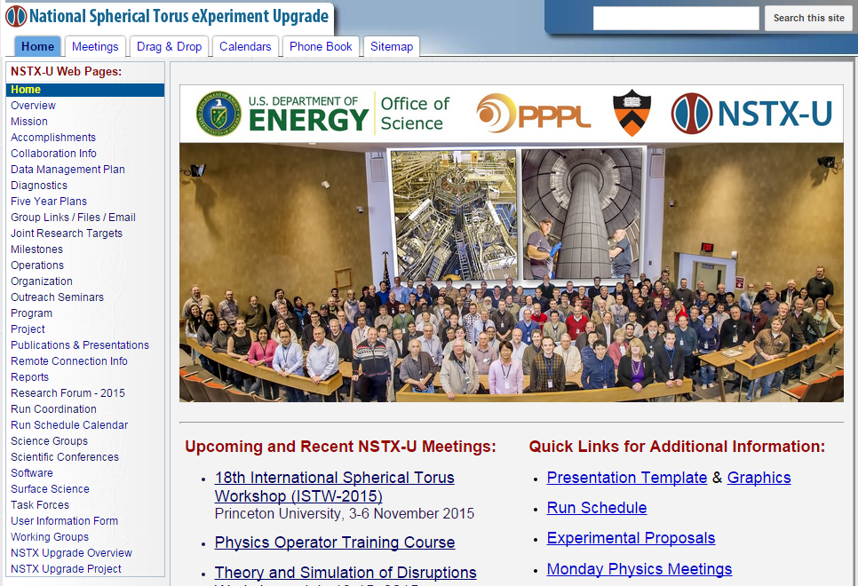
This new PPTX template now available
PPTX, PPT,
PNGs, JPGs

Slide 4
NSTX-U icons / logos included in template Usage compliance will be tracked in performance appraisals and RoDs - just kidding…

Slide 5
NSTX-U university collaborators spearheaded new outreach seminar effort – to begin this fall
J. Berkery (CU)
D. Smith (UW)

Slide 6
FES solicitation for U.S. University and Industry DIAGNOSTIC Collaboration on NSTX-U now available
Pre-Application was due: 07/29/2015
Pre-App required, 2-3 pages (Title, abstract, collaborators, …)
Nearly all (15-20) pre-apps accepted
Application Due: 09/18/2015, 11:59 PM Eastern
Signed Records of Discussion (RoDs) required for application
RoDs due to Jon and Masa for review by 9/10/2015
If you are a research contact – get RoDs discussed, reviewed / iterated, and signed ASAP
Be proactive, work closely with collaborators on their RoDs, and don’t wait until the last minute…
Note: Jon will be on travel most of week of September 14

Slide 7
Overview of FY2015-17 NSTX-U research milestones
FY2016
Obtain first data at 60% higher field/current, 2-3× longer pulse:
Re-establish sustained low l_{i} / high-κ operation above no-wall limit
Study thermal confinement, pedestal structure, SOL widths
Assess current-drive, fast-ion instabilities from new 2nd NBI
FY2017
Extend NSTX-U performance to full field, current (1T, 2MA)
Assess divertor heat flux mitigation, confinement at full parameters
Access full non-inductive, test small current over-drive
First data with 2D high-k scattering, prototype high-Z tiles
FY2018
Study low-Z and high-Z impurity transport
Assess causes of core electron thermal transport
Test advanced q profile and rotation profile control
Assess CHI plasma current start-up performance

Slide 8
NSTX-U Milestone Schedule for FY2016-18
(see updated Milestone web-page for additional detail / text)
FY2016
FY2017
FY2018
Run Weeks:
Incremental
14
16
16
18
12
16
R16-1
R17-1
R18-1
Boundary Science
+ Particle Control
Assess H-mode confinement, pedestal, SOL characteristics at higher B_{T}, I_{P}, P_{NBI}
Assess scaling, mitigation of steady-state, transient heat-fluxes w/ advanced divertor operation at high power density
Assess impurity sources and edge and core impurity transport
R17-2
IR18-1
Assess high-Z divertor PFC performance and impact on operating scenarios
Investigation of power and momentum balance for high density and impurity fraction divertor operation
R16-2
R17-3
IR18-2
Assess effects of NBI injection on fast-ion f(v) and NBI-CD profile
Assess τ_{E} and local transport and turbulence at low ν* with full confinement and diagnostic capabilities
Assess role of fast-ion driven instabilities versus micro-turbulence in plasma thermal energy transport
Core Science
Begin ~1 year outage for
major facility enhancement(s) sometime during FY2018
IR17-1
R18-2
R16-3
Assess fast-wave SOL losses, core thermal and fast ion interactions at increased field and current
Control of current and rotation profiles to improve global stability limits and extend high performance operation
Integrated Scenarios
Develop physics + operational tools for high-performance: κ, δ, β, EF/RWM
R17-4
R18-3
Develop high-non-inductive fraction NBI H-modes for sustainment and ramp-up
Assess transient CHI current start-up potential in NSTX-U
FES 3 Facility Joint Research Target (JRT)
C-Mod leads JRT
DIII-D leads JRT
NSTX-U leads JRT
Assess disruption mitigation, initial
tests of real-time warning, prediction
TBD… possibly something
on energetic particles
TBD

Slide 9
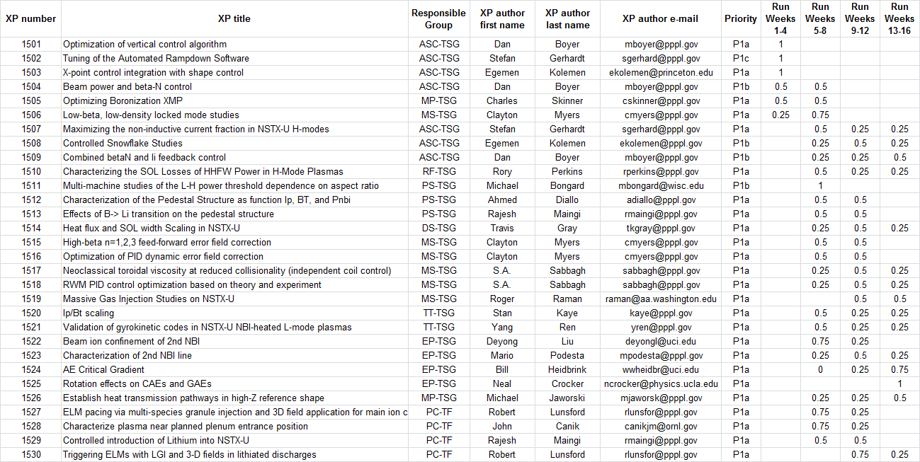
Chosen first 30 experiments to review: Order based on Priority 1 + expected period to be run during campaign
At least 30 XPs will be fully reviewed prior to start of research campaign
17 XPs already reviewed, remaining reviews will be scheduled very soon…
►
►
►
►
►
►
►
►
►
►
►
►
►
►
►
►
►
►

Slide 10
Latest run plan schedule for 2016 Goal is to operate 14-16 run weeks as per research forum
If FY16 budgets are favorable enough, may run more run weeks
Want as much data as possible for IAEA synopses/meeting, APS-2016
October: 0-2 run weeks (XMP)
Depends on bake-out / ISTP / NBI / diagnostic time required…
November: 0-2 run weeks (XMP → XP)
May want to slow/pause for ST workshop, APS, Thanksgiving
December: 3 run weeks (XP)
January: 2-3 run weeks (XP)
Mid-run assessment (if applicable), PAC-37
Feb-Apr: 6-8 run weeks, complete FY16 run
Apr/May: Start outage: install high-k, high-Z tiles, …
Resume operations fall/winter 2016 for FY17

Slide 11
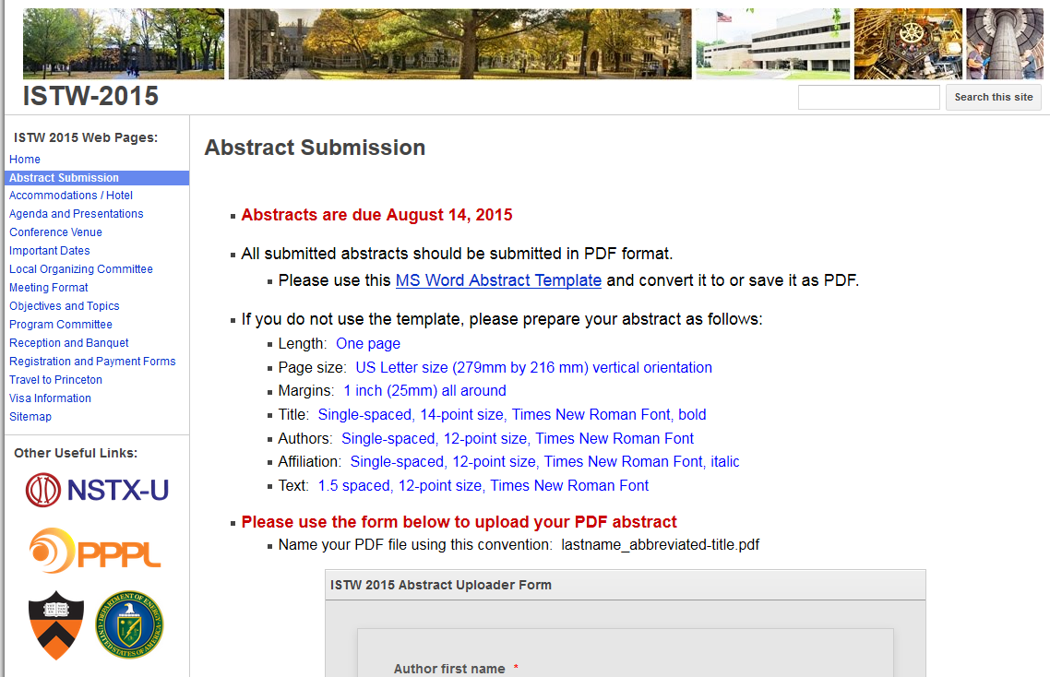
ST workshop abstracts due TODAY! ~40+ (many international) abstracts already submitted
Here’s the link: istw-2015.pppl.gov/abstract-submission

Slide 12
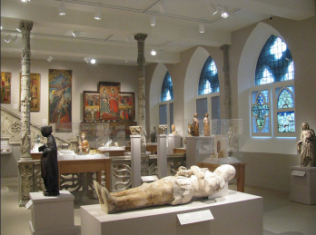
ST workshop important dates
Invitation Letter for Application of Visa: ASAP
Reduced rate hotel reservations (Nassau Inn) available: NOW
Submission of Abstracts: August 14, 2015
Announcement of acceptance of Papers: August 28, 2015
Registration Opens: (no later than) September 14, 2015
Registration fee: $65
Catered/wine reception at Princeton Art Museum: $35
Banquet at Prospect House: $65
Hotel at reduced rate ENDS: Friday, October 2, 2015
Meeting: November 3-6, 2015 in McDonnell Hall, Princeton U.

Slide 13
Thank you for:
Making 1st test-plasma / CD-4 happen!
Staff / lab-wide celebration being planned – stay tuned
Serving as a collaboration RoD research contact
And getting RoDs completed, reviewed, signed ASAP
Volunteering to be an NSTX-U seminar speaker
Revising reviewed XPs (so we can approve them)
And getting unreviewed XPs reviewed and approved
Participating in ST workshop → new collaborations
Get those abstracts in TODAY!

